Slide 1
RALLY

Slide 2
VALUE PROPOSITION
Democracy is a community effort.
PROBLEM/SOLUTION OVERVIEW
Going to political events can be inconvenient and uncomfortable -- RALLY makes civic engagement an easy decision, giving users transportation recommendations and connecting them with friends who want to show out to events.

Slide 3
Three Tasks
Notify user of events located near them
Notify users of mutual friends interested in the same events
Suggest mode of transportation between user and mutual friend

Slide 4
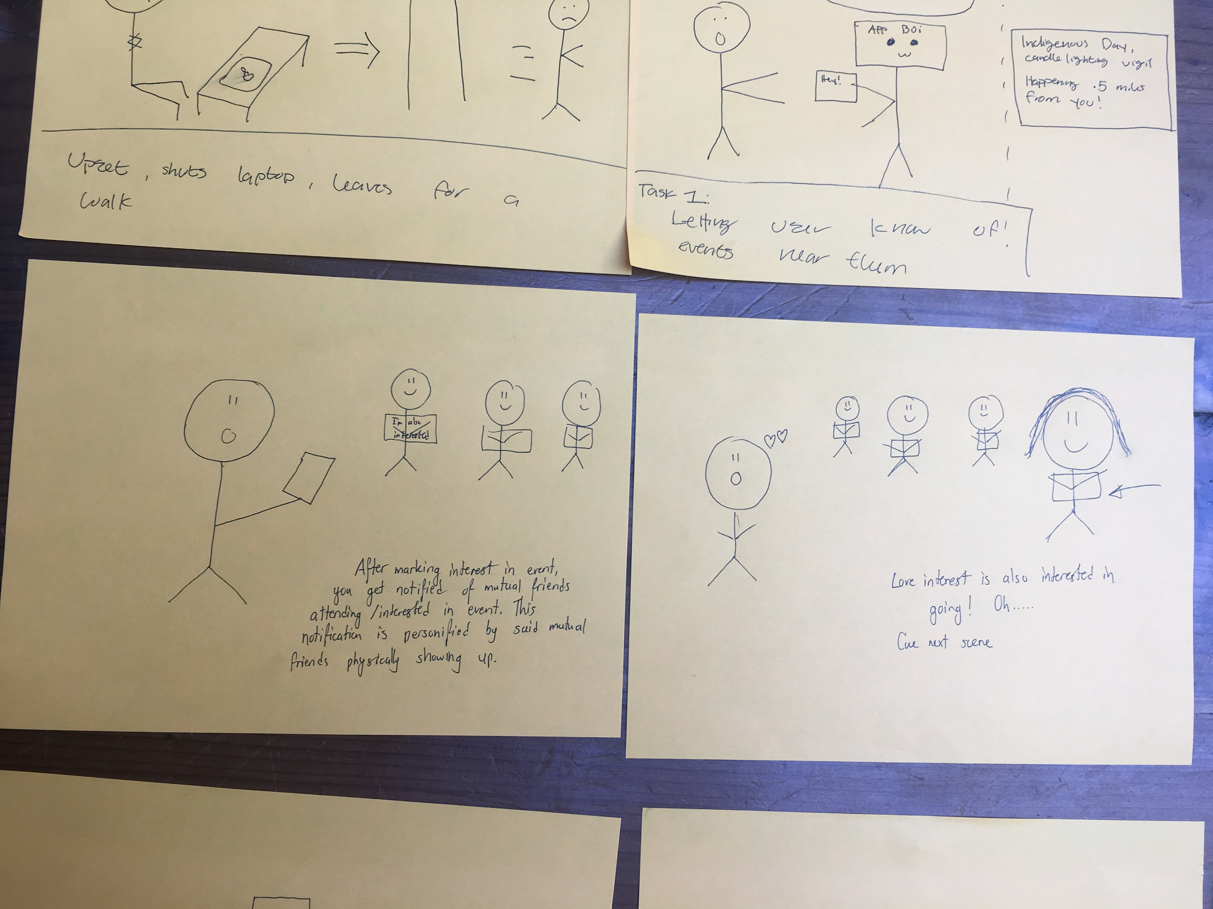
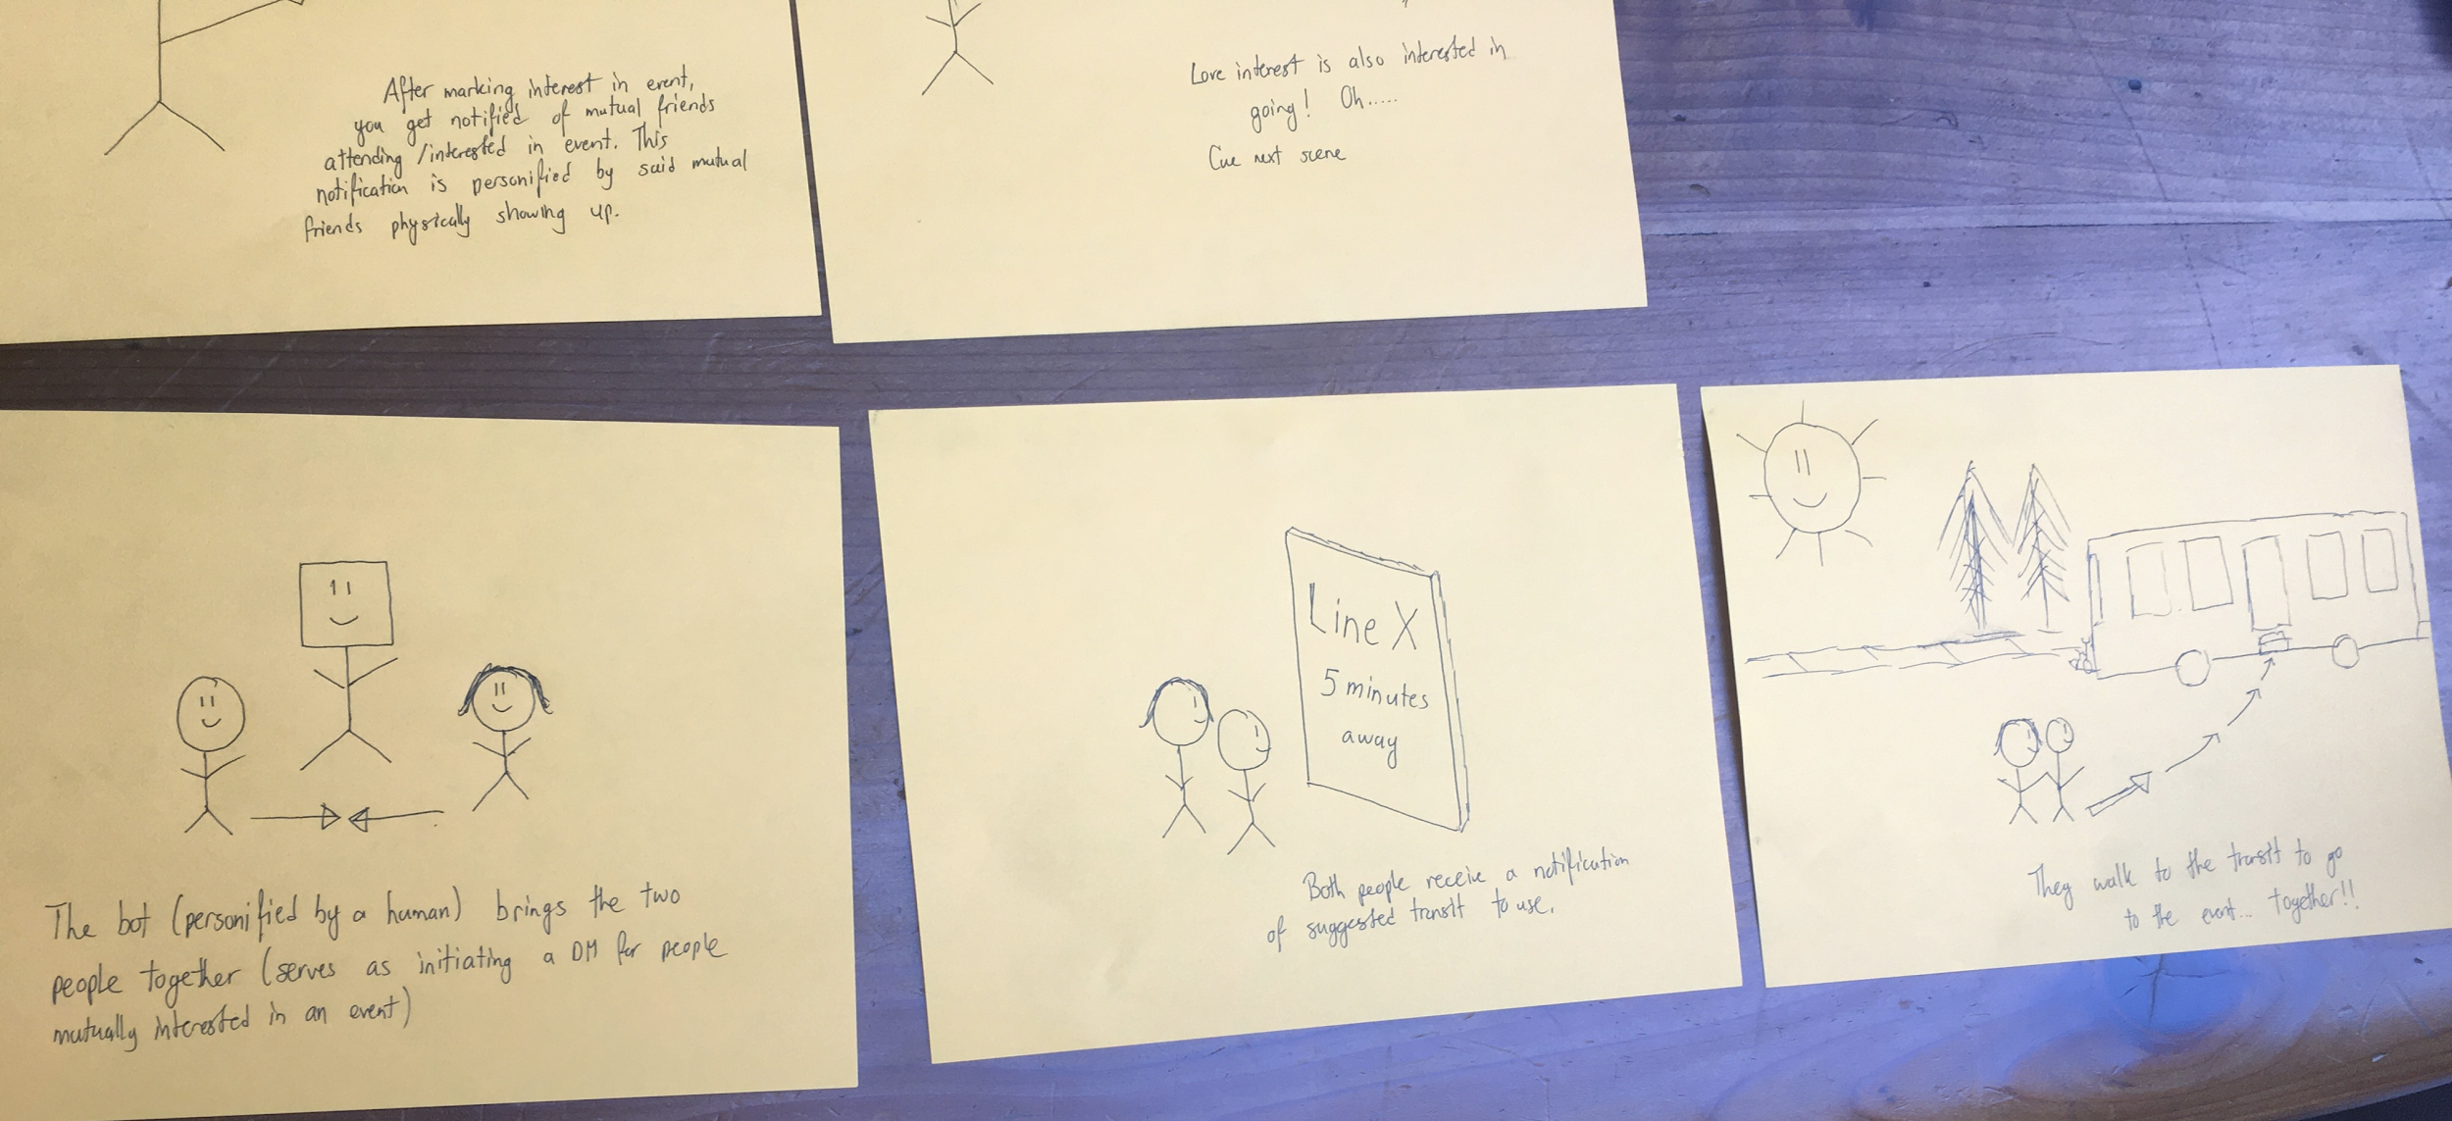
Video Storyboard

