Slide 1
Assignment #2:
POVs and Experience Prototypes

Slide 2
Hello!
We are Kevin, Chester, Sabrina, and Hannah
Notes:
a. List and introduce your team members

Slide 3
Our Problem:
Accessible Housing
Notes:
b. What is your problem domain (in addition to the studio theme)

Slide 4
Initial Point of View
We met students and recent graduates who had to find housing on their own in a new city for the first time.
We were surprised to find that they were unsupported by institutions, and left to advocate and fend for themselves.
It would be game changing if accessibility was made a priority in housing networks
Notes:
2. Initial POV you had going into this testing (1 slide)

Slide 5
Needfinding Results
Betty Nguyen
Notes:
Betty Nguyen: A recent stanford graduate, living in a shared house in San Fransisco

Slide 6
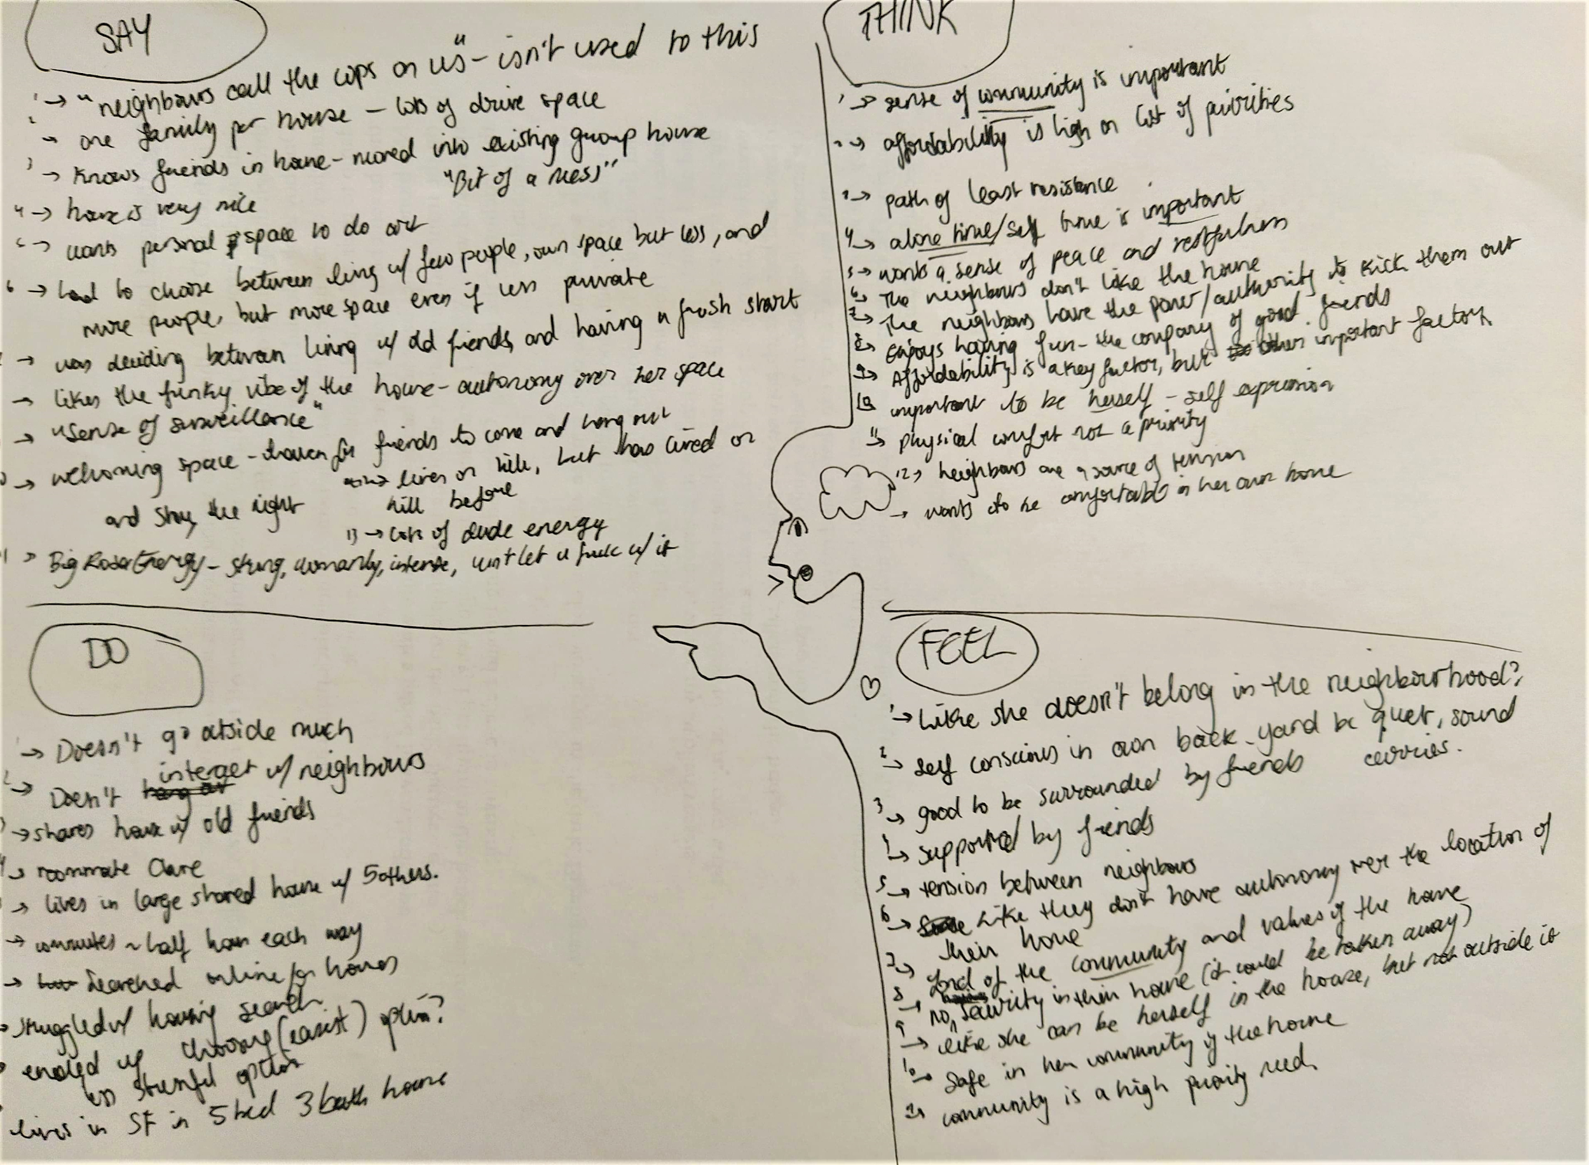
Needfinding Results
Comfort
Community
Notes:
The needs that seemed the most important to Betty were the sense of community, as her sense of comfort was something she prioritised. She needed her own space, and the support of those around her, as much as she needed somewhere she could afford to live.

Slide 7
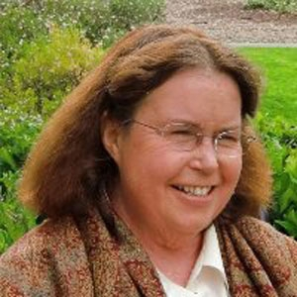
Needfinding Results
Teri Adams
Notes:
Betty Nguyen: A recent stanford graduate, living in a shared house in San Fransisco

Slide 8
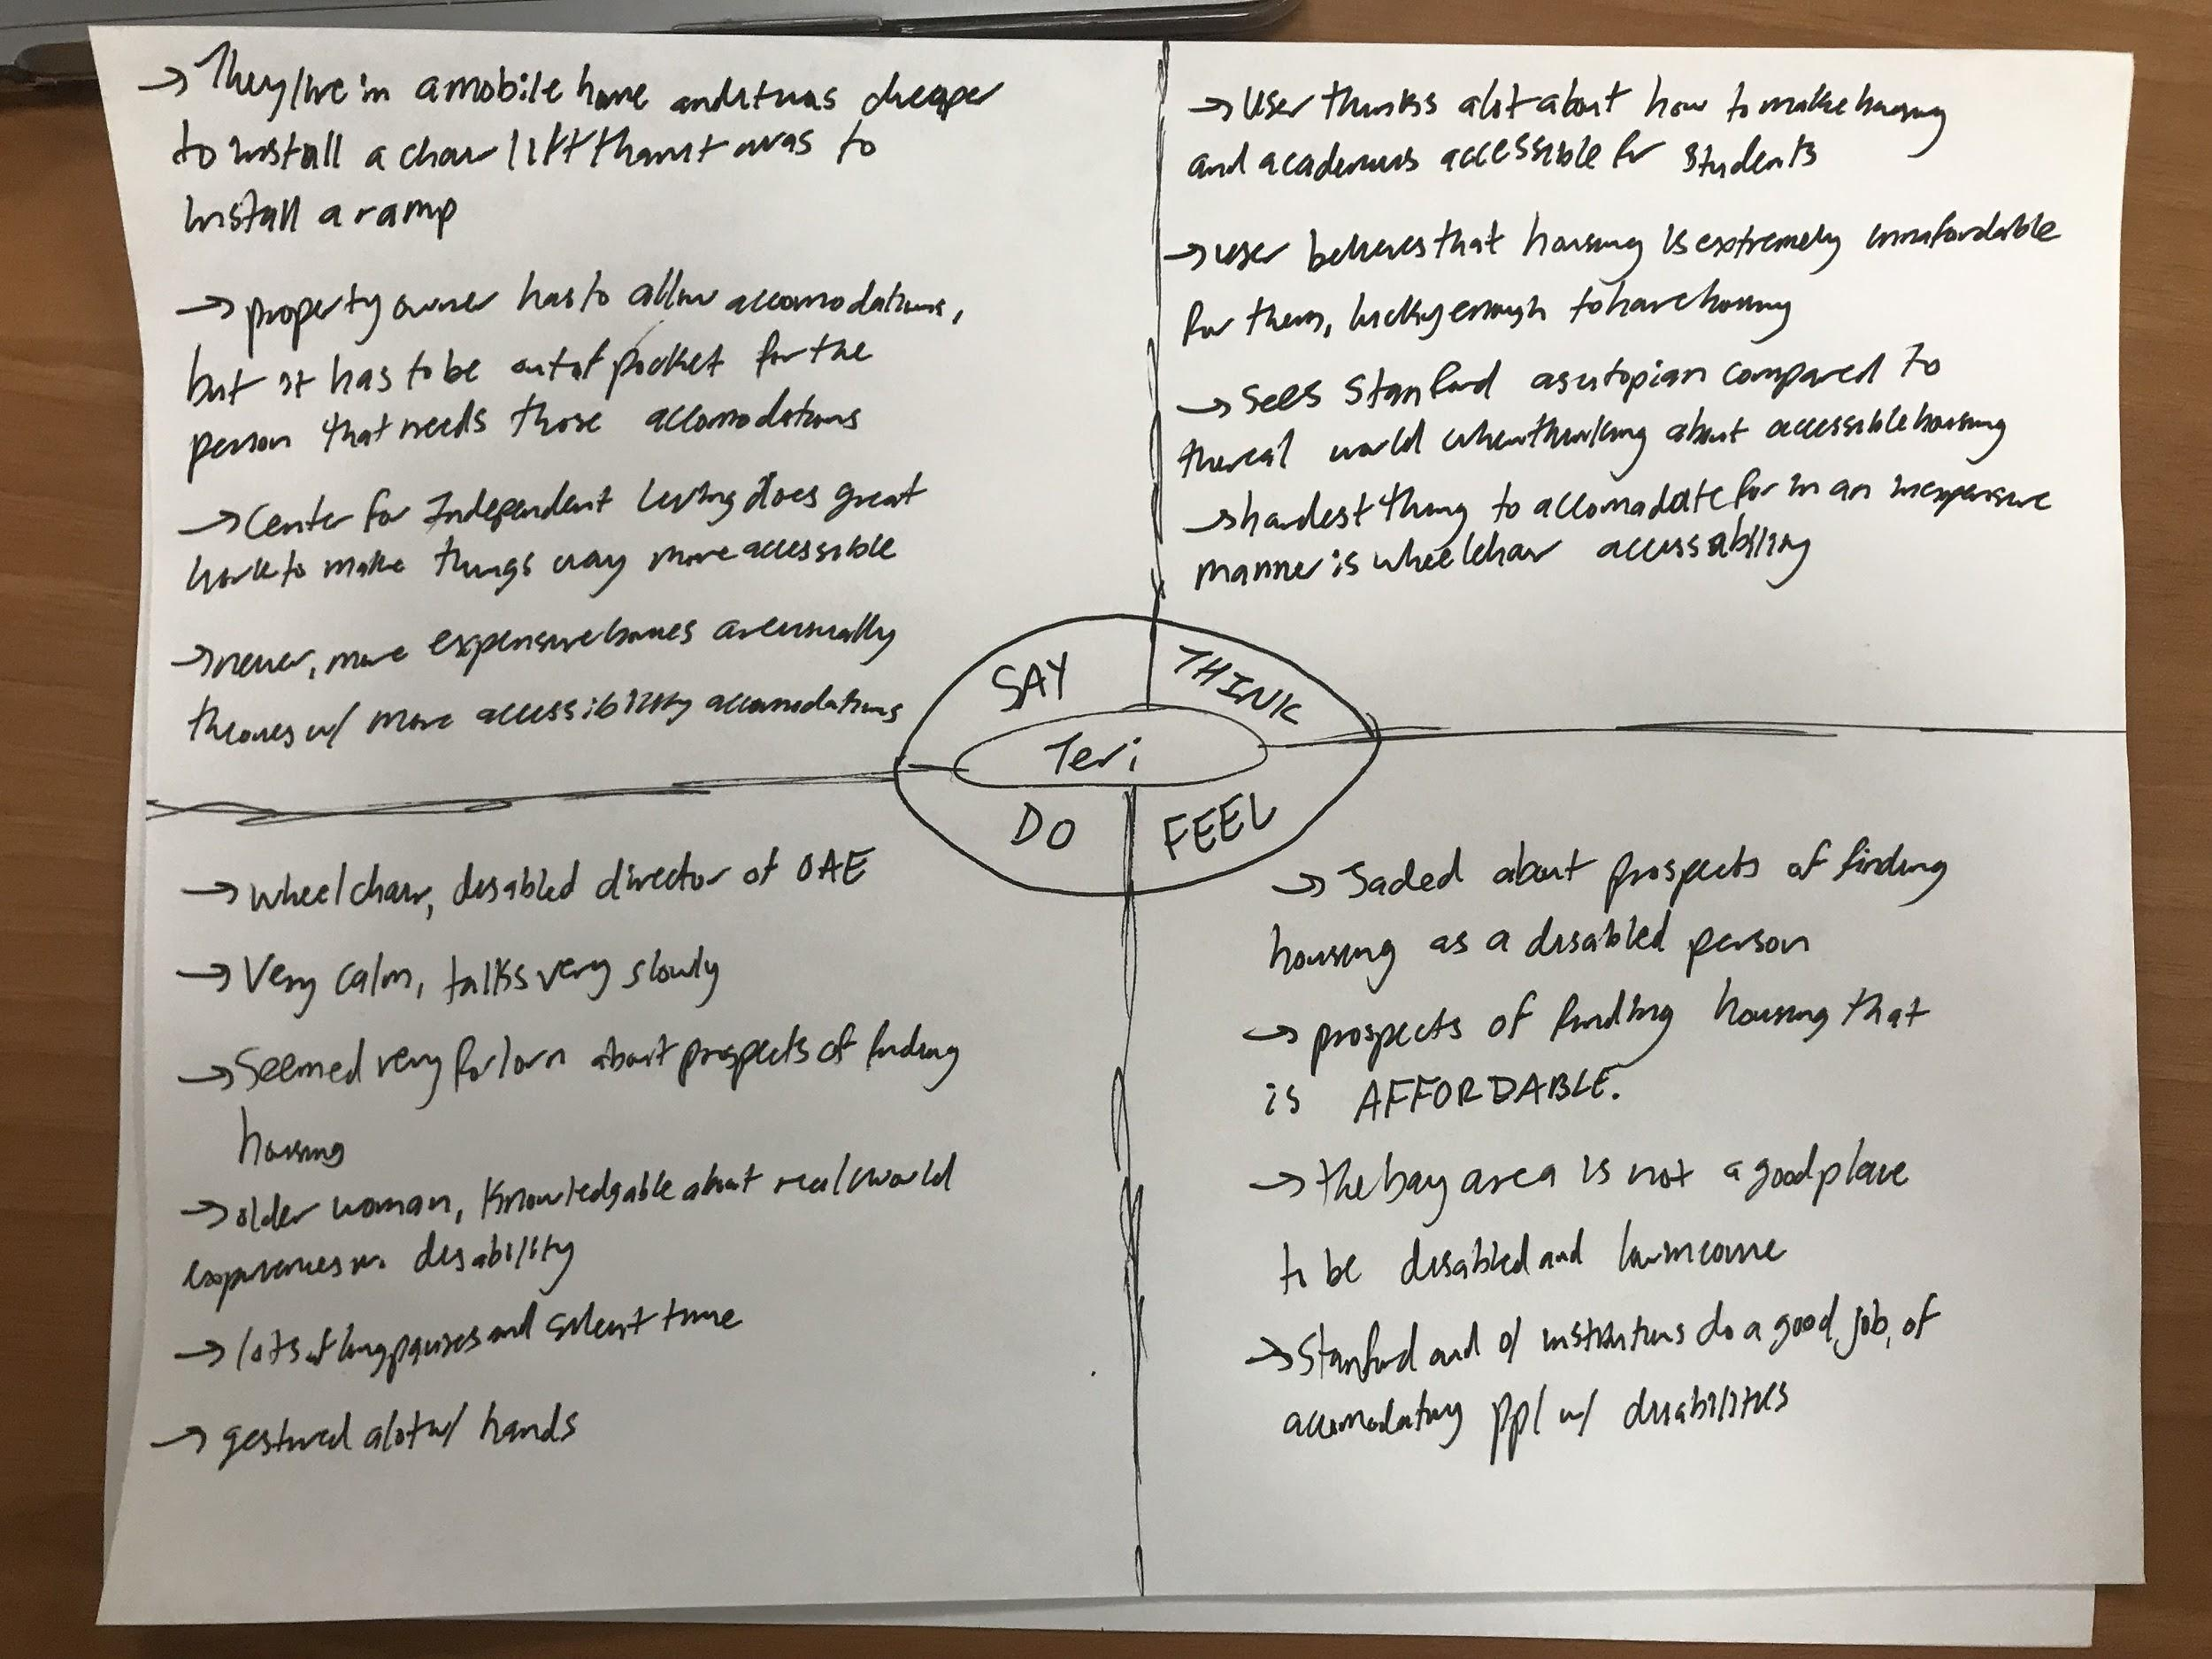
Needfinding Results
(In)Accessibility
Affordability

Slide 9
Needfinding Results
Lisa Ng
Notes:
Betty Nguyen: A recent stanford graduate, living in a shared house in San Fransisco

Slide 10
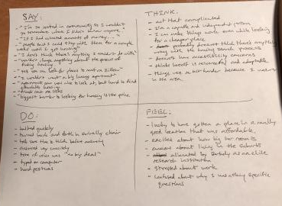
Needfinding Results
Community
Resources

Slide 11
who were surprised to find:
Betty feels uncomfortable in her own backyard because of the judgement of her neighbours.
Teri has experienced in the real world, finding affordable housing that also allows affordable accommodation is extremely difficult, especially in the bay area.
Lisa was able to have a very easy housing search because of the resources made available to them through their community.

Slide 12
It would be game changing to...
Allow Betty to feel comfortable in her own space regardless of who is around
Connect the disabled low income community more easily with resources available to them
Leverage these resources across other communities, lending their utility to people like Betty and Teri, who may find it harder

Slide 13
How Might We...
From Betty….
How might we give Betty a greater feeling of control in the housing process?
From Teri….
How might we prioritize housing for those who most need it within the disabled/low income communities?
From Lisa….
How might we create communities like Lisa’s?
Notes:
5. Present the three top HMW statements with the POVs they stem from (3 slides)

Slide 14
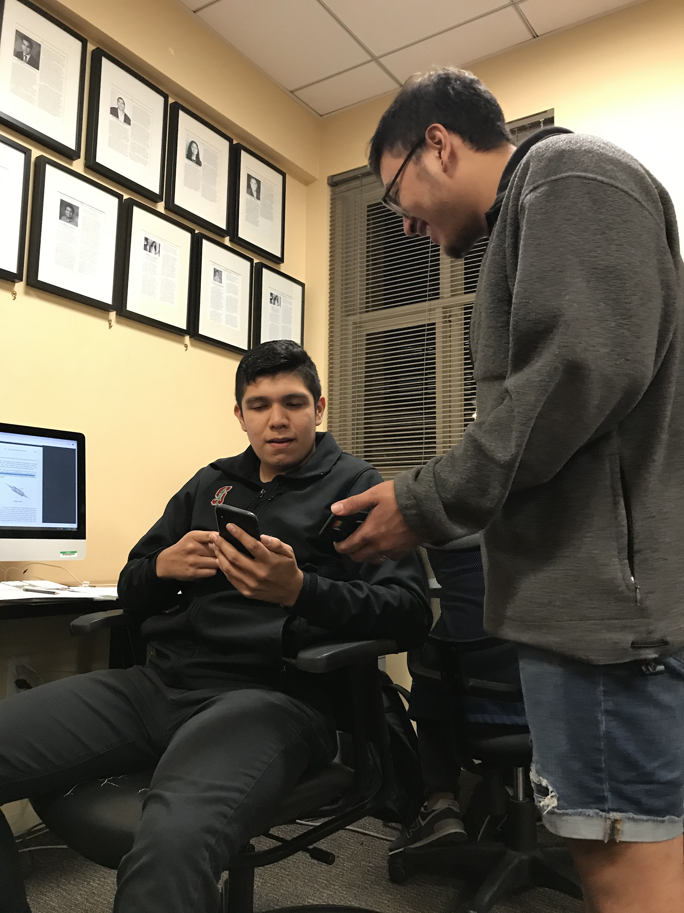
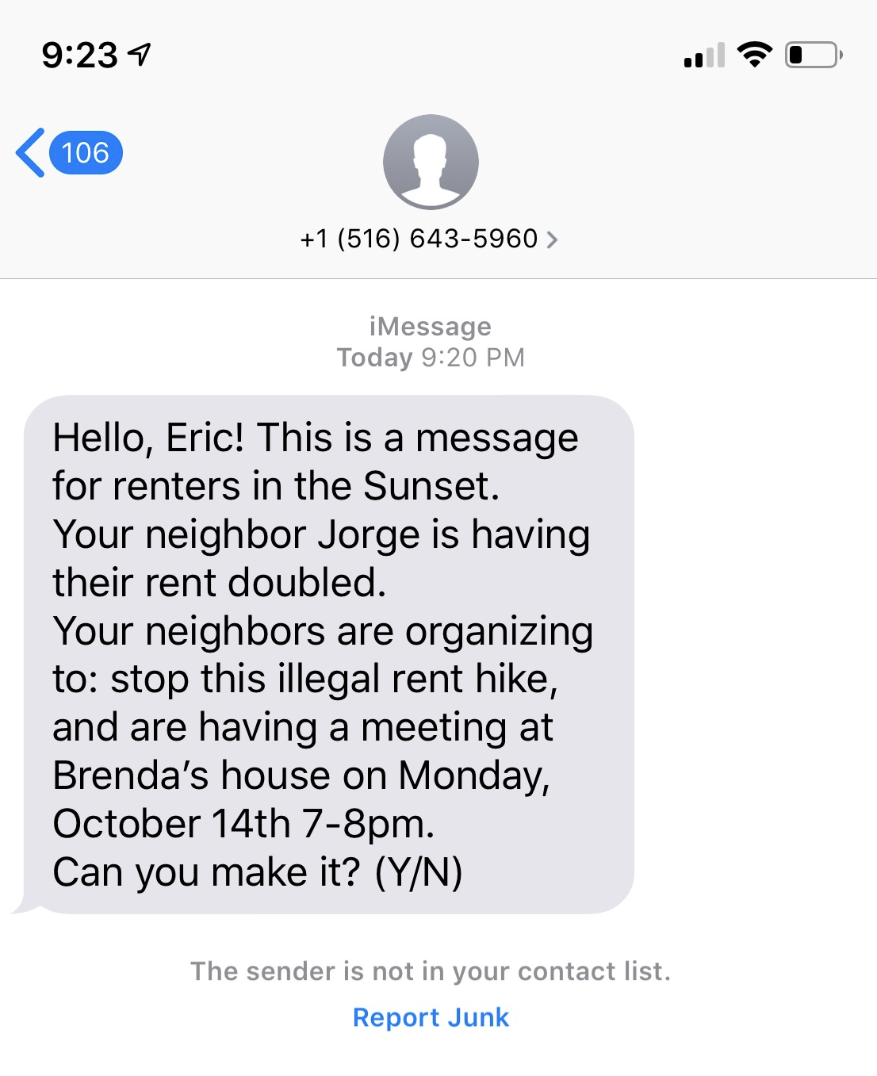
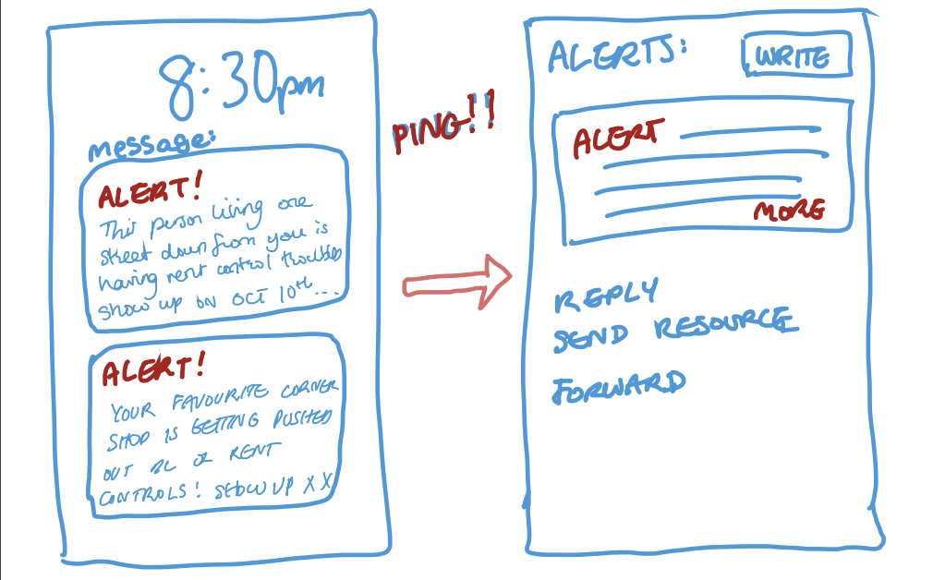
Prototype #1
Housing Call to Action Alerts
Notes:
Three Experience Prototypes: (3 slides) a. Short description of the prototype and how it was tested (with pictures for both) b. Results: 1-2 bullets on each of: Things that worked, things that didn’t work, surprises, and new learnings c. Validity: Was the assumption valid? Why or Why Not? Any new assumptions that emerged? d. Solution: Which of these prototypes or a combination leads to a solution? Why?

Slide 15
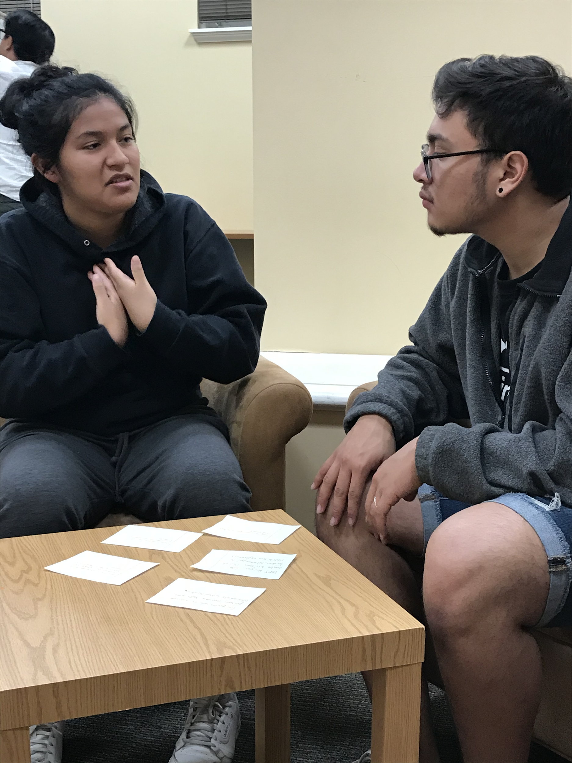
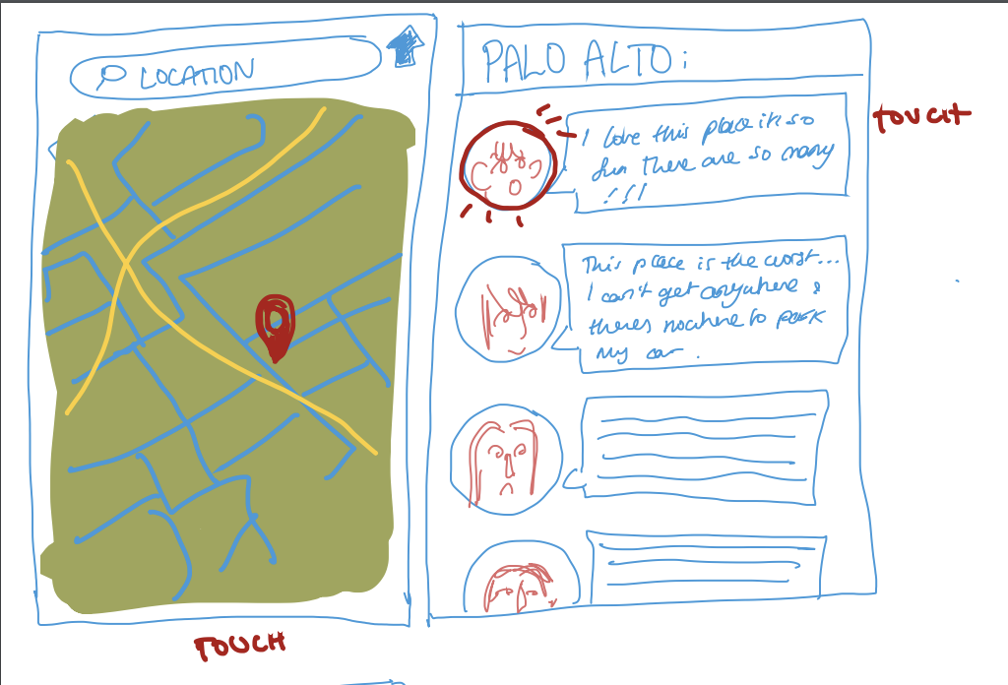
Prototype #2
Neighborhood Reviews
Notes:
Three Experience Prototypes: (3 slides) a. Short description of the prototype and how it was tested (with pictures for both) b. Results: 1-2 bullets on each of: Things that worked, things that didn’t work, surprises, and new learnings c. Validity: Was the assumption valid? Why or Why Not? Any new assumptions that emerged? d. Solution: Which of these prototypes or a combination leads to a solution? Why?

Slide 16
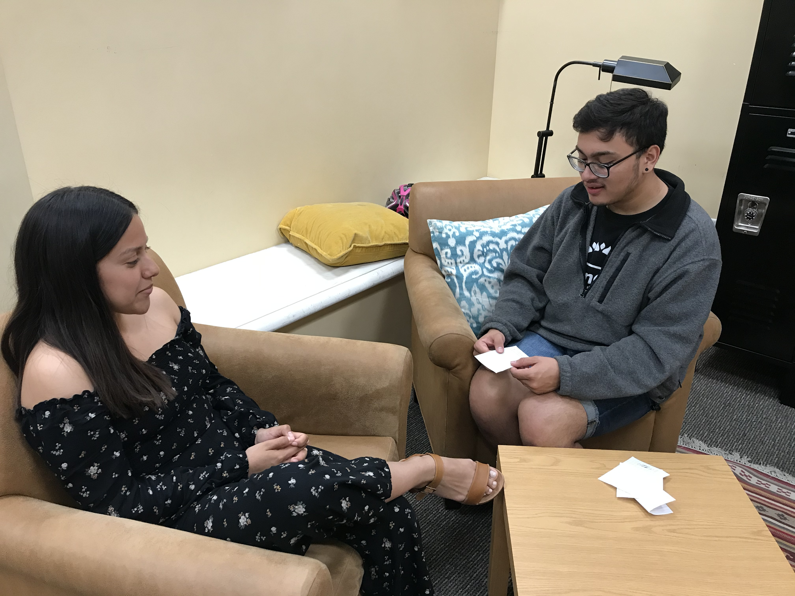
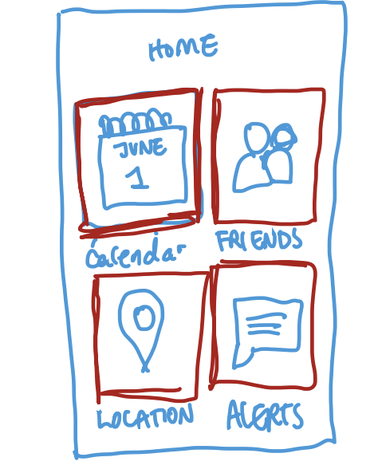
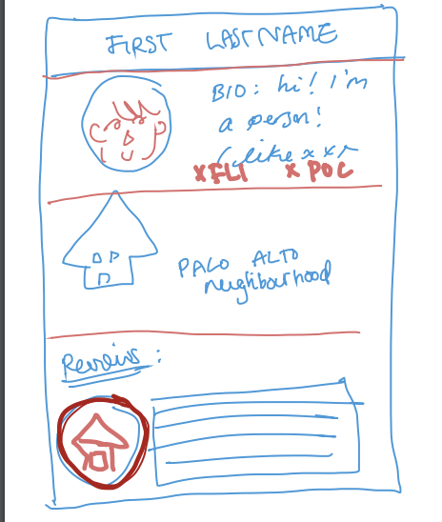
Prototype #3
Aggregate Accessible Houses Search
Notes:
Three Experience Prototypes: (3 slides) a. Short description of the prototype and how it was tested (with pictures for both) b. Results: 1-2 bullets on each of: Things that worked, things that didn’t work, surprises, and new learnings c. Validity: Was the assumption valid? Why or Why Not? Any new assumptions that emerged? d. Solution: Which of these prototypes or a combination leads to a solution? Why?

Slide 17
Next...
create a solution that not only aggregates all these resources, but also allows for organizing in these communities in order to strengthen the bonds between those in the network, and to protect these communities from the adverse effects of problems such as gentrification, rent hikes, etc.
Notes:
7. Summary (what the key learnings & next steps? What would motivate others to follow you?)

