Slide 1
NeighborAid:
Med-Fi Prototype
Team 2: Chester, Seb, Hannah, Kevin

Slide 2
PROBLEM #1 : Adding a Comment
One Problem that we saw with our low-fi prototype was that people who tested the design were oftentimes confused with the way commenting worked, unsure as to what certain icons did, and how to add a comment in the first place. We fixed this by using more direct iconography and methods for indicating how to comment on something.

Slide 3
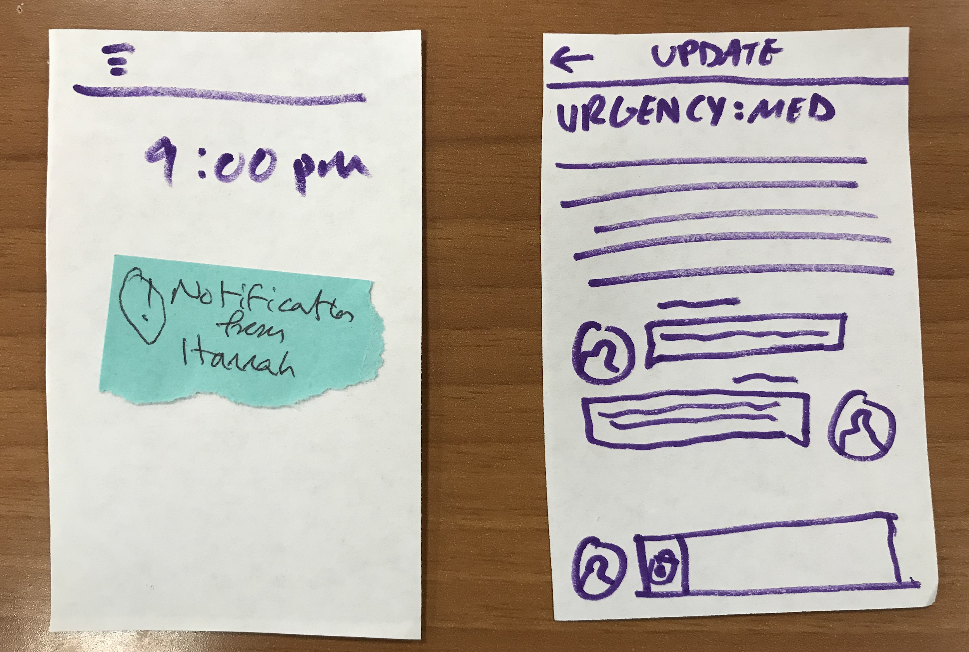
Taskflow #1 - Adding a comment
Locked Phone Screen
Update Details Page

Slide 4
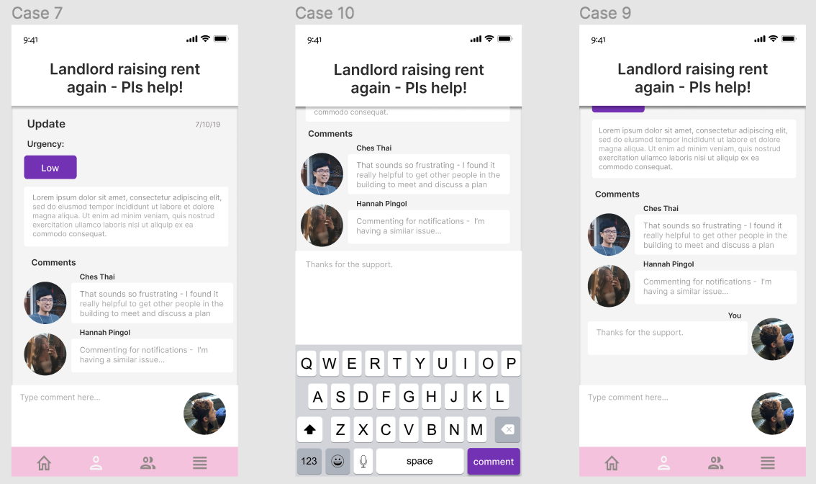
Taskflow #1 (Figma) - Adding a comment
Update Details Page
Keyboard Pop-up
Comment Added

Slide 5
Problem #2: Creating an Update
There was a lot of confusion regarding some of the icons that we used for adding an update, so we went with something more conventional; we used the words themselves and put them inside the buttons to make it more convenient and easier to understand.

Slide 6
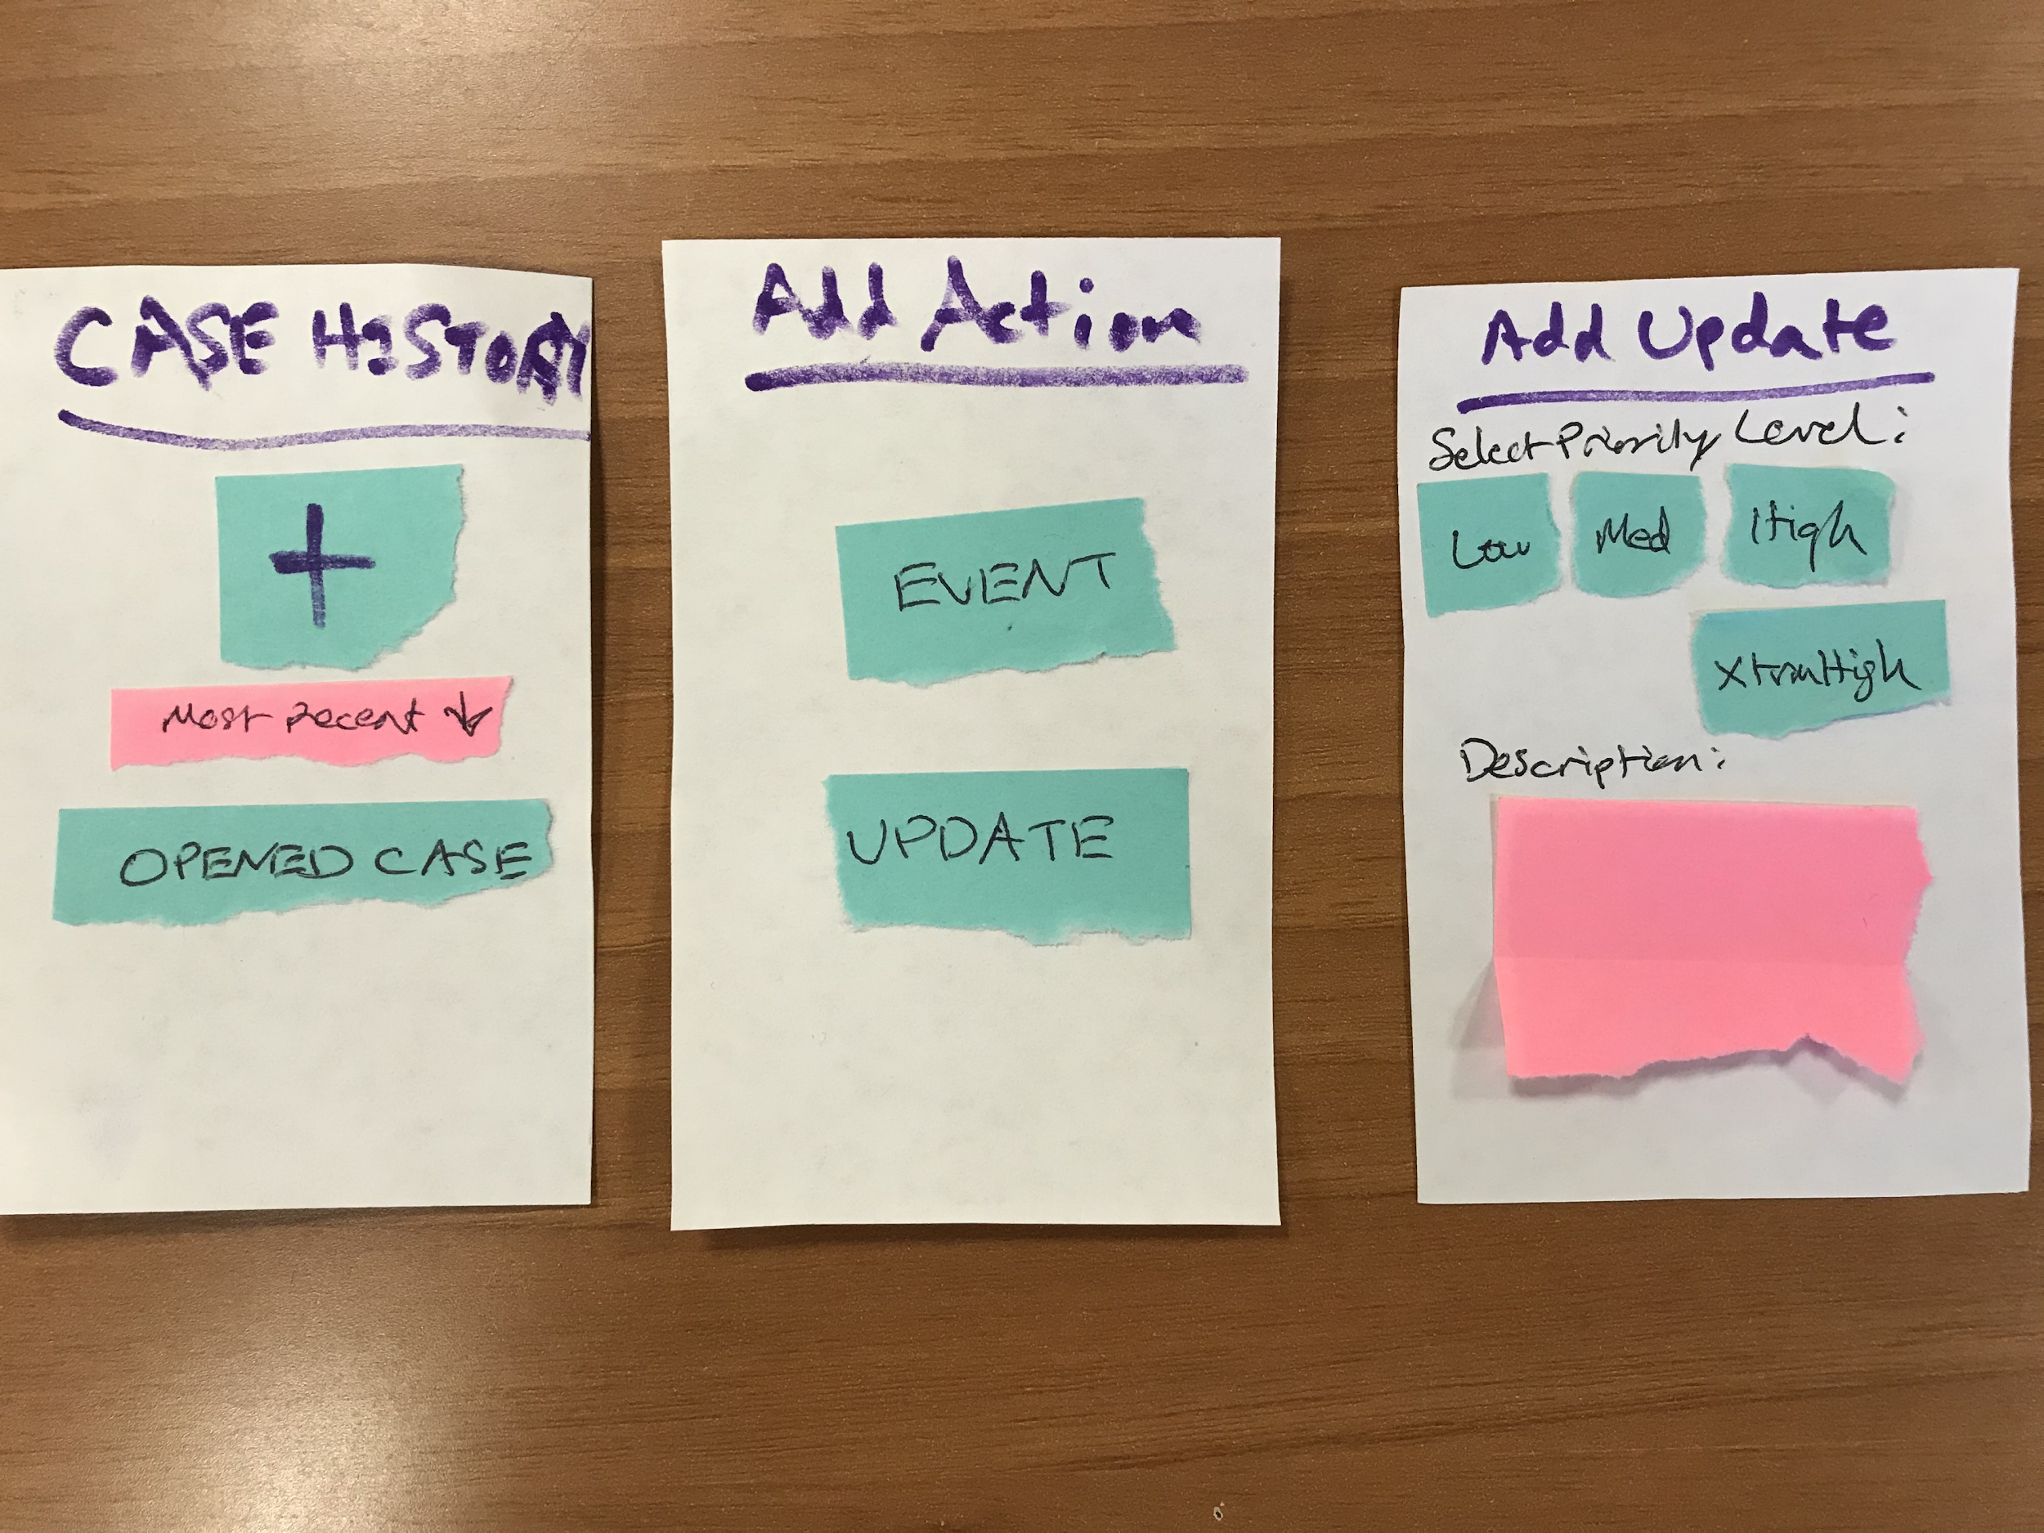
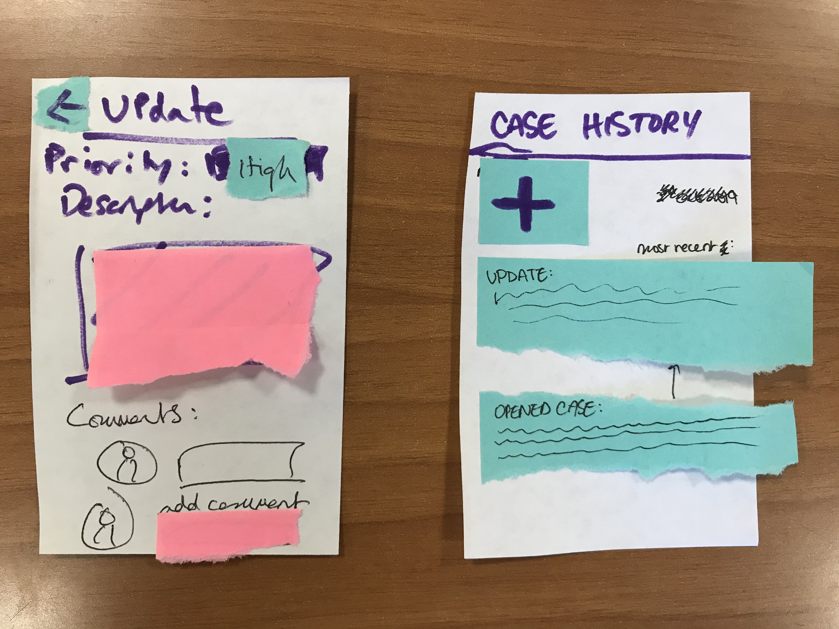
Taskflow #2 - Create an update
Case History Page
Action Selection
New Update Creation page
Update Details Page
Case History Page

Slide 7
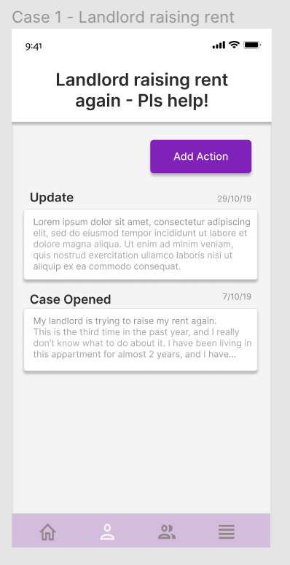
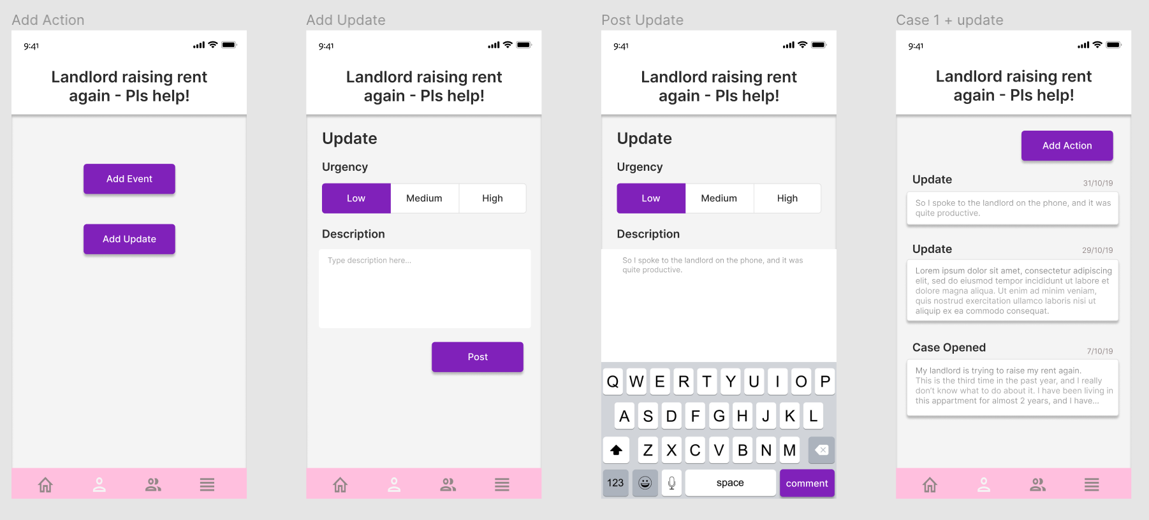
Taskflow #2 (Figma) - Create an update
Case History Page
Action Selection
New Update Creation page
Update Details Page
Case History Page

Slide 8
Problem #3: Creating an Event
The last problem we came across was that those testing our original prototype felt that a lot of it was crammed onto one screen/window, and in order to fix this feeling of being overwhelmed with prompts and information, we streamlined the process to multiple screens.

Slide 9
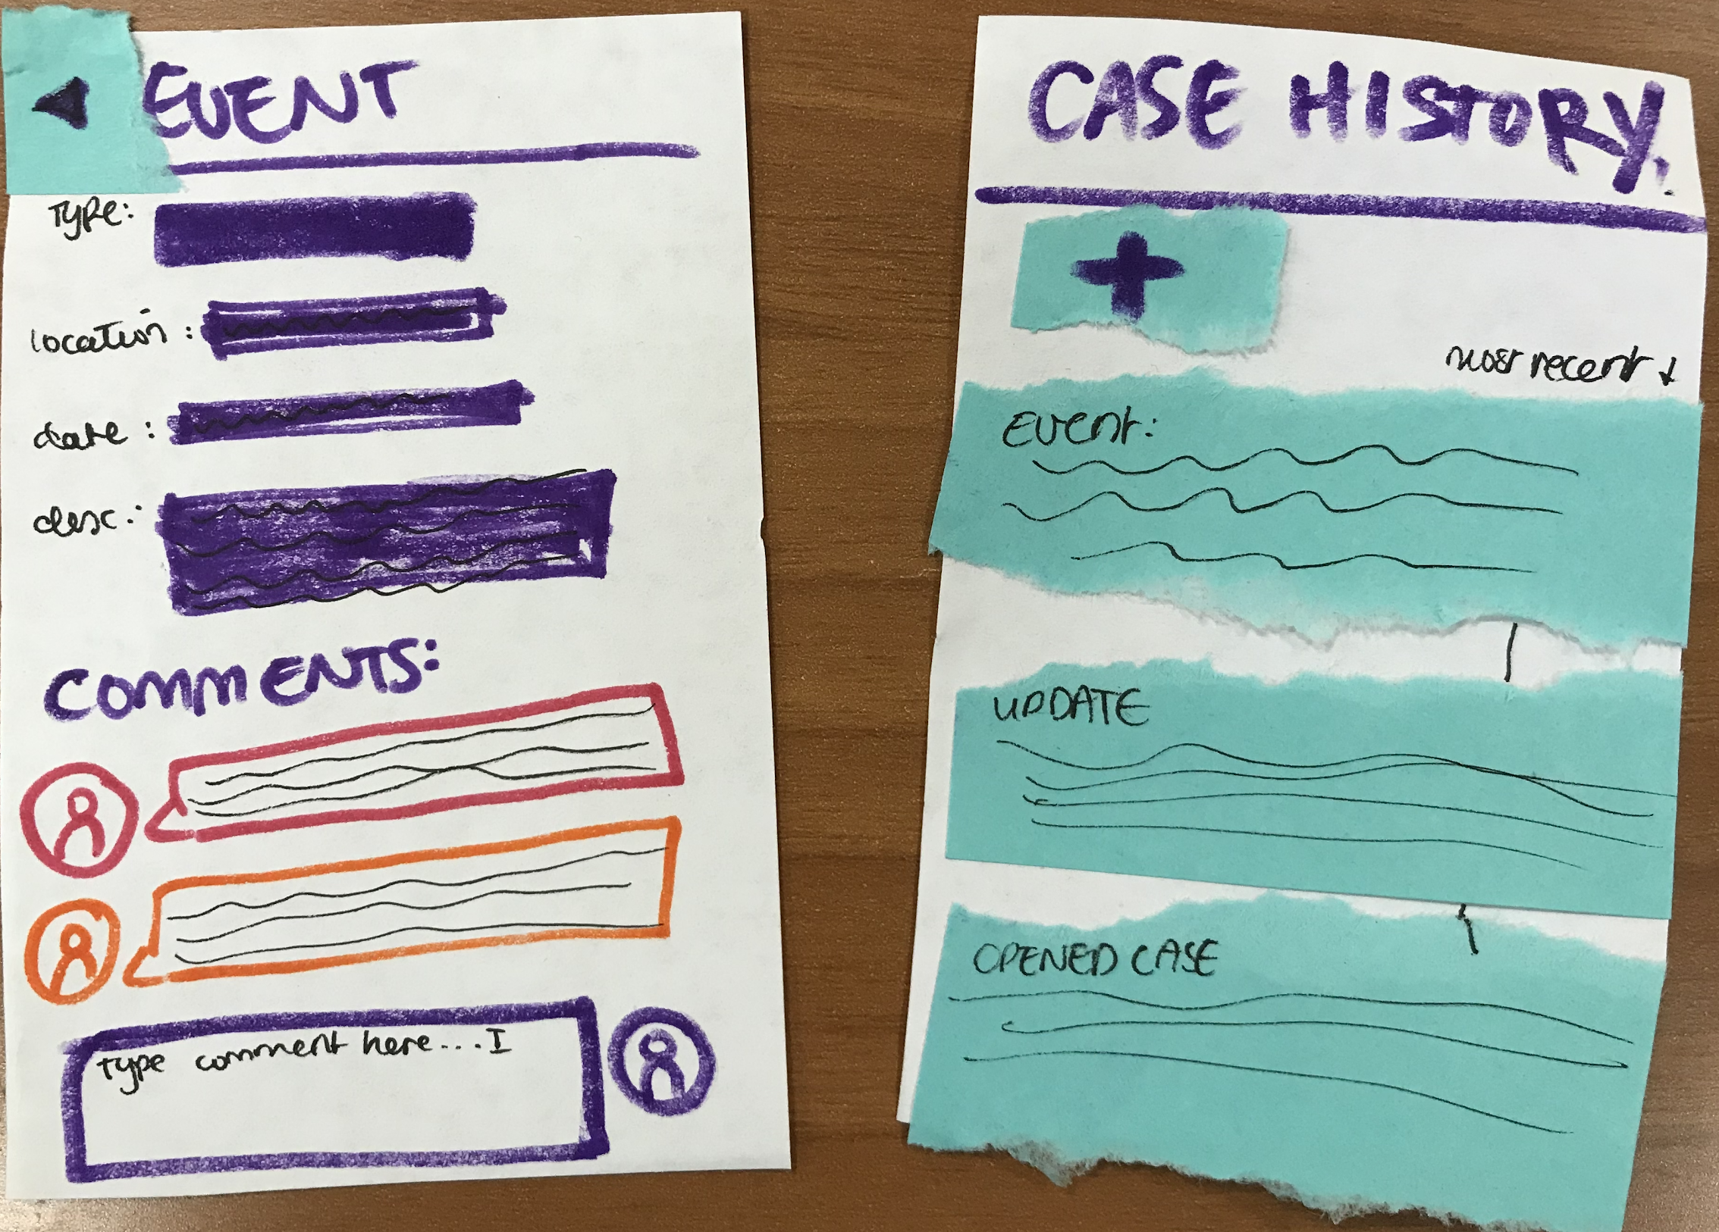
Taskflow #3 - Create new event
Event Details Page
Case History Page

Slide 10
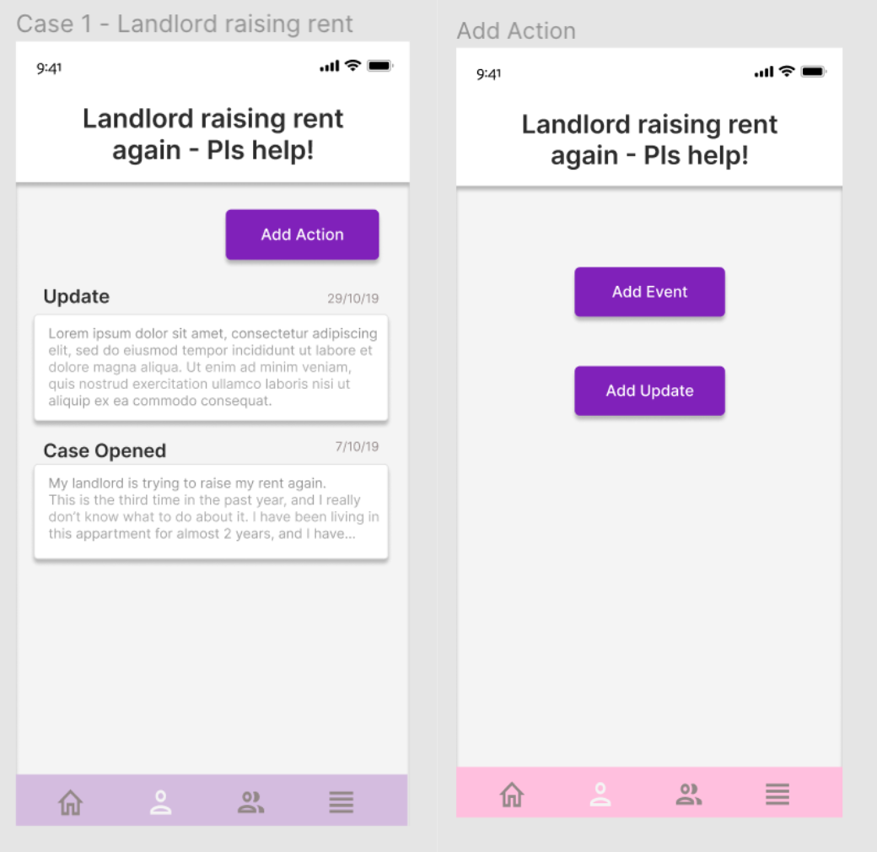
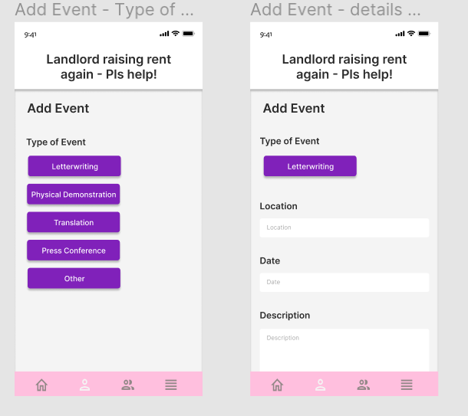
Taskflow #3 (Figma) - Create new event
Case History Page
Action Selection
Event Type
Event Details

Slide 11
Taskflow #3 (Figma) - Create new event
Event Details
Post Event
Event Details Page
Going to Event

Slide 12

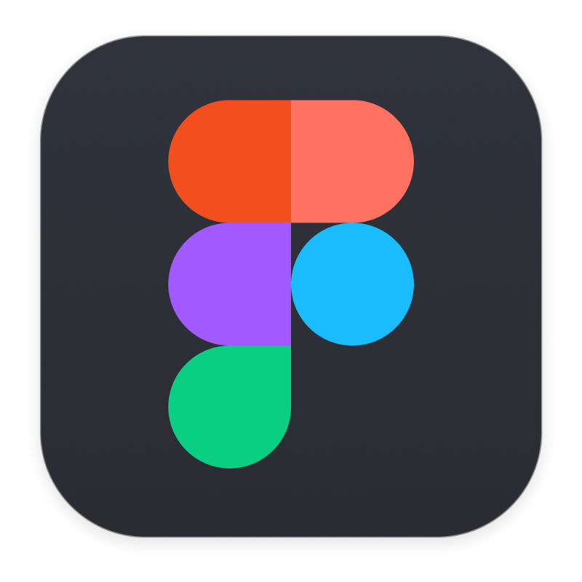
Prototyping Tools
Notability
(for drawing out flows on iPad)
Figma
(for med-fi prototyping)

Slide 13
Figma: Pros & Cons
PROS
Beginner friendly
Easy to add user interactions (clicking buttons, switching between screens)
Easy to add templates and icons
CONS
Can become very convoluted as you increase number of tasks in the prototype
Doesn’t have direct plug-in for integration into a website
Figma
(for med-fi prototyping)

Slide 14
Limitations/tradeoffs of the current prototype
Since we were restricted to the animations on Figma, some user gestures and animations were left out or simplified. For example, in our final version, users will be able to scroll down the screen to view more updates on the home page, to read more about events, to view more of the users’ profiles, etc. Our final implementation will also include a filter on the homepage that allows users to view posts by post date, by location, etc. Other animations, like the transitions between the Going to Event/Not Going/Maybe Going button and Commenting button, will eventually be more seamless and easier to navigate. Since we focused on our three main tasks for this prototype, we left out certain features such as the onboarding page. We also only allow the user to experience the prototype through one user and one case, and only allow the user to view one of their groups. Other features, such as creating a new event, case, or update, are visually represented but are not actually available for the user to act upon.

Slide 15
Hardcoded features
Some of the hardcoded features include:
Any of the other features (excluding the ones featured in this presentation)
Some of the choices a user could make on the app

Slide 16
Figma Prototype
Prototype Link: https://www.figma.com/proto/kw33NNEzy1cjLQvlB1MvMJ/neighbouraid?node-id=1%3A2&scaling=scale-down
Figma File Link:
https://www.figma.com/file/kw33NNEzy1cjLQvlB1MvMJ/neighbouraid?node-id=0%3A1

