Slide 1
NeighborAid
Low-fi Prototyping & Pilot Usability Testing
CS 147: Fall 2019
Kevin C, Sabrina M, Hannah P, Ches T

Slide 2
Table of Contents
Mission Statement
Our App
Taskflows
Paper Prototype
Experiment
Results
UI Changes
Summary
Appendix

Slide 3
Mission Statement
Make finding and affording housing more accessible for all people.

Slide 4
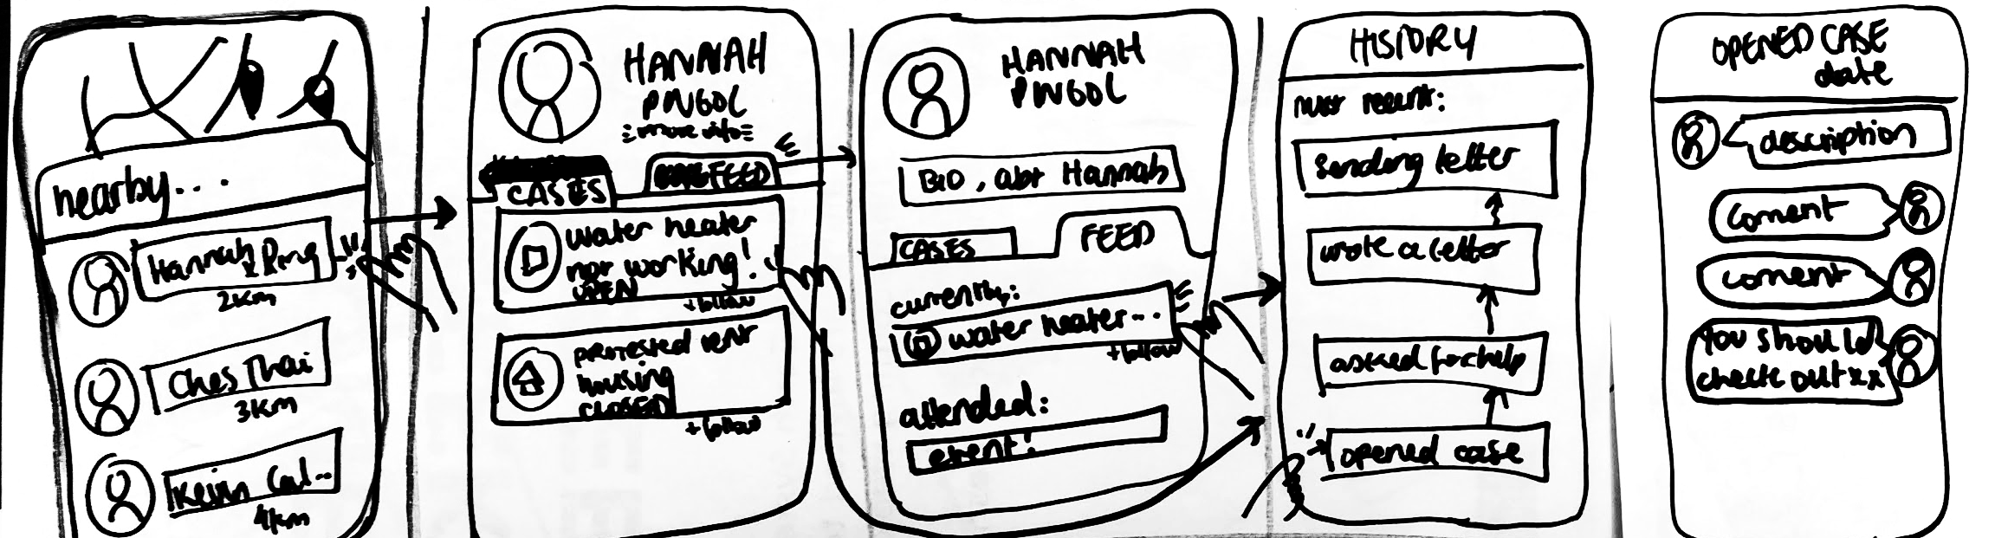
Chosen App: Case-based mobile app
Notes:
More sustainable model, promotes better community support/connection, easier to follow up, makes more sense given goal of creating community, makes better organisation (events linked together, cohesion around concern)

Slide 5
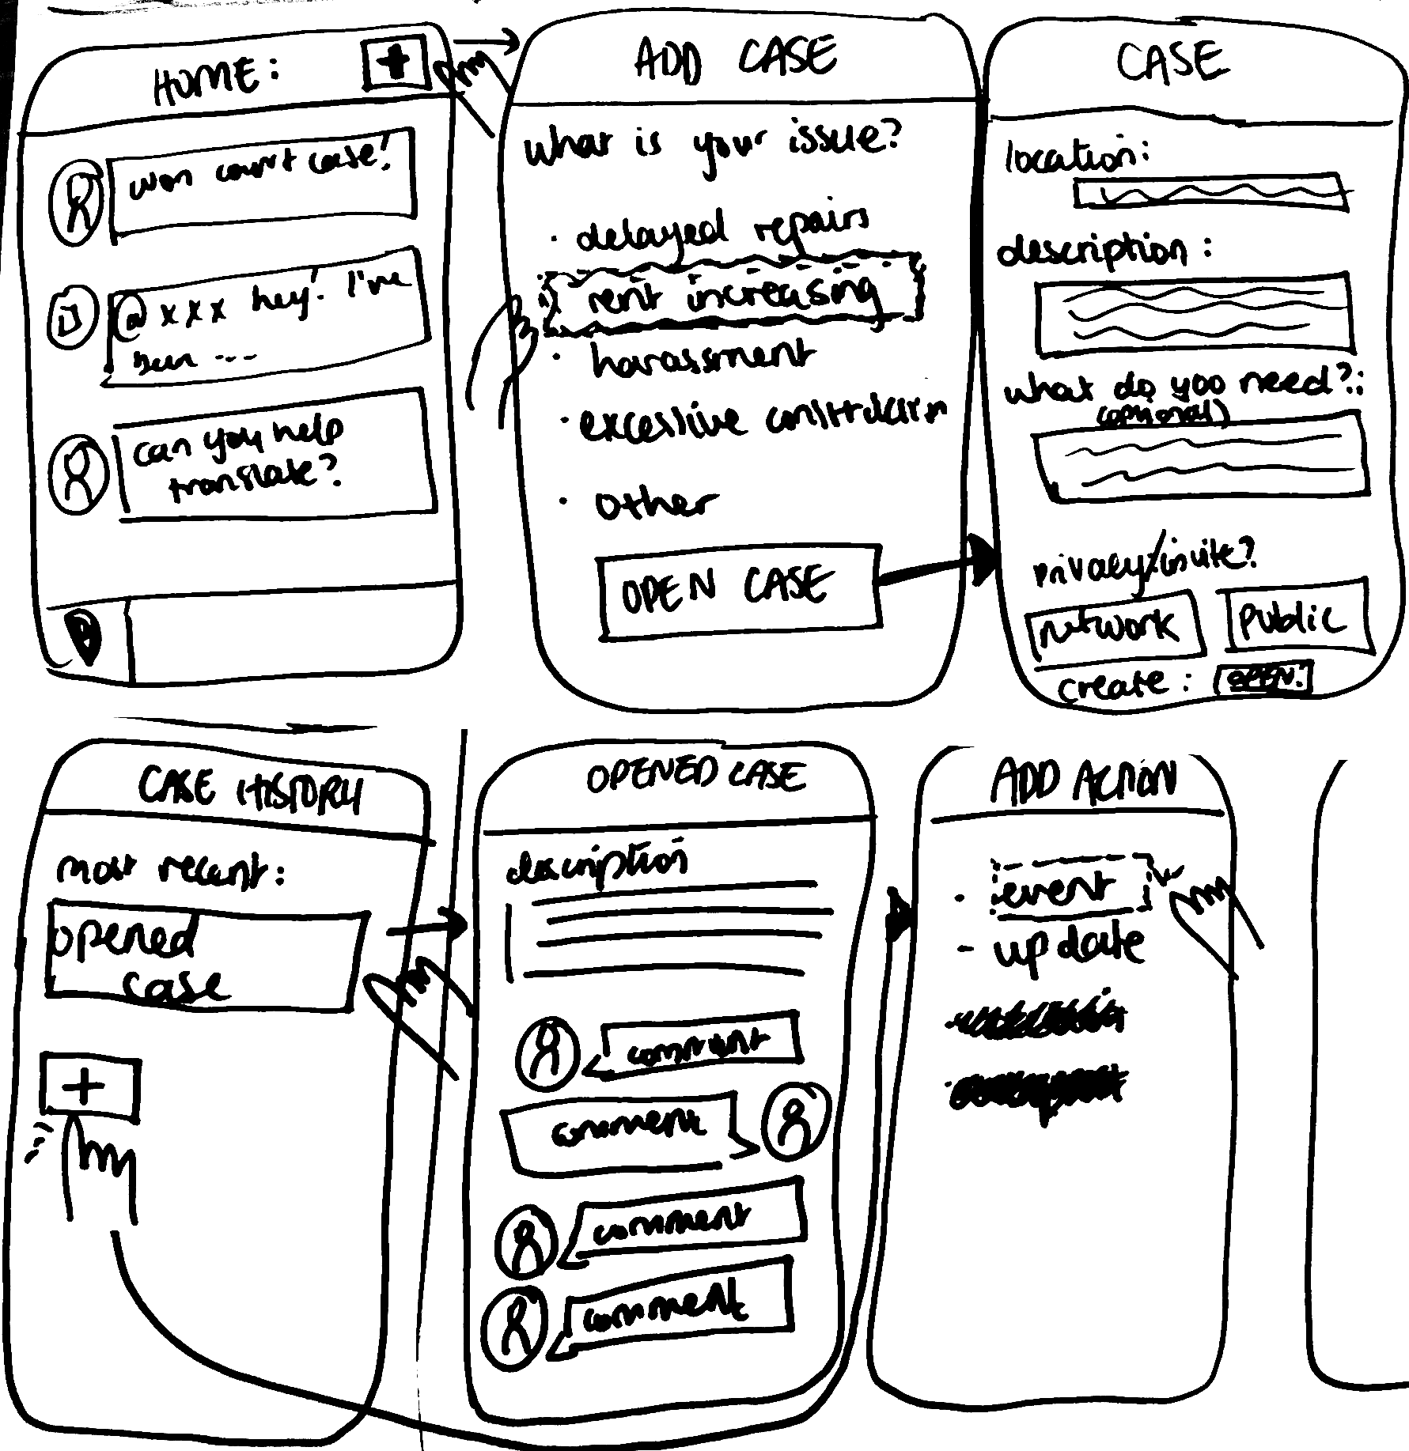
Taskflow #1 -
Create new case

Slide 6
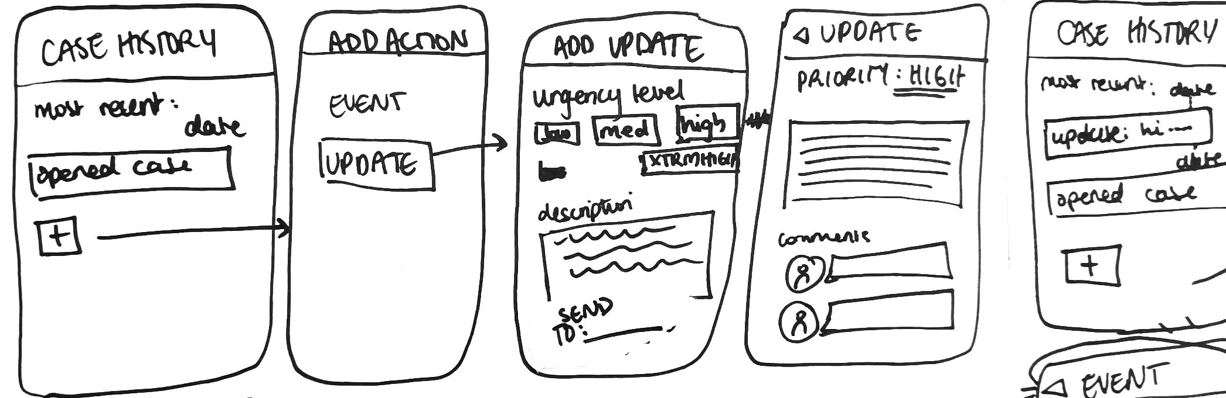
Taskflow #3 - Post an update
Taskflow #2 - Create an update

Slide 7
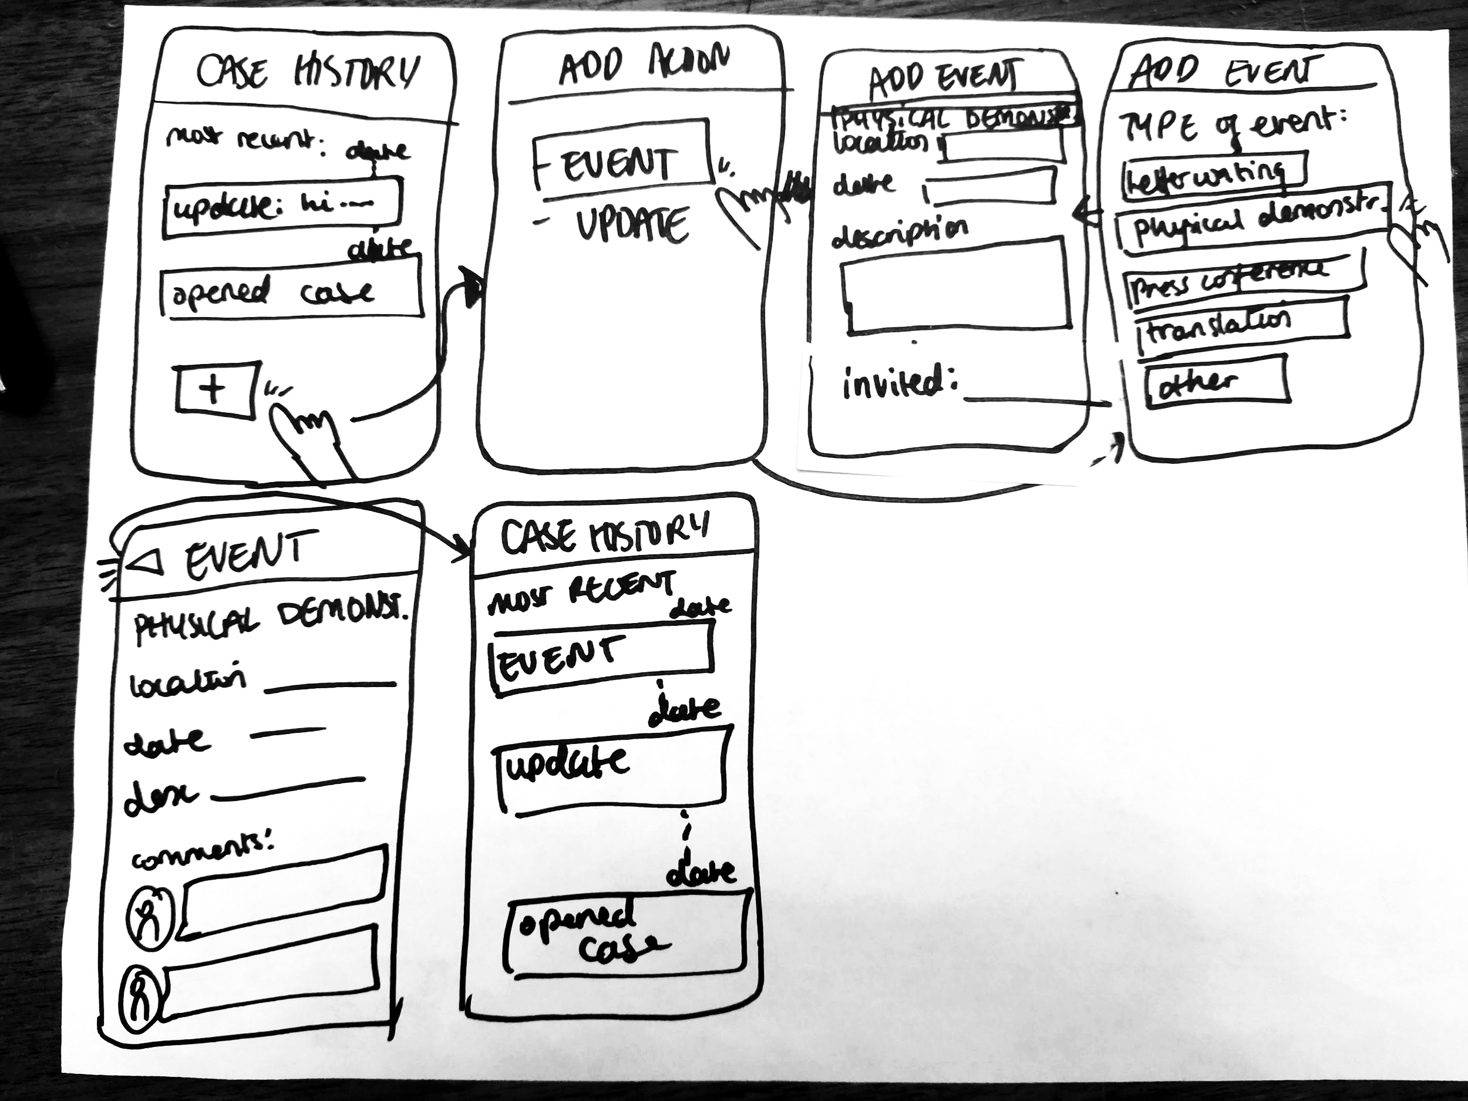
Taskflow #2 - Create an event
Taskflow #3 -
Create an
event

Slide 8
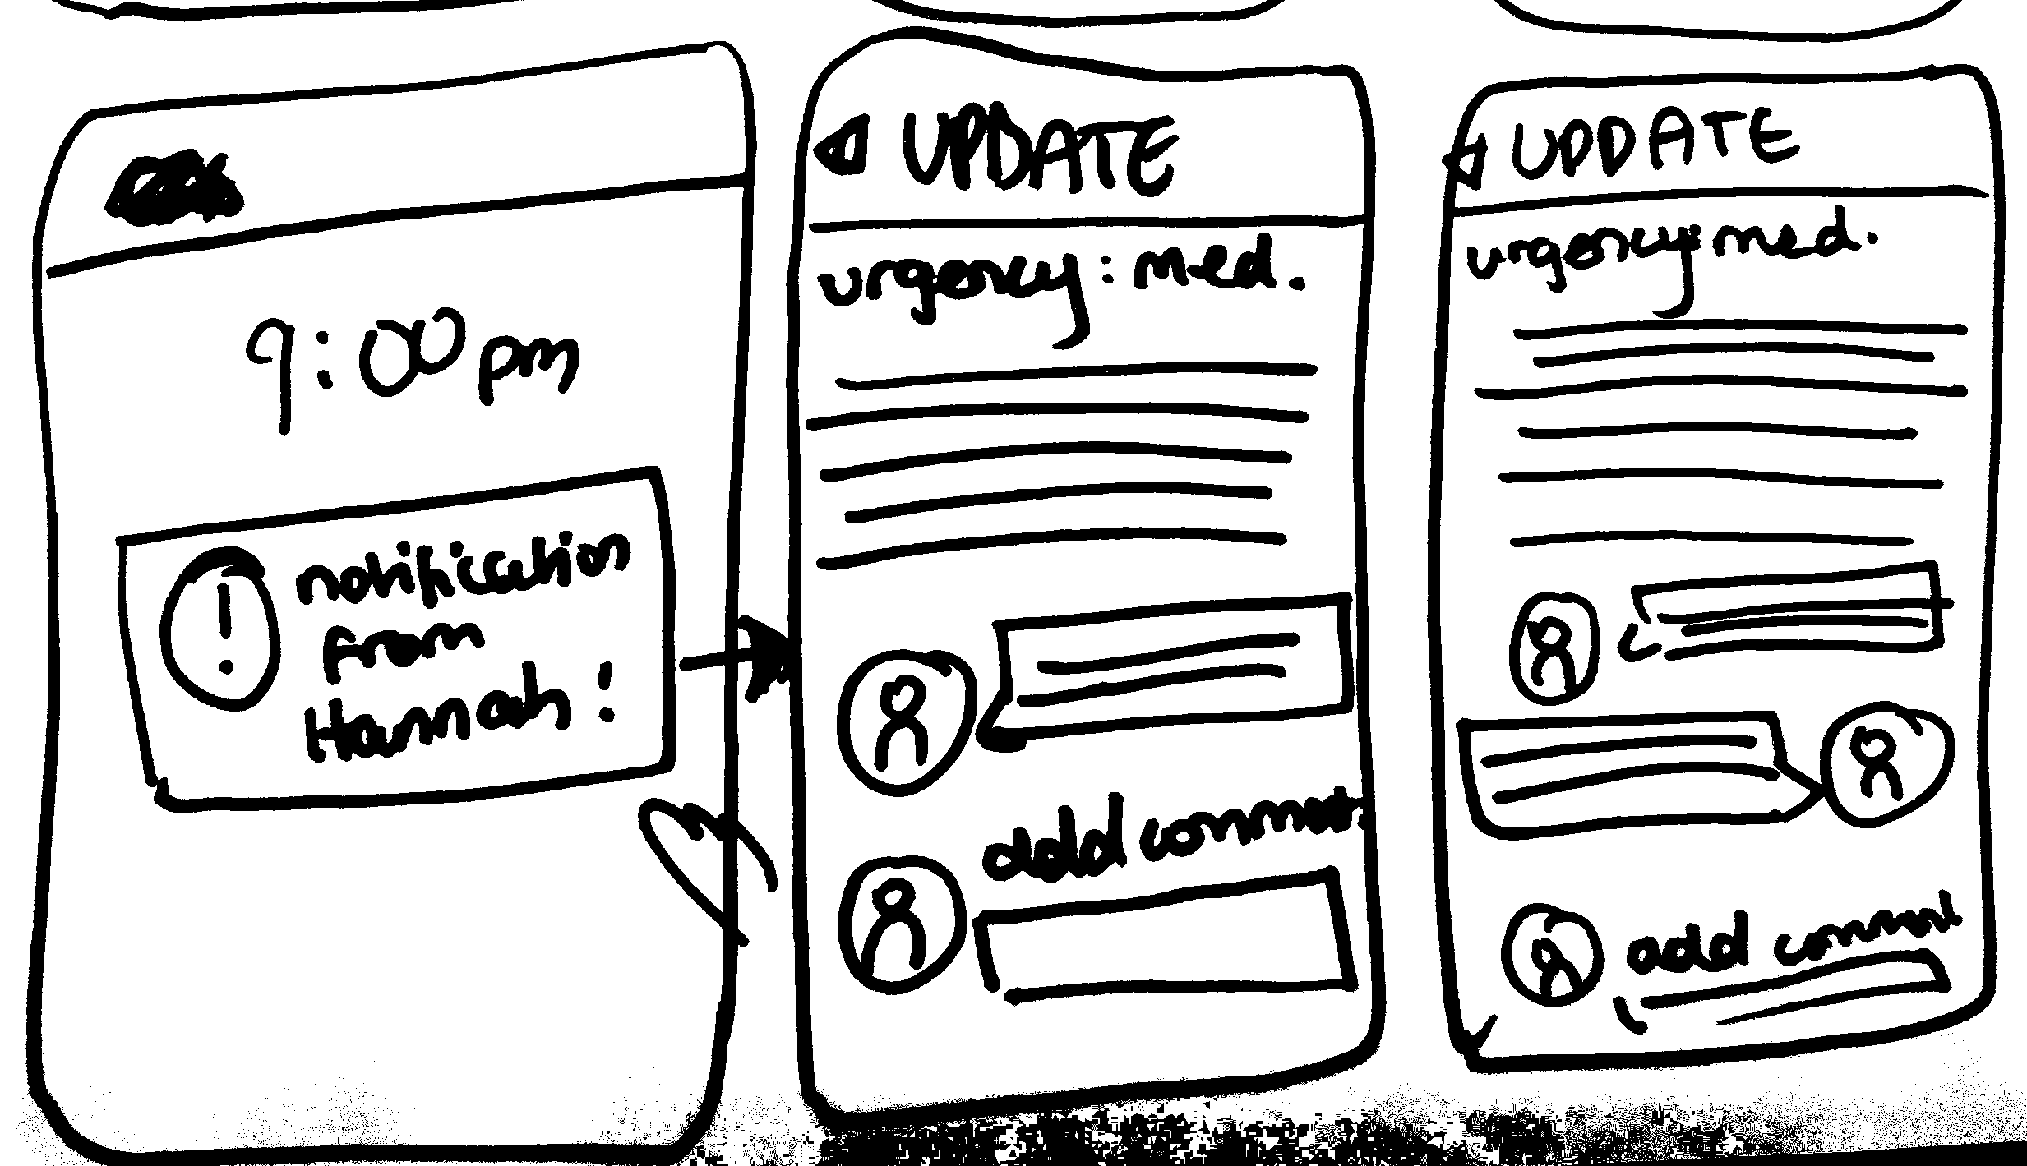
Taskflow #4 - Comment on post
Taskflow #4 - Comment on post

Slide 9
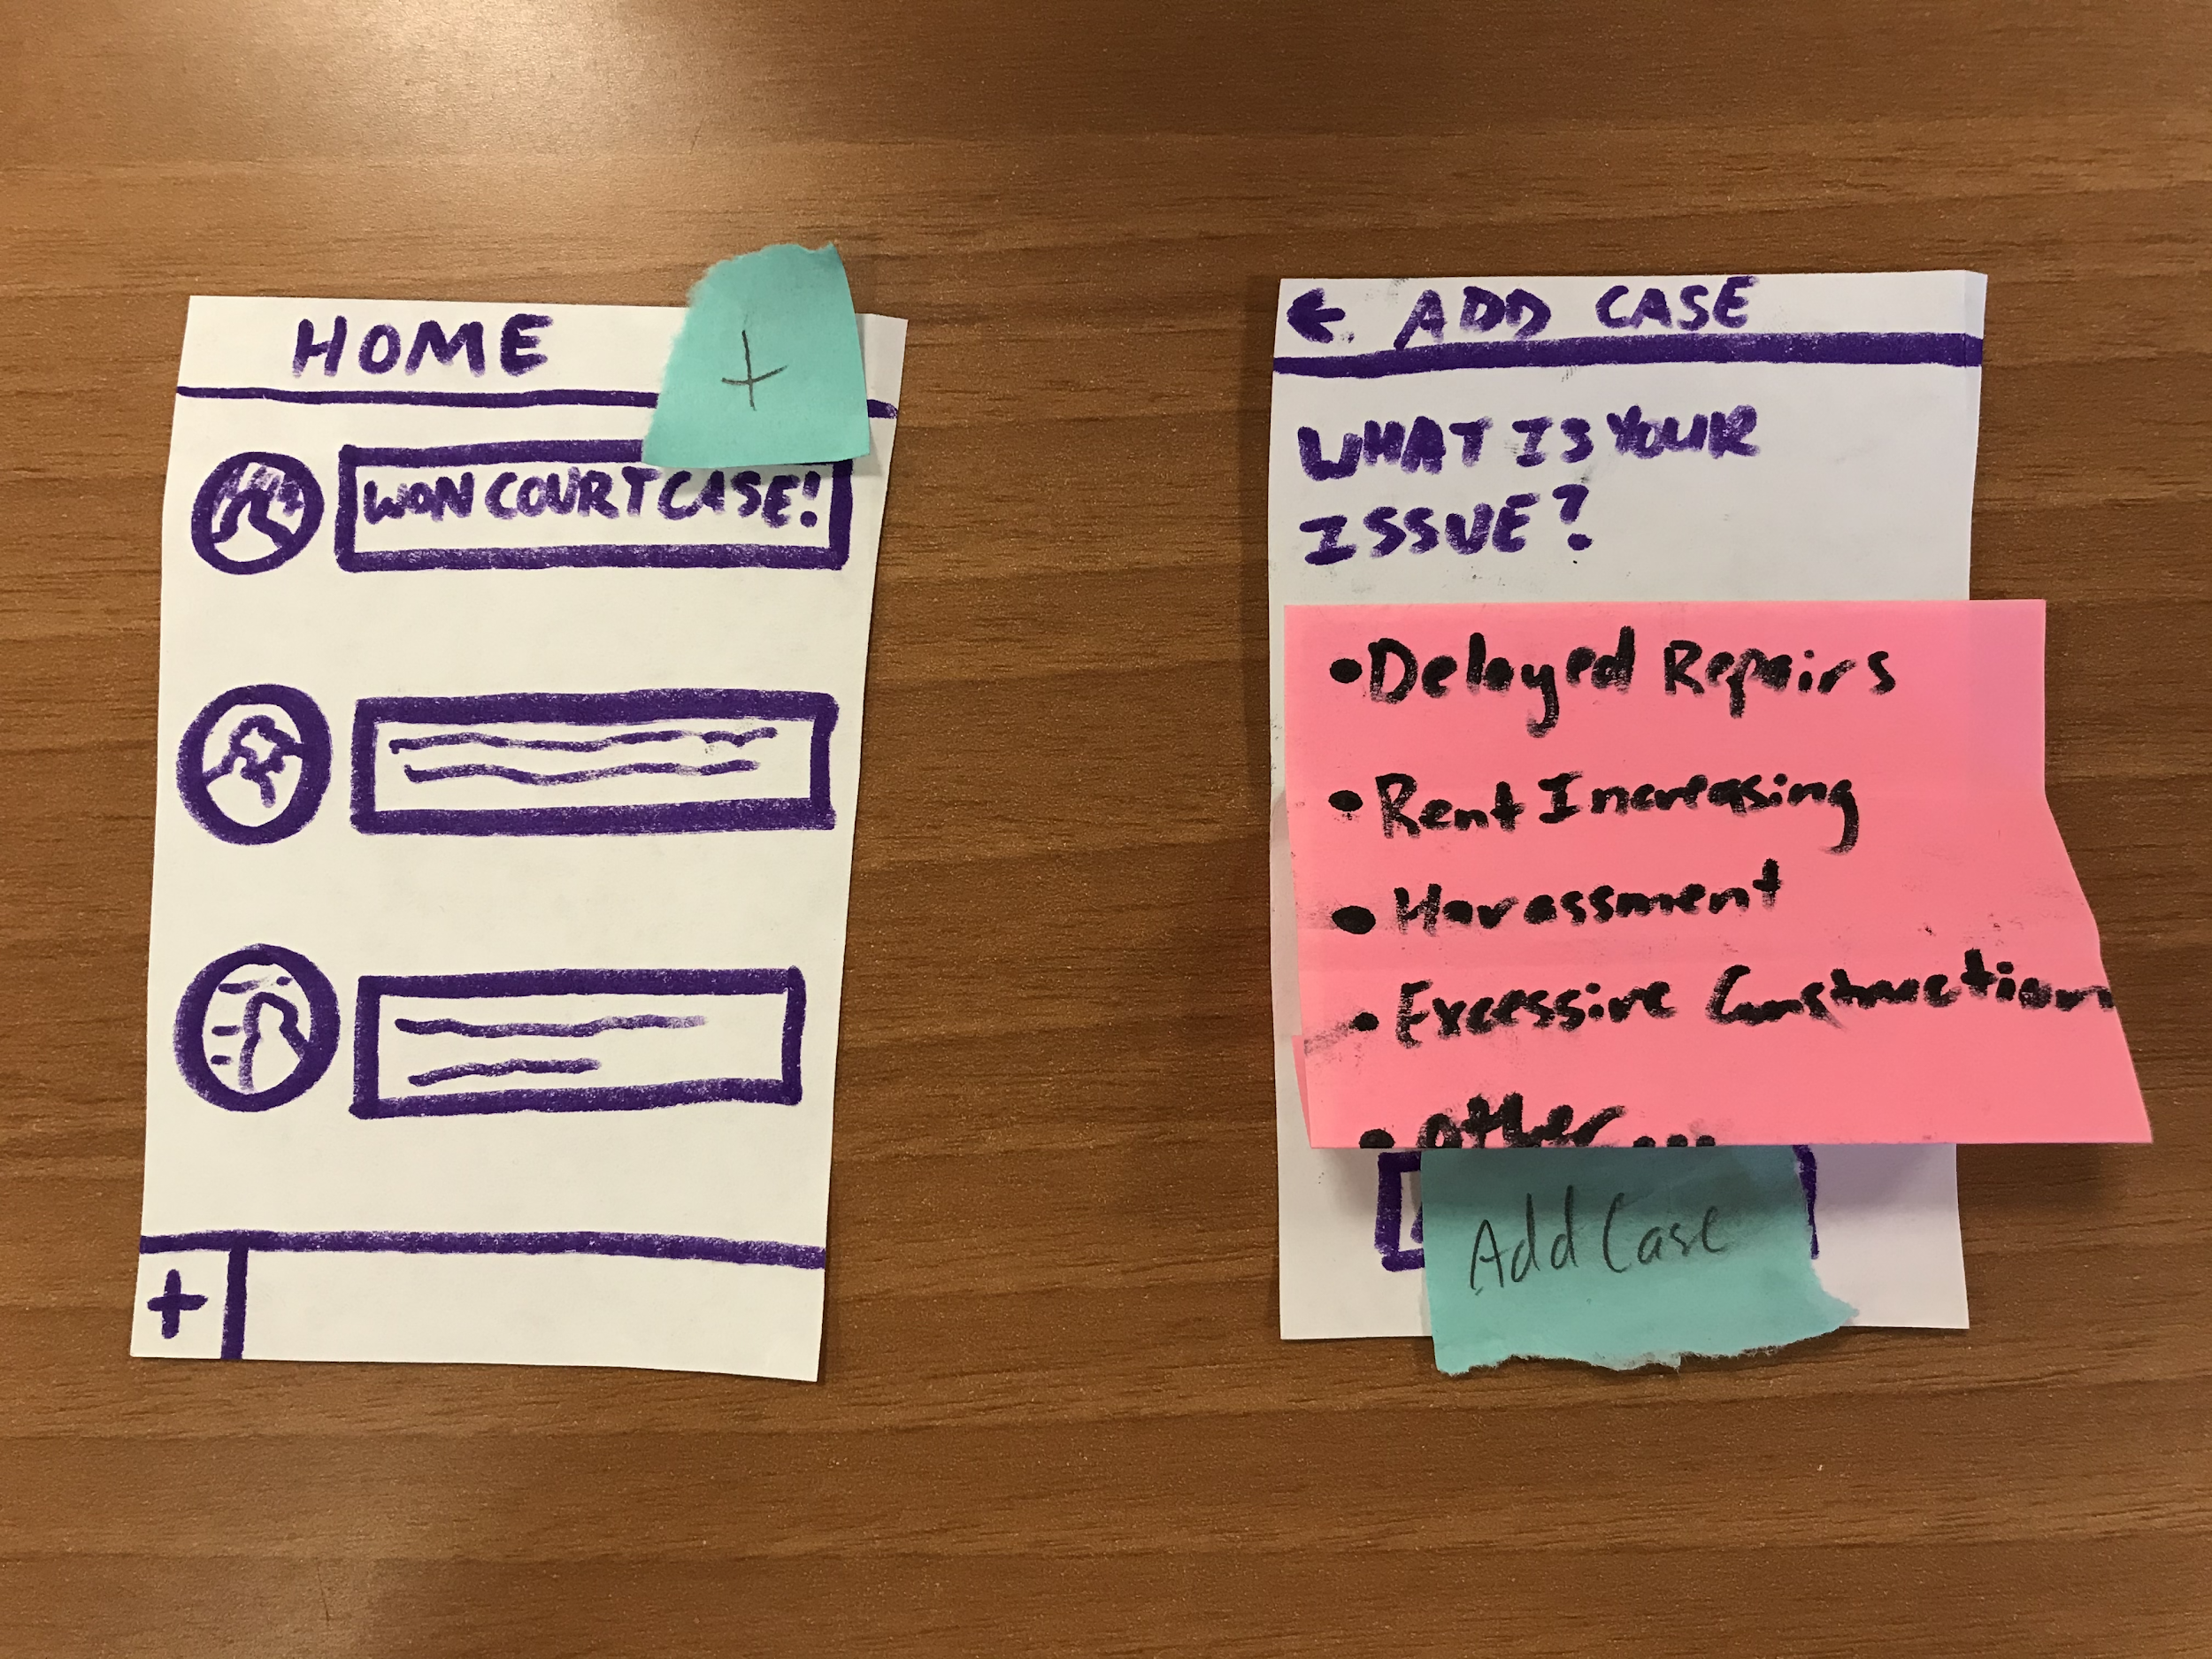
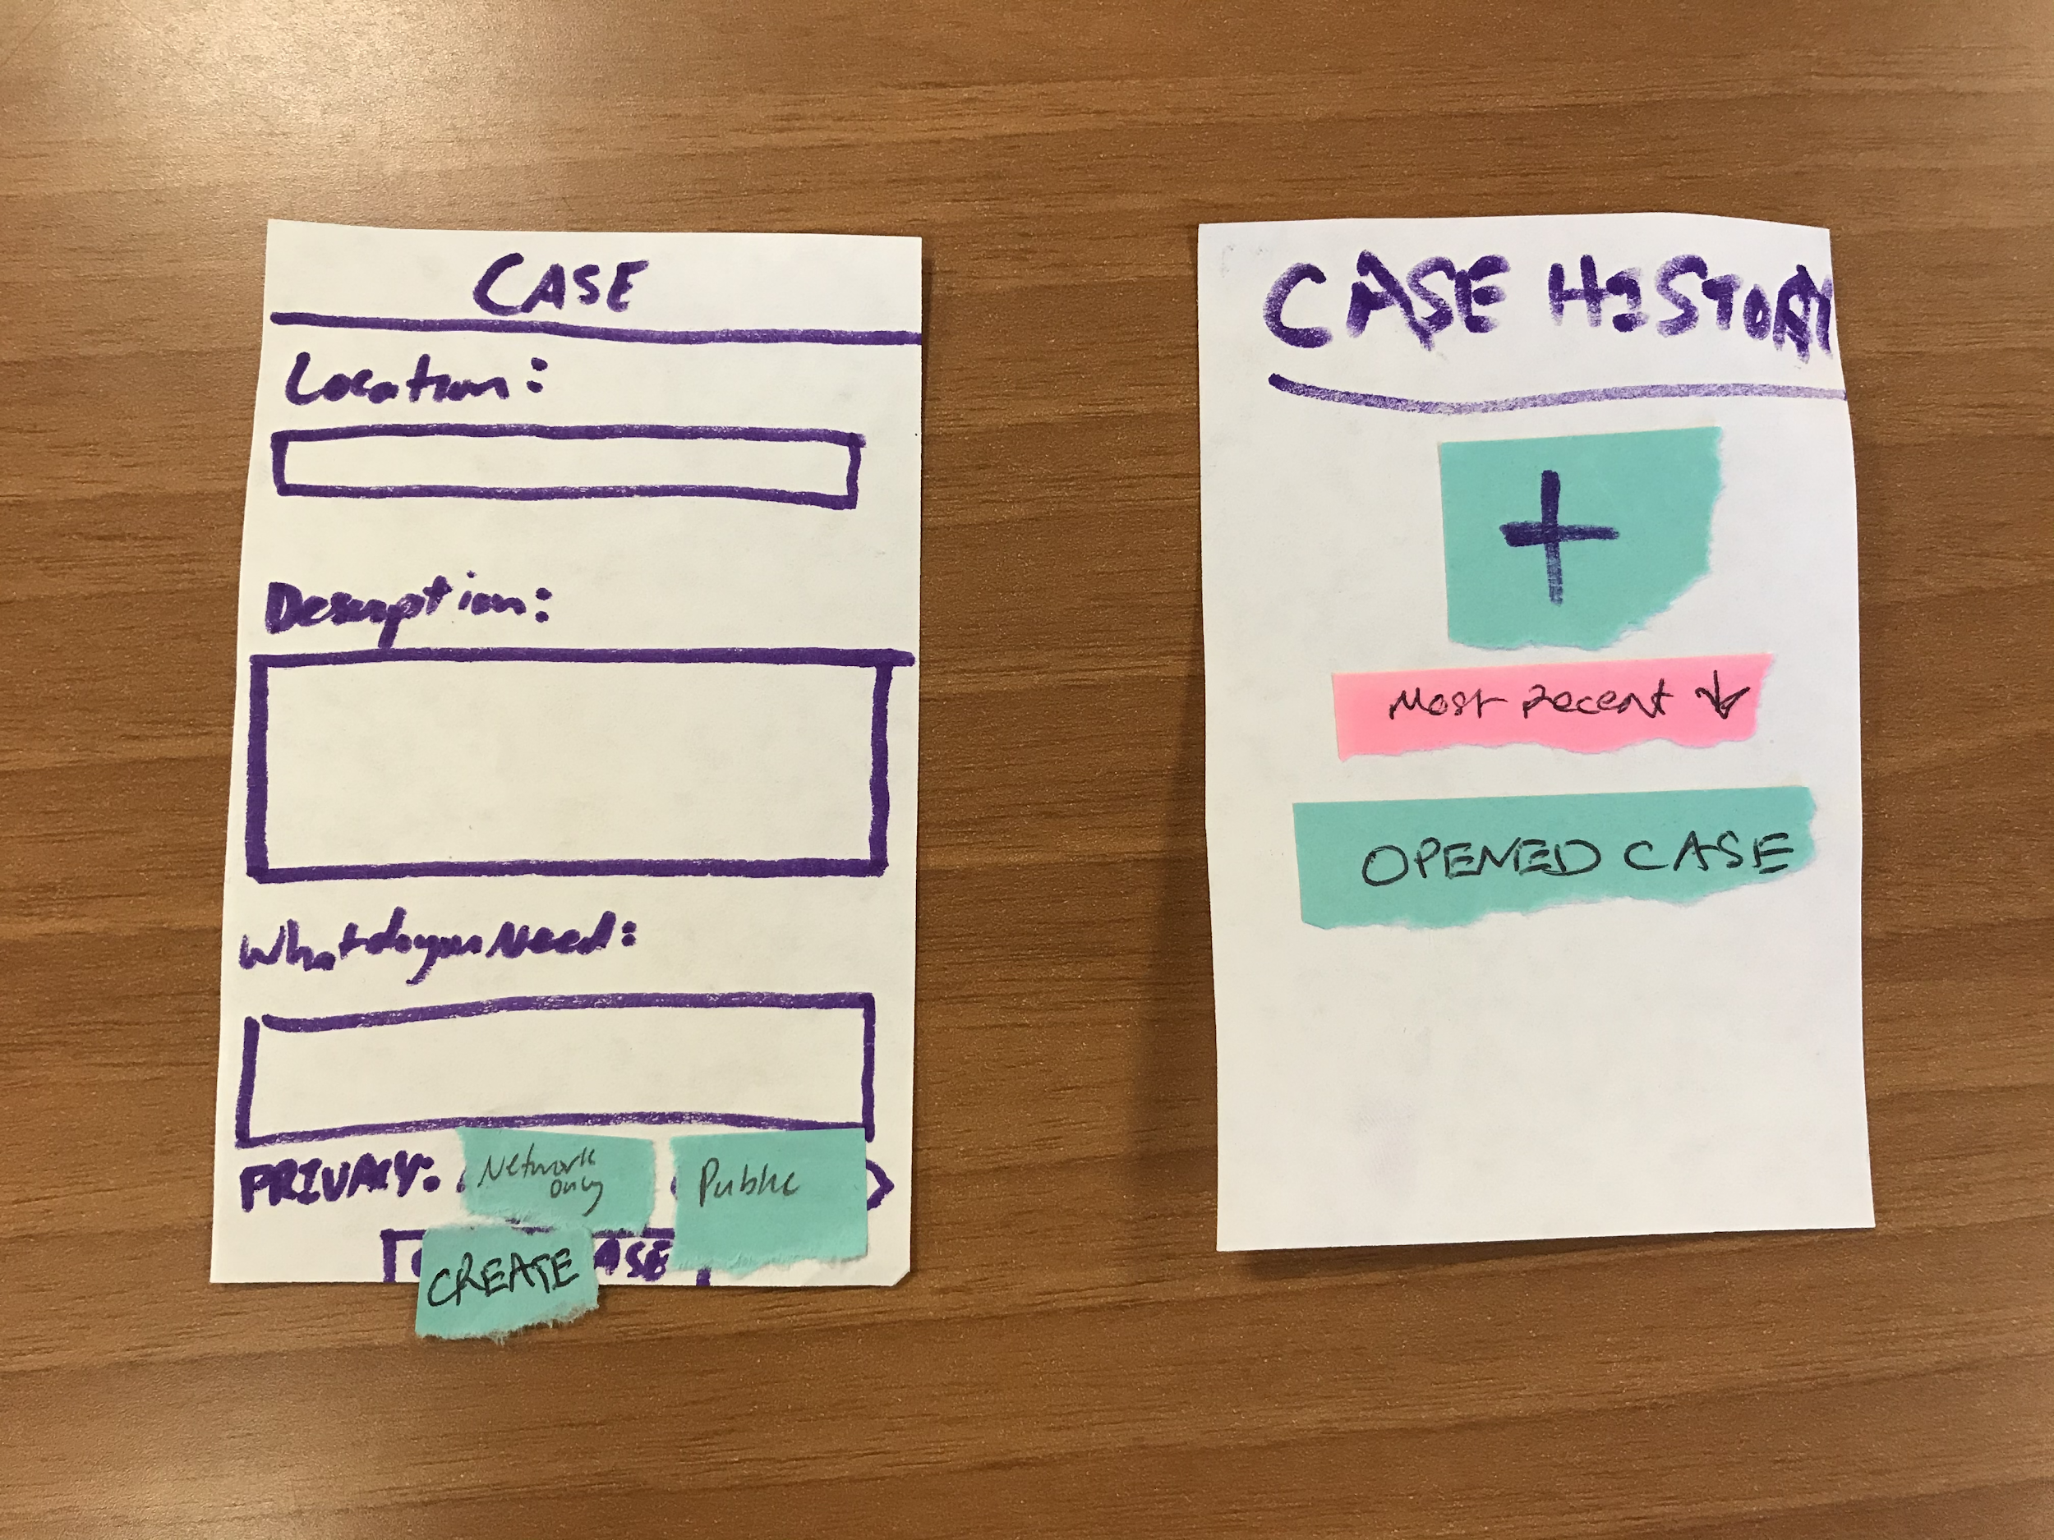
Taskflow #1 - Create new case
Task 1: Create New Case
Landing Page
Add Case Page
Add Case Page cont.
Newly opened case history history page

Slide 10
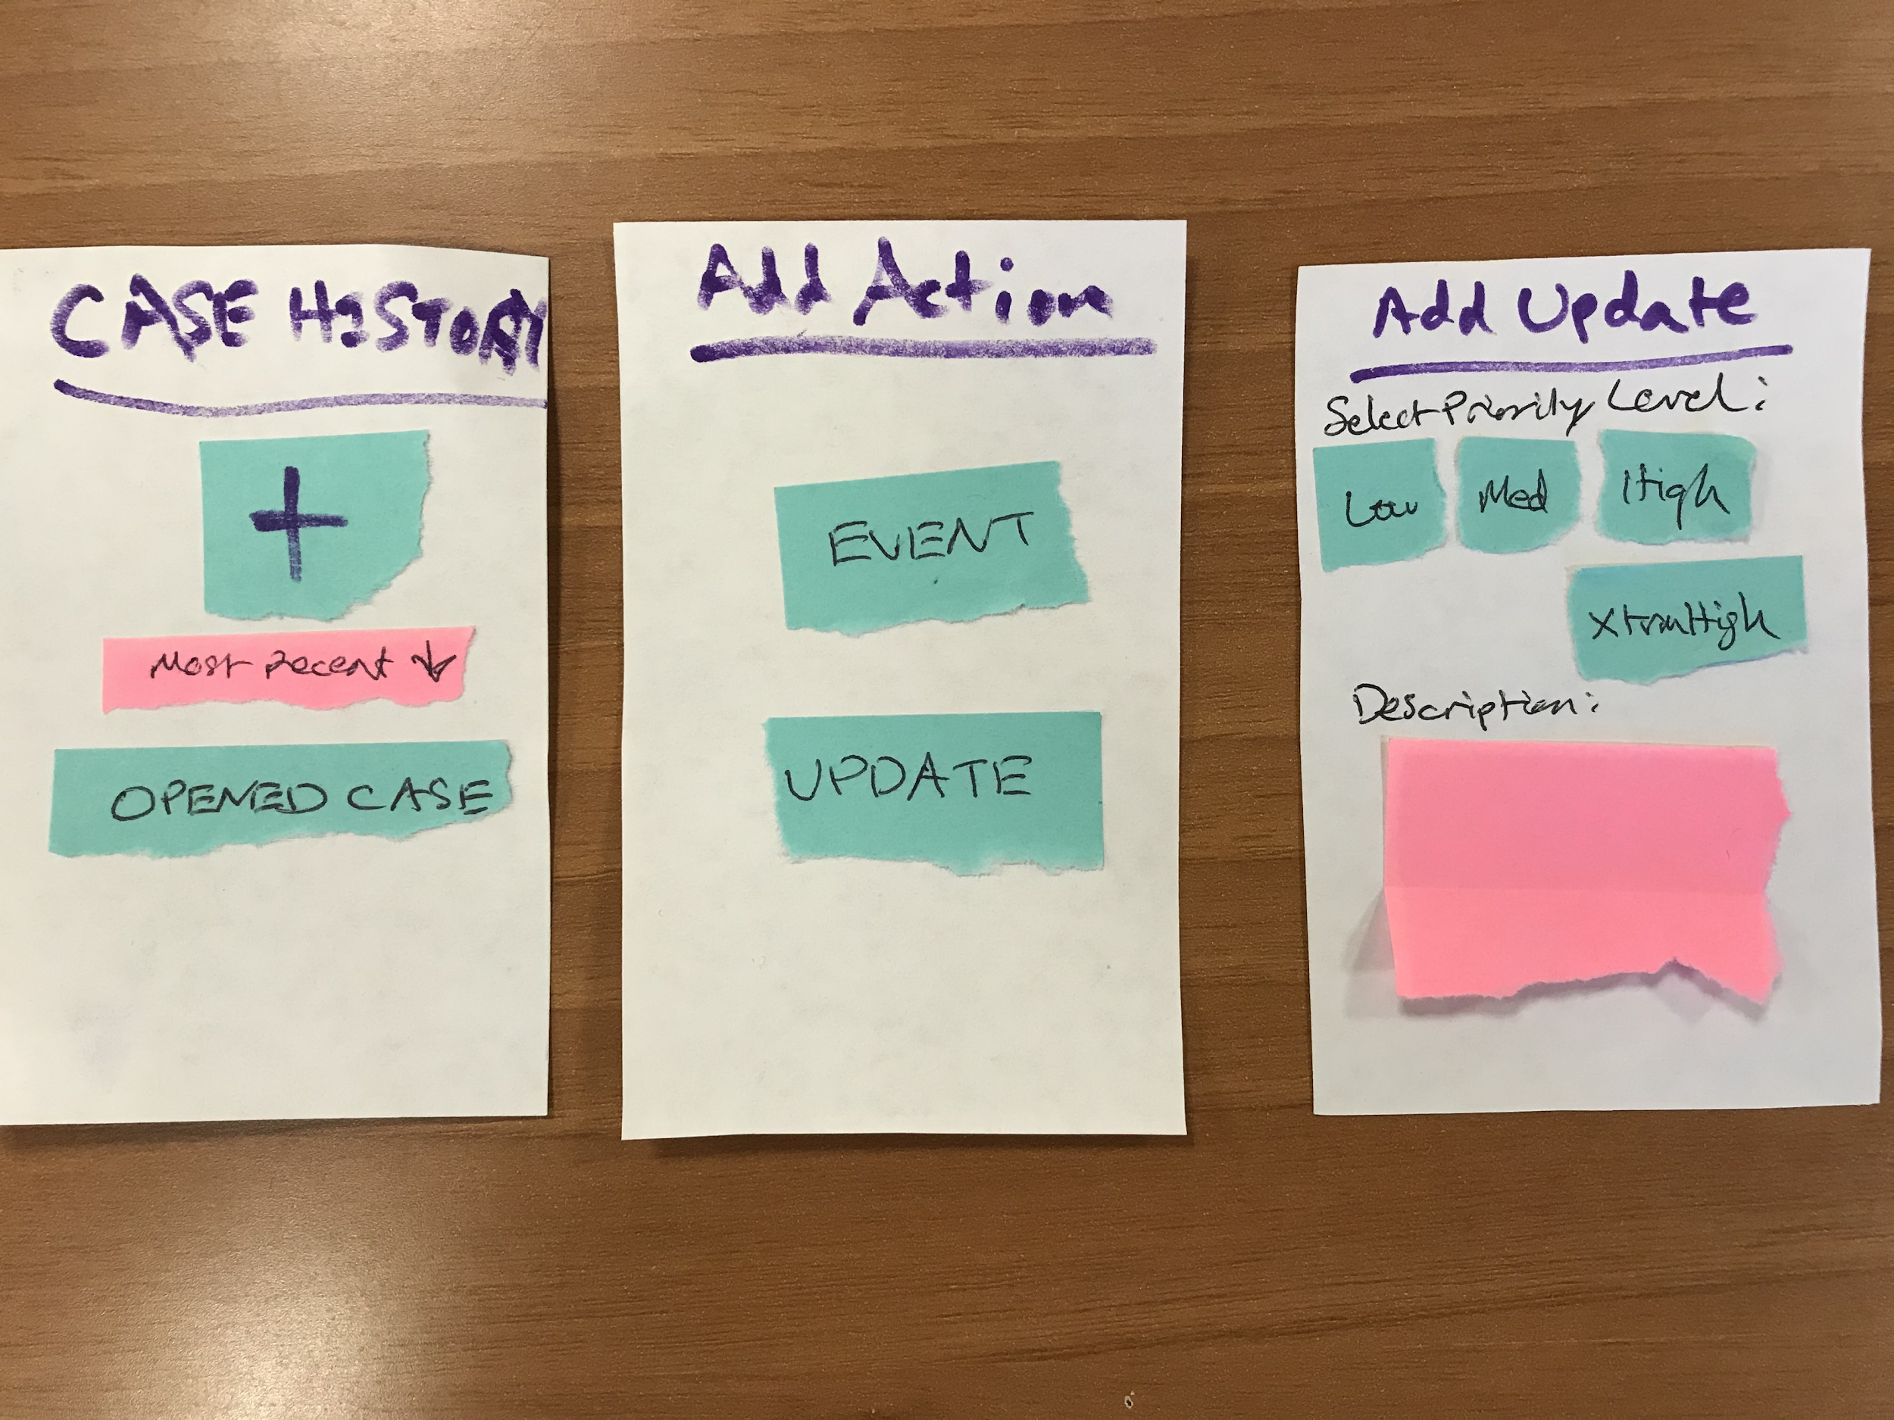
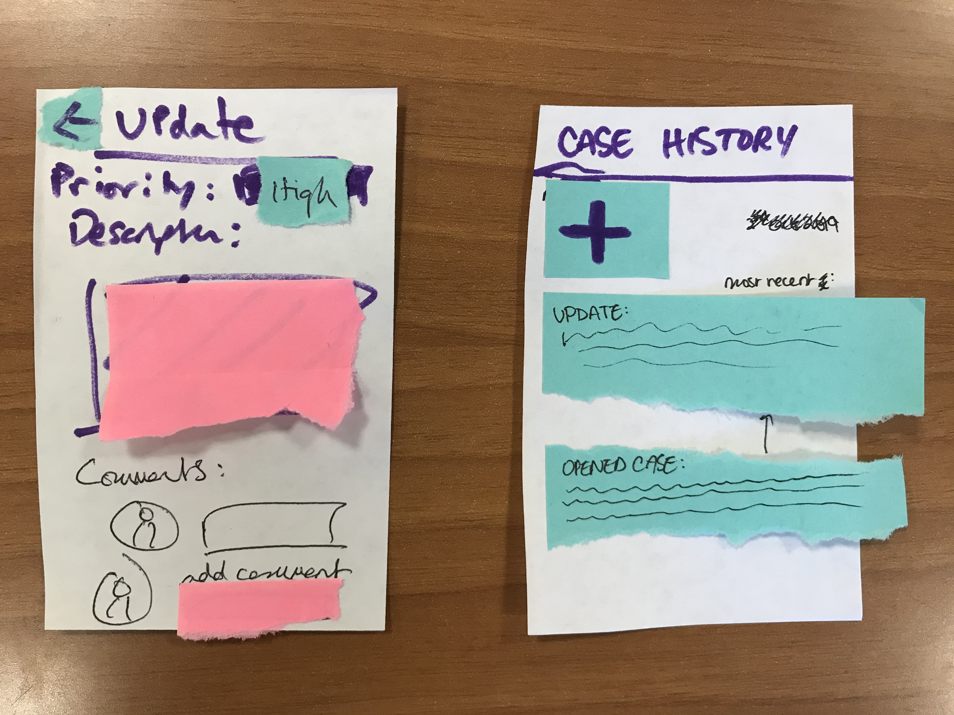
Taskflow #2 - Create an update
Task 2: Add New Update to Case
Case History Page
Action Selection
New Update Creation page
Update Details Page
Case History Page

Slide 11
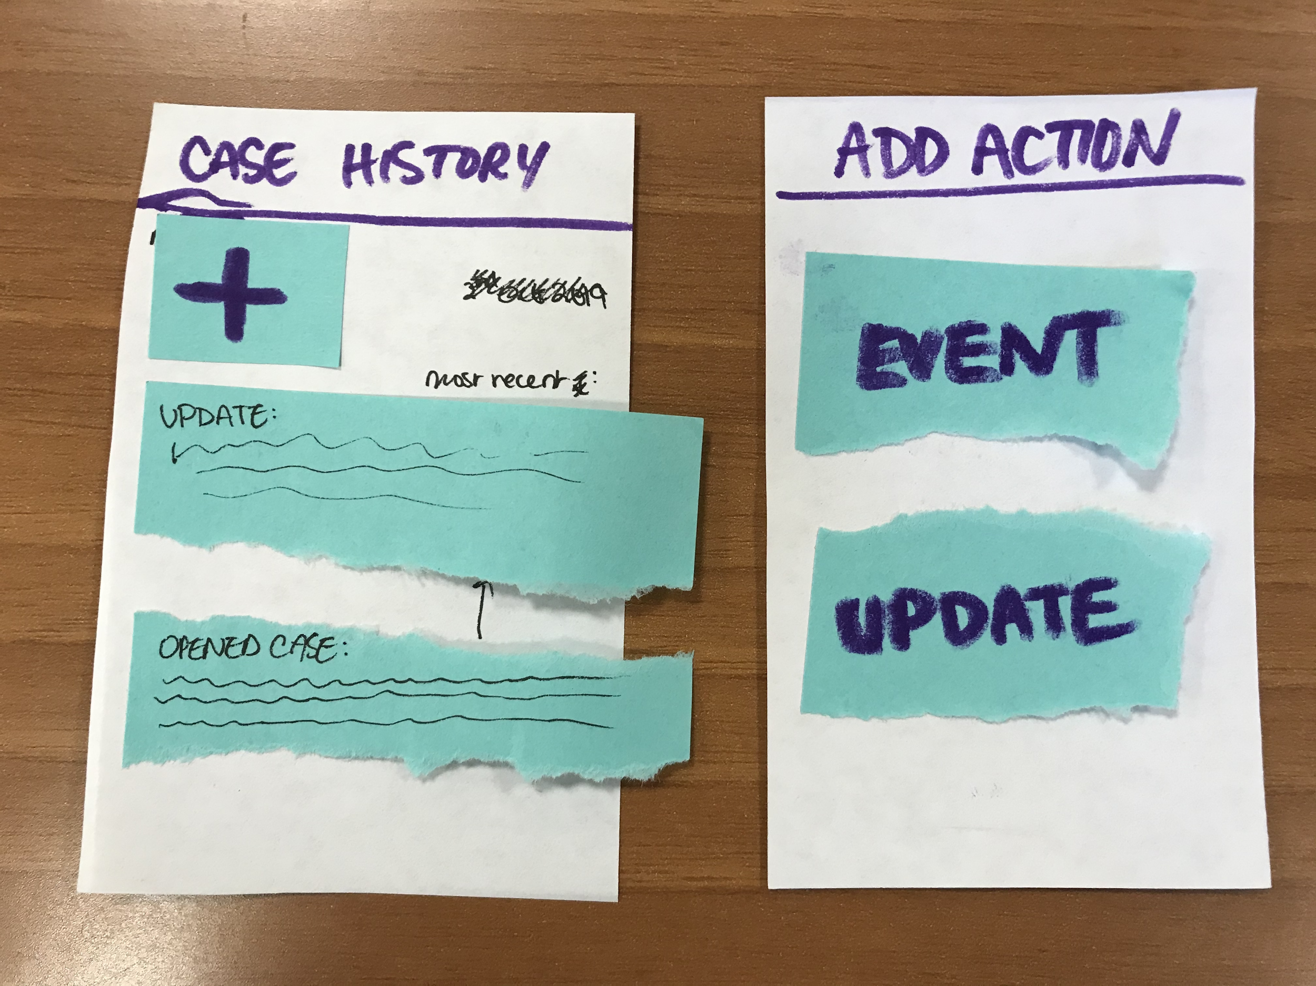
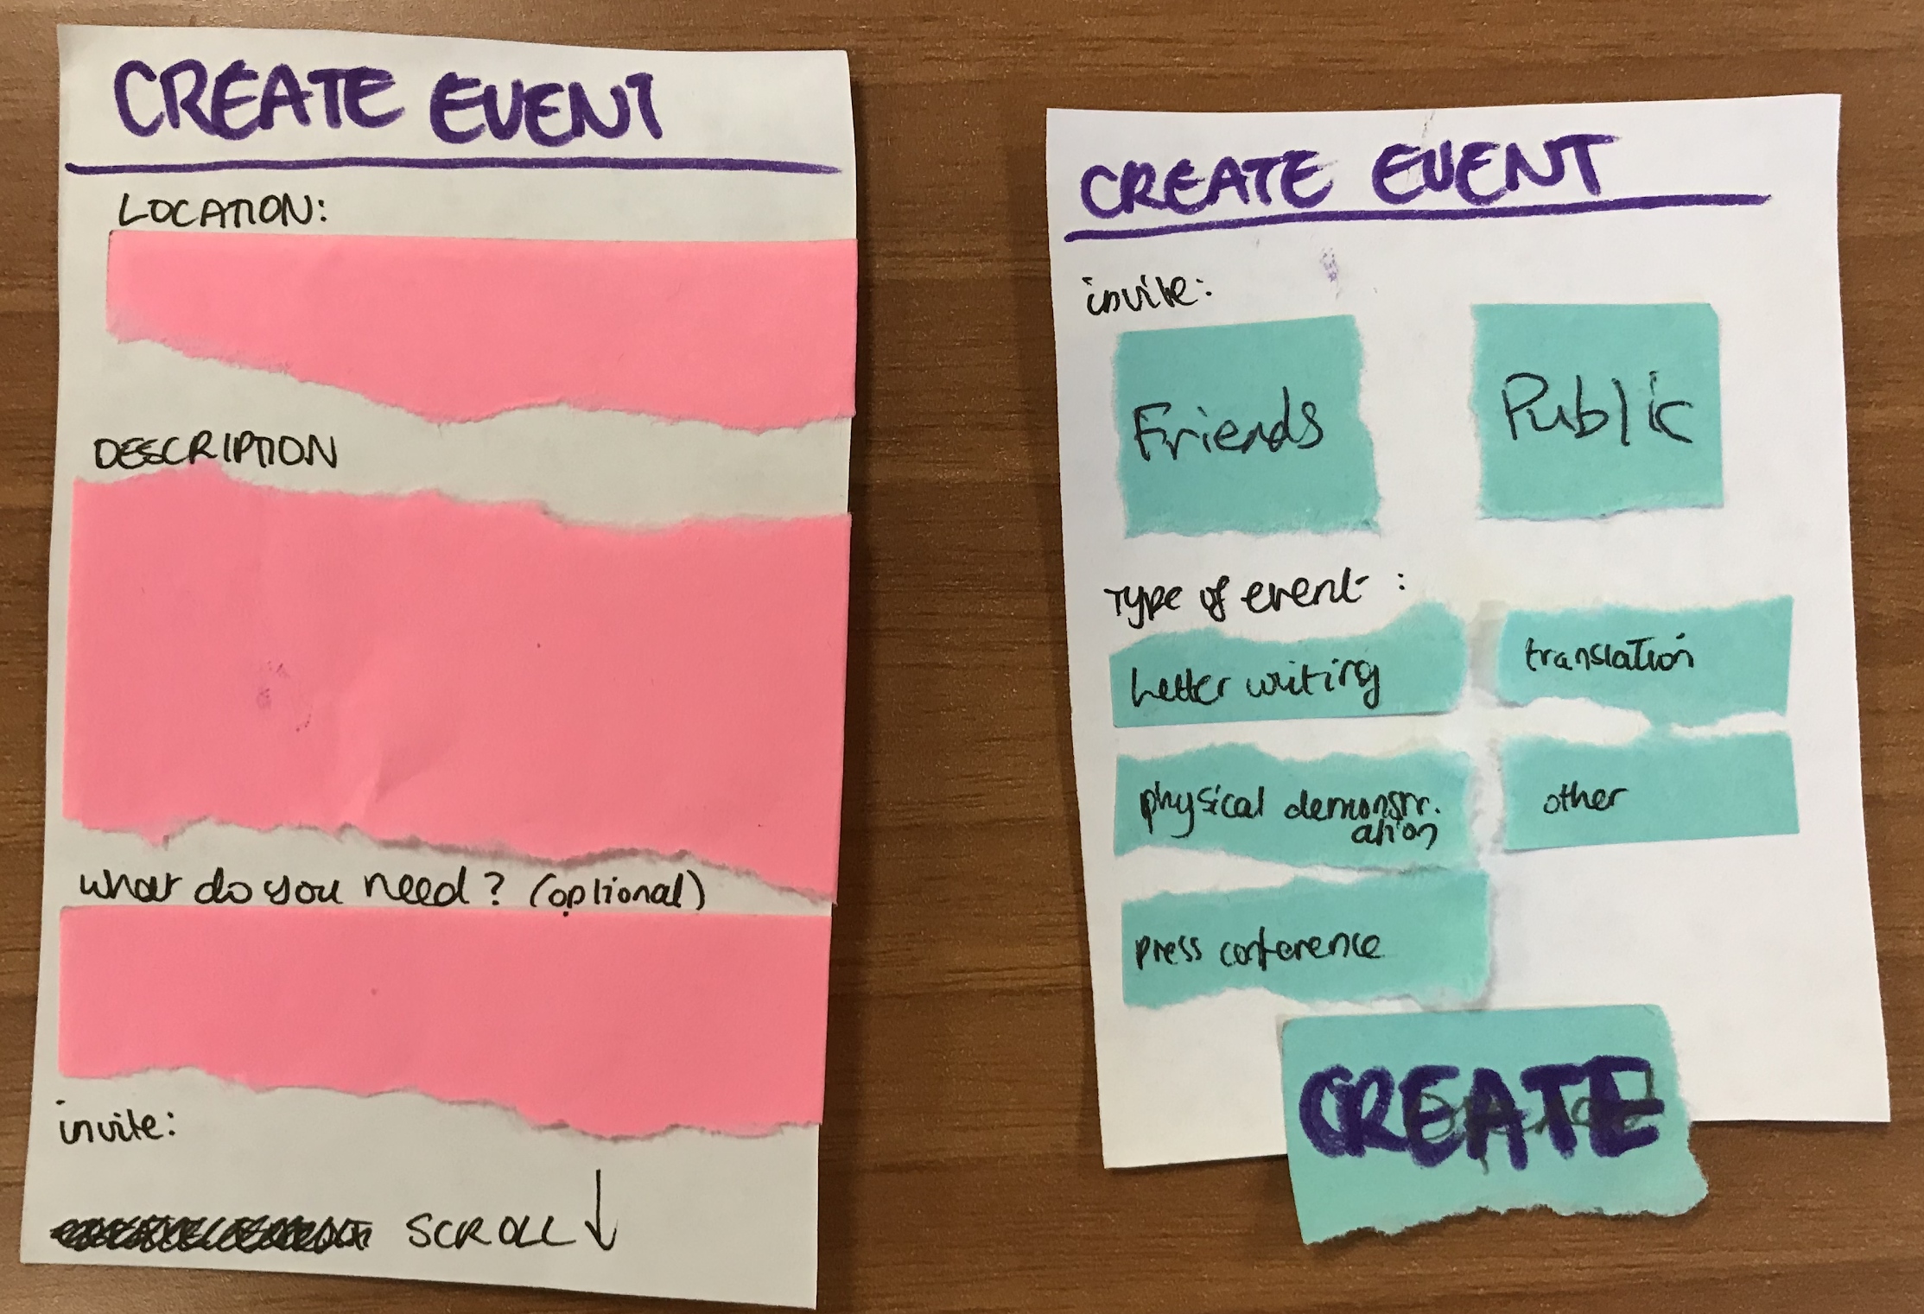
Taskflow #3 - Create new event
Task 3: Create New Event
Case History Page
Action Selection
Create New Event Form

Slide 12
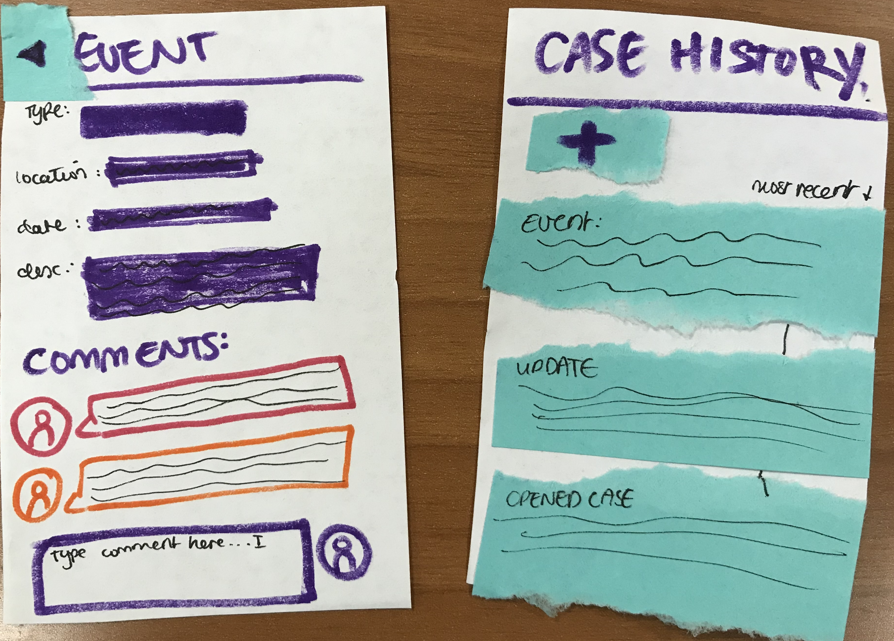
Taskflow #3 - Create new event
Task 3: Create New Event (cont.)
Event Details Page
Case History Page

Slide 13
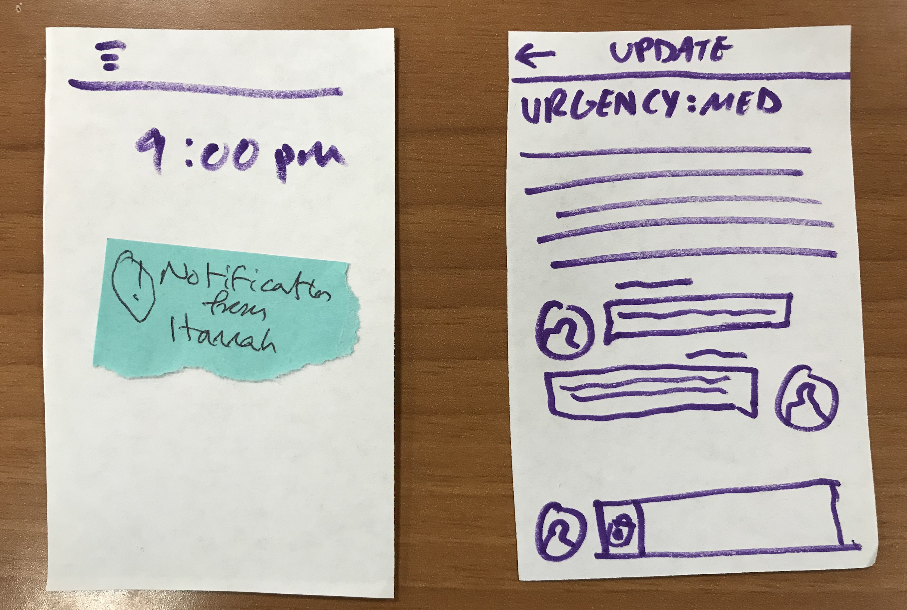
Task 4: Adding a comment
Taskflow #4 - Adding a comment
Locked Phone Screen
Update Details Page

Slide 14

Experiment
DF
Housing organizer in San Francisco
ST
Junior at Stanford
RH
Senior at Stanford
Notes:
We recruited a variety of participants. One was a housing organizer in San Francisco who helps tenants experiencing harassment with tasks such as writing letters to their landlords and fighting eviction notices. Two others were Stanford students.

Slide 15
Method
We started our testing by providing background info on the app:
  Script: The app is a "social network" for renters to crowdsource housing issues they are experiencing, such as slow repairs and illegal rent increases. People can create "cases" that others in their network can subscribe to and get updates on steps being taken to resolve the case and ways they can help.
App Demo:
  show how to view the cases for a profile, and how to view the events and updates in a specific case
Tasks
  Ask the participant to perform each of our tasks listed above
  Start from the landing page (a news feed), where we ask them to create a new case.
  Observed
Feedback
  We asked for general thoughts about their experience using the app

Slide 16
Errors
Home screen looks like a group chat rather than an activity feed
Functionality of “+” button on “Case History” screen is not clear
Users mis-understand what a “case” was, vs an “event” or “update”, even though we took a minute in the beginning to explain background on how the app works.
Participants needed a lot of encouragement to motivate them to click continue along the work flow
Time
  To complete all 4 tasks took roughly 8-10 minutes per participant, which is longer than we were expecting
Notes:
These are the major errors.
4. This also may have been the case because this is a simulated situation, and the people being asked weren’t in the immediate situation. The housing organizer had the least trouble moving through the app.

Slide 17
Successes
Workflows for creating new update and event are smooth
  Participants intuitively understand how to fill in the fields for description, urgency, location, etc.
Participants were excited about the prototype, especially the social networking/community-building component of the app
  DH: “People often don’t share things about their housing situation, but if they see that others are going through the same things, they might be willing to share and try to resolve them too.”
Notes:
The network was also a source of questions--how would these networks be created?

Slide 18
UI Changes
Landing page with “My Cases” rather than activity feed
***Label buttons clearly***
“+” button for creating a new case
⇒ “Create New Case”
“+” button for adding an event or update to a specific case
⇒Drop down menu with two options, “Add Event” and “Add Update”
Back button for leaving update or event details view and returning to history
⇒ “View Case History”

Slide 19
Summary
Participants are very excited about the app and already have suggestions for what it could do
Participants found some concepts a bit confusing at first, such as the meaning of a case vs event and update
Cleaning up the buttons would significantly improve clarity and user flow

Slide 20
Questions?

Slide 21
Appendix

Slide 22
RH Errors
Incident | Severity Rating
“wouldn’t I just write here in the chat? at the bottom...This looks like a group chat, but it’s labelled home” | 4
“I’ve arrived at case history, but how do I go back to add an update? I want to go to another page to add a message” | 4
“I thought this plus would have been to add a case” | 2

Slide 23
RH Errors (cont…)
Incident | Severity Rating
“I want a dropdown menu that says share case (like three dots)” | 2
“privacy? oh ok, choose bw these two” | 1
didn’t understand that the case history page with the new update added to it was the same case history page from before | 4

Slide 24
RH Successes
Incident | Severity Rating
Add example and add update workflow were easy to understand and input descriptions | 0

Slide 25
ST Errors
Incident | Severity Rating
Blocked when trying to create an update to the case because thinks the plus button is for creating a new case | 4

Slide 26
ST Successes
Incident | Severity Rating
Plus sign clearer now context of adding update | 0
everything else very smooth | 0

Slide 27
DF Errors
Incident | Severity Rating
I think a big issue is whether people will get involved when they don’t have a housing issue | 3 (we want lots of people to be in the networks)
Notes:
We didn’t talk about how the networks would be created

Slide 28
DF Successes
Incident | Severity Rating
I like how people can see what other people are doing in their housing situation | 0
understands what a case is | 0
clicks in the right places to make update and event | 0

Slide 29
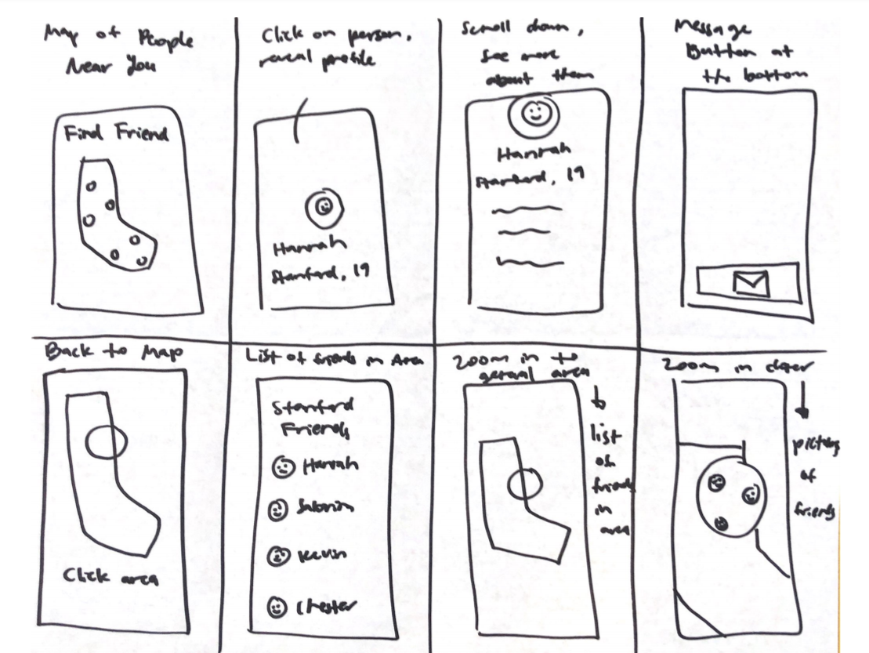
CONCEPT SKETCH #1 -
Location based networking mobile app

Slide 30
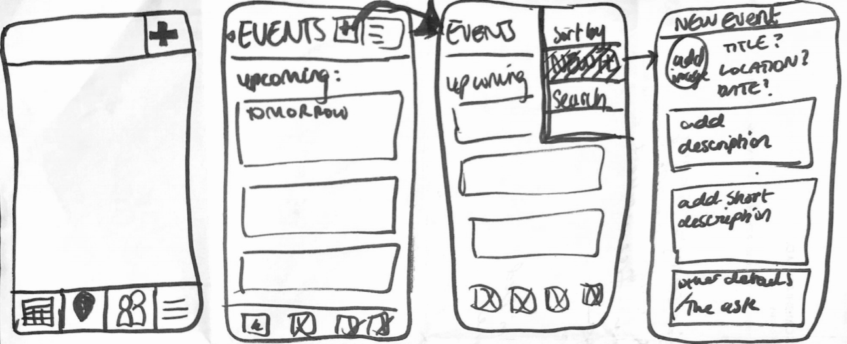
CONCEPT SKETCH #2 -
Event based mobile app

Slide 31
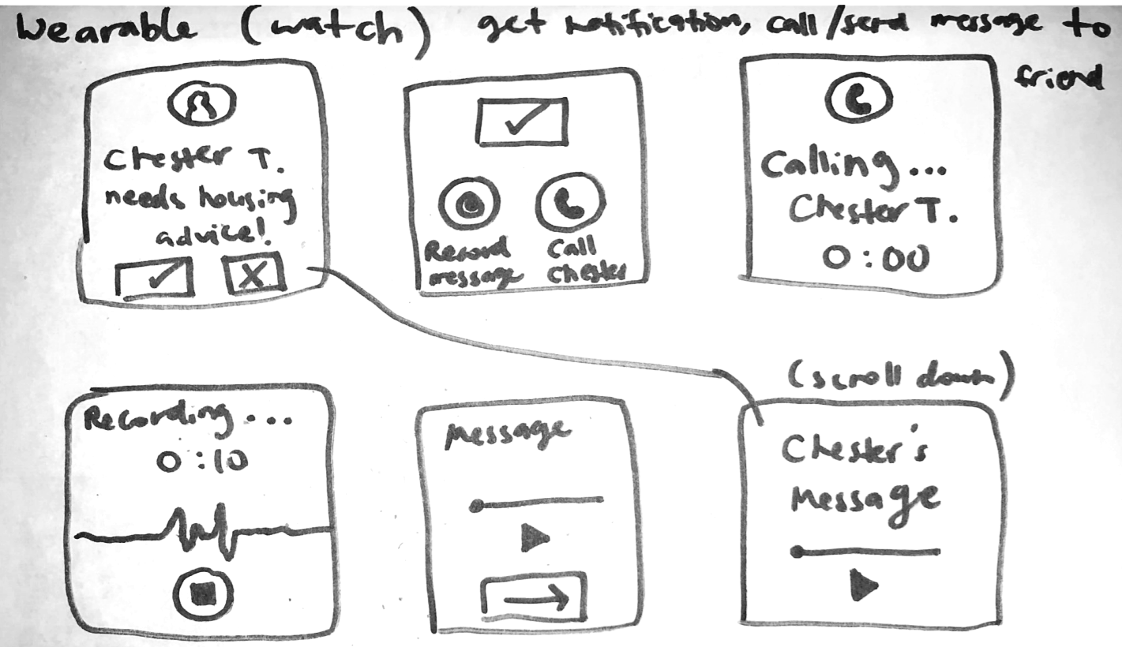
CONCEPT SKETCH #3 - Wearable watch app

Slide 32
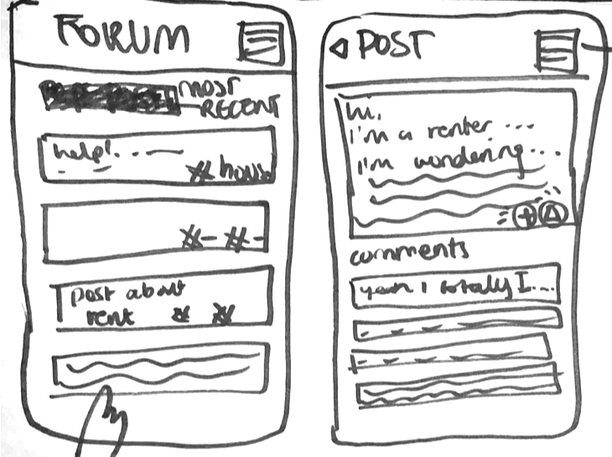
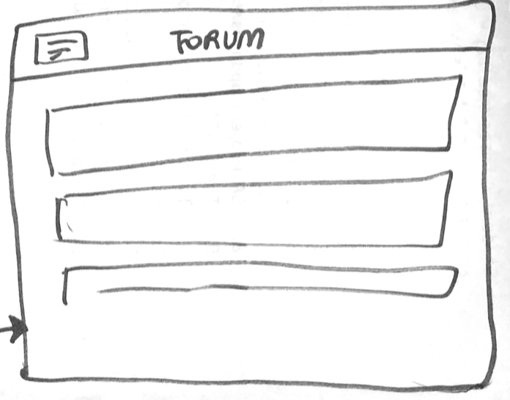
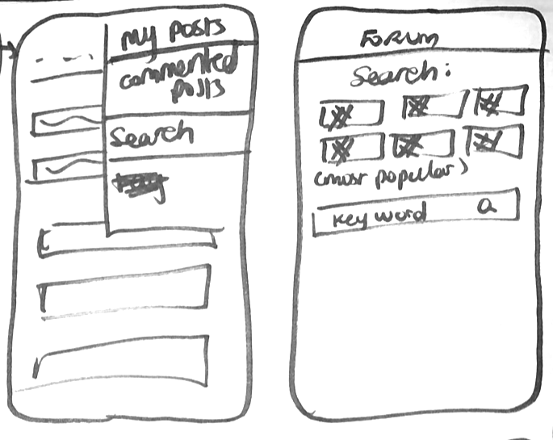
CONCEPT SKETCH #4 -
Forum-Based App/Website

Slide 33
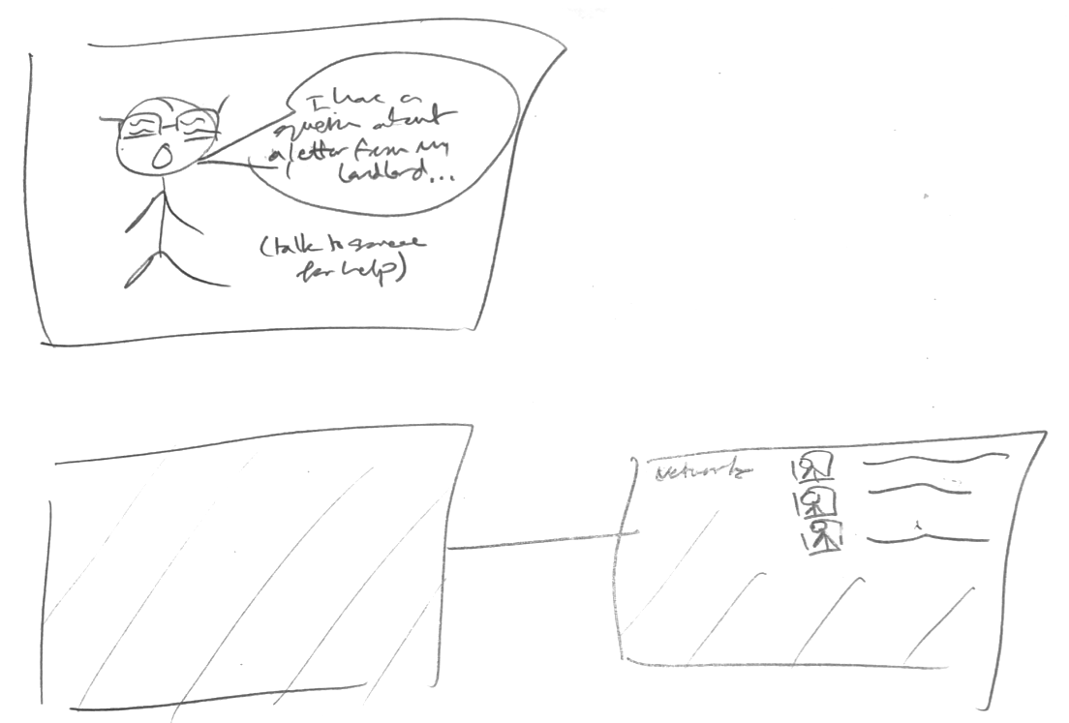
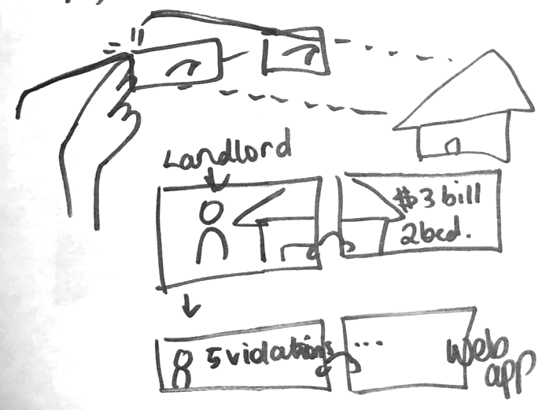
CONCEPT SKETCH #5 - Wearable glasses

Slide 34
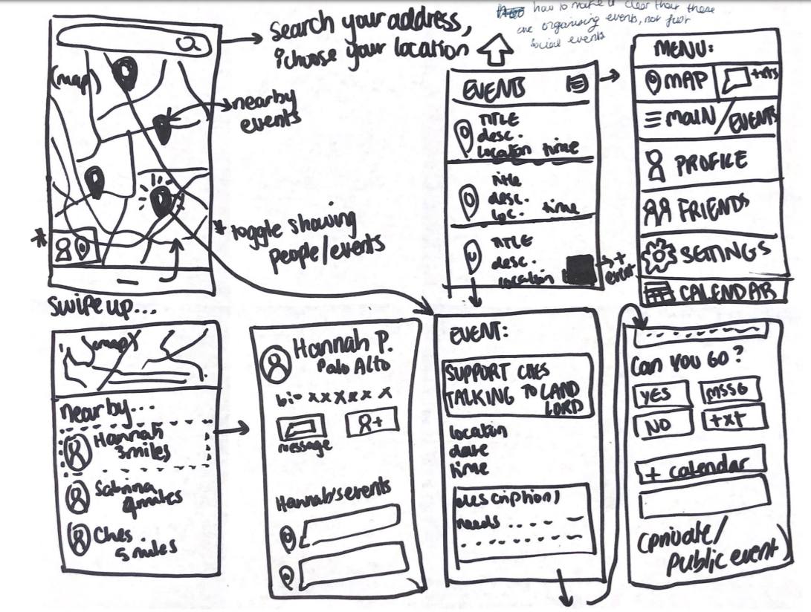
UI SKETCH #1 - Events based app, incorporating map aspect

Slide 35
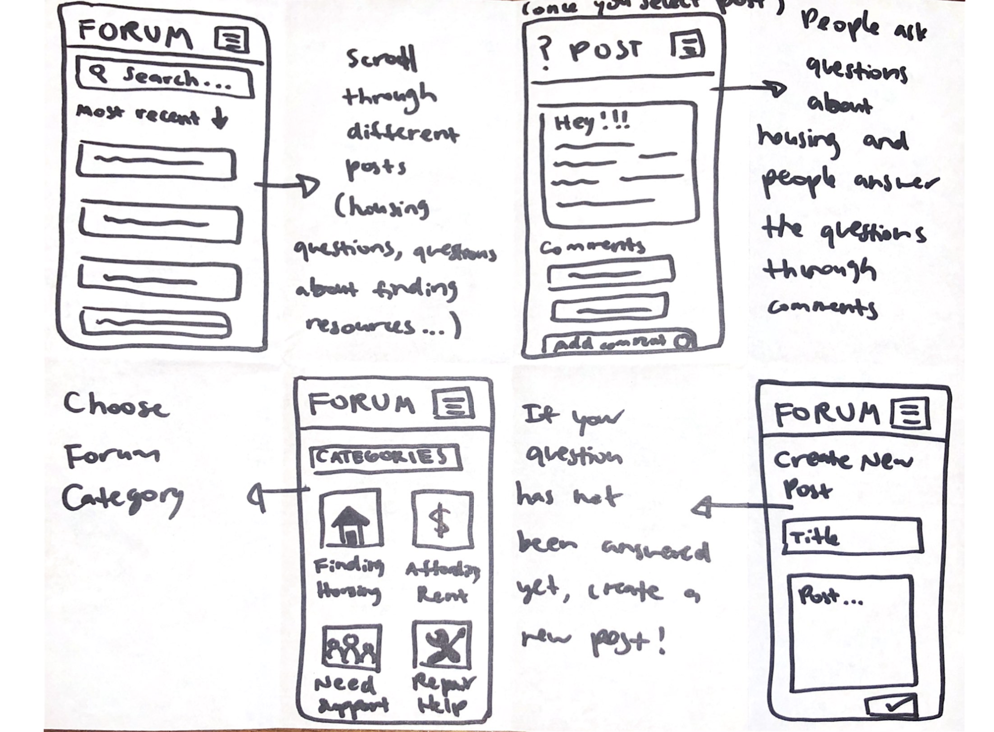
UI SKETCH #2 - Forum -->Case based mobile application

Slide 36
Events Based App
Cases Based App
Pros:
Simple structure/layout
Visualisation of events
Cons:
Events are one-time only
No commitment to person’s journey
Pros:
Can follow a case through different stages - more cohesion
Shows continuity
Control of who’s involved in events / what events you want to be involved in
Focussed on people in the community
Cons:
More complex functionality
More complicated for new users to take part/feel involved
Notes:
Should have less text on slide - for reference

Slide 37
Discussion (What We Learned)
Overall, we have discovered that we need to work on our user interface, because the design of the buttons confuses our users. It needs to be a lot less cluttered, and more streamlined, as we also strive for a more accessible interface as well. However, we did do well in regards that users were at least able to identify the basic fields that they needed to fill out.
We hope that with higher fidelity prototypes, our design will become a lot cleaner, and also to center the purpose of this app a lot more in the design process.

Slide 38
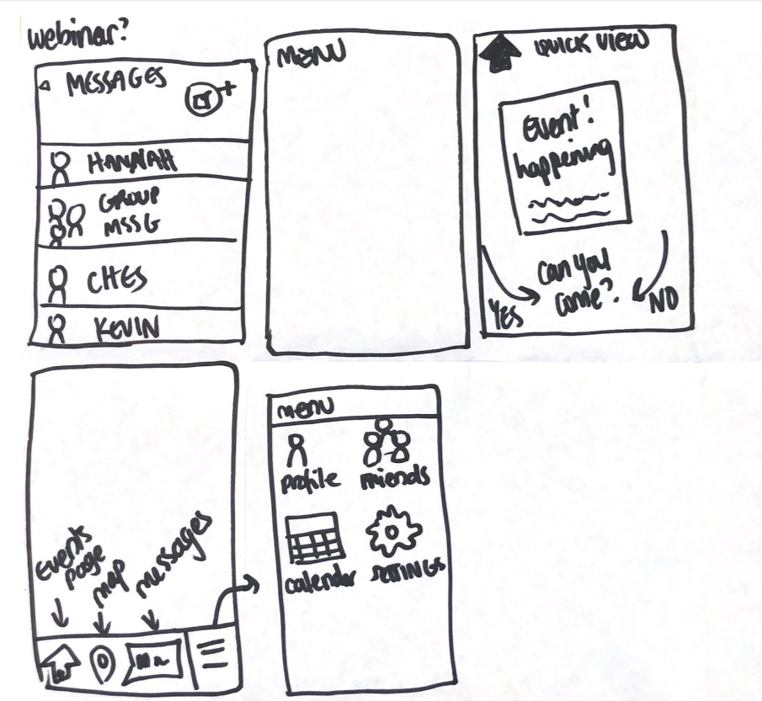
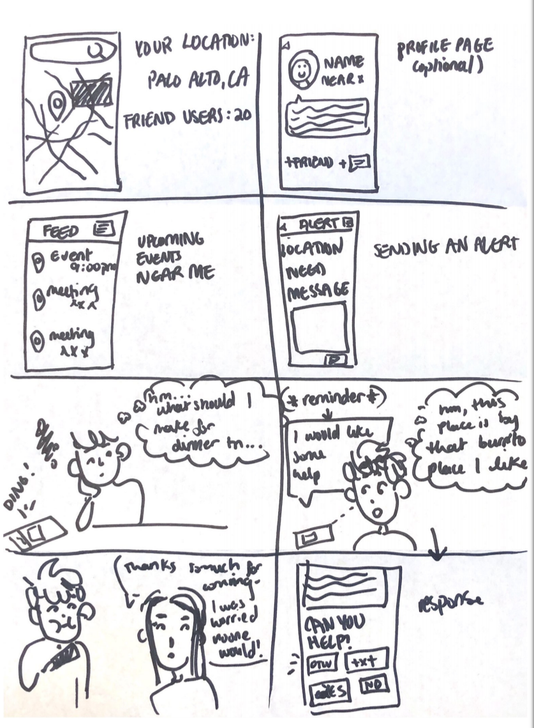
Outtakes of concept and UI sketch ideas

Slide 39
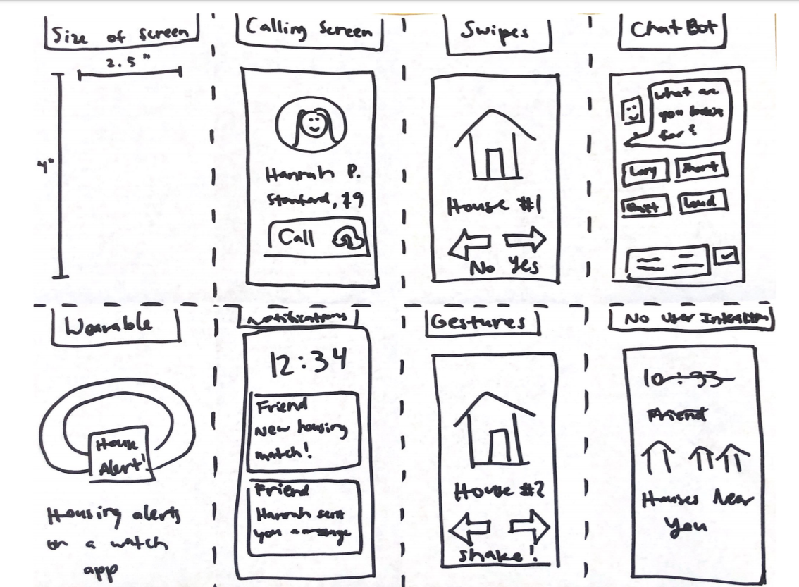
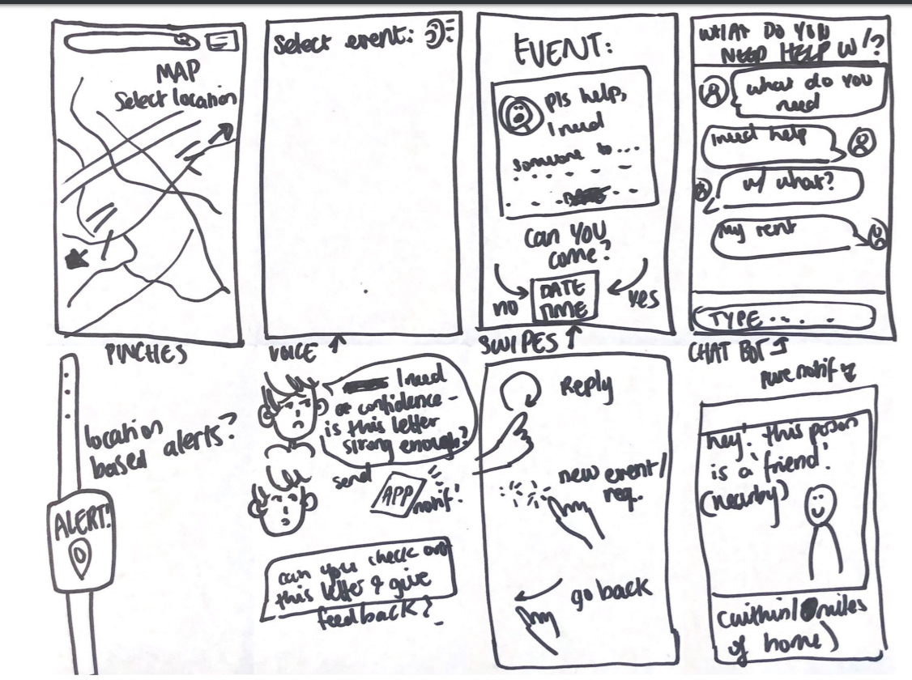
Outtakes of concept and UI sketch ideas

