Slide 1
Assignment 3
Chester, Kevin, Sabrina, Hannah

Slide 2
Friend
working title

Slide 3
Overview:
The problem:
cost is the biggest barrier to finding housing
Lack of mutual aid and community building
The solution:
The two are intertwined - we can’t target cost without the support of many people

Slide 4
Three Tasks:
Complex: Person X uses a wheelchair, and has recently found a place to potentially live. However, their landlord expects them to pay for the necessary renovations to make the living space accessible. Person X cannot afford this, and wants to get their landlord to cover the cost of the building works.

Slide 5
Three Tasks:
Moderate: Meghan is a recent grad working two jobs to make rent. She plans to apply to grad school, but doesn’t have enough time since she is already working many hours. Her landlord is planning on increasing her rent in the new year - she would like to talk with her landlord about not increasing the rent since she is already working so hard, but feels intimidated. She would like some support in knowing what to say to her landlord when they meet.

Slide 6
Three Tasks:
Complex: Person Y is living in an apartment, and has been there for a few years. The boiler is currently broken, but Person Y’s landlord has not fixed it despite many messages. Person Y would like some feedback on how to convince their landlord to fix the boiler, and support from others in the neighbourhood to confront the landlord.

Slide 7
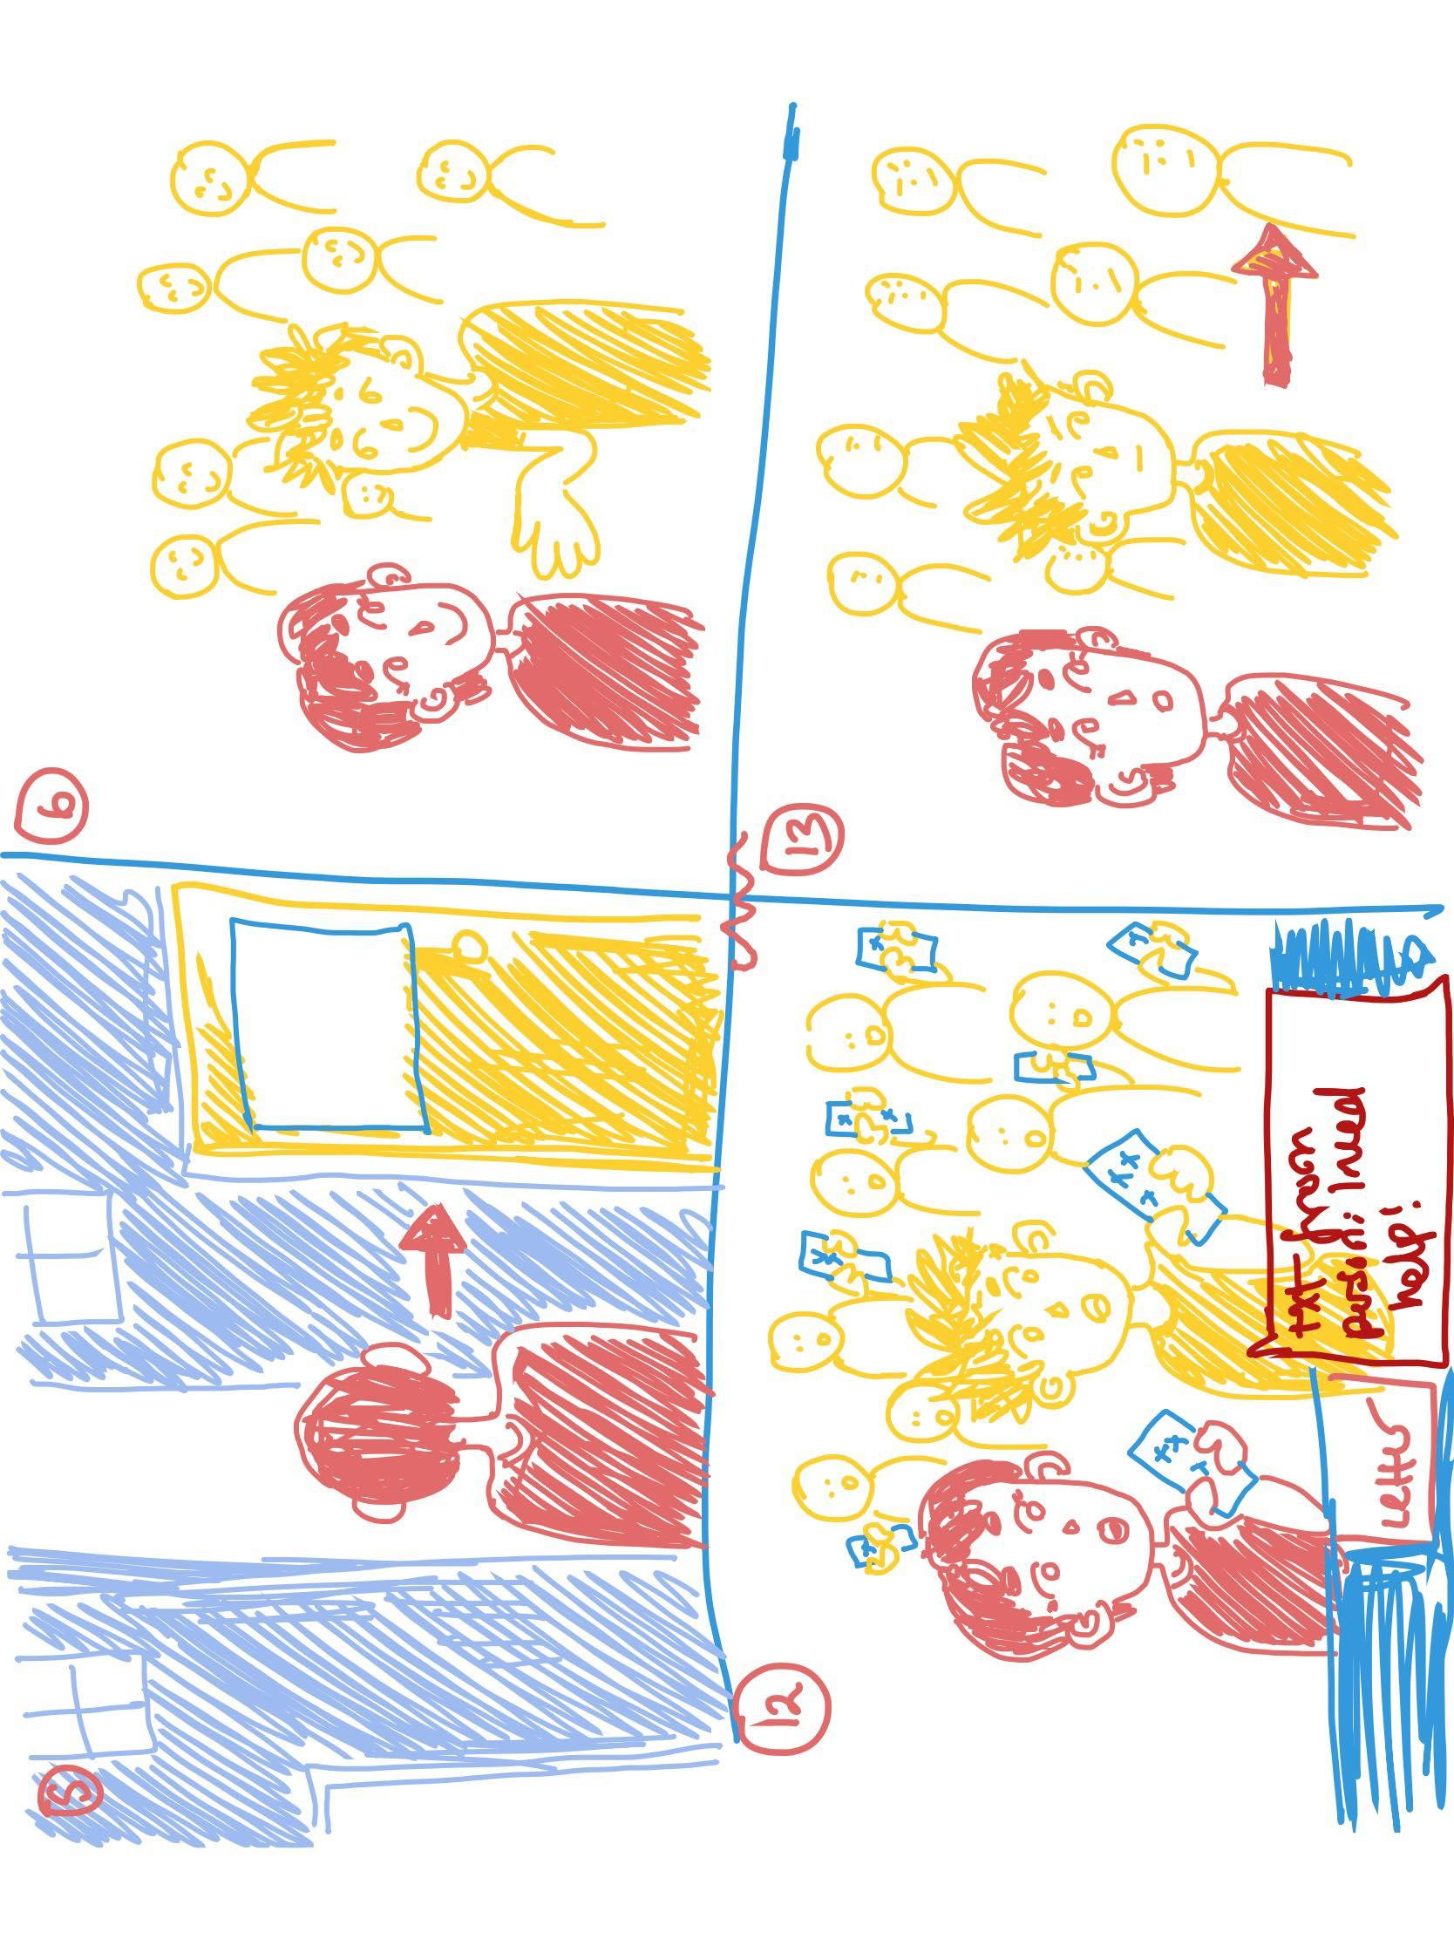
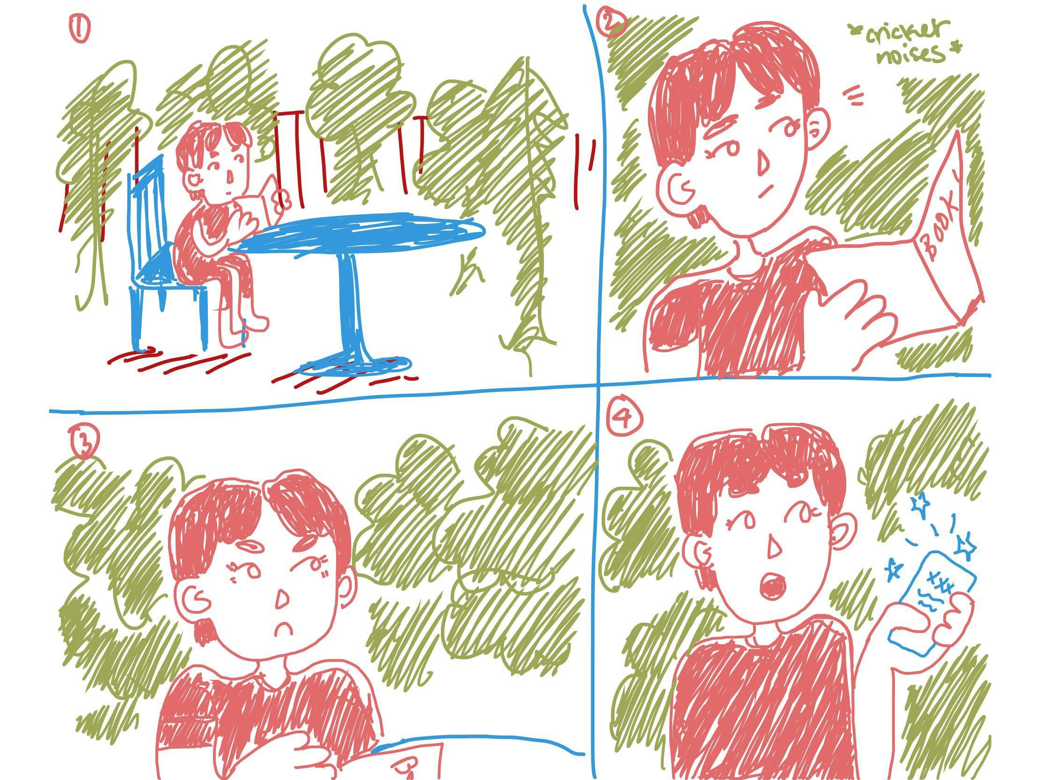
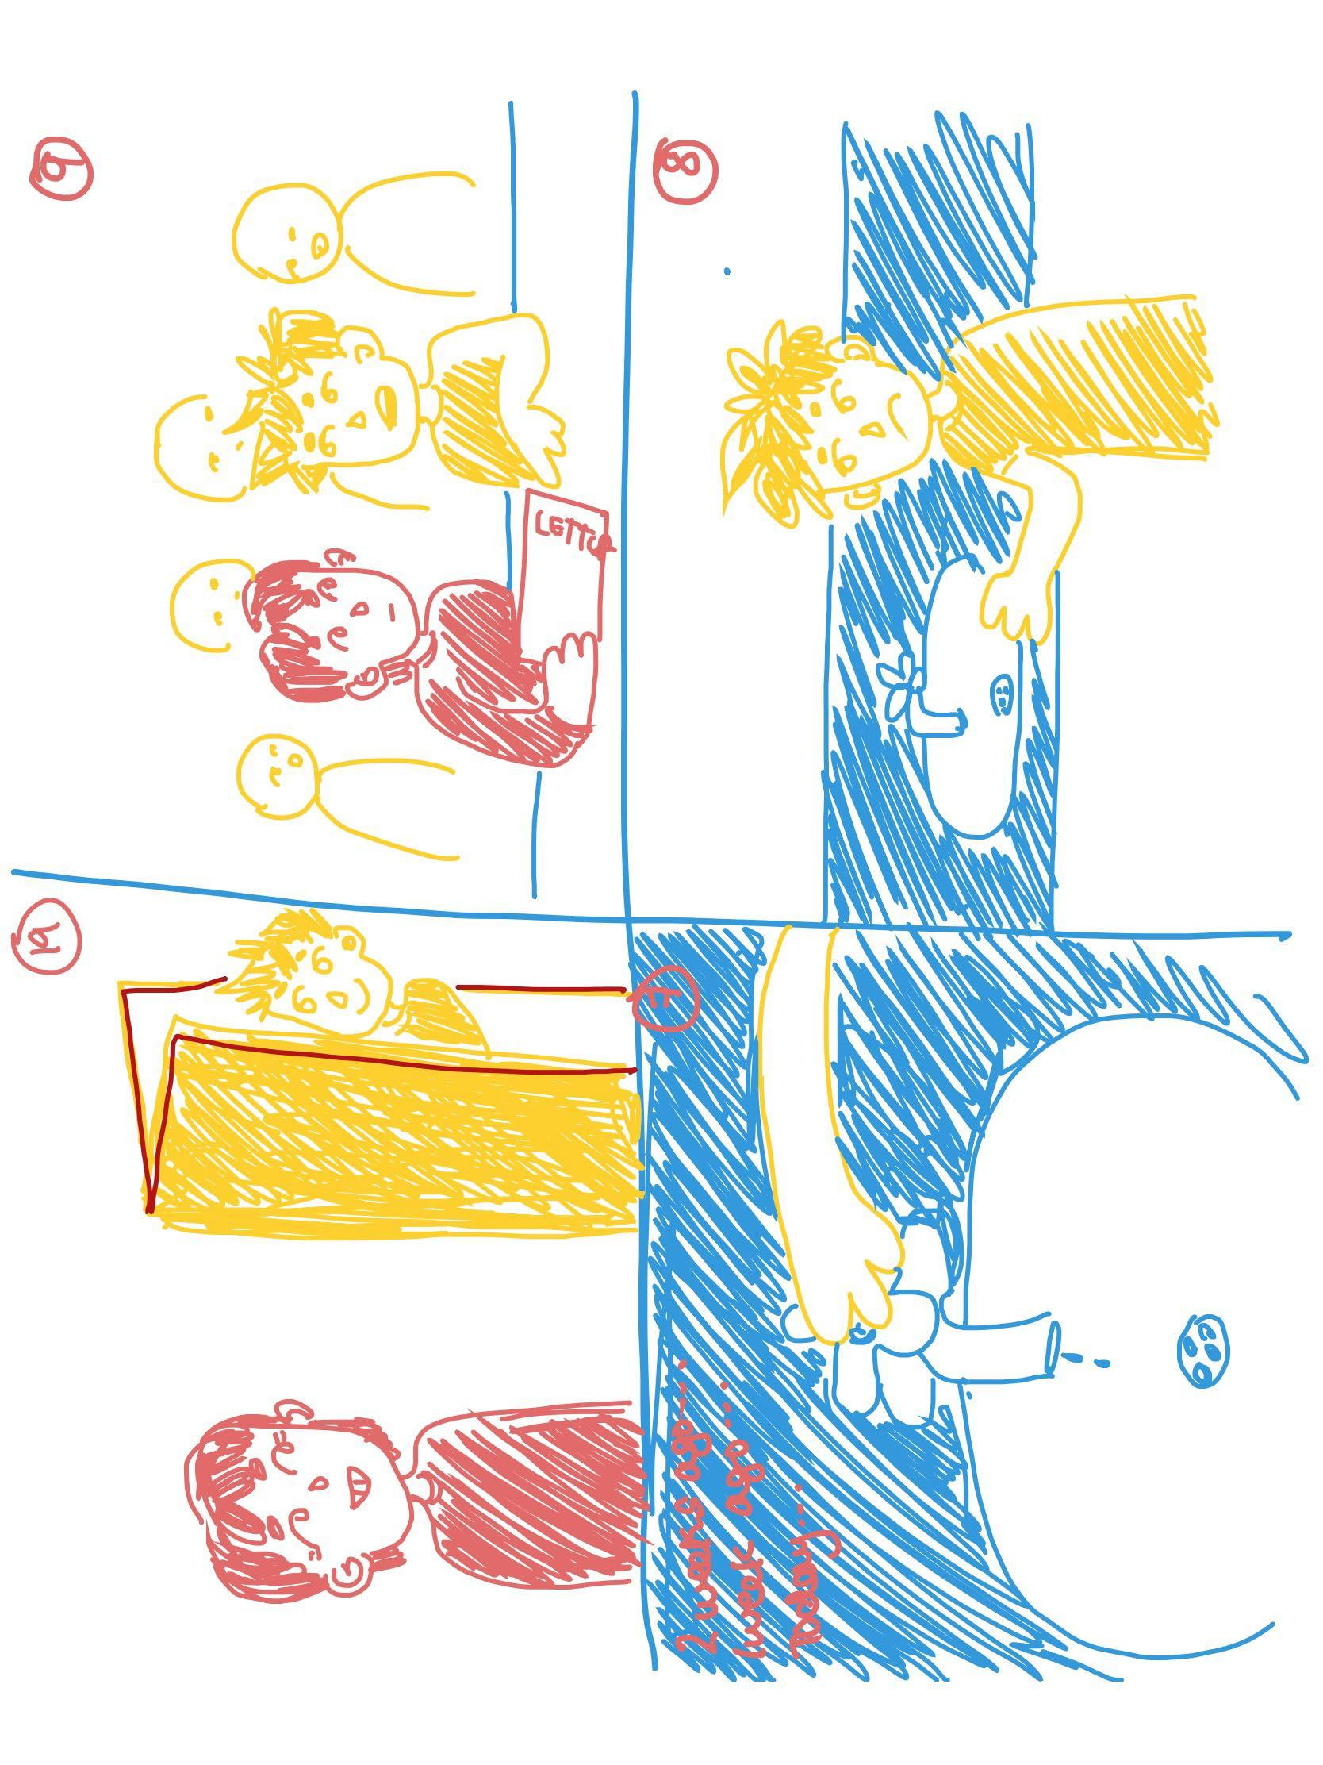
Video Storyboards:
​

Slide 8
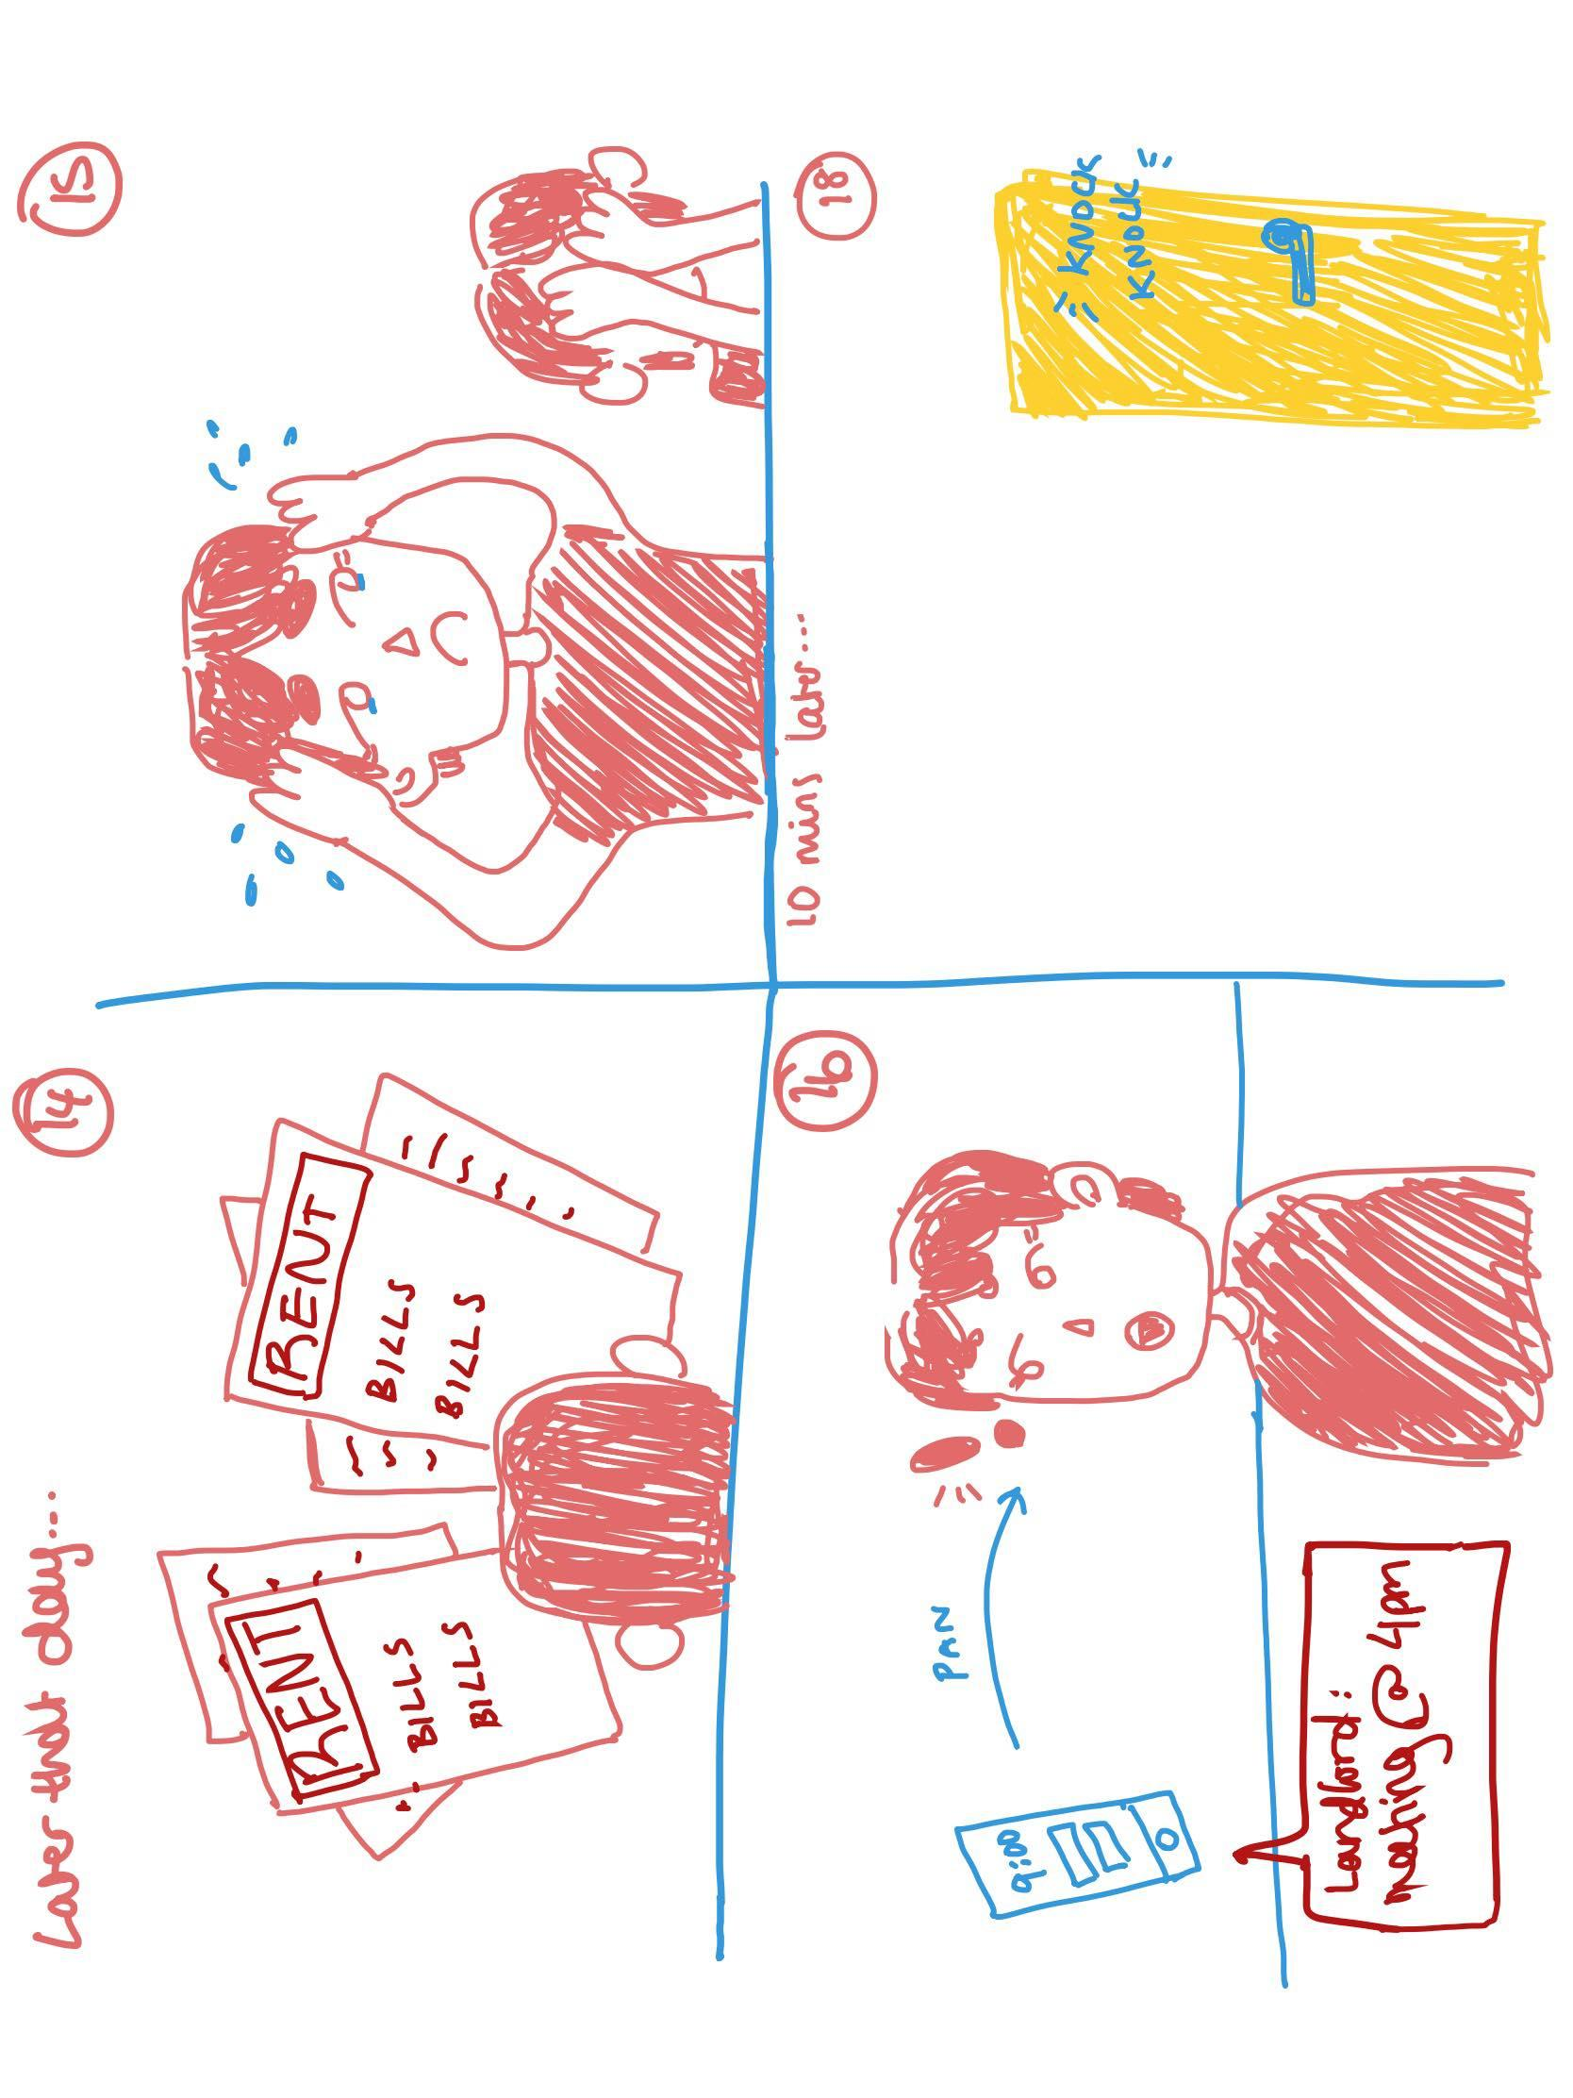
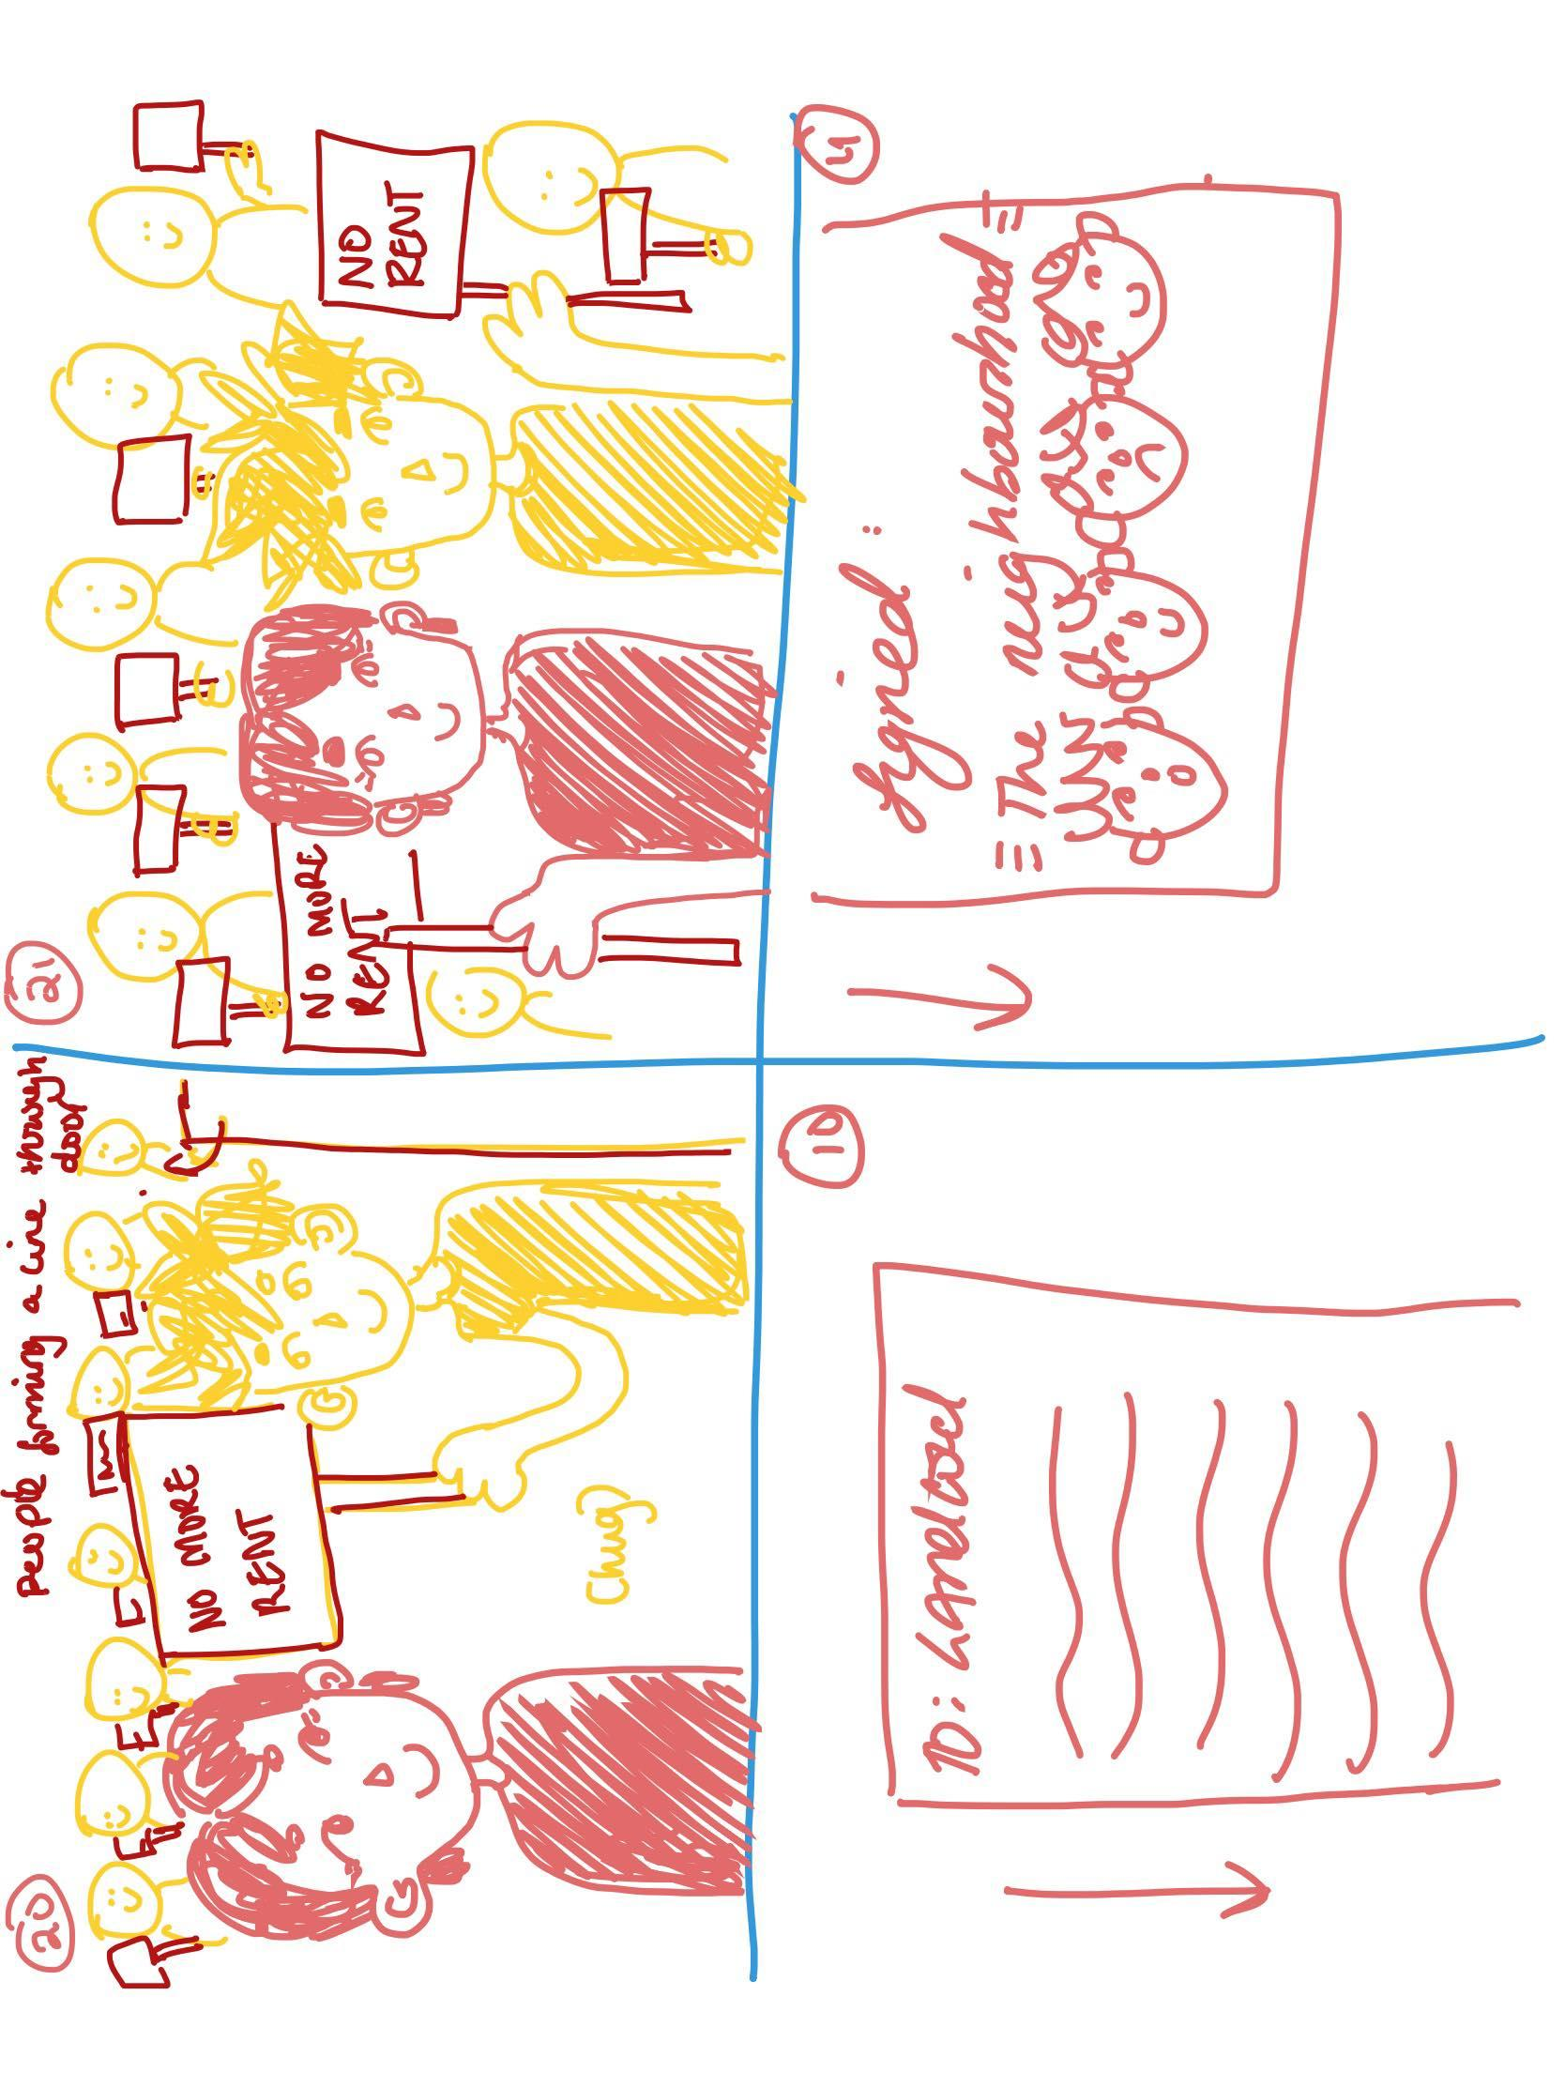
Video Storyboards:
​

Slide 9
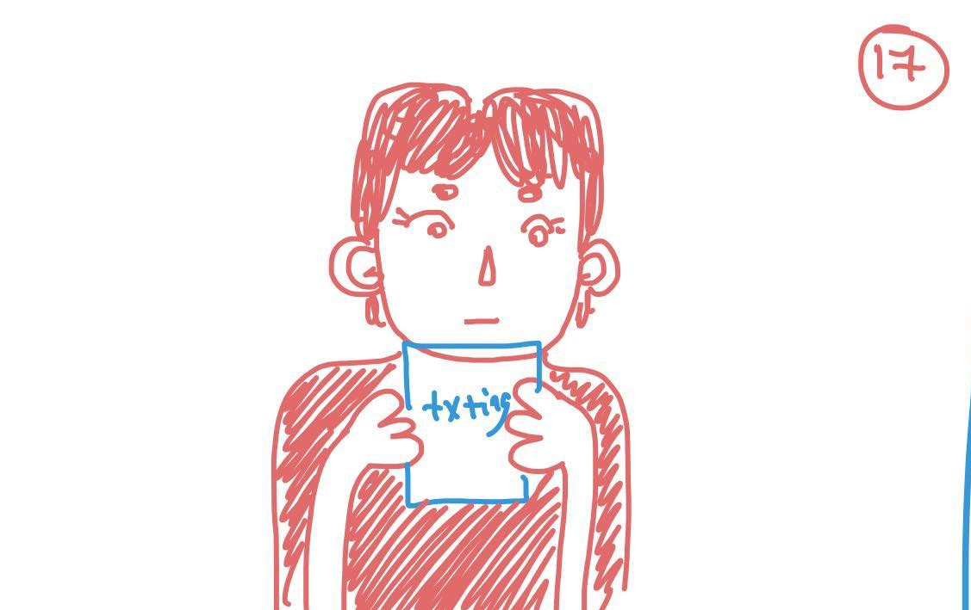
Video Storyboards:
​

Slide 10
VIDEO
https://youtu.be/2IrPVdnhOdA

