Slide 1
CS 147 Guest Lecture Joe Belfiore, Corporate VP, Microsoft
December 4, 2019
Notes:
Announcements, questions at beginning. Then team work (45 min), quiz, and guest lecture

Slide 2
Midterm Results
Regrade requests taken through 11:59 PM on Tue, 12/10
Regrade requests should be based on error in grading
Excessive regrade requests (more than 2-4) may require us to regrade the entire exam
I may curve this up 4-8 points to get closer to rest of our grade distribution
Notes:
Work on pitches, practice, order poster, finish prototype

Slide 3
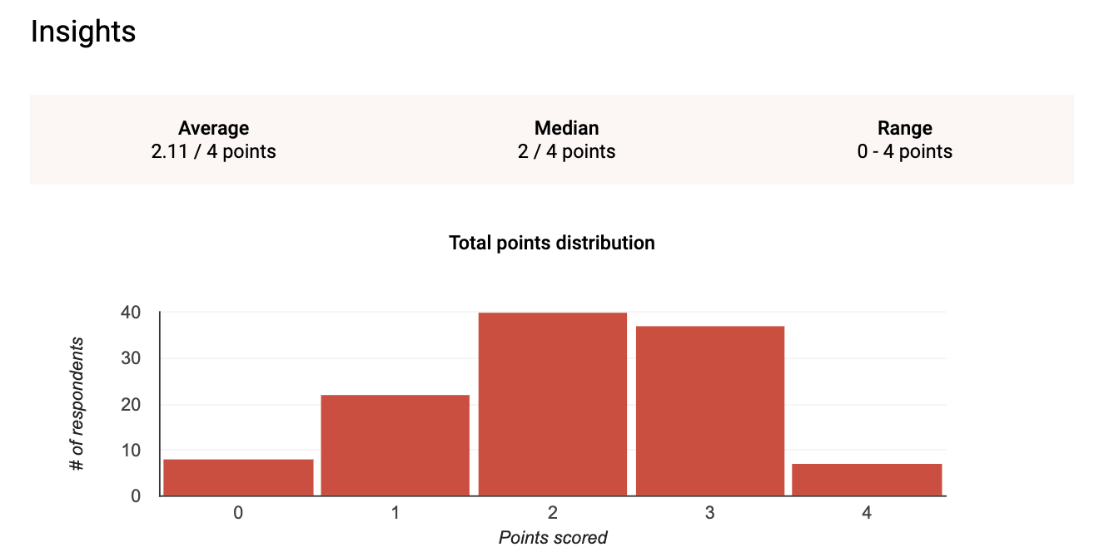
Quiz 3 Stats
Notes:
Work on pitches, practice, order poster, finish prototype

Slide 4
Administrivia
Assignment #7 & #9 – Heuristic Evaluation
A7 Individual HE: ✓-: 4% ✓: 31% ✓+: 65%
A9 Group HE: ✓-: 0% ✓: 11% ✓+: 89%
Assignment #8 – Midway Milestone Prototype A8 Group Pres.: ✓-: 11% ✓: 56% ✓+: 33% A8 Individual Pres.: ✓-: 0% ✓: 22% ✓+: 78%
Notes:
Got here at 55 min in and took a team break of 15 min

Slide 5
Administrivia
Midterm regrade requests due by 11:59 PM next Tue
Final versions of posters & pitch slide due today
need to get posters to the printer so you can get back in time (usually 24 hours required)
pitch slides go in a google slides deck that TAs will share (see Piazza). It needs to be final by Thursday as we will download as PPT
http://bit.ly/cs147au19pitches
Project fair
arrive at 6 PM to set up (show starts at 6:30)
dress code: none, but recommend treating as if it were a job interview
130 RSVPs (feel free to invite others – but RSVP – food for 200 guests)
Questions on project?

Slide 6
Teamwork
Notes:
Work on pitches, practice, order poster, finish prototype

Slide 7
bit.ly/cs147-quiz4-20-15 Closed notes & no web lookup 5 minutes Do not communicate about this quiz with anyone inside or outside this room
Notes:
47:30-52:30

