Slide 1
Voice Interaction Team 4
Rachel Jorgensen, Esther Goldstein, and Ron Tep

Slide 2
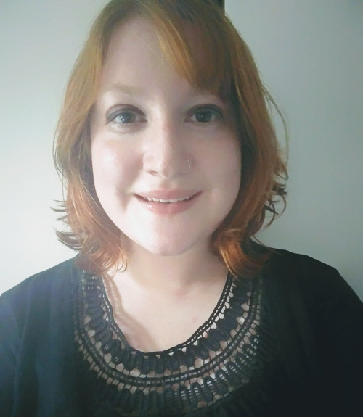

Team Members
Esther Goldstein
1st year MS in CS
Ronald Tep
Senior in CS
Rachel Jorgensen
Senior in SymSys
Notes:
Esther: 1st year MS in CS, specializing in security and HCI
Ronald and Rachel: HCI

Slide 3
Problem Domain
How can we make voice interaction more accessible for people in their day-to-day lives?
Notes:
General question we were trying to tackle in our interviews

Slide 4
Methods: Interview questions
Day-to-day life
How/if you use voice interaction in your work life
How/if you use voice interaction in your personal life
Tasks you think could be improved by voice interaction
Most difficult part of using voice interaction
Any other menial tasks/frustrations/time wasters in your daily or work life

Slide 5
Interviews
Notes:
Interviews and responses

Slide 6
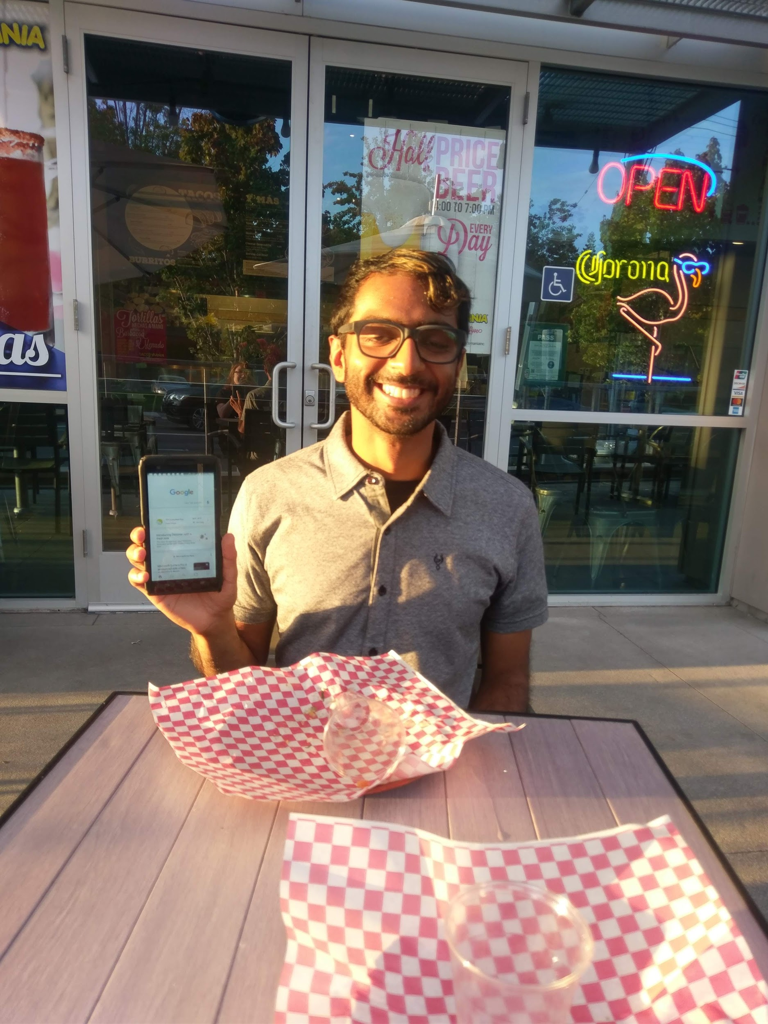
Karan
Software Engineer at Google
Technical opinion on voice interaction
TacoMania in Mountain View
Notes:
Mention why we asked him

Slide 7
Karan
“I don’t want to use VI if it’s slow compared to typing” “I don’t really want to learn to use VI software if it’s too difficult”
Notes:
Karan knows that VI software works well, but he doesn’t trust that it’s worth the effort it would take to learn how to use it
He feels like he doesn’t need it

Slide 8
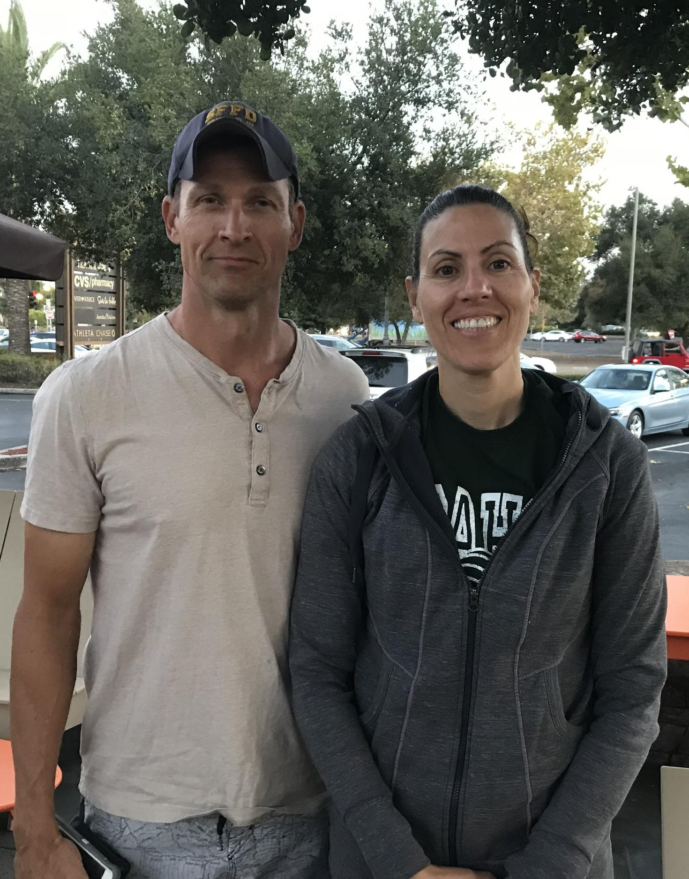
Dawn and Allen
Dawn: Pathologist at Santa Clara Medical Center
Allen: Police officer in San Francisco
Town and Country
Notes:
We met Dawn and Allen in Town and Country. They live in Palo Alto and their daughter goes to the high school nearby. Dawn is a ….
We originally meant to interview Dawn, but Allen ended up jumping into the interview at the end because he had some strong feelings about the need for VI.

Slide 9
Dawn and Allen
“At work I have a foot pedal. When I press it I can give notes verbally, and the software transcribes them immediately” (Dawn)
“The SFPD could use VI systems in MDTs and to eliminate transcription needs” (Allen)
Notes:
Two years ago, Dawn’s company implemented a Dragon voice recognition system. Dawn no longer needs a transcriptionist when giving a diagnosis. Instead she simply presses a foot pedal, and speaks into a microphone, and the computer transcribes the words for her. It’s a much easier and faster system.
As for Allen, he jumped in because he felt frustrated with his police department’s refusal to upgrade its systems. He suggested two areas of improvement:
Mobile desk terminals in cop cars. Currently, cops still have to look down and press buttons on the MDTs in order to get valuable information, like the location and description of the suspect--even while the sirens are on. Allen felt that VI systems could be implemented so that cops could be safer while driving.
Police officers also type up their reports and scan them into the computers to send them through security, where they are later re-transcribed by transcriptionists. The system is old and outdated, and could be made much more efficient if cops could dictate into a microphone.

Slide 10
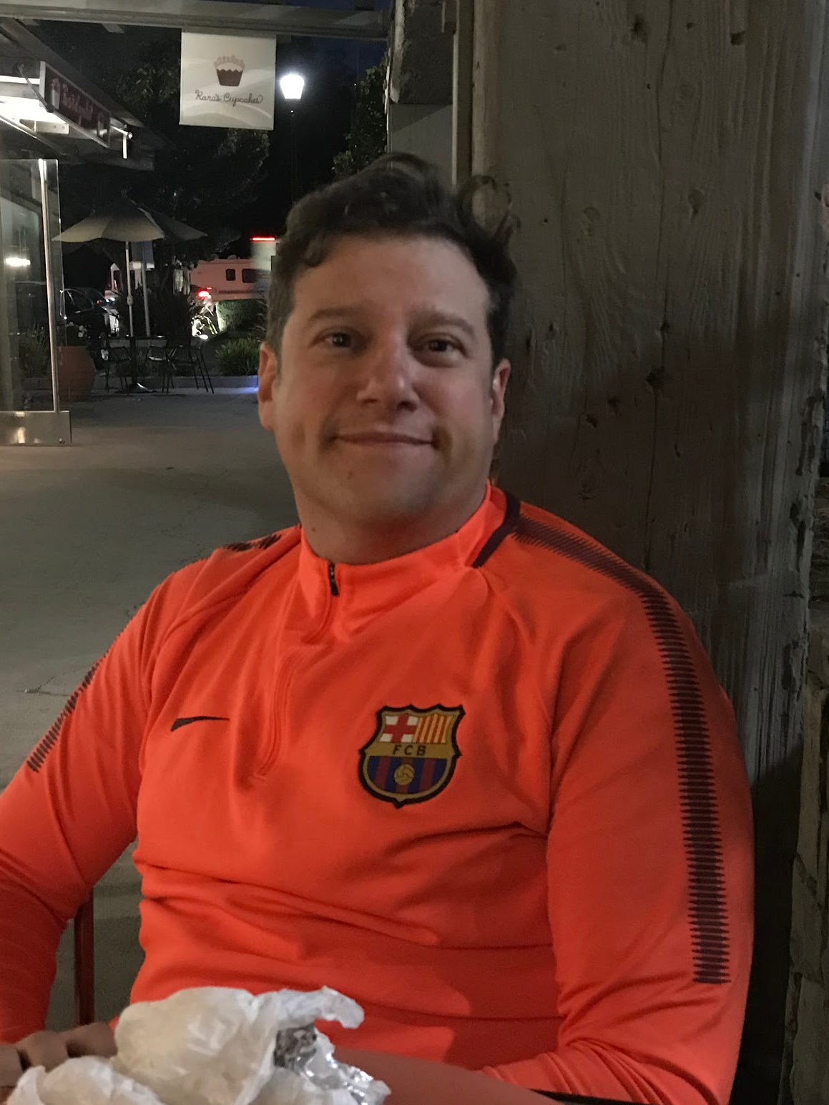
Caleb
Marketing and Sales at Google
Town and Country
Notes:
Caleb also works at Google, but he’s in Marketing and Sales. He also has an elementary-school-age daughter named Charlotte, who added commentary to our interview from time to time.

Slide 11
Caleb
“I own six Google Assistants”
“I’ve used VI to call Ubers and order pizza”
“One time we told Alexa to order toilet paper and ended up with hundreds of rolls”
Notes:
Caleb owns Google Assistants, Nests, and his relatives own Alexas. He has a Google Assistant in almost every room of his house. He uses it every day, mostly for timers, turning on music and turning on the TV, but also for more difficult tasks like ordering pizza and calling Ubers.
One time, his relatives told Alexa to order toilet paper and ended up with hundreds of rolls...

Slide 12
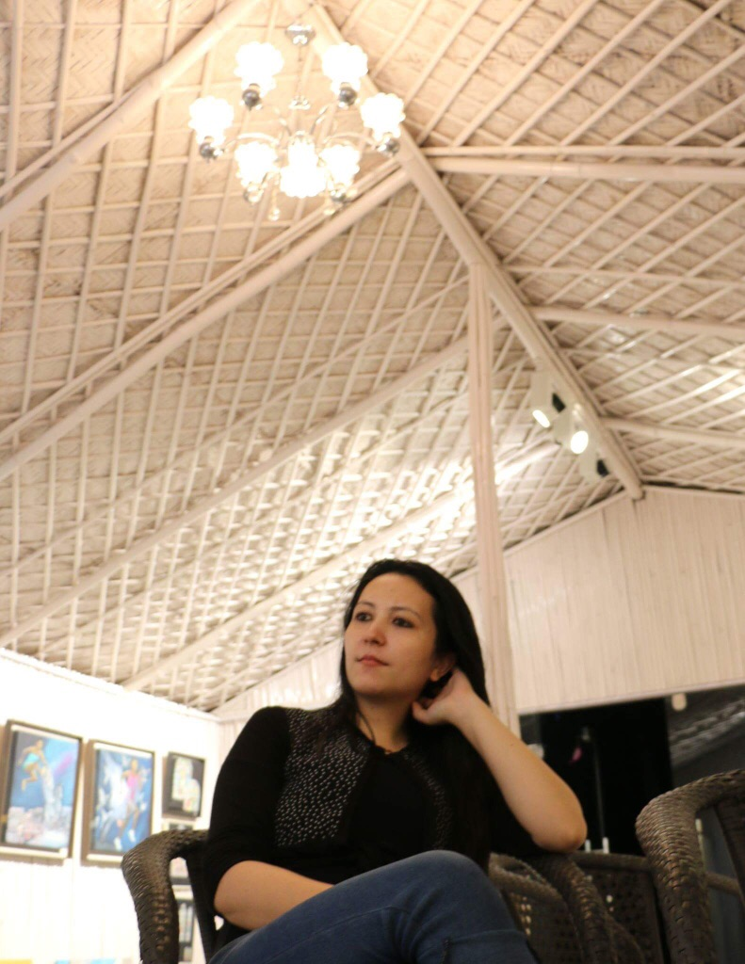
Naina
1st Year LL.M. student at Stanford Law School
At Stanford for 1 month
Worked at National Commission for Women (government body) and The Energy and Resource Institute
Town and Country

Slide 13
Naina
“I rarely use voice interaction”
“I wasn’t really excited about it”
“I’m afraid it wouldn’t understand my accent”

Slide 14

Overall Impression
Dawn and Allen said VI can be useful in both the medical and police fields
Karan preferred using apps like Evernote and Calendar out of habit
Caleb owns 5 Google Assistants and uses them for many things (turning on the TV, locking the door, getting a recipe, etc.)
Notes:
Caleb has even used Google Assistants to call out recipe instructions while making a recipe. Unfortunately, he eventually gave up, because it was too difficult to follow those directions without a visual aid, and he expressed to us that he’d like to see more integration with voice interaction and screens like TVs, or at least interaction that was easier to use. He’d like to be able just to say “Show me the recipe on that screen, and walk me through it.”

Slide 15

Surprises
Dawn has no complaints, even though the software she uses requires human supervision
Allen feels that the SFPD wastes a huge amount of taxpayer money when transcripts are unnecessarily re-transcribed
Notes:
Tensions, contradictions, and surprises

Slide 16
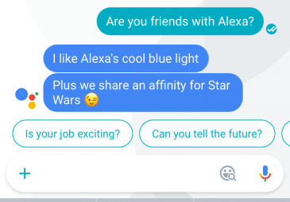
Surprises
Naina is afraid that her accent won’t be understood
Caleb uses VI software constantly but the results are not always what he expects
Notes:
Caleb also mentioned that his elementary-school daughter’s voice wasn’t always understood by the software.
Sometimes he’d tell a Google Assistant in the den to turn the lights on, and the lights in the basement would come on instead.
And of course there was the issue of the toilet paper!
Just some unpredictable behavior.

Slide 17
Empathy Mapping

Slide 18
SAY
“Hardest part is setting up”
“I might just try things at random”
“Completely changed my work for the better”
“My work could definitely use voice interaction”
“I wasn’t super excited by voice assistants, though my peers were”
“I don’t want to have to learn something new”
“I think it could make tasks faster when you don’t have to use your hands”
Notes:
Yellow = Dawn; Orange = Caleb; Lilac = Allen; Purple = Karan; Blue = Naina
In general, people seemed to say positive things about voice interaction. However, a lot of people seemed intimidated by learning the commands and getting everything set up.

Slide 19
THINK
My life is much easier with Google Assistants
Voice technologies can make resources more available to the elderly and people who are disabled or illiterate
VI software would be helpful in cop car MDTs
VI software that can also translate would be useful
Proofreading is still necessary
Don’t want to use VI software if it’d be slow compared to typing
VI software is not yet accessible, usable enough, or worth the effort
Using VI software is better when you’re alone
Notes:
Most people seem to feel that VI software is fairly useful and effective, but isn’t being used to its fullest extent. For example, Dawn says that proofreading is still necessary.
Although Dawn uses VI software in her everyday work when she gives diagnoses, she still doesn’t use the software when she’s in the lab, with gloves on, looking at tissue under the microscope. And the reason for this is that she doesn’t trust the software to be accurate enough to get the measurements right without proofreading, and she can’t change the transcription without taking her gloves off and using her hands. So she still uses a transcriptionist when she’s actually in the lab.

Slide 20
DO
Uses 6 different Google Assistants
Experiments with new commands
Voice tech and transcriptionists work together to accurately transcribe diagnoses
Uses VI to turn on TV and music, order Ubers and pizzas
Does not really use VI tech
Rarely uses VI tech, but often has to look down in the car to press buttons
Evernote and Google Calendar to keep track of events and to-dos
Notes:
We had a wide variety of VI usage. Again, Caleb, who works in tech, is confident in VI and seems to use VI for everything at home, but not at all at work. Dawn uses VI at work but not at home. Allen and Naina rarely use VI at all.

Slide 21
FEEL
Self-conscious about saying something embarrassing in public
Wants more integration with visual elements
Grateful for time-saving at work
Phone is slow already; worried voice will take too long
Afraid that her accent won’t be understood
Excited about the new, growing technology
Frustrated by unnecessary transcription costs
Notes:
People have very mixed feelings about the VI software, ranging from being grateful for its usefulness, to frustration that it’s not being used effectively, to dread of the complexity of learning the commands.

Slide 22
Analysis

Slide 23
QUOTE
“Voice interaction technology isn’t worth the effort it takes to get it to work.”
NEED
Setup should be easier and more intuitive.
INSIGHT
People aren’t opposed to VI itself, they just don’t think that the payoff will be worth the effort.
Notes:
The quote is from Karan, but we also think this need was expressed by Naina and Allen’s government employers.
-both setting up a system and teaching users to use the system

Slide 24
QUOTES
“The SFPD wastes a huge amount of
taxpayer money on transcriptionists.”
“Cops could be safer and get more accurate information faster by implementing VI in MDTs.”
NEED
Voice interaction software is needed in many government workplace scenarios.
INSIGHT
Some people would use VI but don’t have the means to implement the system.
Notes:
The technology is there, but people aren’t always using where they could be.

Slide 25
QUOTES
“When we’re wearing gloves and in the lab, we can’t proofread, so we don’t use VI software.”
“We told Alexa to order toilet paper and accidentally got hundreds of rolls.”
NEED
A system where VI can be easily checked and corrected.
INSIGHT
An easy confirmation system, with visual aids or without the use of hands, would allow to people
to use VI in many more situations.
Notes:
VI isn’t perfect and mistakes can be made. But we can still use it by making human proofreading easier than it has been before. It seems like there’s a need for a system where VI can be easily checked and corrected, either by incorporating a visual aid or an audio confirmation system. This would allow people to use VI in more situations than they do now.

Slide 26
People want...
To use VI at work and at home
To use VI to multitask
An easy way to error-check VI output
An easy way to learn new commands
An easier setup and installation process
Notes:
In summary, people want...

Slide 27
Questions/Feedback?

Slide 28
Image Sources
https://store.google.com/us/product/google_home
http://www.tapsmart.com/tips-and-tricks/siri-tricks/
https://www.informationweek.com/healthcare/mobile-and-wireless/voice-recognition-speeds-ehr-use-for-oklahoma-hospital/d/d-id/1113302

