Slide 1
Midway Milestone
Jourdann Fraser
Vy Mai
Tiffany Manuel

Slide 2
Problem/Solution Overview
Journaling is time-consuming, and photos only capture visual details. Rechords uses the connection between music and memories to recreate the environment of the memory itself and give users a better way to remember.
Notes:
Journaling is time-consuming, and photos only capture visual details. Instead of simply storing mementos of the past, we aim to recreate the environment of the memory itself. Rechords uses the connection between music and memories to give users a better way to remember. Our app records the location and song associated to a memory. Users can then relive past experiences and share them with friends, loved ones, and even the public.

Slide 3
Mission Statement
By connecting music to memories, we hope to add a new dimension to memory keeping.

Slide 4
Overall Design Changes
HE Results
Corresponding Revisions
Prototype Status
Tools
Implemented Features
Unimplemented Features
Wizard of Oz
Hard-Coded Data
Demonstration
Summary

Slide 5
Overall Design Changes

Slide 6
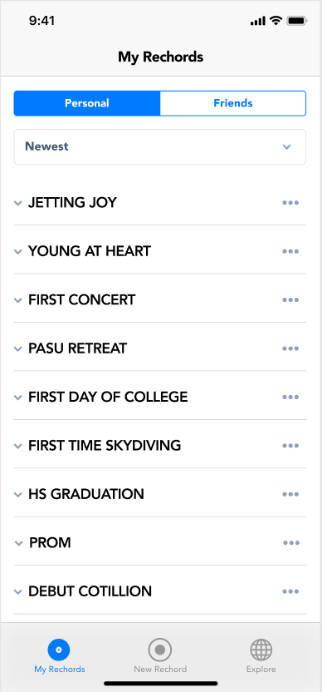
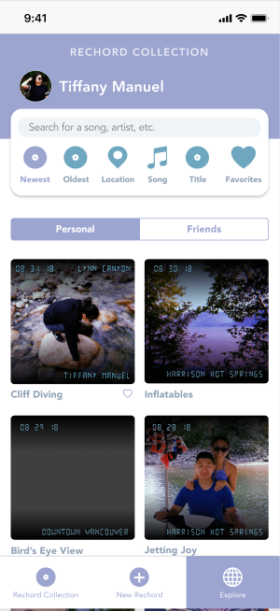
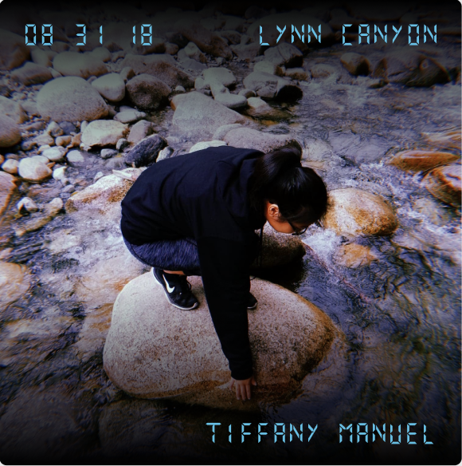
Playlist Design to Album Design
Notes:
Also, terminology (playlist to collection)

Slide 7
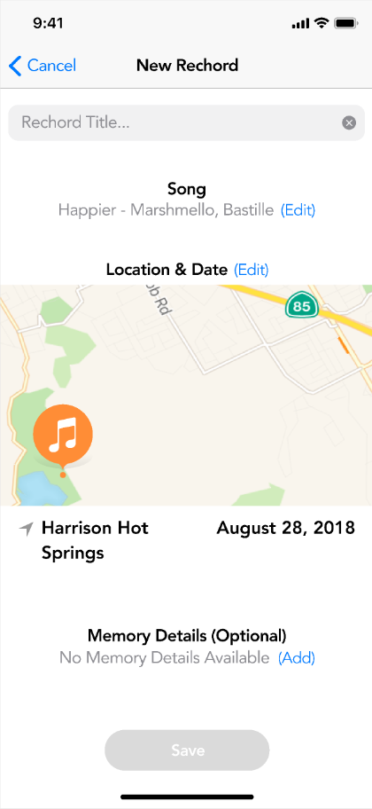
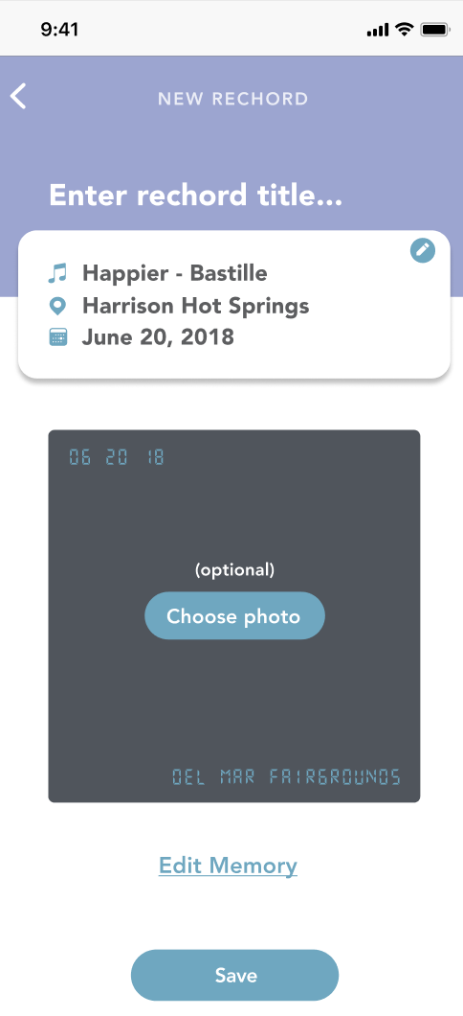
“Create New Rechord” Screen
Required info grouped together at the top
Optional info grouped together at the bottom
Album Design Applied
Notes:
Also, terminology (playlist to collection)

Slide 8
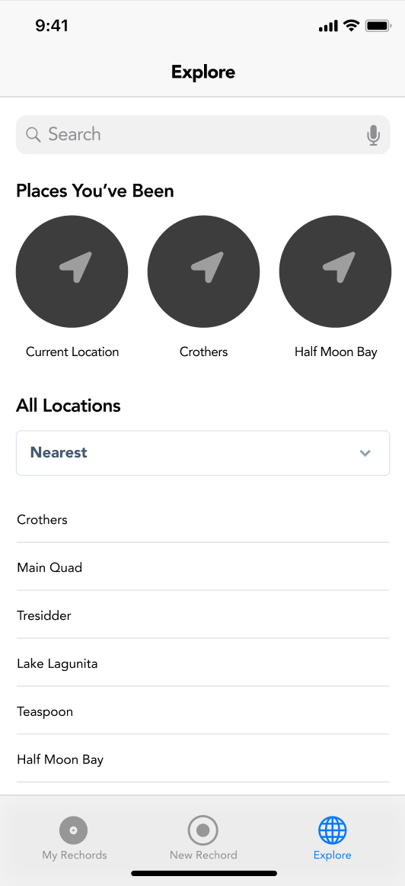
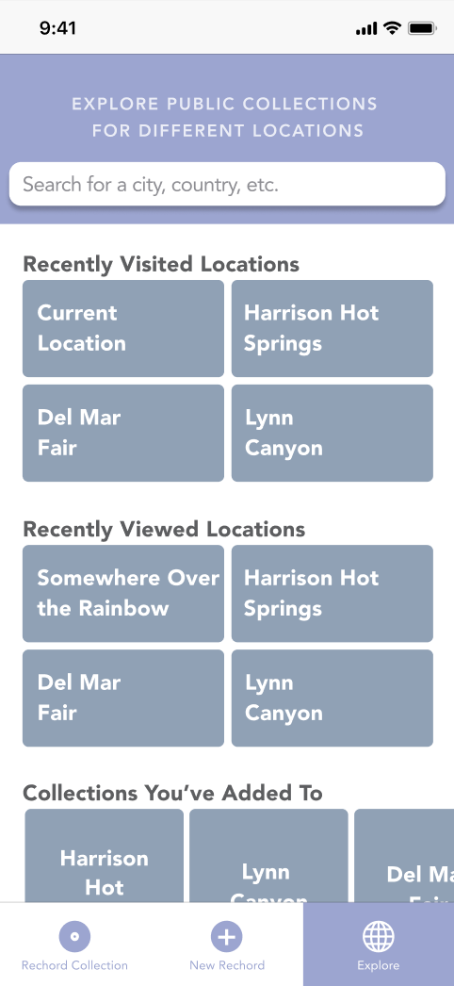
“Explore” Screen
Applied redesign
Made consistent with the feel of the rest of the app
List view easier to look at
Less cluttered
Notes:
Also, terminology (playlist to collection)

Slide 9
Heuristic Evaluation Results

Slide 10
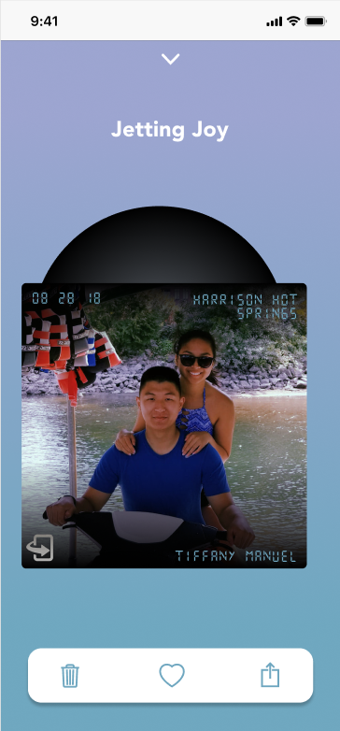
Unclear that rechord card is flippable/clickable
Problem
Unable to find “Rechord Description”
Solution
Include “Flip” icon

Slide 11
No “Add Friend” option
Problem
Unable to find friends when sharing
Solution
No database of friends
Search through all users for now

Slide 12
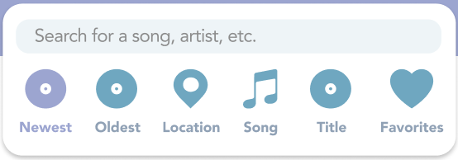
“Favoriting” is unclear
Problem
Unclear what results of favoriting are
Are your favorites private or public?
Solution
“Favorites” added to “Sort By” options

Slide 13
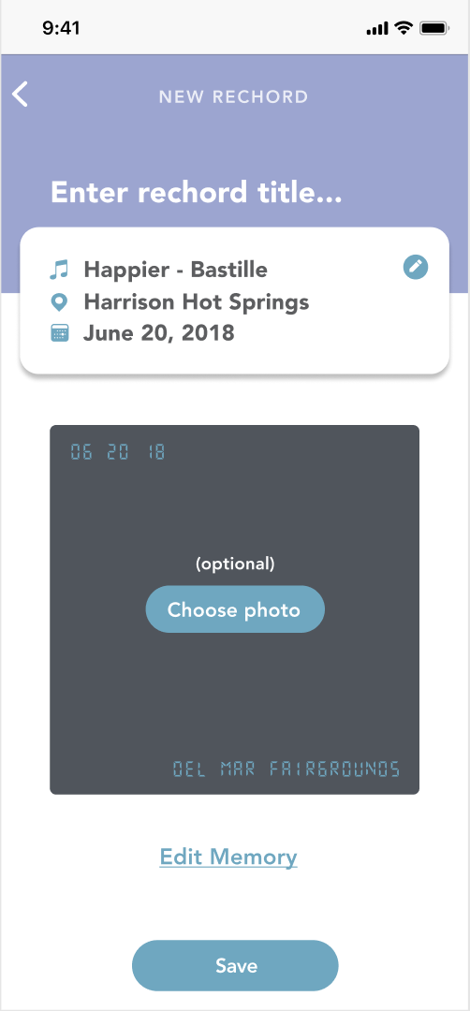
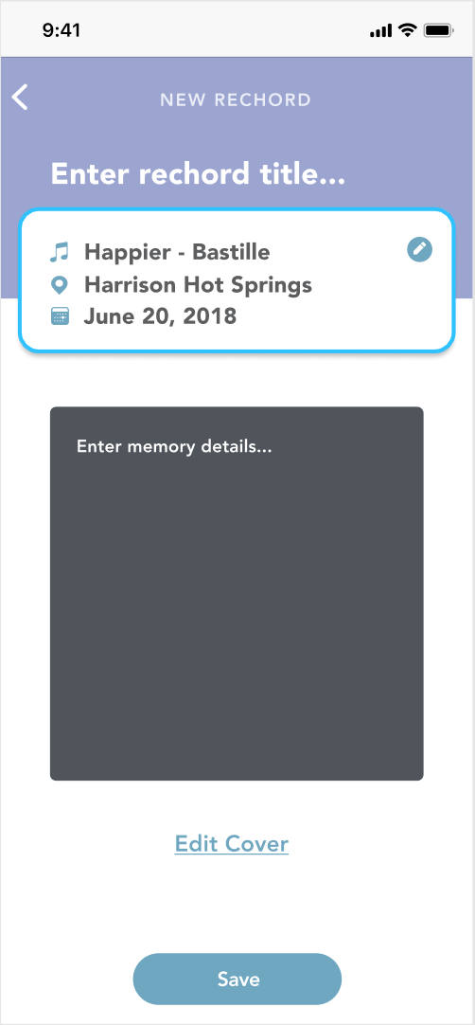
Proofreading “Memory Details” is difficult
Problem
Proofreading requires an extra click
Lack of error prevention
Solution
Text field remains on the same screen

Slide 14
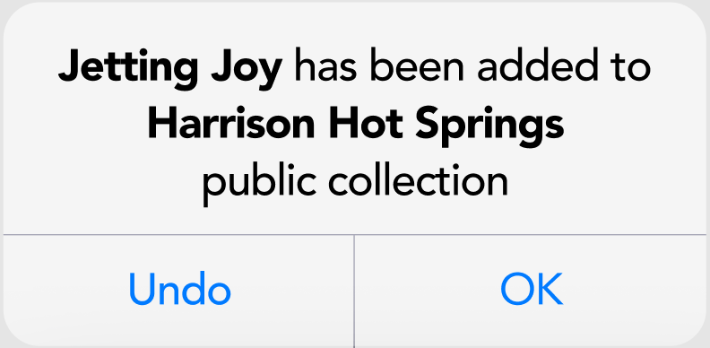
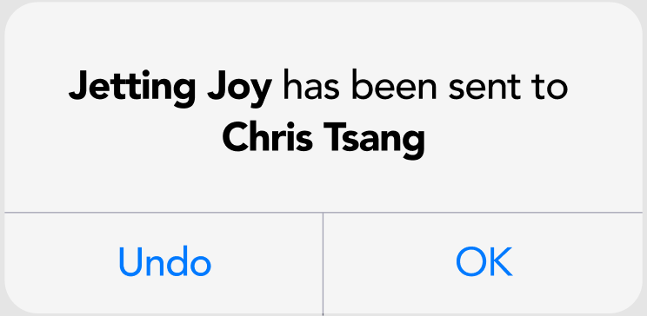
No “Undo” option for adding to location/sharing
Problem
Unable to remove rechord from Location Playlist in case user accidentally adds
Unable to unshare rechord in case user accidentally shares
Solution
Include “Undo” option

Slide 15
Cannot edit song and location
Problem
After saving rechord, only able to edit “Memory Details”
Accidentally save incorrect song/location
Solution
Allow edits to song and location

Slide 16
Prototype Status

Slide 17
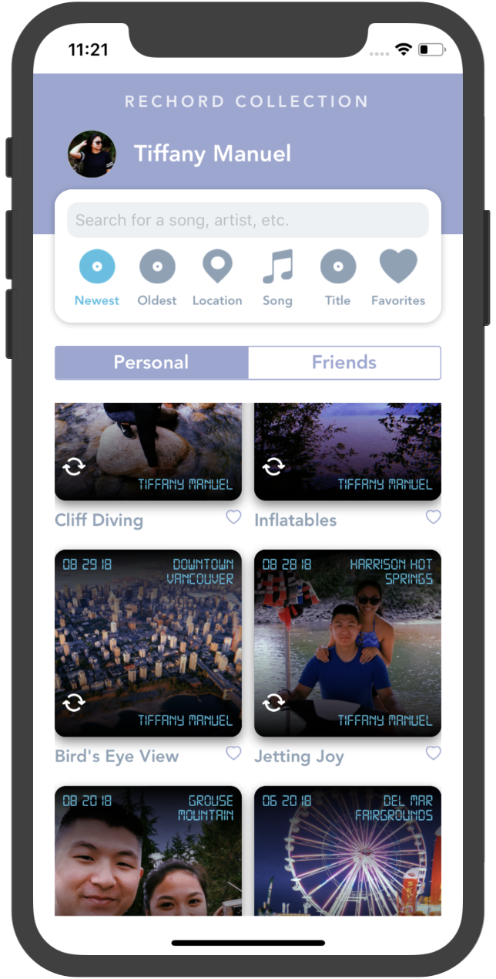
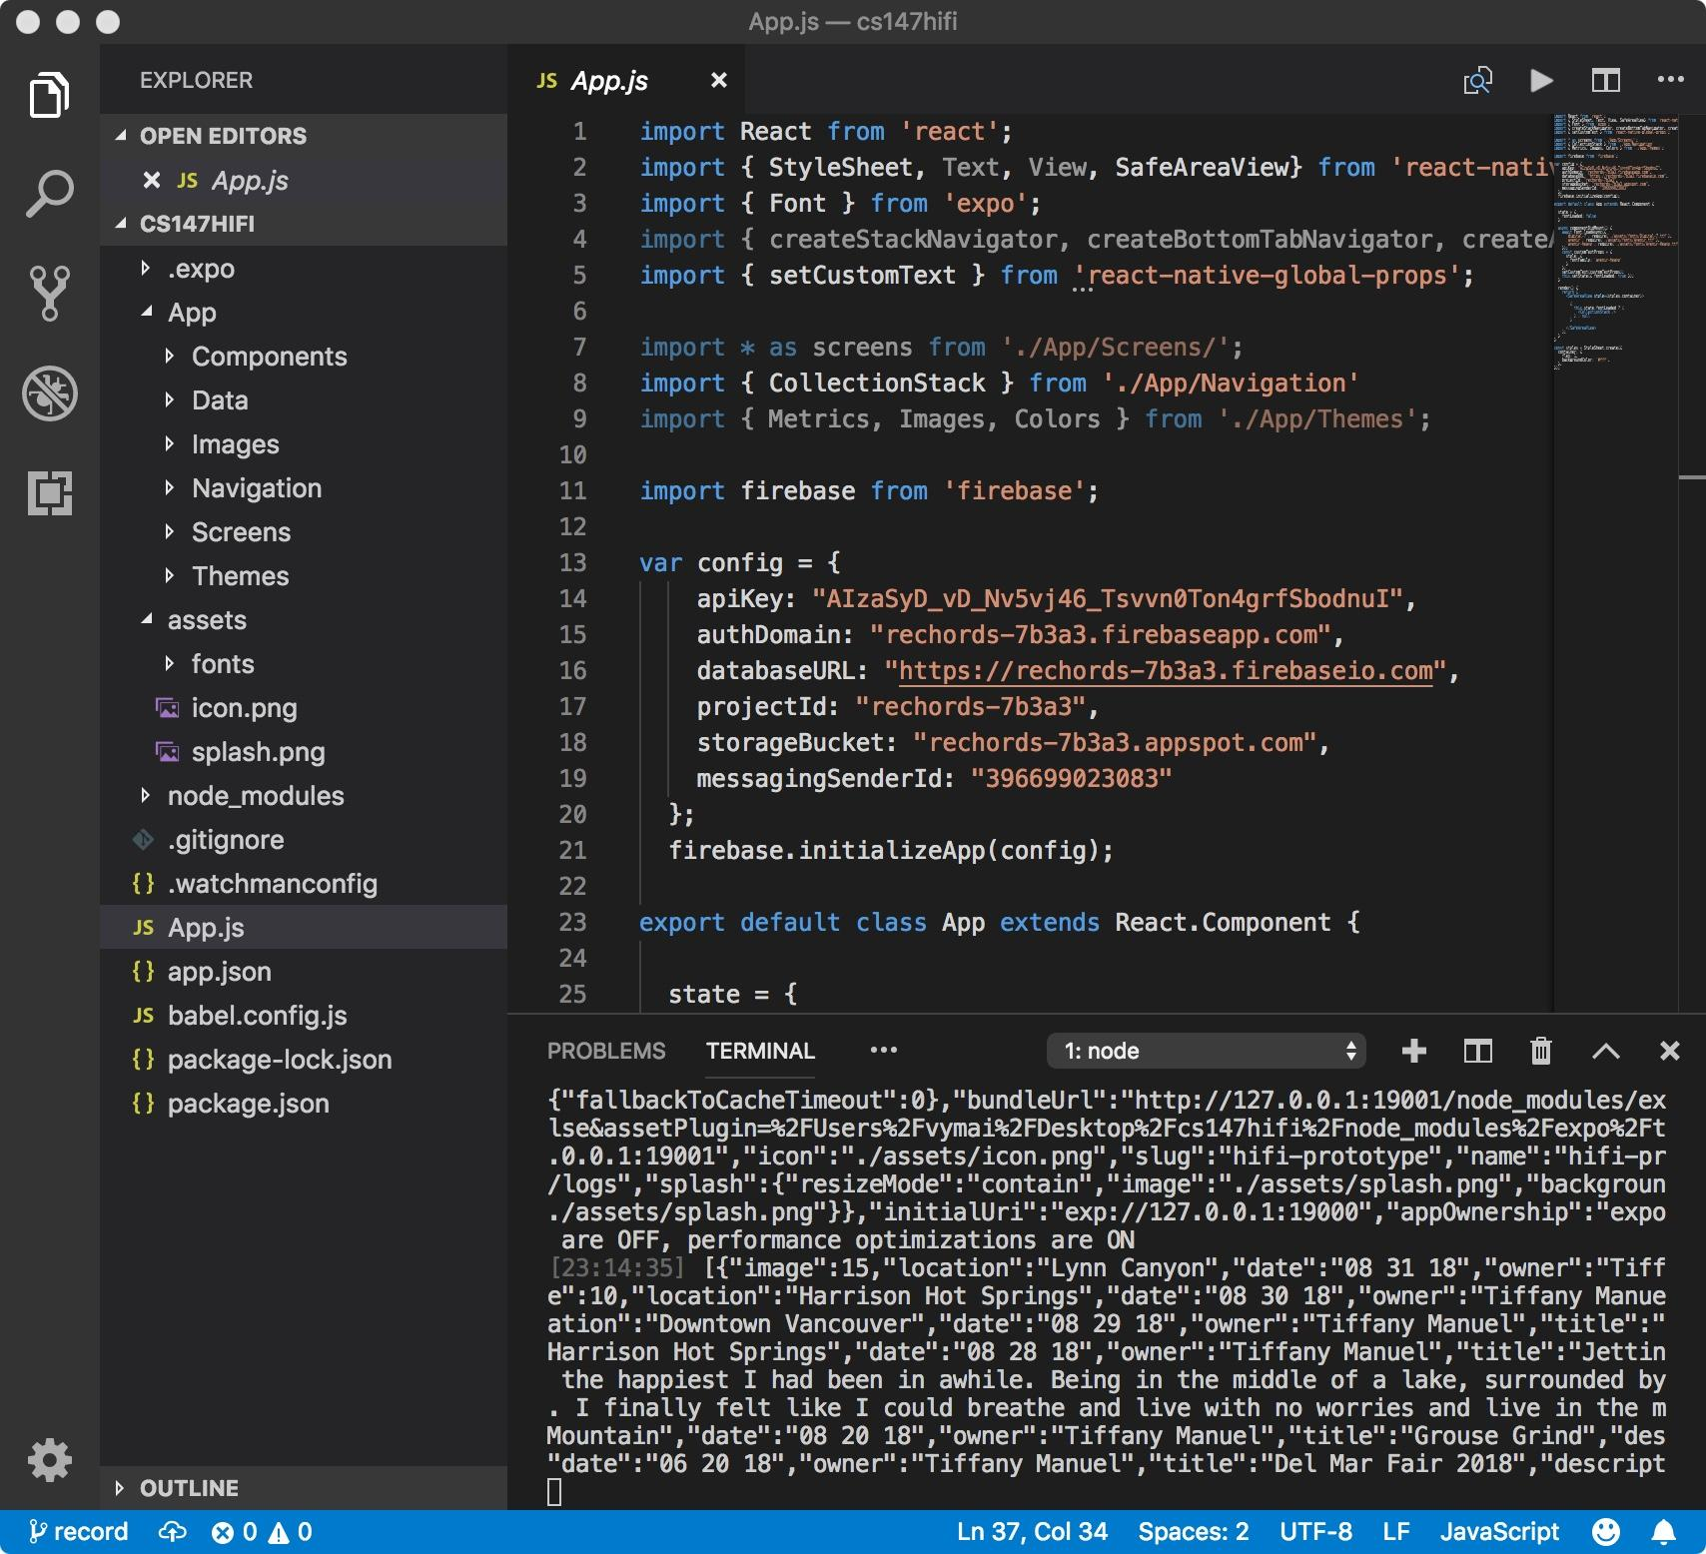
Tools Used
React Native and Expo
IDEs
Visual Studio Code
Sublime Text
iOS Simulator / iPhone
GitHub

Slide 18
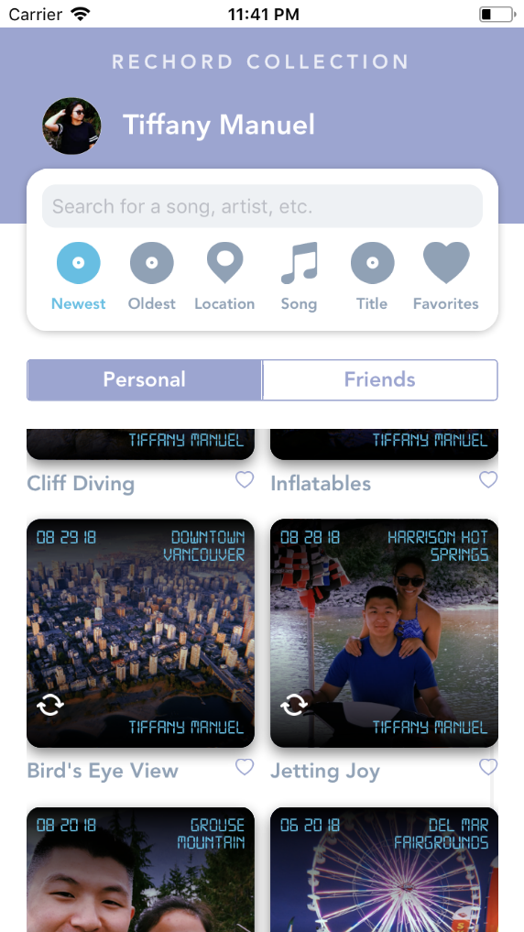
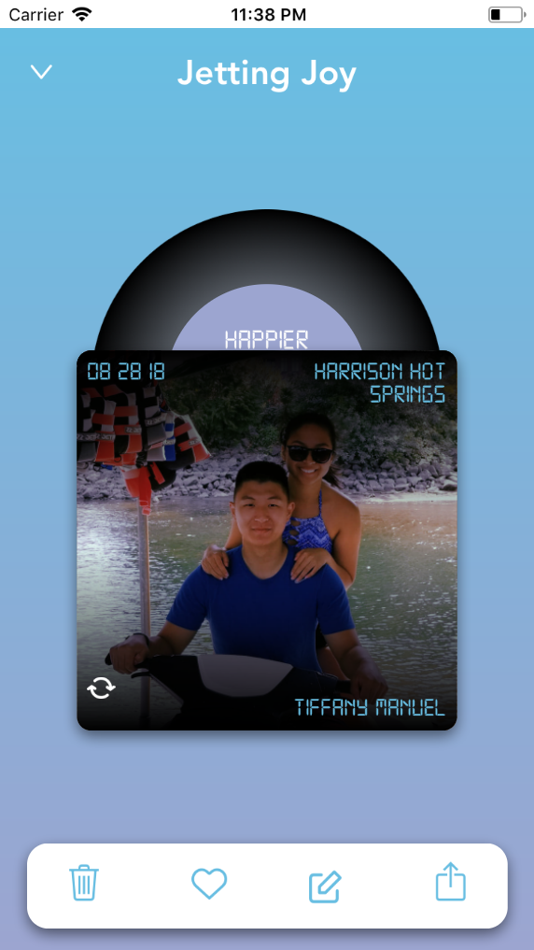
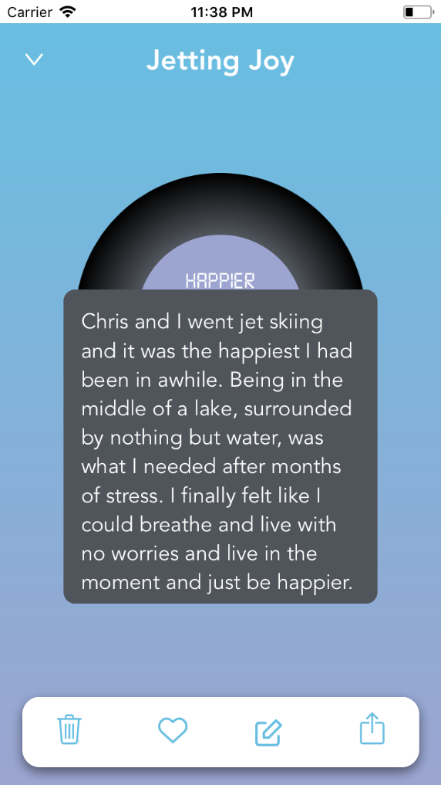
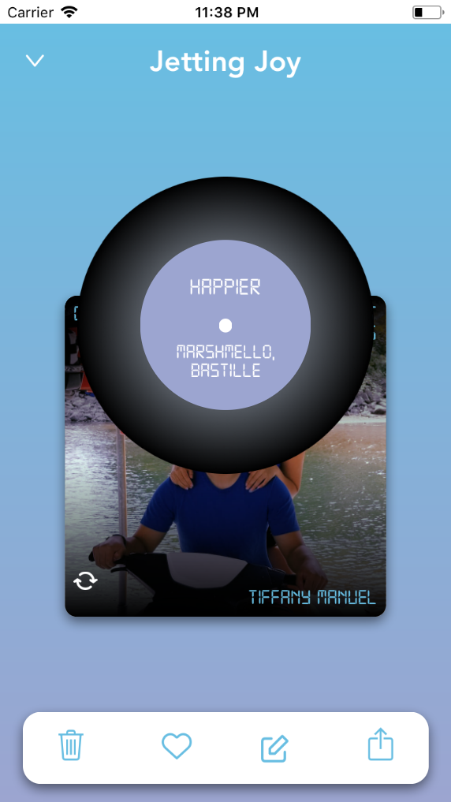
Implemented Features
Rechord Collection / Rechord Viewer (Simple Task)

Slide 19
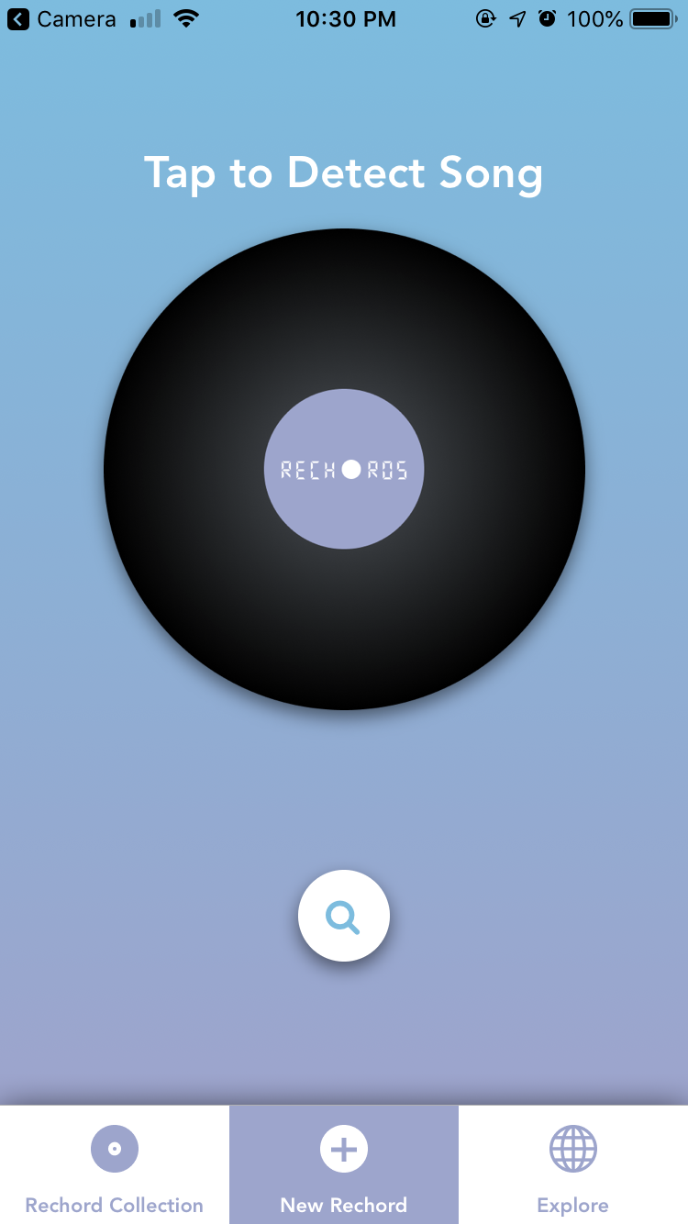
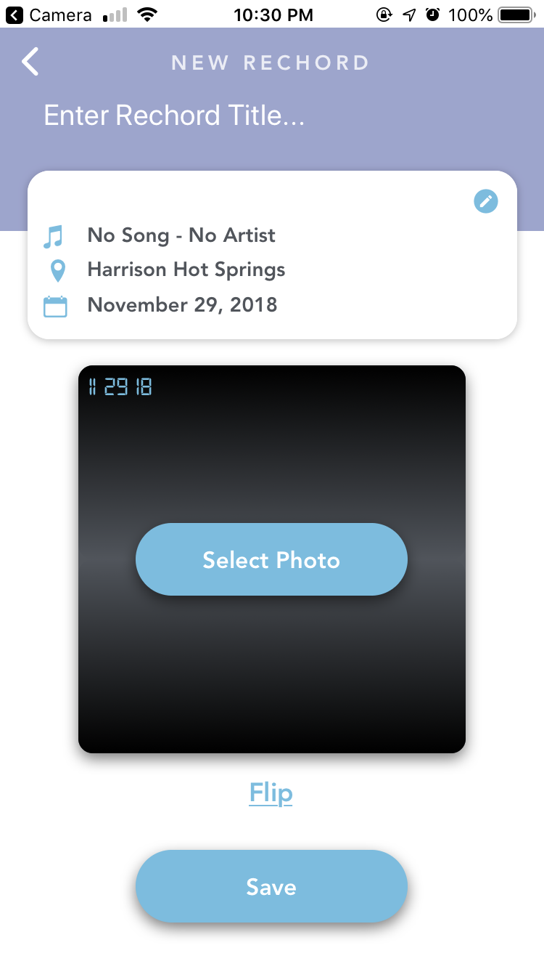
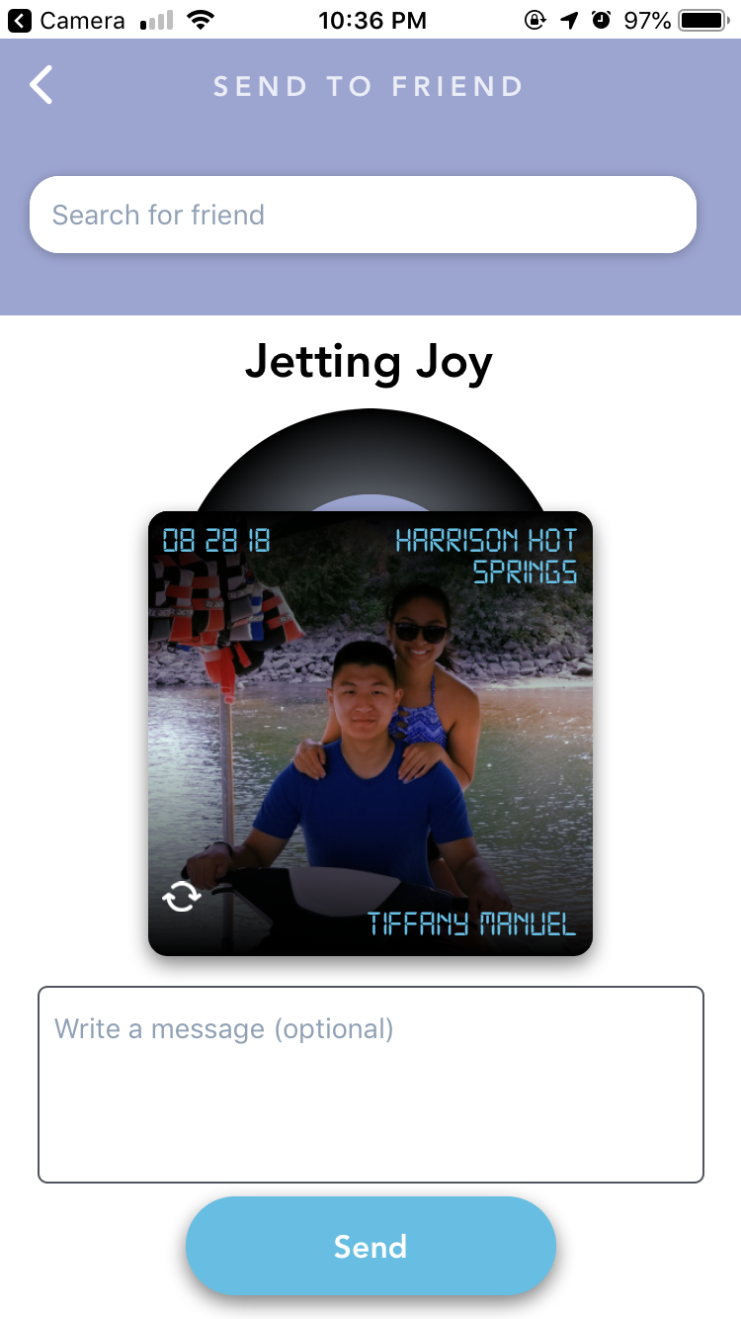
Implemented Features

Slide 20
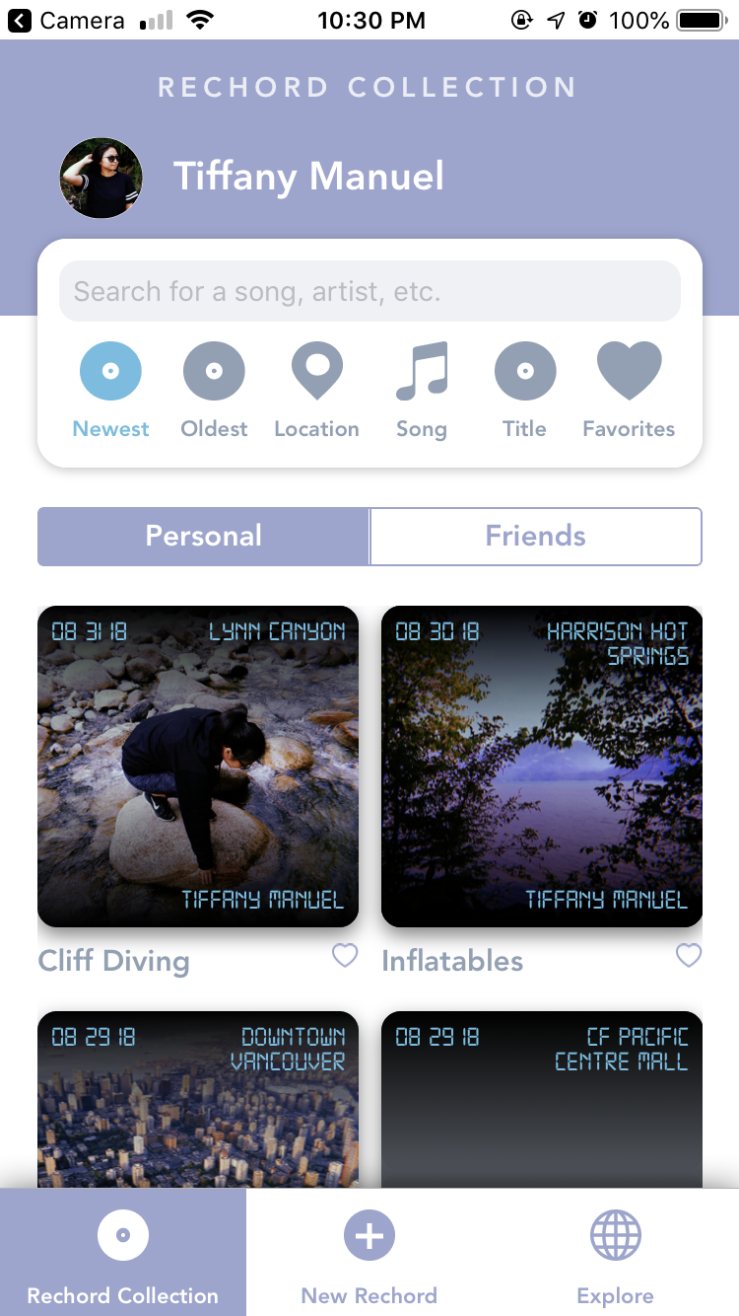
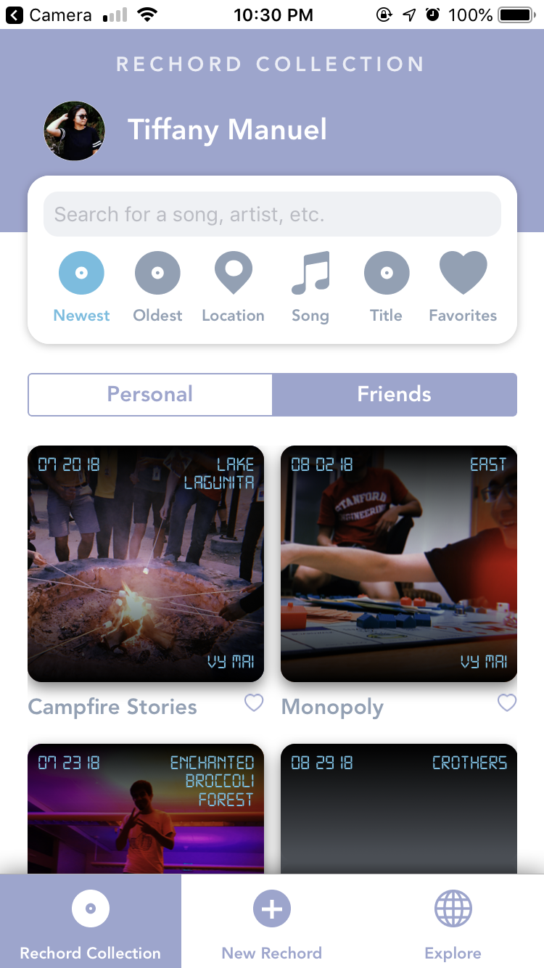
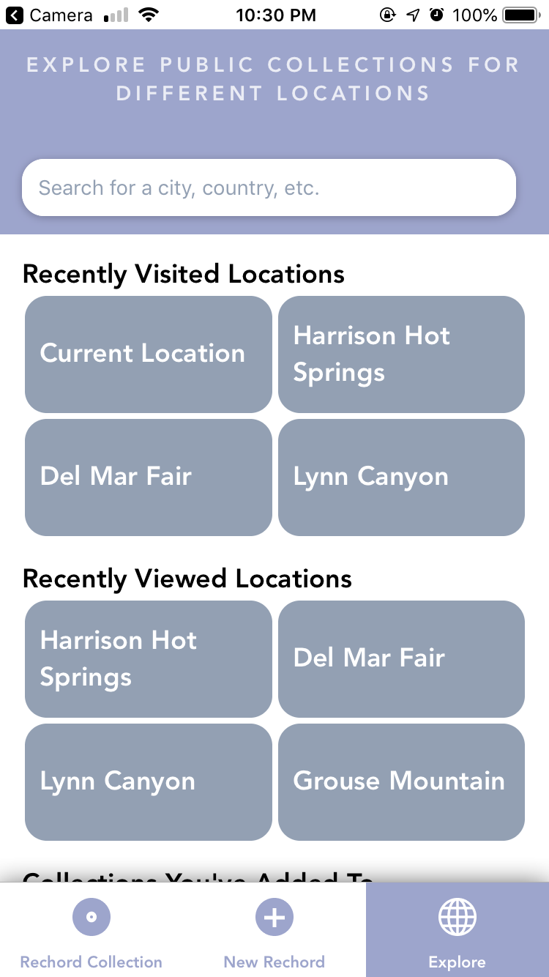
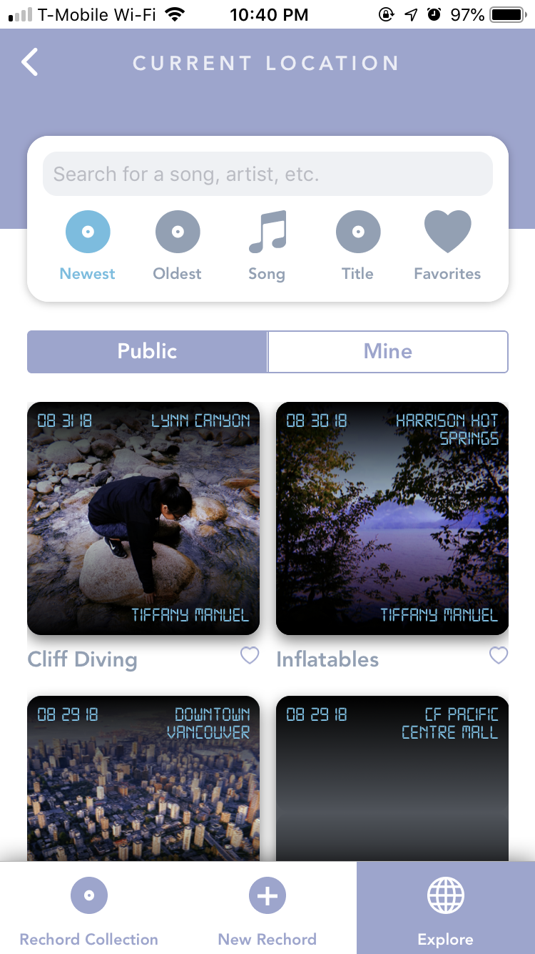
Implemented Features

Slide 21
Unimplemented Features
ToDo
“Create New Rechord” functionality
Public Location Collections
Data
Adding personal rechords
“Send to friend” functionality
Recognize song playing
Plan
Re-use code from similarly styled components
Figure out database
Use existing Spotify API

Slide 22
Unimplemented Features
ToDo
“Create New Rechord” functionality
Public Location Collections
Data
Adding personal rechords
“Send to friend” functionality
Recognize song playing
Plan
Re-use code from similarly styled components
Figure out database
Use existing Spotify API

Slide 23
Hardcoded Data
Details of rechords for “Friends” and “Public Location Collection” (song, location, date, owner, etc.)
List of friends
Sort by functionality
Recognized song (if API plan doesn’t work)

Slide 24
Questions / Issues
Not sure how to use Spotify API in React Native
If we can’t get the feature to work, should we just default to searching/manually inputting the song?

Slide 25
Demonstration

Slide 26
Summary

Slide 27
Summary
Playlist Design changed to Album Design
Terminology changed from “playlists” to “collections”
User given more control and freedom
“Undo” options
Editing song and location
Most of the screens have been created
Few minor fixes will be made in final project
Working on database this weekend to complete functionality
Primarily for creating a new rechord

