Slide 1
RECHORDS
Assignment #6: Med-Fi Prototype
Jourdann Fraser, Vy Mai, and Tiffany Manuel

Slide 2
Problem/Solution Overview
Journaling is time-consuming, and photos only capture visual details. Instead of simply storing mementos of the past, we aim to recreate the environment of the memory itself. Rechords uses the connection between music and memories to give users a better way to remember. Our app records the location and song associated to a memory. Users can then relive past experiences and share them with friends, loved ones, and even the public.

Slide 3
Mission Statement
By connecting music to memories, we hope to add a new dimension to memory keeping.

Slide 4
Value Proposition
Turn Music Into Memories

Slide 5
Change #1
Inbox -> Friends’ Rechords
Rationale: Out testers didn’t like the idea of an inbox because it was too formal and hard to find, leading to the following changes:
Got rid of inbox on the homepage
Moved friends’ rechords from inbox to My Rechords
Replaced search feature with sort by feature
Uses dropdown to view descriptions

Slide 6
Change #1
BEFORE:
AFTER:

Slide 7
Change #2
Creation of New Rechord
Rationale: The old process for creating a new rechord was difficult for our testers to navigate. They thought capturing a song first was more intuitive, so we made the following changes based on that feedback:.
Make creating a rechord the default home screen
Capture a song with shazam or search first
Map of location added
Can do speech-to-text via your keyboard
Memory details are now optional
Automatically takes you to the rechord you just created in your personal playlist

Slide 8
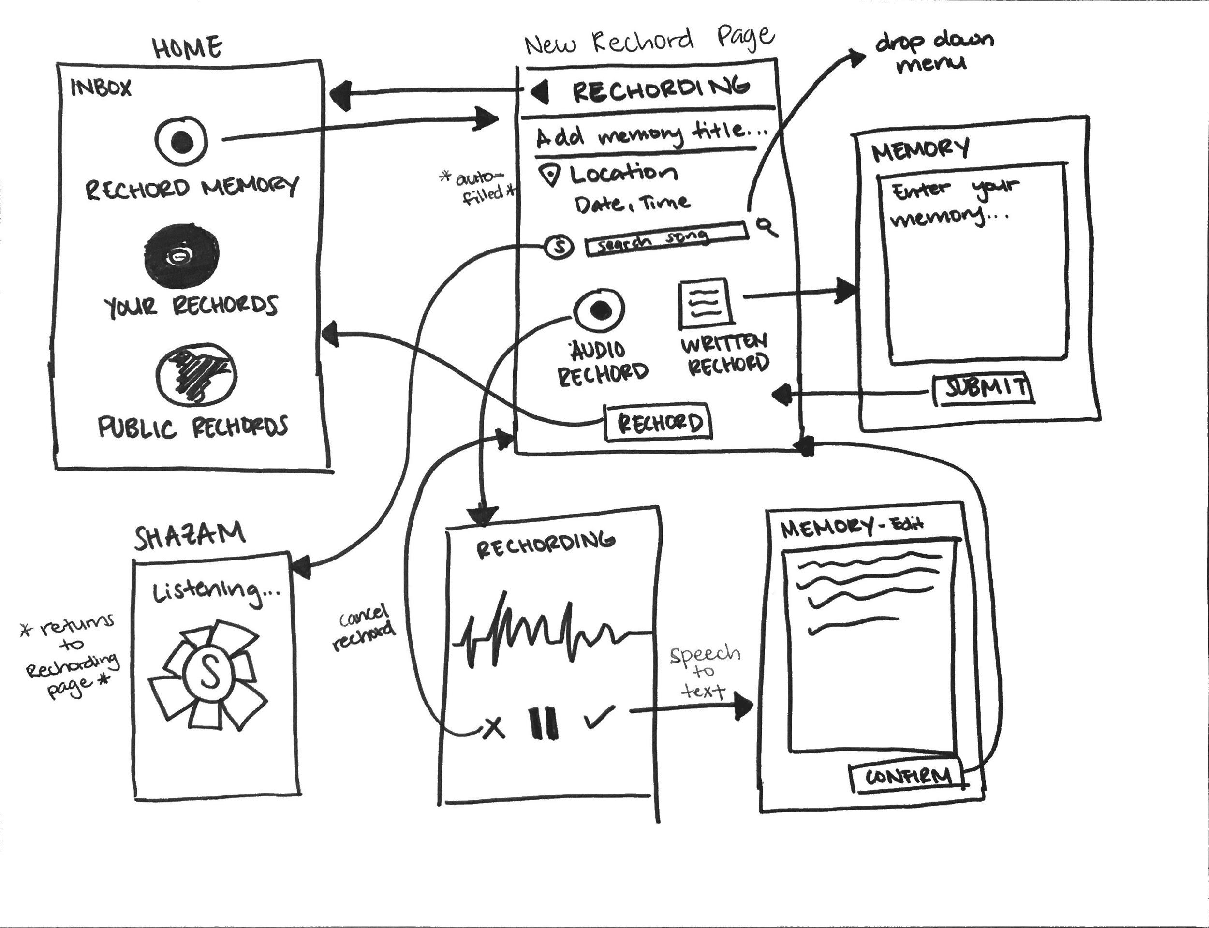
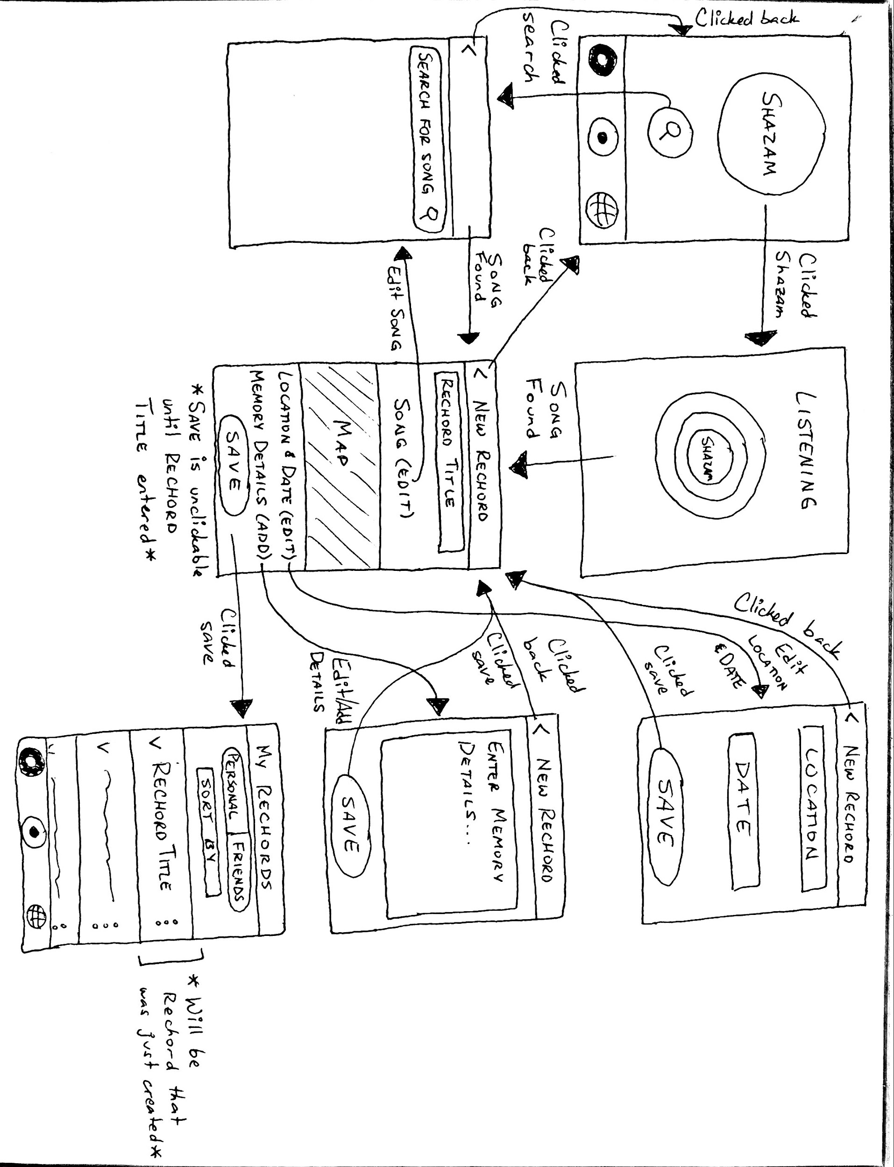
BEFORE
AFTER

Slide 9
Change #3
Changing the Navigation
Rationale: We decided to make this change to make it easier for the user to navigate between different screens. Additionally, the change emphasizes the main function of our app: creating and saving personal rechords.
“New Rechord” page is center tab
Implemented tab navigation (rather than just icons on a single screen)

Slide 10
Change #3

Slide 11
Tasks
[Simple] Create and save your own rechord (memory and song)
[Simple] View your own rechords
[Medium] View rechords from your friends
[Medium] View a public playlist
[Complex] Share a rechord with your friends
[Complex] Share a rechord with the public

Slide 12
Task #1: Create and save a rechord (song+memory)

Slide 13
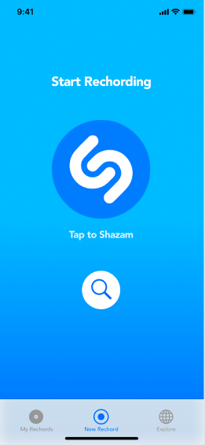
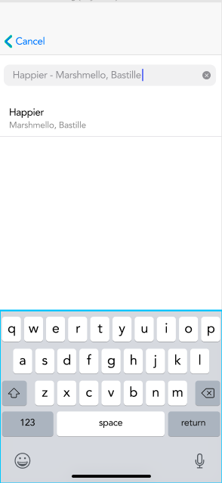
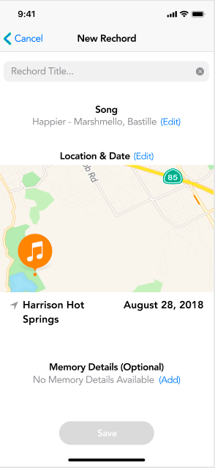
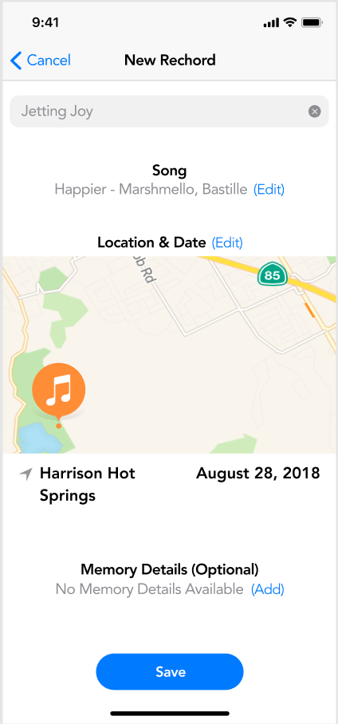
Task #1: Create and save a rechord (song+memory)
edit new rechord page
search music page
find song
input rechord title
Notes:
Note: the screenshots provided here are a simplified version for the entire workflow experienced in the prototype; all the features that could be implemented aren’t shown here.

Slide 14
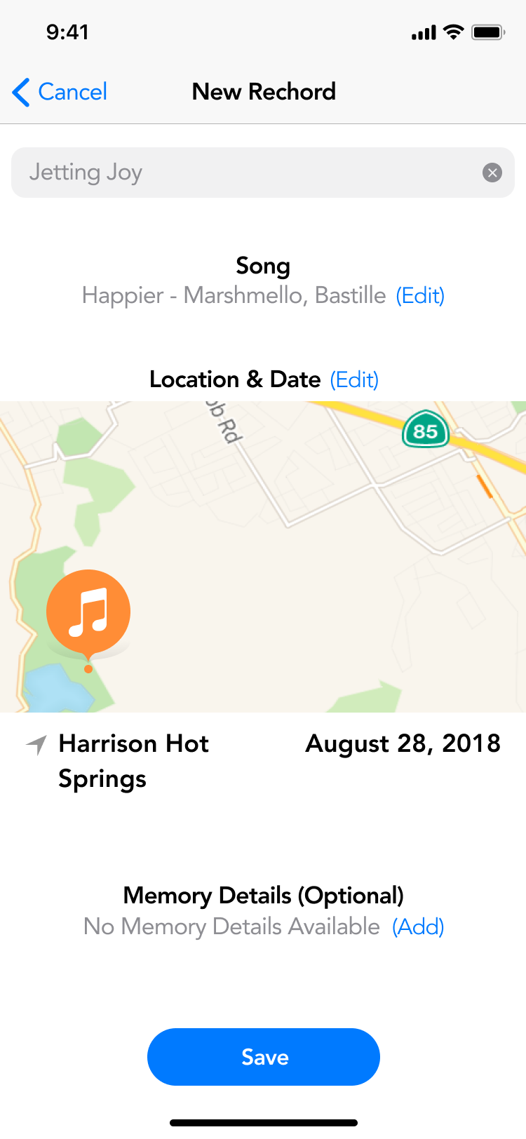
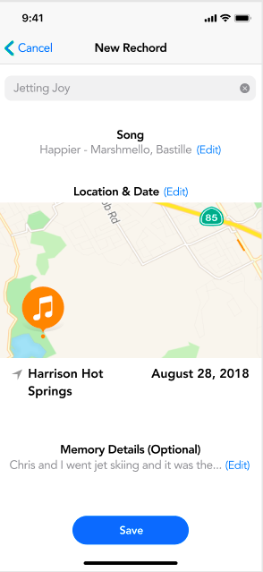
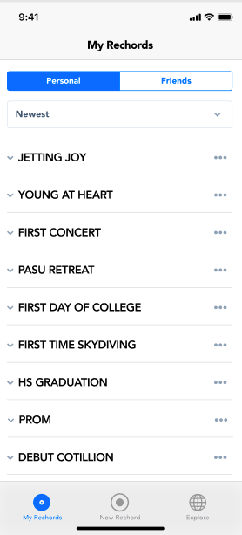
Task #1: Create and save a rechord (song+memory)
edit memory (optional)
save memory description
Save rechord
Add to “My Rechords”
Notes:
Note: the screenshots provided here are a simplified version for the entire workflow experienced in the prototype; all the features that could be implemented aren’t shown here.

Slide 15
Task #2: View your rechord

Slide 16
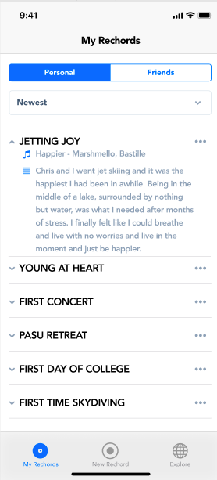
Task #2: View your rechord (Option 1)
nav tab
my rechords page (personal)
my rechords page (expanded)
Notes:
Note: the screenshots provided here are a simplified version for the entire workflow experienced in the prototype; all the features that could be implemented aren’t shown here.

Slide 17
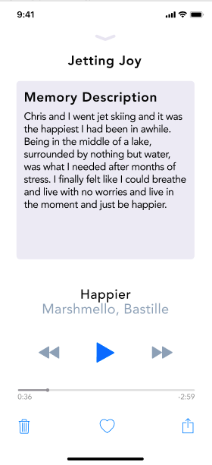
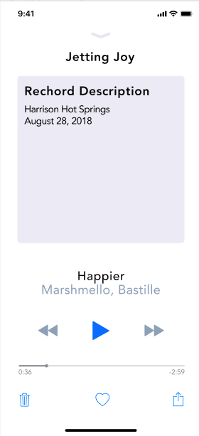
Task #2: View your rechord (Option 2)
my rechords page (personal)
music player (memory)
muisc player (date and time)
homepage
Notes:
Note: the screenshots provided here are a simplified version for the entire workflow experienced in the prototype; all the features that could be implemented aren’t shown here.

Slide 18
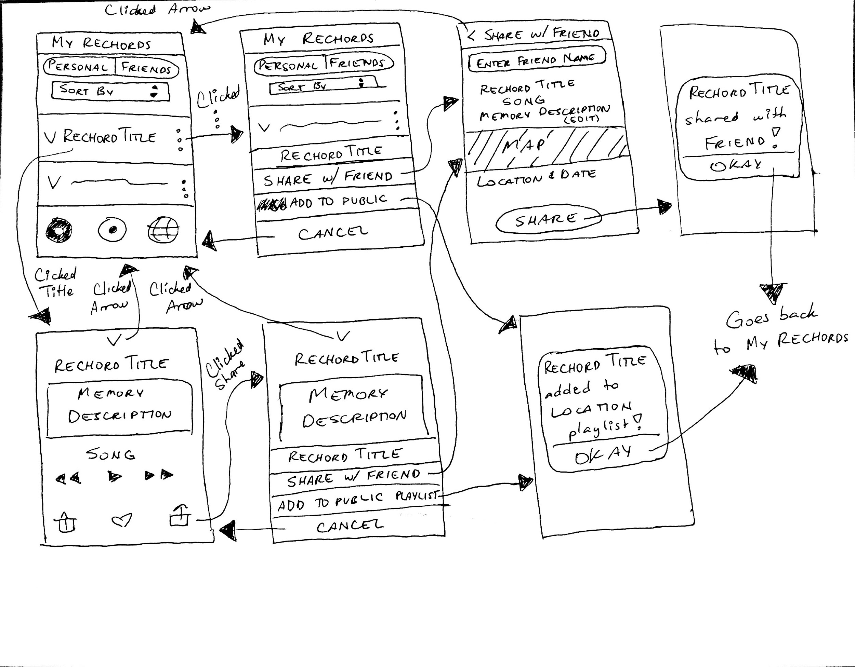
Task #3: Share a rechord w/ friends and public

Slide 19
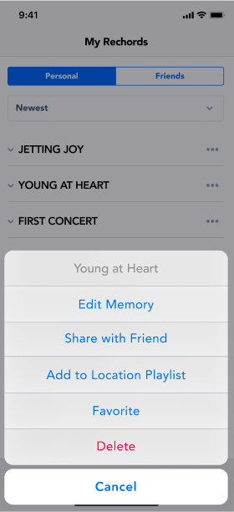
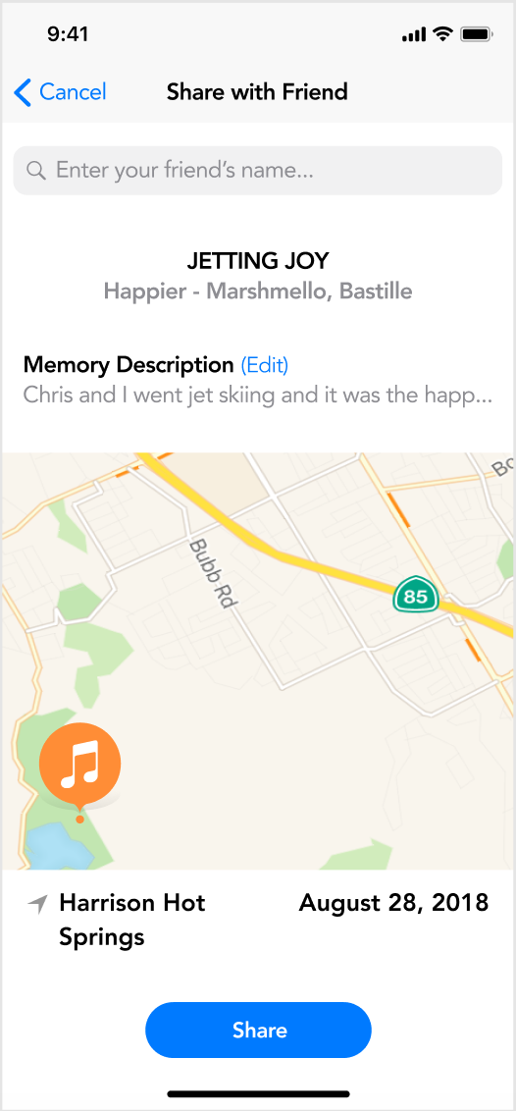
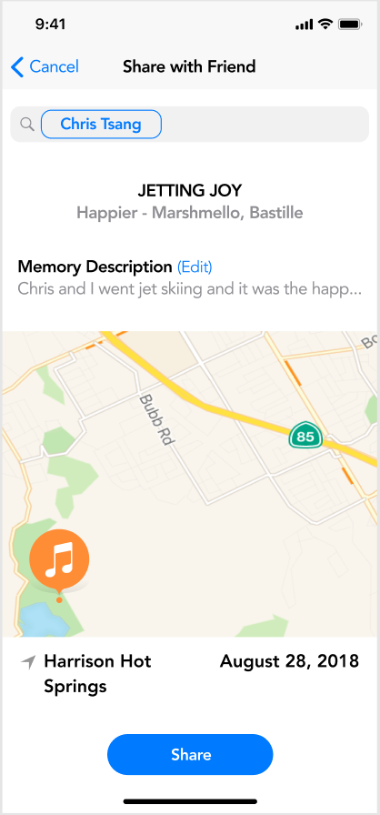
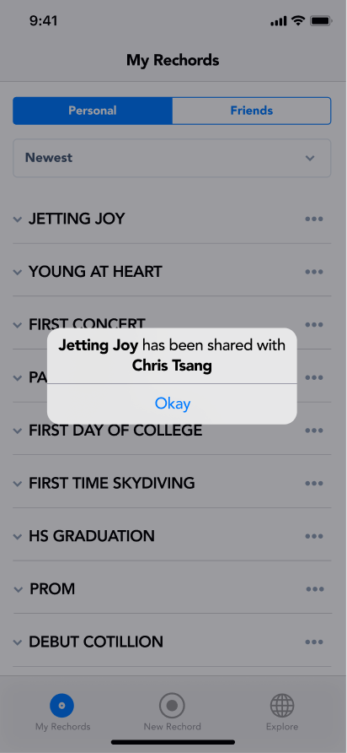
Task #3.1: Share a rechord w/ friends (Option 1)
my rechords page (personal)
list of options
edit share with friend page
enter friend’s name
share
Notes:
Note: The same actions are used to share with friends and public, so I share it with friends in this prototype

Slide 20
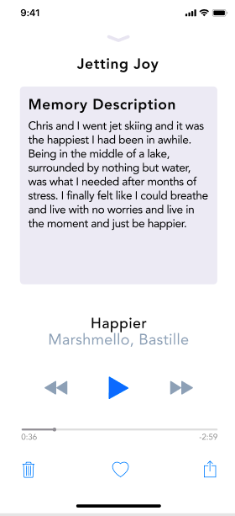
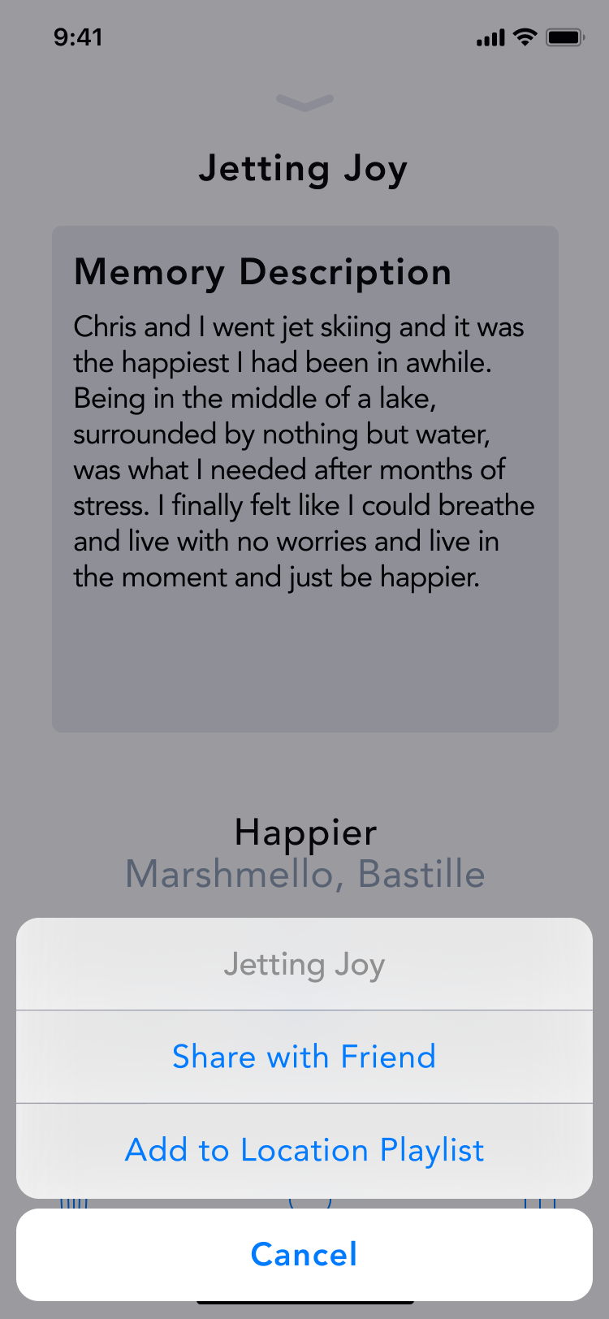
Task #3.1: Share a rechord w/ friends (Option 2)
my rechords page (personal)
my rechords page (personal)
music player (memory)
share with friend
Notes:
Note: The same actions are used to share with friends and public, so I share it with friends in this prototype

Slide 21
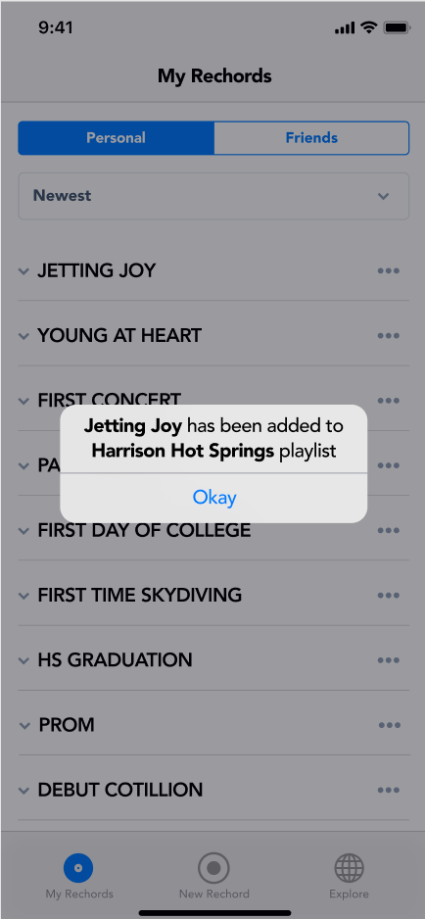
Task #3.2: Share a rechord w/ public (Option 1)
my rechords page (personal)
list of options
add to local playlist
Notes:
Note: The same actions are used to share with friends and public, so I share it with friends in this prototype

Slide 22
Task #3.2: Share a rechord w/ public (Option 2)
my rechords page (personal)
music player options
music player
Add to local playlist
Notes:
Note: The same actions are used to share with friends and public, so I share it with friends in this prototype

Slide 23
Task #4.1: View others’ rechords (friends)

Slide 24
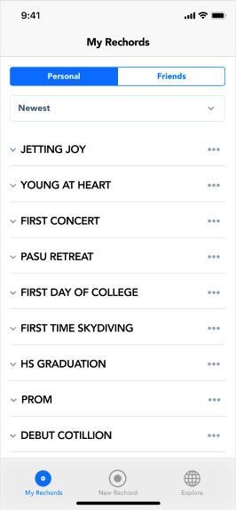
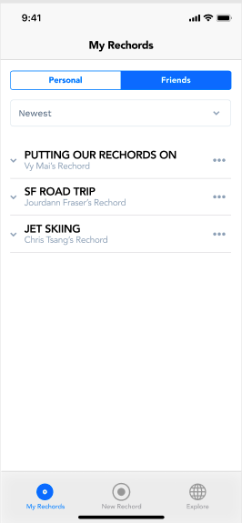
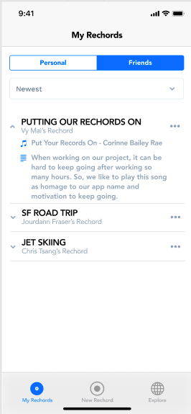
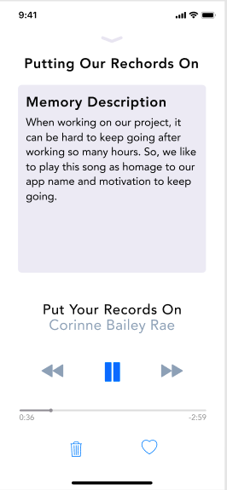
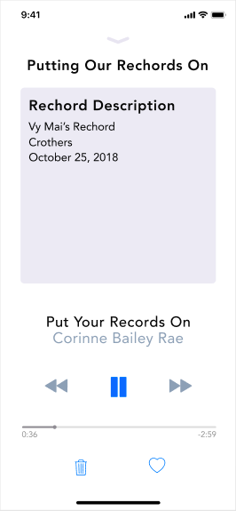
Task #4.1: View others’ rechords (friends)
my rechords page (personal)
my rechords page (friends)
my rechords page (expanded)
music player (memory)
music player (date and time)

Slide 25
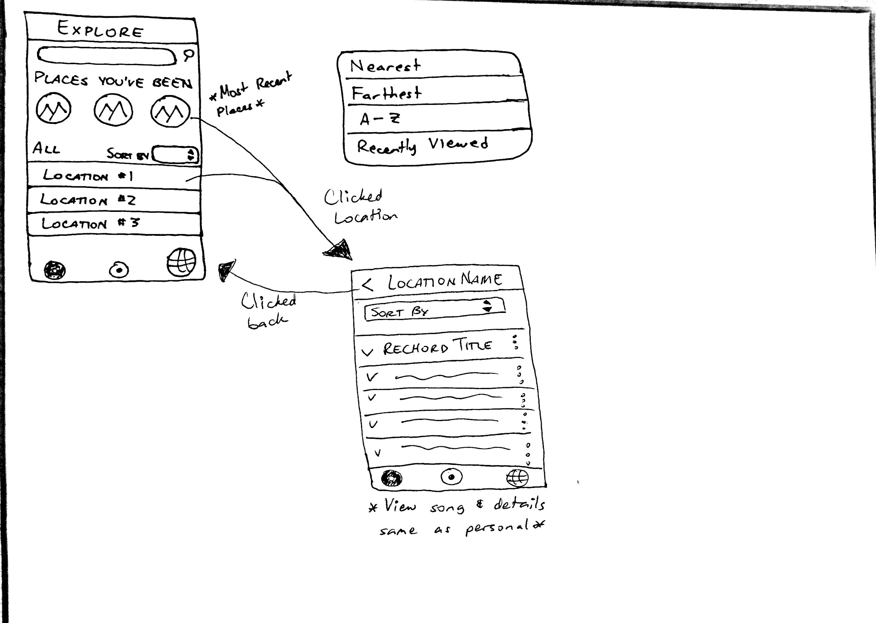
Task #4.2: View others’ rechords (public)

Slide 26
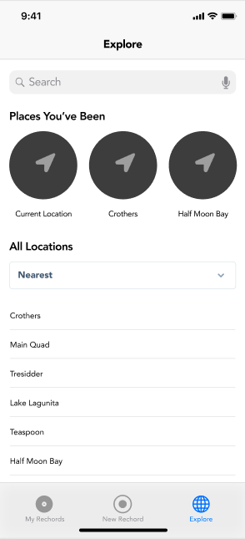
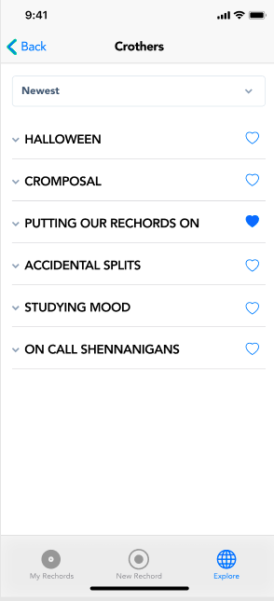
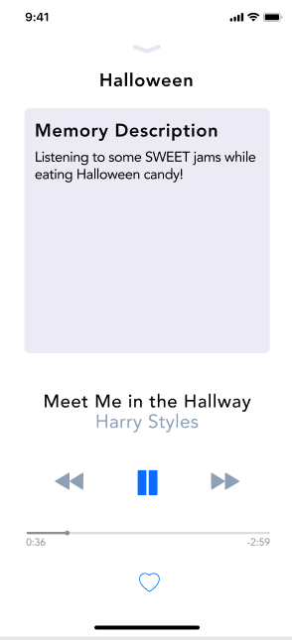
Task #4.2: View others’ rechords (public)
nav tab
explore page
location playlist
music player (memory)

Slide 27
Tools
Figma
Pros
Able to collaborate
Standardizing screens was easy
Cons
Using Components was confusing
Working within groups of elements was a huge adjustment
Copying and pasting was difficult (would not paste to screen)

Slide 28
Tools
Invision
Pros
Able to collaborate
Dragging and uploading screens is easy
Cons
Annoying process to add hotspots
Difficult to create multiple task flows depending on user input
I.e. we can’t create an alternate task flow for when the user doesn’t include a memory description

Slide 29
Limitations and Trade-Offs
Invision limitations
App animations
Speech-to-text
Need to simplify task flows
Including dropdown functionality for all displayed rechords
No implementation of other functions
No way to add a friend
No alert for receiving a song
deleting or favoriting rechords
Sort dropdowns
Limiting color and style to focus on task flow

Slide 30
Hard Coded/ Wizard of Oz
Speech to text
Any text input
Shazam recognizing music
Auto-generated location
Songs generated on personal, friends, and location playlists
Automatic database of friends to send rechords to

Slide 31
Prototype Link - Figma
https://invis.io/GCOWVNHFVK6

Slide 32
Prototype Link - InVision
https://invis.io/GCOWVNHFVK6

