Slide 1
RECHORDS
Presenter: Tiffany Manuel

Slide 2
Mission Statement
Selected Interface
Low-Fi Prototype
Three Task Flows
Experiment
Method
Results
UI Changes
Summary
Notes:
After taking into consideration the feedback you all gave us last week, we were able to more clearly identify our goal for this project. Having a more clear idea of what we wanted this app to do guided us in our sketching and storyboarding, ultimately helping us decide on our “best design.” Then, after this week of prototyping and testing, we learned even more about ways to improve our design and overall project. So with that being said, I’ll start off by talking about our mission statement.

Slide 3
Mission Statement
Selected Interface
Low-Fi Prototype
Three Task Flows
Experiment
Method
Results
UI Changes
Summary

Slide 4
Mission Statement
Notes:
When we travel back through our memories, we usually do so visually. Whether it be reading a journal entry that we wrote down somewhere or by looking through old photos or even videos, there’s usually a visual component to the act of remembering. But sometimes we don’t need a visual to trigger a memory. Most of us, if not all, have experienced hearing a song and immediately being taken back to something that has happened in our past, and sometimes, this audio input makes us remembering something in more detail than any journal entry ever could. This relationship between music and memories inspired our mission statement.

Slide 5
Mission Statement
By connecting music to memories, we hope to add a new dimension to memory keeping.
Notes:
We hope to enhance the act of remembering and intensify the sense/feeling of reliving a moment.
We hope to enhance the act of remembering by using music to help recreate memories.
We hope to enhance the act of remembering by recreating memories with music.

Slide 6
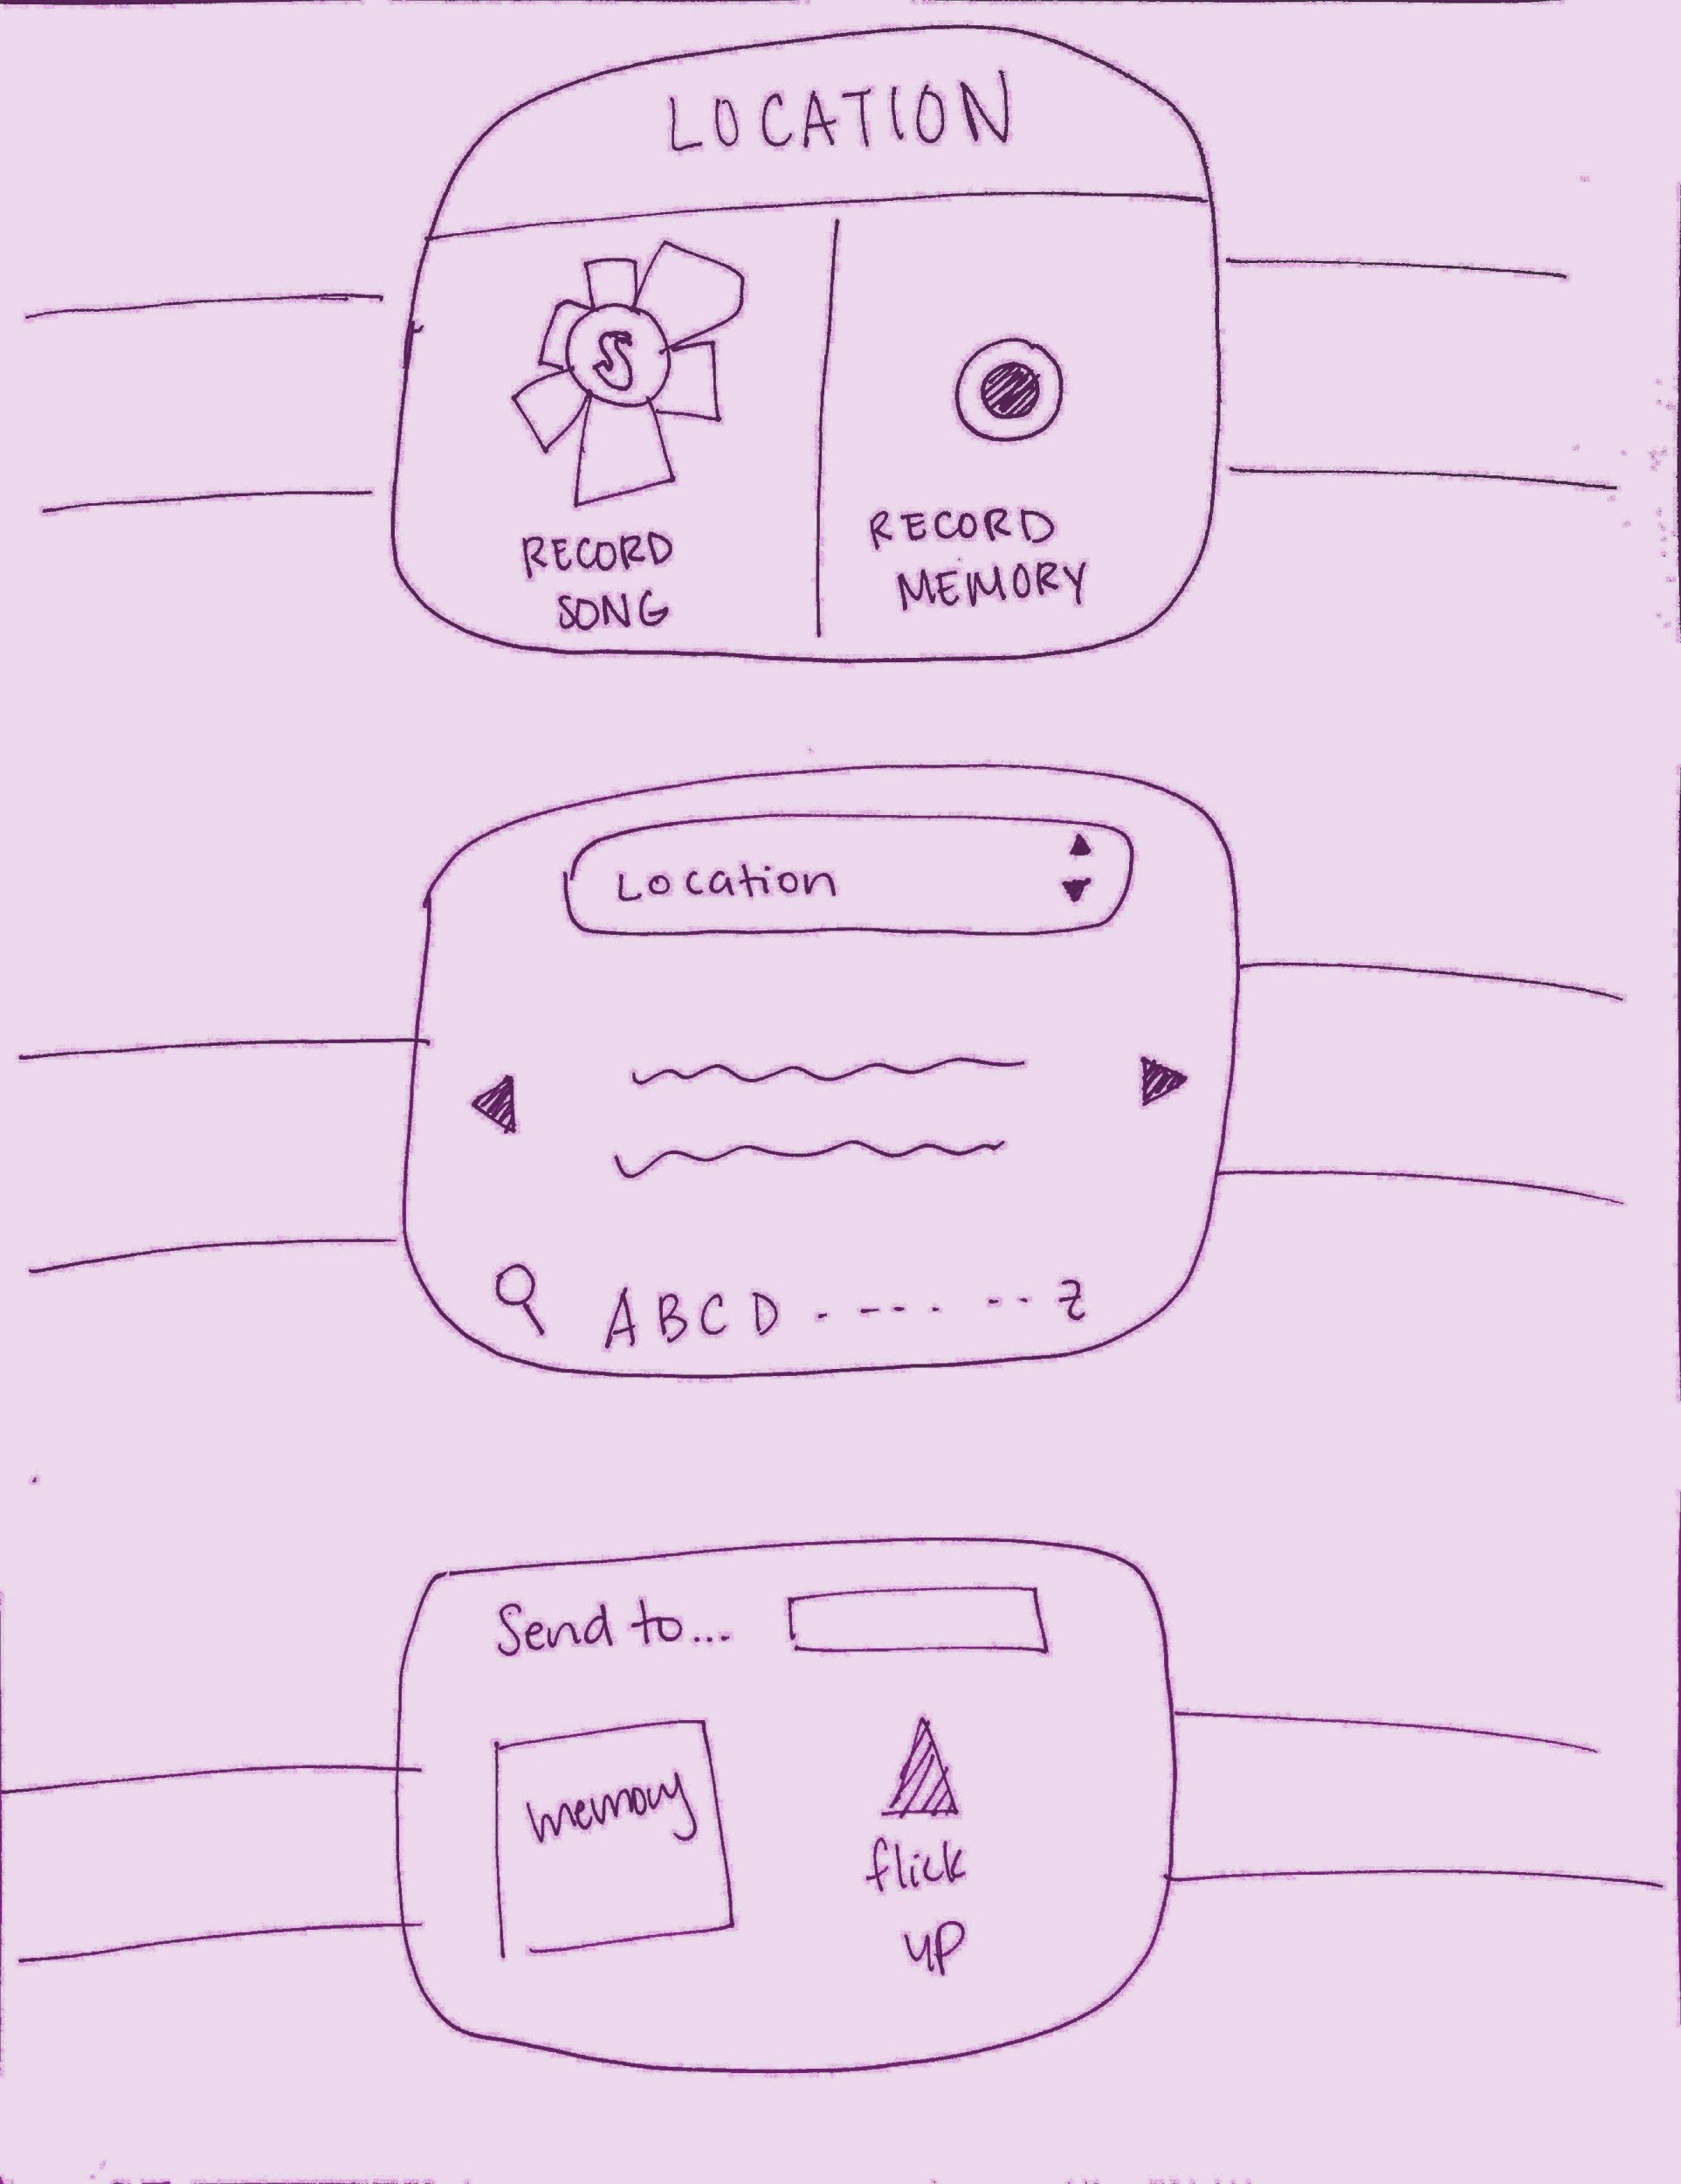
Mission Statement
Selected Interface
Low-Fi Prototype
Three Task Flows
Experiment
Method
Results
UI Changes
Summary

Slide 7
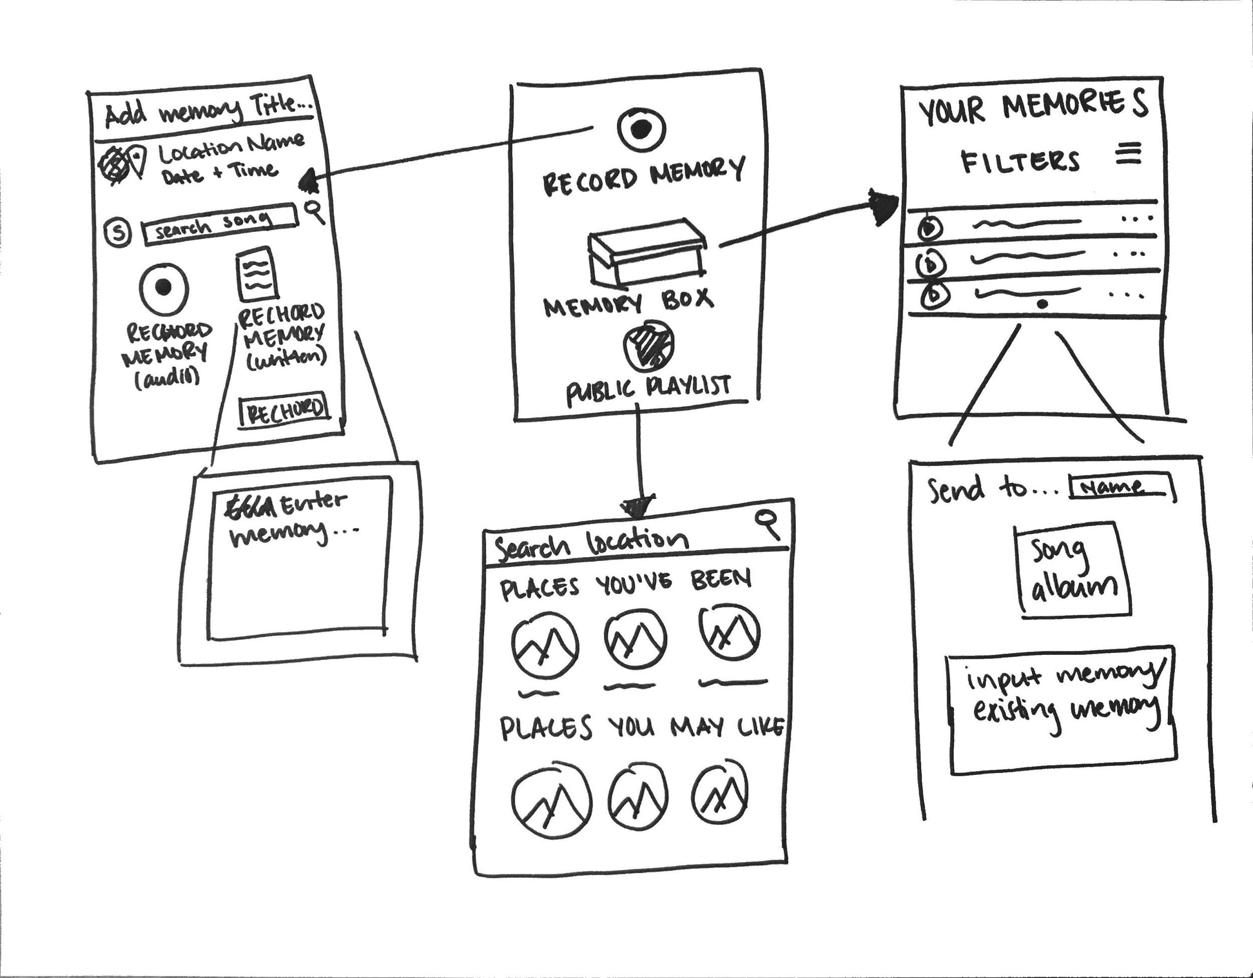
Selected Interface
Capturing memory details
Type or speech-to-text
Playlist design
Recognizable, easy, & quick
Access to public rechords
At any location
*Images*

Slide 8
Selected Interface
Capturing memory details
Type or speech-to-text
Playlist design
Recognizable, easy, & quick
Access to public rechords
At any location

Slide 9
Selected Interface
Capturing memory details
Type or speech-to-text
Playlist design
Recognizable, easy, & quick
Access to public rechords
At any location

Slide 10
Mission Statement
Selected Interface
Low-Fi Prototype
Three Task Flows
Experiment
Method
Results
UI Changes
Summary

Slide 11
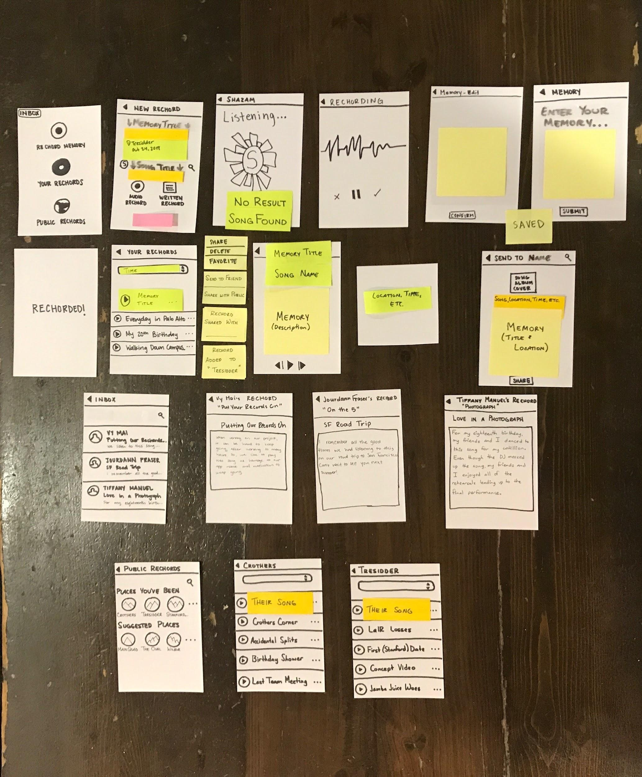
Low-Fi Prototype
Paper Prototype
Phone Interface
Input involves touch, typing, and audio

Slide 12
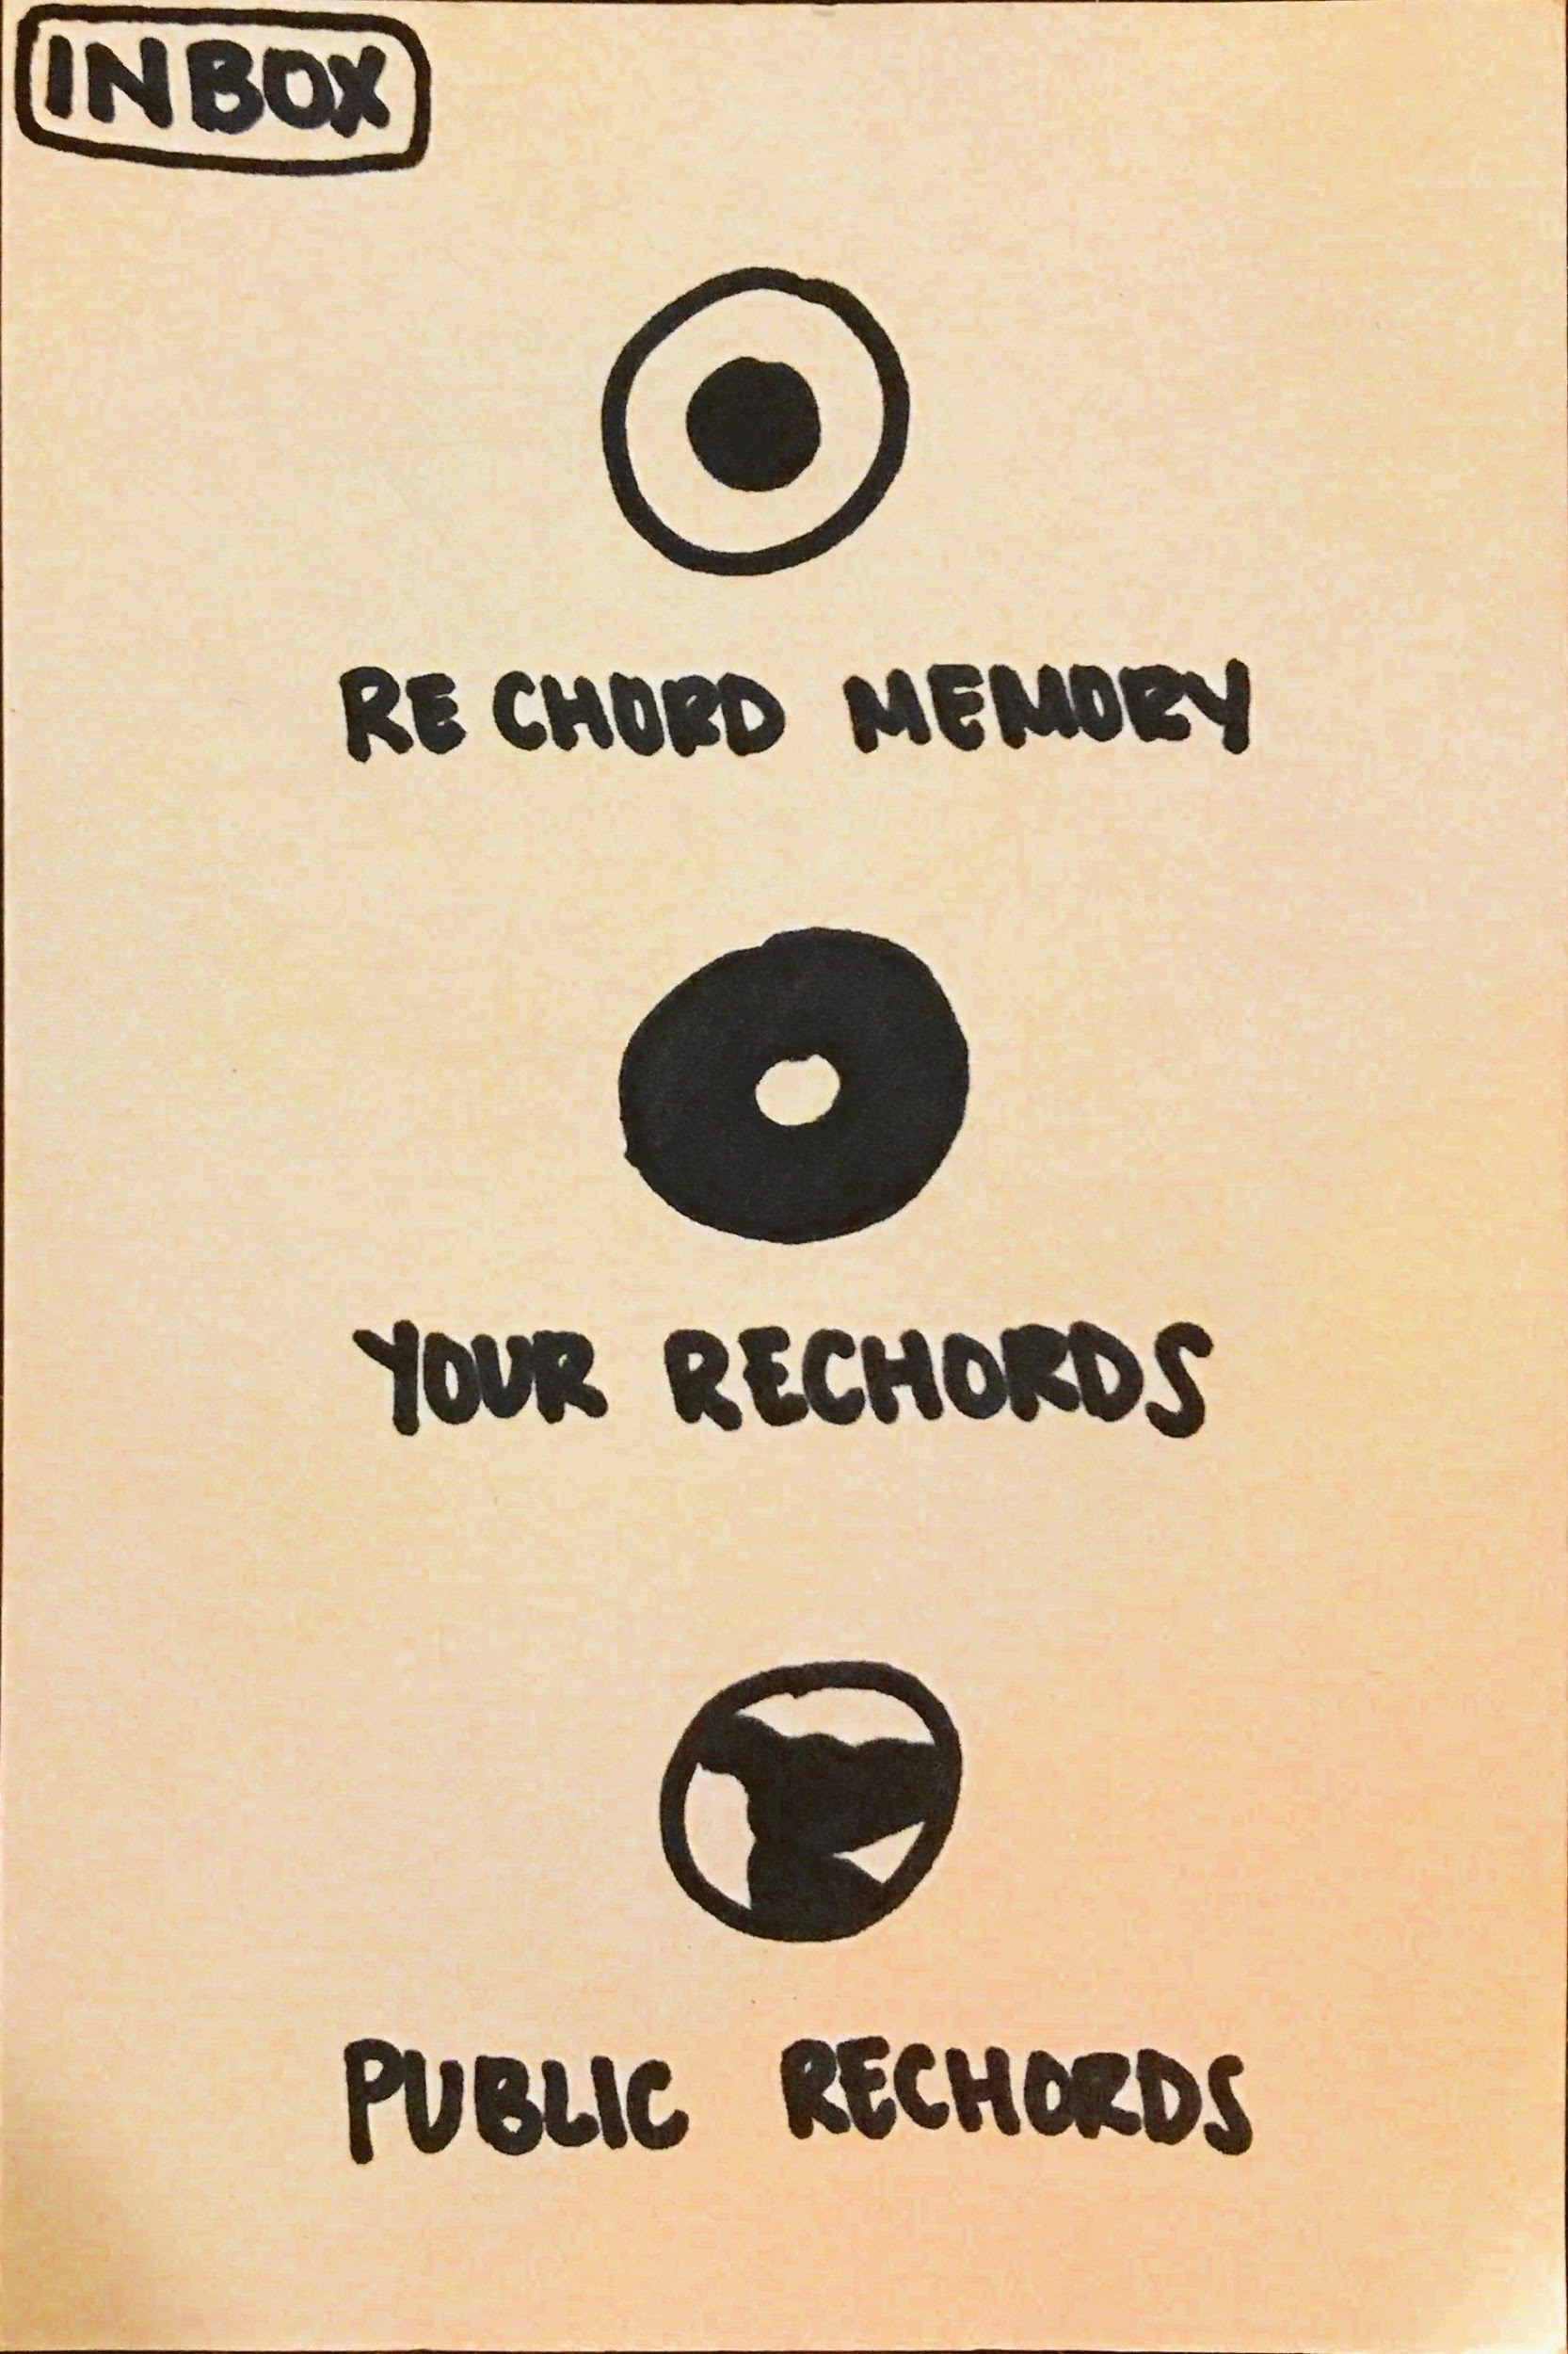
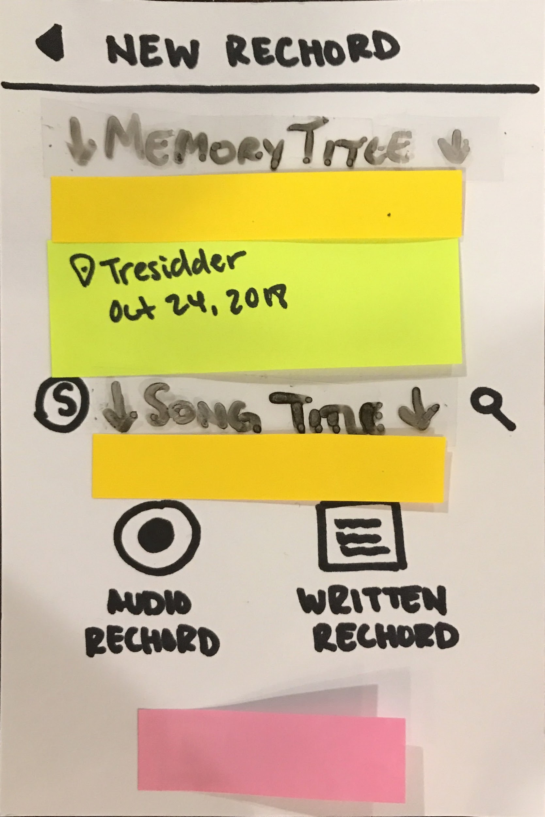
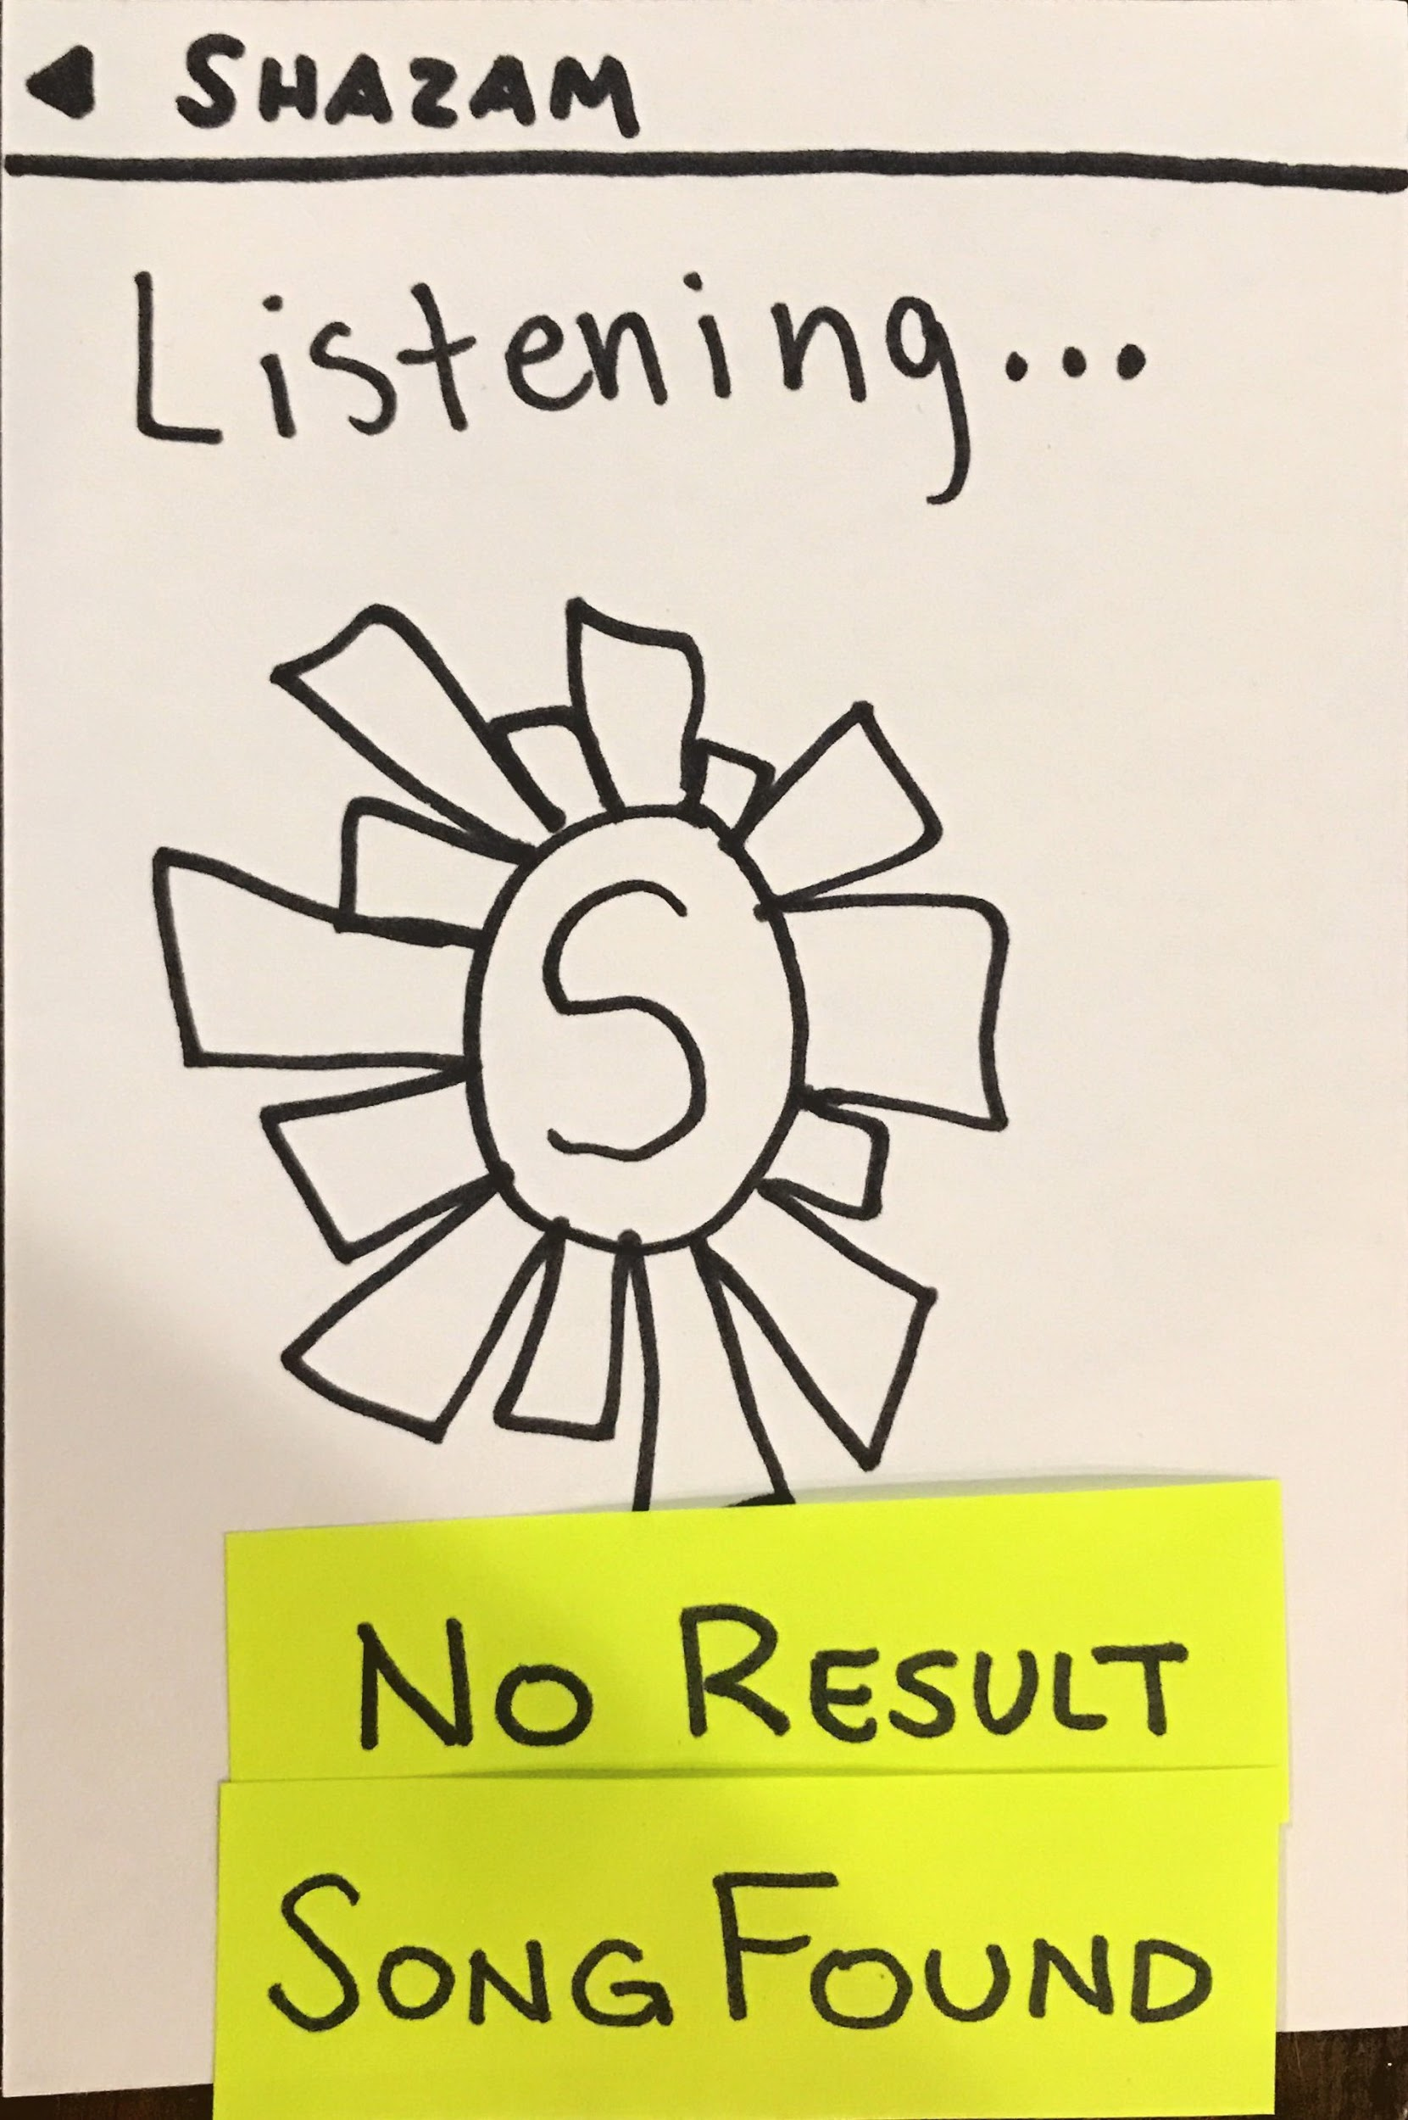
Task #1: Create and save a rechord (song+memory)

Slide 13
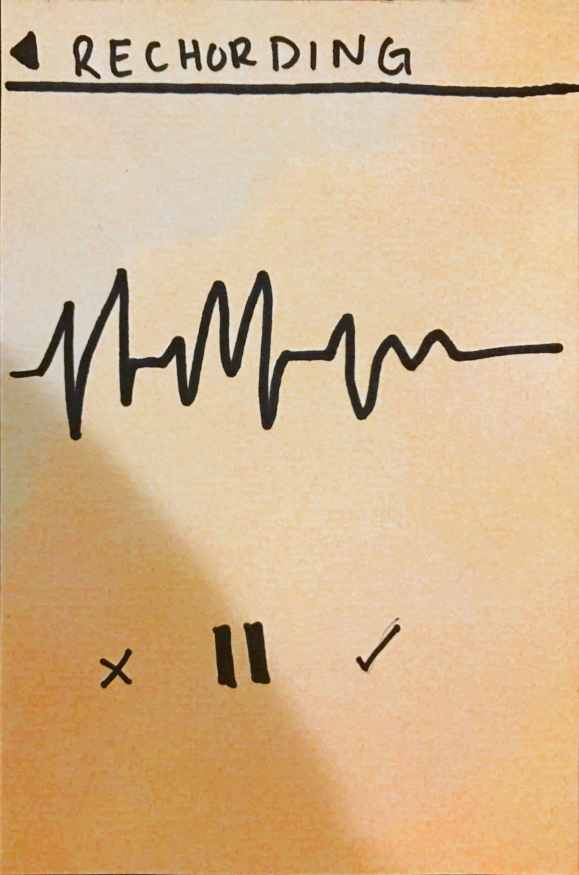
Task #1: Create and save a rechord (song+memory)

Slide 14
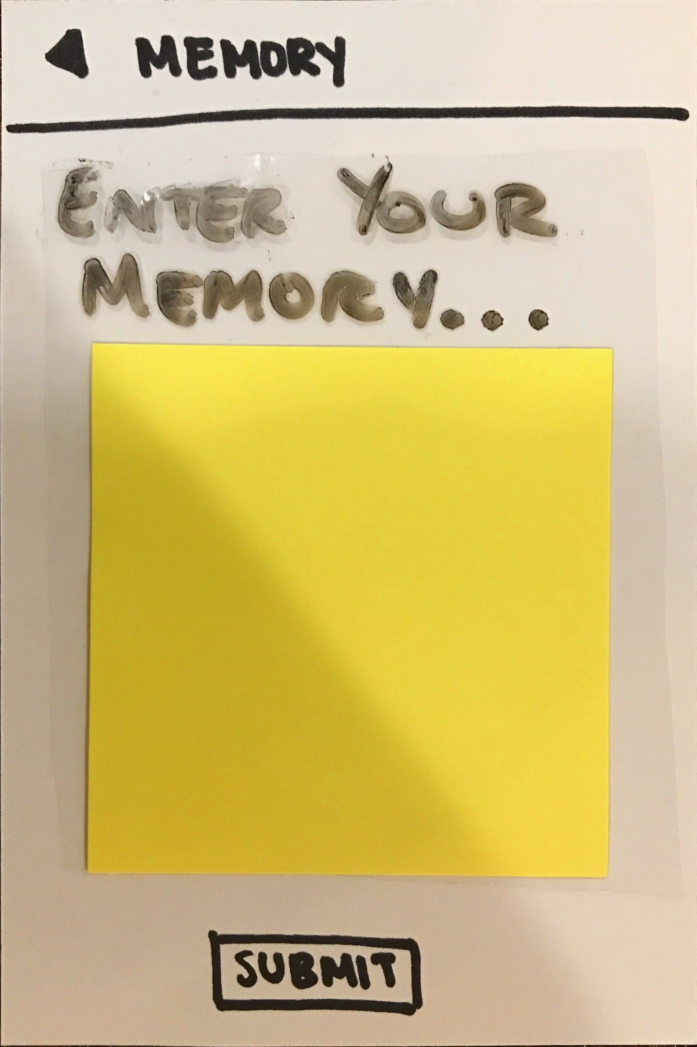
Task #1: Create and save a rechord (song+memory)

Slide 15
Task #1: Create and save a rechord (song+memory)

Slide 16
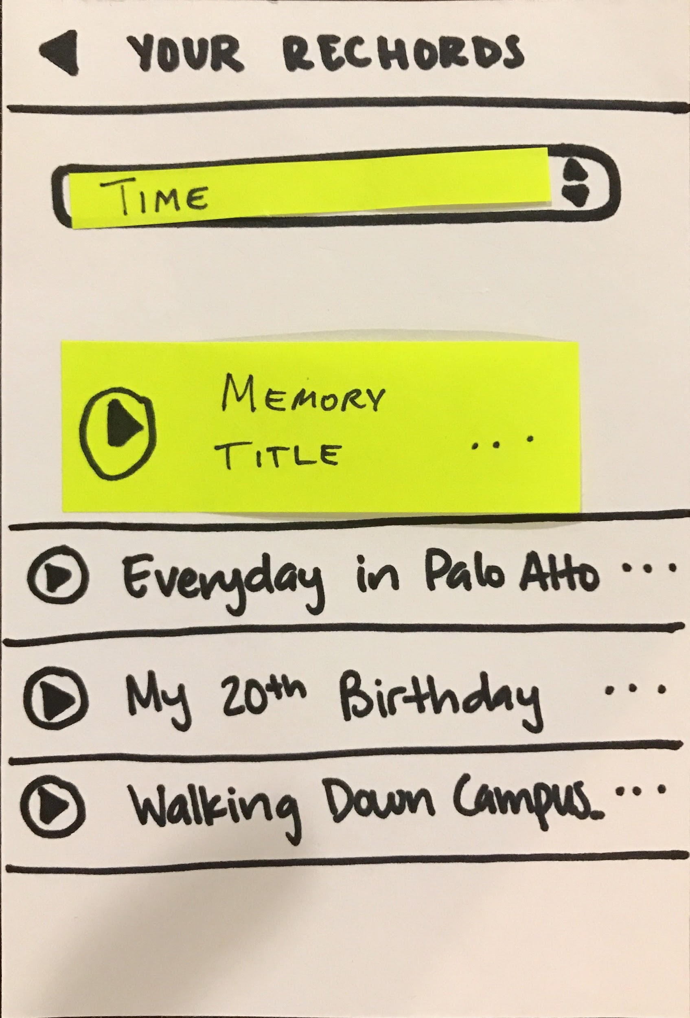
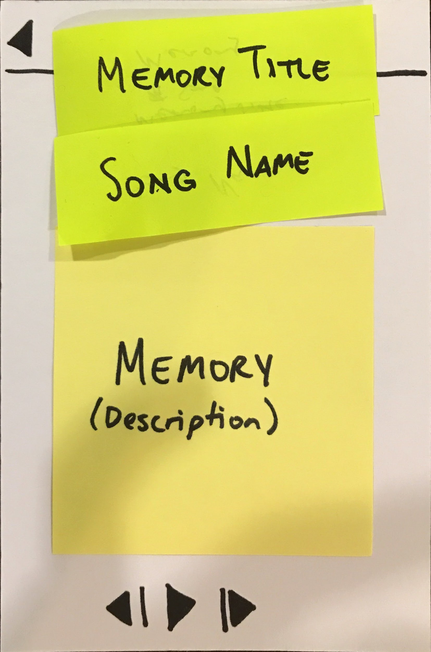
Task #2: View your rechord

Slide 17
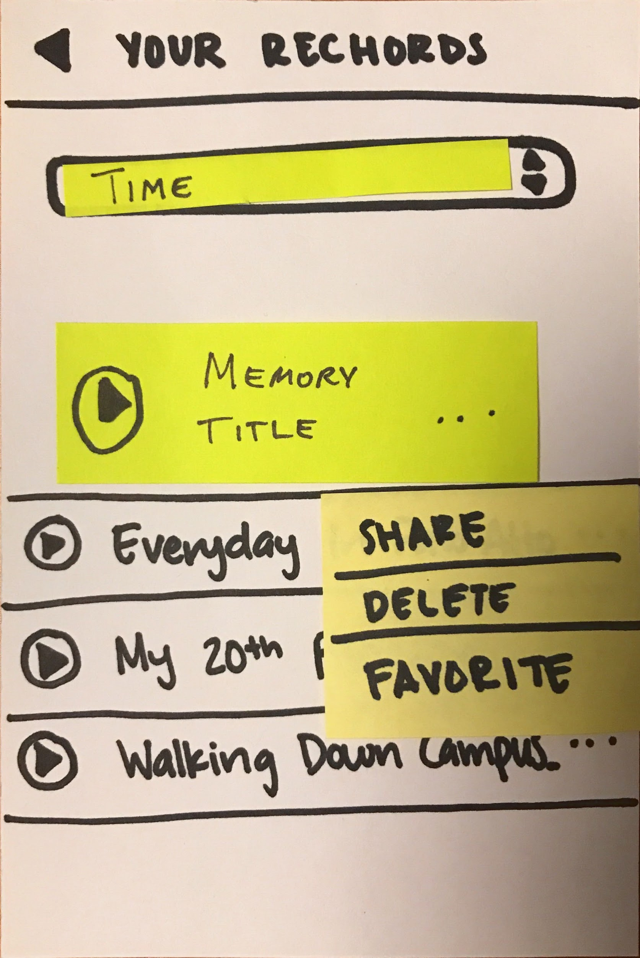
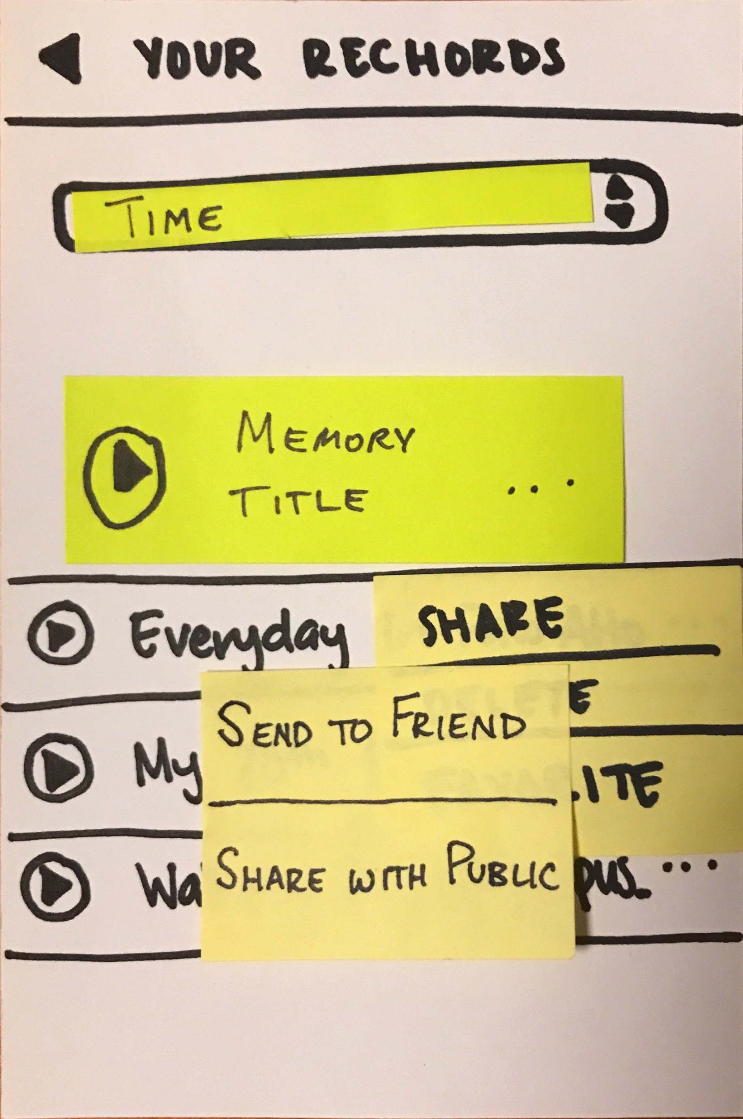
Task #3.1: Share a rechord (w/ friends)

Slide 18
Task #3.1: Share a rechord (w/ the public)

Slide 19
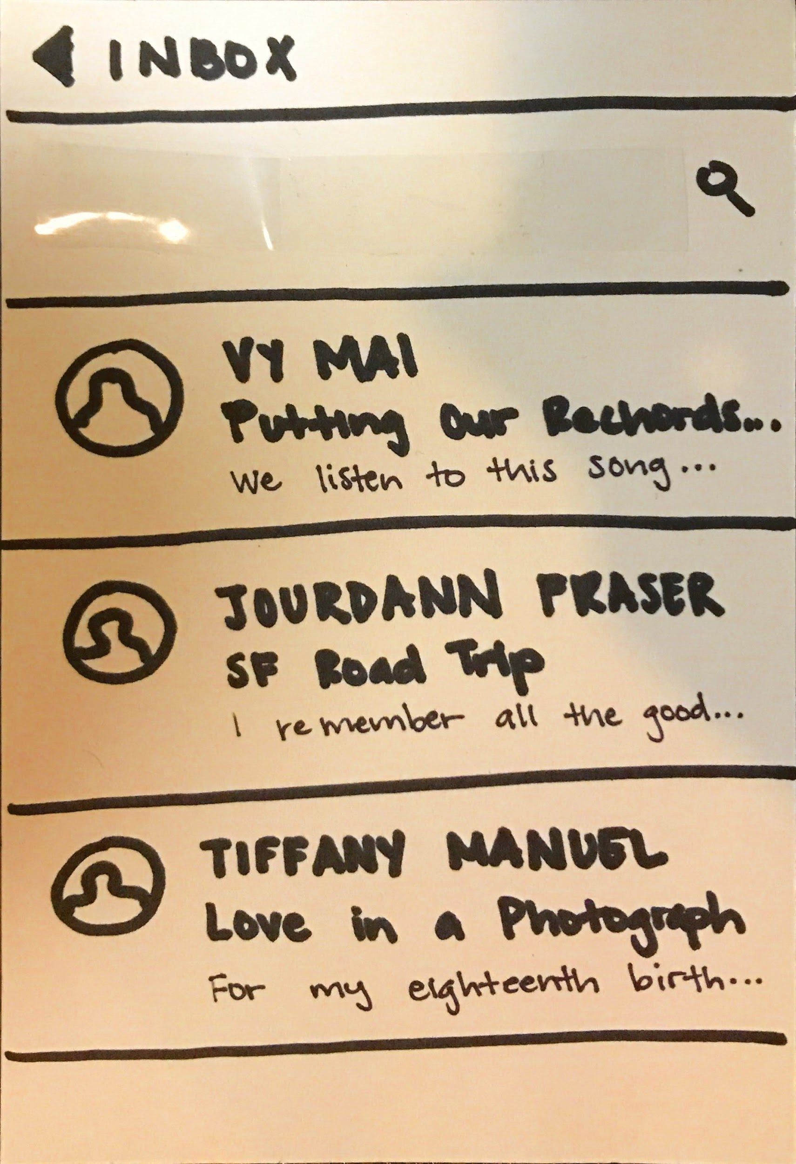
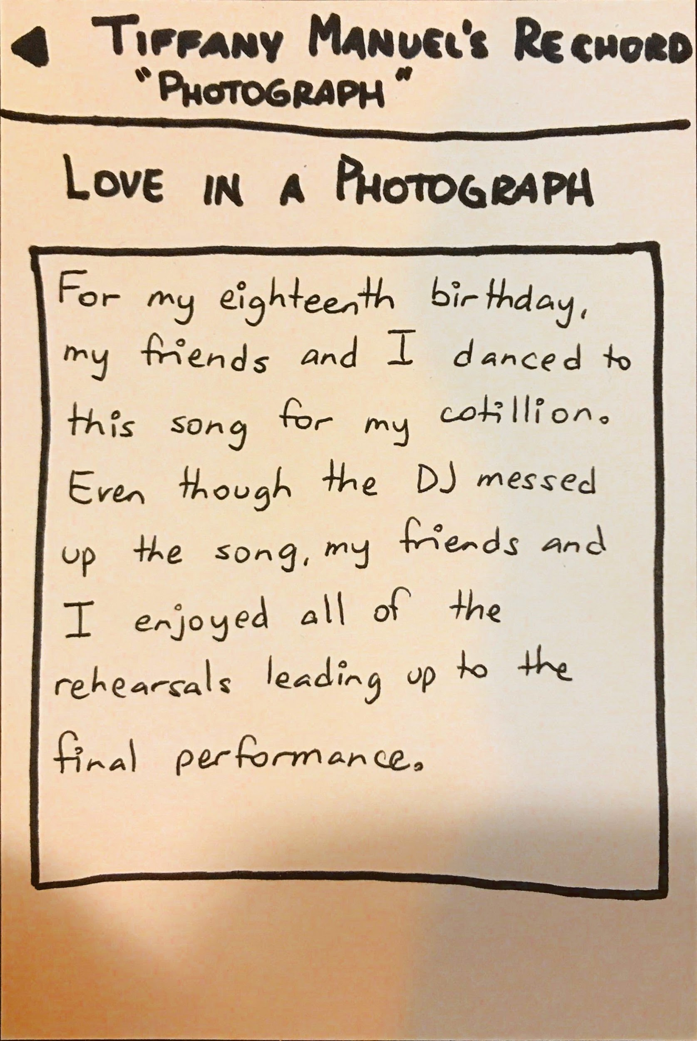
Task #4.1: View others’ rechords (friends)

Slide 20
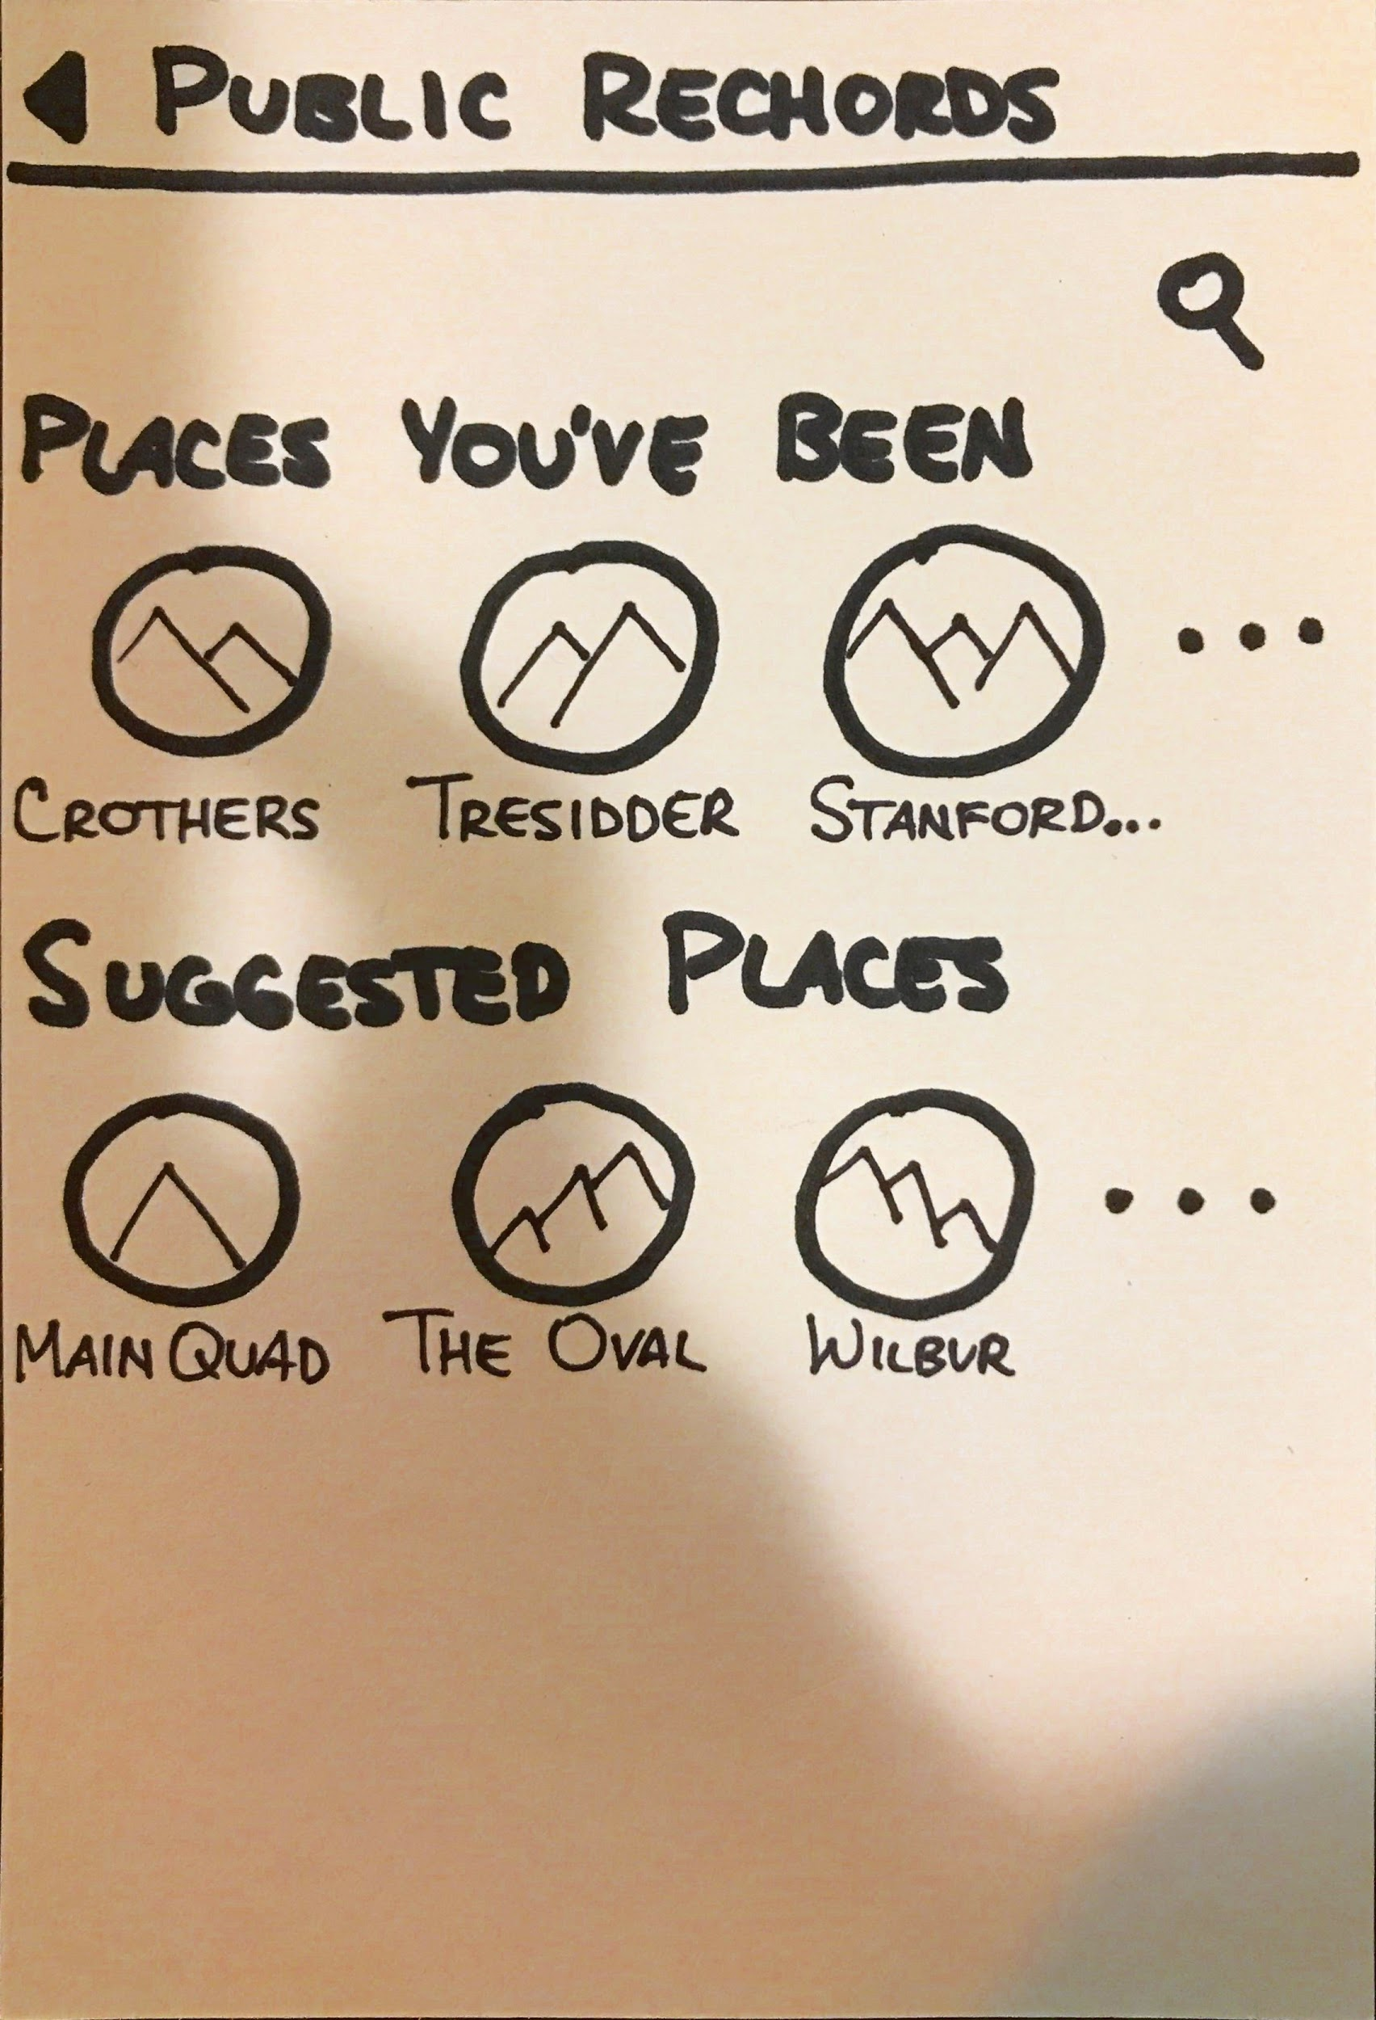
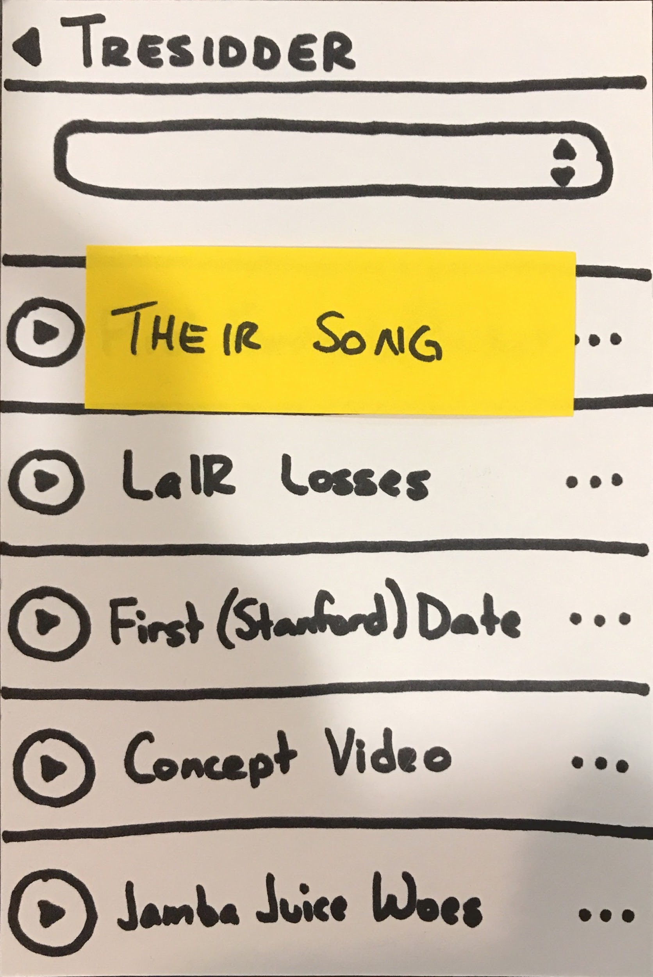
Task #4.2: View others’ rechords (public)

Slide 21
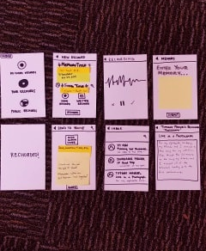
Mission Statement
Selected Interface
Low-Fi Prototype
Three Task Flows
Experiment
Method
Results
UI Changes
Summary

Slide 22
Experiment: Method
Environment/Set-Up
Videotaped prototype interactions
Hid unshown screens
Took note of timing, errors, & successes
Crothers/Tresidder
Procedure
High-level overview
Six tasks
Questionnaire
Interview

Slide 23
Experiment: Method
Participant #1
Musician
Participant #2
Classical Musician
Participant #3
Was listening to music when we approached

Slide 24
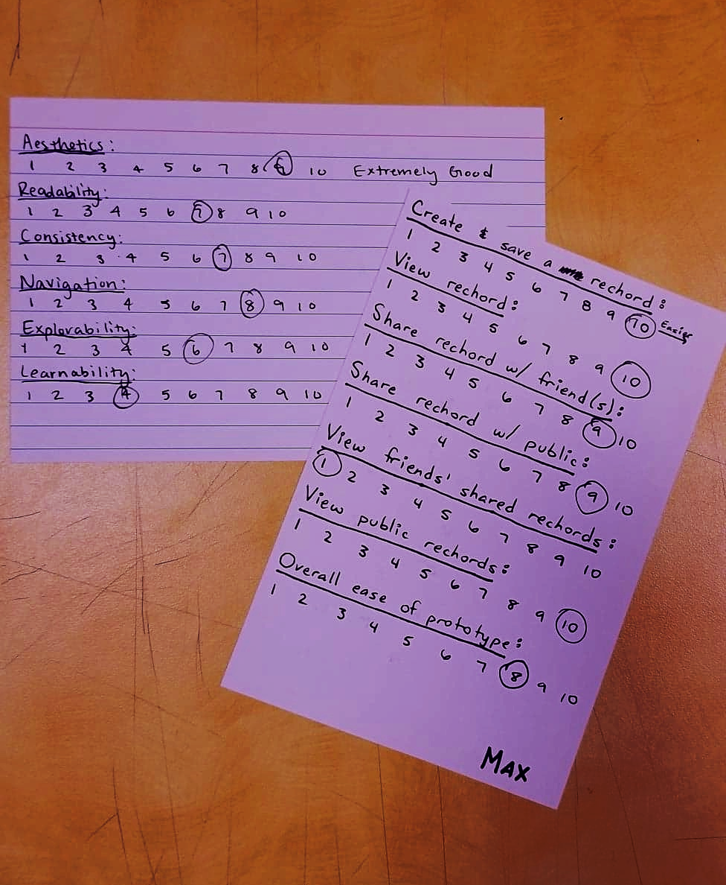
Mission Statement
Selected Interface
Low-Fi Prototype
Three Task Flows
Experiment
Method
Results
UI Changes
Summary

Slide 25
Experiment: Results
Timing
Viewing public rechords completed quickly, as expected

Slide 26
Experiment: Results
Timing
Viewing public rechords completed quickly, as expected
All other tasks took longer than anticipated
Viewing friends’ rechords

Slide 27
Experiment: Results
Timing
Viewing public rechords completed quickly, as expected
All other tasks took longer than anticipated
Viewing friends’ rechords
Some tasks were not completed
Viewing friends’ rechords
Sharing personal rechords

Slide 28
Experiment: Results
Errors
All participants failed to record actual memory
“Memory Title” = memory
Another way to record song

Slide 29
Experiment: Results
Errors
All participants failed to record actual memory
“Rechord Title” = memory
Another way to record song
Participants 2 & 3 clicked “Public Rechords” to share their own memories
Never thought to click the “...”

Slide 30
Experiment: Results
Errors
All participants failed to record actual memory
“Rechord Title” = memory
Another way to record song
Participants 2 & 3 clicked “Public Rechords” to share their own memories
Never thought to click the “...”
All participants had a difficult time realizing that “Inbox” was clickable

Slide 31
Experiment: Results
Successes
All participants were able to find rechord

Slide 32
Experiment: Results
Successes
All participants were able to find rechord
All participants liked concept of app
Enjoyed saving rechord
Connection to song & memory

Slide 33
Experiment: Results
Successes
All participants were able to find rechord
All participants were fond of concept of app
Enjoyed saving rechord
Connection to song & memory
Aesthetics and Navigation

Slide 34
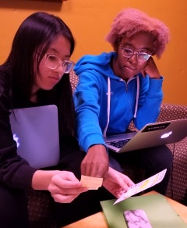
Mission Statement
Selected Interface
Low-Fi Prototype
Three Task Flows
Experiment
Method
Results
UI Changes
Summary

Slide 35
UI Changes
Get rid of inbox

Slide 36
UI Changes
Get rid of inbox
Add “Friends’ Rechords”
“Home” page?
Within “Your Rechords” page?

Slide 37
UI Changes
Get rid of inbox
Add “Friends’ Rechords”
“Home” page?
Within “Your Rechords” page?
Tab Navigation
“New Rechord” as center tab

Slide 38
UI Changes
Get rid of inbox
Add “Friends’ Rechords”
“Home” page?
Within “Your Rechords” page?
Tab Navigation
“New Rechord” as center tab
Change order of “New Rechord” page
Location, Song, Memory Description, Rechord Title

Slide 39
Mission Statement
Selected Interface
Low-Fi Prototype
Three Task Flows
Experiment
Method
Results
UI Changes
Summary

Slide 40
Summary
Users enjoyed connecting songs and memories to create rechord
Users want more emphasis on the main purpose of the project
Labels need to be more clear
Sharing was far too confusing and difficult
Saving rechord took too long because of confusion

Slide 41
Questions?

Slide 42
https://www.google.com/url?sa=i&source=images&cd=&ved=2ahUKEwiw8_ijsZ_eAhXcFTQIHSgBAQYQjRx6BAgBEAU&url=https%3A%2F%2Fwww.pinterest.com%2Fkhrisi%2Frecords-on%2F&psig=AOvVaw0e2ZKujT4zoUZeSyXZvpIW&ust=1540480918061944 (Hand reaching for records)
Target by Gregor Cresnar from the Noun Project
Trophy by Felix Brönnimann from the Noun Project
Prototyping by ProSymbols from the Noun Project
experiment by Dinosoft Labs from the Noun Project
timing by Hugo Heneault from the Noun Project
Error by Roselin Christina.S from the Noun Project
success by Gregor Cresnar from the Noun Project
Idea by Putra Theoo from the Noun Project
abstract by matias porta lezcano from the Noun Project
Bibliography

