Slide 1
RECHORDS
Turn Memories Into Music
Jourdann Fraser
Vy Mai
Tiffany Manuel

Slide 2
SOLUTION OVERVIEW

Slide 3
RECHORDS was created to simplify the task of memory-keeping by tapping into the connections between music, time, and location.

Slide 4
VALUE PROPOSITION

Slide 5
Turn memories into music

Slide 6
VIDEO
STORYBOARD

Slide 7
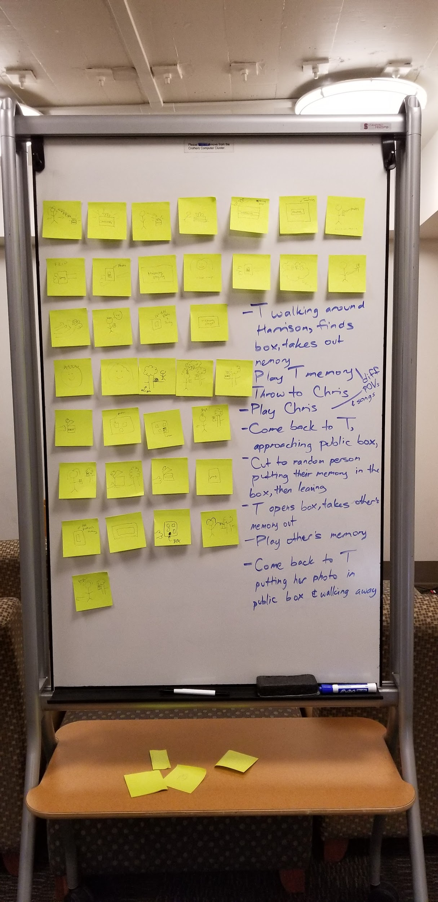

Slide 8
TASK #1
(SIMPLE)

Slide 9
Quickly save meaningful songs to remember
special moments
Notes:
While jet skiing with his girlfriend Sara at Harrison Hot Springs, Will hears a song playing in the background. He wants to save this song on his phone to help him remember this moment.

Slide 10
SCENE #1

Slide 11
Tiffany finishes jet skiing with Chris at Harrison Hot Springs and records her memory by writing a song down on a piece of paper and placing it into her private memory box

Slide 12
TASK #2
(MEDIUM)

Slide 13
Travel back in time and
relive your memories through the power of music
Notes:
Will is in his apartment in Vancouver, missing his girlfriend. He remembers how happy he was when he was jet skiing with his girlfriend, and wants to listen to the song that was playing in the background.

Slide 14
SCENE #2

Slide 15
Tiffany opens the box a few months later and takes out the paper with the song on it, reminding her of her memory

Slide 16
TASK #3
(MEDIUM)

Slide 17
Easily share your
memories with friends
Notes:
Two years later, Sara mentions the time she and Will went jet skiing, making Will want to share the song with her.

Slide 18
SCENE #3

Slide 19
Tiffany tosses this piece of paper to share this memory with Chris

Slide 20
TASK #4
(COMPLEX)

Slide 21
Discover other memories made at the same location
as your’s
Notes:
After listening to the song and remembering his memory, Will is curious to find out what memories other people associate with Harrison Hot Springs. He wants to listen to songs that remind others of Harrison Hot Springs and understand why.

Slide 22
SCENE #4

Slide 23
Tiffany takes out another person’s memory from the public box of memories for Harrison Hot Springs and is able to “experience” this person’s memories

Slide 24
VIDEO

Slide 25
https://youtu.be/3aPqrI1fdZg
Notes:
Two years later, Sara mentions the time she and Will went jet skiing, making Will want to share the song with her.

