Slide 1
WALKING DOWN MEMORY LANE
JOURNAL / MUSIC / AI
PRESENTER:
Vy Mai

Slide 2
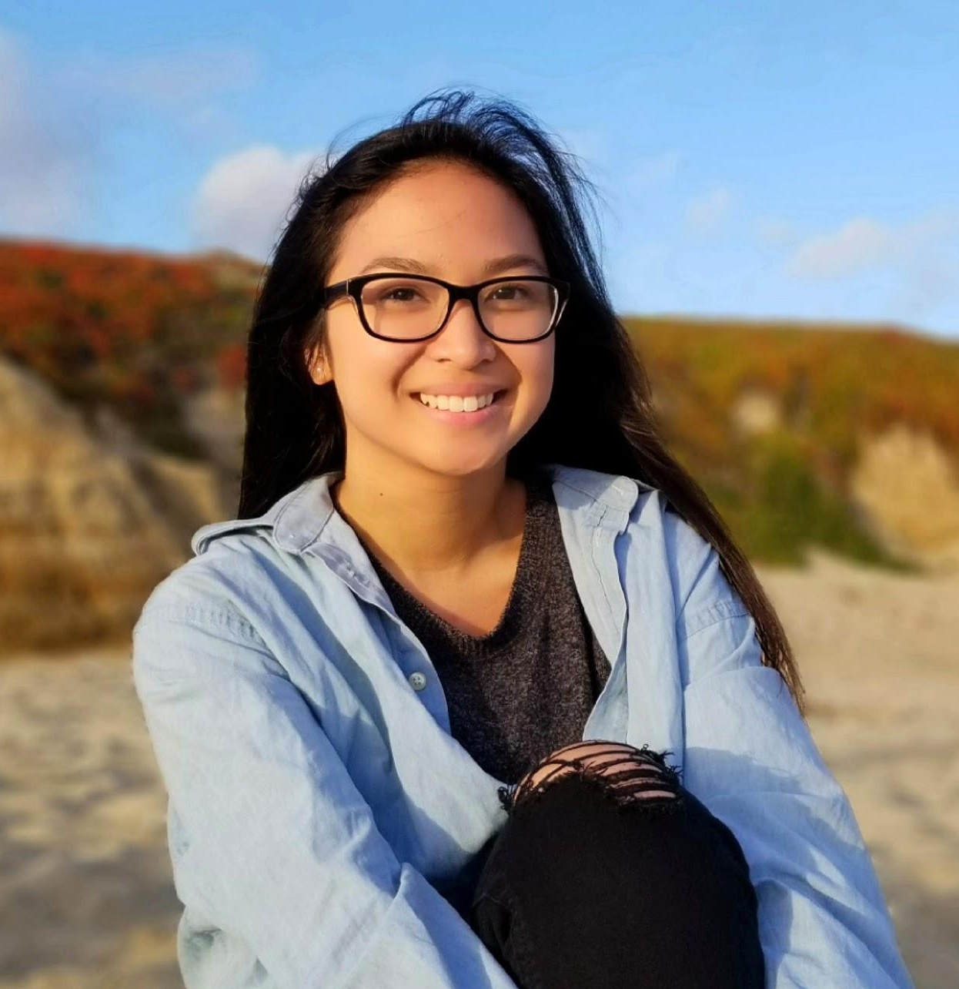
emotional journeys
+
memories as a form of time travel
Vy Mai
Tiffany Manuel
Jourdann Fraser

Slide 3
initial POV

Slide 4
WE MET...
WE WERE AMAZED TO REALIZE...
IT WOULD BE GAME CHANGING TO...
Jiamin, who defines “strong memories” as memories that are associated with strong emotions/feelings
that her favorite place gives her the same feeling that she experienced during her favorite memory
help her connect other strong feelings to other places/memories
Notes:
We met Jiamin. She believes that strong memories are linked to her strongest emotions, what she feels in the moment will make the memory stick.

Slide 5
actively records memories
have trouble remembering
vs
Notes:
We thought it would be game-changing to help her connect other strong feelings to places.

Slide 6
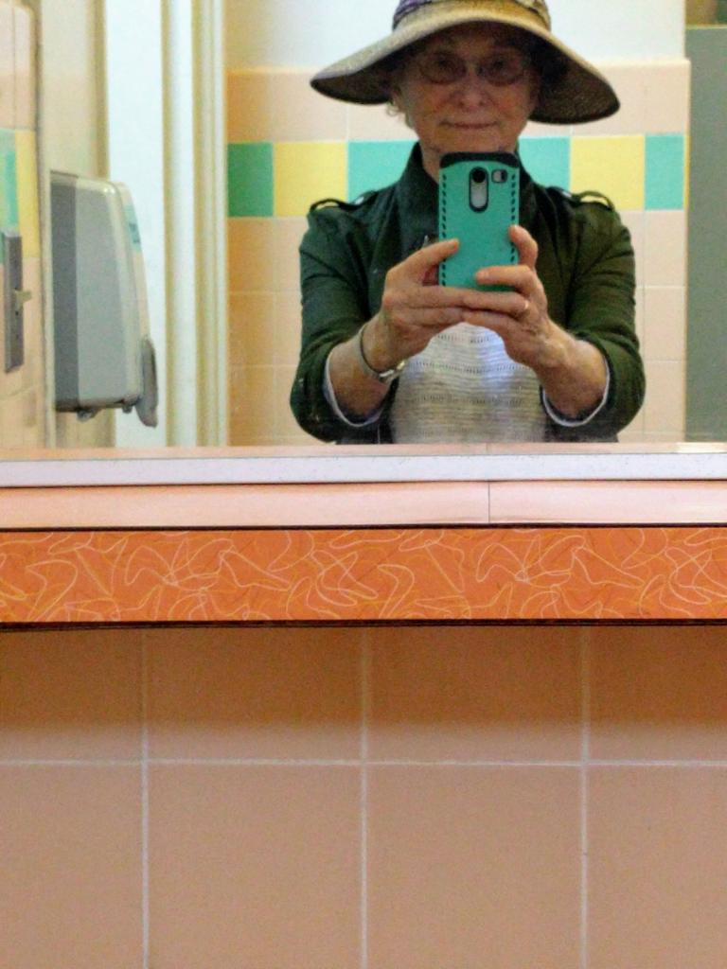
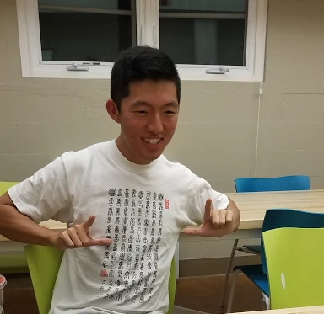

meet our interviewees
Joyce Beattie
Sharon Liu
Cary Huang
Notes:
juhmeen

Slide 7
moved 7 times in the past 6 years
gradual memory loss
Joyce Beattie
Notes:
Due to a constant change in environment, her memory loss worsens.
75 year old Palo Alto resident
suffers from gradual memory loss
has moved 7 times in the past 6 years
doesn’t remember bus routine

Slide 8
Her aunt has Alzheimer’s
reminds aunt through WeChat
Sharon Liu
*preferred to not be photographed

Slide 9
YouTuber/vlogger
loves looking at past photos
and videos
Cary Huang
Notes:
75 year old Palo Alto resident
suffers from gradual memory loss
has moved 7 times in the past 6 years
doesn’t remember bus routine

Slide 10
revised POVs

Slide 11
WE MET...
WE WERE AMAZED TO REALIZE...
IT WOULD BE GAME CHANGING TO...
Cary, a YouTuber who enjoys re-watching his vlogs about his daily life
he doesn’t use other social media platforms (i.e Facebook and Twitter) because it was difficult to navigate to older memories
give people an easy way to access their memories from the past
Notes:
We met Jiamin, who remembers memories with strong emotions the most.

Slide 12
WE MET...
WE WERE AMAZED TO REALIZE...
IT WOULD BE GAME CHANGING TO...
Jiamin, a millennial that does not use social media
that despite wanting to capture her memories, she would rather be more present and in the moment than take a second to snap a photo
give her a non-disruptive, or even hands-free, way to capture her memories
Notes:
We met Jiamin, who remembers memories with strong emotions the most.

Slide 13
WE MET...
WE WERE AMAZED TO REALIZE...
IT WOULD BE GAME CHANGING TO...
Will, a Filipino-American that lives in San Francisco
that his favorite place in San Francisco gives him the same feeling that he experienced during his favorite memory, watching fireworks in the Philippines as a child
help him discover more places in San Francisco that remind him of home
Notes:
We met Jiamin, who remembers memories with strong emotions the most.

Slide 14
how might we...
make revisiting memories a personal learning experience?
(Cary’s POV)
find a new way of capturing memories, focusing on our senses? (Cary’s POV)
create an interactive/hands-free way to help you feel more in the moment while capturing a memory? (Jiamin’s POV)

Slide 15
SOLUTIONS?
Notes:
Create a journal that allows users to look back at their past memories and relate them to their present selves (HMW #1)
Make a public playlist that allows people to associate music, memories, and places (HMW #2 )
Collect photos from friends, family, security cameras, and satellites, using face recognition to gather relevant photos for the user (HMW #3 - DARK HORSE IDEA)

Slide 16
initial assumptions
people want to revisit old memories and hear advice from their past self
Notes:
We assumed that people associate music and memories to places (Assumption #1).
We also assumed that people would enjoy reading memories from other users and listening to songs others associate with a place (Assumption #2).

Slide 17
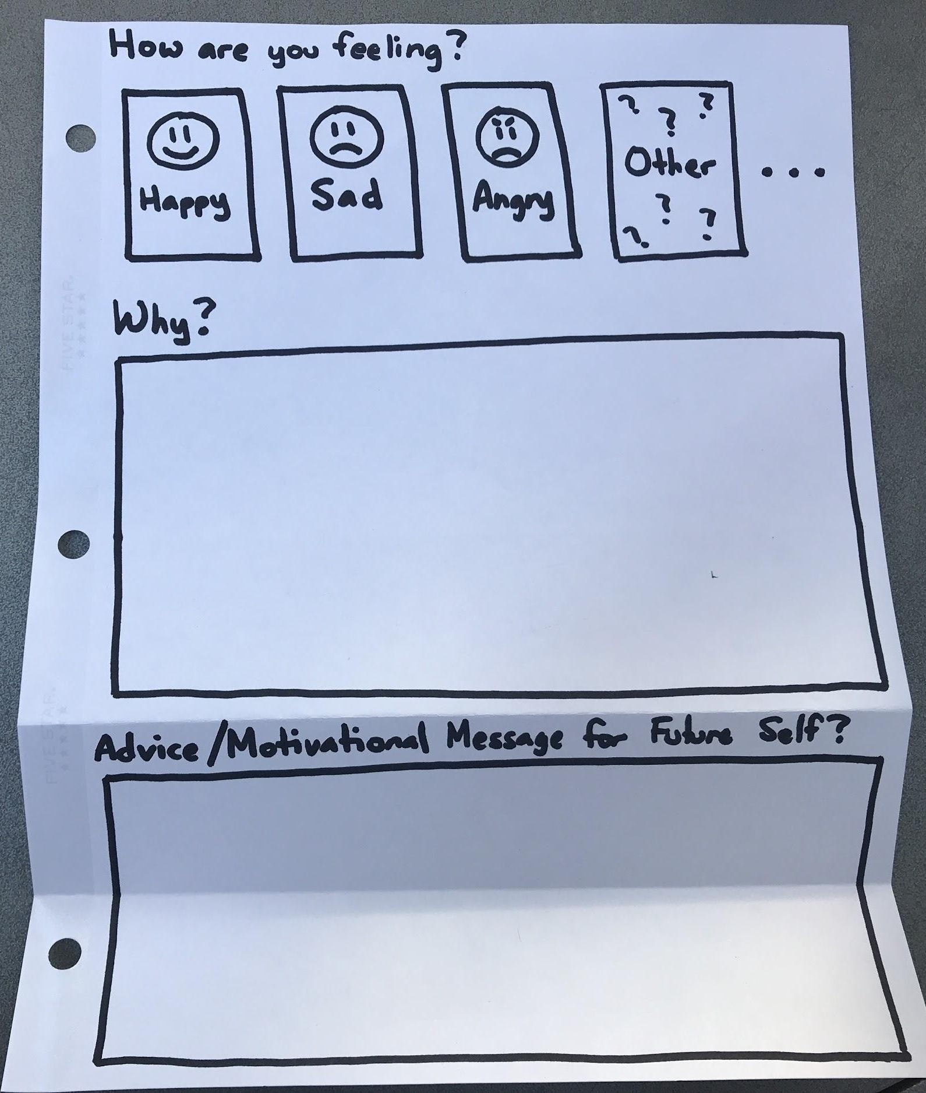
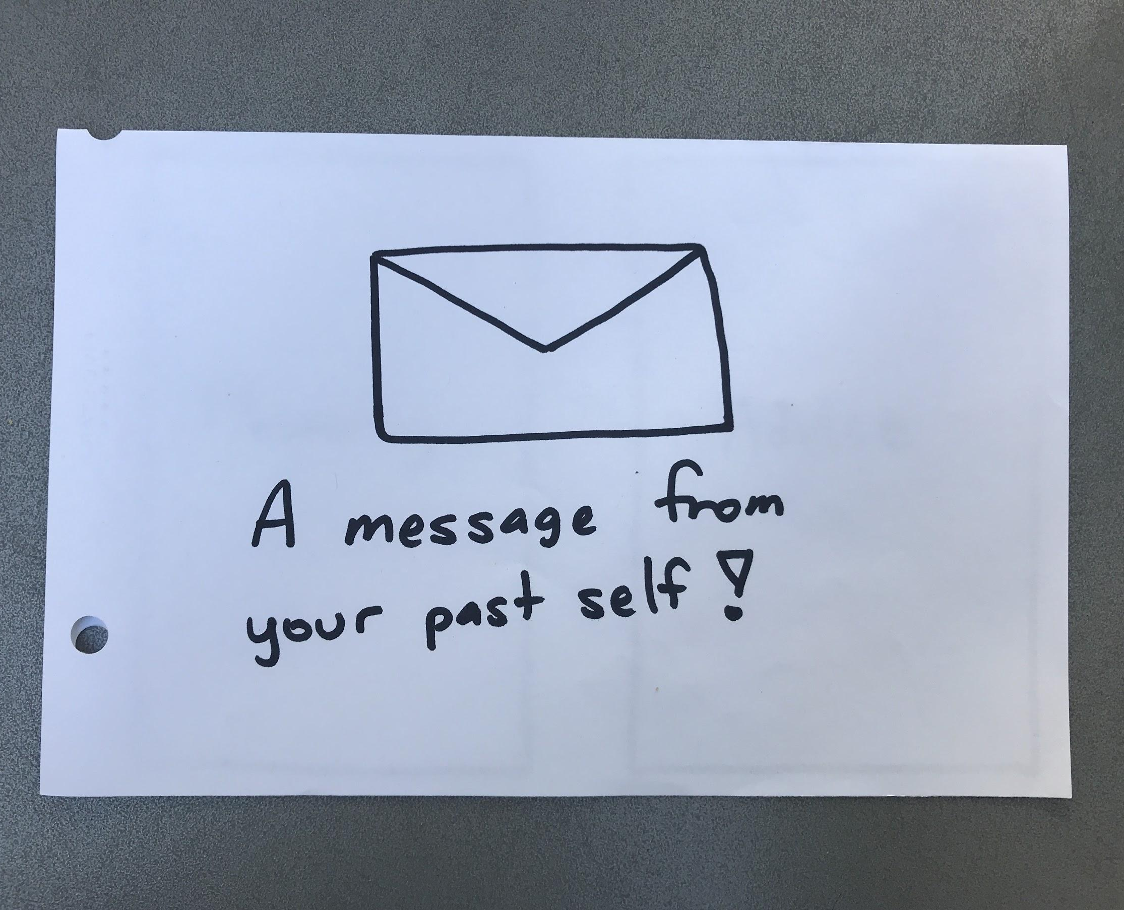
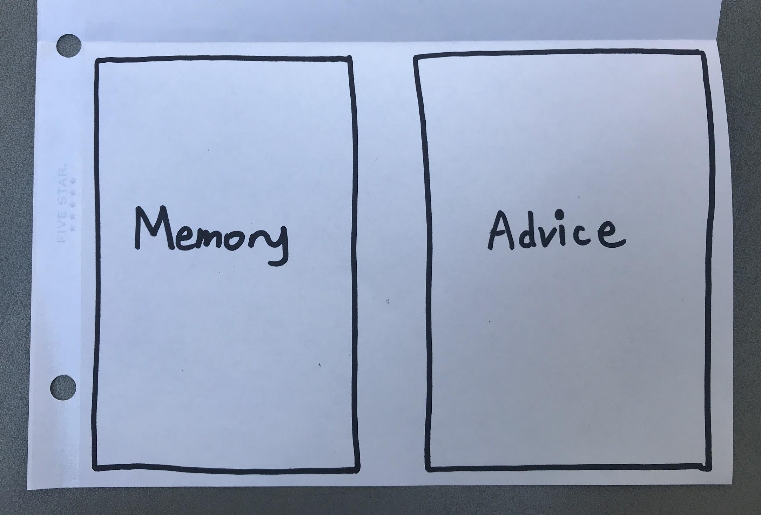
THE TIME TRAVEL JOURNAL
Notes:
We created a paper prototype that allowed users to select an emotion and then explain why they chose that emotion. If the user chose “sad” or another negative emotion, we would ask them to leave advice for their future self. Then, the user would receive a message with a similar negative memory and advice from their past self. If the user chose “happy” or a positive emotion, we would simply share another positive memory.
We assumed that people want to look back on their memories (Assumption #1).
We also assumed that advice from their past self could guide them through a negative experience or remind them that they have persevered through similar negative experiences before (Assumption #2)

Slide 18
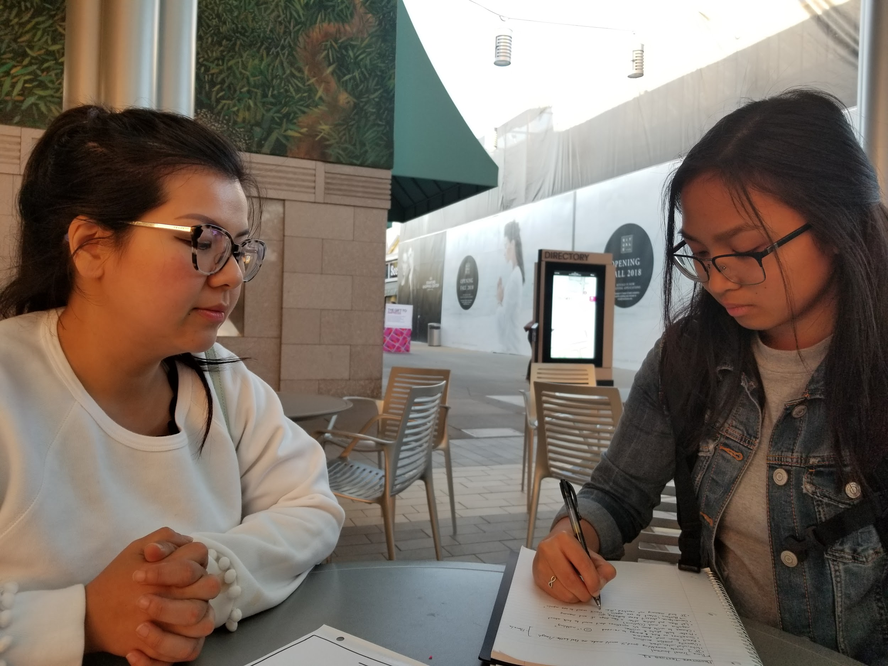
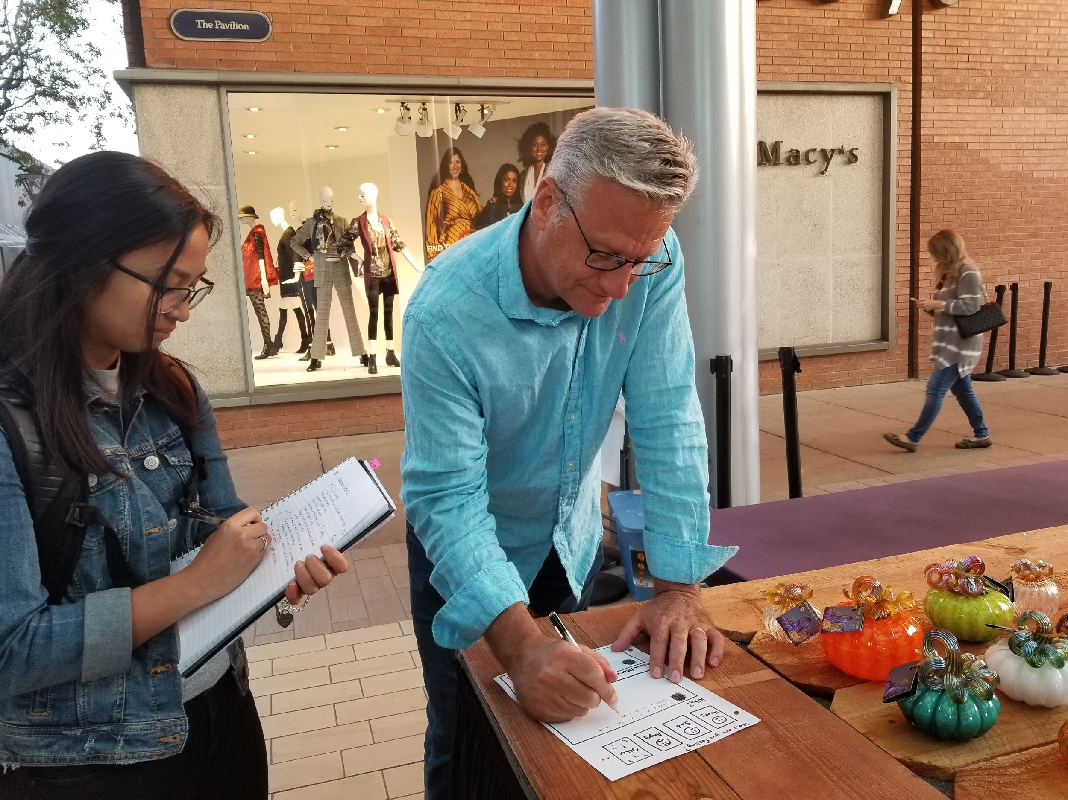
THE TIME TRAVEL JOURNAL
PROS
------------------------------
enjoyed reading positive memory
past advice is helpful

Slide 19
THE TIME TRAVEL JOURNAL
– CONS
------------------------------
don’t ask for advice right away
time-consuming
need pictures

Slide 20
THE TIME TRAVEL JOURNAL
! SURPRISES
------------------------------
inclusion of all memories
vs
exclusion of negative memories

Slide 21
THE TIME TRAVEL JOURNAL
NEW LEARNINGS
------------------------------
negative memories may not be helpful
&
timing of advice is crucial

Slide 22
new assumptions
people want a “happy sad happy” sandwich of memories
journaling is too time consuming

Slide 23
initial assumptions
people associate music and memories with places
people would like to read memories from others
Notes:
We assumed that people associate music and memories to places (Assumption #1).
We also assumed that people would enjoy reading memories from other users and listening to songs others associate with a place (Assumption #2).

Slide 24
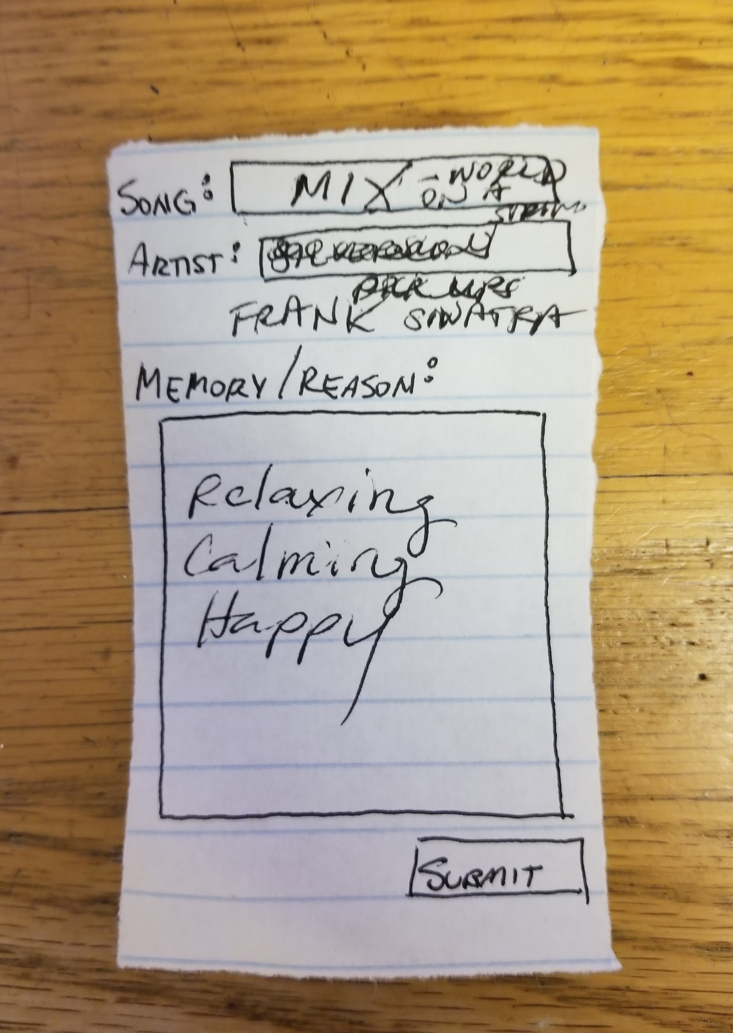
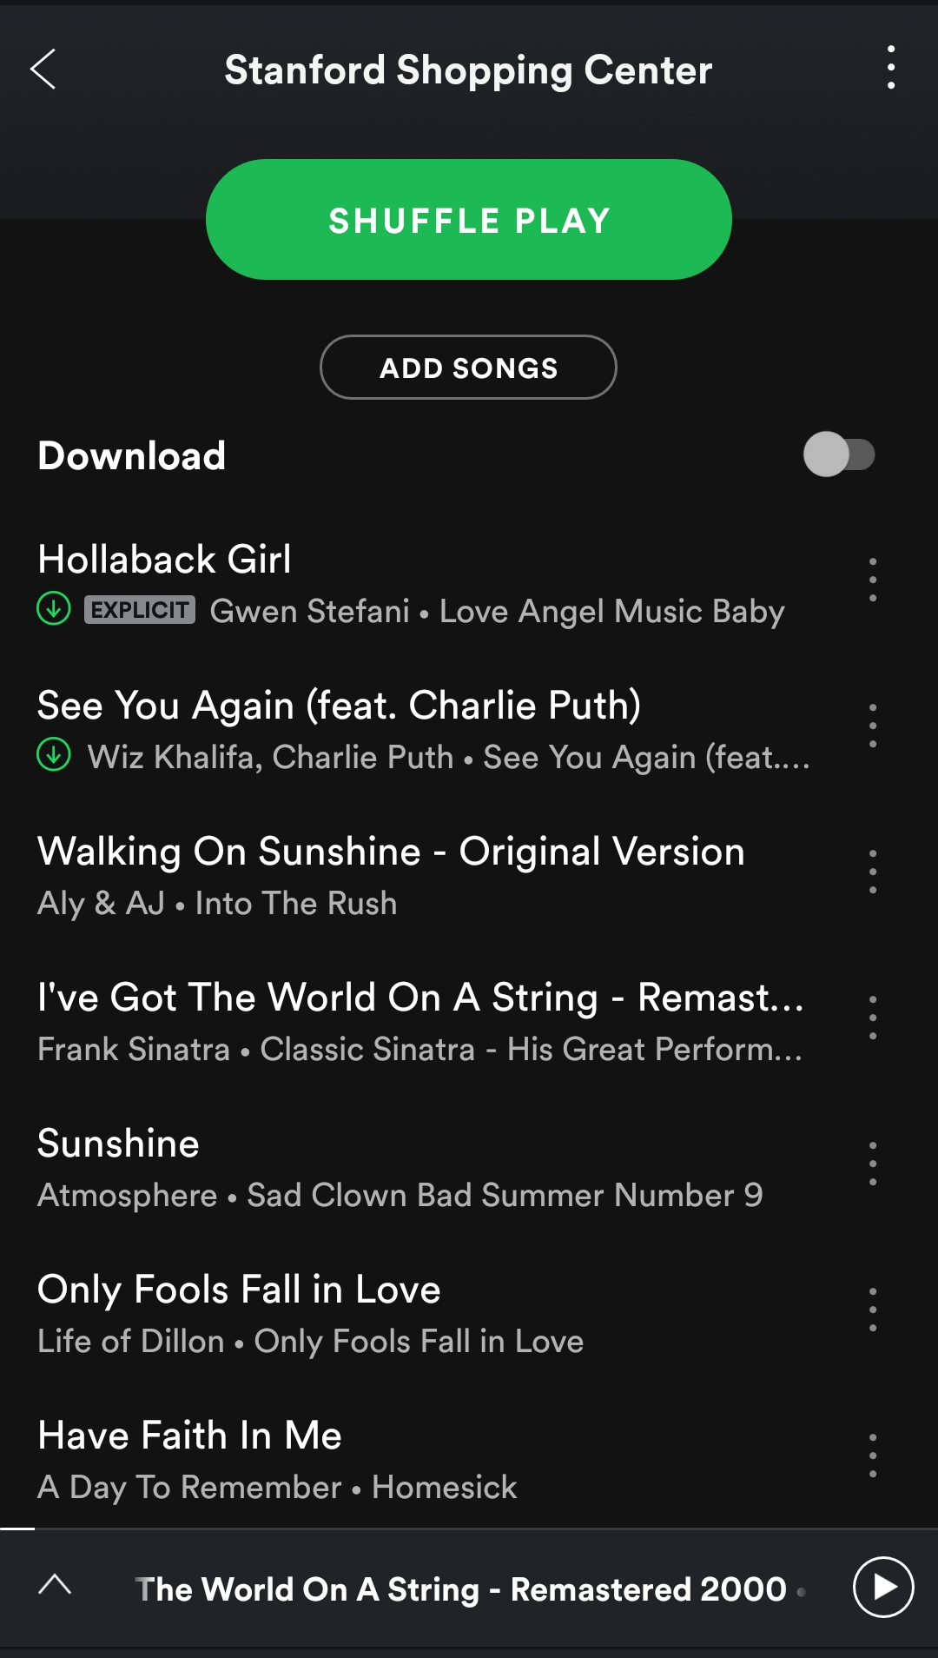
WALKING DOWN MUSIC LANE
Notes:
We simulated a playlist-making app using paper and Spotify. We first had the testers write a song they associated with their current location and then the reason behind their choice. After “submitting” their entry, they were given a playlist of songs that others associated to the place. If they clicked on a song, they were presented with the reason/memory associated with it.

Slide 25
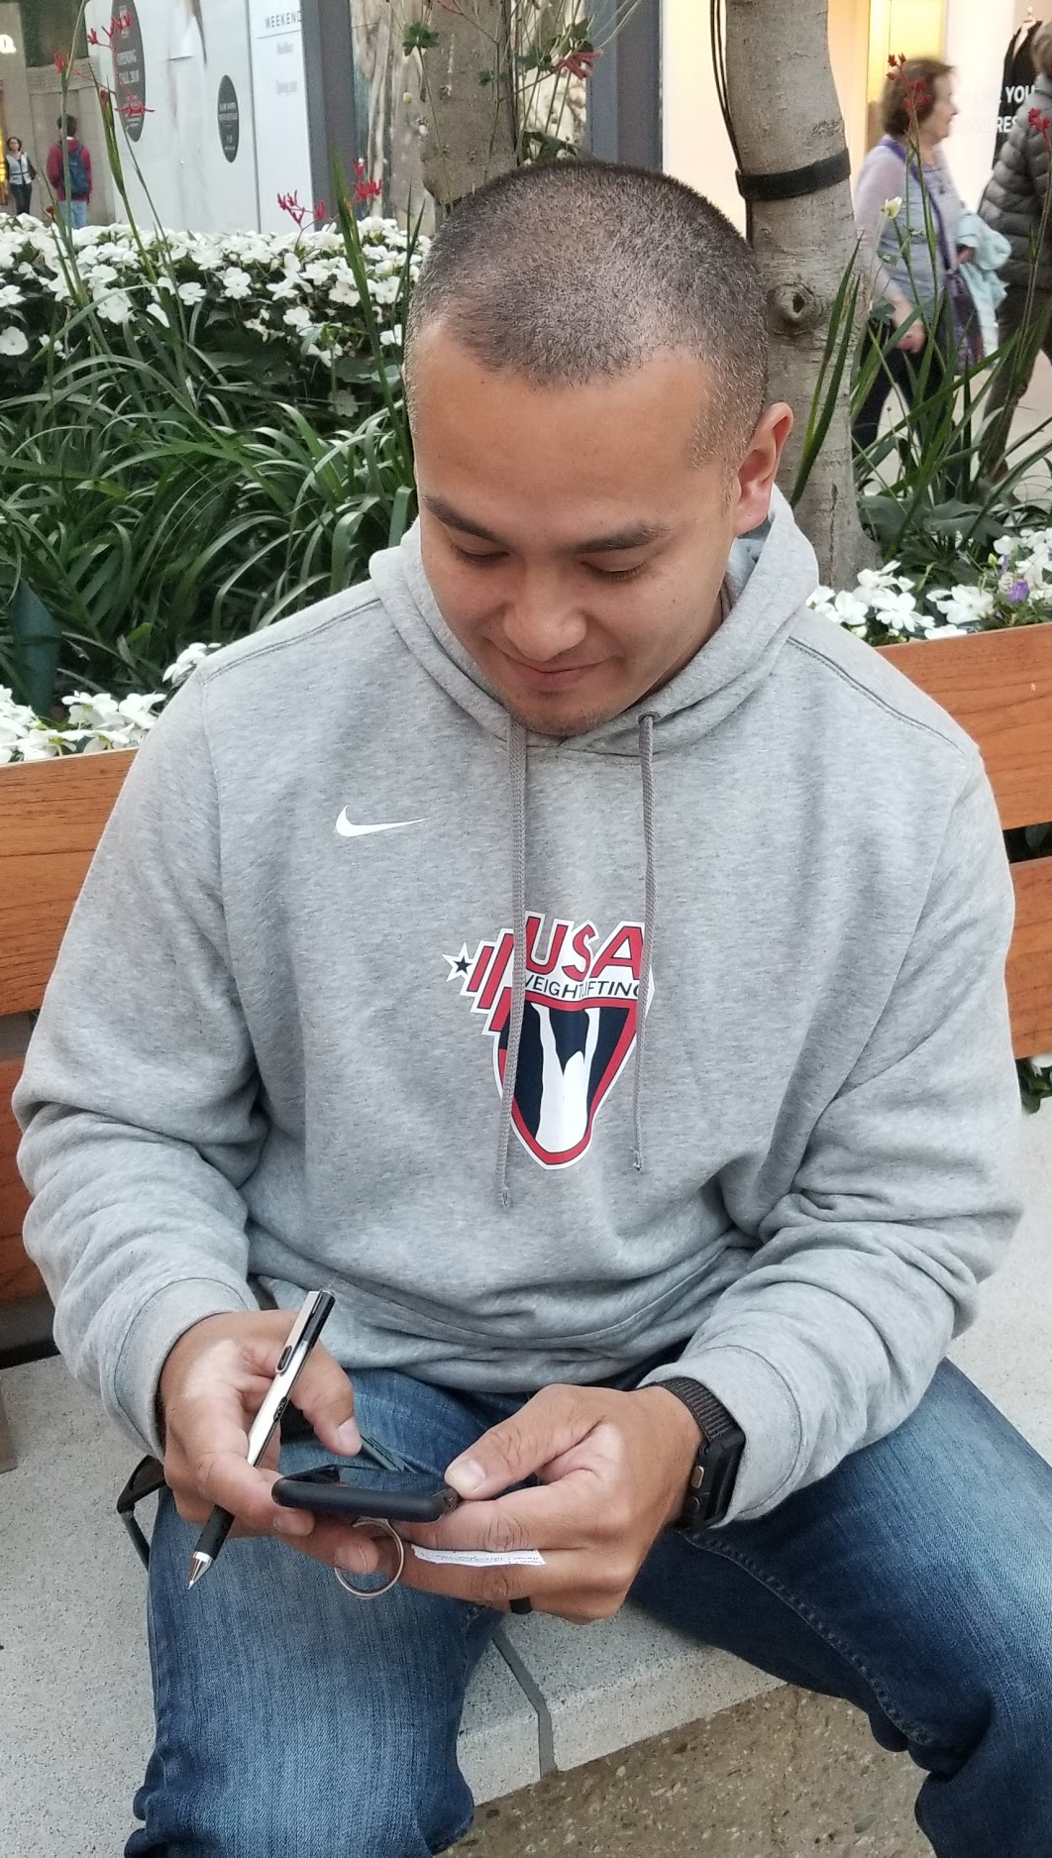
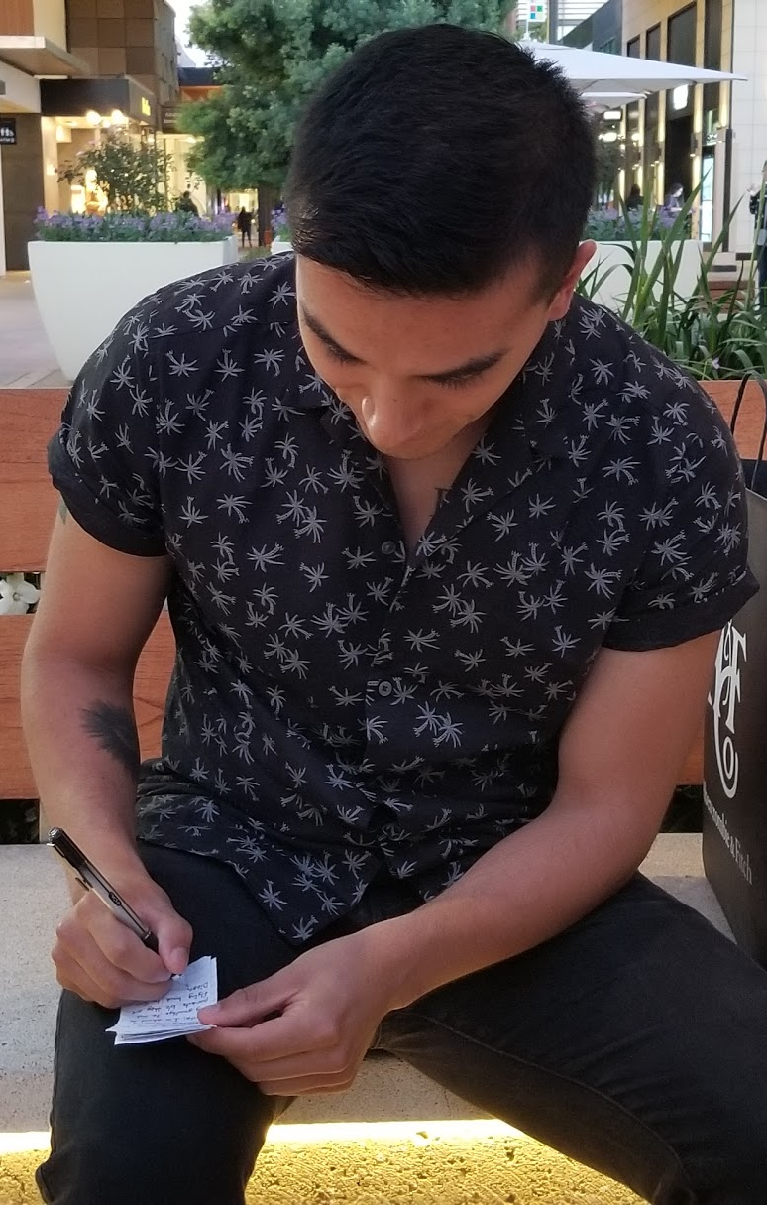
WALKING DOWN MUSIC LANE
PROS +
everyone loved it
easy to understand
intuitive idea
enjoyed reading other’s memories

Slide 26
WALKING DOWN MUSIC LANE
– CONS –
narrow down choice with genre
Notes:
help users narrow down song choices by providing options of genres tied to the place or time of day

Slide 27
WALKING DOWN MUSIC LANE
! SURPRISES !
“meter of feelings”

Slide 28
WALKING DOWN MUSIC LANE
NEW LEARNINGS
people associate music “moods” with locations

Slide 29
WALKING DOWN MUSIC LANE
new assumptions
a friend playlist > public playlist
people prefer more meaningful stories

Slide 30
initial assumptions
people wouldn’t be okay with AI filtered photos
people would like attaching specific emotions to pictures
Notes:
We wanted to test the assumption that people wouldn’t be okay with photos being recognized by AI (Assumption #1)
We also assumed that it would not be a hassle to sort photos by emotions (Assumption #2).

Slide 31
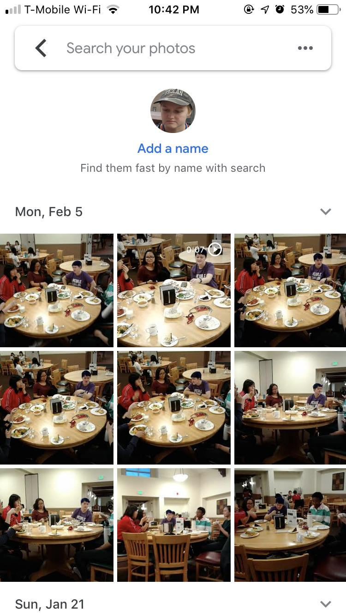
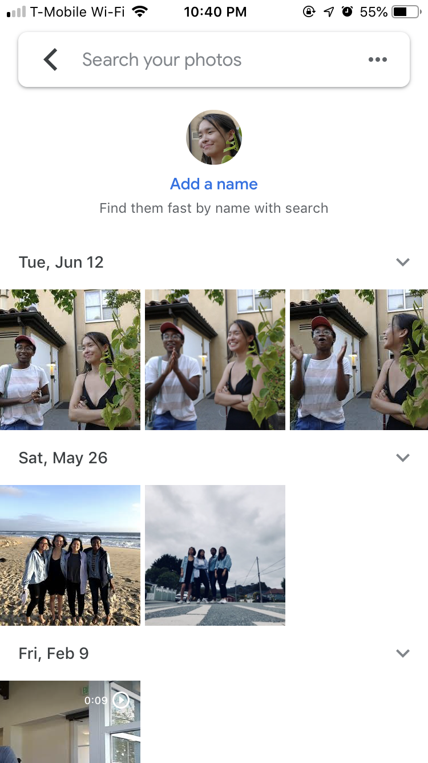
DARK (HORSE) MEMORIES
Notes:
Because we had to create a personalized album, we tested this prototype on two of our friends, one being Jiamin, whose needfinding interview inspired this solution. For each person, the personalized album had pictures of the user from friends, filtered using Google Photos AI. We then asked them to associate one emotion to each photo.

Slide 32
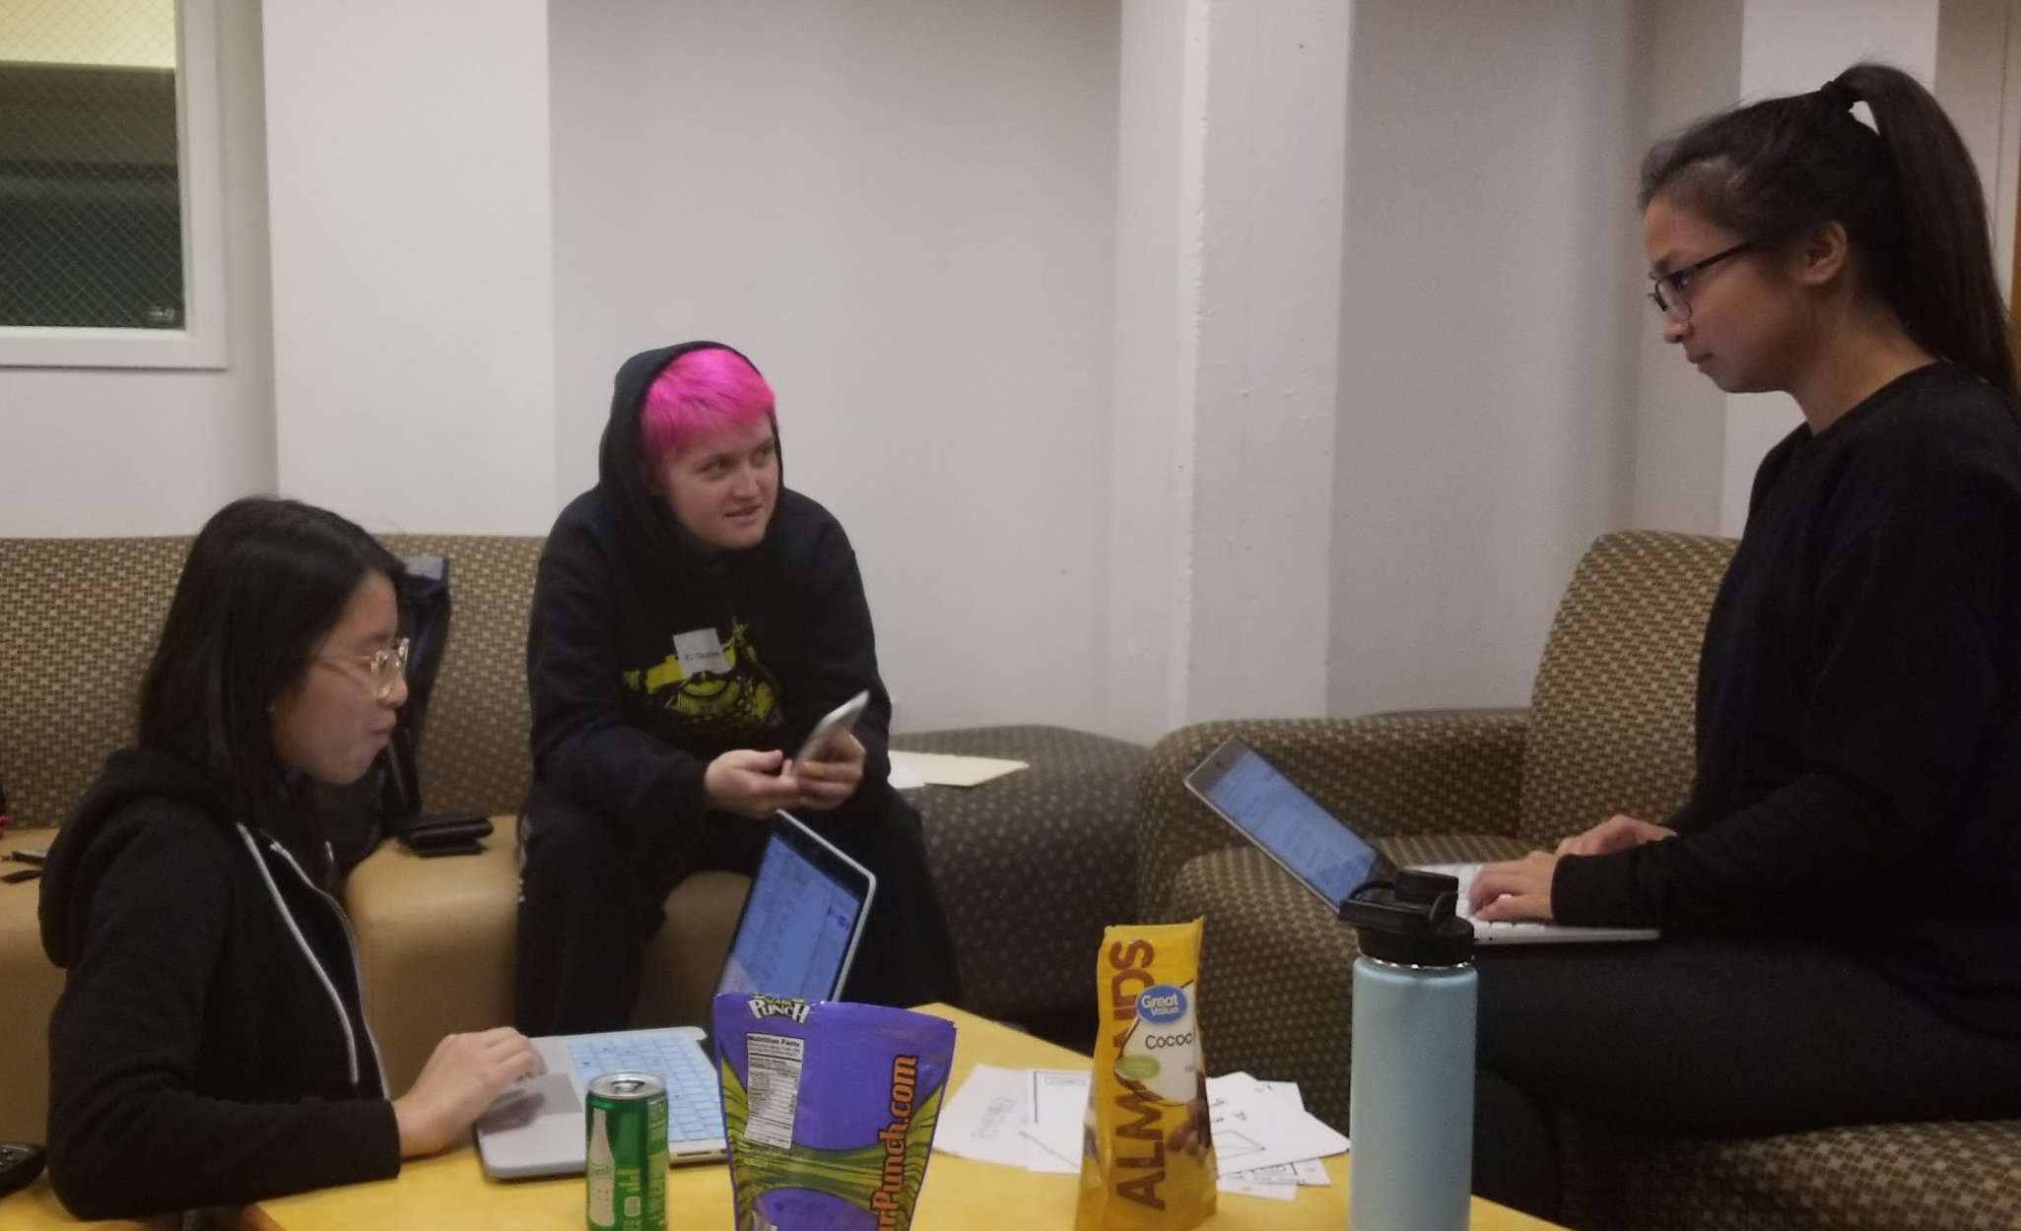
DARK (HORSE) IDEA
PROS +
reflection on photos

Slide 33
DARK (HORSE) IDEA
– CONS –
concerns with use of security cameras and satellites
privacy issues
Notes:
help users narrow down song choices by providing options of genres tied to the place or time of day

Slide 34
DARK (HORSE) IDEA
! SURPRISES !
Jiamin would not use the final product
Notes:
Jiamin clearly expressed that she would not be a user of this app for it would “turn everything into a photoshoot,” just like Instagram

Slide 35
DARK (HORSE) IDEA
NEW LEARNINGS
people would prefer friend-sourcing
prefer a private archive

Slide 36
DARK (HORSE) MEMORIES
new assumptions
people don’t want to look at photos from certain times in their past
people want to be able to “block” memories
Notes:
People want to have more emotions attached to photos. People want to be able to “block” memories (don’t want to reminisce. Private archive would encourage people to use. Photos would not look at from a certain time period

Slide 37
BEST PROTOTYPE?
Notes:
Create a journal that allows users to look back at their past memories and relate them to their present selves (HMW #1)
Make a public playlist that allows people to associate music, memories, and places (HMW #2 )
Collect photos from friends, family, security cameras, and satellites, using face recognition to gather relevant photos for the user (HMW #3 - DARK HORSE IDEA)

Slide 38


BEST PROTOTYPE?
WALKING DOWN MUSIC LANE!!!

Slide 39
Questions?

