Slide 1
Time, Space, and Emotion
Jourdann Fraser
Tiffany Manuel
Vy Mai
Notes:
Emotional journeys, memories in the form of time travel, and location/surroundings

Slide 2
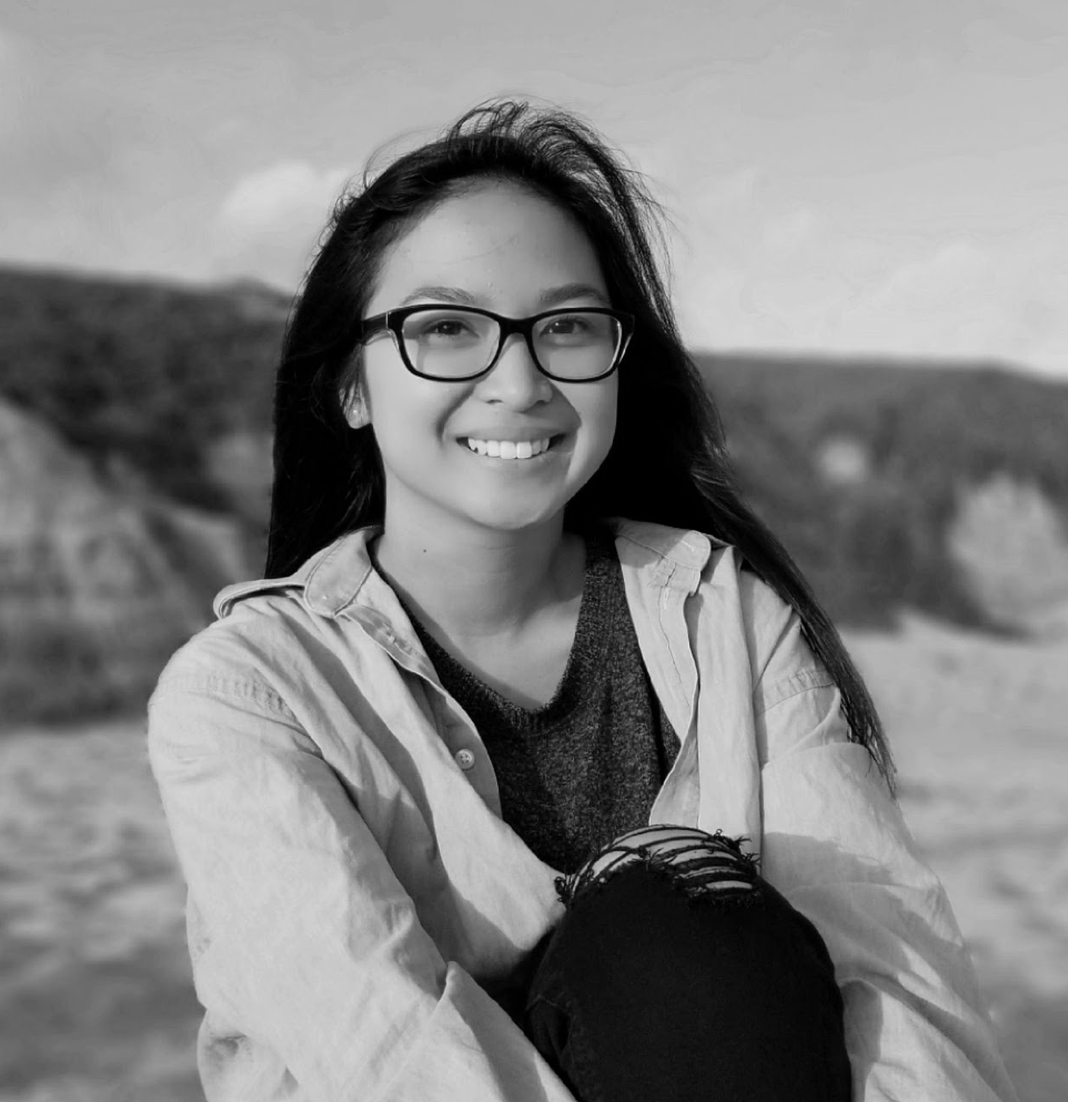
Meet the Squad
Vy Mai
Tiffany Manuel
Jourdann Fraser

Slide 3
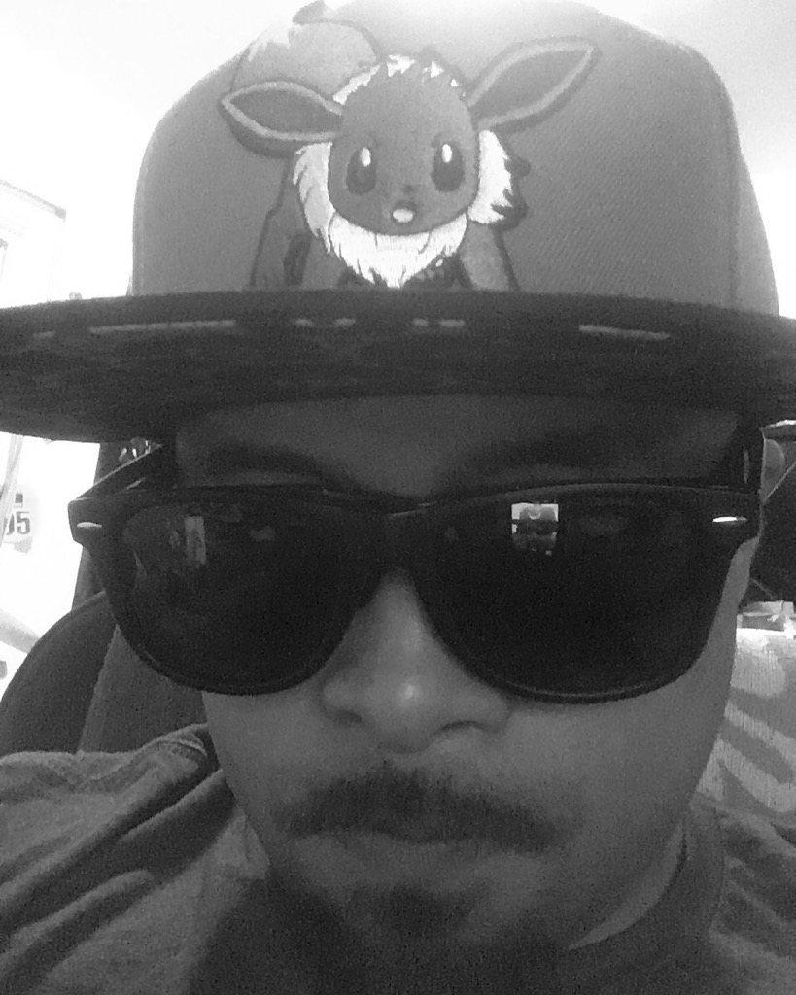

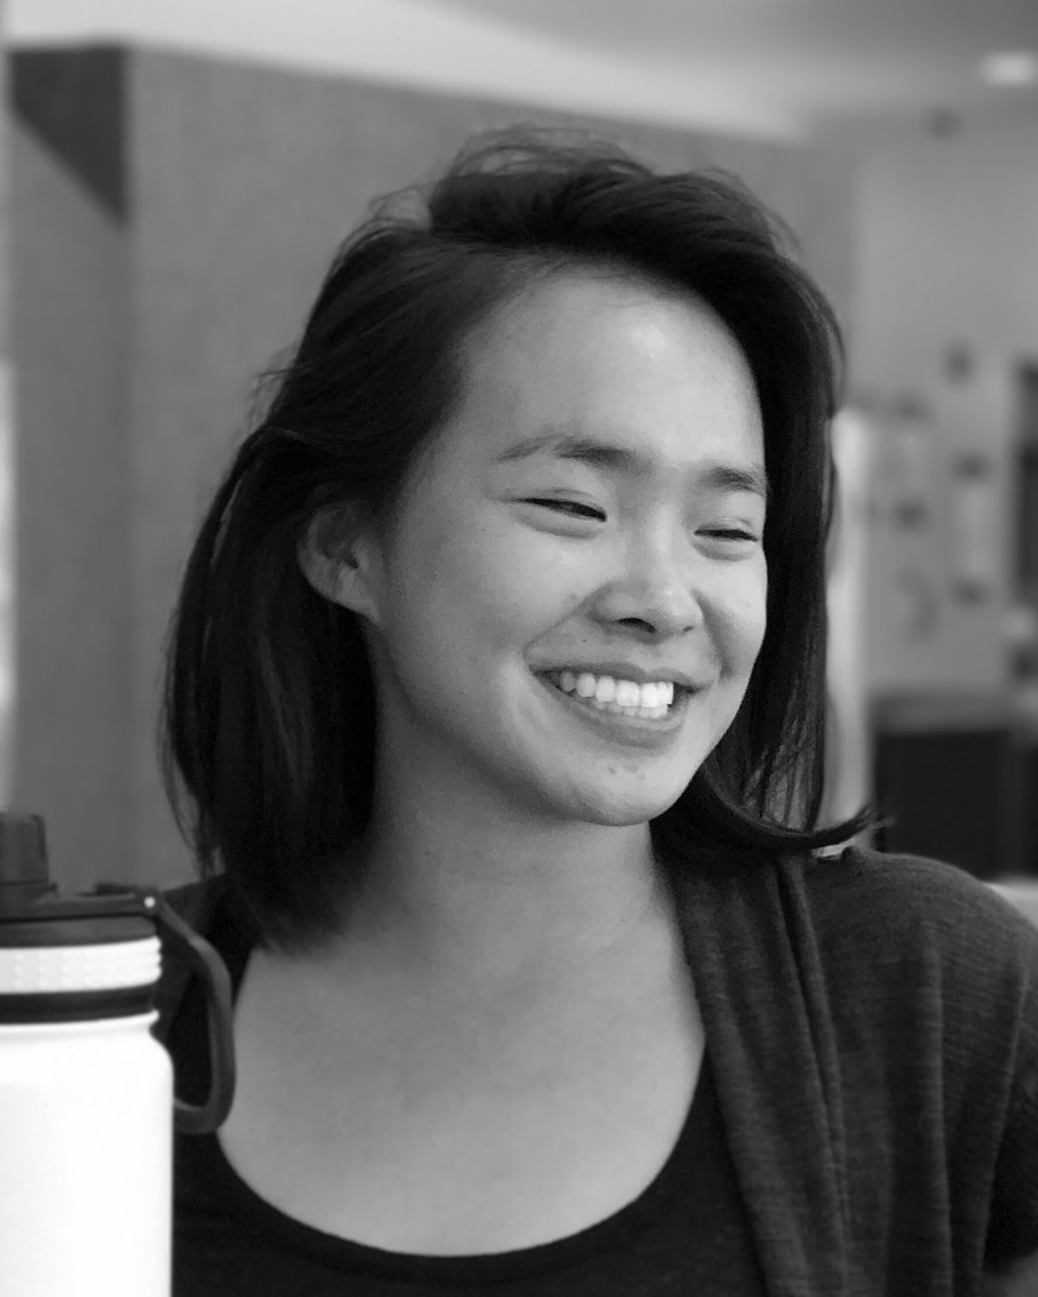
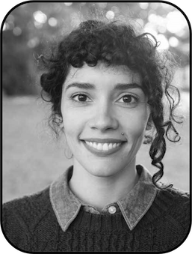
Meet Our Interviewees
Will Vizcayno
Helen Hsu
Jiamin Huang
Gabriella Harari
Notes:
juhmeen

Slide 4
Interview Questions

Slide 5
Questions - Will Vizcayno
What’s your favorite place?
How do you feel when you go to your favorite place?
What’s your favorite memory?
How did your favorite make you feel?
Tell us about an emotional journey.
Why do you write?

Slide 6
Questions - Helen Hsu
How do you get people to open up to you about their memories?
How do people cope with traumatic events?
What is the best/most common coping mechanism?
What is self-care and how important is it in the coping process?
Notes:
Understand more about relationship between memories and emotions

Slide 7
Questions - Jiamin Huang
What is your relationship with social media?
Why do you not use social media?
How do you record your memories?
As a counselor, how do you get people to open up about emotional experiences?
What is your favorite/least favorite place?
What is your favorite memory?
How do you communicate with others?
How was your experience with journaling?
Notes:
Why she does not use social media and how she reflects

Slide 8
Questions - Gabriella Harari
Why do you journal?
Why did you choose that format?
How does journaling affect your memory? What’s the relationship between your journals and your memories?
What moment makes you want to journal?
What keeps you journaling?
What goes through your mind when you re-read journal entries?
What is your journaling process?

Slide 9
Empathy Map

Slide 10
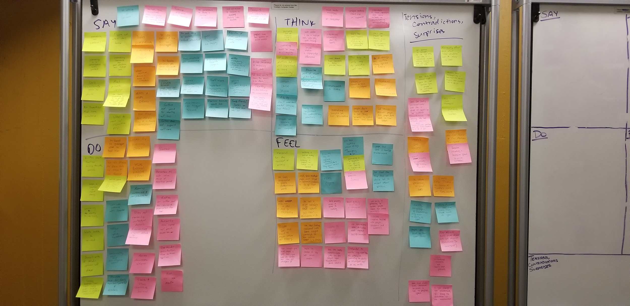

Slide 11
WILL

Slide 12
SAY
THINK
Memories connect to environment
If things are routine they get old and stale
Journaling is a “chore”
Sad stories alienate people
Wants a happy ending
Is more creative when he doesn’t have a schedule
Where you start and end has significance
People don’t want to hear sad stories
DO
FEEL
People feel the need to make other people happy
Looks at whining dogs after telling story about pet grasshopper
Writes when he realizes he hasn’t in a while
WOAH feeling in favorite place and memory
New feeling felt at Bernal Heights persists because emotion is so strong

Slide 13
Claims that spontaneity is need in order to be creative.
Uses a routine in his creative process

Slide 14

Insight: He values spontaneity in small doses
Need: He needs a way to balance spontaneity and routine in his creative process

Slide 15
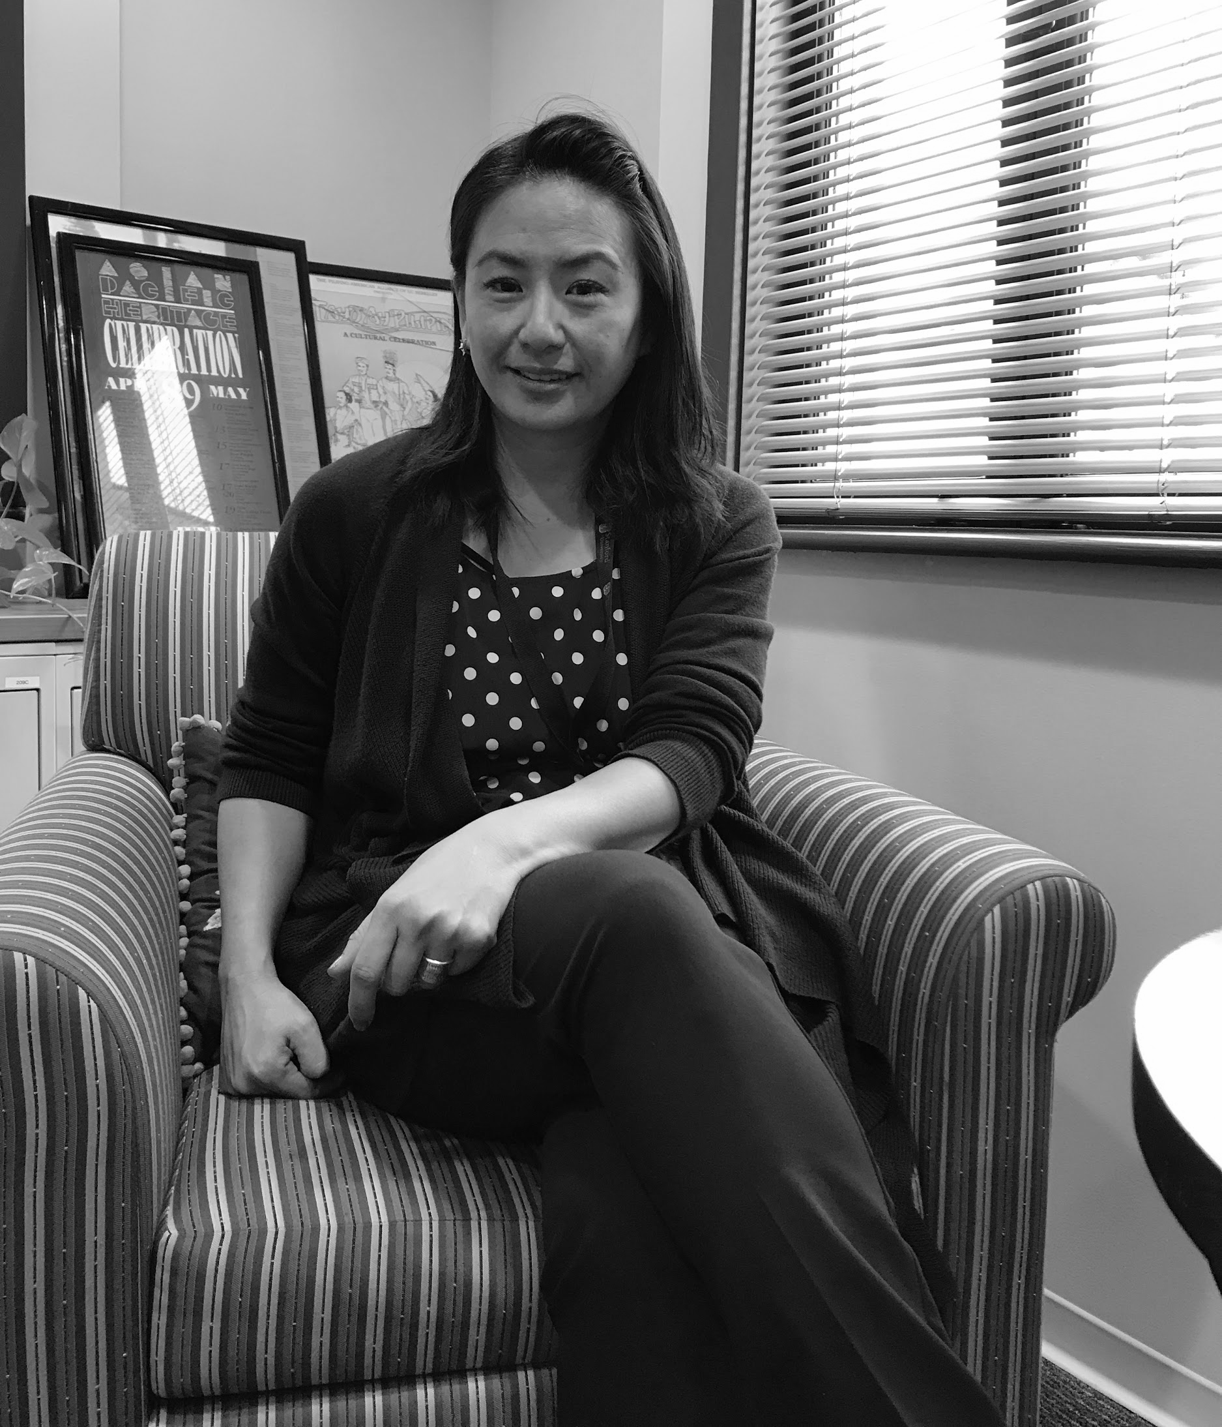
HELEN

Slide 16
SAY
THINK
Young people aren’t taught to articulate their feelings
Relationships play a huge role in determining speed of recovery
Mental illnesses are invisible because there’s no language for it
Some people are can be unwilling to share their feelings, but also UNABLE
Reaction of first few people play a major role in dealing with traumatic memories/experiences
Environment is blueprint for routine (movers story)
DO
FEEL
People feel safe in familiar environments
Provides toolbox of coping mechanisms
Hates stigma
People like routine when things are changing a lot
People feel like they have no other choice but to accept others opinions
Provides help for family members, parents and teachers

Slide 17
Your ability to cope depends on relationships, identity, and language (self- narrative)
Your self-narrative depends on what others think about you

Slide 18

Insight: If you don’t have the language, you can’t tell your story; and therefore, you can’t properly cope with a traumatic experience.
Need: A better way to articulate their identity, emotions, and experiences to others
WHO AM I?

Slide 19
JIAMIN

Slide 20
SAY
THINK
Self-reflection is crucial to dealing with trauma
Journaling must be honest with integrity
Social media messaging is like being “at the beck and call” of someone else
Social media is inherently dishonest
People’s lives are better on social media
Unique emotions stand out in memories
DO
FEEL
Starts and stops gratitude journal
Weird feeling when she goes back to remodelled pool
Puts her hand over her face when asked about the place she hates the most
Likes structure and routine
Relies on other people to record memories for her
Obligate to write negative experiences because otherwise journaling is to similar to the highlight reel on social media

Slide 21
She is very articulate when explaining her emotions and memories to others
She thinks she communicates poorly

Slide 22
Insight: People believe good communication requires consistent participation in social media/messaging.
Need: People need more practice articulating emotions outside of social media contexts
Notes:
This is not about what Jiamin needs. It is about what other people need that Jiamin has. Which is more practice articulation their emotions.

Slide 23
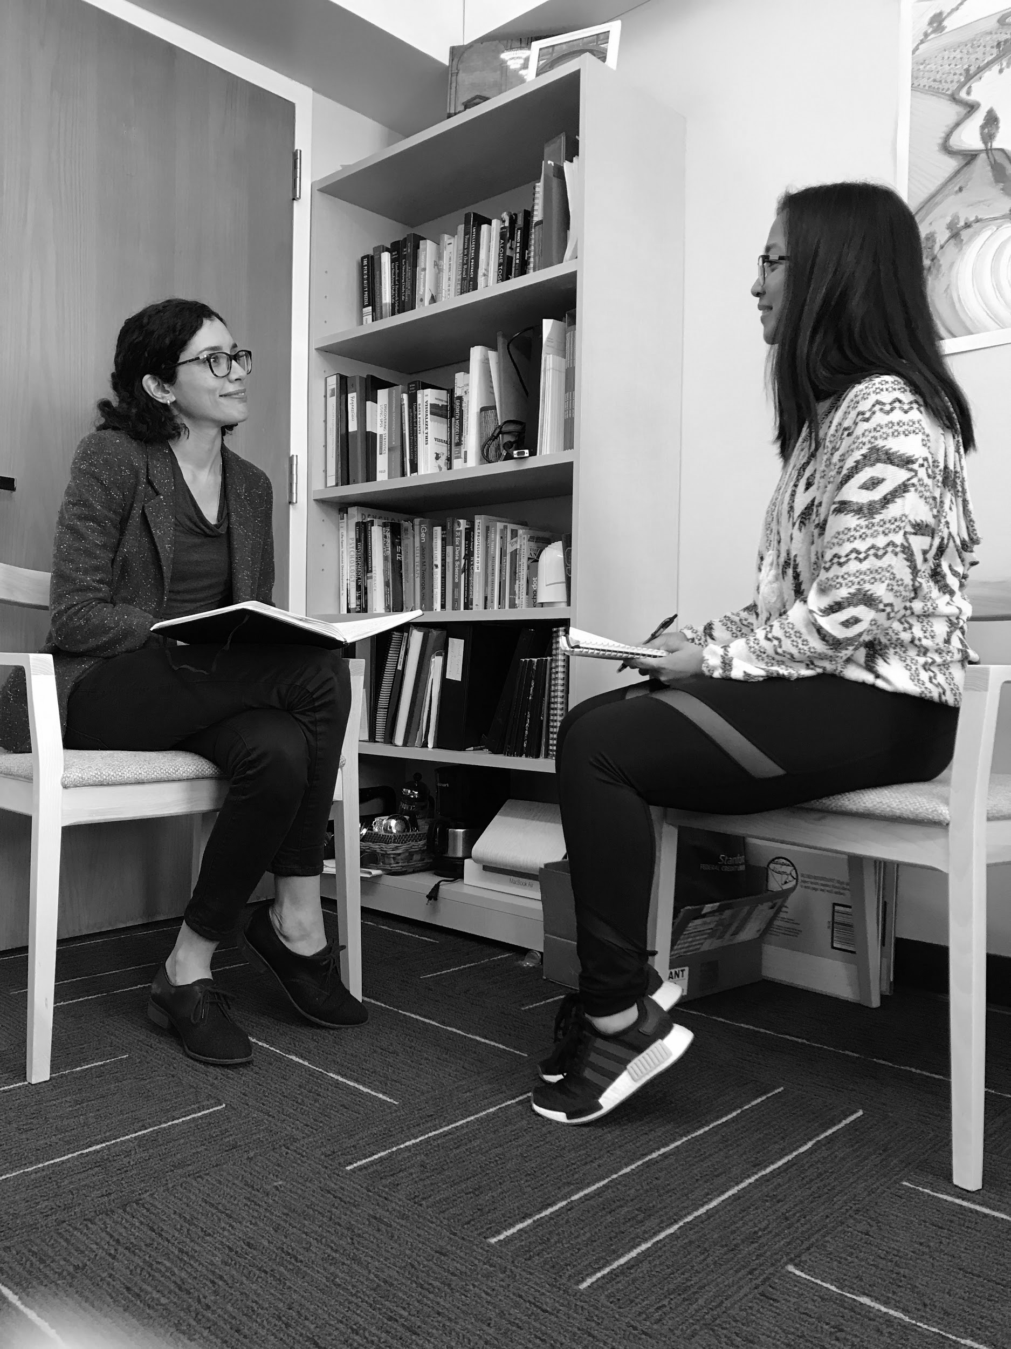
GABRIELLA

Slide 24
SAY
THINK
Journaling helps me learn about where I was, where I am now, and where I want to be.
Her journaling has evolved
She’s not made of stories, she’s made of reincarnations of herself
“You’re with yourself all the time so it is beneficial to know yourself pretty well.”
Needs distance from memories to fully process them
She choose journaling because it is private and secure
Journaling has an inherent integrity to it
DO
FEEL
Turned her head away when talking about a negative experience
Journaling is a routine that grounds her during a transitional period
Writes about feelings during transition periods
Missing a journal entry is like missing a chance to check in with herself
Writes about emotional when she realizes she hasn’t in a while
Respect for the concept of privacy

Slide 25
She chooses not to re-read her journal entries until a significant amount of time has passed in order to gain an objective point of view.

Slide 26
Insight: Journaling is a form of therapy for her.
Need: People need a way to practice their own self-therapy.
Notes:
Positive life phases = time periods when she was happy/experienced positive memories ex: when she did research in Europe

Slide 27
Summary
People Need:
Balance between spontaneity and routine in creative processes
A better way to articulate emotions on and off of social media
A way to provide therapy for themselves

Slide 28
Questions?

Slide 29
Empathy Map - Will Vizcayno
SAY
Hates journaling
Journaling is a “chore”
Is more creative when he doesn’t have a schedule
Wants a happy ending
Going to bernal heights and the fireworks memory are not new but feels new and is always different
His favorite memory was from his hometown in Philippines
The dogs reminded him of his grasshopper
DO
He buried his grasshopper where he found him
Looks at whining dogs after telling story about grasshoppers
Visits bernal heights often
Writes when he realizes he hasn’t in a while

Slide 30
Empathy Map - Will Vizcayno
THINK
If things are routine they get old and stale
Where you start and end has significance
Memories connect to environment
Journaling should be fun, spontaneous
People don’t want to hear a sad story because it makes them feel down
Sad stories alienate people and people don’t want to hear them
FEEL
Feels connected to people through words
WOAH feeling in fav place and memory
People feel the need to make other people happy
The new feeling associated with Bernal Heights continues because the initial emotion is so strong
He has a lot of nostalgia for where he’s from: Philippines and LA

Slide 31
Empathy Map - Jiamin Huang
SAY
Context, tone, hand gestures, body language are not present in texting, detracting from conversation
Feelings create strong memories
No punishment when stop doing journal so no incentive to continue
Self-reflection is crucial to dealing with trauma
Doesn’t get experience across through words
People’s lives are better on social media
Wants conversations with clear beginning and end
“I know you’re there. You know I’m there.”
Texting awkward form of communication
Social media messaging is like being “at the beck and call” of someone else

Slide 32
Empathy Map - Jiamin Huang
DO
Swims
Remembers high school swim meets when thinking of feeling good
Relies on other people to record memories for her
Puts her hand over her face when asked about the place she hates the most
Helped others remember how to cope with past experiences
Overthinks punctuation, time between replies
Starts and stops gratitude journal
Doesn’t remember contextual details to memories
Rememers visual details and then that leads to sensory details.

Slide 33
Empathy Map - Jiamin Huang
THINK
Social media messaging is an obligation
Unique emotions stand out in memories
Investment of time, emotion, and work leads to remembering unintentionally
Intentional memories don’t work
Social media is like a highlight reel, with only good things
Social media is inherently dishonest
Journaling must be honest with integrity

Slide 34
Empathy Map - Jiamin Huang
FEEL
Likes structure and routine
Obligate to write negative experiences because otherwise journaling is to similar to the highlight reel on social media
Badly communicates just because she doesn’t have traditional social media
More in control of her life without social media
Even though your social media is your own you have no control over how people interpret it
Feels anxiety when it comes to texting
Weird going back to remodelled pool
Just being in proximity with certain people makes you change unwillingly
Associates negative feelings with people (distance and emotion)
Wants to choose social obligations

Slide 35
Empathy Map - Helen Hsu
SAY
Culture is not good for dealing with loss
Milestones can trigger trauma
People reprocess traumatic events later because they have a new vocabulary to express their emotions
Family, friends, and teachers can help more than she can
Culture does not support self-care
Some people are can be unwilling to share their feelings, but also UNABLE
“There is no such thing as evolution without discomfort”
You “should” be happy - what people say about successful people
Traumatized people disassociate
Reaction of the first few people play a major role in dealing with traumatic memories/experiences
There is a huge mental health stigma
There is a discrepancy about how children feel versus how other people talk about it
Young people aren’t taught how to articulate their feelings
People take for granted the little things before it is too late
Routine is important to support people who suffer from memory loss
Self-care is important (eating, sleeping, social engagement, excercise, a creative activity, and sometimes a spiritual activity)

Slide 36
Empathy Map - Helen Hsu
DO
Remains unbiased and non-judgemental
Works with patients with dementia
Toolbox of coping mechanisms
Community work and anti-stigma work
Provides help for family members, parents and teachers
THINK
Culture causes stigma
Adults don’t understand mental illnesses
Illnesses are invisible because there is no language
Environment is the blueprint for a routine (the movers story)
Language is important for understanding emotions
Recognizes part of bigger picture/system
Relationships play major role in determining speed of recovery

Slide 37
Empathy Map - Helen Hsu
FEEL
Adults try to regulate children’s emotions and they don’t validate them
Hates stigma
People like routine when things are changing a lot
People feel safer in familiar environments
People feel like they have no choice but to accept others’ opinions

Slide 38
Empathy Map - Gabriella Harari
SAY
Journaling has “evolved”
“Journaling is a conversation with yourself”
Still occasionally sees journaling as a chore
Journals must have substance, not superficial
Journaling helps her figure out where she’s headed
  Journaling helps me learn about where I was, where I am now, and where I want to be.
Journaling connecter her past, present, and future self
A physical journal is the most private form of journaling
She choose journaling because it is private and secure
She likes reading past entries with an objective POV of her past self
“You’re with yourself all the time so it is beneficial to know yourself pretty well.”

Slide 39
Empathy Map - Gabriella Harari
DO
Writes about feelings during transition periods
Keeps a journal on hand daily
Journaling mostly to do lists
Waits awhile to re-read
Doesn’t write if thinks opinion will change
Turned her head away when talking about a negative experience
Writes about emotional when she realizes she hasn’t in a while
THINK
Journaling has an inherent integrity to it
Not public platform but still important to have responsibility
Needs distance from memories to fully process them
Too busy so only way to practice self-care
She’s her best support system,journalling is a relationship w/ herself
She’s not made of stories, she’s made of reincarnations of herself

