Slide 1
planet
travel with a game plan.

Slide 2
Problem
Solution
People aren’t confident in their plans without the input of family and friends, who are generally unmotivated to respond.
Our solution is to gamify the planning process with family and friends, allowing it to be easier, more efficient, and more enjoyable for all.

Slide 3
Three Tasks
Simple: generate a multitude of ideas for a trip
Medium: compose a travel plan
Complex: confirm your plan with those going on the trip

Slide 4
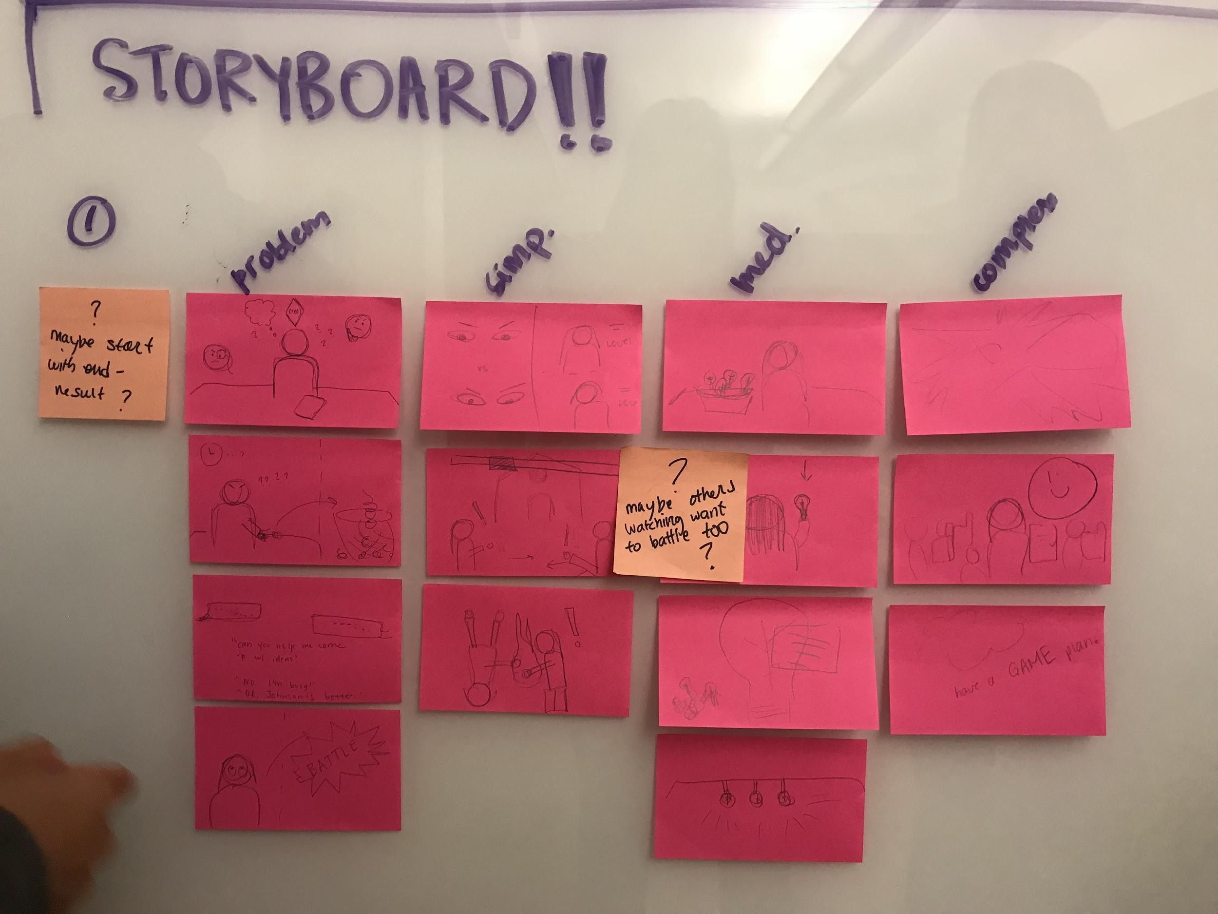
Video Storyboards

Slide 5
Video Storyboards - Problem

Slide 6
Video Storyboards - Simple Task

Slide 7
Video Storyboards - Medium Task

Slide 8
Video Storyboards - Complex Task

Slide 9
Video
https://youtu.be/nR4Iix-sOAE

Slide 10
Questions?

