Slide 1
Adventure
Is
Planning.

Slide 2

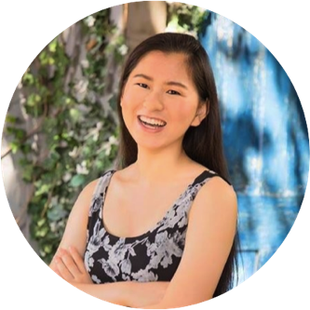
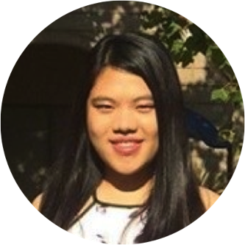
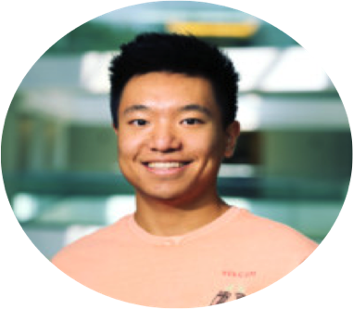
Our Team
Caroline Gao
Catherine Jiang
Lisa Liao
Johnson Song

Slide 3
Initial POV

Slide 4
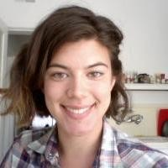
We met…
Christine Bowlus, a 25-year old cross-country coach who finds trip planning frustrating and stressful
We were amazed to realize that…
she seemed more excited to plan when she came acrossunknown places in her planning.
It would be game-changing to…
make planning more enjoyable by making it seem like exploring the unknown.

Slide 5
We met…
Christine Bowlus, a 25-year old cross-country coach who finds trip planning frustrating and stressful
We were amazed to realize that…
she seemed more excited to plan when she came acrossunknown places in her planning.
It would be game-changing to…
make planning more enjoyable by making it seem like exploring the unknown.

Slide 6
We met…
Christine Bowlus, a 25-year old cross-country coach who finds trip planning frustrating and stressful
We were amazed to realize that…
she seemed more excited to plan when she came acrossunknown places in her planning.
It would be game-changing to…
make planning more enjoyable by making it seem like exploring the unknown.

Slide 7
Needfinding
Round 2.

Slide 8
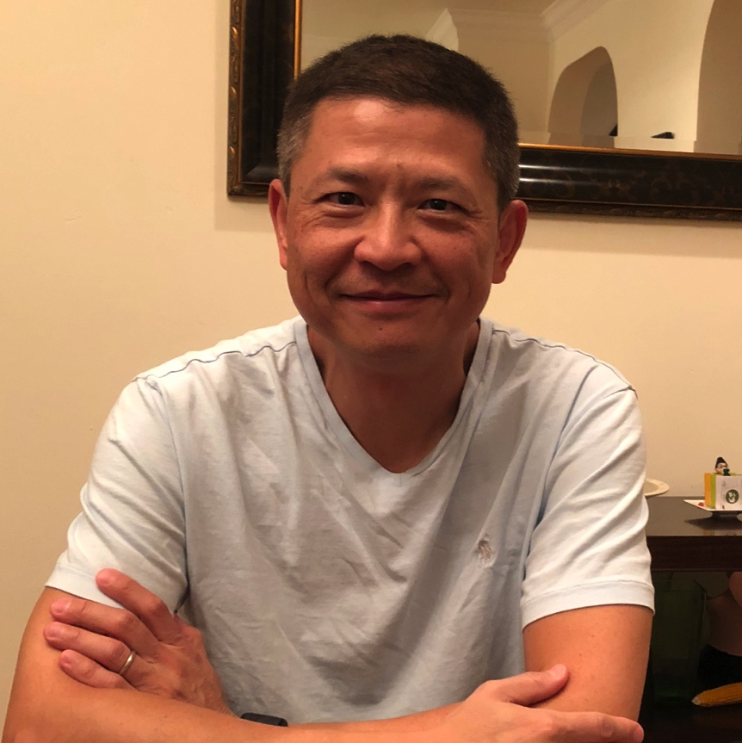
“I plan more than what we do.”
Jason H.
Financial Planner
Extreme User

Slide 9
We met…
Jason, a 51-year-old financial planner who doesn’t like planning but thinks it’s necessary.
We were amazed to realize that…
he plans multiple options for each time slot because he is insecure about all of them panning out.
It would be game-changing to…
Jason H.
Financial Planner
allow people to feel confident in their plans without having them spend unnecessary effort in planning.
Extreme User

Slide 10
We met…
Jason, a 51-year-old financial planner who doesn’t like planning but thinks it’s necessary.
We were amazed to realize that…
he plans multiple options for each time slot because he is insecure about all of them panning out.
It would be game-changing to…
Jason H.
Financial Planner
allow people to feel confident in their plans without having them spend unnecessary effort in planning.
Extreme User

Slide 11
We met…
Jason, a 51-year-old financial planner who doesn’t like planning but thinks it’s necessary.
We were amazed to realize that…
he plans multiple options for each time slot because he is insecure about all of them panning out.
It would be game-changing to…
Jason H.
Financial Planner
allow people to feel confident in their plans without having them spend unnecessary effort in planning.
Extreme User

Slide 12
How might we…
find a way to instill confidence in travel plans?

Slide 13
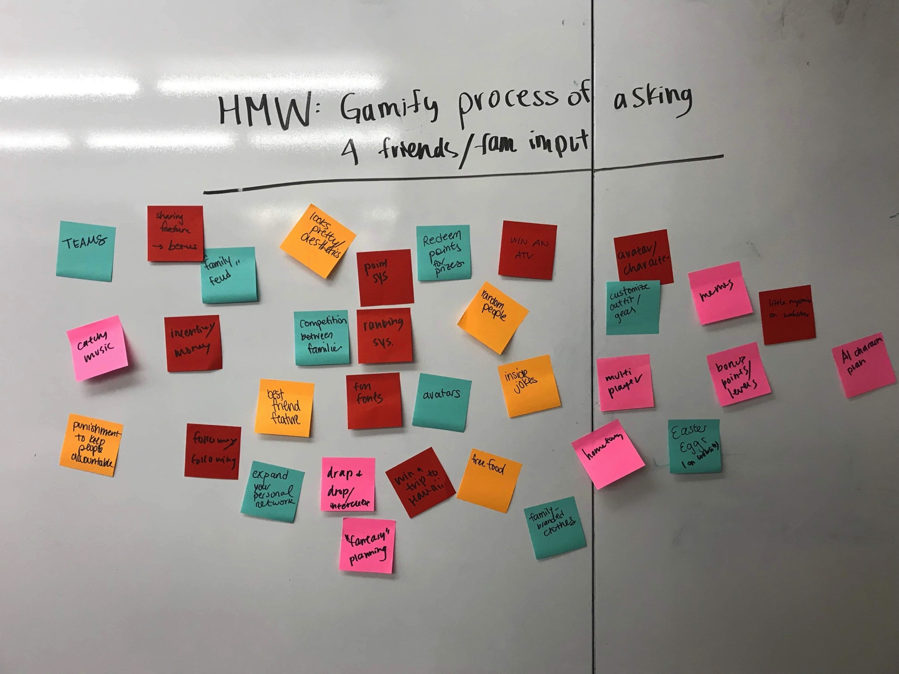

Slide 14
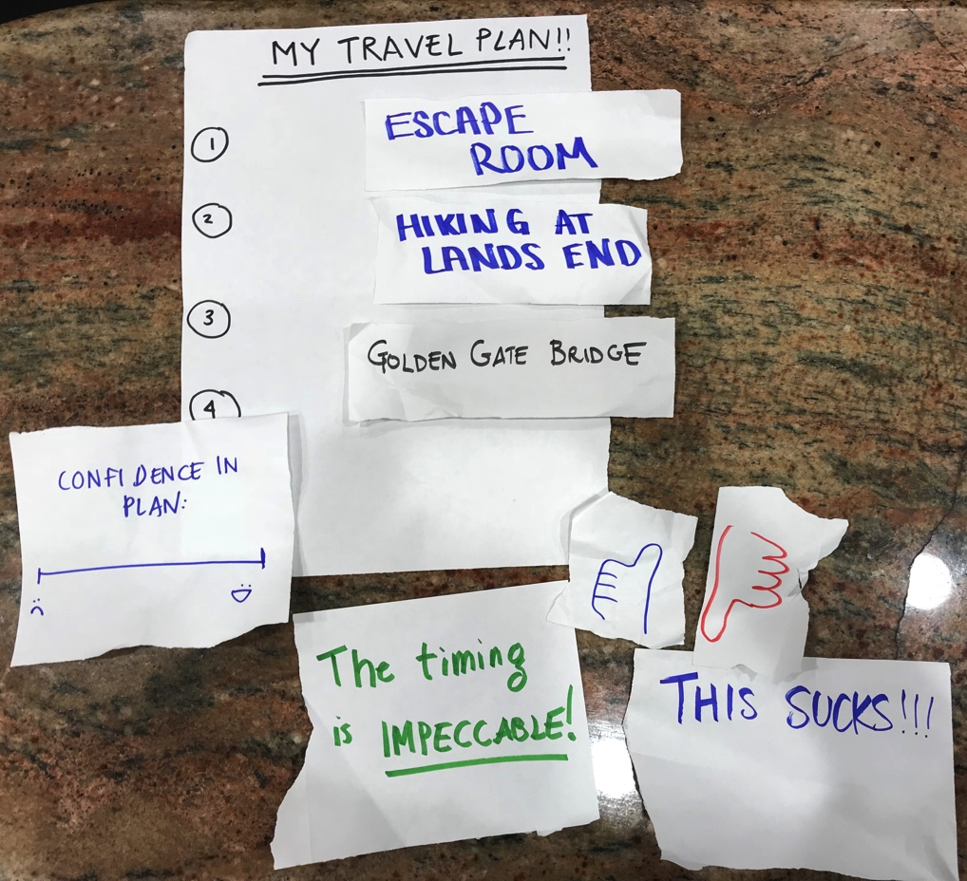
Experience Prototype
Solution: “like” and review for plans
Assumption: people feel more confident (in their plans) when they
get reviewed

Slide 15
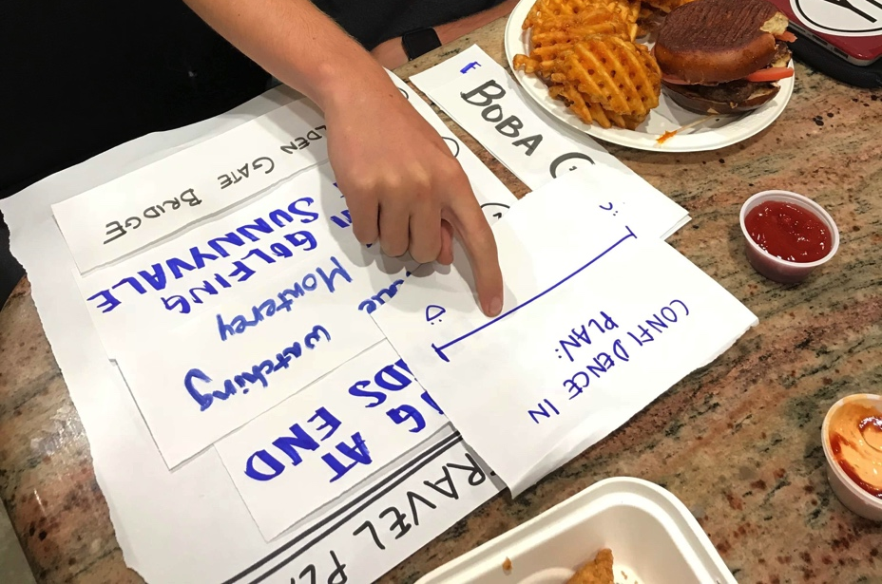
Confidence boost
Minimal plan change
Moderately high initial confidence
Reviews boost confidence

Slide 16
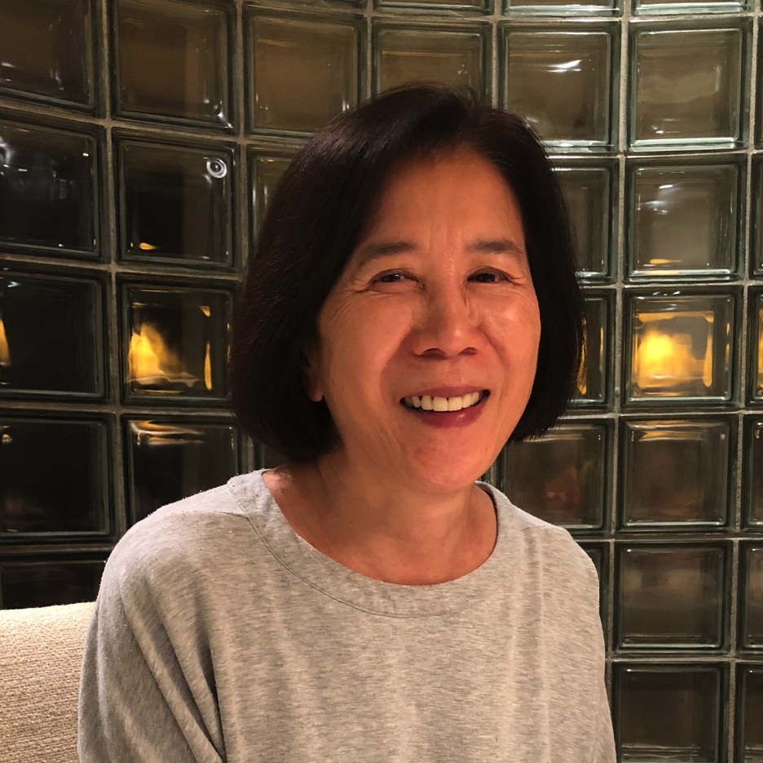
People don’t enjoy when their plans are
too similar to something they’ve done
before.
Joy H.
Financial Controller
Extreme User

Slide 17
We met…
Joy, 60-year-old financial controller who strictly follows her plans most of the time.
We were amazed to realize that…
the only time she ever skips planned activities is when they are too similar to something she has already experienced.
It would be game-changing to…
Joy H.
have an easy way to compare place characteristics.
Financial Controller
Extreme User

Slide 18
We met…
Joy, 60-year-old financial controller who strictly follows her plans most of the time.
We were amazed to realize that…
the only time she ever skips planned activities is when they are too similar to something she has already experienced.
It would be game-changing to…
Joy H.
have an easy way to compare place characteristics.
Financial Controller
Extreme User

Slide 19
We met…
Joy, 60-year-old financial controller who strictly follows her plans most of the time.
We were amazed to realize that…
the only time she ever skips planned activities is when they are too similar to something she has already experienced.
It would be game-changing to…
Joy H.
have an easy way to compare place characteristics.
Financial Controller
Extreme User

Slide 20
How might we…
reveal unknown places to people in an
inspiring manner?

Slide 21
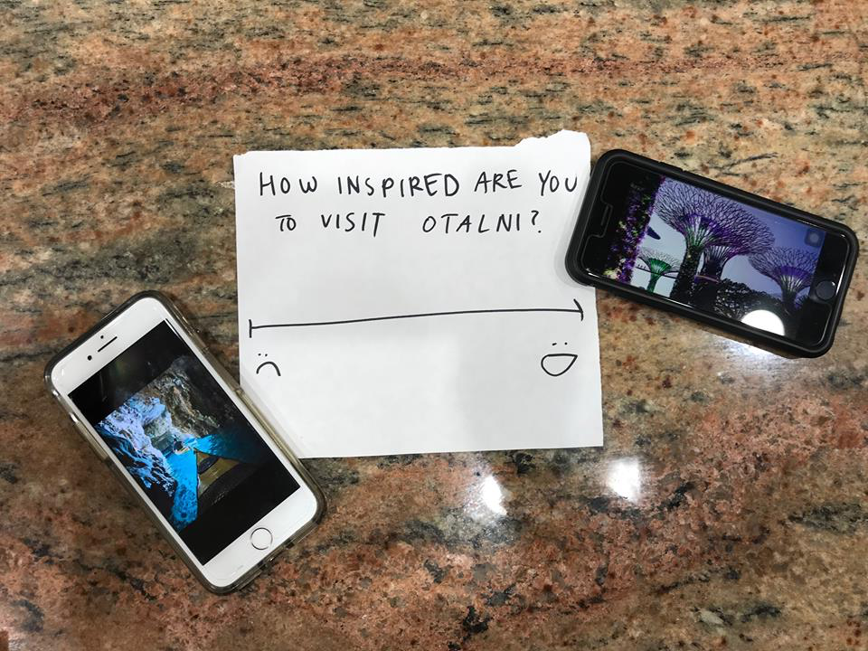
Experience Prototype
Solution: media trial run-through of travel plan
Assumption: people are inspired by media to explore the unknown

Slide 22
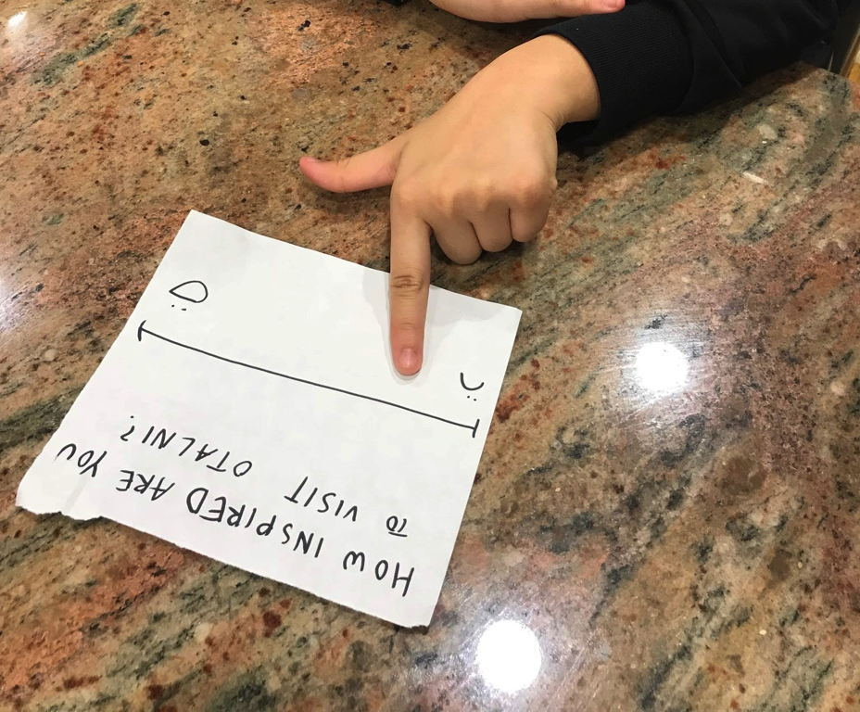
Increased interest
Receptive to media inspiration
User unengaged
Media increases place interest

Slide 23
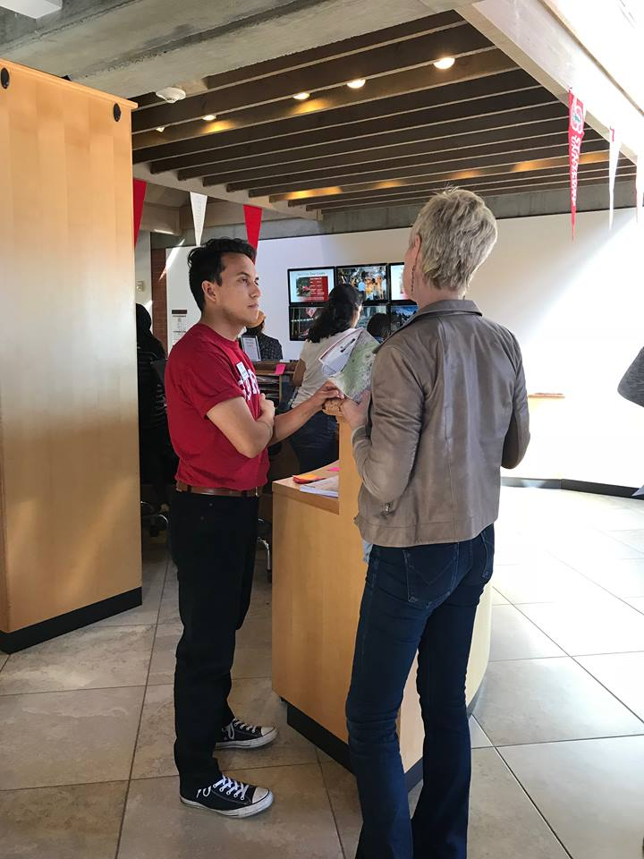
Friends and family make a notable
contribution to travel planning, allowing
it to be easier, more efficient, and more
enjoyable.
Grant Z.
Visitors Relations Coordinator
Extreme User

Slide 24
We met…
Grant, whose honeymoon plans were ruined 4 days before he
and his fiancée were to travel to Seattle, their destination.
We were amazed to realize that…
he was still able to plan a successful honeymoon in two days due to the help of his friends and family.
It would be game-changing to…
Grant Z.
leverage help from others to make planning go faster.
Visitors Relations Coordinator
Extreme User

Slide 25
We met…
Grant, whose honeymoon plans were ruined 4 days before he
and his fiancée were to travel to Seattle, their destination.
We were amazed to realize that…
he was still able to plan a successful honeymoon in two days due to the help of his friends and family.
It would be game-changing to…
Grant Z.
leverage help from others to make planning go faster.
Visitors Relations Coordinator
Extreme User

Slide 26
We met…
Grant, whose honeymoon plans were ruined 4 days before he
and his fiancée were to travel to Seattle, their destination.
We were amazed to realize that…
he was still able to plan a successful honeymoon in two days due to the help of his friends and family.
It would be game-changing to…
Grant Z.
leverage help from others to make planning go faster.
Visitors Relations Coordinator
Extreme User

Slide 27
How might we…
gamify the process of asking for friends and family input?

Slide 28
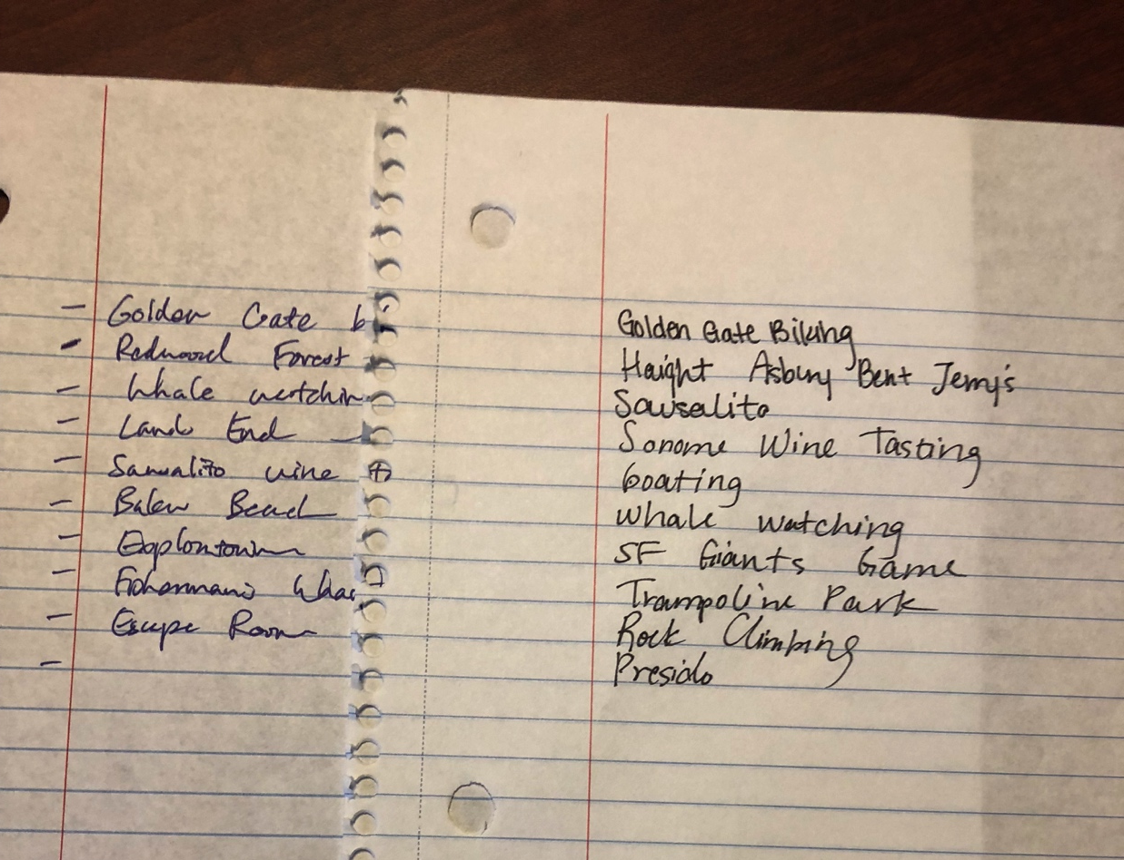
Experience Prototype
Solution: family-feud style competition for most valuable inputs
Assumption: people are more willing to give their input when they’re competing on a team

Slide 29
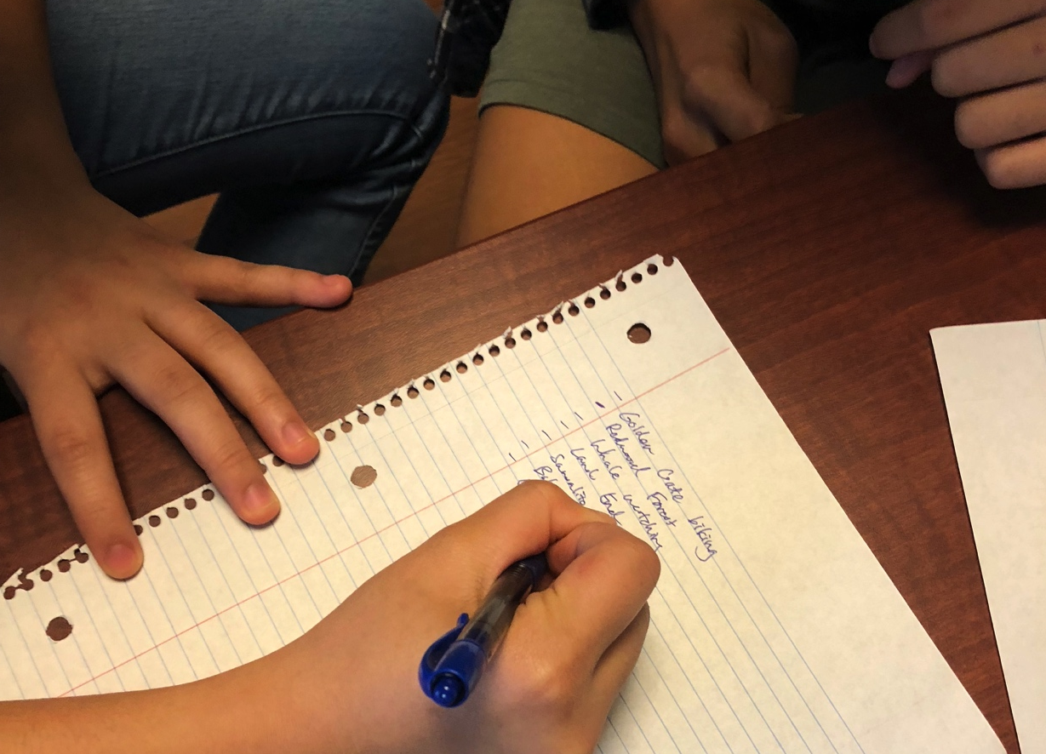
Increased engagement and participation
Family-feud style competition
increased rate of ideas
Good teamwork needed
Competition can act in place of inspiration for ideas

Slide 30
Summary
people feel more confident (in their plans) when
they get reviewed
people are inspired by media to explore the
unknown
people are more willing to give their input when they’re competing on a team

Slide 31
Thank you

