Slide 1
Adventure is planning
.
Caroline Gao, Catherine Jiang, Lisa Liao, Johnson Song

Slide 2
Our Team
Modern PowerPoint Presentation
Graphic Infographic Designed
Caroline Gao
Catherine Jiang
Lisa Liao
Johnson Song
Notes:
Good morning everyone, my name is Johnson.
Caroline, Catherine, Lisa, and I decided to focus on the “Planning” aspect of travel as our problem domain within the studio theme.

Slide 3
Needfinding Methodology
9
Total interviews conducted
Palo Alto & San Jose
Cities visited in the field
3
Highlight interviews
Notes:
Over the past week, we went into field 3 times and conducted 9 interviews. Interviews were conducted in the cities of Palo Alto and San Jose. Some of the places we went into include coffeeshops, electronic stores, and even an airport. Each interview included two team members so as to catch more observations without overwhelming the interviewee.

Slide 4
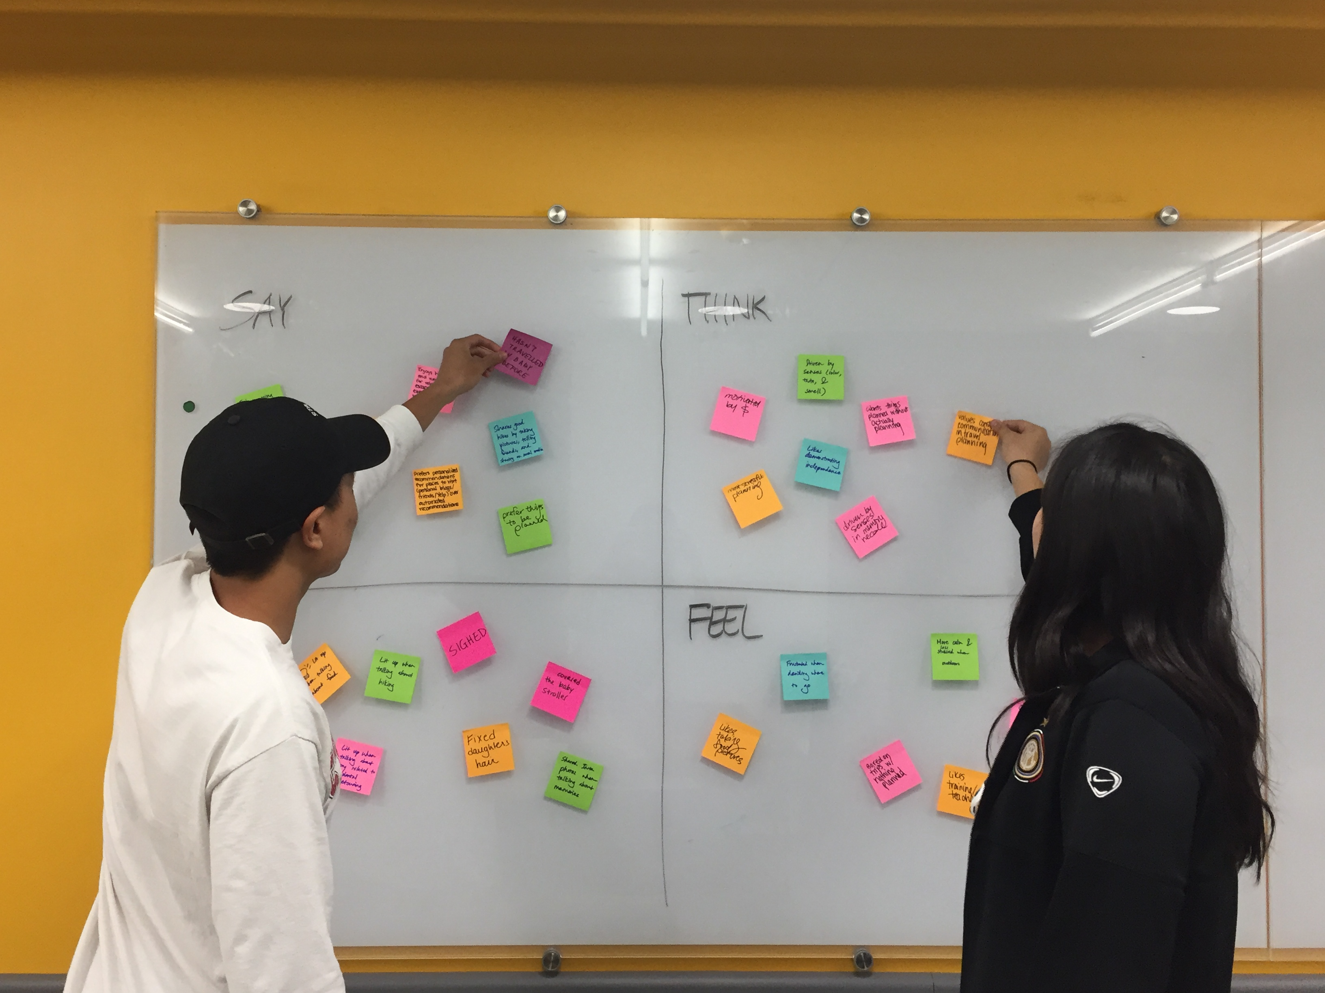
Notes:
After each interview, we as a team debrief our findings and unpacked what we had observed by building an empathy map for each interviewee.

Slide 5
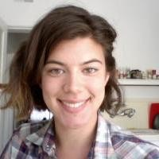
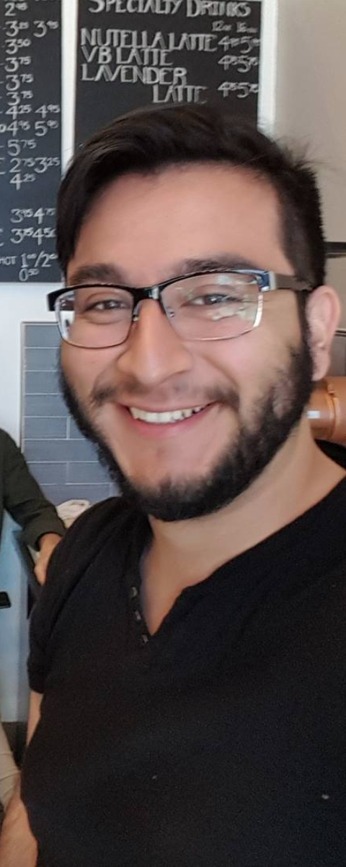
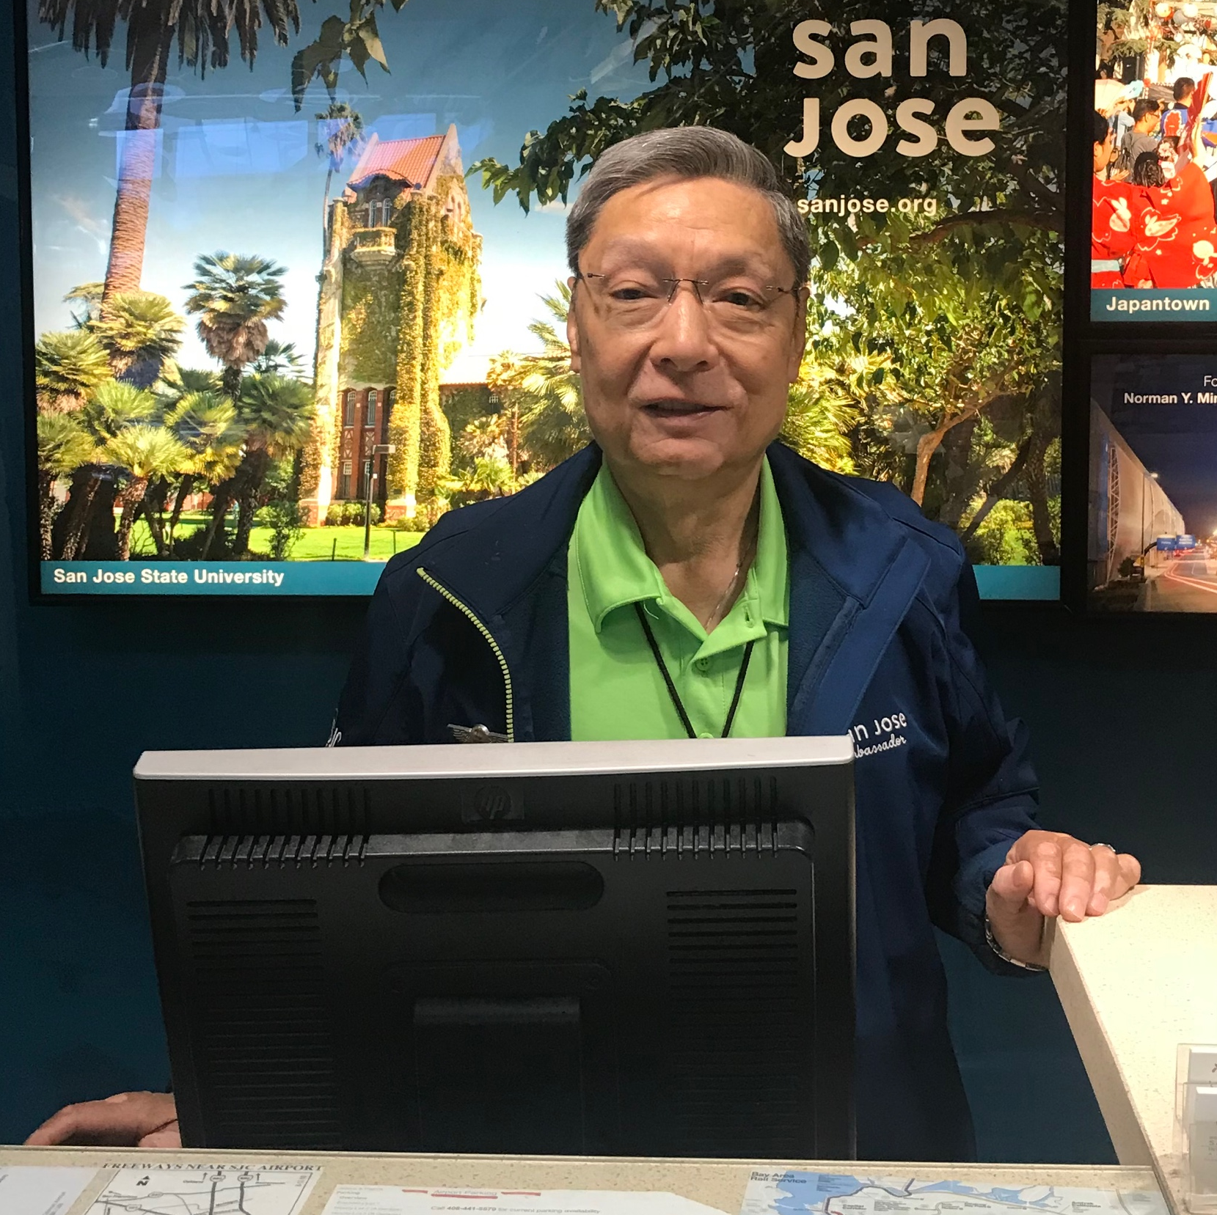
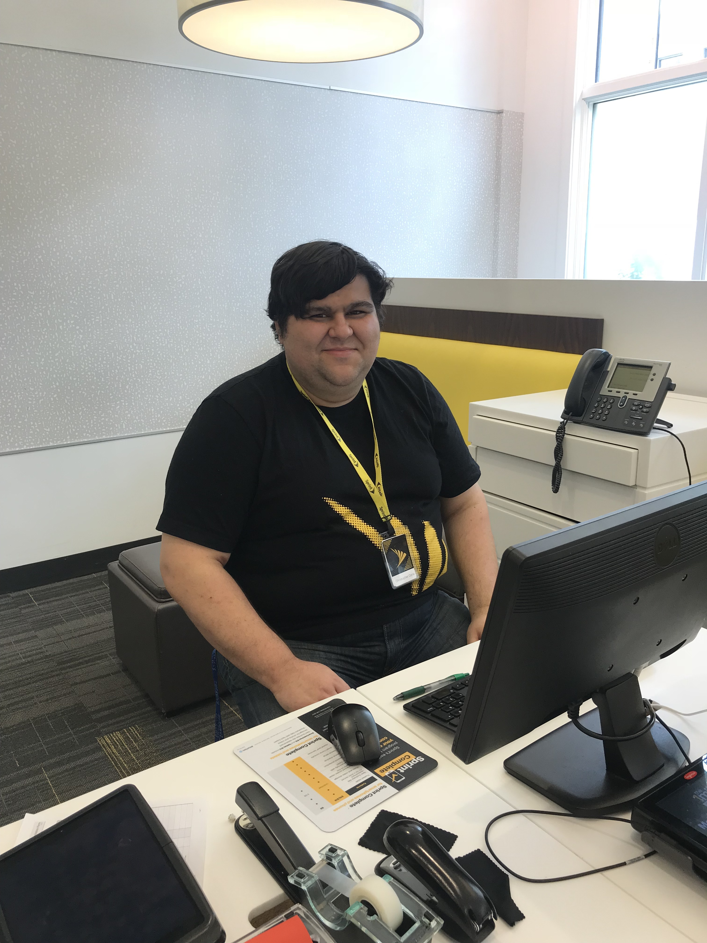
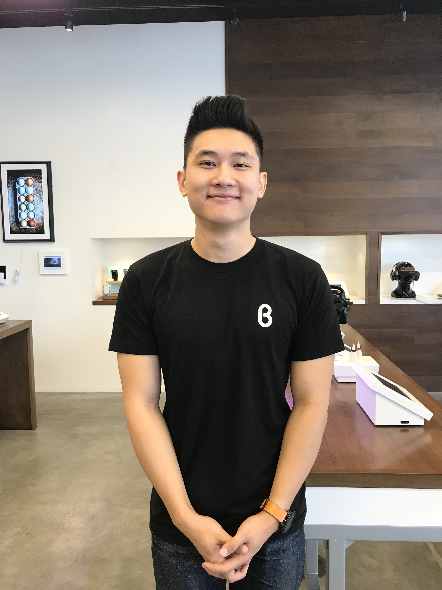
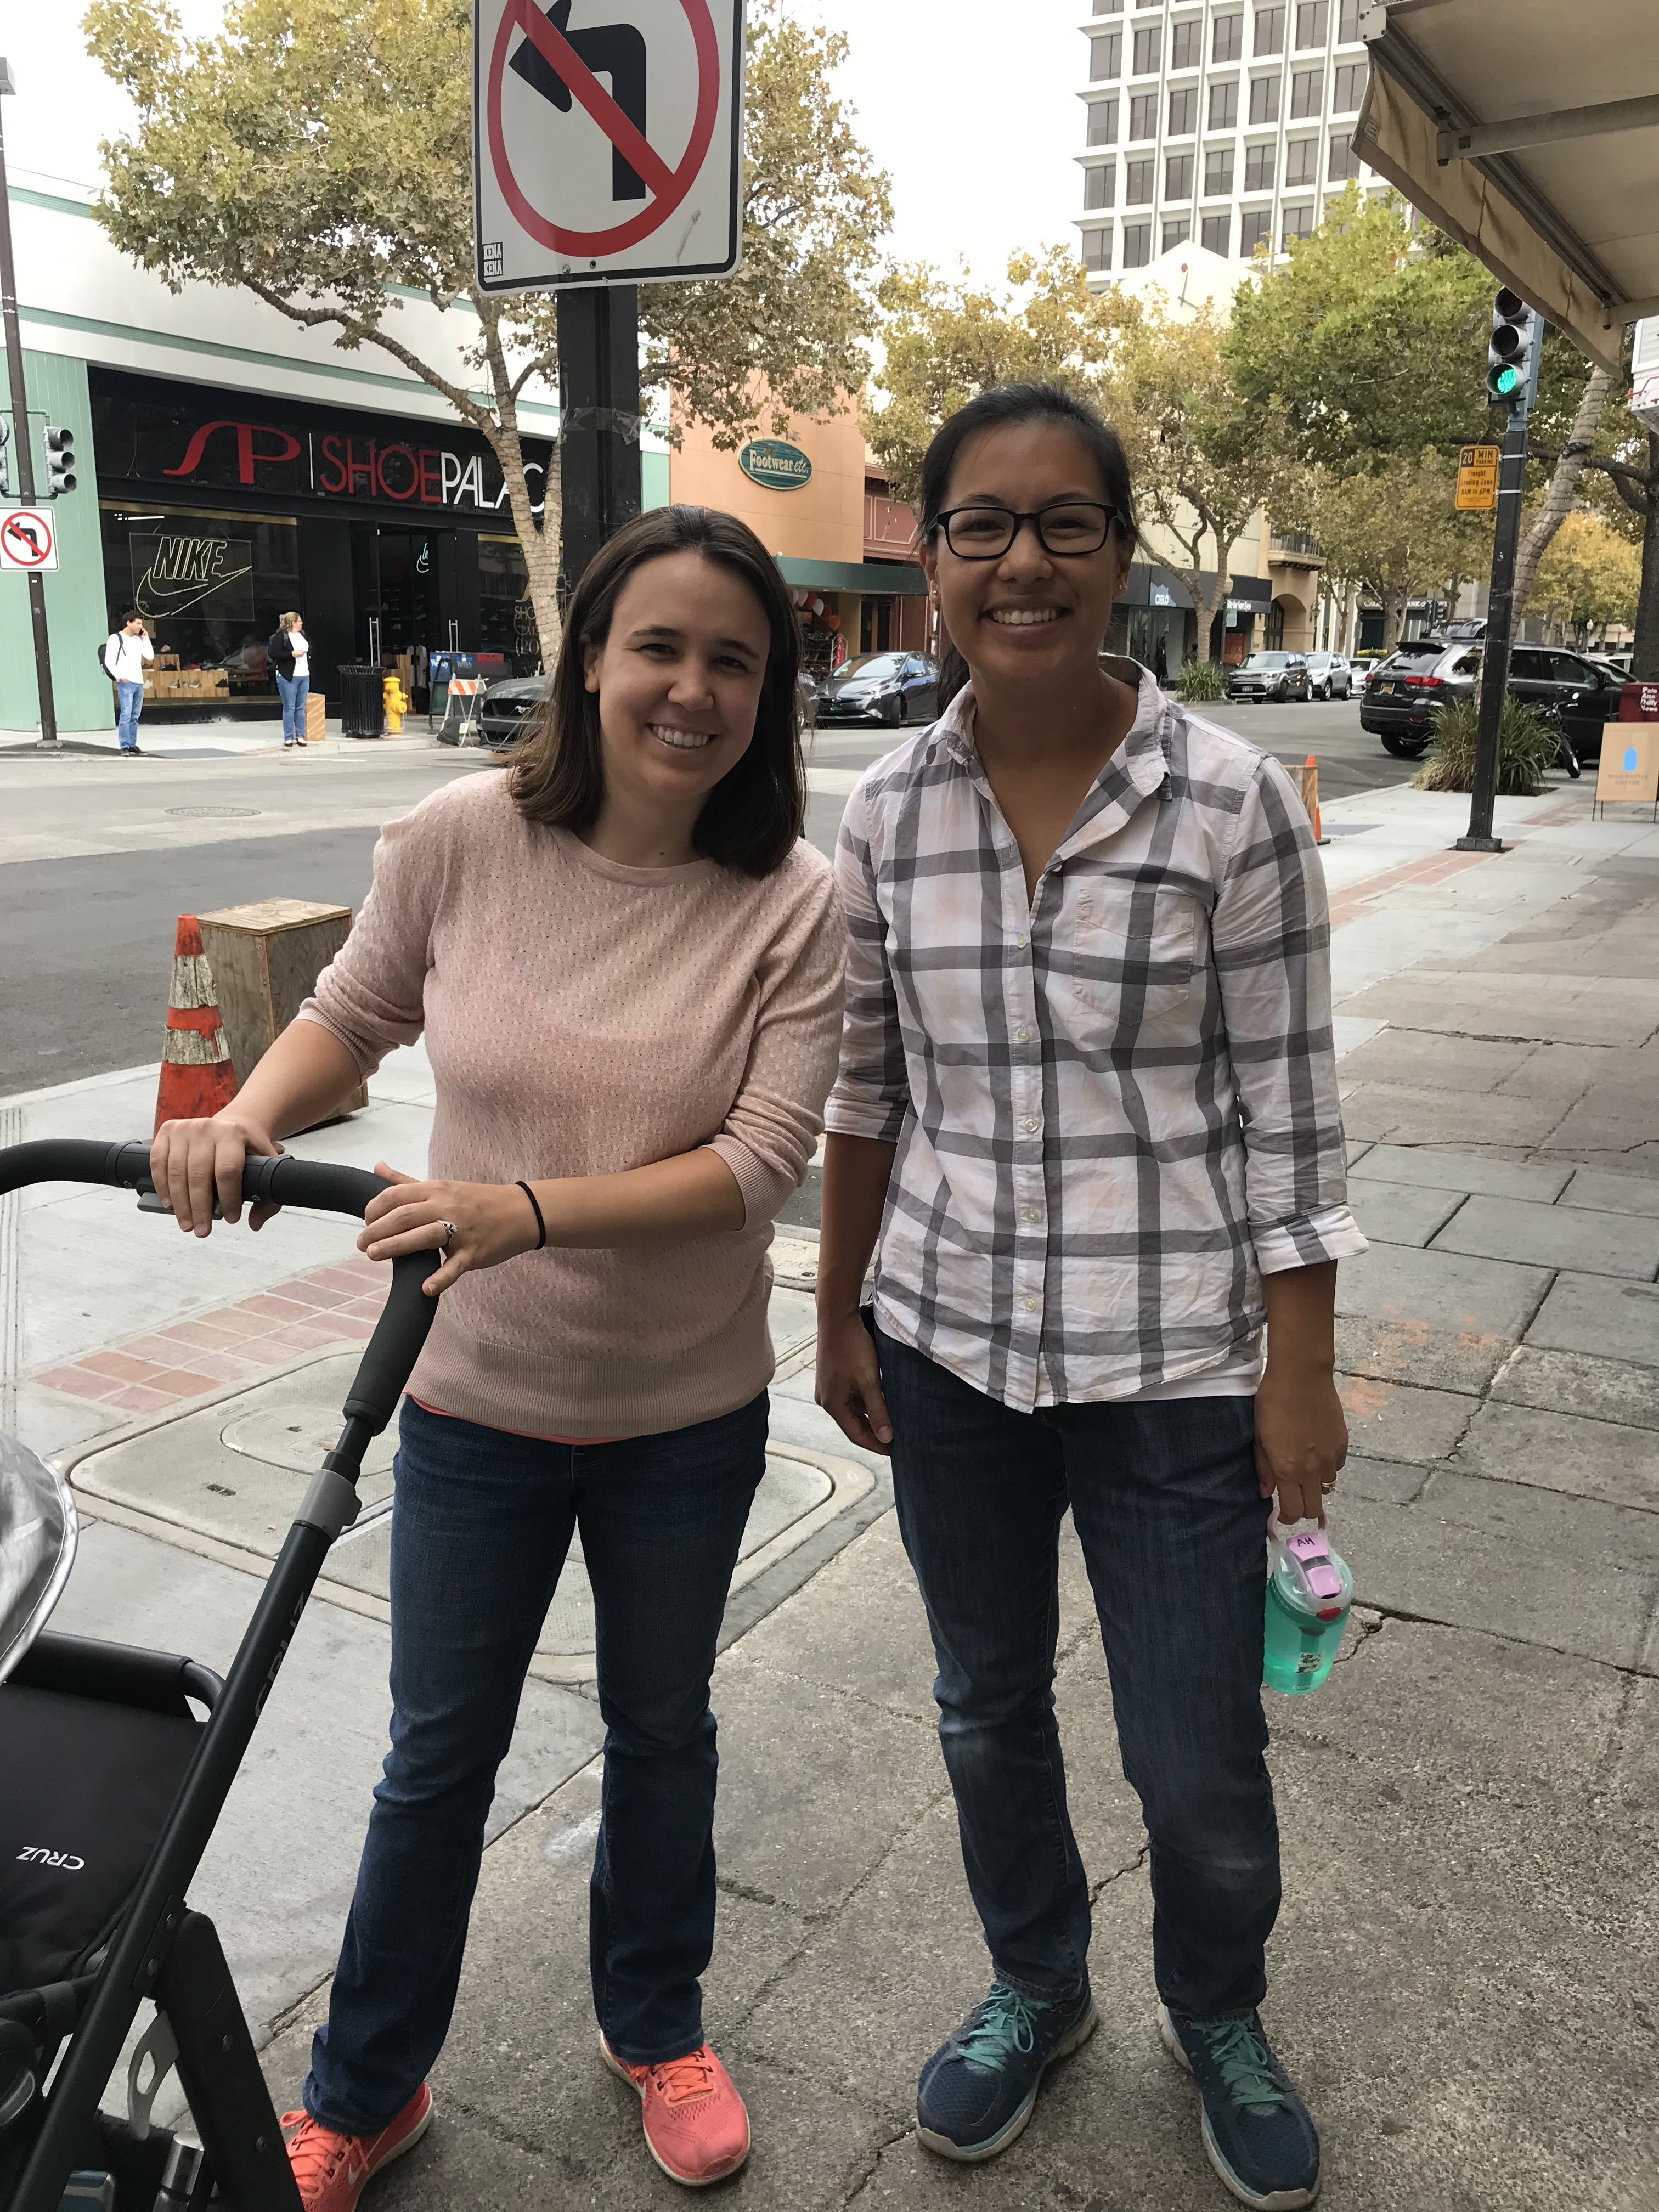
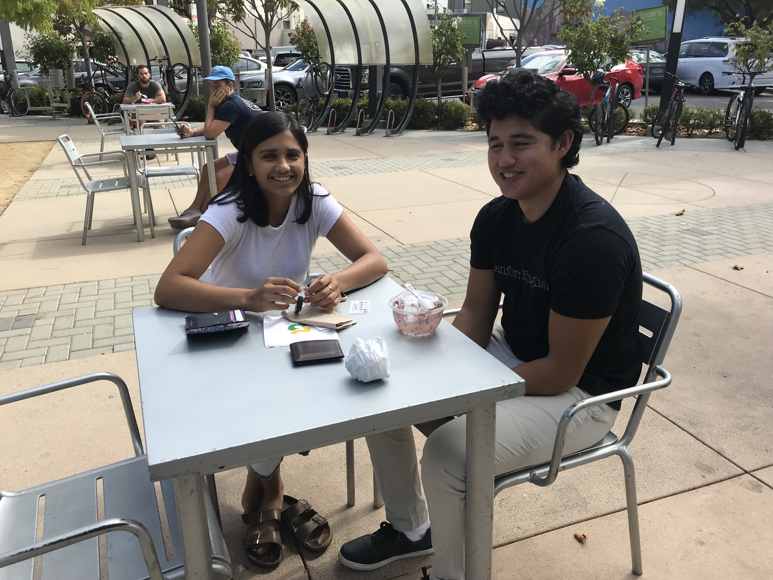
Interviewees
+2 not pictured
Notes:
Though we had 9 interviews, for today’s presentation, we will just highlight 3 of our most insightful interviews that captured the essence of many of the other interviews.
*CLICK

Slide 6
Interviewees
+2 not pictured
Notes:
These interviewees were chosen for their diverse perspectives and backgrounds, unique situations, different environments.
This is why we made an empathy map for each of them and why we’ll highlight separate empathy maps for each individual.

Slide 7
Highlight Interview 1

Slide 8
Christine Bowlus
We asked…
Tell us about a time you discovered a new place without looking?
-
What’s your most/least favorite part about traveling?
-
How do you feel when you plan a trip?
-
What is a memory that sticks out to you from your most recent trip?
-
What brings you here?
Age: 25
High school cross-country coach
Notes:
The first interview I’d like to talk about is with Christine Bowlus, a 25-year old graduate from Berkeley who is currently a high school cross country coach. We sat down with her and after getting to know her better, asked her about travel. We asked questions like…… *read questions*
And here is what we observed.

Slide 9
SAY
Enjoys trips with friends.
THINK
Wants things planned without actually planning.
Calendars are a waste of time.
Runs as an escape.
Values constant communication.
Shares good hikes on social media.
Prefers personalized recommendations over automated ones.
Most stressful part of travelling with others is planning.
Face lit up when talking about hiking.
Feels better with general itinerary.
Bored by just sitting around on trips.
Rolled eyes when mentioning how no other plans had been made besides booking a house on Mexico trip.
Frustrated when deciding where to go.
Overwhelmed by multitasking.
DO
FEEL
Calm when outdoors.

Slide 10

Contradictions
“Actual planning is busywork.”
vs.
“I like to have just a general itinerary…
an idea of where to go. “
Notes:
one thing that she said that stood out to us was that though she believes actual planning to be a waste of time and busywork, she still likes having a general itinerary and to know at least one thing that she will do that day. This stuck out to us because it seemed contradictory that she would want a plan without having to make the plan herself.
* CLICK

Slide 11
Analysis
INSIGHTS
NEEDS
An efficient and engaging way to plan without it feeling like a chore.
Planning is tedious and time-consuming.
Notes:
This led us to the insight that ______. From this insight, we recognized a need for ________.

Slide 12
Highlight Interview 2

Slide 13
Adam Chou
We asked…
What is your most/least favorite part about traveling?
-
Why do you enjoy the planning aspect of travel more?
-
How do you feel when travelers ask you questions?
-
What is surprising in your role as a travel information volunteer?
-
What is your planning process?
Age: 63
Volunteer assistant at Mineta San Jose Airport
Notes:
Adam had previously worked as a US. Customs border patrol and currently is a travel information volunteer at San Jose airport.

Slide 14
SAY
Face-to-face interaction gives passengers comfort and trust.
Information dispersal cannot be improved.
THINK
Job is repetitive but fulfilling.
Very happy to help people in a foreign country.
Planning is always more fun than execution.
Google has everything.
Some people are polite and others expect you to be their concierge.
Stopped to patiently help 3 travelers find the check-in counter.
Excited to learn about the unknown during planning.
Loves to travel.
Used increased hand motions when talking about planning.
DO
Never annoyed by flights or logistics.
FEEL
Notes:
Never annoyed by flights, logistics, etc.
Travelling is always fun, especially when you start the planning, preparation and doing the homework of knowing where you’re going, knowing what to expect and [being in control],
It’s always good, I enjoy it.
I enjoy the planning part more. You know i mean the actual journey itself, 95% maybe is the planning the actual going, you arrive there and just follow the plan.
When do you planning, you talk about the unknown. When you actually arrive there, youre physically in there. so unknown is more exciting and will stir up your interest level, so planning is always more fun than execution.

Slide 15
Surprises
“I enjoy the planning part more…
95% [of the journey] is in the planning.”
and
“Planning is always more fun than execution.”
Notes:
After having interviewed Christine earlier, we were surprised to hear that Adam actually enjoyed the planning part more than the actual trip.

Slide 16
Analysis
INSIGHTS
NEEDS
People feel excited when they get to pick what they want to do.
A way to feel in control of their course of action.

Slide 17
Highlight Interview 3

Slide 18
Krista & Kimberly
We asked…
How do you feel when you travel with your children?
-
Why do you travel?
-
Tell us about the last time you went on a trip with your children?
-
What is your most/least favorite part about traveling?
-
How do you plan for traveling with kids?
Mother to infant
&
Mother to 5-year-old daughter and 8-year-old son
Notes:
The third interview we will focus on is the one where we met Krista on the left and Kimberly on the right. They’re two friends we observed walking with their children. Krista was pushing a stoller with her infant daughter in it while Kimberly was walking with her 5-year-old girl and 8-year-old boy. We wanted to interview them because they were an example of an extreme user since their travel experiences could potentially be very different due to the fact that they have to factor in their children in trip-planning.

Slide 19
SAY
It is a lot of work travelling with kids.
THINK
Hassle to move baby on plane.
Food is the first thing she bases her trips around.
Wants trusted, verified options.
Uses Yelp, Costco Connection, Triple A.
Wants kids to have a good time.
Planning to just sit on beach with baby.
Wants information to be readily-available without long-range planning.
Has to factor in frequent pit stops.
Kept fixing daughter’s hair.
Pressure to be “super mom.”
Frustrated when packing for baby.
Pulled cover over stroller when it started drizzling.
Grabbed and played with daughter’s foot.
Joy when kids get to play and experience different adventures.
DO
Sighed when asked about travelling with children.
Nervous about her baby crying on plane.
FEEL

Slide 20
Contradictions & Surprises
“Adventure things…I just research it first and
make a list of all the things I want to do.”
vs.
“There’s not much planning…we’re just going to sit on the beach.”
Notes:
One particularly interesting contradiction that we noticed with Krista was that although she mentioned her favorite part of travel to be the adventure and activities she gets to experience, her upcoming trip to Hawaii with her infant daughter is simply going to consist of sitting on the beach.

Slide 21
Contradictions & Surprises
“I think [planning] is fun!”
vs.
“It’s a lot of work…
probably not the fun part…
have to factor in pit stops…
long trip just to get from Point A to Point B.”
Notes:
We noticed a similar contradiction with Kimberly’s answers. When first asked about travelling, and more specifically, planning, she mentioned that she was excited to plan, especially around food. However, when we asked more deeply about planning for trips with children, she gave a nervous laugh and said “it’s a lot of work, probably not the fun part. You have to factor in pit stops and know it’s going to be a long trip.”

Slide 22
Analysis
INSIGHTS
NEEDS
People care about the experiences of others traveling along.
A way to prioritize different things when planning a trip.
Notes:
From our interview with Krista and Kimberly, we arrived at a key insight, that people care about the experiences of others traveling along. In this case, most of their concern was placed on their children and they felt compelled to plan their trips (food, activities, breakpoints) around their kids. From this, we found that a need was a way to prioritize different things when planning a trip.

Slide 23

People need…
Summary
An efficient and engaging way to
plan without it feeling like a chore.
-
A way to feel in control of their course of action.
-
A way to prioritize different things on trips.
-
Access to alternative activities based on constraints.
-
To feel a sense of trust when
listening to others’ experiences.
-
Structure within spontaneity.
Notes:
From these 3 highlight interviews as well as the 6 others that we conducted, we discovered a lot of insights about travel planning. We found that people need….

Slide 24
Questions?

Slide 25
Thank you!

