Slide 1
Paola M., Emilia D., Erin C., Amrita V.

Slide 2
Value Prop/Problem/Solution Overview (1 slide)
Value Proposition: Travel through your kitchen.
Problem
Travelers struggle to find authentic local experiences in their destination, while many locals find travel in accessible.
Solution
Homemade connects these groups of people to share and exchange cultures over a meal.
Notes:
Value Proposition: Travel through your kitchen.
Mission Statement: Bring authentic cultural experiences to all people regardless of travel constraints.
Problem / Solution Overview:
Travelers often find it difficult to fully experience local culture and have authentic experiences when they don’t know locals. Additionally, many people want to experience new cultures but don’t have the time or means to do so. We bring these two groups of people together through food, a valued aspect of everyone’s culture. Homemade provides a solution to both of these problems by creating a cultural exchange. Travelers and locals meet, teach each other to cook a recipe from their respective cultures, and enjoy their meal together. As a result, the local learns about the traveler’s culture, and the traveler has an authentic experience.

Slide 3
TASK 1
Meet local people to share interests/passions (traveler perspective)
Simple

Slide 4
Meet local People (Traveler)
Traveller searches for hosts in current location
View a host’s profile for their interests and recipes
Select availability for a shared meal within 48 hrs
Send a request to schedule a meal with host

Slide 5
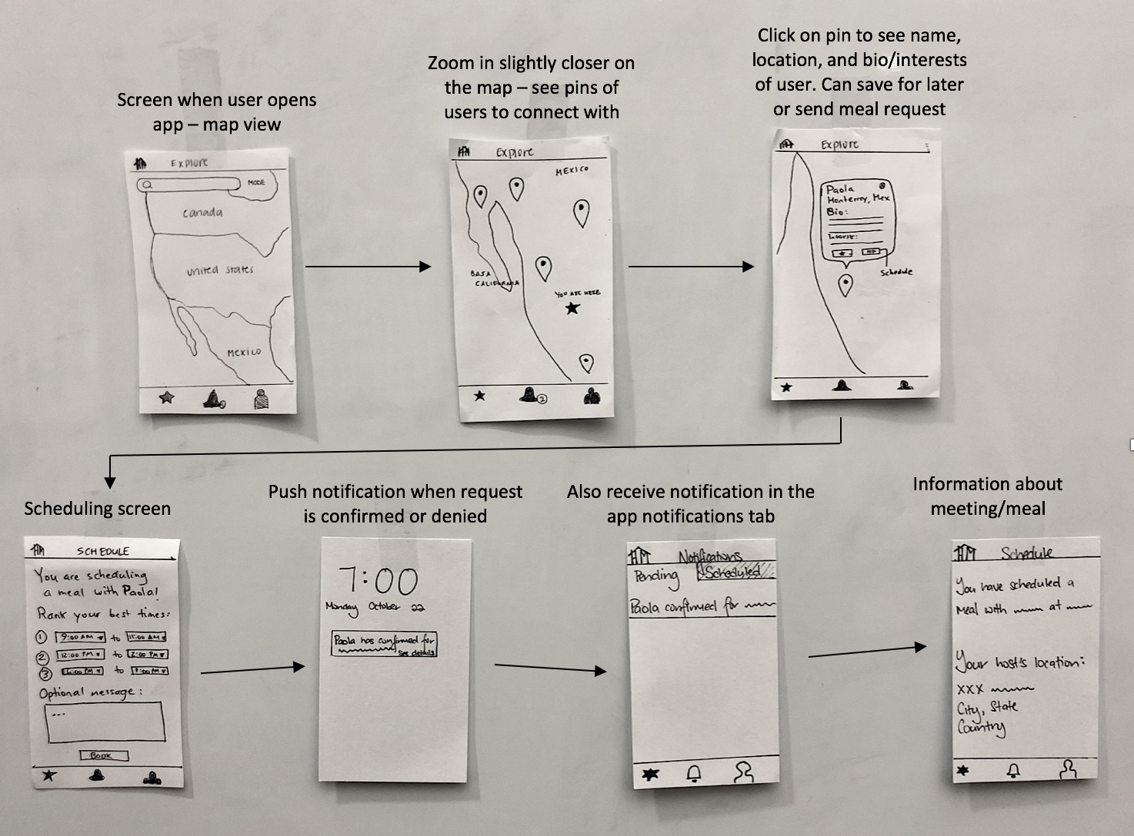
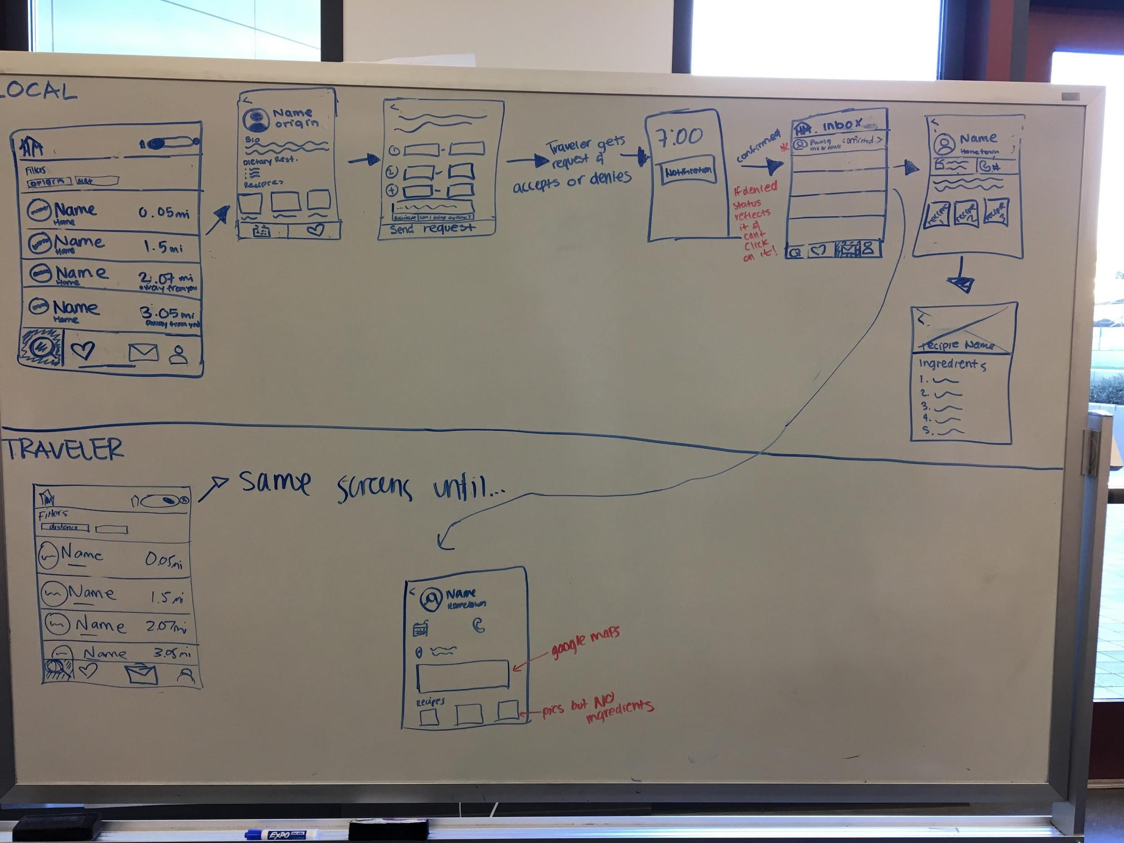
BEFORE
AFTER
Notes:
Coverage: To make sure that there was greater coverage, we added more screens like the confirmation screen (not on sketch, but can be seen on prototype screenshots) that allows for a more pleasant UX experience since the user is more guided throughout the process.
Revisions: The most major revision was not using the map interface. We were sad to see it go but realized that it was more confusing that it was helpful. The other major revision was creating distinction between the UI for local vs traveler mode.
Old vs New:
Old had map. New has list.
Old didn’t have filtering. New lets you filter your results.
Old didn’t have different UI for traveler and local. New has different UI to taylor to the needs of the traveler or the user
Difference 1
For the traveler, we show the distance under the name because we know that travelers are concerned with how far away things are because moving around an unknown city can sometimes be intimidating.
For the local, we show the travelers country of origin, because we know that they might be looking to experience a certain cuisine, or are trying to not repeat a culture that they have already experiences.
Difference 2
For the traveler, we use current location to display results, but he/she has the option of changing the location on the top bar
For the local, the top bar is a search bar that can be used to further filter the search results by country for ease of use and better user experience.
Addressing feedback & rationale:
The main reason why performed the changes that we outlined above is because lots of the people in our studio seemed to be confused by what the map was supposed to display, even after we explained it multiple times. This was a strong indication that our UI was not intuitive and that users would probably struggle with it.
We also noticed during our tests of the low-fi prototype that users wouldn’t really know how to interact with the map. For example, they would tap instead of zooming. This was further indication that the map UI was confusing.
We also had an original version of the med-fi prototype that had the distance in miles being displayed for all the users that showed up in explore. However, we showed it to our TA and the feedback was that this was confusing an impractical (you can’t retrieve the data of live location from everyone all the time). That’s why we took that feature away and instead only included a mileage calculator when on traveler mode. This milage shows how far away the user (aka the traveler) is from the home of the locals that are appearing in the search. Since homes are static, retrieving data shouldn’t be problematic.
Also worth noting, the reason why we added a filter for the local was because this was a suggestion that we received based off our low-fi prototype.

Slide 6
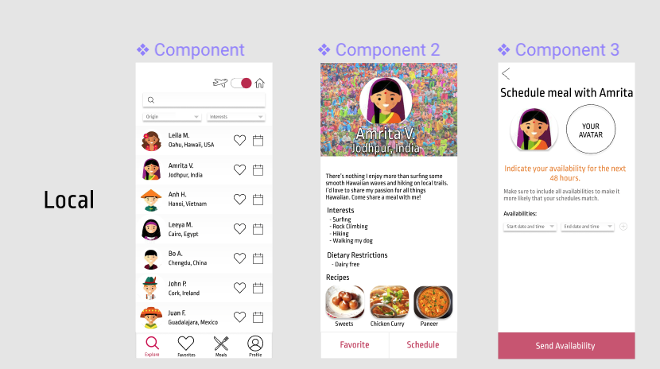

Slide 7
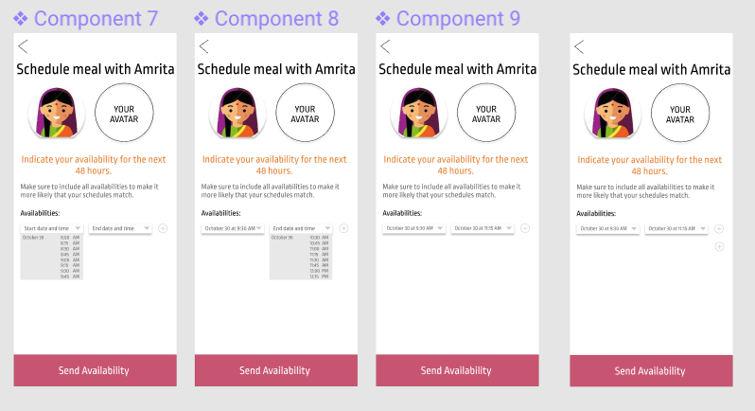

Slide 8
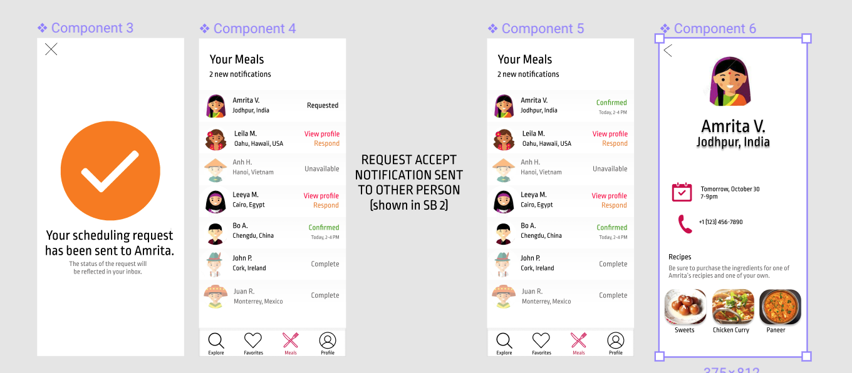

Slide 9
TASK 1 Extended
Meet foreign people to share interests/passions (local perspective)
Simple
Notes:
For the sake of completeness we decided to also do the user flow that accomplishes a task equivalent to task 1, but from the local’s perspective. We did this because we think that it’s important that we begin to explore the differences in the UX of accomplishing tasks that are parallel but from different viewpoints (i.e. the local or the traveler).

Slide 10
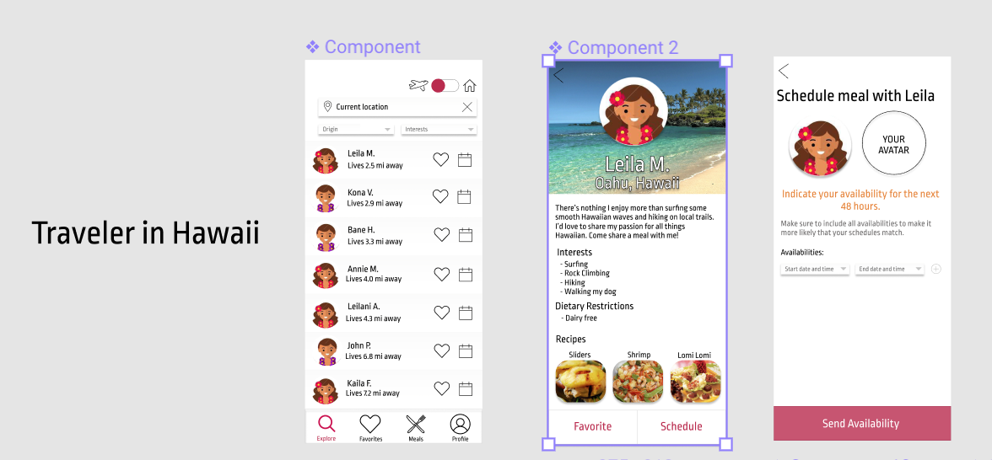

Slide 12
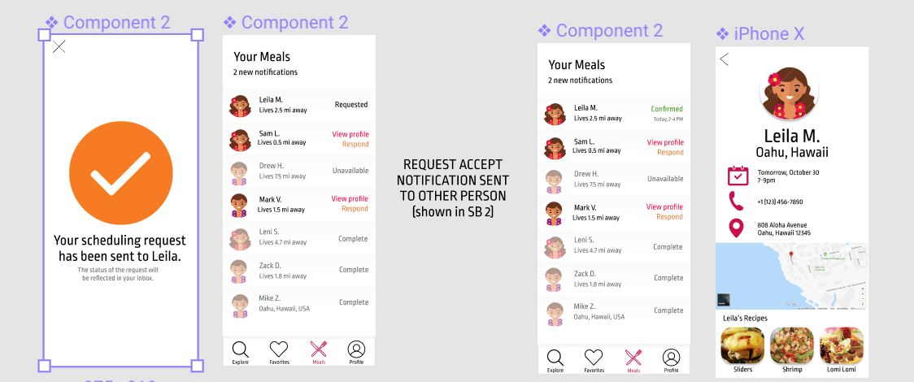

Slide 13
TASK 2
Share a meal with local people to experience authentic culture (traveler)
Moderate
Notes:
We modified task 2 to focus on confirming and preparing for the meal, rather than simply accessing ingredients lists for recipes in order to buy groceries. As a result this task begins with responding to a meal request and ends with all the confirmation details for the meal, including view the counterpart’s recipes.

Slide 14
Share a meal with local people (traveller)
View request with host’s availability
Select preferred meal time and confirm request
View host’ profile with recipes

Slide 15
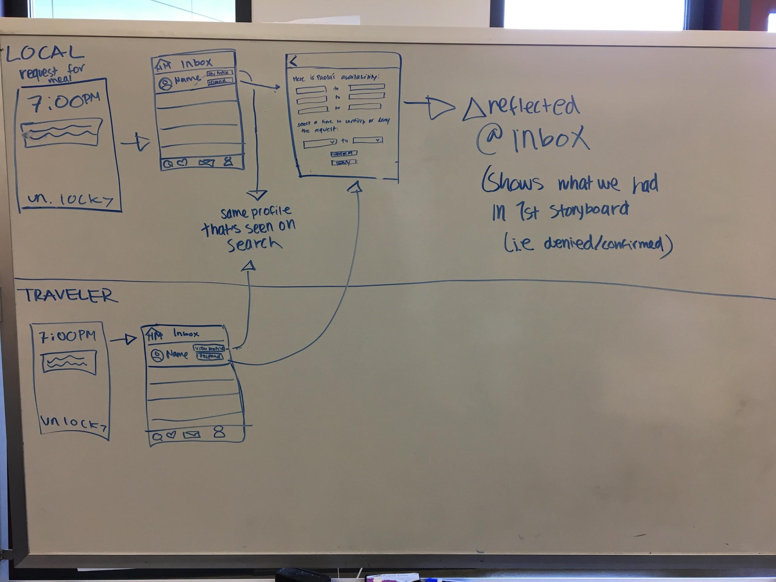
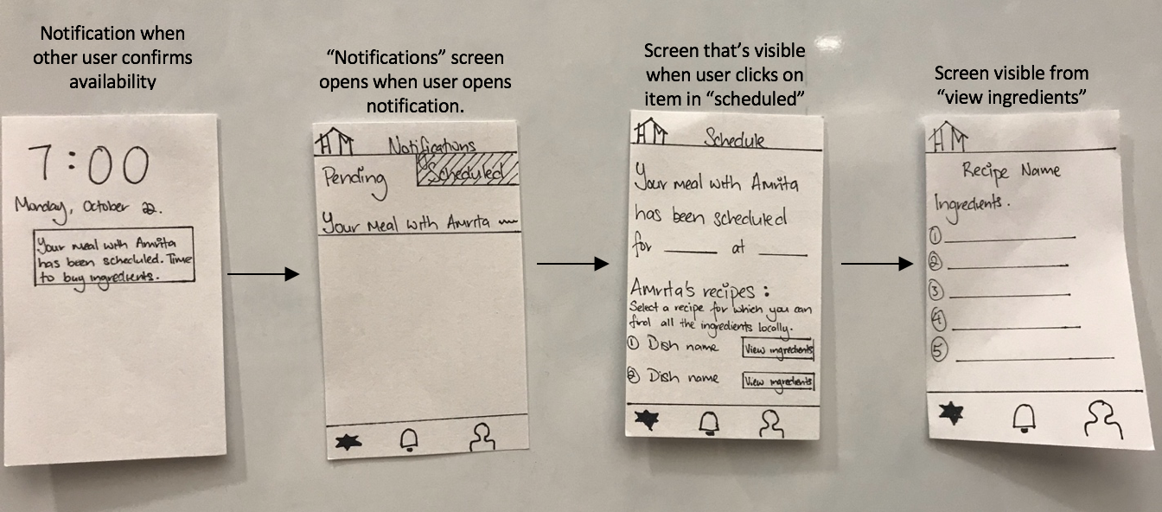
AFTER
BEFORE
Notes:
Coverage: We realize that we weren’t giving enough context to successfully perform the task with just two screens, so we made this task have lots of more screens so that the task would be a lot clearer (not evident in sketches, but evident in med-fi prototype screenshots, coming up).
Revisions:
Our testers were confused by the initial notification message, so we re-wrote it.
Changed the name to no longer be called “notifications”
Merges all notifications into one central “inbox” instead of having two tabs within the “inbox”.
Old vs New:
Old called “notifications”, new called “my meals”.
Old didn’t have graphics when viewing schedule. New has graphics when viewing schedule.
Old had two tabs, one for pending and one for scheduled. New has everything in one place, but differentiated by color and a status on the left.
Addressing feedback & rationale:
We provide tourists and locals a way to communicate with each other because once both sides confirm, they can see the other person’s phone number (this was suggested by TA).
During our tests, didn’t seem to know what the point of this task actually was. For this reason we added more screens, with the hope that walking through the process more slowly would make the task more digestible for the user.
TA mentioned the name “notifications” was confusing, so we changed it to “my meals”.

Slide 16
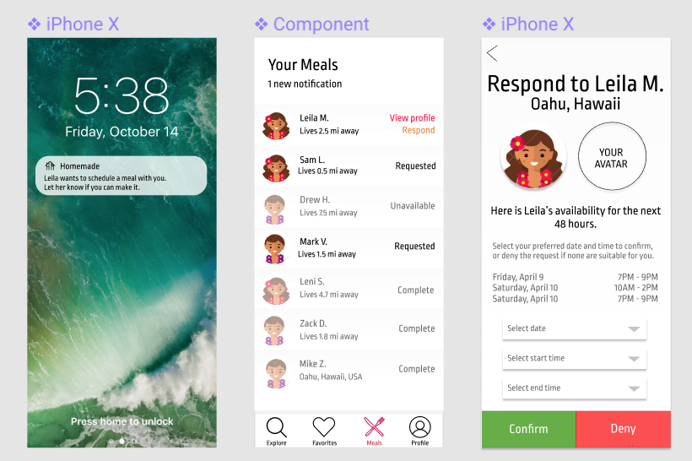

Slide 17
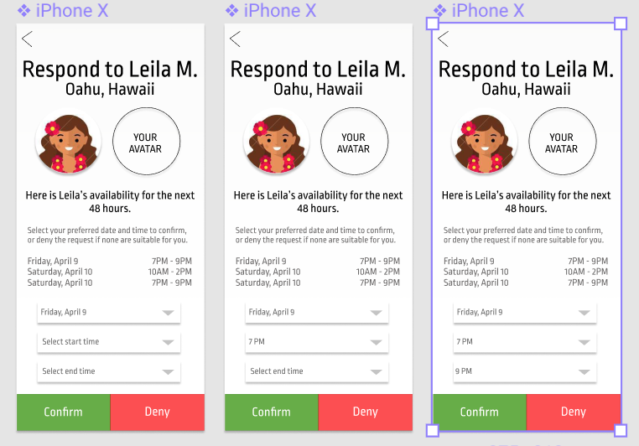

Slide 19
TASK 2
Share a meal with local people to experience authentic culture (traveler)
Moderate
Notes:
Similar to task 1, for the sake of completeness we decided to also do the user flow that accomplishes a task equivalent to task 2, but from the local’s perspective. We did this because we think that it’s important that we begin to explore the differences in the UX of accomplishing tasks that are parallel but from different viewpoints (i.e. the local or the traveler).

Slide 20
Share a meal with local people (Host)
View request with traveller’s availability
Select preferred meal time and confirm request
View traveller’s profile with recipes
Select recipe and export ingredients list

Slide 21
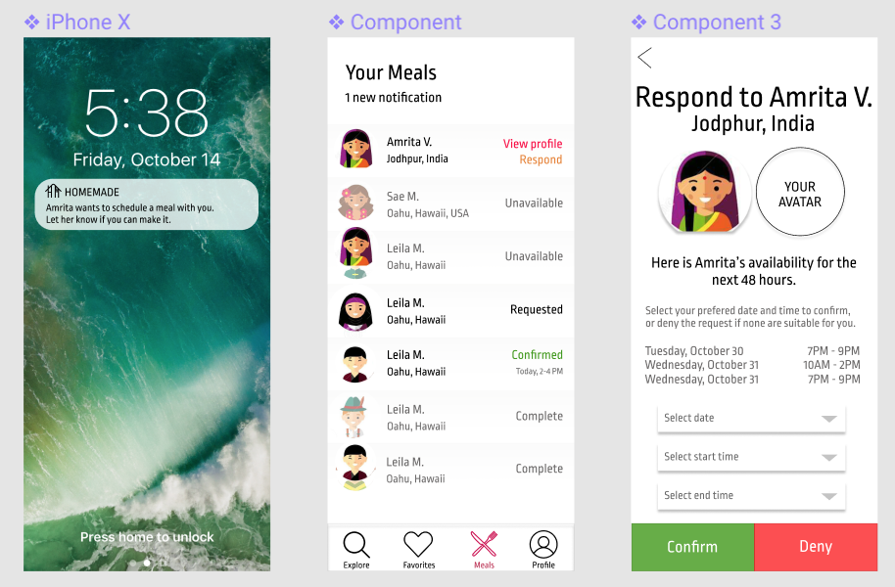

Slide 22
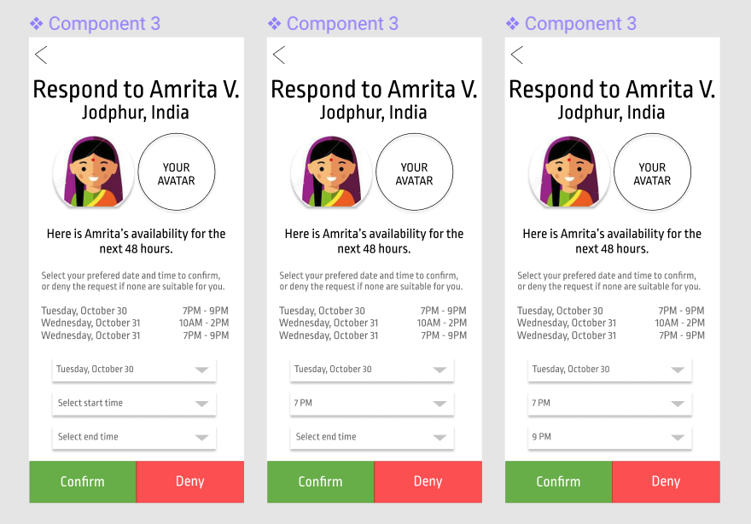

Slide 23
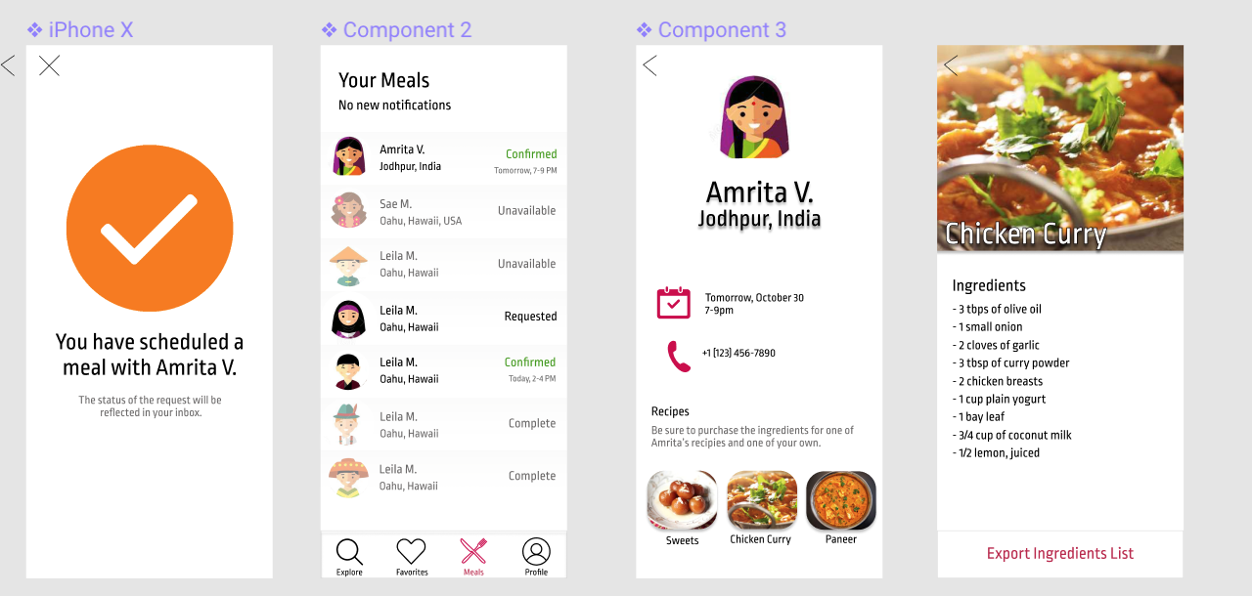

Slide 24
Task 3
Get to know someone from a different culture without traveling (local)
Complex

Slide 25
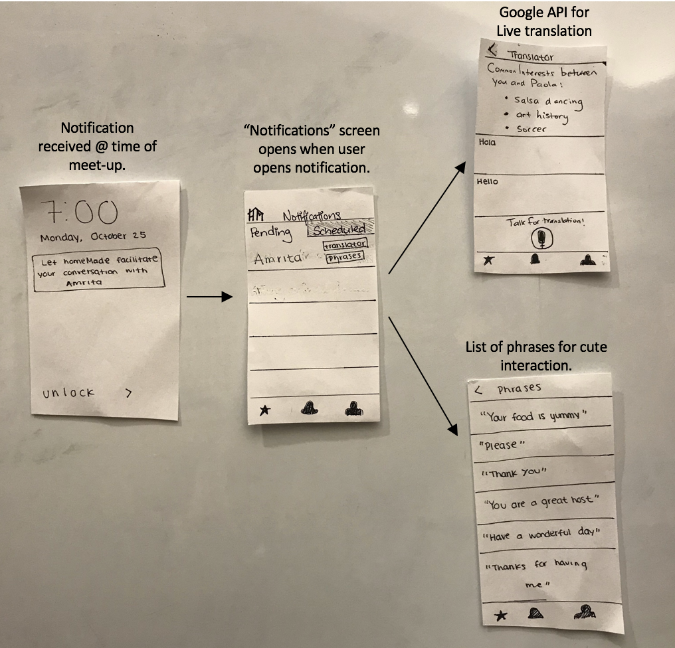
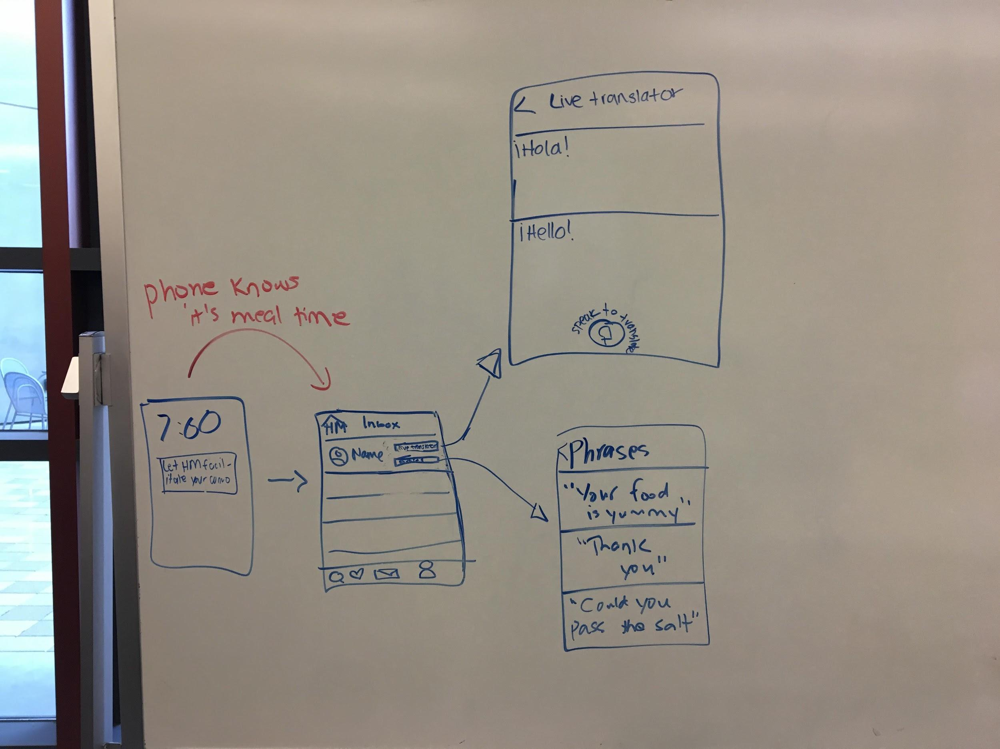
BEFORE
AFTER
Notes:
Coverage: The coverage seemed to be pretty well in our low-fi prototype, so we didn’t make any major changes in our med-fi prototype in terms of coverage.
Revisions: We completely revamped the notifications page (as previously mentioned when discussing changes made to task 1).
Old vs New:
Old had unintuitive “notifications” center. New has “my meals” center.
Didn’t make sense to take the user to “notifications” during time of the meal.
Addressing feedback & rationale:
TA mentioned that the “confirmed screen” was confusing. This was also one of the reasons why we got rid of notifications and created one central location where the users can see all his or her meals called “my meals”.
In general we hoped to convey greater clarity to the user by putting all of the people it was interacting with on one screen instead of having multiple screens.

Slide 26
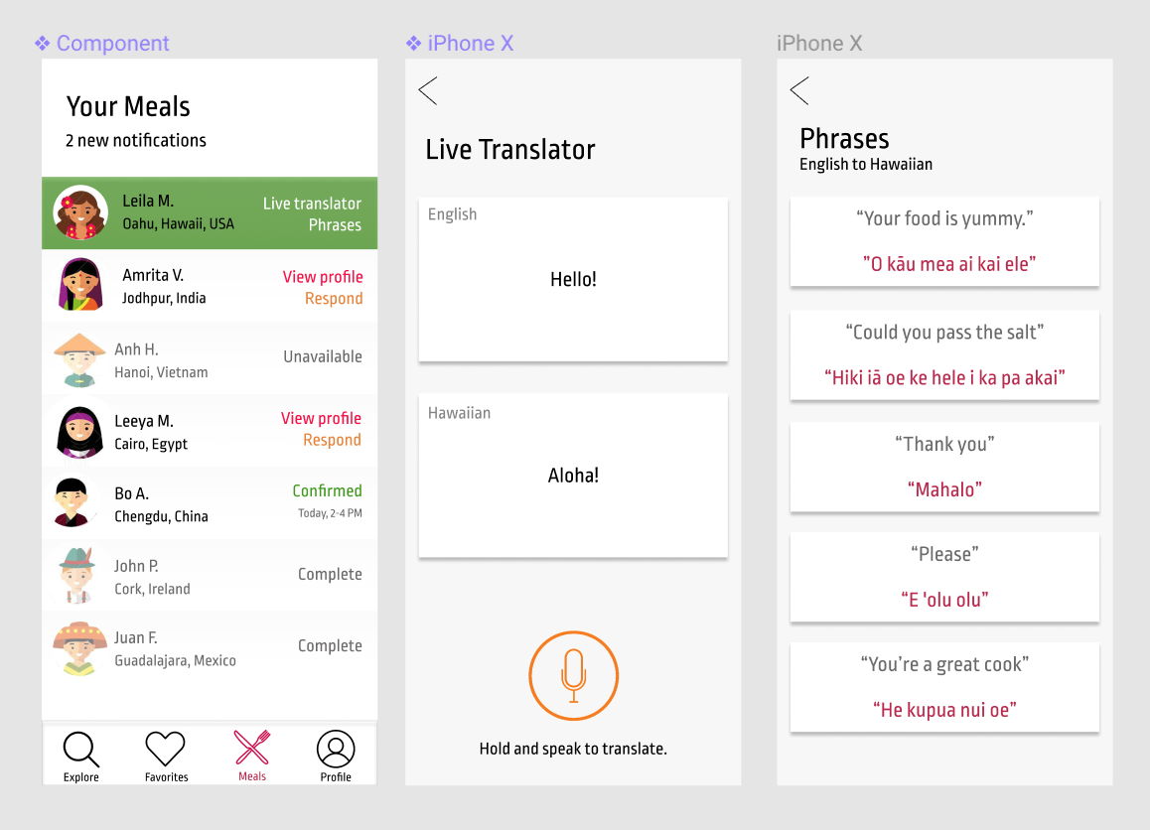

Slide 27
MAJOR CHANGES

Slide 28
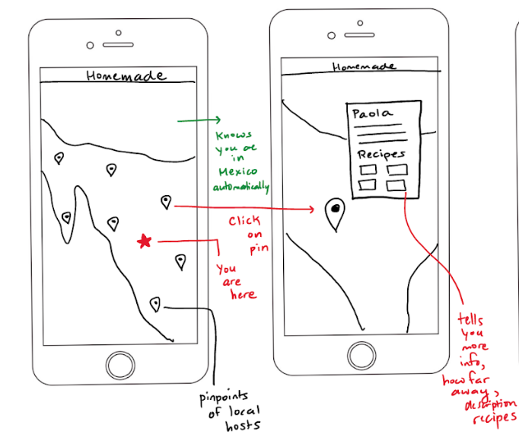
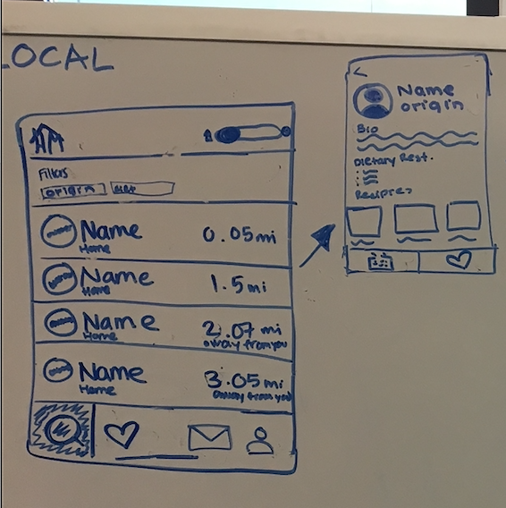
Major Change 1: From Map Design to List Design
Notes:
Rationale: We redesigned the main user interface because viewing people on a map was not intuitive from the host’s perspective when travellers are pinned to their hometown. In order for both user groups to have the best experience, users are now organized via lists.
We also decided to go with this redesign because we realized that we can’t display live exact location all the time because of safety concerns and because it’s simply not practical.
This conclusions were reached thanks to feedback and user testing which made us realize that our map UI was non-intuitive.

Slide 29
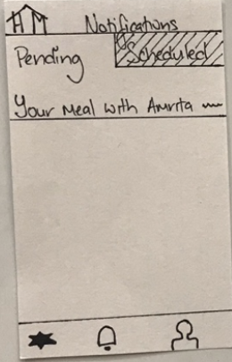
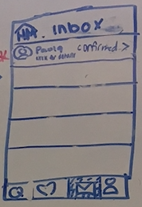
Major Change 2: Reorganized notifications
Notes:
Rationale:
We reorganized all notifications under a “Meals” section in order to streamline and simplify interactions. Rather than dividing notifications between pending and scheduled categories, all notifications are groups by request and their corresponding user. Under this design, it is easier to view the statuses of all meals and any associated tasks.

Slide 30
Major Change 3: Traveler Vs. Local Mode Changes UI Significantly
In our old designs, we thought all our screens would look the same for both the traveler and local (that is, they would have the same interface)
This proved to be a little confusing
One of our newer improvements is to change the interface based on the mode you are in

Slide 31
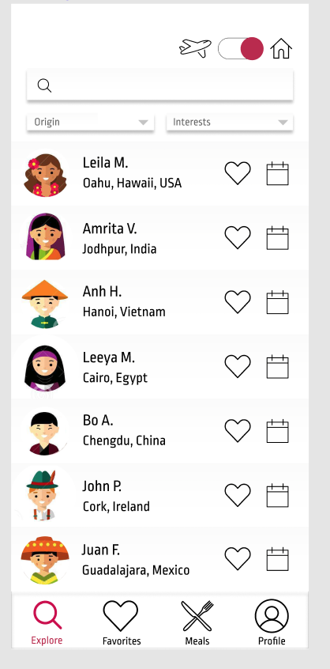
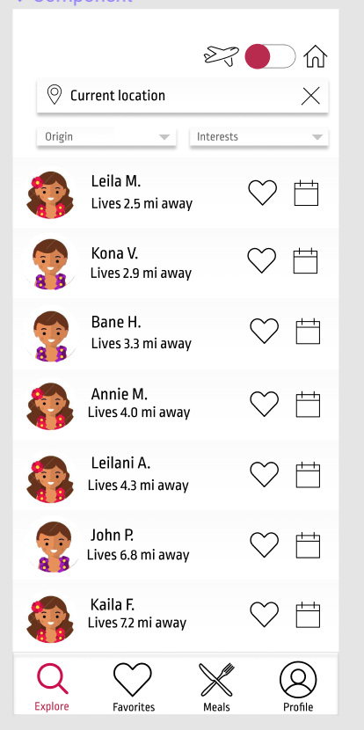
Example: Distances
Notes:
Rationale: We wanted to change the screens for the traveler and local modes so that it would be less confusing and more clear to the user as to what they need to do in the mode they are in. Therefore, for the local, we have a way to see where the travelers are from (and their avatars they choose are also telling) and for the traveler, he can see where the local is staying (approximately) from a specified living location.

Slide 32
Major Change 4: Explore Button
Notes:
We added the explore button at the bottom to go this general search page which is different from what we had before (which was just if you clicked on the icon, it would take you to the home page). We thought this would make it clearer for the user to do their searching and is modeled after many apps that have their search button on the bottom.

Slide 33
PROTOTYPE OVERVIEW

Slide 34
Prototyping Tools
Used Figma to make and style the prototype (emulating iPhone X)
Used InVision to add interactive elements which highlighted clickable areas, giving users hints - easy!
Hard to include audio for our third task - hard!

Slide 35
Limitations/Tradeoffs
Animations simplified/excluded
E.g. users should be able to scroll through more times in drop down menu not there yet
For now, to keep it simple, we had generate a list of sample times
Prototype focused on two users
Prototype does not show how to edit a user profile page
User’s history page (shows who they have previously connected with) currently excluded for simplicity

Slide 36
Wizard of Oz Techniques
Did the scheduling matches behind the scenes so that user can see what happens after a meal has been scheduled
This is done by the InVision Prototype “waiting” for a couple seconds after the meal has been requested, and then having that meal being marked as confirmed

Slide 37
Hard-coded Features
Mock user profiles (textual/image content) to simulate full experience
User can customize profiles and info on it like bio, interests, dietary restrictions, and recipes
Date options hardcoded (in real life this would correspond to actual dates)

