Slide 1
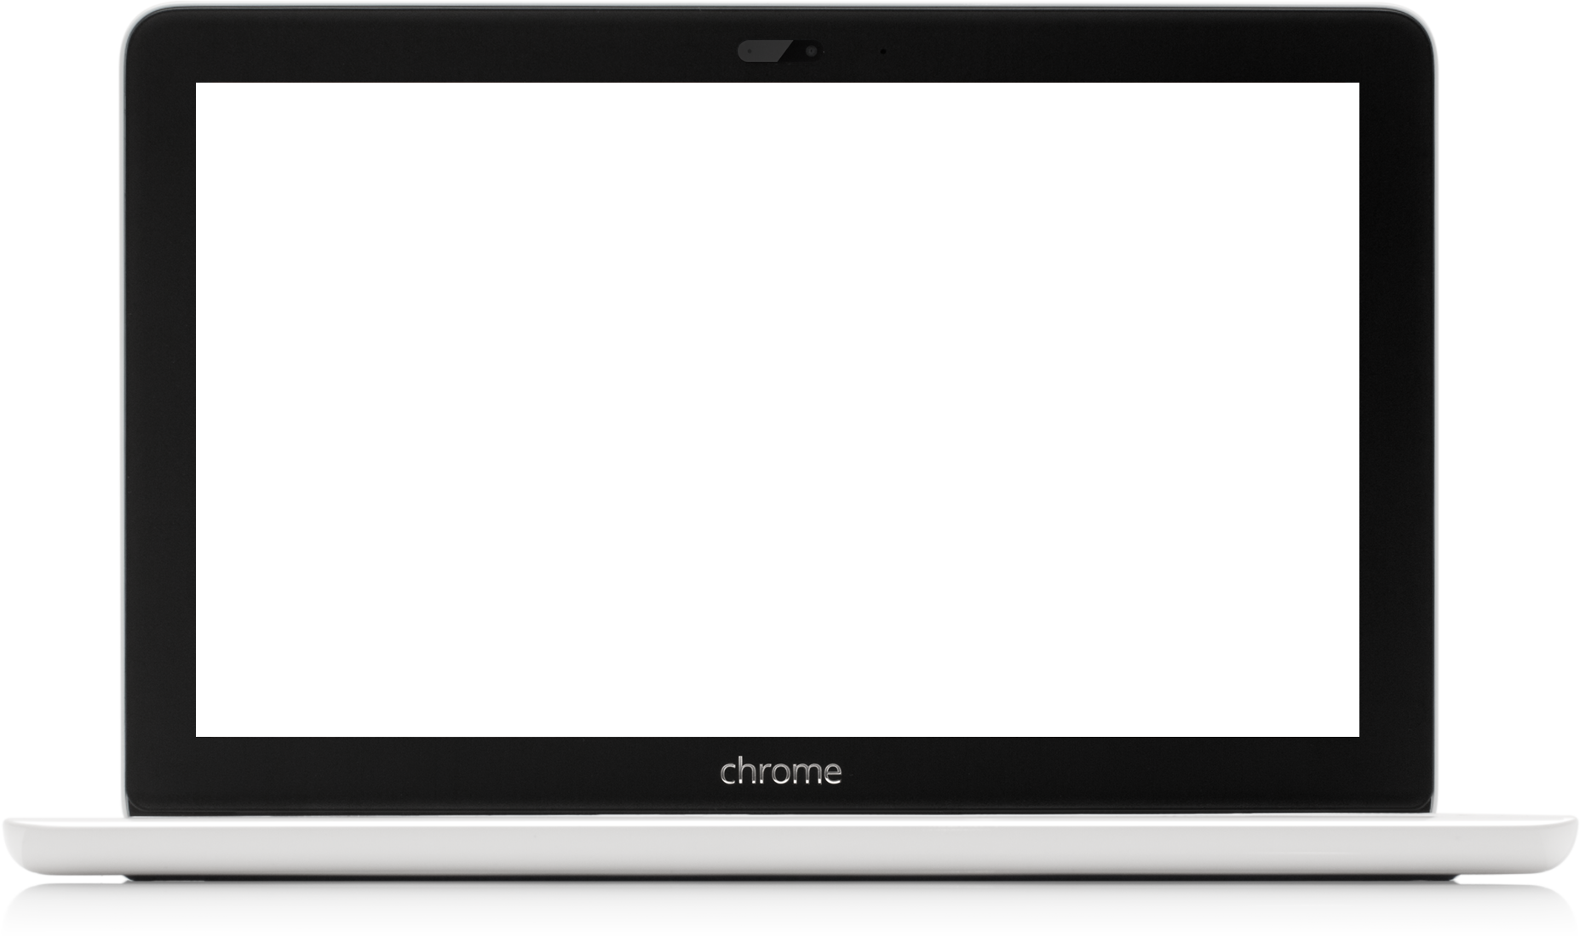
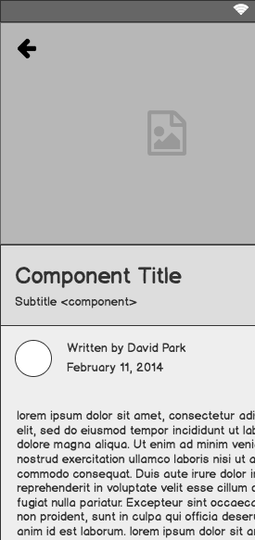
Homemade
Low-fi Prototype
Team 1 :
Erin C, Emilia D, Paola M, Amrita V

Slide 2
Outline
Mission Statement
Interface Design
Low-fi Prototype
Task Flows
Usability Testing

Slide 3
Value Proposition
Mission Statement
Travel through your kitchen.
Bring authentic cultural experiences to all people regardless of travel constraints.

Slide 4
Selected Interface Design

Slide 5
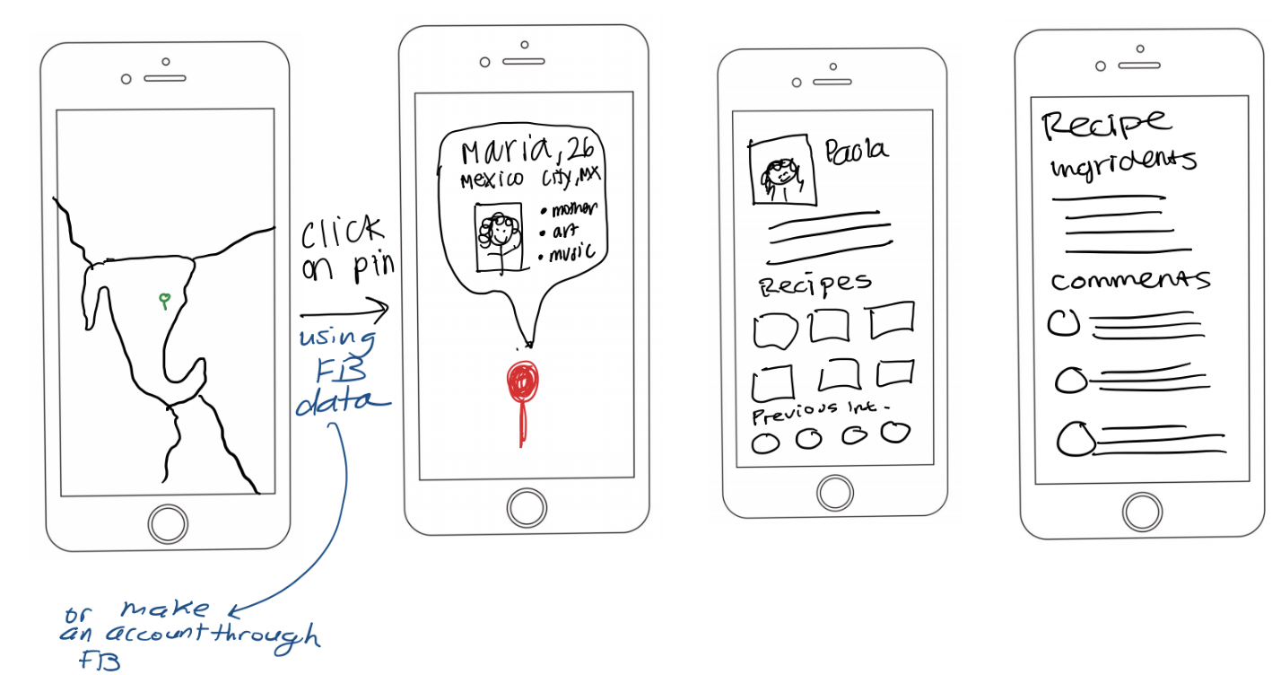
Map Design

Slide 6
Rationale
Emphasizes geographic location
Map visual emphasizes “travel”
Familiarity : UI of the map view is similar to existing apps
Easy for users to answer question: “where do I want to travel?”

Slide 7
Low-fi Prototype

Slide 8
Homemade Paper Prototype
Visual emphasis of travel

Slide 9
Homemade Paper Prototype
Simulate mobile interactions

Slide 10
Task Flows

Slide 11
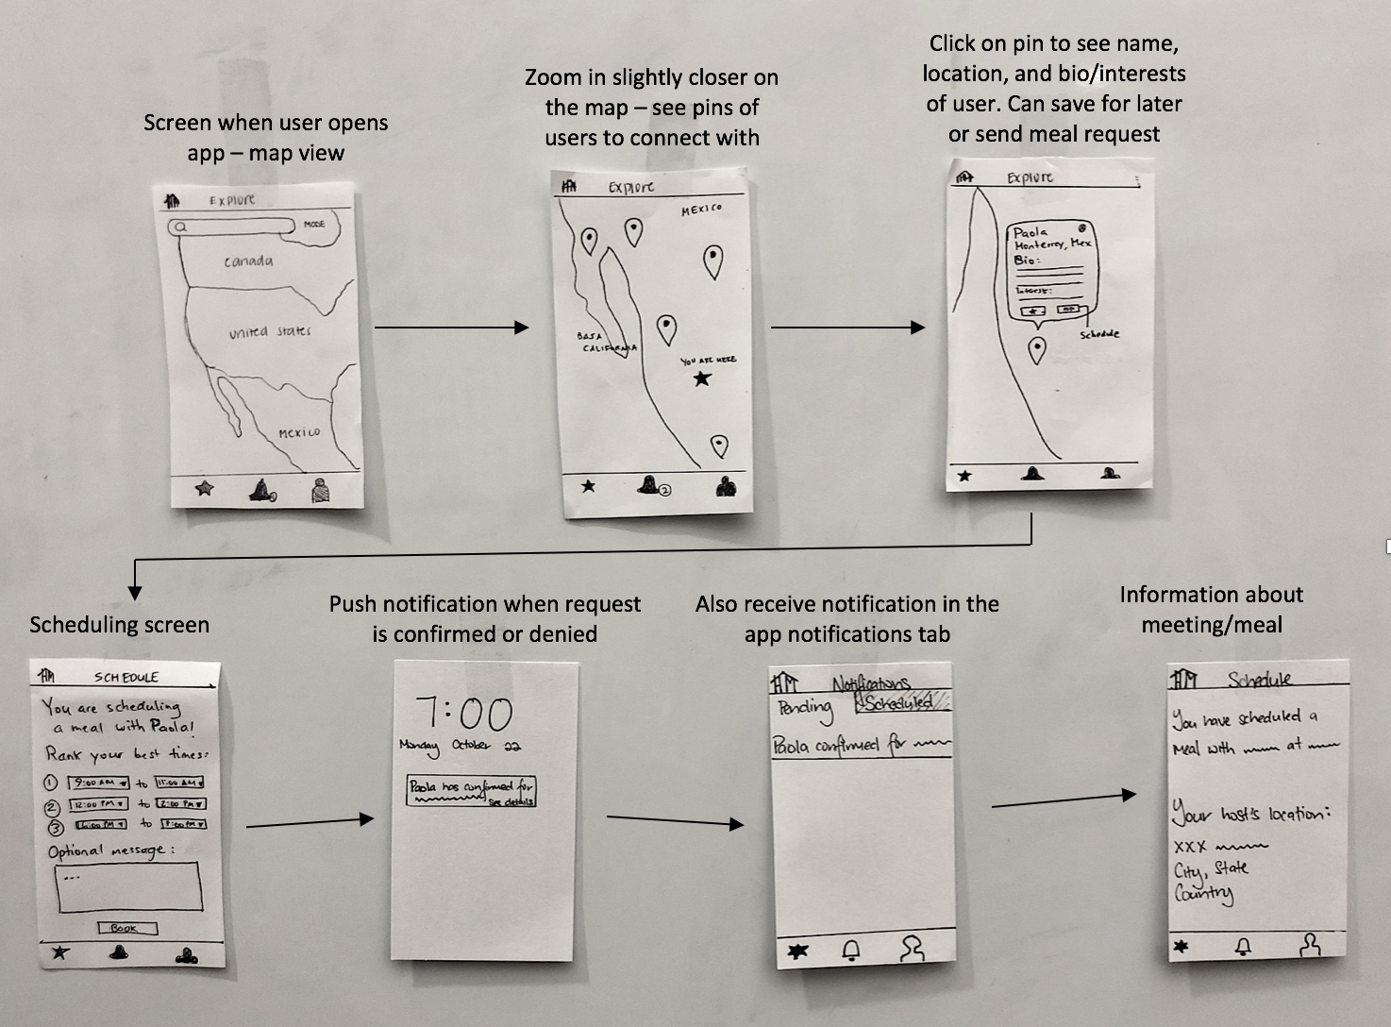
Task 1 : Meet local people (traveller)

Slide 12
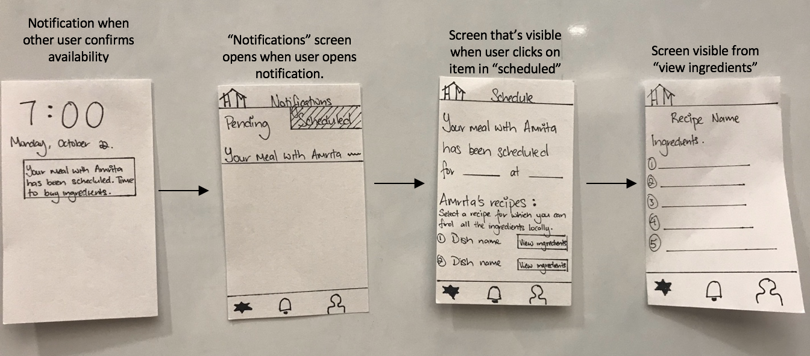
Task 2: Get groceries to share a meal (host)

Slide 13
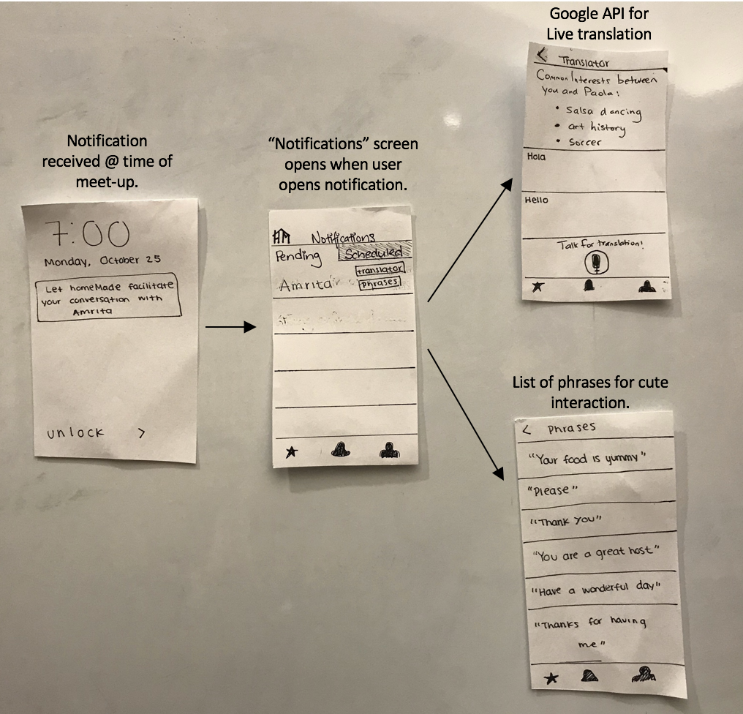
Task 3 : Bond with someone from a different culture (both)

Slide 14
Usability Testing

Slide 15
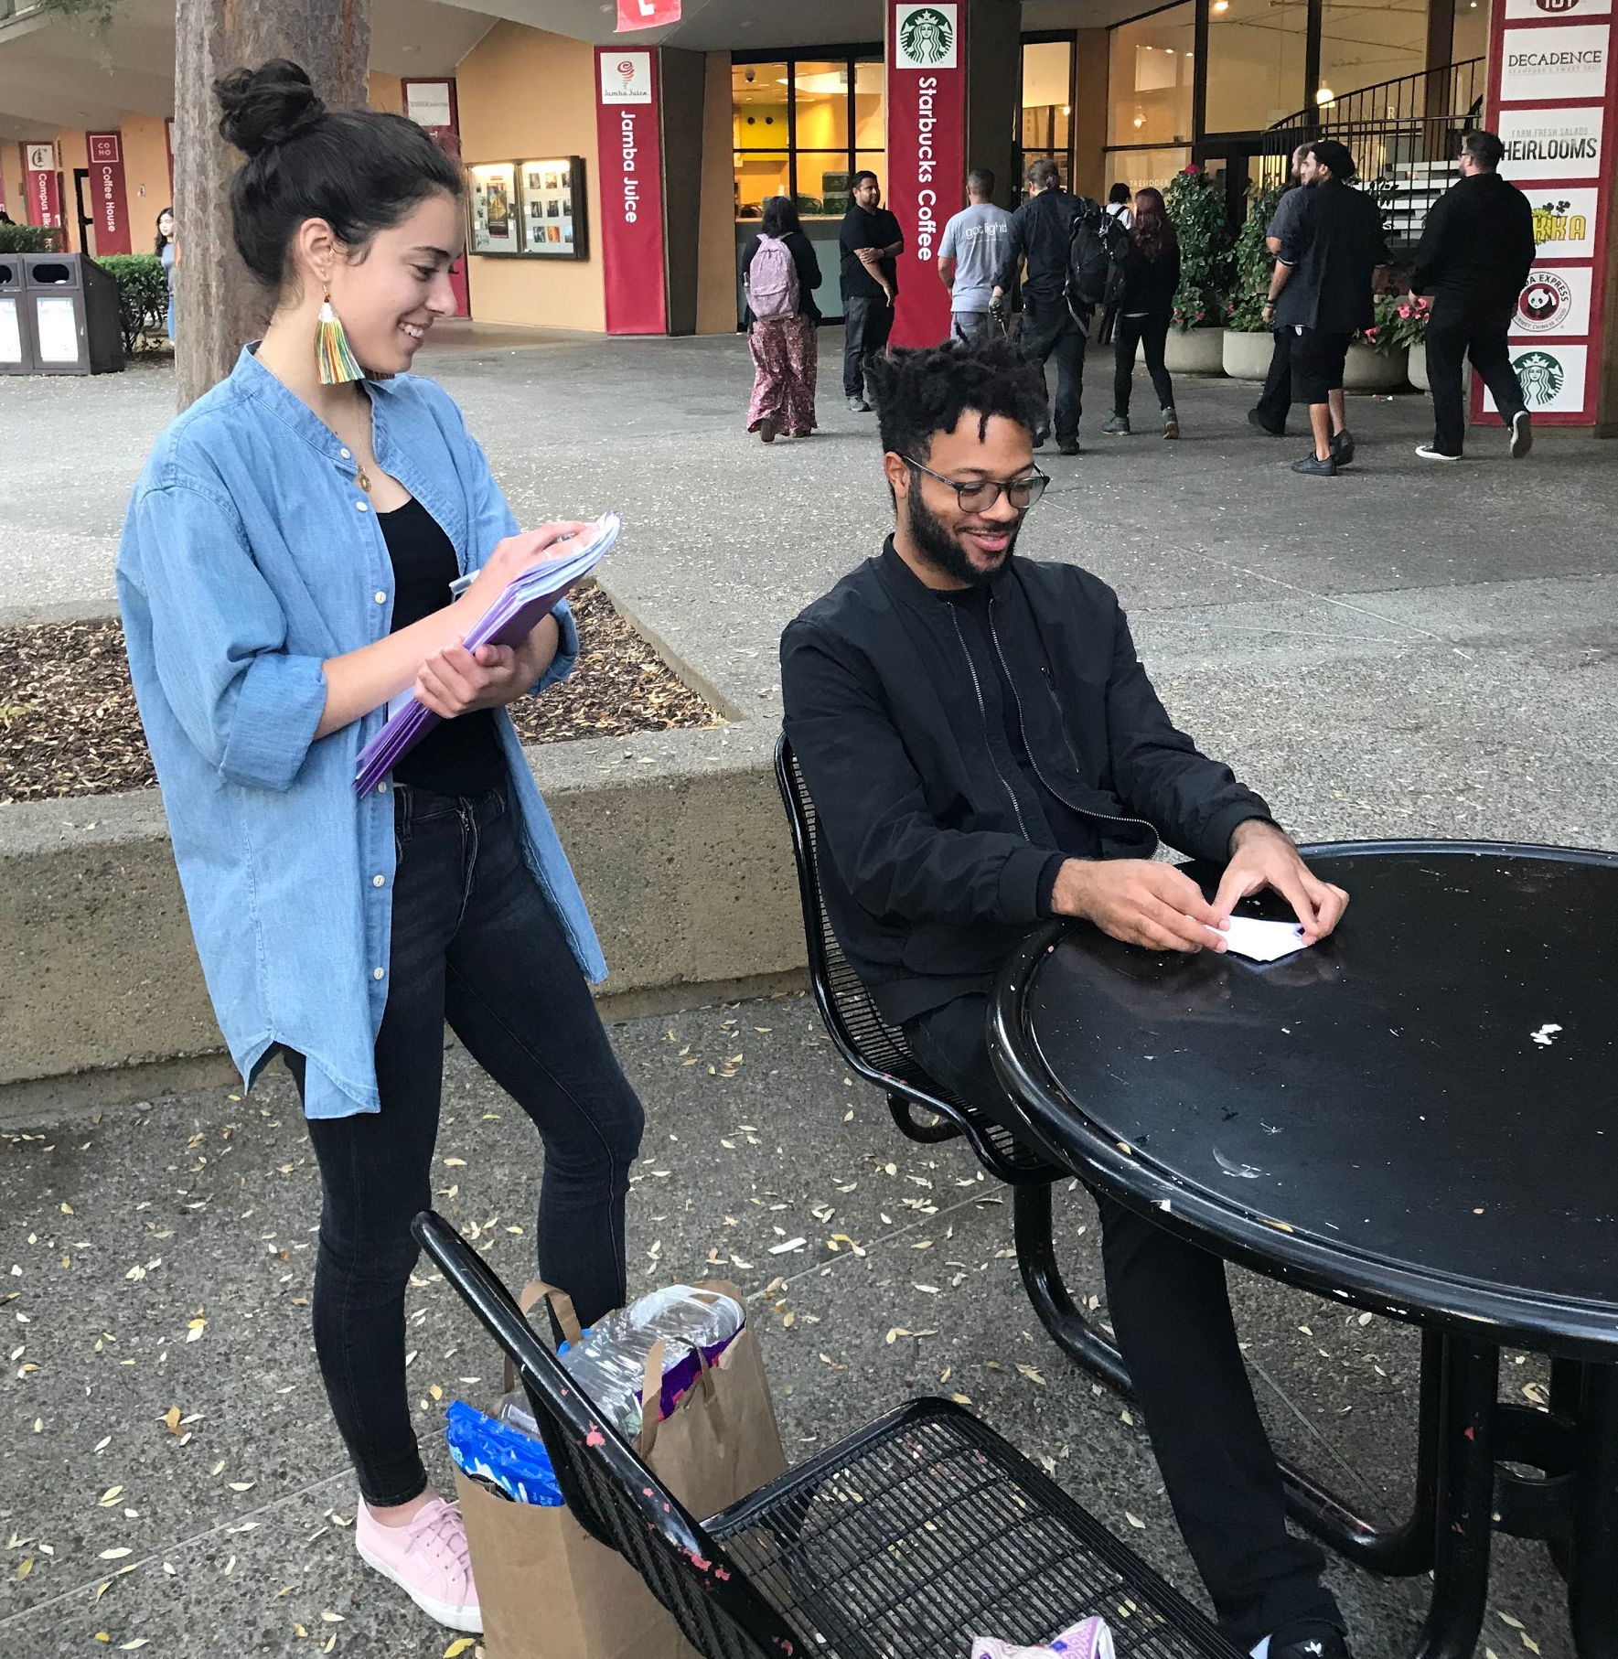
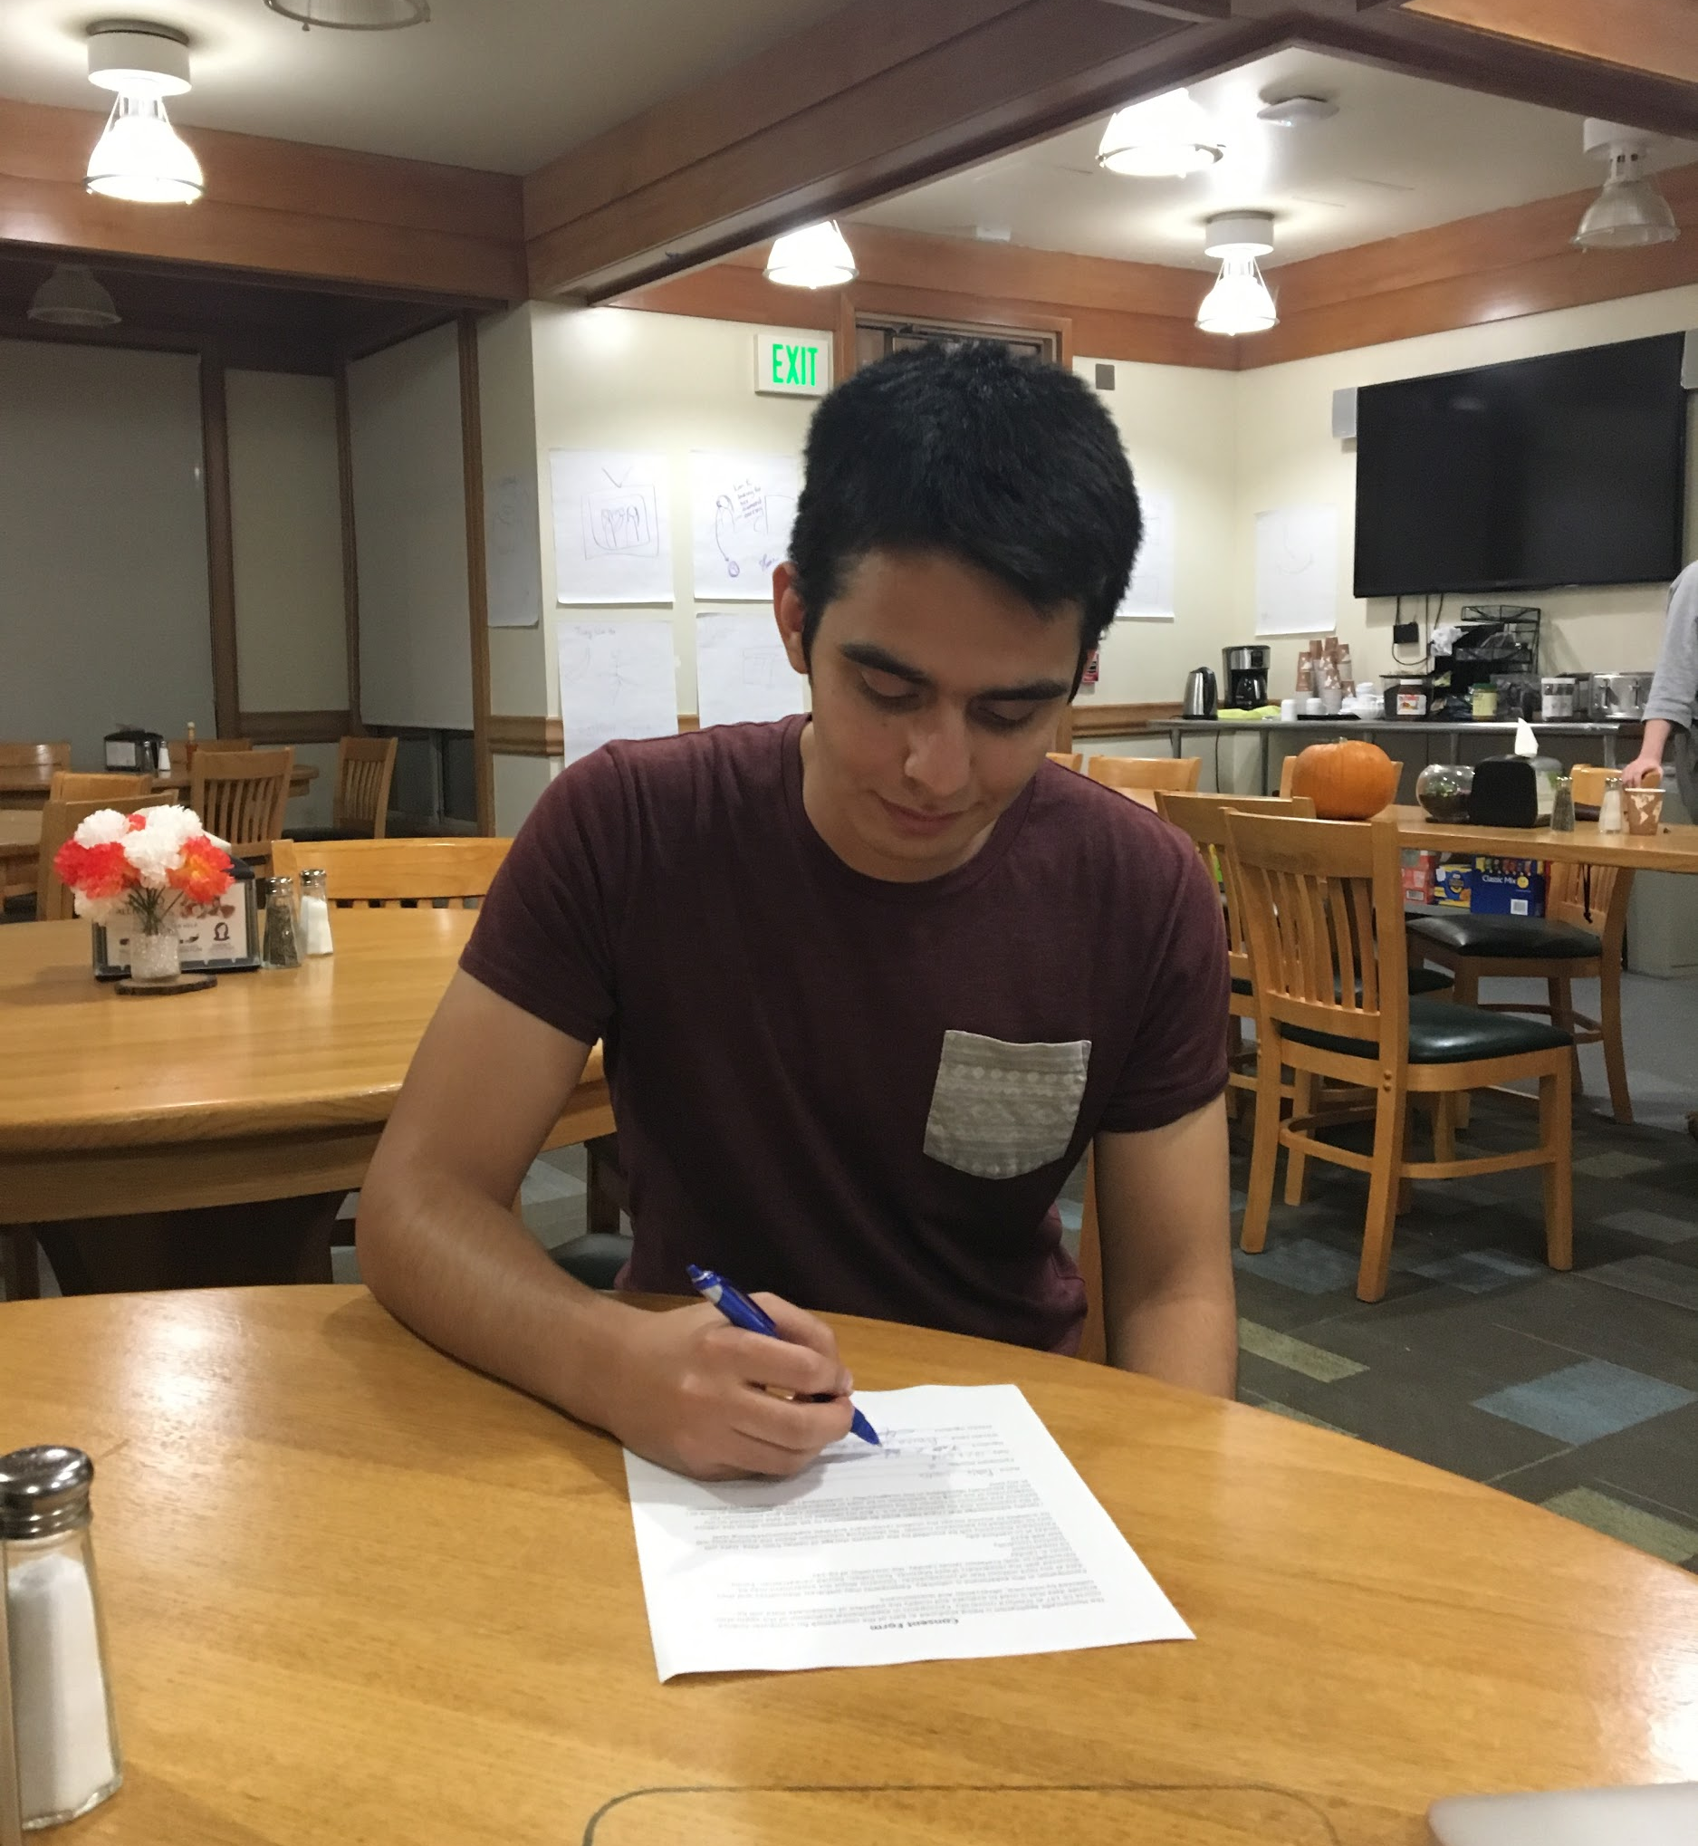
Usability Testing:
Method
3 volunteer participants: no compensation.

Slide 16
Usability Testing:
Results
Users had difficulty understanding our complex process without instructions.
Users did not know what to do with the information presented (buy ingredients).
Notification messages were not clear.

Slide 17
Survey Ratings

Slide 18
Suggested UI Changes
Improve discoverability of search bar with text: : “Search”
New favourites icon; currently used for two features.
Let users “request” meal to signify confirmation pending; instead of “book”.
Ability to print or export ingredients list.
Move common interest to a new screen; currently paired with translator.

Slide 19
Questions?

