Slide 1
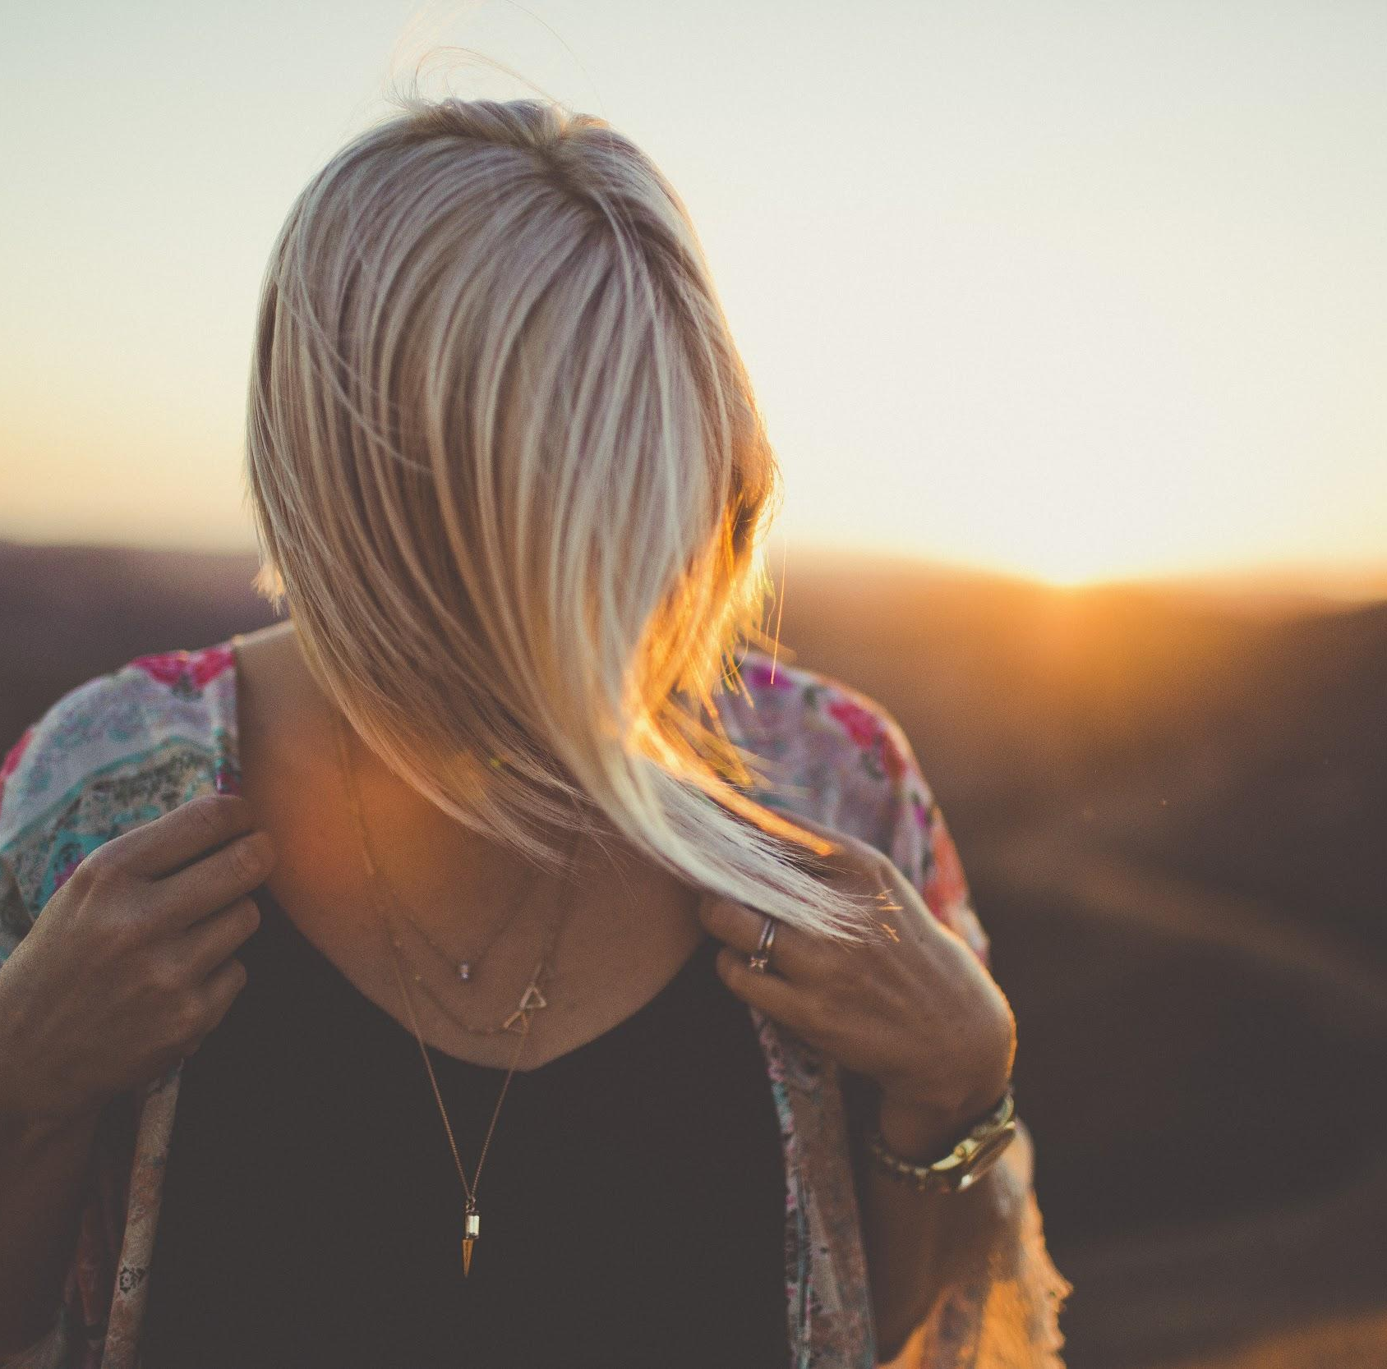
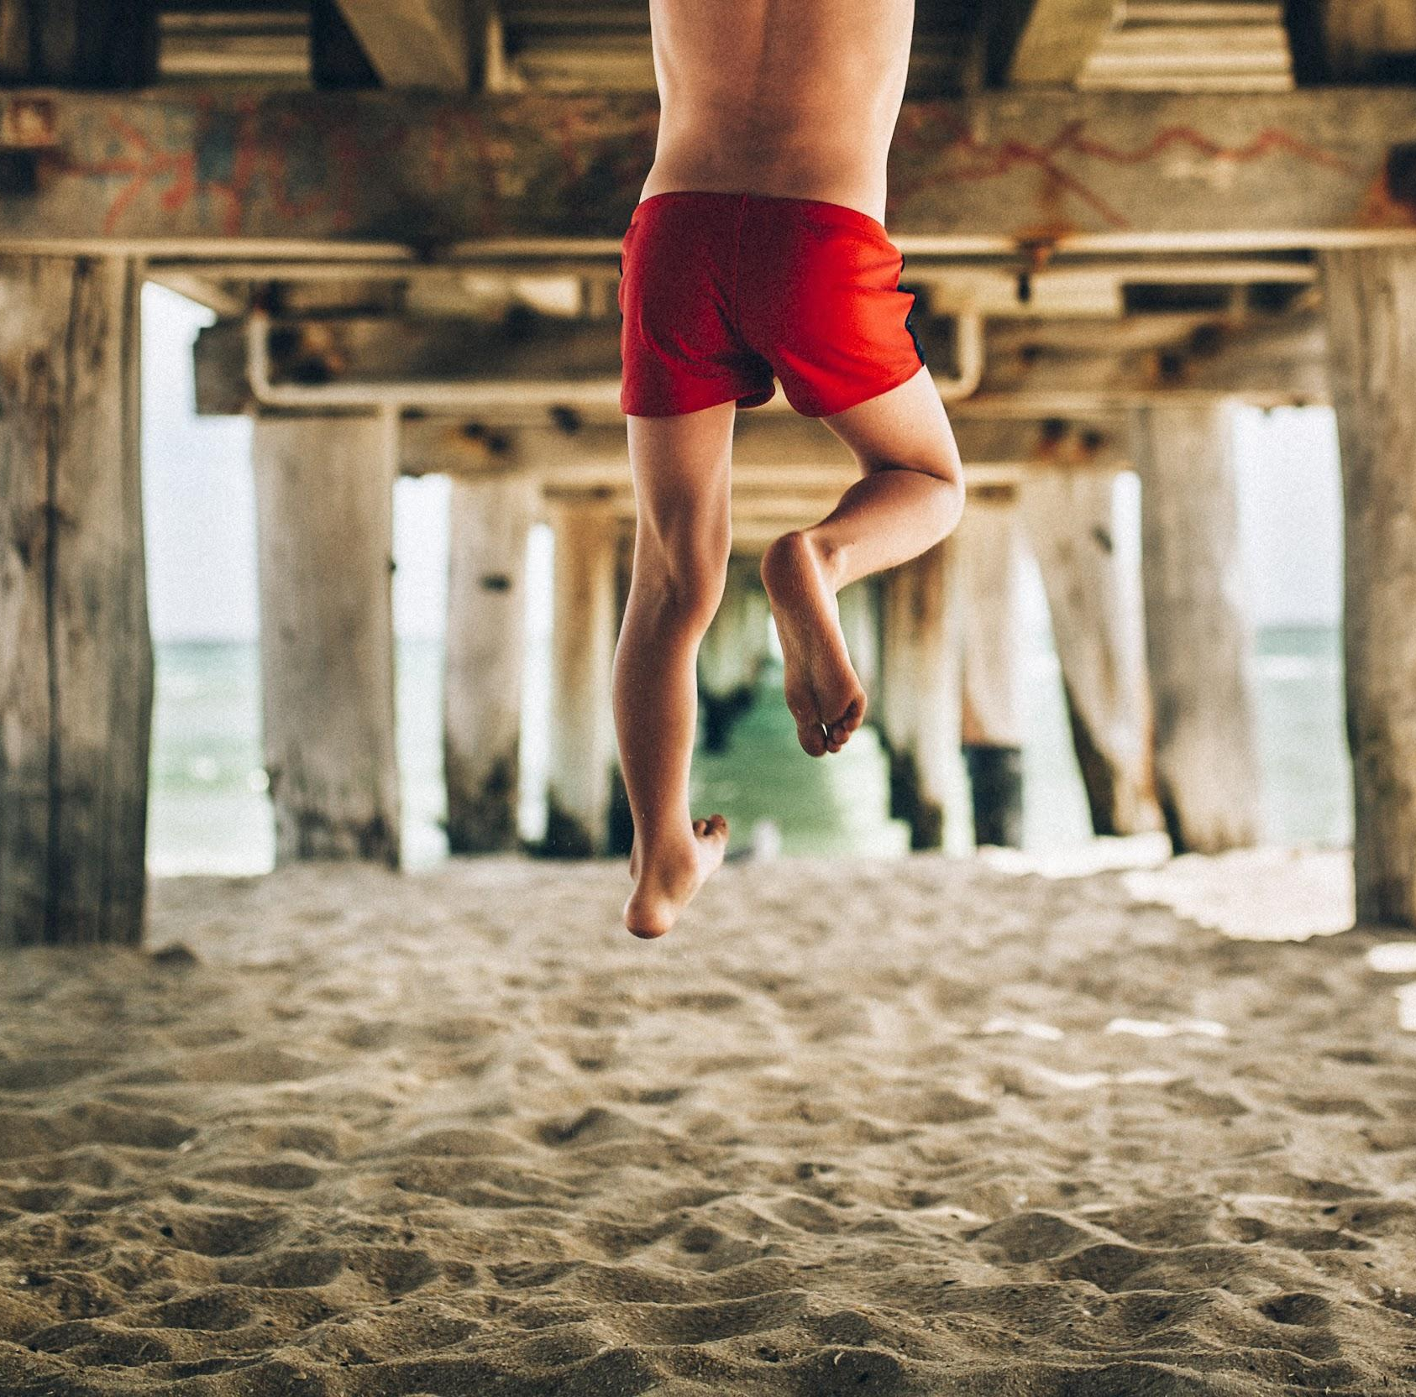
NeedFinding
• Amrita • Emilia •
• Erin • Paola •
Notes:
Present Names… decided to go with sticky notes because this week we learned out the power of sticky notes!

Slide 2
Domain of Interest
Experiencing new places
Notes:
We wanted to focus on physical traveling and let our need finding narrow down or domain of interest even further
Noticed most of the experiences our initial interviewees would share would revolve around traveling to NEW places, learning about NEW cultures and the feelings that they experienced as a result of that
Decided to explore this topic and begin doing our other interviews by basing ourselves off of this domain of interest.

Slide 3
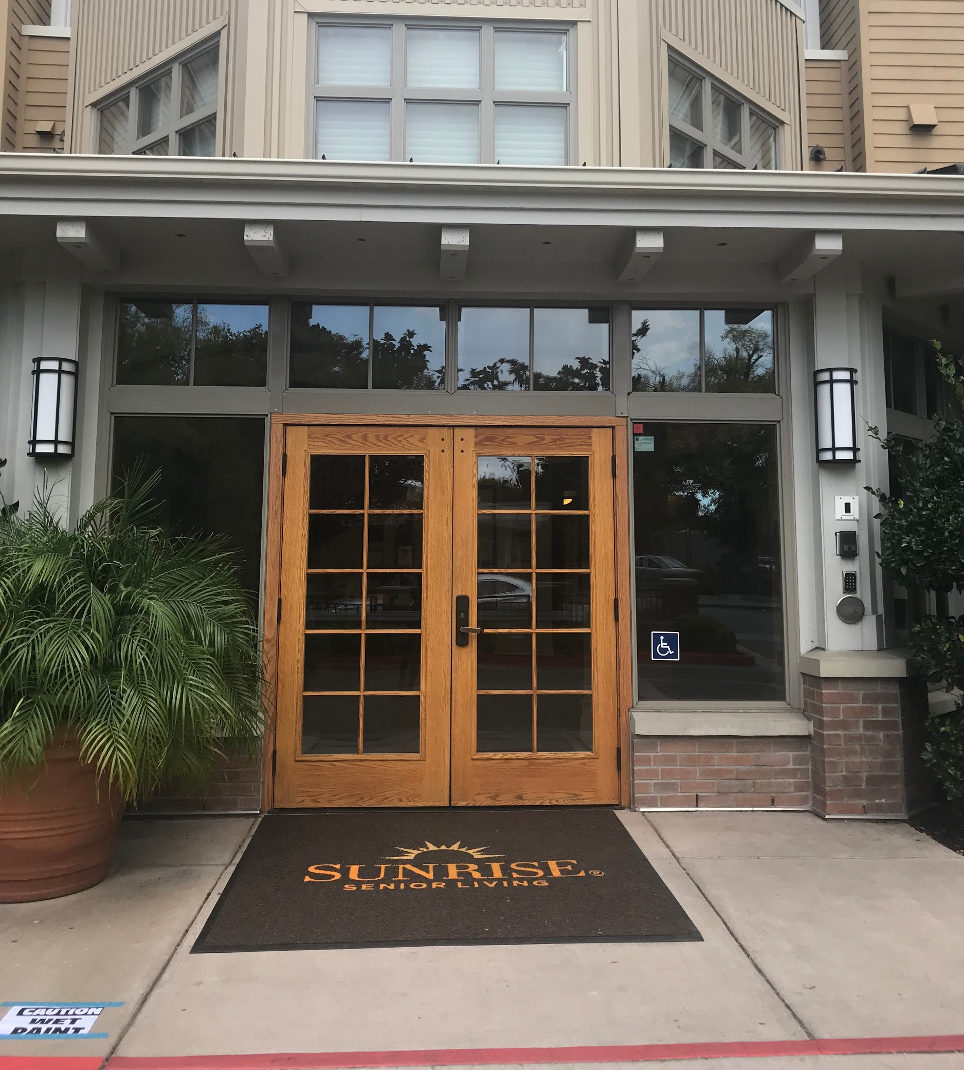
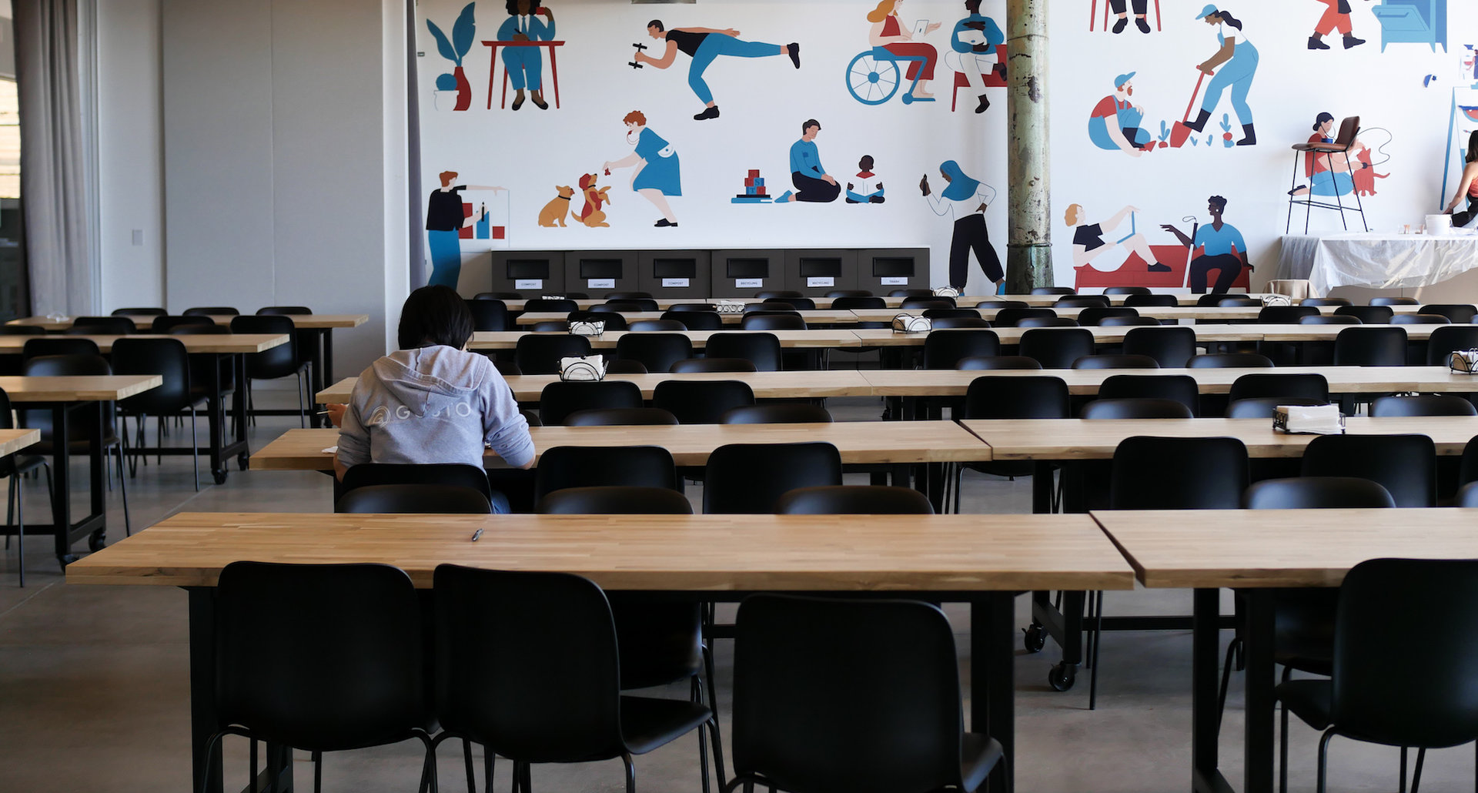
Notes:
Conducted interviews in places where our interviwees would feel + comfortable.
Offered no incentives
MIN 1:30 by end of this

Slide 4
What is the first thing that comes to mind when you hear the word travel?
What has been your best travel experience?
What tools do you use to make travel to new places easier?
?
What has been the most delightful part of travelling to new places? What has been the most frustrating?
What has been your worst / most frustrating experience when traveling to new places?
Notes:
we were always very conscious about asking questions that would make the interviewees tell stories
Made sure that our questions related to our domain of interest
Dive into stories and simply listen and absorb what they were saying
conscious about not projecting our own opinions and ideas
We would time for them to reflect (pause)
We would ask “why” in indirect ways (not actually say “why”)
MIN 2:30 by end of this

Slide 5
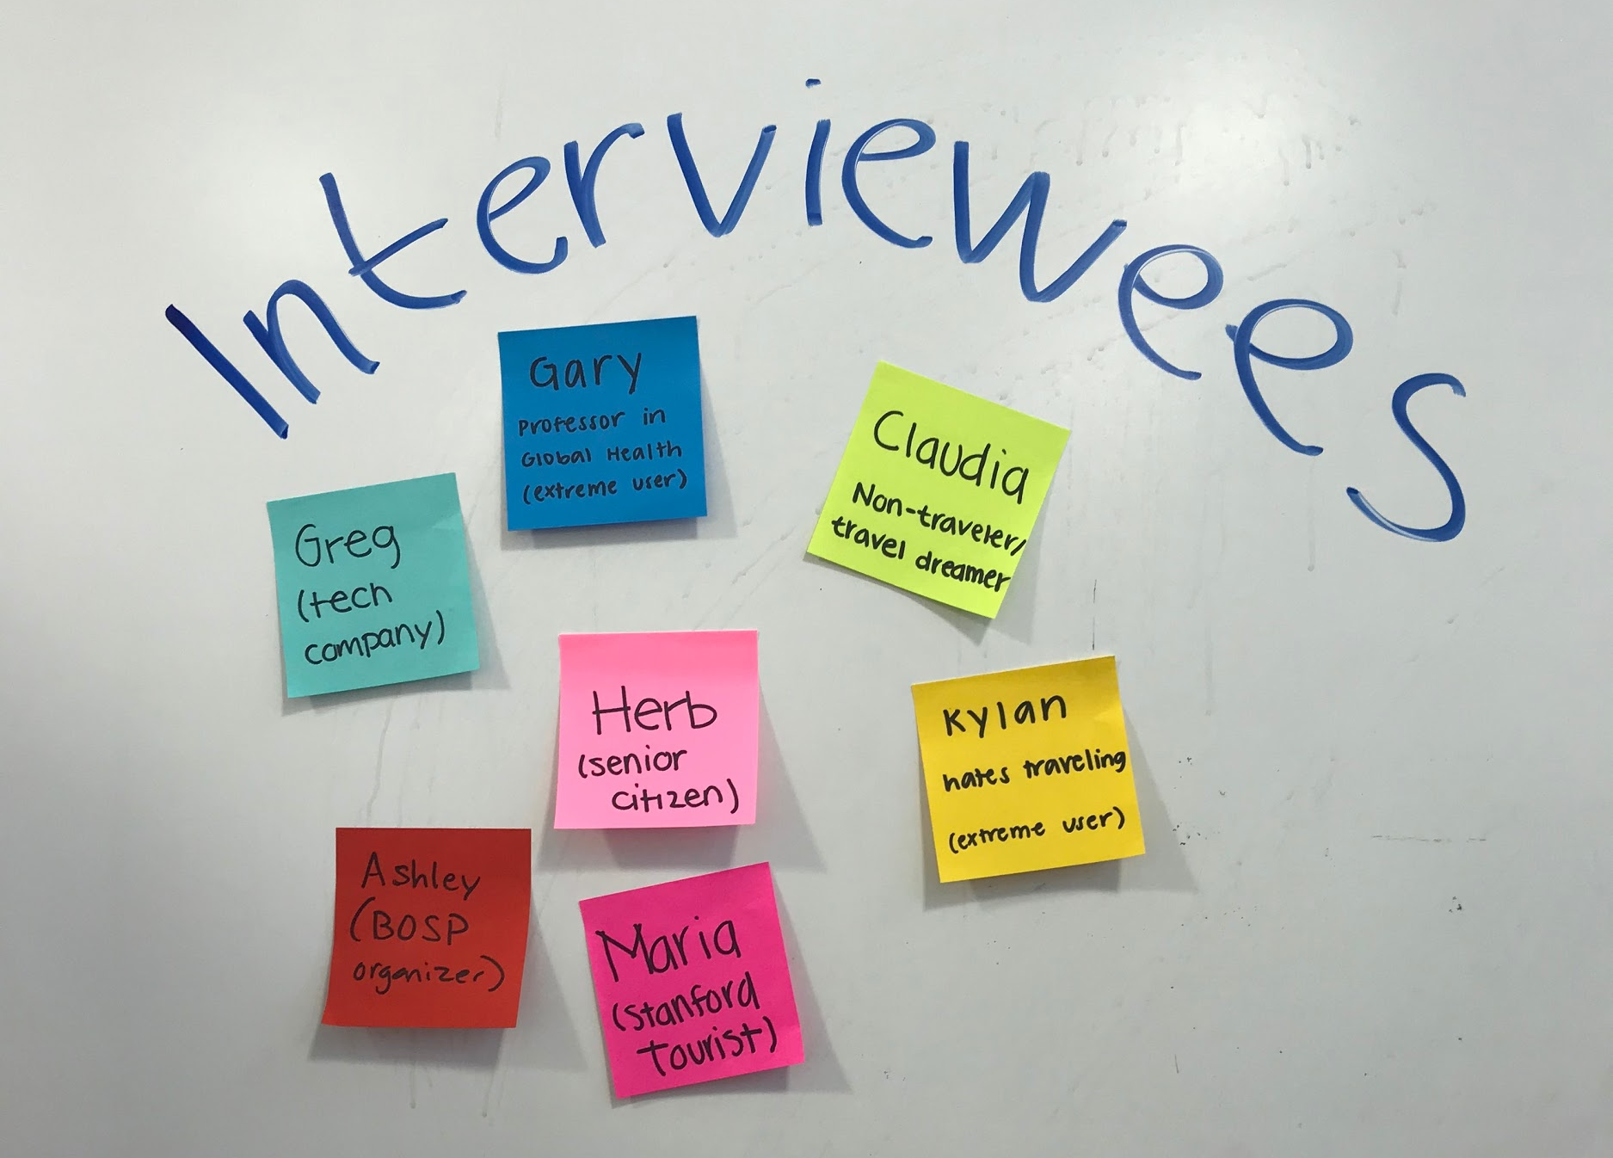
Notes:
We really thought long and hard about who we would interview.
We decided to interview people form all age groups (except children)
Interviewed people of all genders
We color coded our interviewers (you will see this later in our mind map)

Slide 6
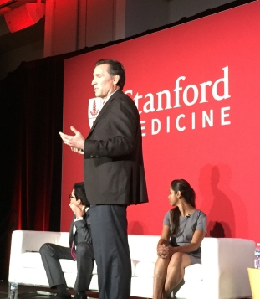
Gary
“
Sometimes you feel on your own when you’re traveling alone or lost and don’t know where to go. It would be really helpful if I knew I had a person or place to go and quickly get information that I knew was reliable.
”
extreme user
Notes:
WHO:
Professor at Stanford
Works in global health
HOW :
Recruited via email.
WHERE:
Interviewed by phone because really wanted to hear his thoughts but he was traveling and this was the only way we could connect with him. He was actually in the airport waiting for a flight during the interview
WHY:
Extreme user - travels A LOT, mostly for work but also for leisure

Slide 7
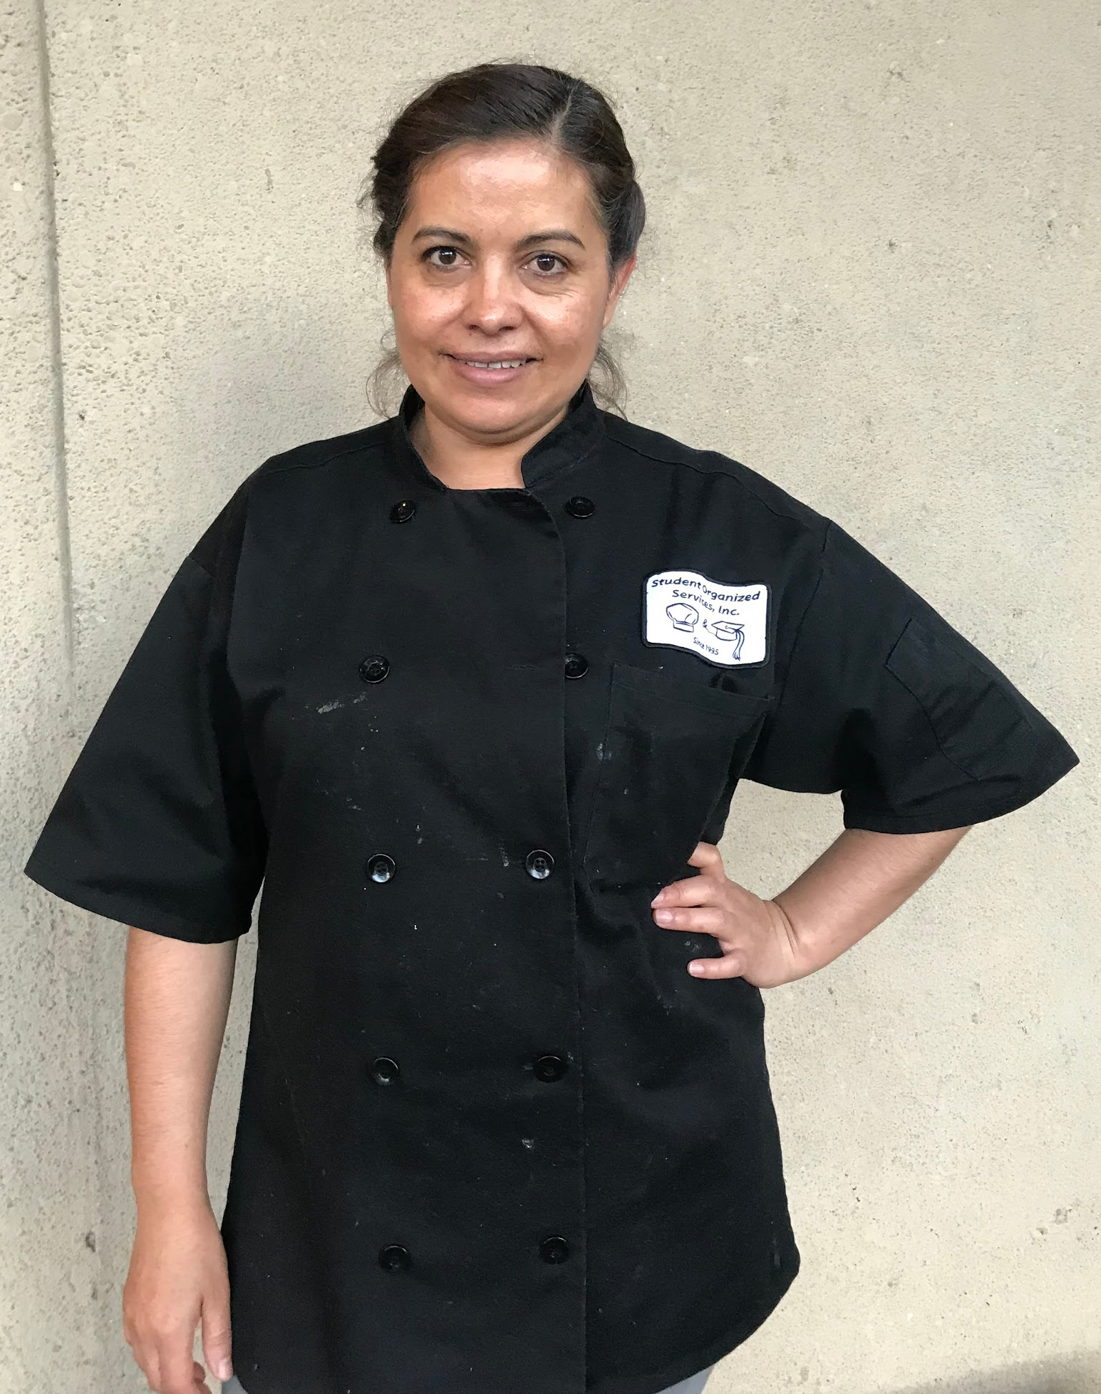
Claudia
“
When I was at the airport my heart was going boom boom boom. I’d always been with my family.
”
non-user
Notes:
WHO: Claudia, a Mexican immigrant that doesn’t have many resources to travel.
HOW : Personal contact with her on a daily basis.
WHERE: In the kitchen of the stanford house that she works for. In person in a place that she is familiar with.
WHY: We wanted to interview someone that likes to travel and wishes she could travel, but doesn’t necessarily have the means to do so (either because of lack of immigration papers of because of her economic situation).

Slide 8
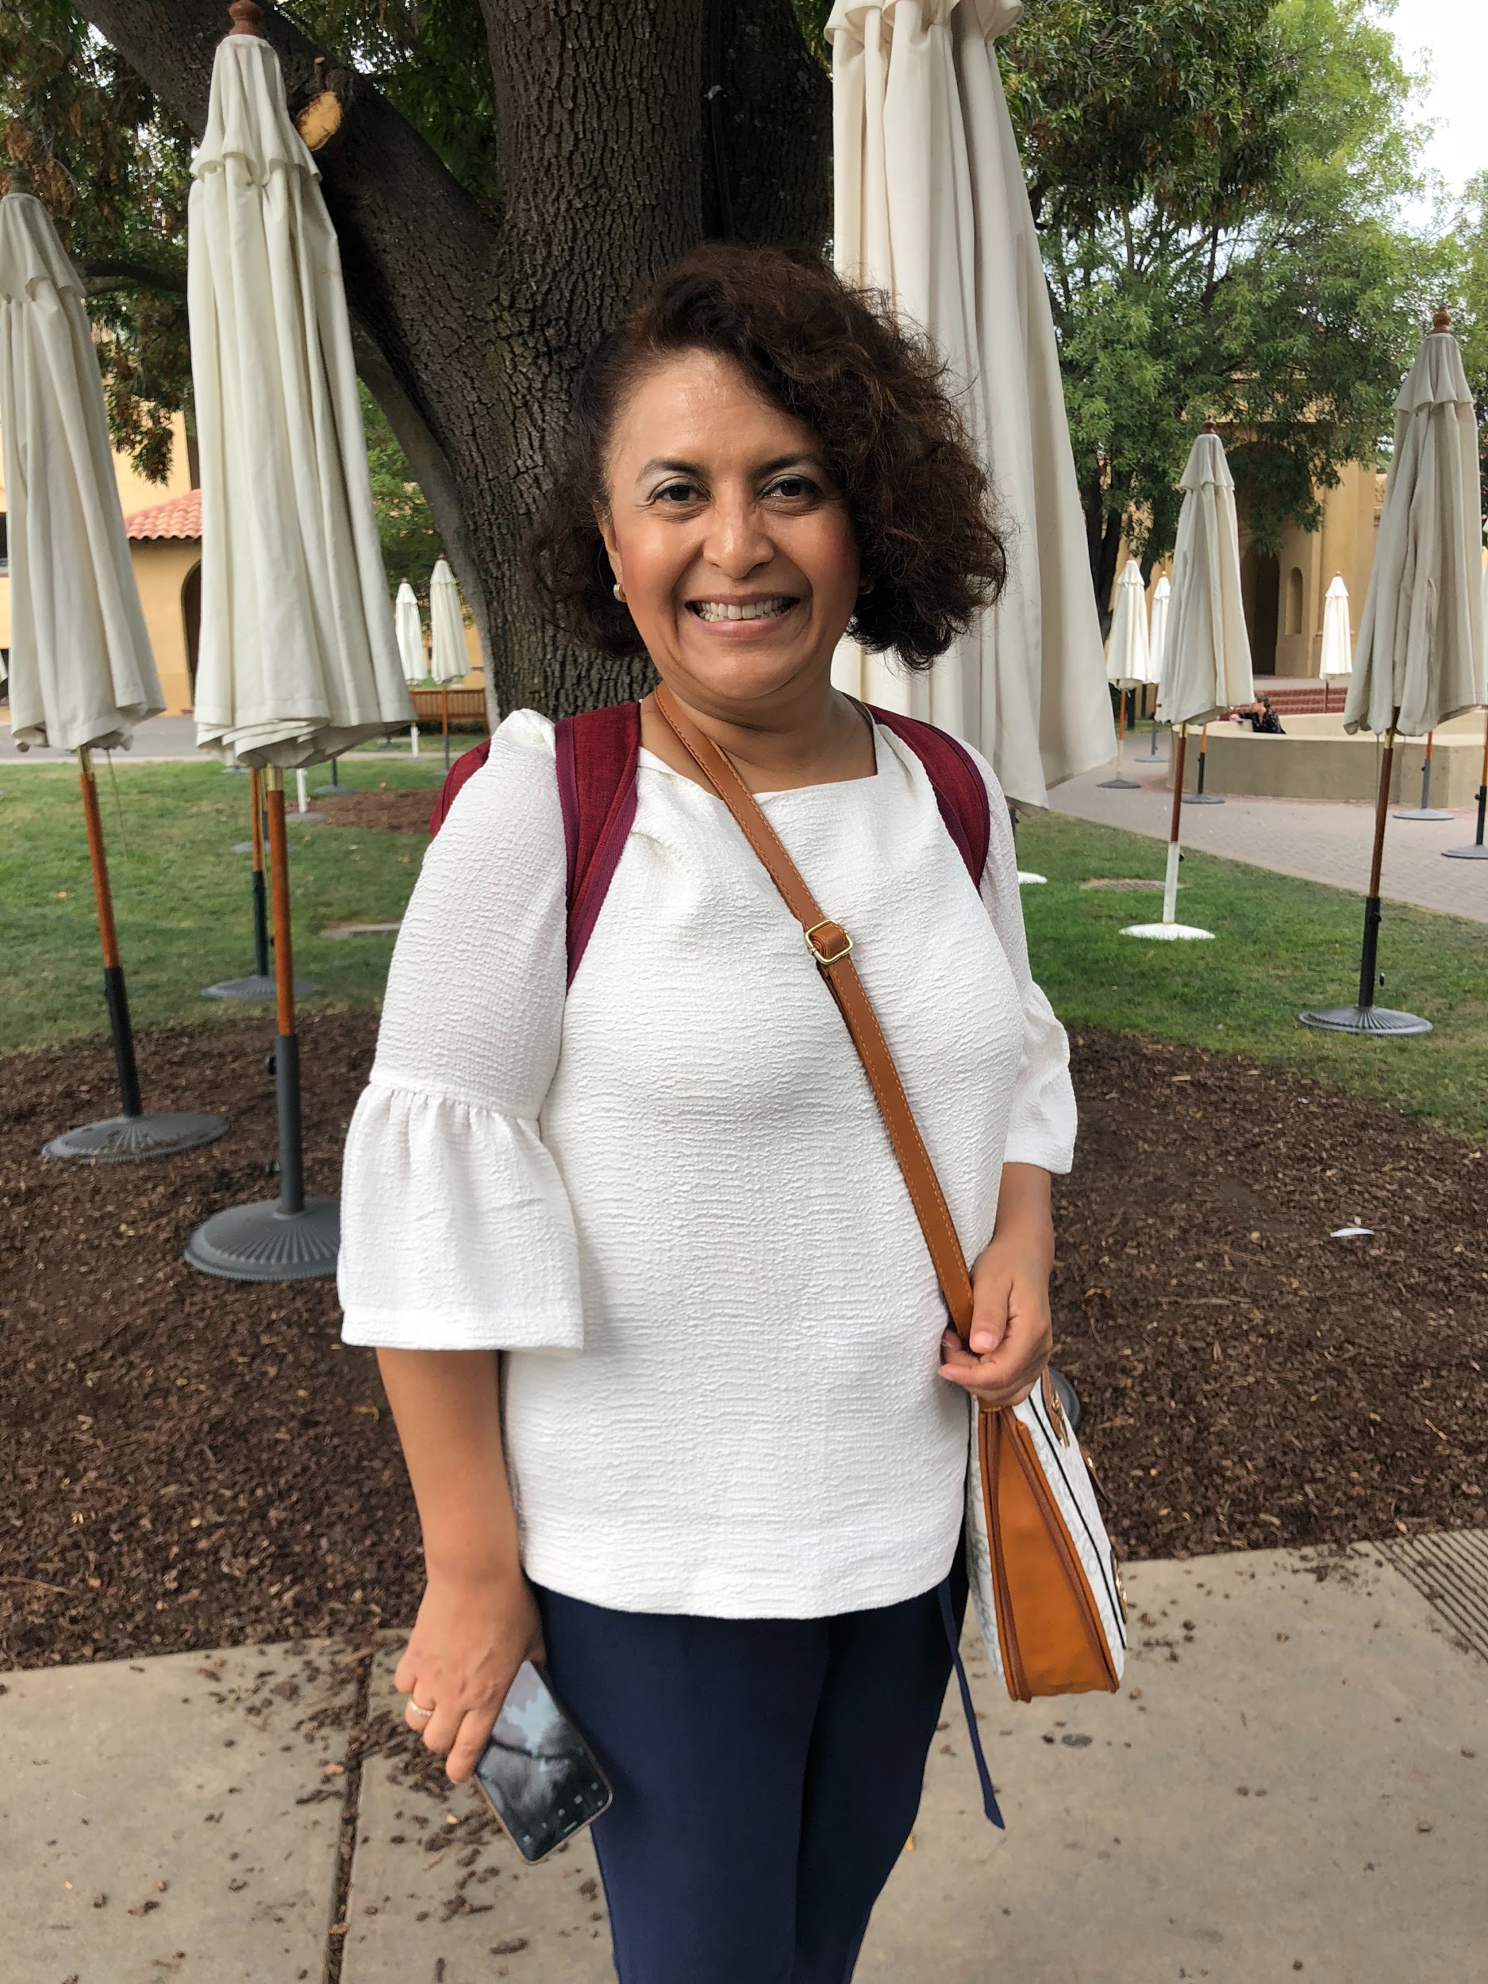
Maria
“
The English [makes travel hard]. The conversation in travel is very difficult for me. In my culture, to speak English is a class.
”
average user
Notes:
WHO:
Woman from Mexico, works in social sciences academia
HOW :
Met her in the quad as she was on a tour of Stanford
WHERE:
At first sat down and talked to her in the quad in front of Mem Chu but as her group started leaving the quad, walked with her for a little longer on the tour
WHY:
Someone currently on a travel experience as a tourist, wanted to target another female user and also interesting to speak with someone who is from another country

Slide 9
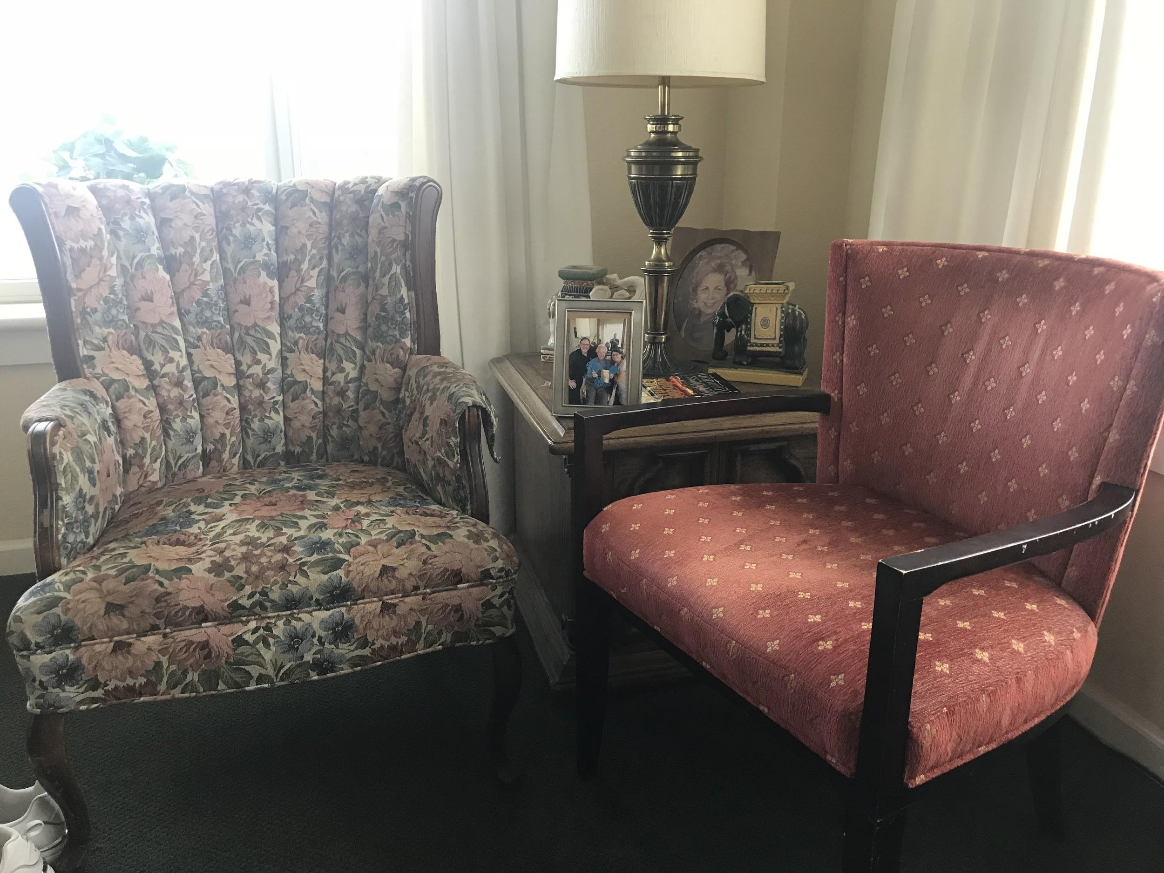
Herb
“
previous user
As you grow older, you stop traveling with family. I began to travel with my wife.
”
Notes:
WHO: A senior citizen living in Sunrise senior living home (didn’t let me take a picture of him)
HOW : Cold called the sunshine elder living and he was first to walk into the door
WHERE: In his living room surrounded by family pictures and drinking V8 juice. In a location where he felt comfortable.
WHY: Thought that it would be interesting to have the perspective of someone that traveled during the times in which there was no technology.

Slide 10
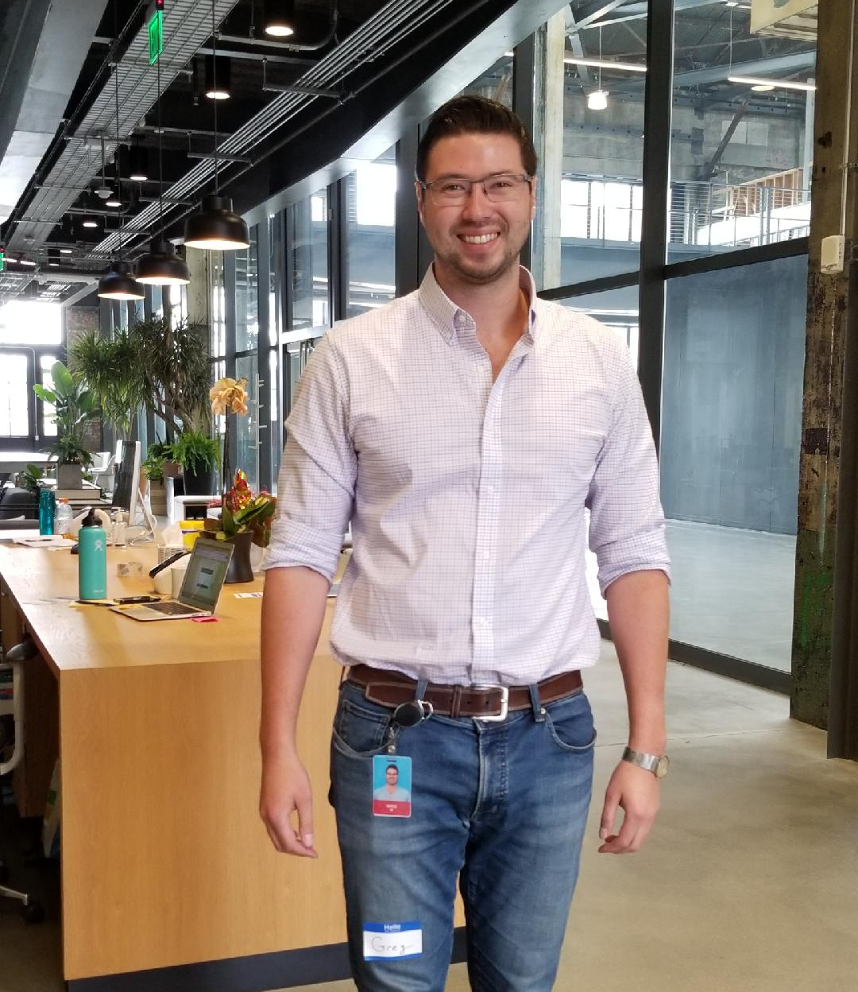
Greg
“
I want to experience different ways to live in a part of the world that I have never experienced before
”
average user
Notes:
WHO: Millennial working at a mid-size tech company in SF
HOW: Reached out to him since he was a coworker this summer of one of my teammates
WHERE: At his office . In person over coffee before the start of his work day; interview was recorded as well.
WHY: His company offers unlimited paid time off/vacation days, so he is able to travel as much as he wants.

Slide 11
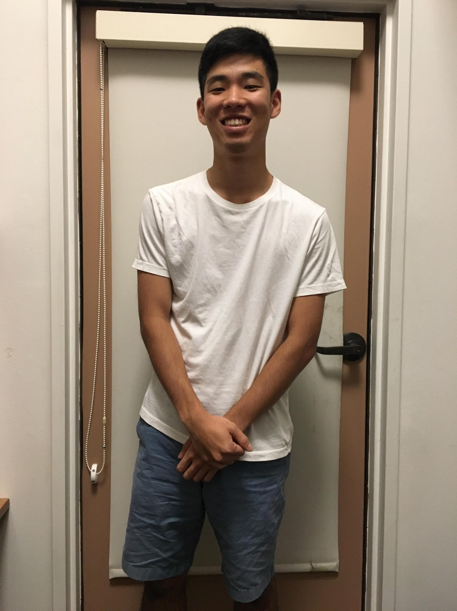
Kylan
“
I don’t like traveling. If i travel, it’s mainly to visit old friends, not to visit anywhere new
”
non-user
Notes:
WHO: Kylan Sakata, Junior at Stanford University, majoring in Computer Science, from Hilo, Hawaii
HOW : He’s a friend of one of our teammates, so we just texted.
WHERE: Outside his dorm on one of the benches during the afternoon. In person, in a place that he’s familiar with, used phone to record interview as well
WHY: Kylan has mentioned to me before that he seriously dislikes traveling. As someone who is from Hawaii, to go anywhere in the contiguous United States, he has to do so a lot.

Slide 12
EMPATHY MAP
Notes:
Min 4:30 by the time you get here

Slide 13
Notes:
We listened to those that had interviewed the speaker and simultaneously developed the mind map.
As you can see the mind map is filled out color by color. First Gary, then Greg, then Maria, and so on
During this session, we were very cognizant of making sure that our ideas built off each others, to ensure that the flow of our work wouldn’t be interrupted and that we would get good quality ideas and participation from all of our teammates.

Slide 16
Airlines don’t seem to care even when they have a big impact on your life
Travel is hard because of immigrant paperwork and limited budget
SAY
My reason for traveling is just to see people: mainly friends or family
The urgency of travel has changed
The food, feelings, culture, and people are important to me
I don’t have a strong desire to travel outside of the U.S. Mainly because of the language barrier
I don’t like to confine myself to the typical tourist experience-I feel that’s very manufactured
Notes:
People don’t like the commute aspect of travel
Feelings, culture, people, food all important aspects of travel experience
With the new technology, people seem to be in a much greater rush to travel quickly. Technology has sped everything up.
The expensiveness of travel makes traveling to new locations be a luxury.
Language differences is a huge issue
People are looking for the genuine experience

Slide 17
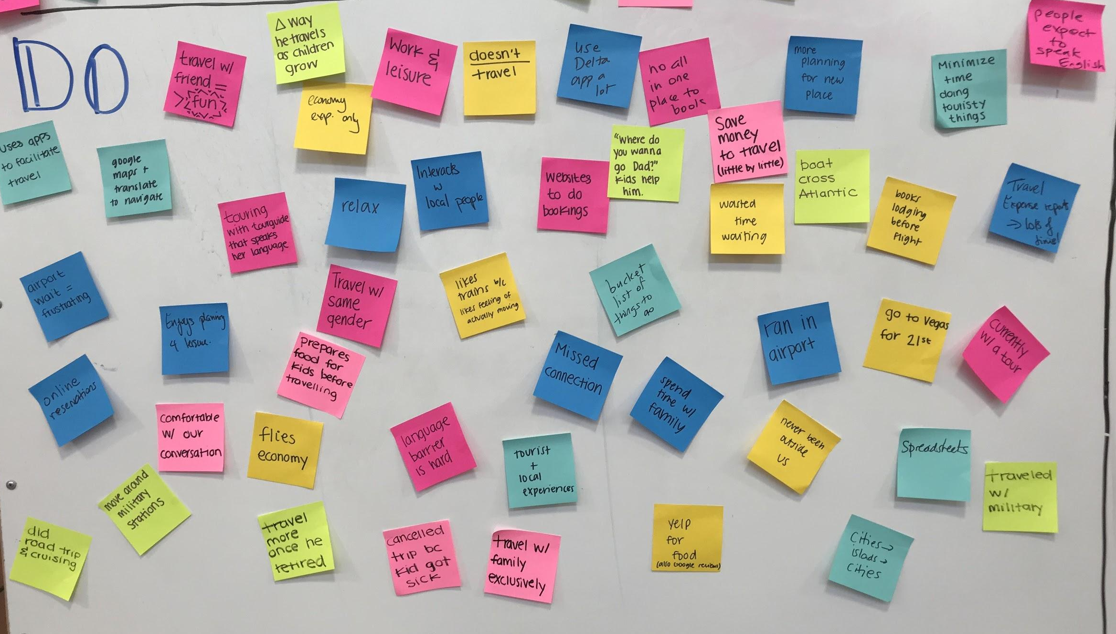

Slide 18
Talk slow… took time to reflect
Look up at the ceiling when recalling old memories
Smile when she talked about her children
DO
Use hand gestures when talking about things he disliked
Ramble when talking about best experiences
Belittle her travel experiences
Talked with much distaste about terrible lodging experiences
Notes:
Interesting to notice physical cues when talking to our interviewees.
Noticed what made them uncomfortable
Noticed what got them fired up
Noticed what got them excited

Slide 19
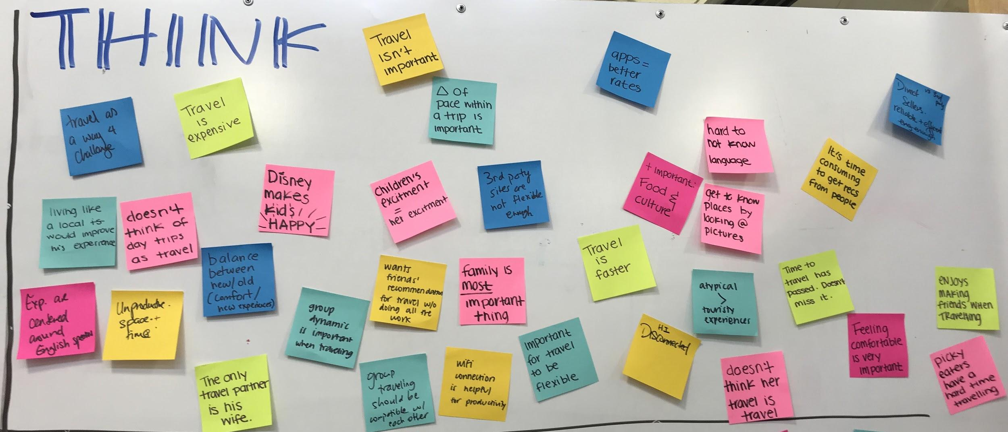

Slide 20
Only travel partner is his wife
Freedom and flexibility are most important
THINK
Where I’m staying, the location especially, is a BIG factor
Safety is very important!
Novel experiences outweigh popular attractions
Travel for work: stressful, exhausting
Travel for leisure: relaxing, exciting
Family is very important. Travel with family is best
Notes:
Many people mentioned safety and that they like to know the places they are going and activities they are doing are safe
Big difference between work and leisure travel: work travel is very stressful and busy and feels like you never have time to catch your breath, whereas leisure travel is more relaxing and there is an excitement to it
As someone who always places her family first, Claudia considers all her trips to be family trips. Spending money on trips is only valuable if she can do it with her family.

Slide 21
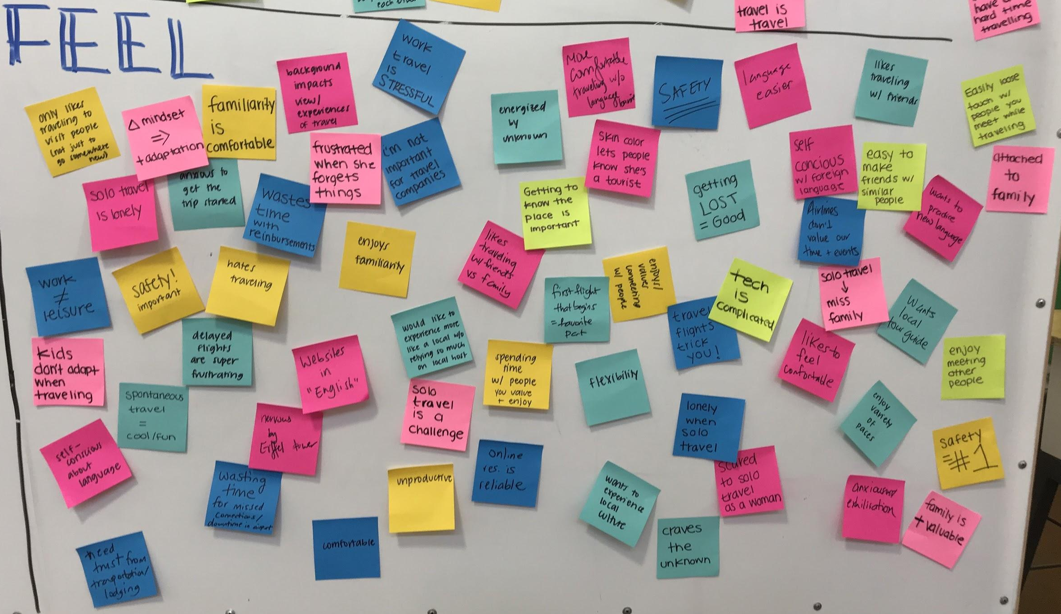

Slide 22
It’s easy to make friends while traveling with people that are similar to you
Connection & bonding with others when traveling together
FEEL
Her children’s joy is her joy
Pictures are unnecessary… live in the moment
Uncomfortable and isolated when there is a language barrier
Energized by the unknown
Notes:
People enjoy traveling with family and friends because they connect and share experiences and spend quality time together
Travel is difficult with a language barrier, especially when traveling alone. She feels that a lot of websites for travel are native to the country and not so friendly to foreign tourists / non-English speakers
Parents spend lots of money on making sure their children love their travel experience.
While traveling you will meet people along the way. It’s easy to become friends with them if they are of the same age and have similar plans in mind about what they want to do while traveling. It’s a great way to get to know people, not locals, but also other tourists.

Slide 23
NEEDS
INSIGHTS
Dichotomy between new and familiarity
Importance of family
Aversion to feeling like a tourist or outsider in a foreign place
Desire to experience one’s destination as a local would
Safety is important
Experience a place without going
Affordable travel
Physically accessible
Traveling with people that provide comfort/fun is best
Use of technology to facilitate travel (e.g. Uber, Yelp, websites)
Local tour guide
Genuine experiences
Better commute experience
Notes:
Needs:
Travel is very expensive (people always talk about having the opportunity to travel when there were good deals/when they saved enough and how lots of money is needed to travel)
It’s hard to travel when you are in a wheelchair or have some sort of physical impediment
Tech has facilitated travel, but there are more things it could be doing
Local life was highlighted throughout the interview. Destinations were picked based on having a local contact for recommendations/introductions or to simply accompany through the destination. Would like to access authentic experiences without relying on “tour guide” as much.
Insights
People want to experience new places but they still want to feel like they are in a safe and familiar place.
Family was a common topic of conversation. Unsurprisingly, travel seems to revolve a lot around the family: where can the whole family travel, during what dates is everyone available, what would all family members enjoy?
People want to feel like they have genuine travel experience
Safety is a top concern → women tend to talk about experiences feeling unsafe more than men
ONe interviewee said she “knew a place form a magazine”. Need not travel to experience a new place.

Slide 24
INFERENCES
CONCLUSION
QUESTIONS
How can we improve the commute that’s necessary for travel?
How can we provide better resources to facilitate pre-travel planning?
How can places incorporate more local life into its tourism?
How can we make travel + accessible?
Happy travelers have both comfort & new experiences
Correlation between money and travel
Destinations are misrepresented by their attractions
“unsafe” locations aren’t visited
Don’t like wasting time
Research has to be done ahead of time for trips
There is not enough adventure in destination travel
“Travel” has evolved into a luxury

Slide 25
THANKS!

