Slide 1
Simbiotic
Concept Video
Anjini K, Ellen V, Vrinda V, Yuguan X

Slide 2
Value Proposition, Problem/Solution
Problem: People usually don’t know their living preferences until they run into conflicts with their roommates
Solution: Show people simulated scenes with roommates and analyze their reactions to that to give them feedback on their preferences
“Live better, together”

Slide 3
Tasks
A user of Simbiotic:
Simple
Wants to understand his level of comfort in various situations
Medium
Wants another perspective on his reaction that he may not understand himself
Complex
Wants to enable himself to articulate his living preferences and tell him how to react/approach a conflict

Slide 4
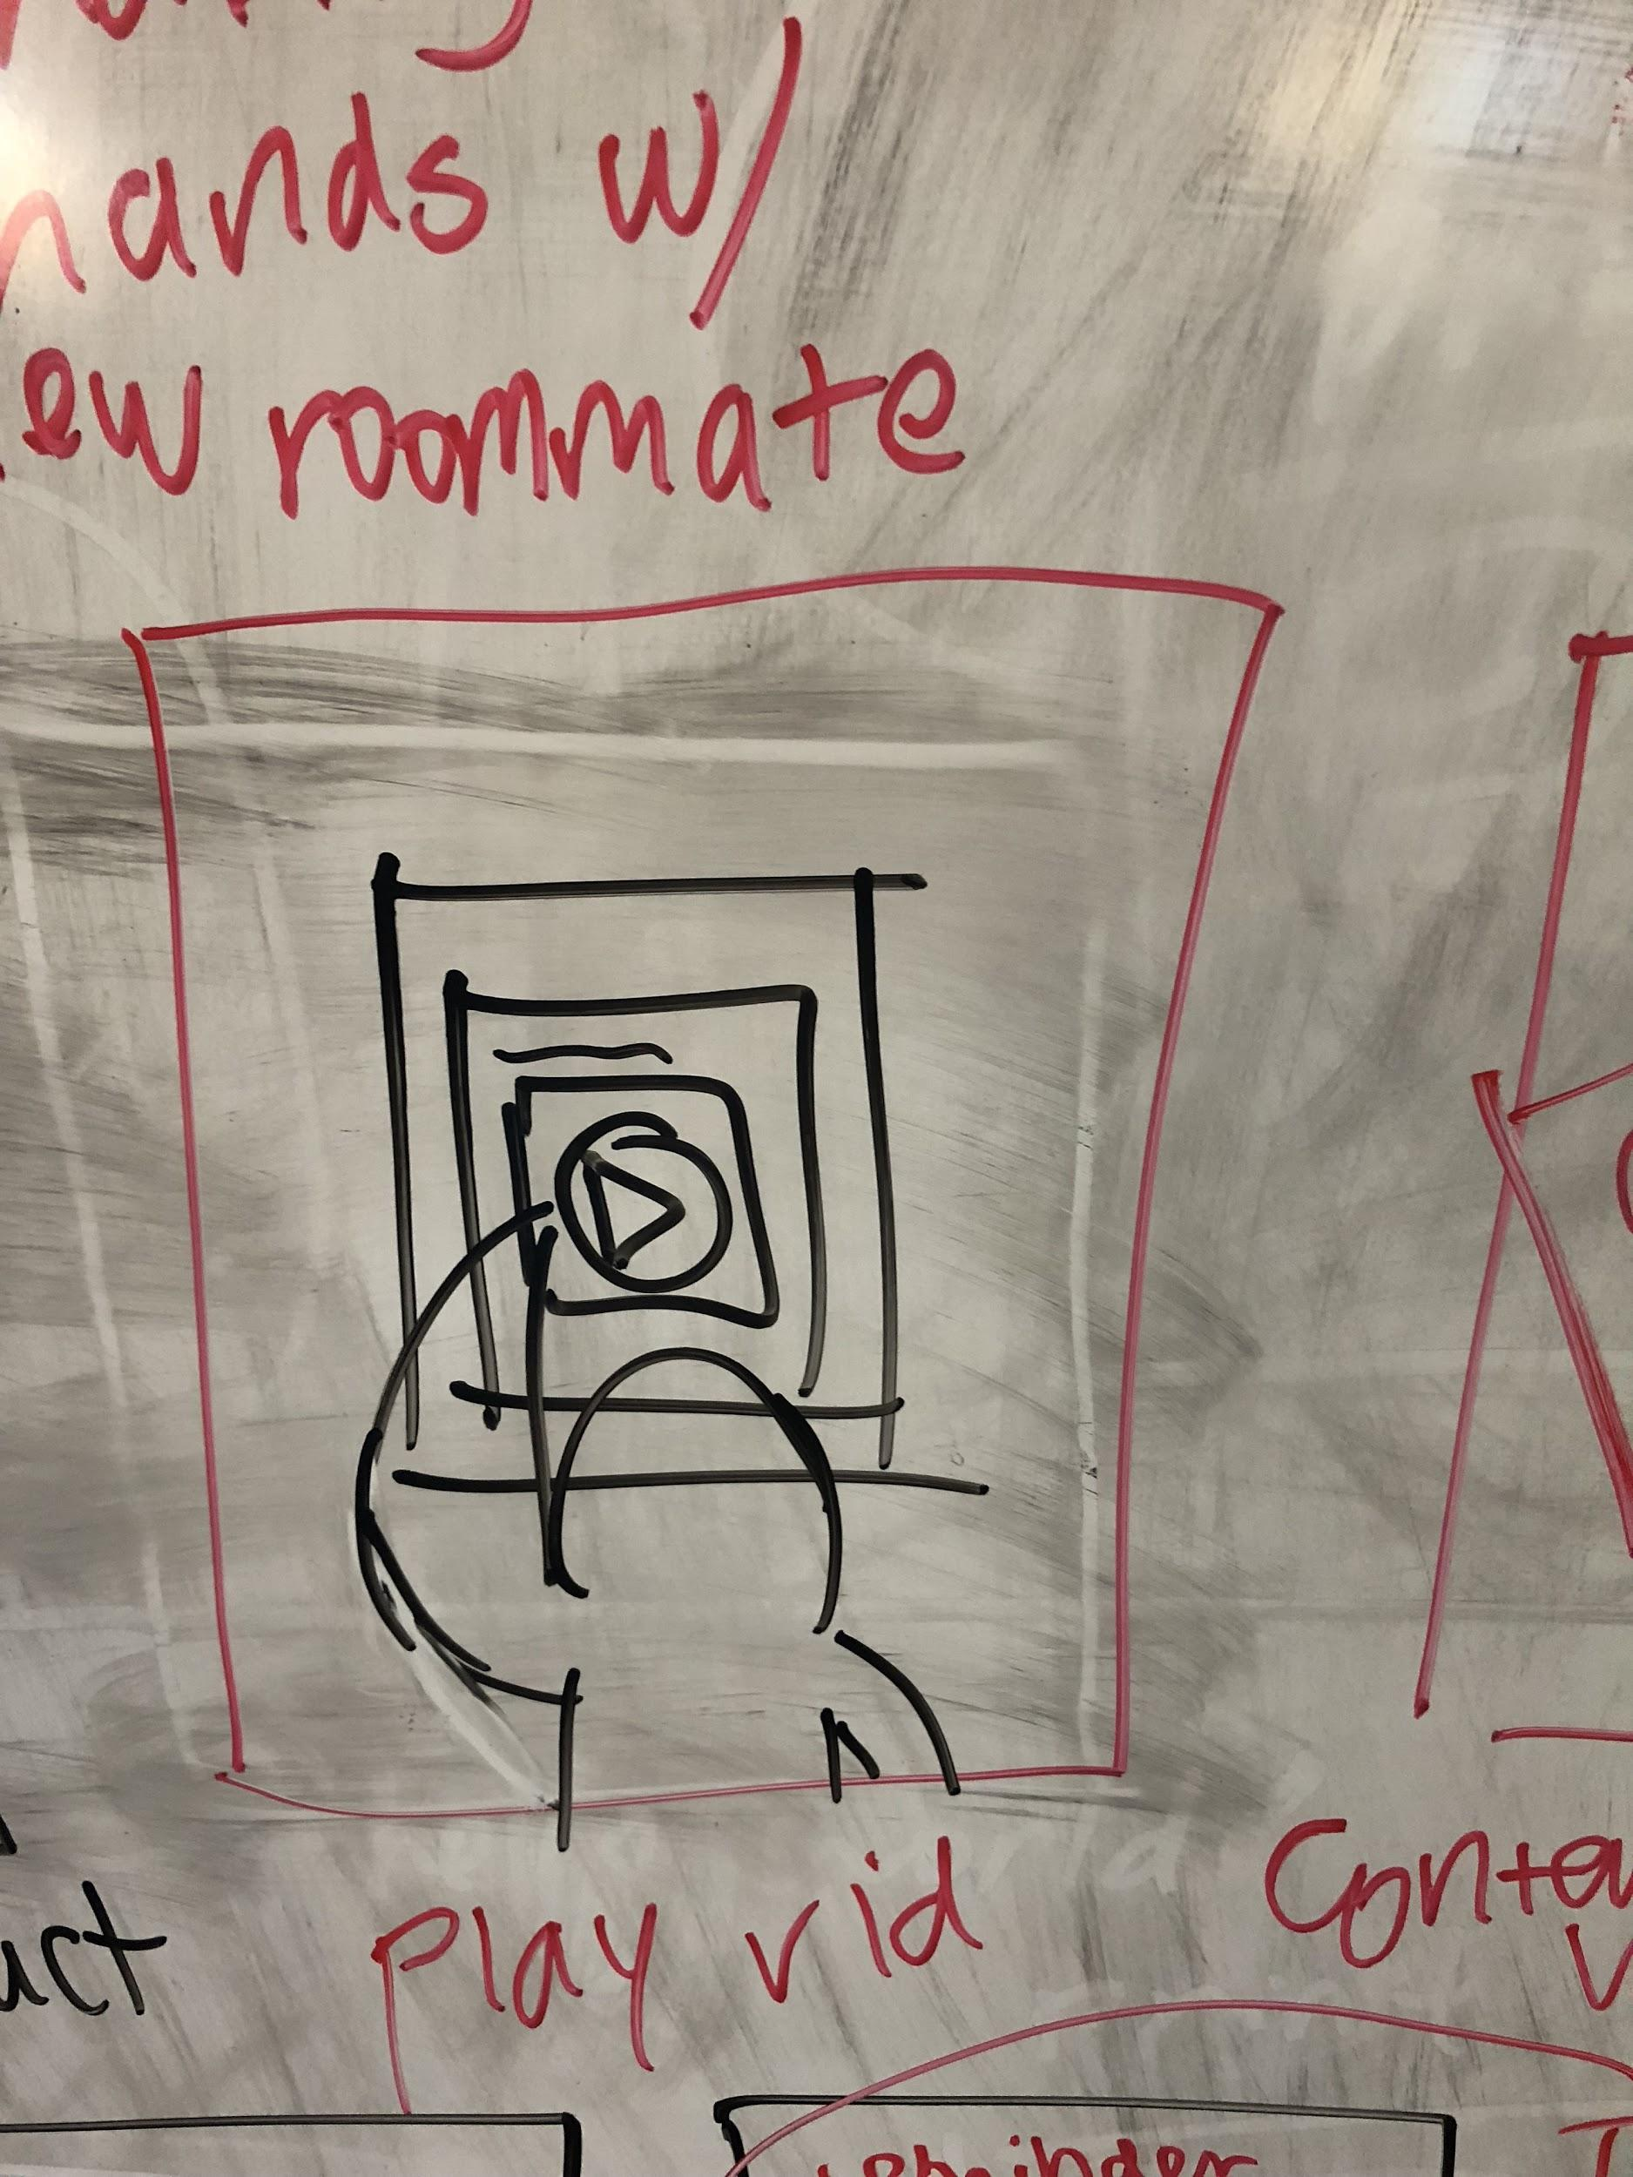
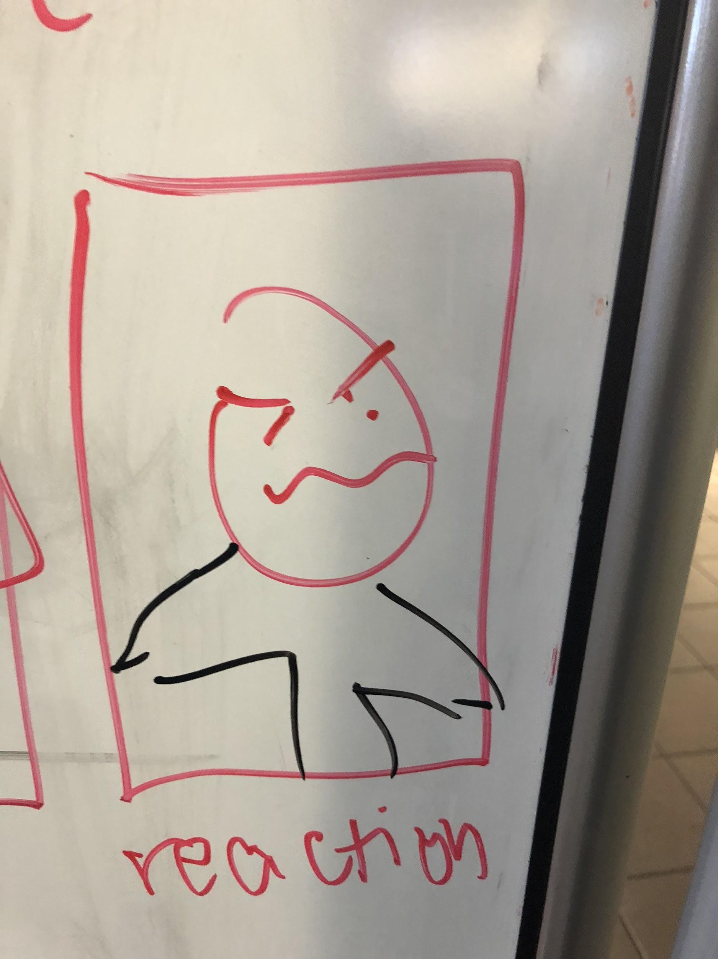
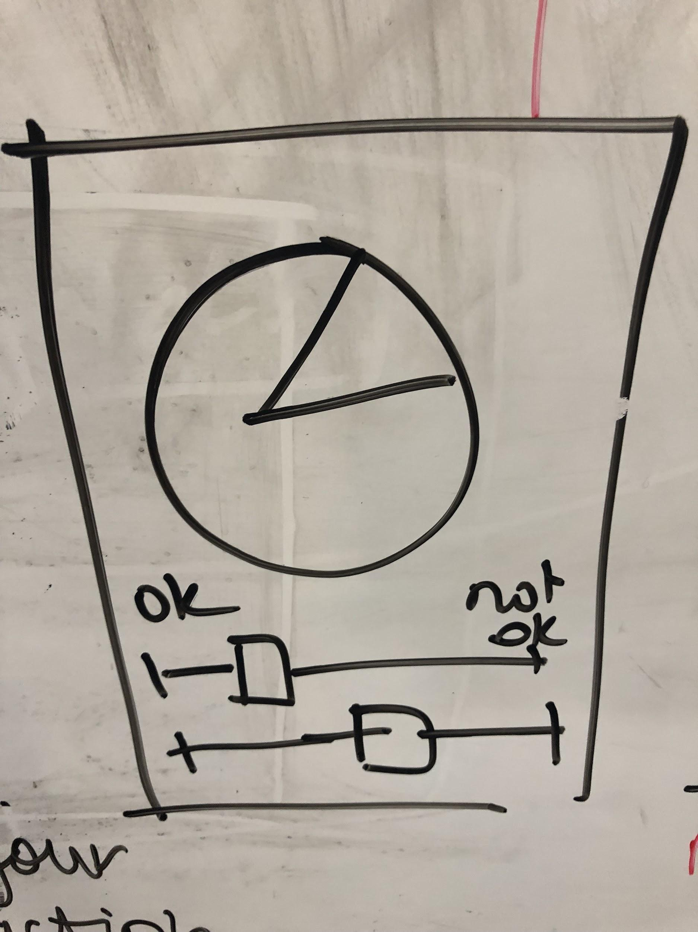
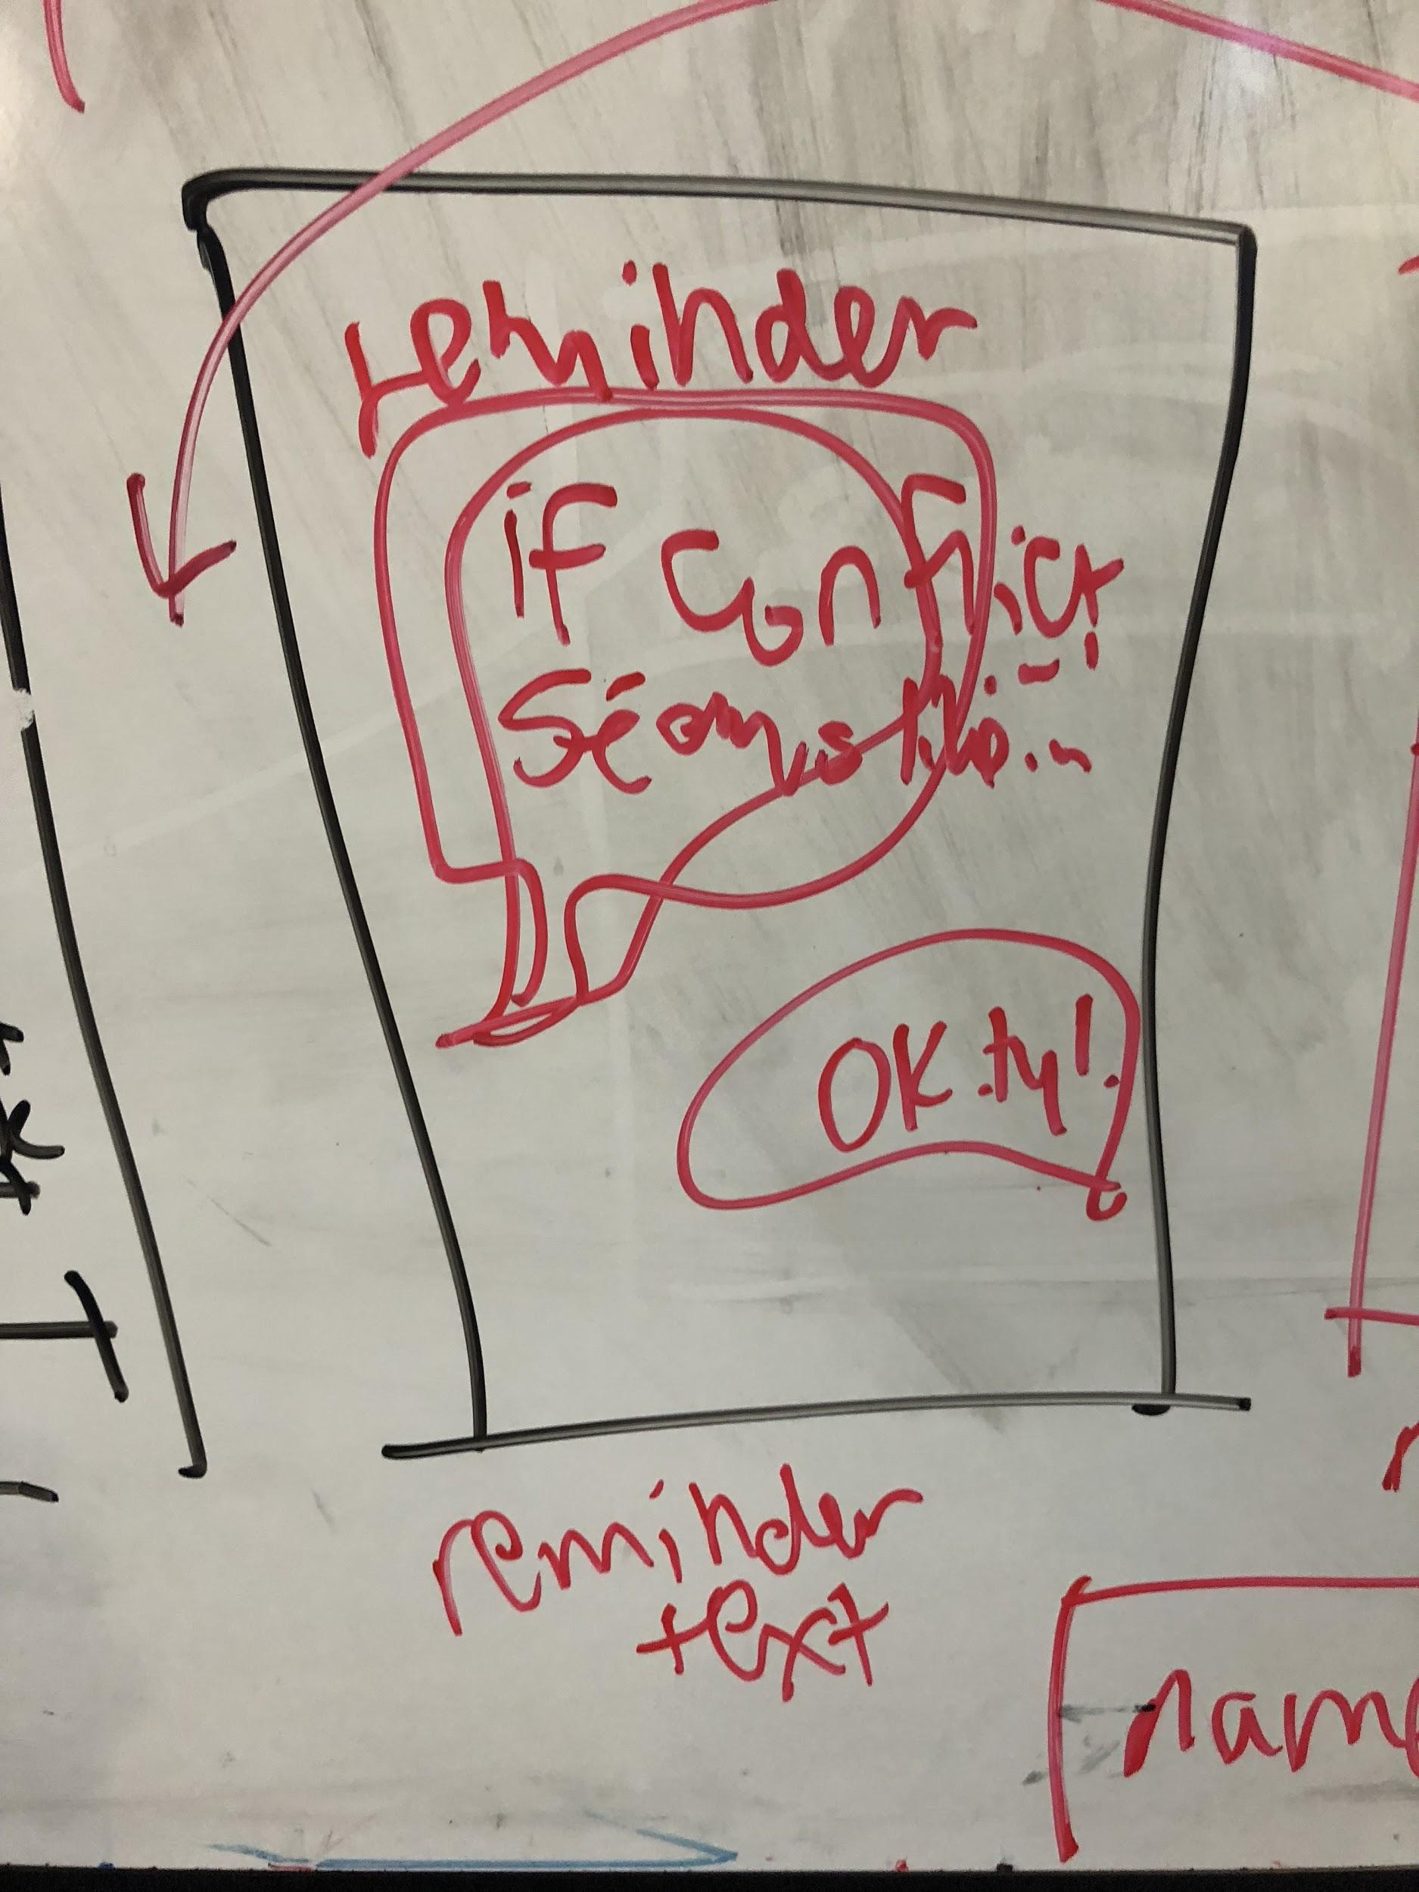
Storyboards
Front shot of main character’s face. We see his disgusted reaction as he finds out about his true feelings about messy rooms.
Over the shoulder shot of main character looking at the app, with “Welcome to Simbiotic” message on the screen. A “Play” button underneath, showing the simulation: Messy Room. We see his hand press play.
Over the shoulder, show paper prop with a pie chart and several bars visualizing the user’s instant reaction to give him a new perspective
As the main character walks up to his room, a reminder notification pops up with tips on his particular confrontation style and values to emphasize when meeting his roommate.

Slide 5

Concept Video:
https://youtu.be/GOh_zK8IUz4

