Slide 1
Feeling @Home

Slide 2
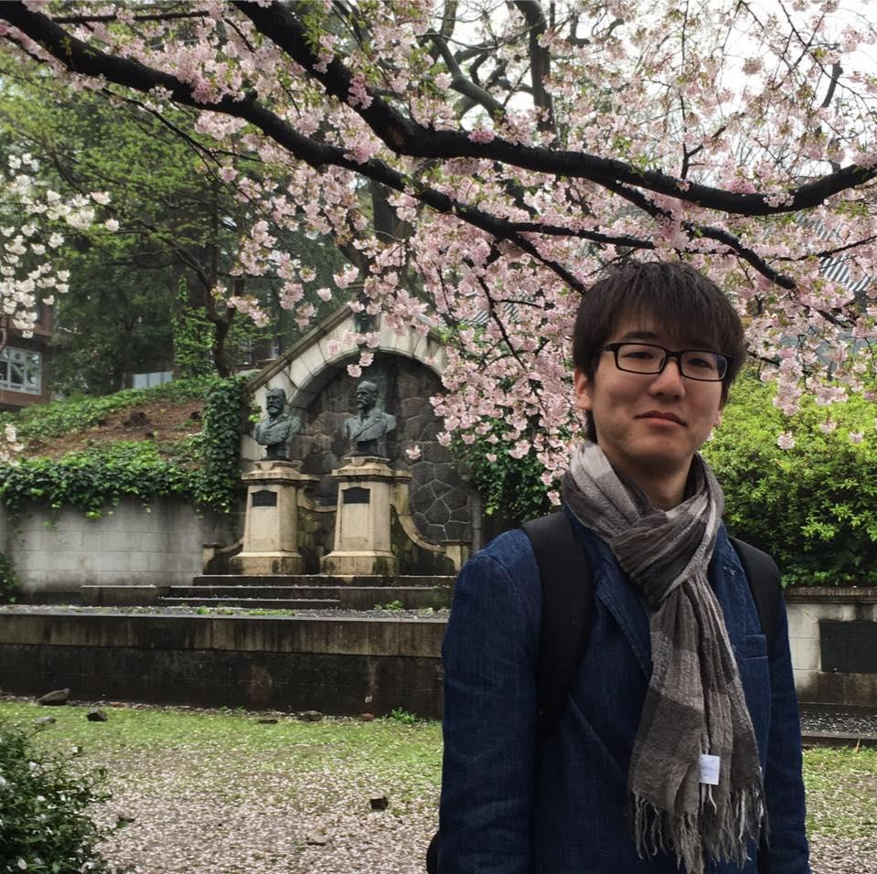


Our Team
Yuguan Xing
Vrinda Vasavada
Anjini Karthik
Ellen Roper

Slide 3
Needfinding Methodology
Notes:
-we decided to focus on college students and young professionals who may be living in a temporary or short-term housing situation such as a dorm or apartment. We talked to seven people in different diverse living situations around the country, a few on the East Coast via Skype and others in person. We found these people through connections that we already knew, referrals from others, and asking strangers on the street and at Foothill Community College. Our focus was on what makes a place feel like home.

Slide 4
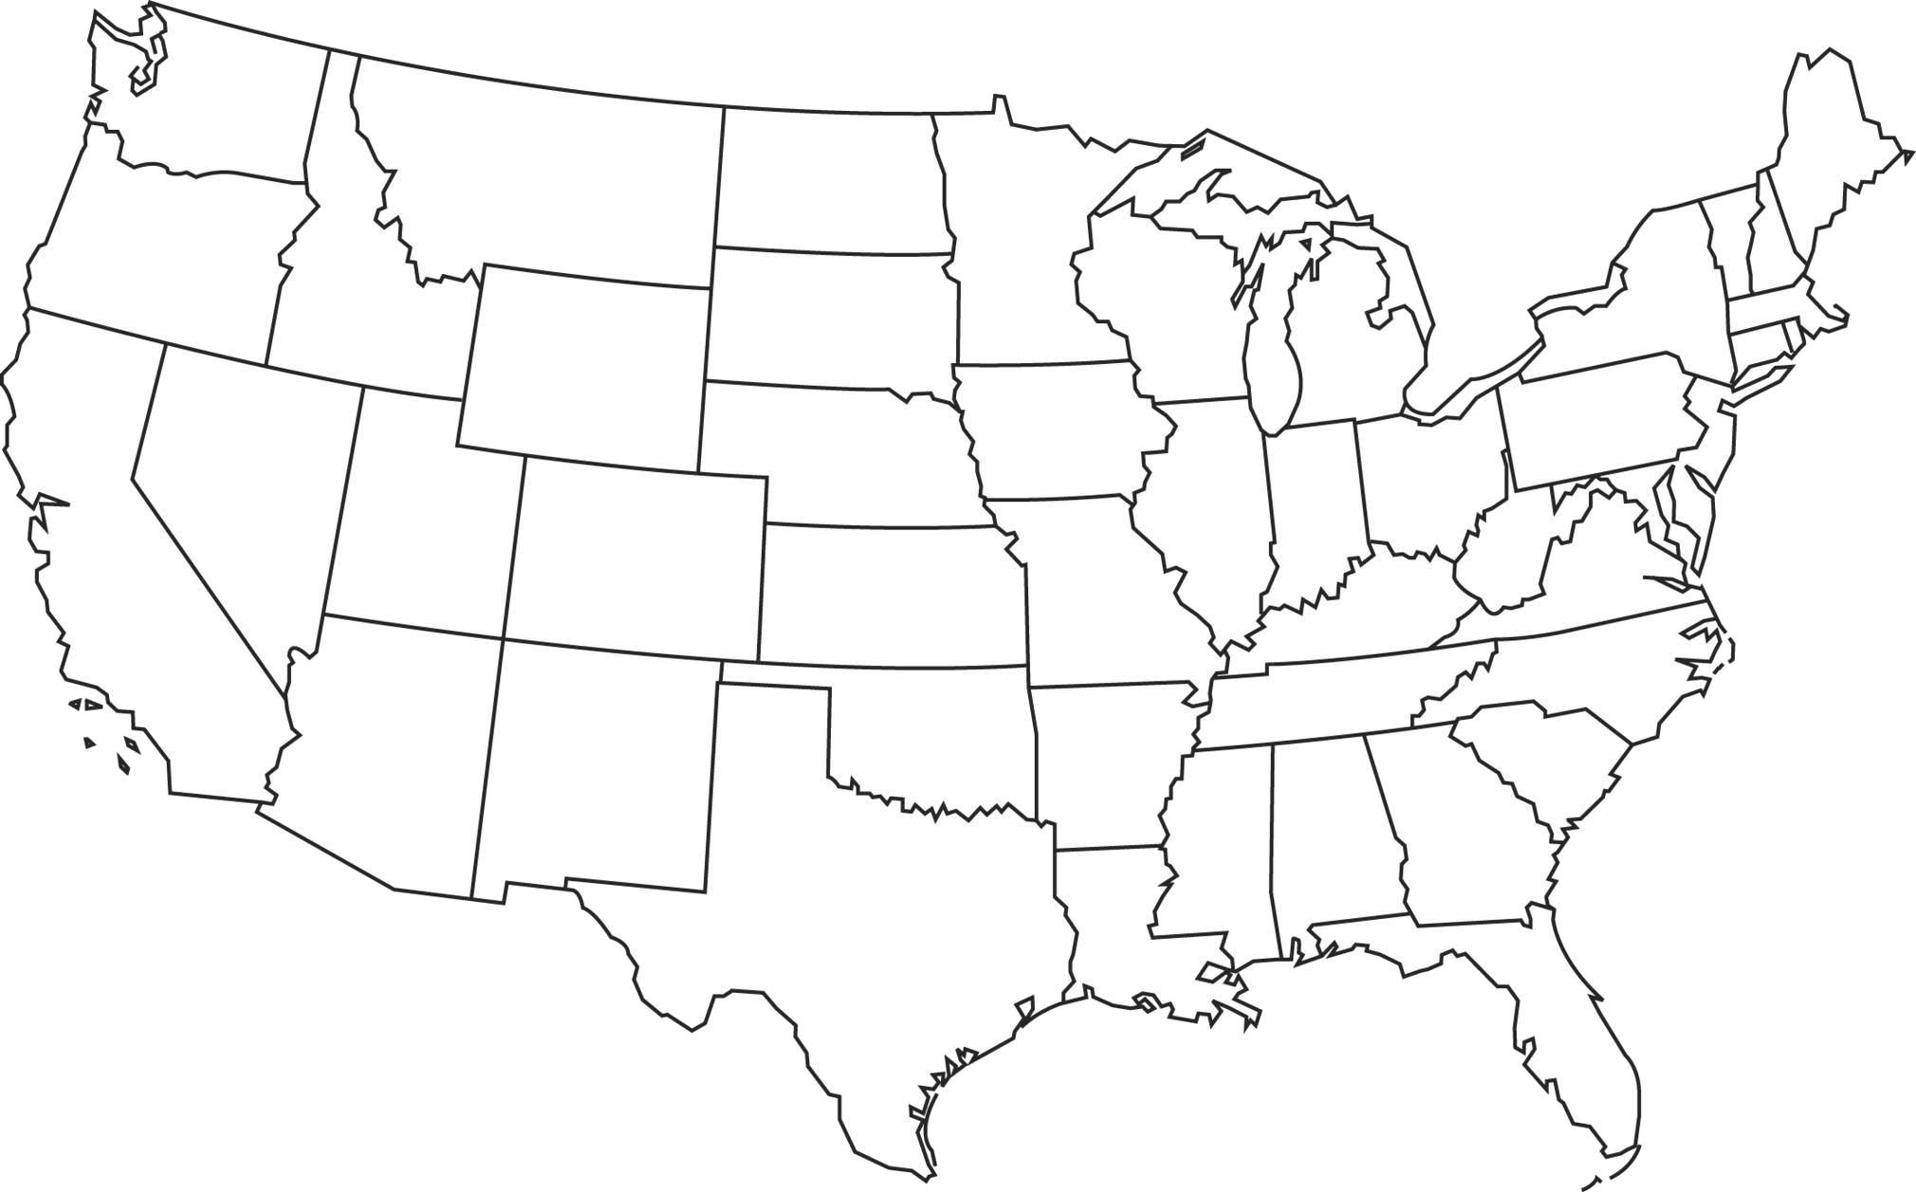

What makes your home feel like home?
What do you have in your room and why?
Tell us about a time you lived with someone else. How did you set expectations?
How does your living space contribute to healthy habits?
Describe your experiences in respecting common spaces.
What makes you feel safe?
Notes:
Who?
Several young people on both coasts (<30 years)
Living in dorms, apartments, homes
Temporary/more permanent housing
Artists and not
Earning and not
Big city and not
What?
Asked them everything about their living situation and about moving
Interactions with the space and with others in it
How?
Went to Foothill College, Philz, reached out to extreme users (co-op, those who travel a lot and have a more fluid definition of home) & a non-user (no interest in a permanent home)
Why?
Trying to find common problems or issues that permeated across different living arrangements

Slide 5

Mark
Synergy
Senior in college
House Manager
Lived in a dorm freshman year
Notes:
Mark is one of our extreme users; he lives in Synergy, which is one of the co-ops on Stanford’s campus. The house is clothing-optional and values inclusivity, fluidity of living style and freedom of expression. He has lived there for two years, and this year he is the house manager, meaning he is in charge of allocating jobs and ensuring that the house stays in good order.

Slide 6
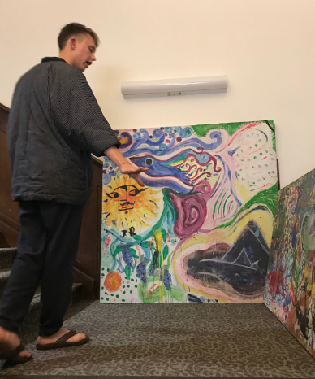
“I choose to live here because labor is important to me, and the fact that it is done by a person that is connected to me in a real way is important. Living in a dorm was a strange experience for me… You never see [the cleaning staff] and they’re totally separated - it’s a distinction that the work and labor is culturally unvalued”
Notes:
Mark seemed to have the strongest feelings about irresponsible treatment of shared spaces. It was clear that he values having responsibility for the space that you are in, saying that he felt uncomfortable having someone clean up after him and others when he lived in a dorm. This was kind of surprising, as it seems that most students would have been relieved not to have to do household chores once they go to college. To Mark, having agency is what makes Synergy feel like home, and he was very passionate about this topic.
Hated not having consequences for actions in a place where he never had to clean up

Slide 7


Julia
UC Berkeley
Junior in college
Loves to cook and paint
Lives in a shared apartment
Notes:
Julia is a junior at UC Berkeley. She represents an average user for us; she lives in an apartment near campus with three other roommates. They get along very well with very little conflict and seem to have an easygoing relationship. Julia is an artist who likes to paint and hang her artwork up on her walls.

Slide 8
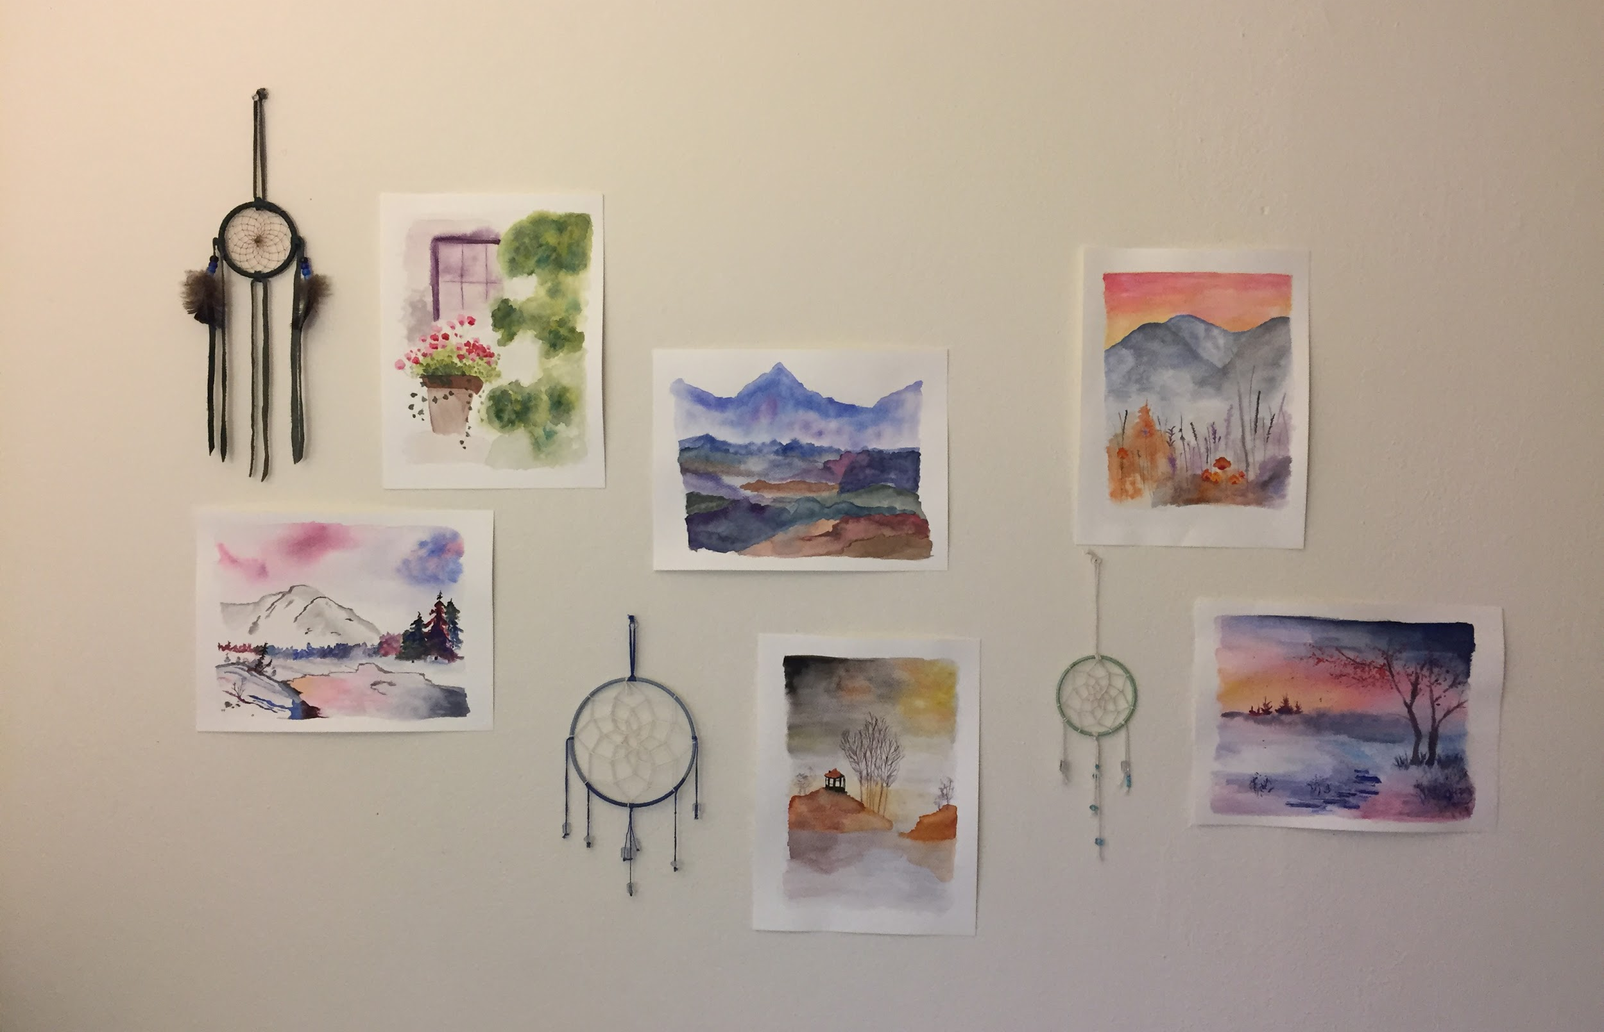
“Being able to have a say in what happens in the space: who is in my space specifically and the general space as well”
Notes:
Julia stressed autonomy in what makes her space feel like home. She disliked living in the dorms her freshman year because she could not cook her own food there; this is a pastime that she enjoys and finds healthier than the dining halls. She said that now she eats healthier as a result of having the autonomy to cook for herself. Perhaps atypically, Julia and her roommates apparently have no conflicts in sharing their common spaces; everyone takes the initiative on their own when they see that some chore needs to get done.

Slide 9
Luda
San Francisco
20-something working at AirBnB
Never wants to buy a home
Prefers sharing to having his own space
Notes:
Luda is another extreme user in our definition: he currently has no plans to buy a home, either now or in the future, and he actually prefers sharing a space with others. He has lived in many unique situations, such as with nine other people in a one-family house. He currently lives in an apartment in San Francisco.

Slide 10
“When you share a house with people, you are inevitably sharing a slice of life with them”
Notes:
Luda was unique to other users in that his beliefs somewhat contradicted what others said they preferred to have. He said that he had no problem living in a small space and prefers to have less stuff to bring around with him as he moves. He is also a non-user in terms of decorating; he specifically mentioned that he doesn’t but art up on his walls. Unlike some other people we interviewed like Julia and Mark, Luda doesn’t make his own artwork and as a result doesn’t put it up on his walls. Despite what he said about not caring about the small space, when he was describing the dorm rooms that he lived in previously, he always mentioned the size of the rooms, so it seems that space may actually be something that he takes into consideration. He seems to be a pretty easy-going guy, but there was definitely some tension when he was describing some situations that arose between him and his 9 roommates. Luda values the interpersonal experience of living in his “home” and thinks that living with others is imperative to learning about them.

Slide 11
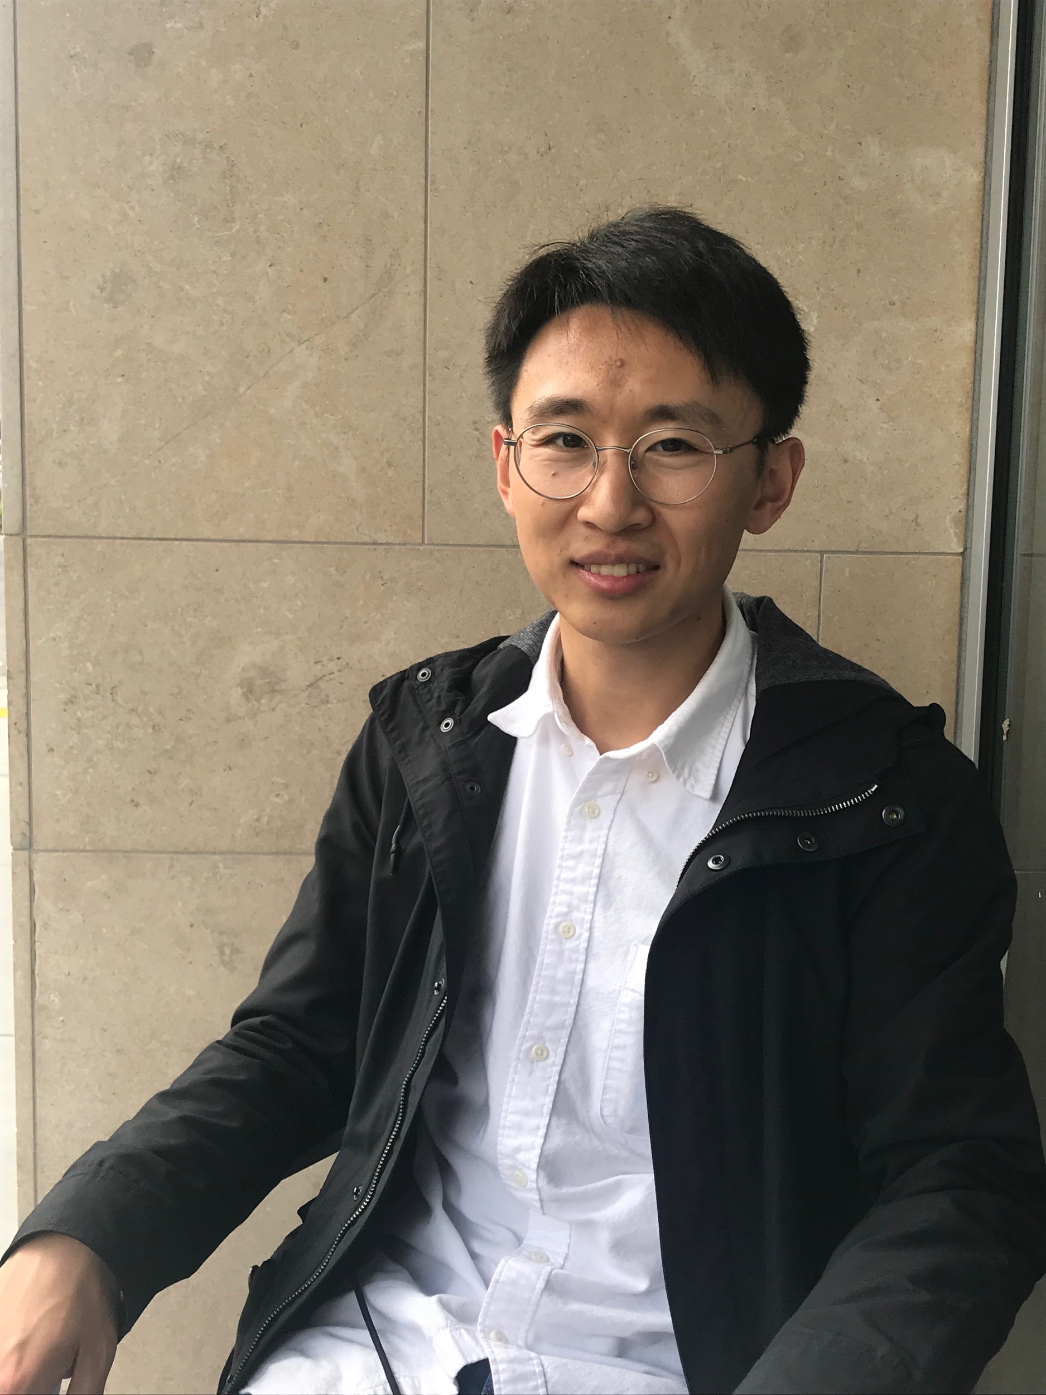
Michael
Palo Alto
20-something working at Amazon
Interested in smart devices and interior decor
Lives in a townhouse
Notes:
Michael is another average user: young, interest in optimizing living space and decor, feels that he doesn’t have the time or knowhow to do a good job decorating; but really wants his home to reflect himself. He currently shares a townhouse with one roommate and seems to be in a less temporary housing situation than some others that we interviewed.

Slide 12
“In decorating, I feel the need to educate myself first, but it’s hard to match what I envision”
Notes:
Michael’s main issue with his living space is not feeling like it reflects himself to his satisfaction. He finds it overwhelming and difficult to know things like how to decorate and which colors go together, and since he doesn’t make his own art either, he doesn’t know where to go to find decorations for his space. He feels like he does not have the time to make his living space into what he envisions it being, specifically around the interior design process. He likes to go on Pinterest and other sites to get inspiration for styles but does not know how to actually implement his ideas. He mentioned not having time to change his living space a lot.

Slide 13
Empathy Map

Slide 14

Empathy Map
“When you share a house with people, you are inevitably sharing a slice of life with them”
“In decorating, I feel the need to educate myself, but it’s hard to match what I envision”
Say
“If it gets too dirty, somebody will start cleaning and then everybody else will be like ‘ooh good idea’ and start pitching in”
“Home means being able to veg out for a couple hours and not feel like someone is judging me”
“The things that I put up are associated with an experience; They remind me of a place that I went to, or like a time in my life, or a friend. Things that have a story”
“Space is something that really matters to me”
“When I moved in as a freshman, that was the first time I decorated my room in a very intentional way”
“I really want to open up my place to the community where I am going to be staying in”
“To be honest, I actually preferred the double, because I felt like I was hanging out with my friends more”
Notes:
Common things that our users said was that college was the first time that they really thought about decorating in an intentional way. People seemed to have started experimenting with their personal styles once they got to college, whereas before their parents had had more of a say in what they had.
Another important thing that someone mentioned was that when they saw others start cleaning in the common spaces, everyone else would start pitching in. This concept of peer perception of work also stuck out across several different interviews as being important to establishing good norms and habits within shared spaces
Finally, a lot of people mentioned feeling like they did not have time to decorate or discover their own personal styles.

Slide 15

Empathy Map
Do
Spoke passionately about lack of responsibility regarding cleanliness and common spaces in a shared home
Laughed in an embarrassed way when talking about getting along with roommates
Needed prodding to share, a little uncomfortable sharing roommate conflict stories
When asked about their room, first thought was of the decorations, then the furniture / layout
Showed us the art in his living space, giving an explanation and origin story of each piece
Slightly sheepish in accepting that he doesn’t know much about artists
Notes:
To summarize:
Conflicts with roommates bother people a lot, but a lot of people have not been very efficient in dealing with these problems
Many people care a lot about how they decorate their living spaces. Some are quite well-versed in this area, while others not so much

Slide 16

Empathy Map
A place does not feel like home if other people do all the labor; it is important that your actions have consequences
Think
What I think of as important things to pay attention to while living with other people are all common sense
Realizing and matching your vision is really hard
The responsibility/ownership of keeping the room clean creates a feeling of homeliness
Decorating takes a lot of time and effort
Moving around a lot means it’s not worthwhile to decorate
Careful research is important when choosing home decors
The norm within a community or perception by a peer can greatly influence behavior
Identity is improvisational, and a home supports such experimentation.
Notes:
To summarize:
People seemed overwhelmed or unsure of where to start, which indicates that they may think that decorating is a really demanding process since it requires careful research, and a lot of time & effort
Ownership and responsibility are important factors in creating the feeling of homeliness, but sharing the same sense of responsibility between people can be challenging since people have different pre-perceptions of how to live in a space together and of what is expected
Finding a place that you are actually satisfied with, and moving from one place to another are some of the things that are really difficult on the issue of living spaces

Slide 17

Empathy Map
Feel
Comfortable when describing familiar objects or decorations
Home is free expression and the ability to experiment with new identities
Hesitant to establish expectations towards roommates when starting to share living space
Anxiety when thinking about home decor
Surprise in realizing that living preferences may not be “common sense”
Discomfort when needing to talk to or convince someone to resolve issues in shared spaces
Desire to feel connected to artist and understand their work before displaying in house
Satisfied if can have freedom in making decisions about home decoration
Notes:
People seemed to feel uncomfortable in confronting others in issues around common spaces; they voiced concerns about remedying issues that originated due to lack of communication/standards
People were often surprised in finding out that others did not share the same core values as they do, especially regarding shared living norms and common areas

Slide 18
Insights and Needs

Slide 19
Insight #1
People have a lot of difficulty setting clear expectations around shared living spaces because of fear of damaging relationships and because it is “common sense”
Need
A method of establishing and upholding norms in a communal or shared living space
Notes:
People have difficulty setting clear expectations because they are afraid to damage relationships and think that others share their same views as to expectations of the space. To fix this, they need a method of establishing norms in a communal living space.

Slide 20
Insight #2
The perception of peers is one of the most important influences on behavior in a shared space
Need
A way to harness the power of social facilitation to promote healthy living habits
Notes:
Perceptions of your peers and community norms are some of the most important influences on behavior in a shared space. People need a way to harness this power to promote good living habits.

Slide 21
Insight #3
Decorations portray both true and aspirational identity
Need
A stress-free way to reflect one’s individuality and style within the home
Notes:
The decorations that people choose to have in their space are indicative of both their true identity and the identity of who they want to be. We found that people often had difficulty expressing this, so they need a stress-free way to reflect their own individuality and style within their homes

Slide 22
Insight #4
College is often the first time living with a stranger and thinking intentionally about one’s space and decorations
Need
To identify and understand their living preferences before they share a living space with someone else
Notes:
College is a first time for many people cohabitating with another person or people. They need to have a way to understand and identify their living preferences before actually sharing a living space with someone else.

Slide 23
Summary
People need…
A means to better understand and articulate their living preferences
A medium for open conversations about expectations in a shared space
A system for maintaining healthy habits, both individually and communally, in a living space
An accessible way to reflect their individuality in the home
Notes:
In general, people have issues with communication as to community norms in their living spaces. They also have hardships with maintaining healthy habits in temporary living situations and in expressing their true selves and individuality in their homes.

Slide 24

Thank you!
Notes:
A more detailed empathy map: https://docs.google.com/document/d/1KEWI8qIZjSKTDkxZnEmwa6UPuCd-f5wpnc9S47X6eQE/edit

