Slide 1
Low-fi Prototyping
Anjini K., Ellen R., Vrinda V., Yuguan X.

Slide 2
Our Mission & Value
Problem: Lack of knowledge on living preferences can lead to roommate conflicts
Our Solution: Help people understand their preferences before they start sharing their living spaces, through simulation of various scenarios
“Live better, together”
Notes:
A problem that we have observed from our previous interviews and from our own experiences, is that people rarely know about their living preferences until they have lived with someone else. This can result in roommate conflicts. We aim to change this by allowing people to know about their preferences before they share their living spaces with someone else, so that they can either 1) Choose someone with more similar preferences to live with or 2) better communicate their thoughts when conflicts arise. We think taking them through simulations of different roommate scenarios would help in this.

Slide 3
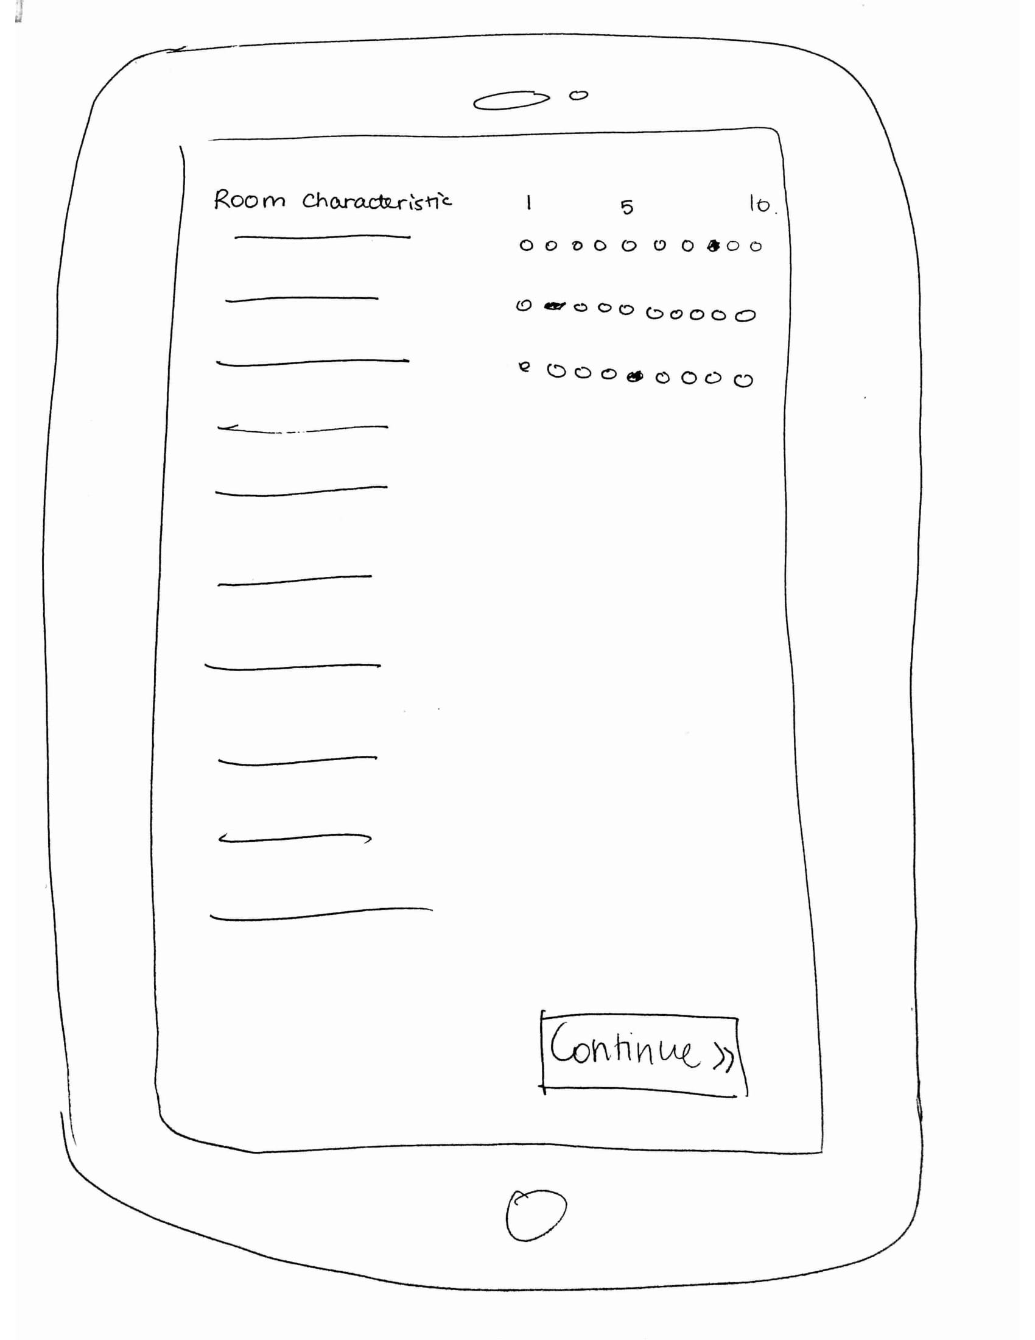
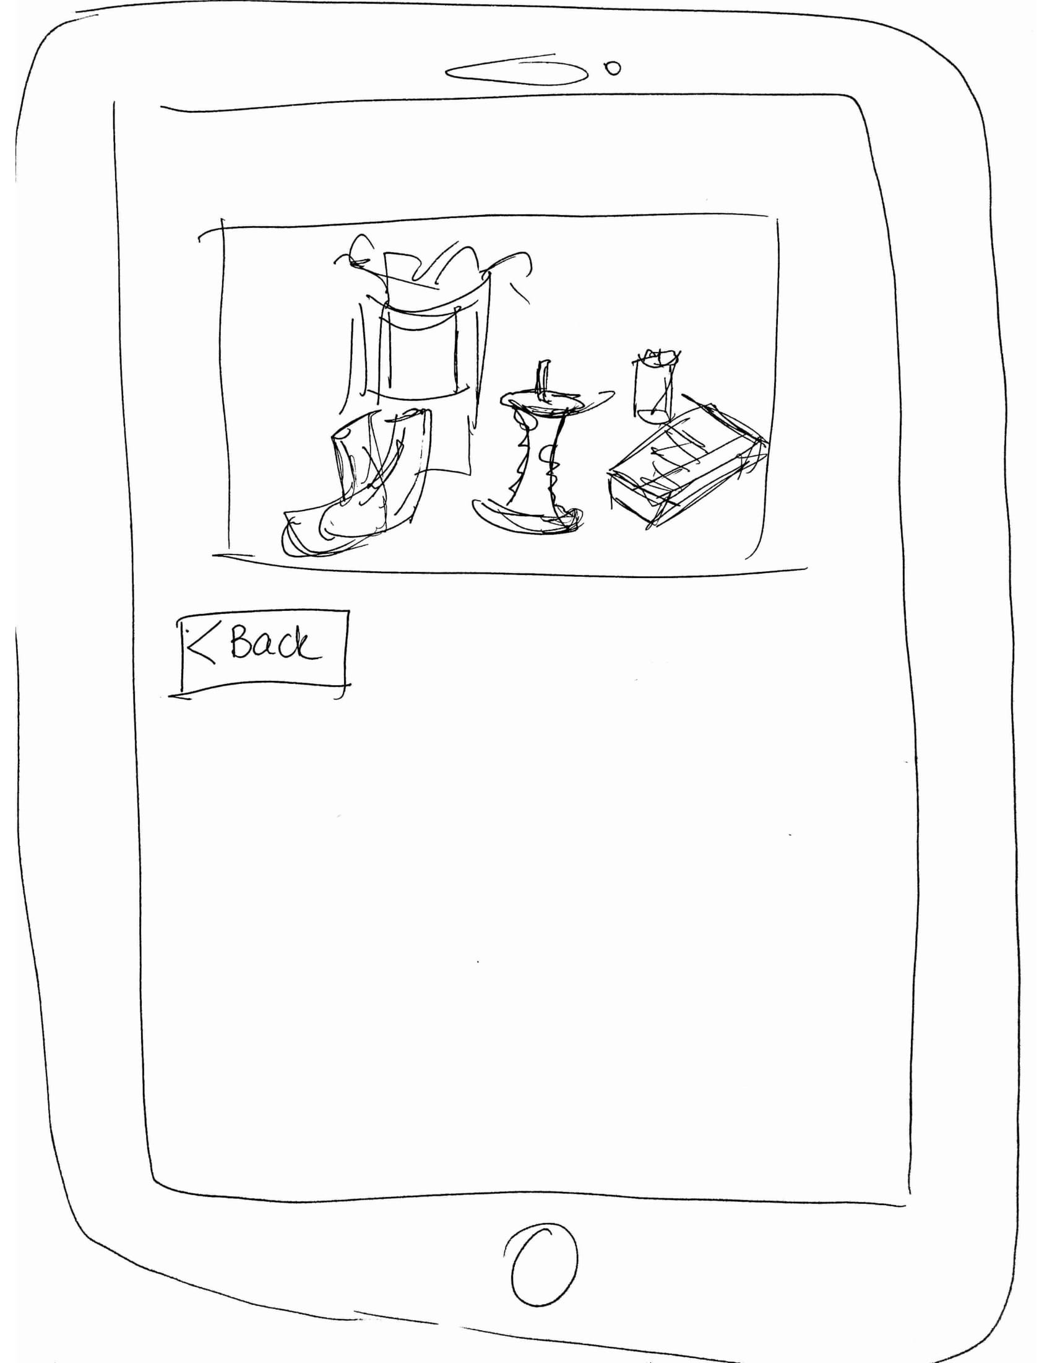
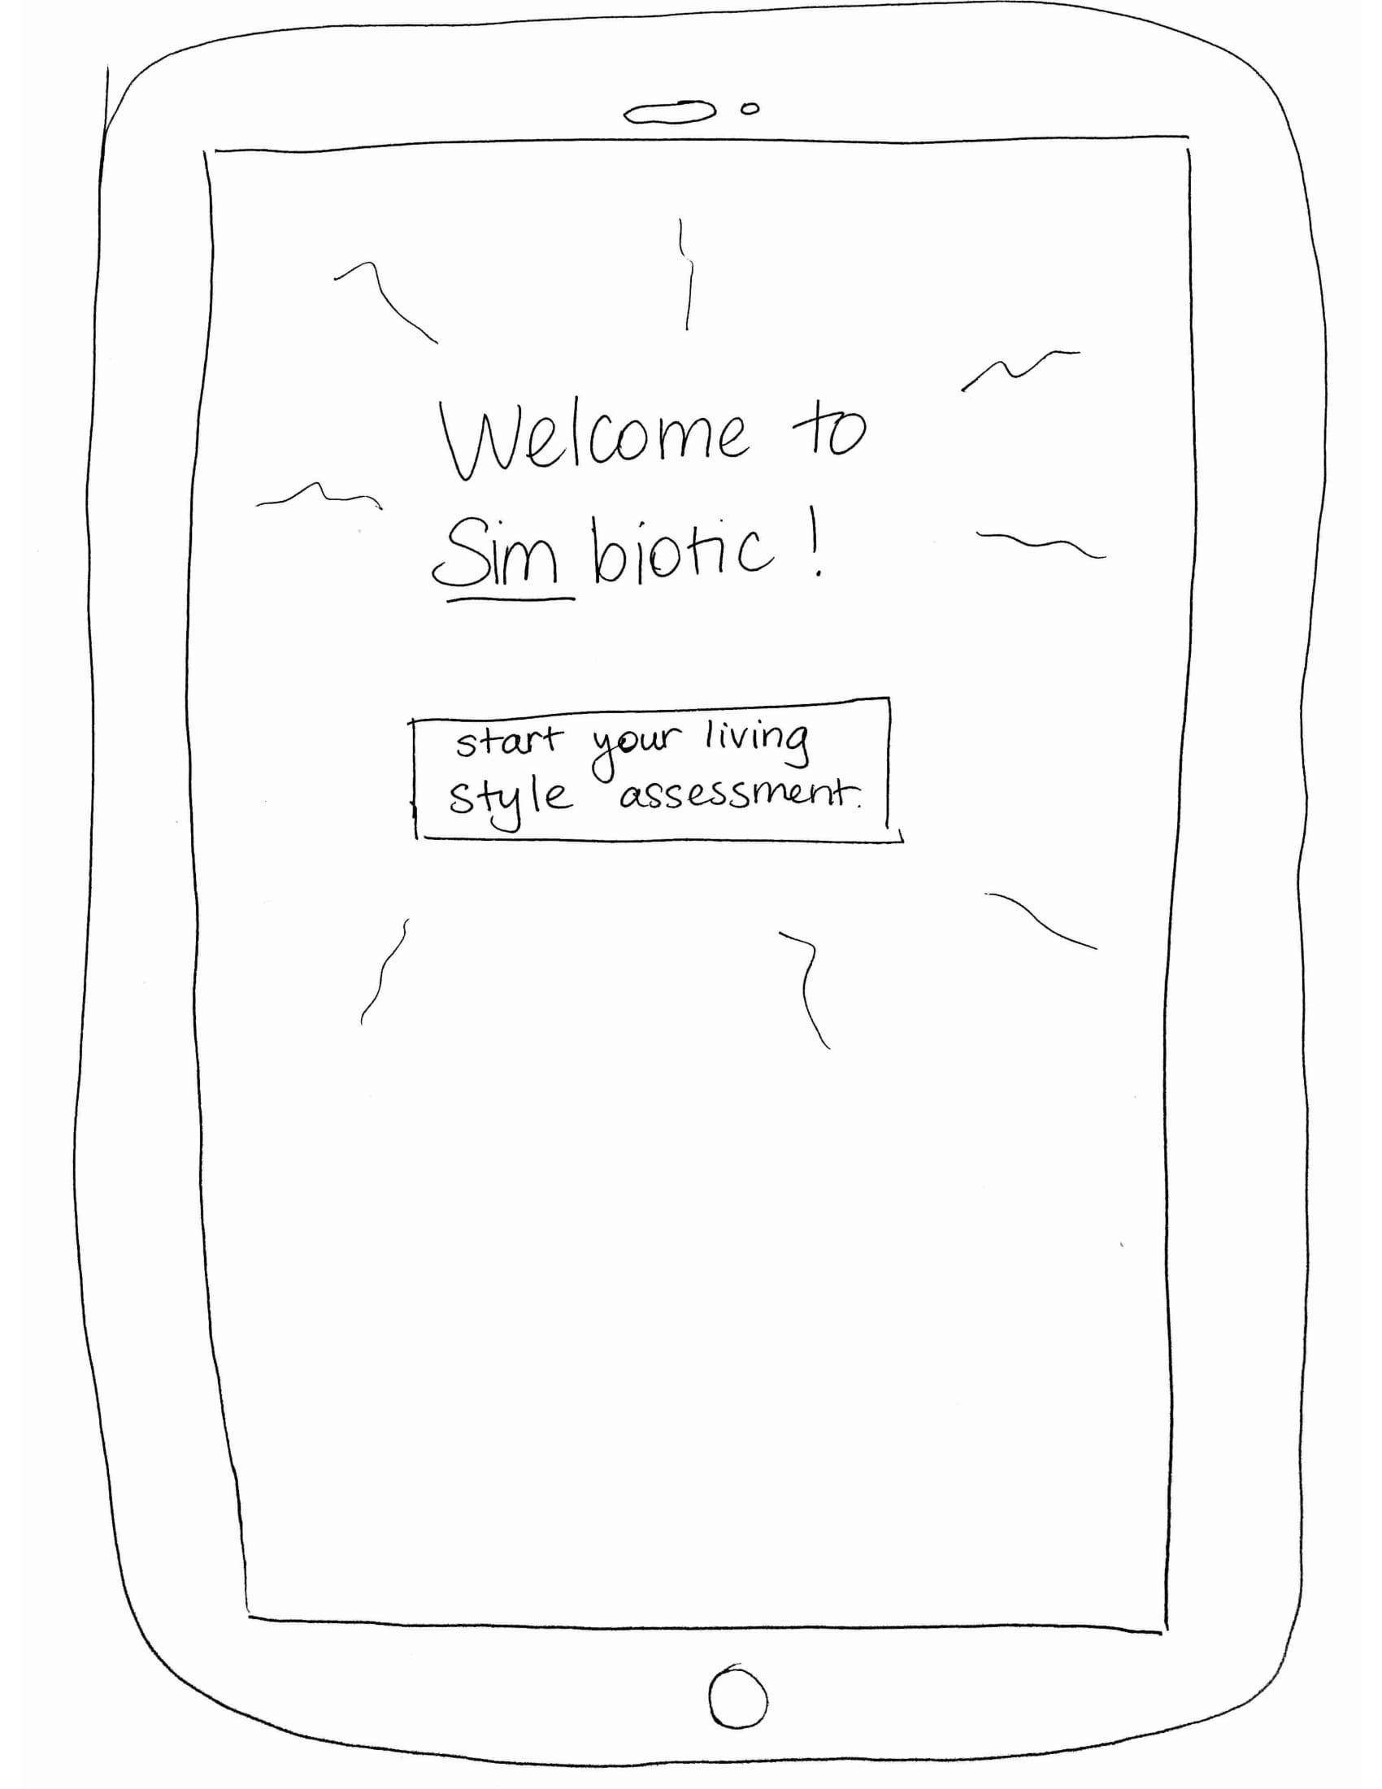
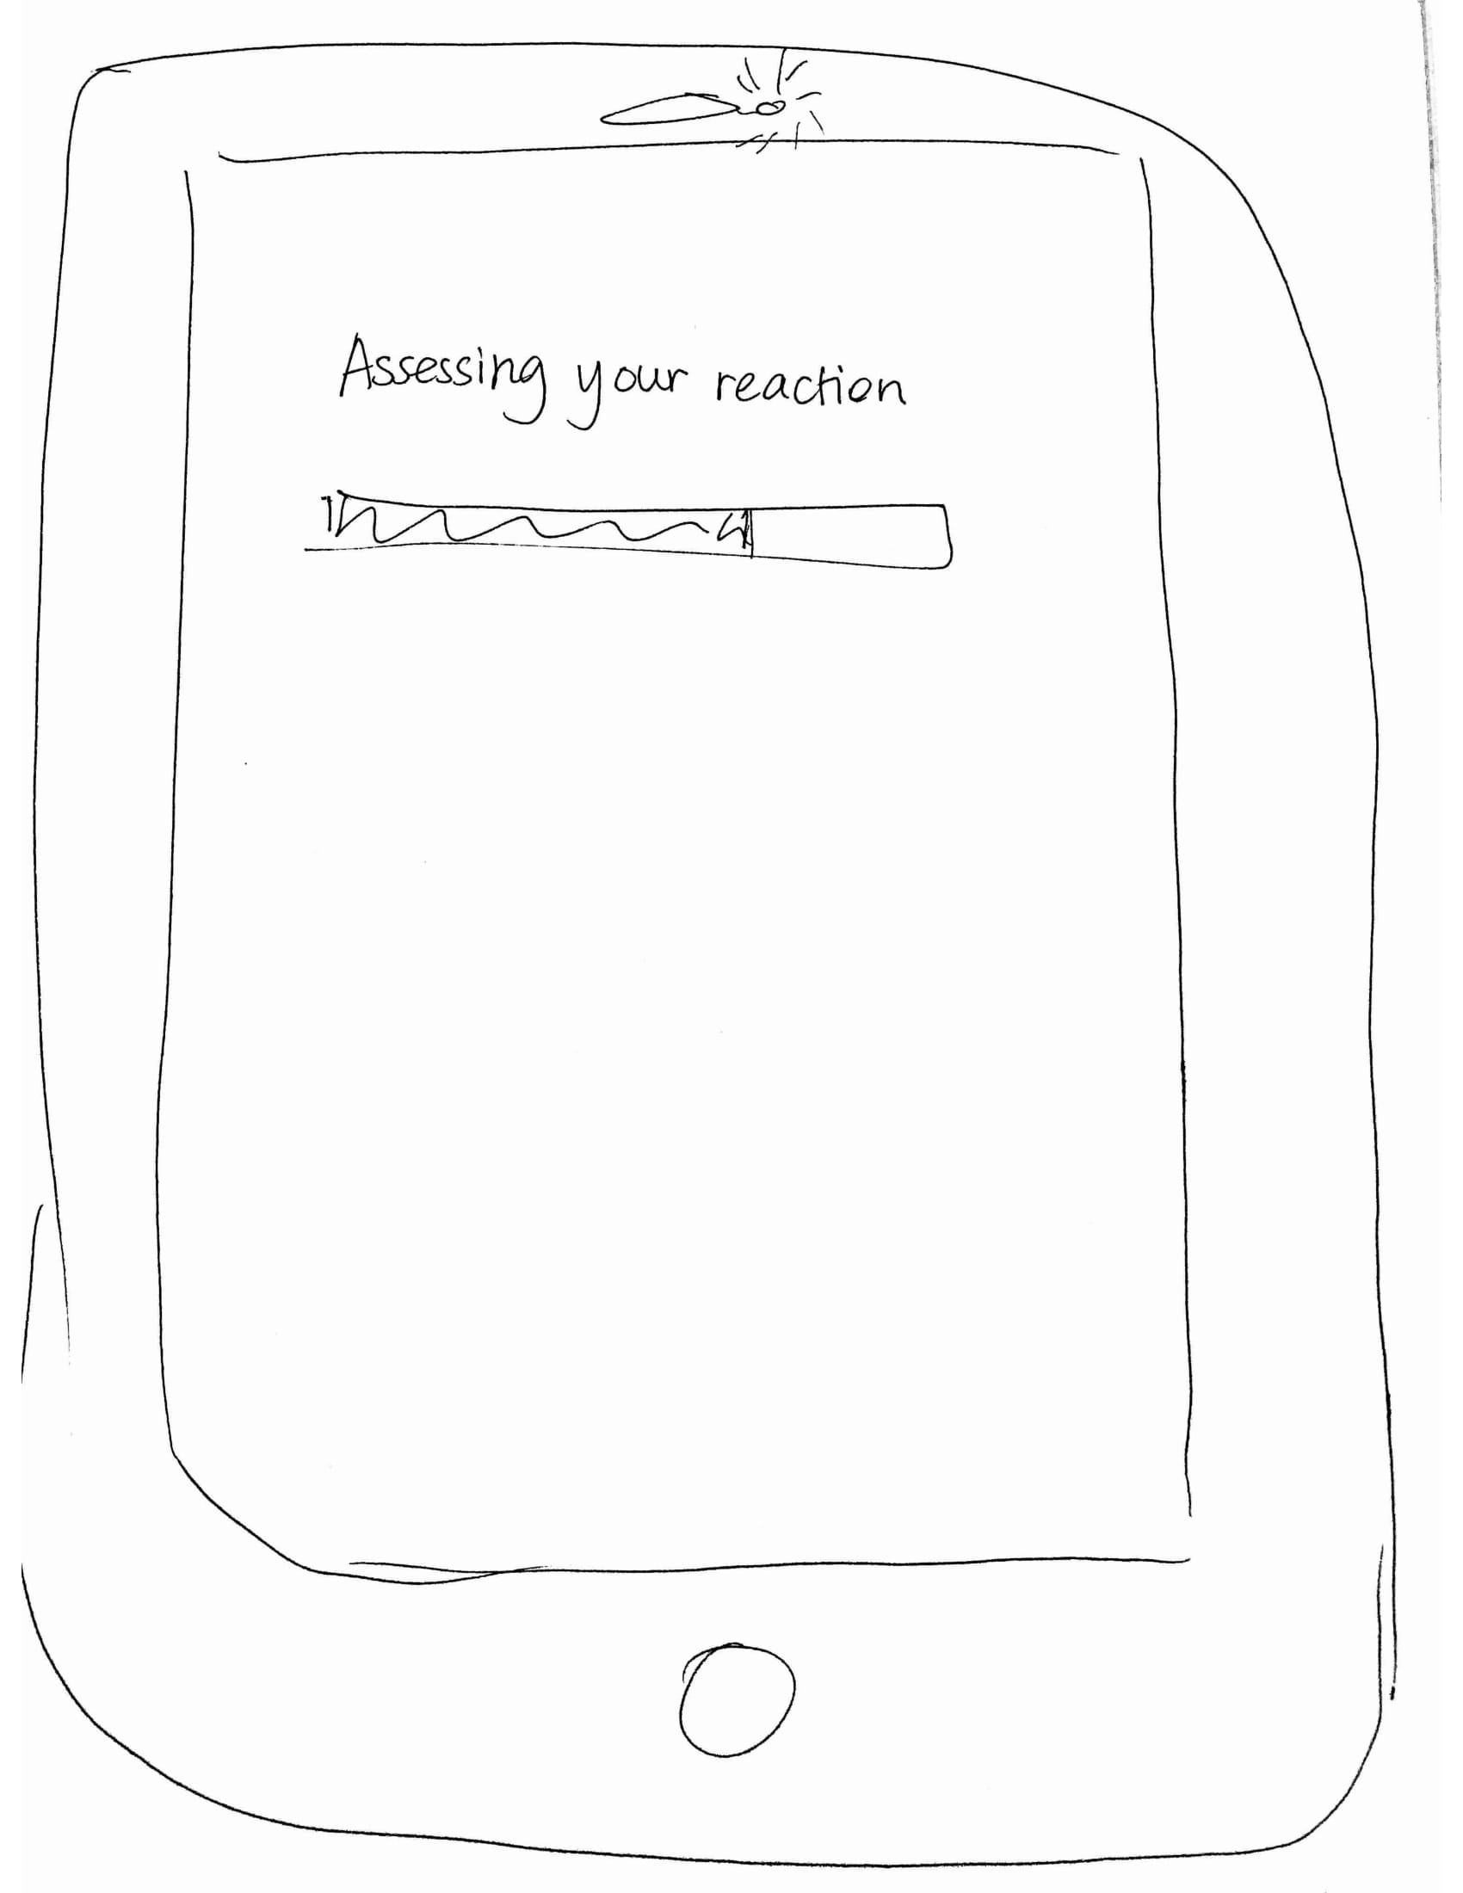
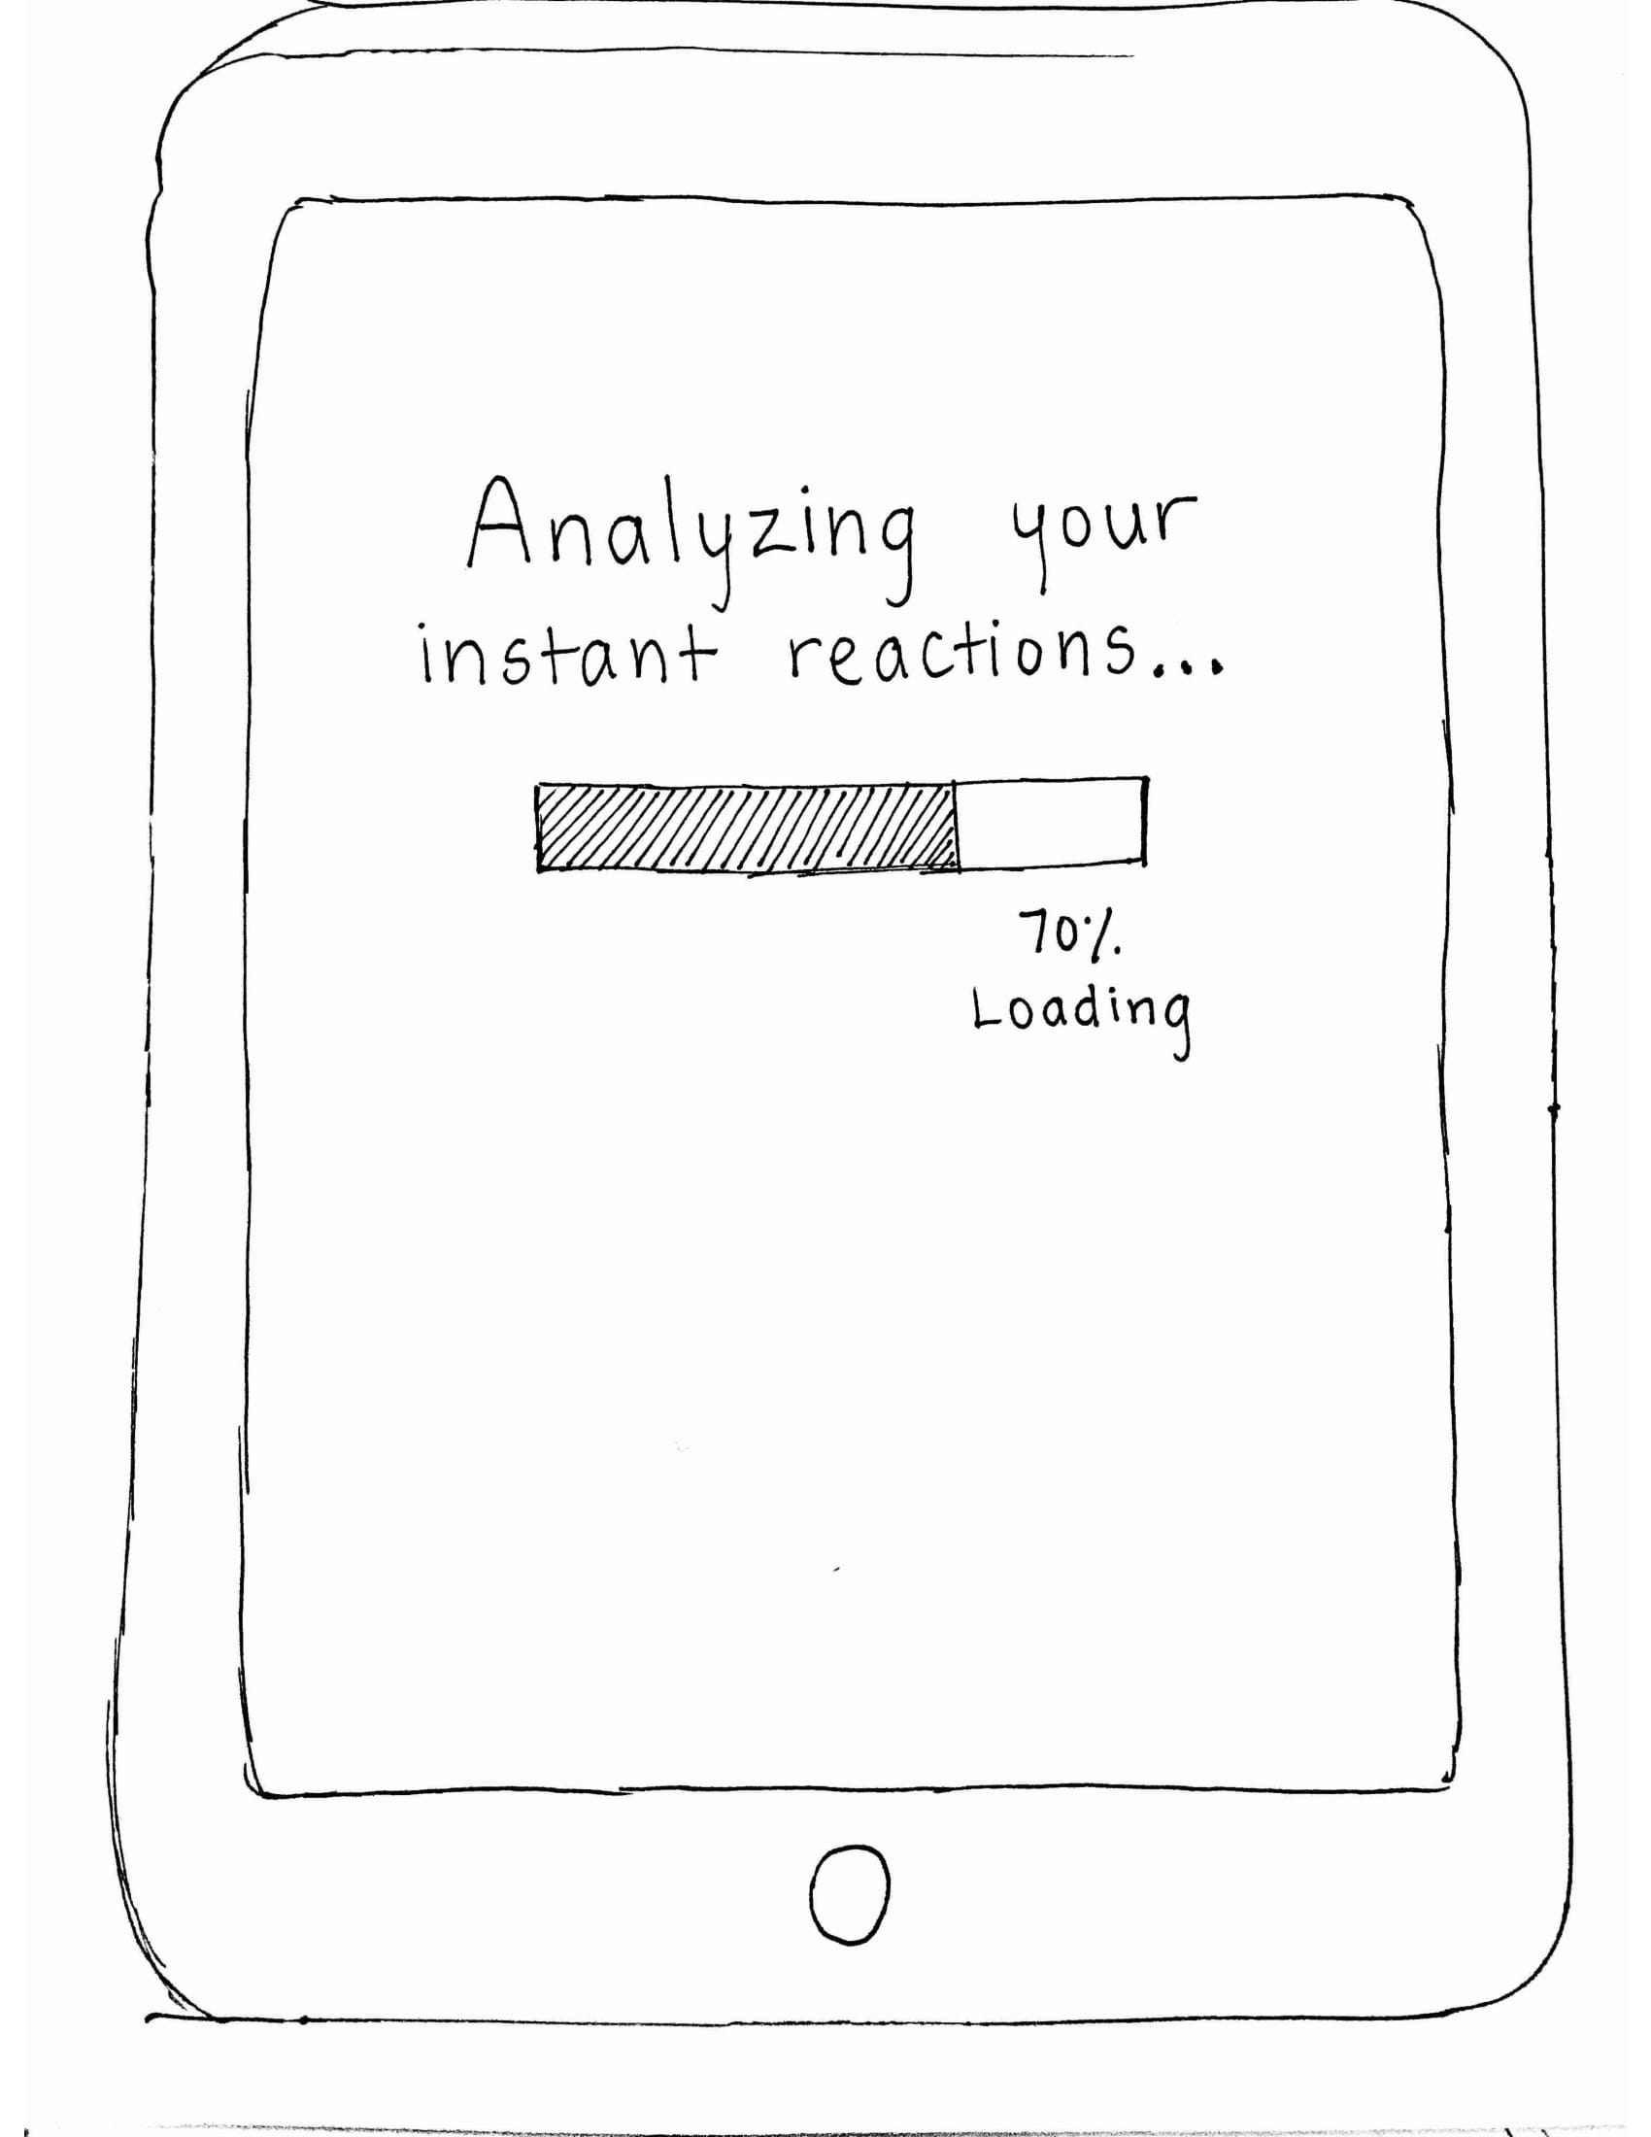
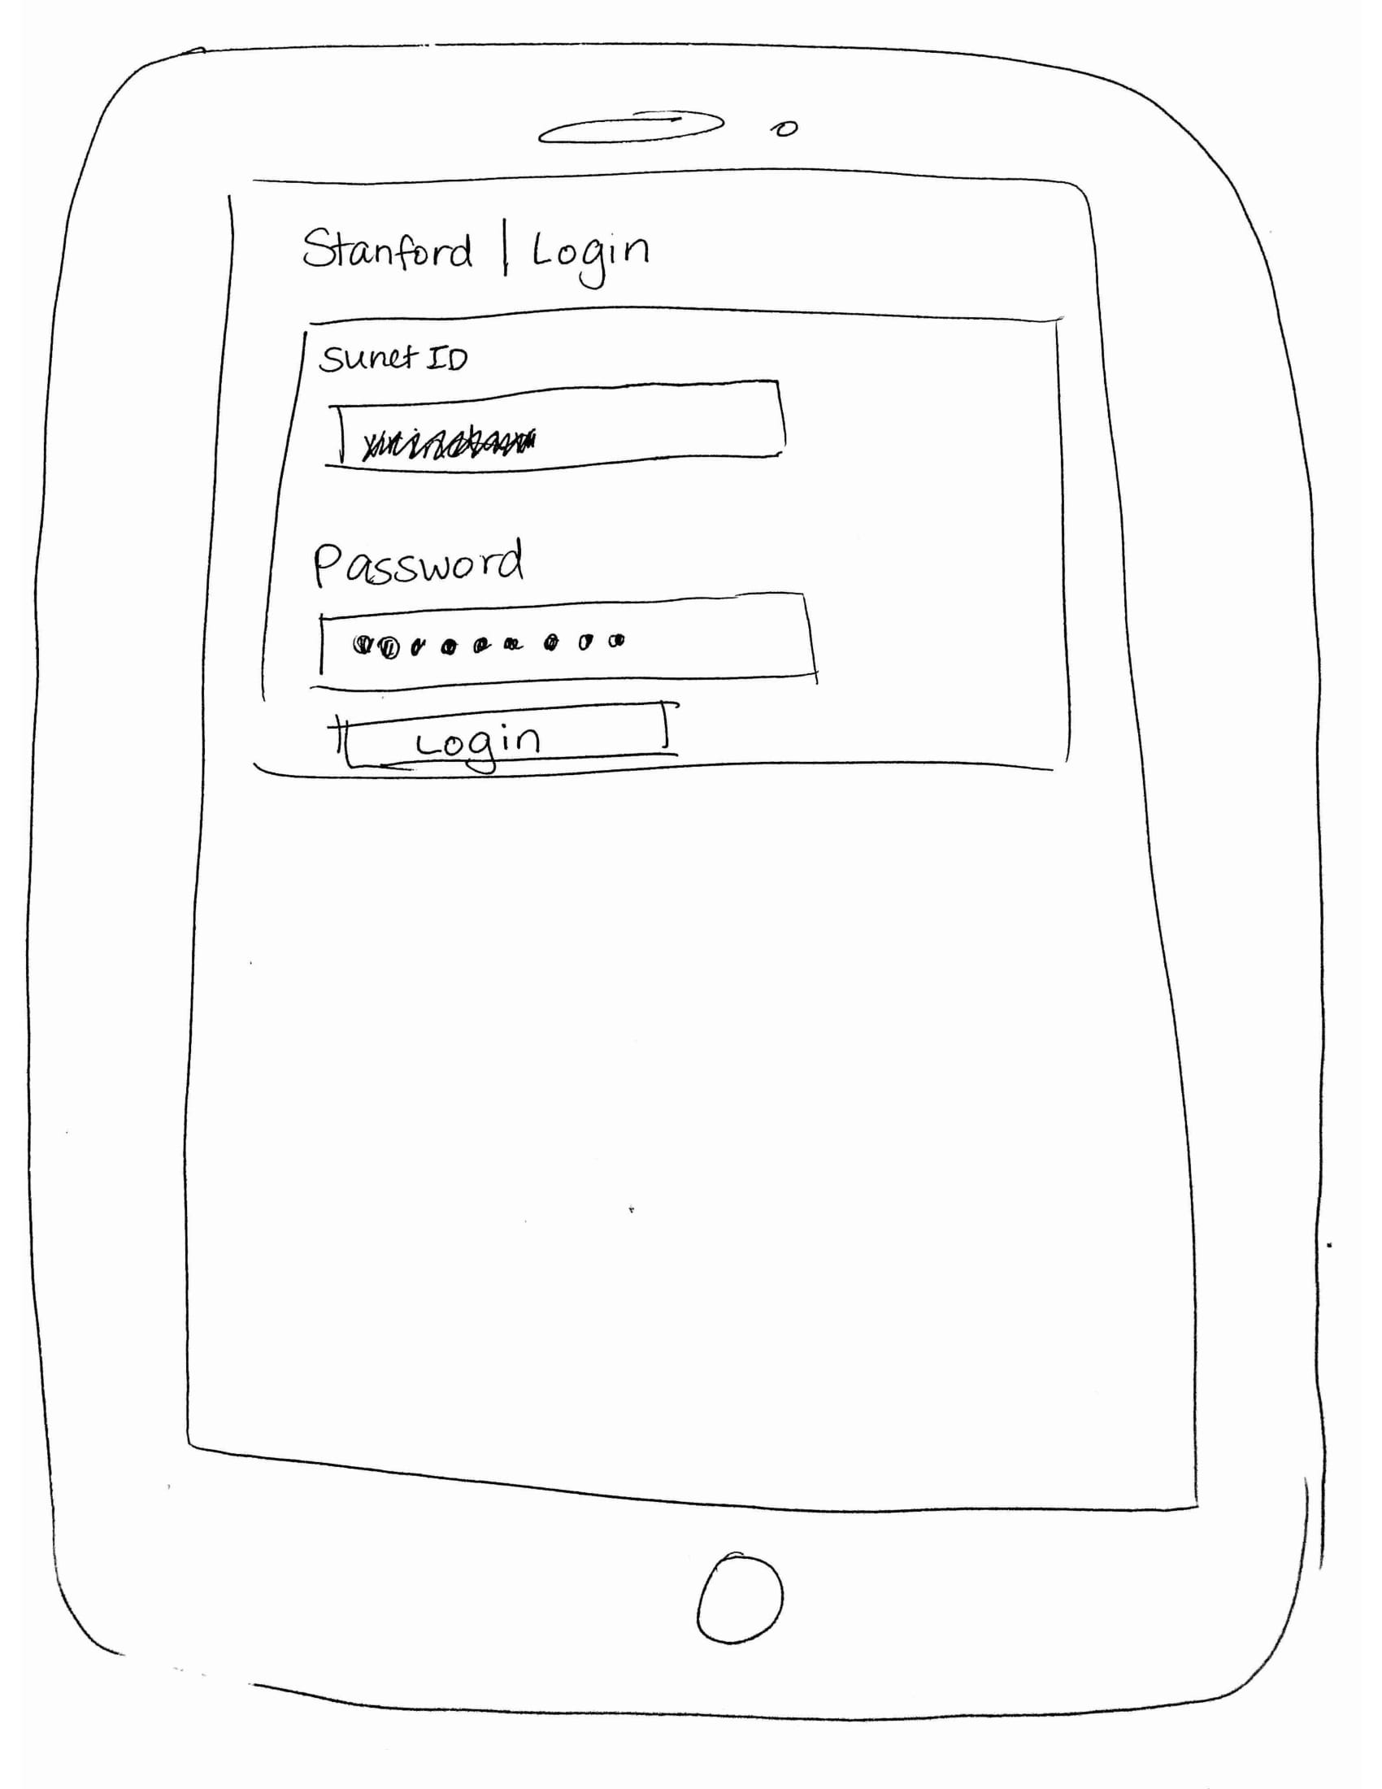
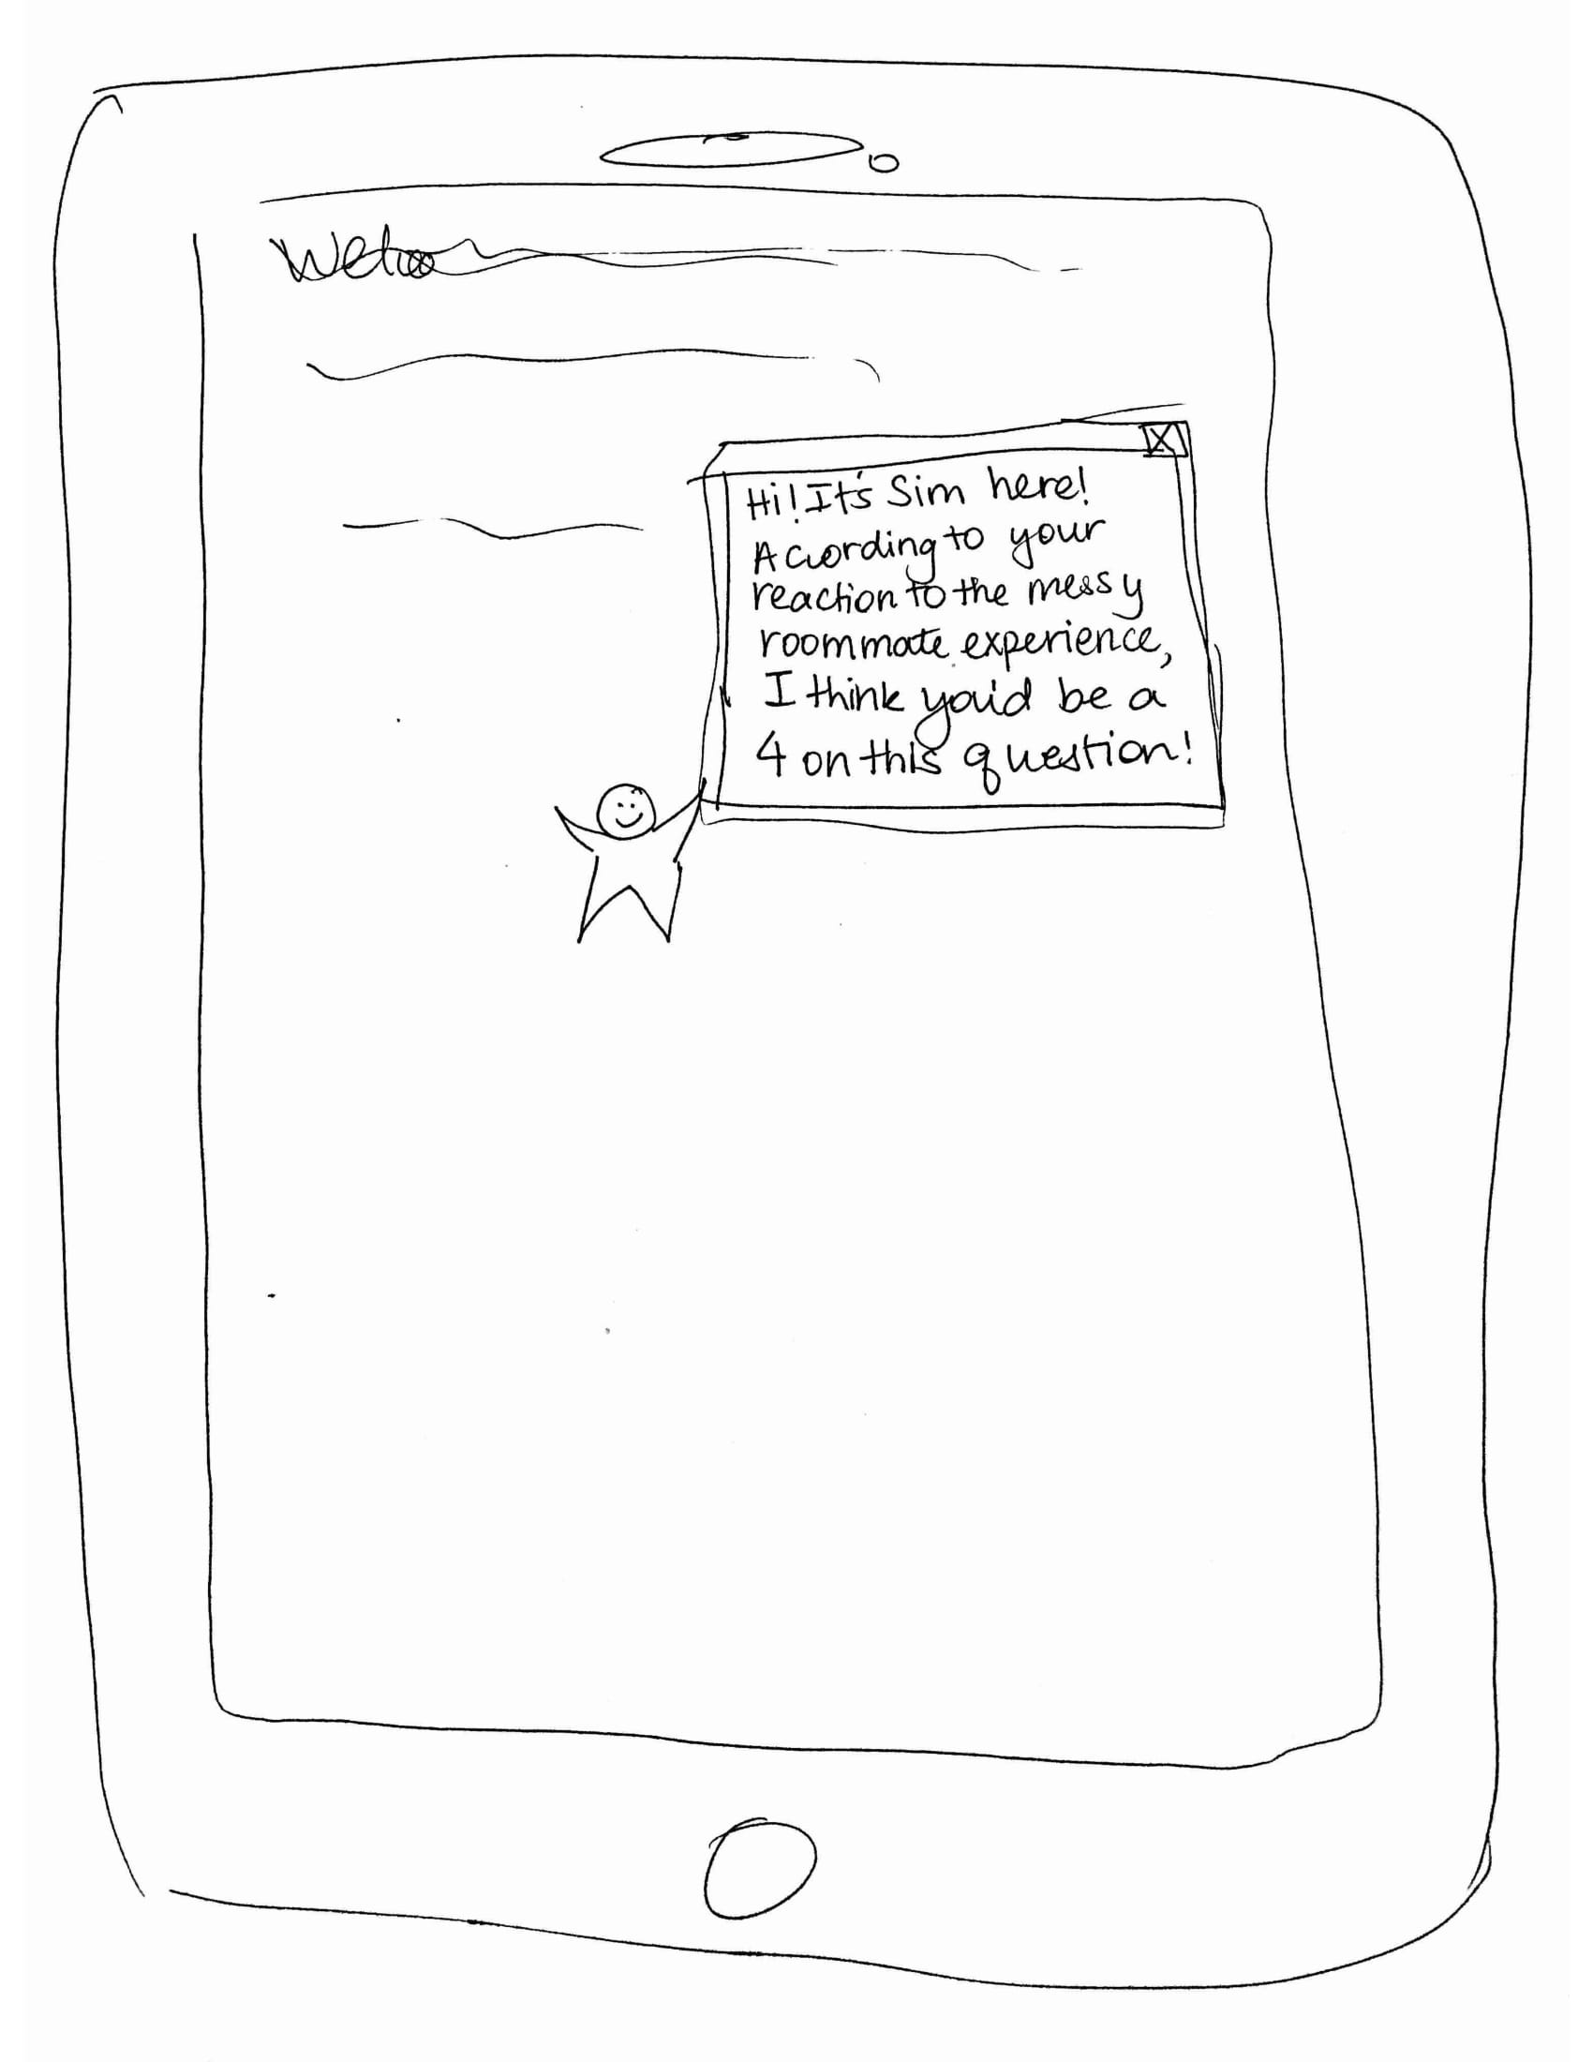
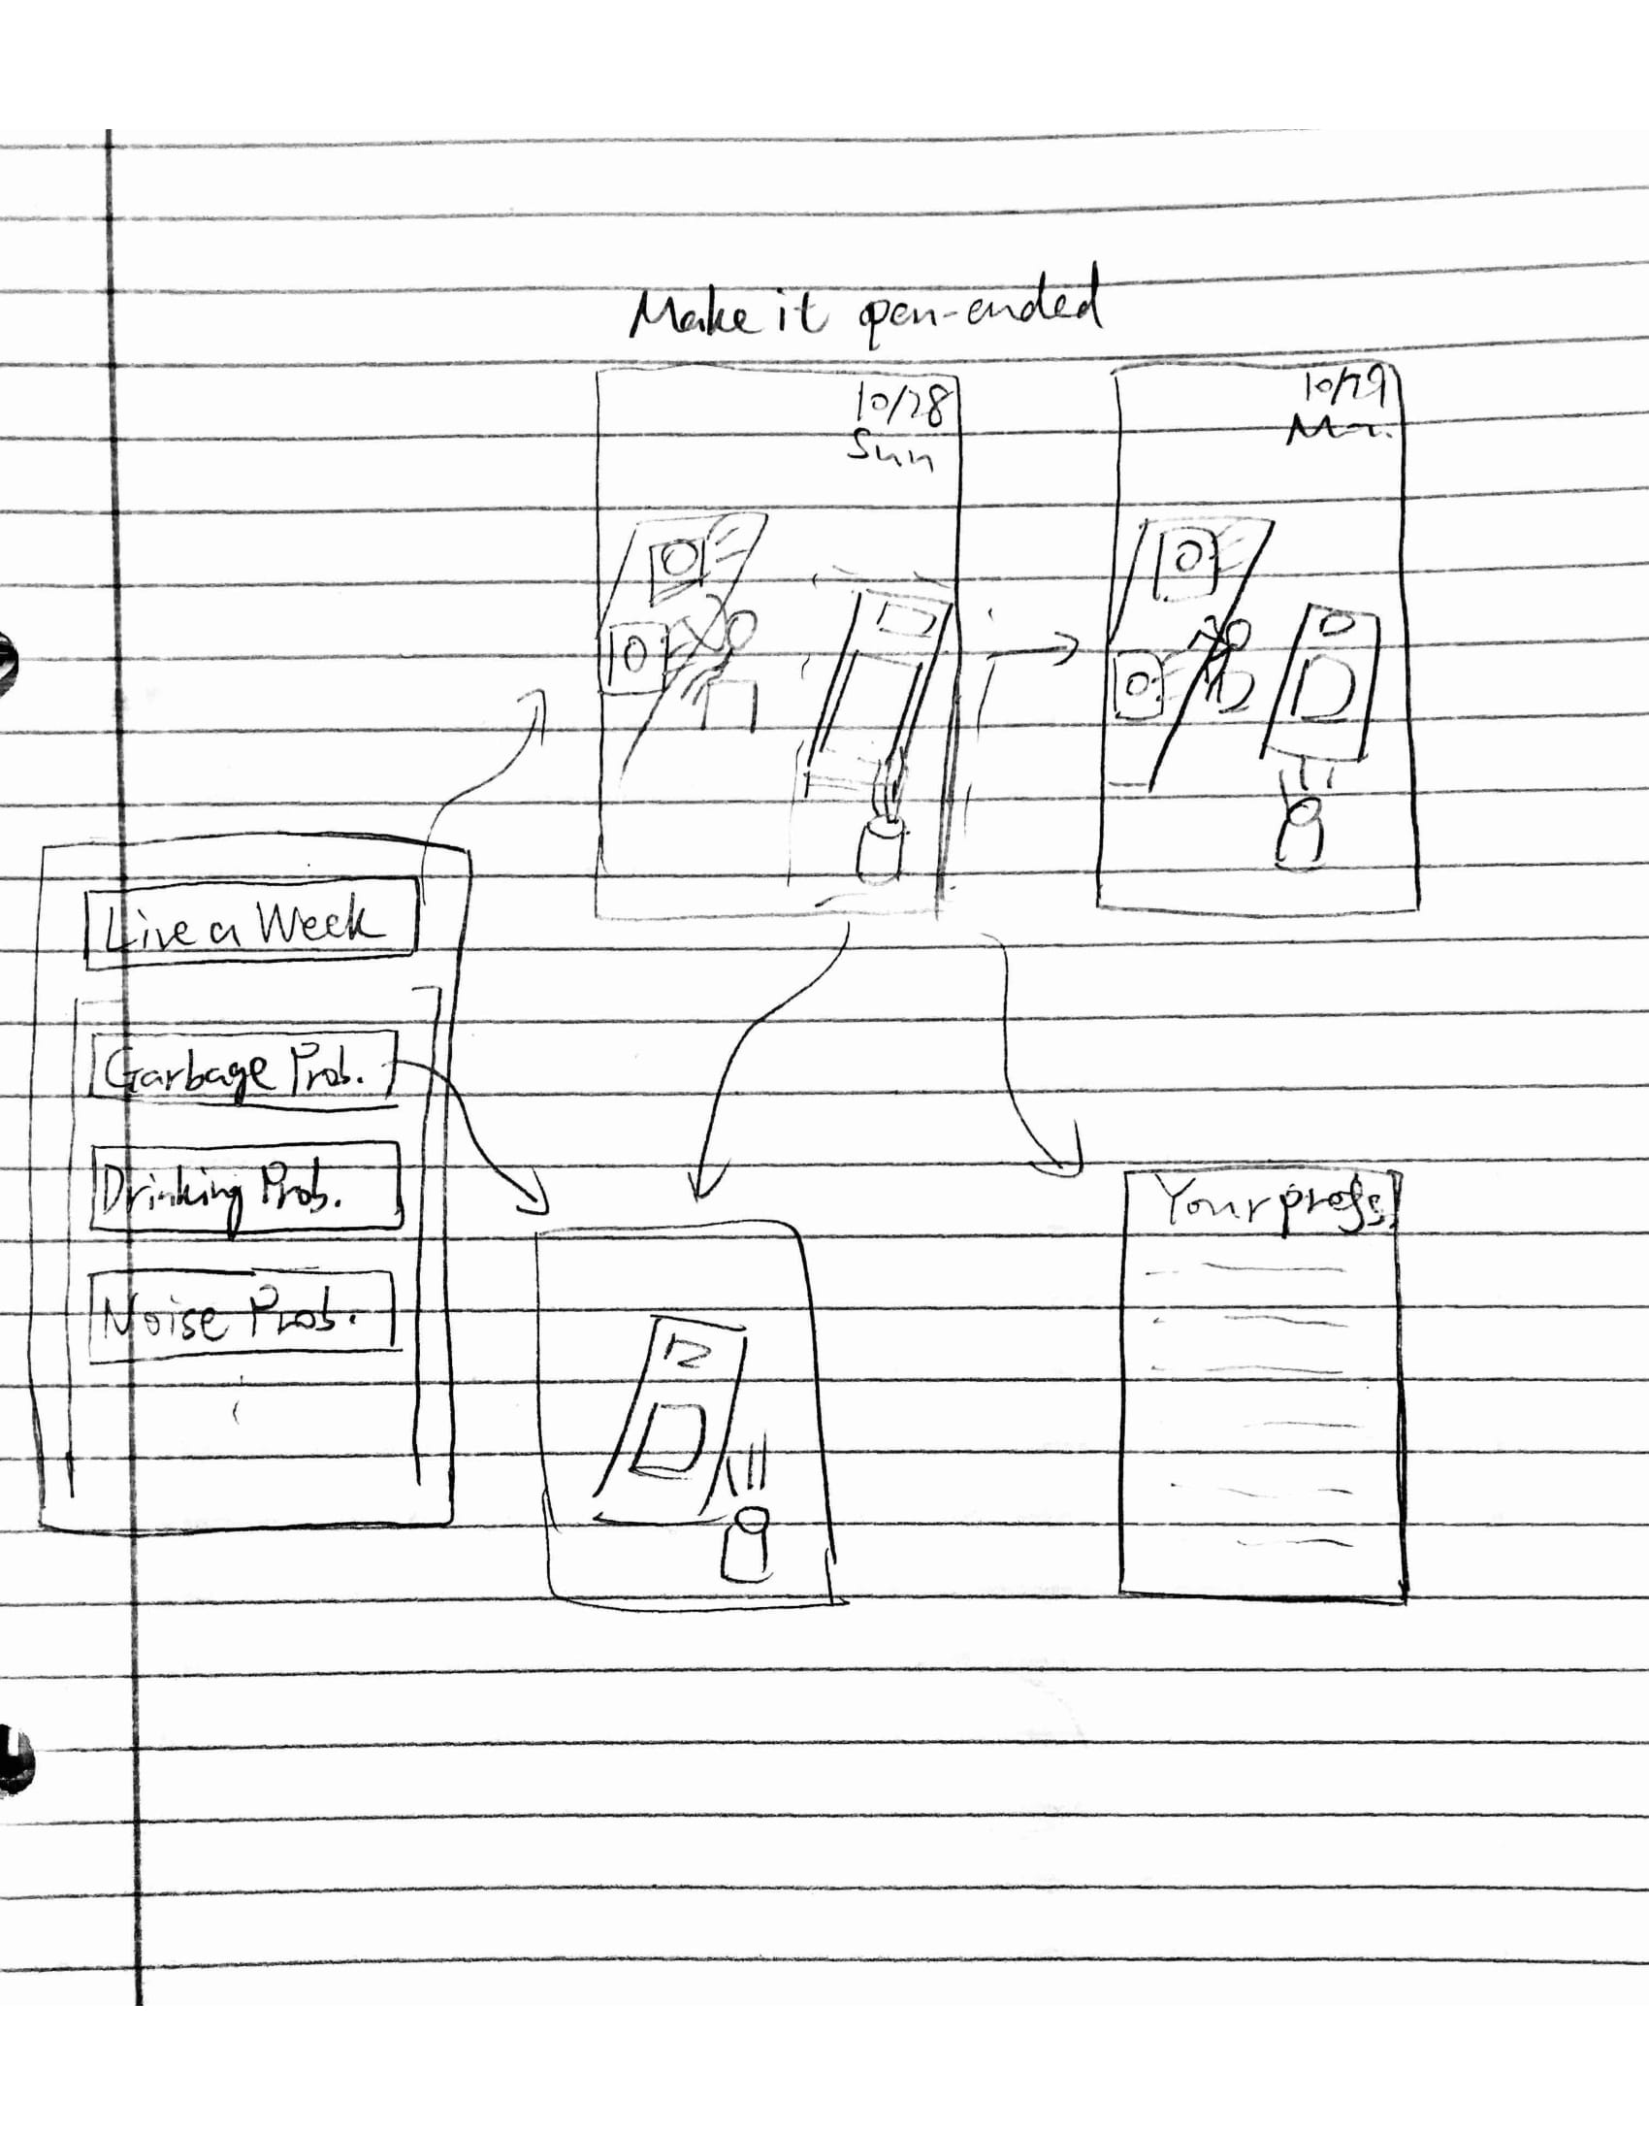
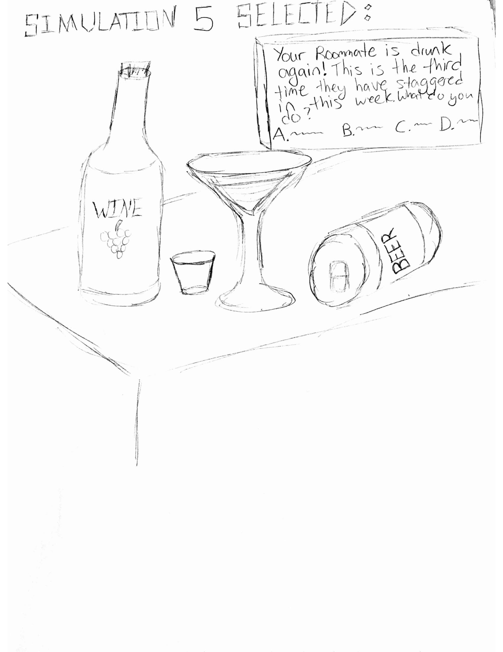
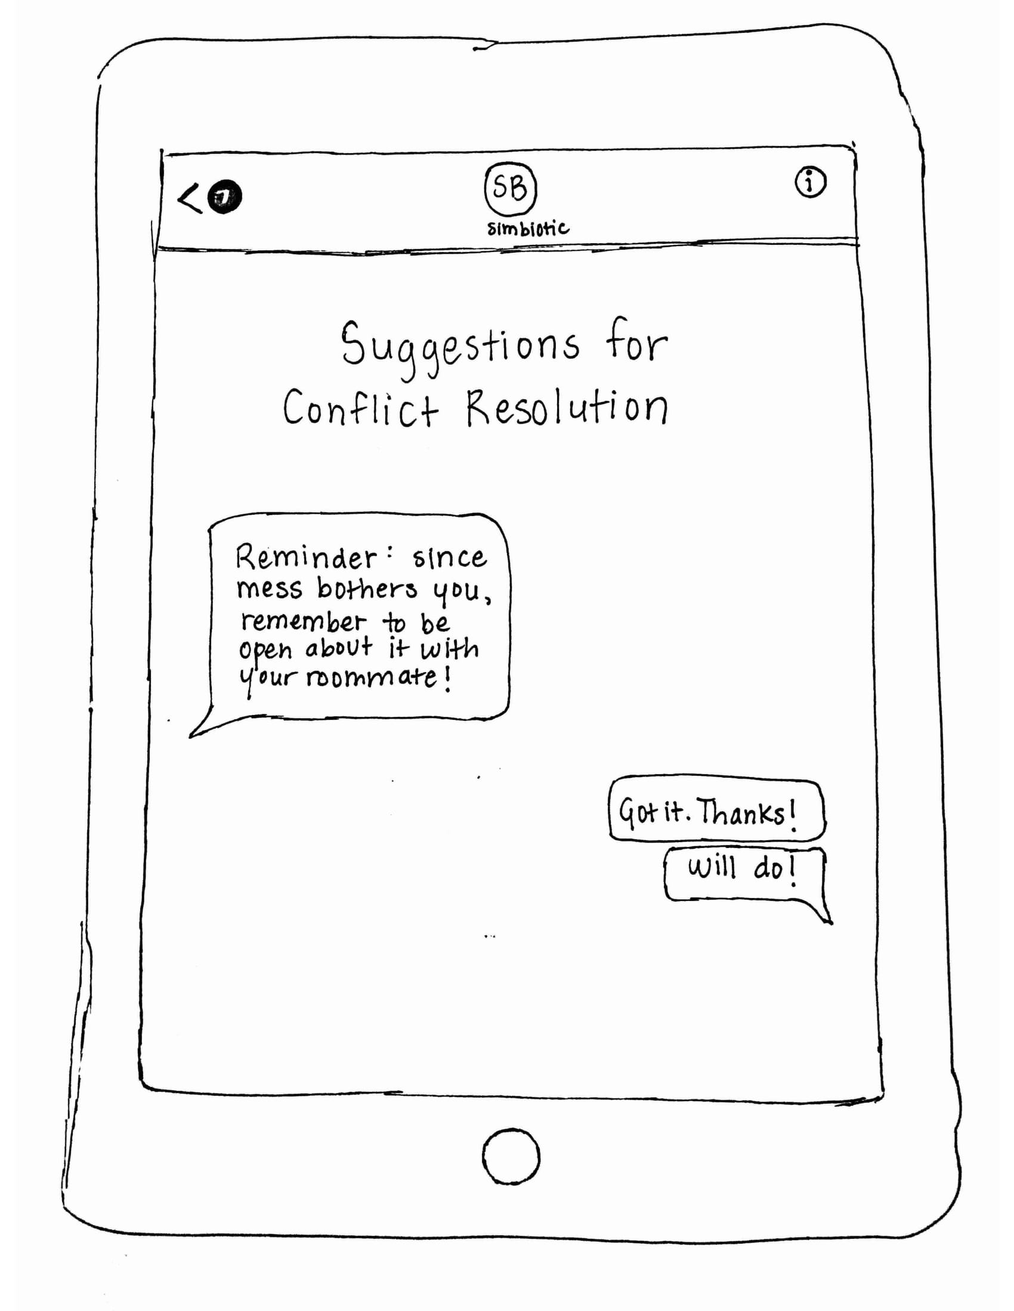
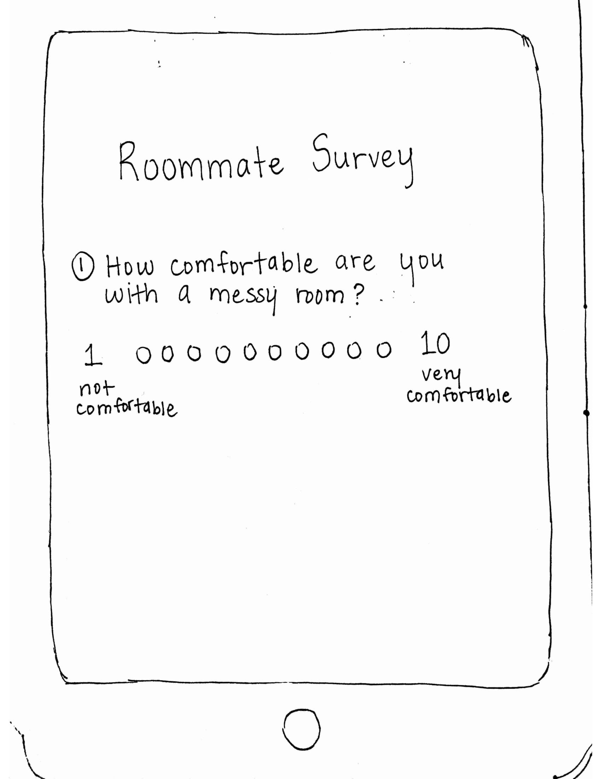
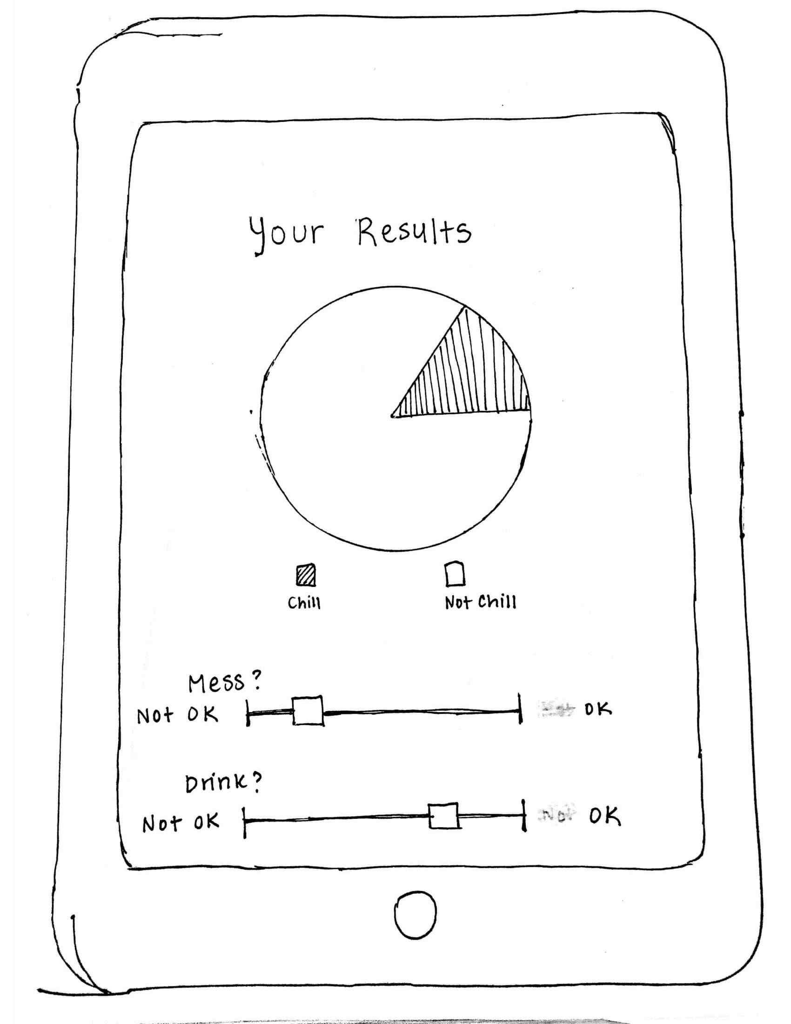
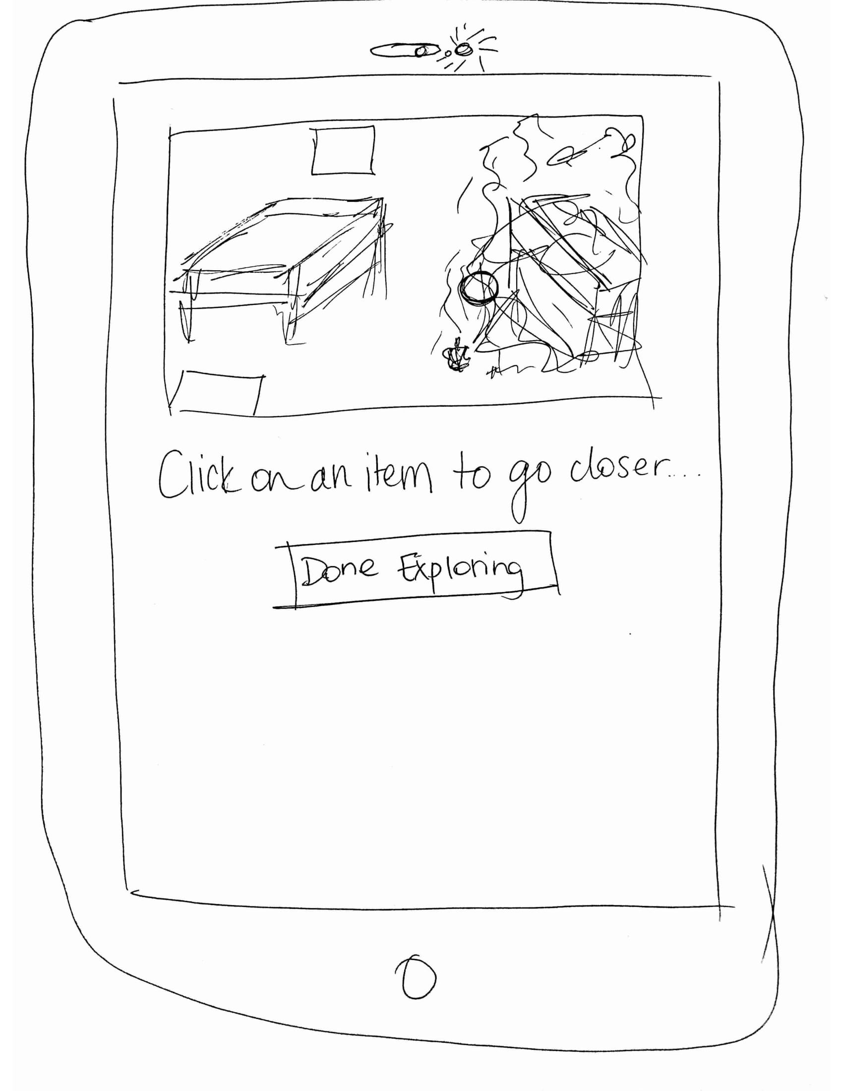
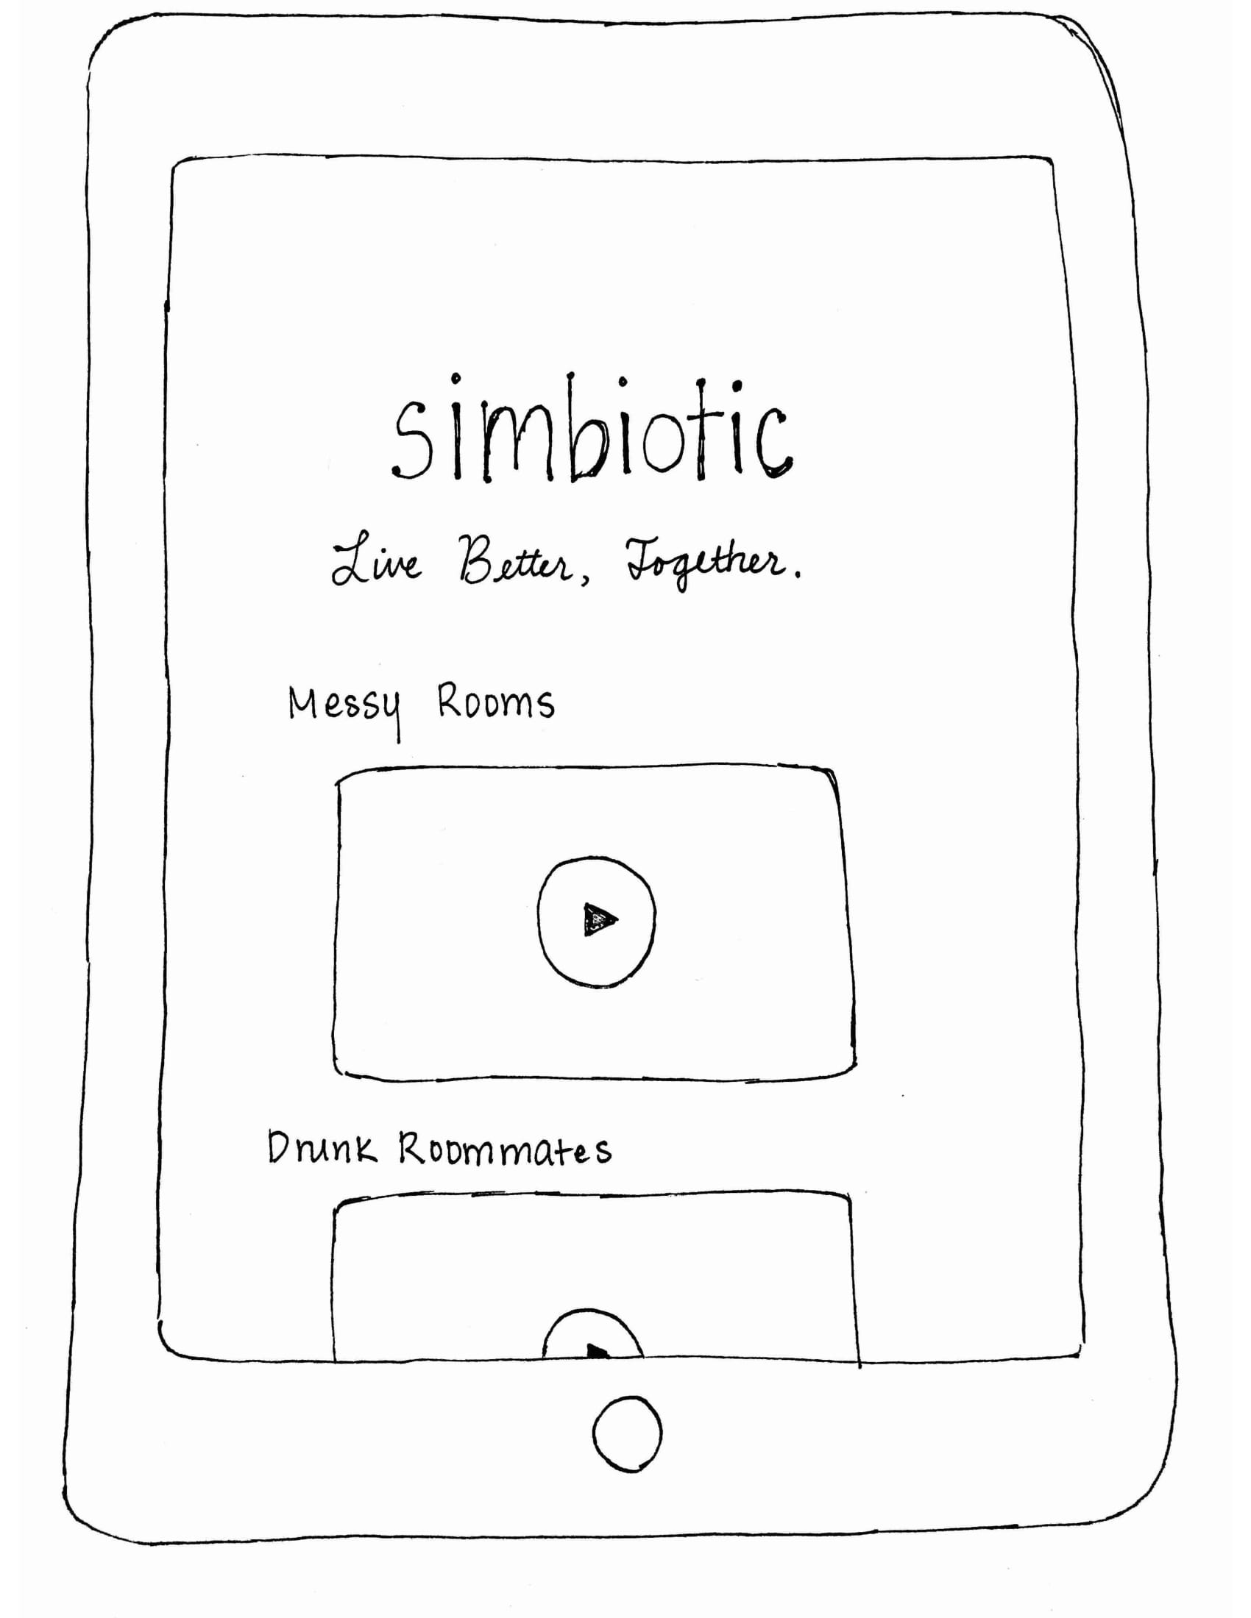
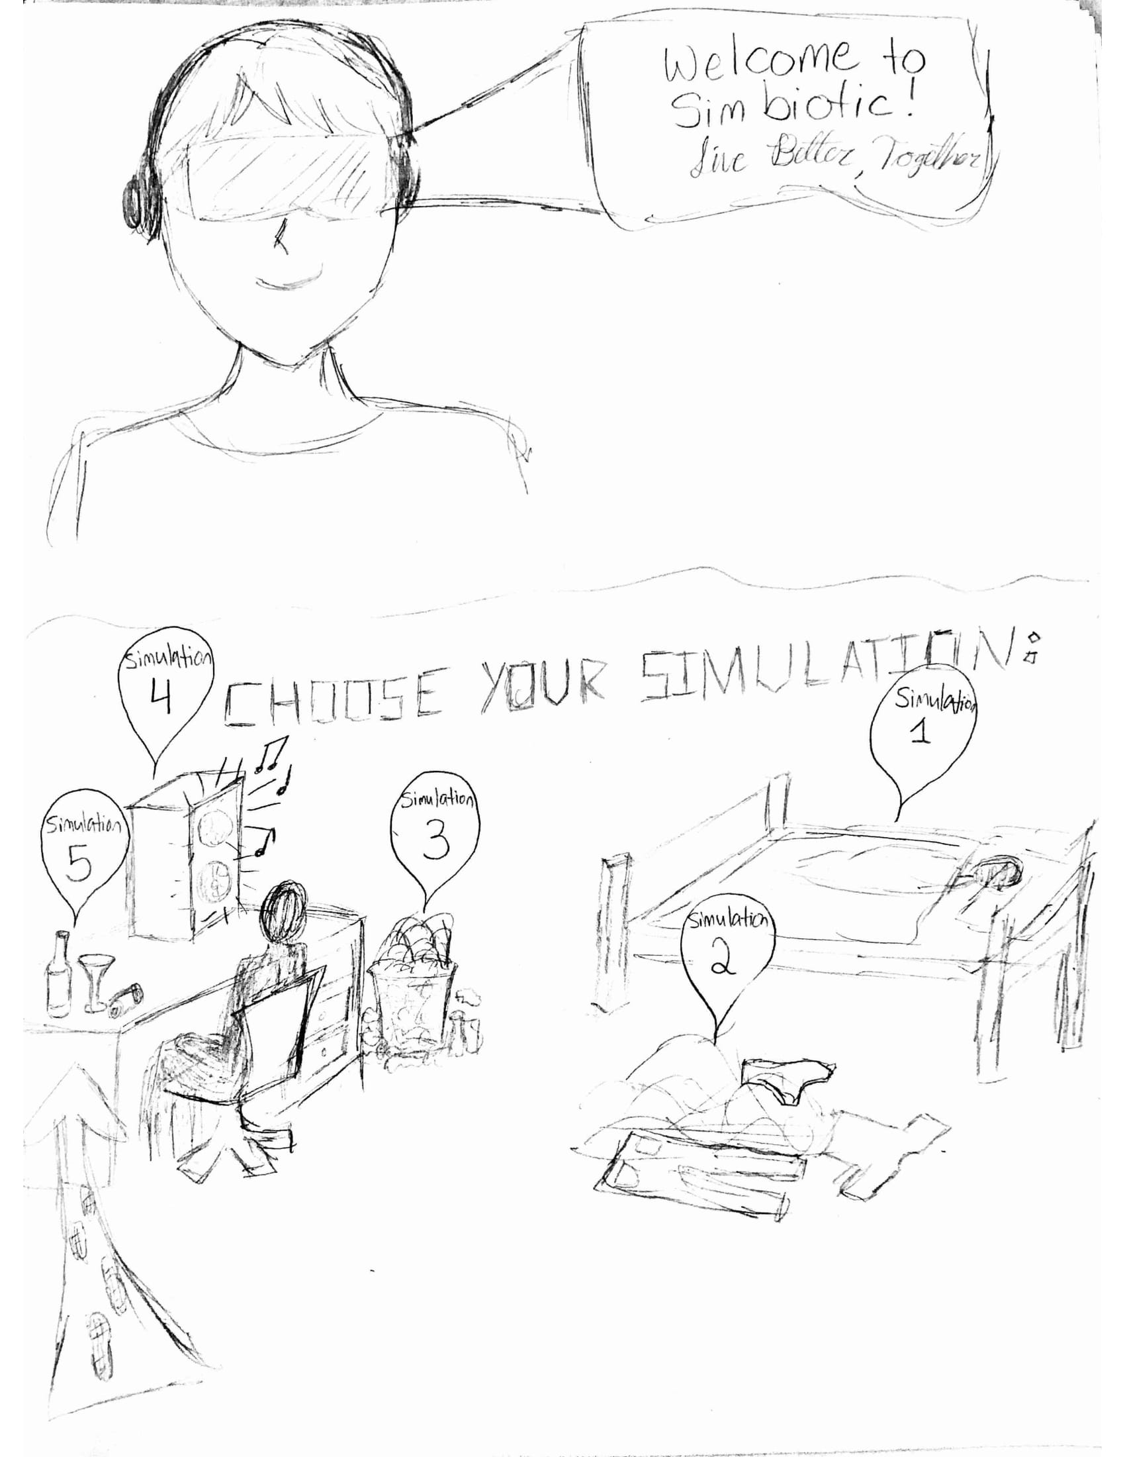
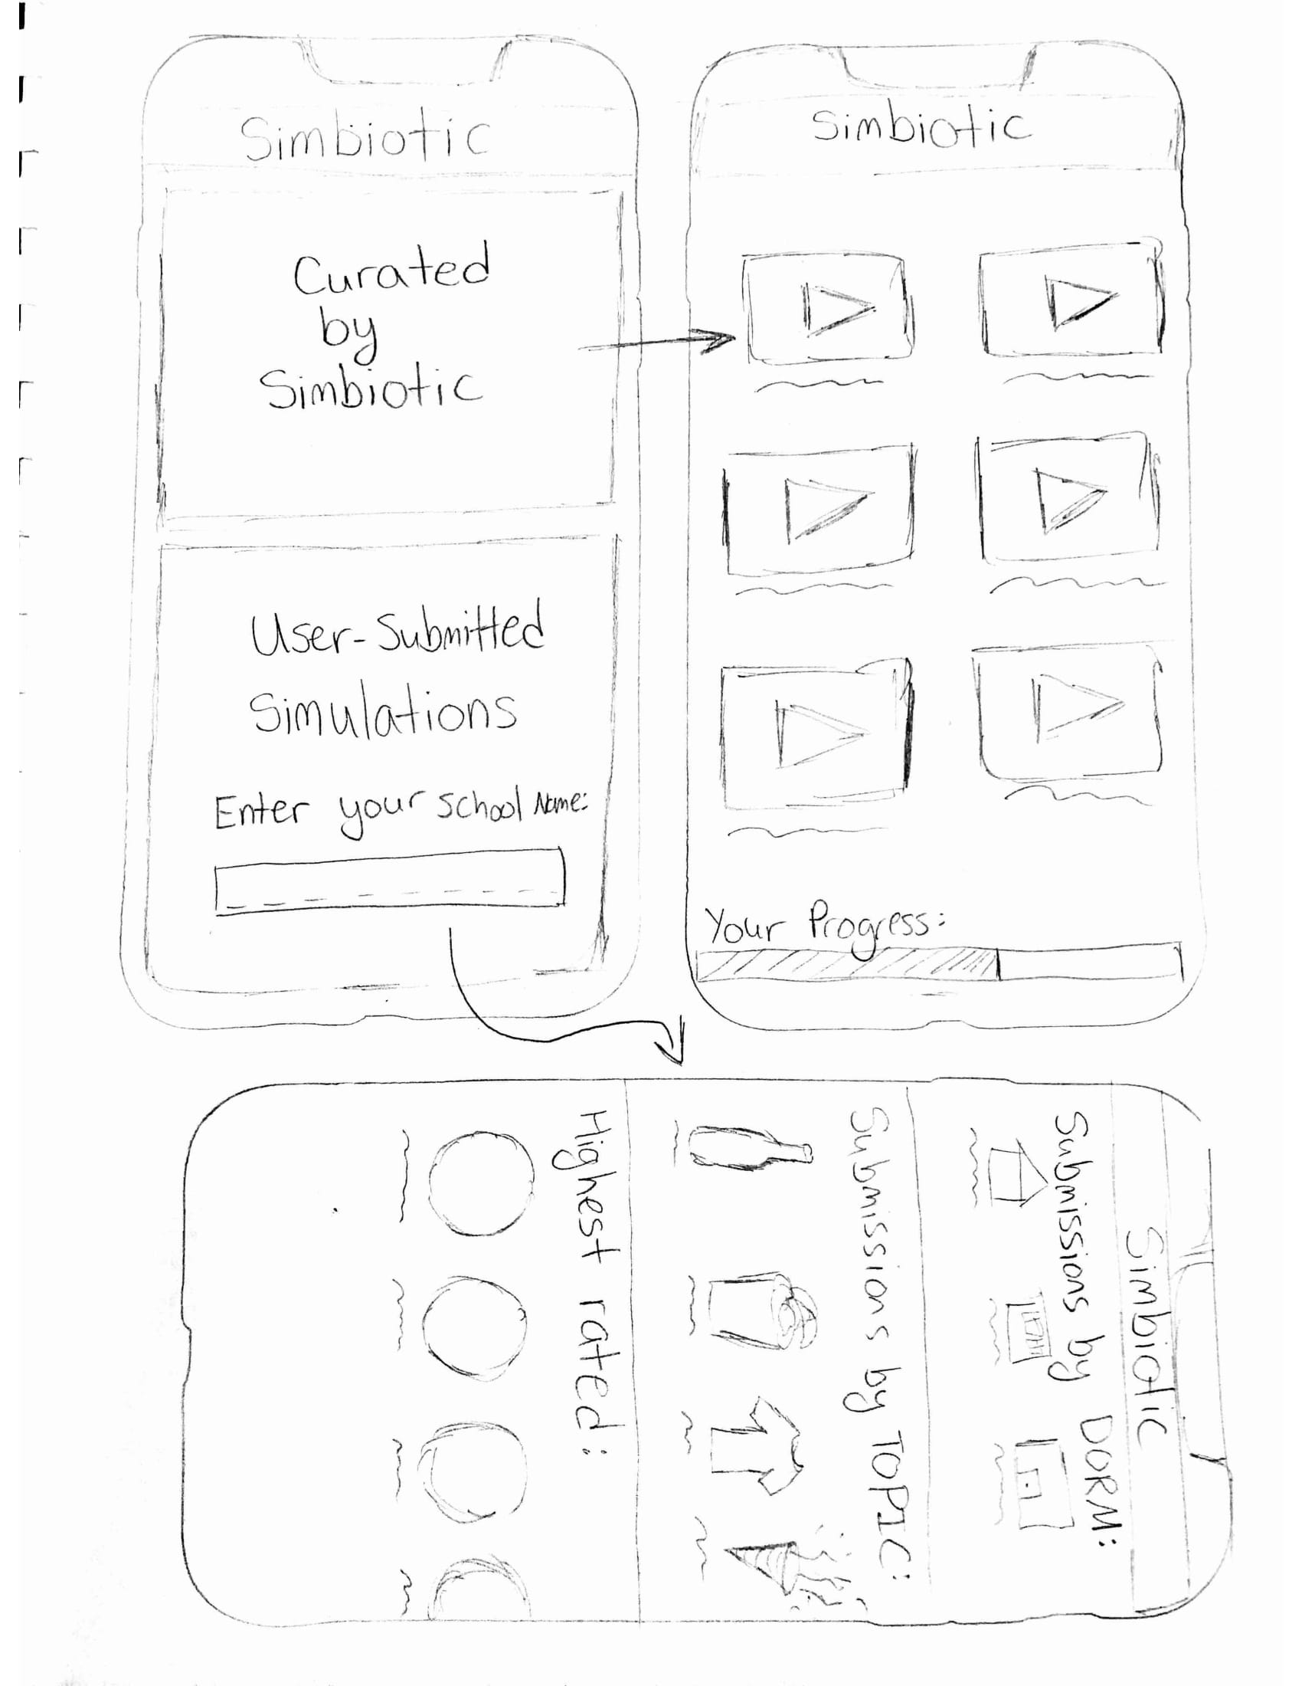
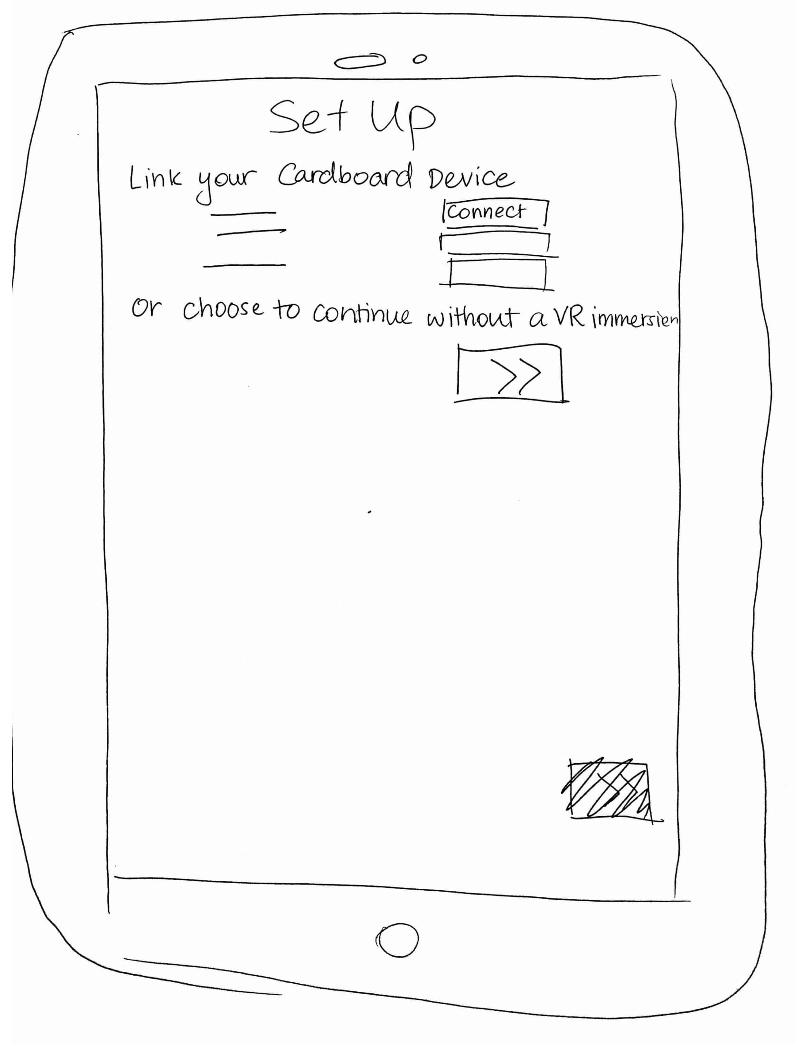
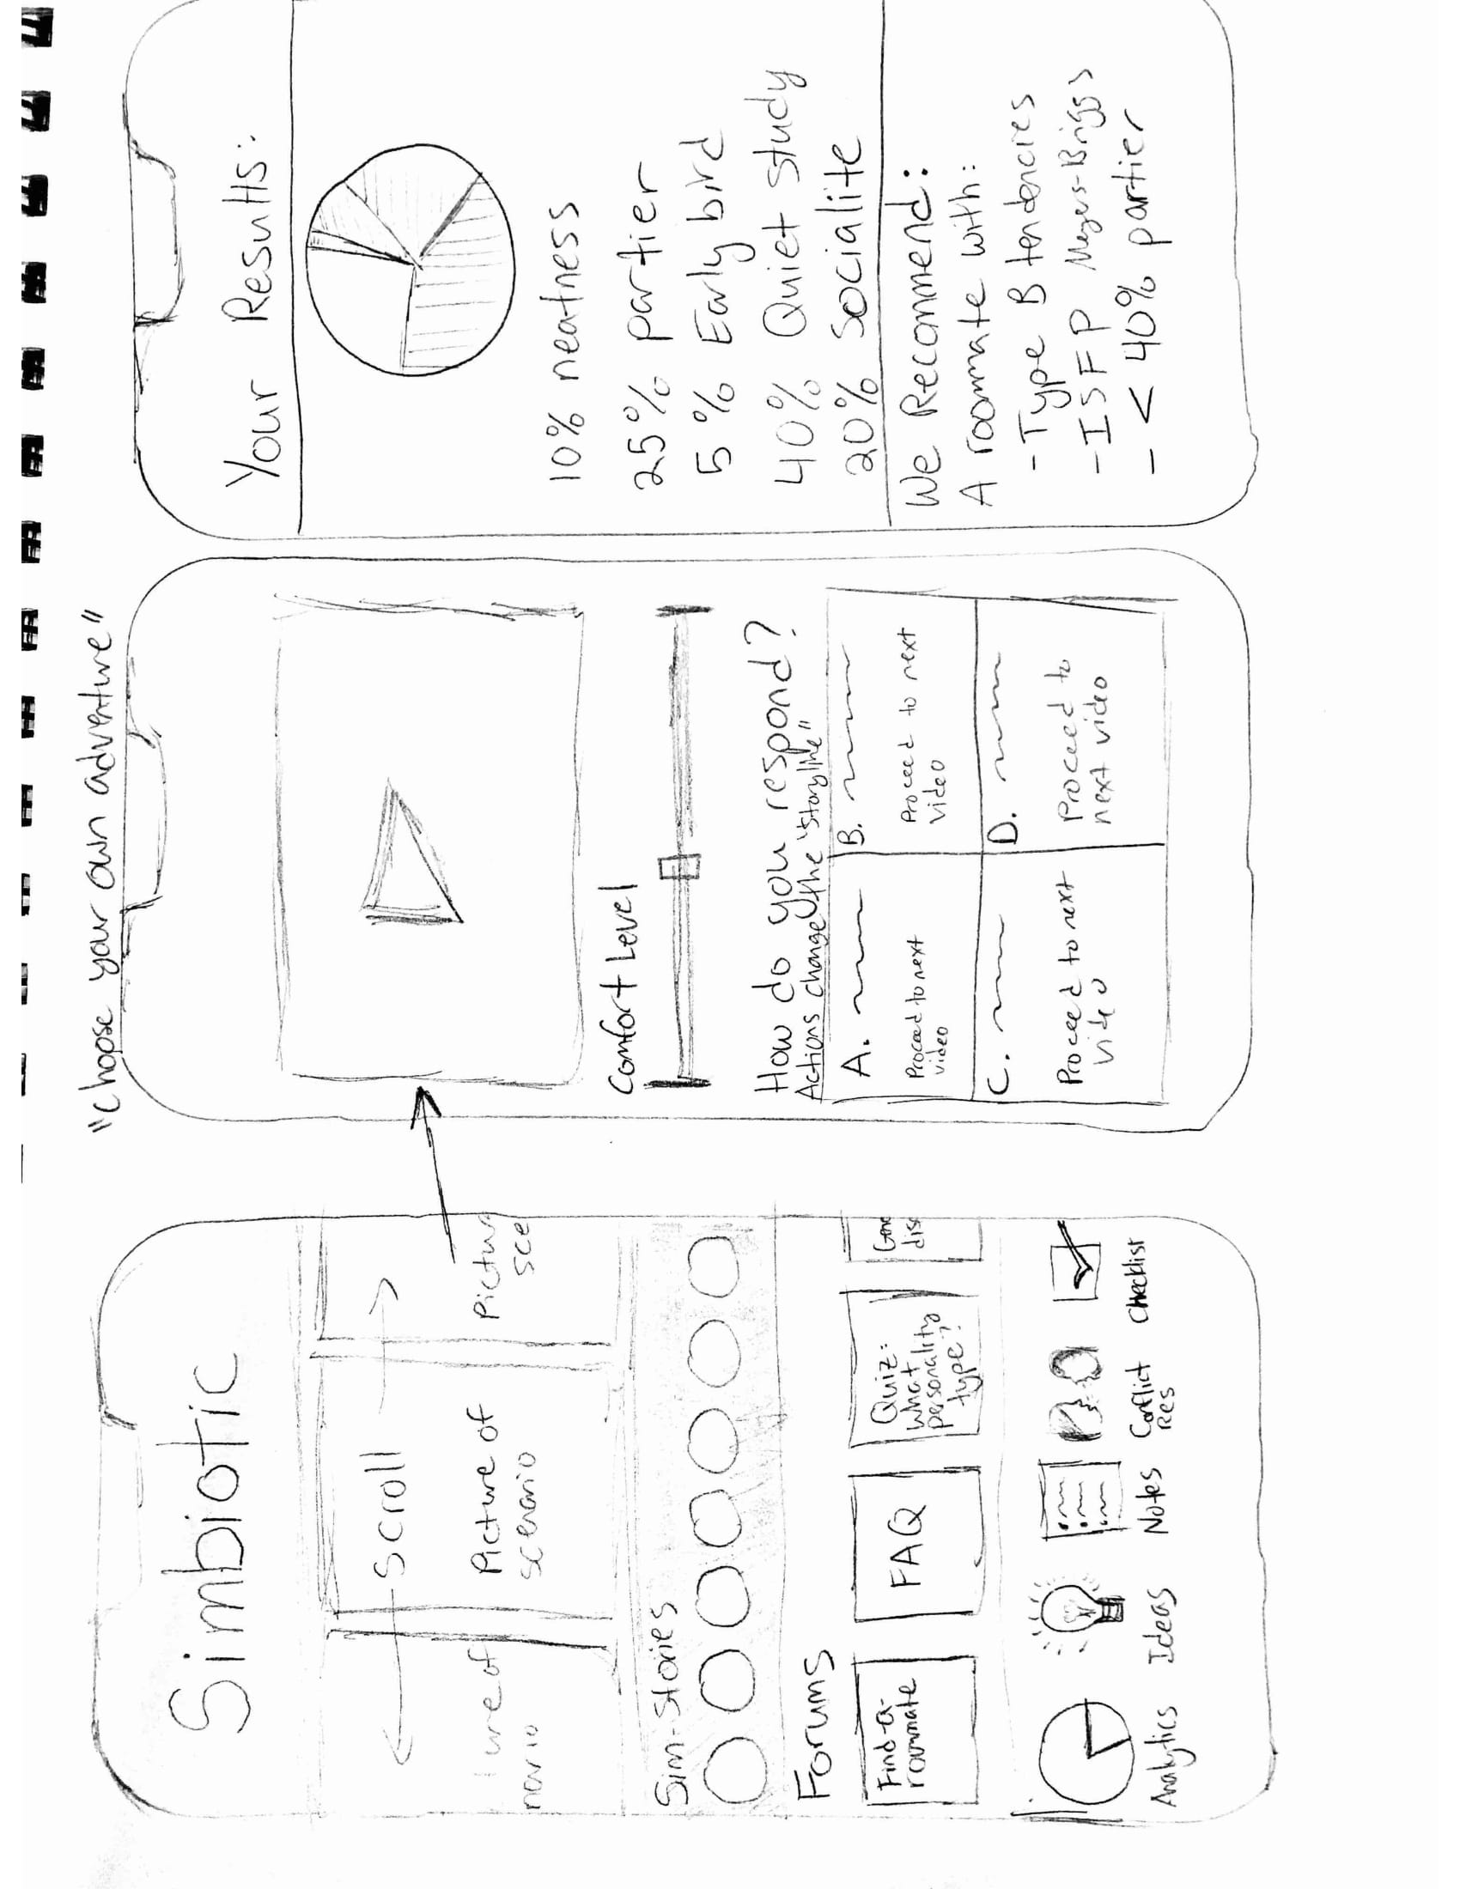
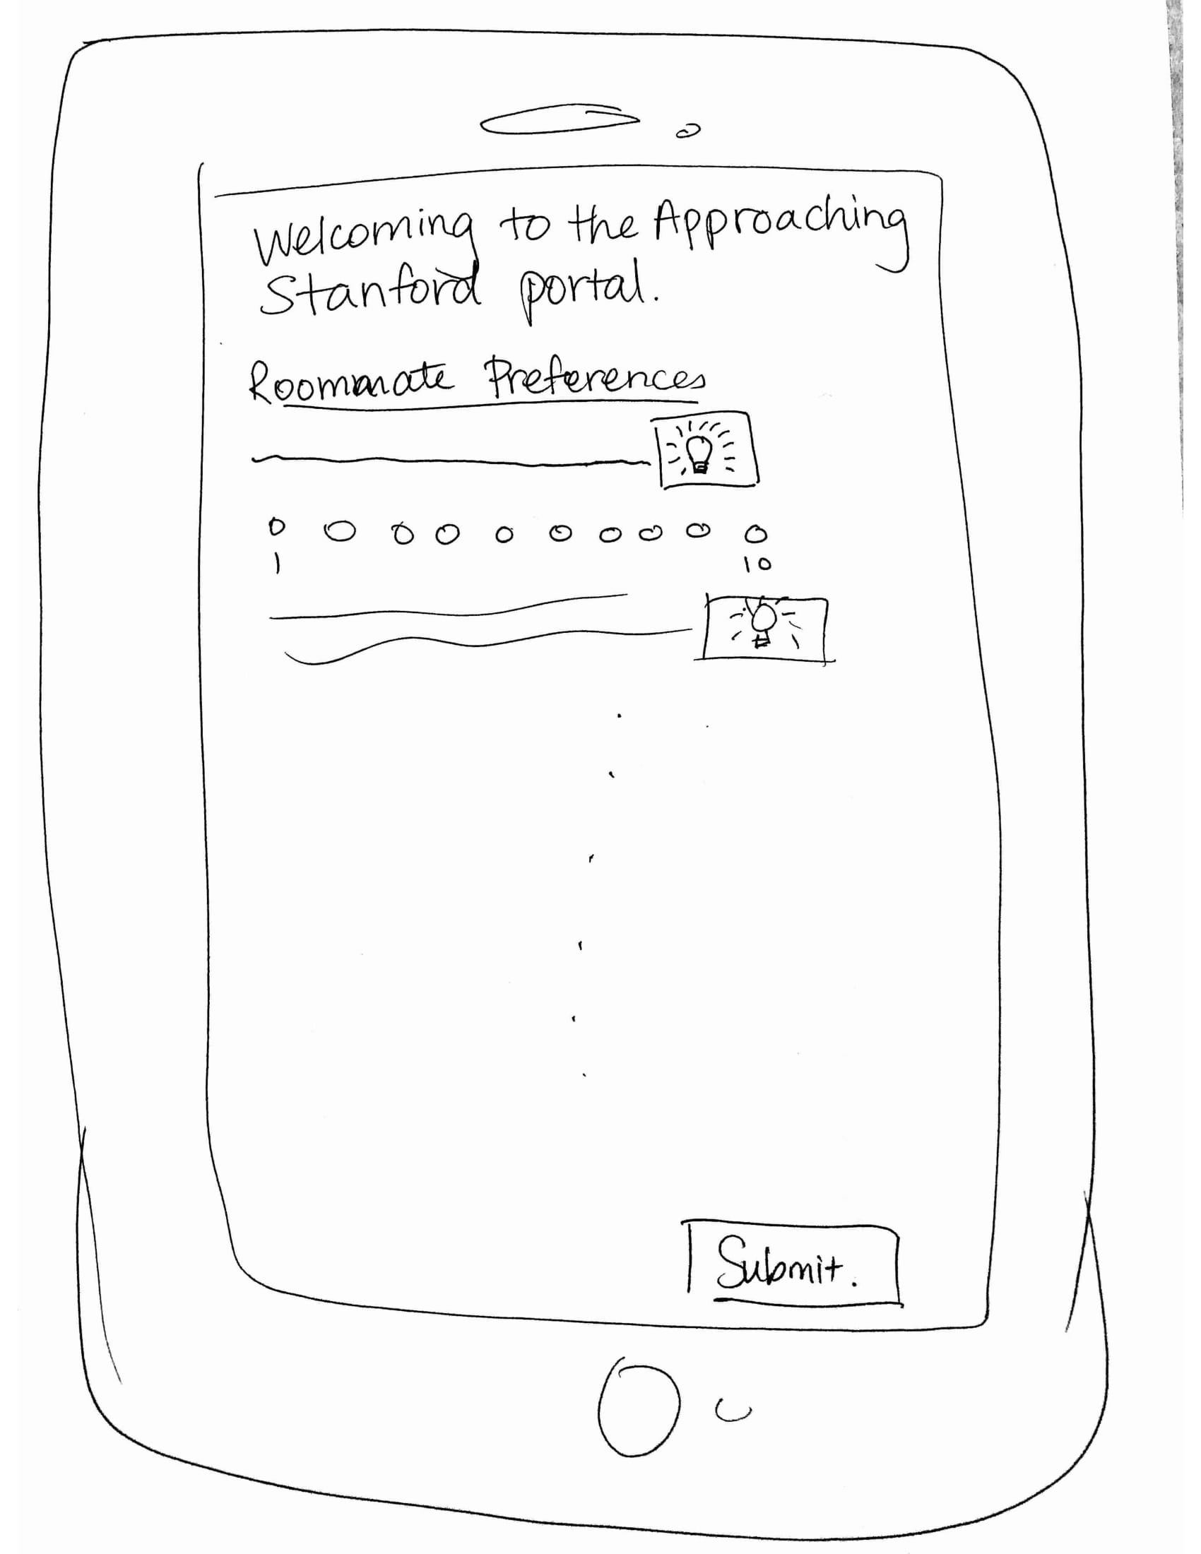
Notes:
Here are some of the rough sketches that we have made to brainstorm UI designs. Our ideas converge to two major distinct designs: an interface based on video content and one based on Augmented Reality (AR)

Slide 4
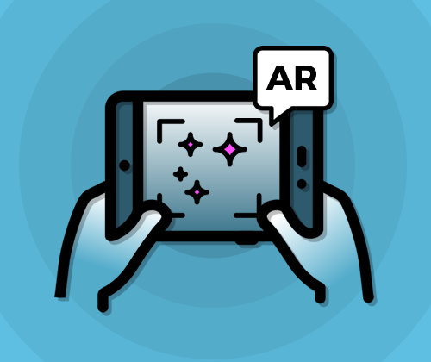
OUR CHOICE OF INTERFACE
An Augmented Reality (AR) based interface
Engaging & Realistic
Notes:
After thinking about the pros and cons of video based interface and AR based interface, we have decided that the latter is superior because 1) It is more engaging since you having an experience as an insider rather than a spectator, and 2) It feels more realistic and therefore help bring out real reactions from people

Slide 5
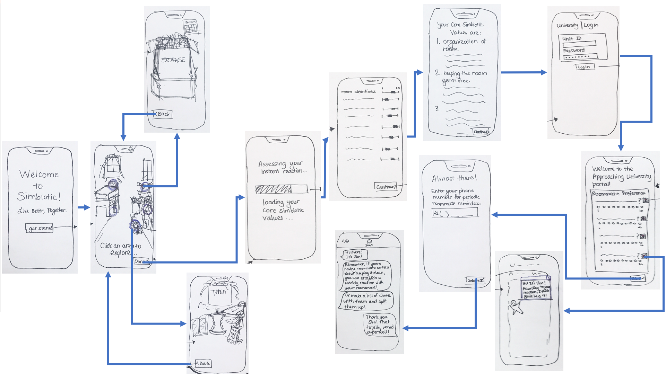
Notes:
Here’s the storyboards illustrating the flow of the experience

Slide 6
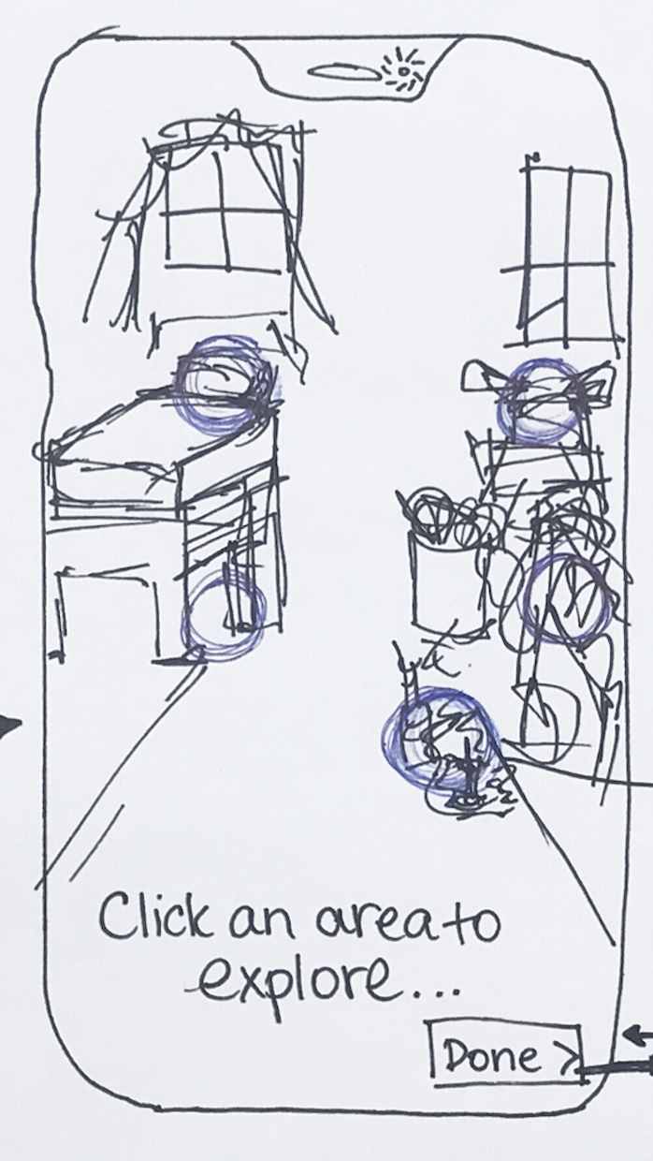
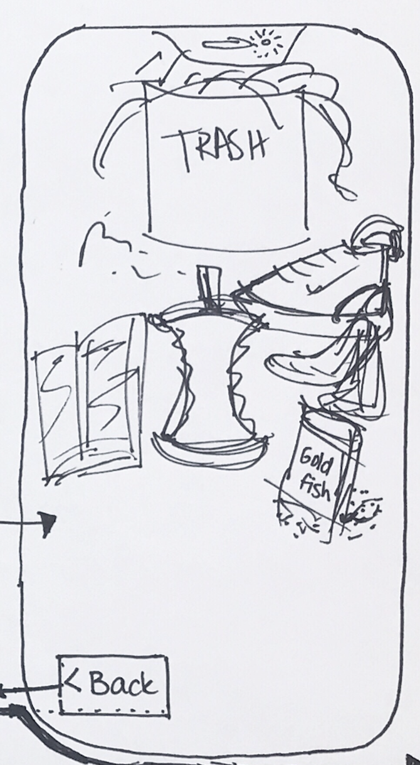

Simple Task
User: to understand his level of comfort in various situations
Notes:
For the simple task, we show people scenarios that they might encounter when they roomshare so that they can know how they would react to these scenarios

Slide 7
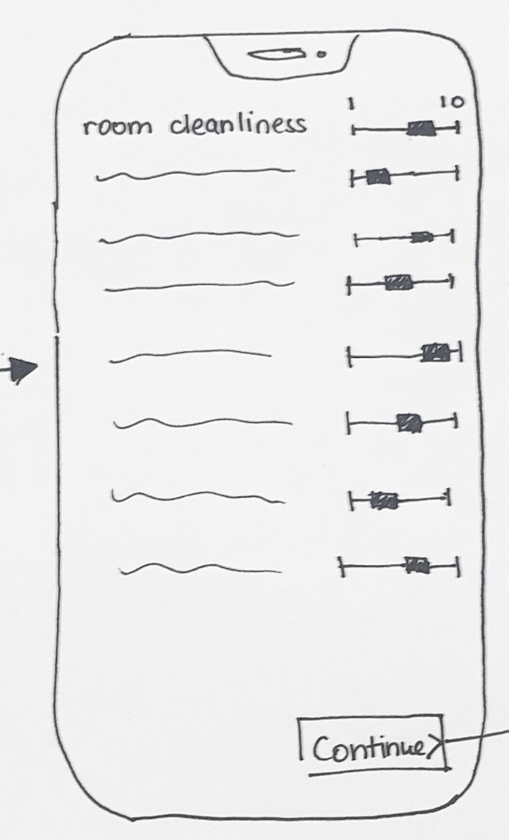
Medium Task
User: to have another perspective on his reaction that he may not know himself
Notes:
Adding to the last task, we are also going to incorporate AI into our product, which analyzes the facial / verbal reactions of the user to generate a report of his/her attitude, which might provide a new perspective that they might not be aware themselves

Slide 8
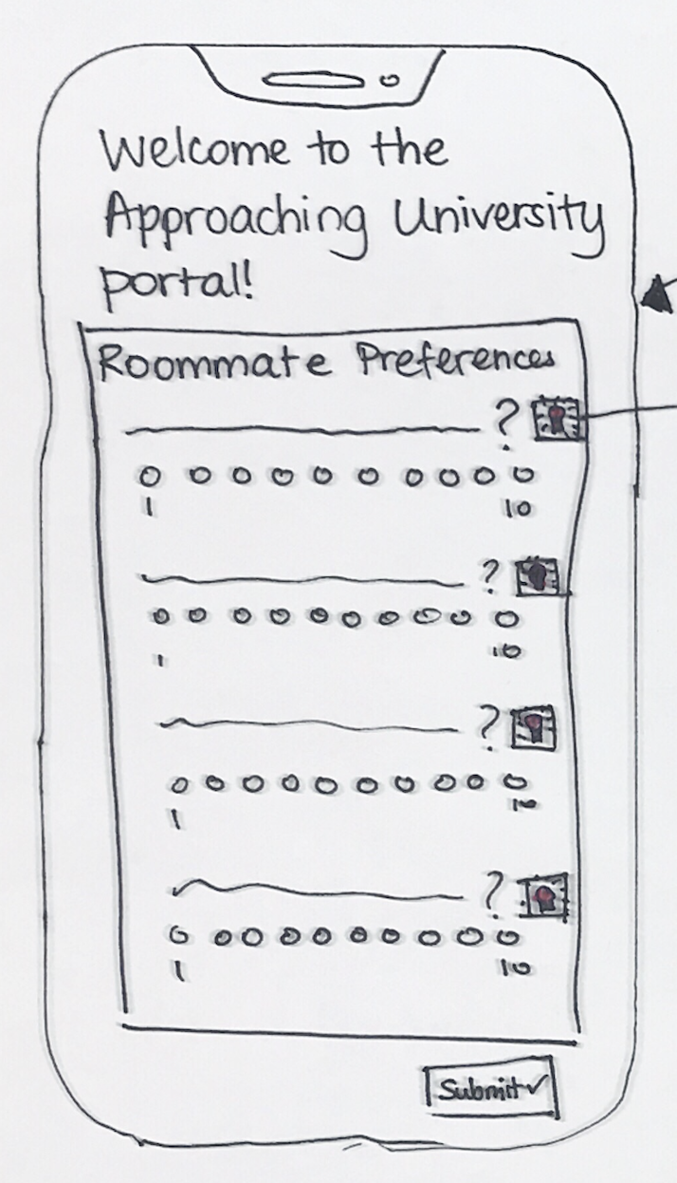
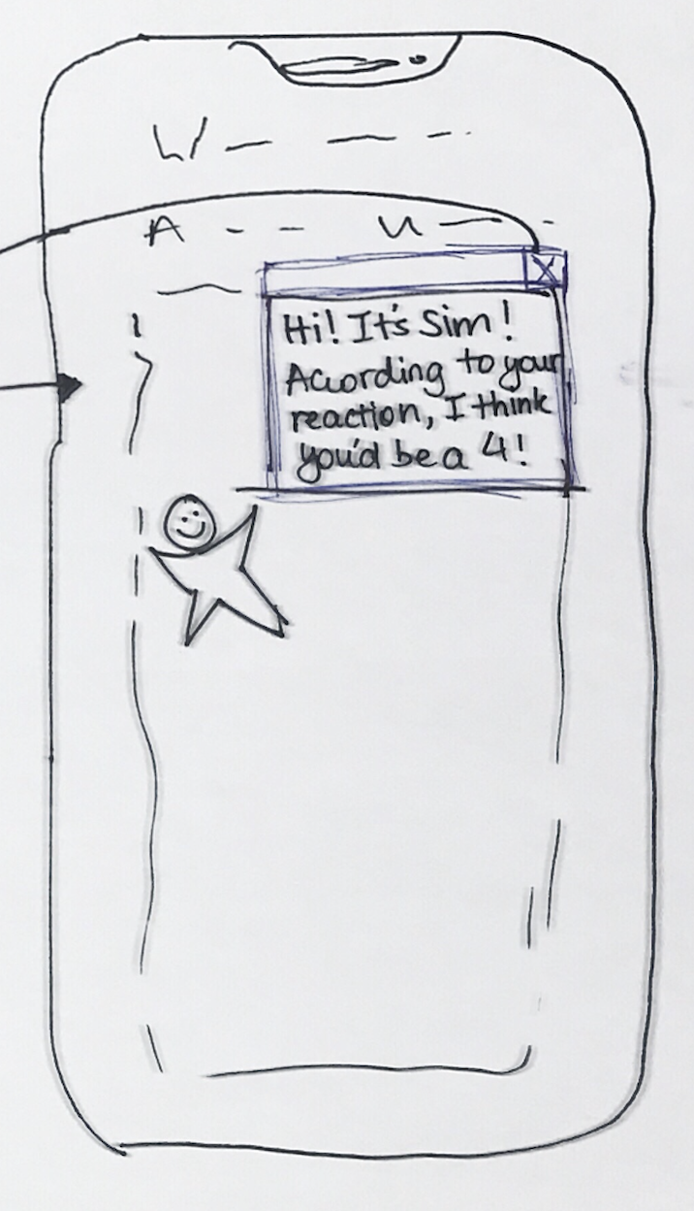
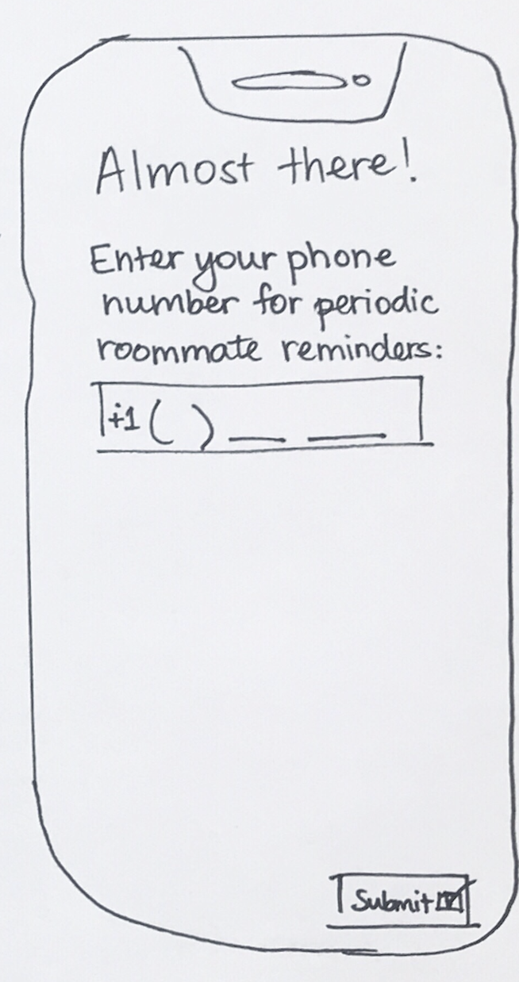
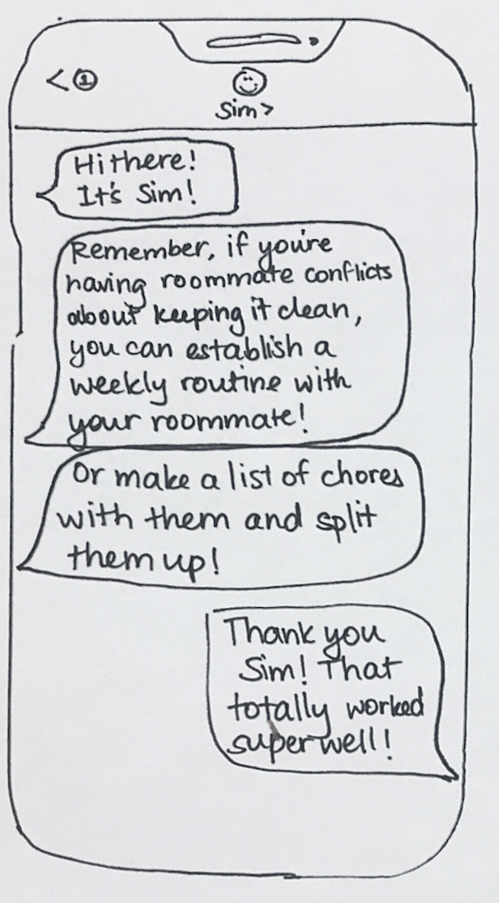
Complex Task
User: to articulate his living preferences and know how to react/approach a conflict
Notes:
After the AR experience, we provide a function that suggests the numeric values that the user might want to use while filling in roommate surveys, and also offer the option of receiving tips for resolving roommate conflicts. The suggestion feature is especially helpful since it provides a standardized metric (the Simbiotic scale)

Slide 9
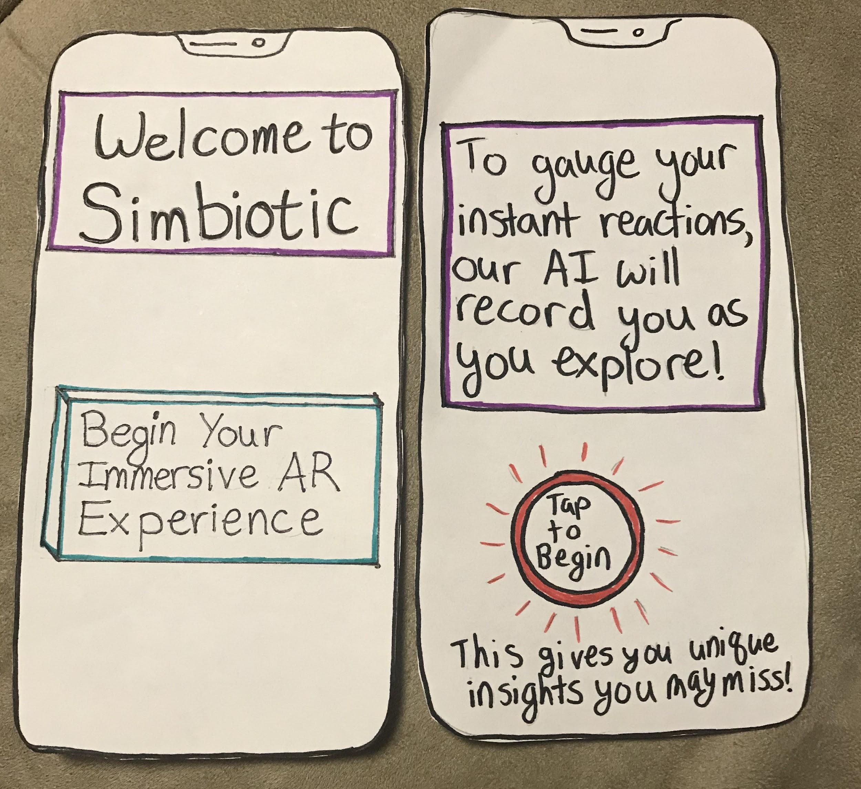
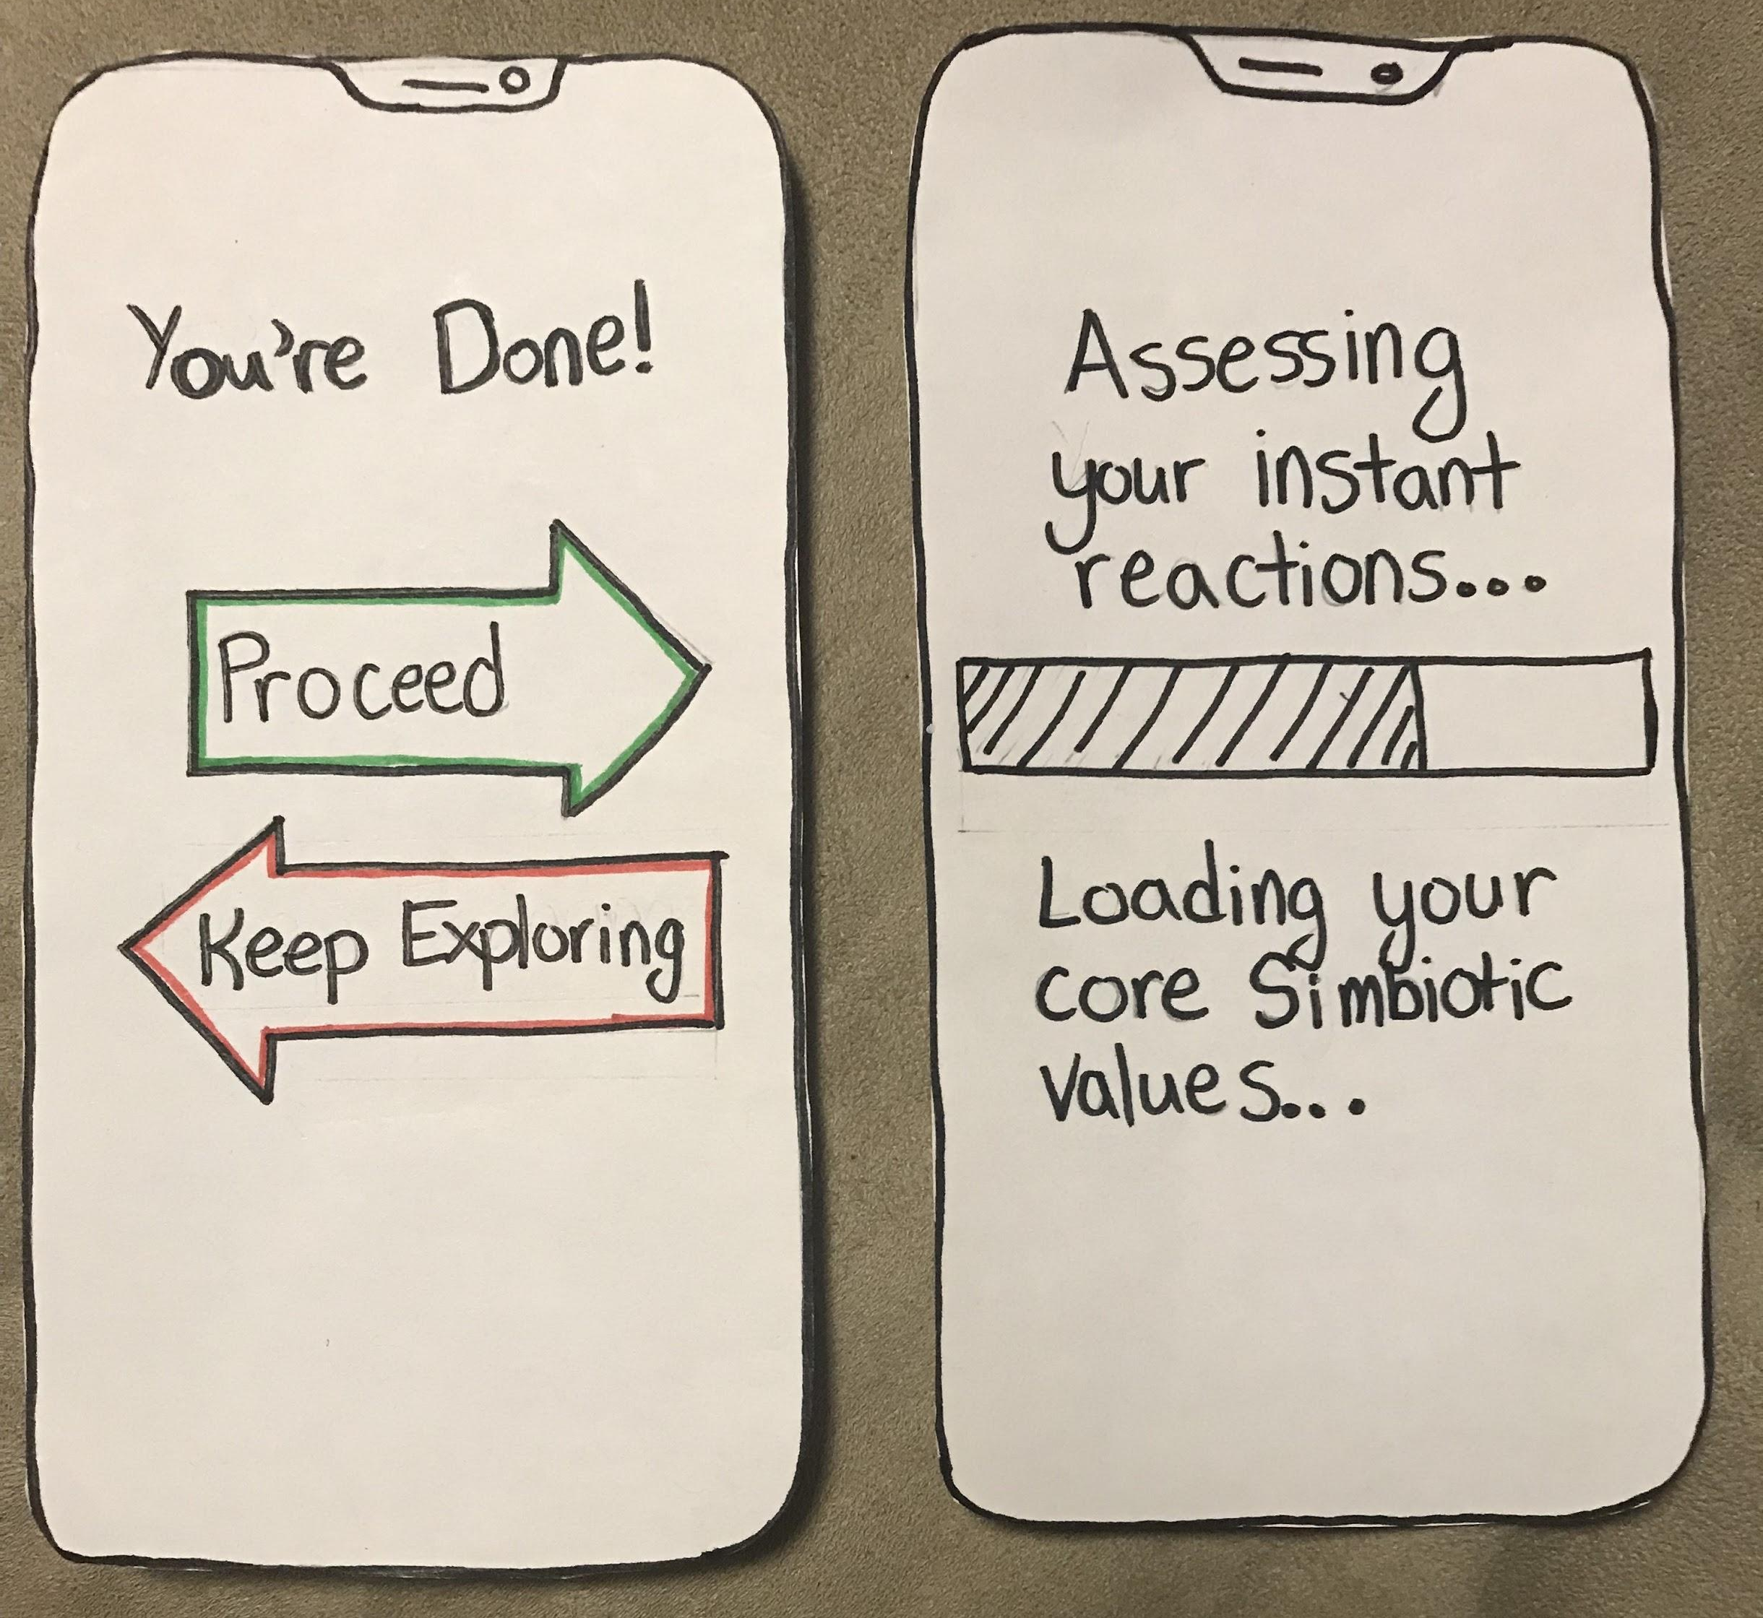
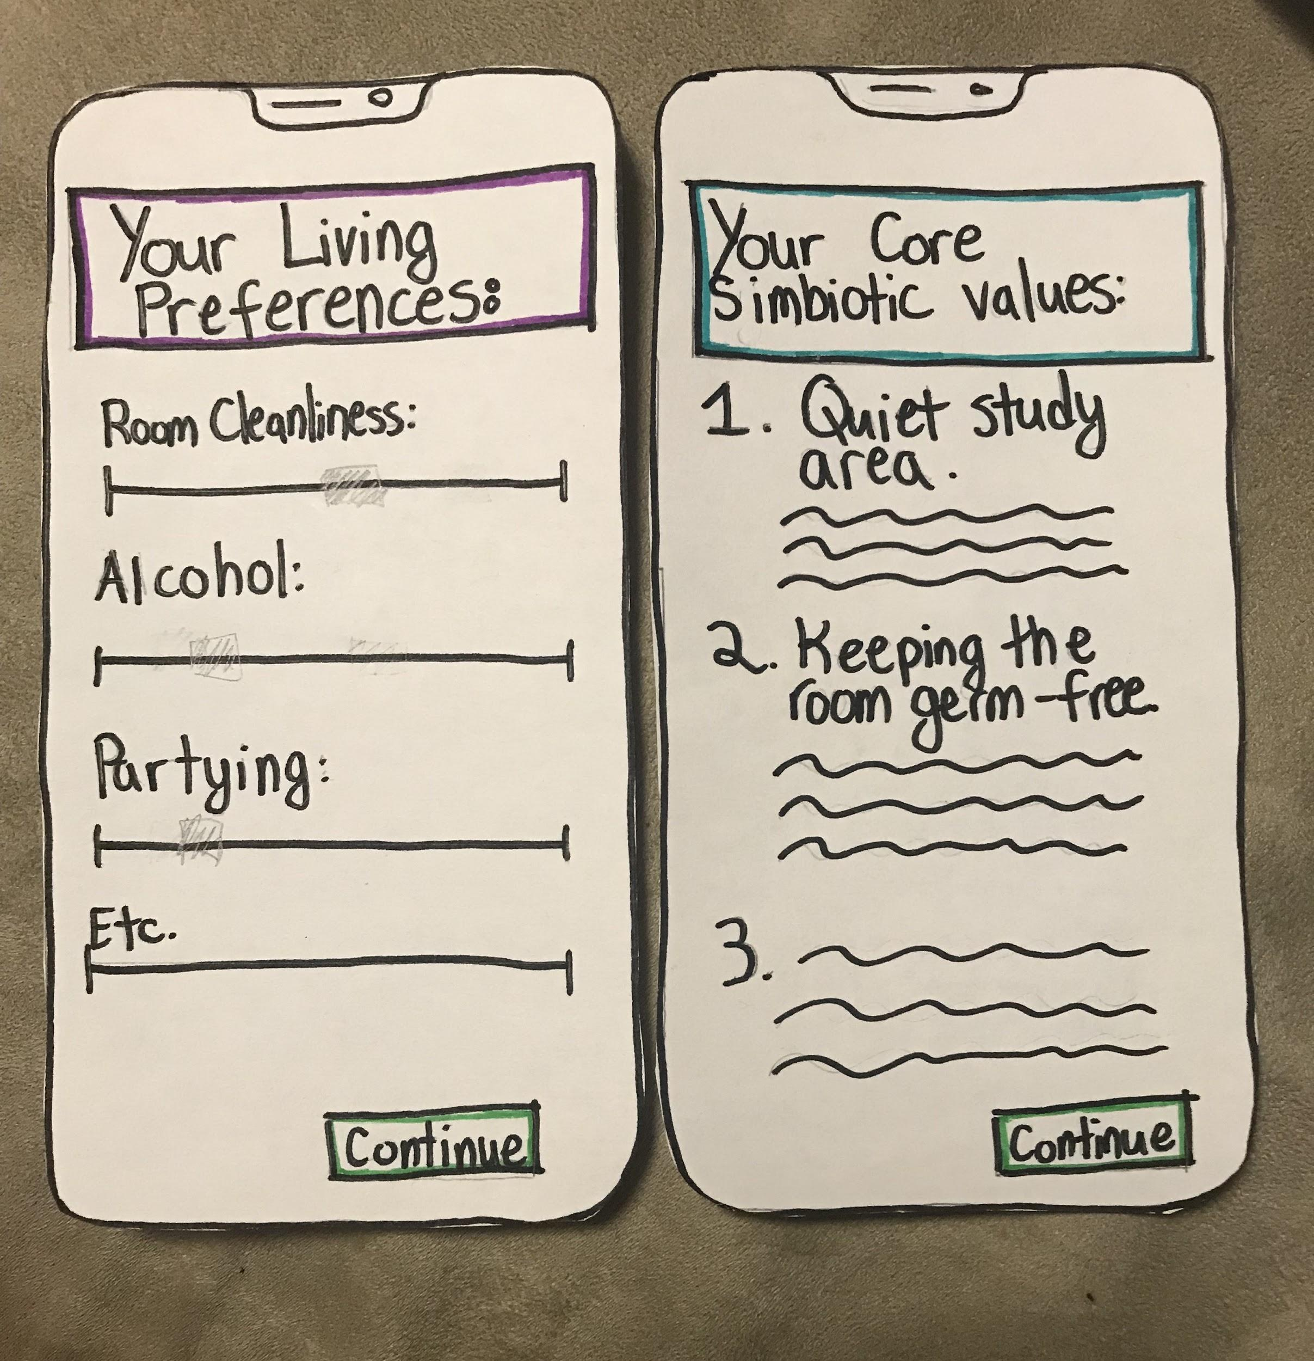
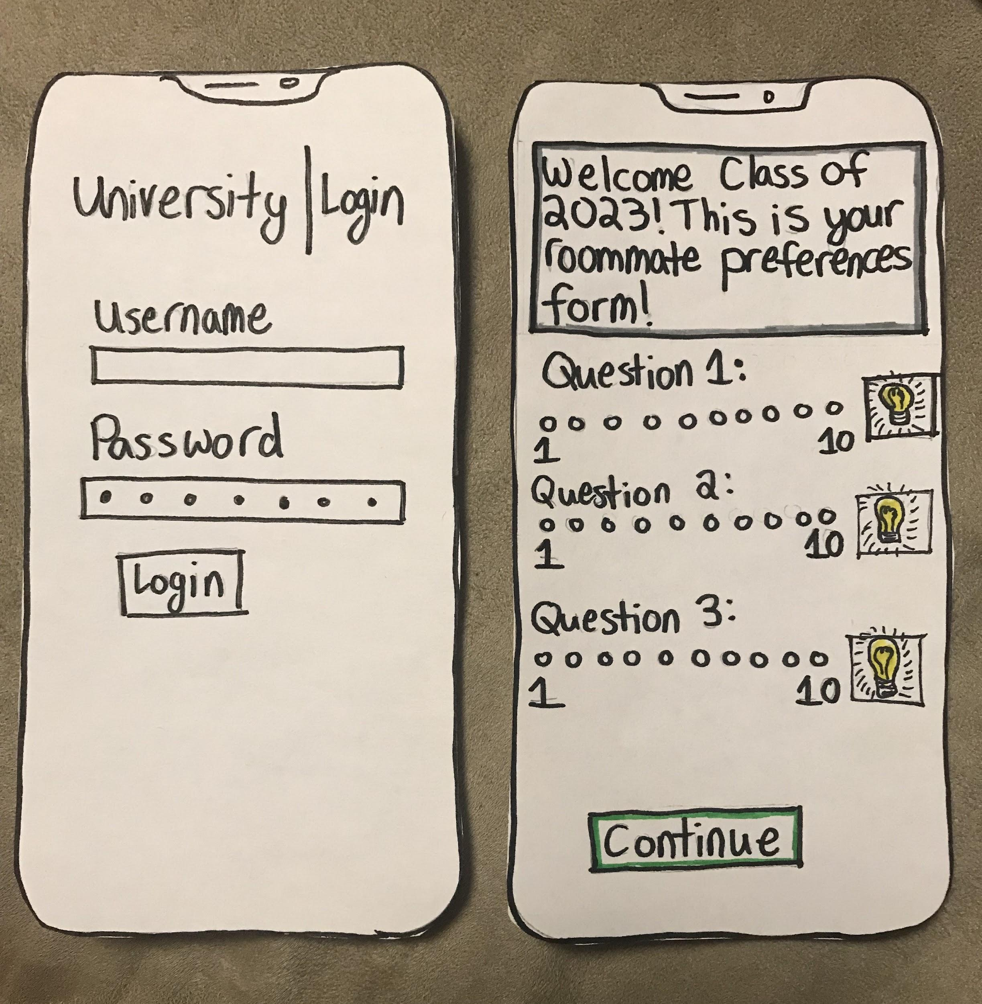
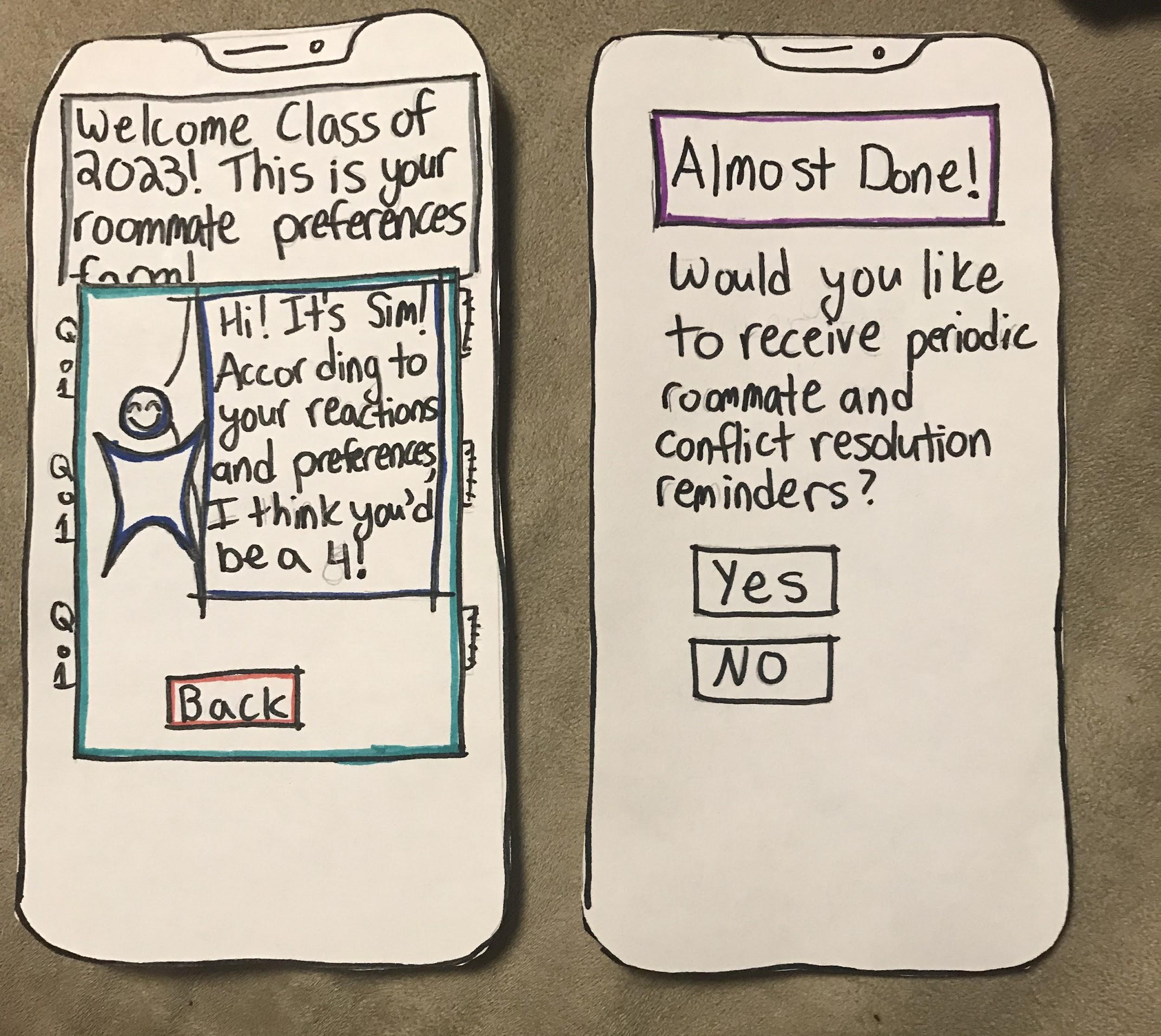
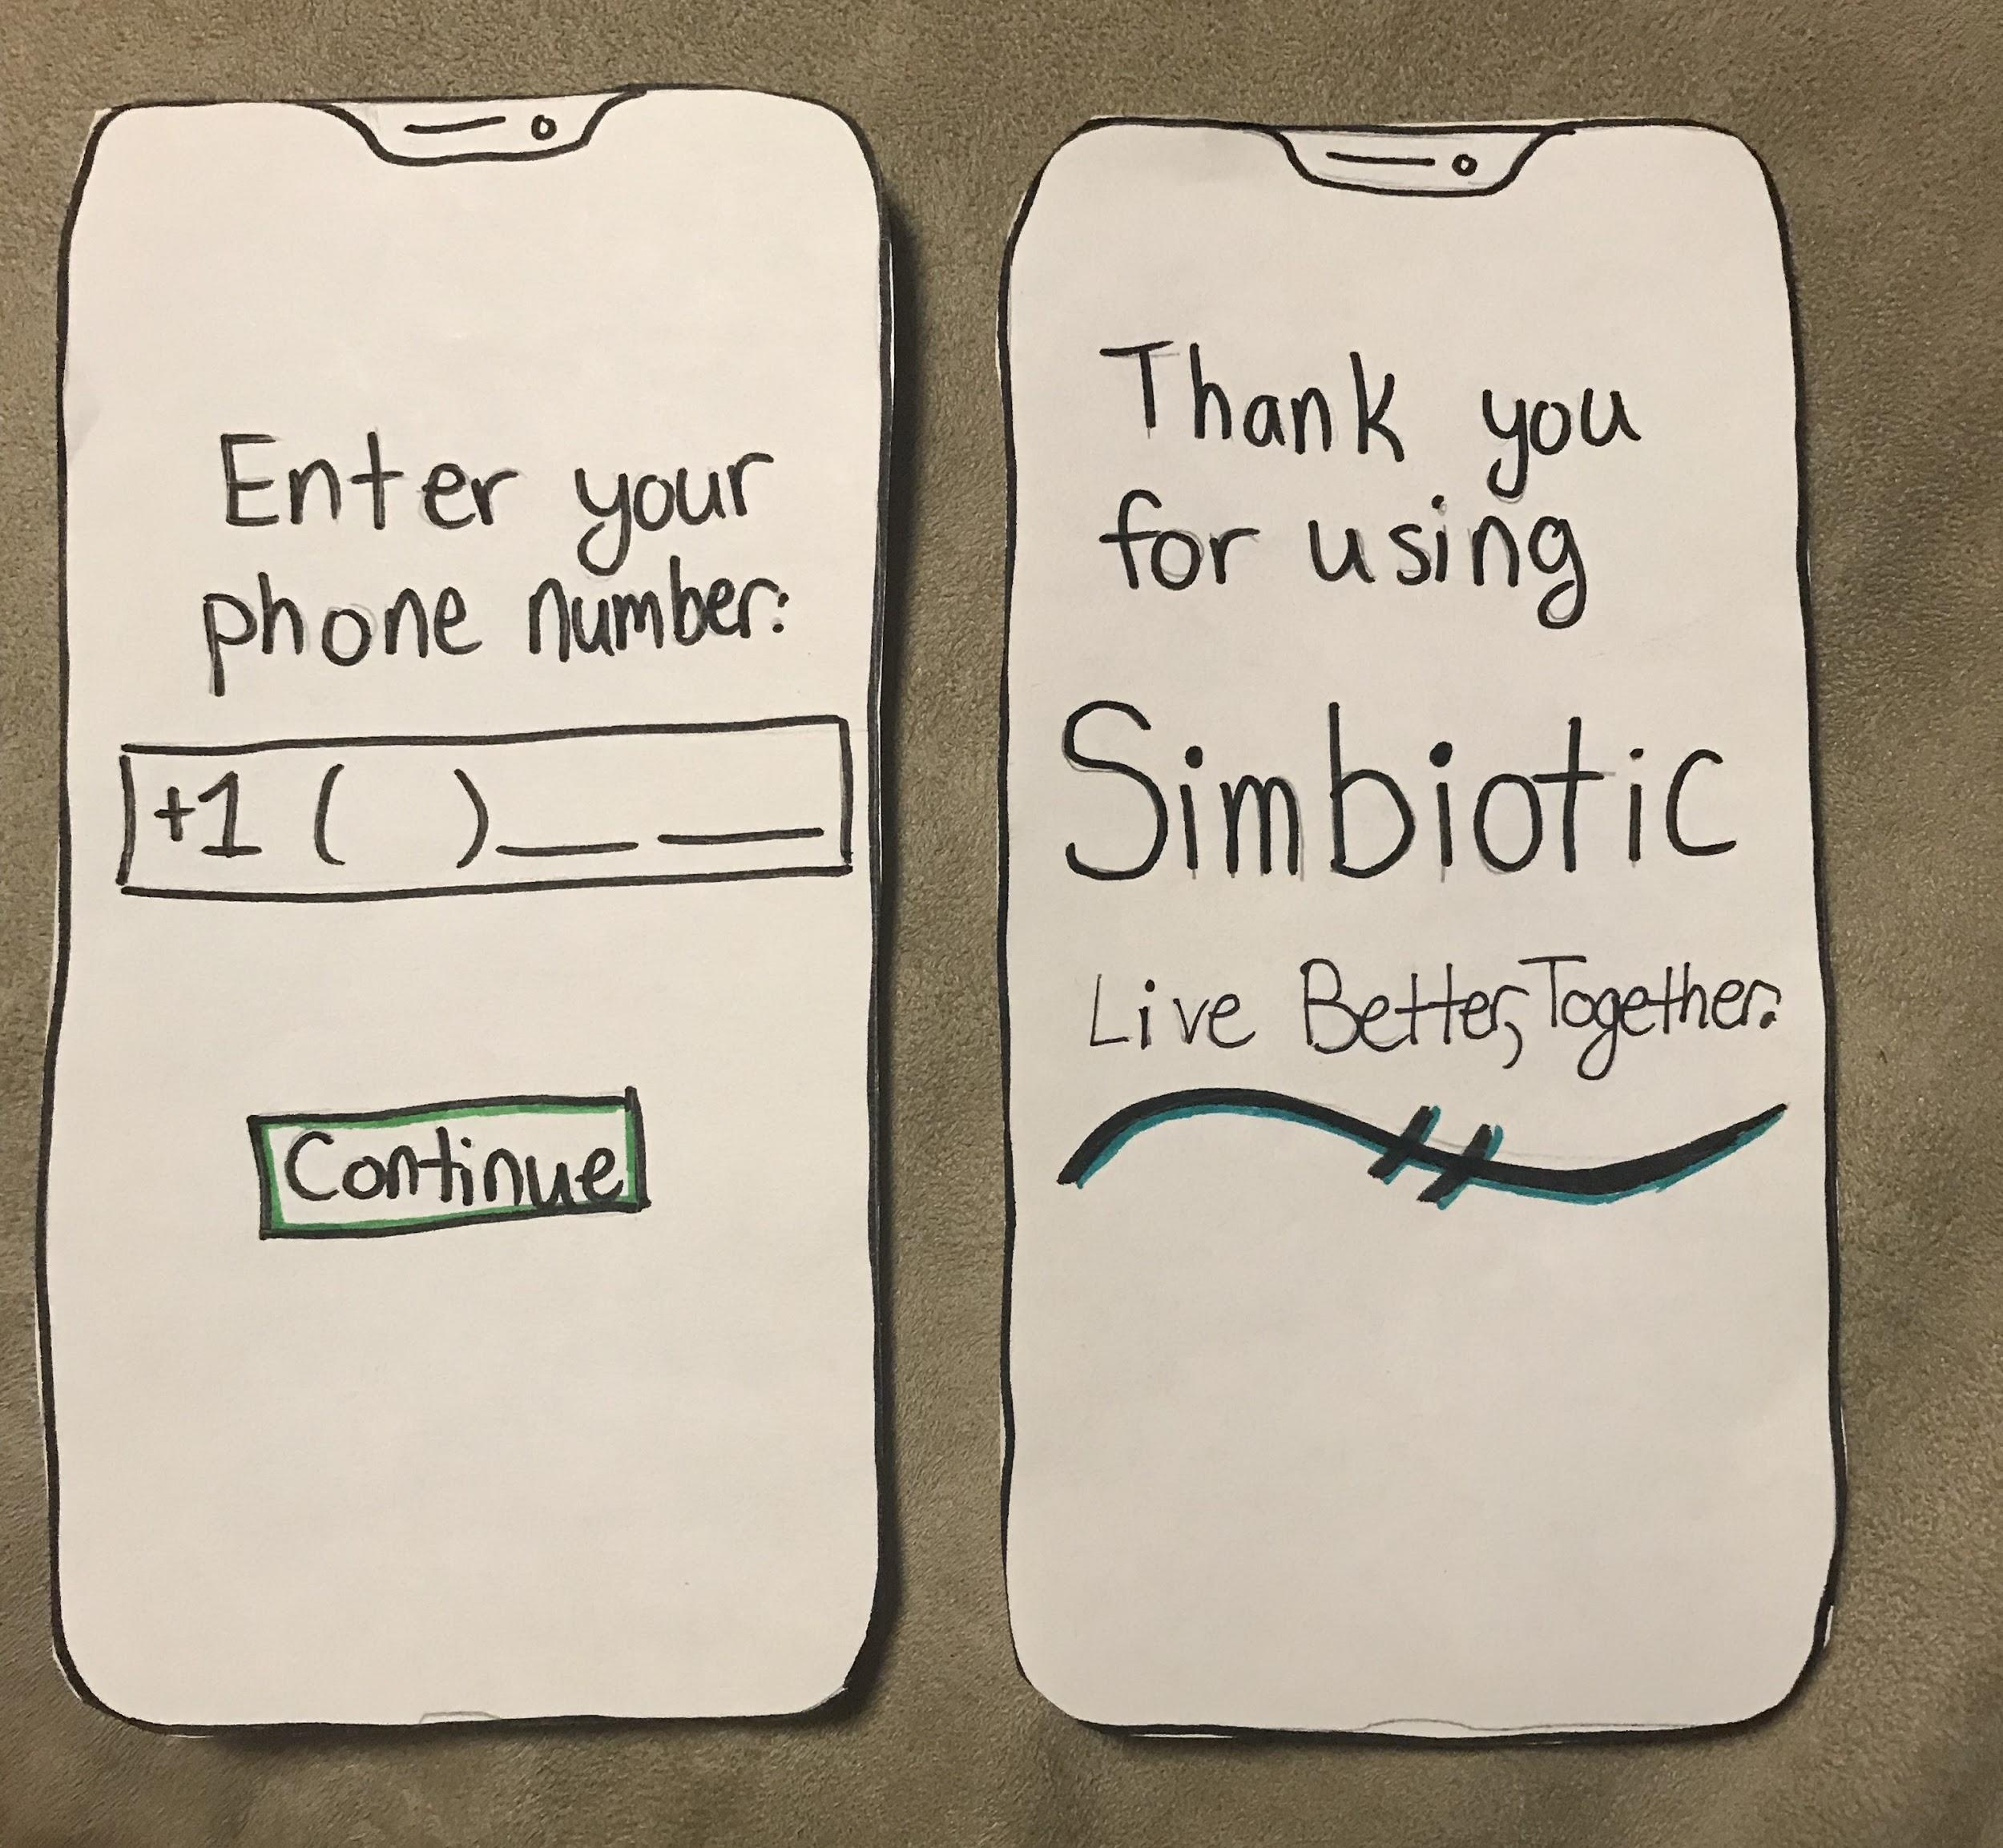
Our Low-fi Prototype
Notes:
Here’s the prototype that we used in testing

Slide 10
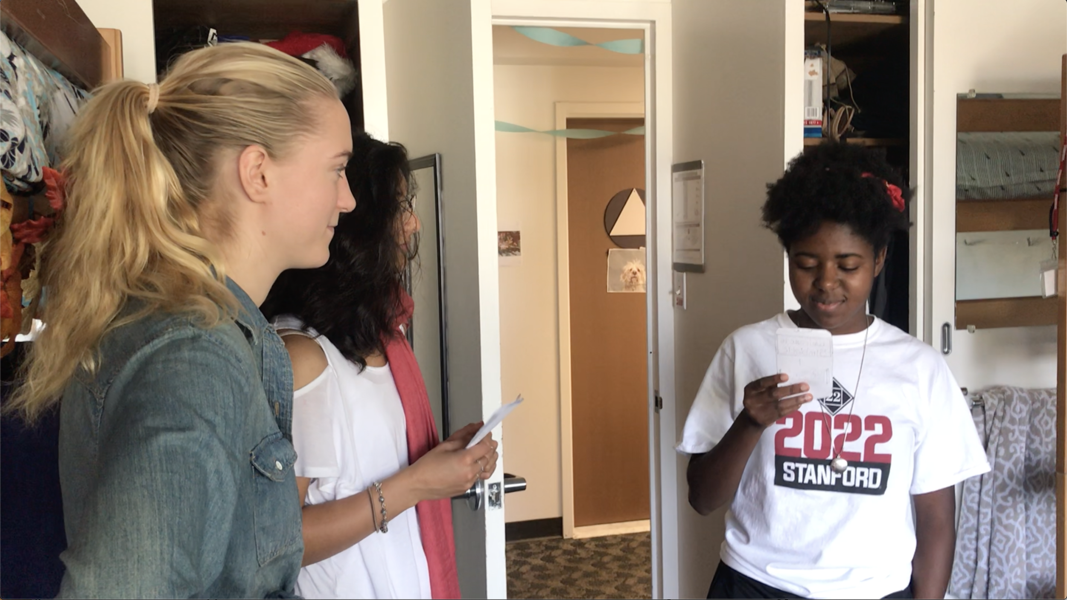
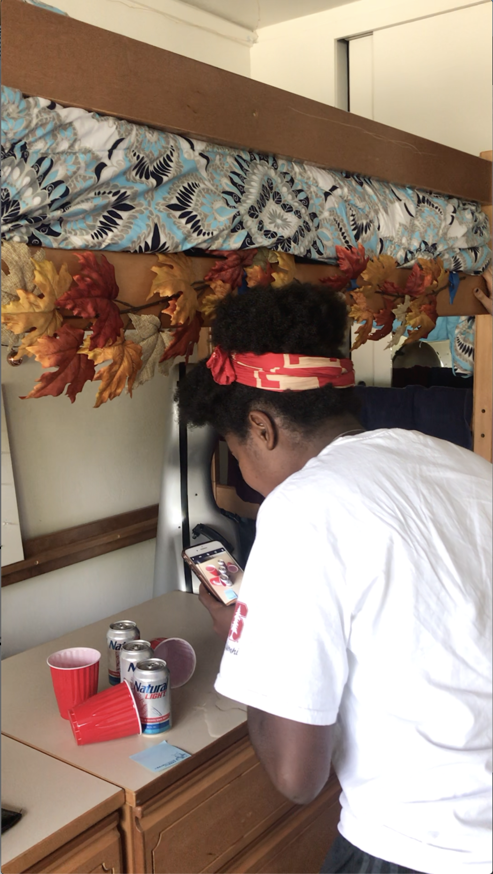
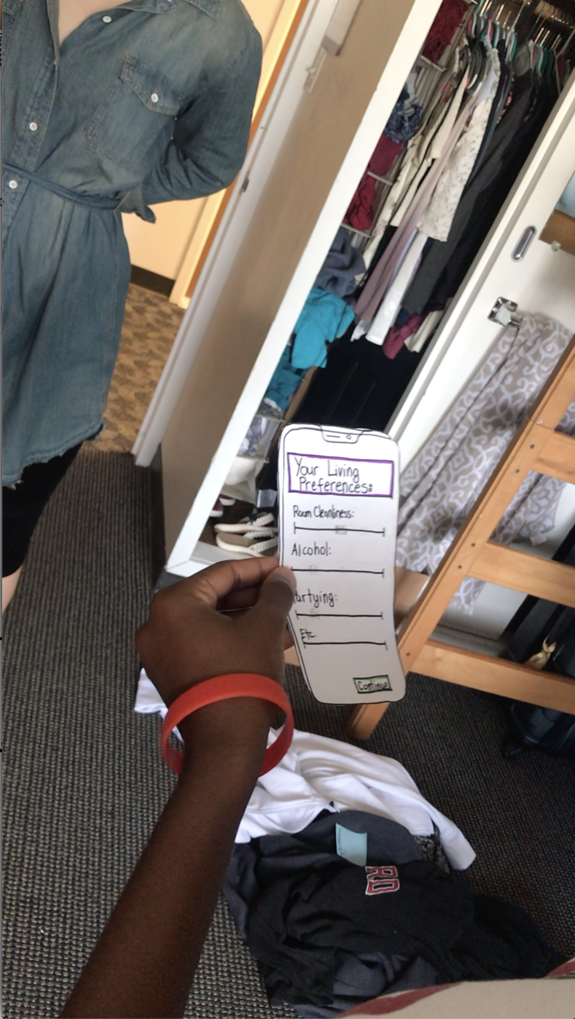
Experiment Method
Intro
AR Experience!
Outro
Notes:
Since our product targets people that are going to live in a dorm and it is difficult to find colleges with dorms in the area, we got permission to choose 2 Stanford students as our testers. The third one is a high school student at Palo Alto High that we found at the visitor center. For each one of the testers, we took them to a dorm room to do the testing. We set up the room to have various potentially agitating problems: spilled beer, half-eaten apple, clothes on the floor, a full trash can, etc. We put sticky notes on each one of them to simulate markers in AR. We first give a brief introduction on what our app does and what problem we are trying to solve, show them the welcome screens, and then simulate an AR experience with phones. People are asked to look through the camera and find the sticky notes that we have placed, and talk about their reactions to the situation. After they discover all the notes, they are shown the screens with analysis reports, living preference suggestions and tips for dealing with roommate conflicts. We carefully observed and recorded their behaviors, and asked them to speak their thoughts out loud.

Slide 11
Results
People generally enjoyed the idea of AR
⅔ of the testers said that it was useful in giving them comparison with their own room

Slide 12
Results
Privacy concerns on providing phone number and being recorded
Improvement:
Provide the options of:
Using push notifications to receive tips
Turn the facial recording off

Slide 13
Results
The “light bulb” button for living preference auto-completion is not intuitive
Improvement:
Click here to see our recommendation!
Notes:
Some of the testers spent a long time thinking about what those light bulbs mean, and some ignored them totally. We think a pop up balloon introducing the feature the first time the screen is viewed would add some clarity

Slide 14
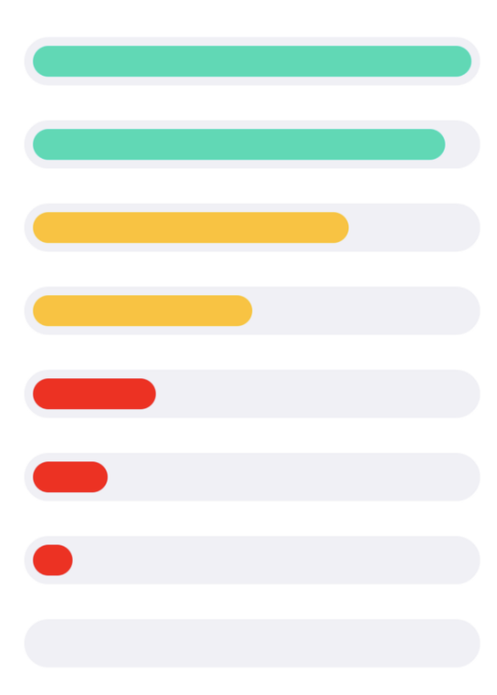
Results
The slide bar representation of living preference scale gives the illusion that it is movable
Improvement:
Notes:
One tester thought that the slide bar is adjustable. We think we can eliminate this confusion by using something resembling a progress bar

Slide 15
Summary
AR- based interface is promising
Room for improvement in UI for better experience

