Slide 1




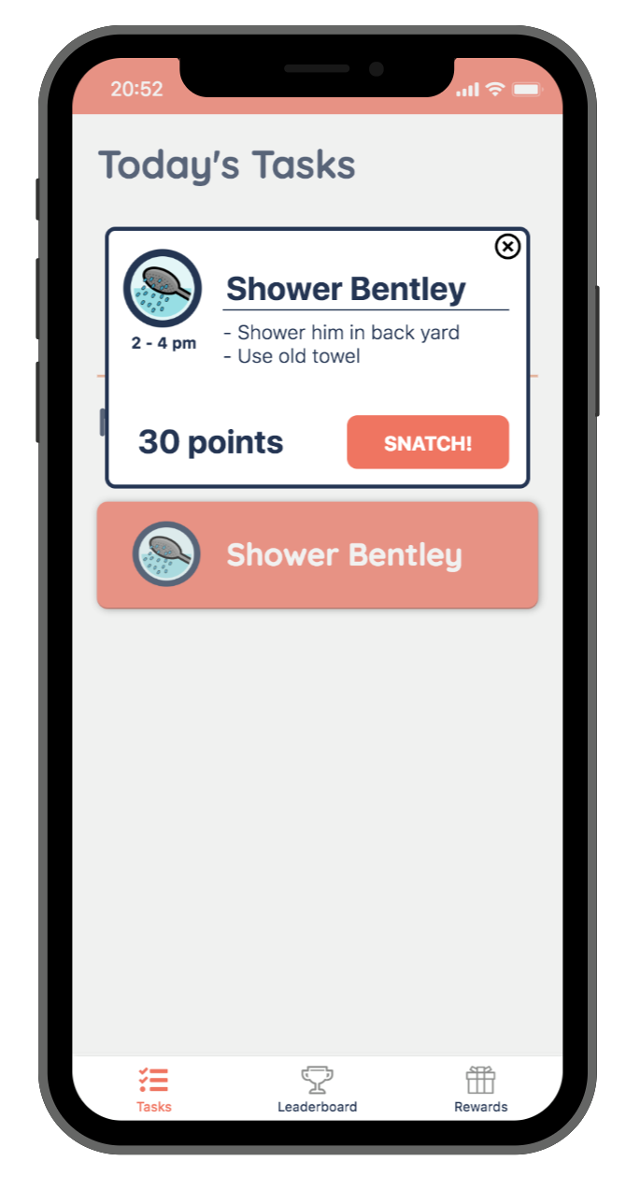
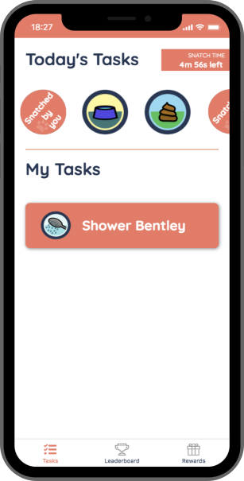
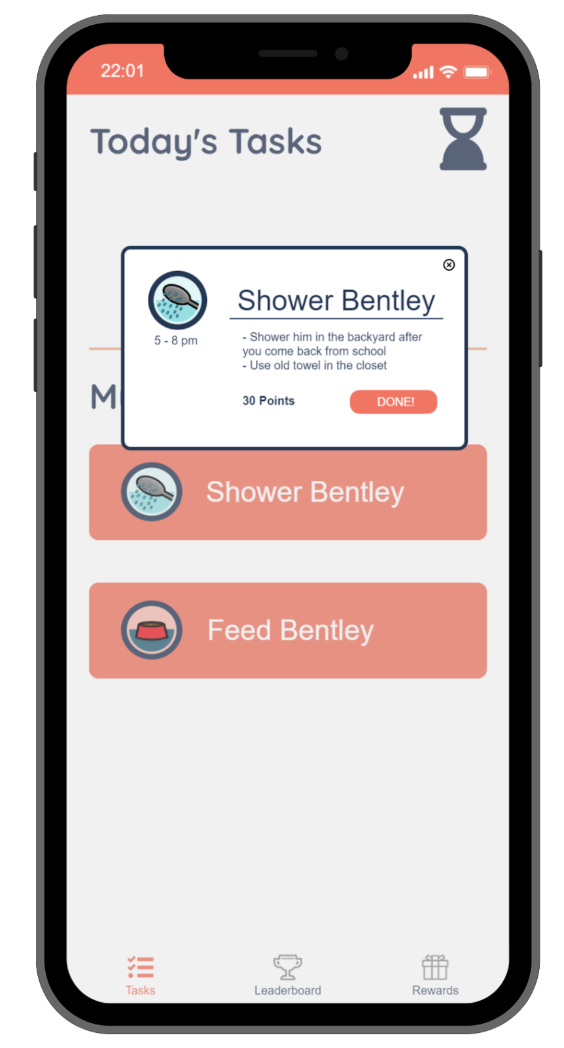
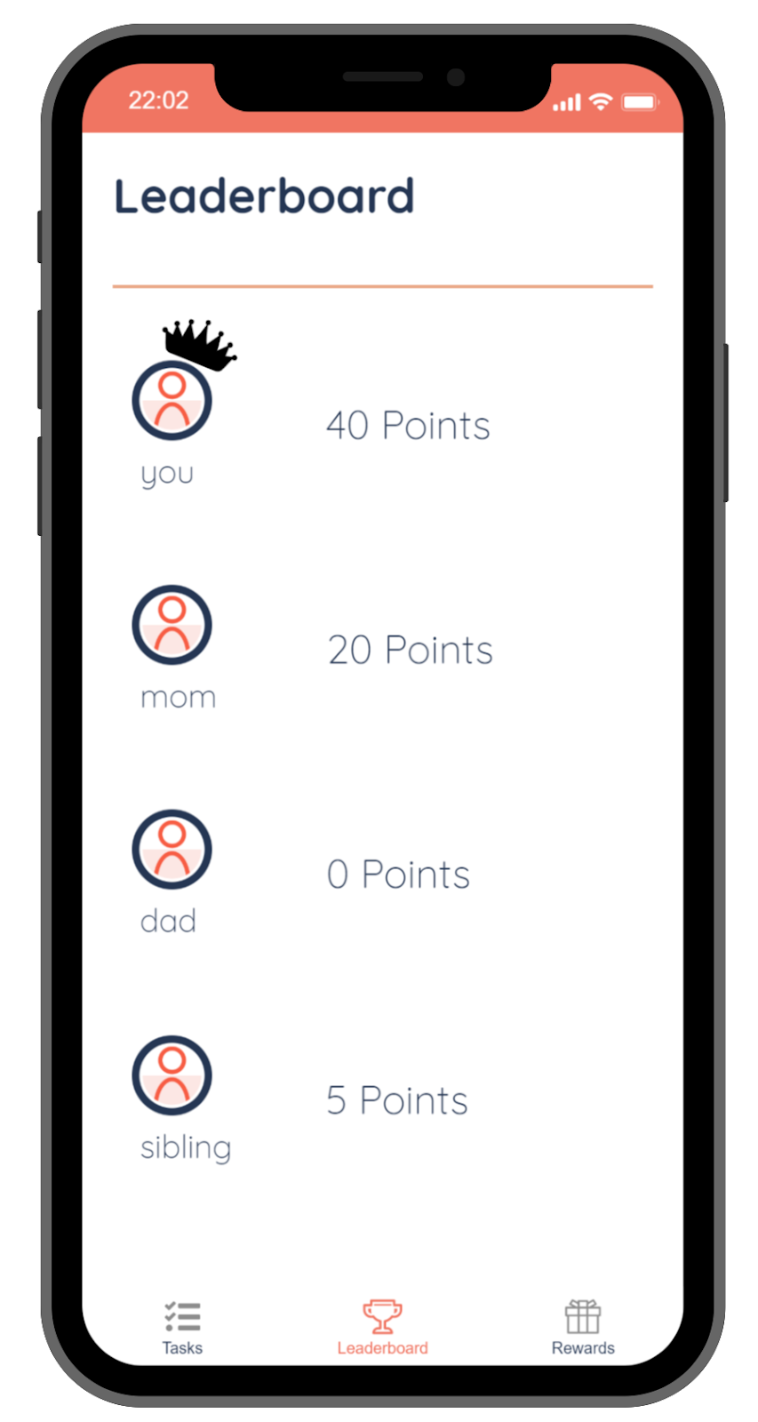
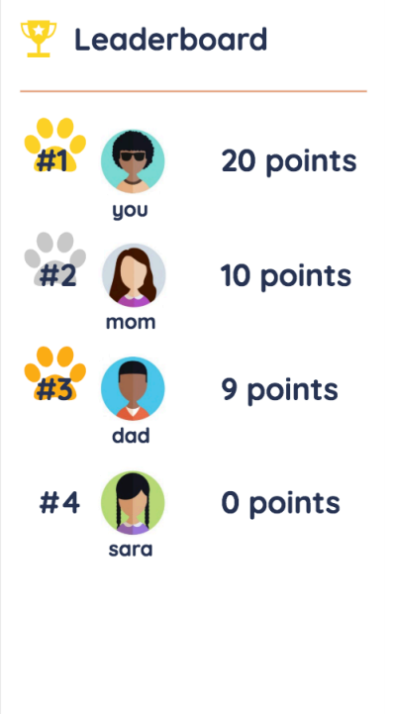
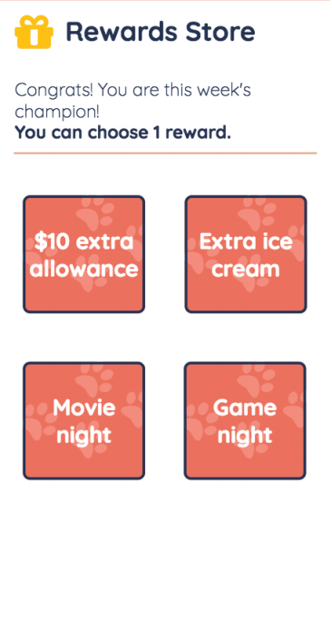
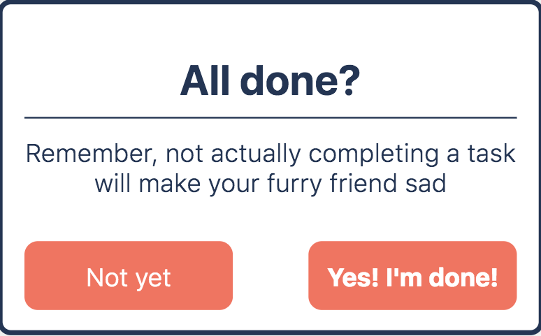
Fetch
Let’s make dog care a family affair!
Problem
Solution
All too often, dog-care chores get pushed onto one person in the family.
But we can encourage everyone to participate by gamifying chores into a family competition.
Key Features
Snatch tasks
Complete tasks
Redeem a reward
Done
Design Evolution
needfinding
low-fi prototype
med-fi prototype
experience prototype
hi-fi prototype
Annie S. • Lucas R. • Geraldine M. • Jackie V. | CS147 Autumn 2018 | http://hci.stanford.edu/courses/cs147/2018/au/projects/DemocratizingEducation/Fetch

