Slide 1
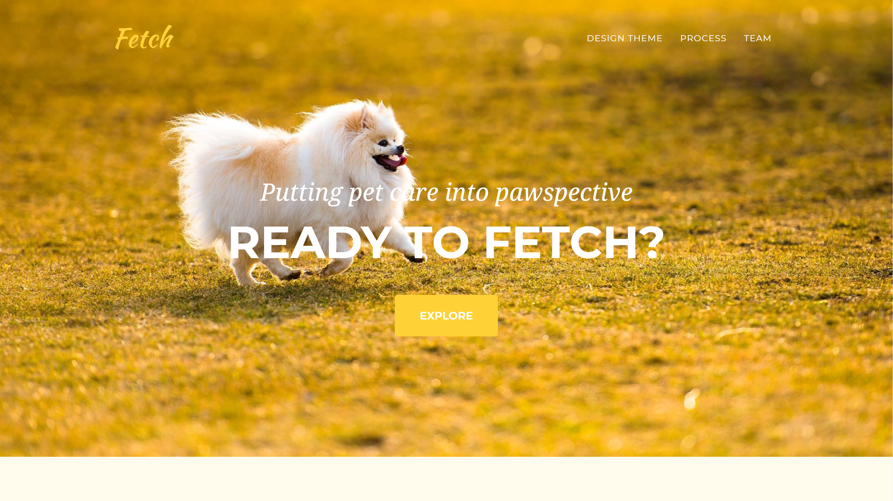

Slide 2

Overview
Problem Domain & Value Proposition
3 Tasks
3 Major UI Changes
Medium-Fi Prototype Flow
Prototyping Overview

Slide 3
Fetch
Putting pet care into pawspective
Caring for a new dog can be a daunting task that not all new dog-owners, especially the kids, are prepared for. Our goal is to make proper dog-care knowledge and task distribution fun and accessible for dog owners- we want to make it a family affair!

Slide 4
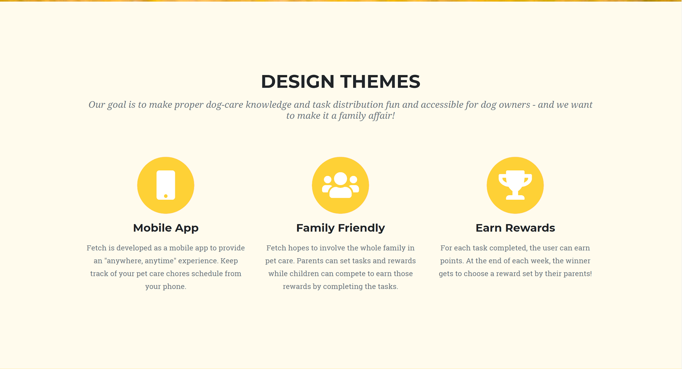
Notes:
Our app is essentially a gamified task-distribution manager for dog-care. Parents onboard as admins and get to set tasks (and details about the tasks such as point values, notes, and time frames) and rewards and then the whole family can compete to snatch tasks and complete them. Each task has a point value that the user can earn upon completion. At the end of each week, the user with the most points get to choose a reward option. By organizing all chores into a fun UI, creating a competitive atmosphere, and adding reward incentives, Fetch turns dog-care chores into something the whole family will want to get involved in!

Slide 5
3 Tasks

Slide 6
Task 1: Snatch Tasks (Complex)
Users snatch tasks they will be responsible for at the start of each day. Tasks include a time frame (i.e. when you must complete it by), description, and point value.
Task 2: Complete Tasks (Medium)
Users mark the task complete once they’ve completed it in real life and they earn the points for that task.
Task 3: Redeem Reward (Simple)
Every week the parents/admins will post reward options. The winner of the week will get to choose a reward.
Notes:
Note: we updated “snatch tasks” to complex due to the many interactions it takes to do it. We need to consider that users will be simultaneously trying to snatch tasks and that we are creating a limited time frame in which they can snatch tasks. On the other hand, we also updated “redeem reward” to simple since now that it has been established that parents will be creating the reward options, we only need to ensure that only the winner can redeem the reward each week.

Slide 7
Major UI Changes

Slide 8
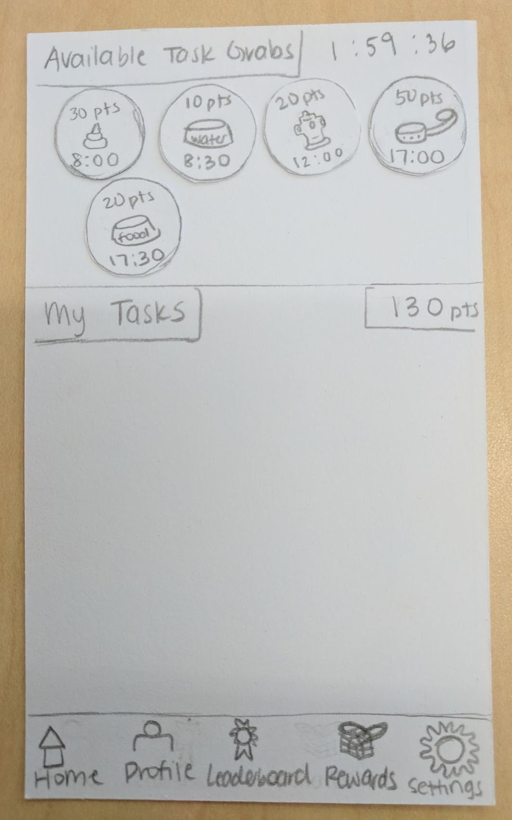
How to deal with “un-snatched” tasks (Low-Fi)
Senario:
Users have limited time to snatch tasks for the day.
This makes scheduling more clear (i.e. everyone knows that all tasks are accounted for by 10am)
However:
What if not all tasks are snatched?
We did not have a case for this scenario in our low-fi prototype
Time remaining to snatch tasks

Slide 9
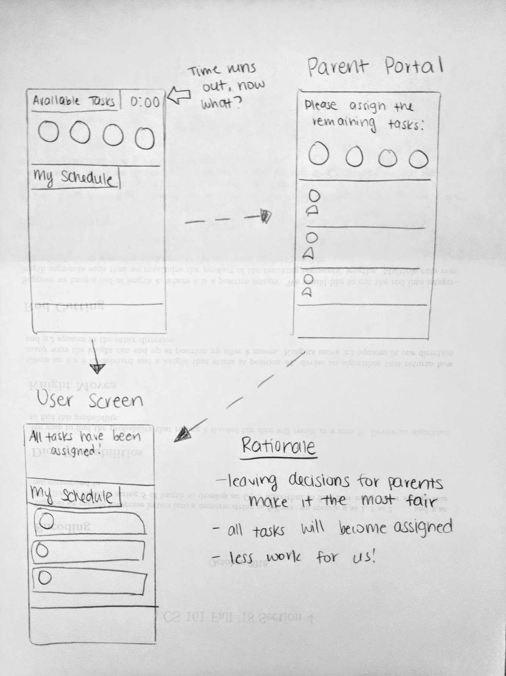
How to deal with “un-snatched” tasks (Med-Fi)
Solution:
Parents will manually assign remaining tasks to family members
Rationale:
Parents know everyone’s schedules best so as not to assign conflicting tasks
Parents are now responsible for the “fairness” of task distribution
The app is a tool and incentive to distribute tasks, but should not be responsible for doing so.
Parents will see new portal to assign tasks
Child’s schedule will be populated regardless

Slide 10
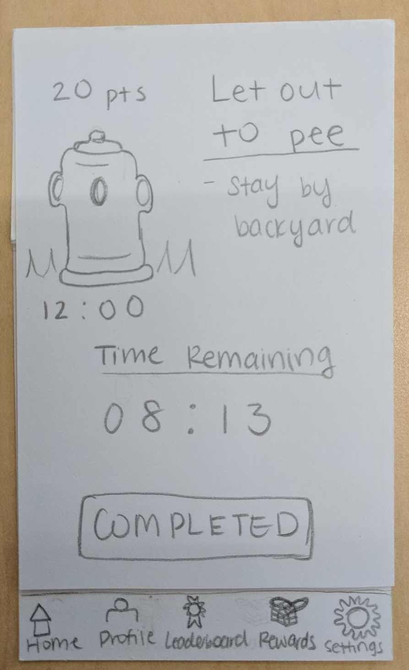
2) Confusion with task completion (Low-Fi)
Senario:
Your phone buzzes to notify you that you have a task to complete soon
Detailed task screen pops up once you open it
However:
Do you click complete before/during/after you’ve completed it in real life?
What happens next?
How constrained is the time limit?
We didn’t really have a screen for after this...

Slide 11
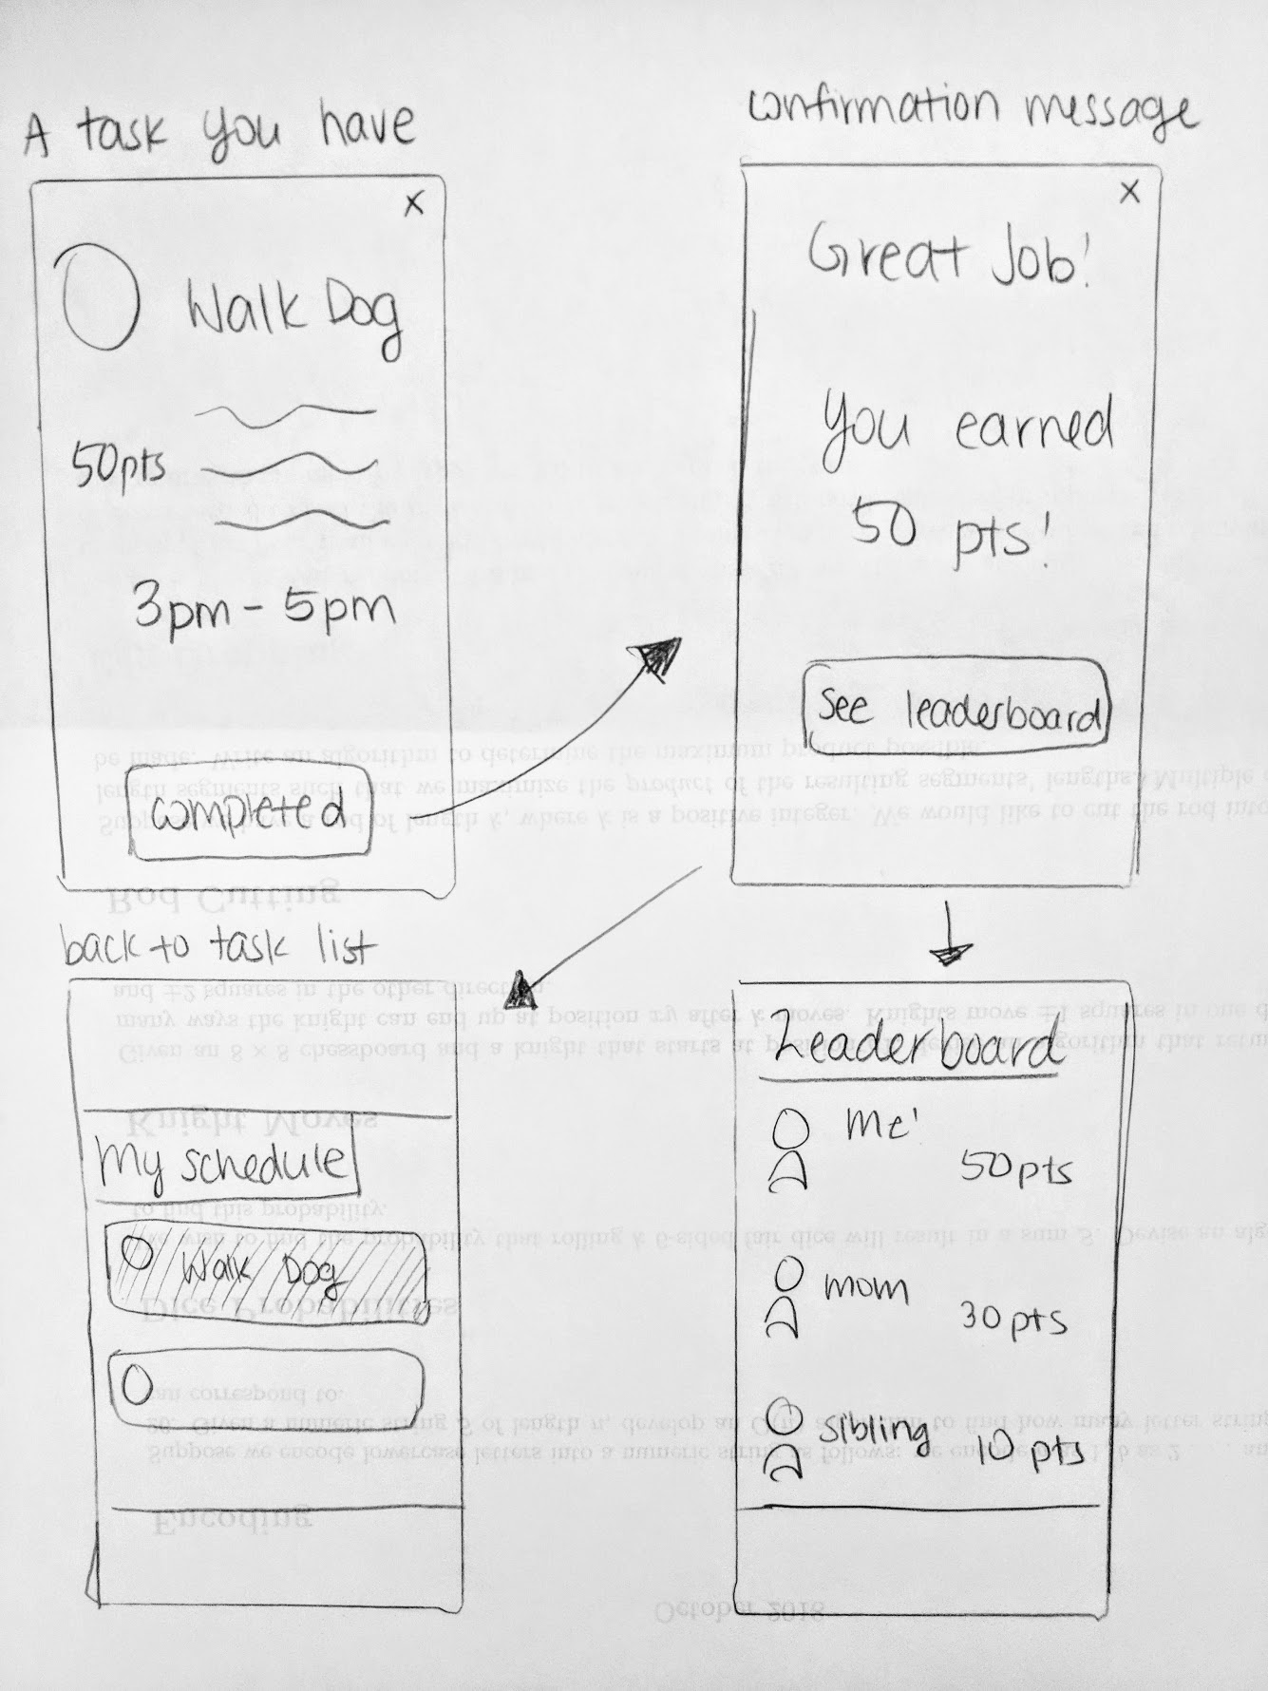
2) Confusion with task completion (Med-Fi)
Flexible time range for completion
Solution:
Flexible time range for completion
Clear confirmation of completion
Intuitive transition to “Leaderboard”
Rationale:
Time range to complete task means they can complete it on their own time without pressure of a countdown (or constant app notifications)
Users will now know when the “complete task” process is finished
Confirmation screen for completion
Clear indication that a task was completed

Slide 12
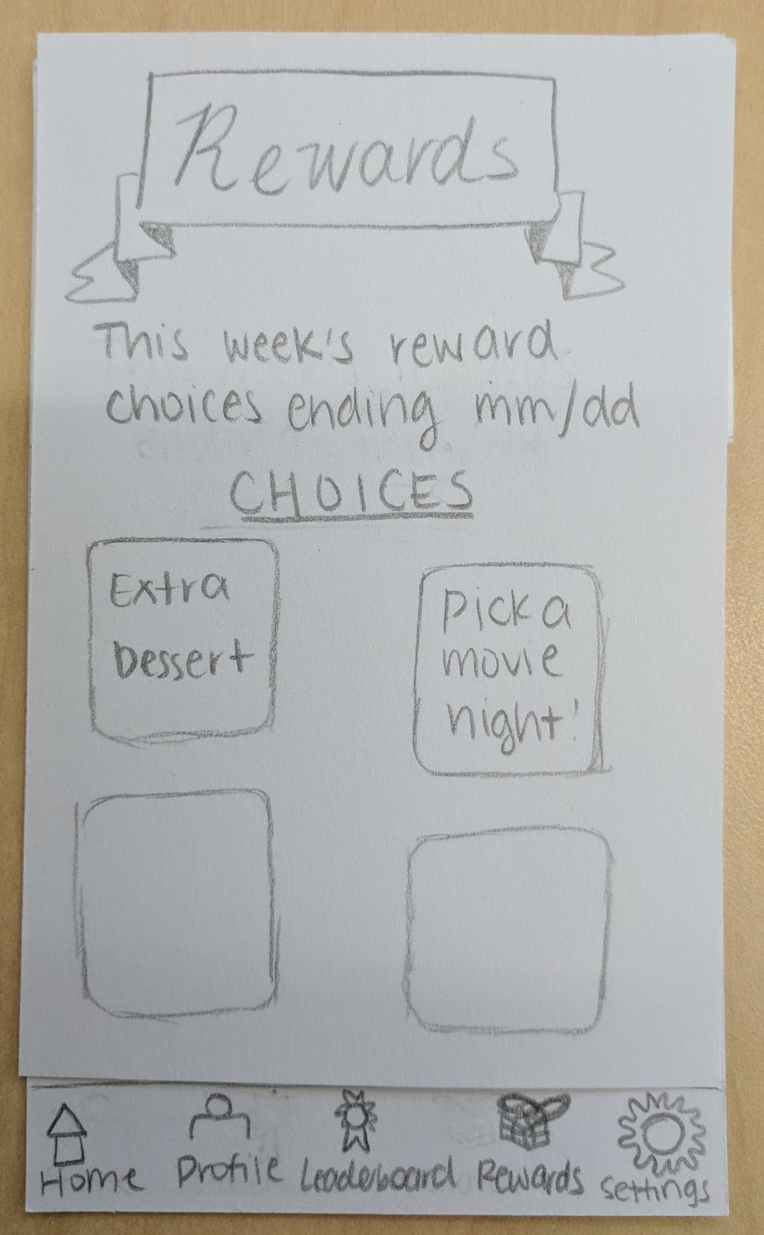
3) Confusing interactions with Rewards page (Low-Fi)
Only had this one page...
Senario:
Users visit the rewards page:
  During the week before anyone has won
  After the week whether or not they’ve won
However:
They can’t choose a reward until the week’s competition ends
Only the winner can choose a reward
They can only choose 1 option
Unclear how many “choices” they could pick

Slide 13
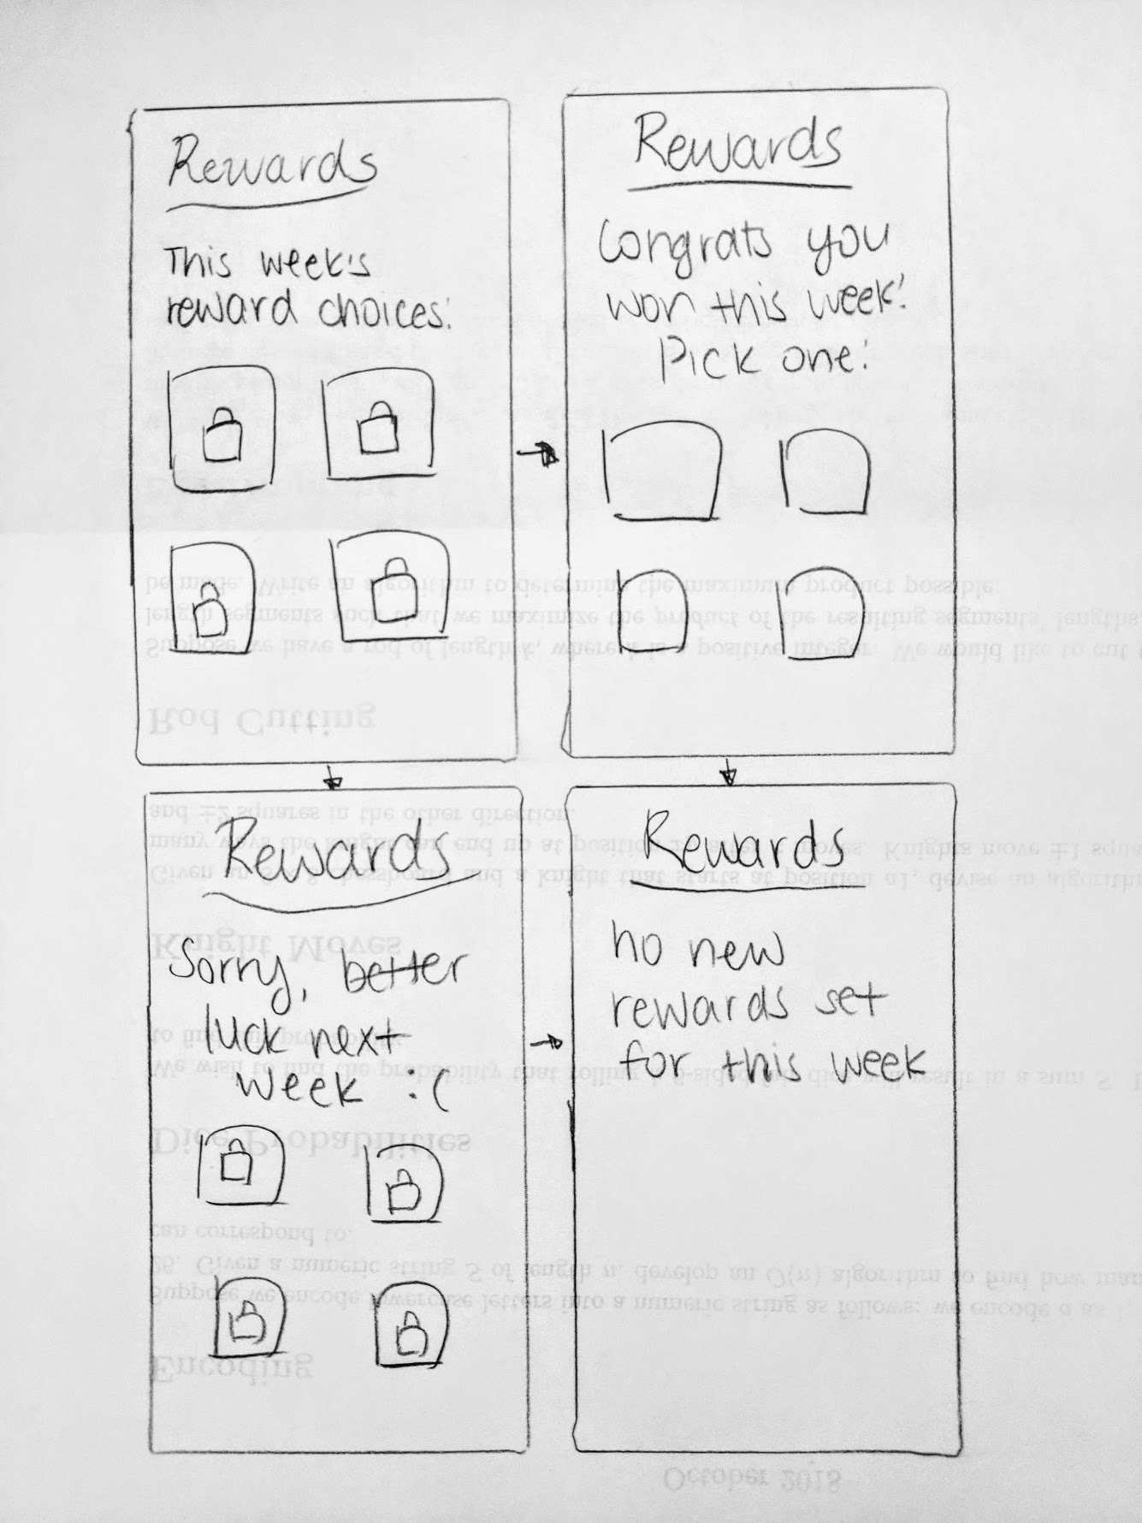
3) Confusing interactions with Rewards page (Med-Fi)
Clear indication that you won & only choose 1
Rewards locked until competition ends
Solution:
Keep rewards visible but “locked” until the competition ends
Clear indication of whether or not you won and how to proceed
Rationale:
Keeping rewards visible adds incentive to work hard!
“Lock” icon shows they’re not interactable (yet)
Clear messages for how to proceed at the end of the week’s competition
Clear indication that the week’s competition has ended
Rewards still locked if you lost :(

Slide 14
Medium-Fi Prototype

Slide 15
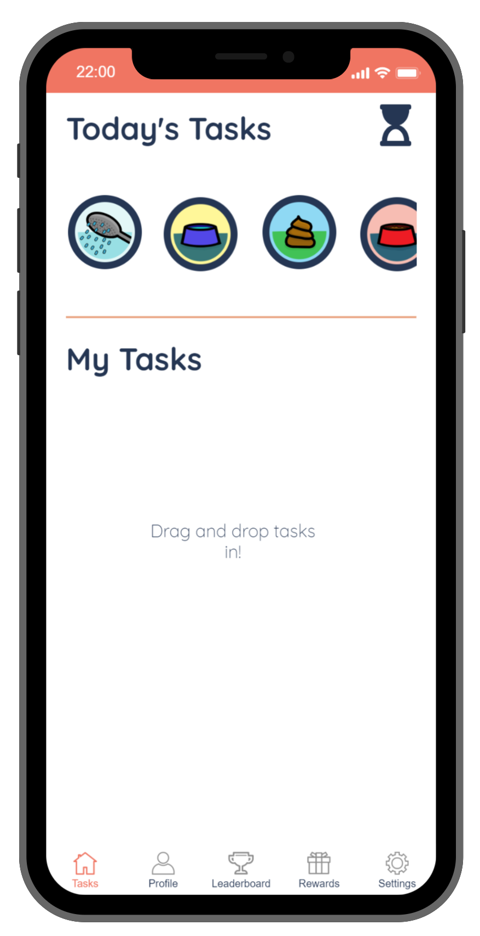
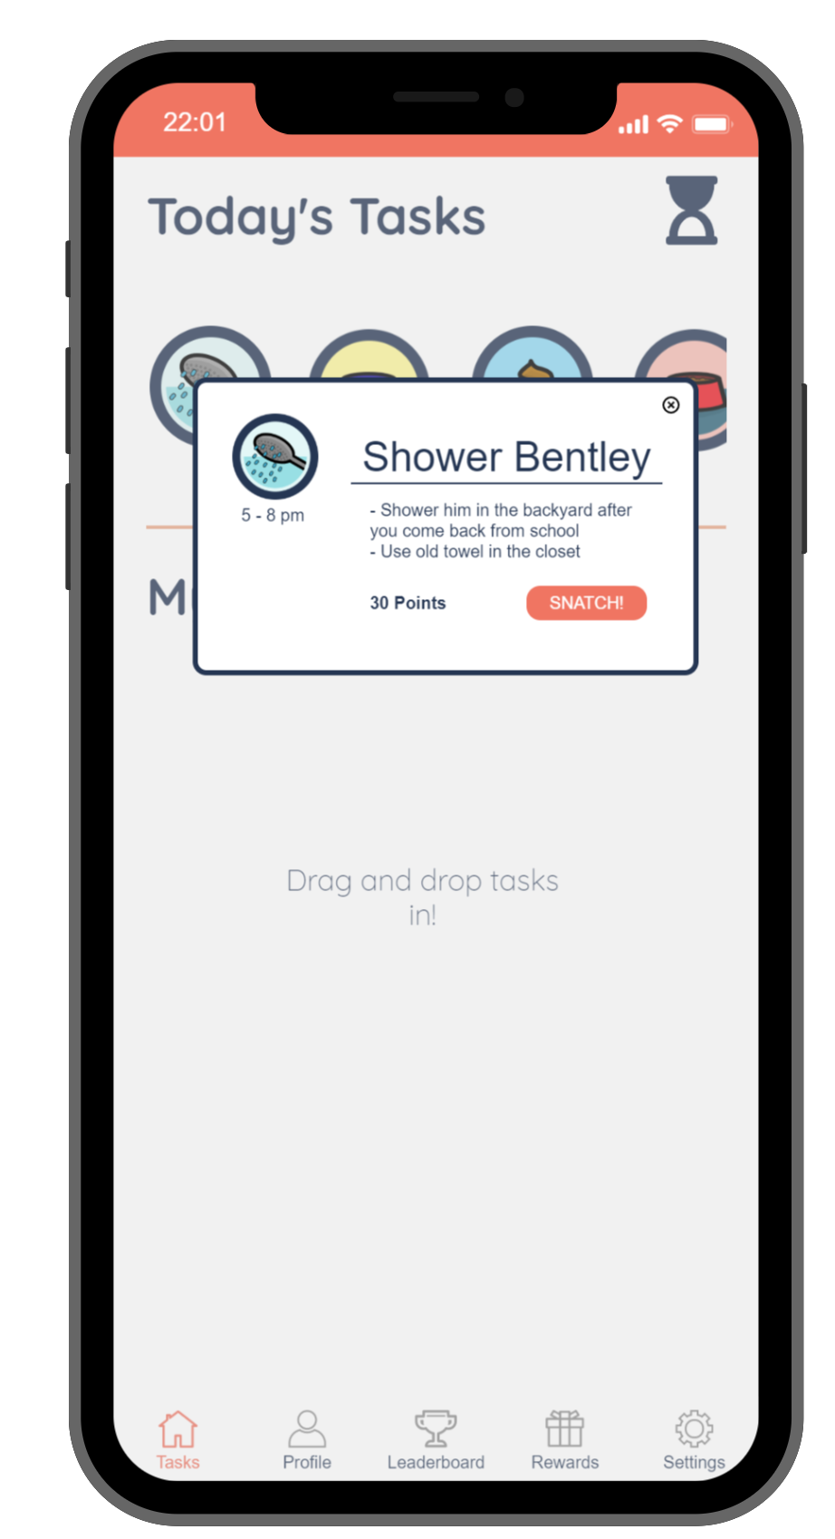
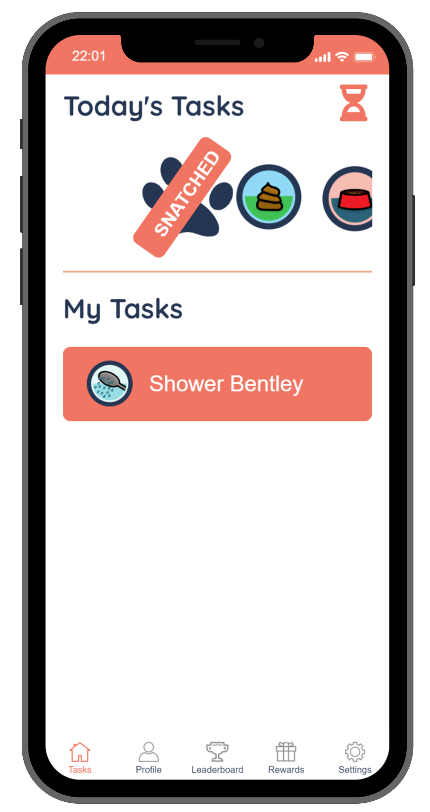
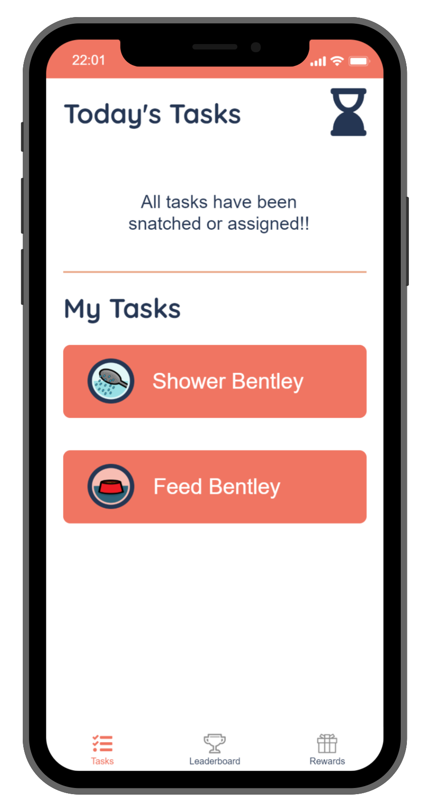
Task 1: Snatch Tasks
Displays all available tasks for today
Information about task (upon click) with “Snatch” option
Available tasks vs. tasks you’ve snatched
All tasks have been snatched or assigned
Note: Timer at top-right tells you time remaining to snatch tasks
Note: You can click for details and snatch or directly drag-and-drop
Note: Other tasks are being snatched by other users!
Note: Snatching period ends, and you have your schedule of snatched/assigned tasks

Slide 16
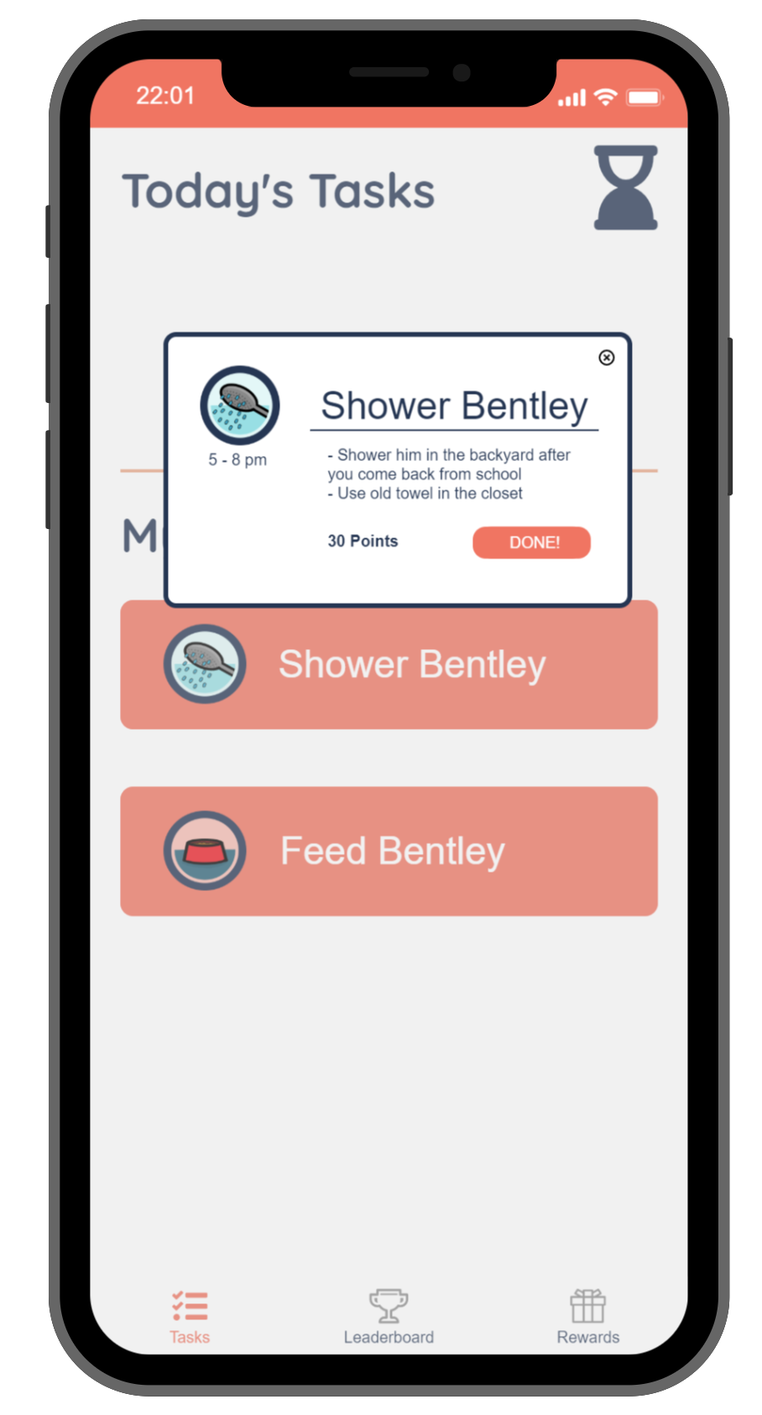
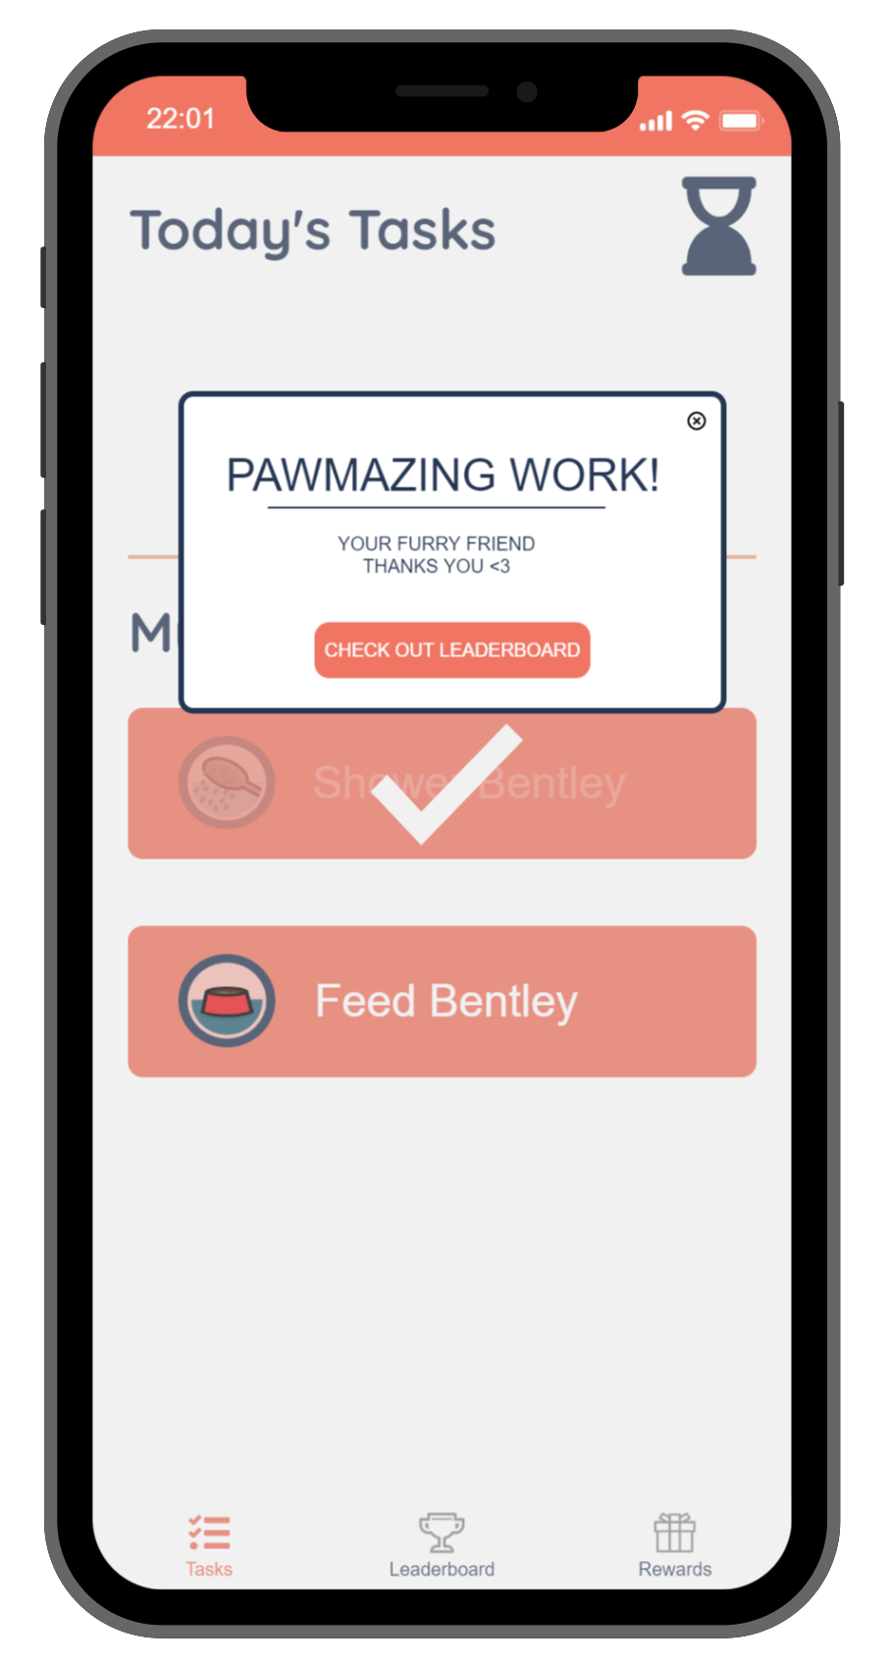
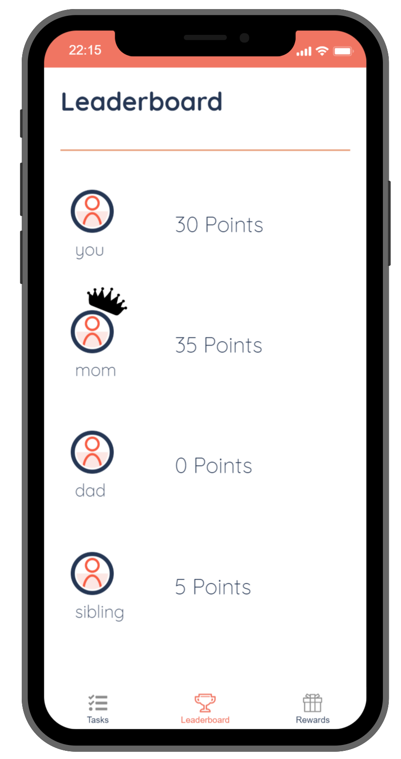
Task 2: Complete Tasks (1/2)
Displays all your tasks for today
When you click one, you can indicate that you’ve completed it
Gives you confirmation & congratulations and suggests you check out the Leaderboard
Wow, the leaderboard has been updated with your points!
Note: Tasks are ordered in chronological order
Note: You will be able to click “Done” anytime within the given time frame
Note: You can go to leaderboard or back to your tasks
Note: Clear indication of who is in the current lead

Slide 17
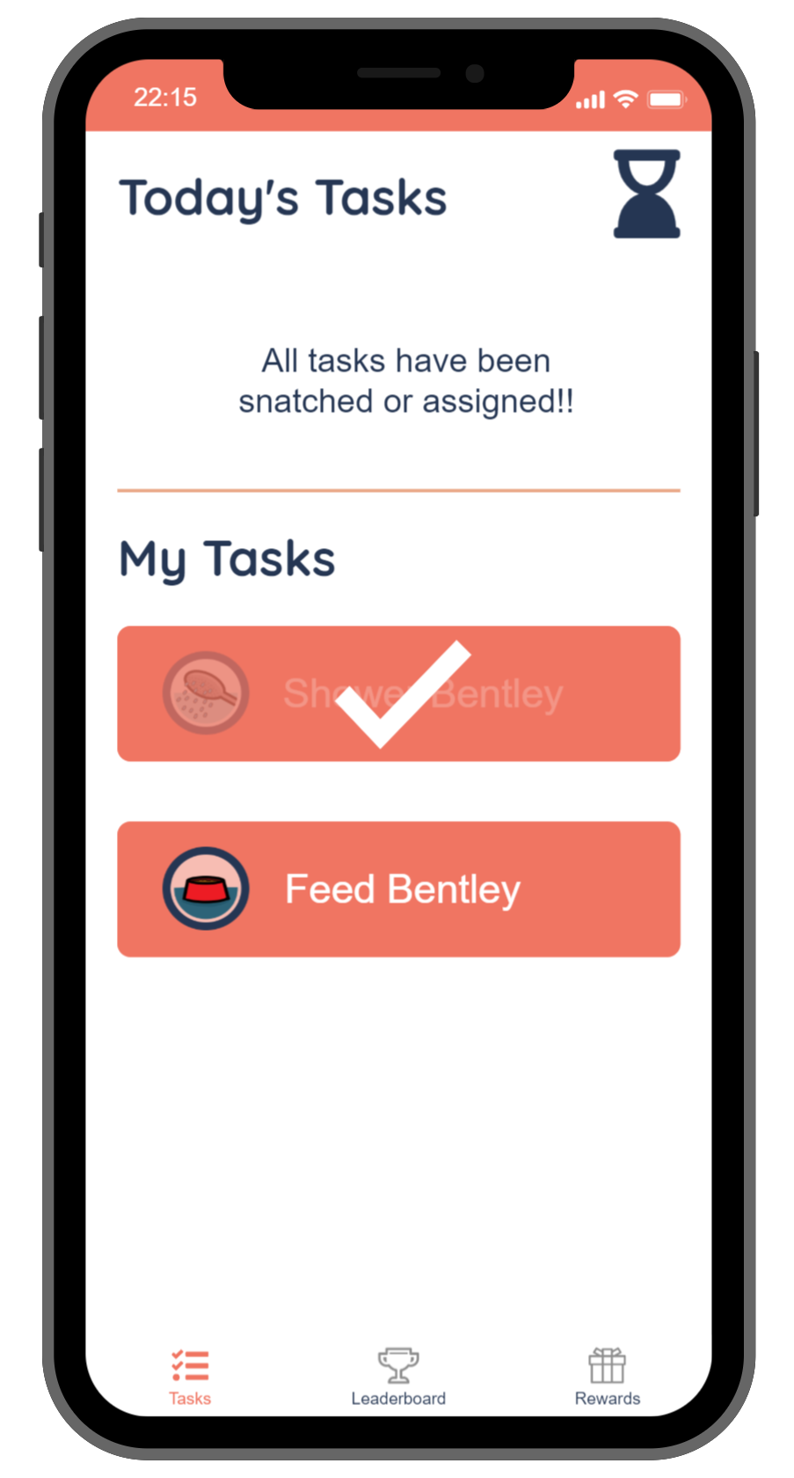
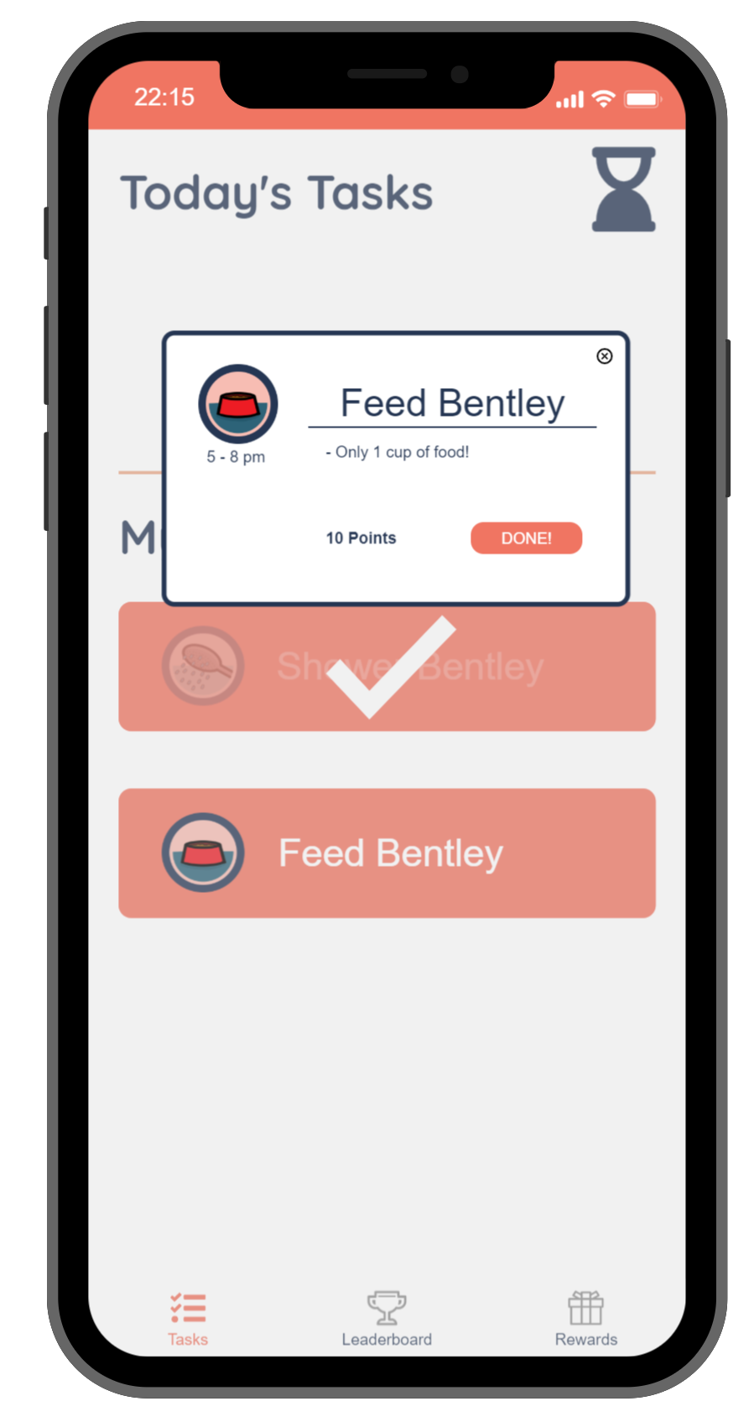
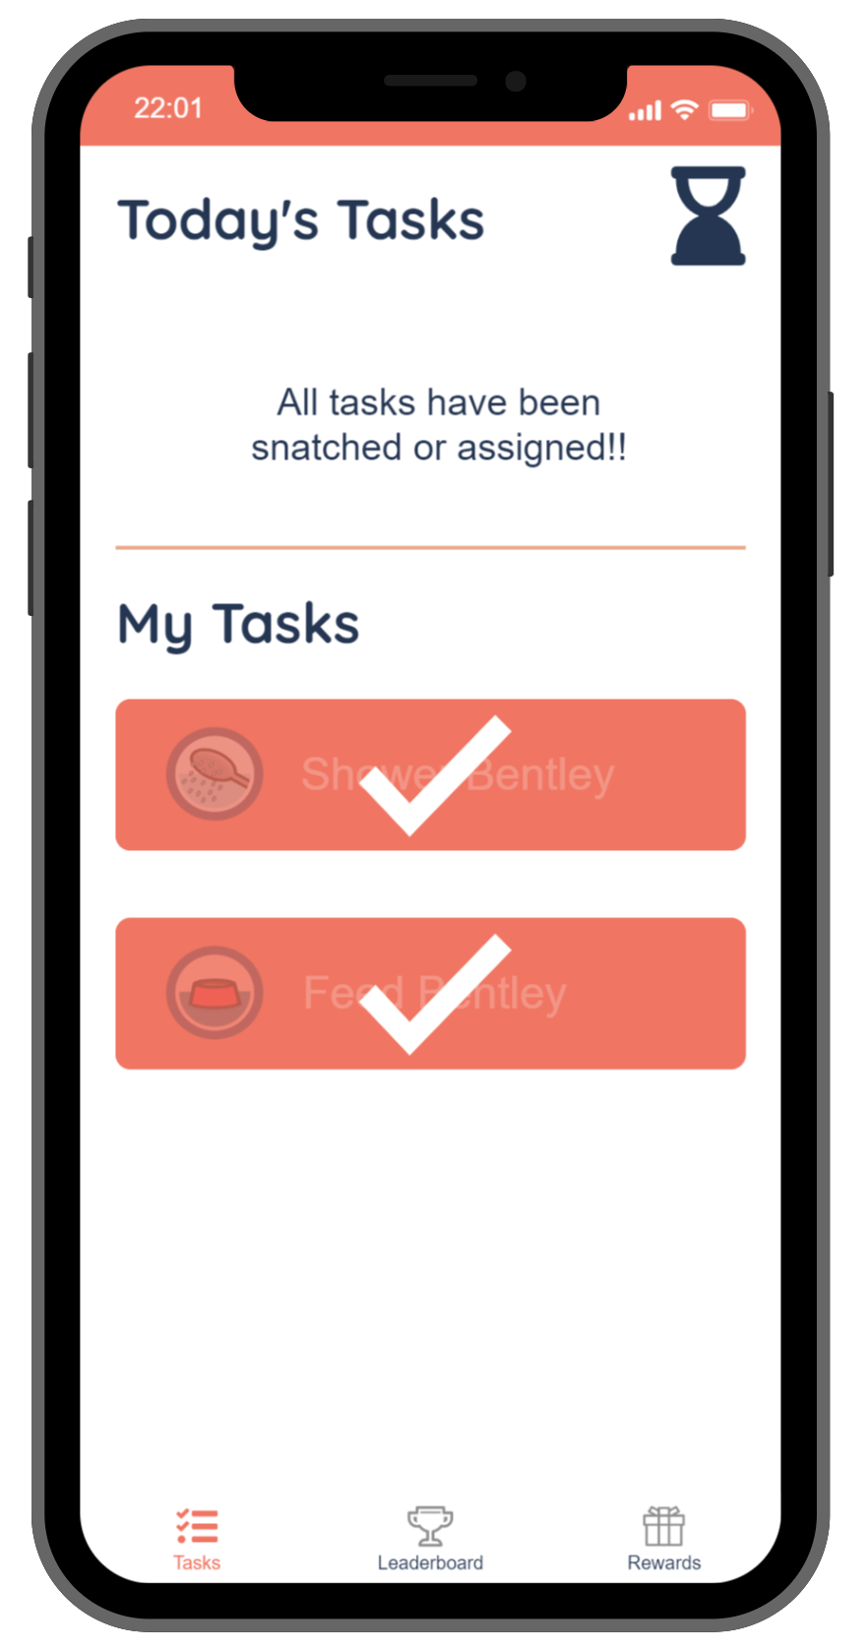
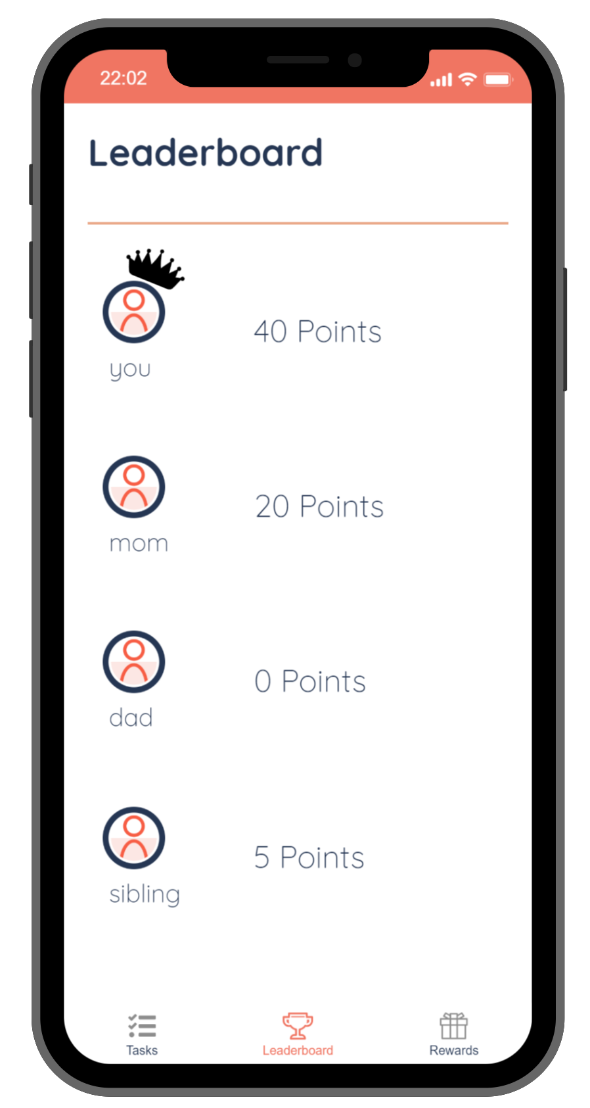
Task 2: Complete Tasks (2/2)
Displays completed vs. remaining tasks
Repeat process for all your tasks
Clearly displaying that you’re done for the day!
You are now in the lead for this week! Great job!
Note: You can always return to “Tasks” in the menu to see your schedule
Note: You can click the ‘x’ to return to your task list
Note: Crown is displayed for whoever is in the lead

Slide 18
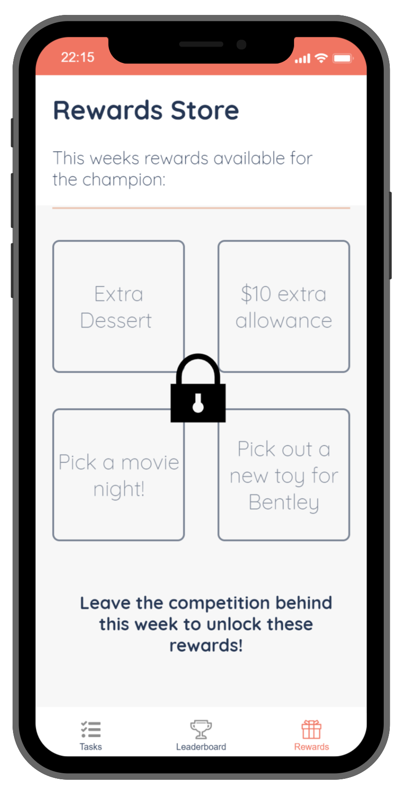
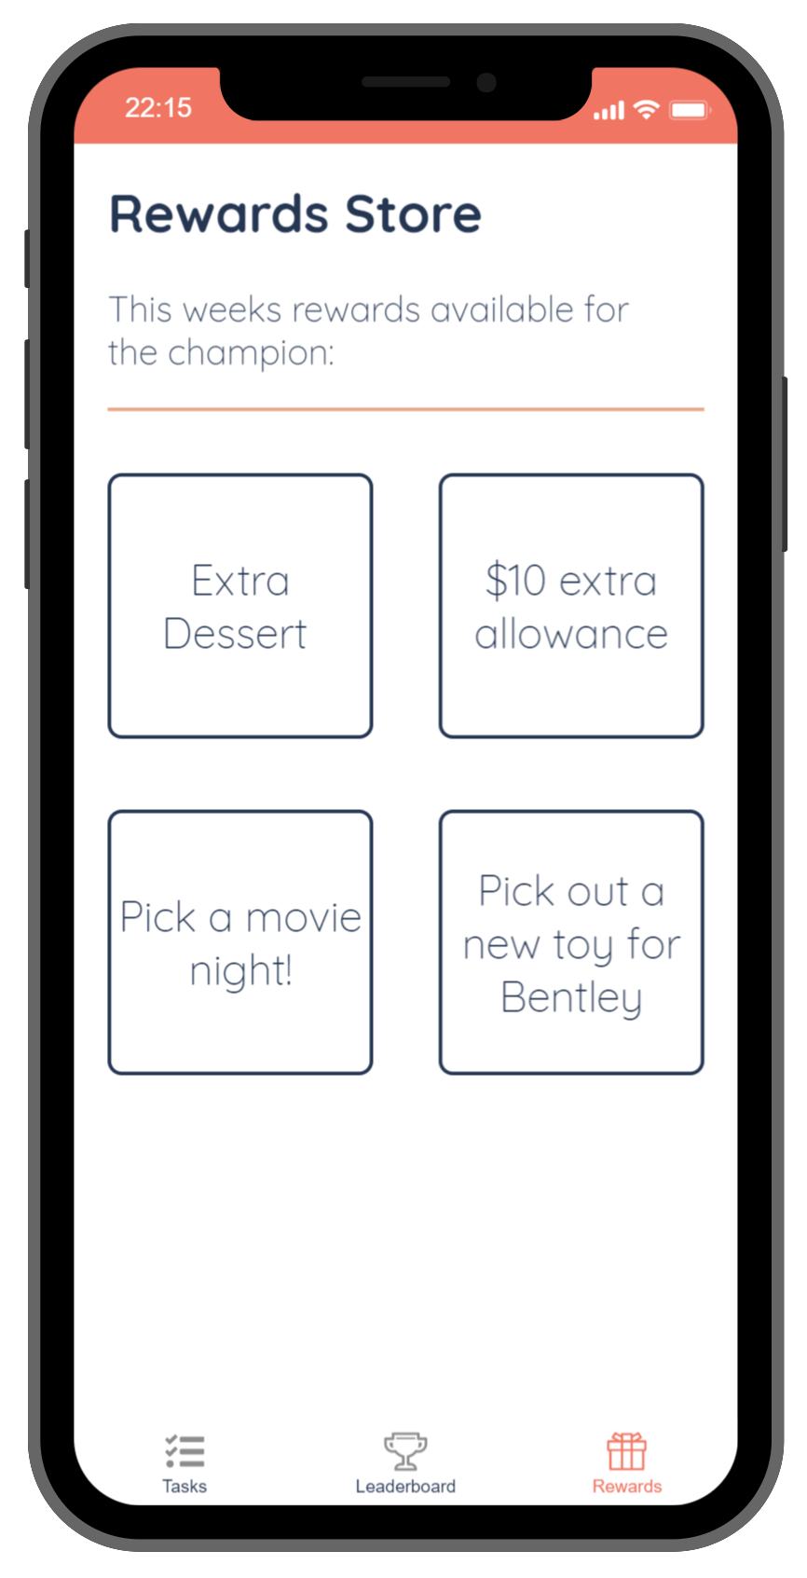
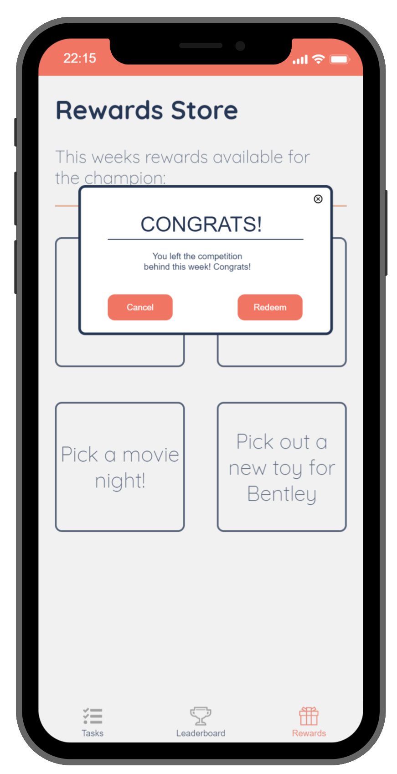
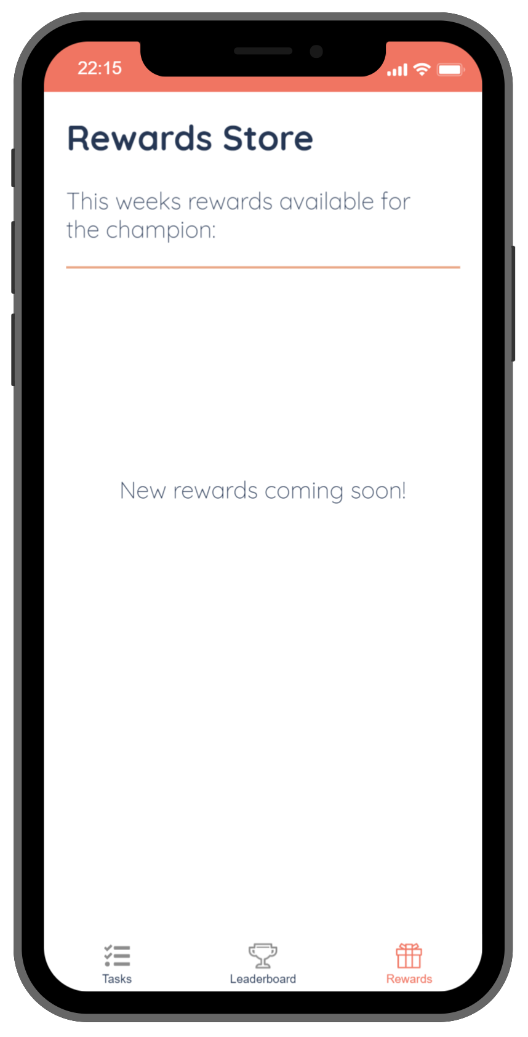
Task 3: Redeem Reward
Rewards are locked until the competition ends
If you win, they become unlocked
As the winner, you can choose (and confirm) one of the rewards
Once claimed, the rewards are updated for next week
Note: You can still see (but can’t claim) the reward choices
Note: This screen only becomes unlocked for the winner!
Note: Asks for confirmation in case you clicked the wrong reward choice
Note: At this points, the parents/admins need to update rewards for next week

Slide 19
Prototype Overview

Slide 20
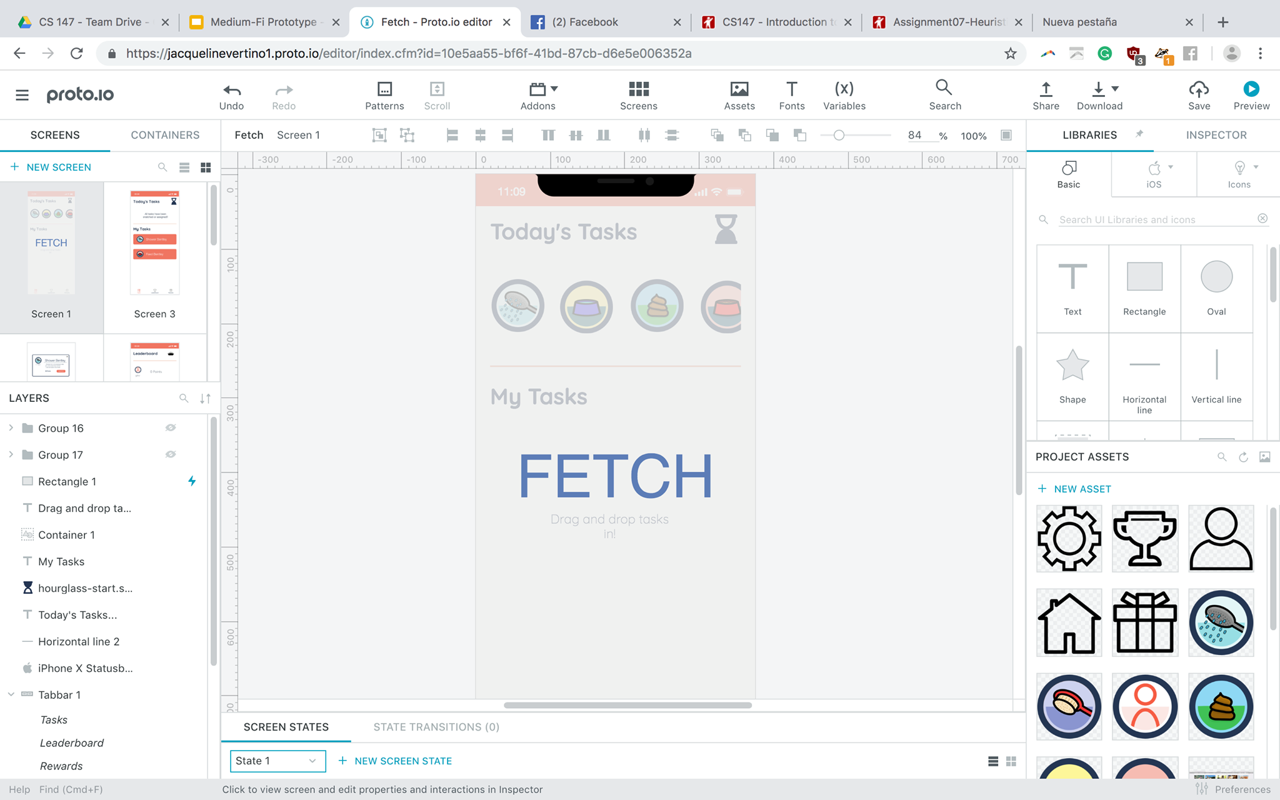
Tool Used: Proto.io

Slide 21
Tool Used: Proto.io
Capabilities
Able to create all visual components in-app, as well as specify hex colors and use a grid when designing
Able to link transitions to each individual component (buttons, images, etc) and cascade these in order to ‘wizard of oz’ more complex interactions (such as other family members snatching tasks from you)
Able to use presets to easily insert normal phone components and their functionality, such as the lower-screen menu and upper time and battery life image
Limitations
Can not have a realistic visual countdown w/o 1 million transitions, which is why we chose to simply use a sand clock flipping for this iteration
Very difficult to simulate points calculations- it takes several conditional transitions to in a very simple way mimic your points adding up in the leaderboard, but this quickly becomes infeasible with more than 2 tasks

Slide 22
Medium-Fi Prototype Limitations
Lack of Admin Portal & Onboarding
For our app, onboarding may require a lot of work for the parent/admin to set-up all the tasks and schedules as well as update rewards and assign tasks occasionally.
We ultimately decided to focus on the experience of a child user rather than an admin, who gets to use the app in a very straightforward manner. As such, in the scenario where not all the tasks are snatched in time, the user’s schedule is “magically” filled anyway because behind the scenes, a parent has assigned them to them! You just can’t see that part yet...
Notes:
Wizard-of-Oz & Hard-Coded features:
In our application, we hard-coded the following:
While in reality the other tasks in the taskbar would really be taken away by family members, we instead simulated this feeling by having them “snatched” away in a certain time interval. The tasks that are “snatched” away cannot be interacted with.
For our redemption process, we have decided that the completion of the two tasks suffices for any reward. In our final application we will most likely put a coin system in place
The leaderboard does not actually maintain the correct scores, rather it shows hard-coded lists of points
Current Limitations:
One of the main limitations of this medium-fi prototype is the lack of an admin account. We have pre-set many of the events that would happen when taking care of a dog, but this will most likely have to be setup by one of the parents.
We also have not created designs for some of the other parts of our applications, such as the profile and settings screens as they were not core features of our application.
Finally, there is no profile section of the application. As the application runs based on a user profile, it will eventually need a page so that people can login.

Slide 23
Medium-Fi Prototype Limitations
Limited Menu Options
We unfortunately had to decrease the number of menu options we gave the user. In our low-fi sketches, we display all of our ideal menu options (tasks, profile, leaderboard, rewards, and settings). However, as we began building the app we realized we only had time to scope out 3 menu options (tasks, leaderboard, rewards).
We chose to only display these 3 for now because they are the main screens that users would need to complete our 3 tasks.
We definitely intend include a profile page for users to see their task history in future iterations. Similarly, a settings page is necessary as this is an account-based app (and parents will need to access their admin portal).
Ideal menu
Current scope menu
Notes:
Wizard-of-Oz & Hard-Coded features:
In our application, we hard-coded the following:
While in reality the other tasks in the taskbar would really be taken away by family members, we instead simulated this feeling by having them “snatched” away in a certain time interval. The tasks that are “snatched” away cannot be interacted with.
For our redemption process, we have decided that the completion of the two tasks suffices for any reward. In our final application we will most likely put a coin system in place
The leaderboard does not actually maintain the correct scores, rather it shows hard-coded lists of points
Current Limitations:
One of the main limitations of this medium-fi prototype is the lack of an admin account. We have pre-set many of the events that would happen when taking care of a dog, but this will most likely have to be setup by one of the parents.
We also have not created designs for some of the other parts of our applications, such as the profile and settings screens as they were not core features of our application.
Finally, there is no profile section of the application. As the application runs based on a user profile, it will eventually need a page so that people can login.

Slide 24
Medium-Fi Prototype Wizard-of-Oz-ing
Time Flies… Really Quickly!
As our app is intended to be used throughout the day, it’s unrealistic to do early testing this way. Thus, for the sake of getting a thorough experience with our app, we’ve sped up/hard-coded the passage of time.
For example, as the user is snatching tasks, they may notice that other tasks have been snatched! In our prototype, we hard-coded these events to happen with the timer (top-right), and they happen quickly!
Notes:
Wizard-of-Oz & Hard-Coded features:
In our application, we hard-coded the following:
While in reality the other tasks in the taskbar would really be taken away by family members, we instead simulated this feeling by having them “snatched” away in a certain time interval. The tasks that are “snatched” away cannot be interacted with.
For our redemption process, we have decided that the completion of the two tasks suffices for any reward. In our final application we will most likely put a coin system in place
The leaderboard does not actually maintain the correct scores, rather it shows hard-coded lists of points
Current Limitations:
One of the main limitations of this medium-fi prototype is the lack of an admin account. We have pre-set many of the events that would happen when taking care of a dog, but this will most likely have to be setup by one of the parents.
We also have not created designs for some of the other parts of our applications, such as the profile and settings screens as they were not core features of our application.
Finally, there is no profile section of the application. As the application runs based on a user profile, it will eventually need a page so that people can login.

Slide 25
Medium-Fi Prototype Hard-coded Components
Limited Tasks to Snatch
For the sake of simulating competition (and simplicity of prototyping), we only allow users to snatch these 2 tasks. In fact, clicking on the other tasks do not do anything.
We believe that only being able to snatch 2 tasks still gives the user a relatively complete experience with the app. After snatching/completing the first task, they are just starting to learn how to use our app, but by the third task, it becomes repetitive.
Moreover, having only 2 possible tasks makes simulating the completion and point system much simpler at this stage!
Notes:
Wizard-of-Oz & Hard-Coded features:
In our application, we hard-coded the following:
While in reality the other tasks in the taskbar would really be taken away by family members, we instead simulated this feeling by having them “snatched” away in a certain time interval. The tasks that are “snatched” away cannot be interacted with.
For our redemption process, we have decided that the completion of the two tasks suffices for any reward. In our final application we will most likely put a coin system in place
The leaderboard does not actually maintain the correct scores, rather it shows hard-coded lists of points
Current Limitations:
One of the main limitations of this medium-fi prototype is the lack of an admin account. We have pre-set many of the events that would happen when taking care of a dog, but this will most likely have to be setup by one of the parents.
We also have not created designs for some of the other parts of our applications, such as the profile and settings screens as they were not core features of our application.
Finally, there is no profile section of the application. As the application runs based on a user profile, it will eventually need a page so that people can login.

Slide 26
Medium-Fi Prototype Hard-coded Components
Stacked Leaderboard
Another hard-coded aspect is the point system and leaderboard. Rather than keeping real-time score of every user’s points, we simply “update” the user’s scores based on which (of 2 possible) tasks they’ve completed.
Ideally, this would keep accurate count of everyone’s scores and would order them accordingly in the leaderboard. However, for this prototype, it was easier to keep them in consistent locations and indicate the “leader” with a crown.
Notes:
Wizard-of-Oz & Hard-Coded features:
In our application, we hard-coded the following:
While in reality the other tasks in the taskbar would really be taken away by family members, we instead simulated this feeling by having them “snatched” away in a certain time interval. The tasks that are “snatched” away cannot be interacted with.
For our redemption process, we have decided that the completion of the two tasks suffices for any reward. In our final application we will most likely put a coin system in place
The leaderboard does not actually maintain the correct scores, rather it shows hard-coded lists of points
Current Limitations:
One of the main limitations of this medium-fi prototype is the lack of an admin account. We have pre-set many of the events that would happen when taking care of a dog, but this will most likely have to be setup by one of the parents.
We also have not created designs for some of the other parts of our applications, such as the profile and settings screens as they were not core features of our application.
Finally, there is no profile section of the application. As the application runs based on a user profile, it will eventually need a page so that people can login.

