Slide 1
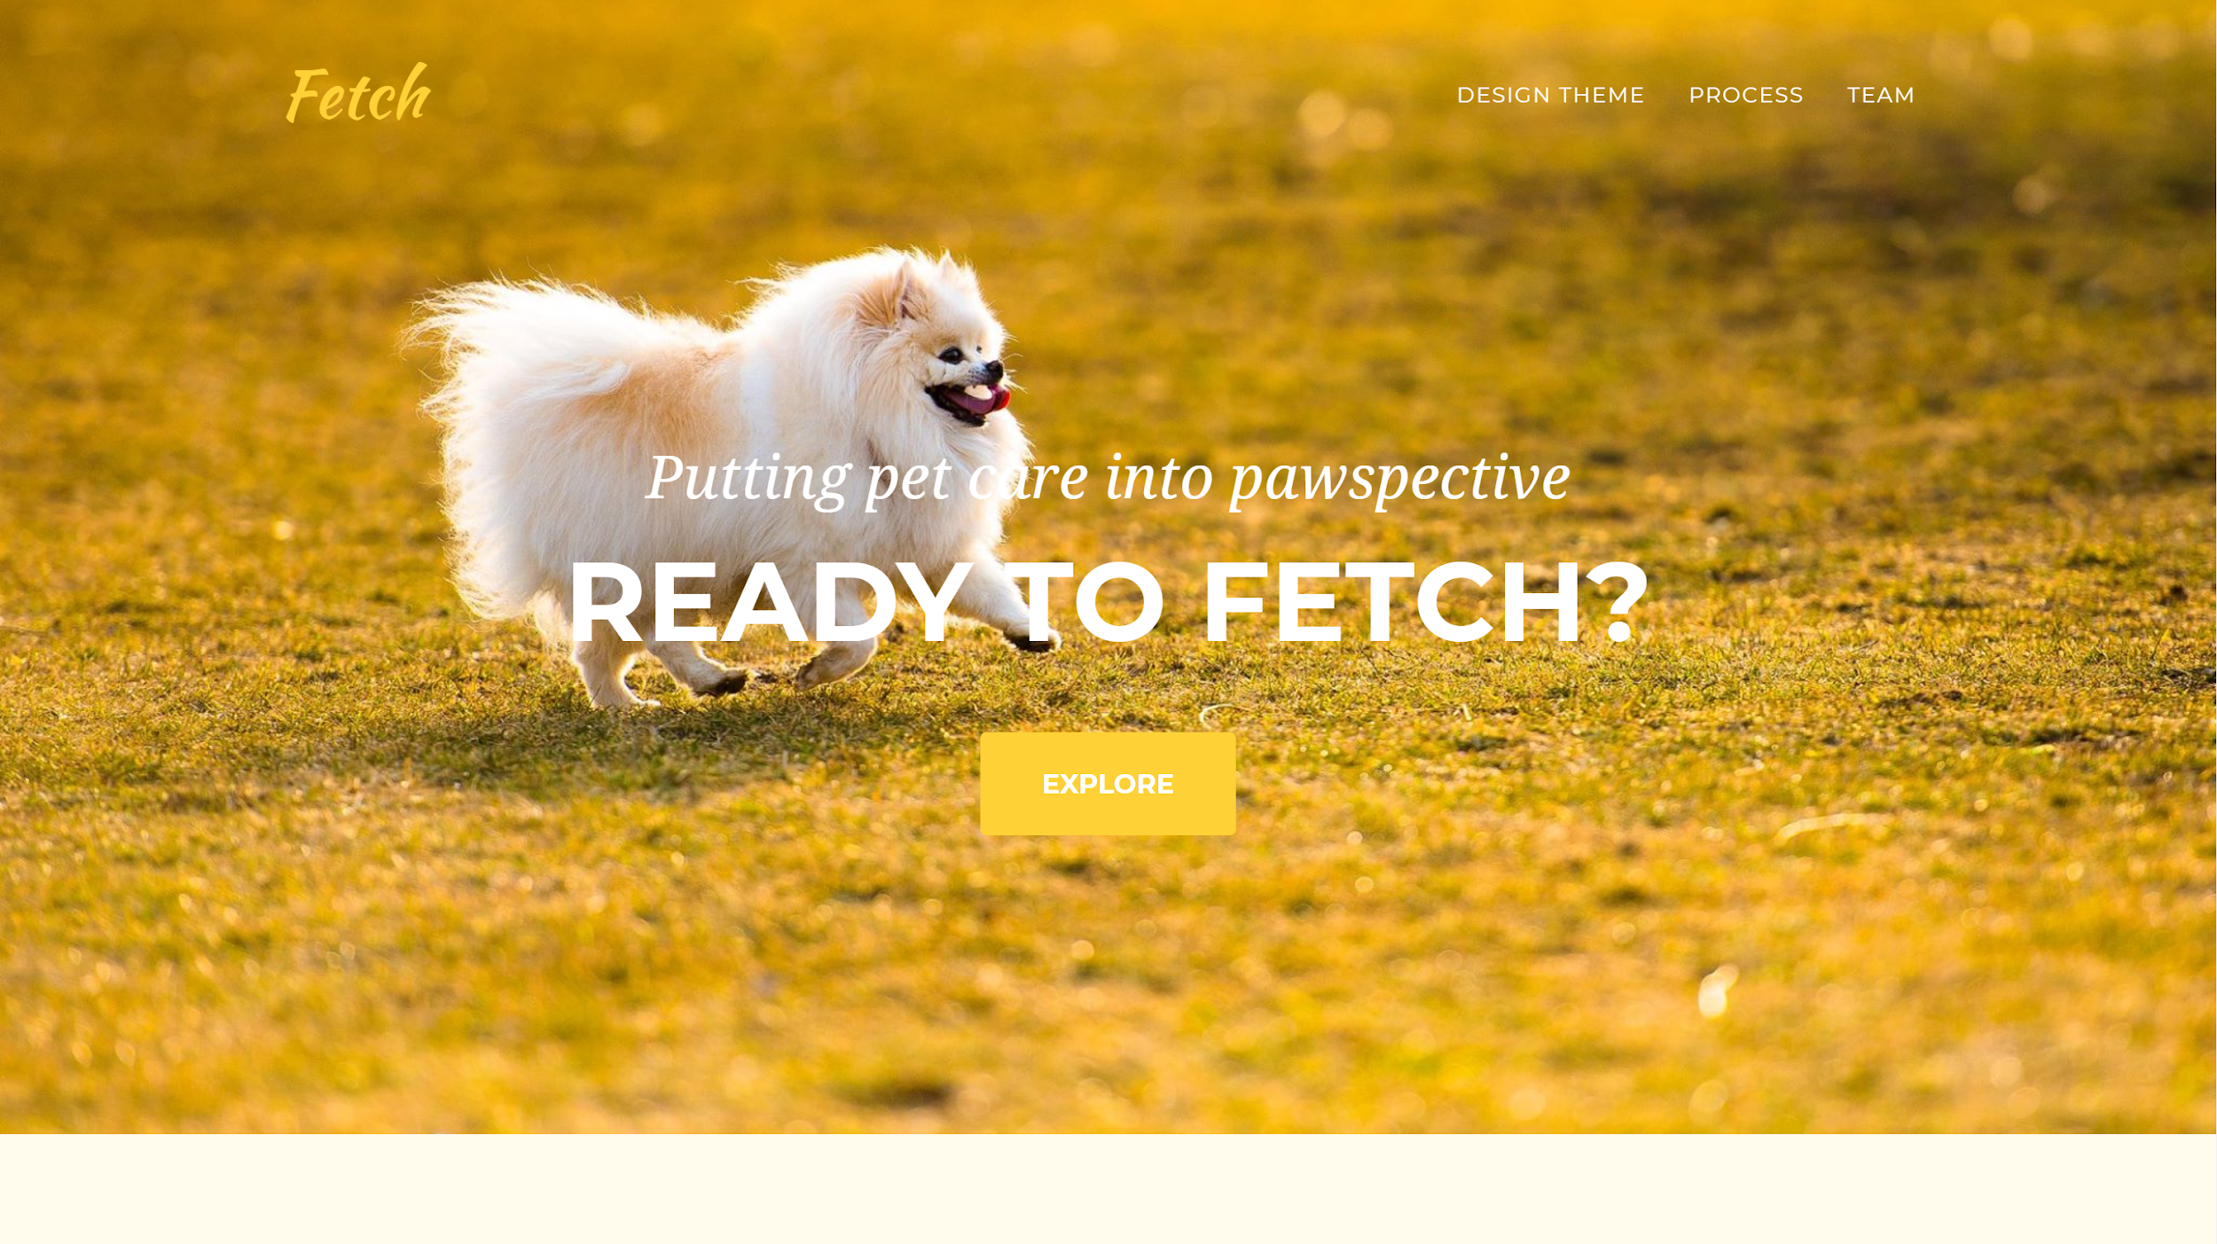
Notes:
Overview of talk, but tell it like a story rather than reading it? Maybe an outline?

Slide 2

Overview
Mission Statement
Selected Interface
Low-fi Prototype
3 task flows
Experimental Method
Results
UI changes
Summary
Notes:
Our goal is to make proper dog-care knowledge and task distribution fun and accessible for the entire family.

Slide 3
Fetch
Putting pet care into pawspective
Caring for a new dog can be a daunting task that not all new dog-owners, especially the kids, are prepared for. Our goal is to make proper dog-care knowledge and task distribution fun and accessible for dog owners- we want to make it a family affair!
Notes:
Our goal is to make proper dog-care knowledge and task distribution fun and accessible for the entire family.

Slide 4
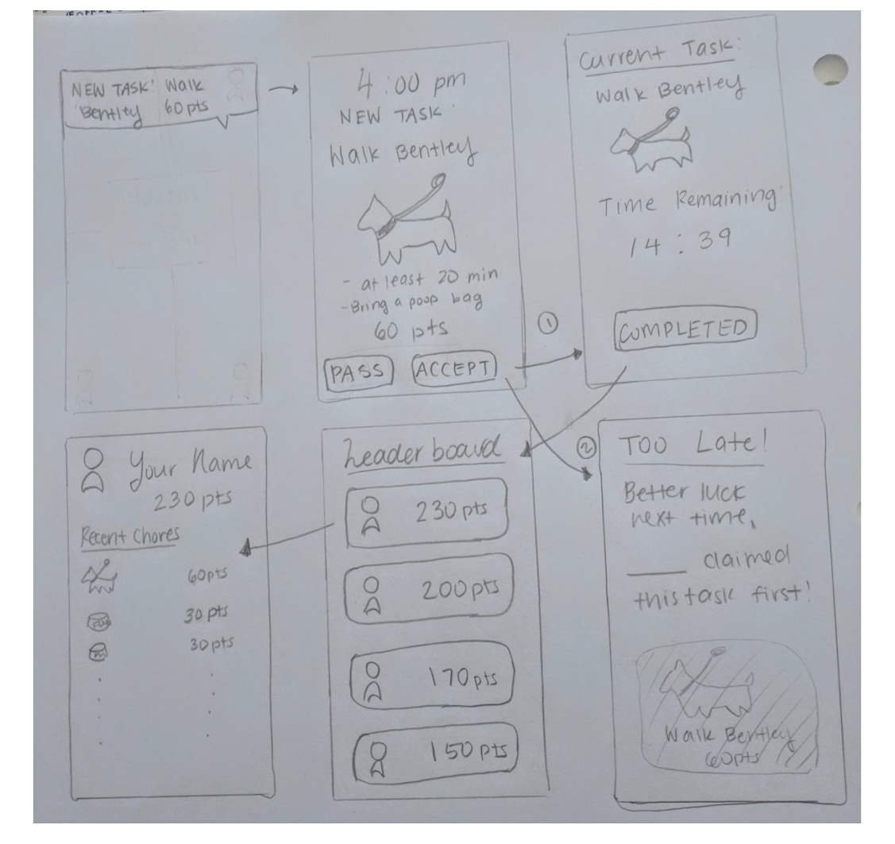
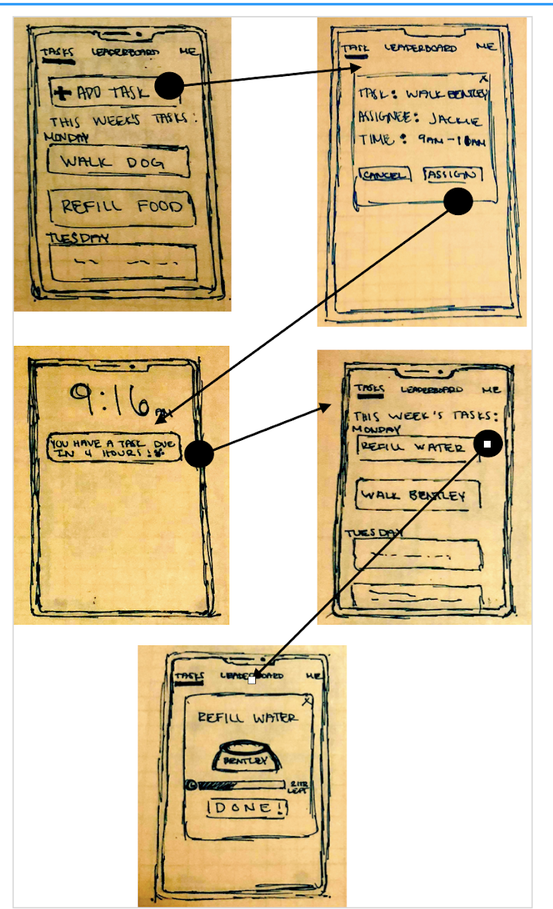
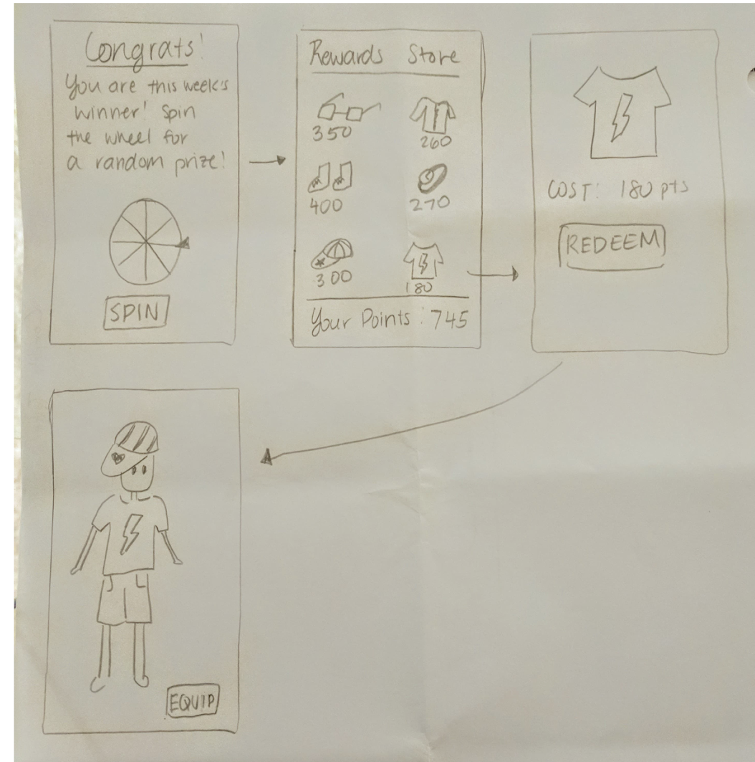
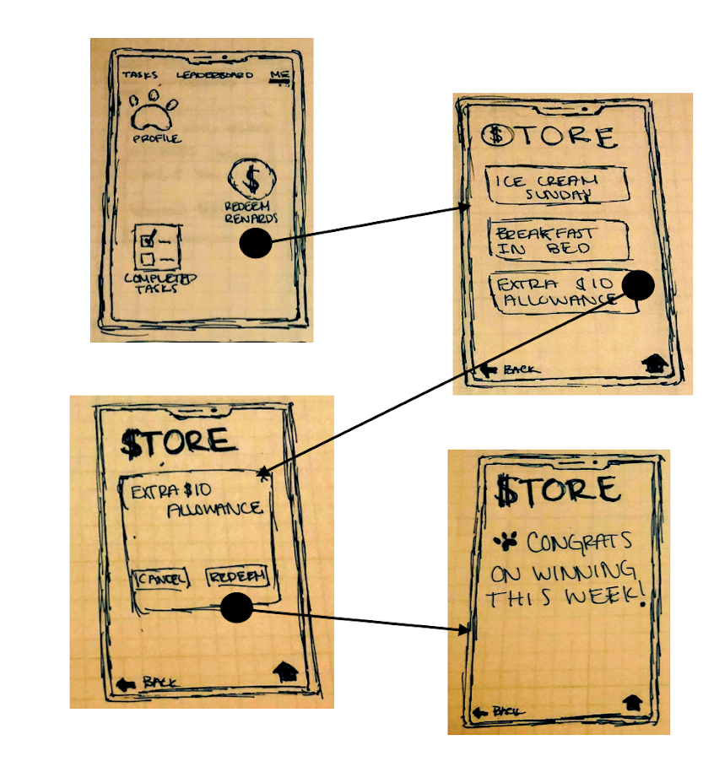
Preassigned Tasks
Task Snatching

Slide 5
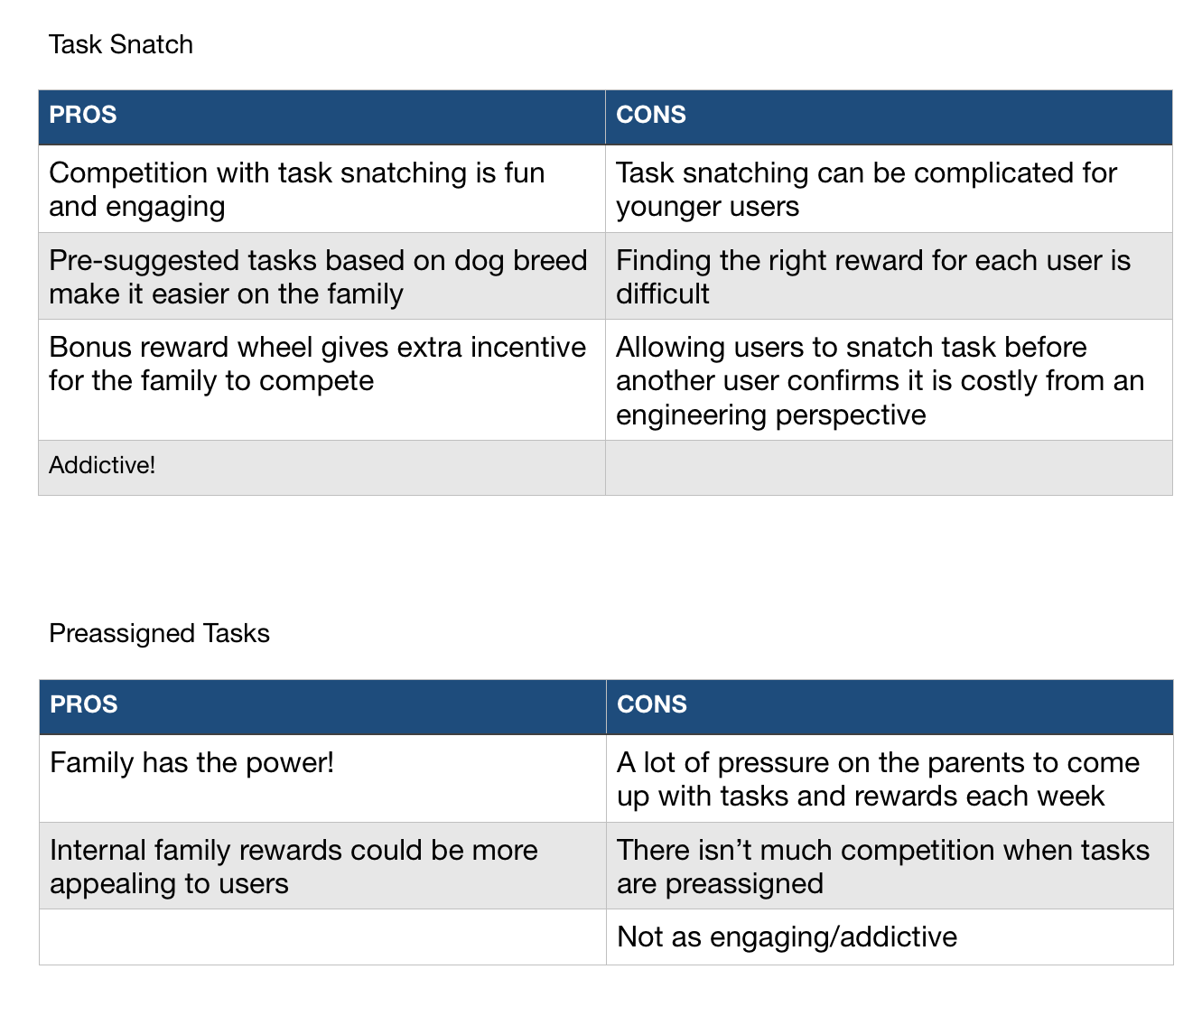
Rationale
Notes:
Picked this design because it made the most sense
Allowed for easy dragging of tasks onto the screen

Slide 6
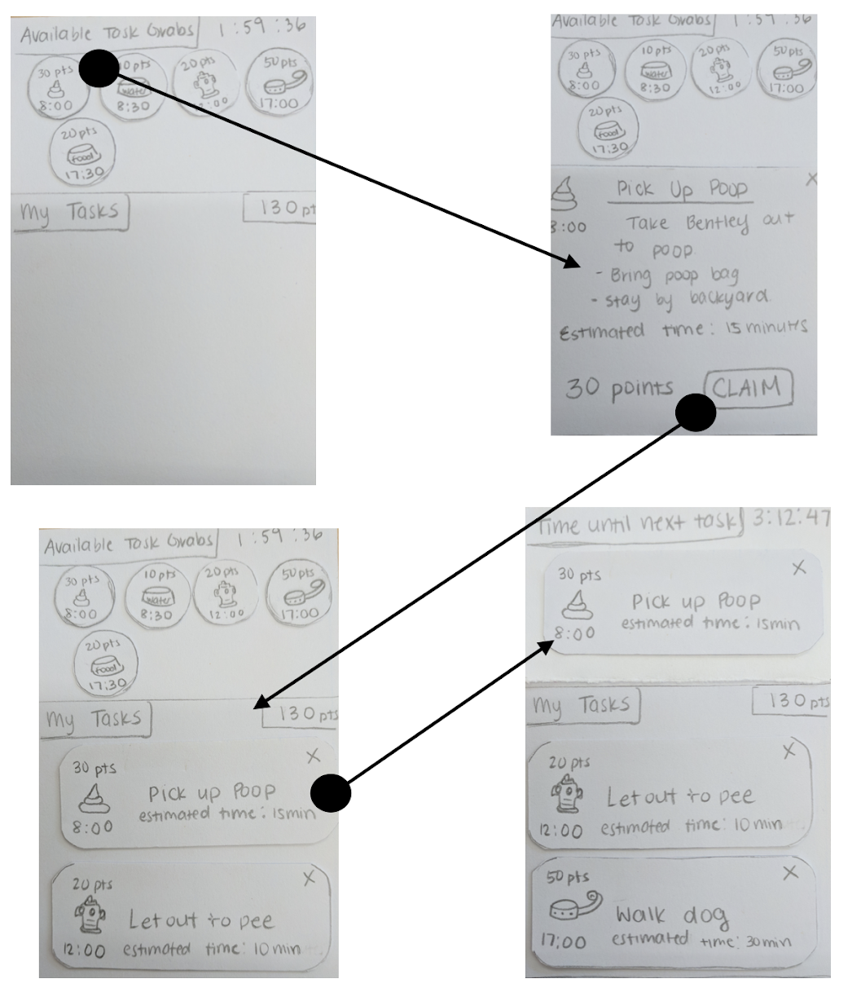
Low-Fi Prototype
UI Drawn on index cards
Moveable and clickable “objects” (tasks) for interaction

Slide 7
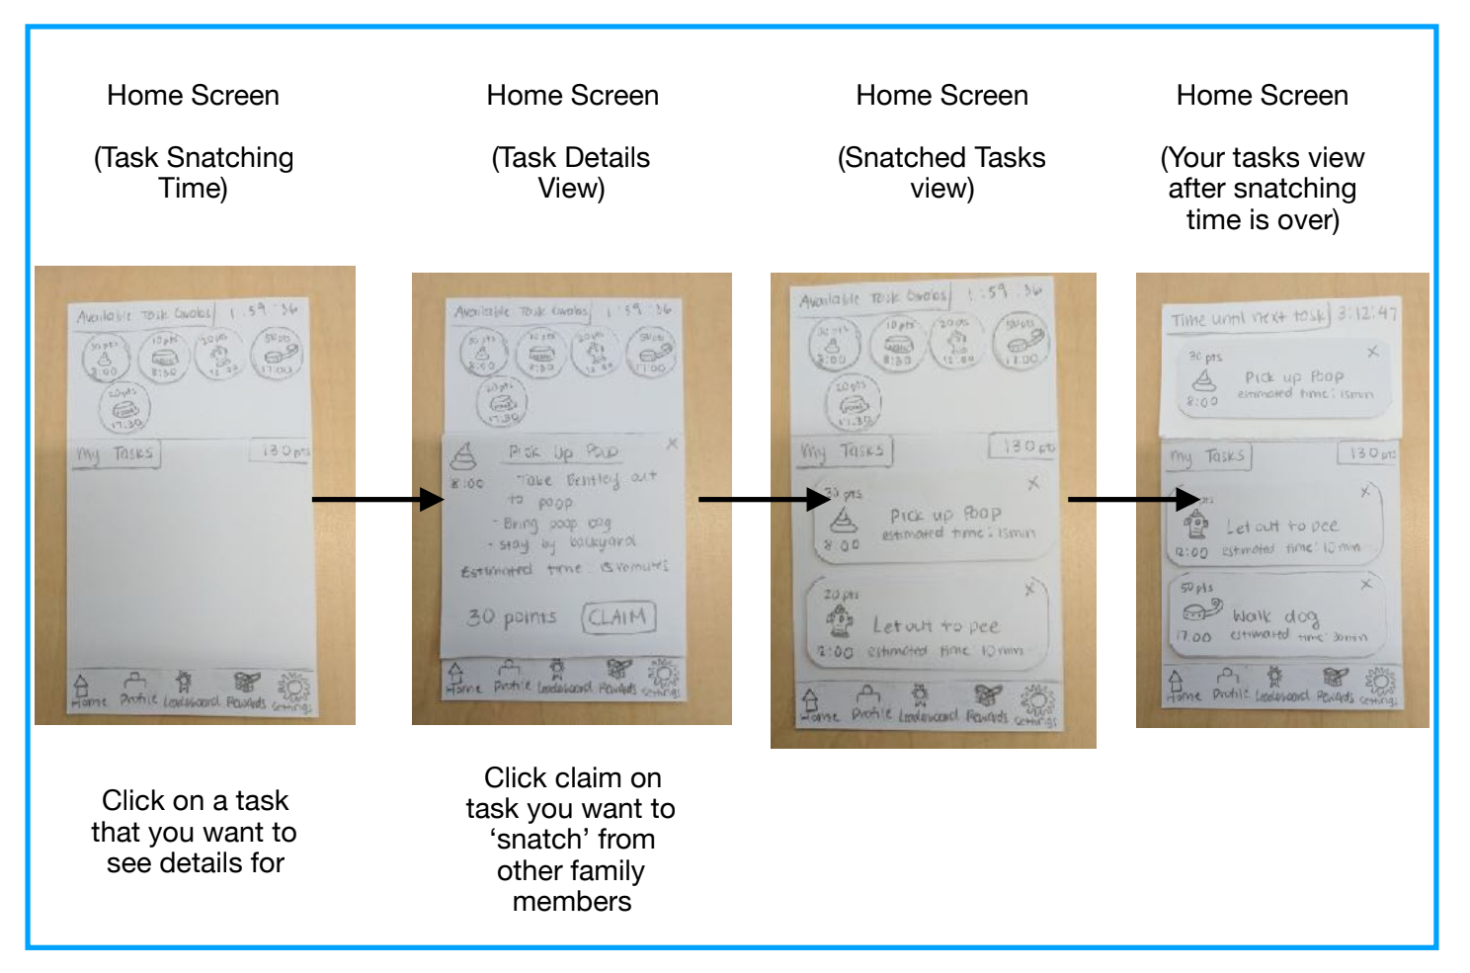
Task 1: Snatch Tasks

Slide 8
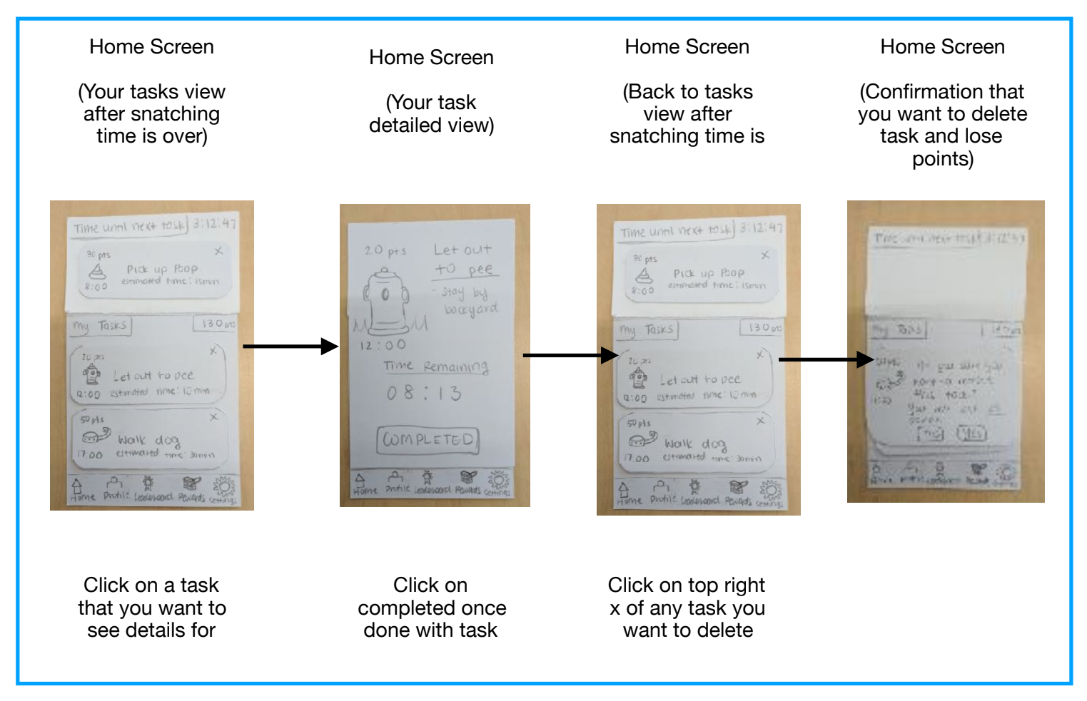
Task 2: Complete Task

Slide 9
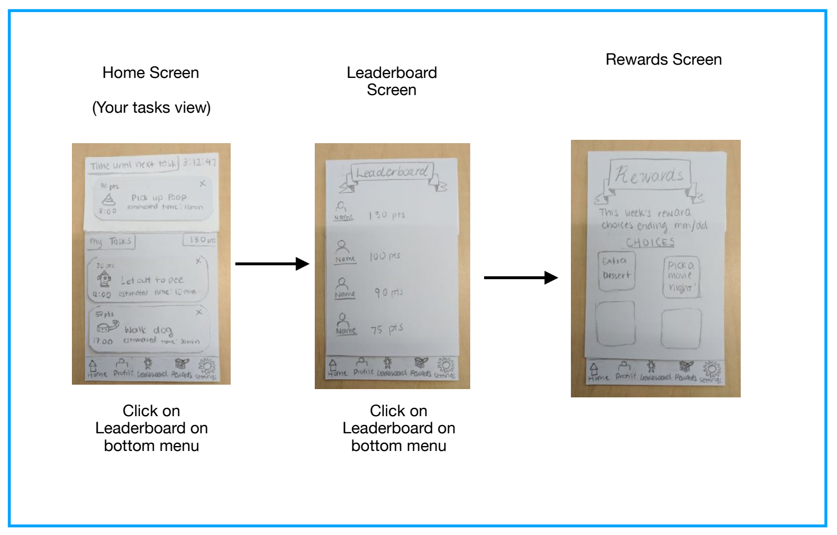
Task 3: Redeem Reward

Slide 10
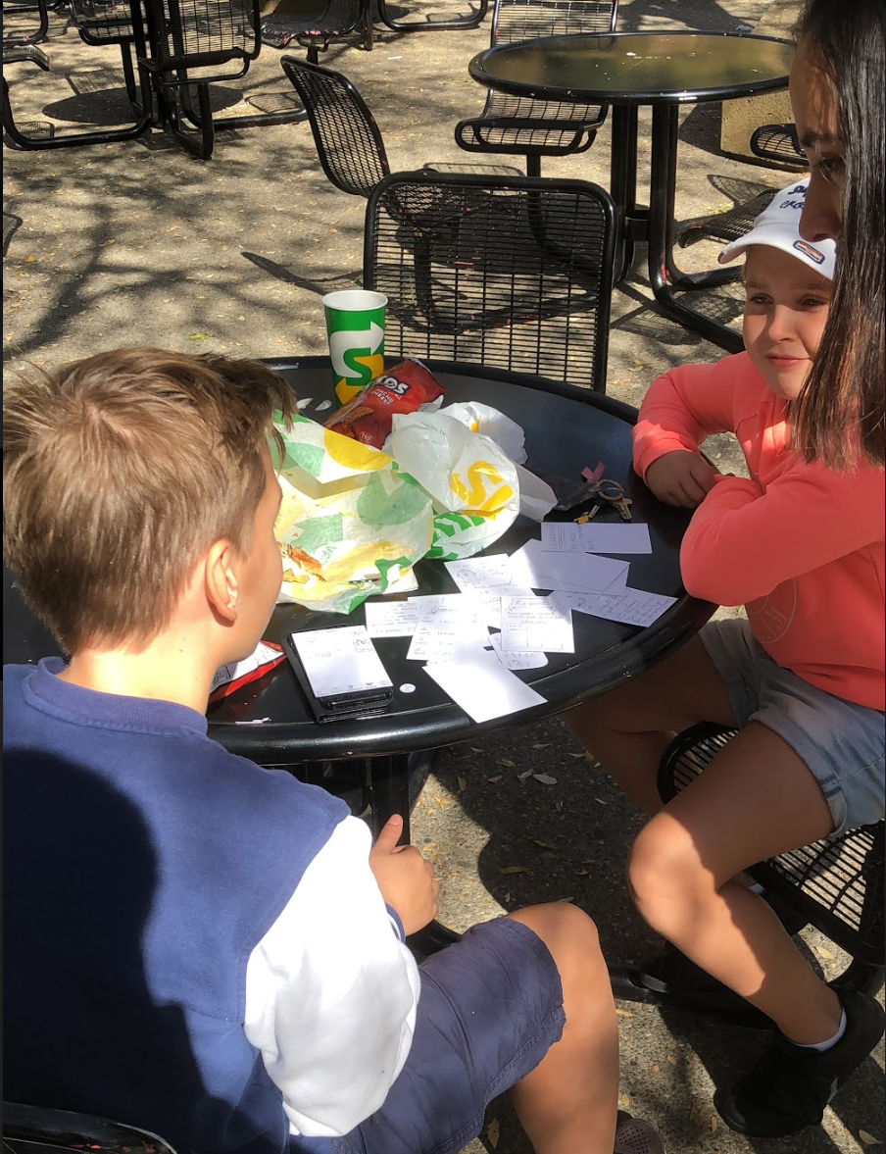
Experimental Method
Users : focus on diversity, i.e different age groups
Environment: Where they felt comfortable
Roles:
Facilitator
Computer
Recorder

Slide 11
Experimental Results

Slide 12
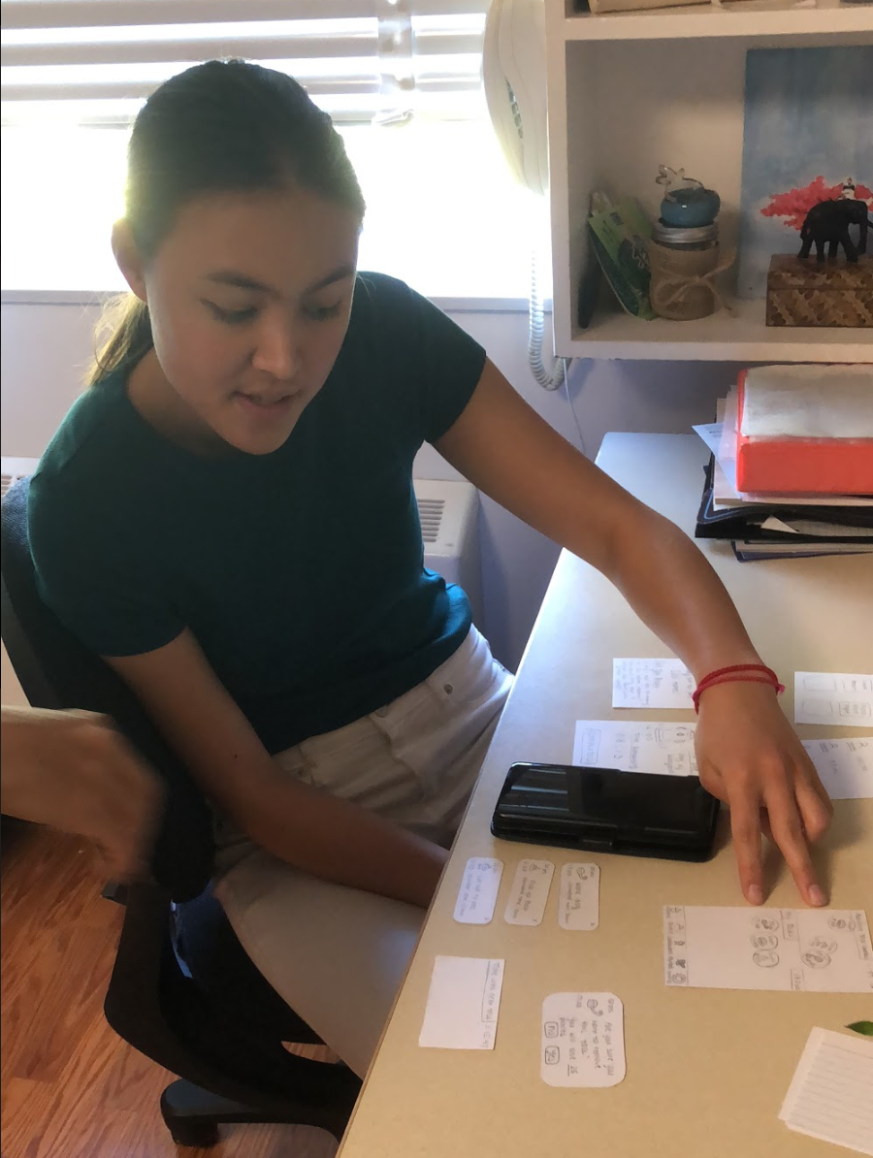
Snatching tasks was surprisingly intuitive
Users seemed to immediately catch on to this gamification UX

Slide 13
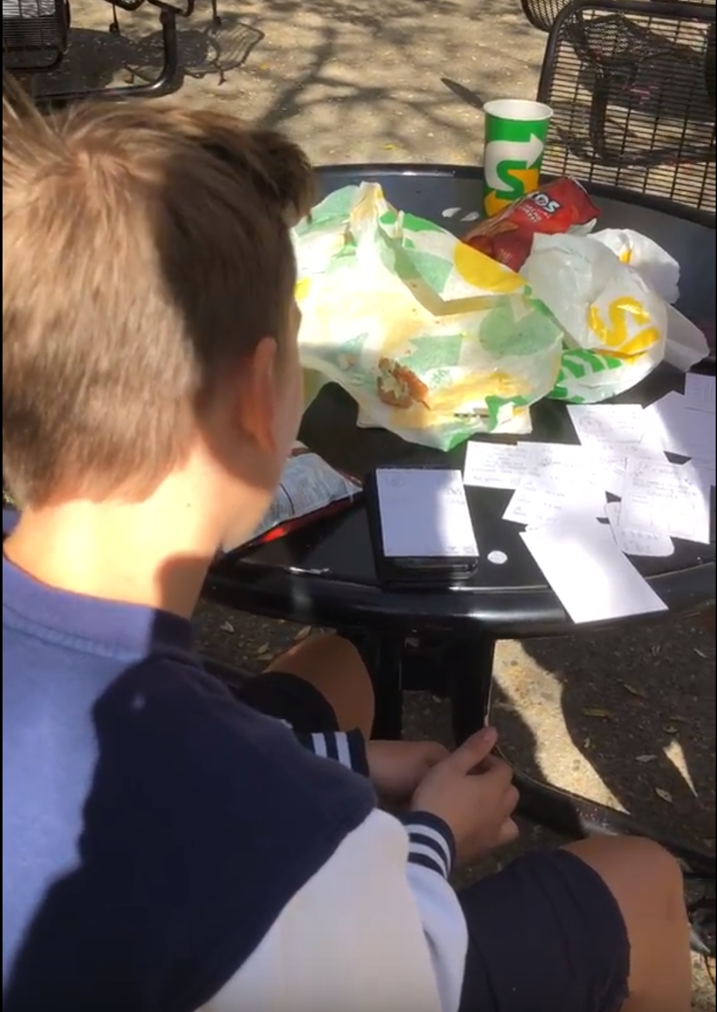
Completing tasks was surprisingly unintuitive
Lacking transitions between notification, physically completing the task, and digitally recording the completion of the task.

Slide 14
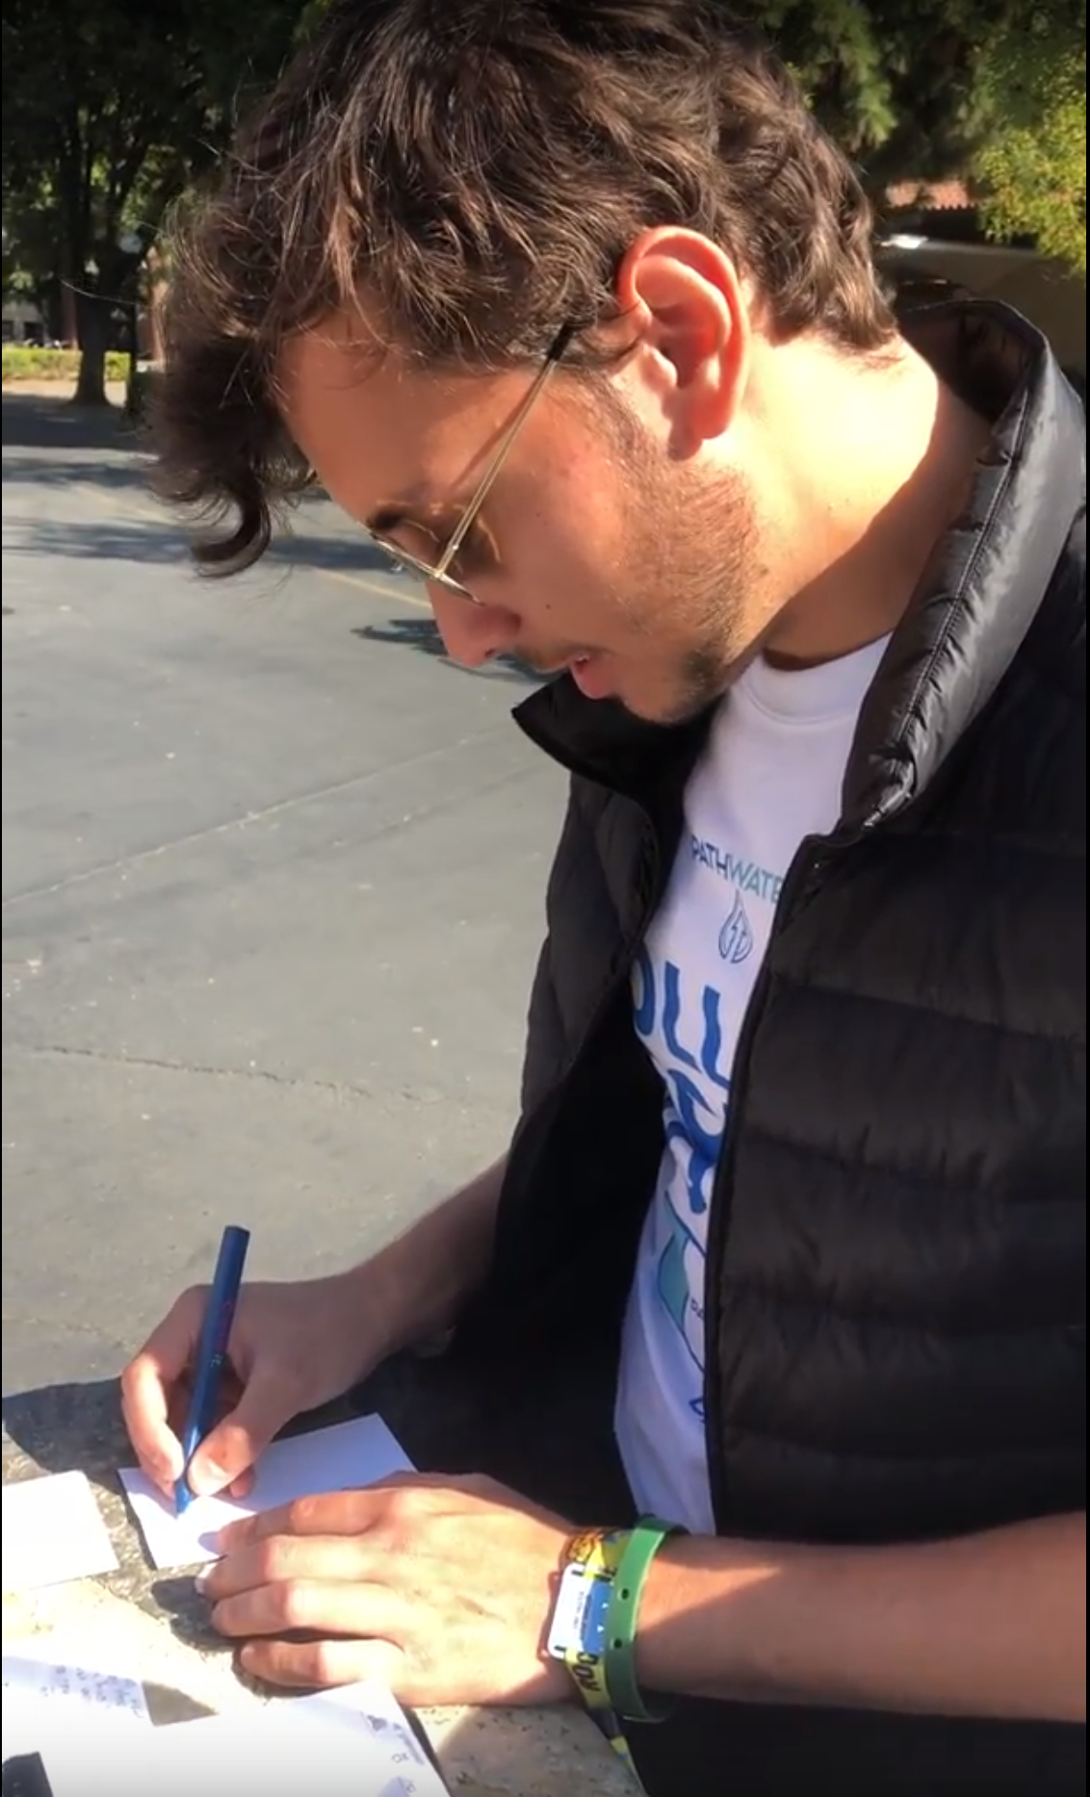
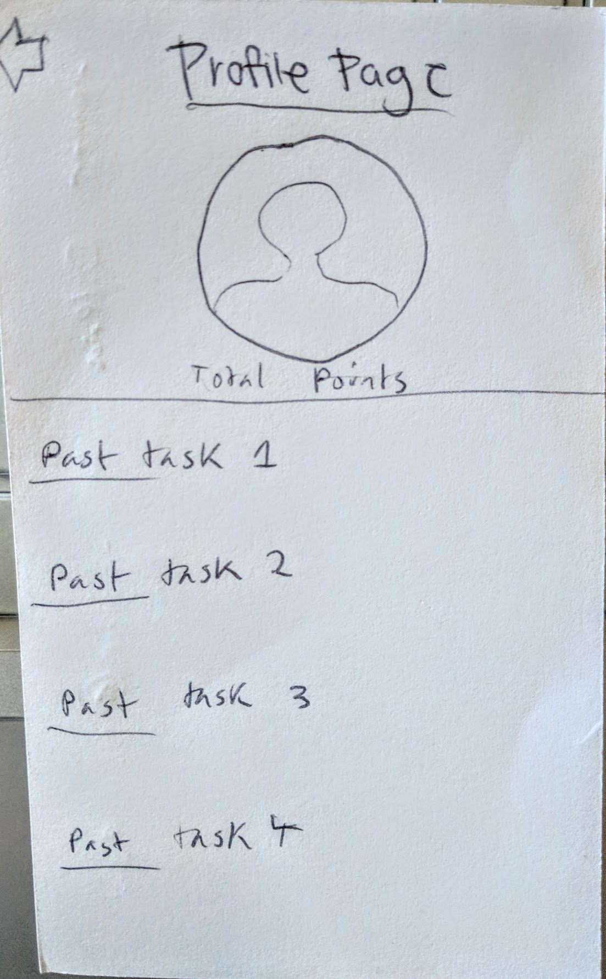
Users emphasized wanting a “profile”
Users wanted to be able to see their personal contribution history.

Slide 15
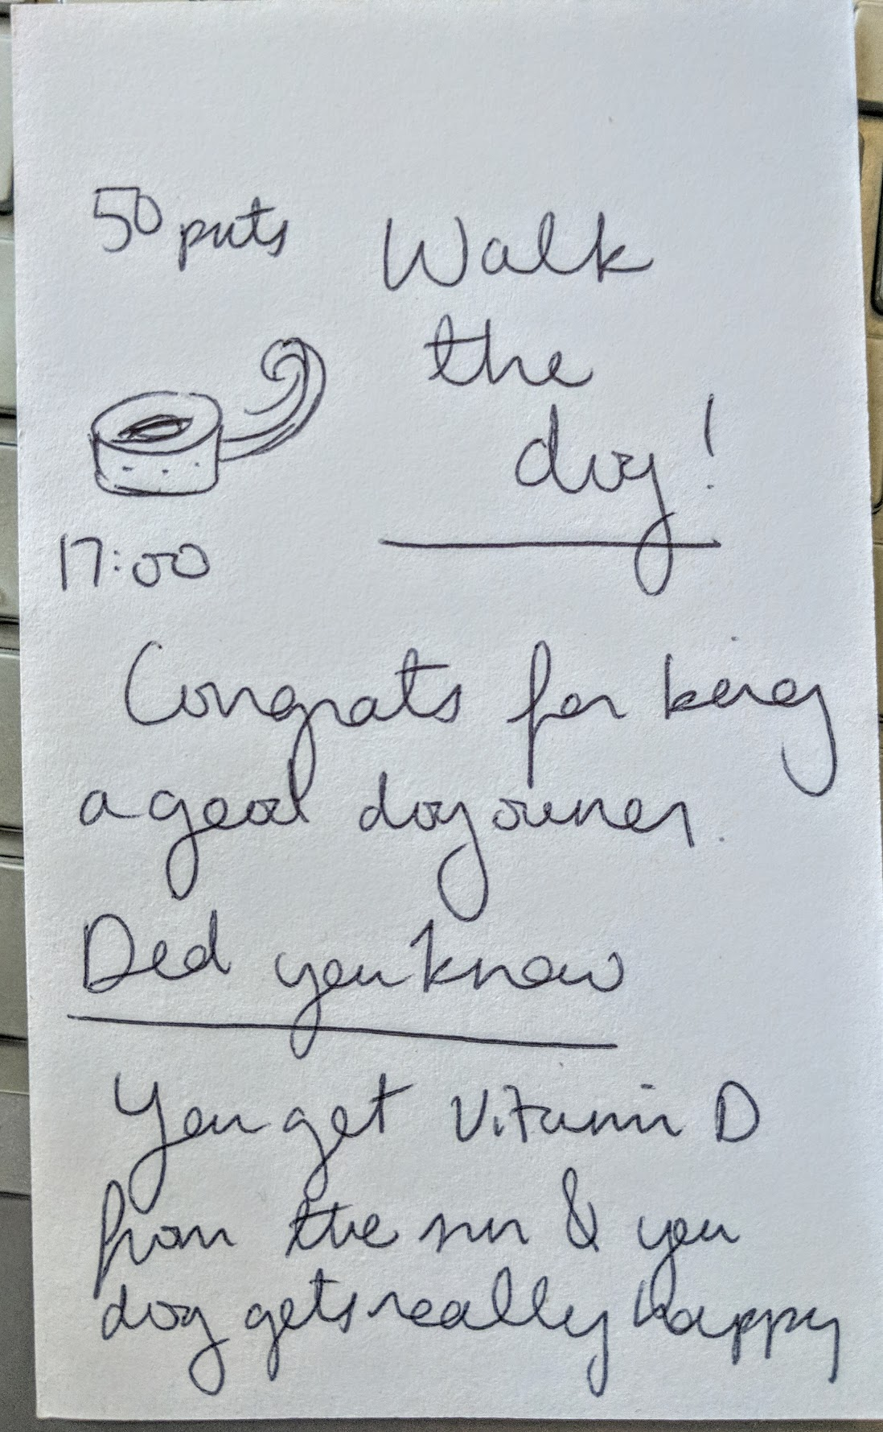
Suggested UI Changes
Better ways to bridge the physical to digital gap of completing a task
Personal profile view
Ability to invite ‘friends’
Warning for when losing too many points

Slide 16
Summary
Users found the app innovative and engaging
We hope to make the entire experience flow better and more intuitively
Need to decide which features have the highest priority to focus on

