Slide 1

Dog Owners
Knowledge unleashed
Notes:
Today I’ll be presenting our efforts to discover problems that dog owners face and what types of educational resources we can provide them.
I’ll be elaborating on the process we went through to reach our POVs and experience prototypes.

Slide 2
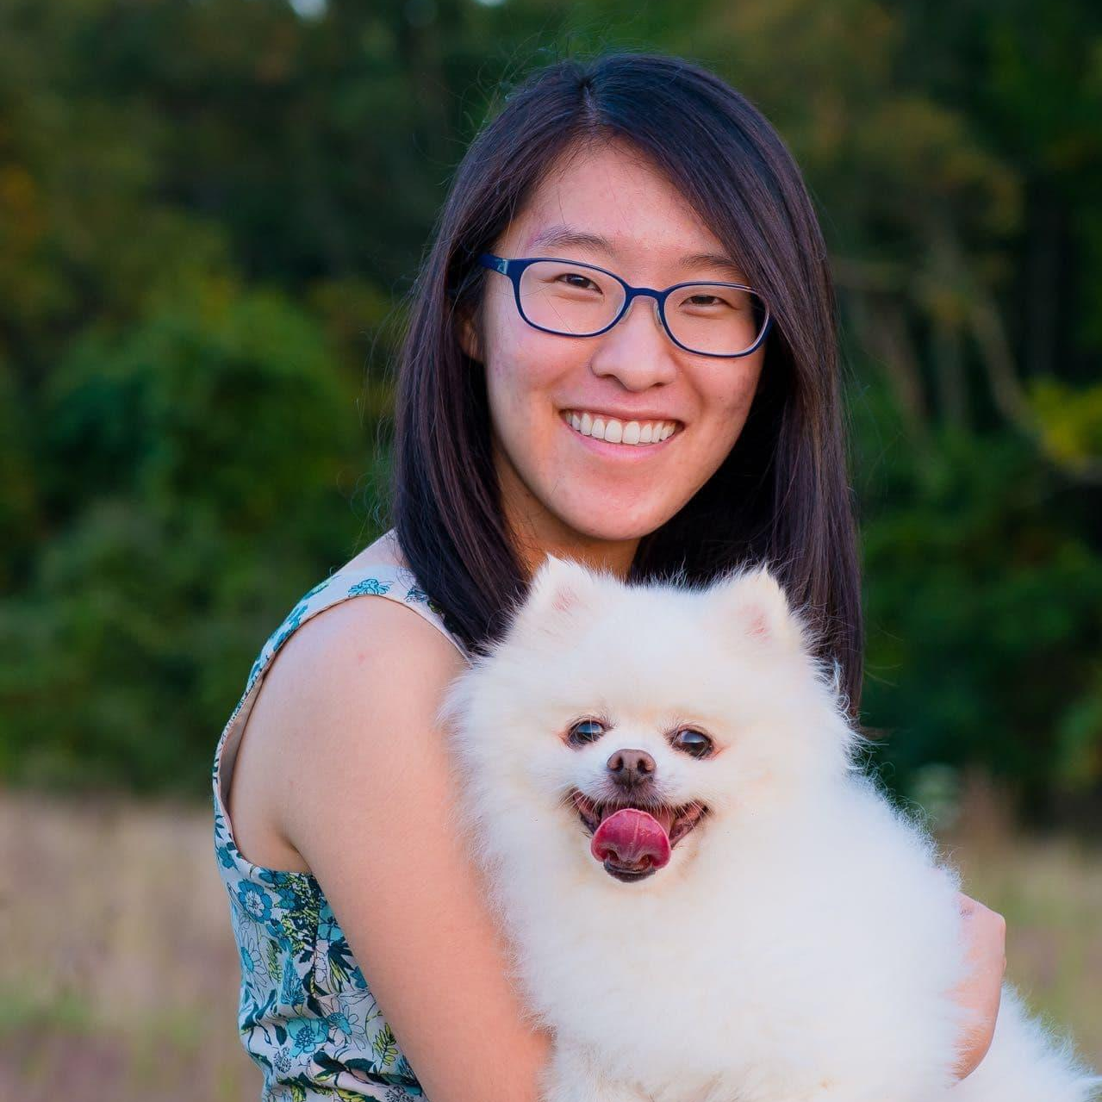
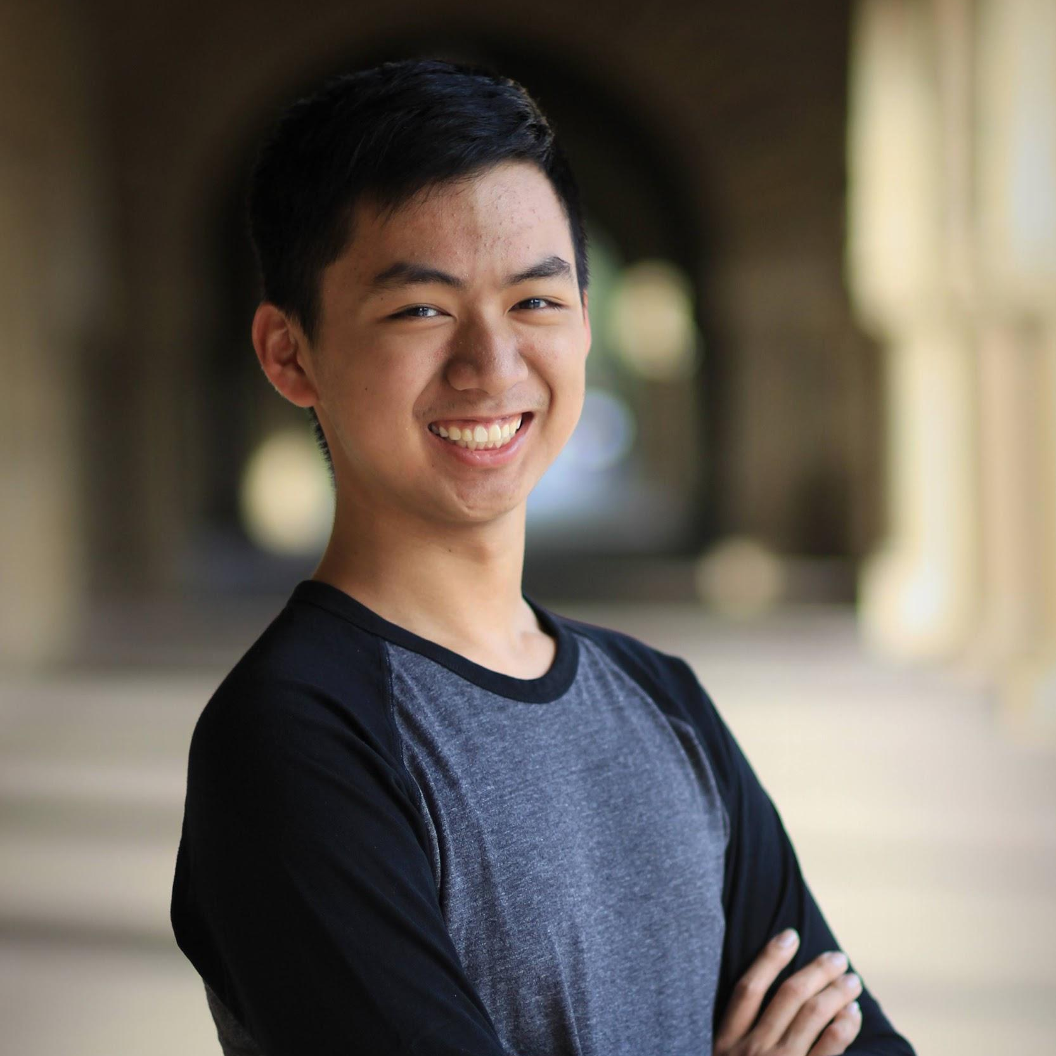
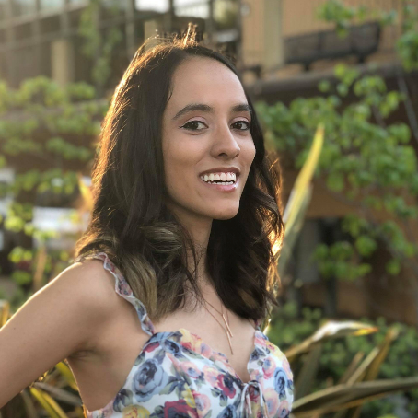
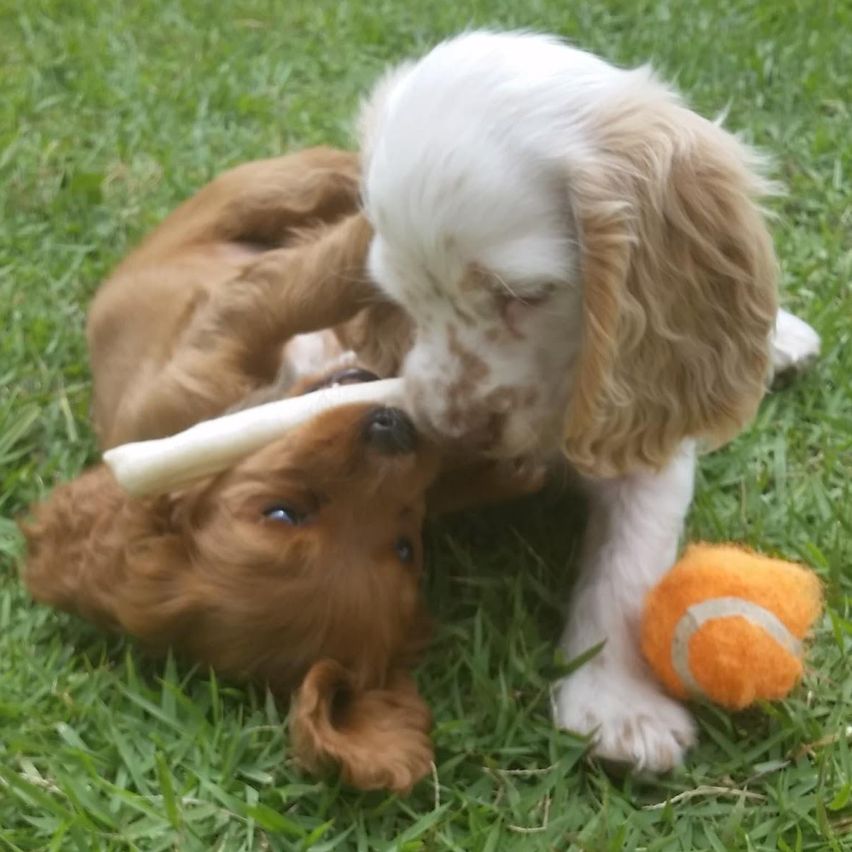
The Team
Annie Shi
Lucas Ramos
Jackie Vertino
Geraldine Millos-Lopez
Coterm, CS HCI
Senior, CS AI
Senior, Symsys HCI
Senior, CS BioComp
Problem Domain: Educational resources for dog owners
Notes:
Team

Slide 3
Preliminary
POV
We met Mateo, a 12 year-old boy and first time dog owner of Chili. We were amazed to realize that Mateo enjoyed saving up money to pay for Chili's expenses, but disliked doing simple chores such as feeding her because it didn't feel "rewarding". It would be game changing to make mundane chores feel rewarding.
Notes:
Our initial POV coming in this week came from Mateo, one of our interviewees from last week.

Slide 4
Additional Needfinding
Notes:
During our additional needfinding we went ahead and interviewed a variety of dog owners and individuals who really wanted a dog but didn’t own one at the time.

Slide 5
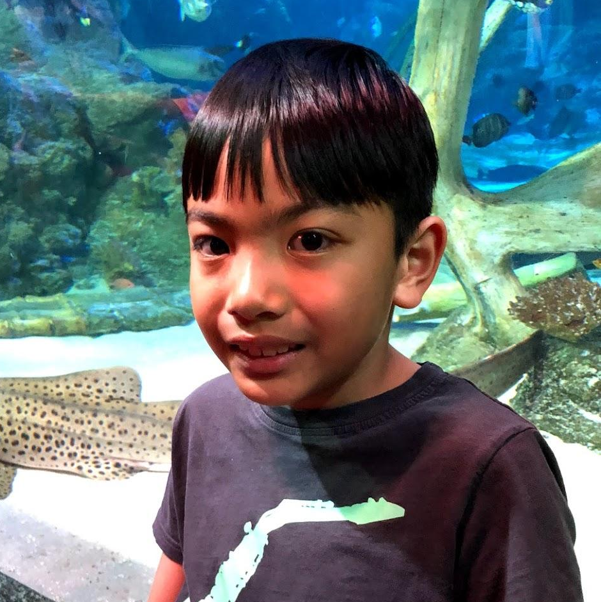
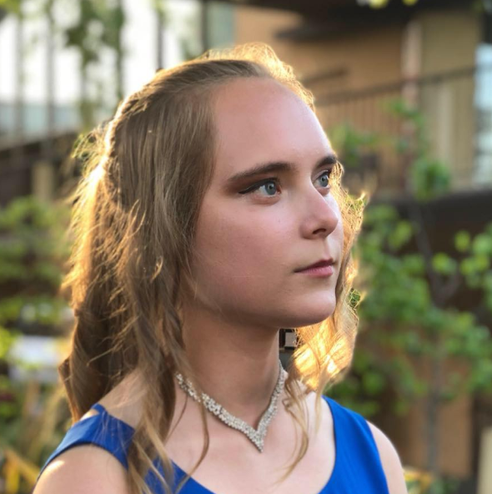
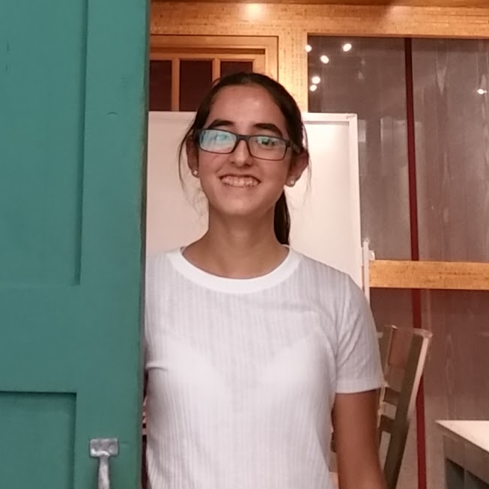
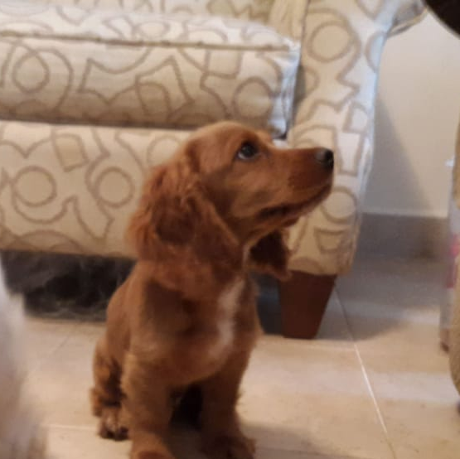
The interviewees
Julian, 22
Ian, 9
Katie, 21
Christelle
Previously owned a dog for 8 years.
Had a dog which they had to rehome.
Ella & Anka
Veteran dog owner and advocate of adoption!
Sahara & Nile
Dog owner of two. Is finally old enough to train her dogs!
Notes:
Julian, 22 year old software engineer who works in SF. He owned a dog growing up, and both him and his girlfriend both really want a dog at the moment.. However, due to both of their busy work schedules they have not gone through with the adoption process.
Ian, a 9 year old, (and his mom Lili). When we initially reached out to them we knew that they had a dog, however during our very emotional interview we soon found out that they had to rehome him because of financial difficulties that resulted from providing all the necessary resources (time/space).
Katie, a senior majoring in Civil Engineering. She’s a veteran dog owner, having had at least 6 dogs so far. She is an advocate for adoption, and really stressed out the importance of finding a dog who is the right “fit” in terms of personality for the family.
Finally, we spoke to Christelle, a 15 year old in 10th grade who just recently got two puppies, Sahara and Nile. Christelle spoke to us about the difficulties she’s facing contributing to training dogs given the time constraints she has from school.
We got some great insights from our interviews including the following:

Slide 6
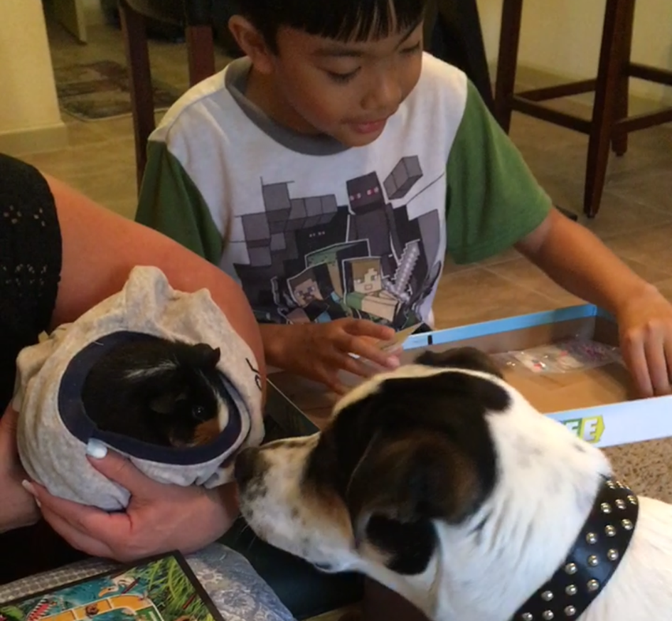
Julian
“I got lucky with her, she was a pretty lazy dog, so, low maintenance”
- Julian
"When you are socializing, hanging out with them, it doesn't feel like a chore."
- Julian

Slide 7
Ian & Lili
“Who’s cleaning it? Me! Who’s giving him a shower? Me! Who’s cutting his nails? Me! Who's doing it all? Me me me!”
- Lili
Notes:
Recurring issue within some families. Not being able to balance out the workload.

Slide 8
Ian & Lili
“If you believe that a dog is good with food and water, then you’re wrong. It needs so much more. You have to have responsibilities. If you don’t have experience, get someone who does.”
- Lili
Notes:
Responsibilities

Slide 9
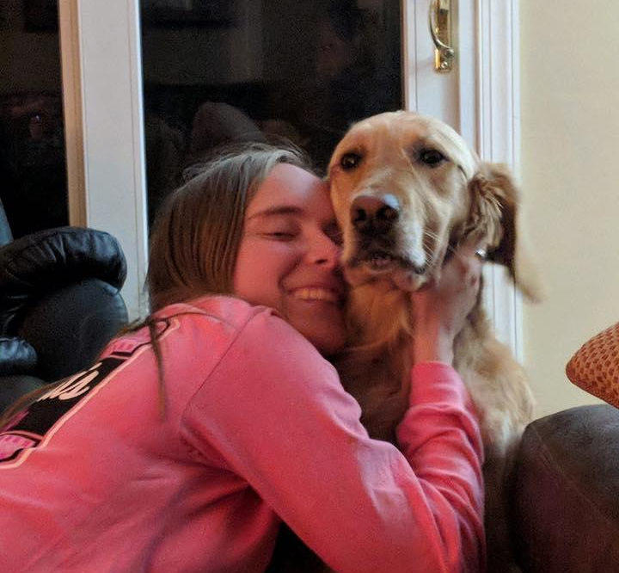
Katie
“I definitely will have a dog once I graduate college and I will treat the process the same way I’d treat having a child [in regards to planning/saving for one]”
- Katie
Notes:
Really need to plan ahead for having a dog

Slide 10
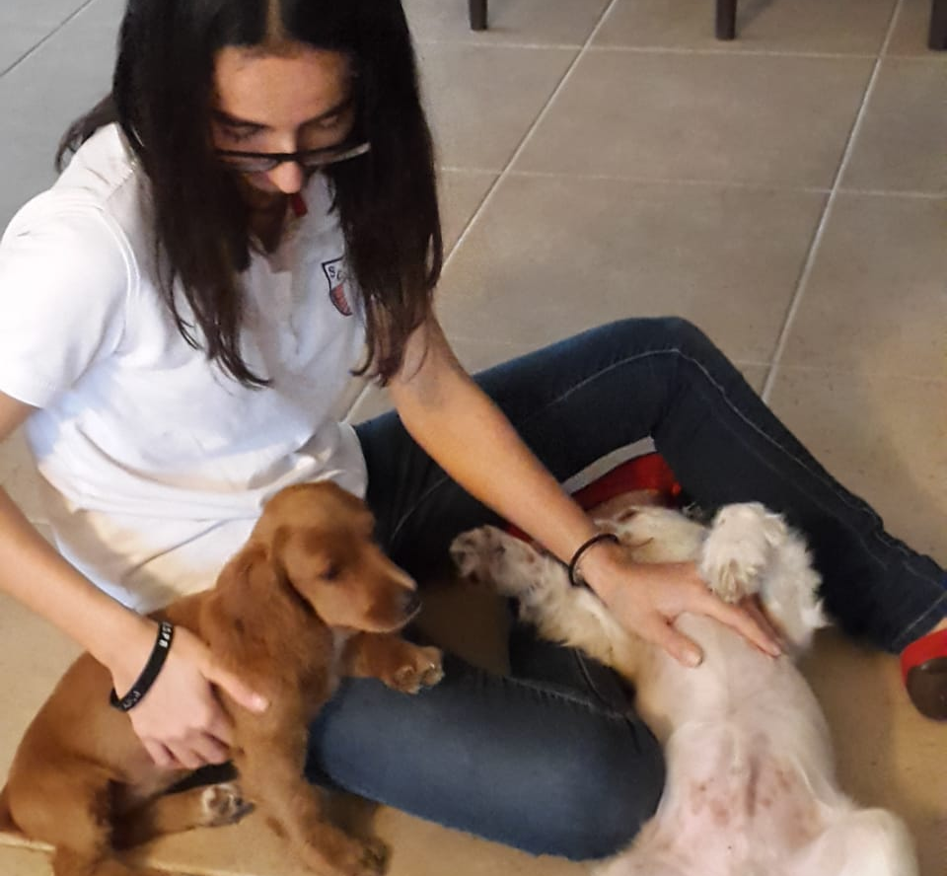
Christelle
“My sister does most of the training because I don’t have time. I wish I could contribute more to training them. This is quite unfortunate.”
- Christelle
Notes:
Wishing to contribute

Slide 11
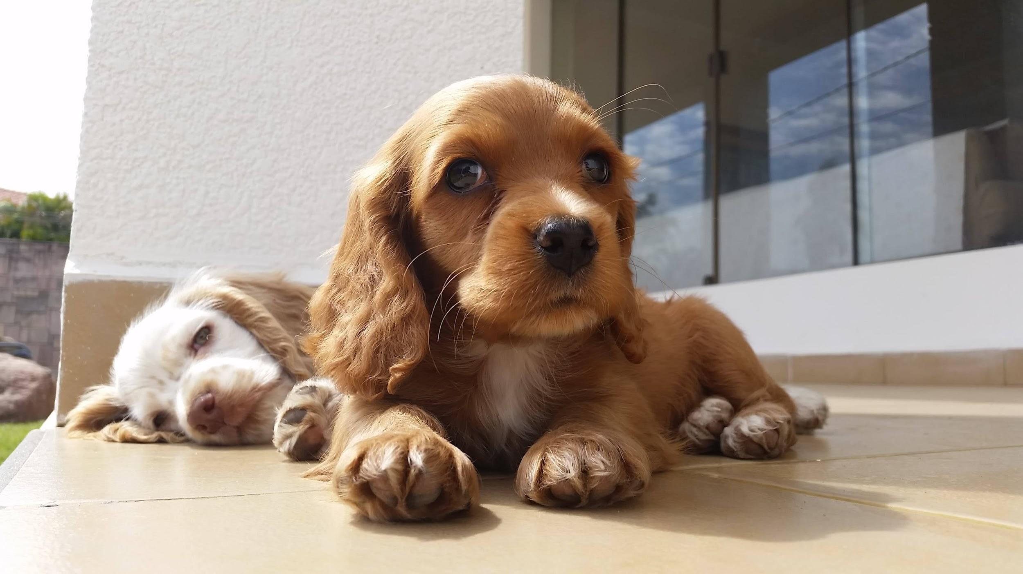
PoVs & Prototypes
Notes:
The results we got from all these great interviews led to us refining our PoVs, and creating a few prototypes to test out with users.

Slide 12
We met Lili, Ian’s mom and primary caretaker of Spot.
We were amazed to realize how she was the the only person in the household to clean up after Spot.
It would be game changing if we could evenly distribute the cleaning tasks around the home.

Slide 13
How might we encourage all members of the family to help take care of the dog?
Notes:
The HMW that we got out of this is:

Slide 14
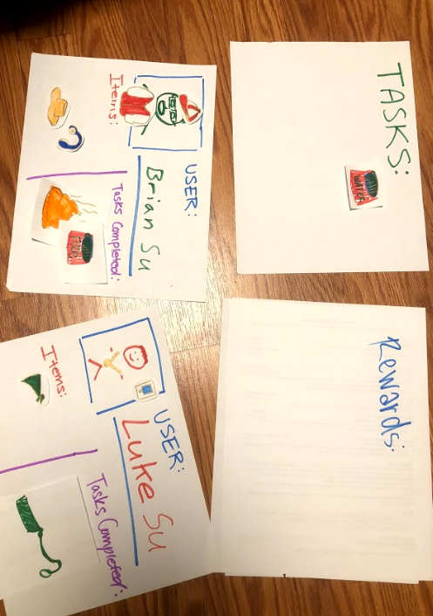
Gamified Family Contribution
Assumption: all family members will partake in the competition/ completion of tasks
Notes:
Assumption: That in a competitive environment, will people do their best to gain an edge over family members

Slide 15
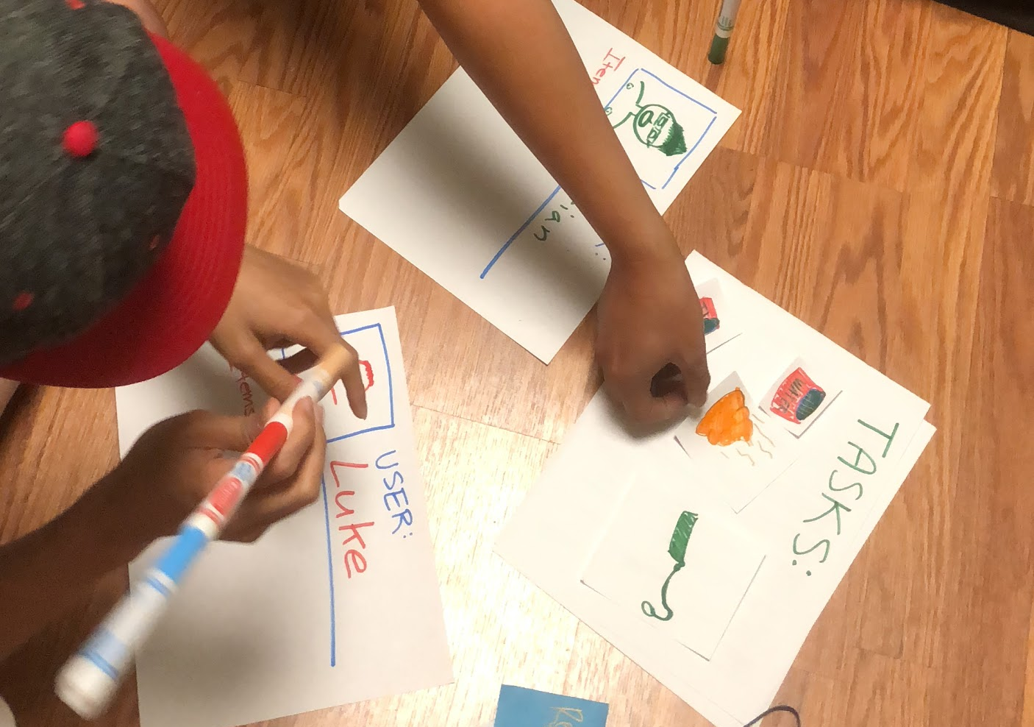
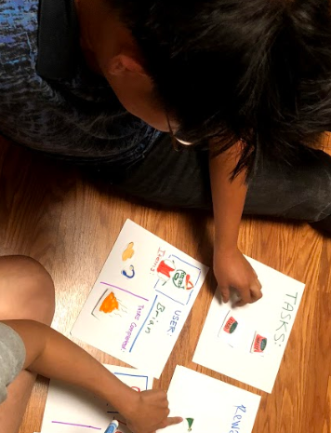
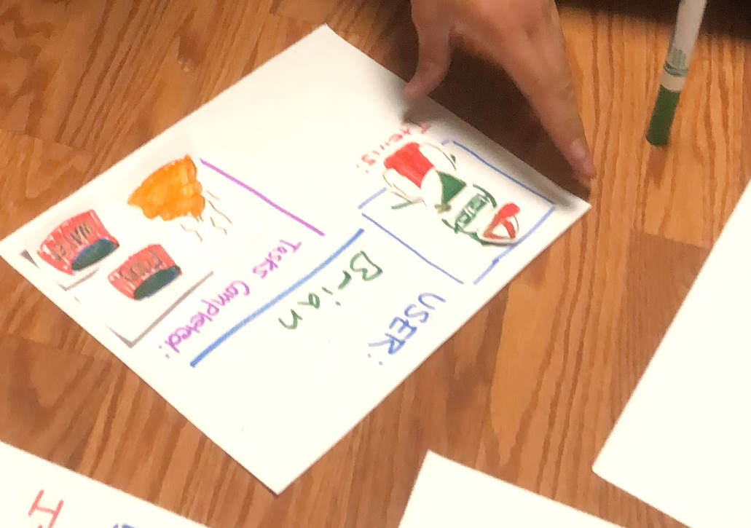
Gamified Family Contribution
Enjoyed competing with each other
Personalizing avatars made it feel “real”
Seeing tasks the other completed motivated him
How to confirm tasks were completed
Might get tired of using app

Slide 16
We met Mateo, a 12 year-old boy who is a first-time dog owner of Chile.
We were amazed that Mateo enjoyed saving money to pay for Chile’s expenses but disliked simple chores such as feeding her.
It would be game changing if we could make mundane chores feel rewarding as well.

Slide 17
How might we make mundane chores feel more rewarding?

Slide 18
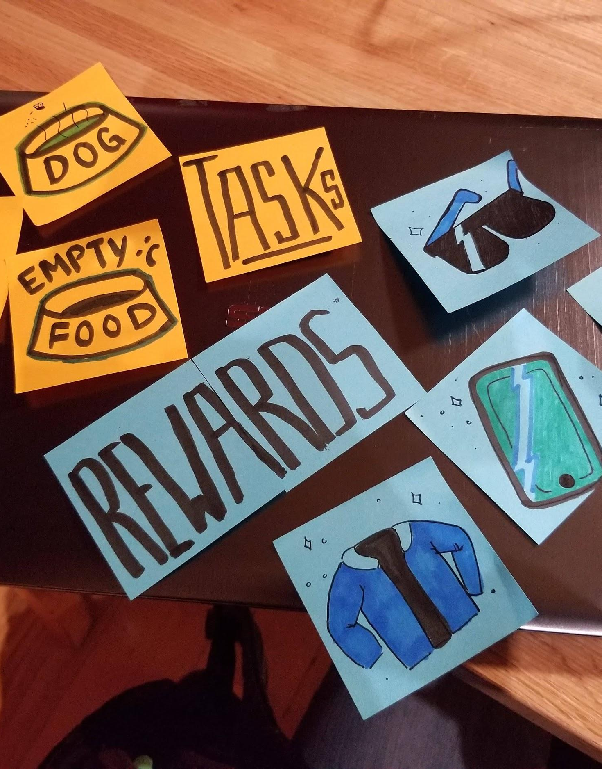
Reward Incentives
Assumption: A reward system will motivate people to do tasks they hesitate to do otherwise
Notes:
Assumption: Will some sort of reward system motivate people to do tasks they might not do otherwise

Slide 19
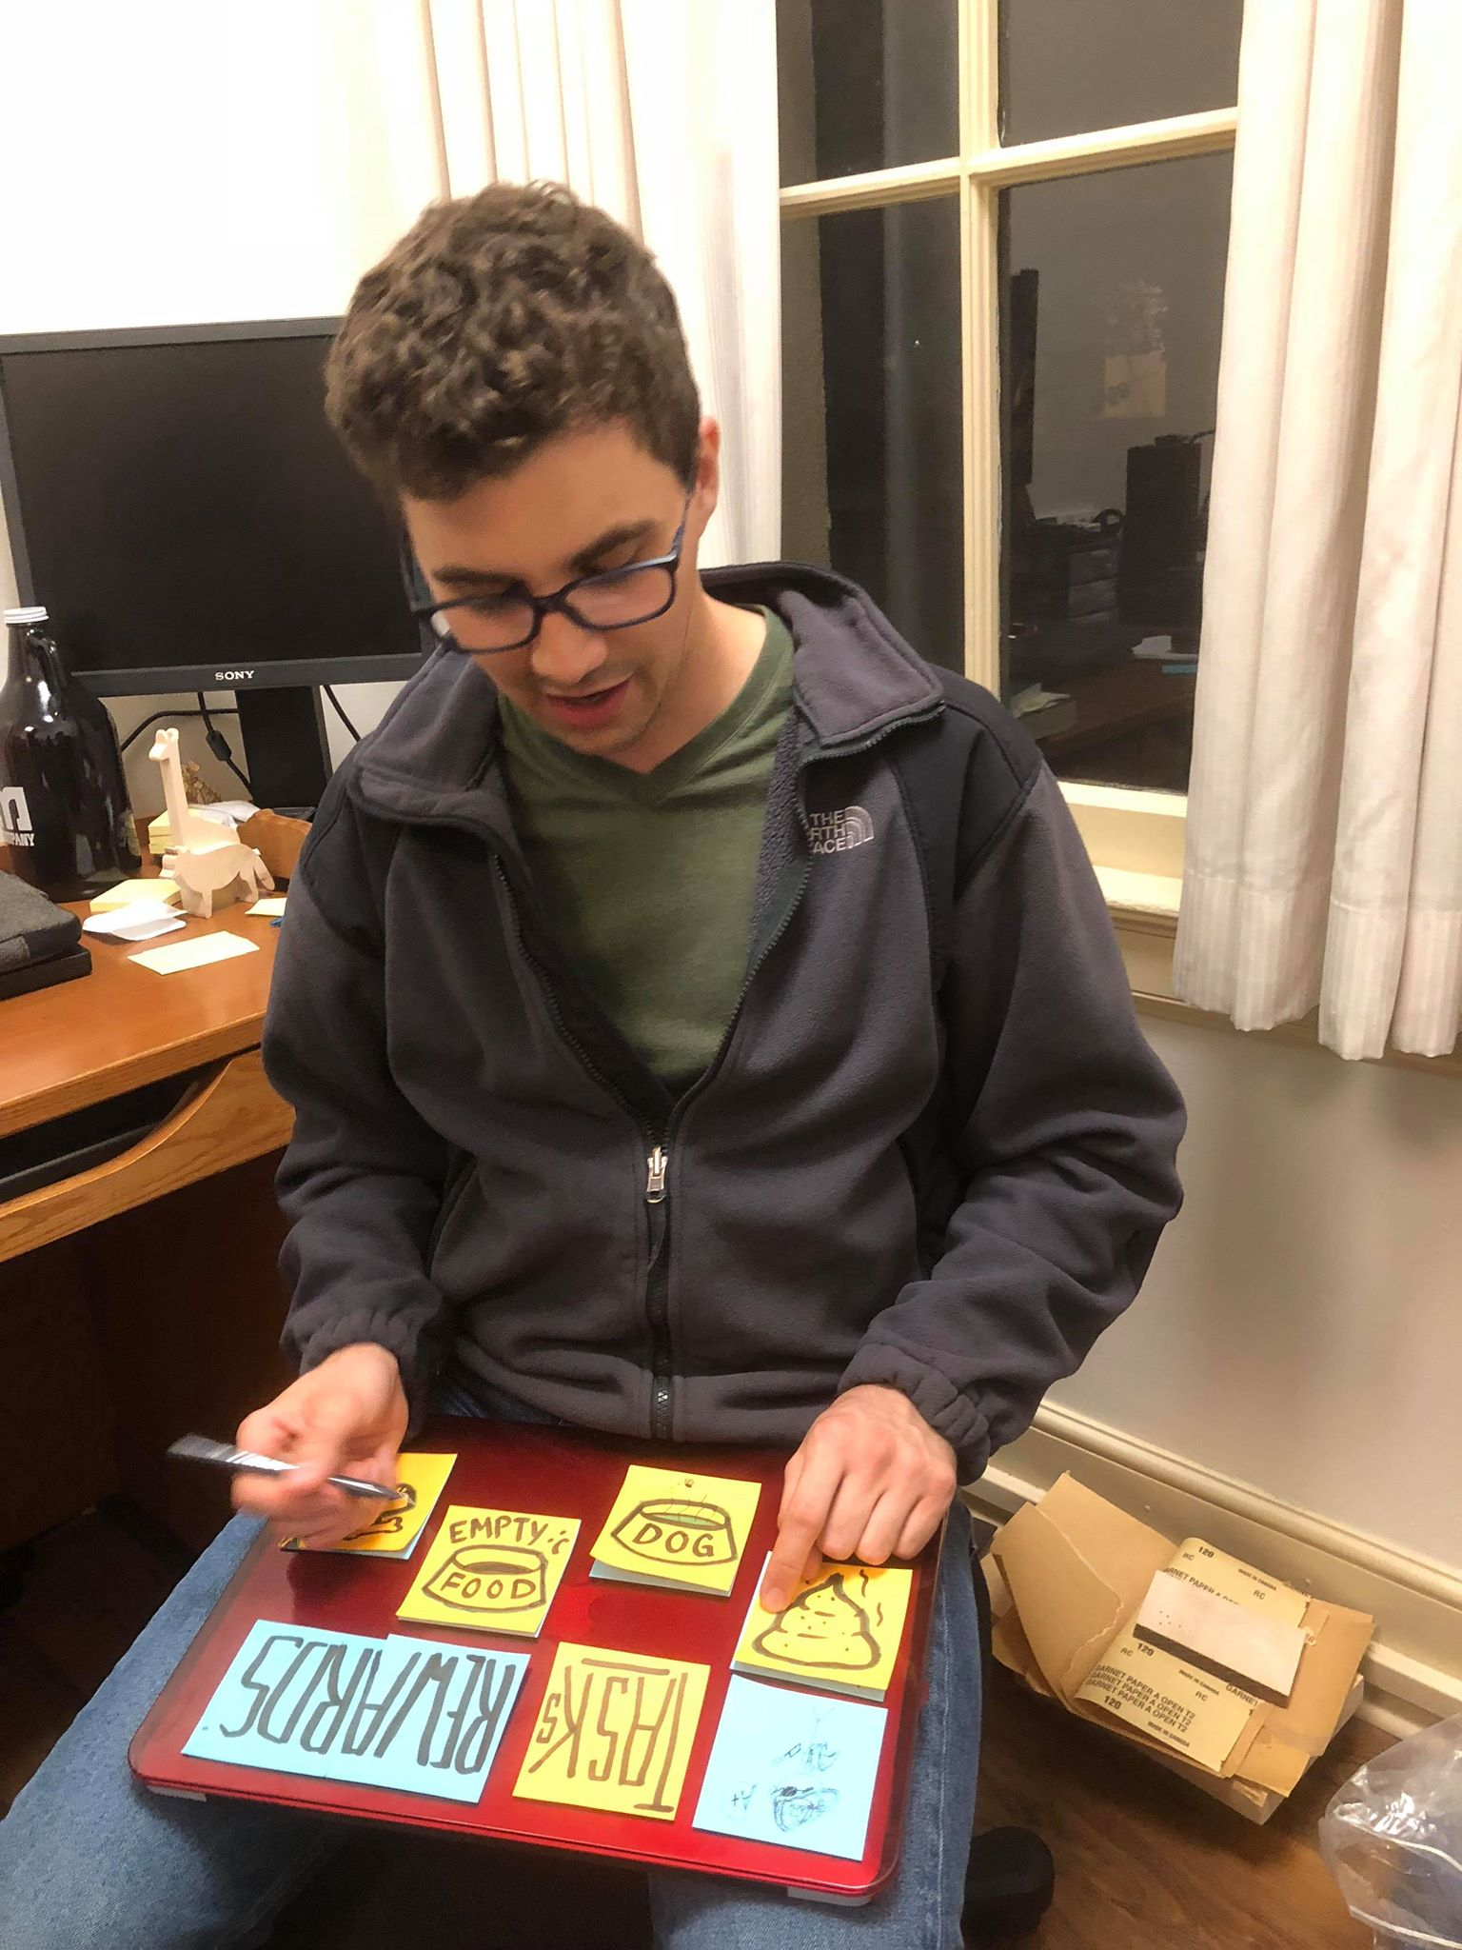
Reward Incentives
Gamification gives sense of accomplishment
Having more reminders is useful
Might be something more appealing to younger people
App may not provide enough long-term incentive
Notes:
Gamification provides sense of pride and accomplishment
Would keep people interested in taking care of dogs
Having an extra source to remind him of doing certain tasks would be very useful
Might be something more appealing to younger people
App may not provide enough long-term incentive

Slide 20
We met Katie, a senior at Stanford who owns 2 dogs, Anka and Ella.
We were amazed how passionate she was about adoption and how much she emphasized the amount of research needed to find the “right” dog.
It would be game changing if we could help potential dog owners find the dog that best fits their lifestyle.

Slide 21
How might we help people find the “right fit” from adoption centers?

Slide 22
Playdate Scheduler
Assumption: removing the task of searching for the right dog facilitates the adoption process
Notes:
The assumption we came in with was that: ….
The first step was to have the user take a buzzfeed quiz to figure out the type of dog that matches their personality.
Next up we gave the user a coupe of

Slide 23
Playdate Scheduler
Scheduling is taken care of
Takes away fear of not visiting pound
Dog’s profile helpful
Low commitment
Wants more recommendations (3+)
Uncomfortable about being the right “user”
Notes:
Can anyone play with dog even if theyre not serious??

Slide 24
Summary
After more needfinding and prototype testing, we realized the importance of the “right” family dynamic.
Ultimately, we decided that targeting dog-owning families was more realistic and exciting for us.
From here, we will focus on what kinds of rewards and competitions will keep the user incentivized and how these assumptions will work in a family.
Notes:
We dug deeper into how to balance family dynamic with dog care, and found that gamifying taking care of a dog makes it less of a chore
OUR Prototypes made helped us realize
that placing an interface in between the adoption process not only streamlines playdates, but also reduces the initial commitment anxiety.
Through testing each prototype, we realized that there is a need to keep the user incentivized to continue using the app. This is an area we will need to further consider as we narrow in on a solution!

