Slide 1

Dog Owners
Learning one paw at a time
Notes:
Hello
Talking about educating dog owners

Slide 2
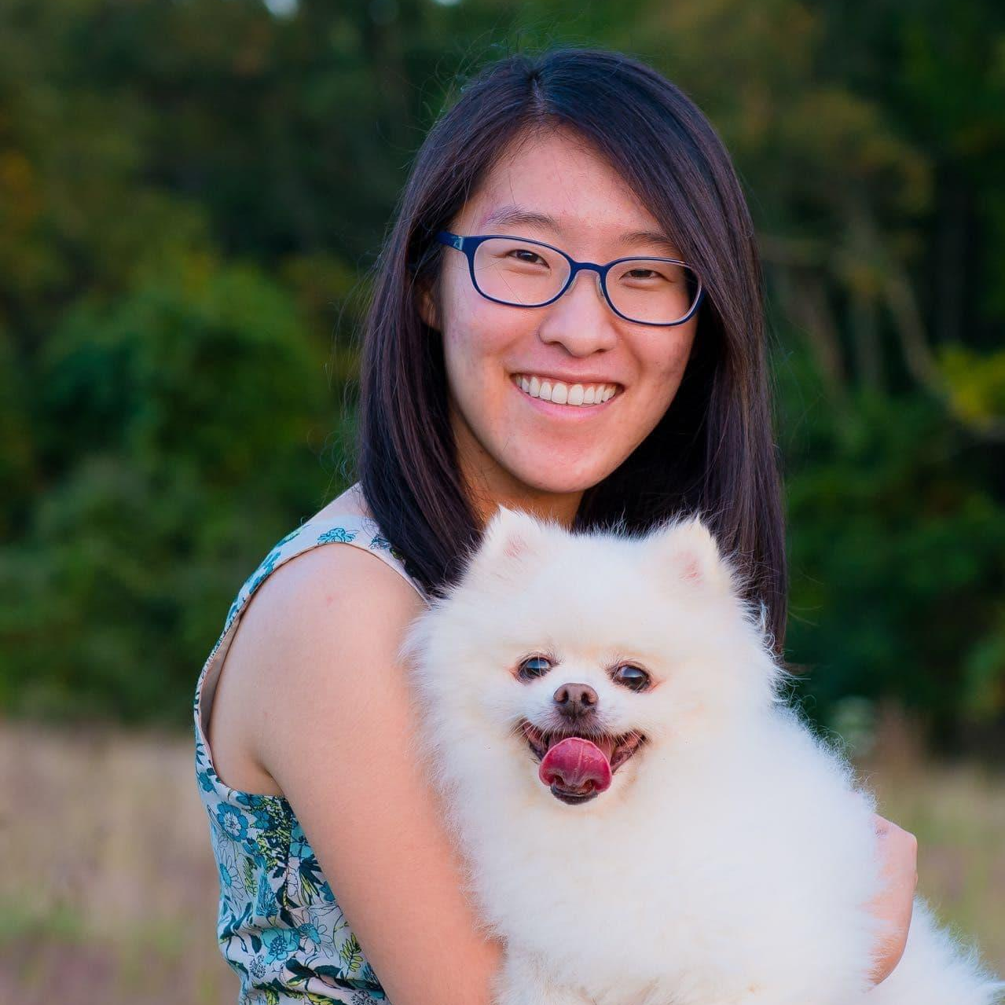
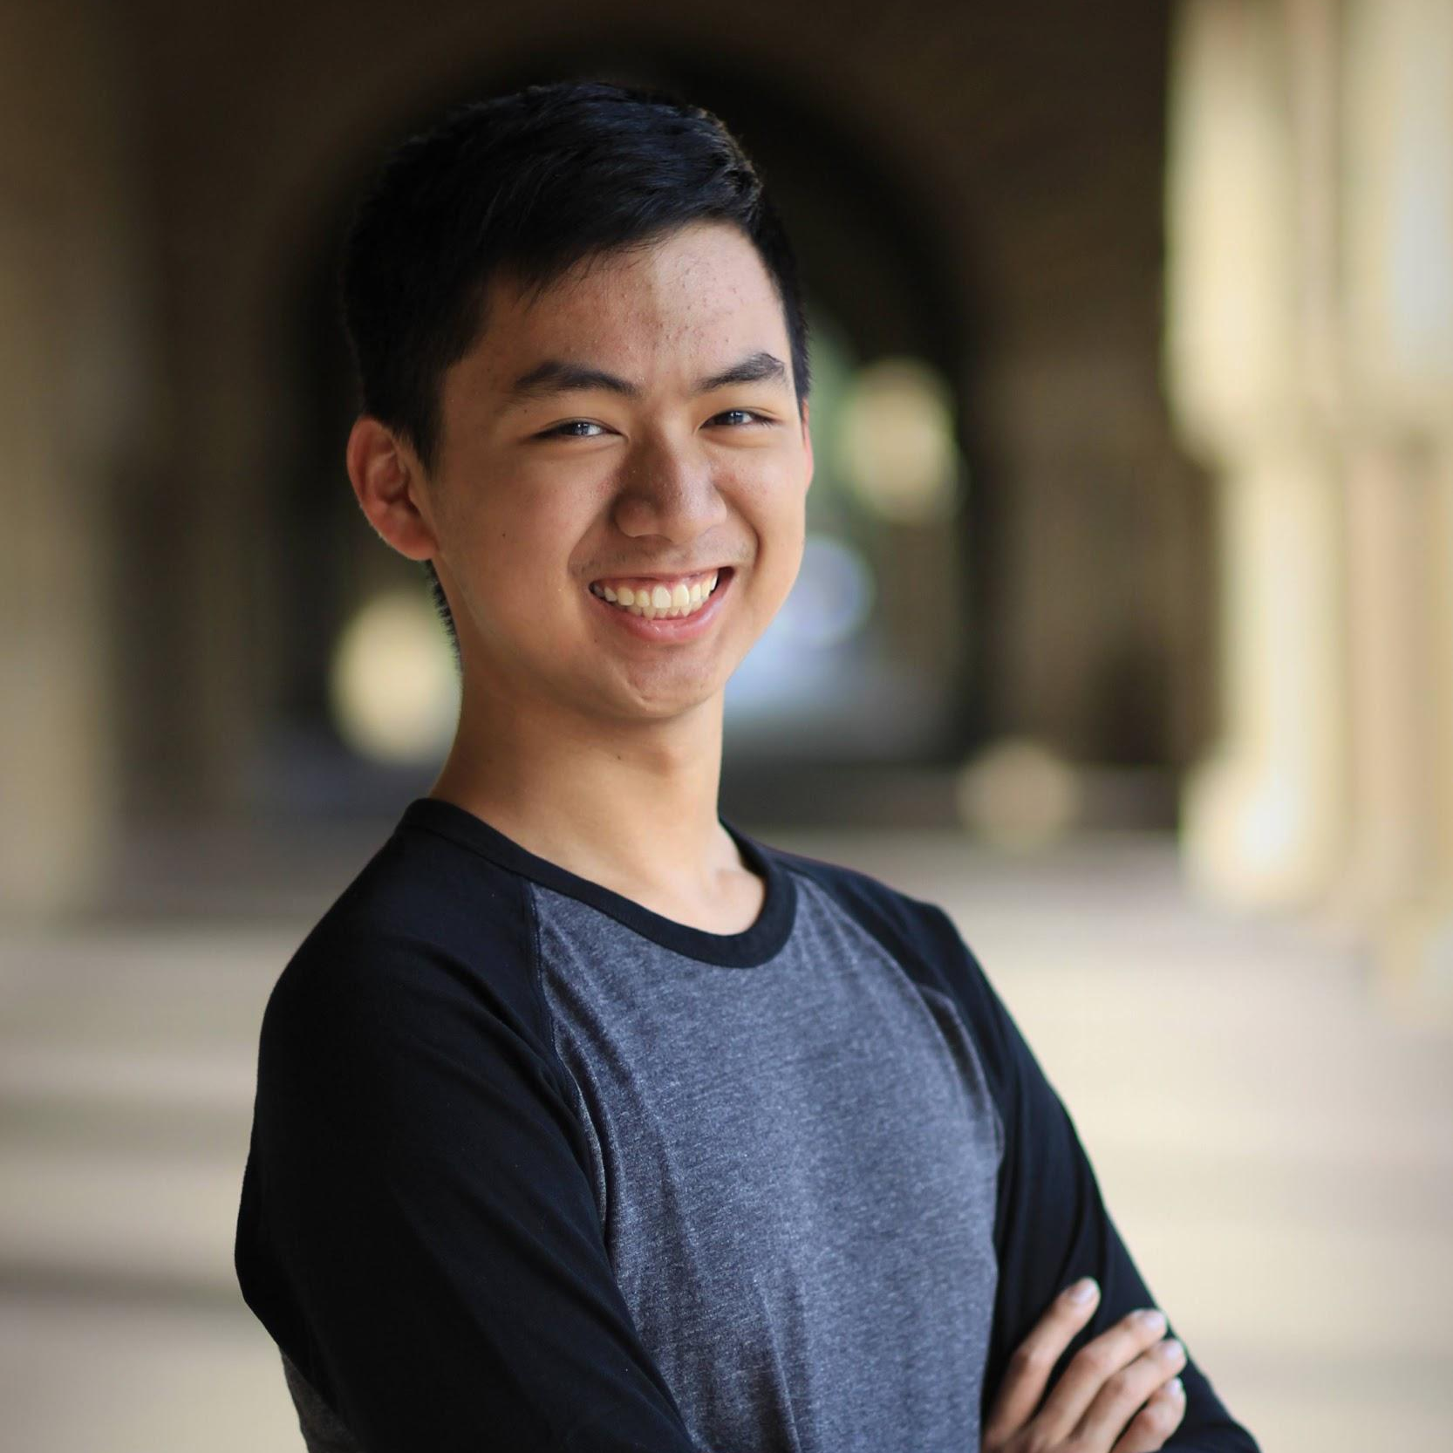
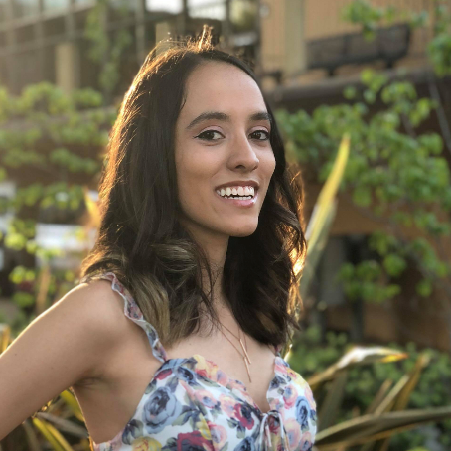
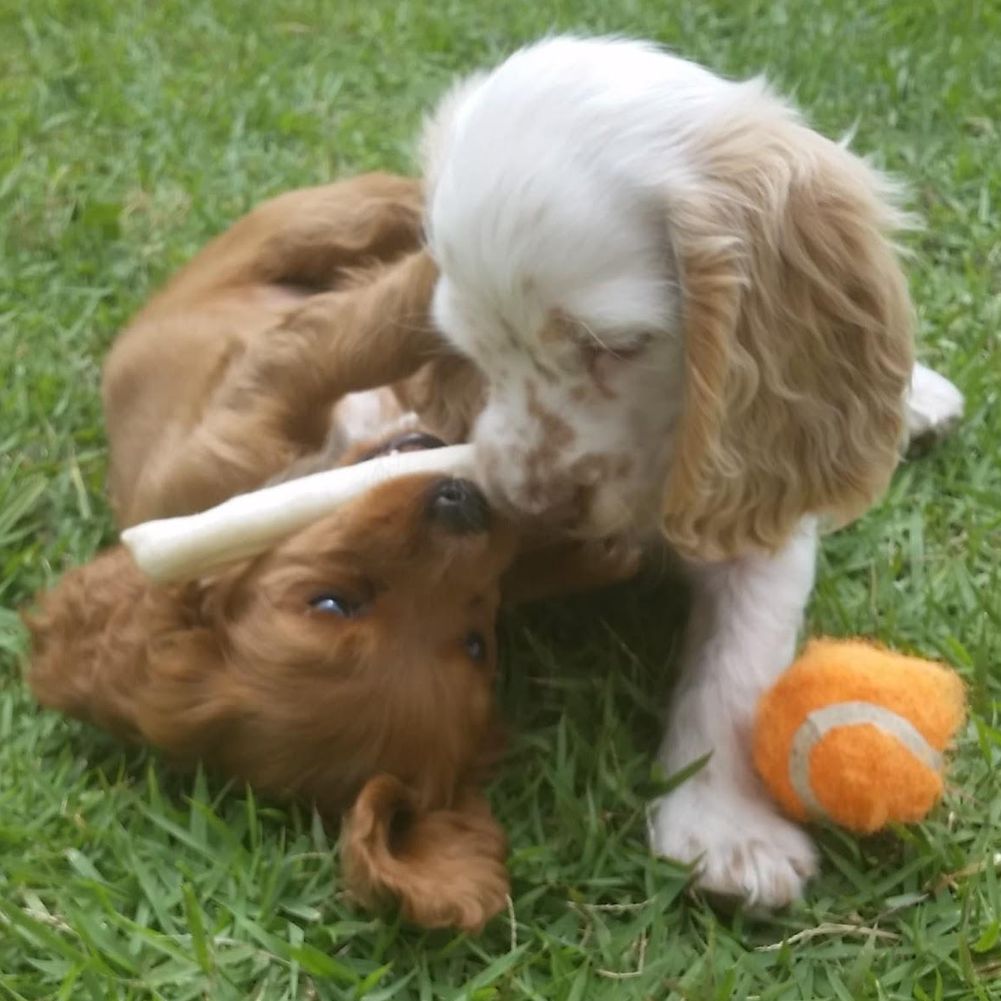
The Team
Annie Shi
Lucas Ramos
Jackie Vertino
Geraldine Millos-Lopez
Coterm, CS HCI
Senior, CS AI
Senior, Symsys HCI
Senior, CS BioComp
Problem Domain: Educational resources for dog owners
Notes:
Team

Slide 3
Needfinding
Notes:
Speaking to dog owners
Goal: Find problems that dog owners unexpectedly experience
Struggles had with getting dogs

Slide 4
Questions
Tell me about your dog!
Did you feel prepared when you got your dog? What would you have done differently?
What advice would you give to someone getting a new dog?
Did you have a moment when you regretted getting your dog?
Notes:
Some Questions we asked: (ON SLIDE)

Slide 5
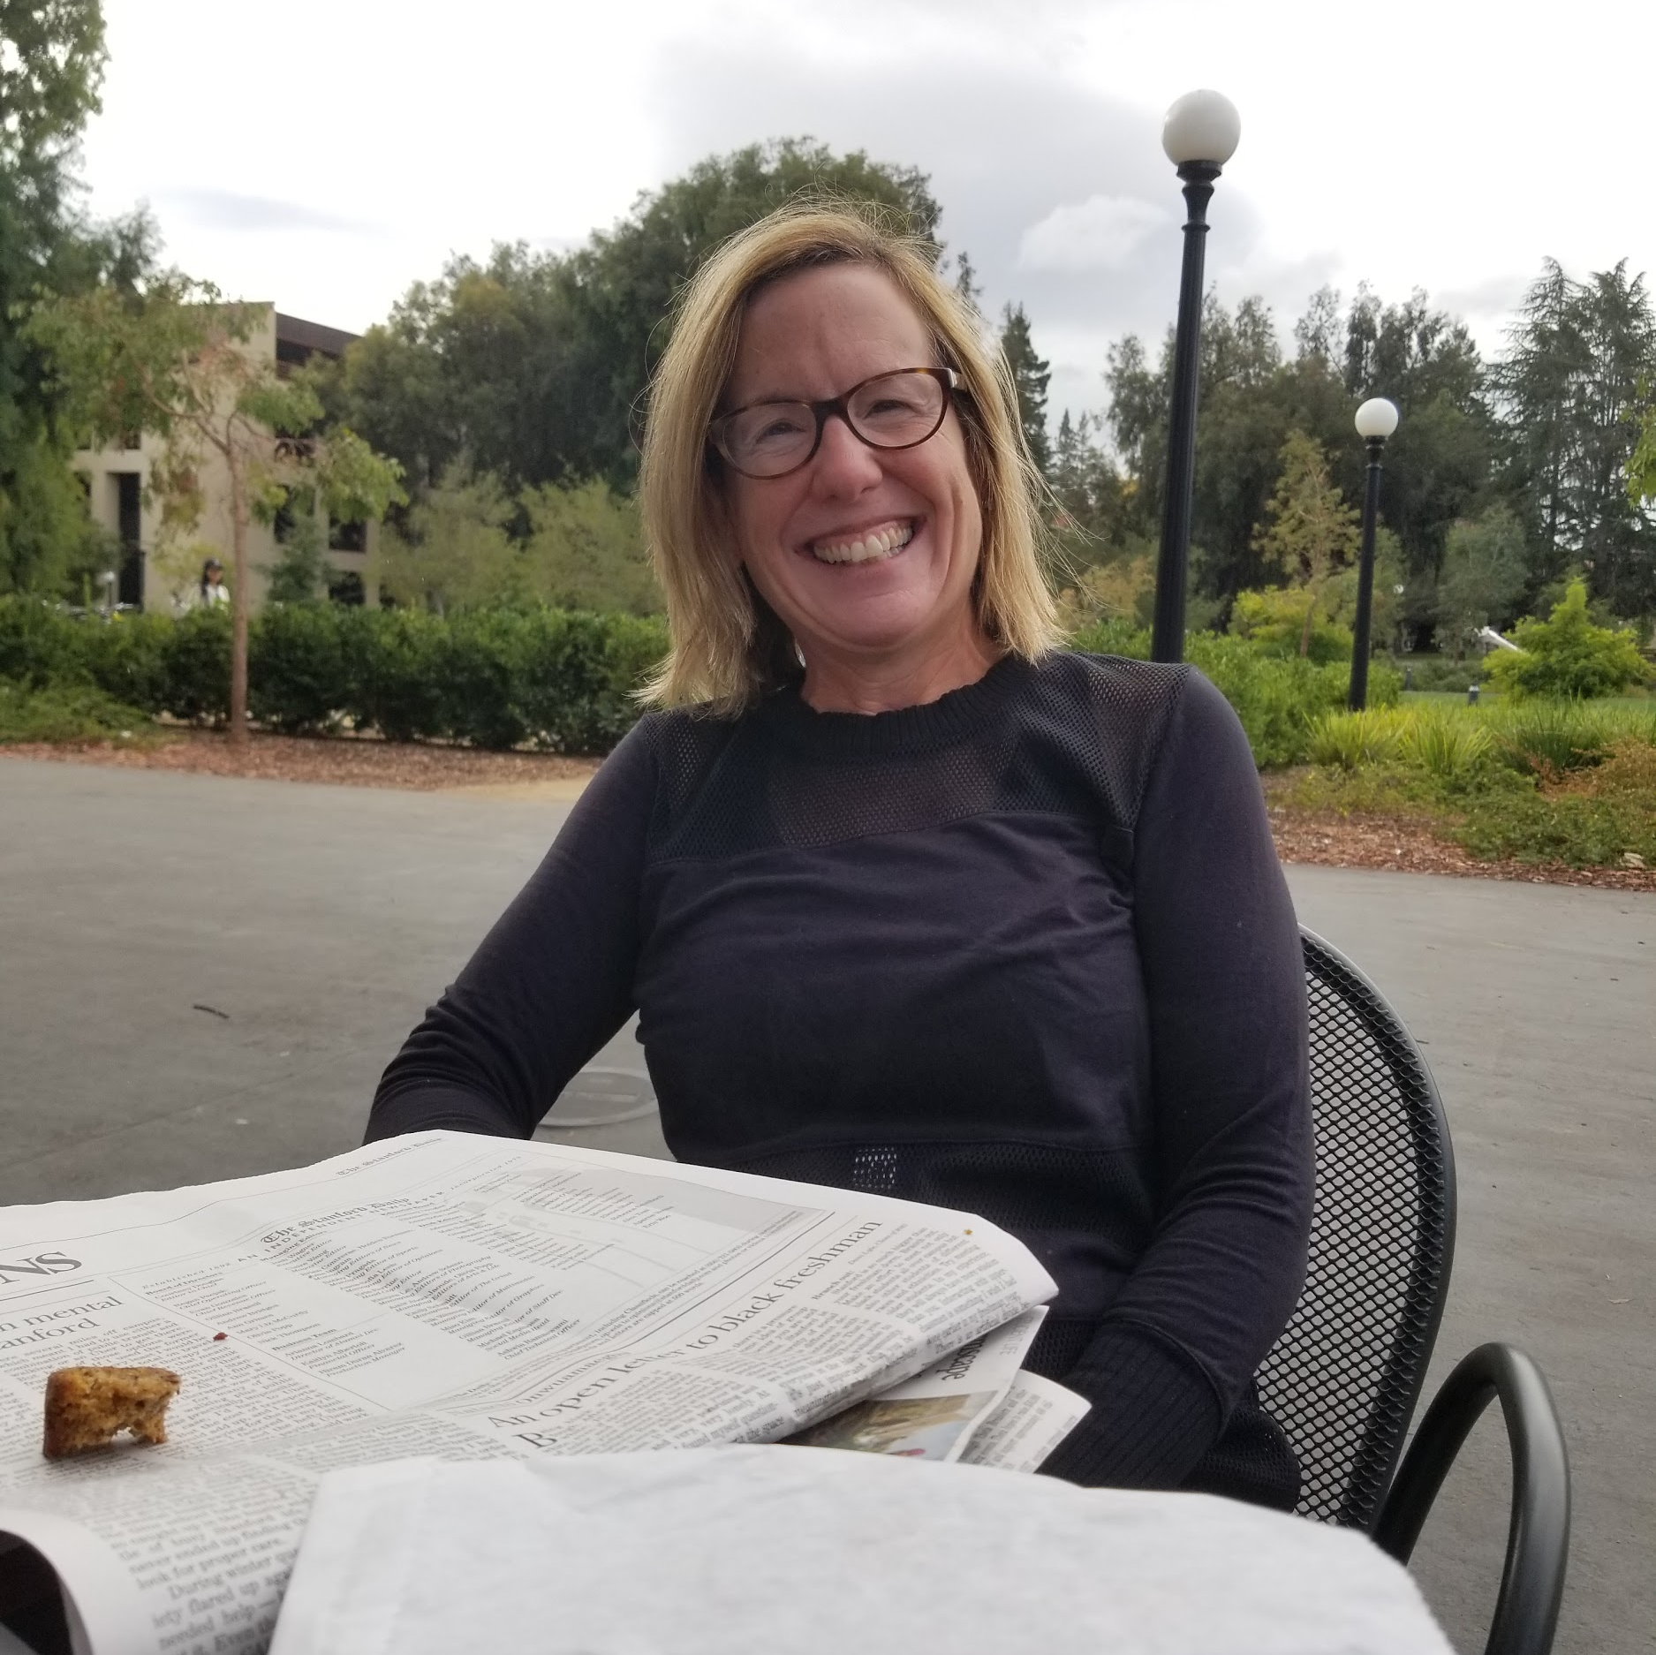
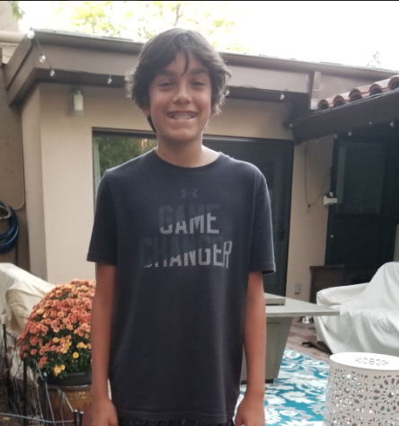
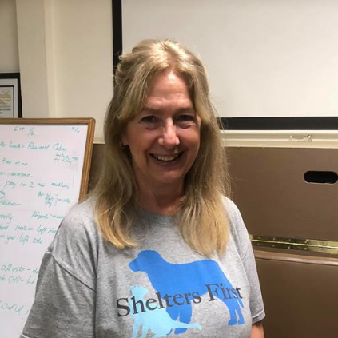
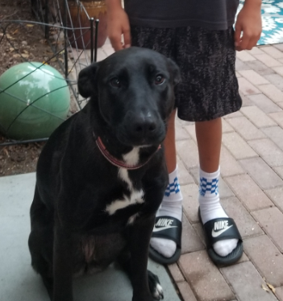
The interviewees
Julia, 50
Mateo, 12
Molly, 62
& Dog: Bentley, 9
Veteran pet owner, has always had a dog!
& Dog: Chili, 2
First time dog owner!
Dog Trainer
Owner of Molly's AdobeDogs Dog Training
Notes:
Julia
Mother of 3 (with Bentley), former pediatrician @ Stanford Hospital
Daughter of Vet, always grew up with pets
Interviewed her @ Coupa
Upbringing/Medical Background made her unique
Doesn’t have concerns over dog health as knowledgeable
However has had issues training Bentley
Pool person problems w/Bentley
Mateo
12 year old boy, first time dog owner
Interviewed him at Wilbur
2 yr journey with getting Chili
Saved up for Chili and did research for dog
Expected work, but still was surprised
No ragrets
Molly
Experienced Dog Trainer, training for 20 yrs
Able to observe obedience class (Los Altos) and interview
Class goal was to work with dogs/owners, help each of them learn basic commands
Molly believes owners should put effort to know dog and strong relationships
Julia is a mother of three (including Bentley) and Pediatrician at Stanford Hospital. As the daughter of a veterinarian, Julia grew up surrounded with all sorts of pets. Julia was kind enough to visit us on campus at CoHo along with Bentley. Julia’s upbringing and medical background make her a unique type dog owner as she doesn’t experience the usual concerns over her dog’s health as most dog owners do. Julia spoke about her difficulties training Bentley.
Mateo is a 12 year old boy who is a first time dog owner. We met up with Mateo at Wilbur for dinner where he spoke to us about his 2 year journey with dog Chili. Mateo saved up for Chili on his own and did all the research necessary in order figure out what type of dog he’d adopt. He expected a lot of work before adopting Chili but did not really realize how much time and effort owning a dog would require. Nevertheless adopting Chili is something he would never change!
Molly is an experienced dog trainer who has been training dogs for around twenty years. We were able to visit one of her group dog training sessions in Los Altos. During this obedience session, we were able to observe her and her co-trainer work with dogs and their owners, helping each of them learn how to execute basic commands. Molly believes that owners should really put in the effort to get to know their dog and build strong relationships.

Slide 6
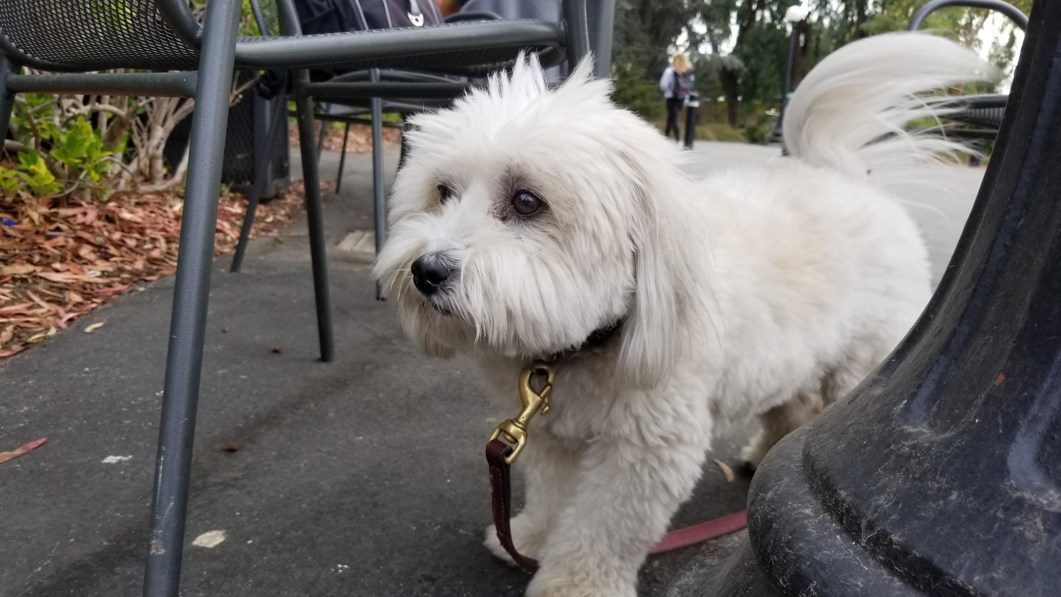
Empathy Map

Slide 7


SAY
“I felt like I was prepared, but I wasn’t”
“Our next dog will definitely be a pound rescue”
“Can you truly teach an old dog new tricks?”
“There’s always that one person in the family who takes responsibility”
Owner: “I spend 4 hours every day working with my dog.”
Trainer: “It shows!”
Notes:
“I felt like I was prepared, but I wasn’t” (Mateo)
Shows that even with research, Mateo wasn’t as informed as he liked about dog-rearing
“There’s always that one person in the family who takes responsibility”
Molly said, Mateo interview echoed sentiment

Slide 8

DOES
Tone of voice and patience when working with dog
Teaches dog new tricks
Struggle to control hyper dog during training
Saves up money from chores to buy dog things
Practiced timing with rewarding dog’s behavior
Trains dog to not pull on leash
Notes:
Saving is beyond adoption process
Continued needs

Slide 9

THINK
I wish I could only play with my dog, and not have to change its water so often.
I wish my husband would be willing to get a second dog
I think people often expect too much from their dog and also overestimate their capabilities
I wish more owners would take the time to build a relationship with their dog
I wonder why our dog stopped behaving as well as he did when he had a trainer
I wonder why people are scared of my dog

Slide 10

FEEL
Overwhelmed by all the new chores owning a dog brings.
Amused by the individual personality traits that make my dog up
Proud to have saved so much money for pet expenses
Pressure that their dog’s behavior reflects their “parenting”
Frustrated with owners that are not patient with their dog
Worried other people walking dog did not know how best to care for her

Slide 11
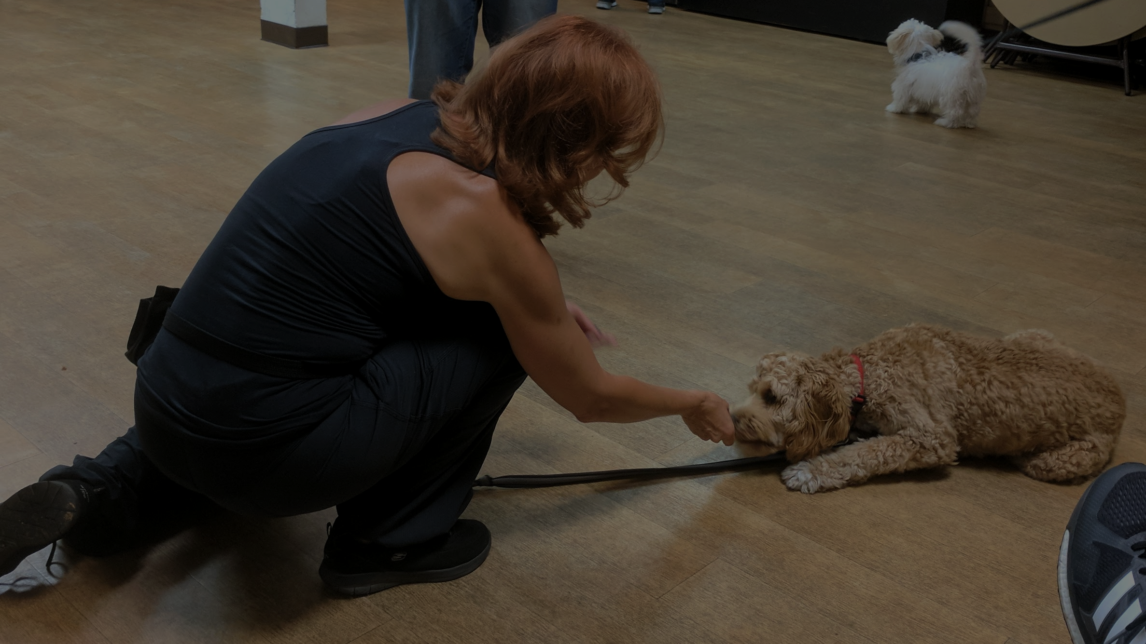
Insights, Needs & Analysis
Notes:
From our findings, we came across insights ands needs

Slide 12
“I felt like I was [prepared] but I wasn’t. I didn’t expect all the work you need to do and how expensive it is.”
Mateo
Notes:
Mateo said quote
Insight
Hard to budget
Lack of ready information about owning dog
Need
Recognize ongoing commitment
People need more accurate information about what it takes to raise dog

Slide 13
Insight
Need
“I felt like I was [prepared] but I wasn’t. I didn’t expect all the work you need to do and how expensive it is.”
Mateo
It’s hard to budget/prepare for a dog when you have no way of truly knowing what it wants or needs.
To recognize the ongoing commitment and planning adjustments necessary to raise a dog.
Notes:
Mateo said quote
Insight
Hard to budget
Lack of ready information about owning dog
Need
Recognize ongoing commitment
People need more accurate information about what it takes to raise dog

Slide 14
“I think people often expect too much from their dog and also overestimate their capabilities”
Molly
Notes:
Insight
People see other ppl’s “perfect dogs”, think that it’ll be ez
She commented with this with respect to generally high-achieving people in this area
Also reflected in one of people in class
Family had a very wild dog, seemed a bit embarrassed he couldn’t keep in check
Need
People need better expectations with dog’s training
Better know what to expect

Slide 15
Insight
Need
“I think people often expect too much from their dog and also overestimate their capabilities”
Molly
A dog is like a family’s “golden” child - their behavior reflects the family’s success
To calibrate their expectations with the dog’s training
Notes:
Insight
People see other ppl’s “perfect dogs”, think that it’ll be ez
She commented with this with respect to generally high-achieving people in this area
Also reflected in one of people in class
Family had a very wild dog, seemed a bit embarrassed he couldn’t keep in check
Need
People need better expectations with dog’s training
Better know what to expect

Slide 16
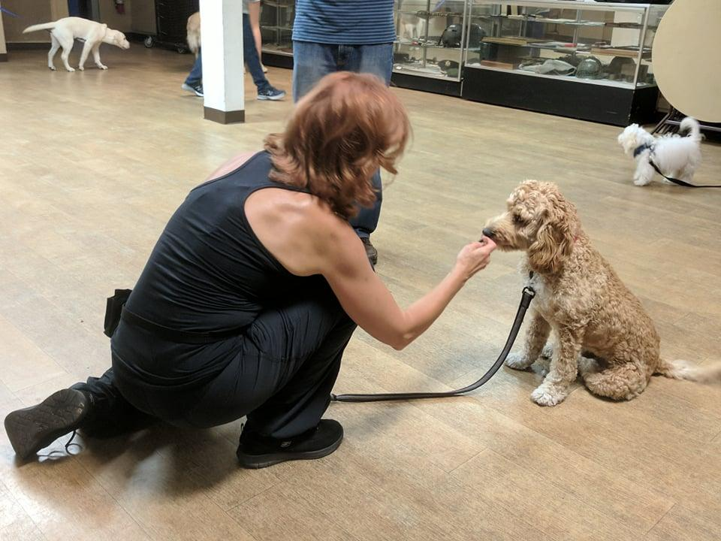
“There’s always that one person in the family who takes responsibility”
Molly
Notes:
Insight
Always falls to one person
Molly said this tends to be mom, as she is “caregiver”
Makes it sometimes difficult to raise properly, as one person ends up with all the burden
Need
Dog should be a family matter that everyone understands work
Makes it easier on family if everyone knows that they share the work

Slide 17
Insight
Need
“There’s always that one person in the family who takes responsibility”
Molly
Regardless of intentions, there’s a trend towards responsibilities falling on the main “caregiver” in the family.
To incentivize/involve the whole family with caring for the dog.
Notes:
Insight
Always falls to one person
Molly said this tends to be mom, as she is “caregiver”
Makes it sometimes difficult to raise properly, as one person ends up with all the burden
Need
Dog should be a family matter that everyone understands work
Makes it easier on family if everyone knows that they share the work

Slide 18
Questions about results
How do you gauge a person’s “readiness” in owning a dog?
How important are family dynamics in owning a dog?
What are accessible and understandable ways to “build a relationship” with your dog?
Notes:
Future q’s to study
Recurring problematic topics

Slide 19
Summary
3 interviews, each from different arenas of dog ownership (veteran dog owner, first time dog owner, professional trainer)
Found interesting juxtapositions between dog ownership and dog care-taking responsibilities
Dig deeper into how to balance family dynamic with dog care and education

