Slide 1



Relation-Education
Paulina Reyes Jailene Miranda-Enriquez Sanura N’Jaka Kristina Inouye

Slide 2
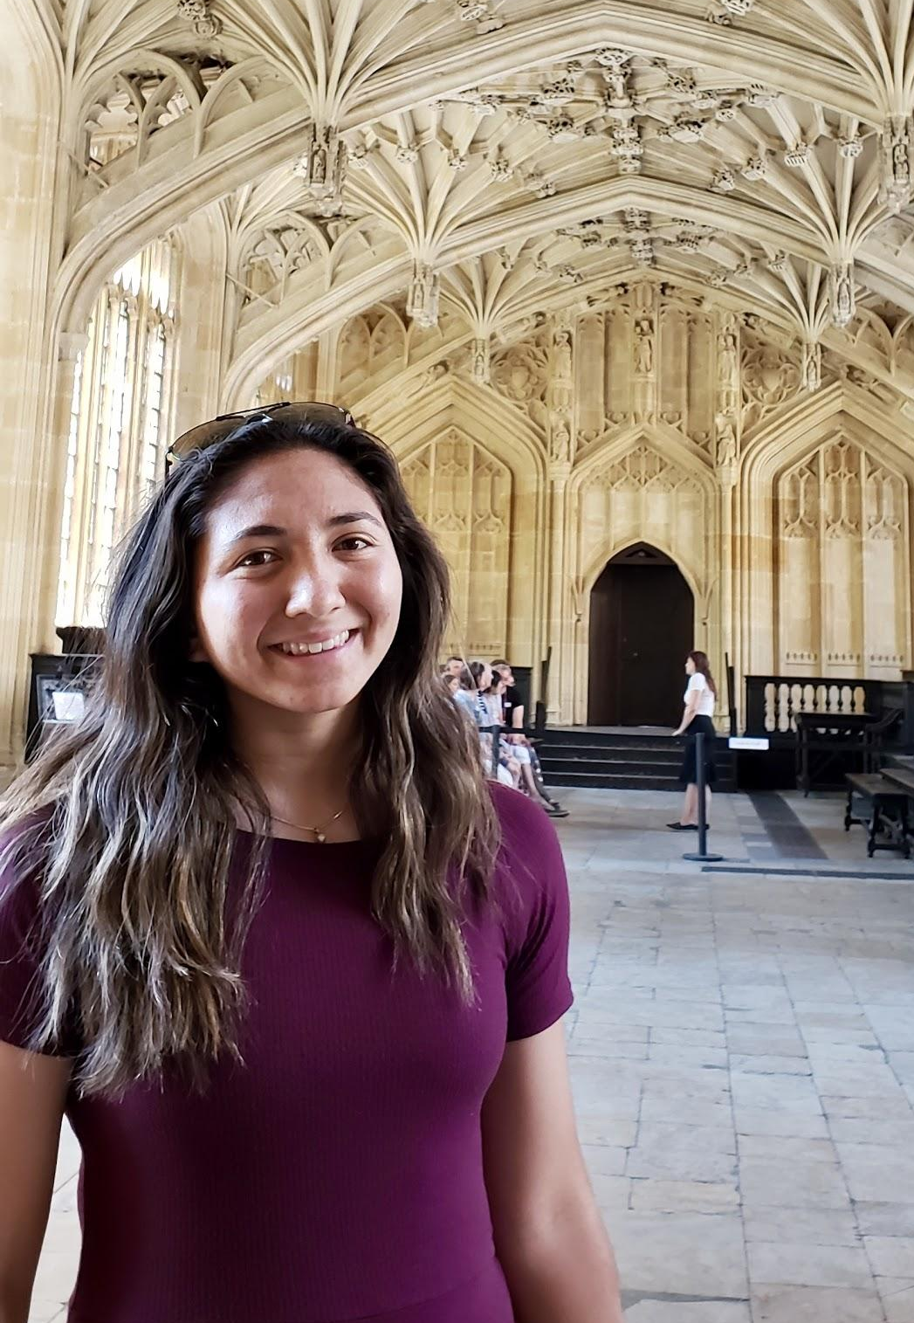
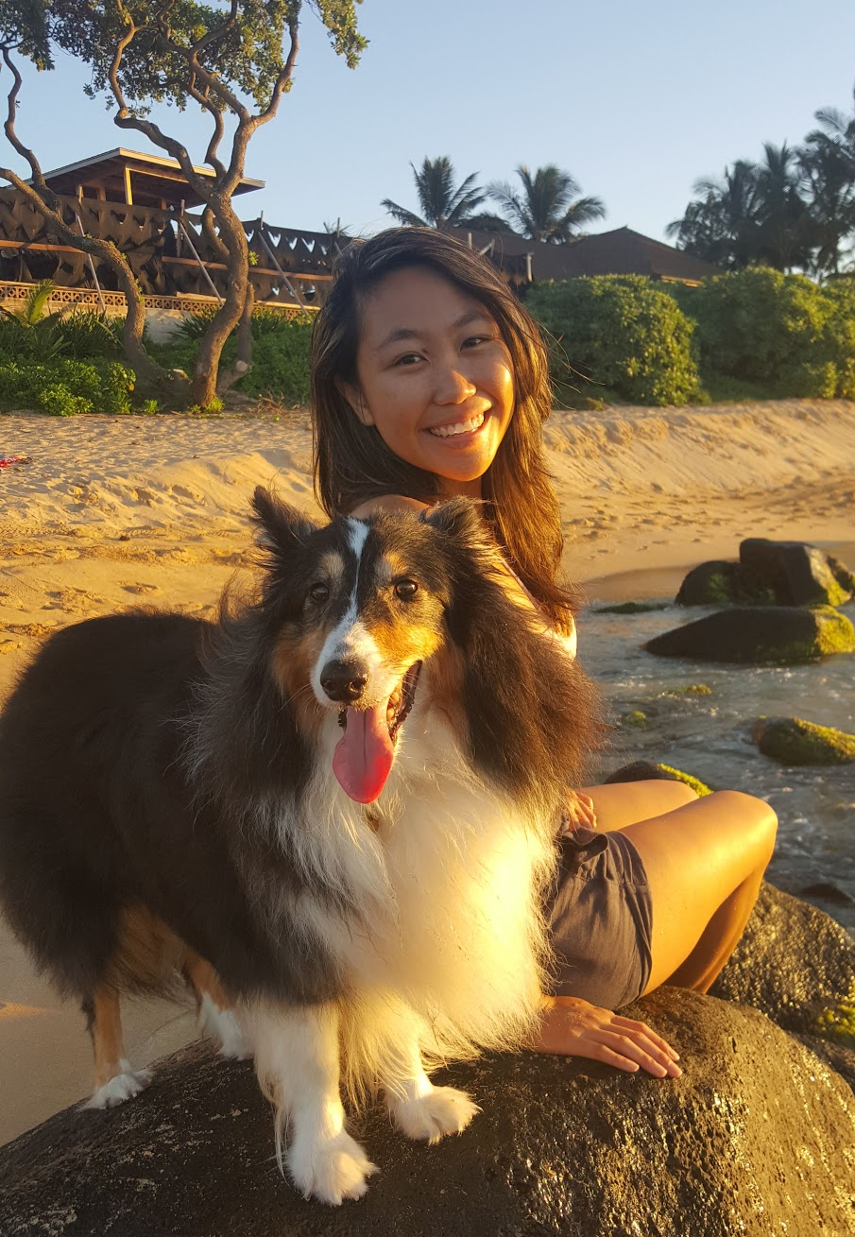
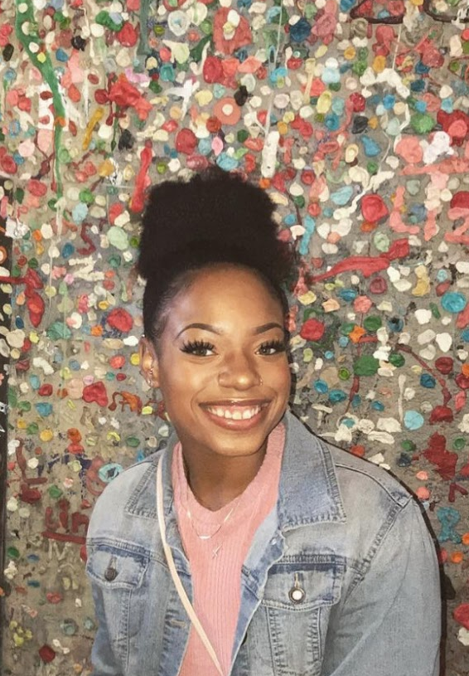
Meet Our Team
Kristina
Paulina
Jailene
Sanura

Slide 3
Needfinding Methodology

Slide 4


Teachers
Students
What do you like about your job?
Tell me about a time that you enjoyed your classroom lesson.
How do you keep students engaged in a lesson?
Describe a typical lesson in _____ class.
What is your ideation process when you prepare to teach?
What about school excites you? What about school do you dread?
What resources help you in the classroom?
What incentives help you participate in class?
Notes:
Our main stakeholders are educators and students. Focused on grade school education (before college).

Slide 5
Interview Results

Slide 6
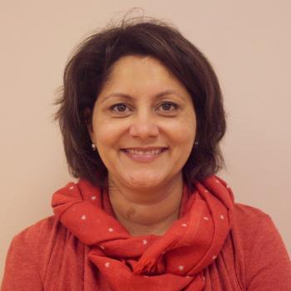
Parul Chandra
Stations with specific resources together encouraged interactions.
Head Teacher, Bing Nursery School
“In [our] classroom… it’s all about group teaching and learning.... Our lessons are based off of students’ interests - if it rains and they all talk about worms they see on the ground, we’ll teach them about worms.”
Taken with permission at Bing Nursery School, do not copy.
Notes:
Why was this person chosen?: Wanted to hear a perspective from the very initial stages of education. Proximity was also a factor in order to have an in-person interview. Main ideas from interview: Ages they work with range from 2-5 year olds, these programs are where they first begin to learn to develop attachments to people other than their parents. So, environments that encourage collaboration are important. No tech usually.

Slide 7
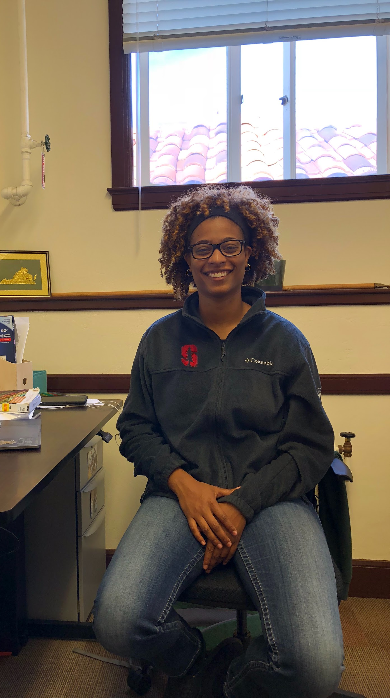
Danielle
Current Stanford PhD Student
Former Middle/High School Teacher
Green
She hardly ever used the textbooks. It’s all about knowing the kids and connecting lessons to their interests.
“If you don’t tell them
why they need to learn something, why does it matter? Be honest with them.”
“I’m a
storyteller.”
Notes:
Reason for choosing her: Has experience teaching a wider range of students. Used to teach middle school and high school for 5 years and currently she teaches college students as a TA for education classes here at Stanford as she pursues her PhD. Also, she has experience working with a diversity student population. When she taught middle and high school in Virginia, 100% of her students were low-income. Coming to Stanford, where the students come from everywhere and are of all different backgrounds.

Slide 8
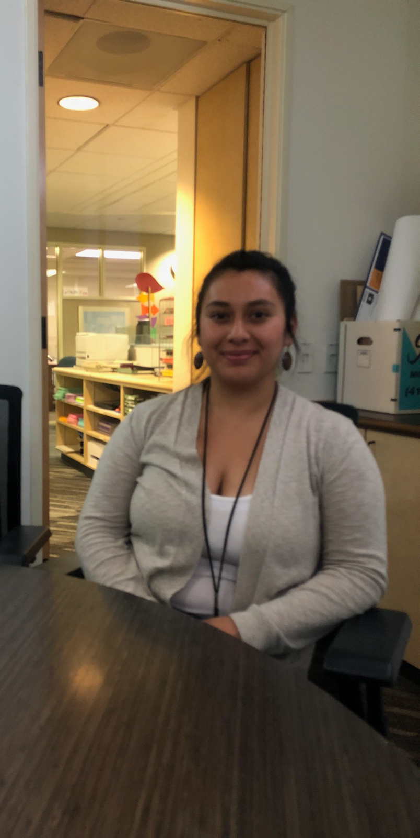
Ashley Diaz
Program Supervisor for Third Street Community Center
“Our goal is to make sure students are improving.”
Allowing students to figure out what their creative factor is helps to keep them engaged.
She believes in sharing her own story to help connect with the kids.
Notes:
Reason for choosing her: She is different form of educator. While she has never been a teacher, she works as a program supervisor for a program that helps to improve students academic growth over the summer and during the school year. Over the summer, they have lots of STEM hands-on activities, teaching them what it is and how they use it. During the school year, they do homework and enrichment activities (like art or dance) with the kids.

Slide 9
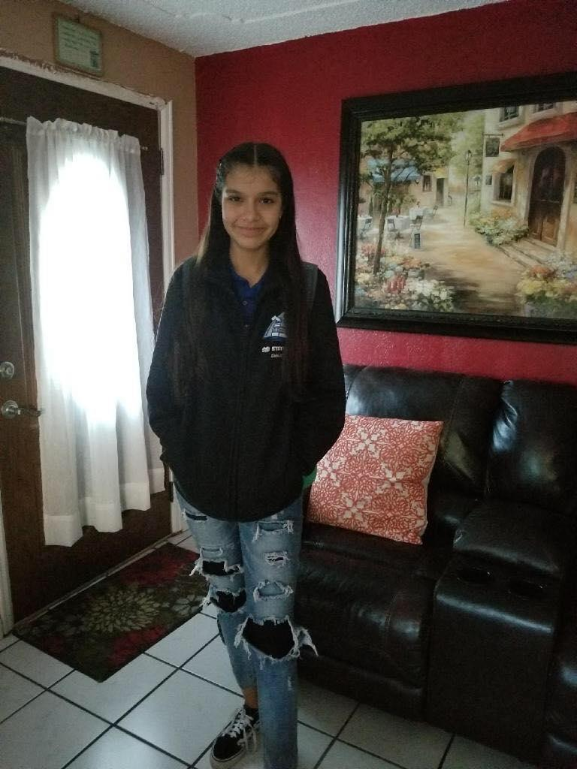
Jocelyn Miranda
High School Freshman
Chicano Arts is exciting for her because she learns something different and it connects to her heritage.
Enjoys socratic circles because it’s student led and a collaborative environment

Slide 10
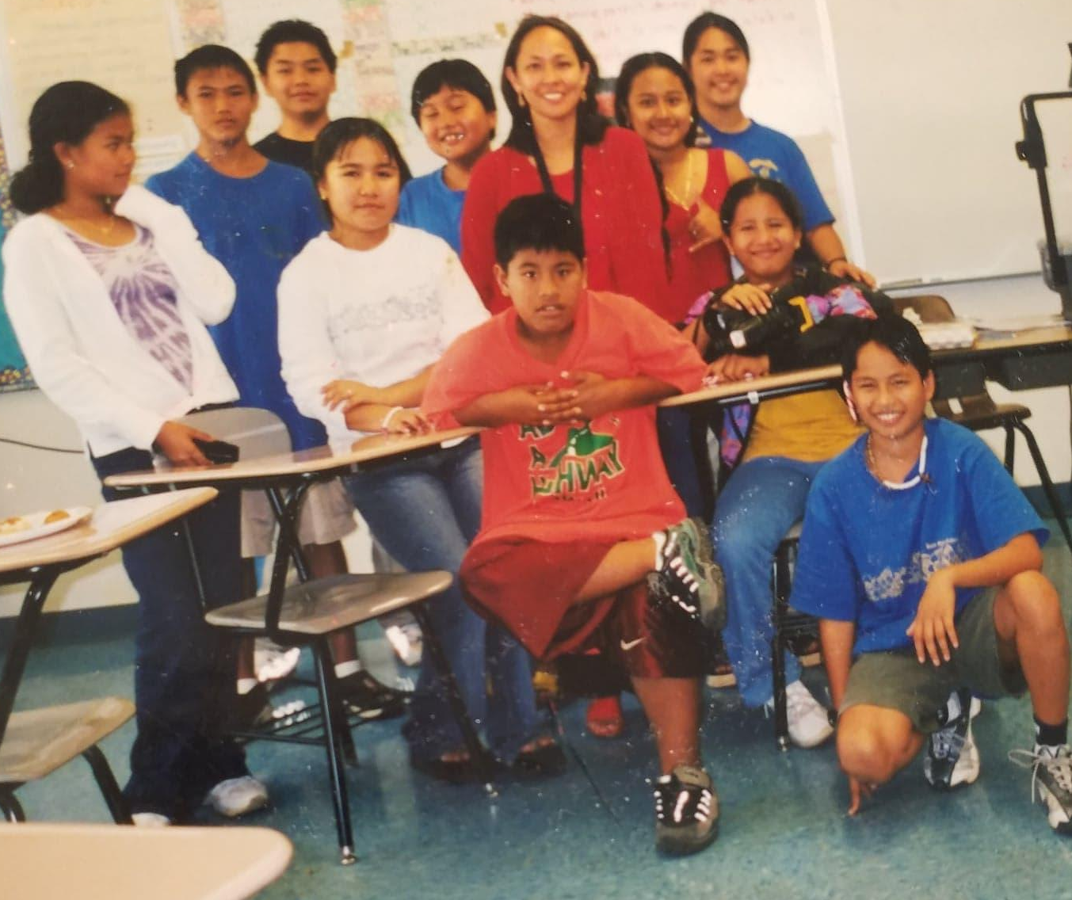
She engages with students by getting to know them.
When creating lessons, she uses backwards planning based around standards, called the “common core.”
Maria Victorio
ELL Middle School Teacher

Slide 11
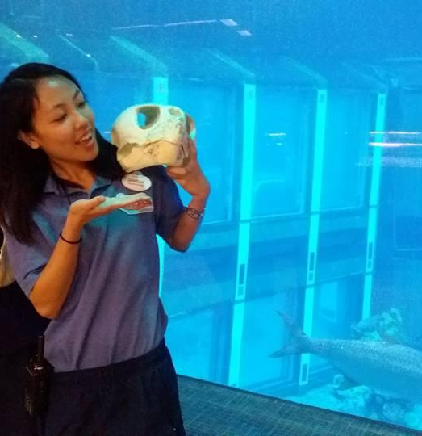
Daniella Reyes High School Teacher
“It is helpful to learn at least one personal aspect about the students to connect with them.”
She uses online resources to find lesson plans from other teachers.
When she connects lessons to the real world, she gets more engagement.

Slide 12
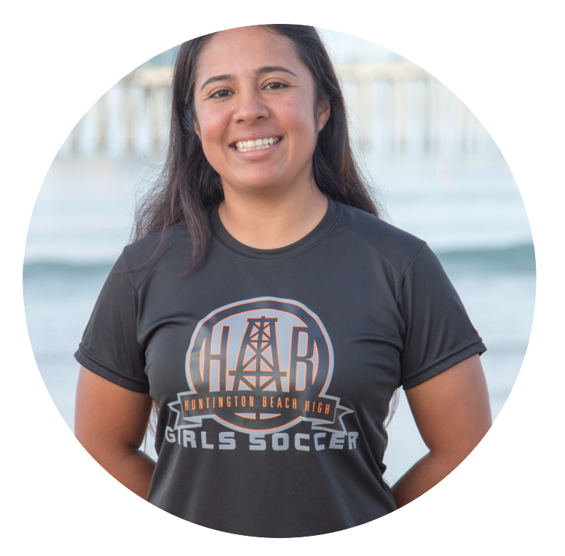
Señorita Lorena Adame
High School Spanish Teacher
“I’ve been working a lot on building community”
“The main thing we’re trying to do is change the layout of the classroom to be more dynamic.”
“We’re trying to change the environment of school, so hopefully they’ll be attracted to being there as well.”

Slide 13
Empathy Map

Slide 14
“Social development is the most important aspect of this nursery school.”
“I like going to my Chicano Art class because we’re learning something different...more interesting”
“I get tired of sitting down in my seat for most of the class.”
“...make it relevant… tell them why this is important, why they need to know this, and how it can help them...”
“I enjoy my english socratic circles because we lead them and they’re collaborative.”
SAY
“Getting to know my students is the first step to engaging them.”
“The system is consequence-driven for teachers rather than support-driven.”
She appreciates the common core because it gives structure to keep her students on track.
“They’re so social and just want to talk”

Slide 15
Every resource was in use.
Teachers tried to make time to talk to each student individually.
Students flocked to areas of the classroom that allowed for collaboration.
Expressed excitement when talking about activities that were successful.
DO
Held her hands together when talking about how much she loves her job.
Reached with excitement to show pictures of her former students.
One student was very attached to the teacher, “like a barnacle.”

Slide 16
“I think it is scary for teachers to try new things.”
“I think there are barriers that need to be broken down with students”
“I think that students are a lot more distracted with their phones.”
THINK
“We’re trying to change the environment of school, and I hope that they’ll be attracted to
being here as well..”
“I think when students do not know each other, it is more difficult to get them to work in groups.”
“I wish I had more one-on-one time with students.”

Slide 17
Students were excited when the teacher announced they would get to take home books
Disappointed that not every student could be helped
It is heartwarming for her to see the kids and even their parents come for her because they trusted her
FEEL
Afraid that a new lesson plan will be boring and unsuccessful
Looked tired when talking about how teachers are treated
Nervous to try new things in the classroom.
Students were eager to get to make a podcast, just as their teacher does

Slide 18
Needs, Insights, & Analysis

Slide 19
Insight: Students get bored in class because the outside world is more interesting and available at their fingers.
“I think they’re bored of doing the same repetitive things… Students are a lot more distracted with their phones and maybe they see the outside world in a SnapChat and that makes them want to get out…”
Need: Bring the outside world into the classroom OR the classroom into the outside world!

Slide 20
Insight: Students like taking ownership over their education.
Jocelyn Miranda enjoys socratic circles because it’s student led and a collaborative environment
Need: Education strategies and classroom layouts based around collaboration between teachers and students.

Slide 21
Insight: It is vital that teachers meet standards, but they don’t want to use traditional means to get there.
When creating lessons, Maria Victorio uses backwards planning based around standards, called the “common core.”
Need: Exciting education strategies built around meeting “common core” requirements.

Slide 22
Insight: Teachers like to borrow ideas that are successful and well thought out because they are afraid of trying a new lesson and having it be unsuccessful.
Daniella Reyes uses online resources to find lesson plans from other teachers.
“I usually work with the other teachers in language when creating lesson plans.”
Need: Creative and engaging lesson plans that are produced and used successfully by other teachers accessible through any search engine.

Slide 23
Insight: Students are afraid to sound dumb or generally not fit in with their peers.
“I think there are barriers that need to be broken down with students… I take that into consideration and [ask myself] how can we make them feel like everybody’s in the same boat?”
Need: Learning environments that celebrate failure as a step towards success and build community; student-student and teacher-student.

Slide 24
Chicano Arts is exciting for Jocelyn Miranda because it connects to her heritage.
Insight: Students need to understand the value of the subject they are learning.
“It is helpful to learn at least one personal aspect about the students to connect with them.”
Need: Interdisciplinary, cultural, and personal connections forged between the student and the material in the classroom.
“If you don’t tell them why they need to learn something, why does it matter? Be honest with them.”

Slide 25
...to bring the outside world into the classroom OR the classroom into the outside world!
...exciting education strategies built around meeting “common core” requirements.
...education strategies and classroom layouts based around collaboration between teachers and students.
SUMMARY
...learning environments that celebrate failure as a step towards success and build community.
The classroom experience needs...
Interdisciplinary, cultural, and personal connections forged between the student and the material in the classroom.
...creative and engaging lesson plans that are produced and used successfully by other teachers accessible through any search engine.

