Slide 1

Understand your students.
Appreciate your teachers.
Learn like never before.
EDUCONNECT

Slide 2
Problem:
How to effectively build positive student-teacher relationships
Solution:
An application that collects data on how a teacher and his/her students are feeling to suggest activities that help tailor the classroom experience
Value Proposition
Understand, connect, and engage with your students

Slide 3
Tasks (Original)
Invite students to share how they’re feeling when class starts (simple)
Synthesize feedback from students in order to tailor the classroom experience accordingly (medium)
Collect feedback from teachers and students (simple)
Identify outliers in the class who might need extra attention (complex)

Slide 4
Tasks (Student)
Request extra attention from teacher if needed (complex)
Share how you are feeling at the beginning of class
(simple)

Slide 5
Tasks (Teacher)
Analyze the synthesized data of student feedback to tailor the classroom experience
(medium)
Share how you are feeling at the beginning of class (simple)
Receive and respond to requests for extra attention/help (complex)

Slide 6
Revised Interface Design

Slide 7
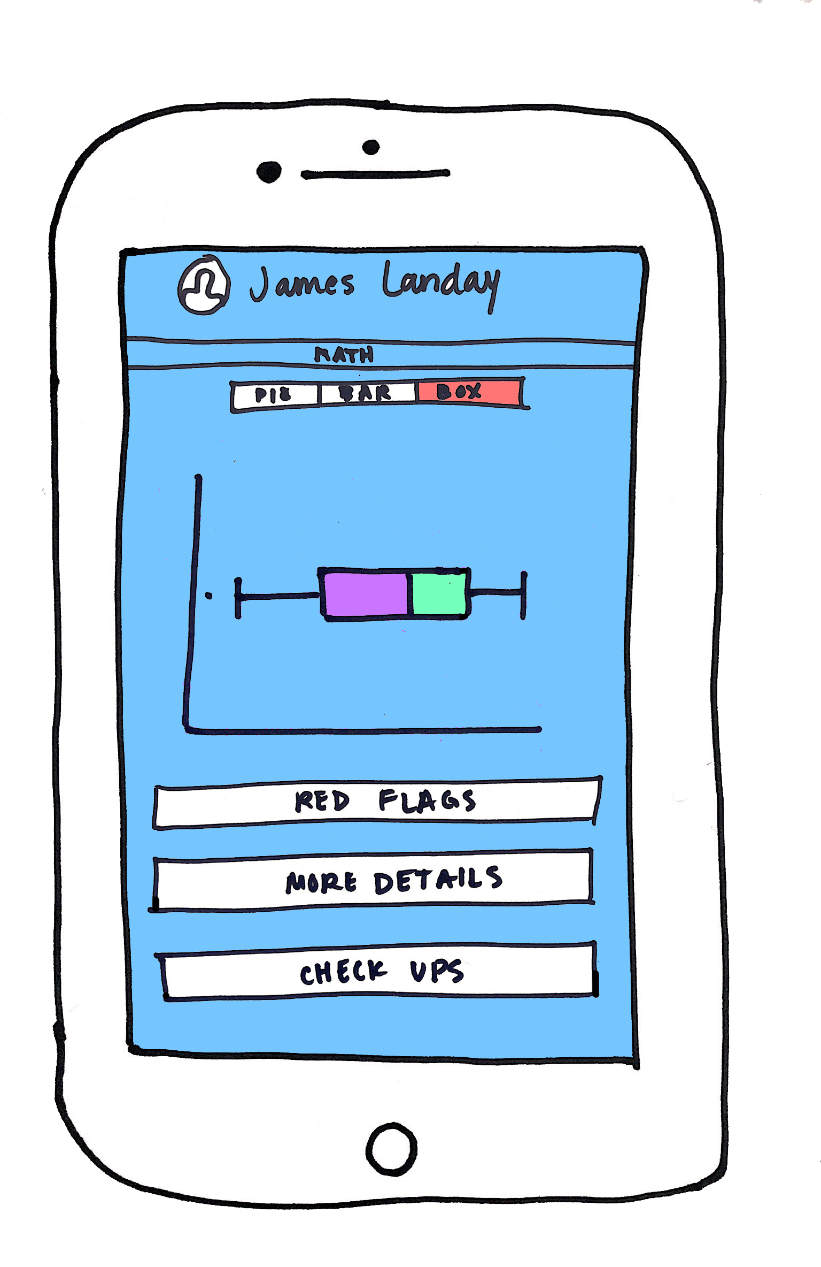
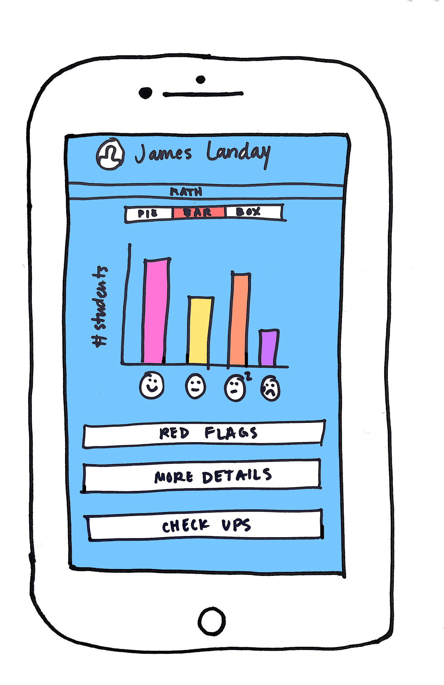
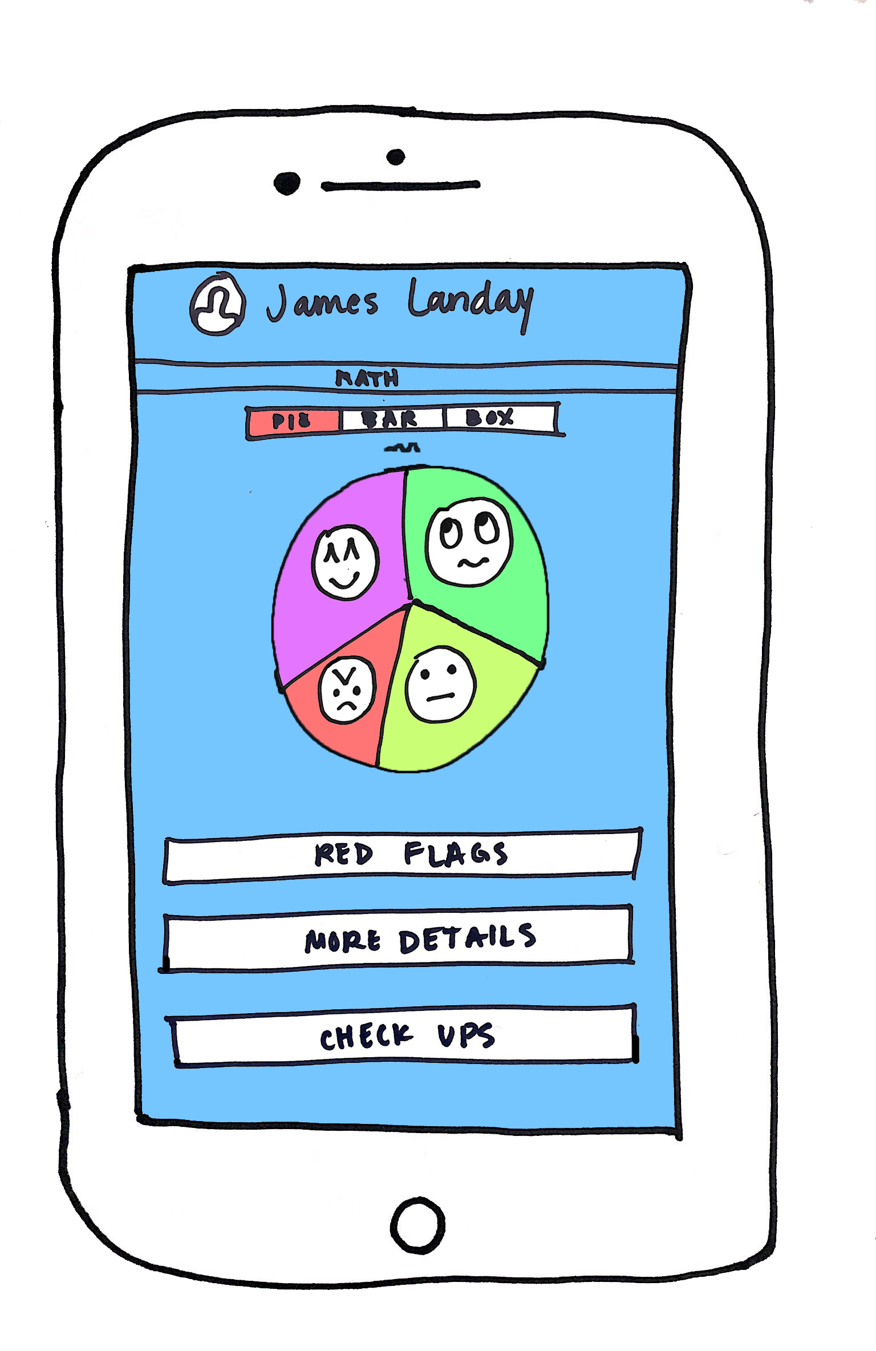
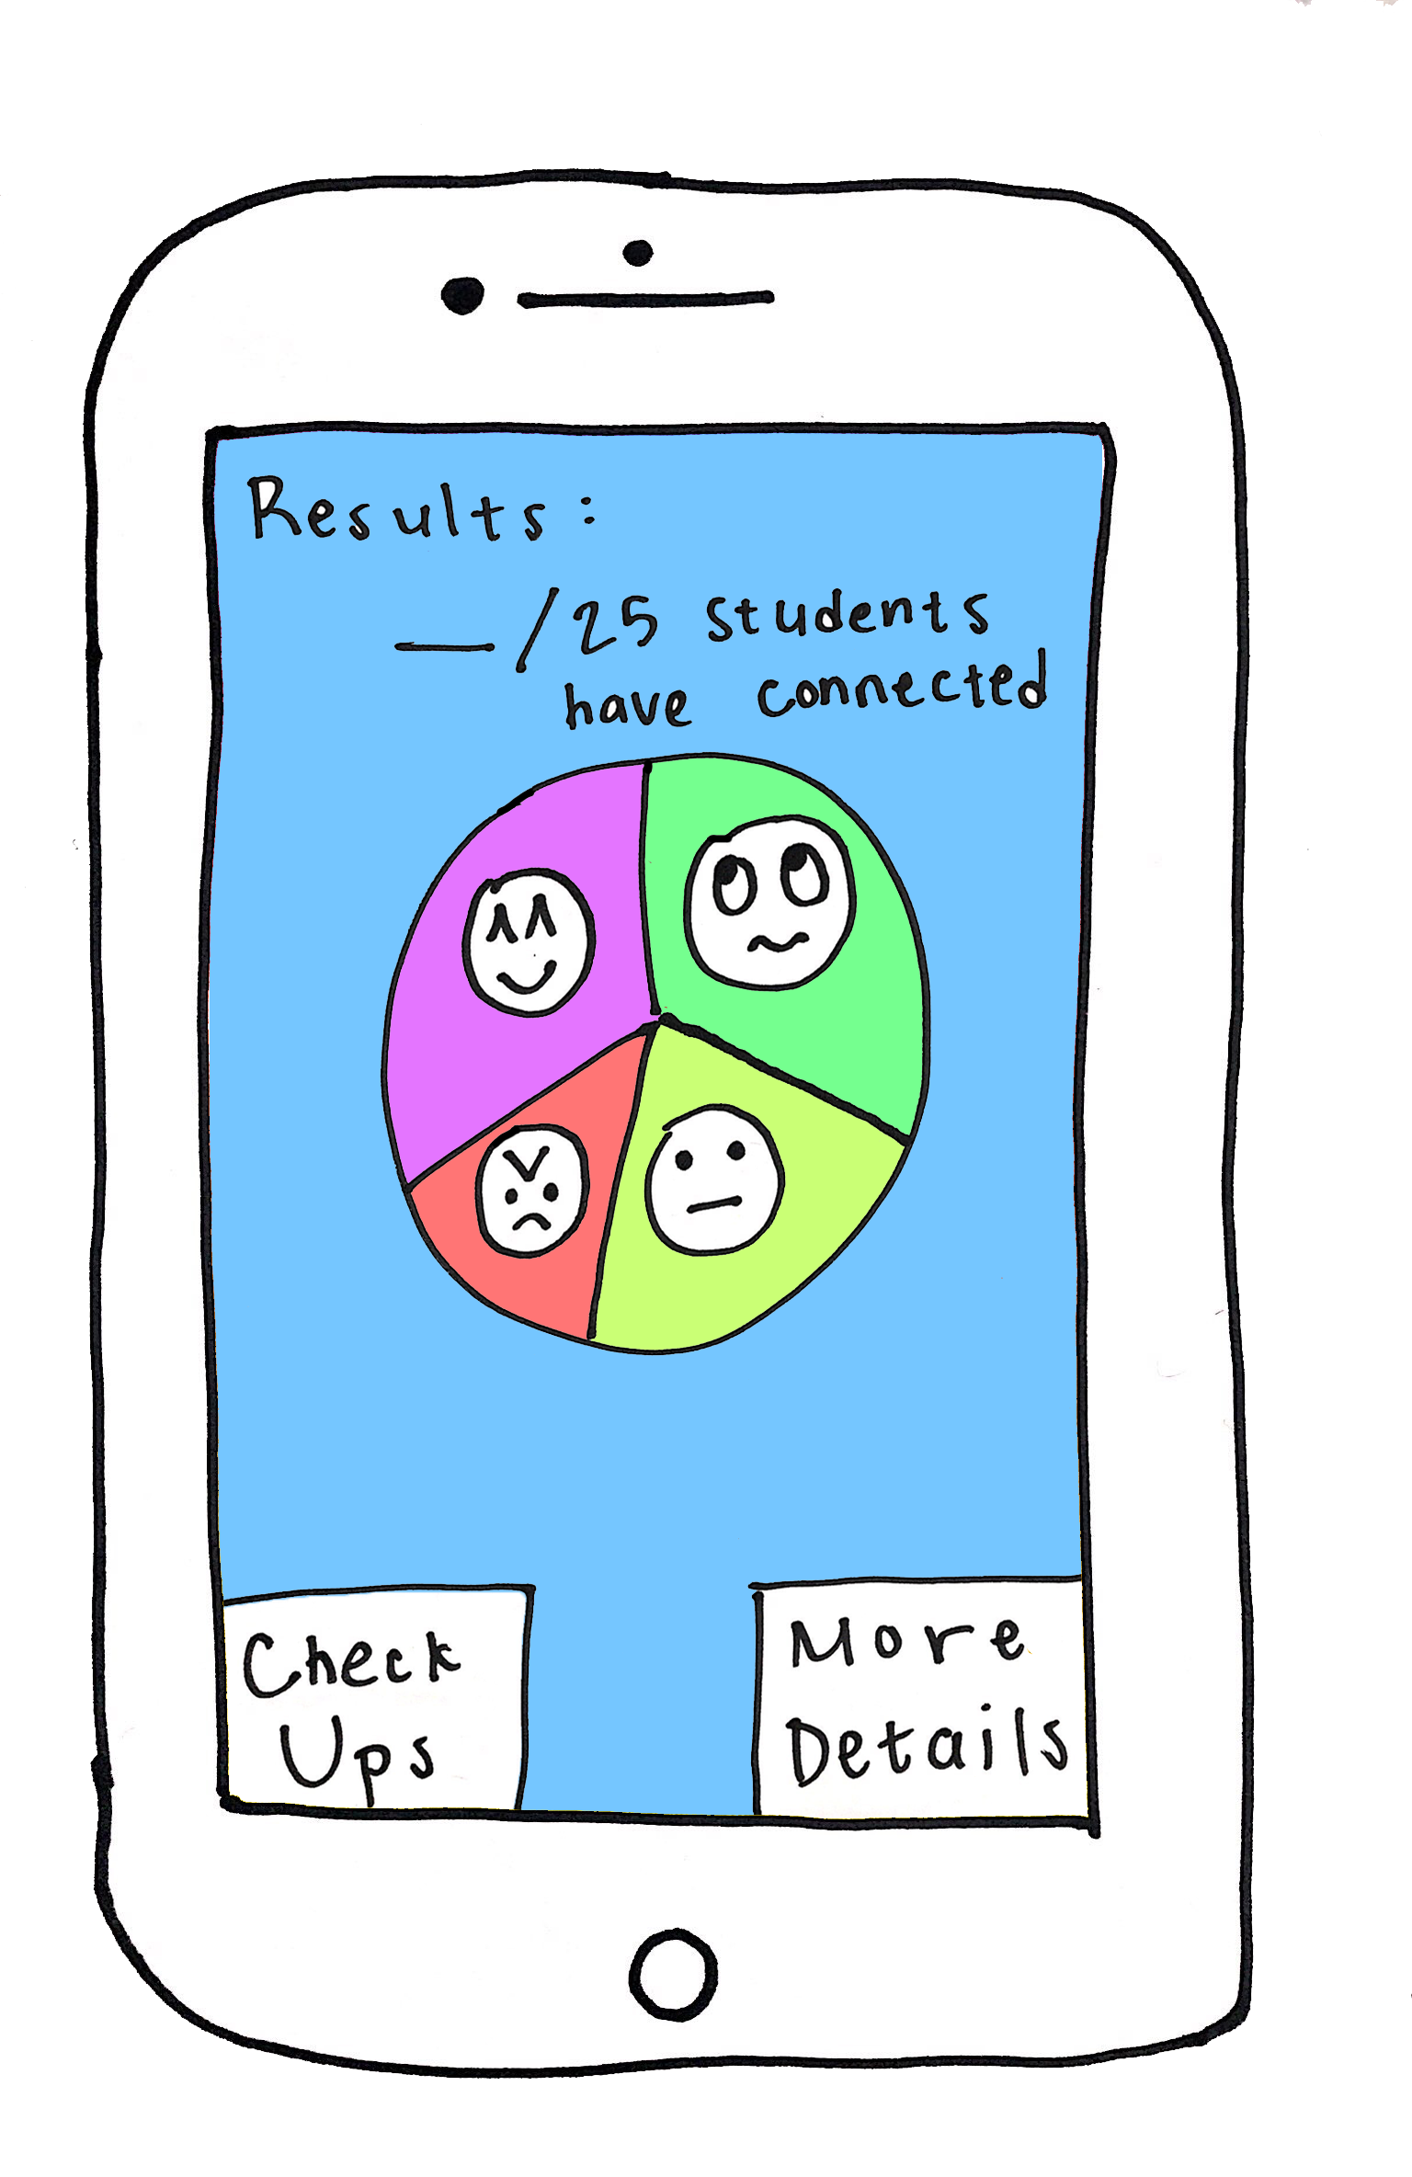
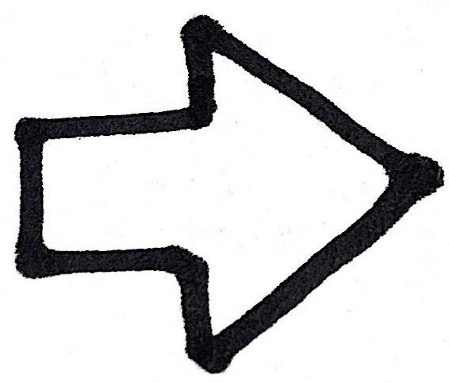
Change #1
Different options for teacher to display class emotions
Rationale:
One of the teachers that we tested our low-fi prototype on suggested that there be different ways to view the data. We thought this would be a nice addition because it would make the app be more customizable and therefore comfortable for teachers.

Slide 8
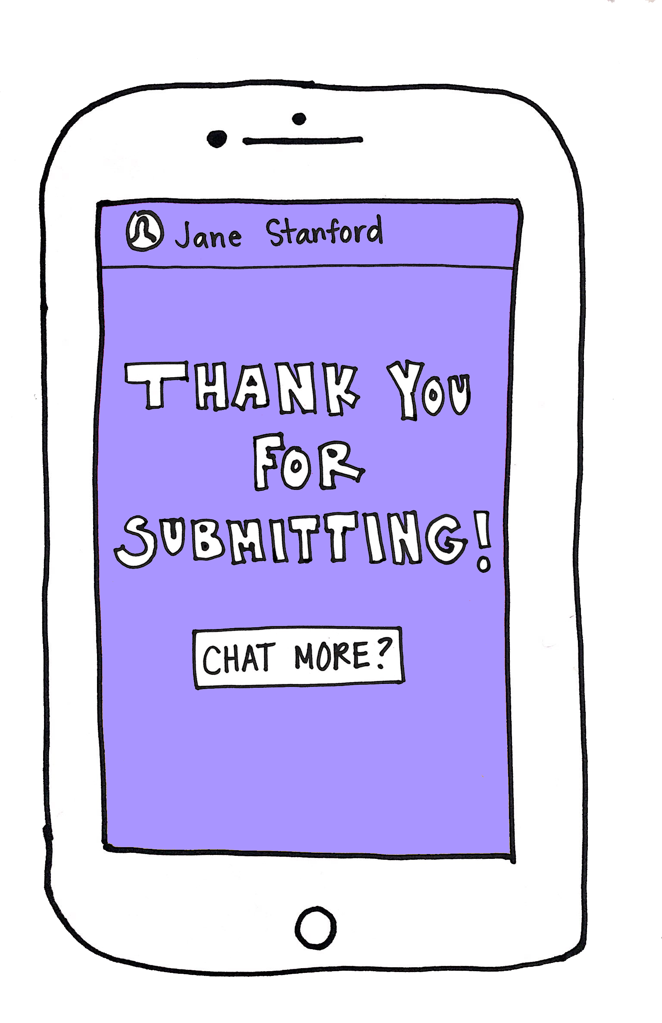
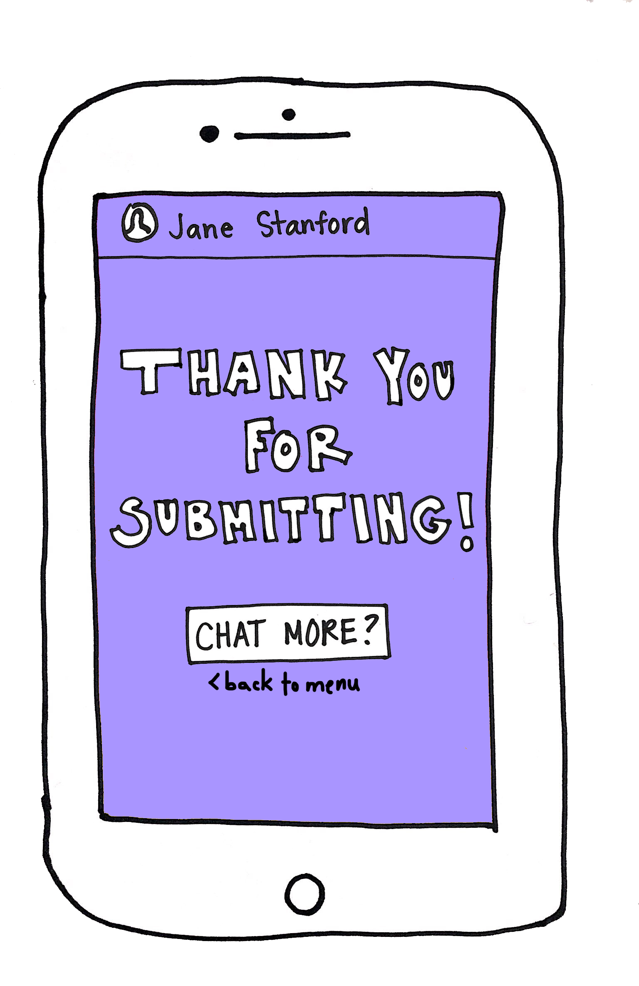
Change #2
Menu/Home button for both students and teacher
Rationale:
After our participants submitted their emoji responses, they were confused on what to do next. We noticed that there is no way for the students or the teacher to get back to their home/courses screen. We felt that this was a very necessary navigation tool in the app.

Slide 9
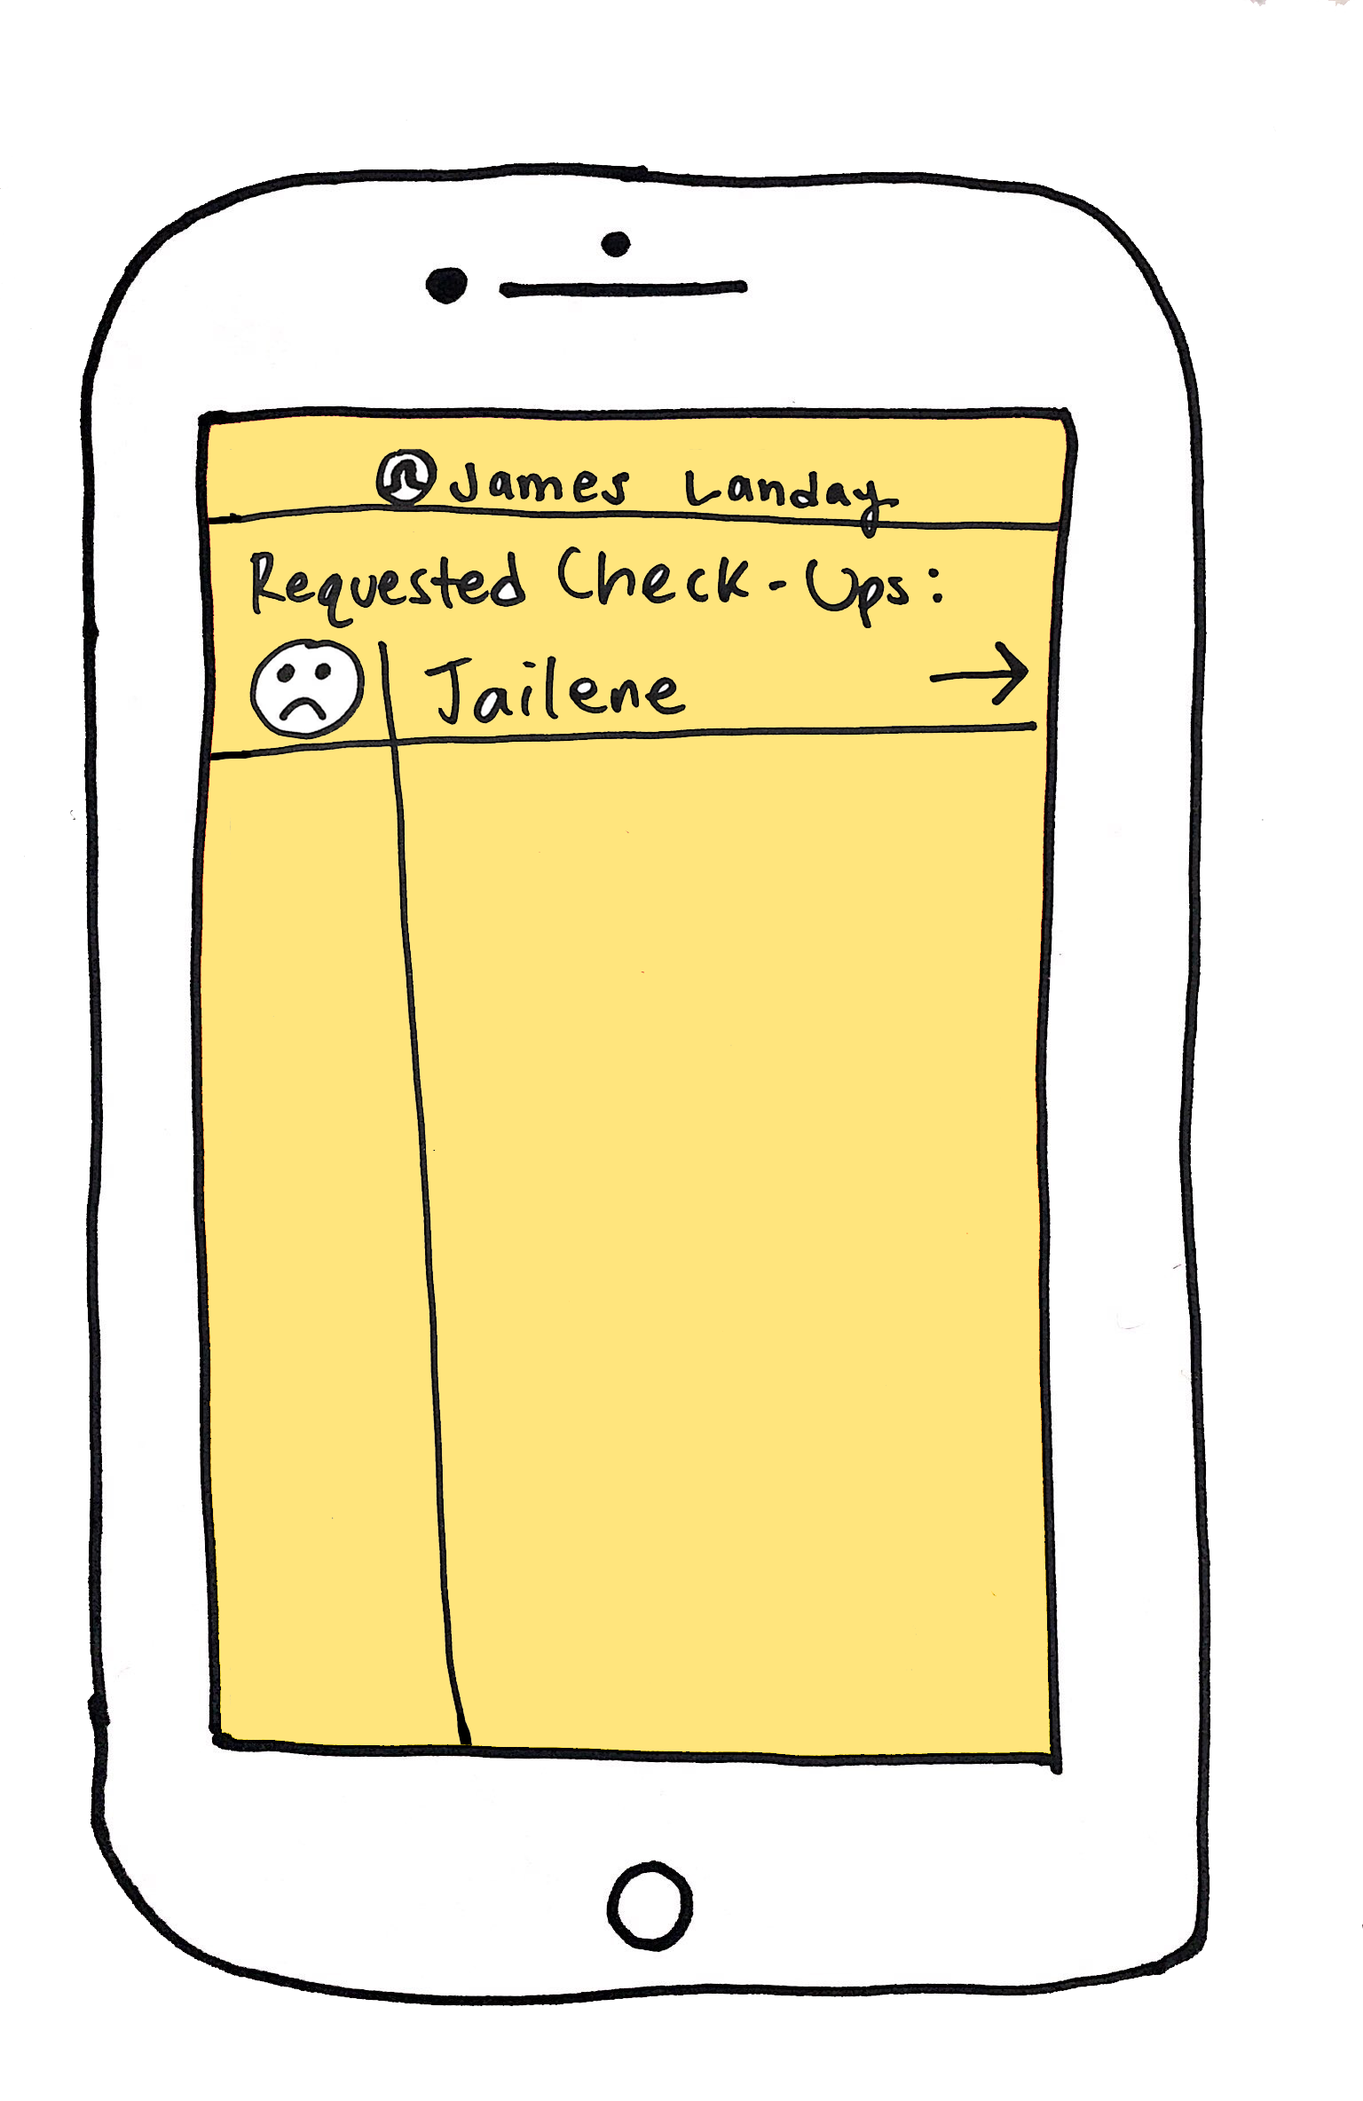
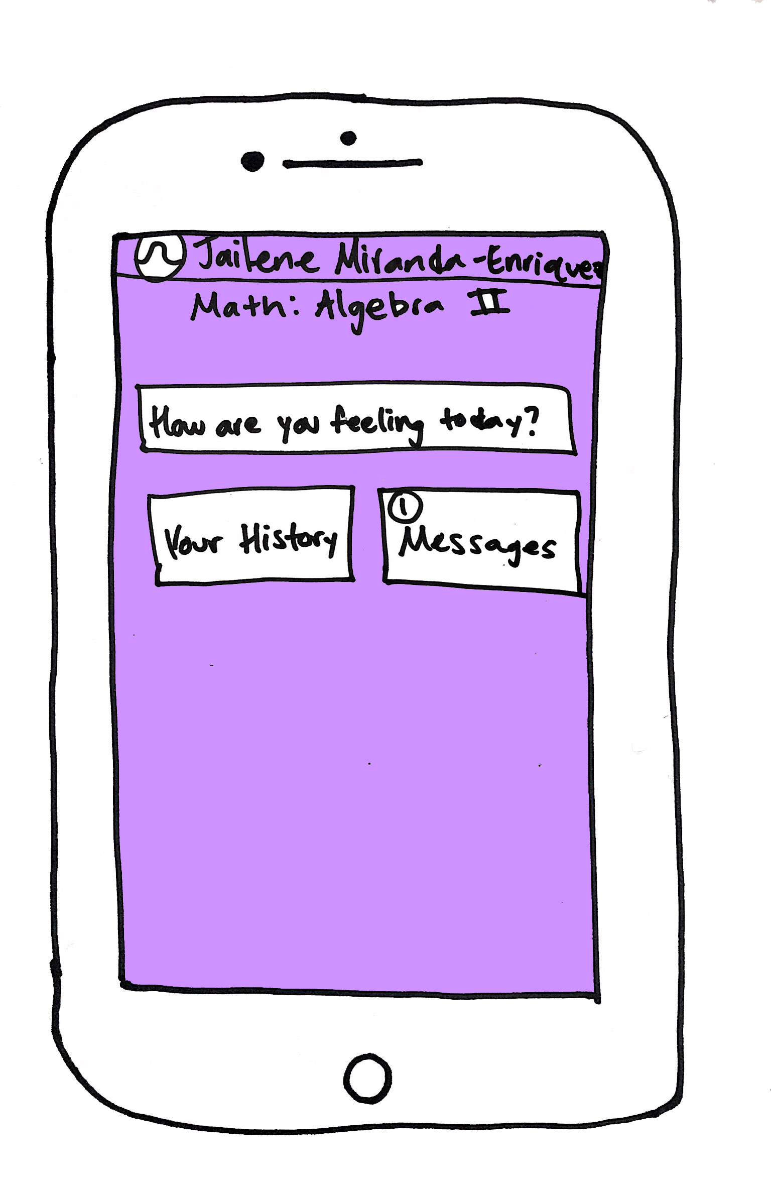
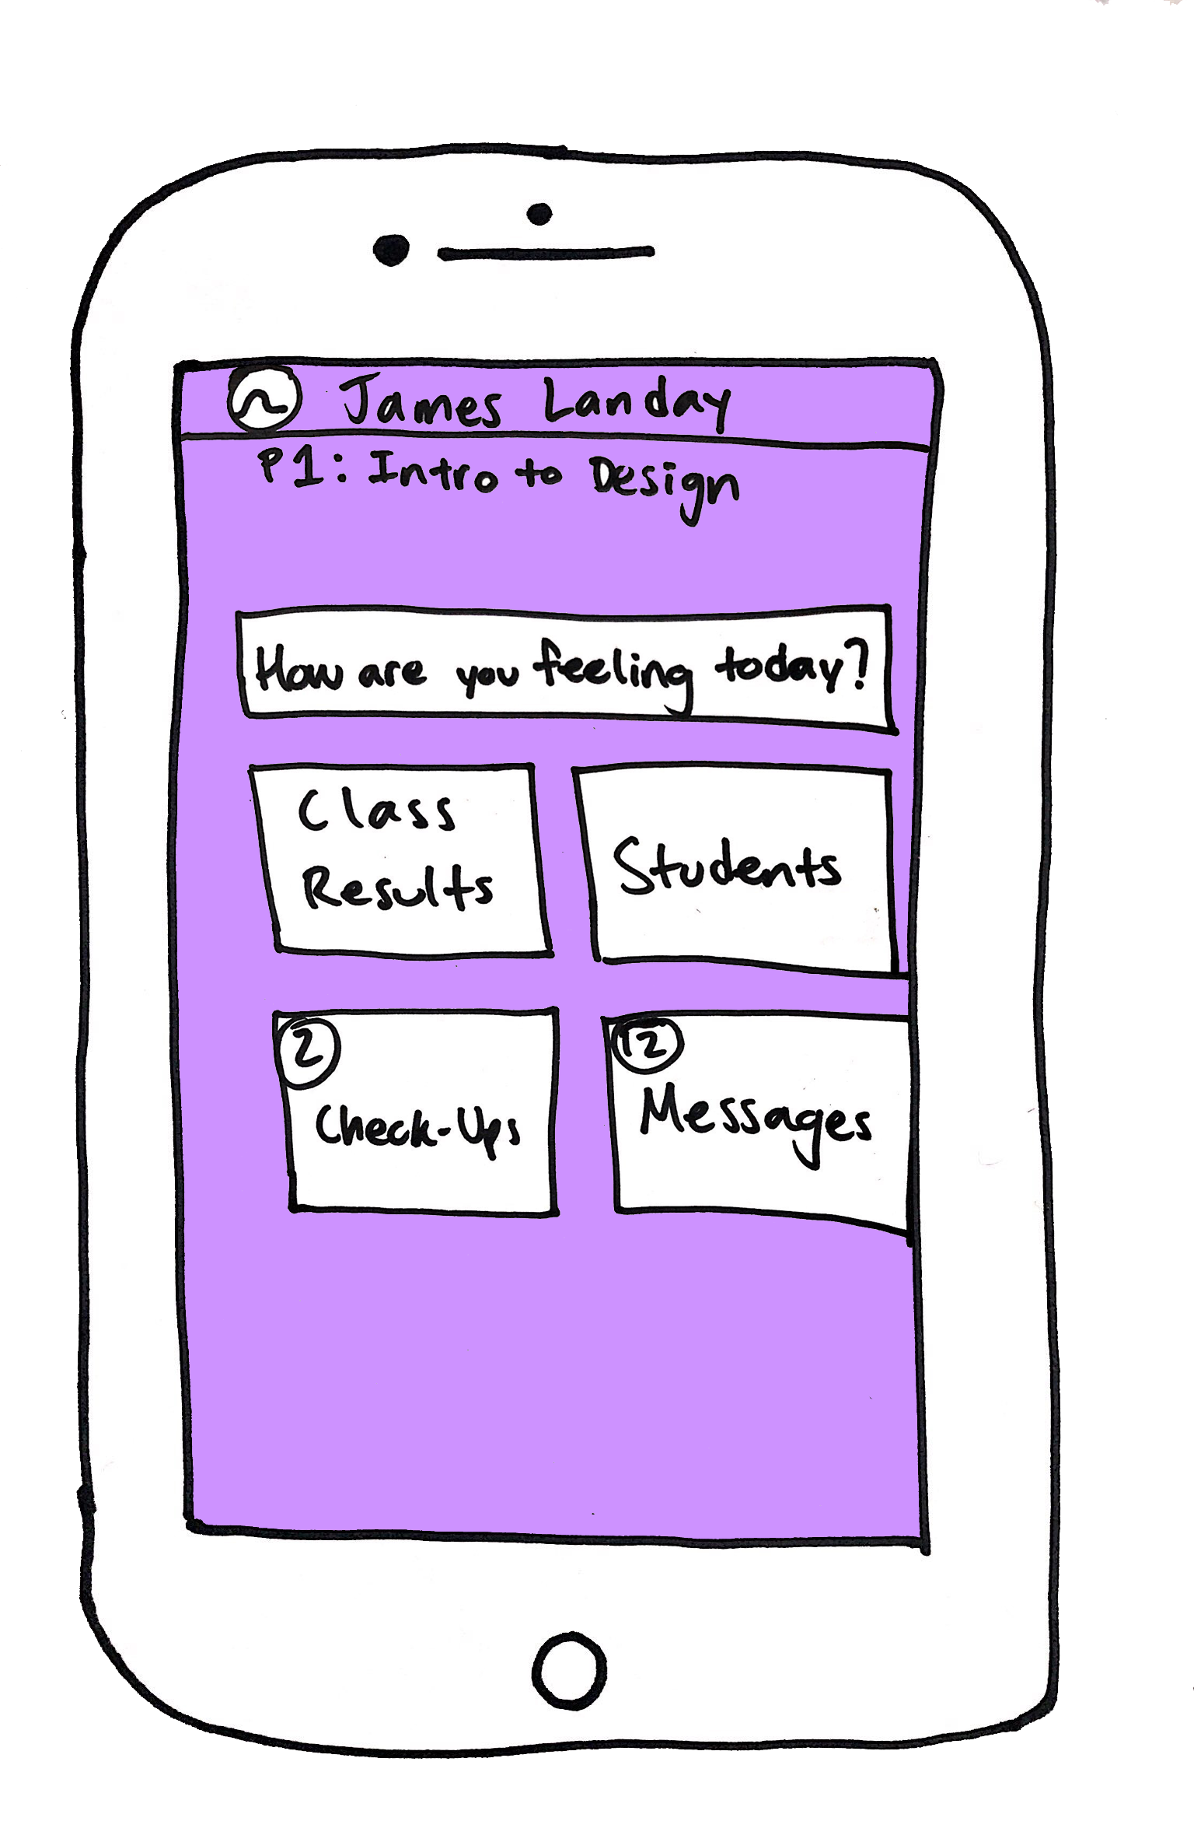
Change #3
Messaging system between teacher and their students
Rationale:
We would like for the teacher to have a way to, at least, notify a student requesting a check-up that their check-up was seen. Using the messaging system, the teacher could let the student know when they can talk. We thought this would be an extending factor in helping to foster the student-teacher connection that our app to designed to create.

Slide 10
Medium-Fi Prototype Task Flows

Slide 11
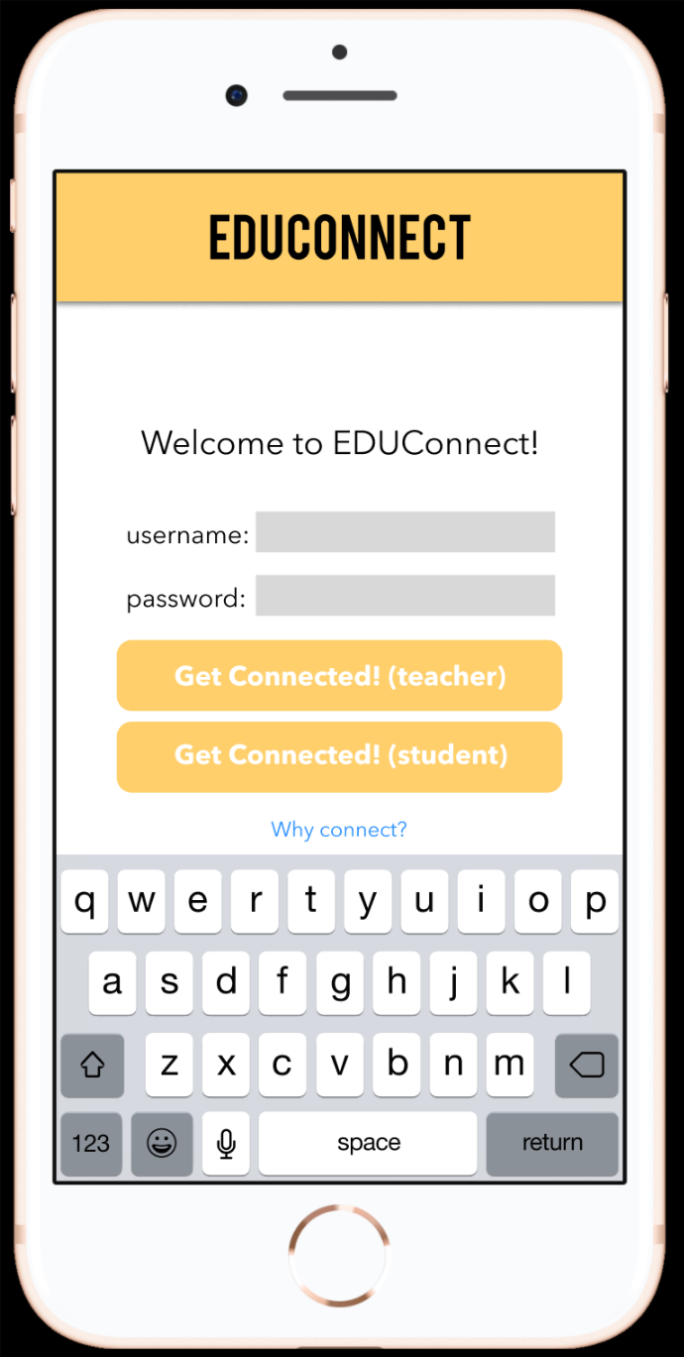
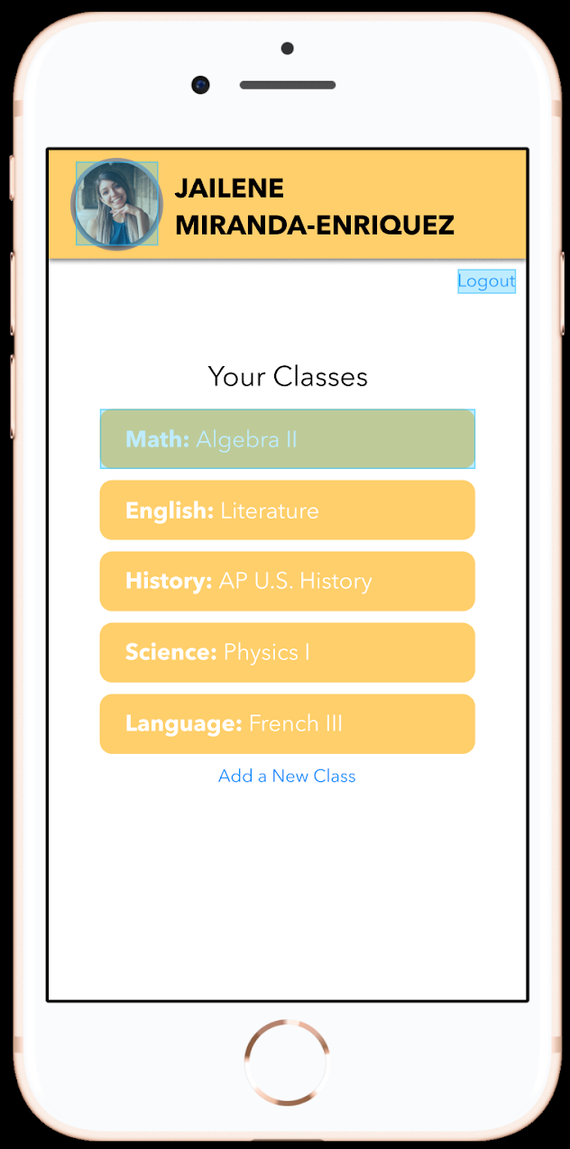
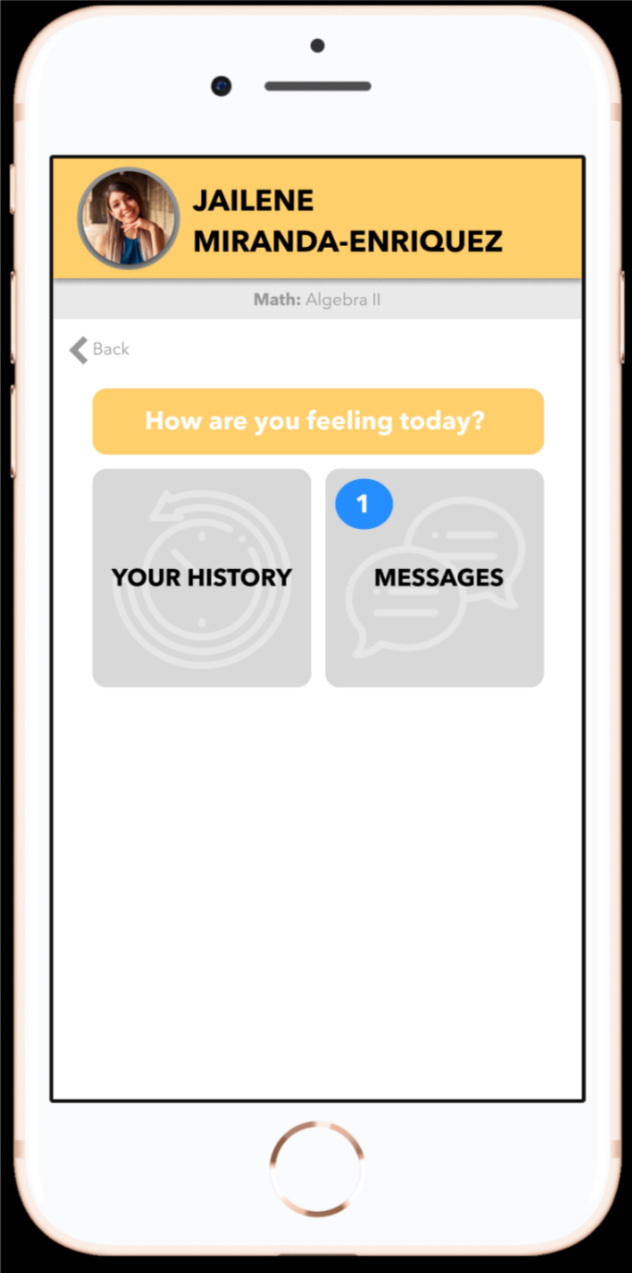
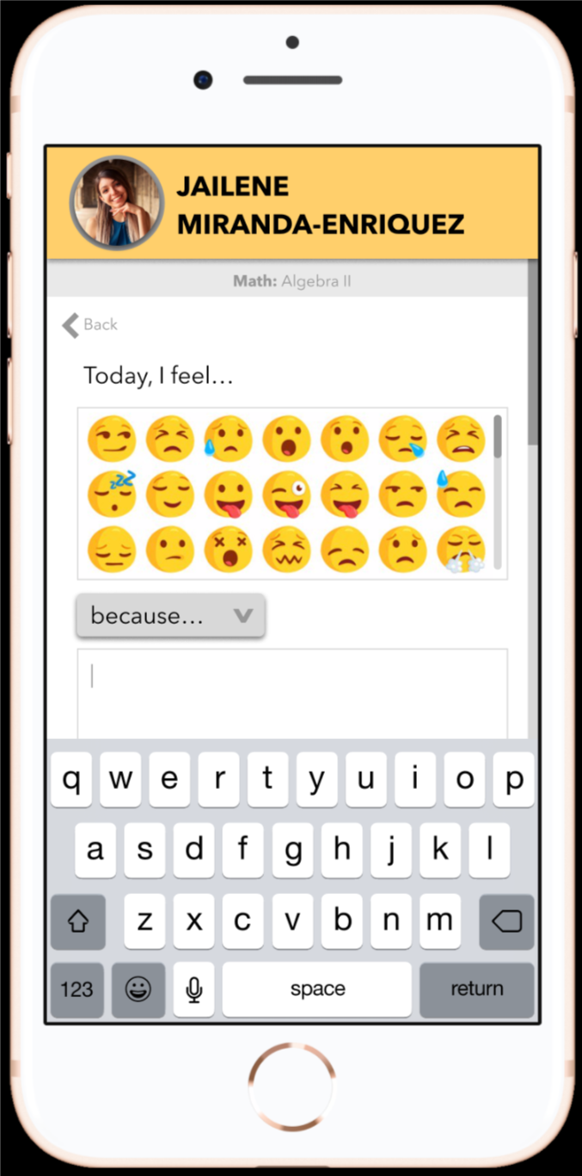
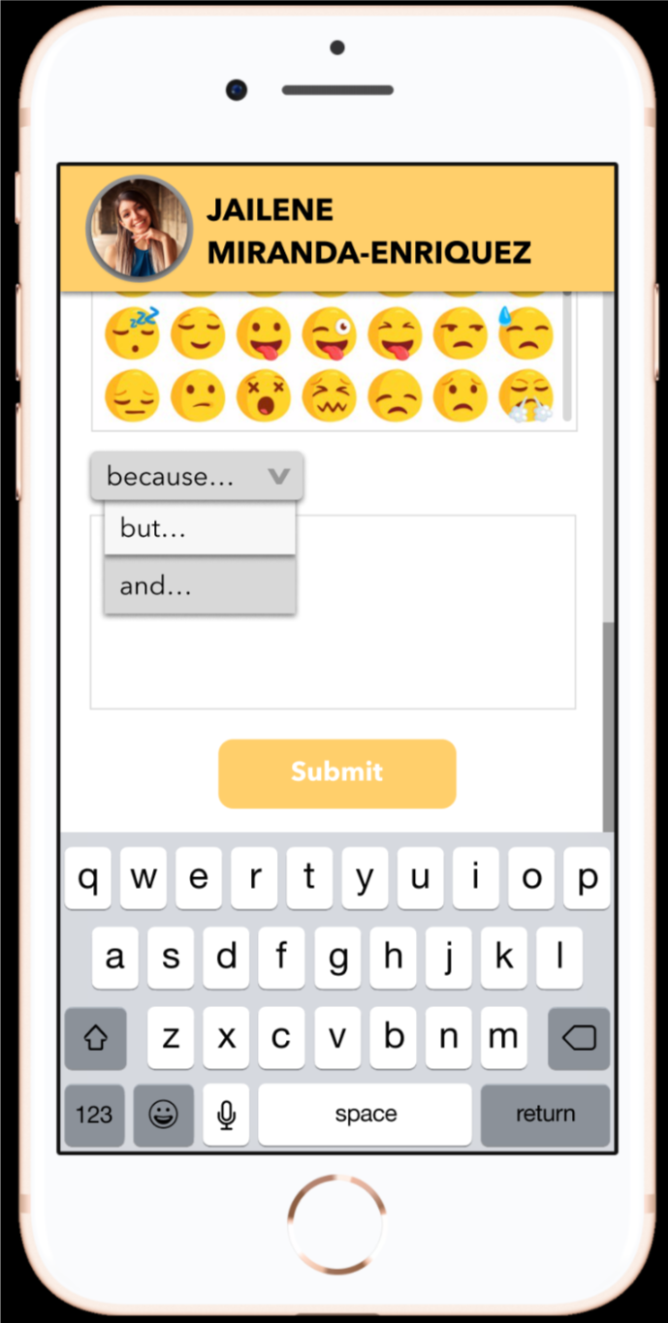
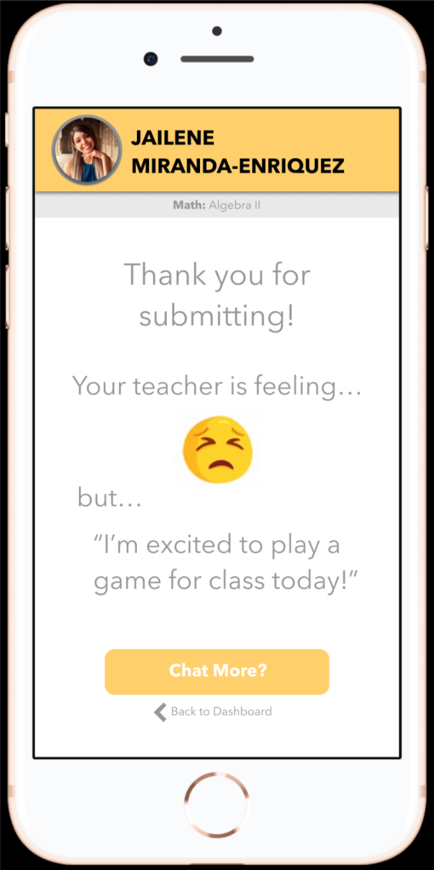
Student Tasks
Share how you are feeling at the beginning of class (simple)
Notes:
ANNOTATIONS: The student will first log in so we know which type of user they are and who they are, specifically. From there, she can click on the class she is going to next. Then, click the “How are you feeling today?” button to then choose her selected emoji for the day/period and then write a brief elaboration (she can choose between different transition words to accurately express what she would like to say. After she submits, she can then see how her teacher is feeling for the day/period.

Slide 12
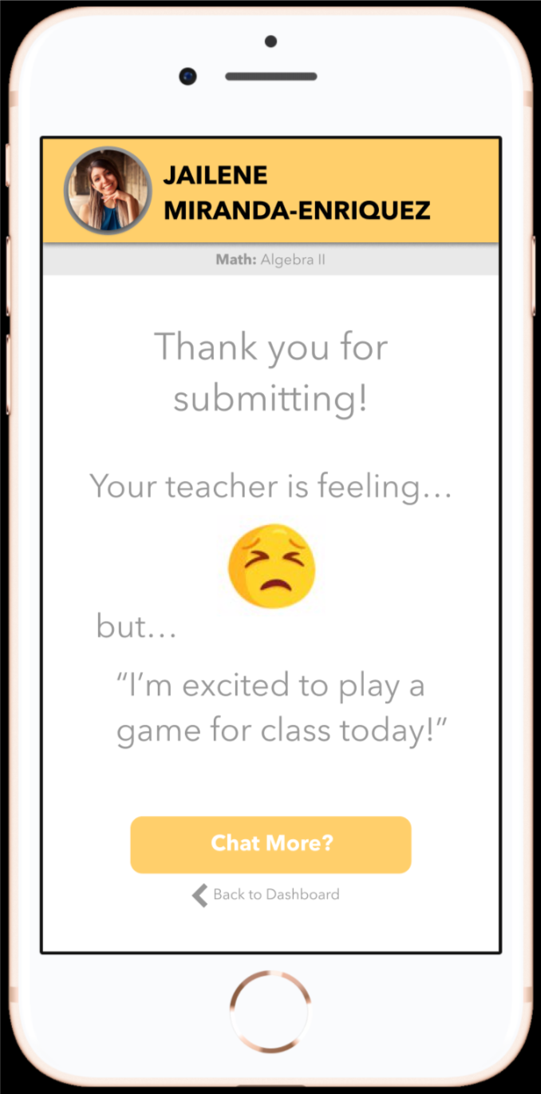
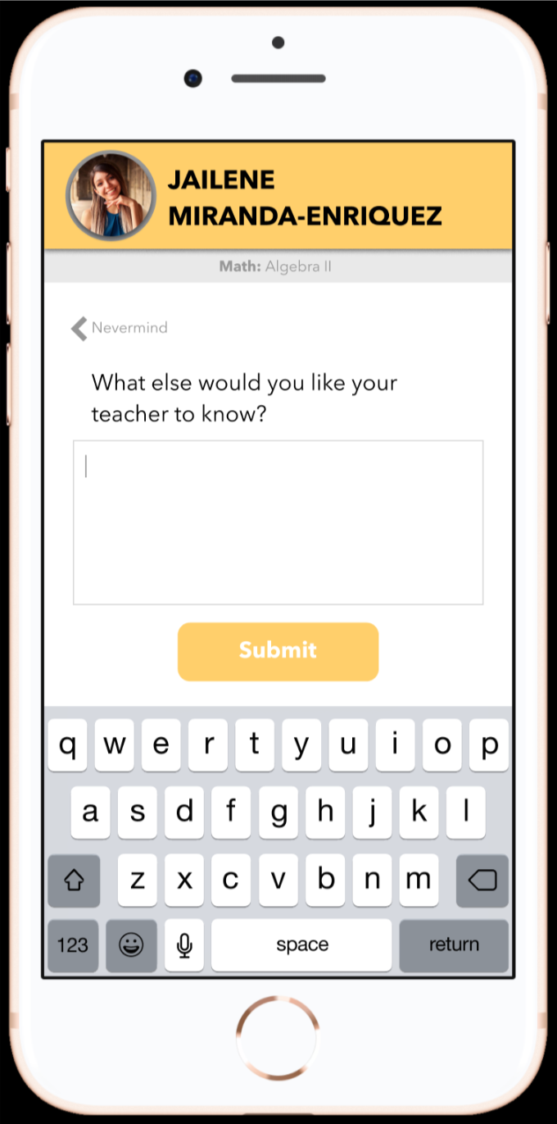
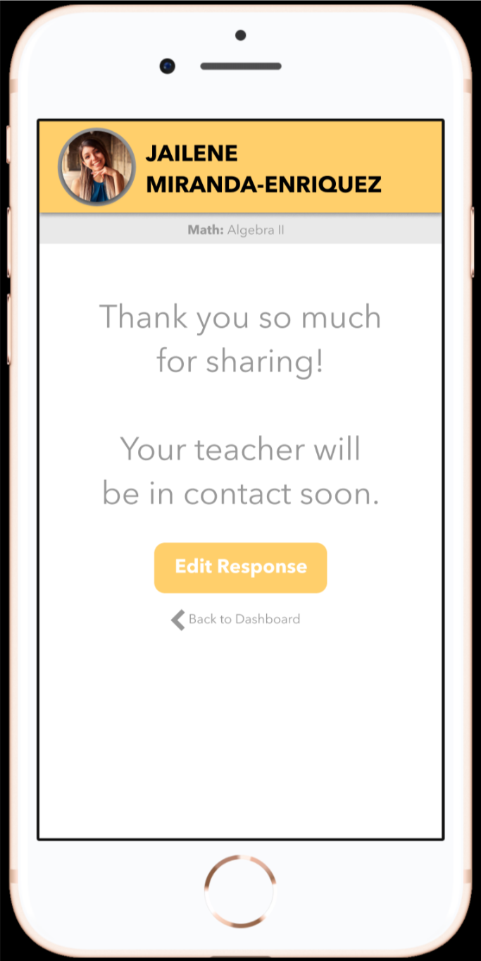
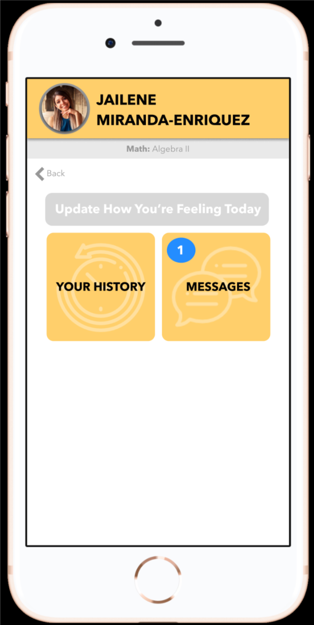
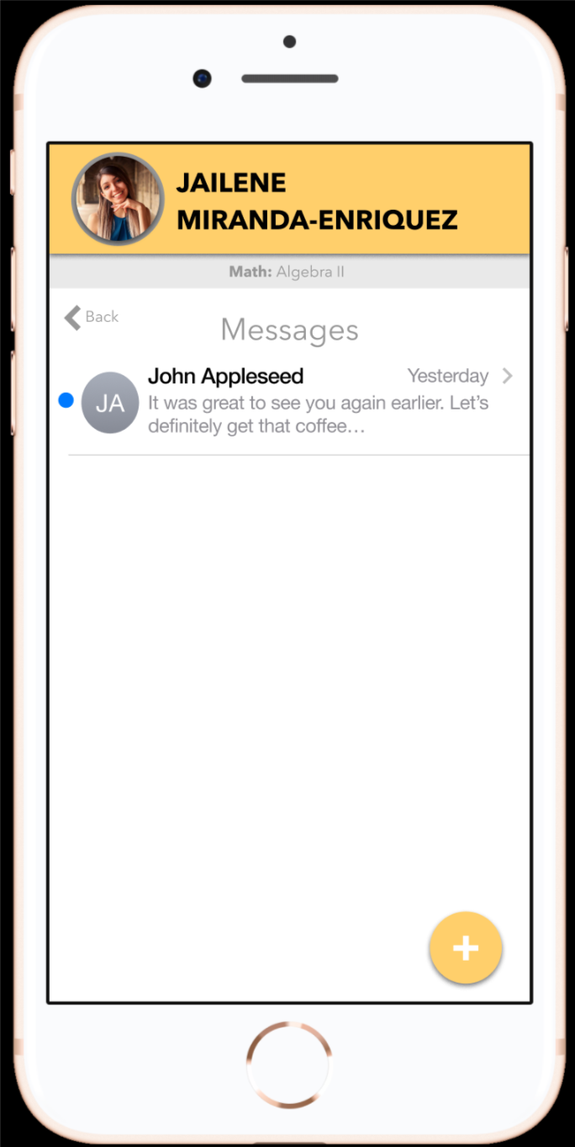
Student Tasks
Request extra attention from teacher if needed (complex)
Notes:
ANNOTATIONS: After the student submits their emoji response, they will have the option to select the “Chat More?” button to talk to their teacher outside of class or during some down time. After selecting to chat more, they can let their teacher in on whatever else they would like to talk about and submit (they can also go back and edit this response). To see if their teacher has responded, they can go back to their home screen for the class and it will show that they have a message (if they have one of course). They can click on this and view all their messages for the class.

Slide 13
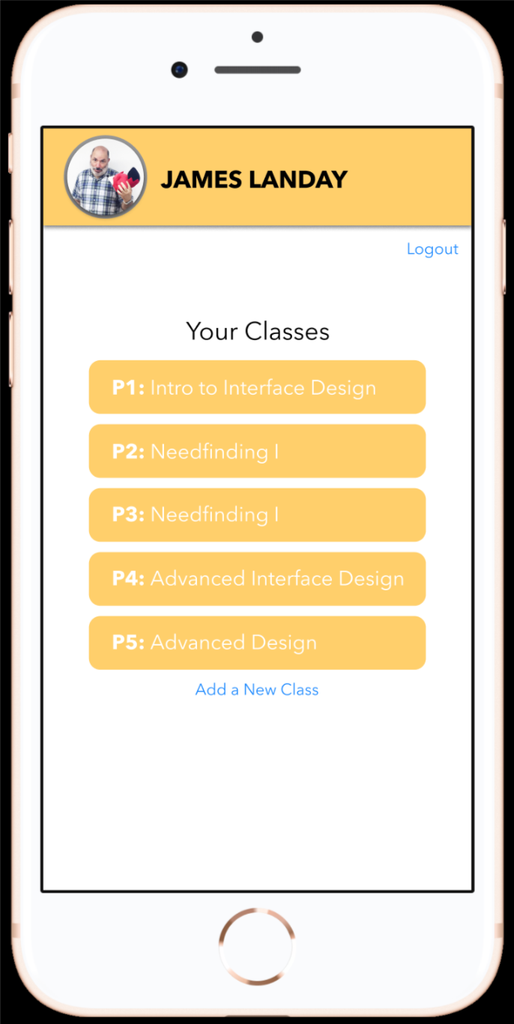
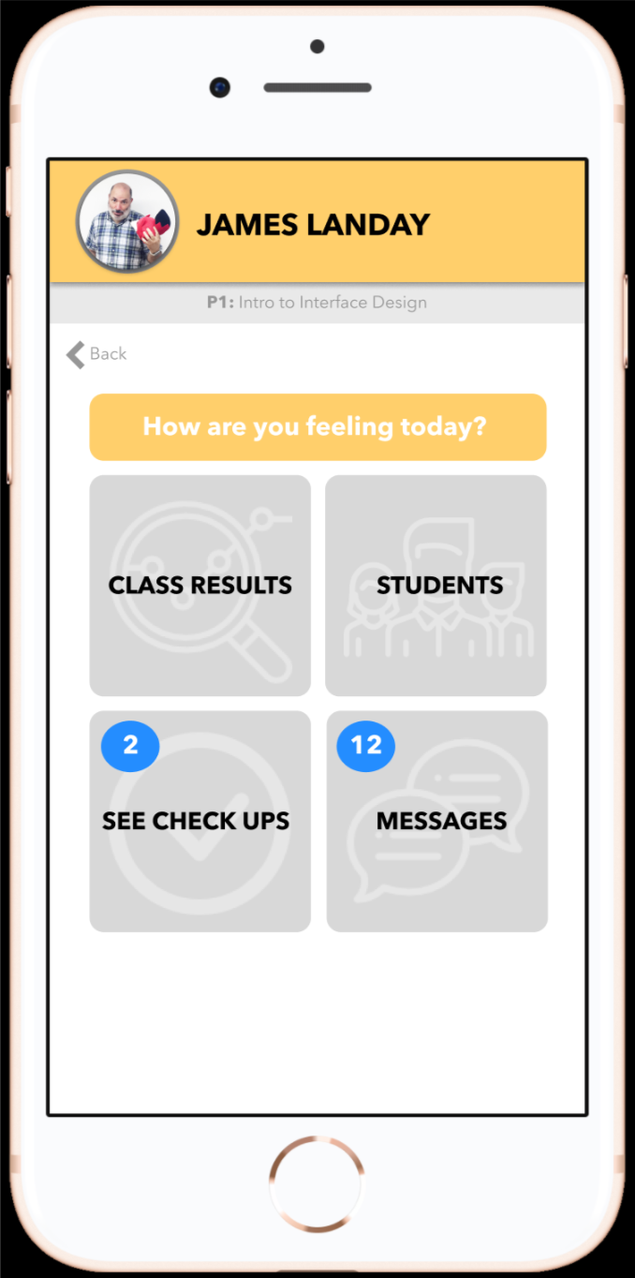
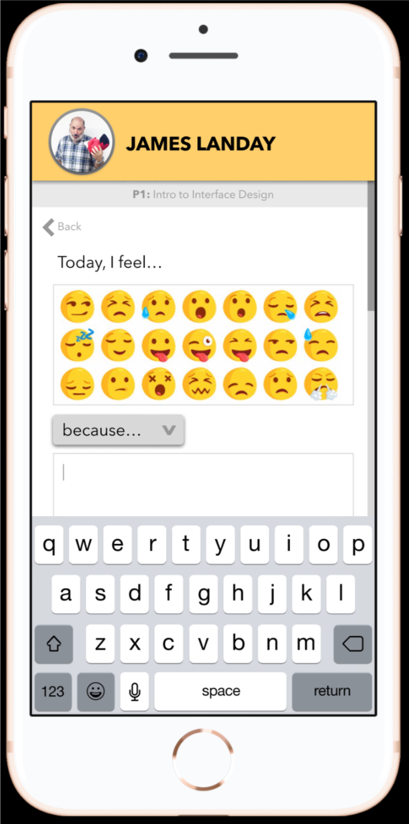
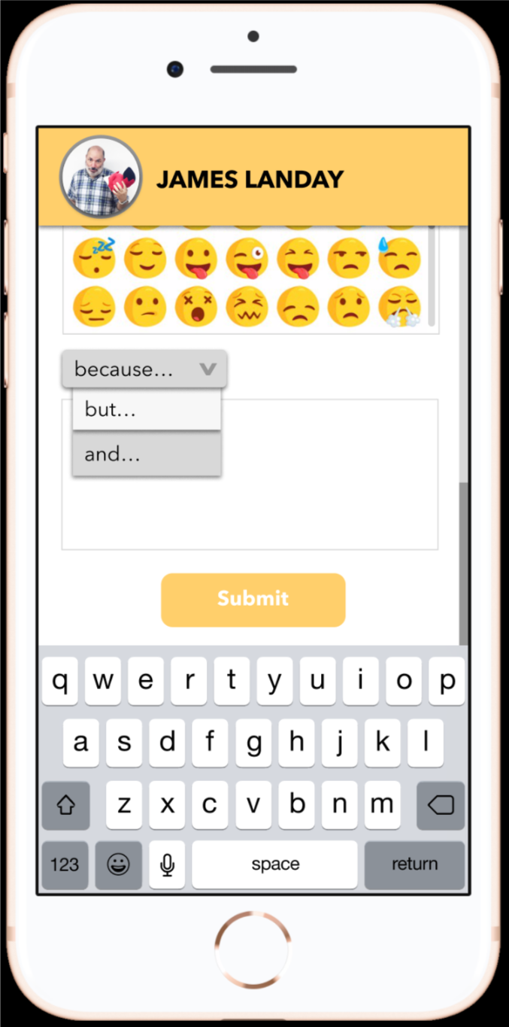
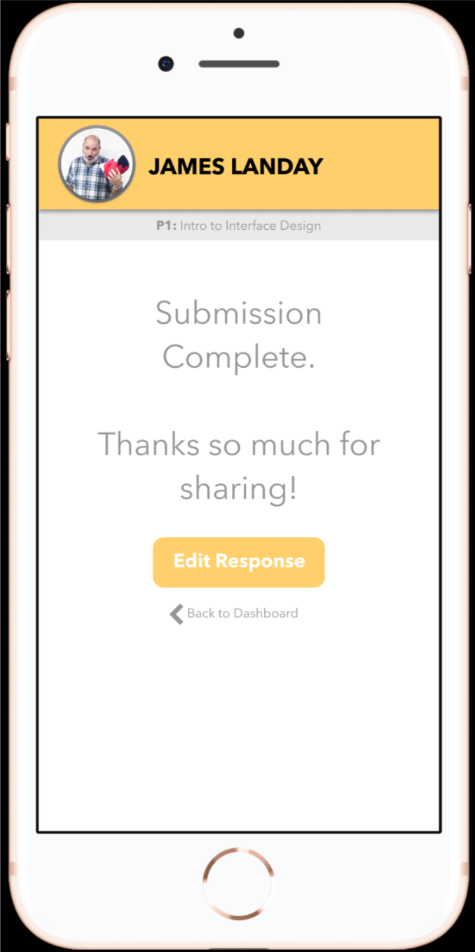
Teacher Tasks
Share how you are feeling at the beginning of class (simple)
Notes:
ANNOTATIONS: The teacher will first log in so we know which type of user they are and who they are, specifically. From there, he can click on the period that he has next. Then, click the “How are you feeling today?” button to then choose his selected emoji for the day/period and then write a brief elaboration (he can choose between different transition words to accurately express what he would like to say. His response will be shown to each student after they submit.

Slide 14
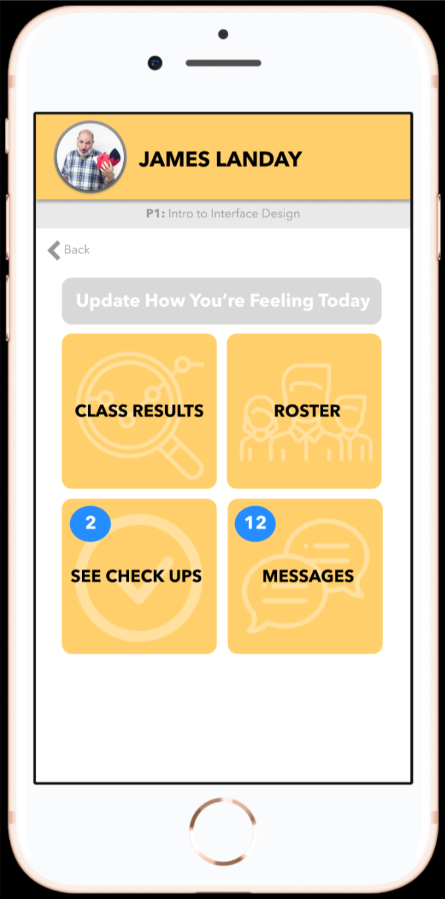
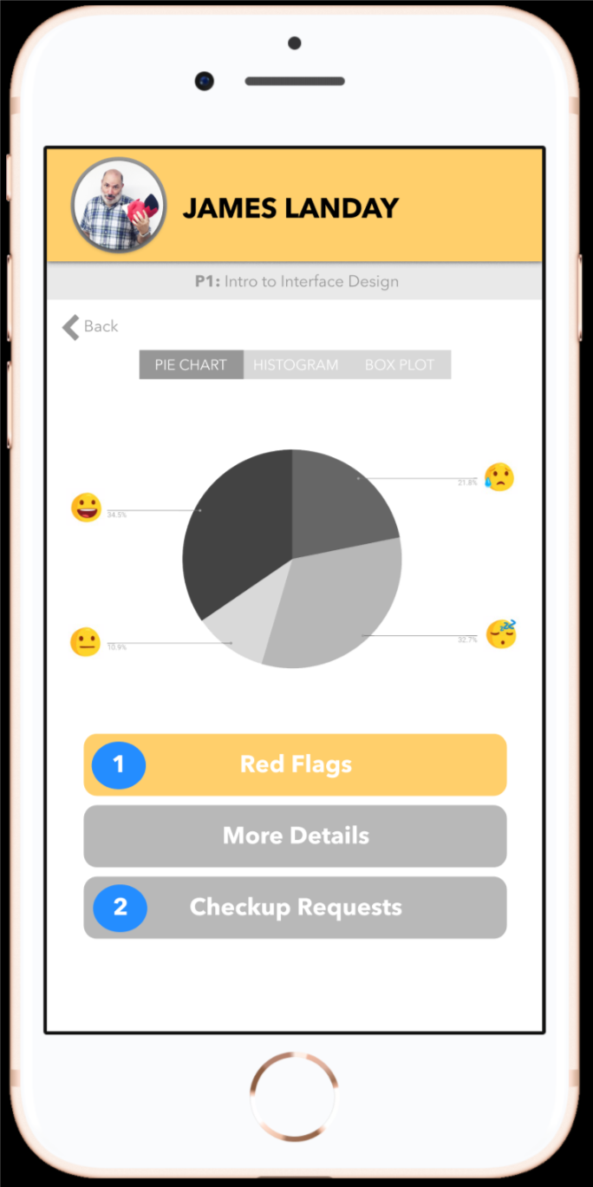
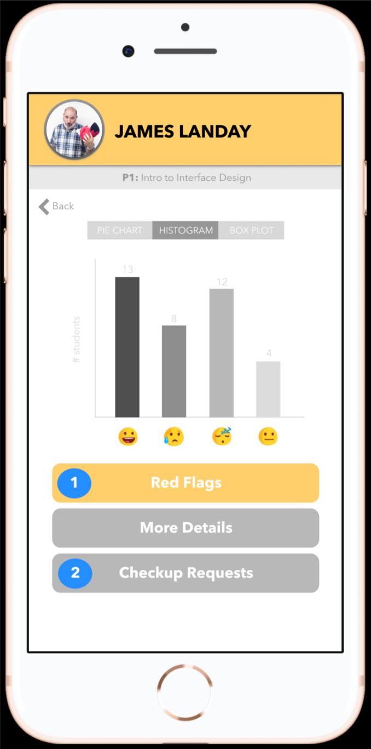
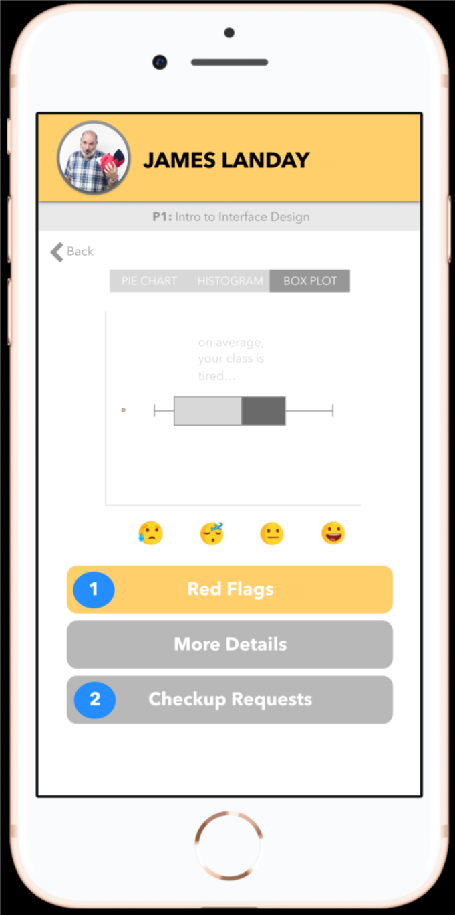
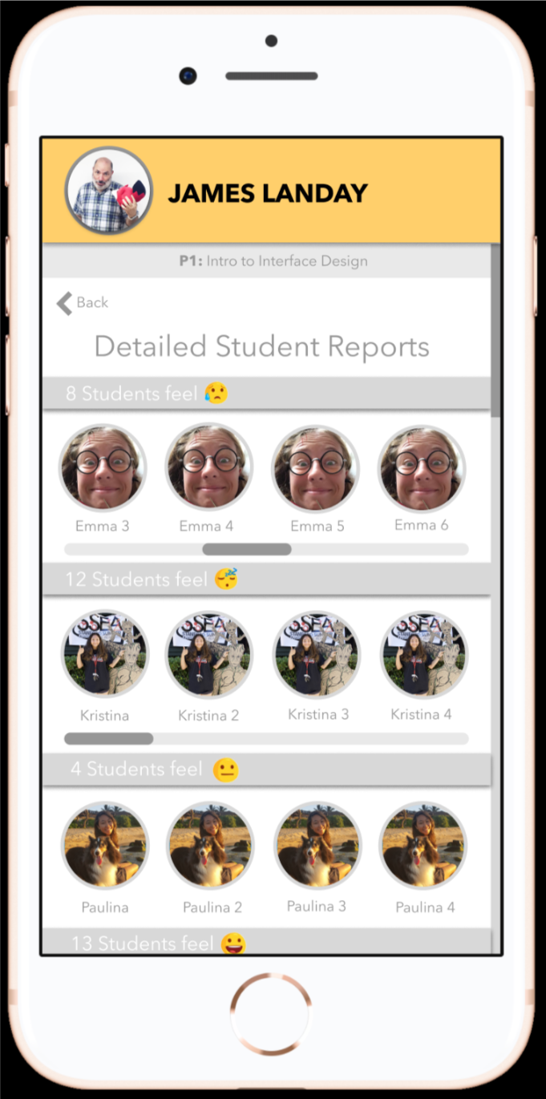
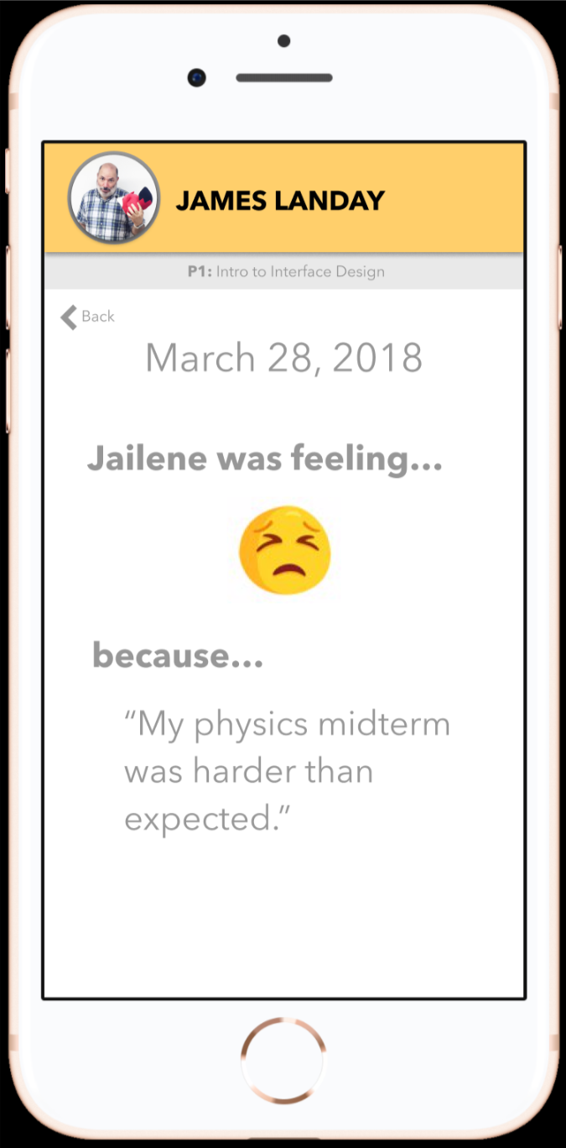
Teacher Tasks
Analyze the synthesized data of student feedback to tailor the classroom experience (medium)
Notes:
ANNOTATIONS: From their home screen for a particular class period, the teacher can click on “class results” to view the synthesized representation of the class’ emotions for the day/period. From the top, they can selected whichever data display they would like (pie chart, histogram, or box plot). The teacher can also select “more details” to view which students selected which emojis. They can click on the student to see their elaboration on their emotion.

Slide 15
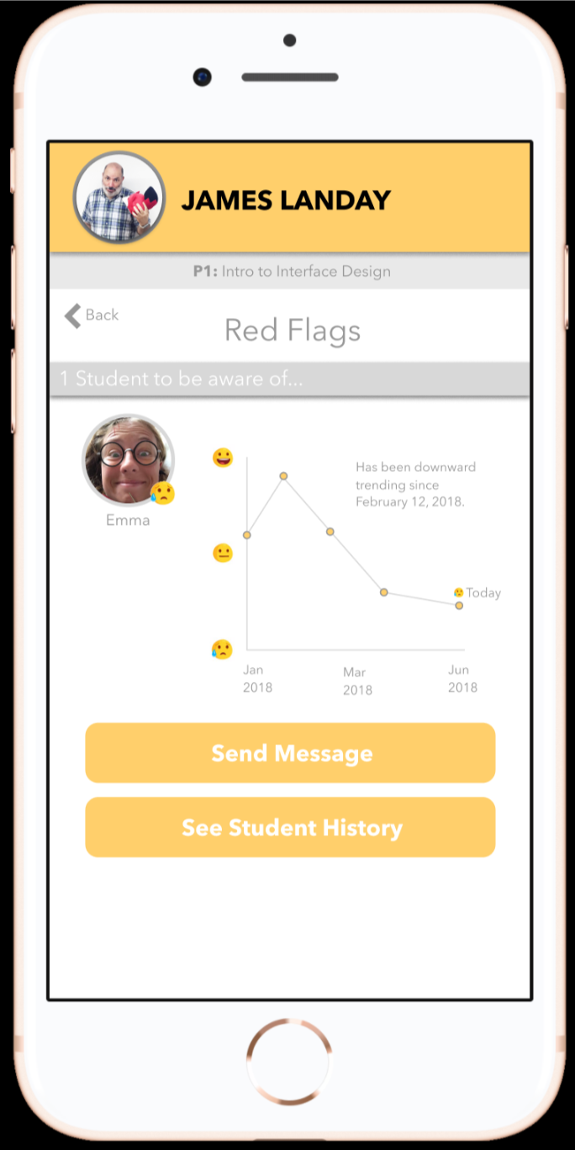
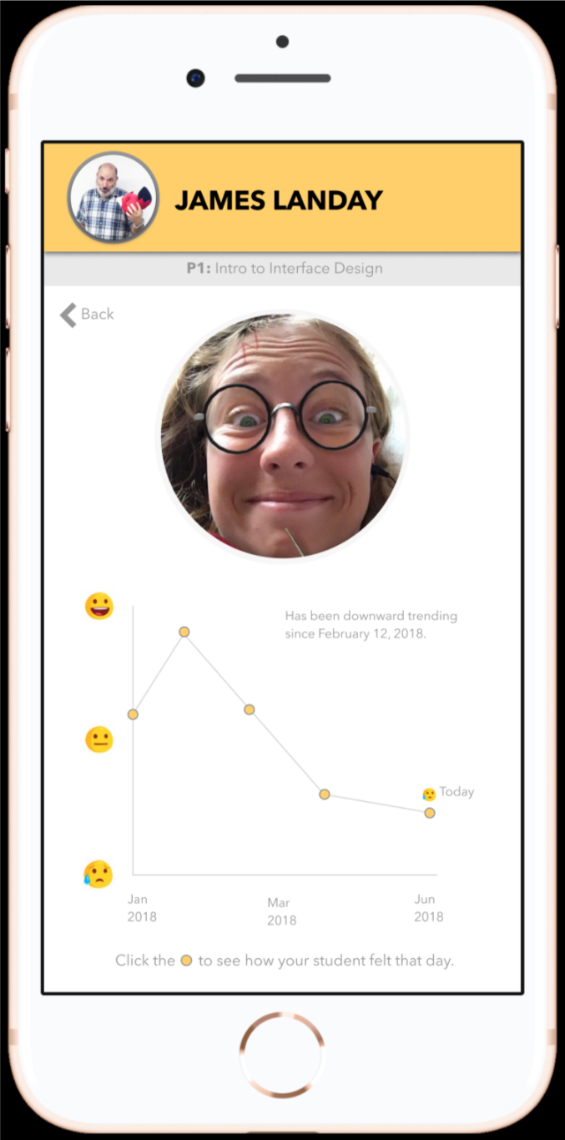
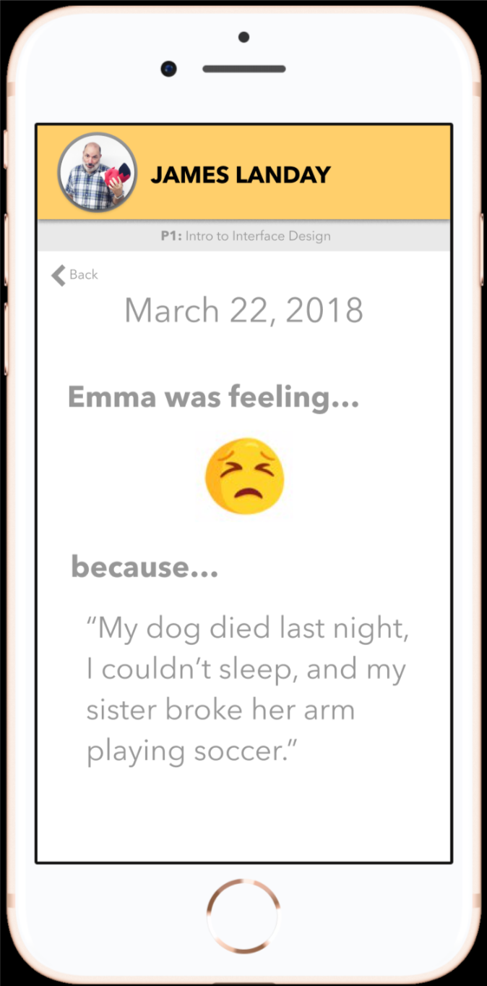
Teacher Tasks
Receive and respond to requests for extra attention/help (complex)
Notes:
ANNOTATIONS: While the teacher is viewing the class results, they can click the “red flags” button to see which students they should be aware of due to a history of negative emotions. They can click “see student history” and from there they can click on a data point to see how the student felt on a particular day and why they felt that way.

Slide 16
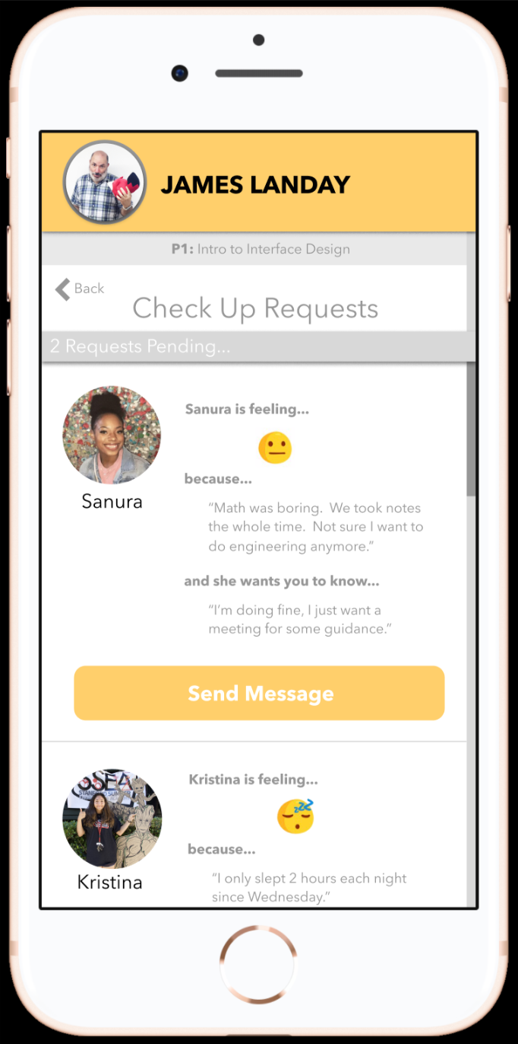
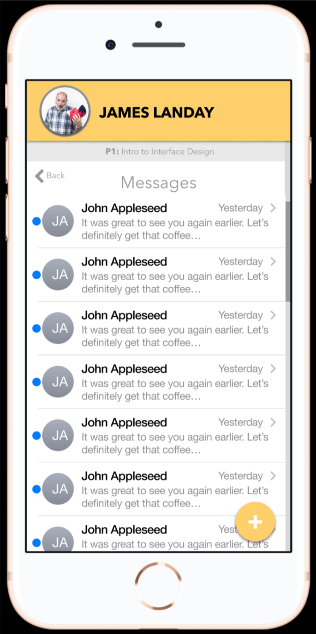
Teacher Tasks
(Pt. 2) Receive and respond to requests for extra attention/help (complex)
Notes:
ANNOTATIONS: While the teacher is viewing the class results, they can click the “checkup requests” button to view which students would like to have a set-aside check up with the teacher. They can also see the additional information that the student provided when requesting a check up. They can click the “send message button” to go to their messages and send them one.

Slide 17
Prototype Overview

Slide 18
Prototyping Tool
Figma and Sketch
Sketch was helpful to create the individual screens with more customizable tools than what were available on Figma
Figma was helpful to link the screens together through “buttons” to look like a functioning mobile app prototype
Figma did have a bit of a learning curve

Slide 19
Limitations/Tradeoffs
There is no actual data collection or synthesis going on
The synthesized data displayed is simply a visual created through Sketch not representing any actual data

Slide 20
Wizard of Oz Techniques
The box plot is already generated and does not use any data synthesis
The historical data of each student does not come from actual data but is displayed a representative visual

Slide 21
Hard-Coded Features
The answers to the prompts are hard-coded to show how this data would be displayed to the teacher/student if the information were actually gathered

Slide 22
Additional Prototype Screenshots

Slide 23
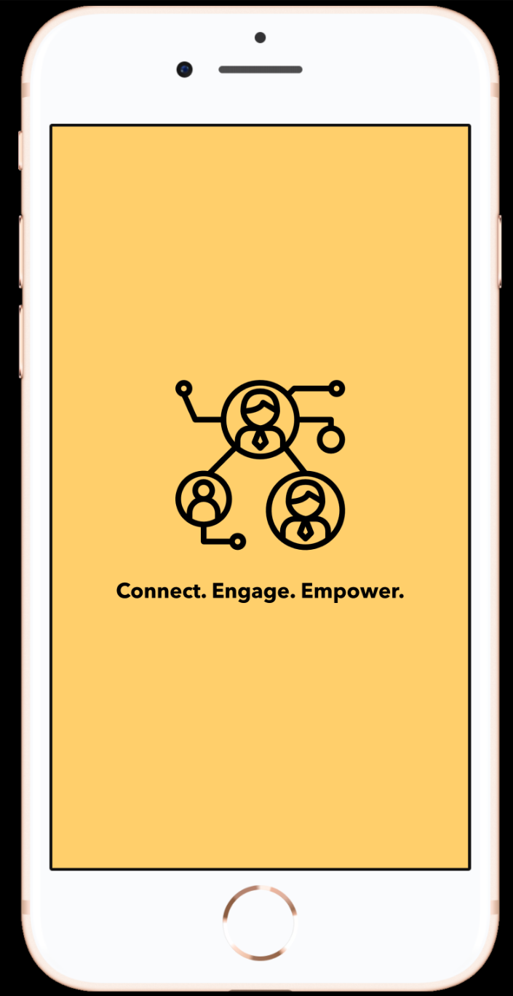
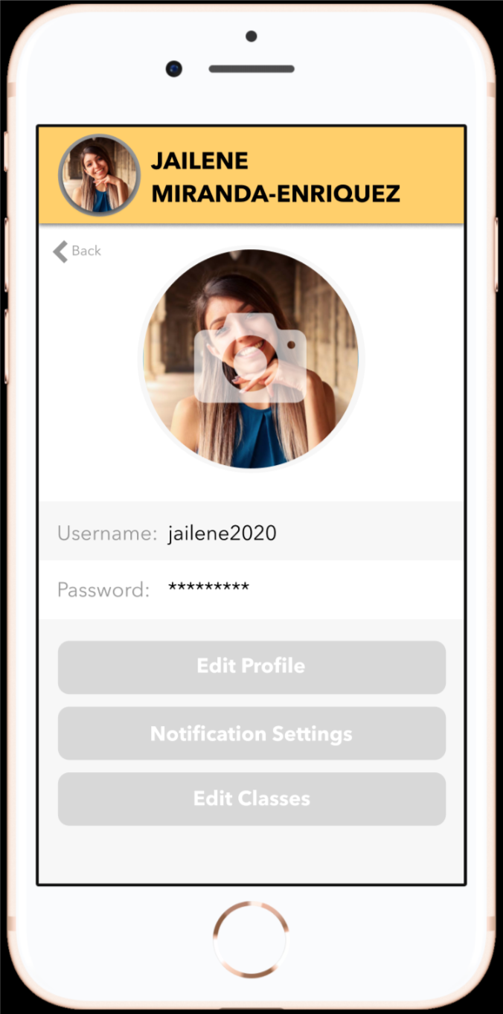
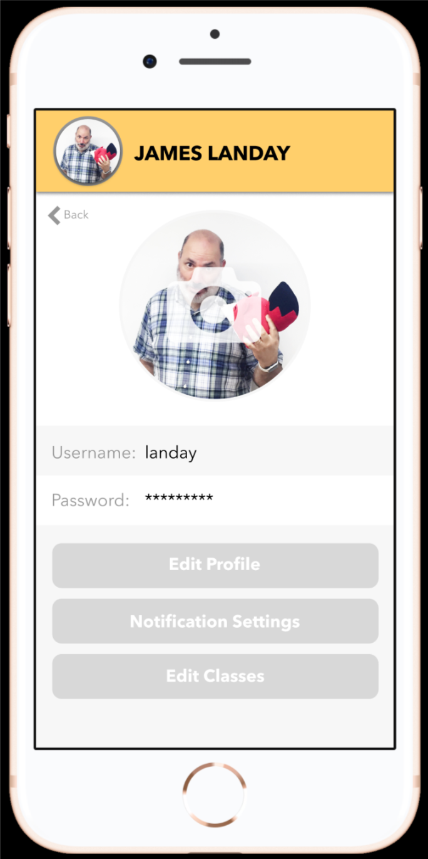
Additional Screenshots
Start Screen
Profile Page
Profile Page
Notes:
ANNOTATIONS: The first screen is the start/splash screen for the app. The second and third screens can be gotten to from any screen by clicking on the profile picture at the top of the screen. On these screens, they can edit their information.

Slide 24
Thanks!
Any questions?

