Slide 1

EDUCONNECT

Slide 2
Problem:
How to effectively build positive student-teacher relationships
Solution:
An application that collects data on how a teacher and his/her students are feeling to suggest activities that help tailor the classroom experience
Value Proposition
Understand, connect, and engage with your students

Slide 3
Tasks
Invite students to share how they’re feeling when class starts (simple)
Synthesize feedback from students in order to tailor the classroom experience accordingly (medium)
Collect feedback from teachers and students (simple)
Identify outliers in the class who might need extra attention (complex)

Slide 4
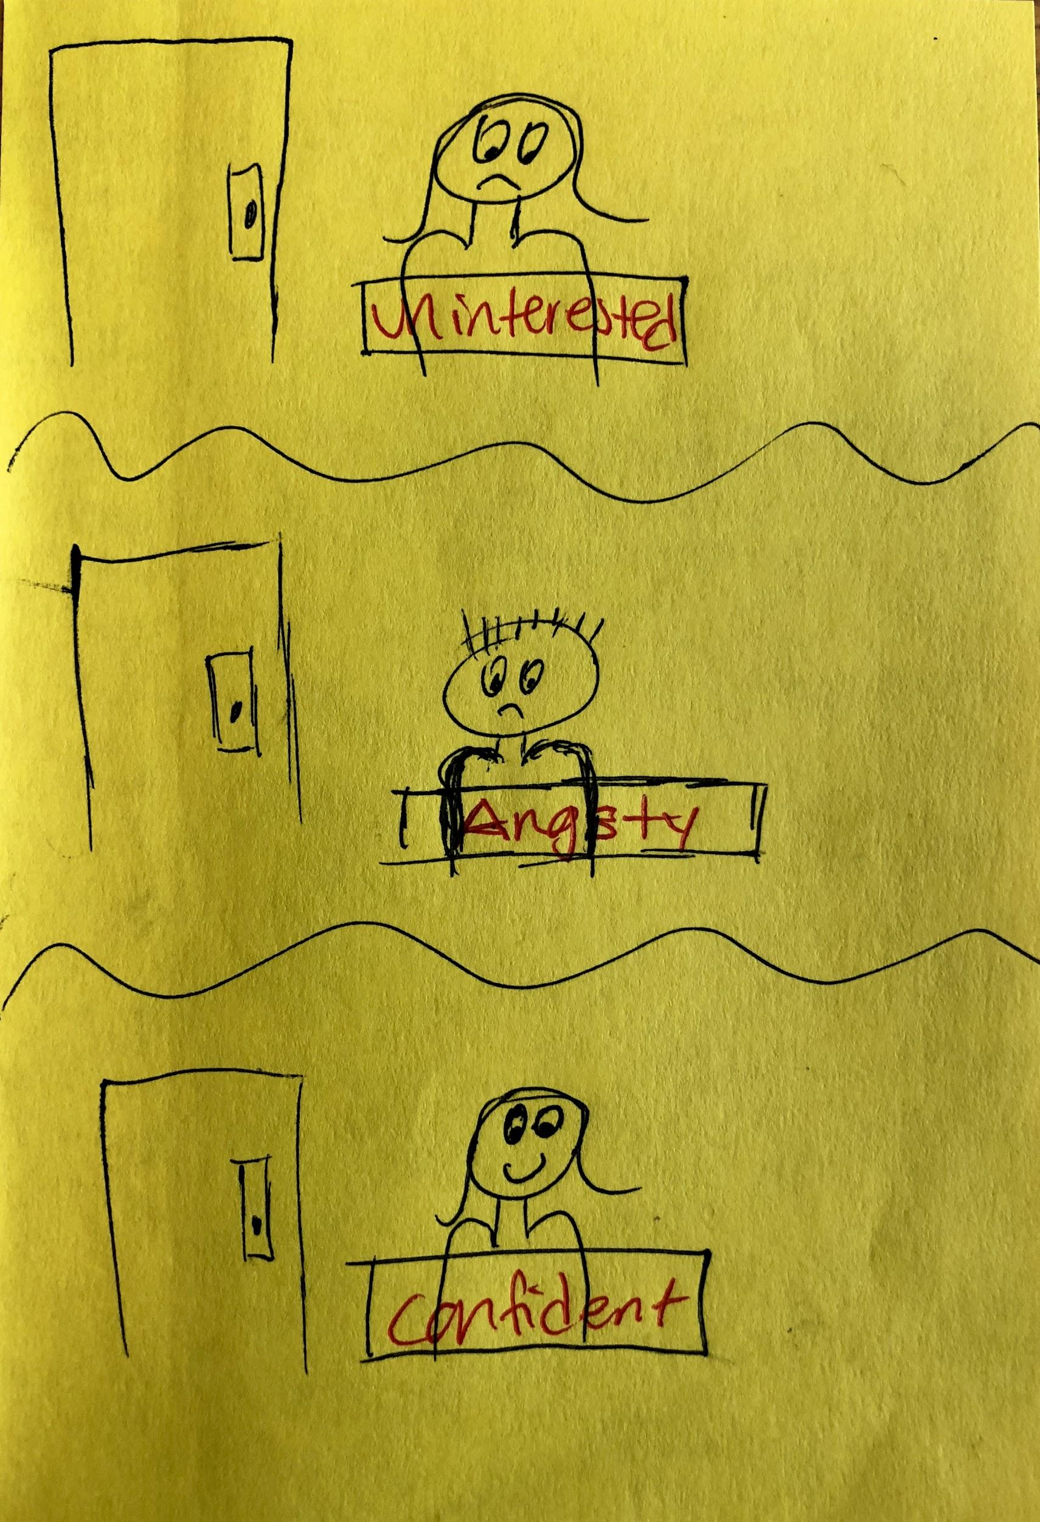
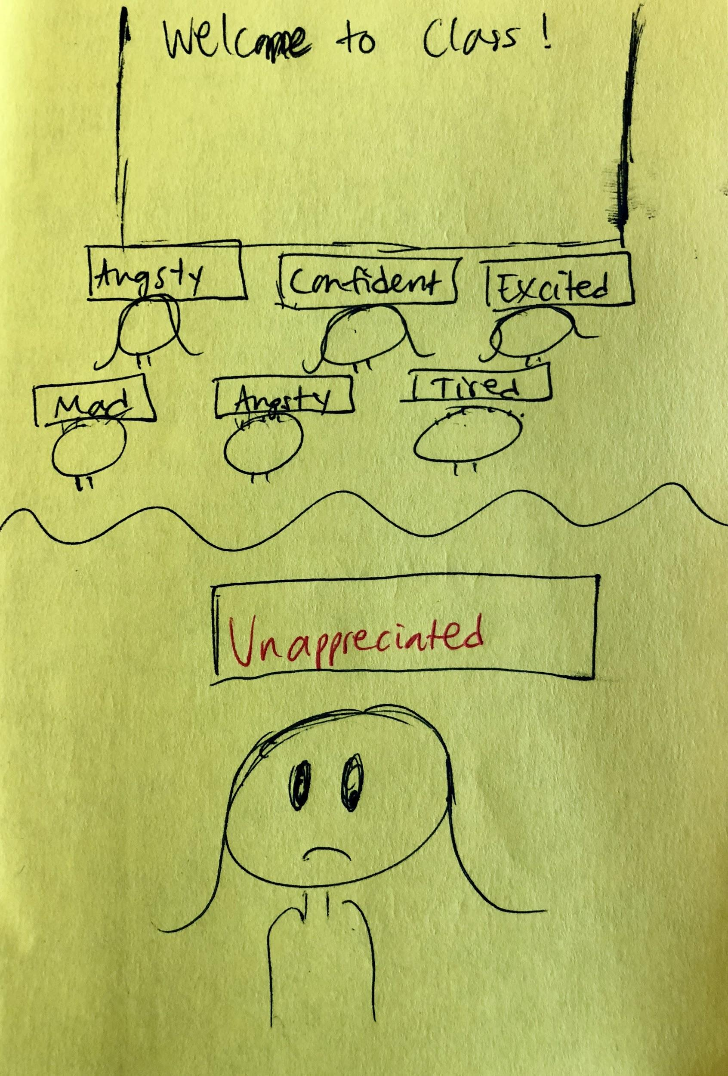
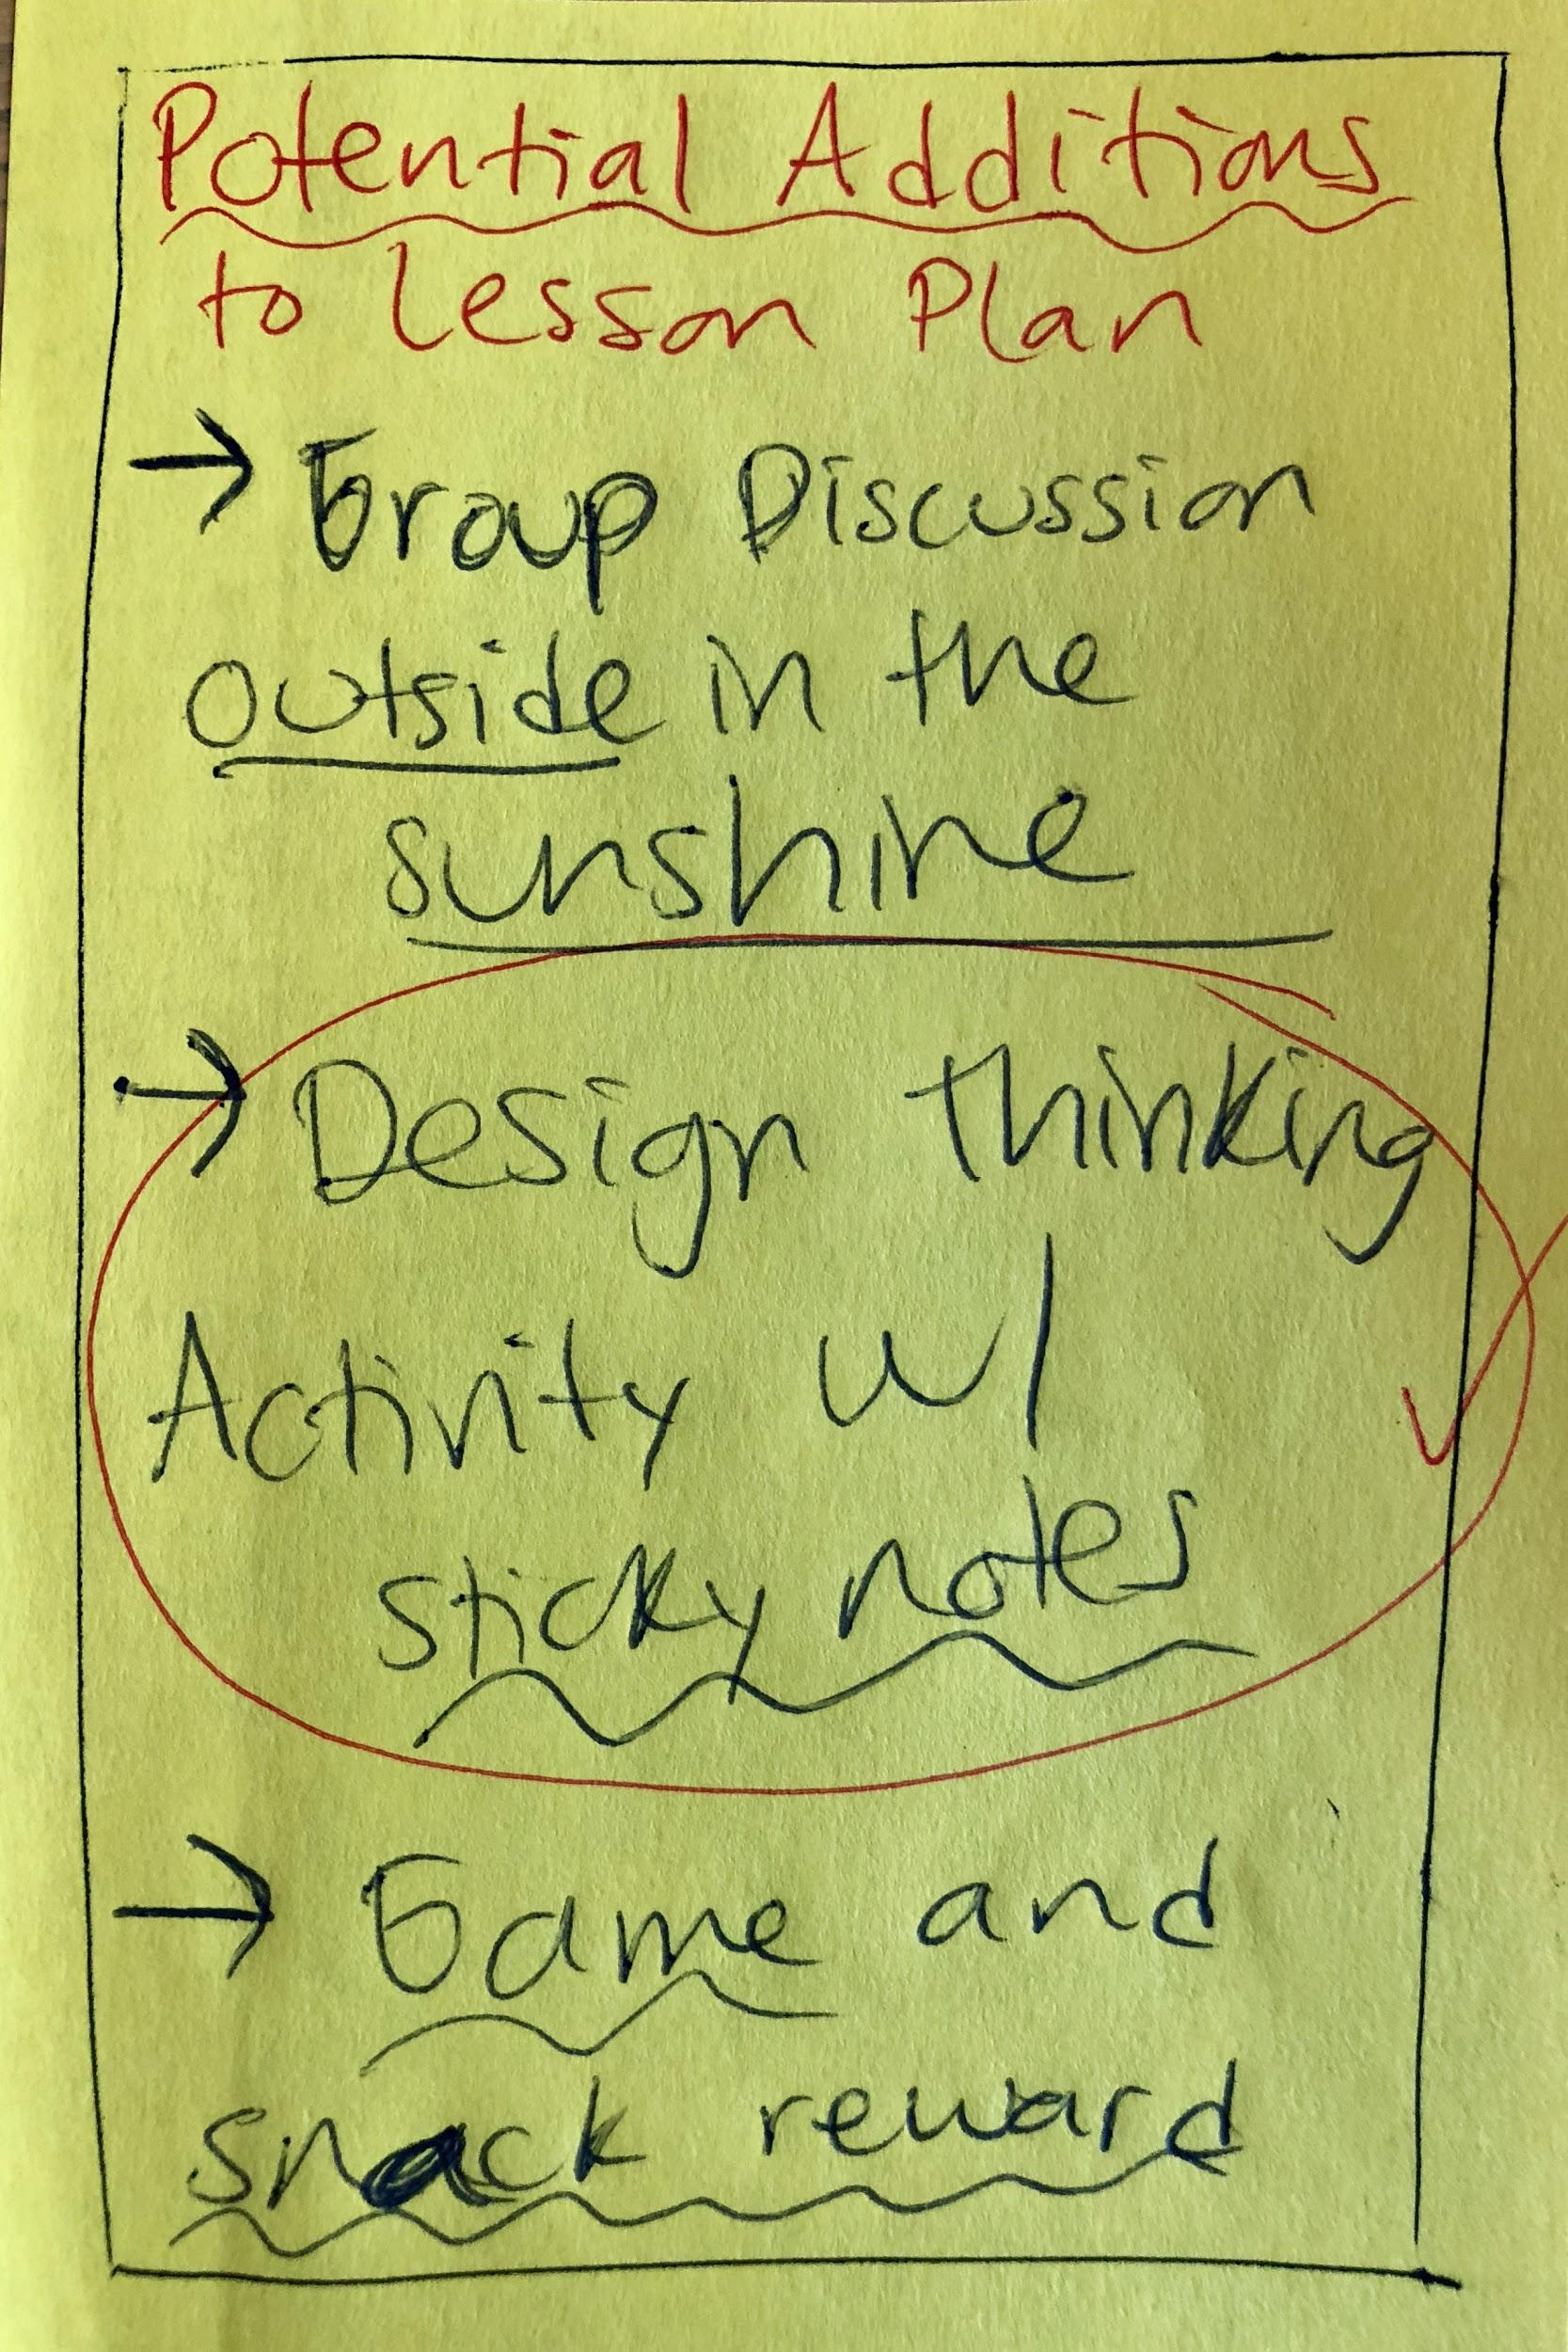
Video Storyboard
Notes:
Scene on left shows the task of inviting students to share how they’re feeling at the beginning of class
Middle scene shows task of collecting feedback from teachers and students
Scene on right shows task of synthesizing the feedback from students in order to tailor the classroom experience accordingly
We did not include our complex task because we assume teachers pull student “outlier”s aside to have more personal conversations

Slide 5
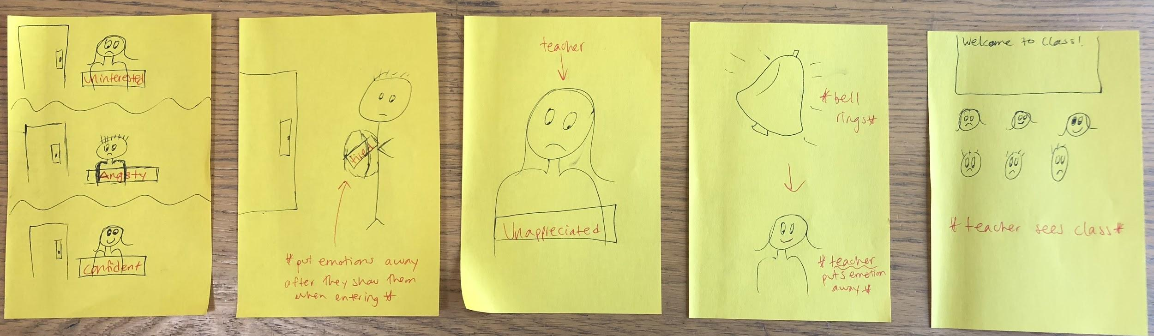
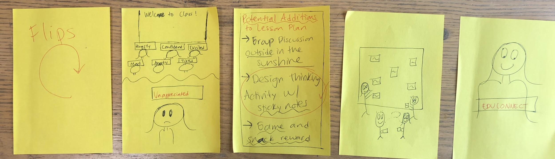
FULL Video Storyboard

