Slide 1
Assignment 4 Slides
Team Magic HW

Slide 2
Value Proposition, Problem/Solution Overview:
Magic Homework “Homework that helps you!”
The problem we are tackling is the difficulty in finding and accessing the necessary resources to complete homework assignments. We are solving this by integrating an overlaying system that uses recorded lecture, categorized resources, and a smart ai to give the user individualized feedback and support on classwork.

Slide 3
Three Tasks
Simple:
A student would use MagicHW to get a synthesized review of previous lecture before starting assignment with options to see what parts of lecture each section of the video refers to. This task is simple as it would be used before starting every assignment and by a first time user.
Moderate:
When a student gets a question wrong/is stuck on an aspect of homework, they may become stuck and not know where to look for help. Magic HW enables students to instantly access the relevant resources for where they went wrong and makes the moment in the lecture where the teacher taught that material appear before them. This is moderate as it still has a fairly common use case, but using all of the features and rewatching the relevant lecture might require a more devoted user.
Complex:
When trying to study, a student will oftentimes want to create problems similar to those they have gotten wrong in the past, across multiple subjects and PSETs. MagicHW allows students to create just such a problem sheet. This task would require a User who both uses MagicHW a lot, so that it knows about where the user struggles, as well as a user who is actively trying to complete more problems to shore up their weaknesses and study for a big test.

Slide 4
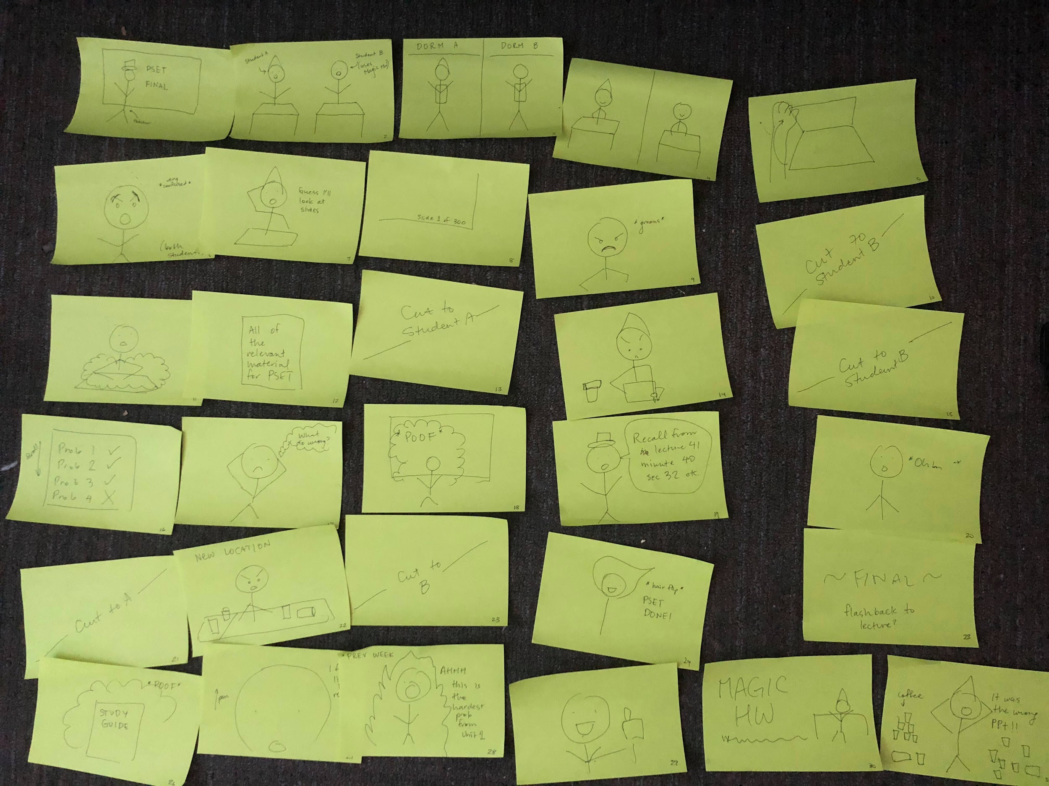

Slide 5
Concept Video!
https://youtu.be/Md7IZl304Z8

