Slide 1
Redefining Education

Slide 2
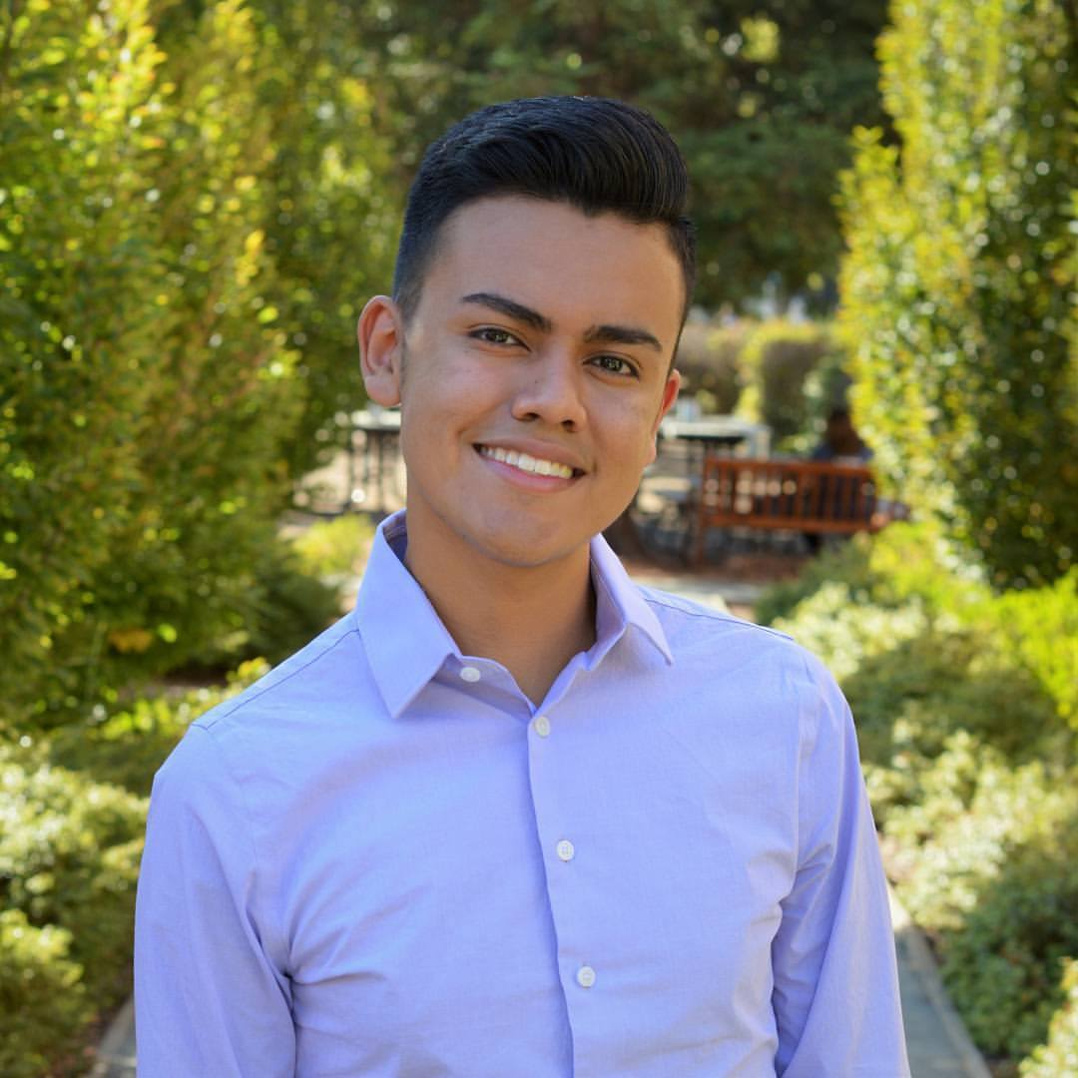
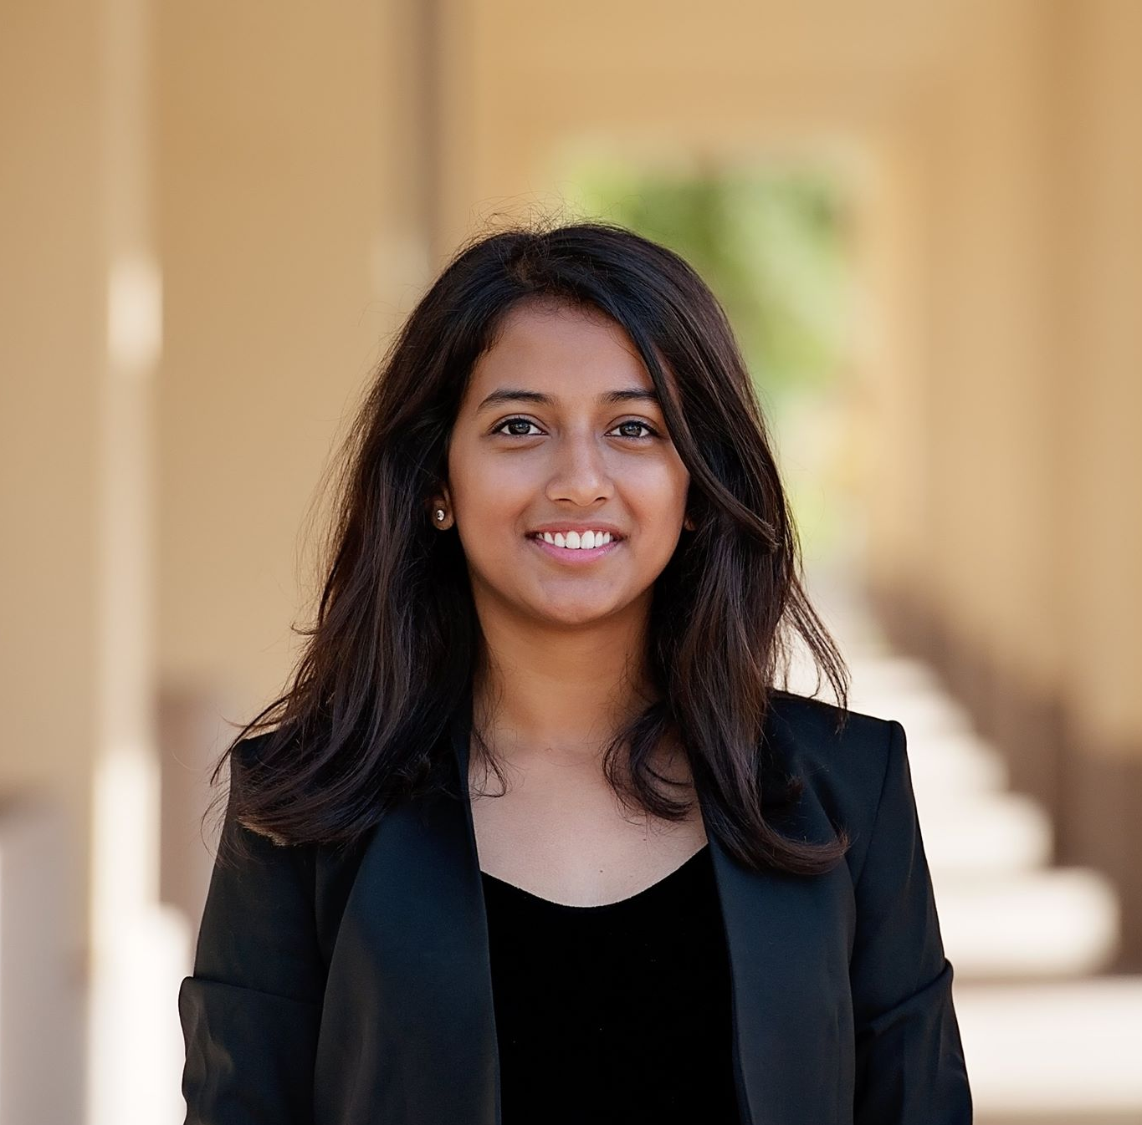
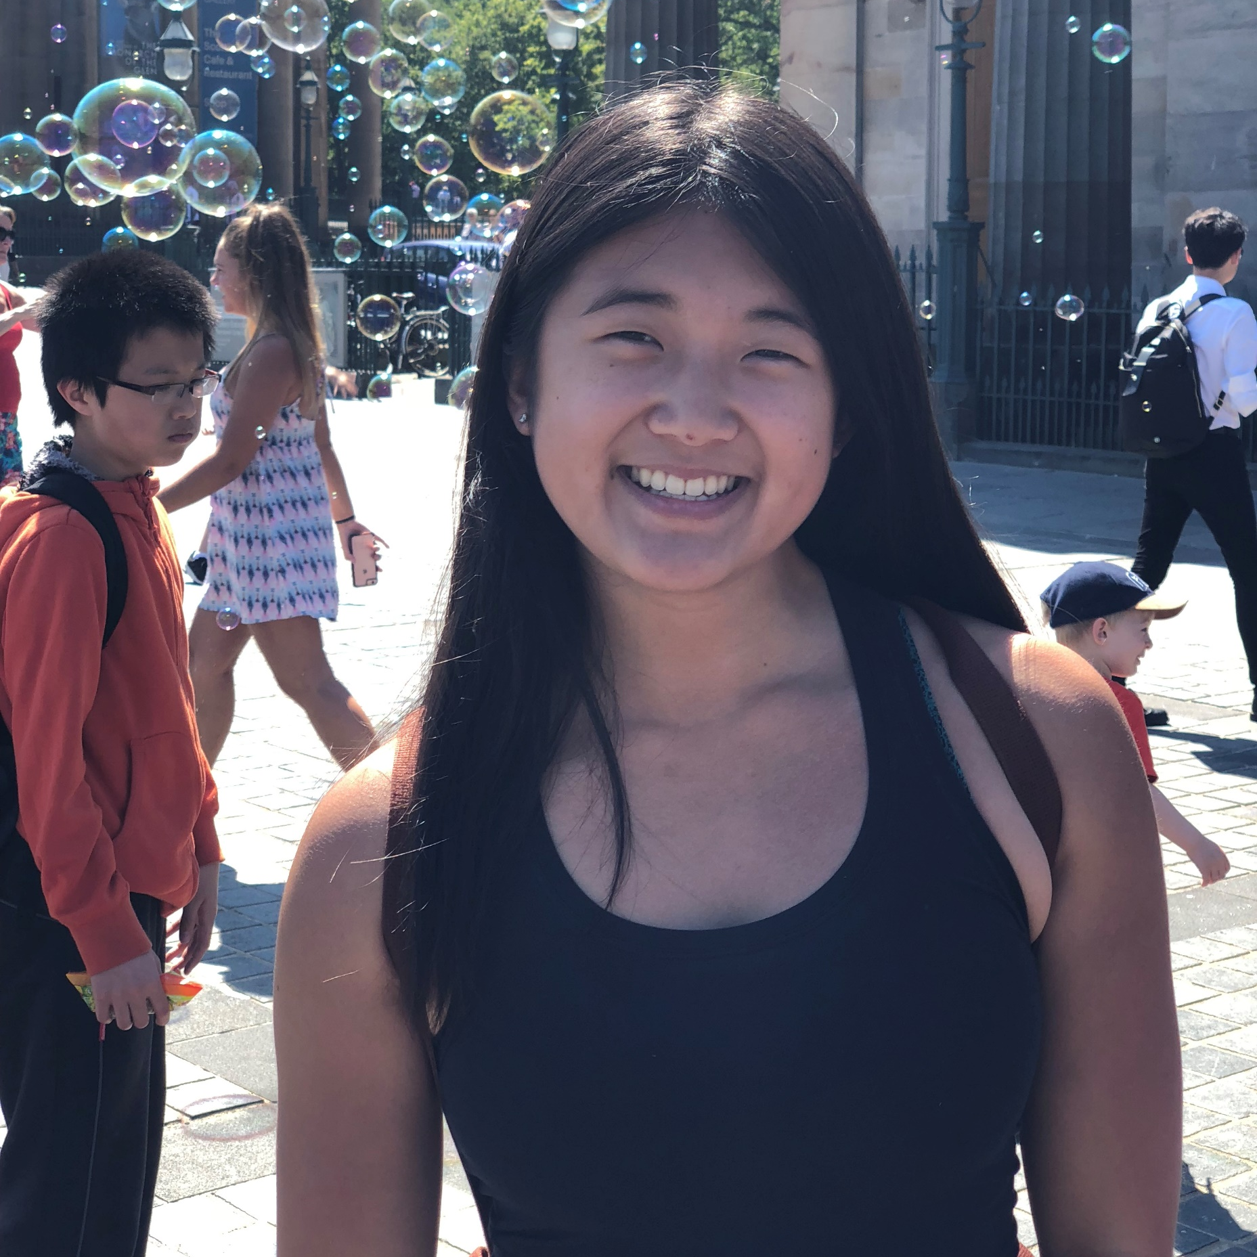
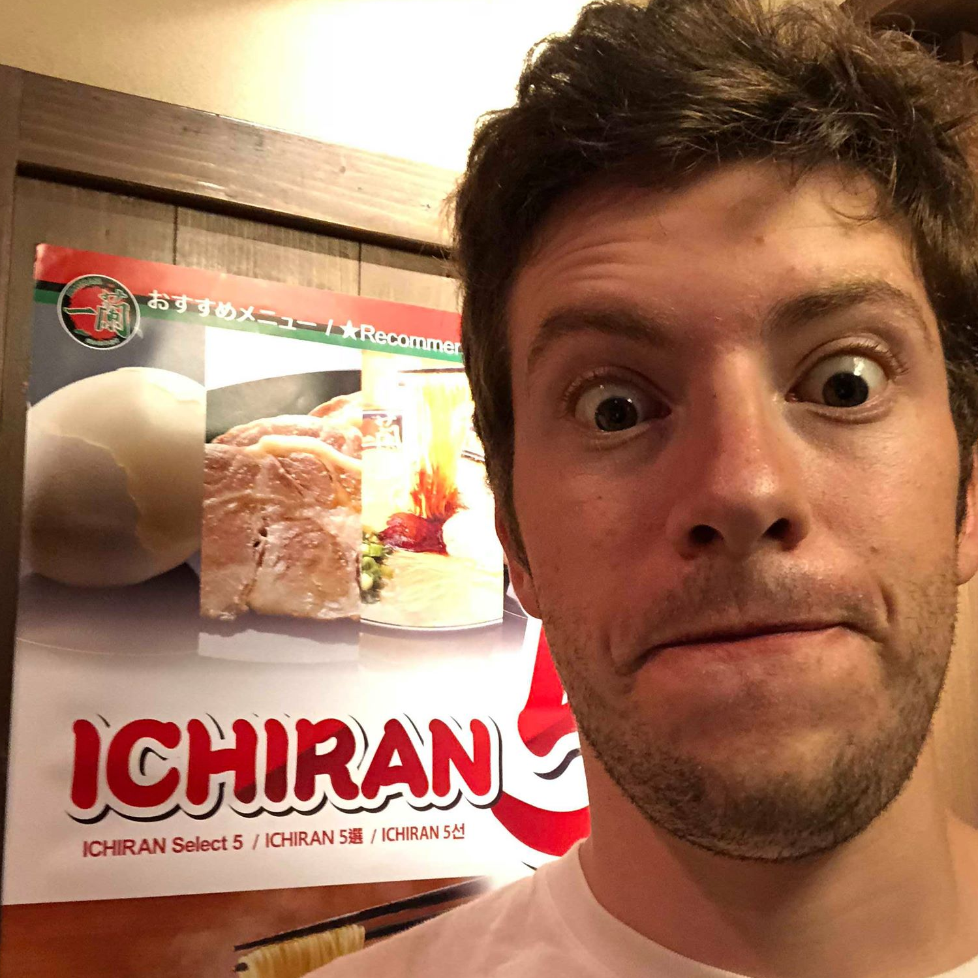
Introduction
“We hope to improve the educational landscape for instructors and students alike”

Slide 3
Initial Point of View

Slide 4
We met
Terry, who is an instructor in a prison and a California college.
We were amazed to realize
that he felt it was impossible to effectively teach all of his students since he could not connect with each of them and appeal to their ways of learning
It would be game changing if we could
help Terry tailor his content to the majority of his students and to restore his faith in education

Slide 5
Additional Need finding

Slide 6
New Interviews
Coffee + Boba (2)
Elementary School (2)
Neighborhood Walk (1)
East Palo Alto
Downtown Palo Alto

Slide 7
New Interviews
Annia
Learning
Feels Neglected
- 5 years old
- Kindergarten
“I always raise my hand but the teacher does not call on me”
- East Palo Alto
“5..4..3..2..1..”
Boredom Strikes
6 years old -
“I hate writing cursive. It takes so long and I’m a fast writer. I’m already good at it”
First grade -
Bowman -
Liam

Slide 8
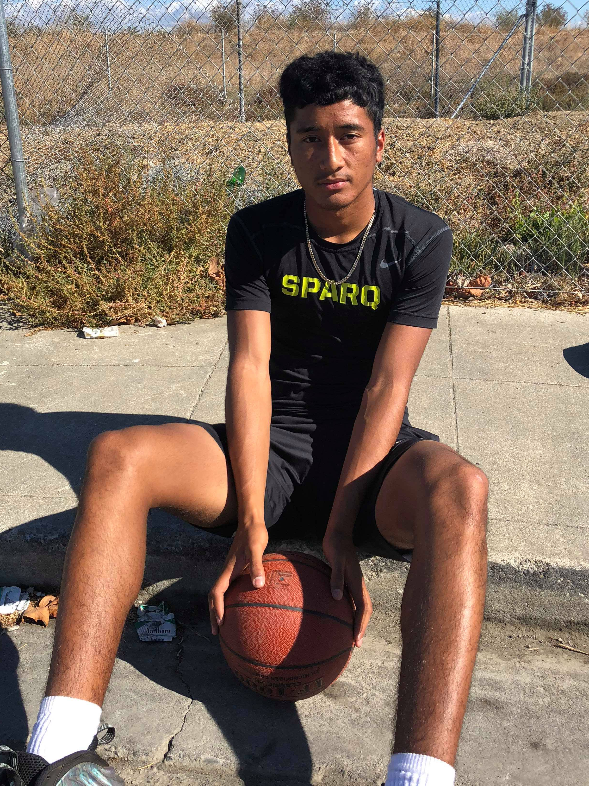
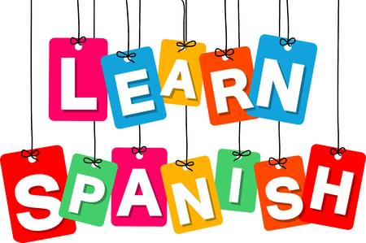
New Interviews
Albert
Started in 4th grade
“Learning from YouTube was as effective as having a coach... It was a smooth transition joining a team”
YouTube Guidance
Joined team in Middle School
9th grade
“The teachers assume we know the basics... they test us on stuff not taught... 11/30 students have a tutor.
Tutor 1 month in
40% of class speaks Spanish
Junior @ Sequoia HS
Lives in East Palo Alto
Basketball Player
Physics lover

Slide 9
New Interviews
Adrian
Values:
Credentials + Experience
Wants relevant examples to understand importance
Allen
Professor:
Create new knowledge
Other
“Repeater”
Still important
Quick
Test results
Formula derivations + sources
Good Learners:
Curiosity → true learning
True learning → create “new things”
American, recent Italian B-School grad
“Strong learner”
Law Professor, Paris
“Strong learner”

Slide 10
New Interview Takeaways
Differing baseline of understanding is detrimental for those ahead and behind in the content
1.

Slide 11
New Interview Takeaways
Technology can be an effective learning tool (no human interaction needed)
2.

Slide 12
New Interview Takeaways
CONTRADICTION:
Leverages technology to learn hobby
vs
Doesn’t try same for Spanish. Relies on human interaction
3.

Slide 13
New Interview Takeaways
Lack of personal attention can reduce desire to learn over time ... impossible to call on everyone every time (similar to Terry)
4.

Slide 14
New Interview Takeaways
“Good Teacher, Good Student” is so variable based upon person + values (grades, credentials, teaching style)
5.

Slide 15
New Points of View (3)
+
How Might We

Slide 16
We met
Adrian, a recent Italian Business School grad
We were amazed to realize
that he dozes of in lecture when he does not feel connected to the material / can’t see its significance
It would be game changing if we could
help instructors ensure understanding of material by appealing to students needs and wants

Slide 17
How Might We (Top 3)

Slide 18
Experience Prototypes

Slide 19
1
We met
Annia, a kindergartener in Palo Alto
We were amazed to realize
in her first year of instruction, she already feels neglected by the school system
It would be game changing if we could
help Annia get more consistent feedback on her work and feel more connected to her education

Slide 20
1
How Might We
allow instructors to continuously provide personal and effective feedback to each student based on their performance and understanding of the material?

Slide 21
Solution: Magic Homework
1
Intelligent homework that provides personalized feedback + instruction
get question wrong → refers to part of lecture where material taught
categorize student strengths + struggles
Provide resources for help
Assumption: people are too lazy to look up resources but will use them if they are convenient

Slide 22
1
Magic HW Experience Prototype
Methodology:
Instructor (us) shows student (subject) how to fold a butterfly
(5 Step Fold)
Trial 1: Tell student to do whatever it takes to re- create fold
Trial 2: Provide student with a video showing process. Do whatever it takes to re-create fold

Slide 23
Magic HW Prototype Results
1
Trial 1: No resources
Trial 2: Video provided
Newton
Don
Low 20s
Journalism, Canada
Stanford
Bookstore
Confused after step 1
Does random fold
Gave up (2-minute total)
First 2 steps alone
Fast-forward video, replay
Completes task (6-minutes)

Slide 24
Experience Prototype Findings
1
Assumption: people are too lazy to look up resources but will use them if they are convenient
Mistakes –> dig deeper hole, give up
Given right resources –> use immediately when struggling

Slide 25
2
We met
Albert, a high school junior living in East Palo Alto
We were amazed to realize
in his Spanish class, the teacher would skip over essential material because 40% of students spoke Spanish
It would be game changing if we could
help instructors accommodate students of all backgrounds in their curriculum

Slide 26
2
How Might We
assist instructors in ensuring a baseline understanding of material necessary for each lesson and course

Slide 27
Solution: Student Pairing
2
Pair “expert” students in a class with beginners
Test for expertise in a subject
Reduce course load for “experts” in exchange for tutoring beginners
Intelligent pairing
Assumptions:
Struggling students would be willing to accept help from their peers
2. Knowledgeable students would be willing to help out those struggling given some incentive

Slide 28
2
Student Pairing Experience Prototype
Methodology:
On a language sheet, give expert student the ability to do less work by helping beginner student. Beginner student has a choice as well
Trial 1: The subject is the “expert”, we are beginner
Trial 2: We are the expert, subject is the beginner

Slide 29
Student Pairing Prototype Results
2
Trial 1: Subject is expert
Trial 2: Subject is beginner
Eva
Sami, Sabine
Barista, Coupa
STEM, grads @ Stanford
HS, fluent Spanish
Weak in French
Chooses to help
Gave answers, couldn’t explain how she got to them
Would want tutoring
Want to evaluate competency of student

Slide 30
Experience Prototype Findings
2
Assumptions:
Struggling students would be willing to accept help from their peers
2. Knowledgeable students would be willing to help out those struggling given some incentive
BUT..... assumed “experts” can teach (not the case)

Slide 31
3
We met
Adrian, a recent Italian Business School grad
We were amazed to realize
that he dozes of in lecture when he does not feel connected to the material / can’t see its significance
It would be game changing if we could
help instructors ensure understanding of material by appealing to students needs and wants
Notes:
We met Allen, a Law professor from France. We were amazed to realize that he considered the best students to be not the ones with the best grade, but the ones with the most curiosity and interest. It would be game-changing to assist students’ curiosity.

Slide 32
3
How Might We
increase student understanding of lecture material and content in real-time

Slide 33
Solution: Lecture Kit
3
Lecture Kit Includes:
Continuous student feedback on understanding (displayed visually)
Keep track of reactions, run analytics, provide suggestions for professor
Biggest Assumption:
Giving lecturers information in real time will aid lecture teaching

Slide 34
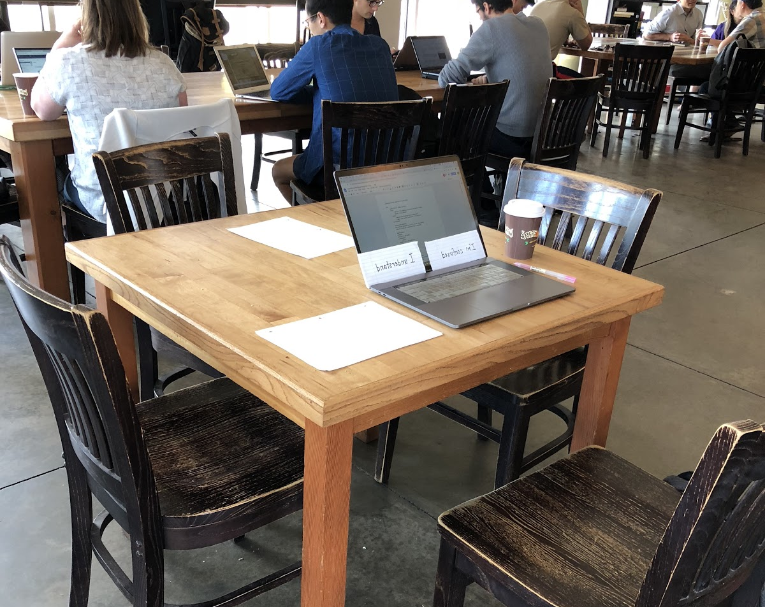
3
Lecture Kit Experience Prototype
Methodology:
Have a subject give a 5-10 minute “lecture” to us (students) on anything they wanted
Can draw from work or school experiences
Given preparation time
Students provide live feedback

Slide 35
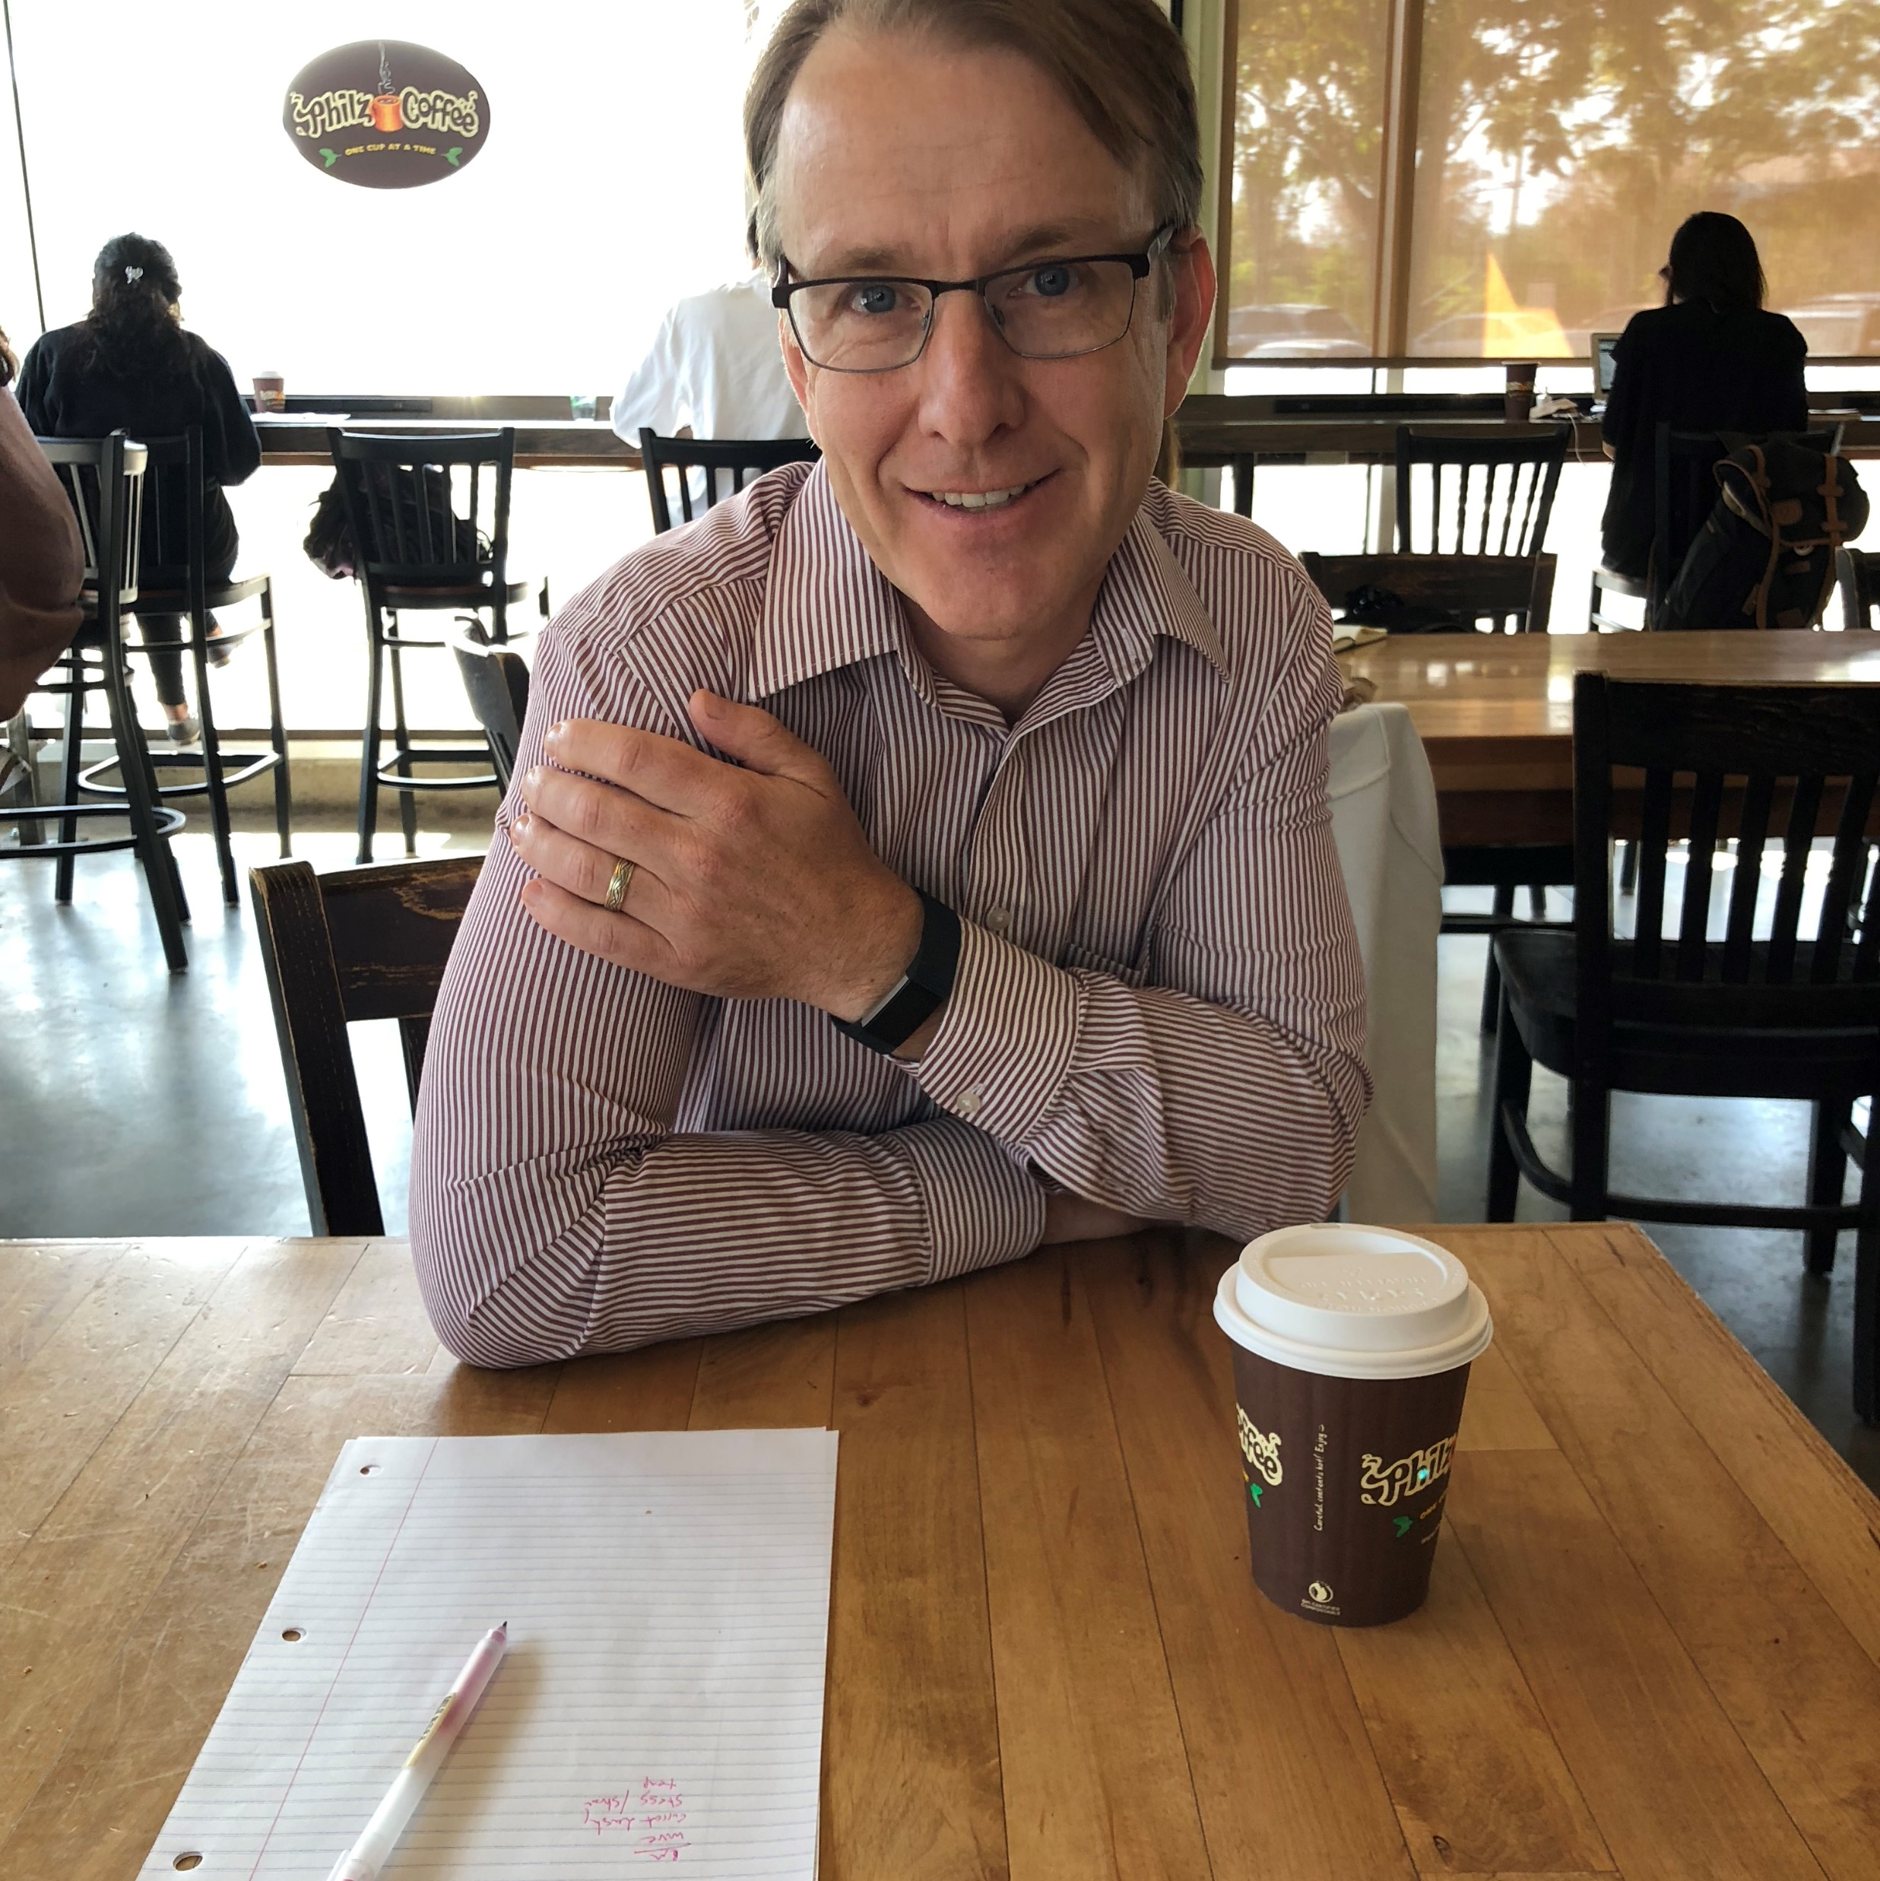
Lecture Kit Prototype Results
3
John
Philz coffee
When lifted “I’m Confused” he would stop and ask what students were confused on
Wouldn’t move on until this was pinpointed
Battery company
Battery lesson

Slide 36
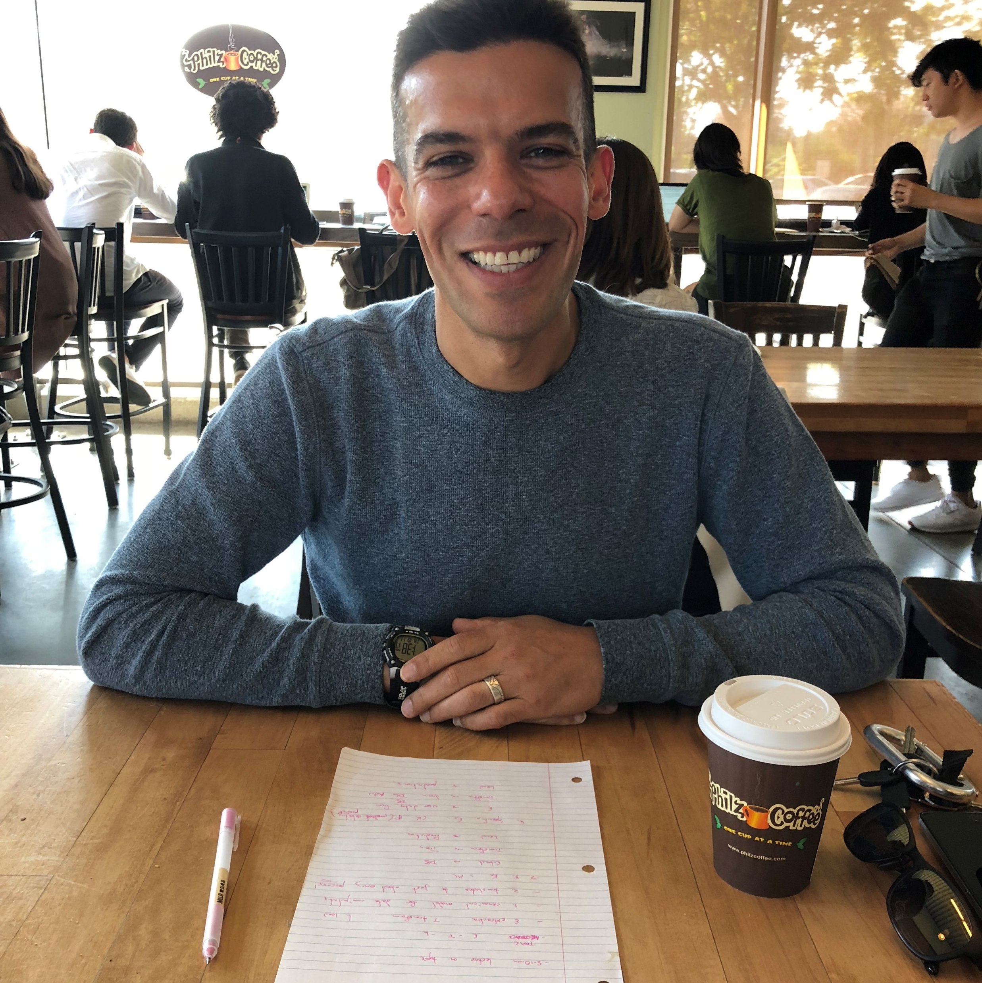
Lecture Kit Prototype Results
3
Nick
Felt we took material in well. “could tell by looking at us [eye contact] (already looking for feedback)
Got distracted by signs
Philz Coffee
ML @ Credit Karma
Battery lesson

Slide 37
Experience Prototype Findings
3
Assumption:
Giving lecturers information in real time will aid lecture teaching
Our way of giving information was distracting + wouldn’t fully work for lectures.

Slide 38
Summary + Next Steps
Learned a lot this week!
Got to test out assumptions + brainstorm solutions
Moving forward with Magic HW (assumption strongly reinforced)

