Slide 1
Augmenting Humans:
Learning

Slide 2
Who are we?
1

Slide 3
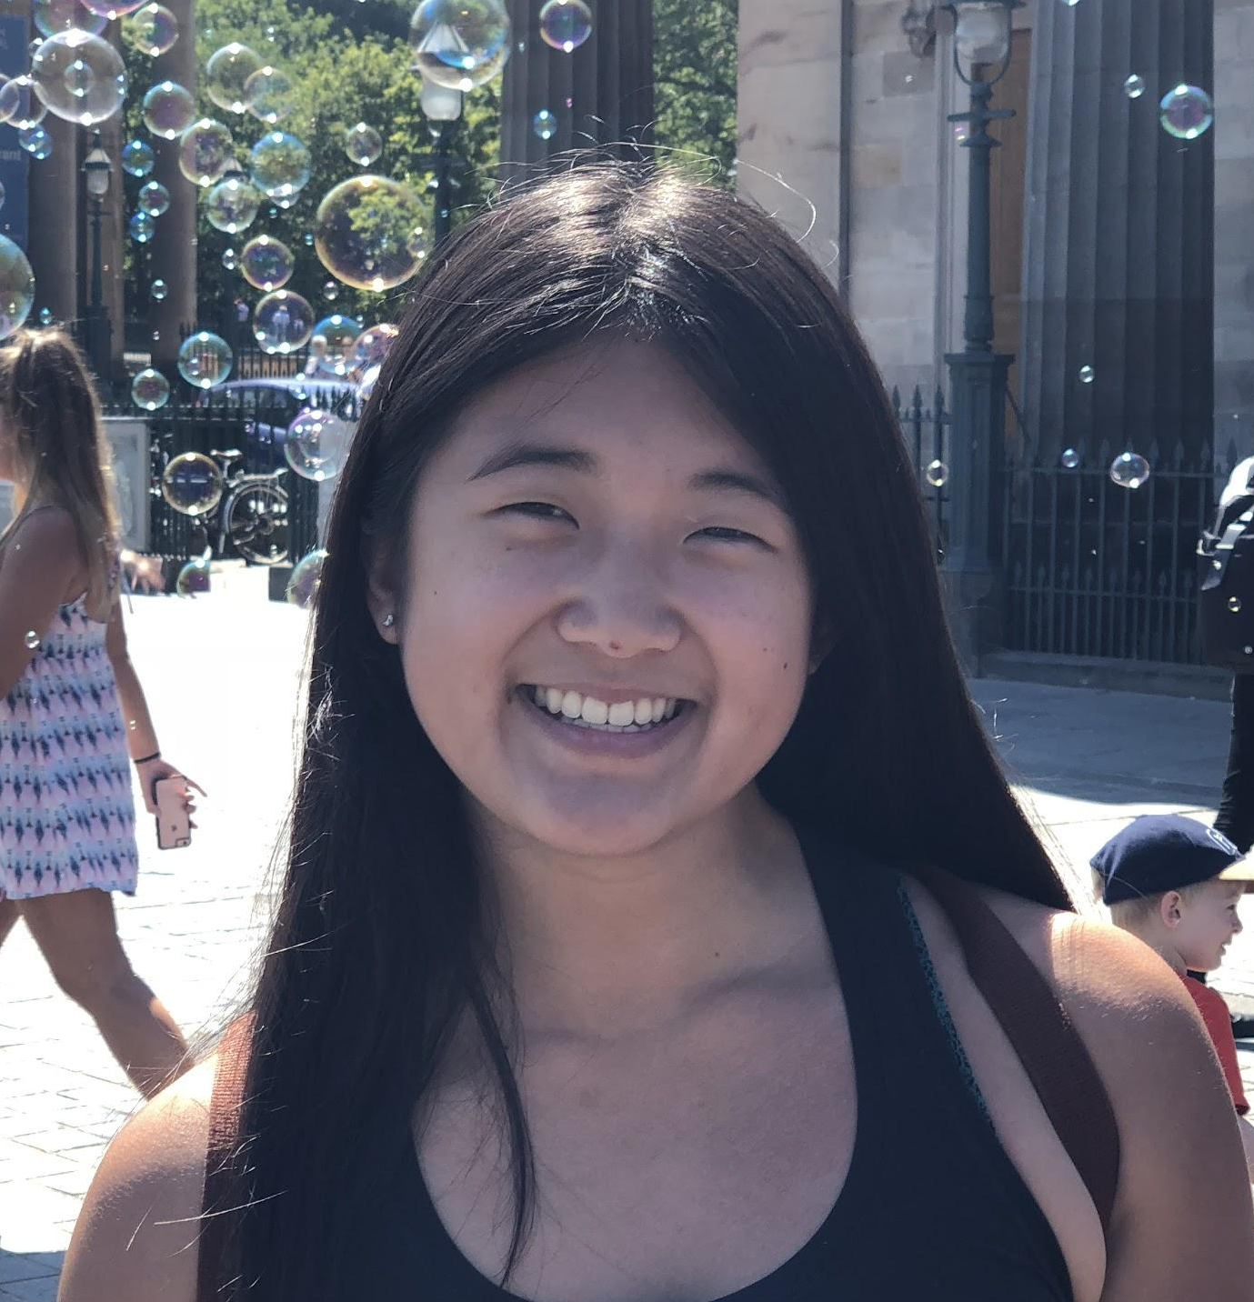
Our Team

Slide 4
Our domain
2

Slide 5
recall
applicability

Slide 6
Interviews
3

Slide 7
Do you think what you do now directly relates to your academic workload that you’ve experienced in the past?
Are there any particularly memorable courses that you’ve taken? What sticks out to you about them?
Do you have any hobbies or skills that you are proud of? How did you pick up these skills?
Are there hobbies that you’ve failed to pick up? Why did these not stick?
Notes:
Ask both academic learning related and personal learning questions

Slide 8


Slide 9
Kian
from France
CS230 Instructor
Aarti- co-head TA
before office hours

Slide 10
Visualization and anticipation
“What we’re teaching you’re probably going to think that you’ll never use it again, but it builds your mind, it helps you understand things quicker.”
Either know info, or know where to point to find it

Slide 11

Terry
Protestant campus minister
Philosophy professor
Recruited outside Tressider

Slide 12
The key to teaching is empathy.
It’s hard to approach a topic in a way that works best for all individuals.

Slide 14
Scott
former Stanford physics PhD candidate
Aarti’s friend
Scott’s living room
Enjoys blacksmithing
Recent classroom exposure

Slide 15
People use memory as a crutch.
The value of education is not memorizing, it’s knowing where to look for the answer.
Education works better when you let people to discover on their own

Slide 17
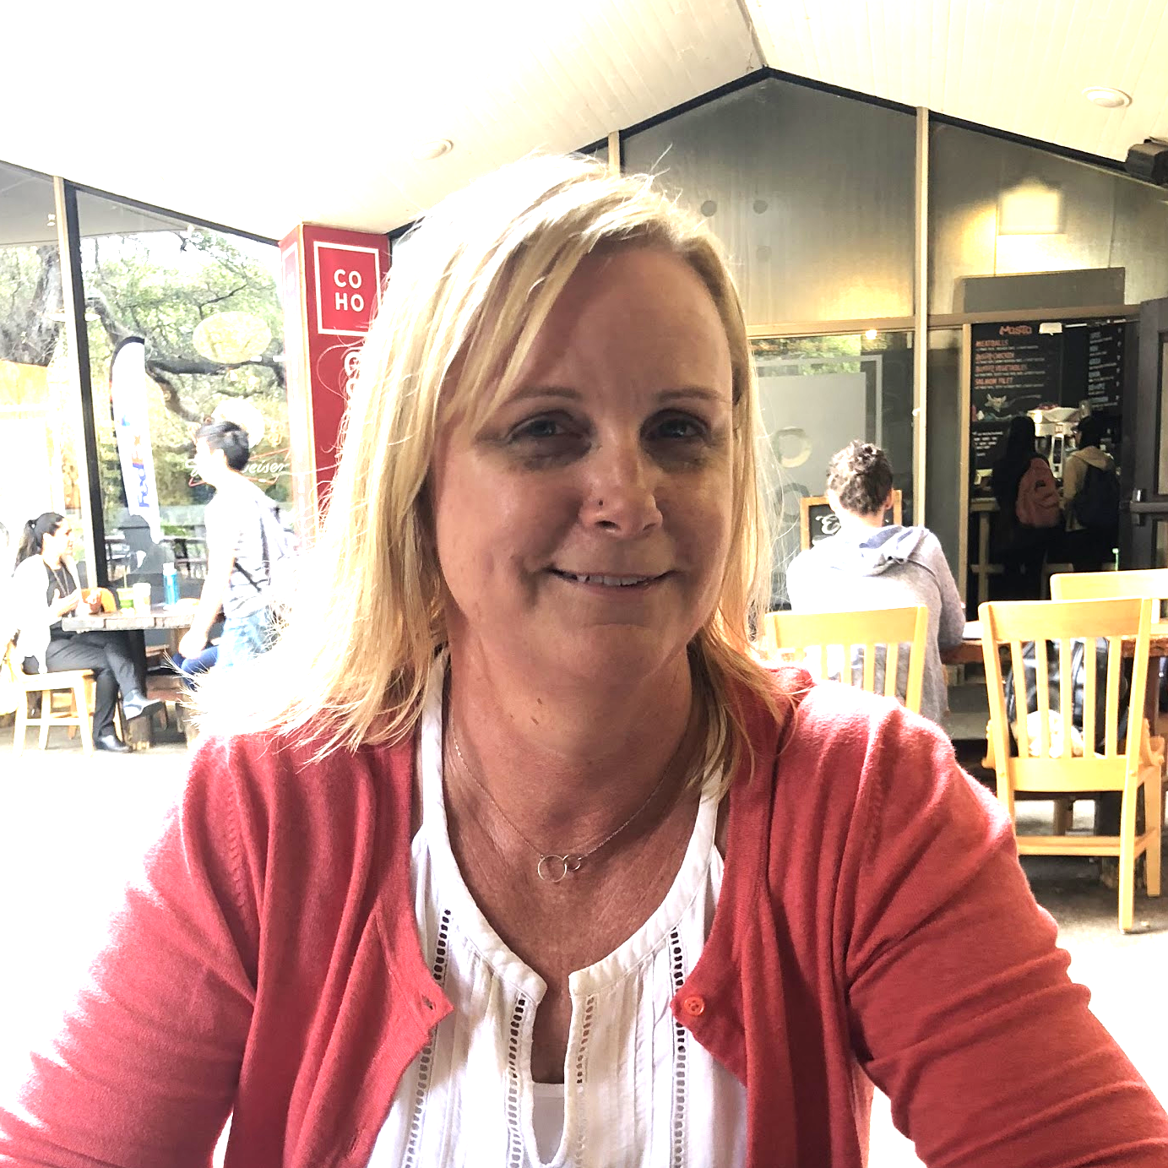
Susan
Front desk at dance studio
Recruited outside FedEx
Interviewed outside Tressider
Flower arranger
Mid-removed classroom exposure

Slide 18
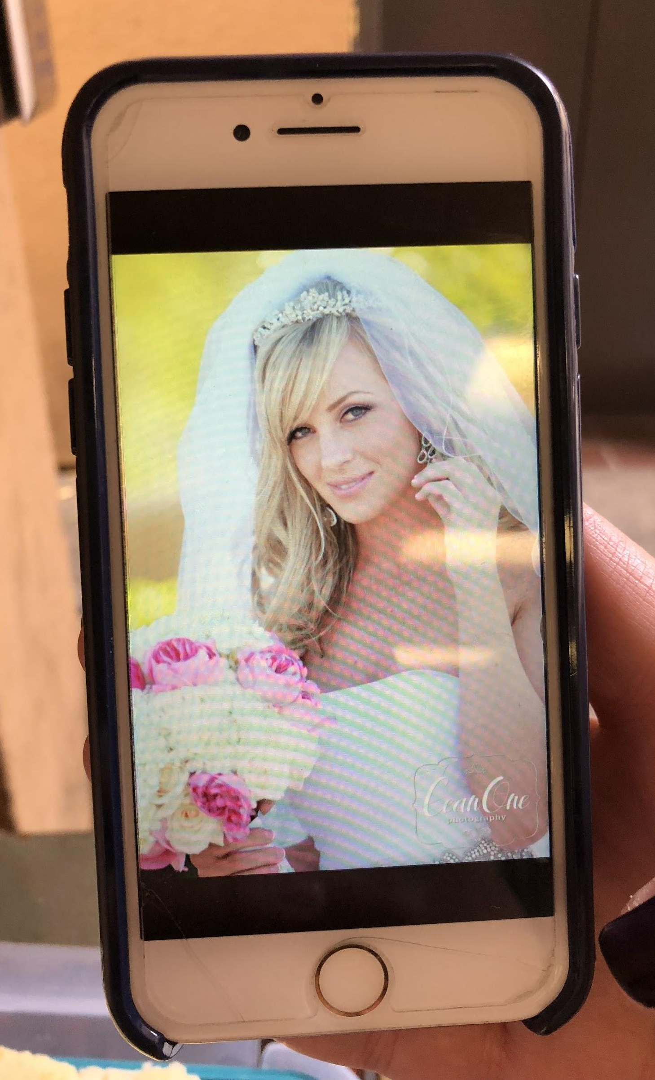
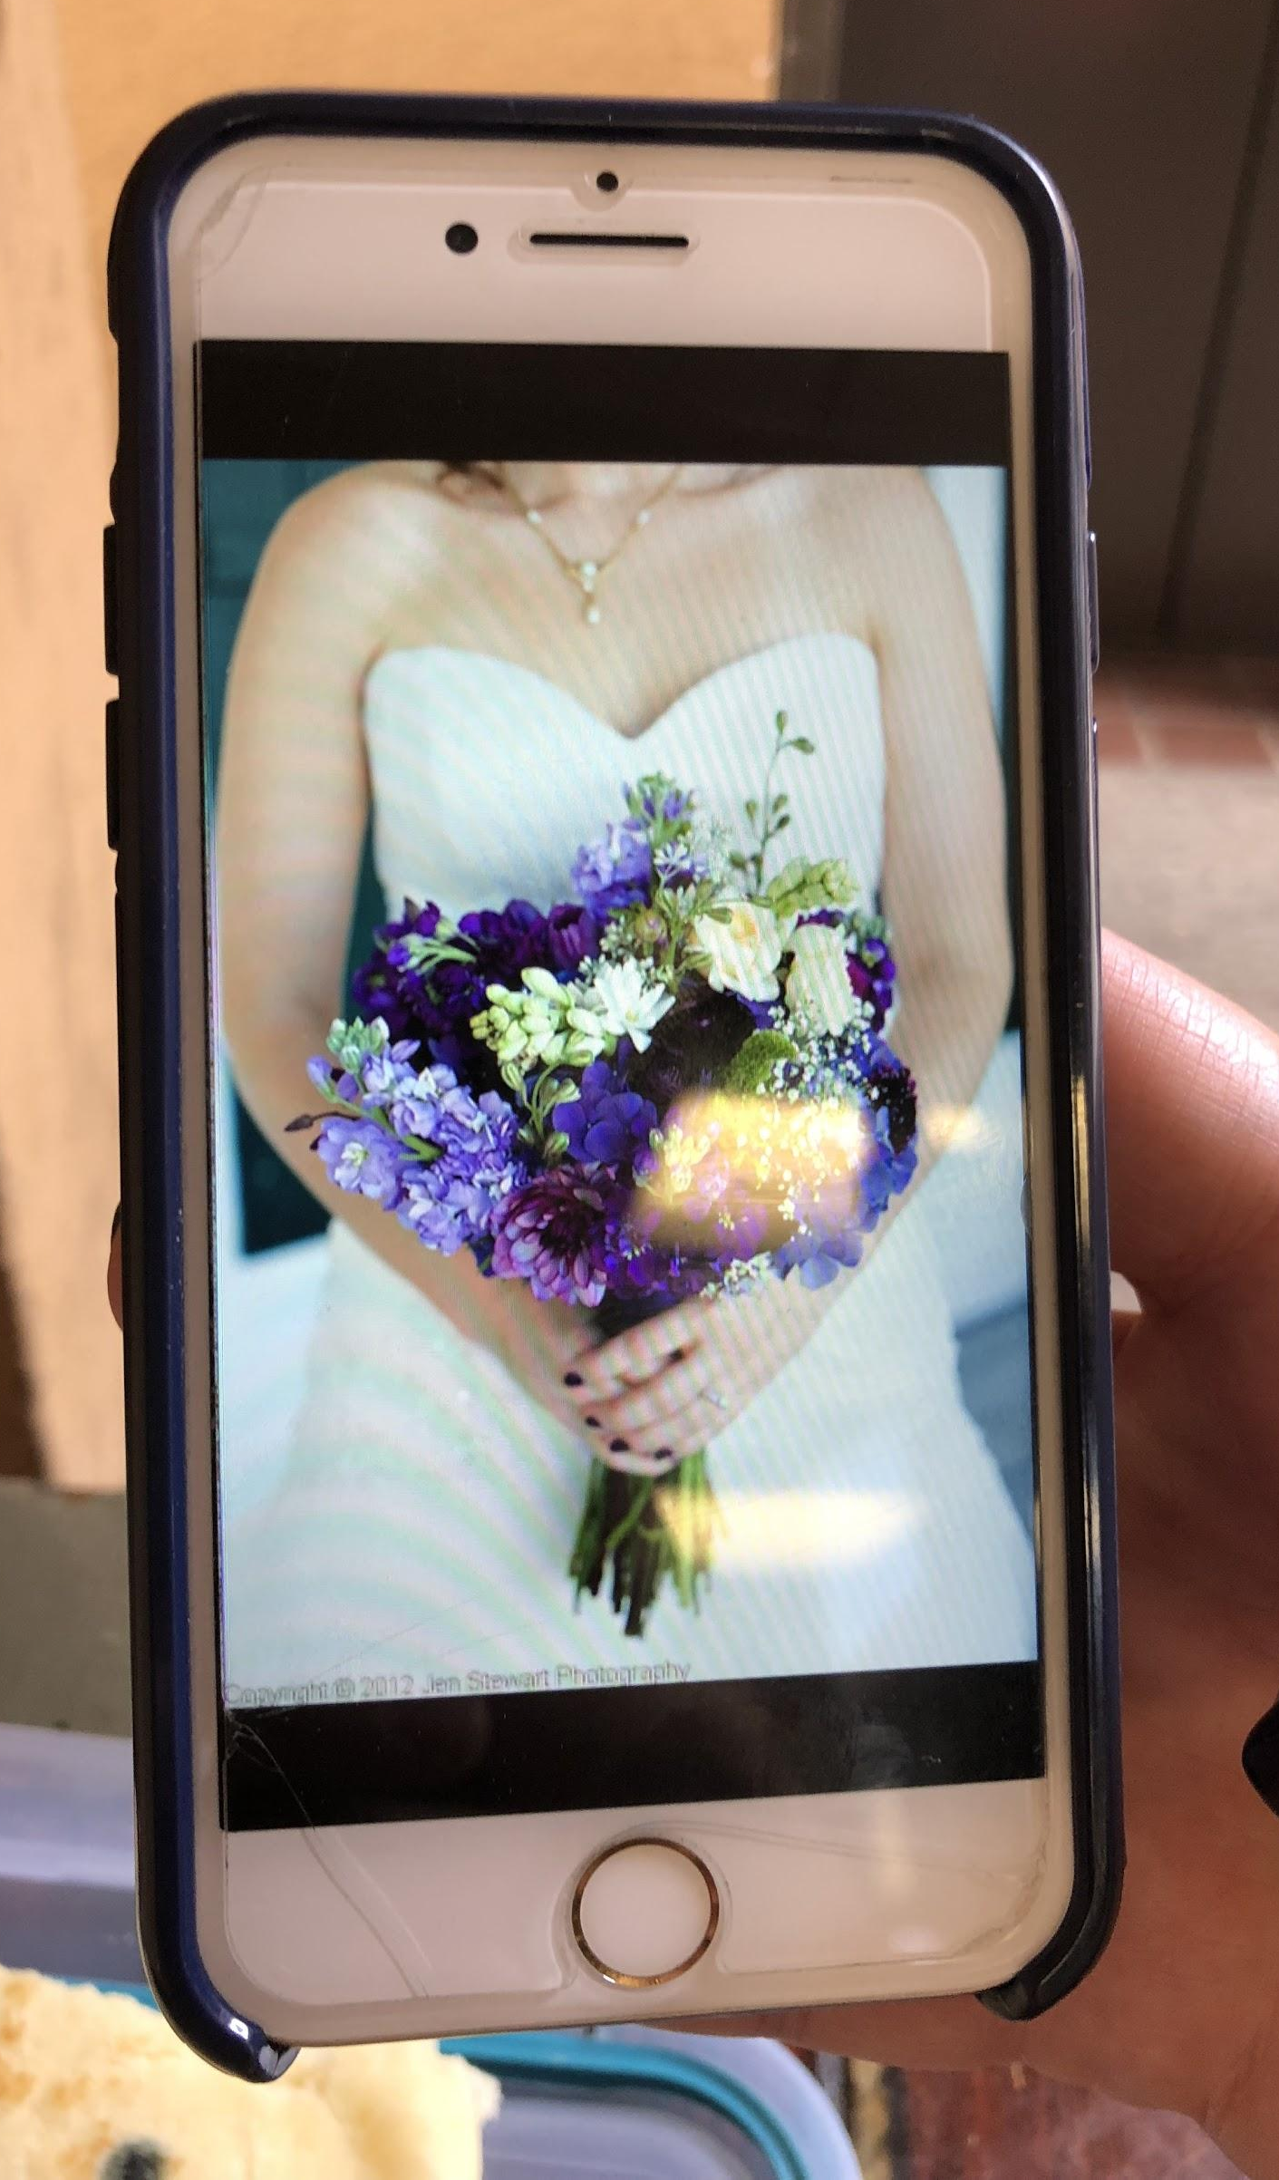

Slide 19
“Can you show me that like a hundred more times in slow motion?”
[about class called Marriage and the Family] Professor felt the need to teach a college class about the details of sex.
First flower arranging experience - WOW

Slide 21
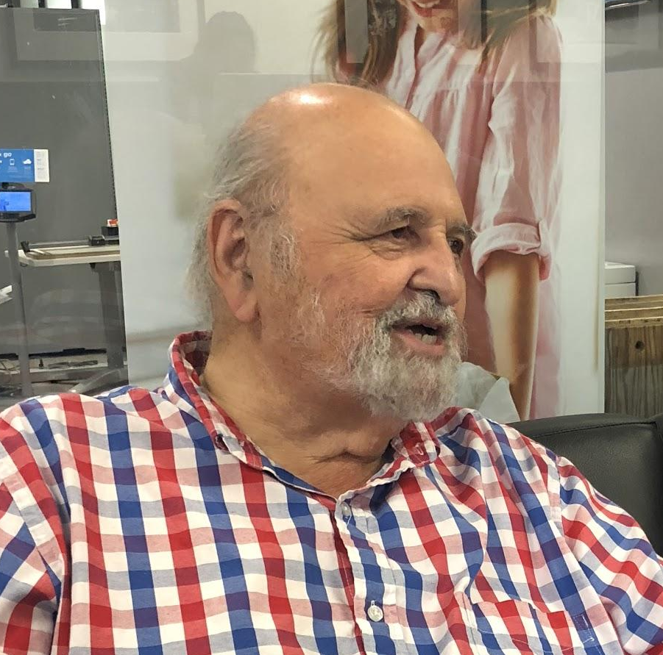
Carmelo
Owner of Stanford Hair Salon
Recruited/interviewed outside FedEx
Far-removed classroom exposure

Slide 22
“[ Q: How did you build up that knowledge base of being able to do any hairstyle?]
Little by little[…]You hear, you pick up every little gem and that’s how you pick up your knowledge.”
“I know every hairstyle...yeah, and if I see a picture, I can duplicate it”

Slide 23
Identifying Needs
4

Slide 24
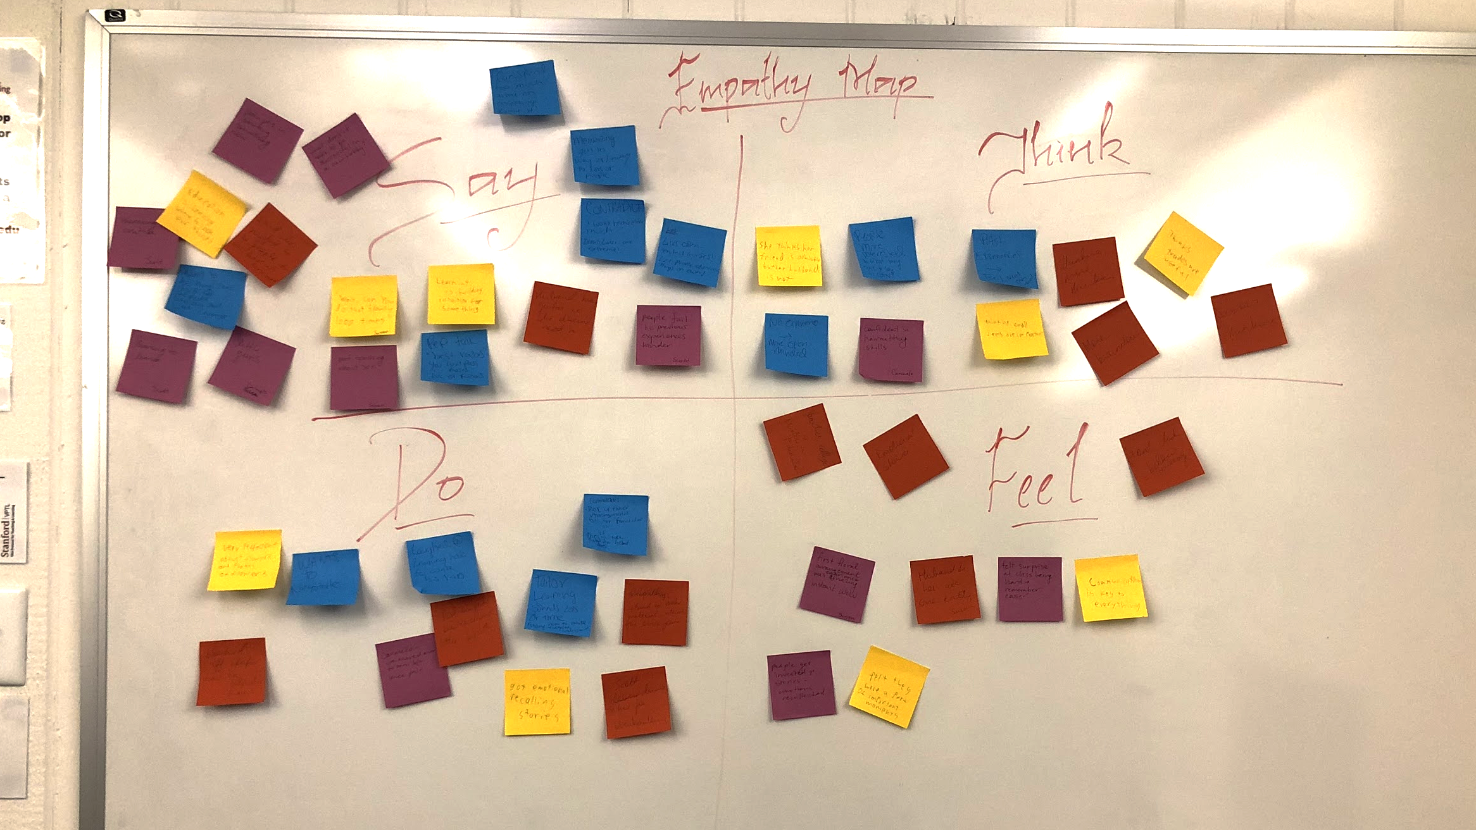

Slide 25
Say
Think
Do
Feel

Slide 26
“Can you show me that like a hundred more times in slow motion?”

Slide 27
Insight
Need
tailor content to promote understanding for many different people’s needs
People have different backgrounds and needs

Slide 28
Was amazed by first flower arranging experience.
Poor professors lead to poor students.

Slide 29
Insight
Need
Negative previous experiences can hinder learning new things. First impressions matter.
Reset mindset → beginner’s mind. Wow in beginning of learning something new

Slide 30
Feels unconfident about running unless with a partner at equal level.
Difficult to find blacksmithing place so dropped hobby for bit.
Travels 3 hours to go blacksmithing every week.

Slide 31
Insight
Need
Make learning new things accessible to wide range of people. Encourage passion.
It can feel too difficult to start a new hobby.

Slide 32
“I don’t remember much…”
Tells an extremely detailed story with emotional impact

Slide 33
Insight
Need
People remember stories better than actual content
Harness emotional connection to enhance retention

Slide 34
Stanford physics labs > NYU physics labs - less step-by-step guidance
Enjoys open-studio style blacksmithing

Slide 35
Insight
Need
Promote self-discovery and problem generation in learning process
Students learn better when exploring on their own

Slide 36
Memory can be used as a crutch.
Uses memory as a foundation for discovering insights in math proof

Slide 37
Insight
Need
Memory without understanding is not learning
Build foundation for developing insights

Slide 38
Thanks!
Any questions?

Slide 39
Elaborated Empathy Map
“Education is learning where to look for things”
“Memory can be a crutch”
“Learning to learn”
“Little gems”
“Can you show me that like a hundred more times in slow motion?”
“These are the best two razors in the world… if you don’t pass you should pick up something else like plumbing.”
“Learning is building intuition for something”
“You can spend too much time on anything. Limit yourself.”
“Memorizing gets in the way of learning for lots of people”
Contradiction: “I won’t remember much” → remembers extremely detailed story
Remember negative previous experiences with skill/activity
Husband knows guitar so she thinks “what’s the point?”
Challenged to come up with problem and solution on own
Contradiction - She is not deterred by her friend’s expertise but is by her husband’s
People more interested in what they have to say
Deconstructing what people actually want in their hairstyles
French system in setting up foundation is good to have before learning the actual skills used in the workforce
Memory serves to help draw connections
Wants to do things she’s bad at with people who are also bad
In digital age, not worth to memorize things
Anticipates where the formula comes from
Quality of professors greatly affects quality of students
Many professors aren’t trained to teach
Important to be self aware when learning to teach
Perfectionism in flower arranging
Travels 3 hours to do blacksmithing every week
Asked interviewers to start Habitat for Humanity at Stanford
Laughed when explained that he was just learning how to write his raps
Asks domain experts for list of readings and the learns
Learns from Twitter, reddit, students, lab work
Follows intuition when writing rap
Uses analogies and concrete examples when teaching
Wants to feel less intimidated when picking up new skill
Entertained by conservative Japanese professor
Feels confident in haircutting ability
Amazed by first floral arrangement experience
Husband is close to her, his skills are accessible to her
Humans like to be able to predict a song and feel confident, but the song should not be too predictable
Feels privilege to understand the new words rappers use
Enjoys open-studio style blacksmithing

