Slide 1
Magic Hw: Med-Fi Prototype
Aarti, Richard, Ryan, and Samantha

Slide 2
Value Proposition
With long lecture videos, multitudinous lecture slides, and little one-on-one time with instructors, it’s difficult for students to get the information they need. MagicHW aims to make it easy for students to find the exact resources that they need and connect with other students, as well as to provide personalized feedback on homework assignments and tailored exam review material to cater to their unique strengths and weaknesses.
Homework that Helps You

Slide 3
Tasks

Slide 4
Task 1
You can use MagicHW to look at an upcoming pset, and easily get access to relevant material

Slide 5
Task 2
OLD: You can receive personalized feedback on graded pset.
NEW: Added - When you get a question wrong you can connect with someone who got it right.
Notes:
We got feedback that all our tasks felt very similar, both in the functionality that they provided as well as the taskflows that were implemented for each. We modified our tasks to take this feedback into account

Slide 6
Task 3
OLD: You can receive a review sheet comprised of past missed problems and problems from previous exams
NEW: You can create a custom review sheet that covers multiple units with recommendations from our AI

Slide 7
Major Design Changes

Slide 8
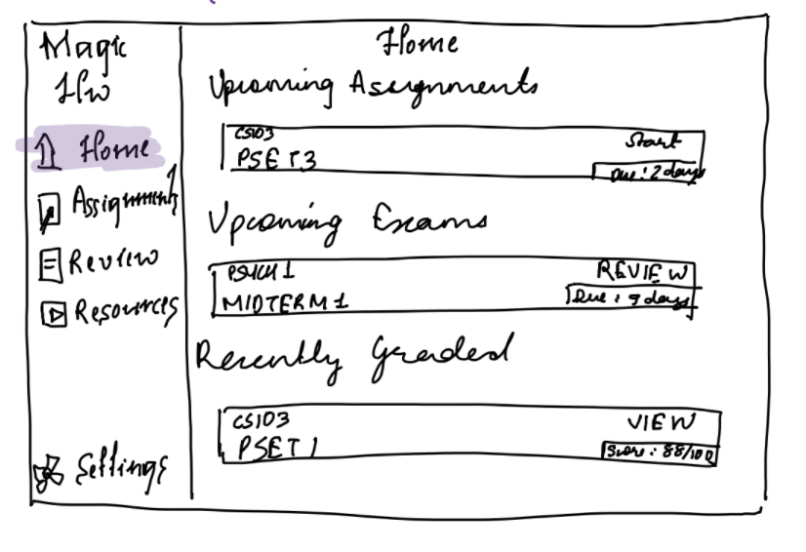
#1 Mobile to Tablet
Before
After

Slide 9
#1 Mobile to Tablet
Our biggest change between the low-fi sketches and the new sketches this week was moving from a mobile application to a tablet application
We modified all the design elements to adapt to a tablet interface (eg: menu on the side, as opposed to on the top, bigger menu items)
Rationale - The tablet application has more screen space which provides a better interface for a homework application. Students are more likely to do their homework on a tablet, as opposed to on their phone.

Slide 10
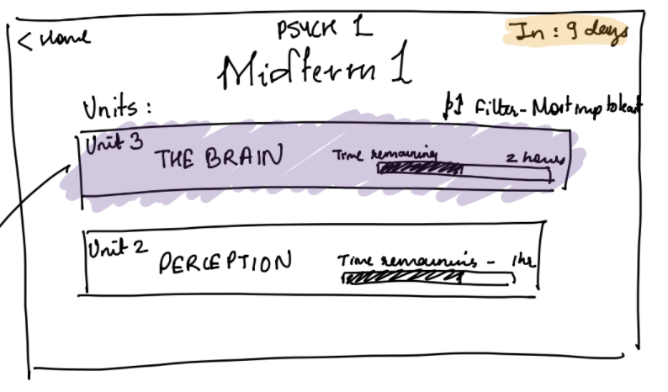
#2 Simplified Analytics
Before
After

Slide 11
#2 Simplified Analytics
We switched from complex analytics showing time taken to study a topic, recommended review breakdown, progress, importance on midterm etc to a simple interface that sorts units as “recommended”. This weighs all the factors mentioned above and presents it in a simple list. The only metric presented is “time remaining” as a progress bar.
Rationale -Through all our interviews last week, we got the feedback that the analytics we presented were very confusing and hard to interpret. They did not help the students in any decisions about which modules to pick.

Slide 12
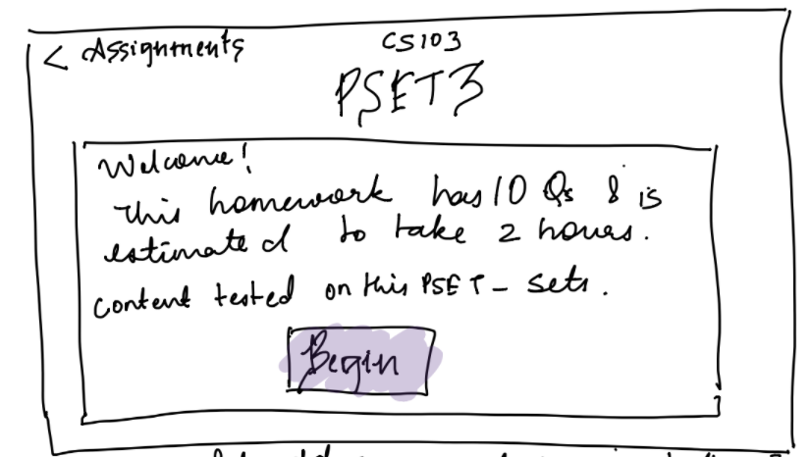
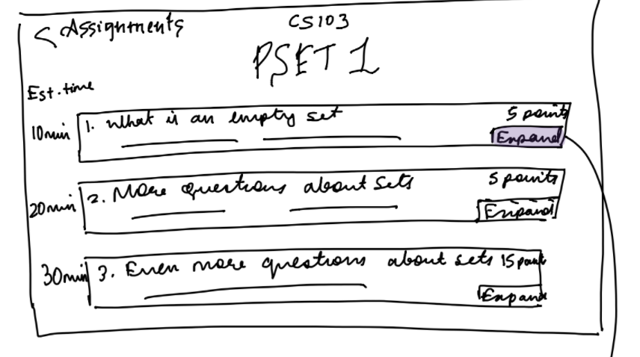
#3 Previews/ Time taken
Before
After

Slide 13
#3 Previews/ Time taken
Another recurring feedback that we got from our users last week was it was hard to know what problem/PSET they should start working on (given their time constraints). The app interface also provided no knowledge about a problem/PSET before it’s clicked on
To remedy these issues, we added “Estimated time taken” to each problem/PSET as well as each midterm review Unit
In addition, we added short snippets of text describing the content of each PSET/ problem, along with useful information such as number of points for each question

Slide 14
Task Flows

Slide 15
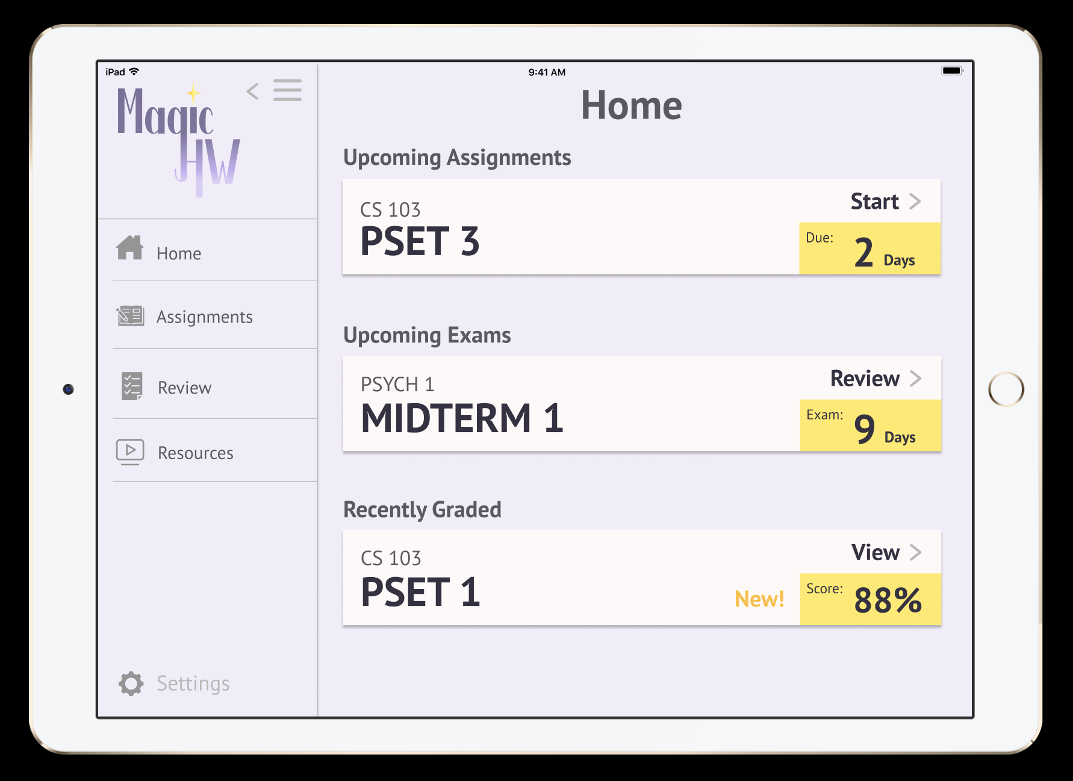
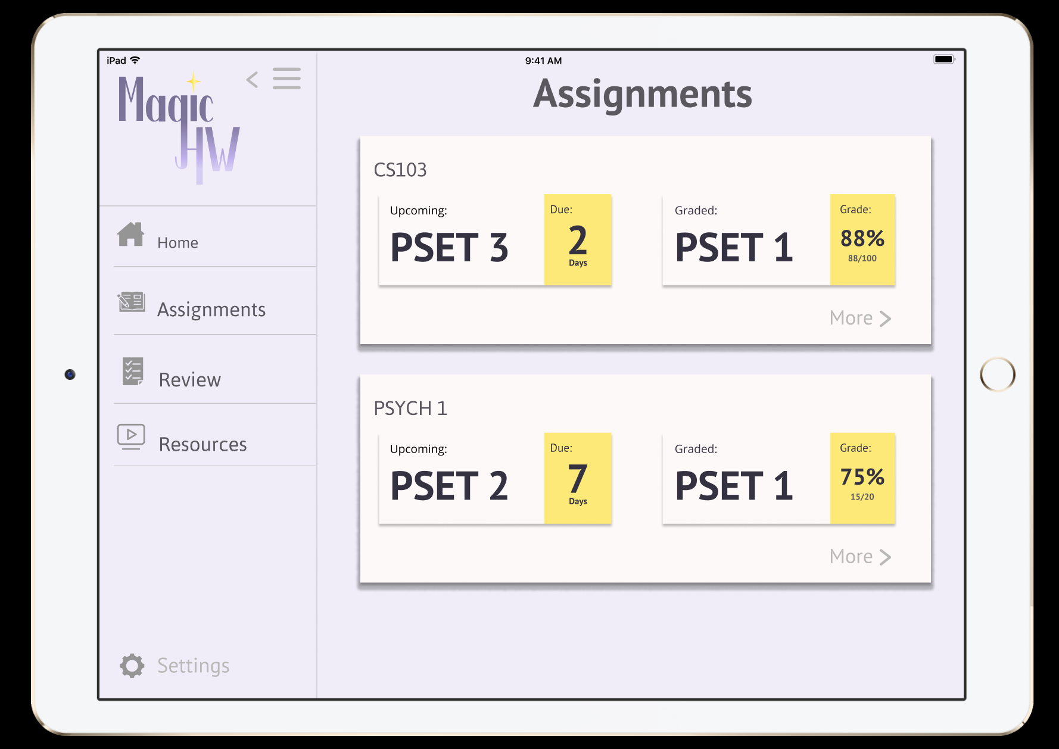
Task 1: Access material relevant to upcoming PSET
Click on “Assignments”
Click on “PSET 3”

Slide 16
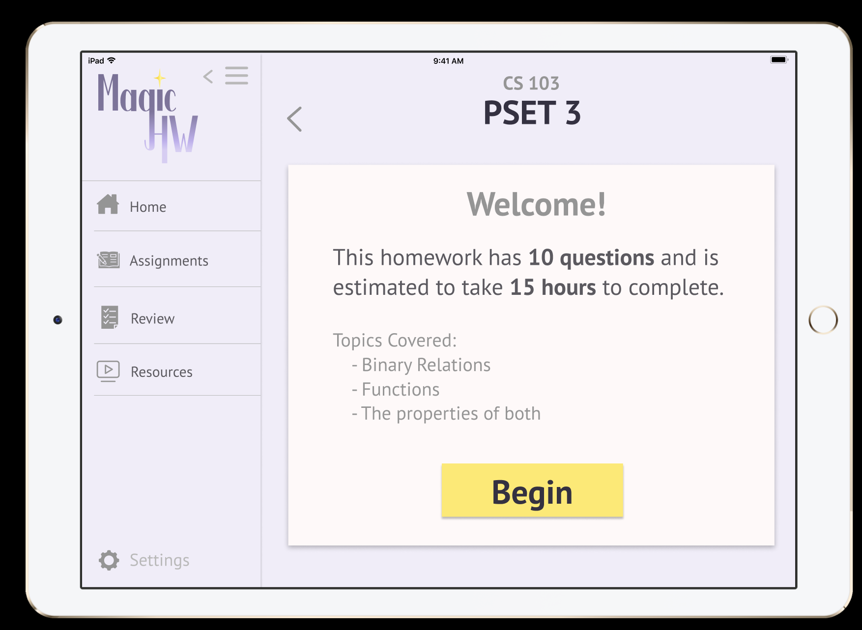
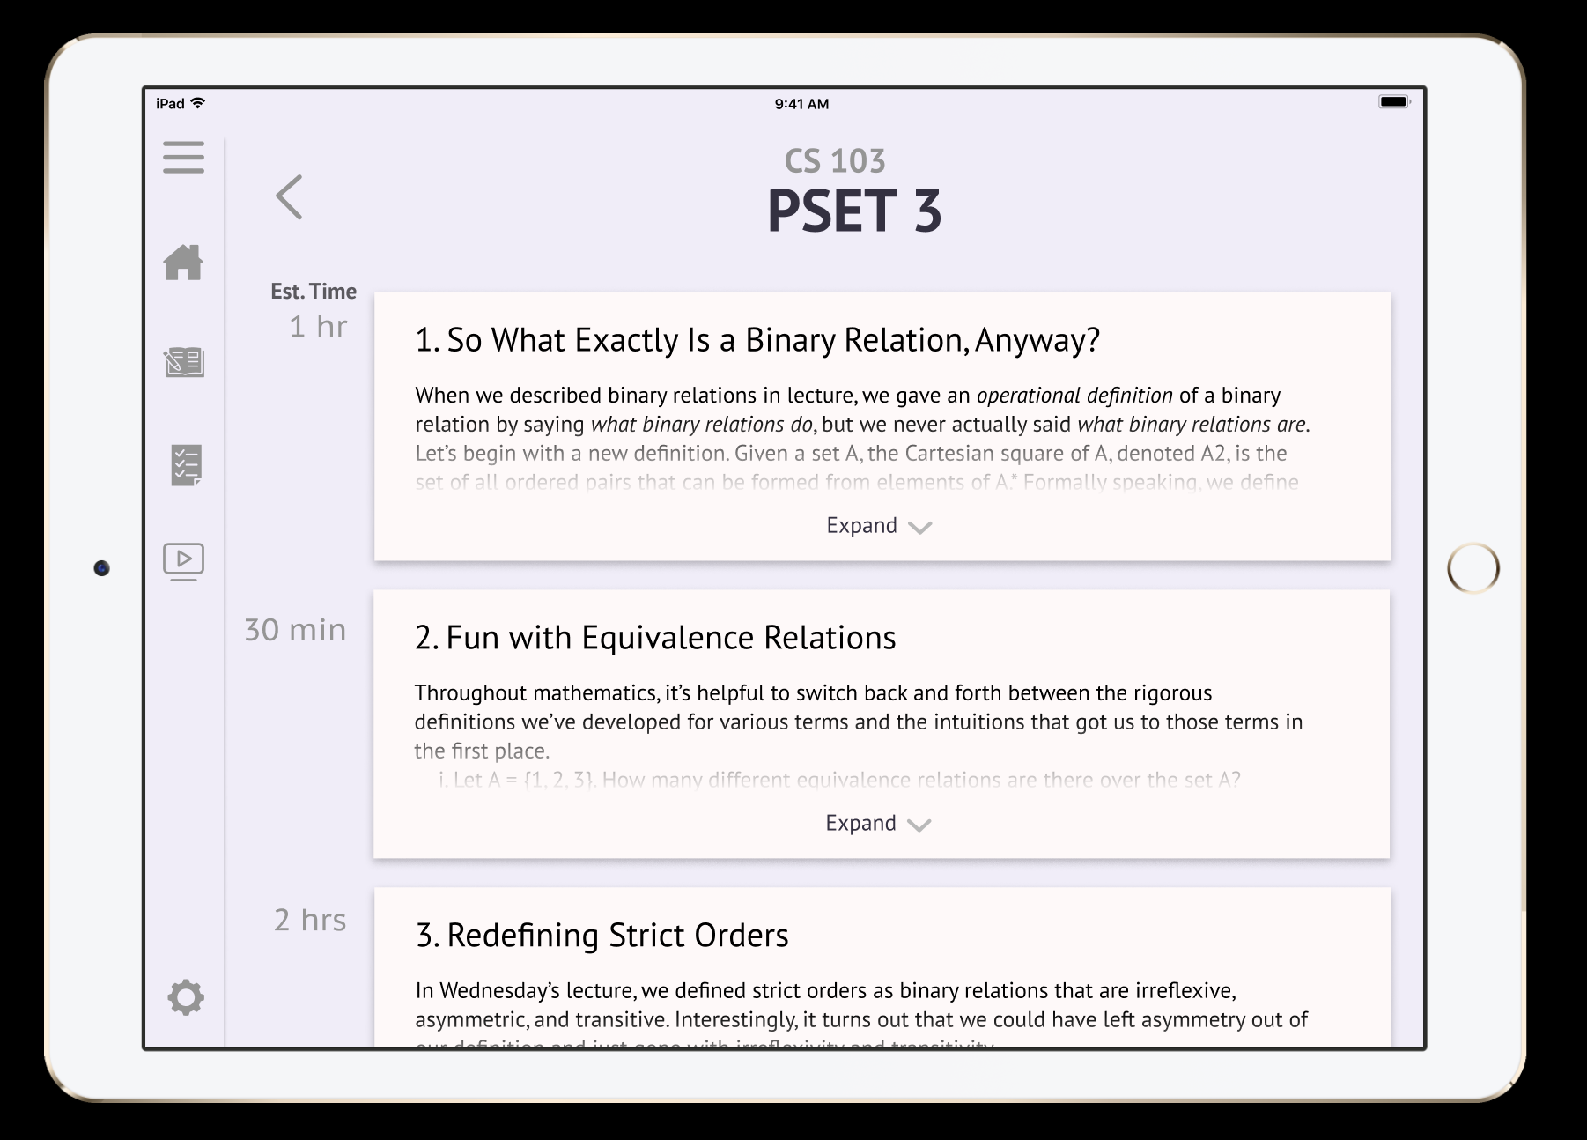
Task 1 (Continued)
Click on “Begin”
Click on “Expand”

Slide 17
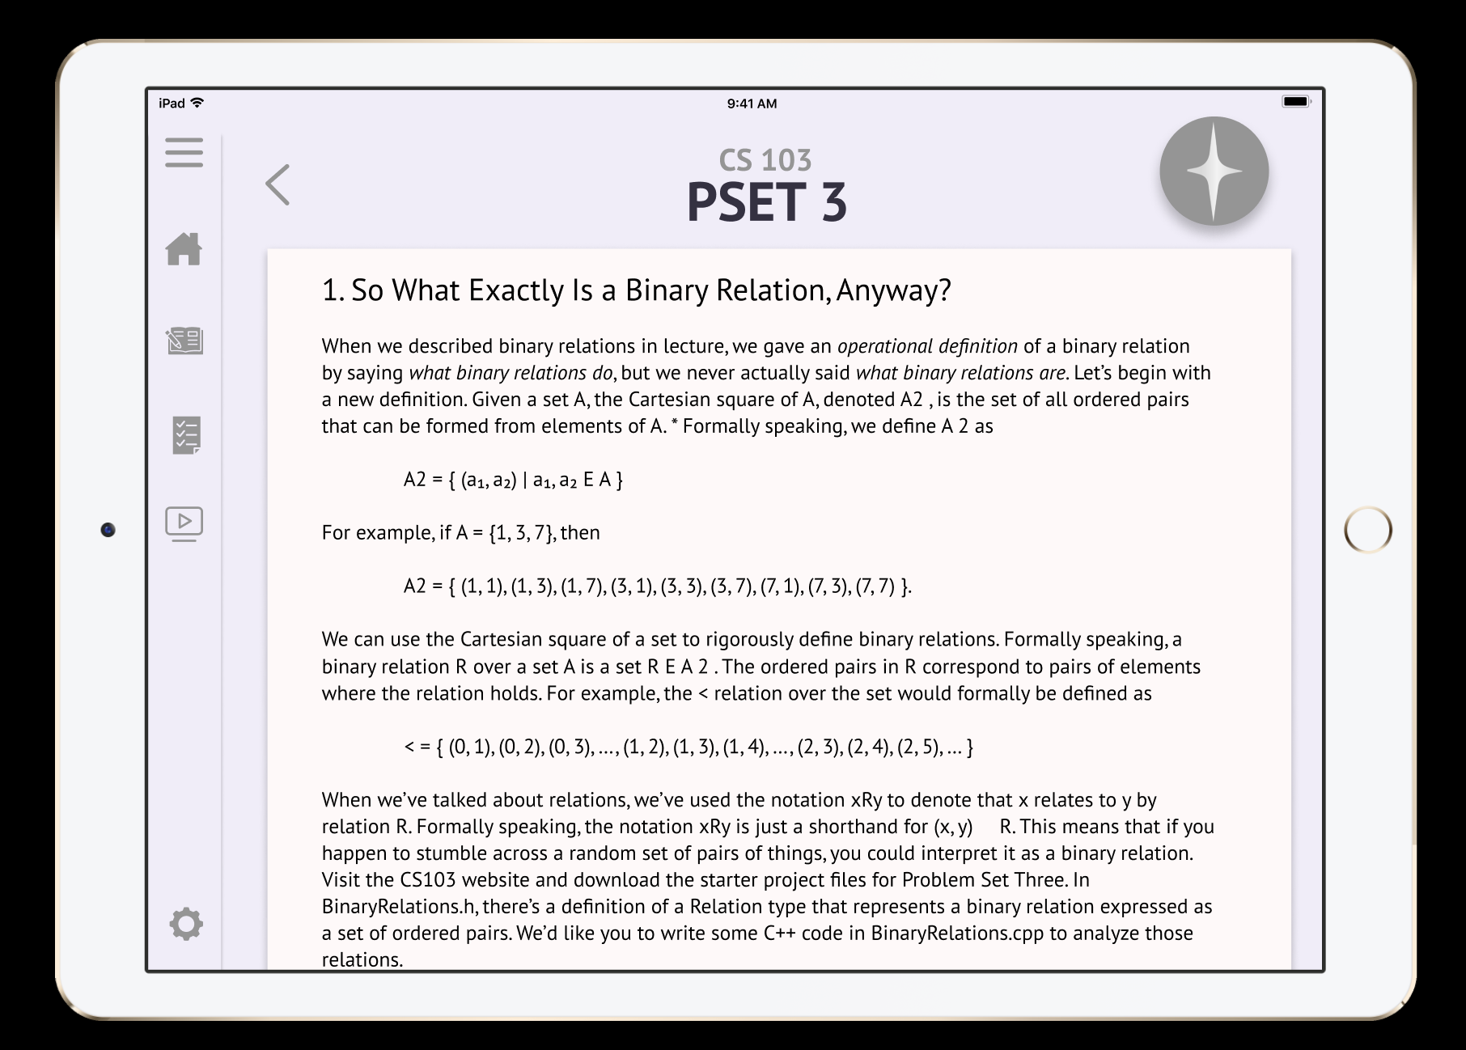
Task 1 (Continued)
Click on grey button at top
Click on the first pin

Slide 18
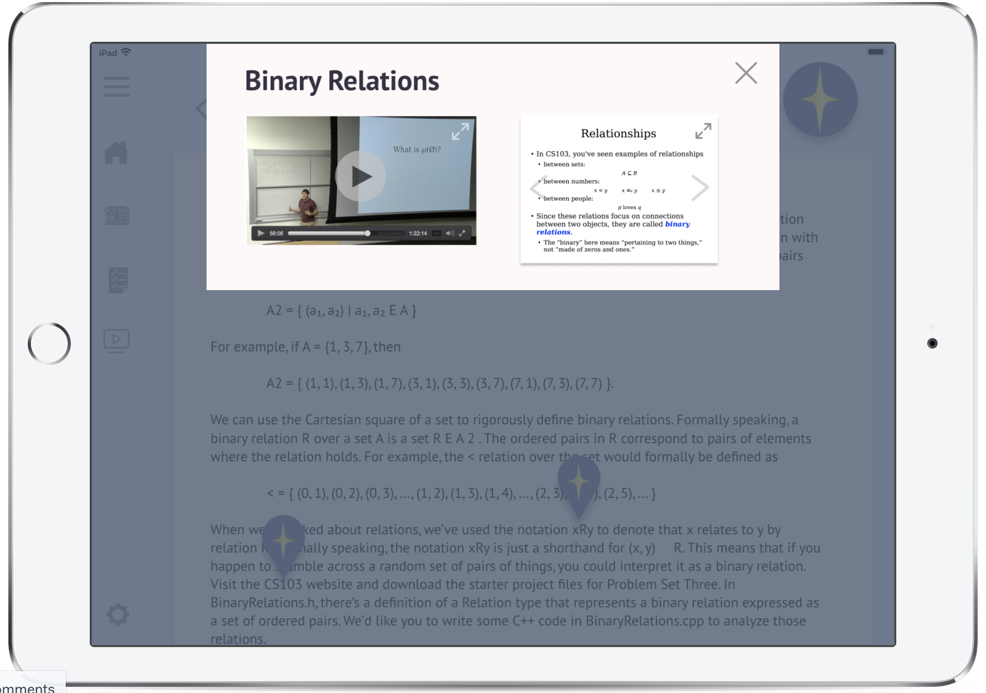
Task 1 (Continued)

Slide 19
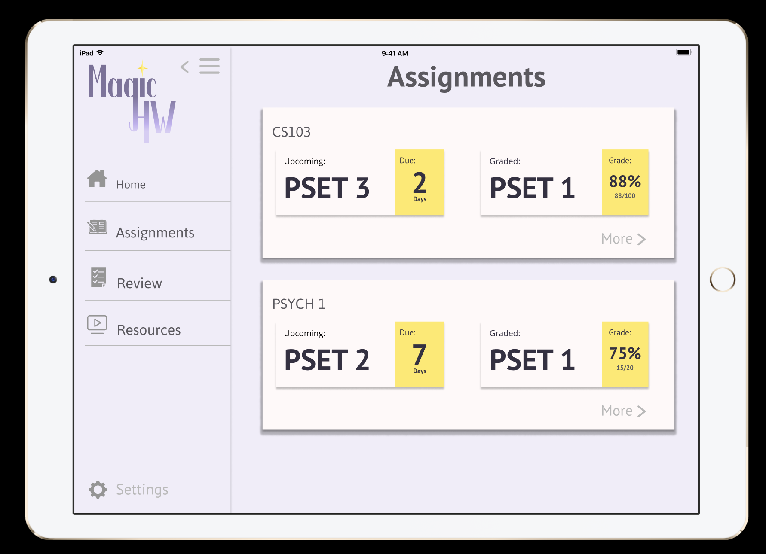
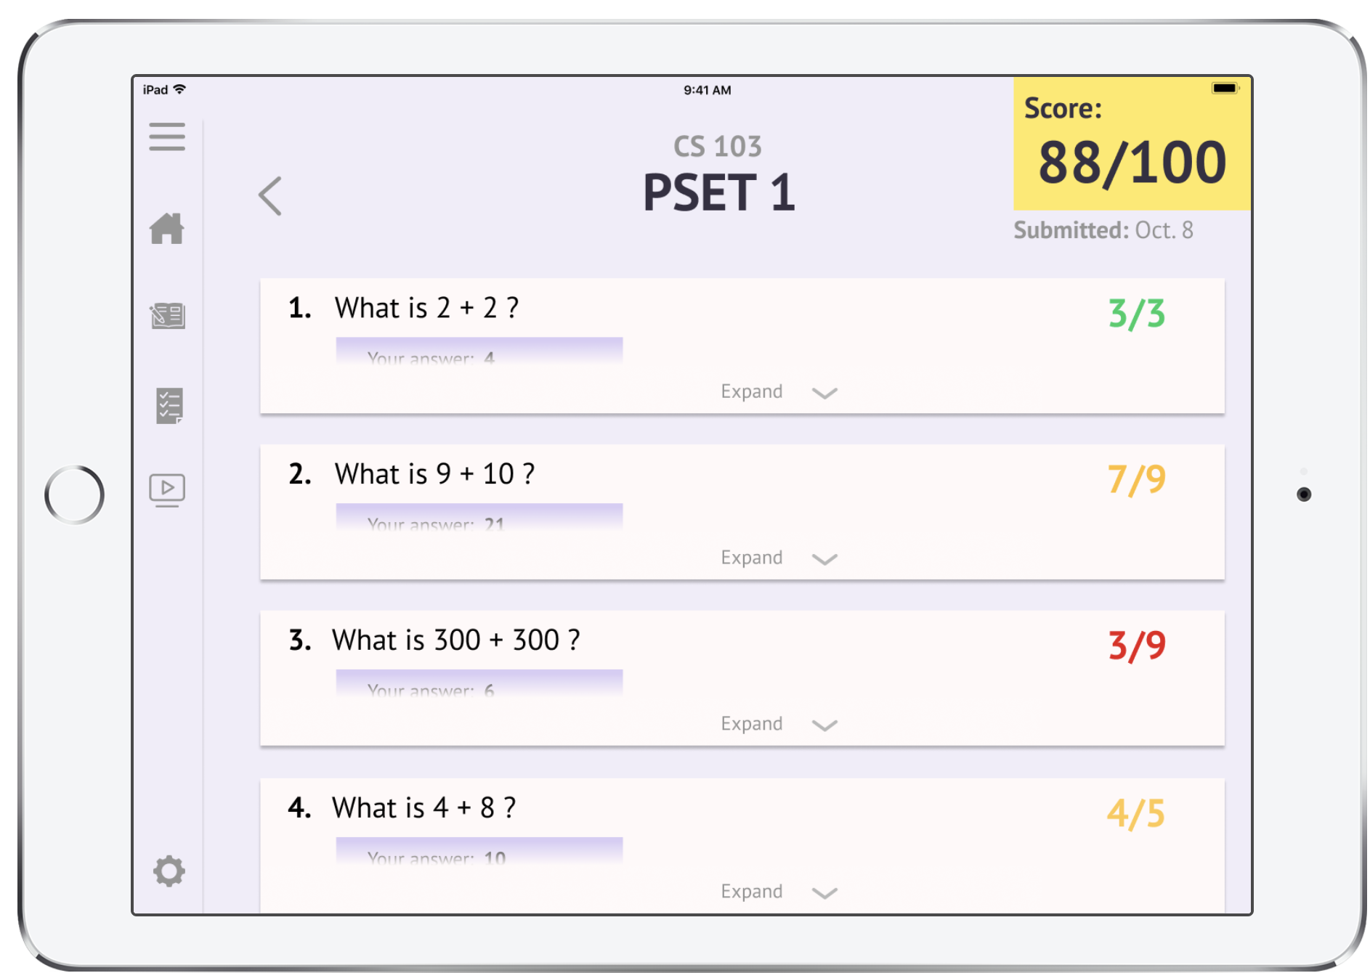
Task 2: Get feedback when you get a problem wrong and connect with a student
Click on “PSET 1”
Click on “Expand” for Q3

Slide 20
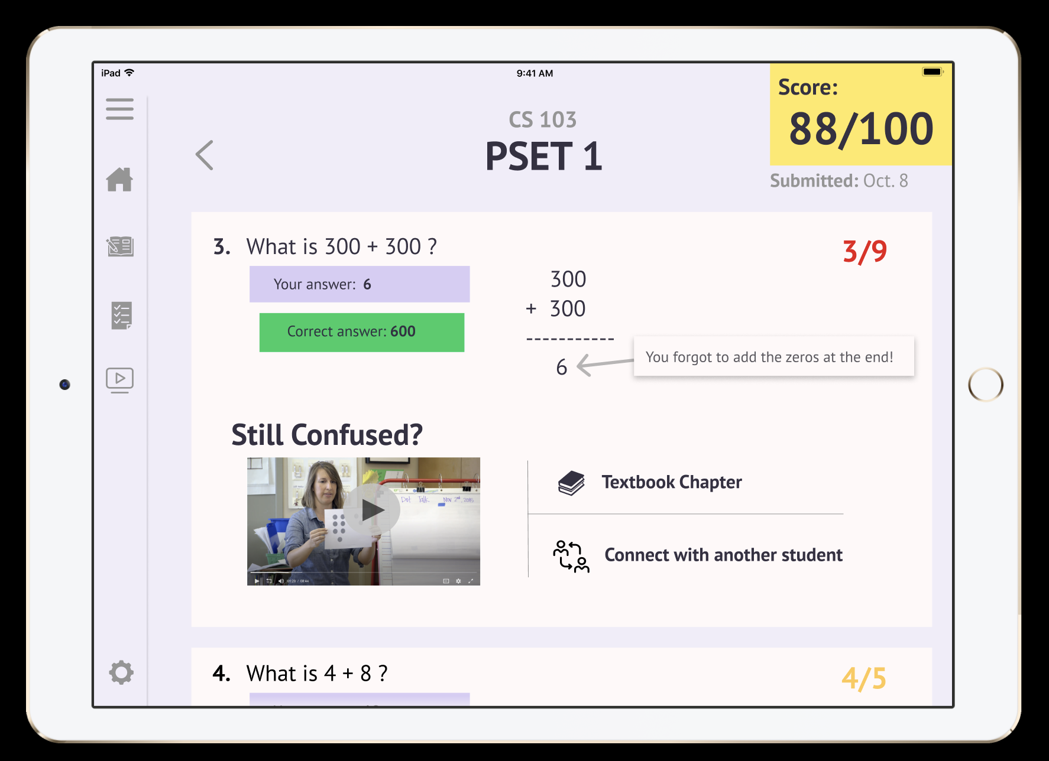
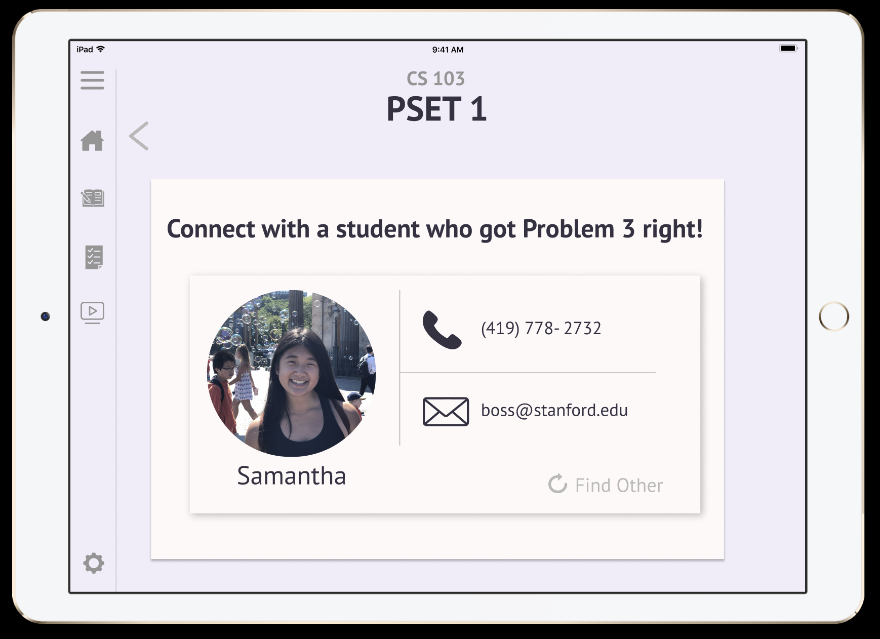
Task 2 (Continued)
Click on “Connect with Another Student”
Optional : Click on “Find other”

Slide 21
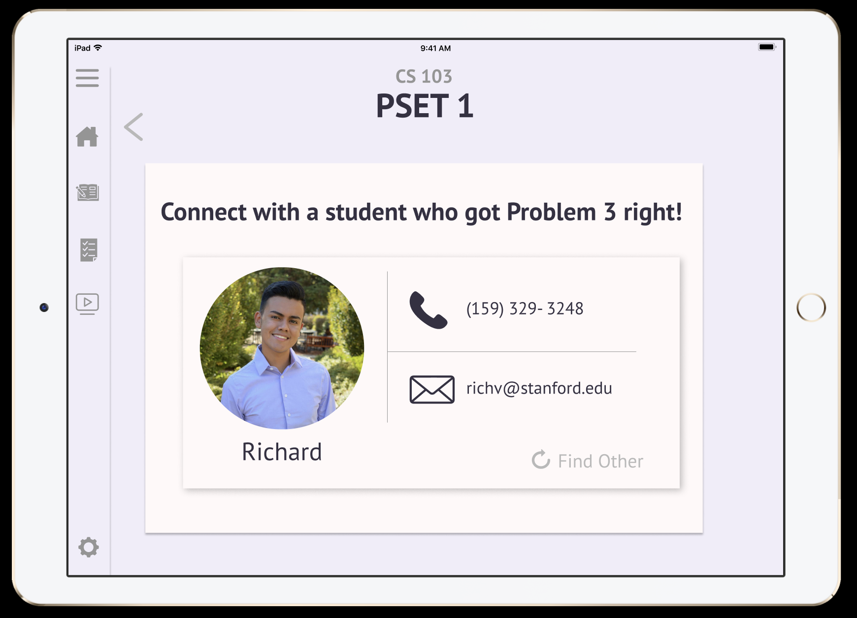
Task 2 (Continued)

Slide 22
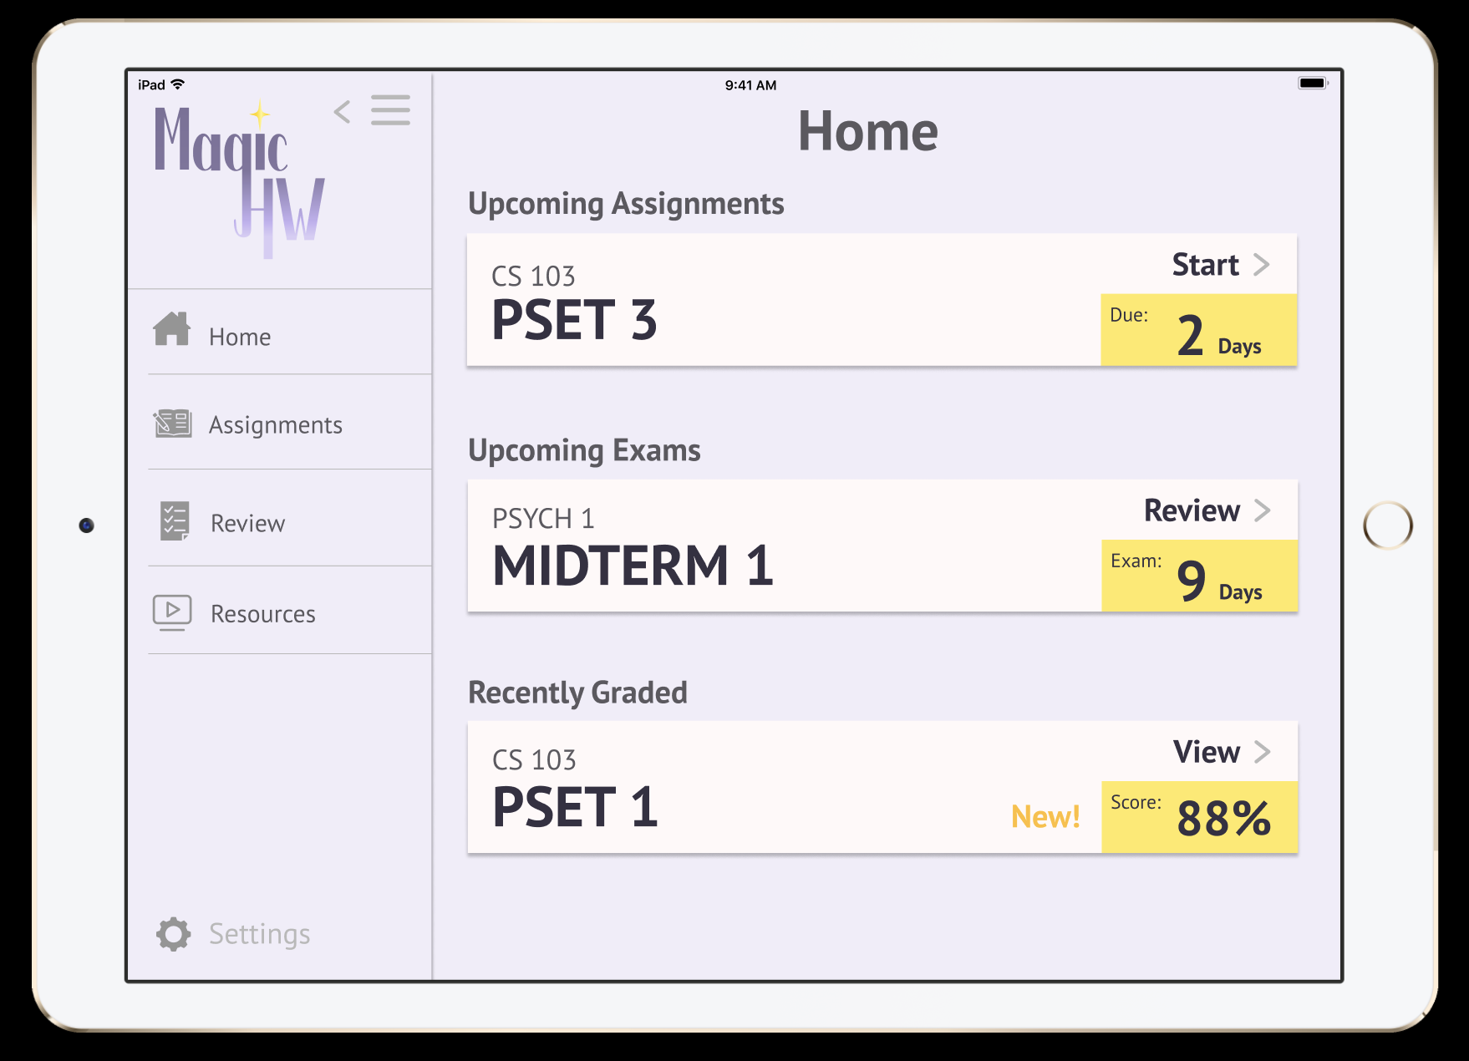
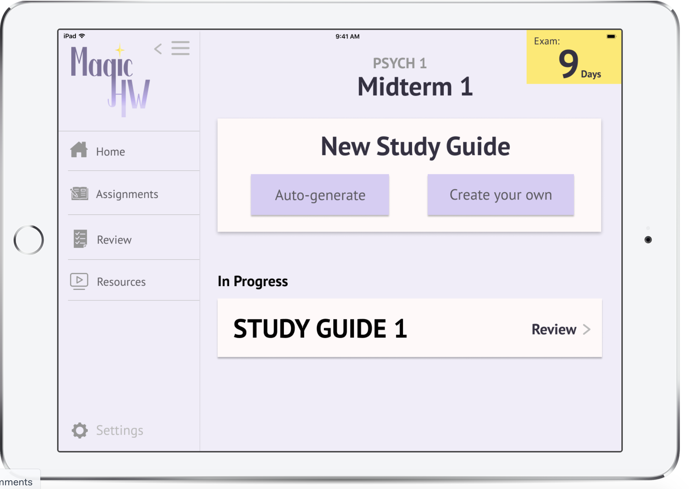
Task 3: Create a custom review sheet
Click on “Review” next to “Study Guide 1”
Click on “Review” for Midterm 1

Slide 23
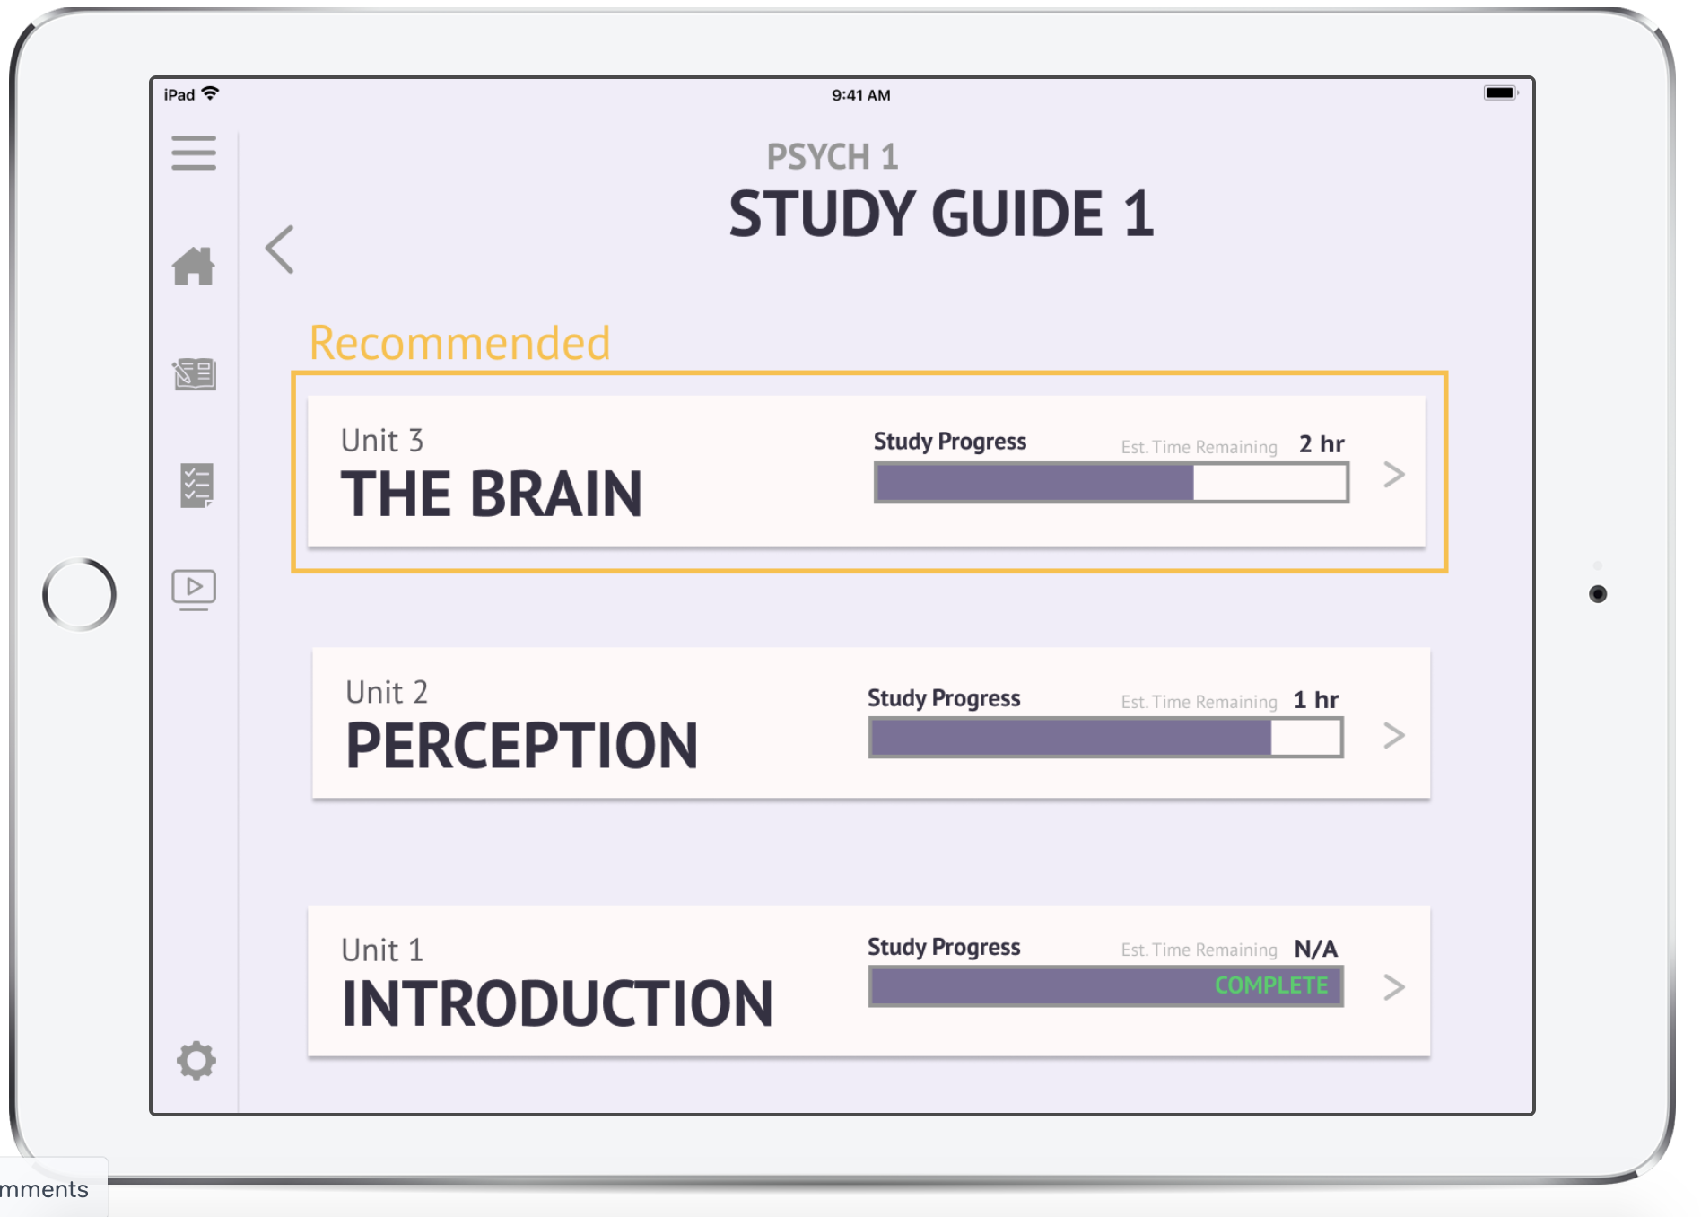
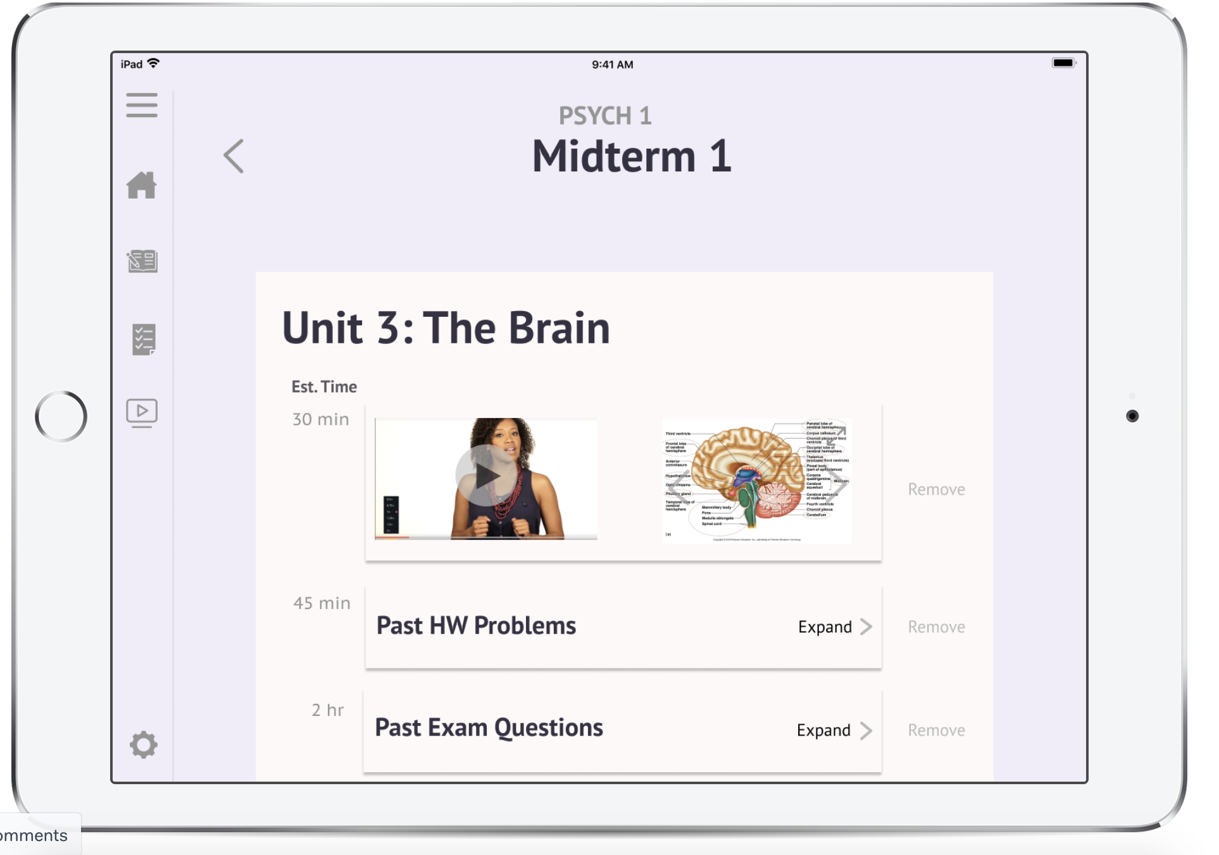
Task 3 (Continued)
Click on “Unit 3”
Click on “Expand” next to past HW problems

Slide 24
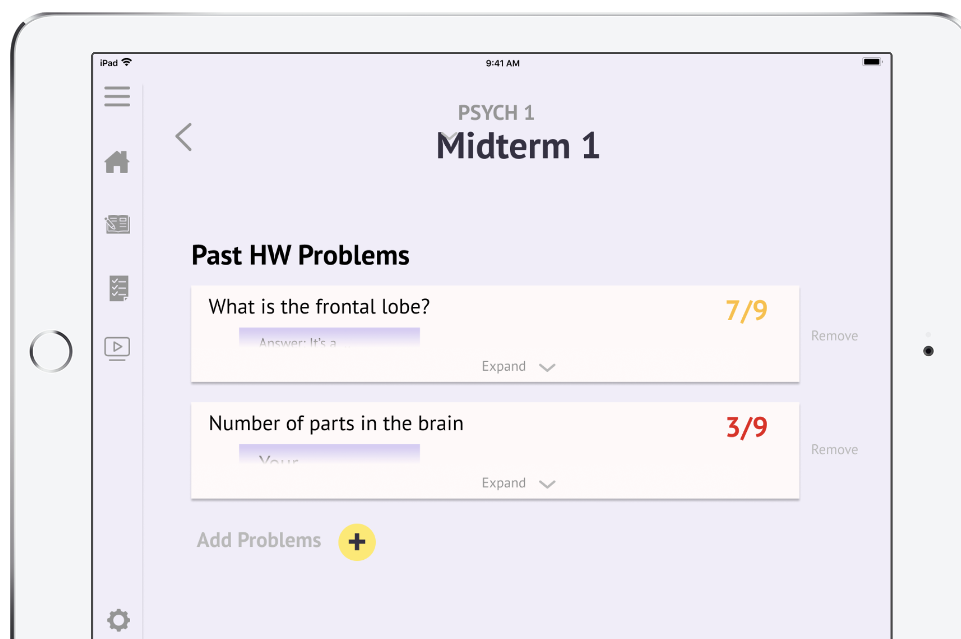
Task 3 (Continued)

Slide 25
Prototype Overview

Slide 26
Prototyping Tools
We used
Figma
Marvel
How the tools helped
Collaborative - all members could work on different aspects of the project at the same time
Keyboard shortcuts were consistent with other tools (i.e. Adobe Illustrator) and intuitive
Easy to make aesthetically pleasing screens

Slide 27
Prototyping Tools cont.
How the tools did not help (especially in comparison to Adobe)
Fonts were limited to ones included on Figma, or those available free online. A complicated process to have everyone install the fonts
If using Adobe Creative Cloud, font integration is much easier
Tools are less robust than Adobe software
Various functionality requests:
Figma
Make it easier to un-make a component
Capability to lock placement of components/objects across screens or make it easier to align the same object between frames
A general master screen
Marvel
Allow manipulation from the Userflows page
Make it easier to access the Userflows page
Make the screens smaller when editing so the entire screen can be viewed

Slide 28
Limitations of Current Prototype
We did not implement the following things for task 3 -
Creating a new review sheet/ Customizing a review sheet
We added place holders for adding/removing parts of the review sheet but the envisioned implementation for a custom review sheet (drag and drop system) was too complicated given the time constraints. We had to reduce our interactions all to click interactions
We did not implement the “Resources” tab since it was not a part of our task workflows
We only implemented the task workflows for a single class
Assignment related workflows are only implemented for CS103
Midterm related workflows are only implemented for PSYCH 1
This was because we had limited time and the core functionality would simply have to be duplicated across classes

Slide 29
Hardcoded features
Login screen is there to show a login system but doesn’t actually let you put in your own information
Why hardcoded - Hard to track user input in Marvel
The settings page is populated with hardcoded info
Why hardcoded - Same as above
The classes and assignments are currently hardcoded in while the actual version will pull from the user’s classes.
Why hardcoded - We haven’t implemented the integration with Canvas to have this feature
When selecting a new student to review with on problems you got wrong, we hard coded in 2 people
Why hardcoded - We don’t have any real users to match with
The review material and progress is all hardcoded
Why hardcoded - We picked two classes just to demonstrate basic functionality

Slide 30
Wizard of Oz features
Time taken for a unit for midterm review/ a problem on the PSET
Currently, random numbers. Ideally, these will be predictions based on a student’s past performance
There are “pins” on key words in problem sets that provide more information about that concept.
The videos accompanying each problem set/midterm unit
The explanation for why a problem was done incorrectly
Generating a custom review sheet
This will ideally be done using an AI that takes into account a student’s past performance on PSETs

Slide 31
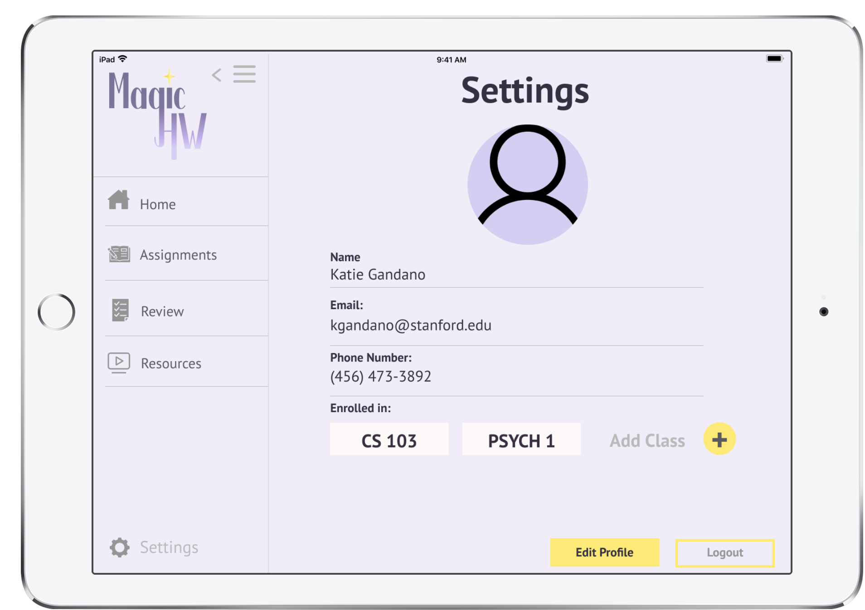
Appendix: Additional Prototype Screenshots
Settings

Slide 32
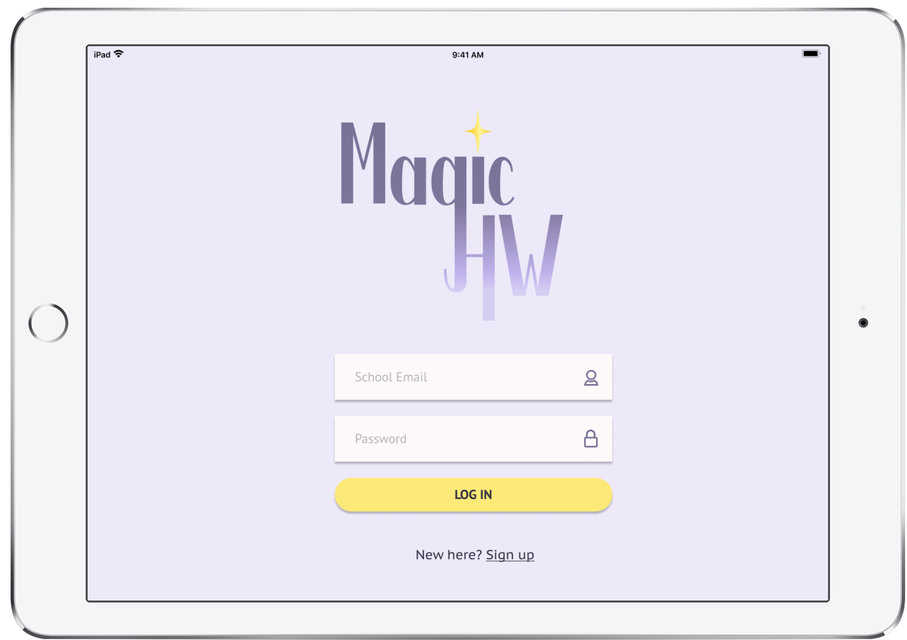
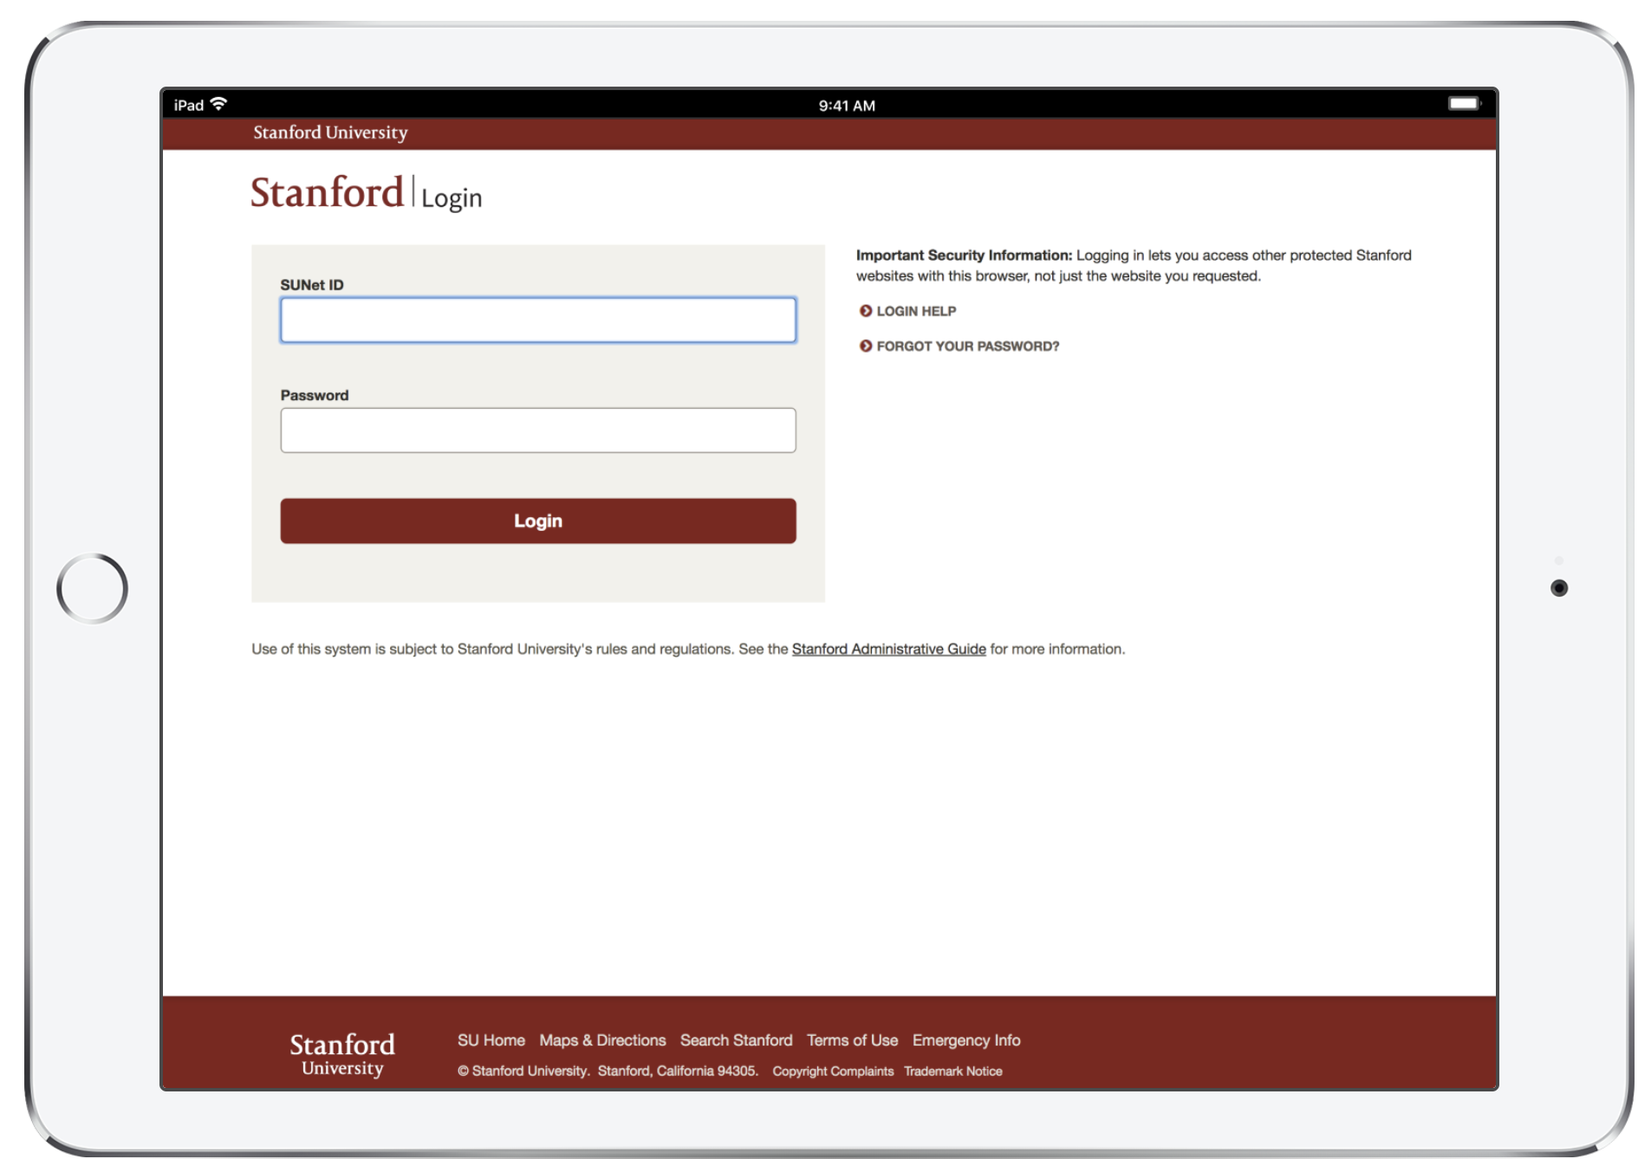
Appendix: Additional Prototype Screenshots
Login Process

