Slide 1
Magic Hw: Low-Fi Prototype
Aarti, Richard, Ryan, and Samantha

Slide 2
Overview
Mission Statement
Selected Interface
Low-fi Prototype
3 Task Flows
Experiment
Method
Results
UI Changes

Slide 3
Mission Statement
Homework that Helps You
Notes:
Our mission statement is Homework that Helps You. The idea behind this is that our homework helps everyone that uses it. Not only does it provide personalized statistics and feedback, it provides easy access to course content, review material and assignment breakdowns. The entire idea of this app is

Slide 4
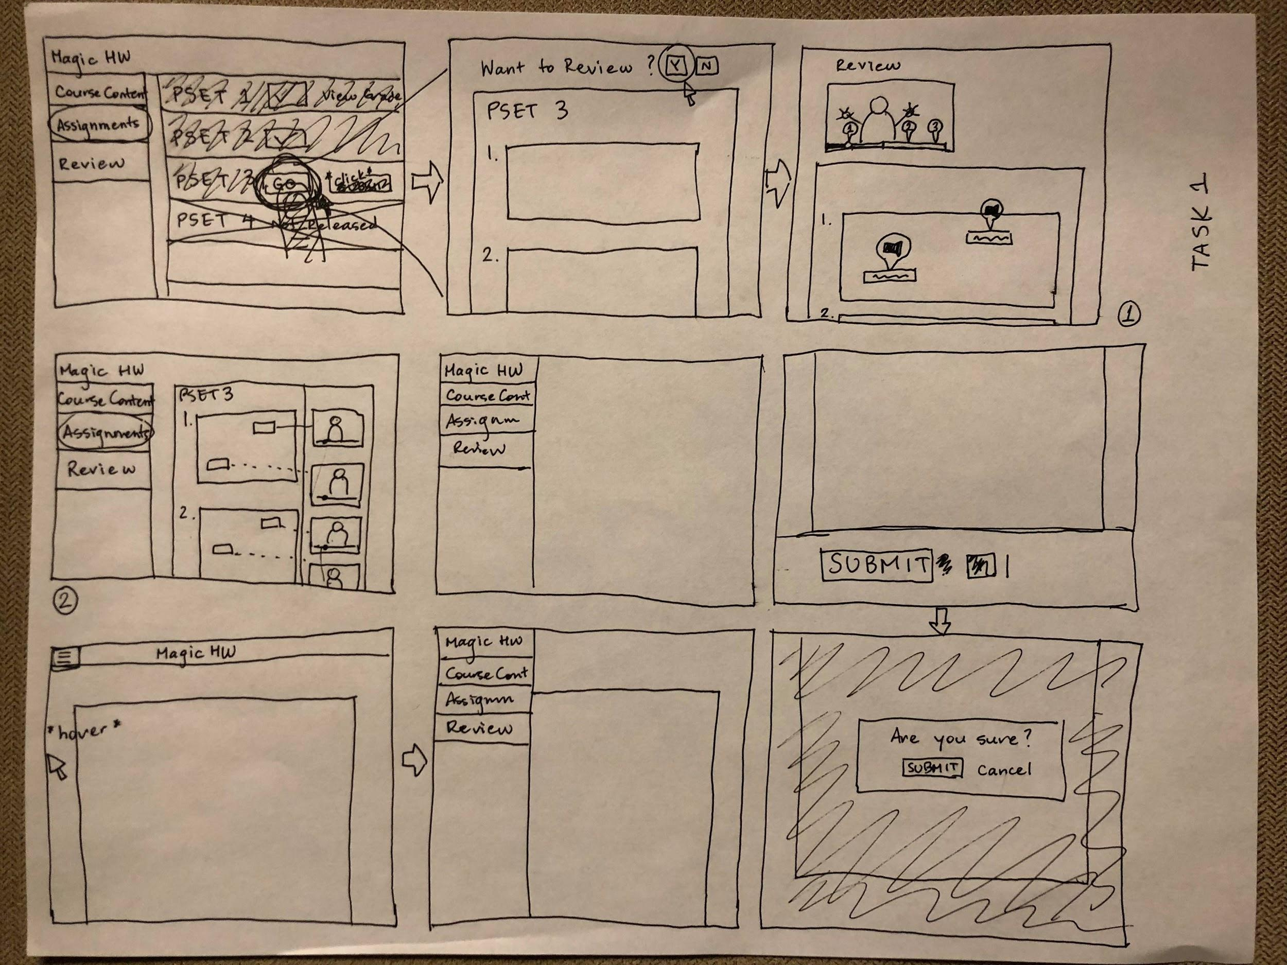
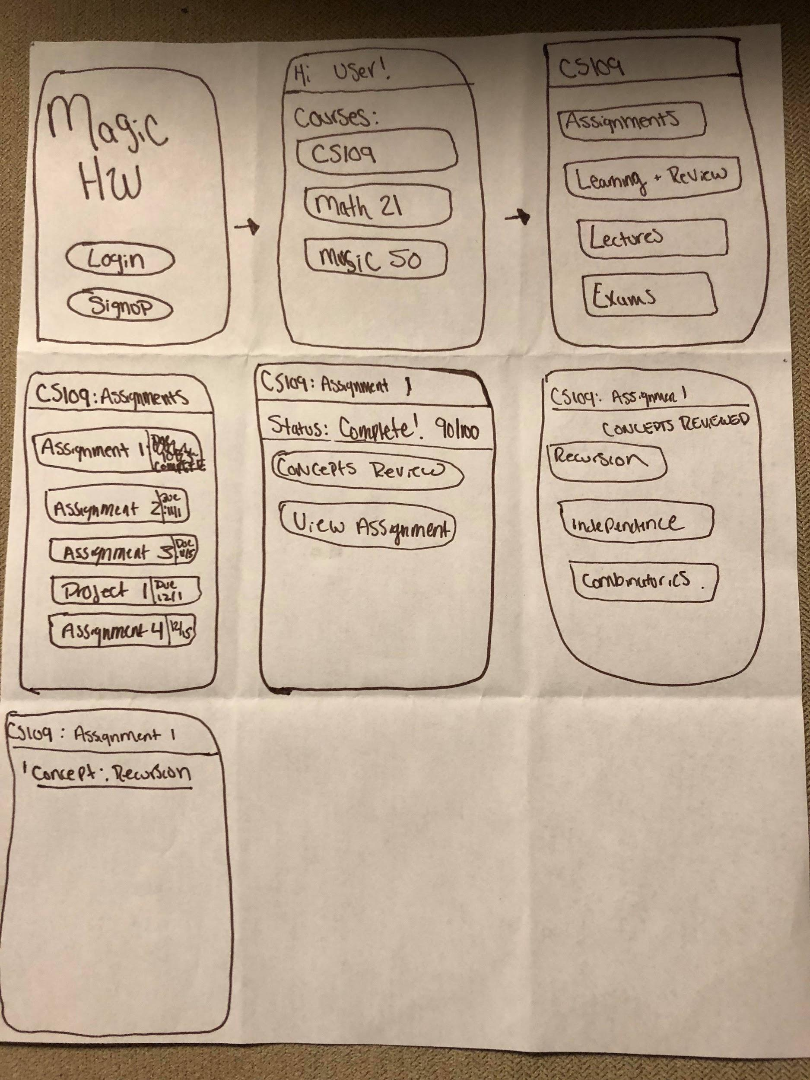
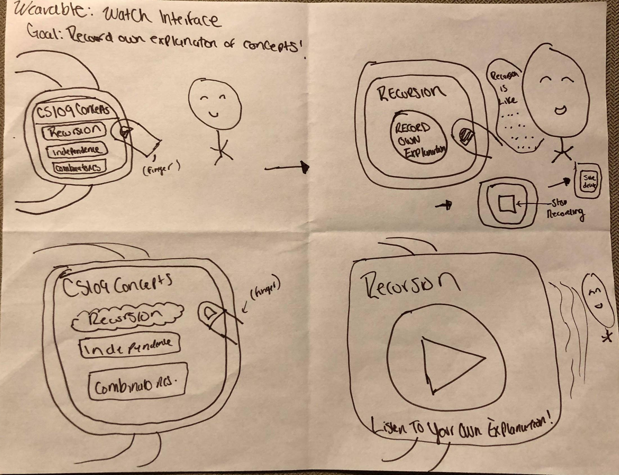
Selected Interface
Web Interface
Smart Watch Interface
Mobile Interface
Notes:
We liked the global menu from web interface, The visual feedback from the smart watch interface, and the organization and cleanliness of the mobile interface
Initially we wanted to make our product a desktop application so that we could provide assistance and resources while actively completing the assignment. What we realized, however, was that by altering things slightly for use as a mobile app, we could provide all the same information and resources even more conveniently. You can always have access to your assignment, feedback, and resources no matter where you are

Slide 5
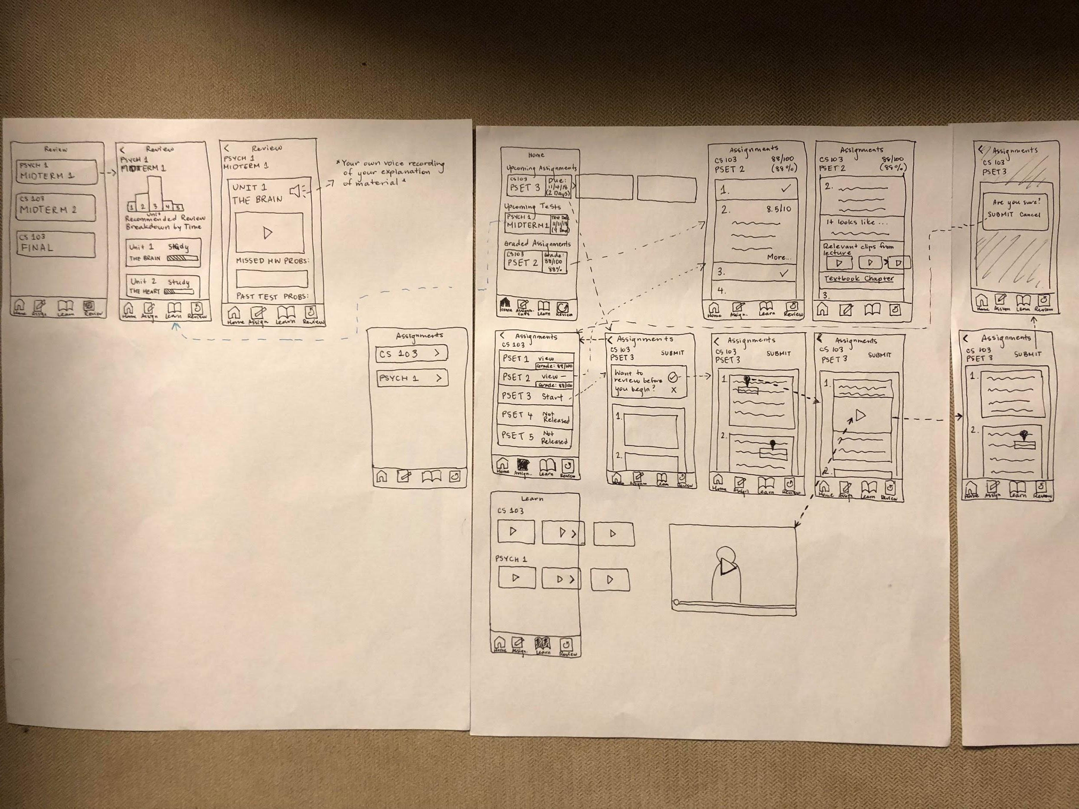
Low-fi Prototype

Slide 6
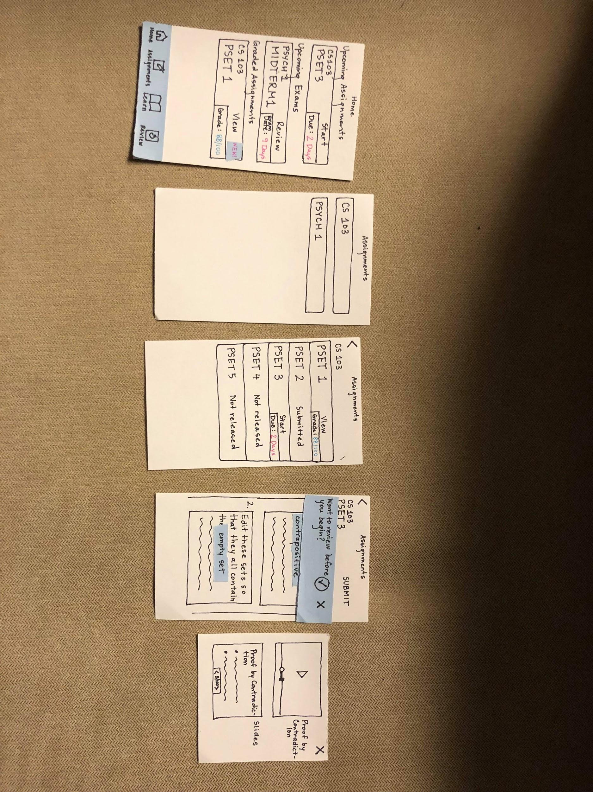
Task 1: Simple

Slide 7
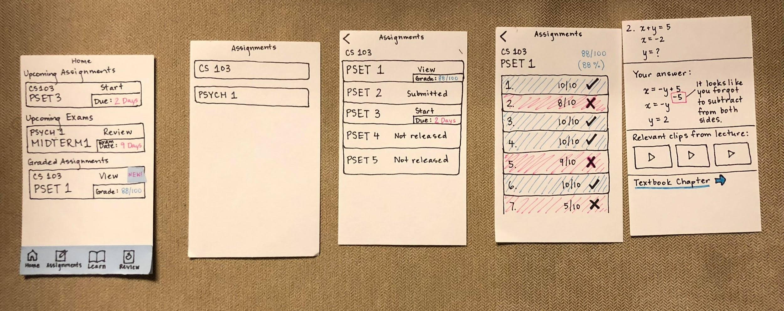
Task 2: Moderate

Slide 8
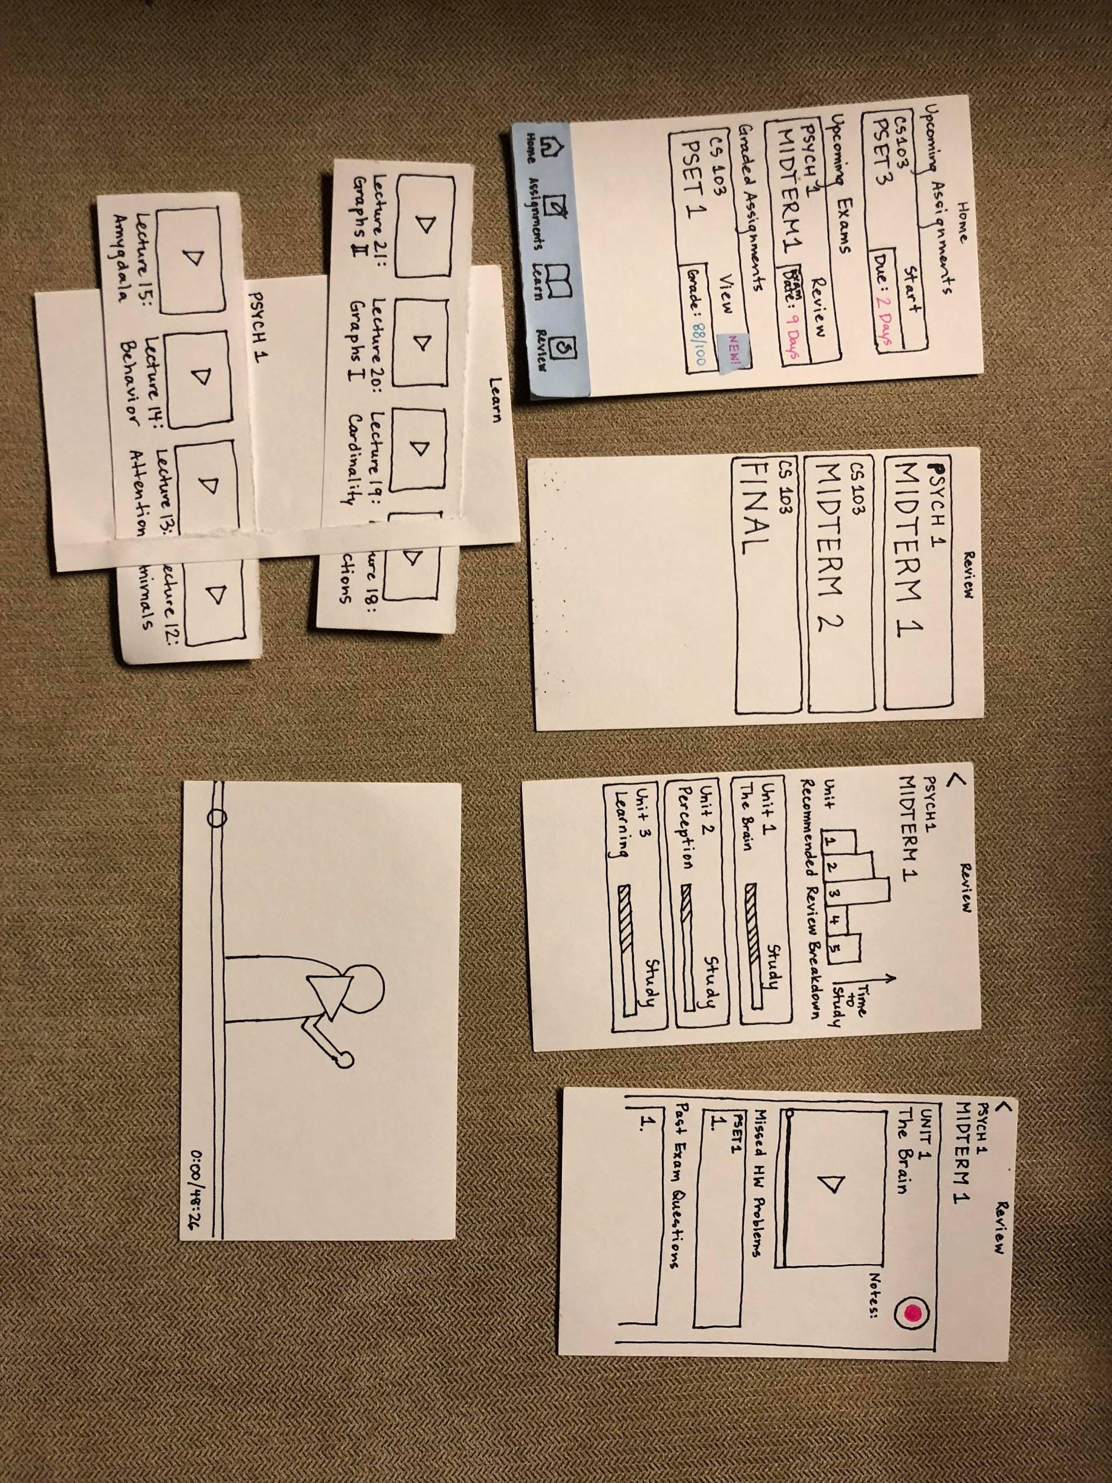
Task 3: Complex
Notes:
How much time it will take to study each unit, how much progress/studying you have already done, and a recommendation of what is the most important to study.

Slide 9
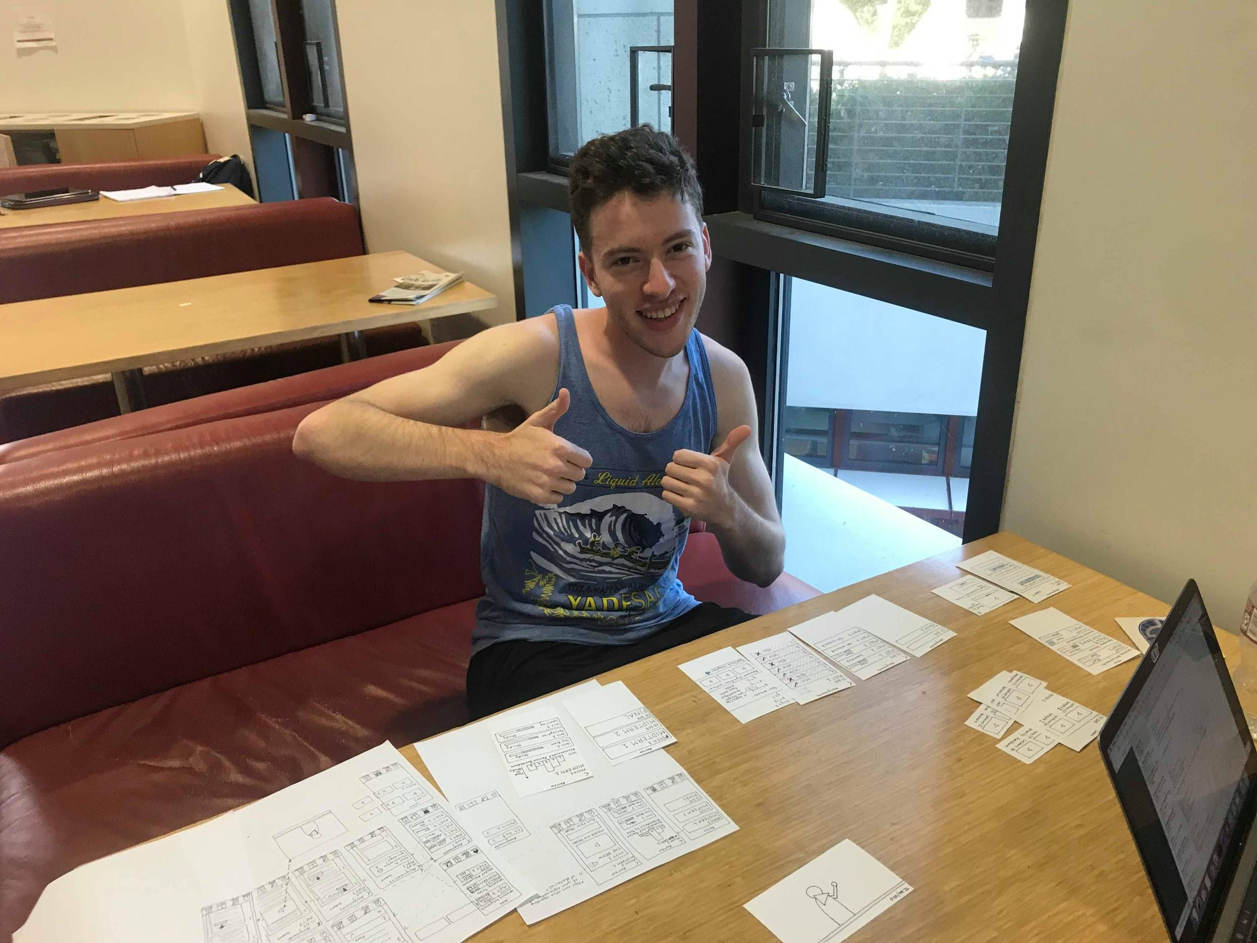
Method
5 interviews
4 students
1 analytics
professional
Notes:
Participants: demographics, how recruited/compensated: students because its a learning app. We also are trying to provide useful analytics to our users so we also had 1 woman who works professional in analytics try our app and give us feedback. I just want to clarify that we did get permission in class from minh-an to interview more than 1 student as our app is most relevant to college students.
Environment: We conducted all 5 of these interviews in the huang engineering building
Tasks
Procedure
Test Measures
Team Member Roles:
I acted as both the computer and the facilitator and we had two group members taking down information and observations.

Slide 10
Results
The Home page was
extremely effective
for those who used it.

Slide 11
Results Continued
The Learn button generally confused users

Slide 12
Results Continued More
Analytics were enjoyed but unclear
People loved personalized feedback, approximate study times, and recommendations

Slide 13
UI Changes
Label every button with more information
Rename and position Learn to Course Content
Redo the Analytics to be more clear

Slide 14
Conclusion
Notes:
Overall, we made great progress this week thanks to the Low Fi Prototype. We initially tried out many interfaces before settling on a combination of our web and mobile interfaces. Afterwards we created and conducted tests with our lowfi prototype which gave us great feedback in both people greatly enjoying the product, and seeing how they used the interface and what difficulties they had. Going into next week, we have good plans for how we want to change and update the interface both to provide better information to the user, as well as to disambiguate the different features.

