Slide 1
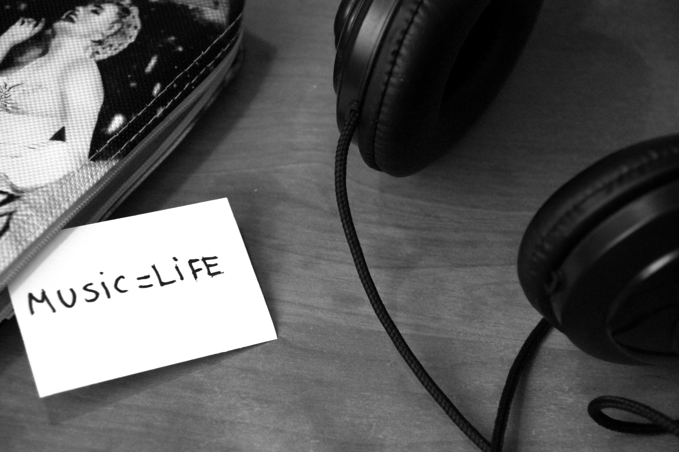
MUSIC
Abanezer Sisay, Arkira Chantaratananond, Armando Bañuelos, and McDavis Ansere
Notes:
List and Introduce Your Team Members:
-Abanezer - CS HCI
-Arkira - Symsys HCI
-Armando - CS AI
-McDavis - CS BioComp
What is your problem domain and studio?
A: Our studio is arts and culture. And since arts and culture is such a huge topic we have decided to narrow it into the intersection of music and culture via the side of the creators.

Slide 2

NEEDFINDING METHODOLOGY

Slide 4

Questions we asked...
Can you walk me through a story of a time you felt extremely accomplished as a musician?
What are some frustrations you have when composing your own music?
How did you get into playing music?
Can you tell me about a time you performed in front of other people. How did that make you feel?
Can you walk me through a typical practice session?
What brings you into Guitar Center today?
Can you tell me about a musical challenge?
What advice would you give to novice music players?

Slide 5
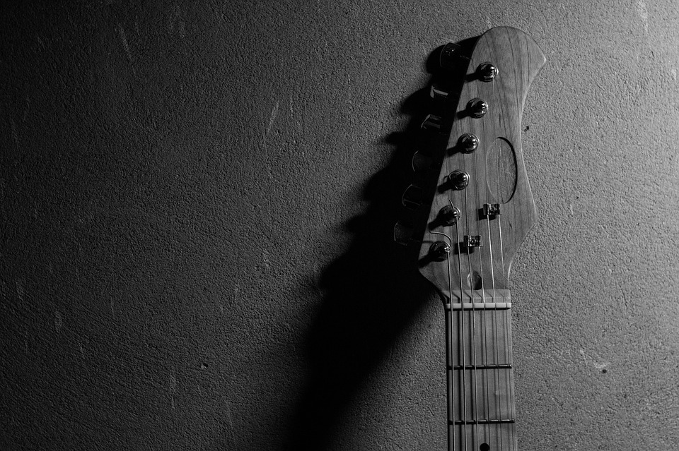
INTERVIEW RESULTS

Slide 6
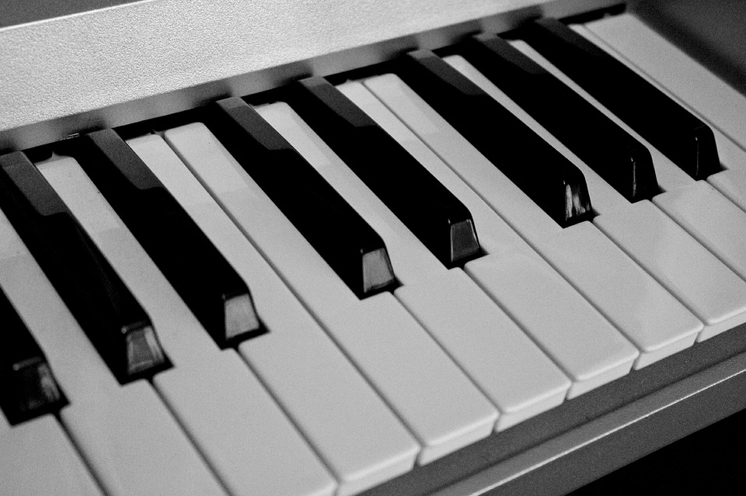
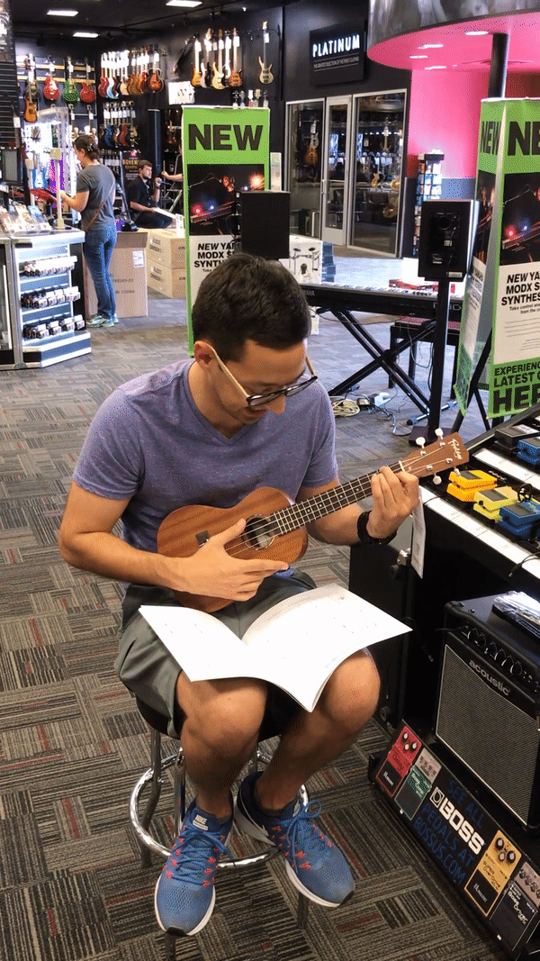
Who?
Complete beginner to music creation
“I want to learn at a slow and steady pace - I’m intimidated when things move too fast”
Why?
Looked confused and hesitant looking for a music book
Where?
Guitar Center
Gilbert
Notes:
The reason why we decided to construct our slides in this specific manner is to show that we are ultimaltey human centered. Our people come first

Slide 7

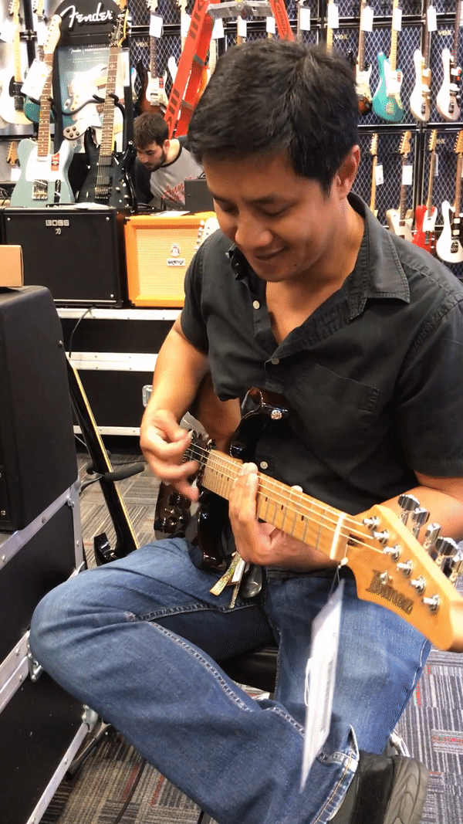
Who?
Very experienced guitar player
“I was chosen by the guitar gods”
Why?
He was jamming out to some crazy tunes!
Where?
Guitar Center
Jay

Slide 8
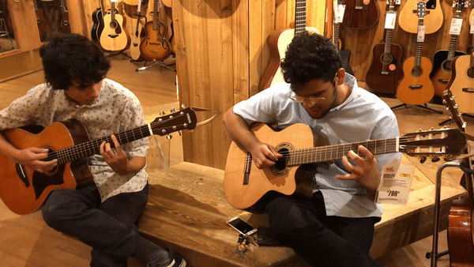
“I think that people lose sight that music is about an emotional experience. Music is up there with the strongest emotions like love, near-death experiences, and hallucinogenic drugs.” - Carlos
Who?
2-year self taught guitar player
Who?
Has been playing bass for 6 years and guitar for 3
Why?
Playing a wonderful duet
Why?
Playing a wonderful duet
Jose and Carlos
Where?
Guitar Center
Where?
Guitar Center
“I just sounded like shit. I just knew that I needed to practice. There is no science behind it. Just practice.” - Jose

Slide 9
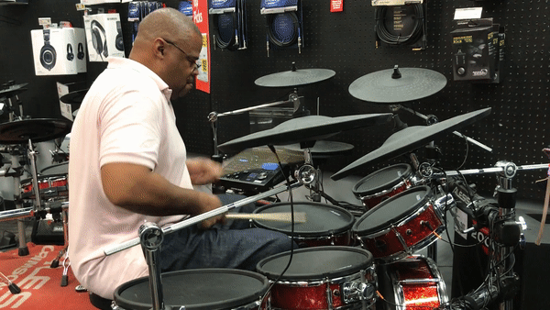
Who?
Has been playing drums since middle school
“Well I wasn’t always a drum player. I first played bongos. Then my friend introduced me to a high-hat and snare drum. I have never looked back since”
Why?
Rocking out to an insanely catchy beat
Troy
Where?
Guitar Center

Slide 10
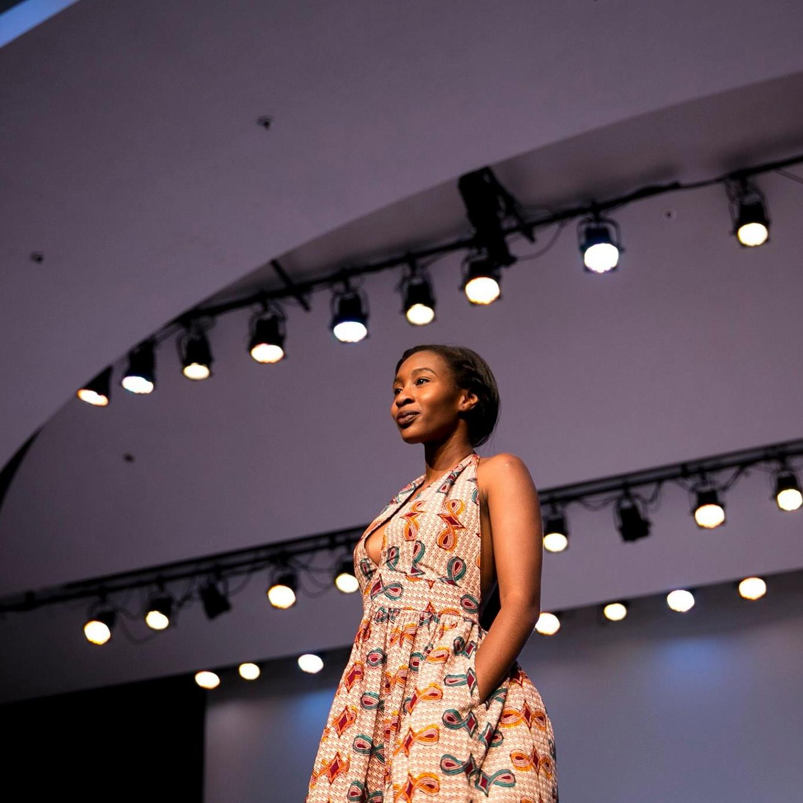
Who?
Stanford student who is a frequent listener music
“Music is where I feel at peace and understood ”
Why?
Listening to music while walking to class or lying in bed
Where?
Stanford Campus
Isi

Slide 11

EMPATHY MAP

Slide 12
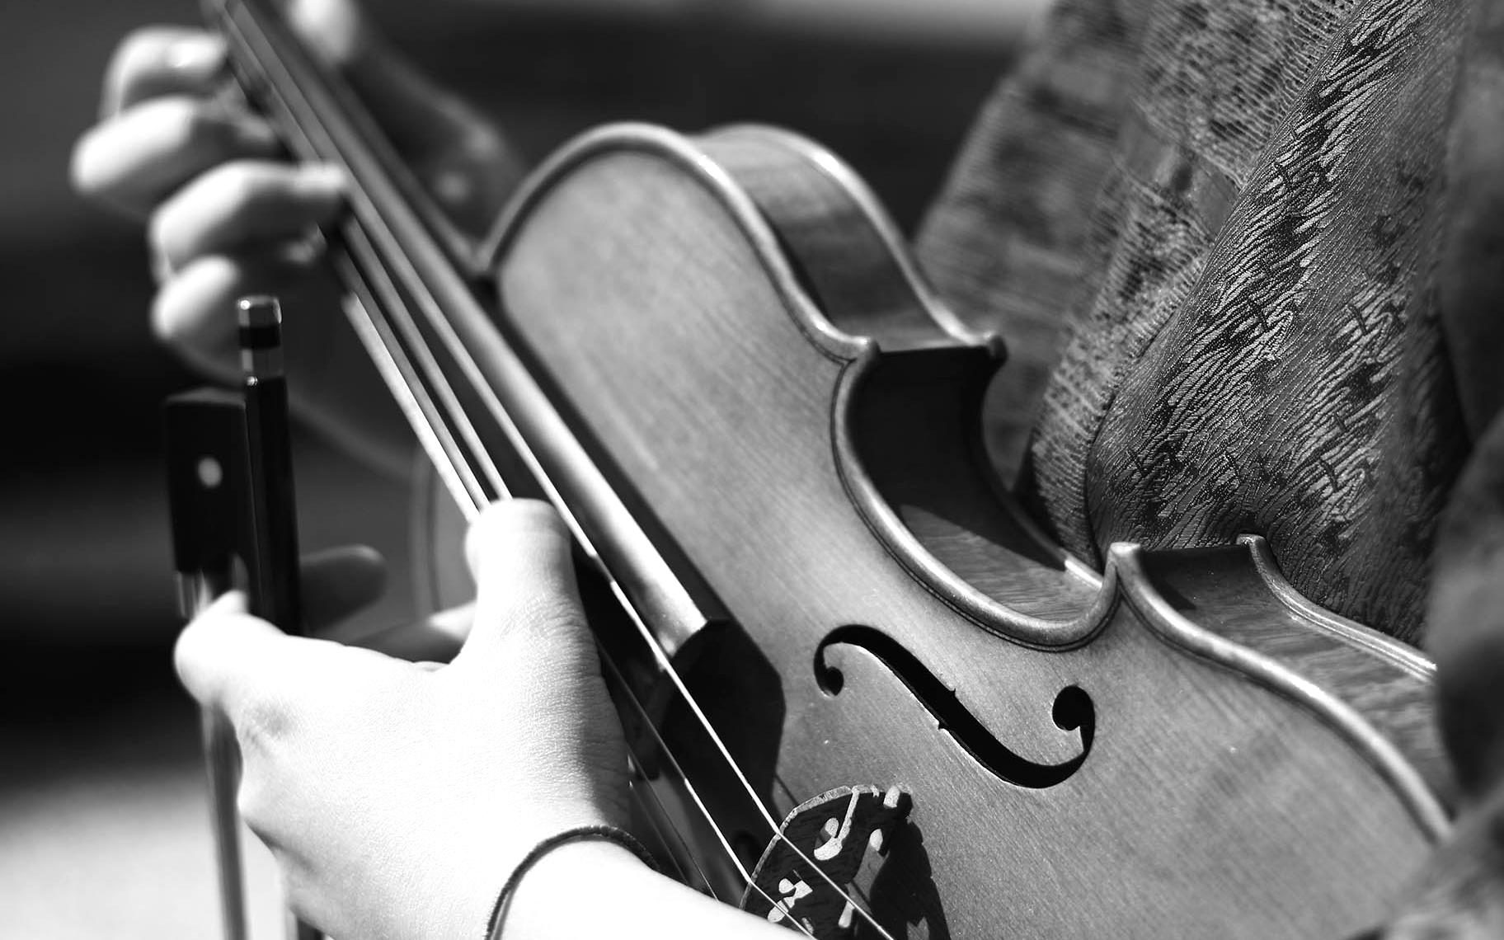
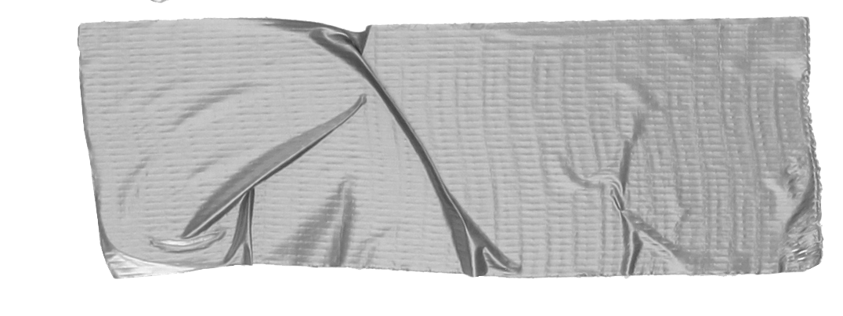

SAY
“I learn the best with progressive lessons, from beginning to hard”
“I want to find new music and connect to the artists I listen to “
“There was no YouTube back then; I would record cassettes and play them slowly to learn”
“I was honestly fascinated with rhythm and what I could potentially do on the drums”
“Simple design for beginner learning tools is way more trustworthy to me”
“You have to figure if new players match your style and if you can work with their attitudes”
“You feel nervous up until you perform, then it’s just jamming”
“Brother taught the basics to me... after I spent like $300 on books”

Slide 13
DO
Shake head when recounting experiences with bad attitude members
Showing determination when talking about experiences of practicing
Staying at the shop to play, despite having picked up gift
Use Youtube to learn new songs
Practicing very little due to time constraints
Ask friends about artists they have been listening to
Plays random gigs with friends sometimes
Find rehearsal space only on weekends in SF
Looks up lyrics and chords to slowly play along with
Individuals played different styles to show off talents

Slide 14
FEEL
Somber to acknowledge the fact that his life was slowing down and unable to practice or perform as much.
Felt excited to be playing again and being able to talk musically.
It is satisfying to progress through levels; it is motivating to learn this way
There is a feeling of connection when listening to new music that is out of the norm
Feels strongly committed to his musical career
Felt a little sad/lonely that he couldn’t play with his friends
There is comfort in using a trustworthy tool that teaches you at your pace
Felt more comfortable when Armando played his guitar

Slide 15
THINK
I want to be able to smoothly play along to songs at my pace
If there was a way of being exposed to the artists thought process and what makes their music “different”
I want to build a strong foundation for my playing
I want to be talented enough to improv-jam with other musicians
That music is important and just wants to get better
There needs to be more music partners and time for them to practice.
Music is a way for me to convey an emotional idea through a physical barrier
There are more important things in my life than music, but music will always draw me in

Slide 16
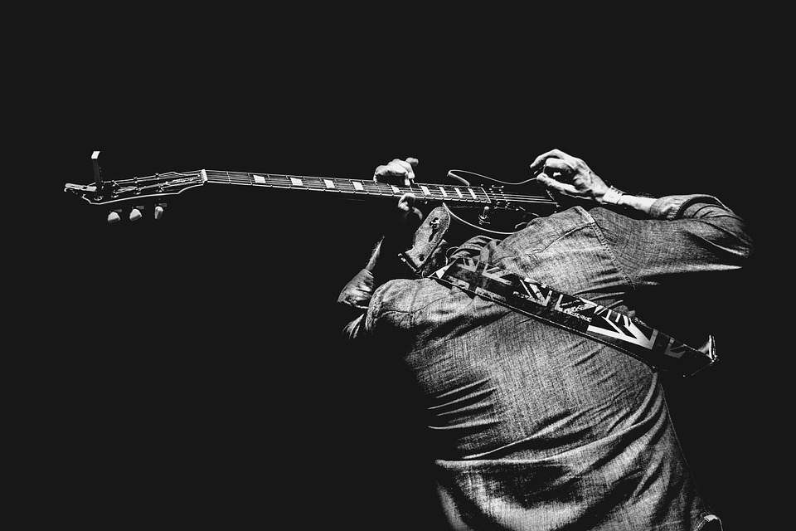
NEED, INSIGHTS, AND ANALYSIS

Slide 17
INSIGHTS:
Looking for ways to learn ukulele at his own pace
NEEDS:
Easy access to play-along music lessons that move at the individual’s pace

Slide 18
INSIGHTS:
He needed time and people to rehearse with
NEEDS:
Easy access to rehearsal space
Time-flexible people to jam with
More time to jam

Slide 19
INSIGHTS:
They want to connect with people who are also serious about music
NEEDS:
Creating a platform with serious music players to connect

Slide 20
INSIGHTS:
He does not have time to practice
NEED:
Creating a schedule for practice

Slide 21
INSIGHTS:Want to expand her knowledge of music
NEEDS:
A way to find more music and connect with artists

Slide 22
SUMMARY

Slide 23

Easy access to rehearsal space
Time-flexible people to jam with
More time to jam
Creating a platform with serious music players to connect
Easy access to play-along music lessons that move at the individual’s pace
Creating a schedule for practice

