Slide 1
POV and Experience Prototypes
By Armando Banuelos, McDavis Ansere, Arkira Chantaratananond, and Abanezer Sisay

Slide 2
Problem Domain:
Help music creators best practice their art

Slide 3
Initial POV

Slide 4
We met Jay, an experienced funk guitarist, at the Guitar Center. We were amazed to realize that despite saying he had no free time, he spent hours playing at the Guitar Center when his objective was simply to buy a distortion pedal. It would be game changing to shift his mindset from thinking of playing the guitar as a time-consuming, energy-taxing activity to a relaxing activity.
Initial POV

Slide 5
Additional Needfinding Results

Slide 6
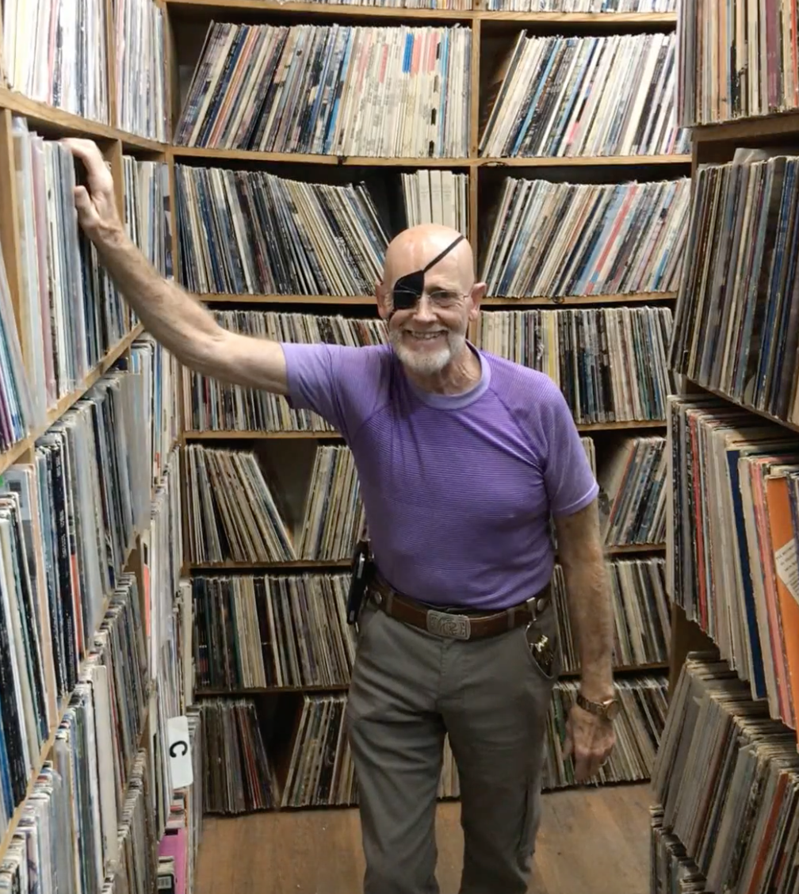
Gary
Who?
  Pianist and owner of the Record Man in Redwood City
Why?
  He was wearing a cool eye patch!
Where?
  The Record Man in Redwood City
Insights
  He feels that the new generation of musicians are disinterested in older music genres and try to create original sound without reference to other artists

Slide 7
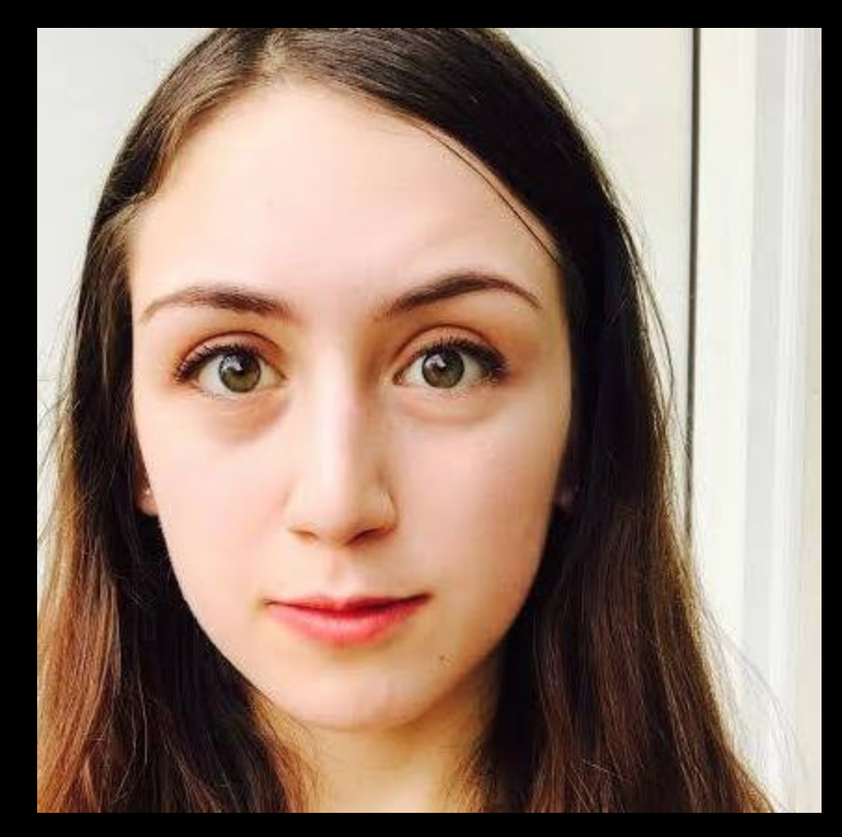
Ofir
Who?
  Music and Drama Major at UC Berkeley
Why?
  We found her singing a beautiful tune on the street
Where?
  UC Berkeley
Insights
  She feels frustration for not being able to find people with a similar passion for music

Slide 8
Dave
Who?
  Novice Guitar Player
Why?
  Dominated the room with his strong personality
Where?
  Gelb’s Music Shop in San Mateo
Insights
  Dave doesn’t use online resources but rather learns via one-on-one lesson and by listening to his idols play

Slide 9
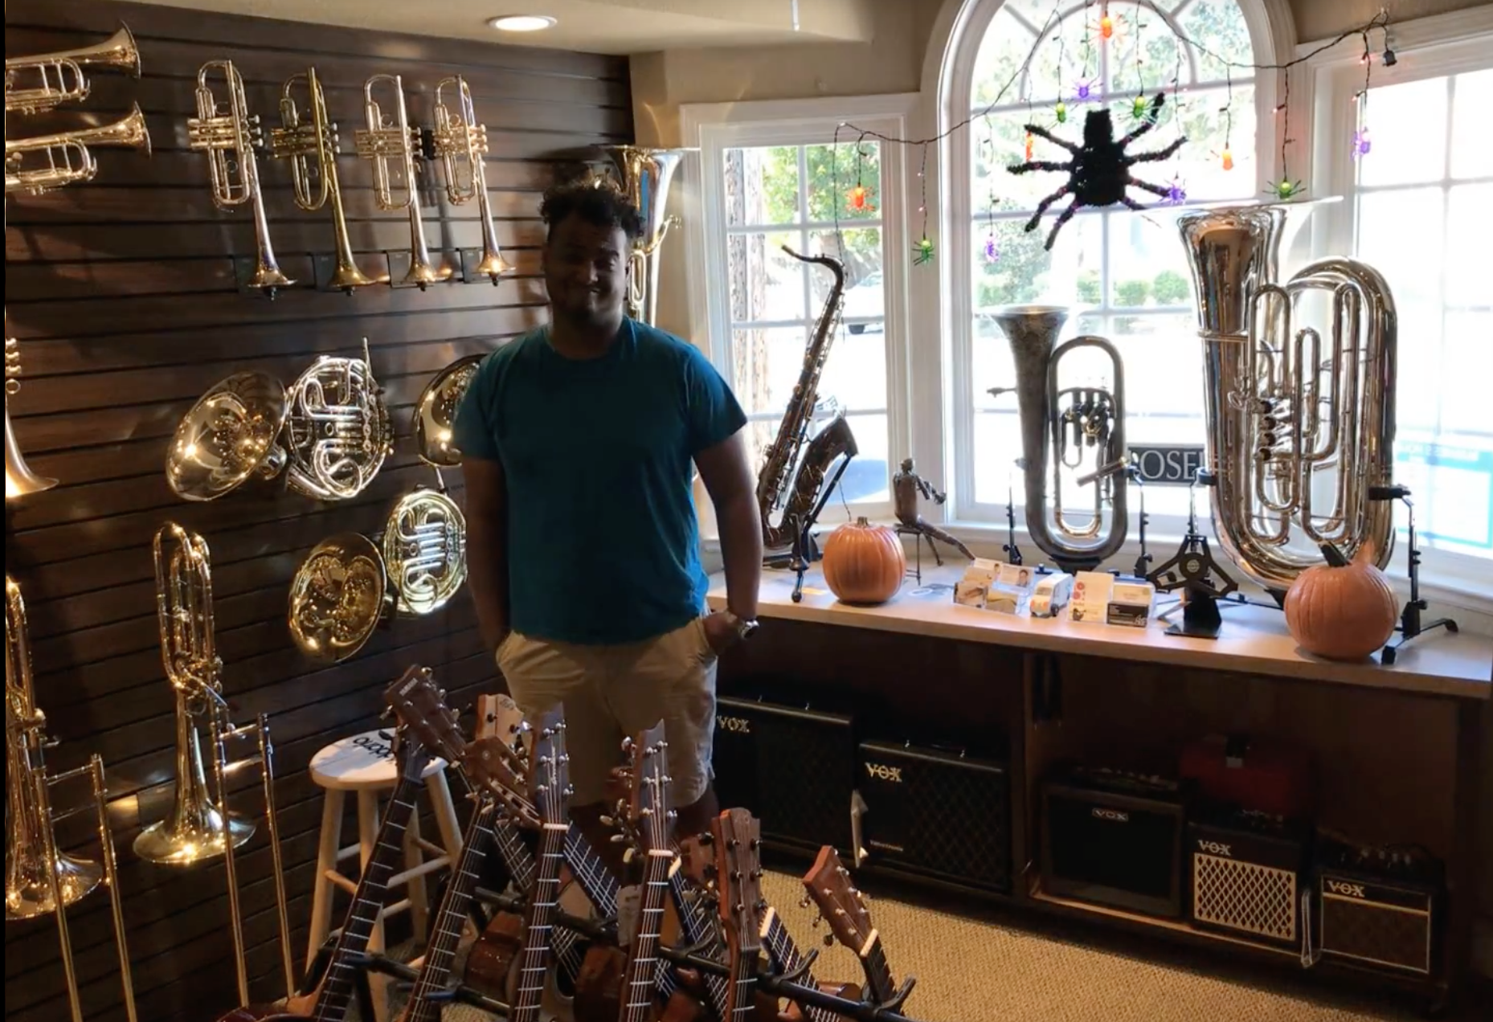
Laura
Who?
  Music Major from St. Joseph University
Why?
  Employee at Gryphon Stringed Instruments
Where?
  Gryphon Stringed Instruments
Insights:
  Laura said that she found it difficult to rehearse because she had nothing to practice for

Slide 10
3 Revised POVs

Slide 11
We met Jay, an experienced funk guitarist, at the Guitar Center. We were amazed to realize that despite saying he had no free time, he spent hours playing at the Guitar Center when his objective was to just buy a distortion pedal. It would be game changing to shift his mindset from thinking of playing the guitar as a general health requirement.
POV #1

Slide 12
We met Carlos and Jose, two San Jose State students who play classical jazz guitar. Carlos is a intermediate guitar player and Jose is a beginner guitar player. We were amazed to realize that while they practiced a lot individually, they struggled to come together to rehearse songs so their performances were inconsistent. It would be game changing to guide musicians in collaboration practices in order to provide them with consistent rehearsals.
POV #2

Slide 13
We met Troy and Laura. Troy is an expert drummer we met at the Guitar Center and Laura has a Music B.A. from Saint Joseph’s University and currently works at Gryphon Stringed Instruments. We were amazed to realize that despite their dedication to music, they feel as if music is not as important to them anymore because they have nothing to practice for. It would be game changing to make musicians see practice not as a means to an end but as a means in itself.
POV #3

Slide 14
Top 3 HMW Statements

Slide 15
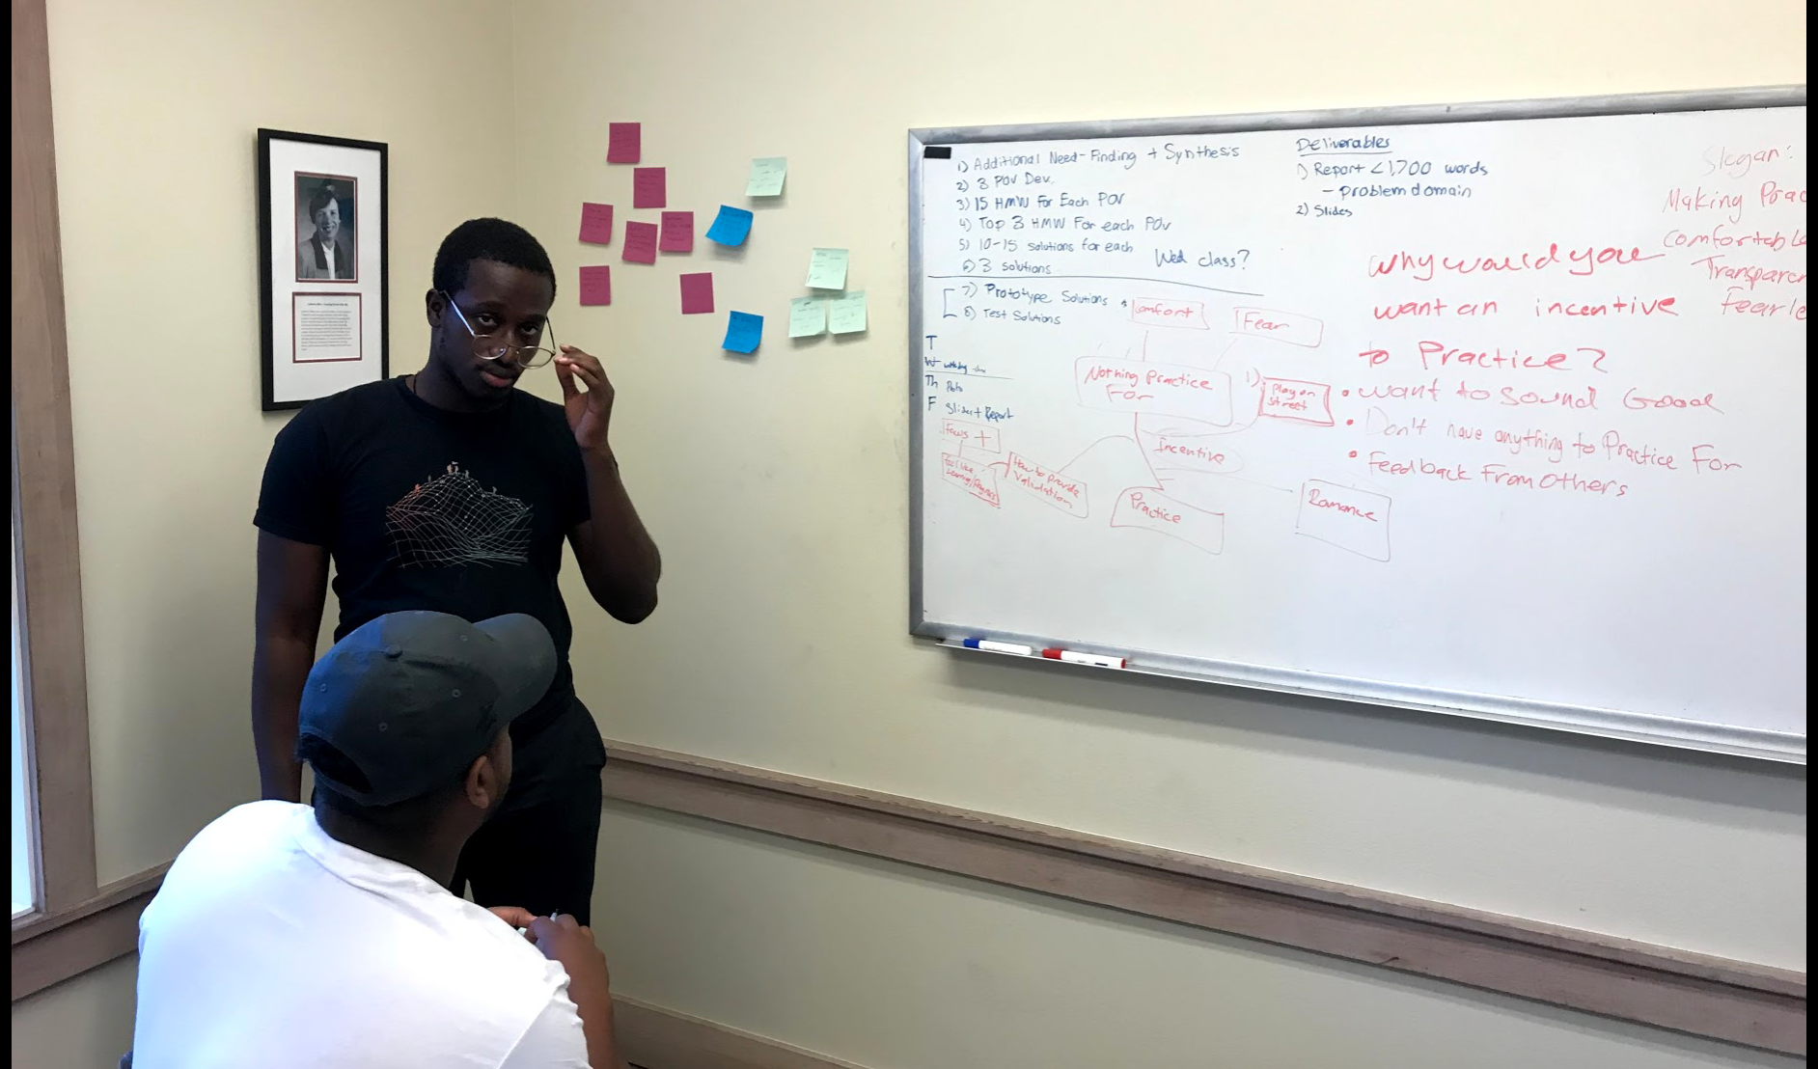

Slide 16
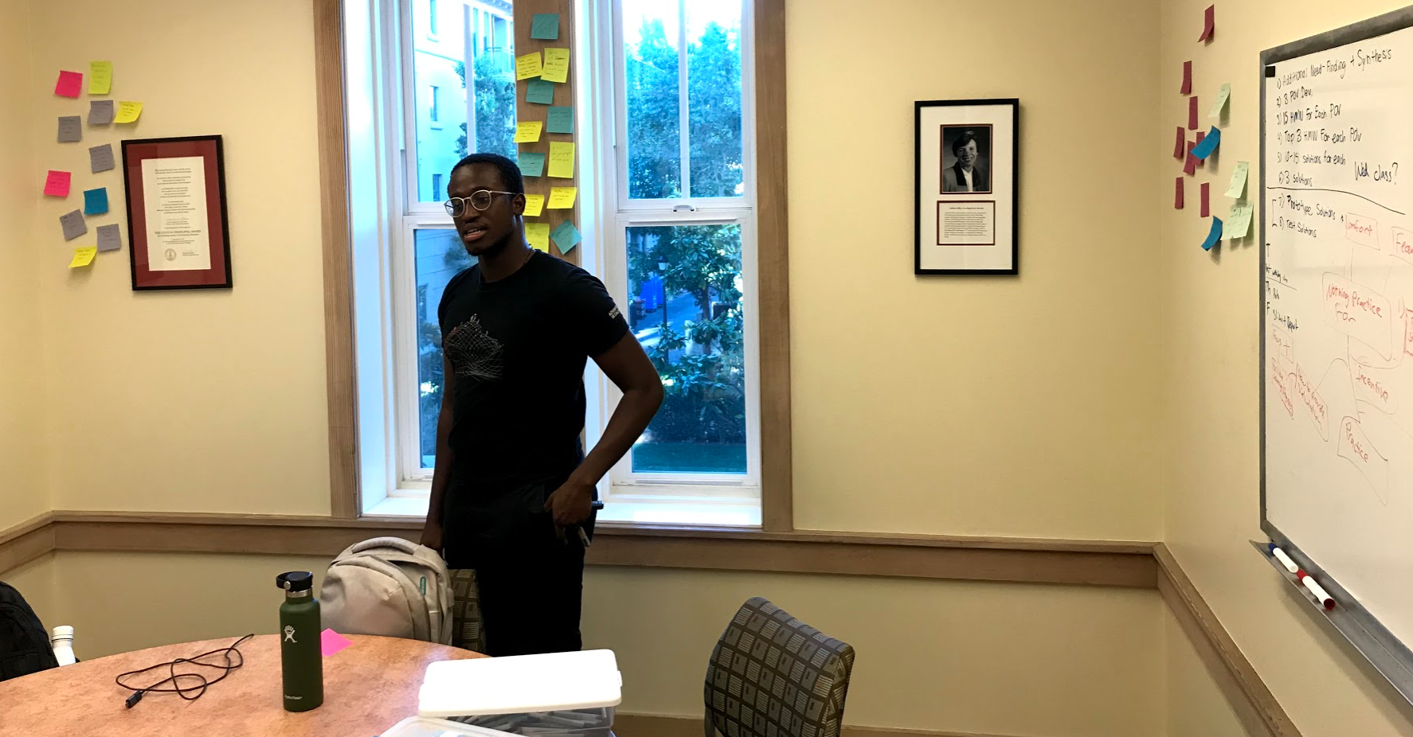

Slide 17
It would be game changing to guide musicians in collaboration practices in order to provide them with consistent rehearsals with others
How might we make low-commitment, easy-access, and quick-decision collaboration happen?
HMW #1

Slide 18
It would be game changing to guide musicians in collaboration practices in order to provide them with consistent rehearsals with others
How might we integrate musicians and non-musicians into an inspiring jam session?
HMW #2

Slide 19
It would be game changing to make musicians see practice not as a means to an end but as a means in itself
How might we incentivize practice in a way that makes it addicting?
HMW #3

Slide 20
3 Experience Prototypes

Slide 21
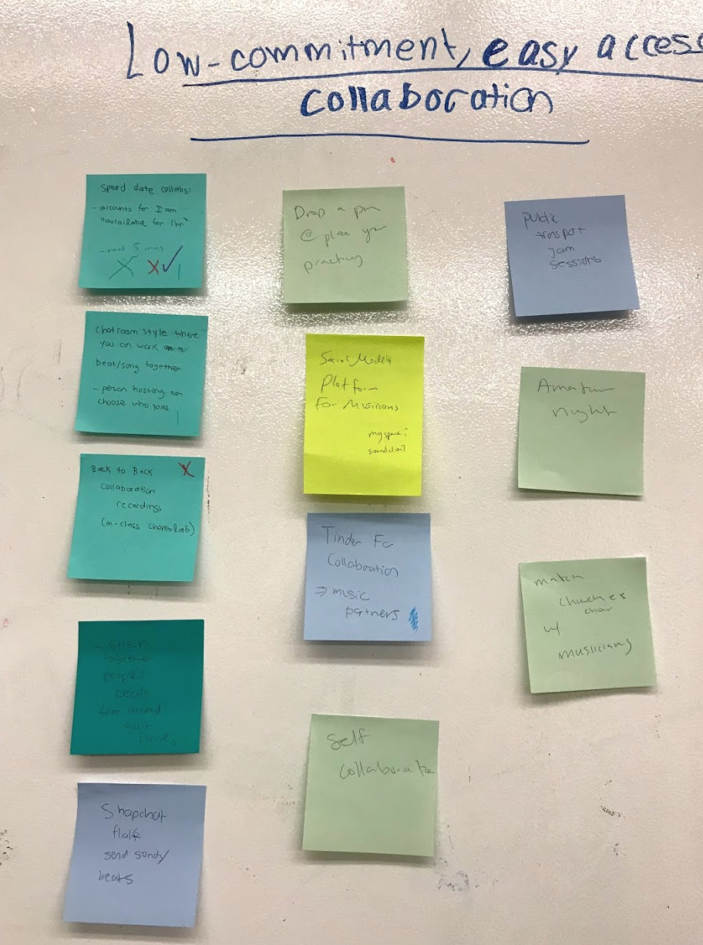
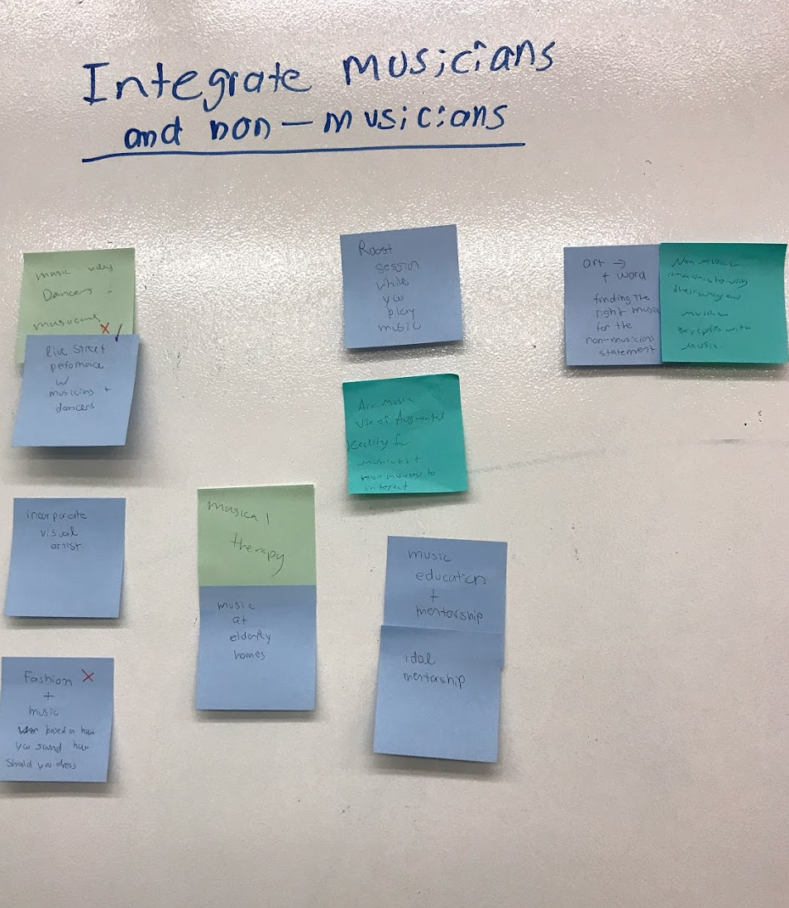
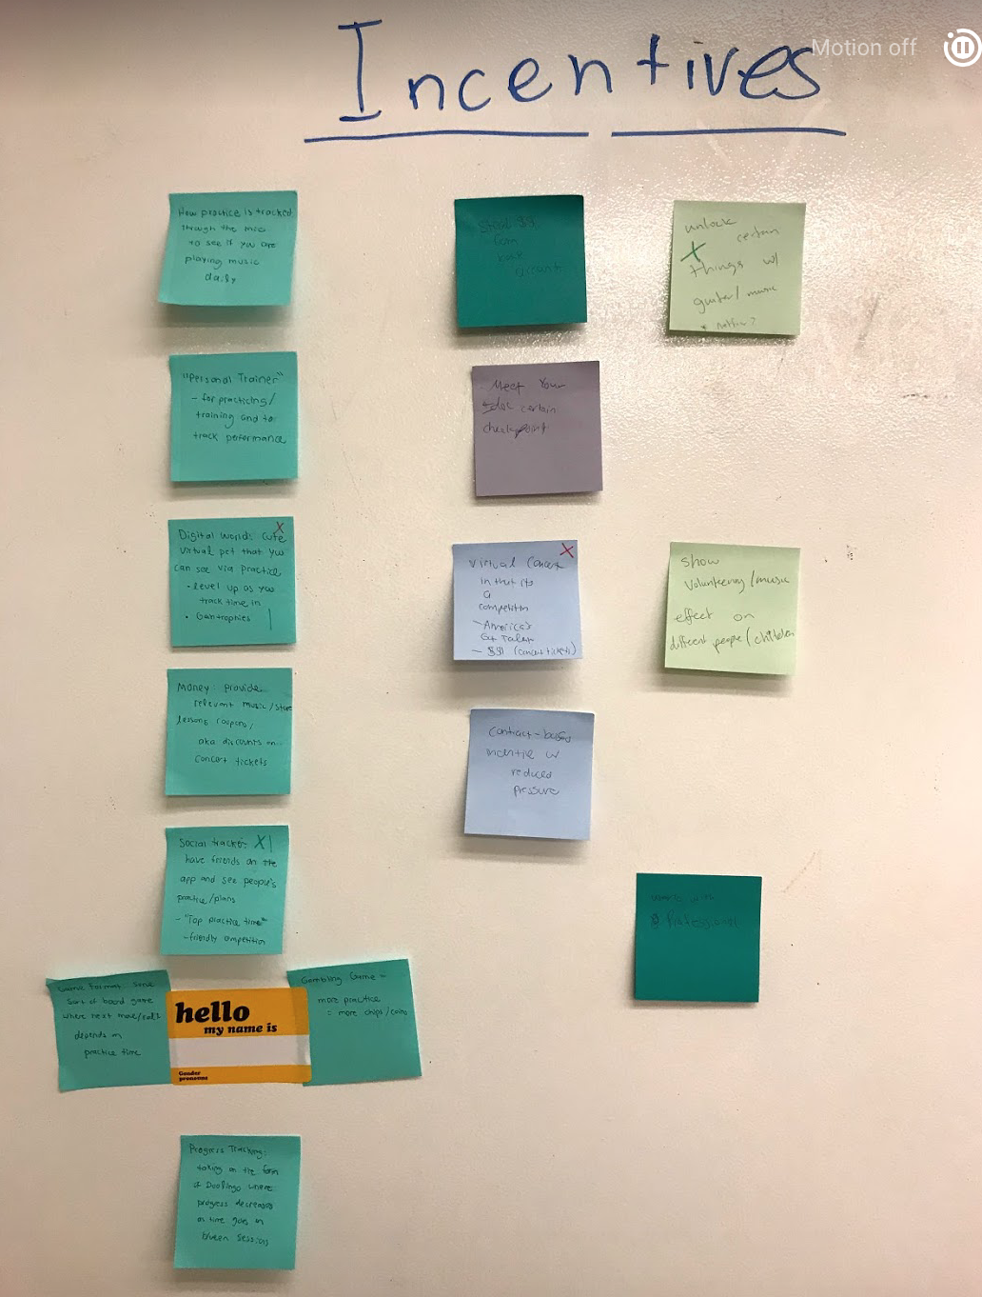

Slide 22
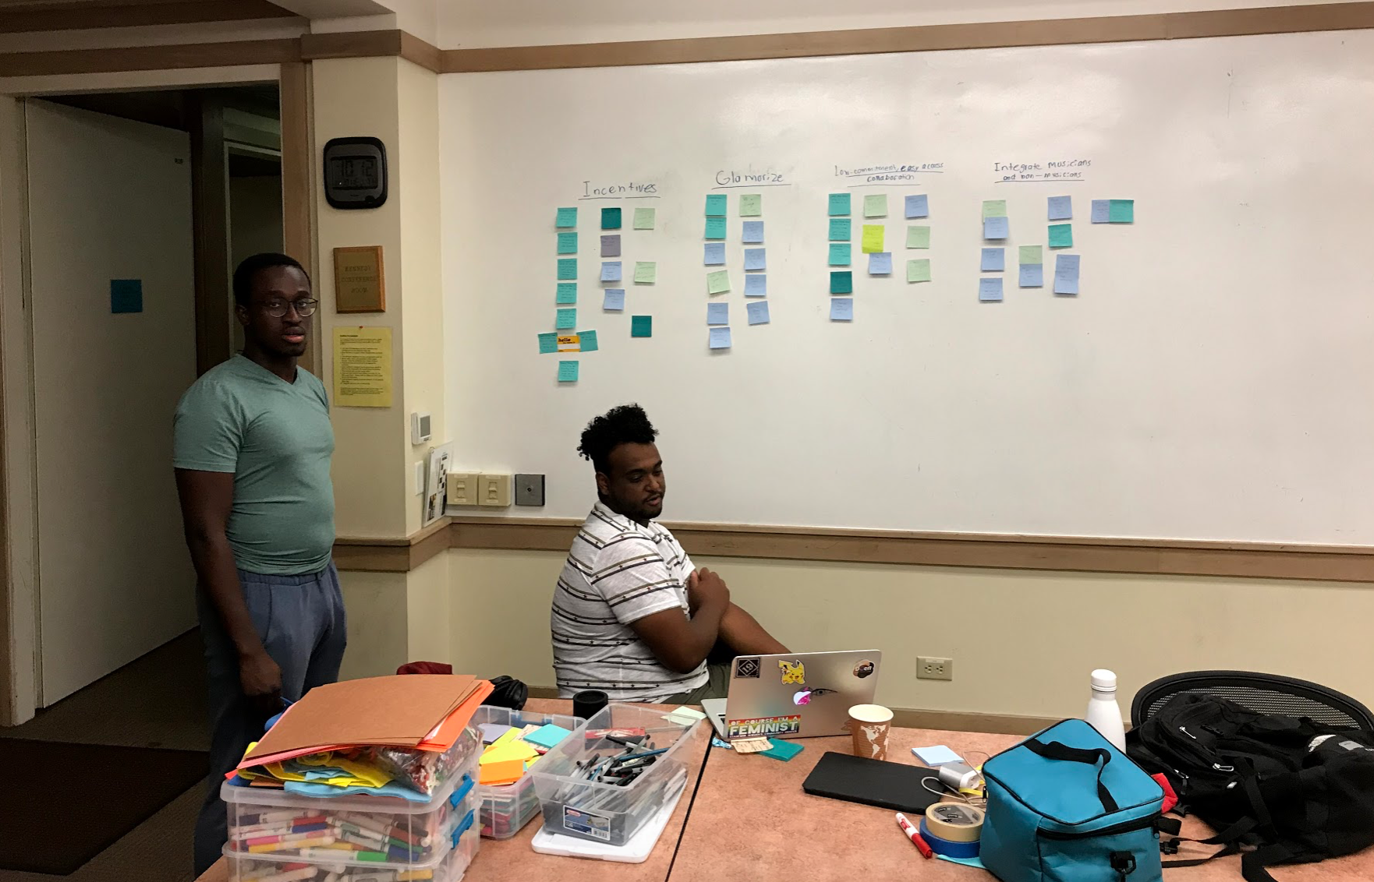

Slide 23
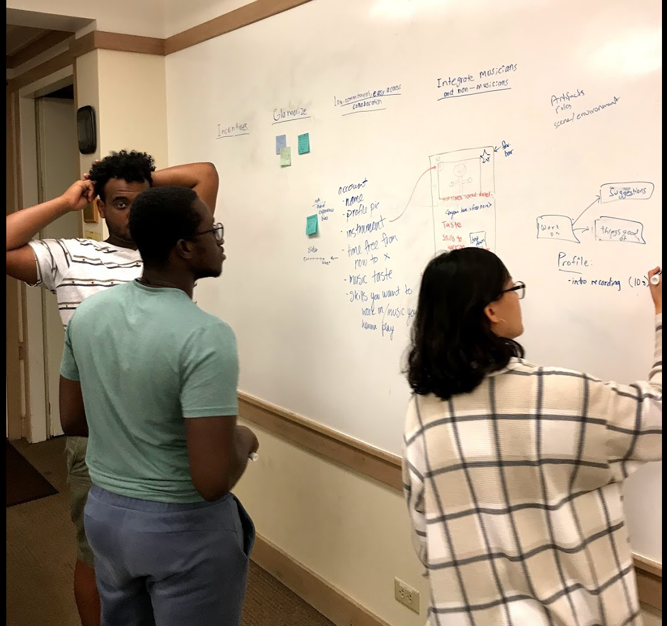

Slide 24
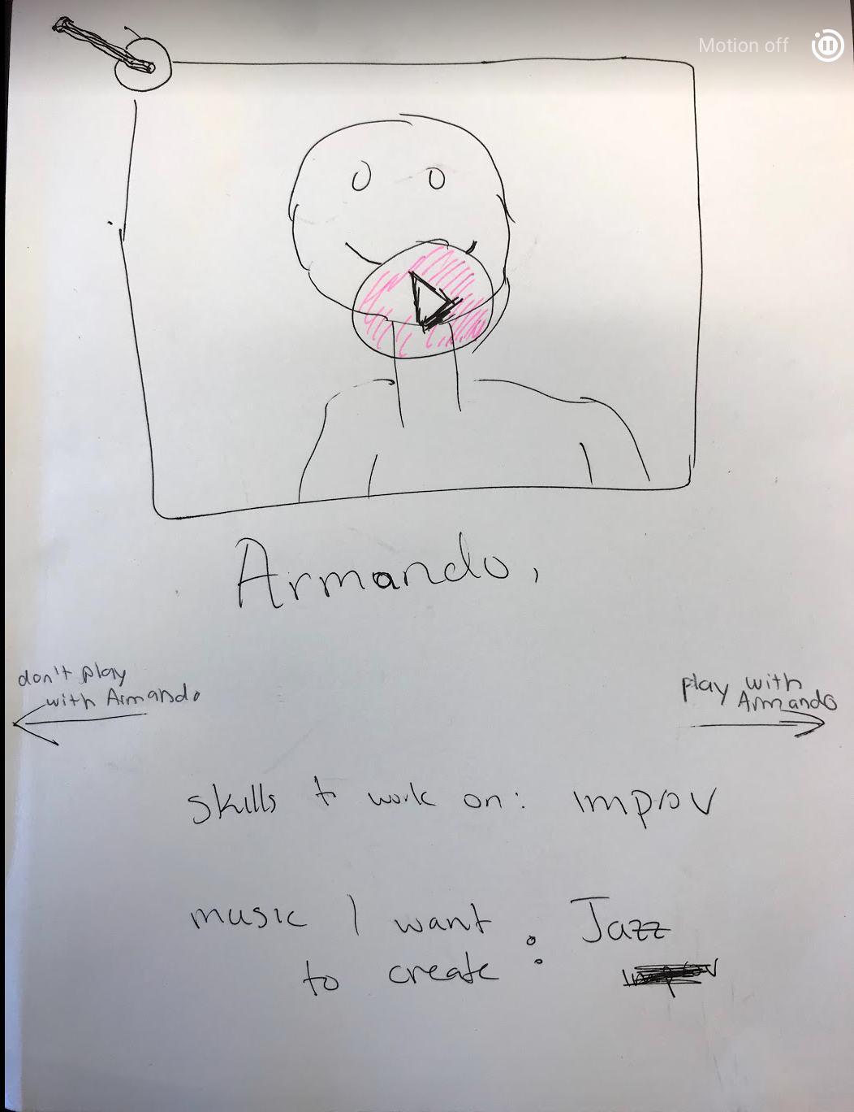
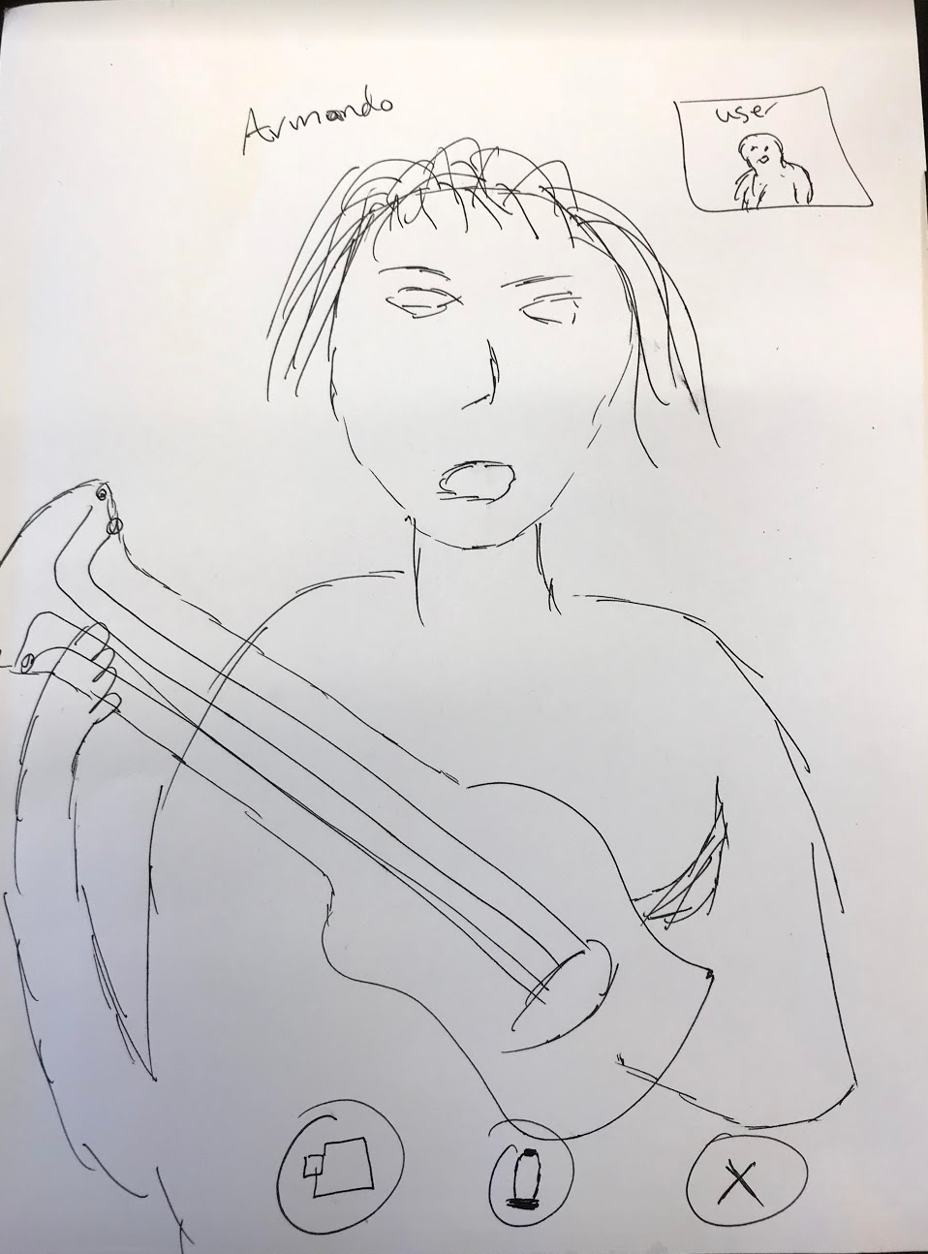
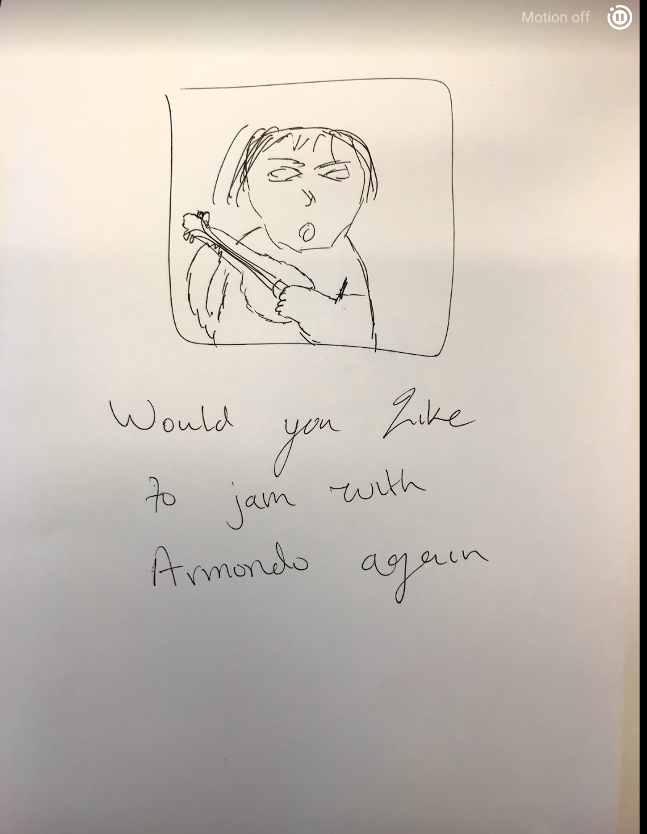
Prototype #1: Virtual Speed Collaboration

Slide 25
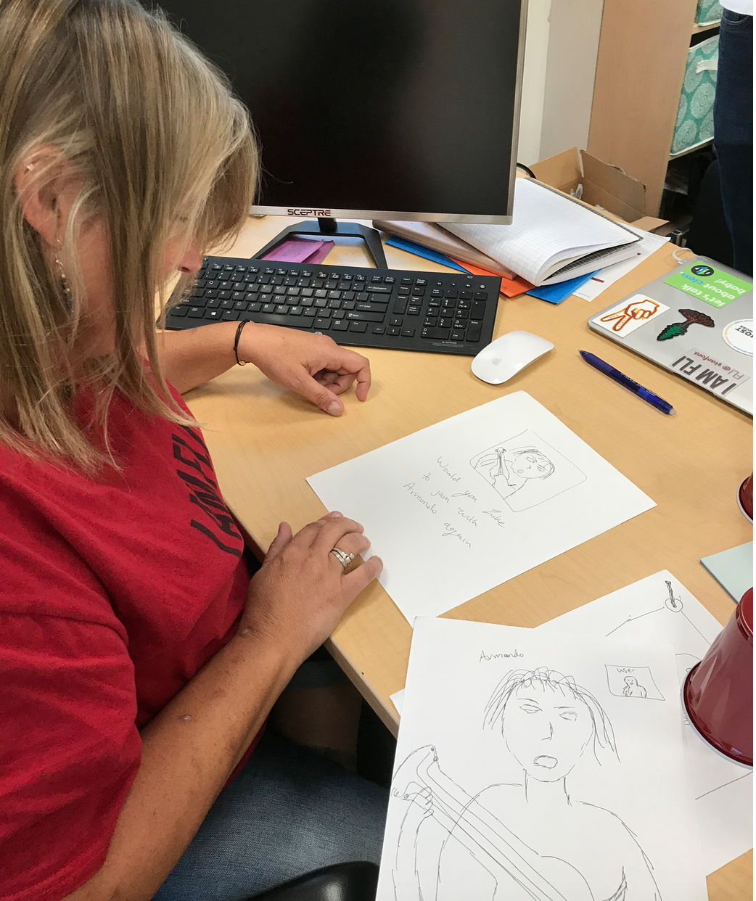
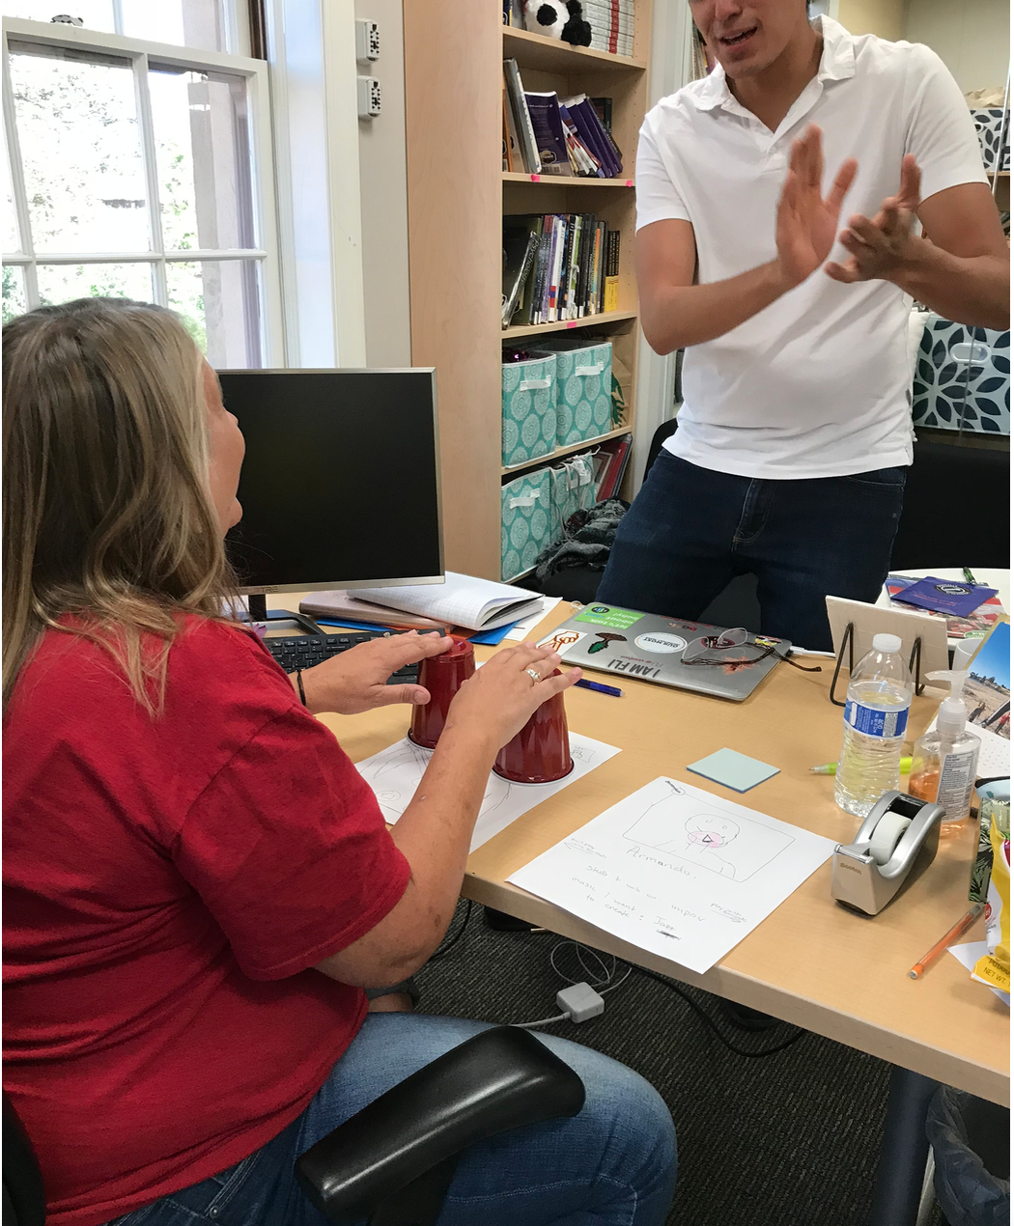
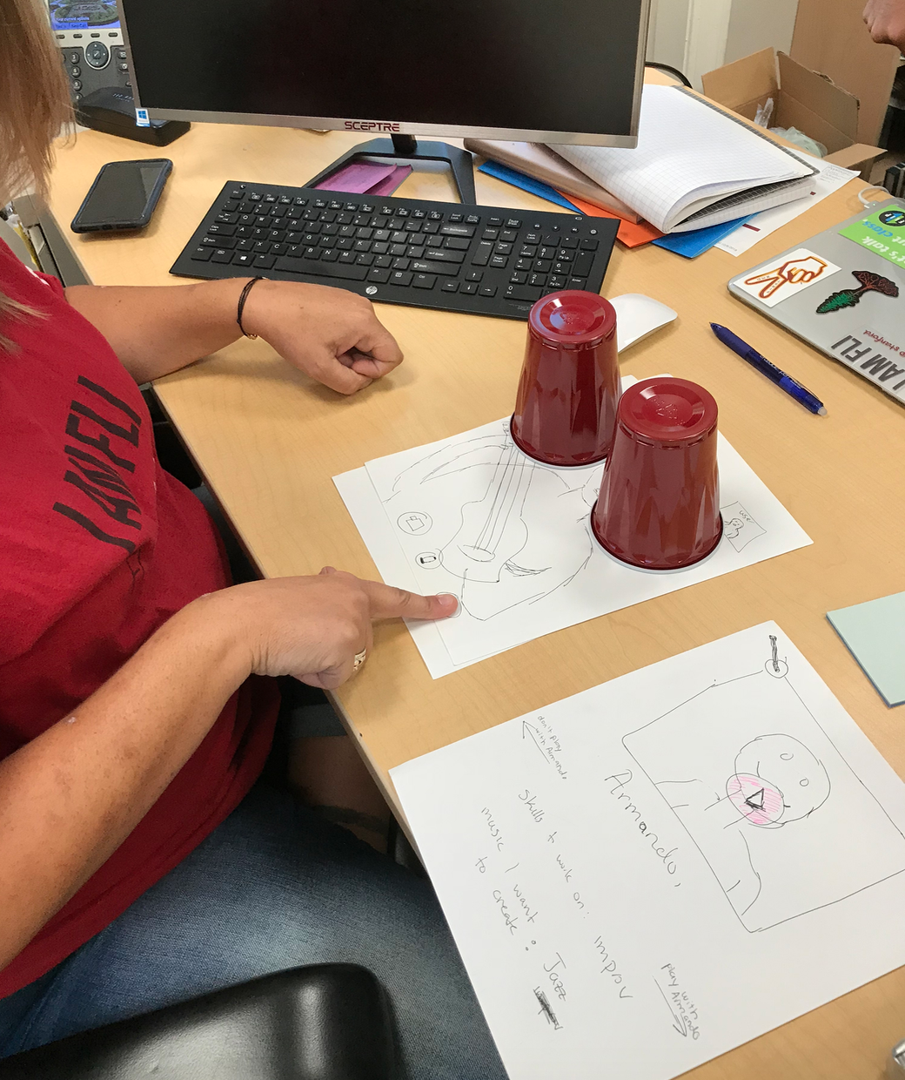
Adriana

Slide 26
Results for Experience Prototype #1
What they liked:
  Quick & intuitive
  Time-flexible
What they didn’t like:
  Concerned about creepers on the app
Suggestions:
  Recording function within the video chat feature

Slide 27
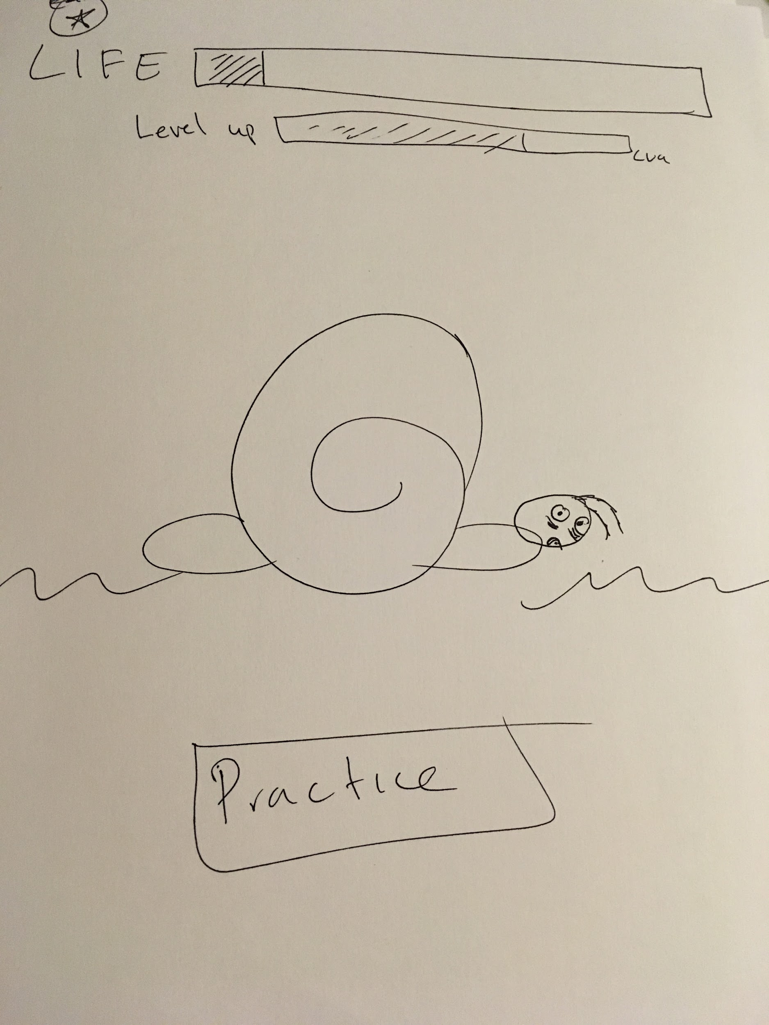
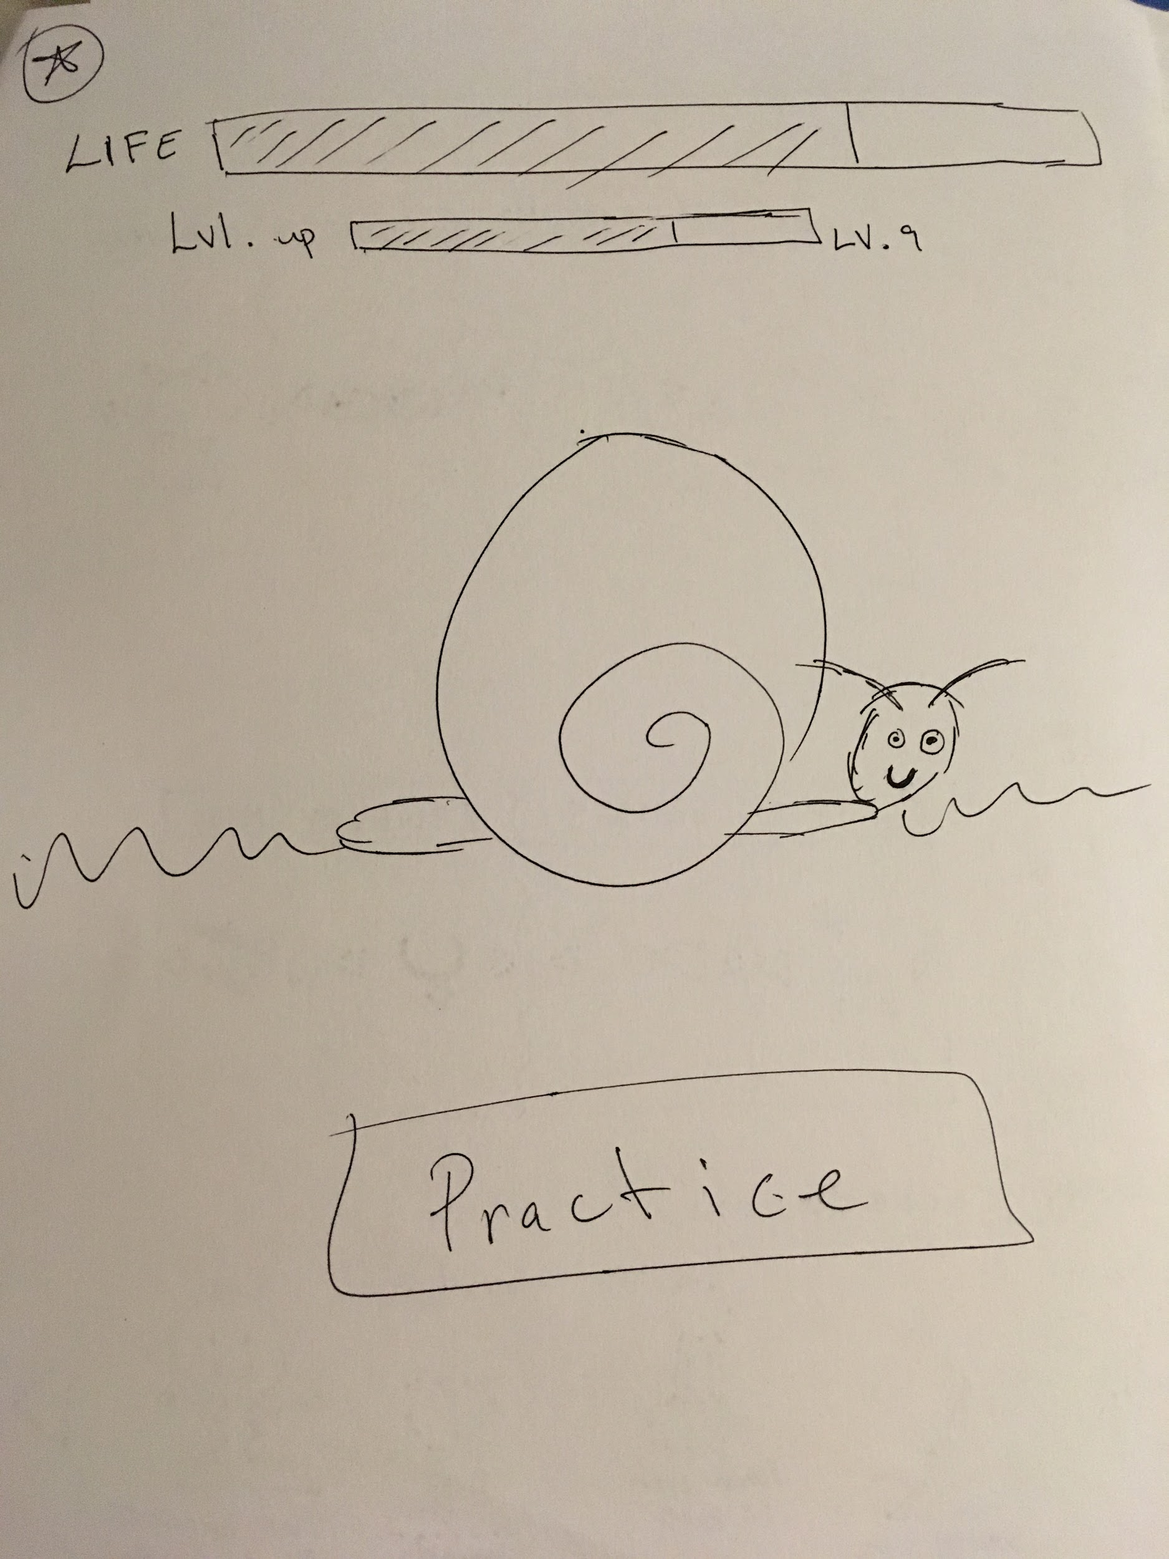
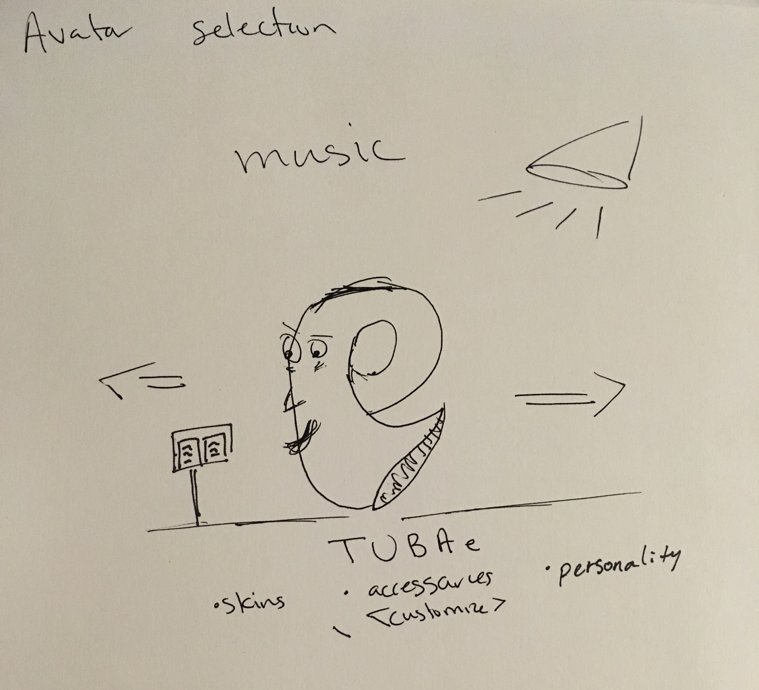
Prototype #2: Digital Pet

Slide 28
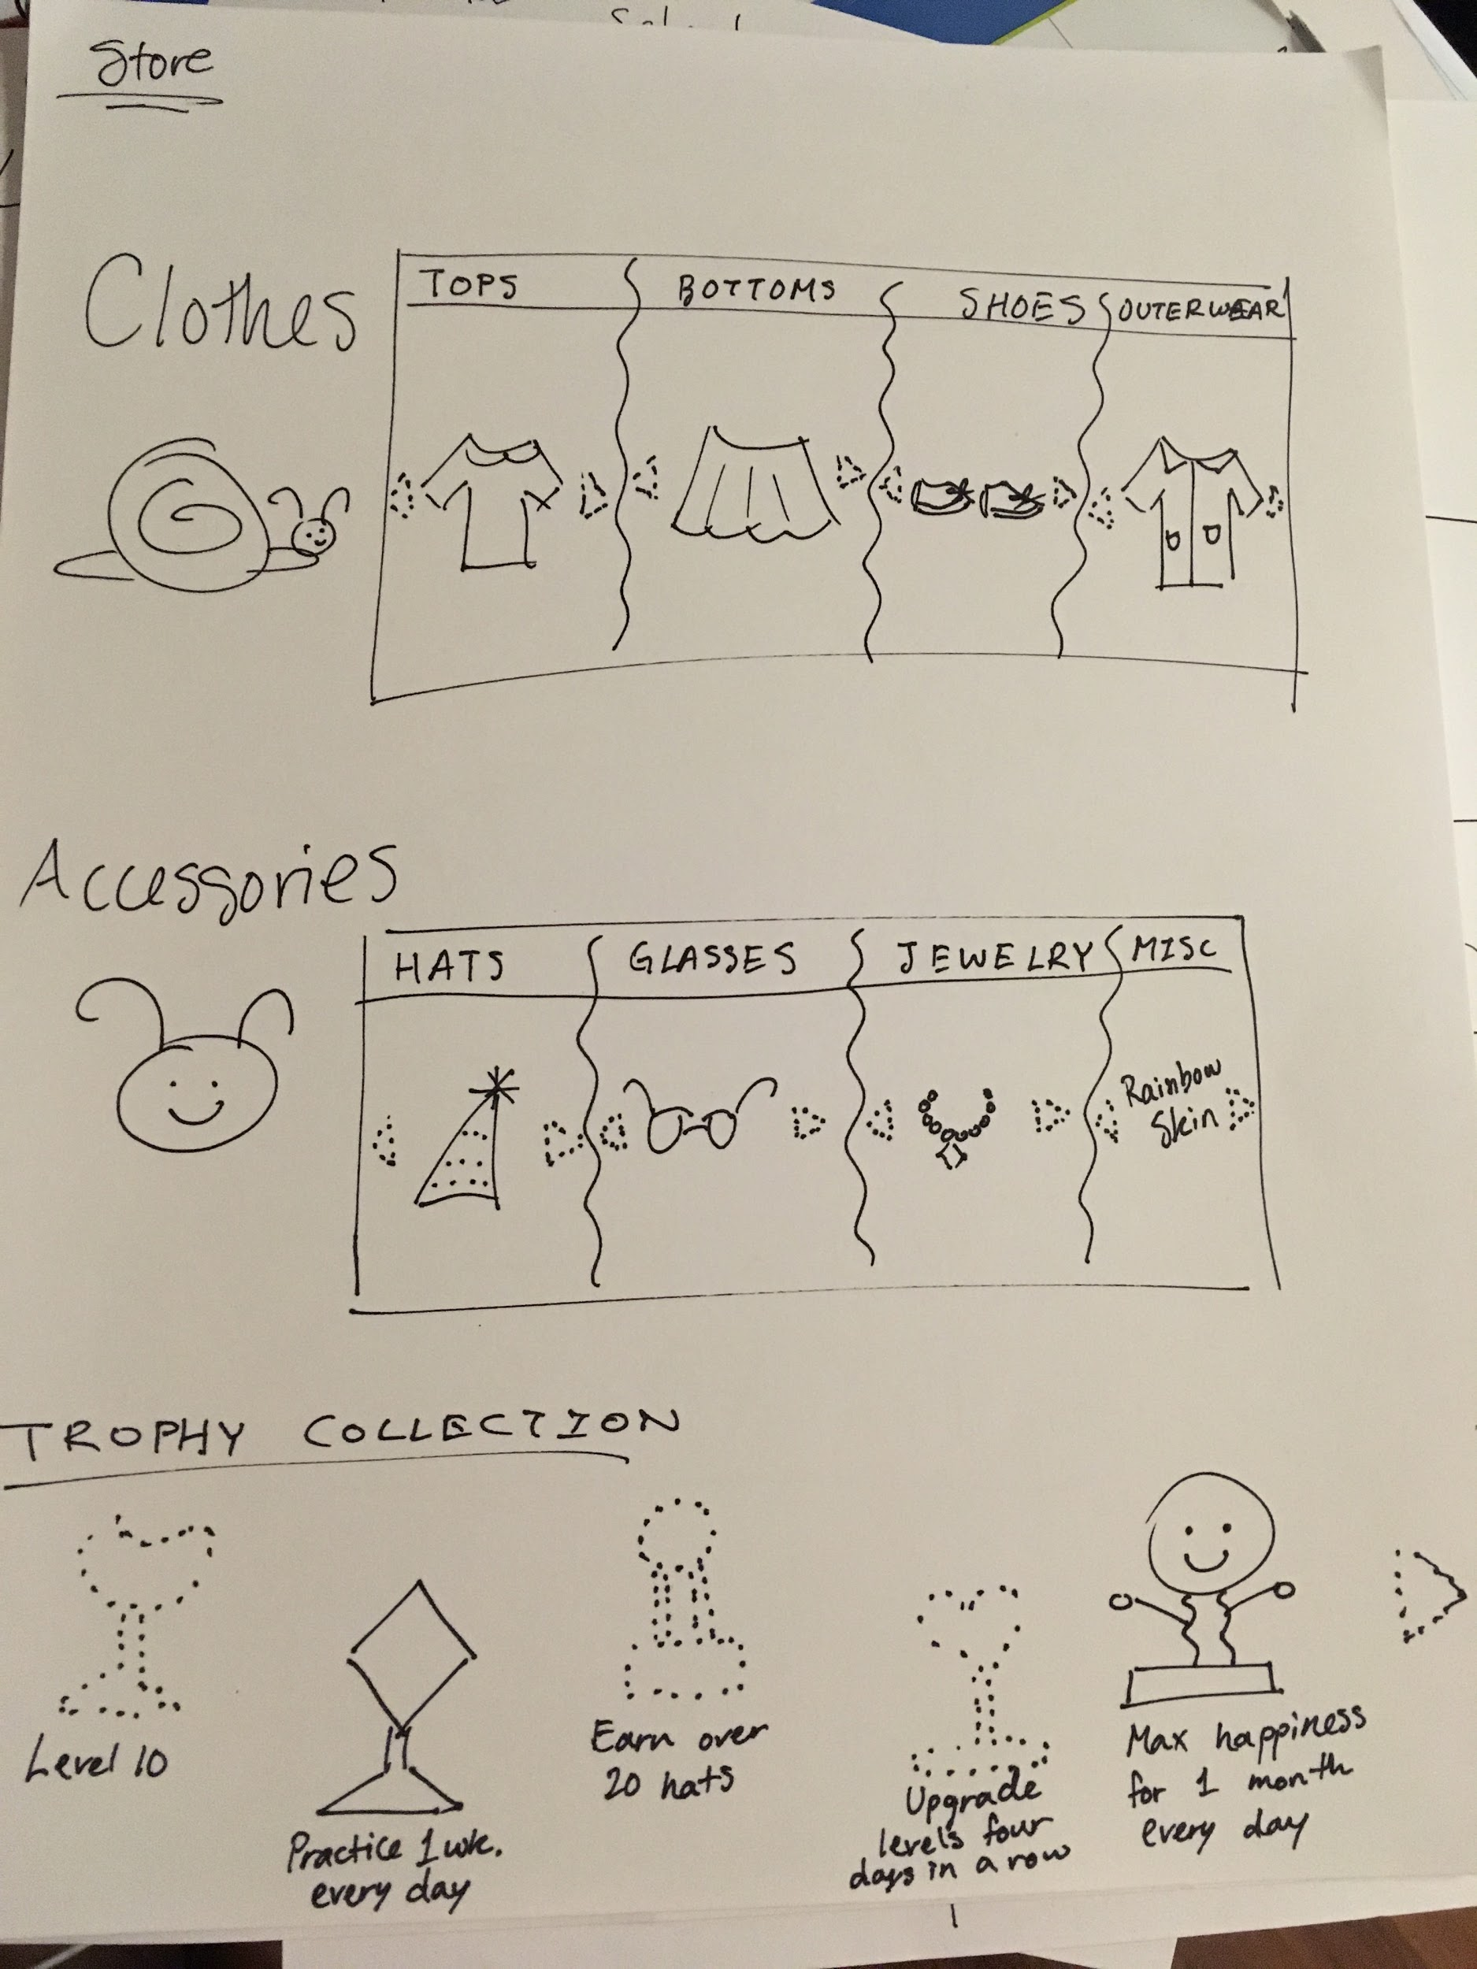
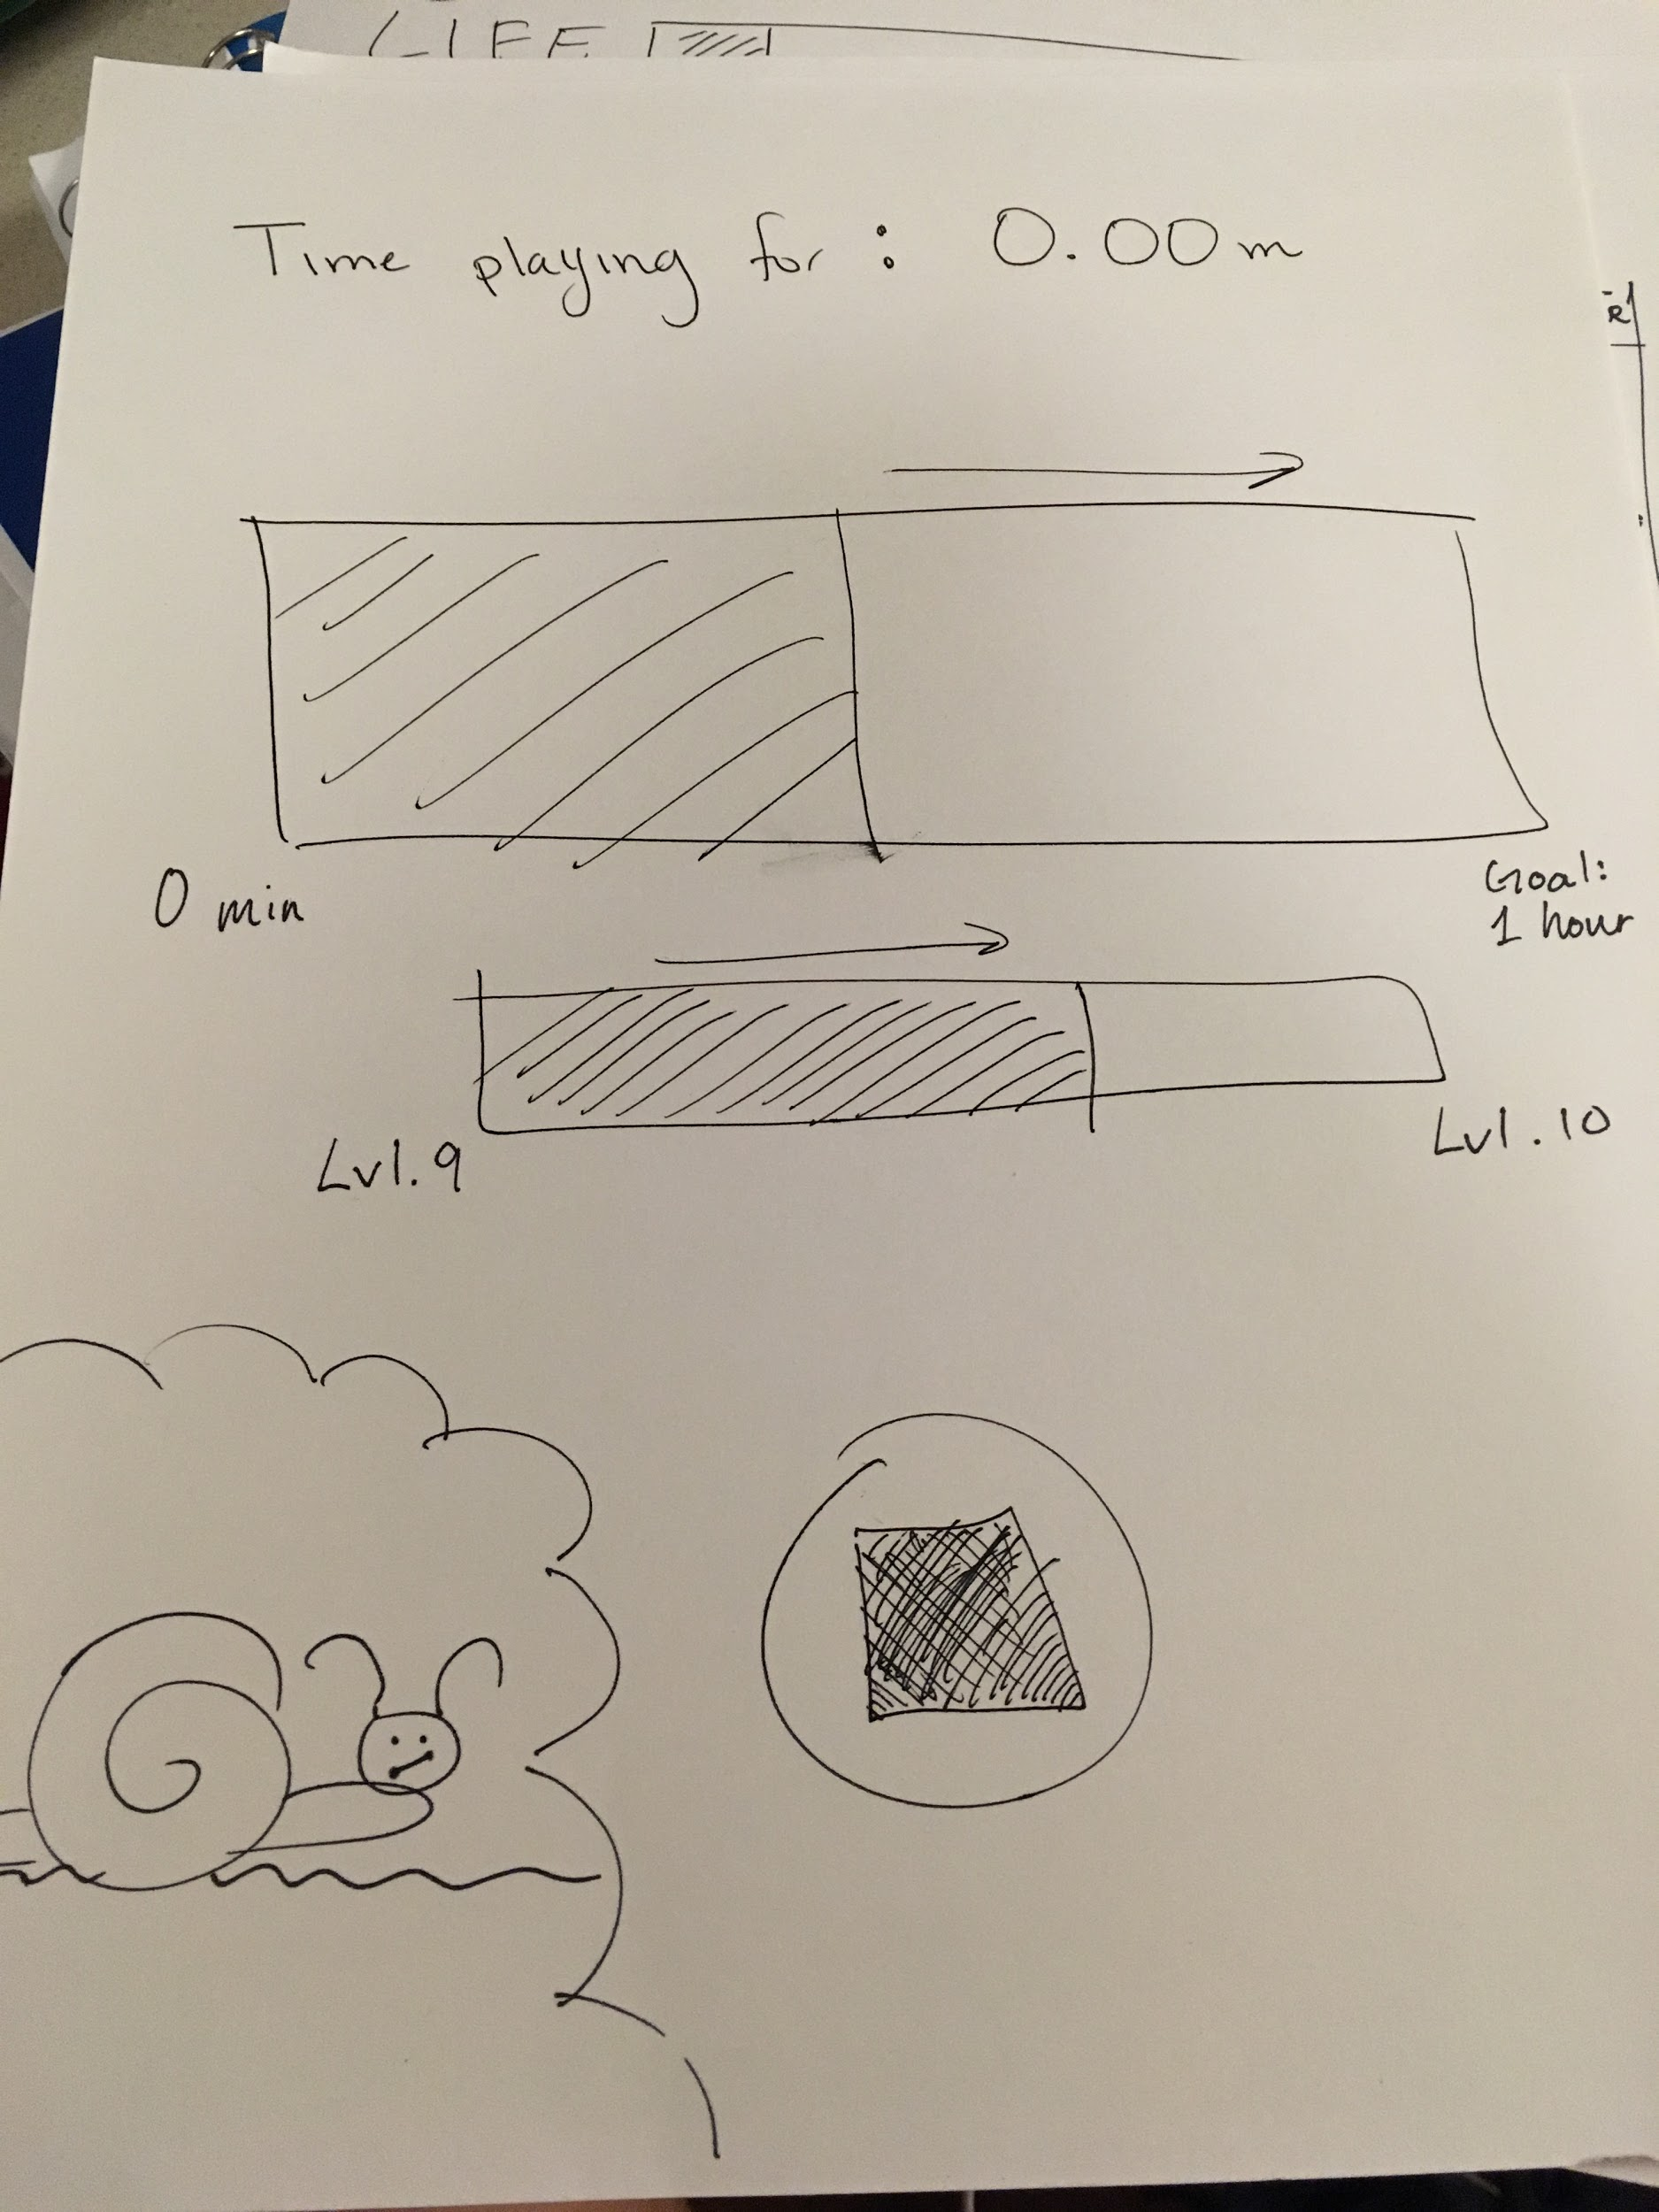
Prototype #2 Cont.

Slide 29
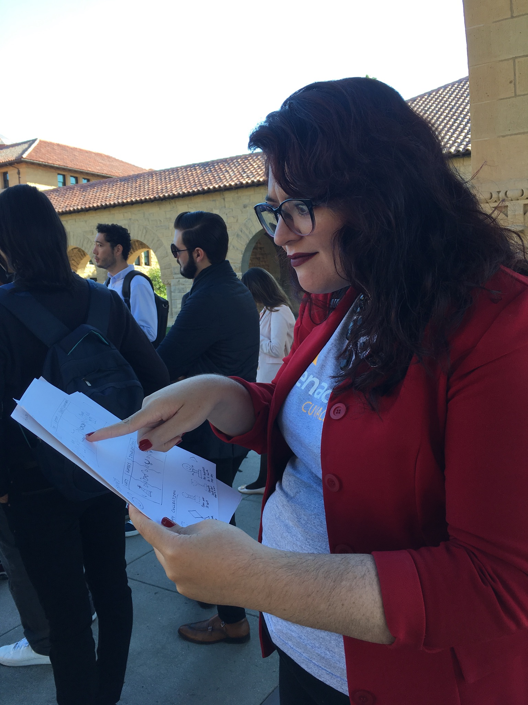
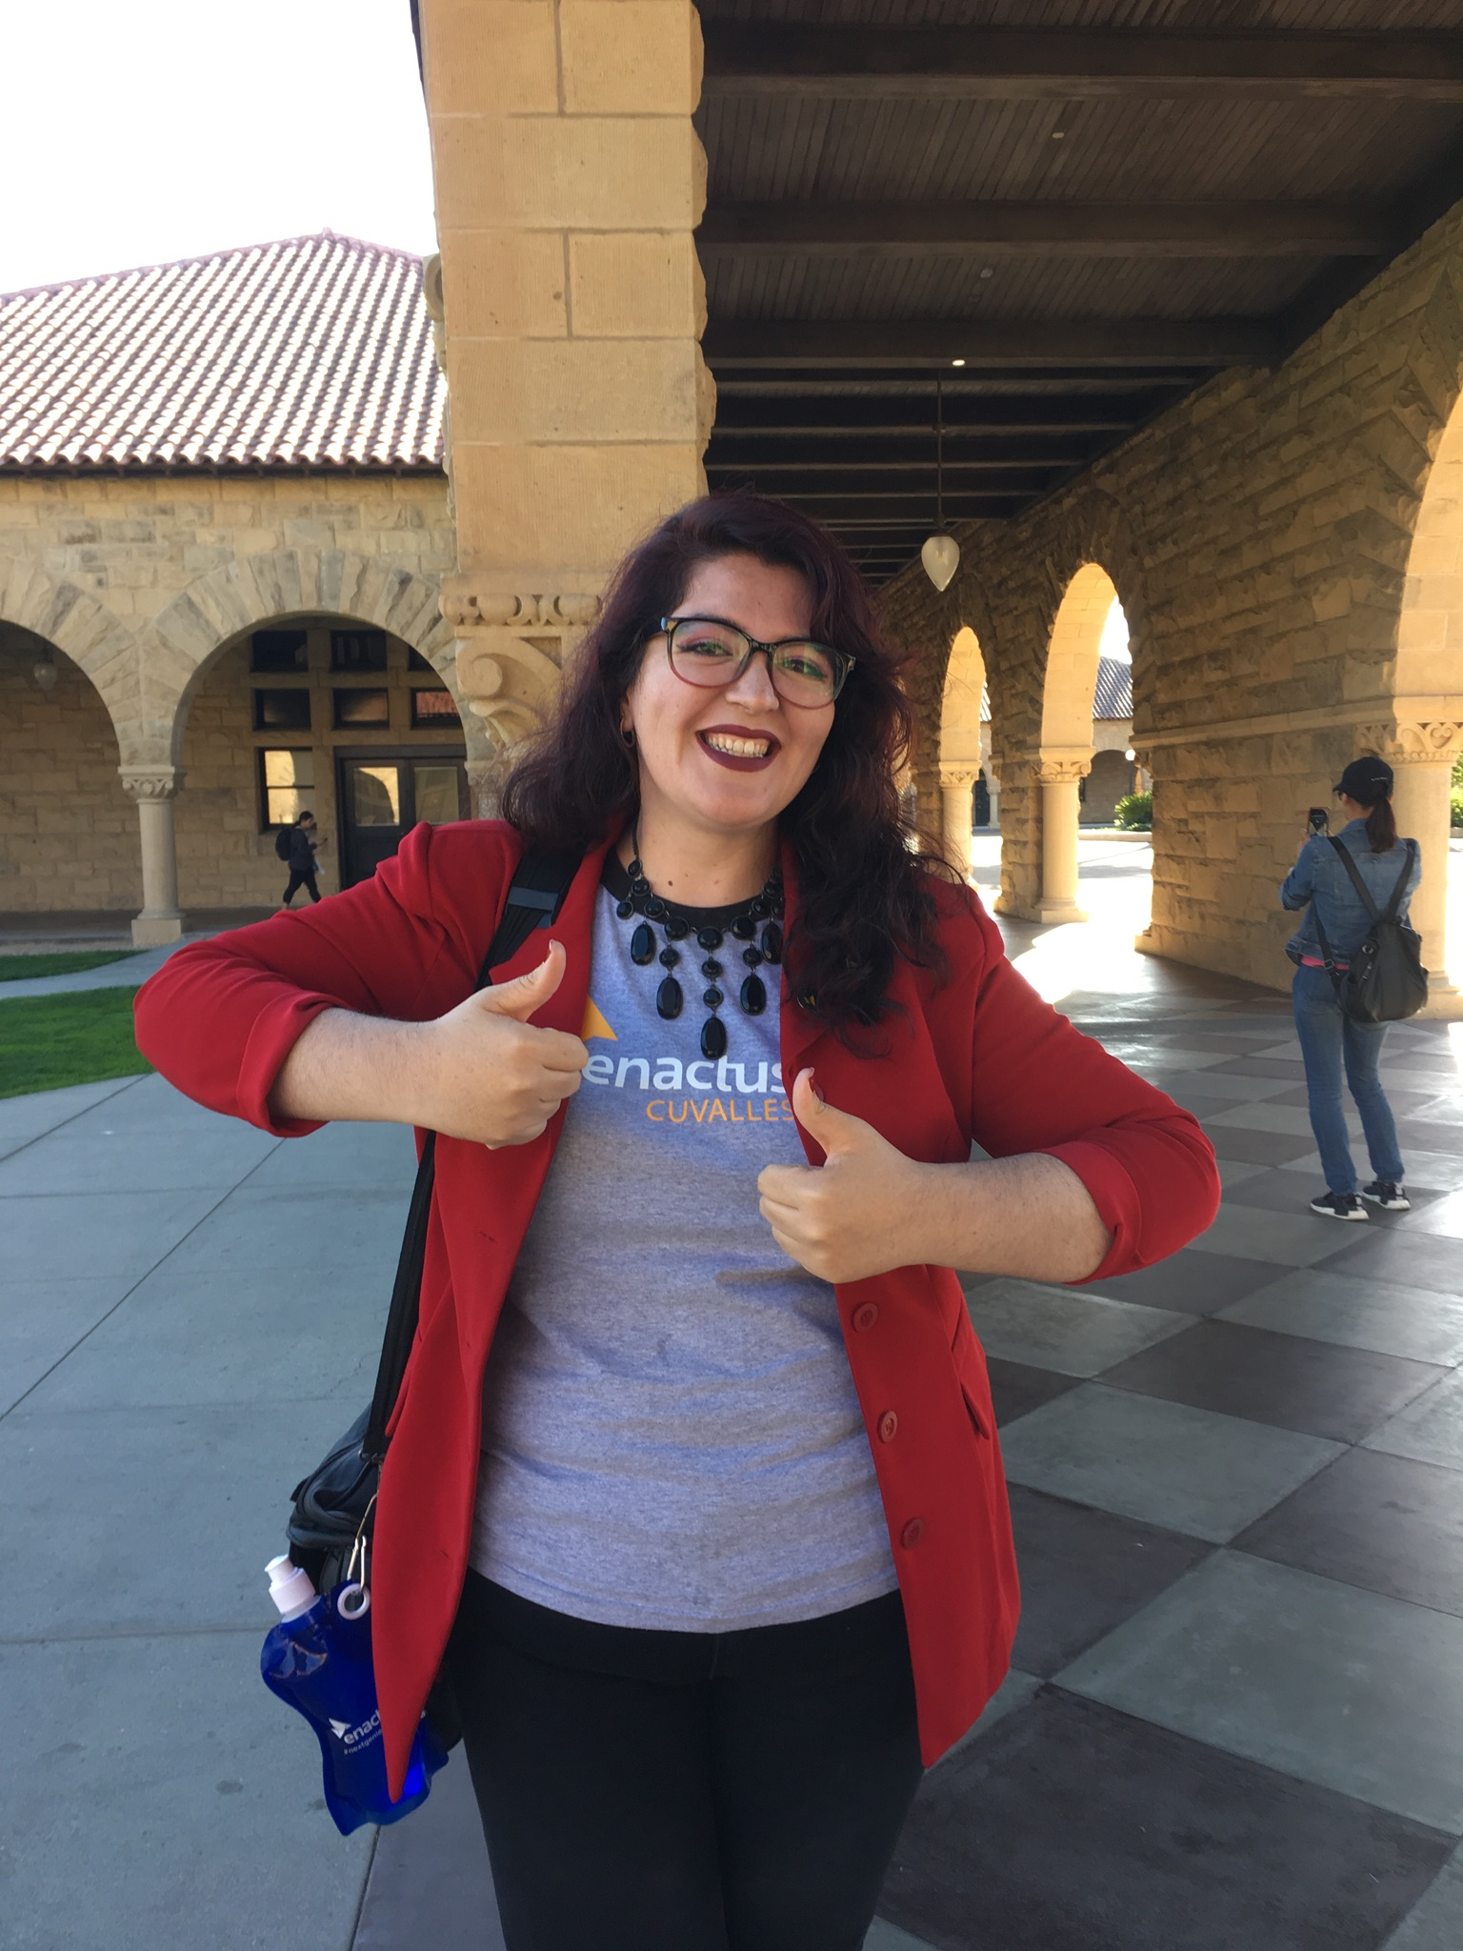
Ahtziri

Slide 30
Results for Experience Prototype #2
What they liked:
  General concept of the digital pet
  Reward system of clothing accessories and trophies
What they didn’t like:
  Was confused by the level up bar in practice interface
Suggestions:
  More practicality: add a metronome feature
  More interactiveness: add music related games you can play with the avatar

Slide 31
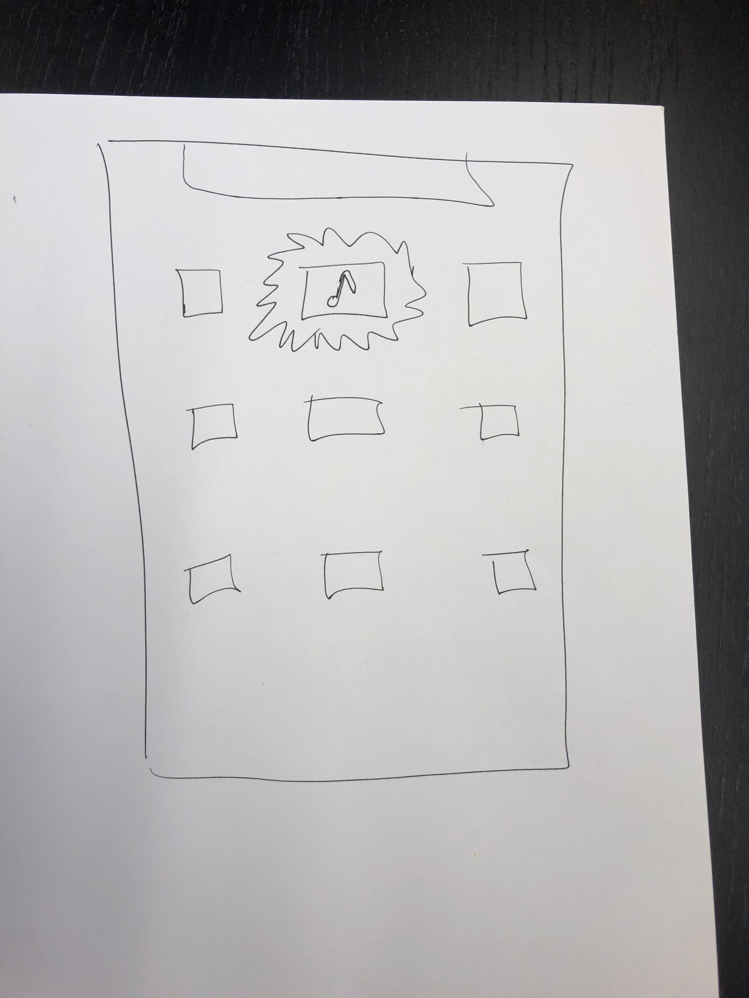
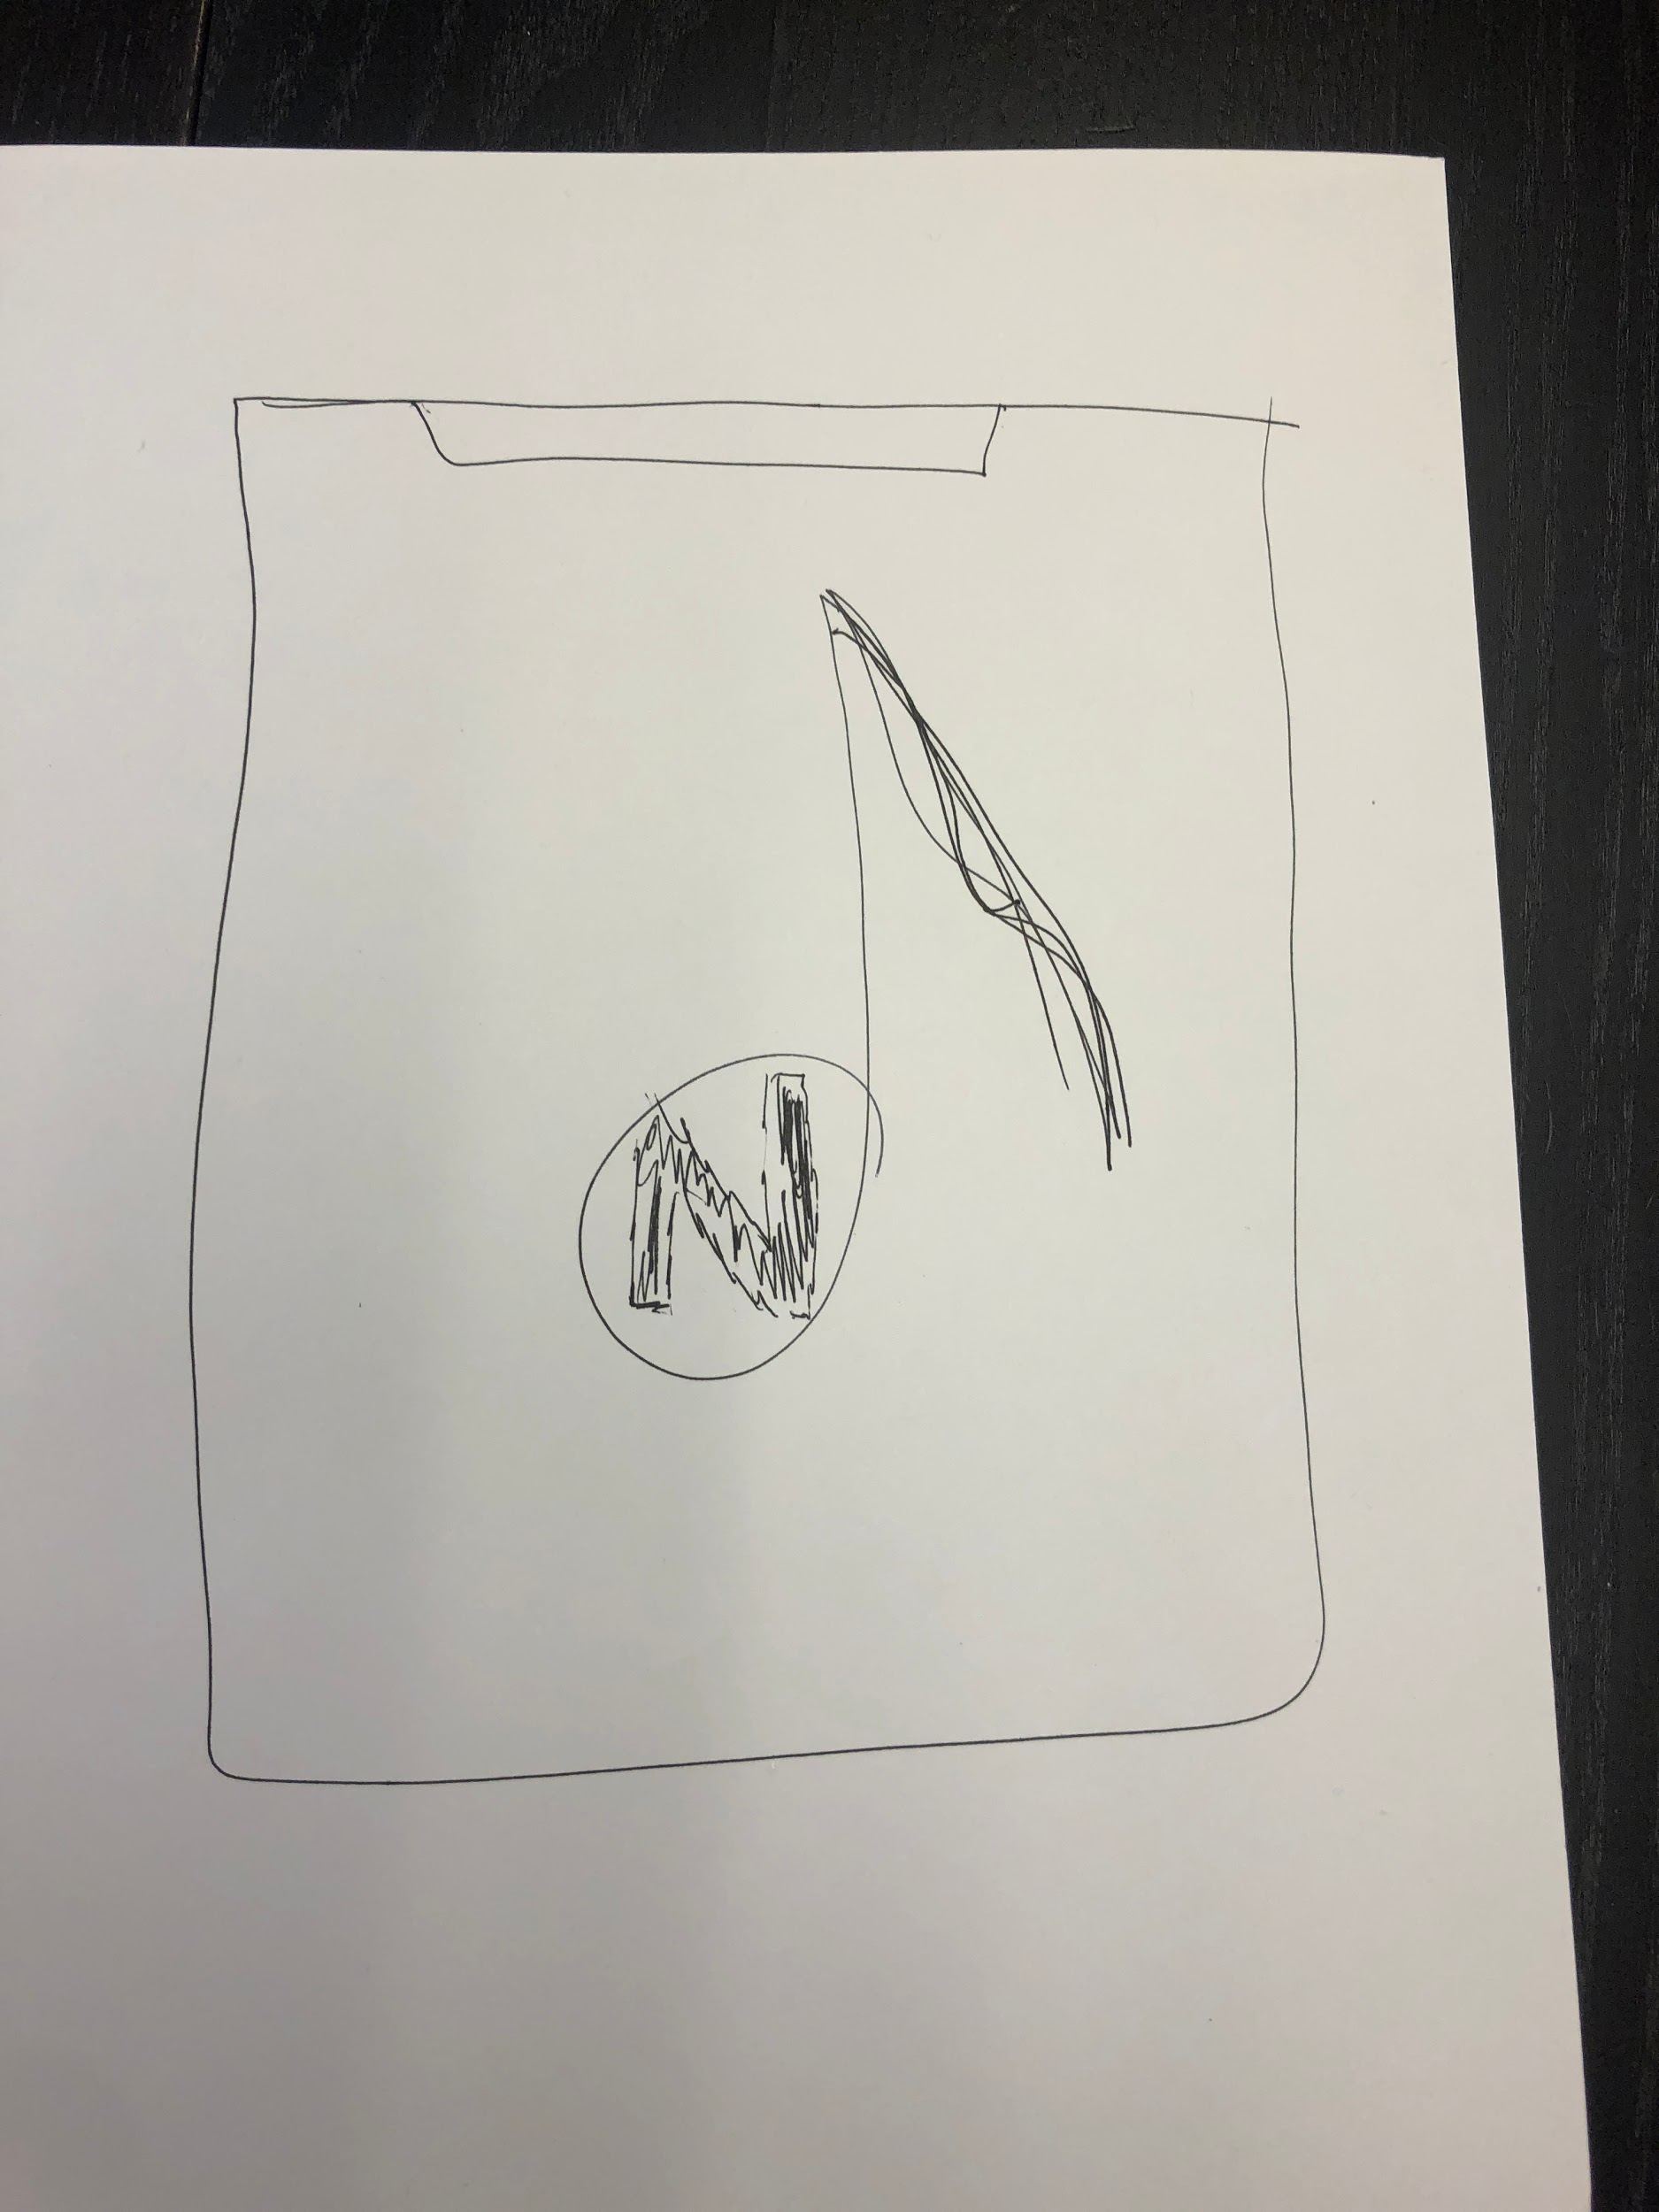
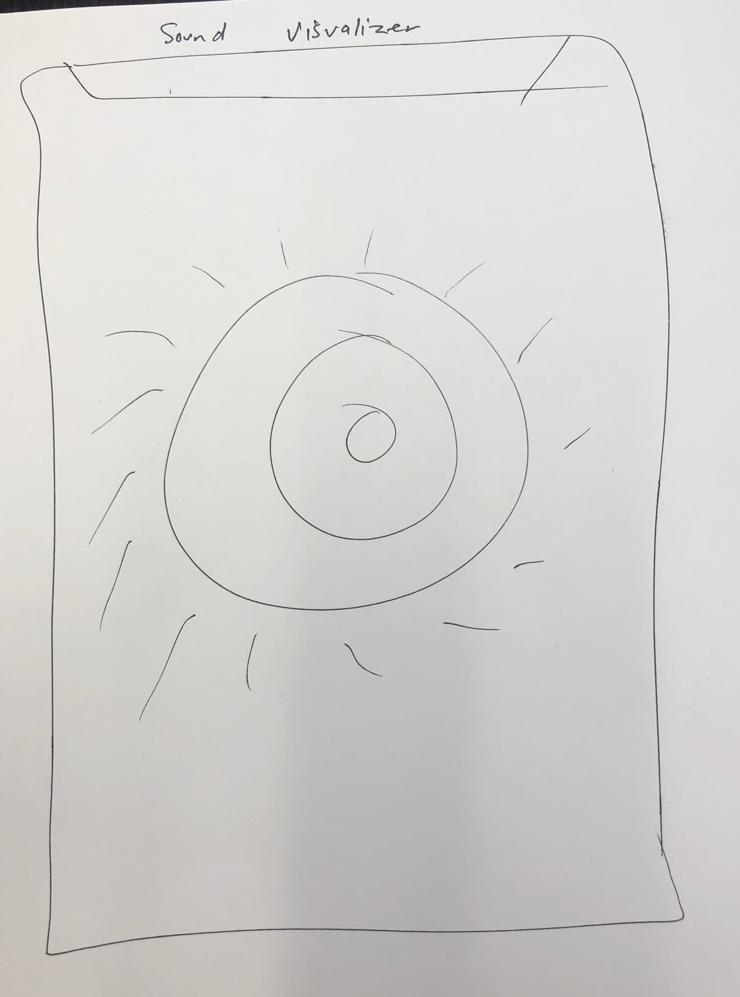
Prototype #3: Practice Lock

Slide 32
Results for Experience Prototype #3
What they liked:
  Liked the concept itself of making practice more of a habit than thinking about it heavily
What they didn’t like:
  It can get annoying to unlock apps by playing music
Suggestions:
  Having an option to turn the app on or off (optional disablement)

Slide 33
Summary

Slide 34
Summary
We learned that people prioritize the low-commitment prototype #1 due to the their lack of time
Moving forward, we would like to continue iterating on this prototype and including a health component through a human-to-human interaction lens

