Slide 1
Arts and Culture Needfinding

Slide 2
Our Team.
Isaac Goldstein
SymSys ‘19
Cody Hankins
CS ‘19
Mischa Nee
CS ‘20
Ian Hodge
CS ‘19
Experiencing Music

Slide 3
Methodology

Slide 4
Questions
What is your relationship to music?
Can you talk to me about a typical experience listening to music?
When do you share music with friends? How do you go about that?
When do you listen to music alone versus with friends?
What was one of the best experiences with music you’ve had?

Slide 5
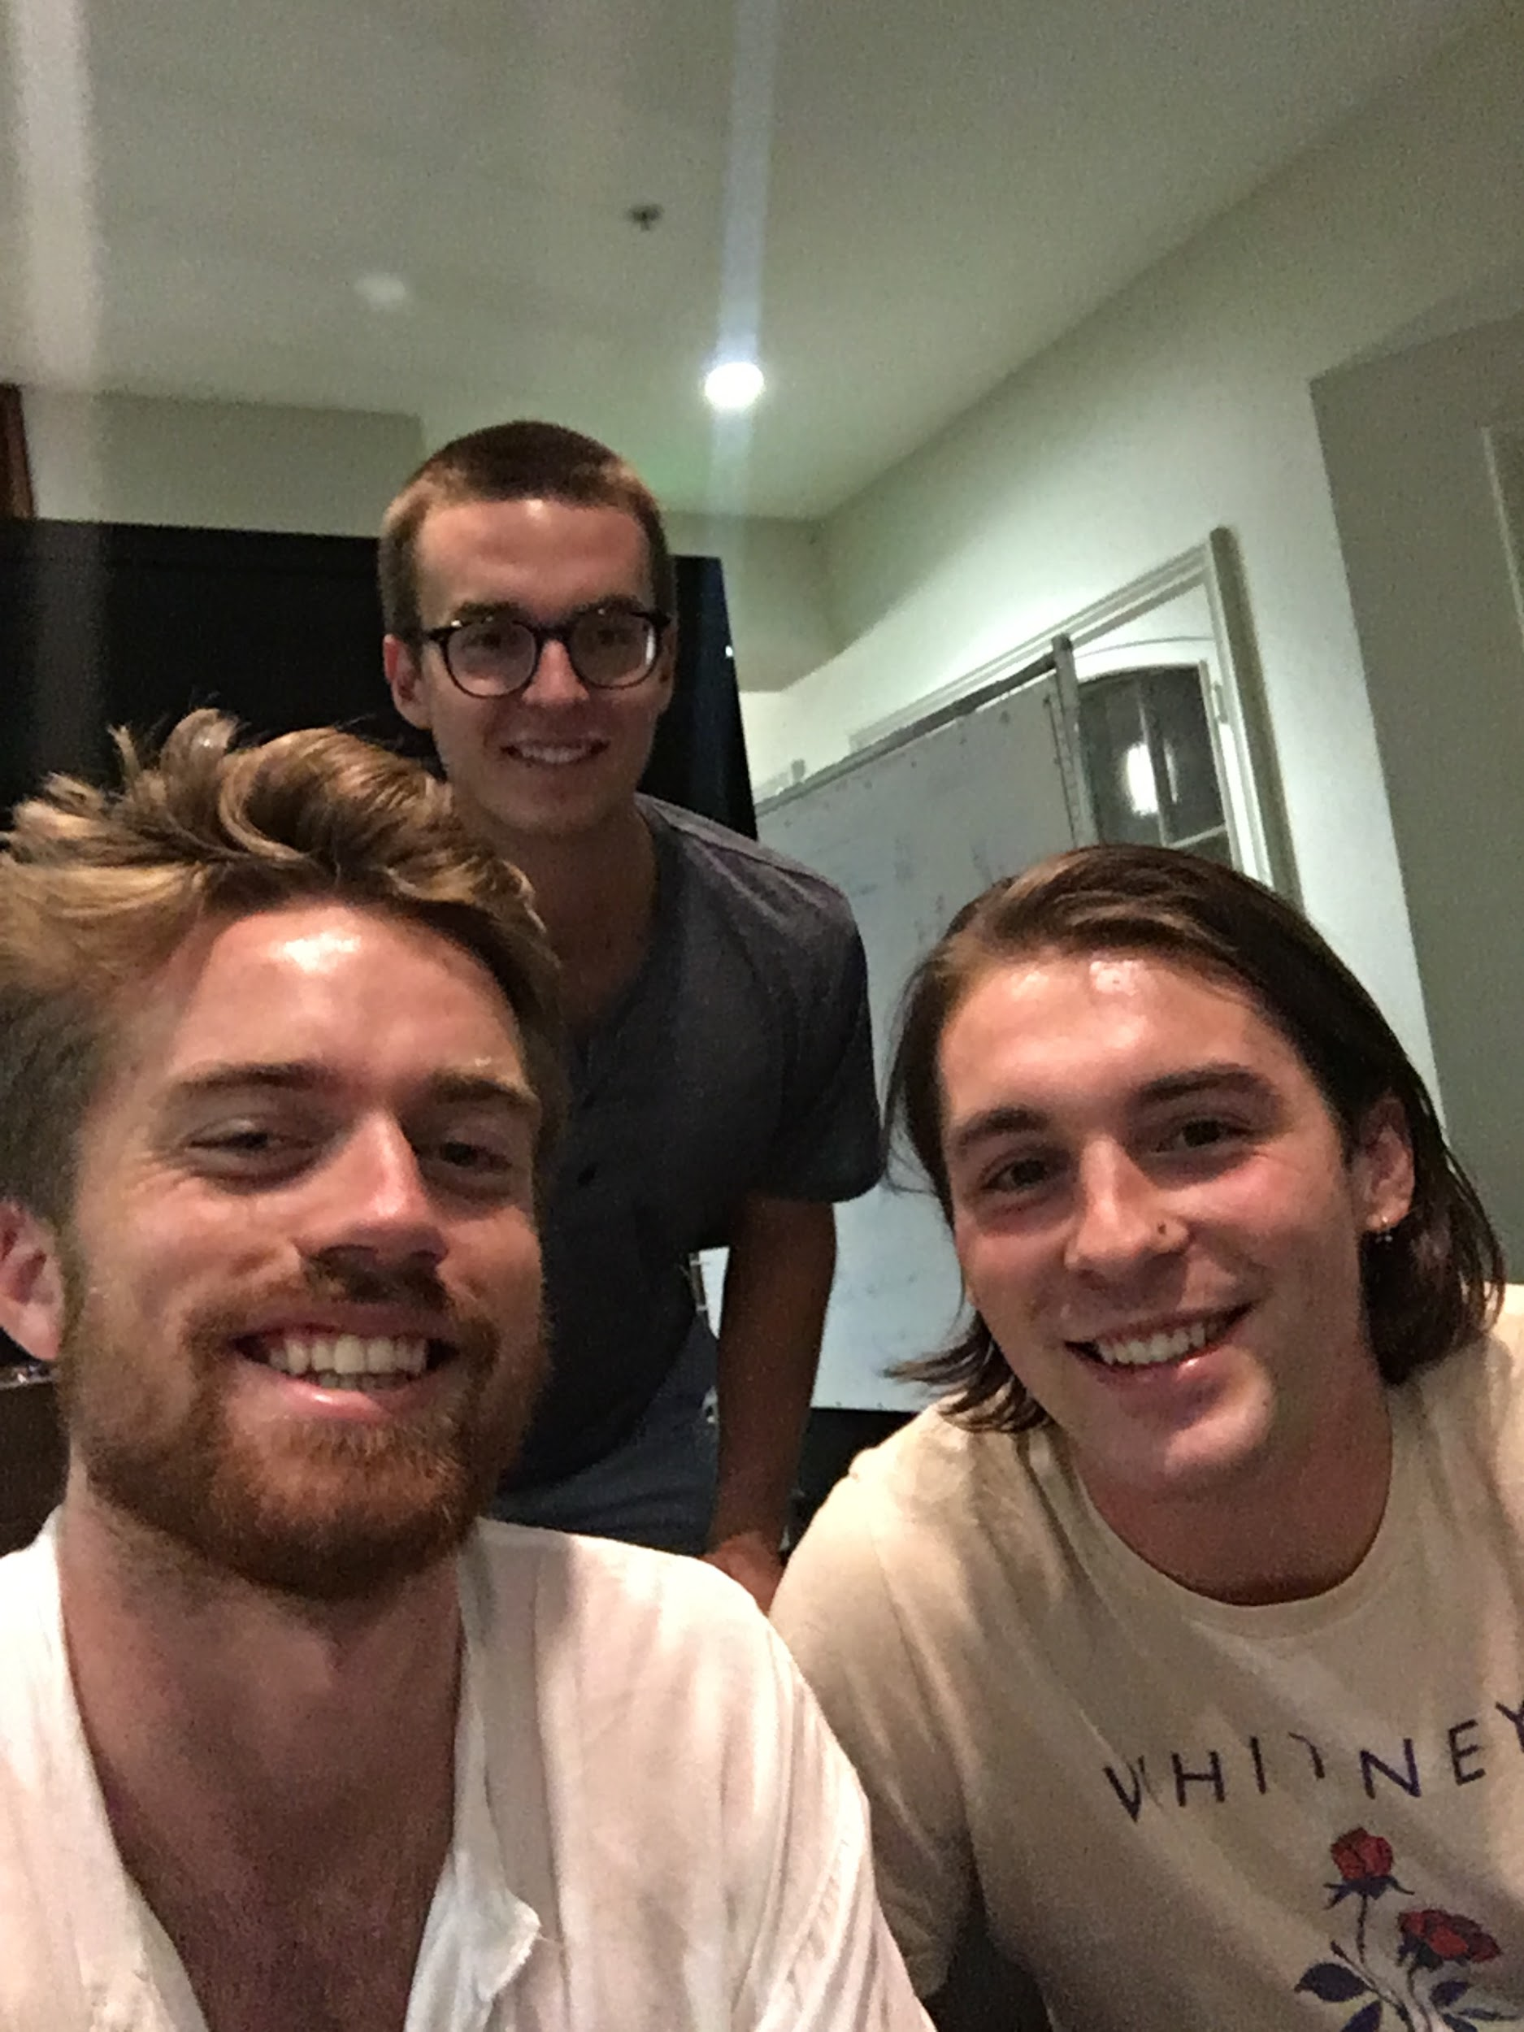
Methodology
Interview Overview
Ben Josie
MST major at CCRMA
Domain expertise
Messaged
CCRMA

Slide 6
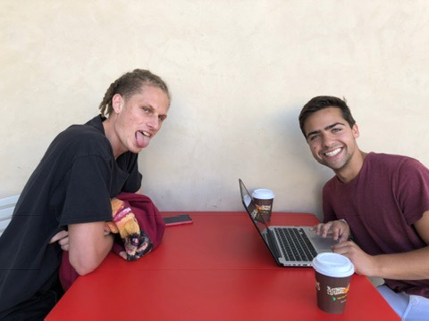
Methodology
Interview Overview
Josiah Burnham
Barista at Philz
Very avid music listener
Friend of a friend
Philz, Palo Alto

Slide 7
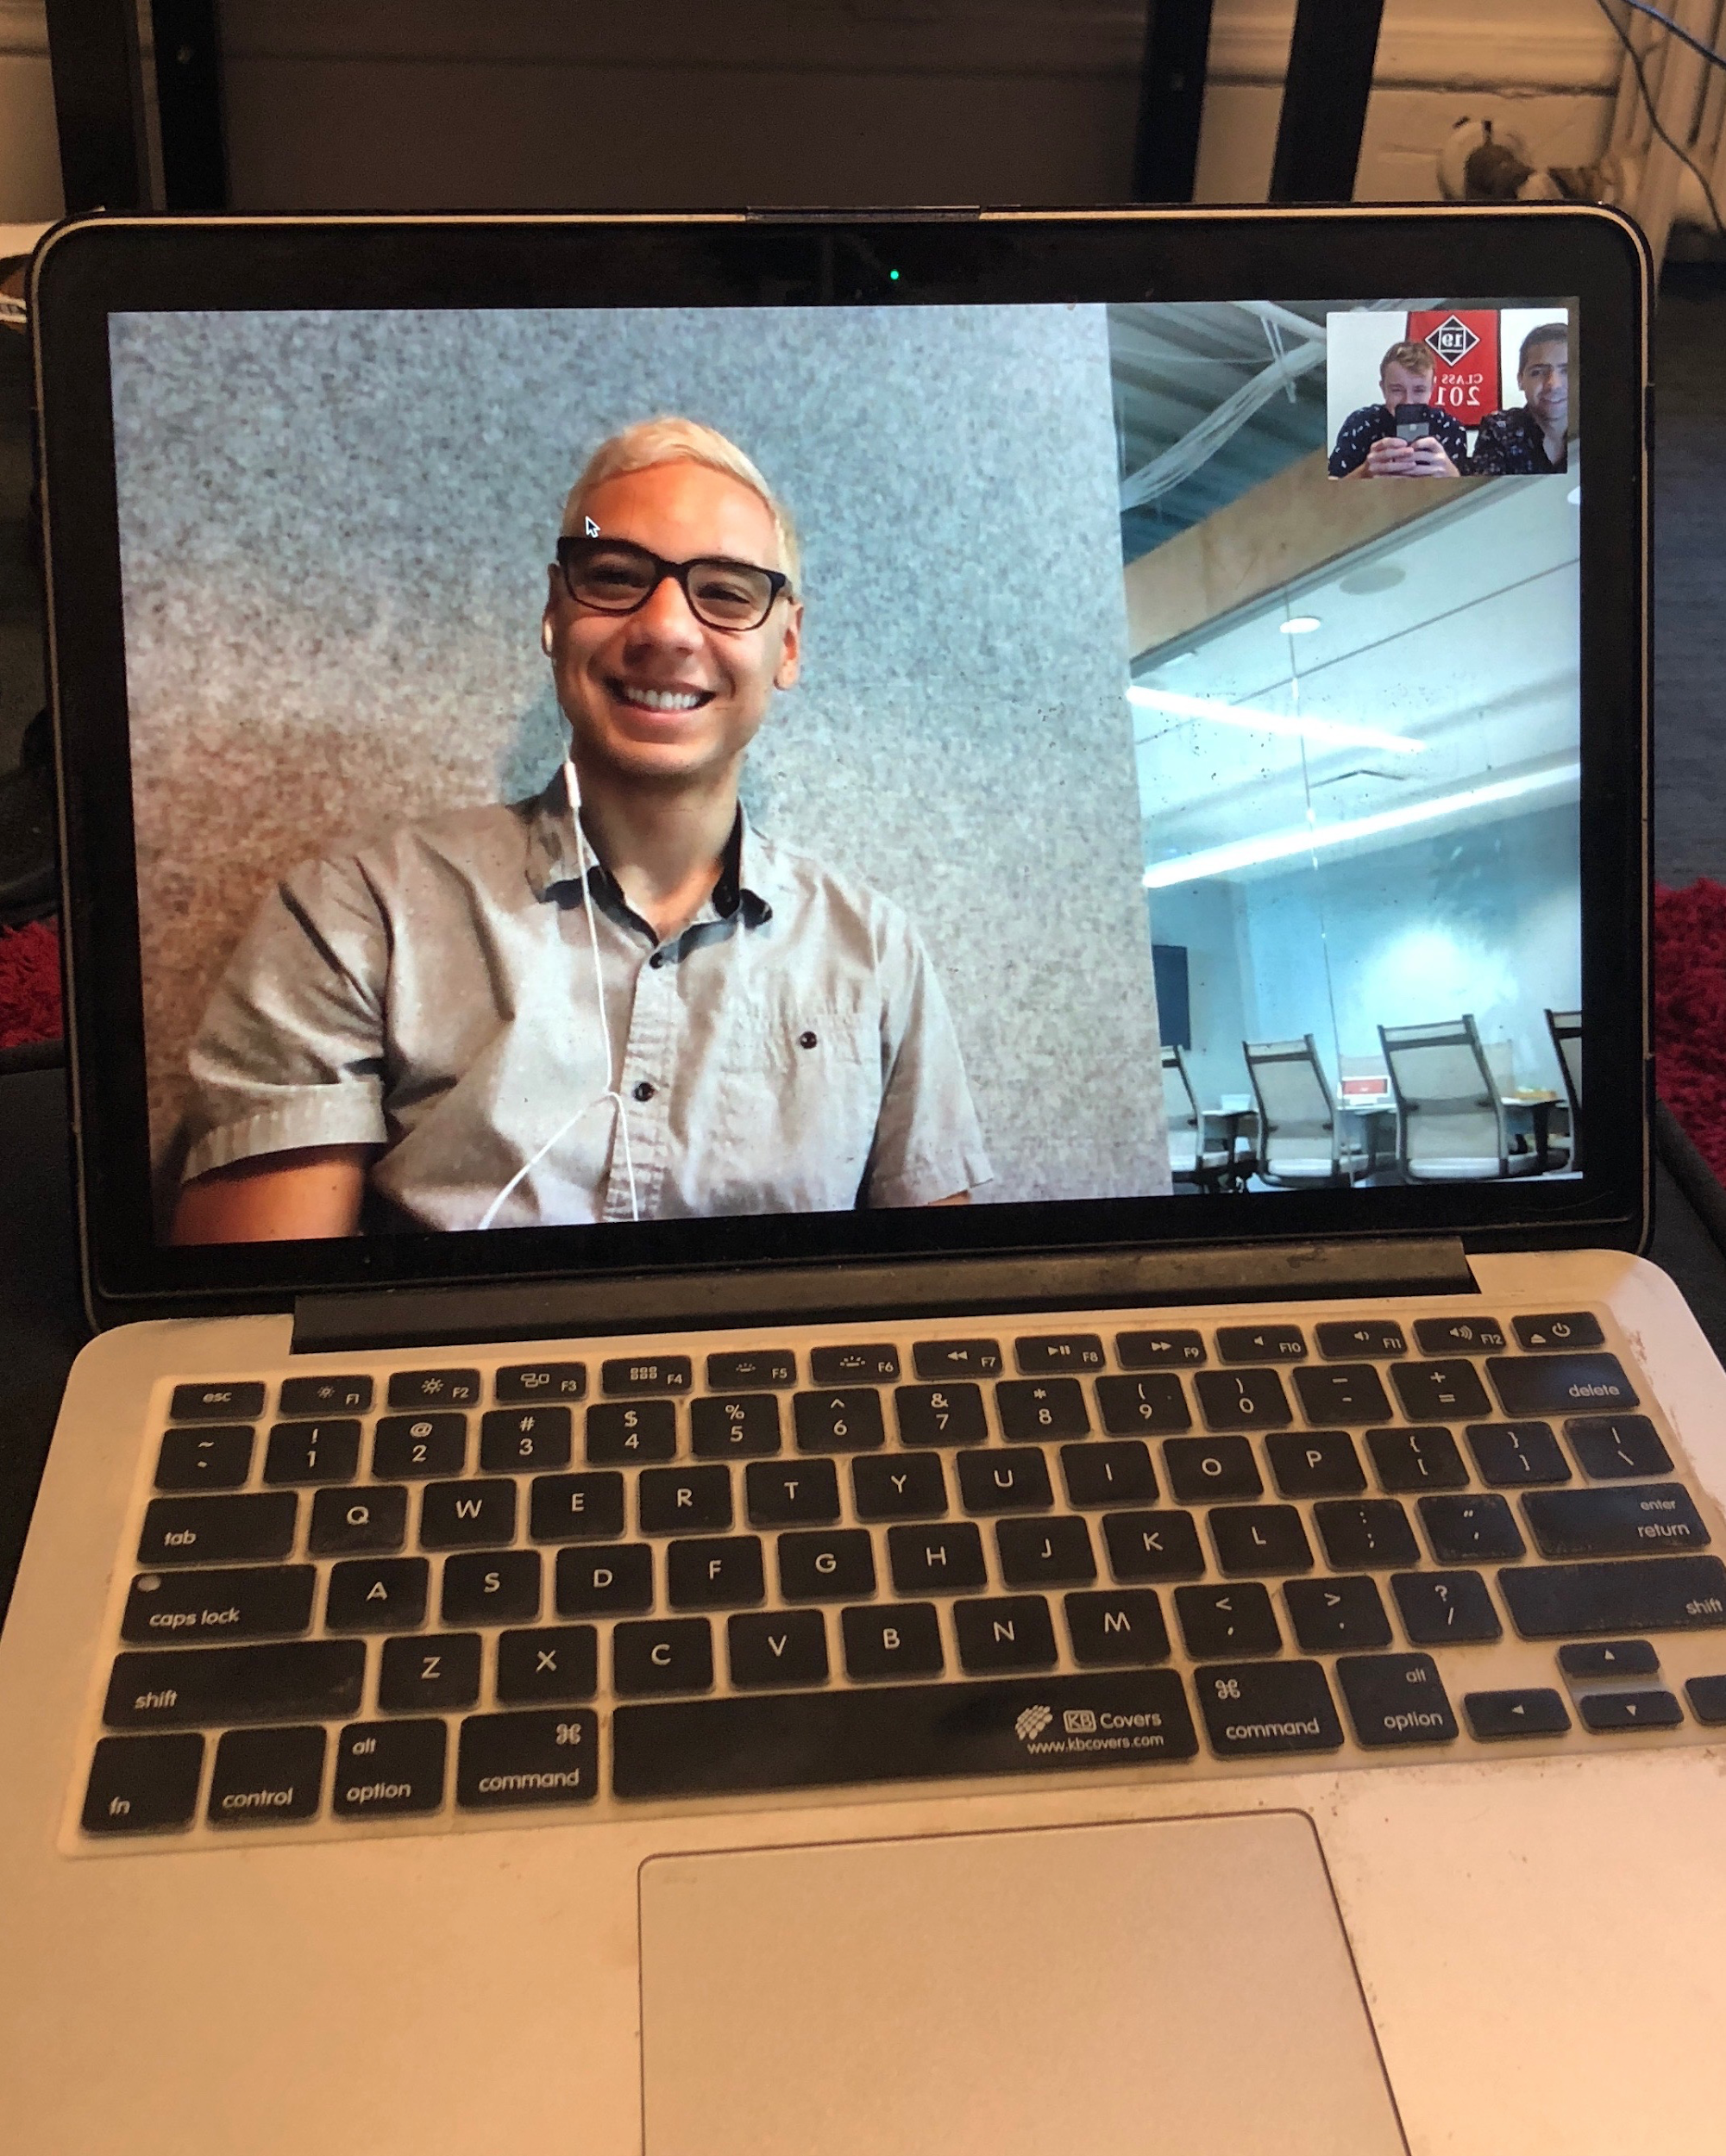
Methodology
Interview Overview
Rocco Cervantes
Tech worker in SF
‘Older’ demographic
Connected through a friend
Facetime interview

Slide 8
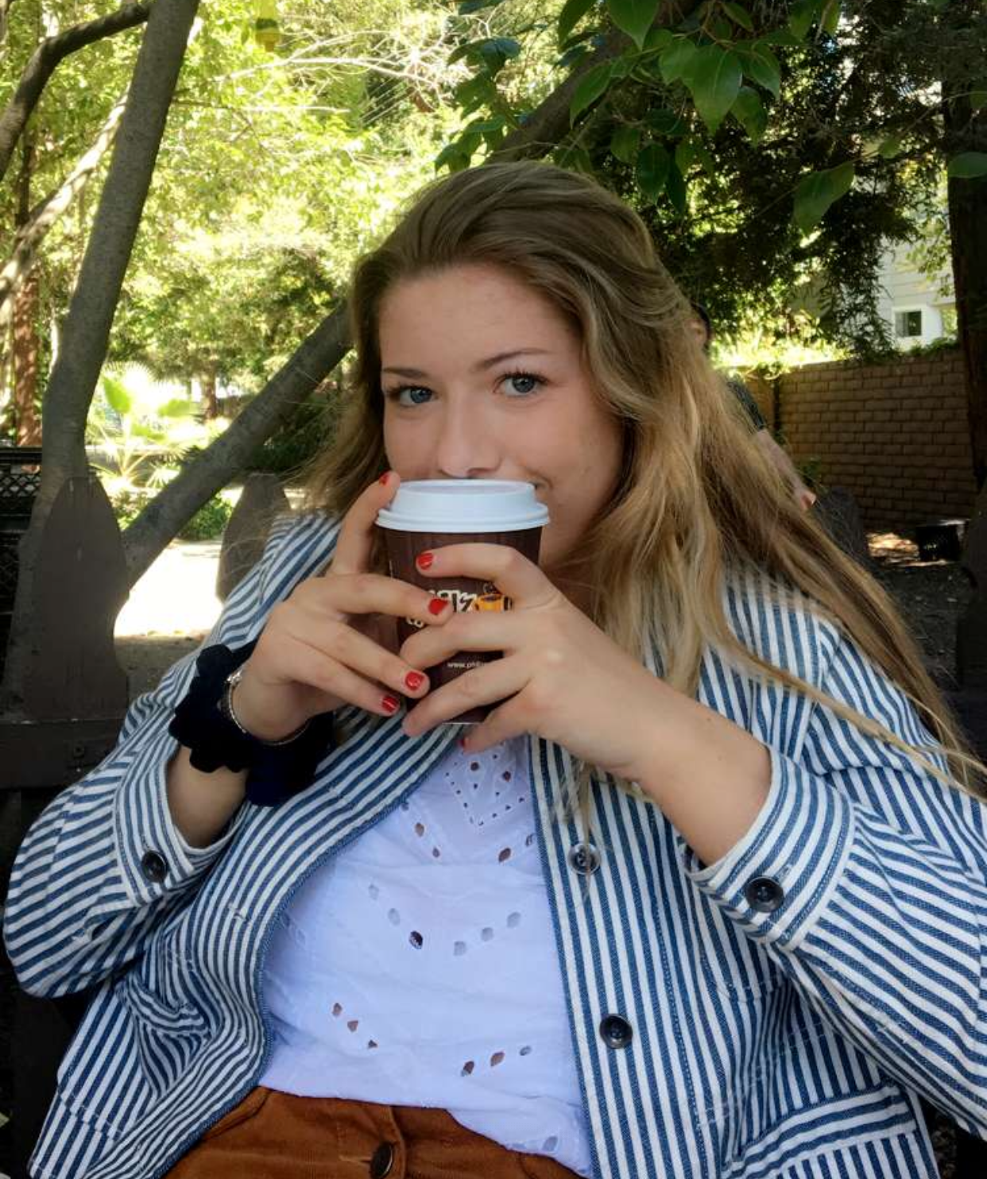
Methodology
Interview Overview
Emily Crist
Student at Foothill
Non-Stanford youth opinion
Friend of friend from high school
Philz, Palo Alto

Slide 9
Interview Results

Slide 10
Ben
“My CD player only held one at a time so you really spent a lot of time with each album”
“My folders are separated by ‘high-energy’, ‘low-energy’, ‘in a mood’”
“One of my favorite conversations is, what are your top 10 favorite albums?”
Notes:
“If somebody wanted to listen to Alex G, a difficult artist, I send them easy songs to get into him in order.”

Slide 11
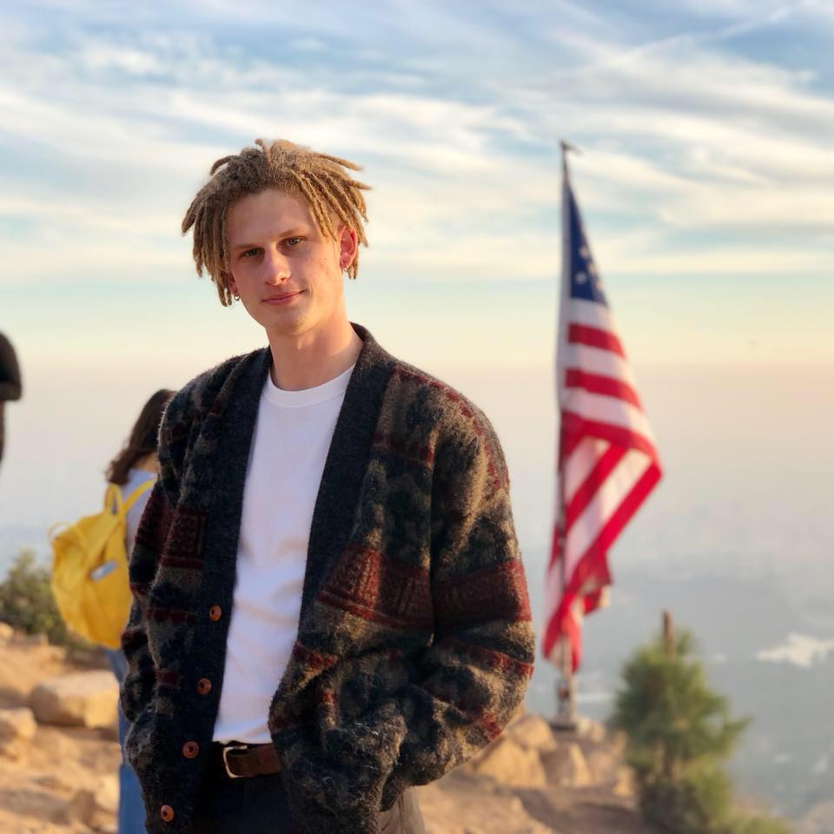
Josiah
“Music is all in the production.”
“Listening to music with others is cool when everyone enjoys it.”
“Making a playlist is a lot of work.”

Slide 12
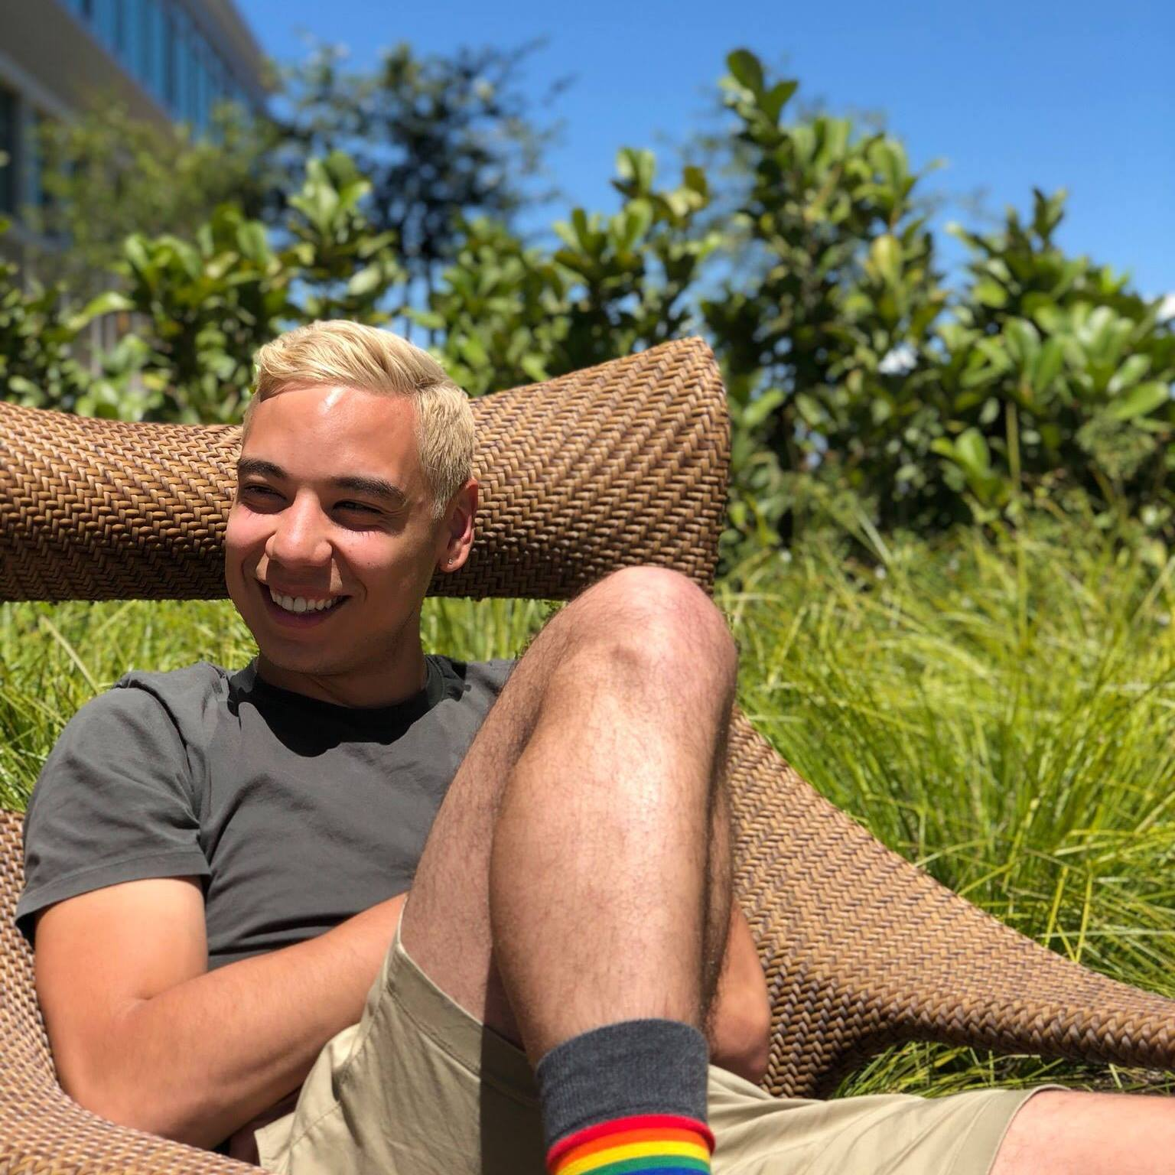
Rocco
“I’m listening to music 90% of the day.”
“What I listen to always relates to my mood.”
“It’s annoying when I’m at a pregame or party and they’re only playing stuff I don’t like.”

Slide 13
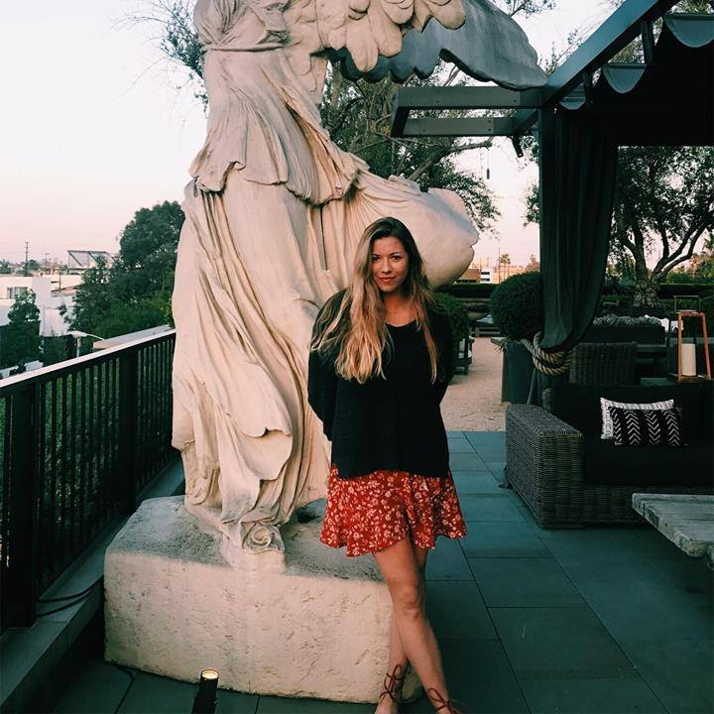
Emily
“The older I get the more things mash together.”
“I always multitask with Spotify, but with a record player I just listen.”
“I liked Spotify’s year in review to show off my taste and see friends’.”

Slide 14
Analysis

Slide 15
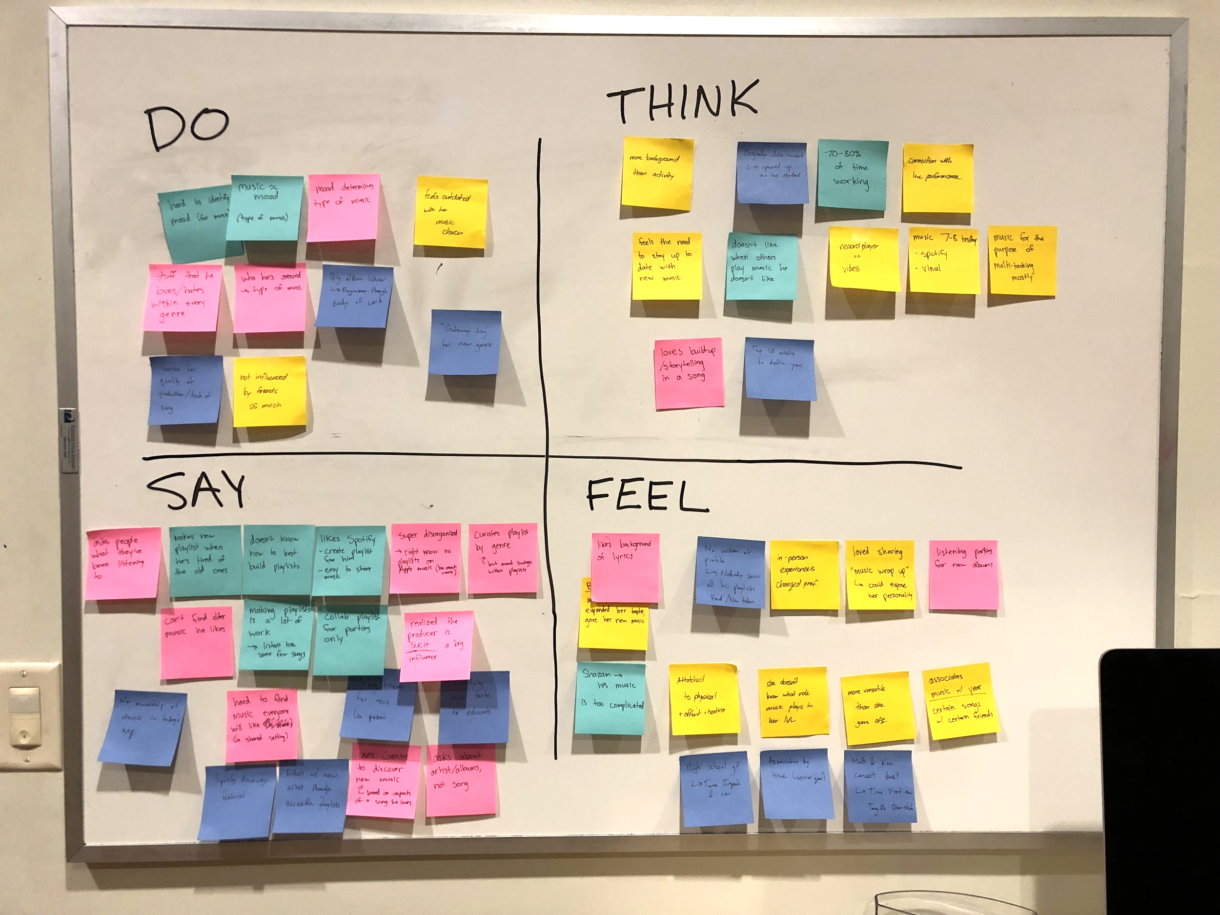
Analysis

Slide 16
SAY
THINK
Music is critical to my life
I always end up listening to the same stuff
It’s hard to find music everyone will like
I wish everyone could know what music I liked
Others will be upset if I try to change their music
I want nicely built playlists without the effort of making them
Always have music playing
My playlist are disorganized
I don’t know how to build playlists
I am missing out on good music that is older
Vinyl is great for relaxation
The amount of effort impacts the experience (vinyl)
Wants to conform to social setting
I wish understanding production style was easier
The producer plays such a big role in the sound
Having a playlist doesn’t feel like I “own” anything
Making a playlist is only worth it for large events
Wants to “show off” selection
Too much new music, not enough quality
DO
FEEL
Constantly listening to music
Use apps to research more about a song’s production
Loves music that makes you move
Annoyed when music is playing they don’t like
Listen to music based on mood
Pressure to stay up to date with music
Lose good music over time
Respect for more than just the artists
Proud to show off favorite artists
Inspired by music they really enjoy
Attempt to make playlists
Desire to discover new music
Asks others what music they’ve been listening to
Seek out music actively
Find new music passively through discover weekly
Listen to music for different purposes
Content when finding music that fits taste
Invested in experiences that required resources
In awe with group experiences like concerts
Categorize by genre

Slide 17
Do
Listen to/categorize music based on mood
Constantly listening to music either passively or actively
Use apps to research more about a song’s production
Attempt to make playlists

Slide 18
Say
My playlists are disorganized and I don’t know how to build them.
It is hard to find music everyone will like.
I always end up listening to the same stuff.
Having just a playlist doesn’t feel like I ‘own’ anything.

Slide 19
Think
I wish I could know what music everyone liked.
I want nicely built playlists without the effort of making them.
I want more low effort ways of discovering music that I will like.
I want more ownership of the music I listen to.

Slide 20
Feel
Annoyed when there’s music playing they don’t like
Inspired by music they really enjoy
Proud to show off their top artists

Slide 21
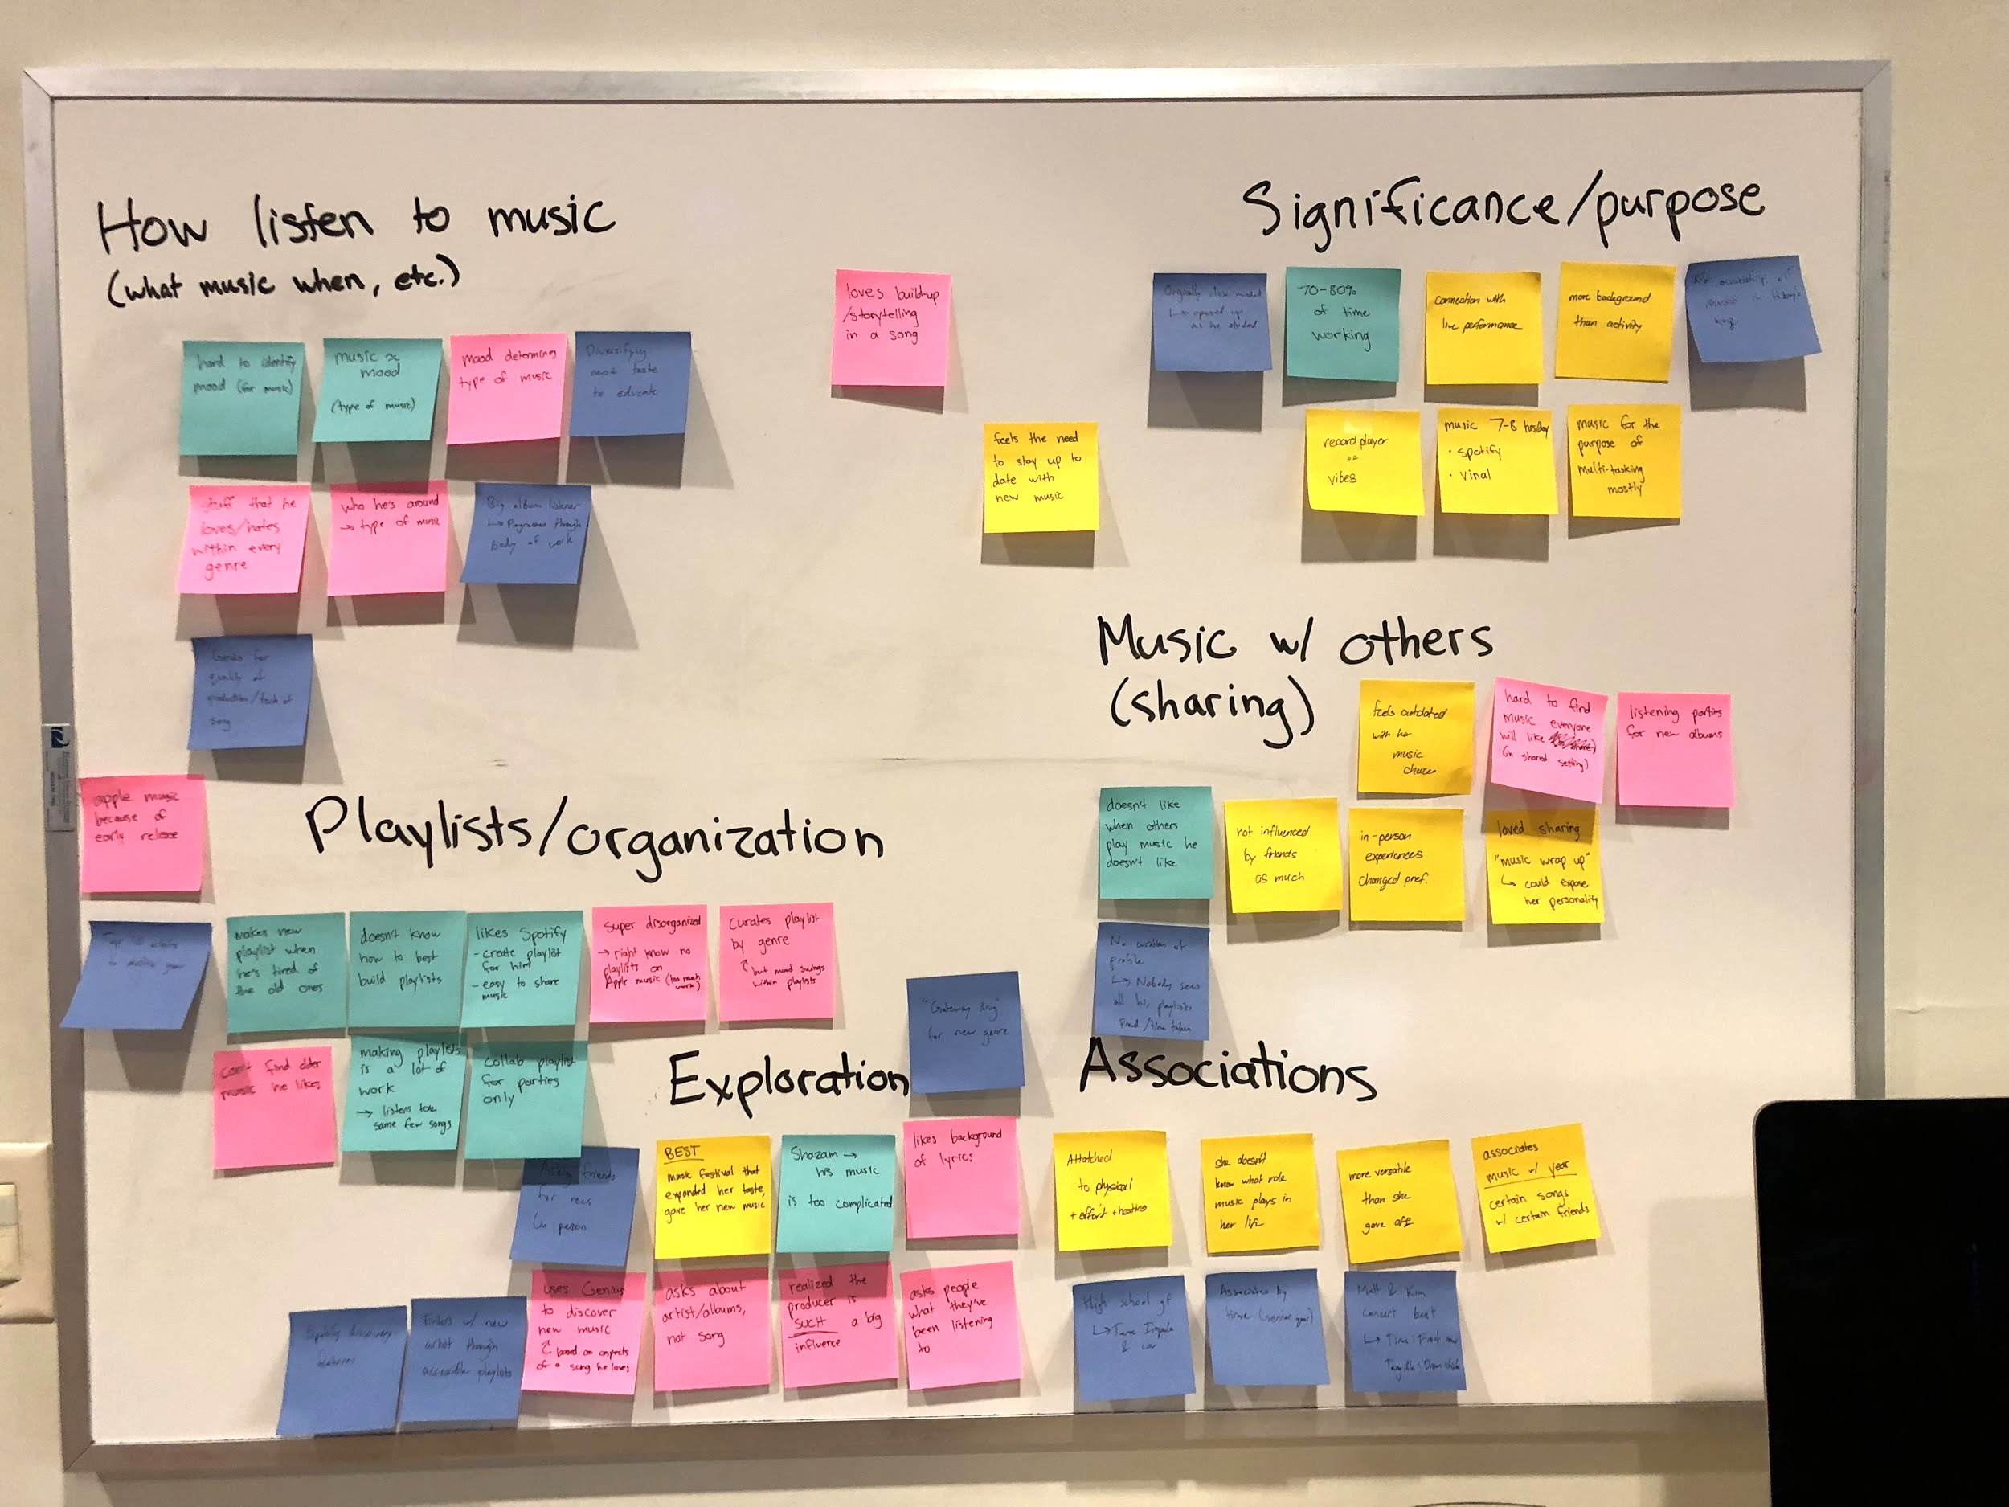
Analysis

Slide 22
Analysis
Needs
Faster creation of playlists
Guidance in entering a new genre of music and music discovery in general
Better organized music
Playlists that others will like
Music that supports current mood

Slide 23
Analysis
Insights
People want specific curated playlists, but it takes too long to create them
It is hard to discover a common ground in music tastes between even a small group of people
People think about different types of music by mood and use, not genre…
People want to find new music, but they don’t know where to start

Slide 24
In Summary
We met…
People who consider music a big part of their life
We were amazed to realize…
It is hard to discover a common ground in music tastes between even a small group of people
It would be game-changing to...
Actually bring people together by revealing music of shared tastes

