Slide 1
OX
Isaac Goldstein
Ian Hodge
Cody Hankins
Mischa Nee

Slide 2
OX
become closer through shared music,
seamlessly
PROBLEM
College students want to listen to music with friends but don’t know what music others will like and find it uncomfortable to figure that out.
SOLUTION
OX finds the intersection of music tastes both through automatically providing common songs and curating music profiles for intimate interpersonal discovery.

Slide 3
Task Overview

Slide 4
Simple Task
Find songs of everyone in a room will enjoy
NOTE: This new version more directly reflects our goal. We are not just trying to finding songs of common interest. We are trying to find songs of common interest in this moment

Slide 5
Medium Task
Gain the “language” to talk about shared music tastes

Slide 6
Complex Task
Discover new music with multiple other people

Slide 7
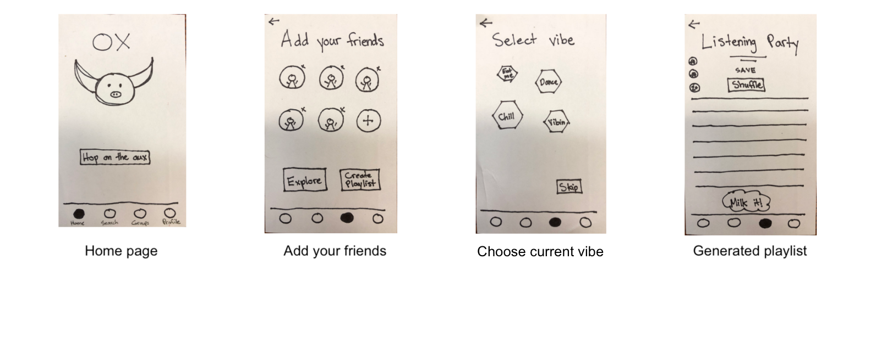
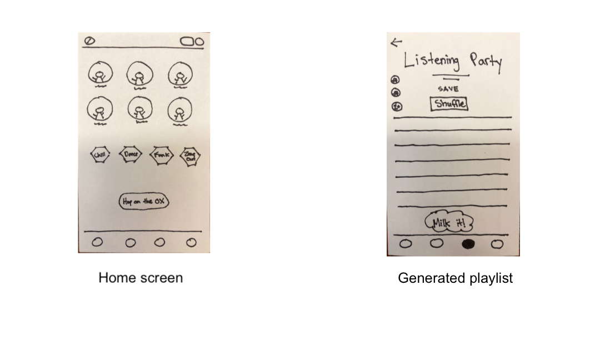
Major Design Change #1
Original Sketch
Rationale
Our problem domain stems from the uncomfortable experience “hopping on the aux.” We needed to streamline that process, making it as simple as possible to generate a playlist of shared music tastes for any user.
New Sketch

Slide 8
Major Design Change #2
Original Sketch
Rationale
In taking a step back to the core of our problem domain (finding intersections in music taste), we overhauled the ability to view other people’s profiles and leveraged the search ability to find commonalities is music taste with other individuals.
New Sketch

Slide 9
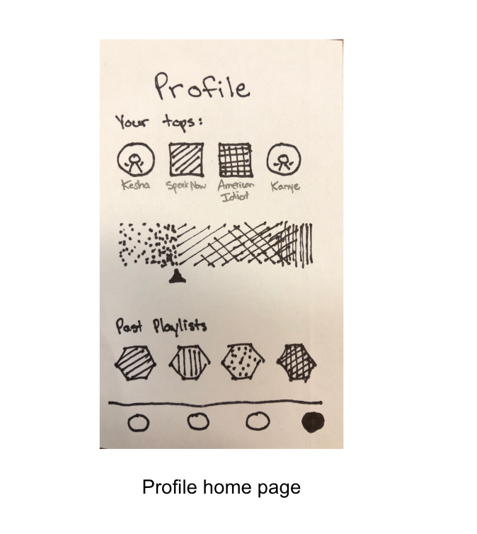
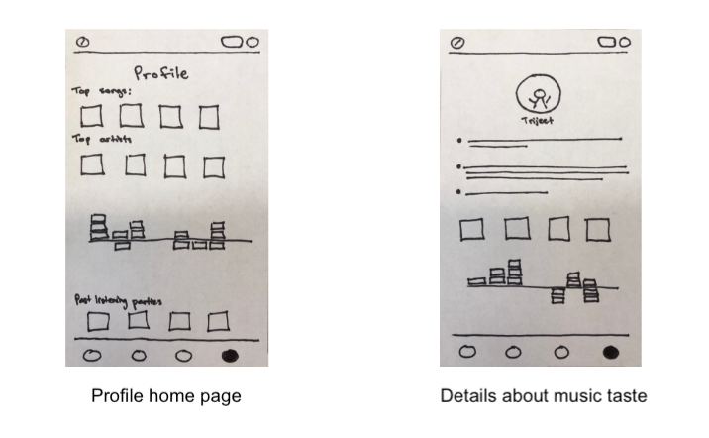
Major Design Change #3
Original Sketch
Rationale
In thinking about what insights we wanted to provide with the music profile, we realized that there is no congregate linear representation of a music taste. We therefore want to create a more graphical representation that opens up into more specific insights, both verbal and visual.
New Sketch

Slide 10
Medium Fidelity Task Flows

Slide 11
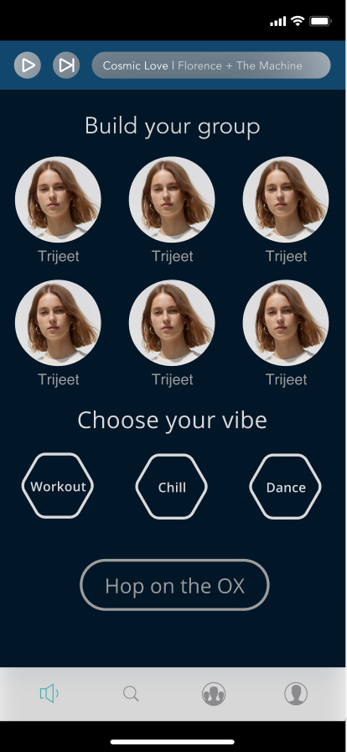
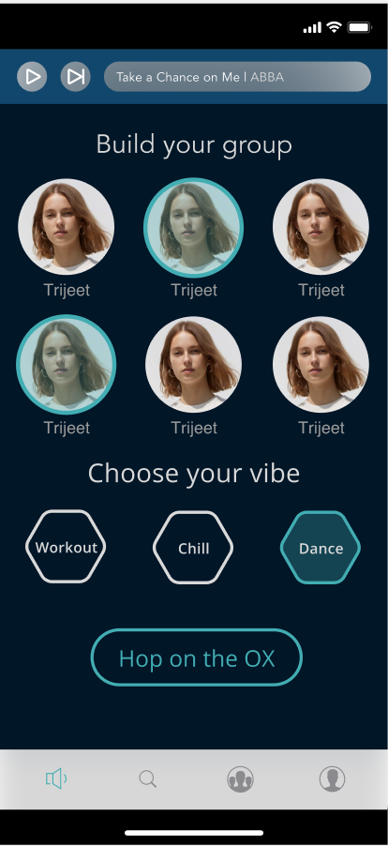
Find songs that everyone in a room will enjoy
Notes:
We wanted to allow a user to jump on the OX as fast as possible. We made it so that directly on the home screen, you can select group members and a vibe and go directly to a listening party.

Slide 12
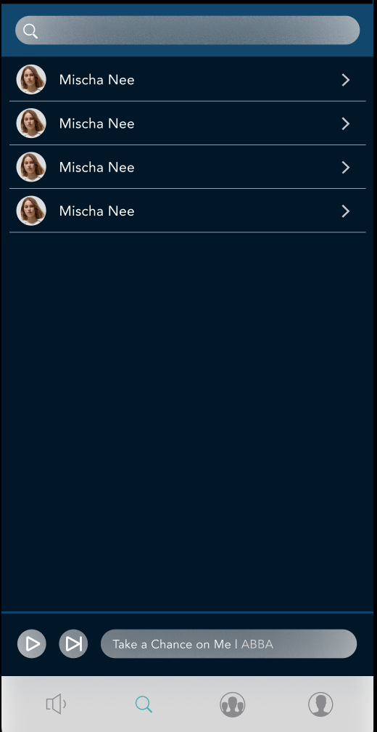
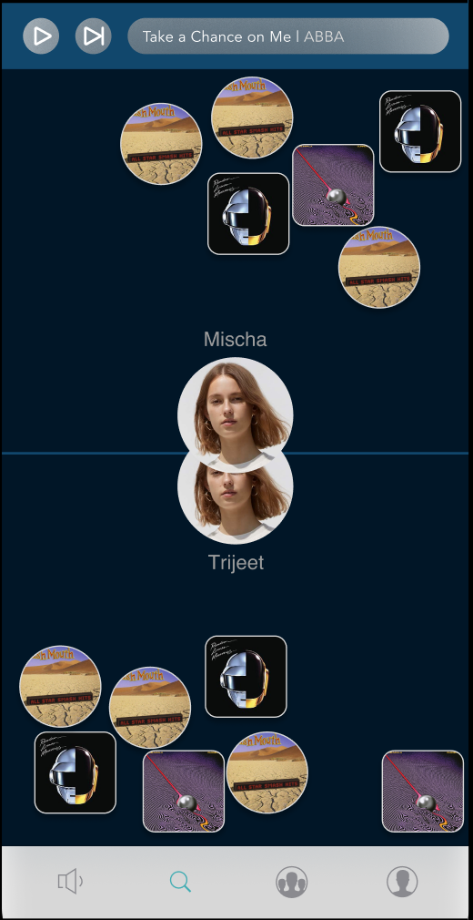
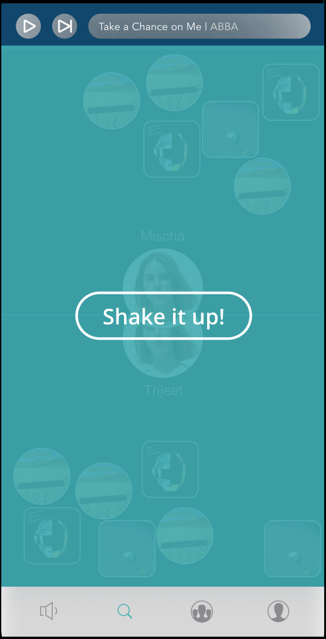
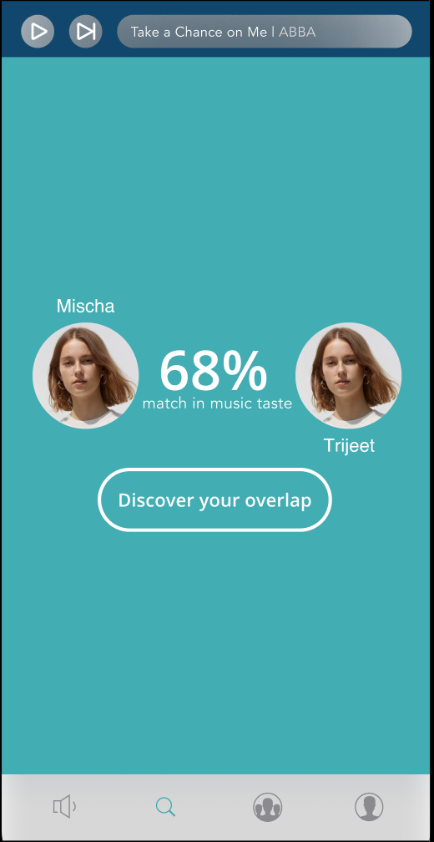
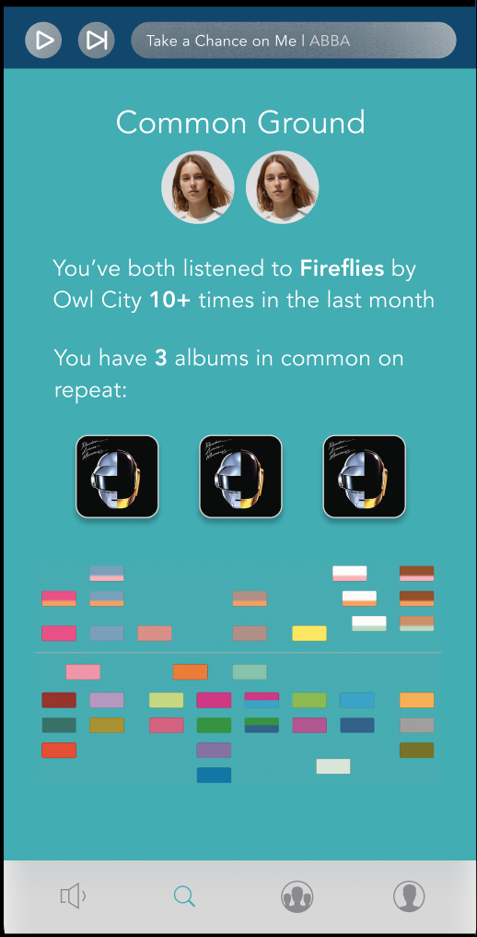
Gain the “language” to talk about shared music tastes

Slide 13
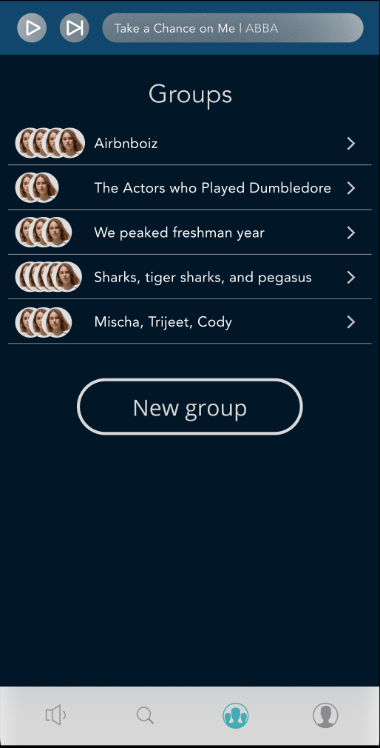
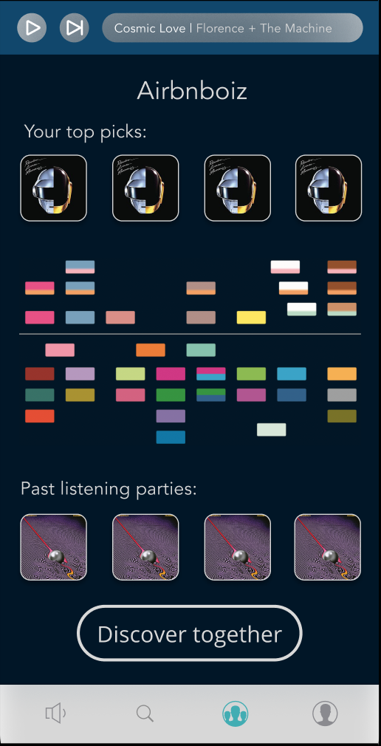
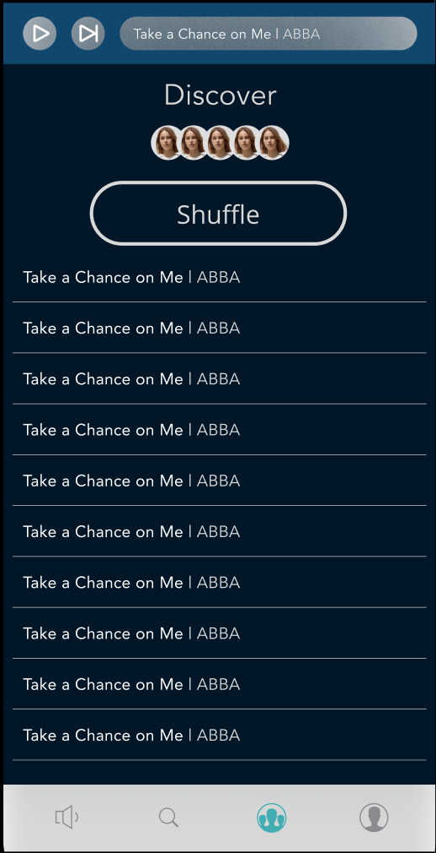
Discover new music with multiple other people

Slide 14
Prototyping Overview

Slide 15
Primary Tools
Figma was the primary tool for designing and prototyping
Great for collaborative working
Had a very steep learning curve, none of us had used a tool like this before
The “building-block” nature of the tool helped ensure that our designs were consistent and intentional. We were able to uncover flaws in our low-fi prototype through actual designing sketches

Slide 16
Current Prototype Limitations
All of the songs, groups, and insights are hard coded - we do not have to capability to find overlap in taste without user information.
The pictures are currently stock photos - we are brainstorming ways to present a default picture and have the capacity to upload a personal photo
Detailed features of the music taste visualization are currently absent - we need to know what technical information we have to work with before we can make final decisions on what we showcase

Slide 17
Current Prototype Limitations (cont.)
We want to add a feature where you can click on a song to see ‘why it was chosen,’ but this idea came too late to put it into the design.
There are currently no “back” buttons on the slides - we don’t know how to keep track of the specific previous page in a prototype
The sequence of finding similarities with a friend is not animated (and will be) - the static nature of a protype did not allow us to showcase this

