Slide 1
OX
Isaac Goldstein
Ian Hodge
Cody Hankins
Mischa Nee

Slide 2
OX
become closer through shared music,
seamlessly
PROBLEM
College students want to listen to music with friends but don’t know what music others will like and find it uncomfortable to figure that out.
SOLUTION
OX finds the intersection of music tastes both through automatically providing common songs and curating music profiles for intimate interpersonal discovery.

Slide 3
Tasks
1. Simple: Find songs of common interest with others
2. Medium: Gain the “language” to talk about shared music tastes
3. Complex: Discover new music with multiple other people

Slide 4
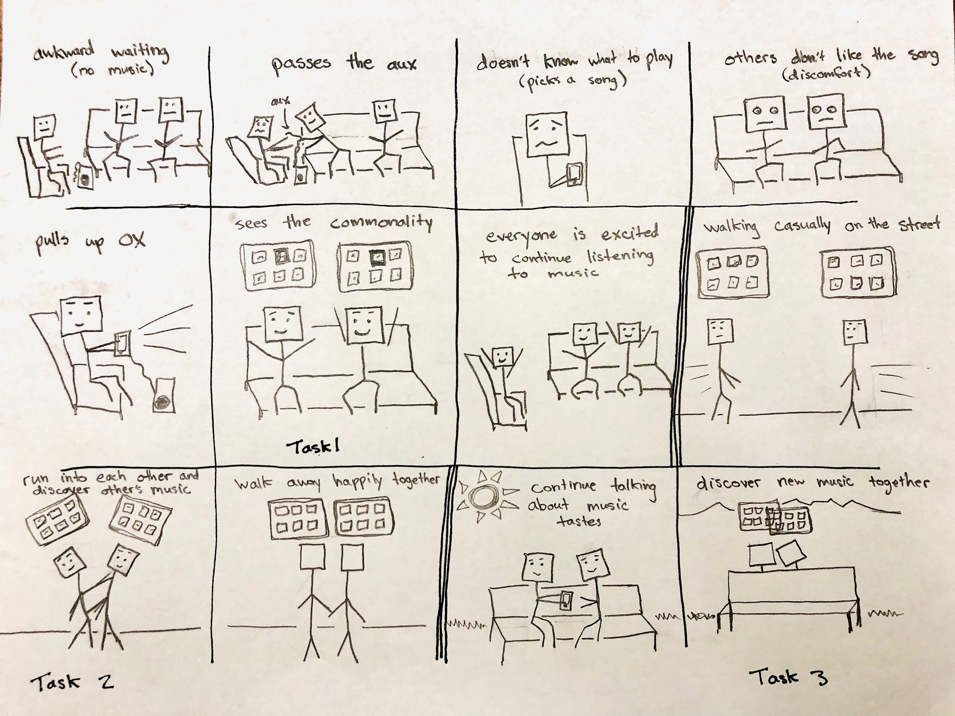
Storyboard

