Slide 1
Design Patterns
November 28, 2018
Notes:
58 min + 5 min quiz + 35 min break (was supposed to be 20) + 10 min to do patterns in exploration (fast)
Should work fine with 20-25 min break

Slide 2

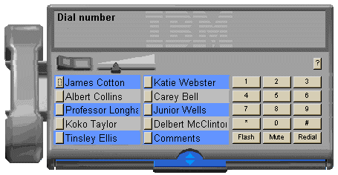
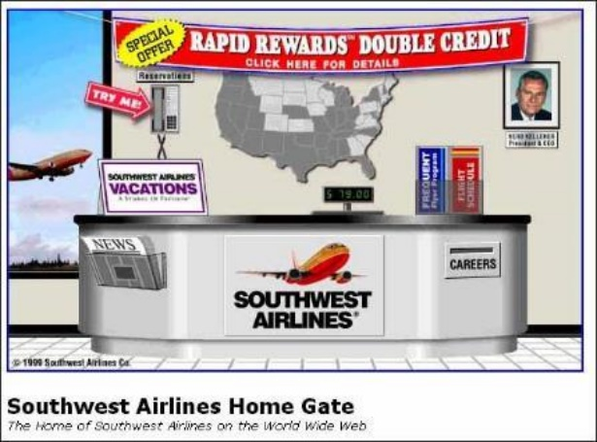
Hall of Fame or Shame?
Direct translations
  software telephony solution where users dial a number by clicking on a simulated keypad
  airline web site that simulates a ticket counter

Slide 3

Hall of Shame!
Direct translations
  software telephony solution where users dial a number by clicking on a simulated keypad
  airline web site that simulates a ticket counter
Misused Metaphors!
Notes:
What do I come to an airline site to do????

Slide 4
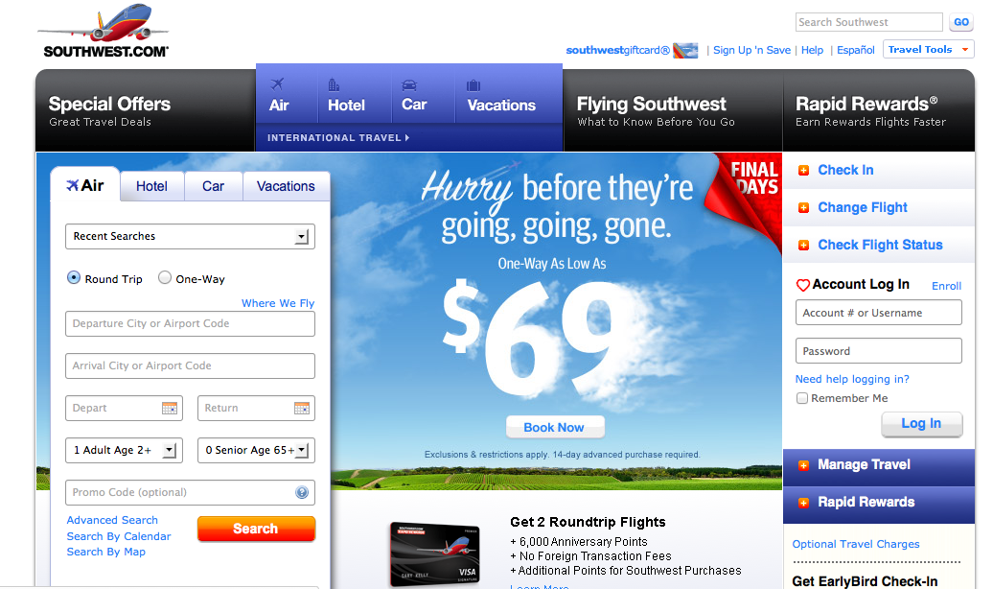
Improved southwest.com
Notes:
Southwest.com as of 2/25/2014
Note how it highlights the obvious things you’ll want to do on a airline web site.
Purchase air flights
Hotels, cars, vacations
Frequent flyer
Special offers

Slide 5
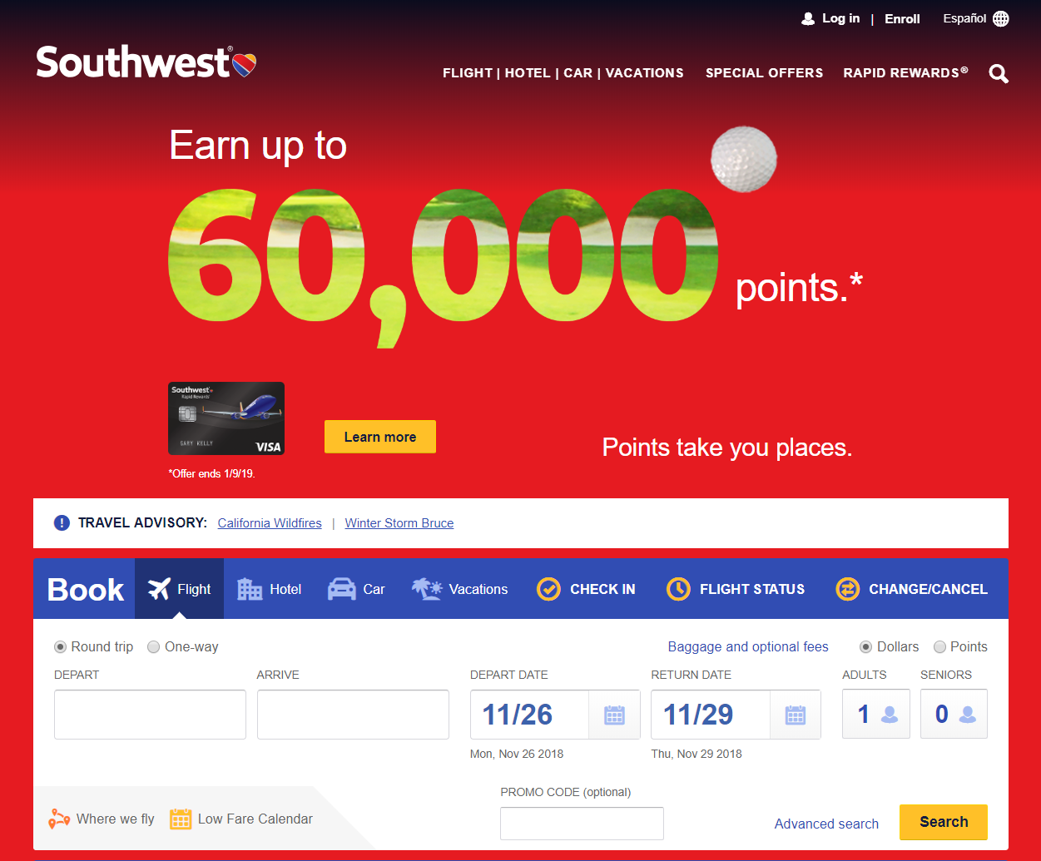
Improved southwest.com
Notes:
Southwest.com as of 11/25/2018
Credit card offer may be too much…

Slide 6
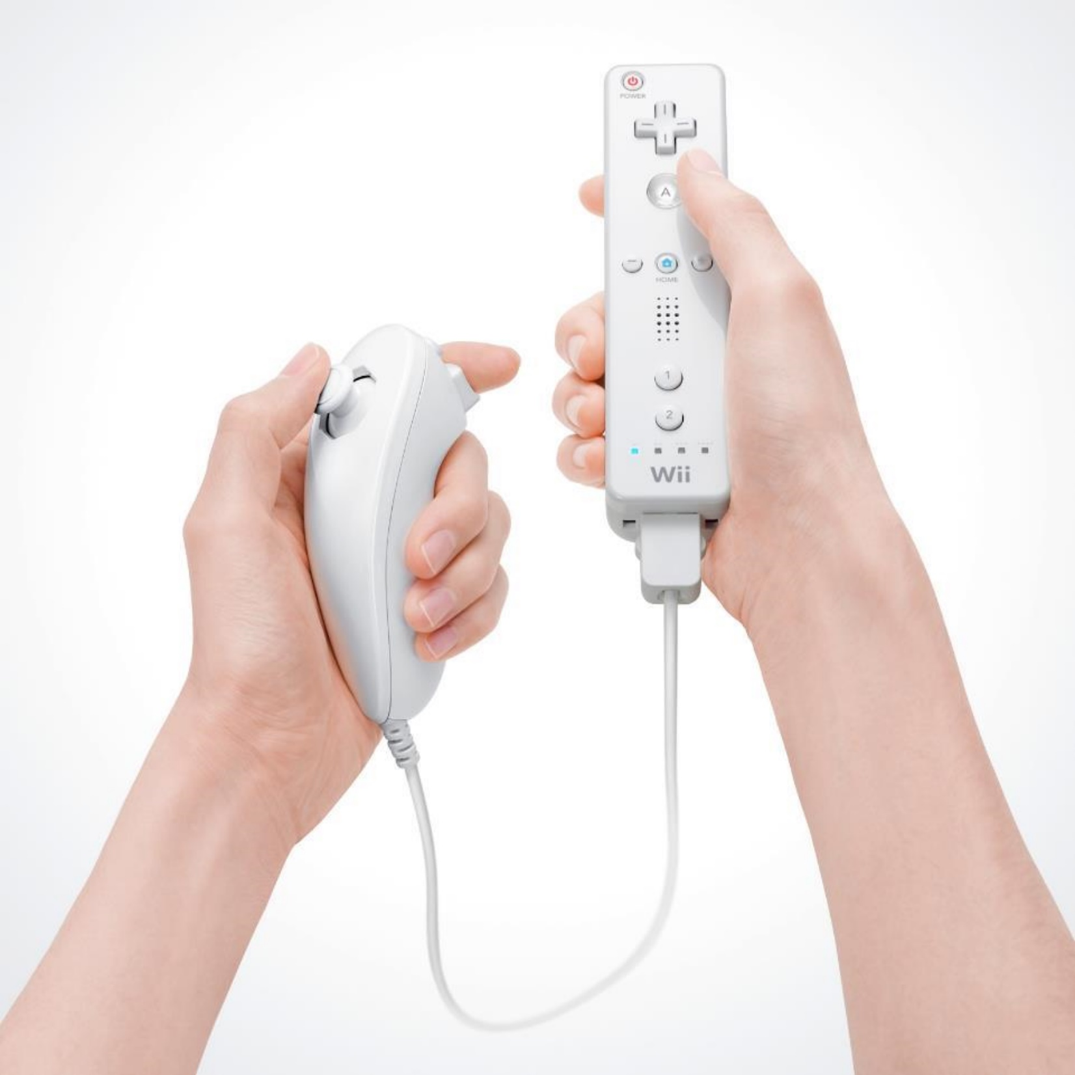
Hall of Fame or Shame?
Wiimote
By Nintendo
Notes:
What was good about this when it came out?
What might have been wrong?

Slide 7
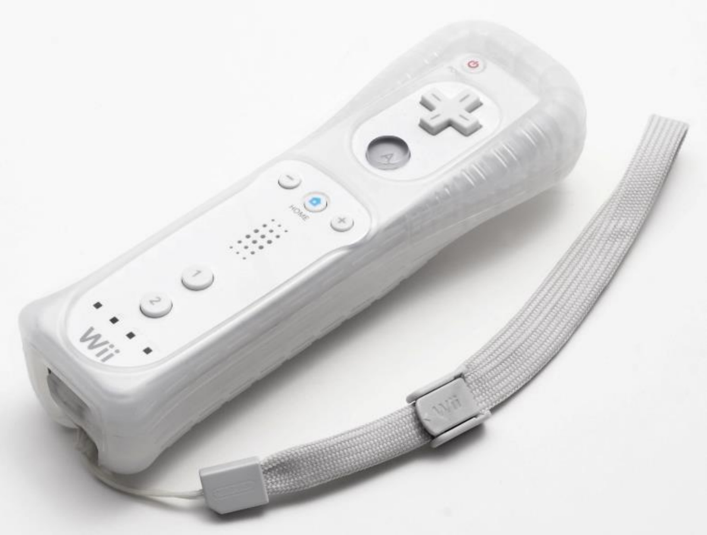
Hall of Fame/Shame!
Great at opening up gaming to a wider audience but…
the main thing that differentiated the product (movement in gaming)
resulted in it being thrown at windows/TVs
slippery plastic hard to hold onto. Later designs added rubber case & strap
lack of a joystick was initial problem resulting in a second controller
Notes:
mixed result and some of the initial problems were fixed.

Slide 8
Design Patterns
November 28, 2018
Notes:
48 minutes (skipped how to use patterns)

Slide 9
Outline
Detailed Design Example
Web Design Patterns
Team Break
Patterns in the Design Exploration Phase

Slide 10
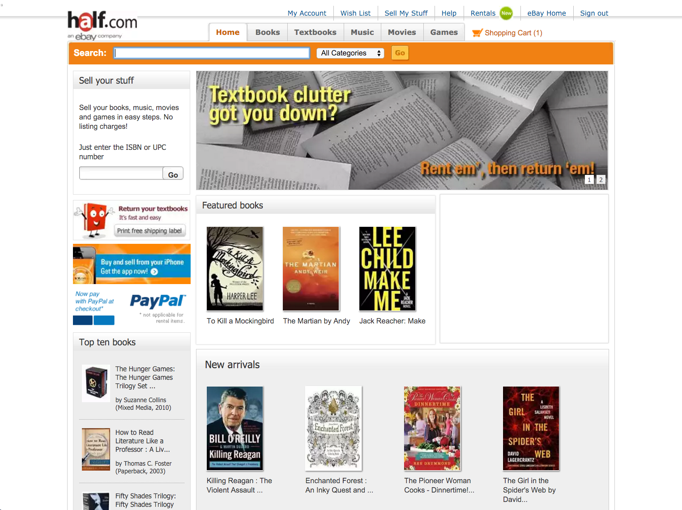
1
Notes:
Action Buttons
High-visibility Action Buttons
Error messages
Value Proposition
Process Funnel
Product Details
Obvious Links

Slide 11
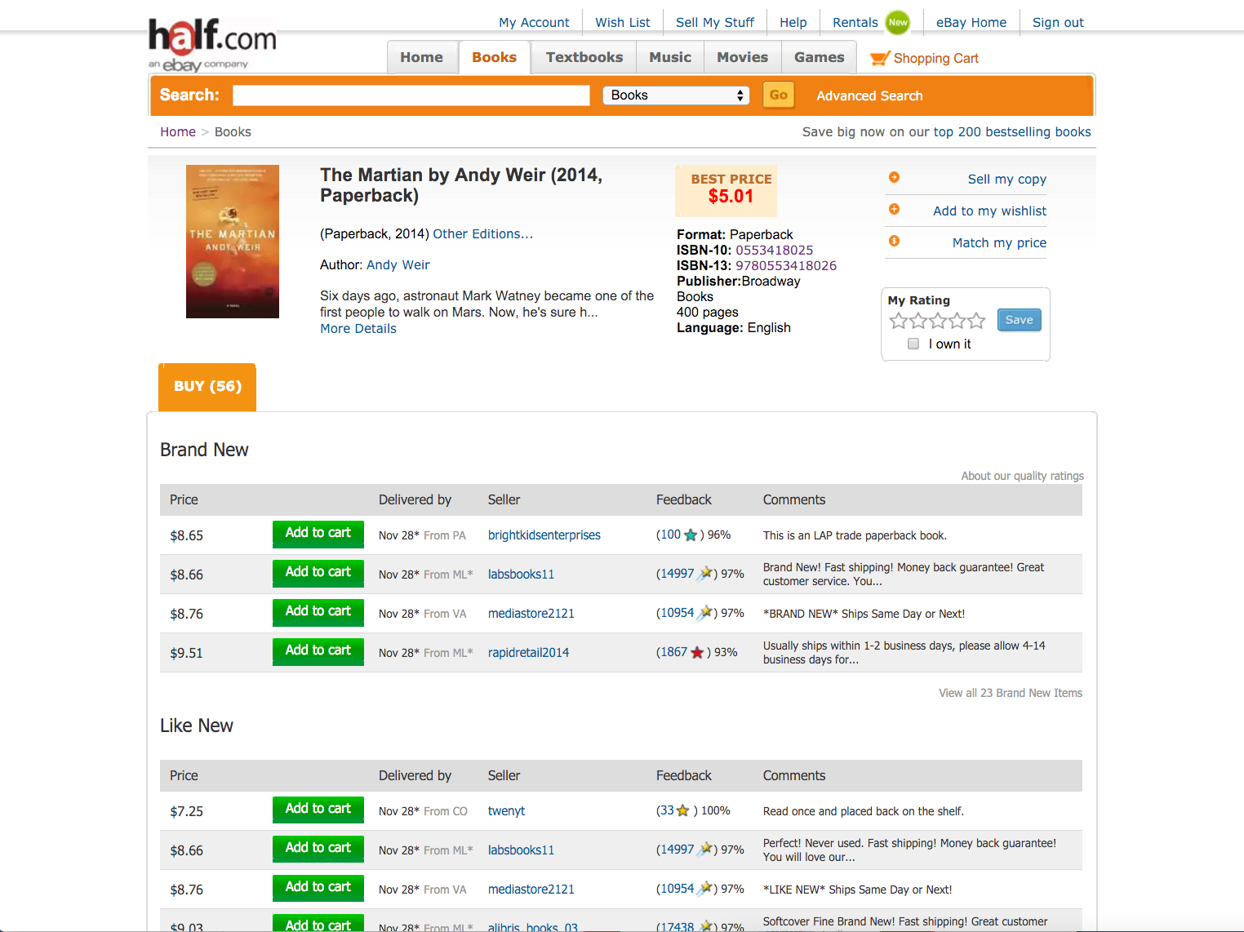
2

Slide 12
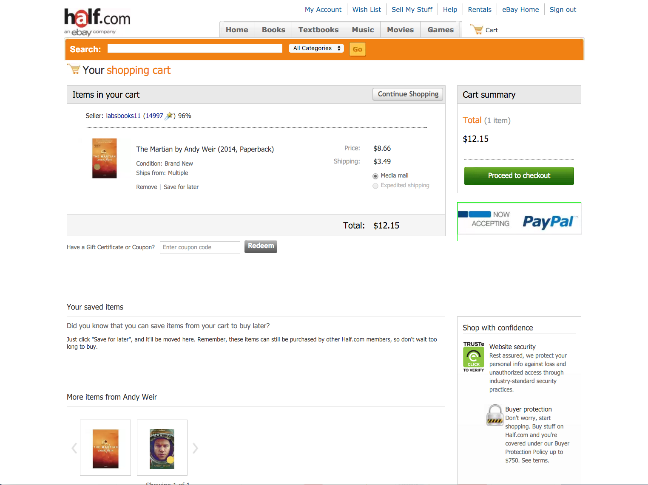
3

Slide 13
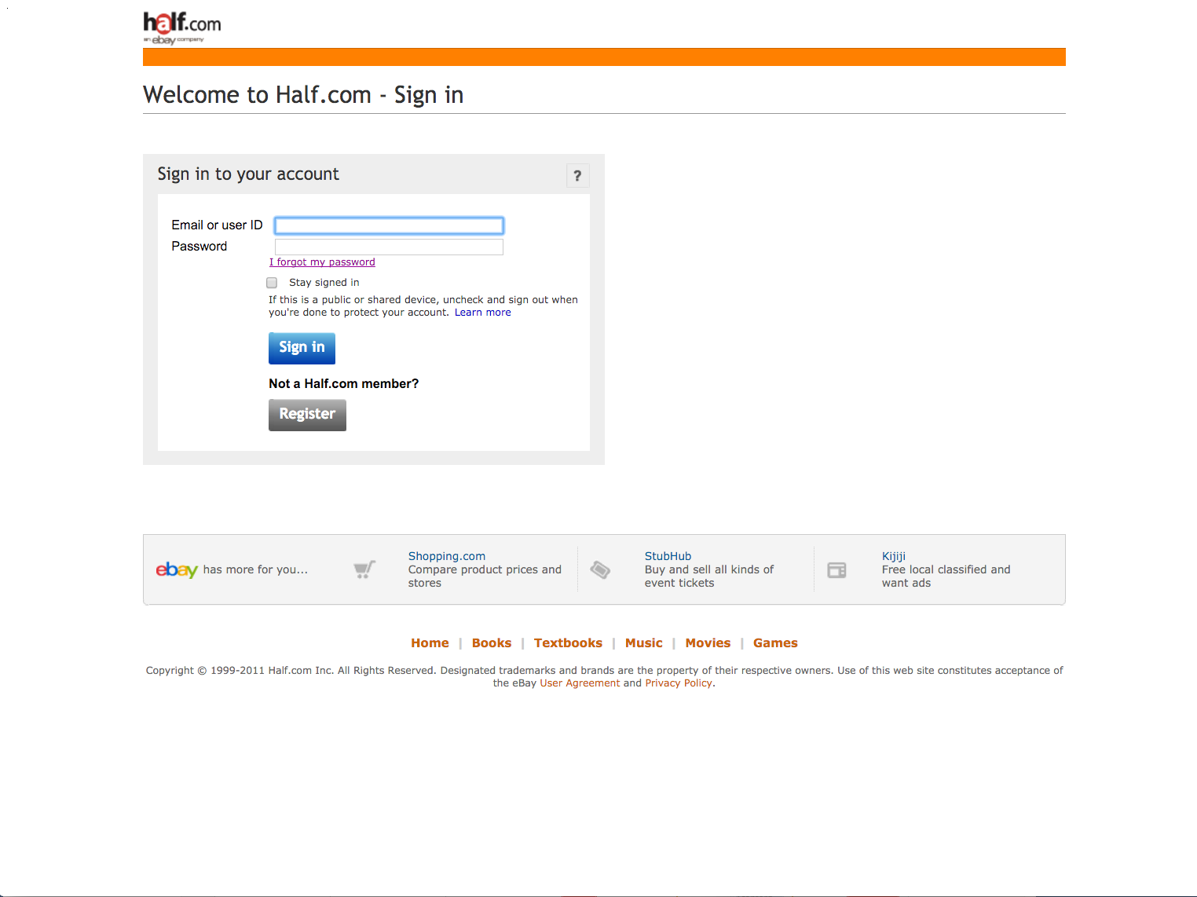
4

Slide 14
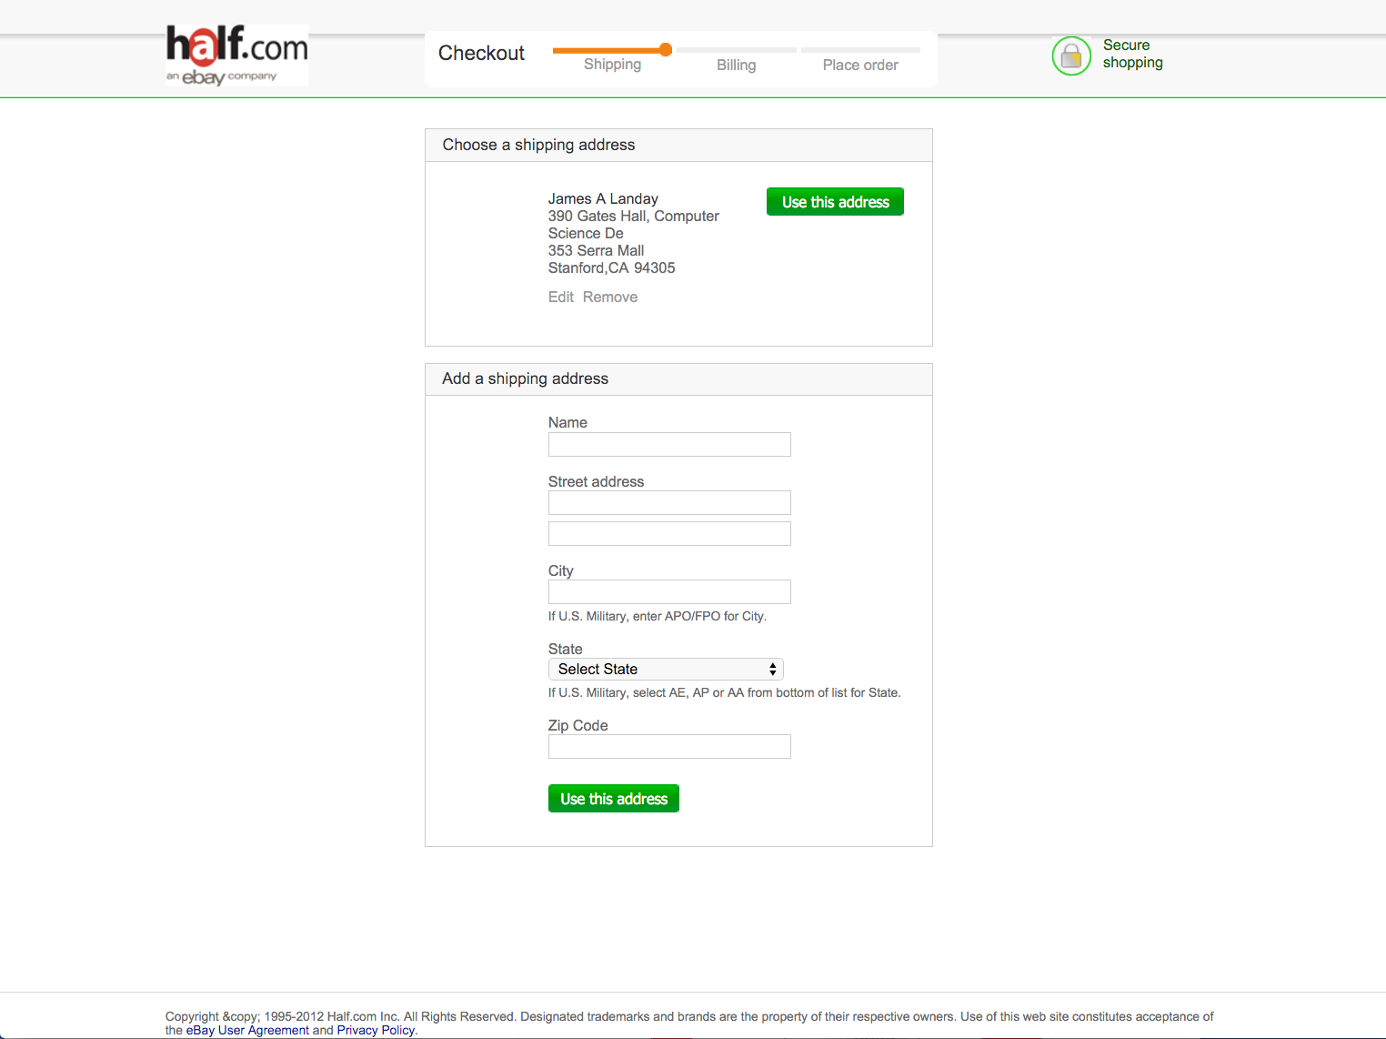
5

Slide 15
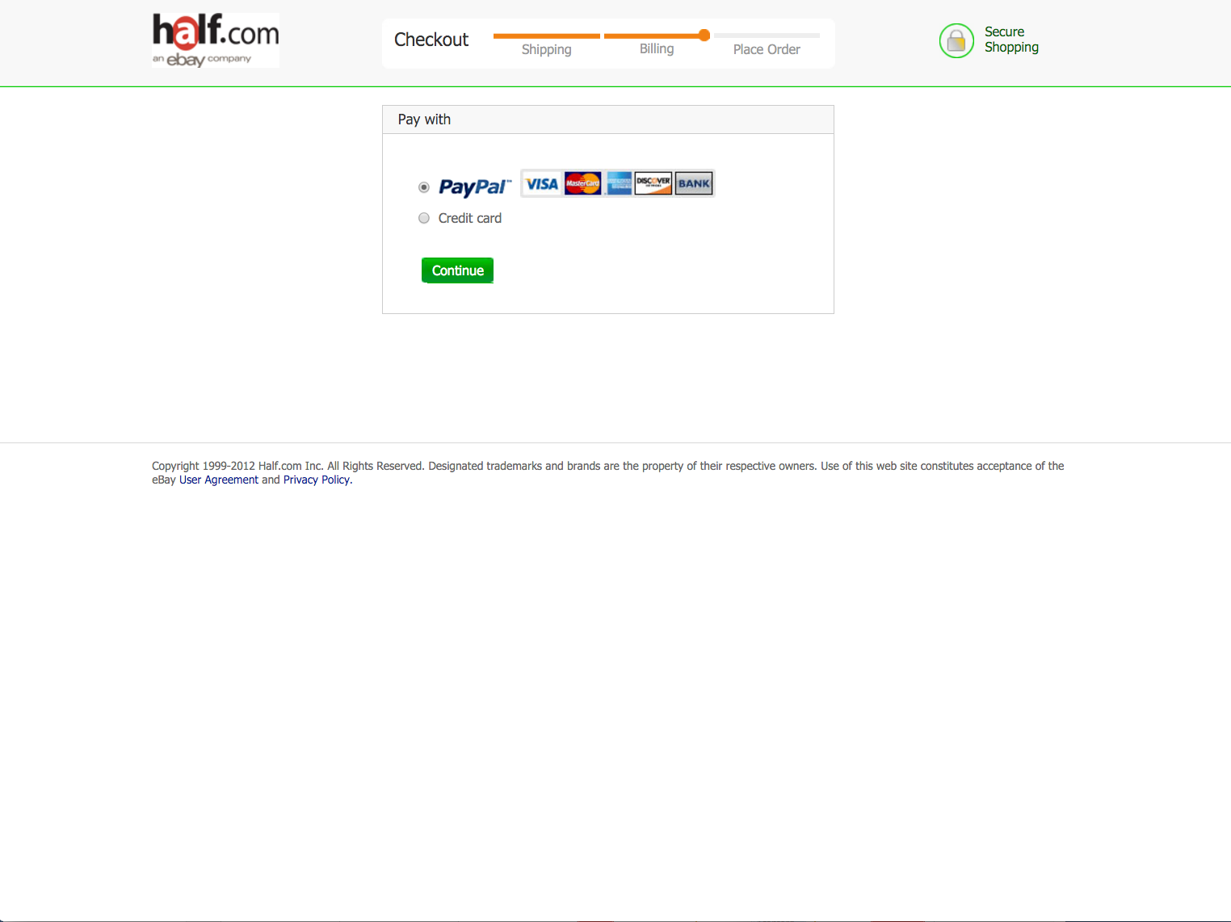
6
Notes:
strange how the credit cards align with PayPal….

Slide 16
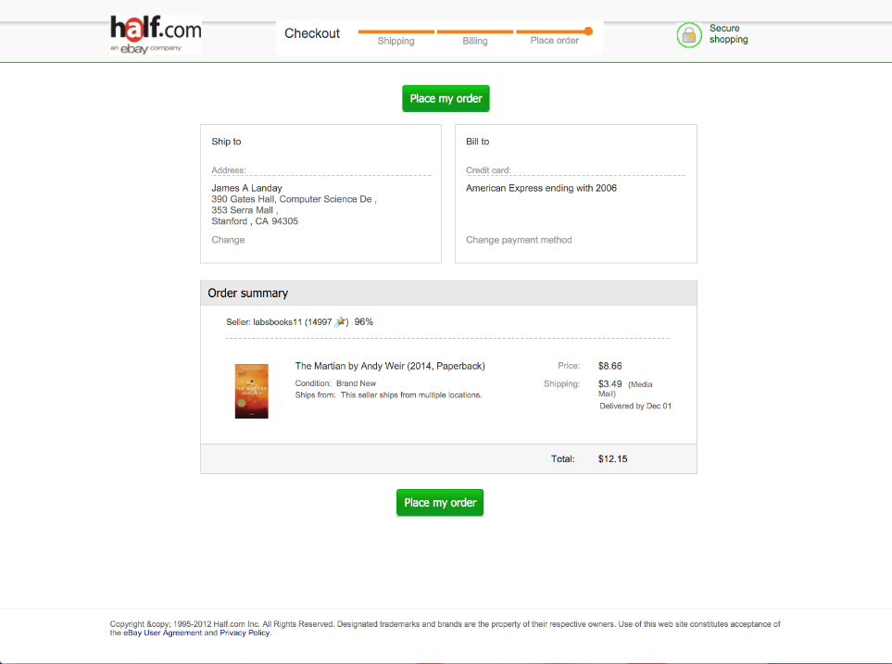
Quick-Flow Checkouts
7

Slide 17
Basic Web Design
Let’s take a closer look page by page

Slide 18
1
Notes:
Clear logo in top-left corner (a standard), click to go home
Another logo at the top right (eBay)
Easy link to shopping cart, suggests that it's an ecommerce site even if you've never seen it before
Tab row (another standard) along with top ten books box on the side, reinforcing that it's an ecommerce site and suggests what this site sells
A welcome module here that makes it easy for people who don't know anything about this site to learn what it does
A large content area in the center
A large "New Arrivals" to suggest things that people might like
Majority of the content "Above the Fold” (BUT what has changed over the years is a BIG AD!)
Grid layouts?
Content modules?
Obvious links and Action Buttons (know where you can click)
Above the fold
Welcome content module
Action Buttons
High-visibility Action Buttons
Error messages
Value Proposition
First Reads
Process Funnel
Product Details
Obvious Links

Slide 19
1
What site is this?
  Logo in top-left corner denotes the site
  Another name/logo at top-right to reinforce
  examples of SITE BRANDING (E1)
Notes:
Clear logo in top-left corner (a standard), click to go home
Another logo at the top right (eBay)
Easy link to shopping cart, suggests that it's an ecommerce site even if you've never seen it before
Tab row (another standard) along with top ten books box on the side, reinforcing that it's an ecommerce site and suggests what this site sells
A welcome module here that makes it easy for people who don't know anything about this site to learn what it does
A large content area in the center
A large "New Arrivals" to suggest things that people might like
Majority of the content "Above the Fold” (BUT what has changed over the years is a BIG AD!)
Grid layouts?
Content modules?
Obvious links and Action Buttons (know where you can click)
Above the fold
Welcome content module
Action Buttons
High-visibility Action Buttons
Error messages
Value Proposition
First Reads
Process Funnel
Product Details
Obvious Links

Slide 20
1
What kind of site is this?
  Shopping cart icon
  Tab row categories & content on left
  UP-FRONT VALUE PROPOSITION (C2)
  changes from past version – no prices!
  example of PERSONAL E-COMMERCE (A1)
Notes:
Clear logo in top-left corner (a standard), click to go home
Another logo at the top right (eBay)
Easy link to shopping cart, suggests that it's an ecommerce site even if you've never seen it before
Tab row (another standard) along with top ten books box on the side, reinforcing that it's an ecommerce site and suggests what this site sells
A welcome module here that makes it easy for people who don't know anything about this site to learn what it does
A large content area in the center
A large "New Arrivals" to suggest things that people might like
Majority of the content "Above the Fold” (BUT what has changed over the years is a BIG AD!)
Grid layouts?
Content modules?
Obvious links and Action Buttons (know where you can click)
Above the fold
Welcome content module
Action Buttons
High-visibility Action Buttons
Error messages
Value Proposition
First Reads
Process Funnel
Product Details
Obvious Links

Slide 21
1
What can I do here?
  Sell your stuff
  Tab row / Search on top
  Click on books
  Not great examples of
  OBVIOUS LINKS (K10)
Notes:
Clear logo in top-left corner (a standard), click to go home
Another logo at the top right (eBay)
Easy link to shopping cart, suggests that it's an ecommerce site even if you've never seen it before
Tab row (another standard) along with top ten books box on the side, reinforcing that it's an ecommerce site and suggests what this site sells
A welcome module here that makes it easy for people who don't know anything about this site to learn what it does
A large content area in the center
A large "New Arrivals" to suggest things that people might like
Majority of the content "Above the Fold” (BUT what has changed over the years is a BIG AD!)
Grid layouts?
Content modules?
Obvious links and Action Buttons (know where you can click)
Above the fold
Welcome content module
Action Buttons
High-visibility Action Buttons
Error messages
Value Proposition
First Reads
Process Funnel
Product Details
Obvious Links

Slide 22
1
Most important info visible without scrolling
ABOVE THE FOLD (I2)
Notes:
Clear logo in top-left corner (a standard), click to go home
Another logo at the top right (eBay)
Easy link to shopping cart, suggests that it's an ecommerce site even if you've never seen it before
Tab row (another standard) along with top ten books box on the side, reinforcing that it's an ecommerce site and suggests what this site sells
A welcome module here that makes it easy for people who don't know anything about this site to learn what it does
A large content area in the center
A large "New Arrivals" to suggest things that people might like
Majority of the content "Above the Fold” (BUT what has changed over the years is a BIG AD!)
Grid layouts?
Content modules?
Obvious links and Action Buttons (know where you can click)
Above the fold
Welcome content module
Action Buttons
High-visibility Action Buttons
Error messages
Value Proposition
First Reads
Process Funnel
Product Details
Obvious Links

Slide 23
2

Slide 24
2
What site am I at?
  Logo in upper-left reinforces brand, can click to go to home
  Same font, layout, color scheme also reinforces
  examples of SITE BRANDING (E1)
  prices emphasize I can buy
  example of PERSONAL E-COMMERCE (A1)

Slide 25
2
Where am I in the site?
  “Home > Books” is
  LOCATION BREAD CRUMBS (K6)
  “Books” selected in
  TAB ROW (K3) & SEARCH ACTION MODULE (J1)
  Book cover, “Product Info”, … are additional cues

Slide 26
Can I trust these sellers?
  Who am I buying from?
  Are they reputable?
    aside: what do stars mean?
  What about shipping?
    used to show total price!
2

Slide 27
2
The Fold
  Hmm, what’s below here?

Slide 28
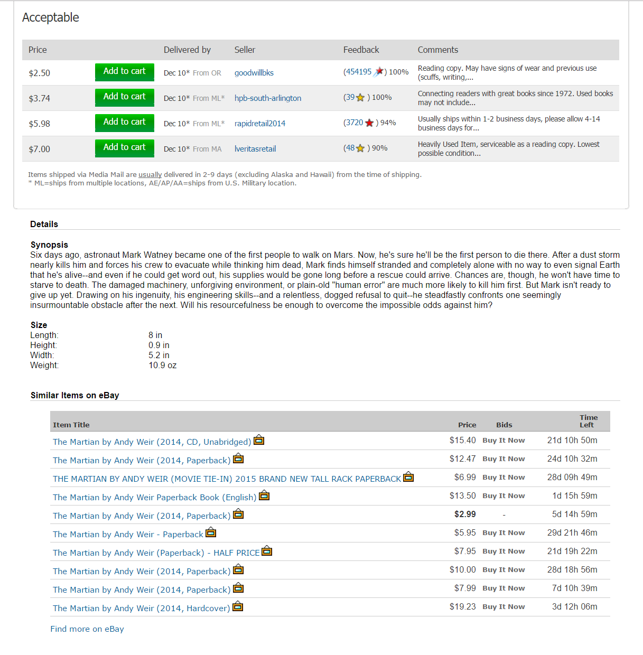
2

Slide 29
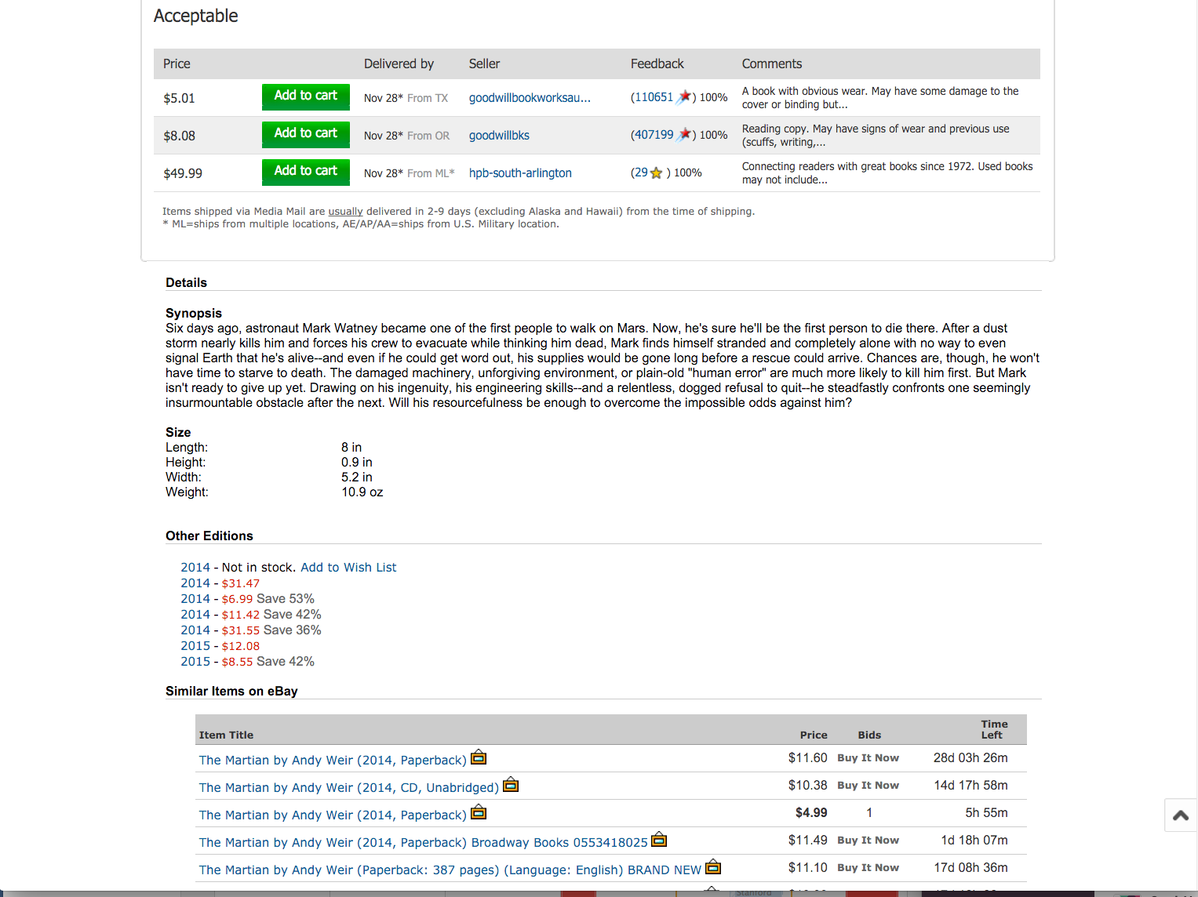
3
2
2
More versions
Used to have!
  Editorial reviews
  Customer reviews
  RECOMMENDATION COMMUNITY (G4)
Impulse buy
  PESONALIZED RECOMMENDATIONS (G3)
About this album
Lots of unused space
Still more info below…
Notes:
More books in different conditions:
Very Good, Good, Acceptable
Details about the book (Synopsys, size, other editions), similar items
REMOVED ALL REVIES & RECOMMENDATIONS!

Slide 30
3
What site am I at?
  Logo in upper-left
  Colors, layout, font
  examples of SITE BRANDING (E1)

Slide 31
3
Where am I in the site?
  Last button clicked was “Add to cart!”
  “Shopping Cart” and “Proceed to Checkout” reinforce that this is “the right page”
  SHOPPING CART (F3)

Slide 32
3
Cross-selling
  Possibly a pleasant surprise
  Impulse buy
  CROSS-SELLING &
  UP-SELLING (G2)

Slide 33
3
What am I going to buy?
  Easy to remove
  Easy to move to save for later
How much will it cost?
  Shipping costs there, no surprises
SHOPPING CART (F3)

Slide 34
3
What can I do (they want me to do)?
  “Proceed to Checkout”
  HIGH VISIBILITY ACTION BUTTON (K5)
    visually distinct
    3D, looks clickable
    large
    used to be repeated above and below the fold

Slide 35
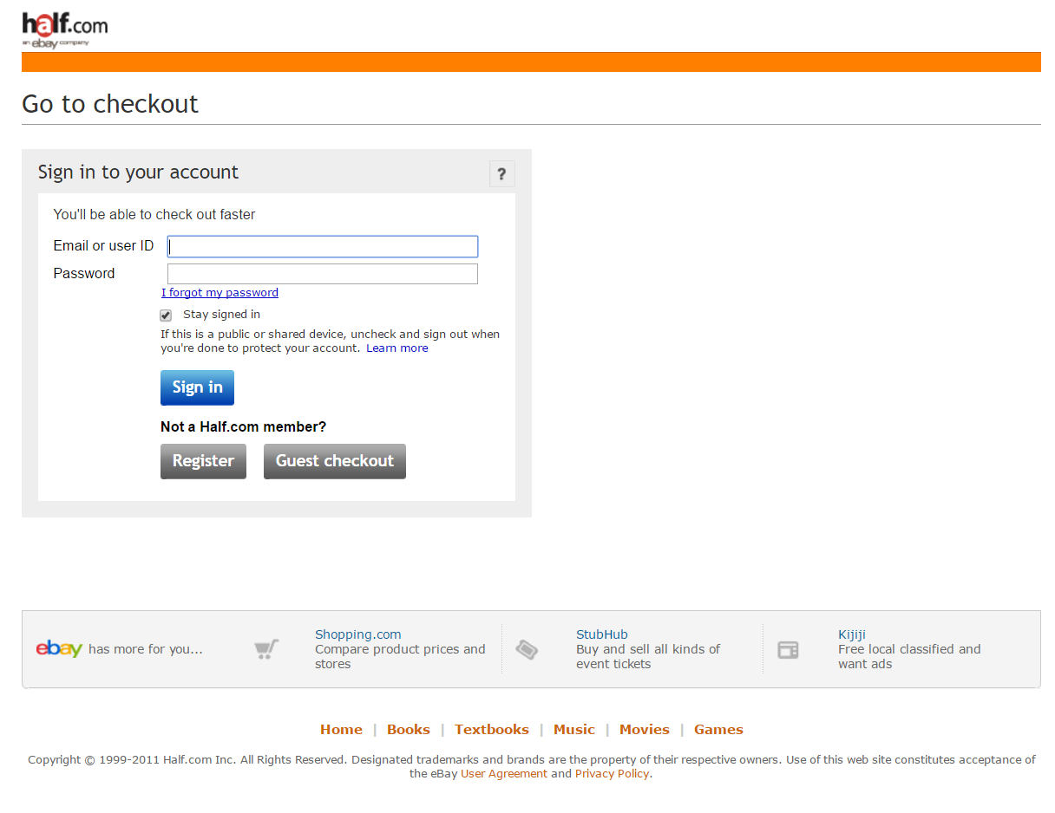
4

Slide 36
4
What if I don’t have a User ID?
What if I forgot my password?
SIGN-IN/NEW ACCOUNT (H2)

Slide 37
5

Slide 38
5
What site?
  Logo, layout, color, fonts
Where in site?
  Checkout, step 1 of 3
  “Choose a shipping address”
  QUICK-FLOW CHECKOUT (F1)

Slide 39
5
Note what’s different (?)
  No tab rows
  No impulse buys
  Only navigation on page takes you to next step
This is a PROCESS FUNNEL (H1)
  Extraneous info and links removed to focus customers

Slide 40
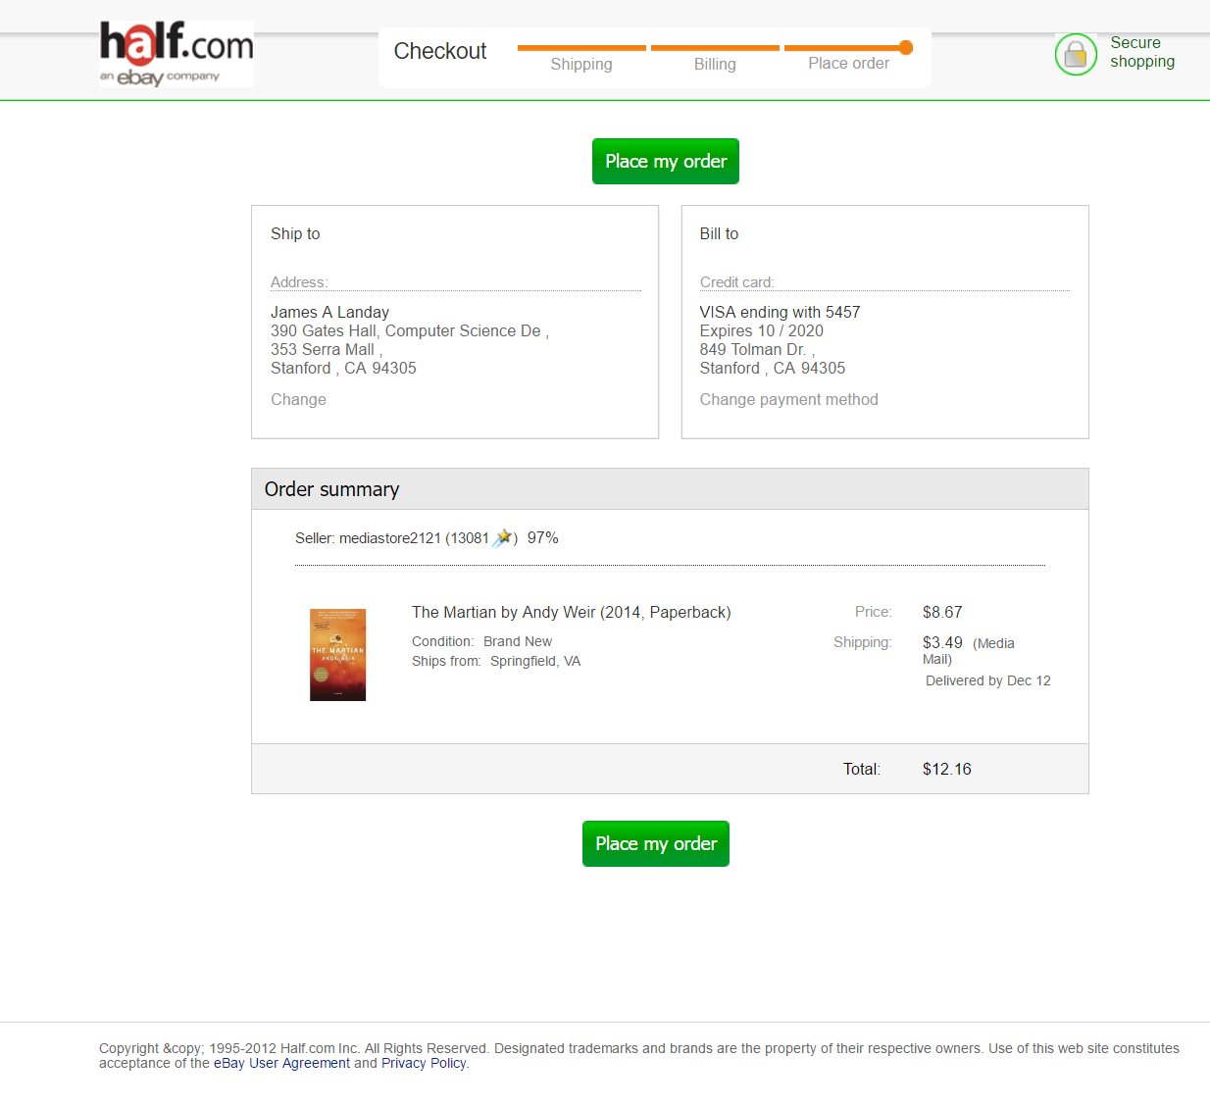
6

Slide 41
6
Last step of process
  Step 3, “Place Order”
  “Place my order” button
Two HIGH-VISIBILITY ACTION BUTTONS (K5) for fold

Slide 42
6
No nasty surprises
  Can see order
  Total price is same as shopping cart
  ORDER SUMMARY (F7)

Slide 43
6
Easy to change shipping and billing

Slide 44
Design = Solutions
Design is about finding solutions
Unfortunately, designers often reinvent
    Hard to know how things were done before
    Why things were done a certain way
    How to reuse solutions

Slide 45
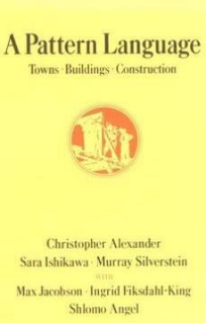
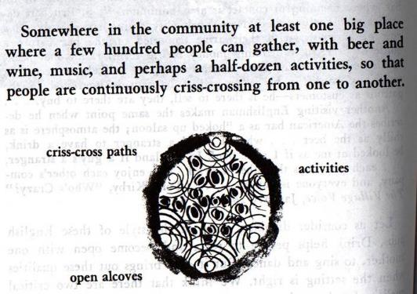
Design Patterns
Design patterns communicate common design problems and solutions
  First used in architecture [Alexander]
    Ex. How to create a beer hall where people socialize?

Slide 46
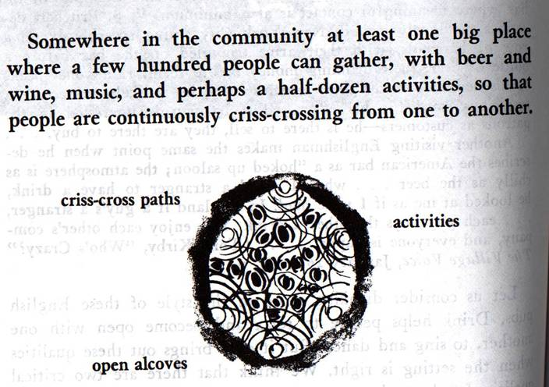
Design patterns communicate common design problems and solutions
  First used in architecture [Alexander]
    Ex. How to create a beer hall where people socialize?

Slide 47
Using Design Patterns
Not too general and not too specific
  use a solution “a million times over, without ever doing it the same way twice”
Design patterns are a shared language
  for “building and planning towns, neighborhoods, houses, gardens, & rooms.”
  Ex. Beer hall is part of a center for public life…
  Ex. Beer hall needs spaces for groups to be alone… ALCOVES

Slide 48
A Web of Design Patterns
(8) Mosaic of Subcultures
Cities
& Towns
(31) Promenade
(33) Night Life
(90) Beer Hall
Local
Gatherings
(95) Building Complex
Interiors
(179) Alcoves
(181) The Fire

Slide 49
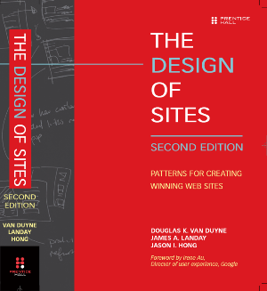
Web Design Patterns
Now used in UI design
Communicate design problems
& solutions
  how to create navigation bars
  for finding relevant content…
  how to create a shopping cart
  that supports check out…
  how to make e-commerce sites where people return & buy…

Slide 50
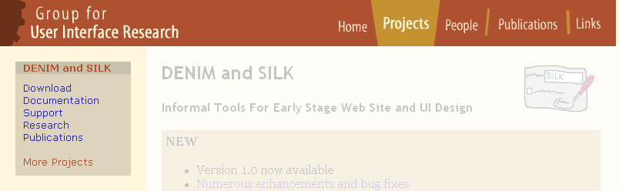
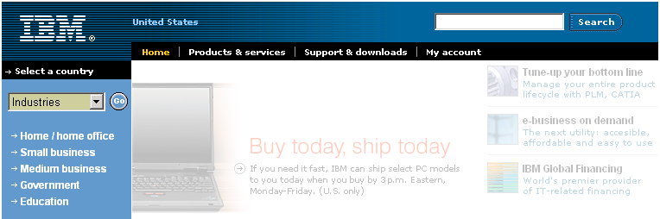
NAVIGATION BAR (K2)
Problem: Customers need a structured, organized way of finding the most important parts of your Web site

Slide 51
NAVIGATION BAR (K2)
Solution diagram
  captures essence on how to solve problem
First-level navigation
Link to home
Second-level navigation

Slide 52




Pattern Groups
Our patterns organized by group
  Site genres
  Navigational framework
  Home page
  Content management
  Trust and credibility
  Basic ecommerce
  Advanced ecommerce
  Completing tasks
  Page layouts
  Search
  Page-level navigation
  Speed
  The mobile web

Slide 53
PROCESS FUNNEL (H1)
Problem: Need a way to help people complete highly specific stepwise tasks
  Ex. Create a new account
  Ex. Fill out survey forms
  Ex. Check out

Slide 54
PROCESS FUNNEL (H1)

Slide 55
What’s different?
  No tab rows
  No impulse buys
  Only navigation on page takes you to next step
What’s the same?
  Logo, layout, color, fonts

Slide 56
PROCESS FUNNEL (H1)
Problem: What if users need extra help?

Slide 57
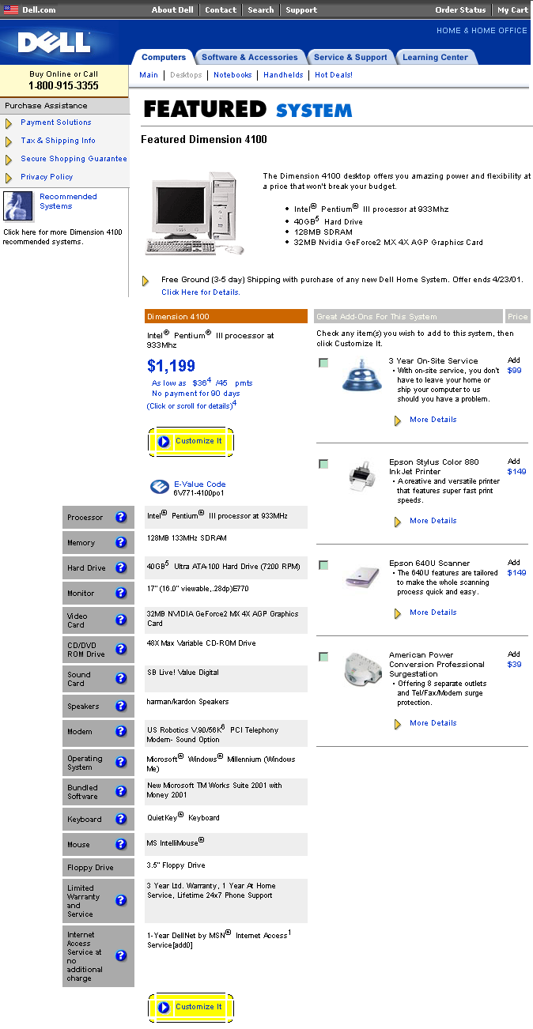
Process Tunnel

Slide 58
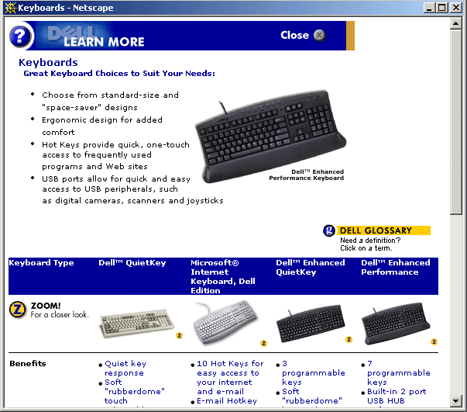
CONTEXT-SENSITIVE HELP (H8)
Notes:
If you search for this topic on Google, you will come up with thousands of articles on how to disable popup blocking so contextual information can show – problem!

Slide 59
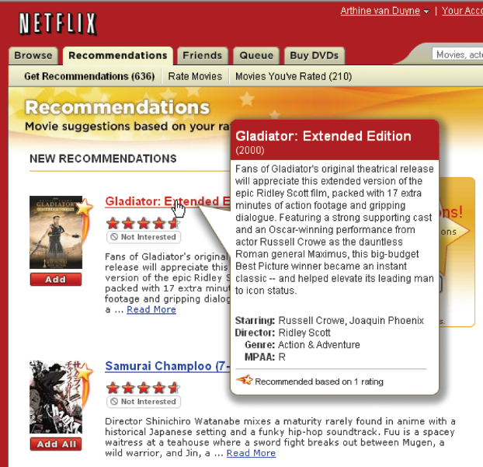
FLOATING WINDOWS (H6)

Slide 60
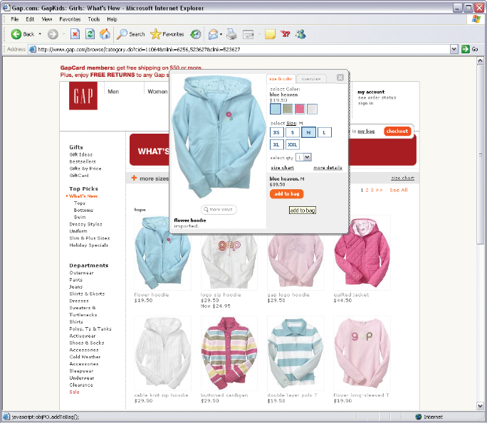
FLOATING WINDOWS (H6)

Slide 61
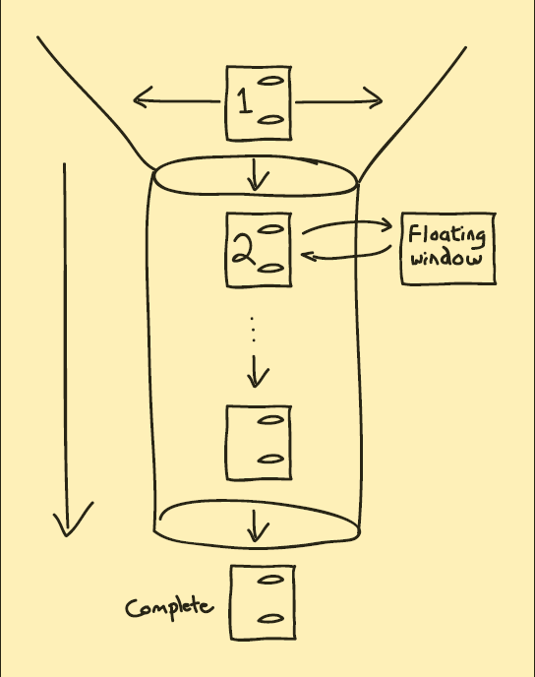
PROCESS FUNNEL (H1)
Solution Diagram

Slide 62
PROCESS FUNNEL (H1)
Related Patterns
(A1) E-Commerce
(A10) Web Apps
(A11) Intranets
(H1) Process Funnel
(K2) Navigation Bars
(H8) Context-Sensitive Help
(K3) Tab Rows
(I2) Above the Fold
(K4) Action Buttons
(K5) High-Viz Action Buttons
(K12) Preventing Errors
(K13) Meaningful Error Messages

Slide 63
Patterns Support Creativity
Patterns come from successful examples
  sites that are so successful that lots of users are familiar with their paradigms (e.g., Google, Amazon, Yahoo, Facebook…)
  interaction techniques/metaphors that work well across many sites (e.g., shopping carts)
Not too general & not too specific
  you need to specialize to your needs
Patterns let you focus on the hard, unique problems to your design situation
  every real design will have many of these
Notes:
(e.g., Yahoo’s breadcrumbs)

Slide 64
Patterns Offer the Best of Principles, Guidelines & Templates
Patterns help you get the details right, without over-constraining your solution
  unlike principles, patterns not too general, so can see how to apply to your situation
  unlike guidelines, patterns discuss tradeoffs, show good examples & tie to other patterns
  unlike style guides, patterns not too specific, so can still be specialized
  unlike page templates, patterns illustrate flows among different pages
Patterns can serve as documentation for team-oriented environments

Slide 65
Format of Web Design Patterns
Pattern Name and Number
Exemplar
Background
Problem
Forces
Solution
Solution Diagram
Related Patterns

Slide 66
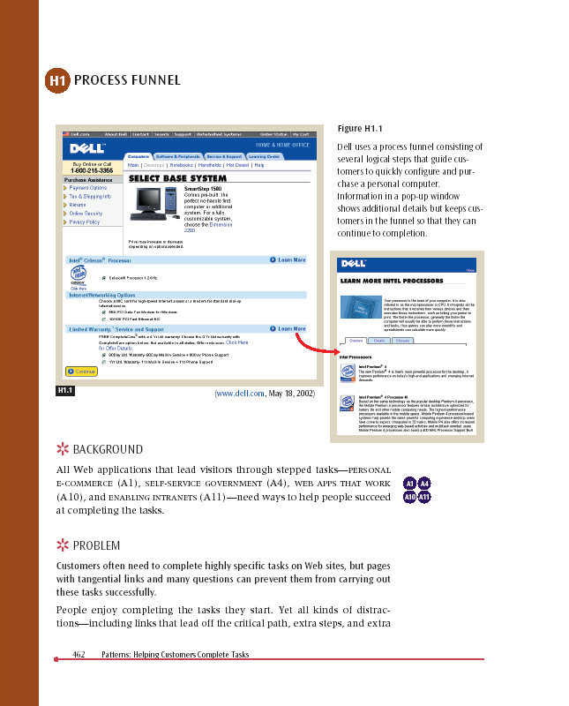
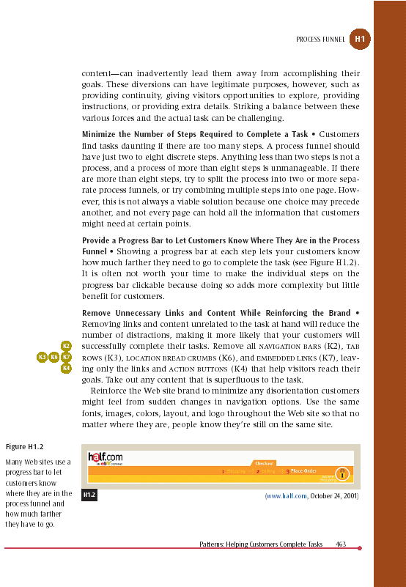
Pattern Name and Number
Exemplar
Forces &
Solution
Background
Problem Statement

Slide 67
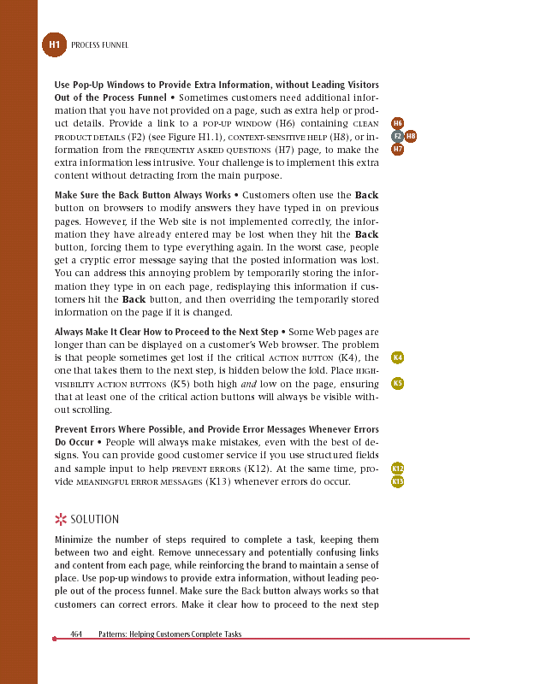
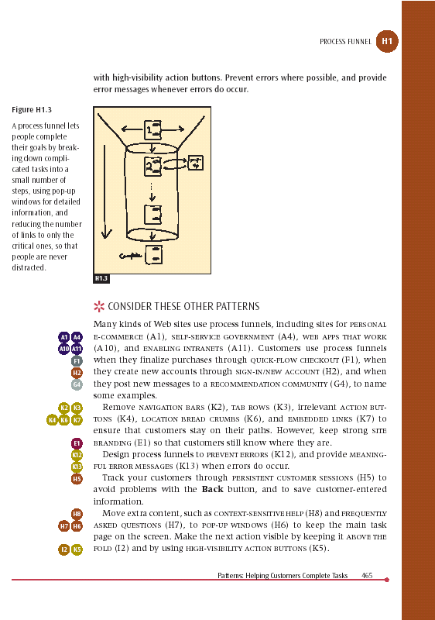
Bus Stops
Solution
Diagram
Related
Patterns
Solution
Summary

Slide 68
Administrivia
Final assignments online later today
Project Questions?
Project Fair Questions?
Exam should be graded by tonight

Slide 69
Quiz
https://goo.gl/forms/oQ2cEv86VjwAcpZ42
Notes:
5 min quiz – took 58 minutes to get here

Slide 70
team break
(20 minutes)
work on midway milestone presentations

Slide 71
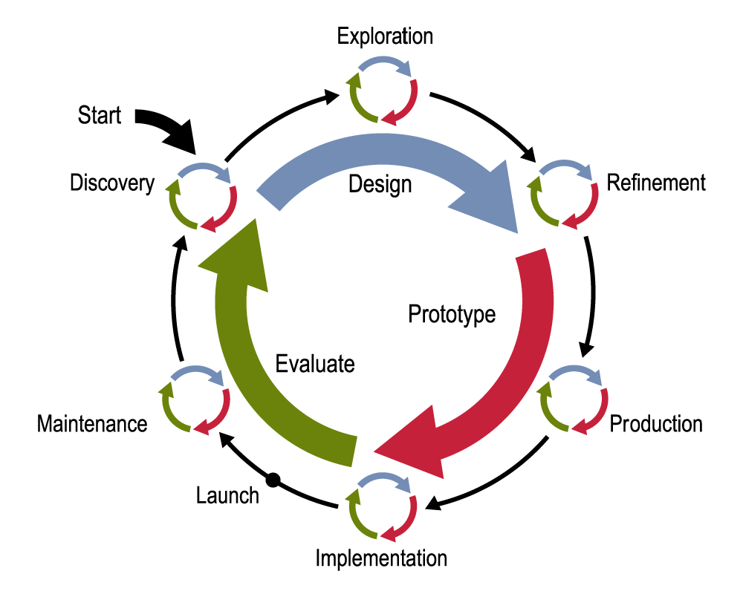
Web Design Process

Slide 72
Patterns in Exploration Phase
Use Exploration-level patterns to design overall structure
  different choices will give radically different designs
For example, how to organize information
  HIERARCHICAL ORGANIZATION (B3)
  TASK-BASED ORGANIZATION (B4)
  ALPHABETICAL ORGANIZATION (B5)
  …

Slide 73
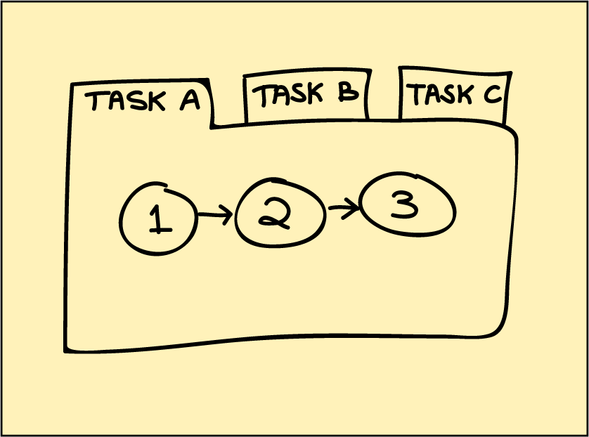
Patterns in Exploration Phase
TASK-BASED ORGANIZATION (B4): Link the completion of one group of tasks to the beginning of the next related task(s)

Slide 74
Design Exploration Example
John given the task of designing a new subsite for showing maps to businesses
  listings found by typing in address
  key feature: show nearby businesses
John comes up with two design sketches
  Design #1 uses ALPHABETICAL ORGANIZATION (B5) for list of all nearby businesses
  Design #2 uses TASK-BASED ORGANIZATION (B4) for list of related nearby businesses
Notes:
15 minutes

Slide 75
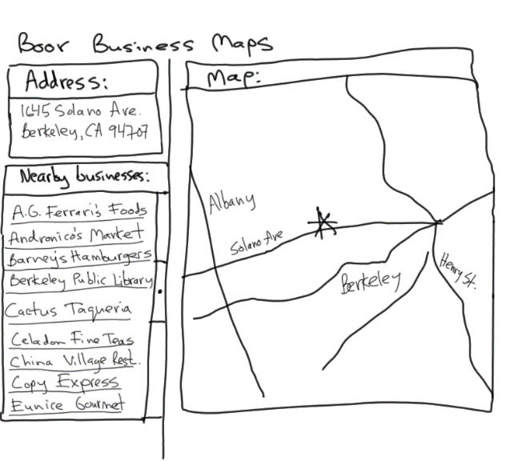
Design #1
ALPHABETICAL ORGANIZATION (B5)

Slide 76
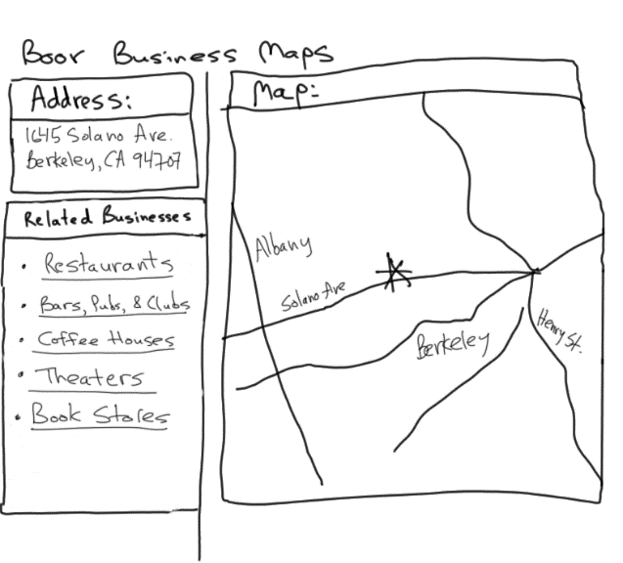
Design #2
TASK-BASED ORGANIZATION (B4)

Slide 77
Evaluating Which Design to Choose
Low-fidelity Usability Test
  sketches the rest of the key screens on paper
  brings in 5 participants to his office
  asks each to carry out 3 tasks while John’s colleague Sam “plays computer”
  John observes how they perform
Tasks
  look up 1645 Solano Ave., Berkeley CA
  look up 1700 California Ave, San Francisco CA & find Tadich Grill
  look up 2106 N 55th St, Seattle WA & find a Sushi restaurant nearby
Notes:
15 minutes

Slide 78
Evaluating Which Design to Choose
Results with Design #1 (Alphabetical)
  Task 1: look up 1645 Solano Ave
    no difficulties encountered – warm-up task!
  Task 2: look up 1700 California &
  find Tadich Grill
    several users didn’t notice that the list of nearby businesses was scrollable (due to paper affordances?)
    those that scrolled took awhile to find in list of over 500
  Task 3: look up 2106 55th St & find nearby Sushi restaurant
    3 users only picked restaurants that had “restaurant” in the name & thus couldn’t find “Kisaku”
Notes:
15 minutes

Slide 79
Evaluating Which Design to Choose
Results with Design #2 (Task-based)
  Task 1: look up 1645 Solano Ave
    no difficulties encountered – warm-up task!
  Task 2: look up 1700 California & find Tadich Grill
    1 user took awhile to figure out that Tadich Grill was a restaurant & to click on the “Restaurants” link
    all others found it in 2 clicks (Restaurants->Tadich Grill)
  Task 3: look up 2106 55th St & find nearby Sushi restaurant
    3 found “Kisaku” in 2 clicks
    2 others asked for a listing of Japanese restaurants
Notes:
15 minutes

Slide 80
Evaluating Which Design to Choose
General comments
  2 users said they often want to email/SMS maps to friends who they will be meeting (task-based)
  3 users wanted driving directions (task-based)
→ TASK-BASED ORGANIZATION (B4) worked better, but still had some minor problems
Notes:
15 minutes

Slide 81
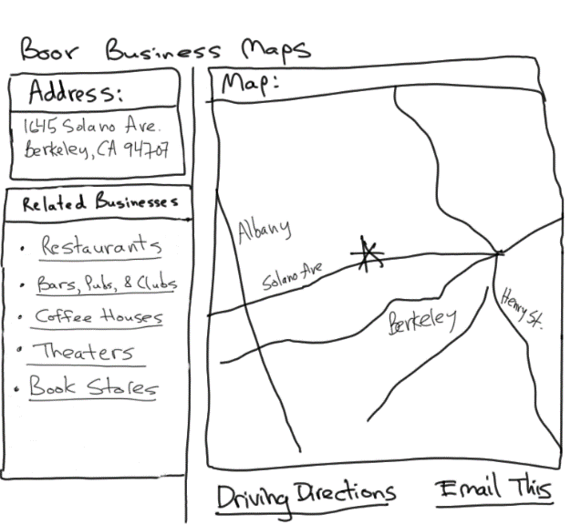
Design #2 – Revision 1
Adding More Related Tasks

Slide 82
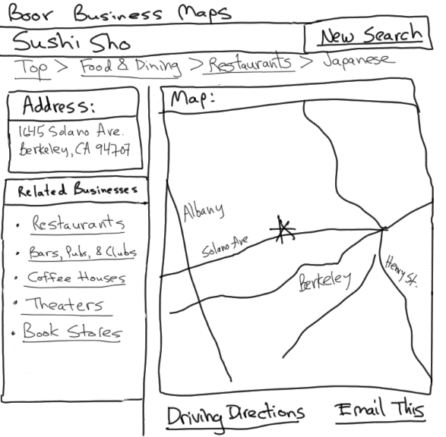
Design #2 – Revision 2
Adding HIERARCHICAL ORGANIZATION (B3) & LOCATION BREAD CRUMBS (K6)

Slide 83
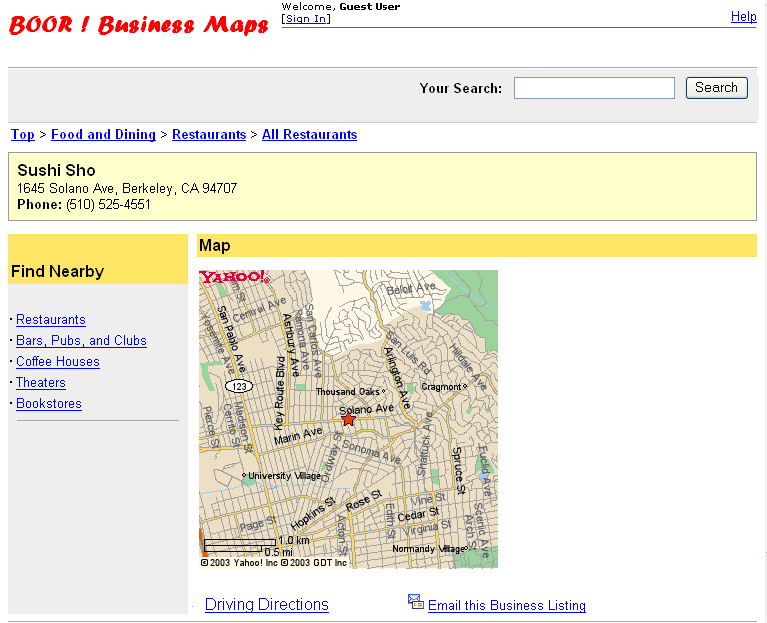
Design #2 – Revision 3 Hi-Fi Prototype
Adding SEARCH ACTION MODULE (J1)

Slide 84
Summary
Lots of issues involved in designing compelling, usable web sites
Design patterns are one way of capturing good design knowledge
  generative (help you create new designs)
  consider trade-offs
  concrete examples of successful uses
  a networked language that works together

Slide 85
Further Reading
Books on Web Design
The Design of Sites. Doug Van Duyne, James Landay, Jason Hong. Addison-Wesley. 2nd edition. 2007.
Information Architecture for the Web and Beyond. Louis Rosenfeld, Peter Morville, Jorge Arango. O'Reilly. 4th edition. 2015
Don’t Make Me Think!, Revisited. Steven Krug. Que. 3rd edition. 2014.

Slide 86
Further Reading
Websites on Web Design
UsableWeb.com, links to other usability sites
Usability.gov, for building accessible websites & more
User Interface Engineering, at http://www.uie.com
Mark Hurst’s creativegood.com
Jakob Nielsen’s www.nngroup.com

Slide 87
Next Time
Mon
  Team Work on Project
Wed
  Smart Interfaces for Global Grand Challenges

