Slide 1
CS 147 Course Midterm Review
Design Thinking for User Experience Design, Prototyping & Evaluation
November 12, 2018
Notes:
45 minutes including questions at the start

Slide 2
Administrivia
Heuristic Evaluation Grades
  see Piazza tonight or tomorrow (still grading)
React Native Workshop
  Tonight at 7 pm @ Gates 219

Slide 3

Balance
design
technology
Notes:
You need to find a balance between:
design & technology, human-centered approaches & CS approaches
Especially now HCI needs to find a balance between careful controlled experiments of existing technologies or minor tweaks on technology and building major new systems that can solve important world problems.
East: more family centric… west; individualistic… balance

Slide 4





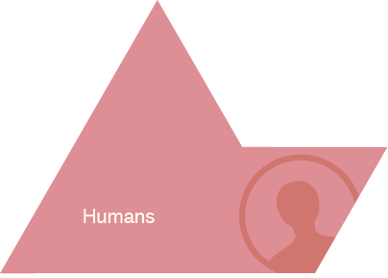
HCI Approach to UX Design
Notes:
Give Examples of Tasks/Activities:
activity:
learning history
high level taskl:
- writing a paper
- drawing a picture
low level task (operation):
- copying a word from one paragraph to another
- coloring a line

Slide 5
How to Design and Build Good UIs
Iterative development process
Usability goals
User-centered design
Design discovery
Rapid prototyping
Evaluation
Programming

Slide 6
Iteration
At every stage!
Design
Prototype
Evaluate
Sketch
Paper
Video
Tool
Program
Gut
Crit
Expert Eval
Lo-fi Test
User Study

Slide 7
Usability/User Experience Goals
Set goals early & later use to measure progress
Goals often have tradeoffs, so prioritize
Example goals(?)
  Learnable
    faster the 2nd time & so on
  Memorable
    from session to session
  Flexible
    multiple ways to do tasks
  Efficient
    perform tasks quickly
  Robust
    minimal error rates
    good feedback so user can recover
  Discoverable
    learn new features over time
  Pleasing
    high user satisfaction
  Fun
Notes:
DO THIS ON THE BOARD!!!

Slide 8
Design Process: Discovery
Assess Needs
understand client’s expectations
determine scope
of project
characteristics of customers & tasks
evaluate existing practices & products
Discovery
Design Exploration
Design Refinement
Production

Slide 9
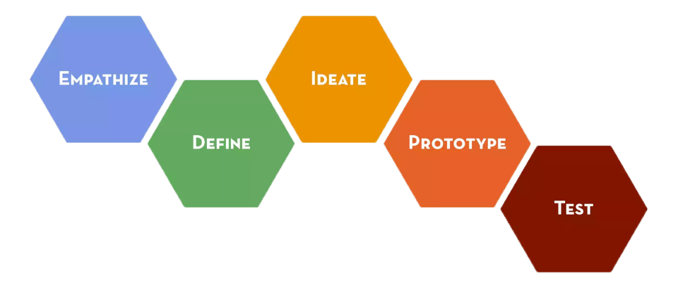
Design Thinking Process
Notes:
We will organize our work in CS147 with the Design Thinking Process popularized by ideo and the Stanford d.school

Slide 10
User-centered Design
“Know thy User”
Cognitive abilities
  perception (e.g., color)
  physical manipulation
  memory
  Fitts’ Law, MHP: processors? cycle & decay times?
Organizational / educational job abilities
Keep users involved throughout
  developers working with target customers
  think of the world in users terms
Notes:
`

Slide 11
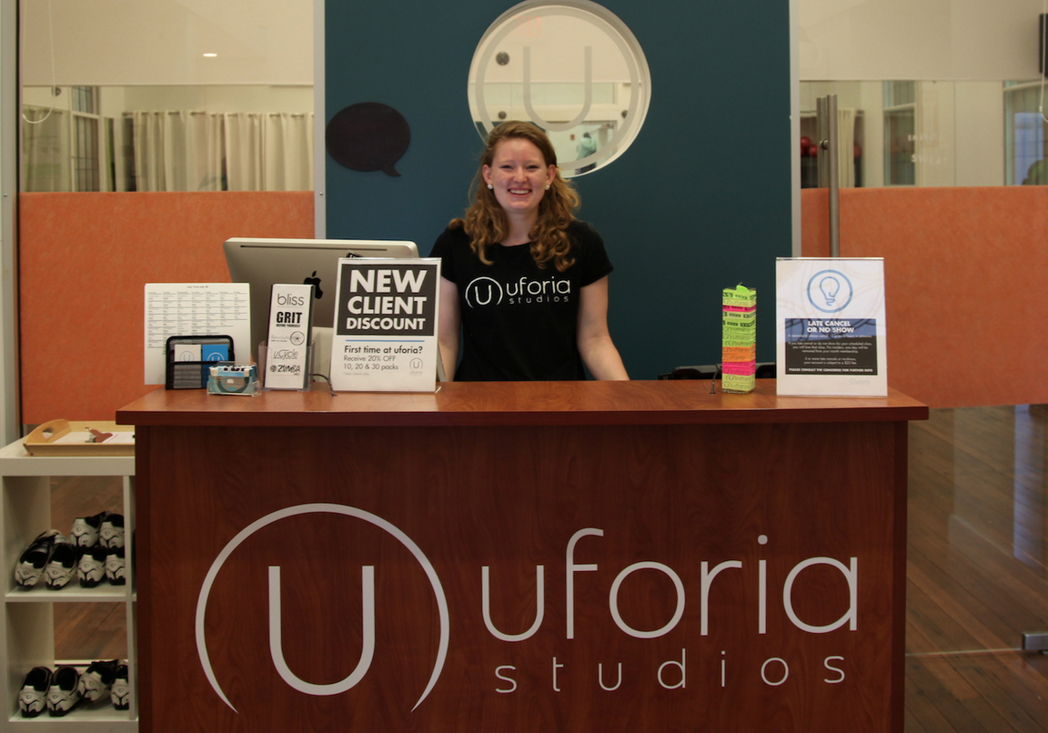
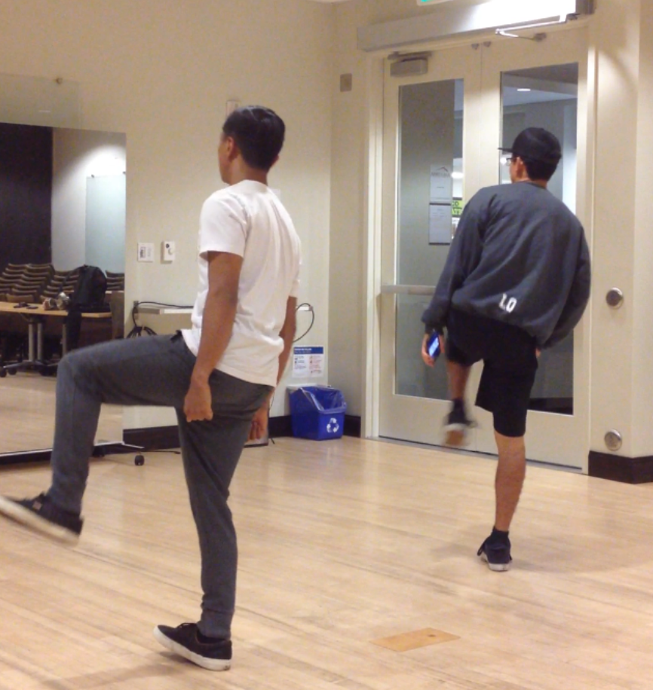
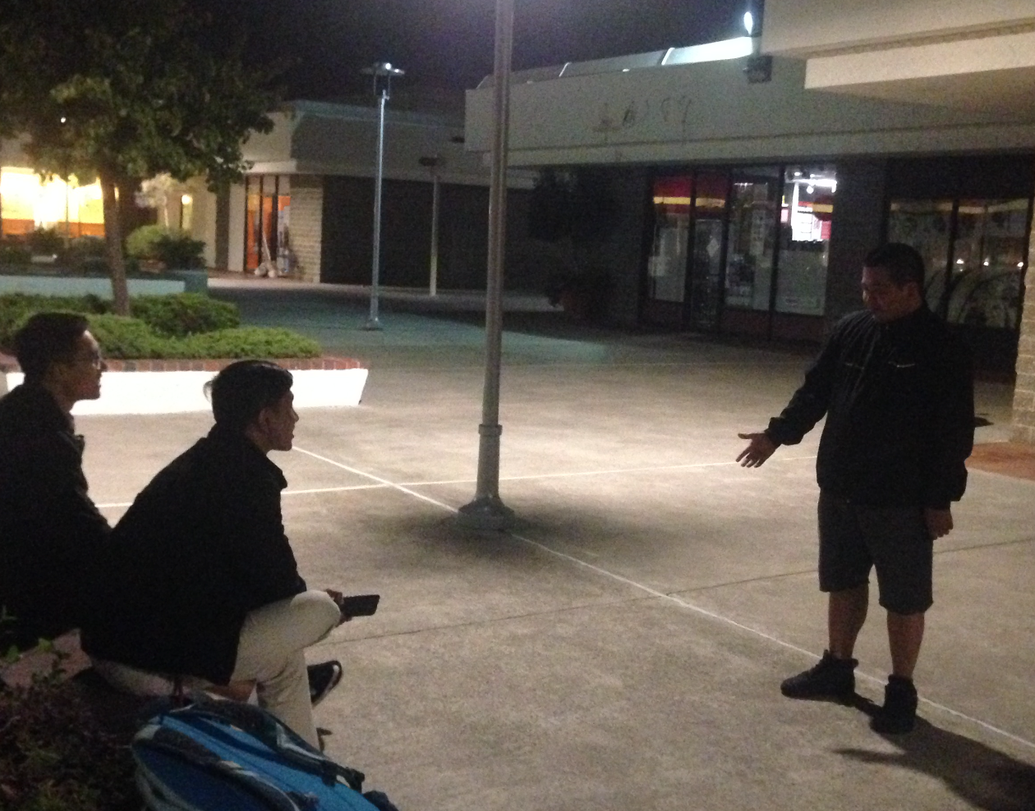
Design Discovery
Needfinding & Task Analysis
Observe existing practices for inspiration
Make sure key questions answered
Ethical questions in design w/ underserved communities
ChoreoLab observed/interviewed dancers in studios…. and out in the streets ...

Slide 12
Reframing the Problem as a Point of View
WE MET . . .
(user you are inspired by)
WE WERE AMAZED TO REALIZE . . .
(what did you learn that’s new? Insight – verb reflecting user need)
IT WOULD BE GAME-CHANGING TO . . .
(Synthesized statement to leverage in designing solution.
NOT just a reason for the need! NOT a solution )
Notes:
Focus your work by writing a Point of View. Three straight-forward sentences.
We use the user, their need, and the insight to write the Point of View.
(We met): “What specific person did you meet that inspires your work?”
(We were amazed to realize:) “This is your insight. Tell us something we didn’t know or wouldn’t have thought about before we started this project. What unique new perspective do you have now?”
(A game-changer would be to:) “This is your call to action. Build on your insight and take an aspirational stance on what you can do as a team. This isn’t your solution -- it is the problem to be solved. A problem with a more informed perspective.”
As a test, a good point of view (POV) is one that: • Provides focus and frames the problem • Inspires your team • Provides a reference for evaluating competing ideas • Empowers your team to make decisions independently in parallel • Fuels brainstorms by suggesting “how might we” statements • Captures the hearts and minds of people you meet • Saves you from the impossible task of developing concepts that are all things to all people • Is something you revisit and reformulate as you learn by doing • Guides your innovation efforts

Slide 13
Ideate: From POV to How Might We
POV: We met Janice, a harried mother of 3, rushing through the airport only to wait hours at the gate. We were surprised at the many games she makes up to to entertain her children so they don’t irritate frustrated fellow passengers. It would be game changing to bring the other passengers and the airport facilities into helping families have a better travel experience.
How Might We Generators http://dschool.stanford.edu/wp-content/uploads/2012/05/HMW-METHODCARD.pdf
  Break POV into pieces
  Amp up the good/Remove the bad
  Explore the opposite
  Question an assumption
  Go after adjectives
  Identify unexpected resources
  Create an analogy from need or context
  Change a status quo
Notes:
Use these to generate HMW
5 minutes and report out

Slide 14
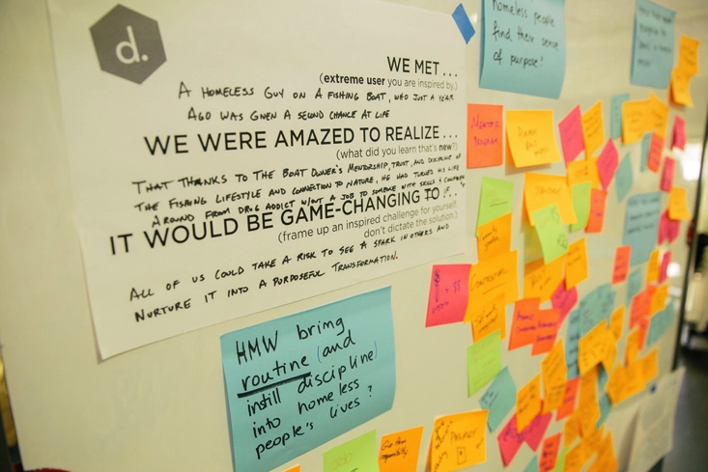
Brainstorm: “How Might We’s” → Solutions
Notes:
We met a homeless guy on a fishing boat, who just a year ago was given a second chance at life
We were amazed to realize that thanks to the boat owner’s mentorship, trust, and display of the fishing lifestyle and connection to nature, he has turned around his life from drug addict without a job to someone with success and compassion
It would be game-changing if all of us could take a risk to see a spark in others and nurture it into a purposeful transformation.

Slide 15
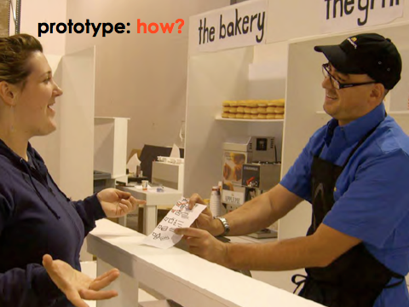
EXPERIENCE PROTOTYPE
INTERACTS LIKE
Notes:
So how can we get from all the ideas we generated in our brainstorm to making a prototype that helps us learn from users
You can prototype what something INTERACTS like.
[ADVANCE]
We also call these EXPERIENCE prototypes. In these, we test how users interact with our ideas– what they think and how they feel during that experience.
This is a picture of a team testing a new fast food counter concept. They are actually letting the users experience the process the team has developed.
Don’t just tell users about an idea that you have—a prototype is an opportunity for you to create an experience for your user.
You get to observe how the user acts, and also ask them about the experience they had.
Let the user react to something they are doing, rather than just intellectually judging something you describe.

Slide 16
Design Process: Exploration
Expand Design Space
brainstorming
sketching
storyboarding
prototyping
Discovery
Design Exploration
Design Refinement
Production
Notes:
Expand design space:
brainstorming, sketching, storyboarding, prototyping

Slide 17
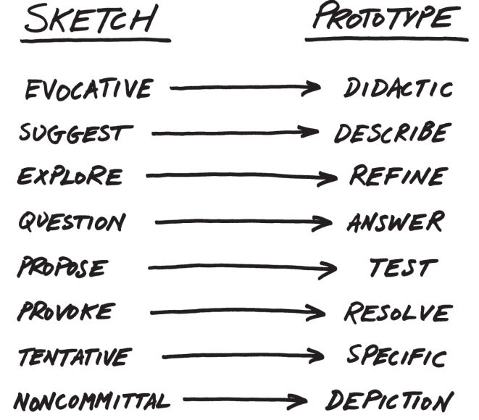
From Sketch to Prototype
Difference in intent rather than in form
Courtesy Bill Buxton
Notes:
This is a continuum, not an either/or proposition
[ADVANCE SLIDES]
The difference between the two is as much a contrast of purpose, or intent, as it is a contrast in form

Slide 18
Design Exploration Summary
Sketching allows exploration of many concepts in the very early stages of design
As investment goes up, need to use more and more formal criteria for evaluation
Experience prototyping lets us quickly try many ideas & learn more about the problem & solution space (prototype to learn)

Slide 19
Concept Videos
Illustrate context of use rather than specific UI
Quick to build
Inexpensive
Forces designers to consider details of how users will react to the design
More important when context is not traditional work scenario

Slide 20
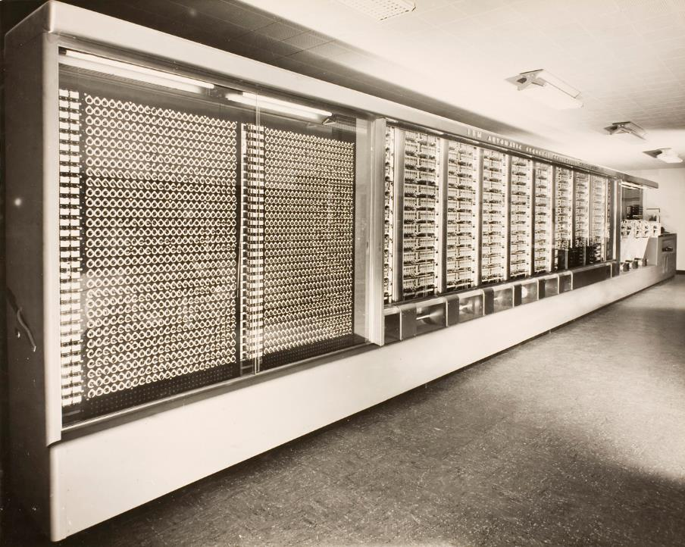
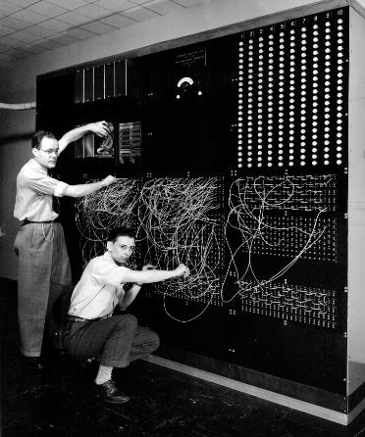
Computing in 1945
Harvard Mark I: 55 feet long, 8 feet high, 5 tons
http://sites.harvard.edu/~chsi/markone/images/Mark1HousingSmall.jpg
Notes:
Let’s set the Context. Computing in 1945
This was the STATE OF THE ART!
[ADVANCE]
This is how you programmed it
Picture from http://piano.dsi.uminho.pt/museuv/indexmark.htm

Slide 21
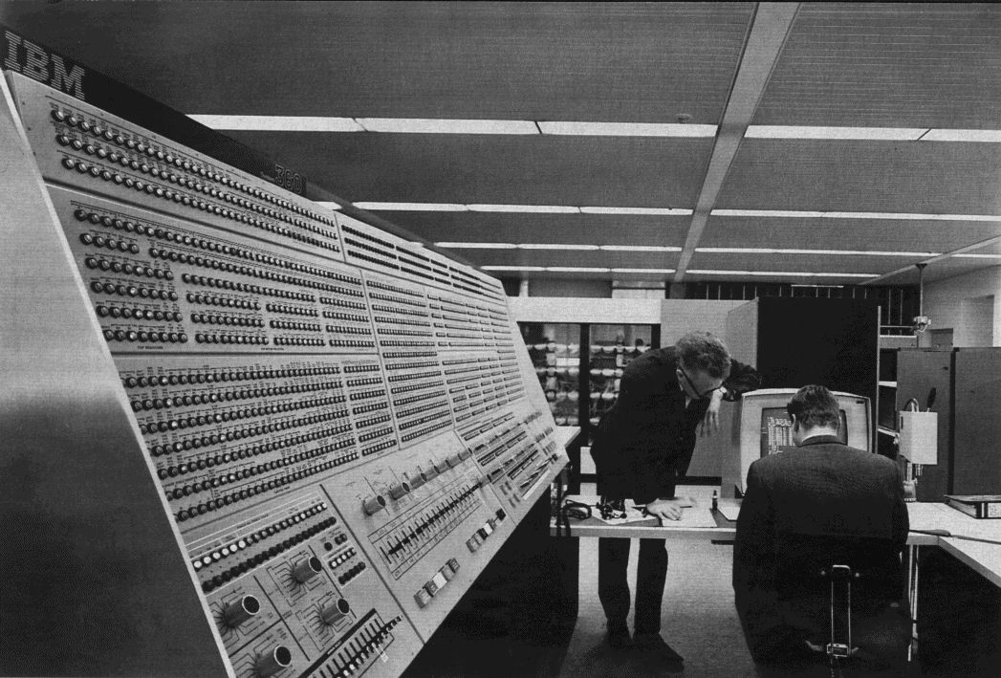
Computing in 1965
IBM System/360
360-91-panel. Licensed under Public Domain via Wikimedia Commons.
Notes:
This bigger model 360/91 at NASA a few years later had a much larger control panel and a CRT display (just text!)
the computer of the 1940s, 50s, and 60s, was essentially for manipulating math
A few pioneers had a different vision.

Slide 22
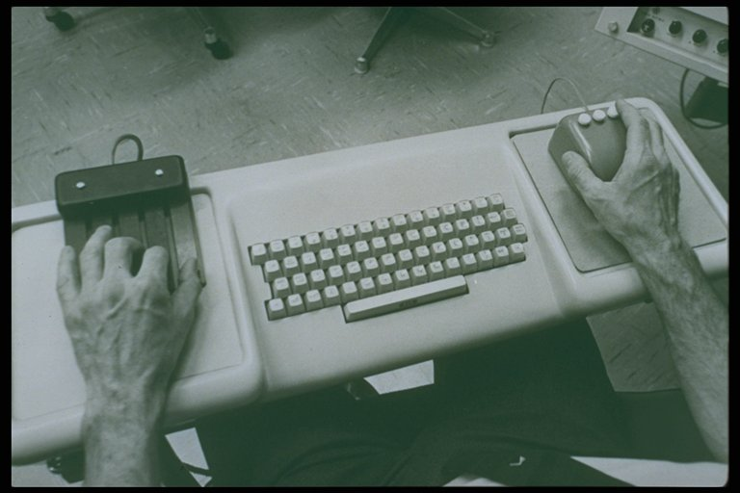
Augmenting Human Intellect – Engelbart (1968)
The NLS Hardware
Notes:
NLS was for expert use! (two hands working at once!)
1:45 sec video

Slide 23
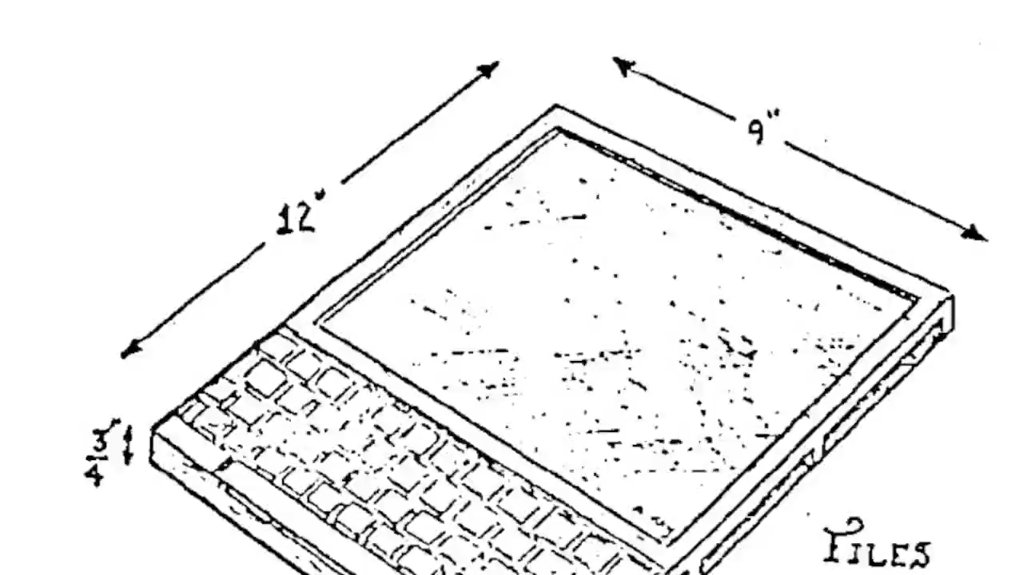
Dynabook – Kay (1974)
Notes:
What does it look like that you are familiar with today?
Invented 1968, over 40 years before the iPad, but wasn’t realizable
1:15 video

Slide 24
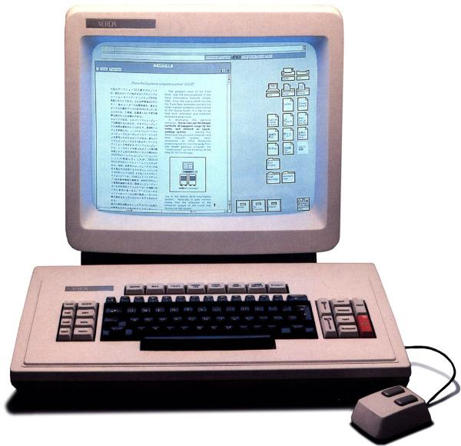
Xerox Star – 1st Commercial GUI (1981)
Notes:
The key computer that led to the Apple Macintosh in 1984 (Jobs saw the Alto – prototype of the Star)
Invented:
Icons
WYSIWYG (with bitmapped display)
Dragging icons to cause actions
1:30 sec video

Slide 25
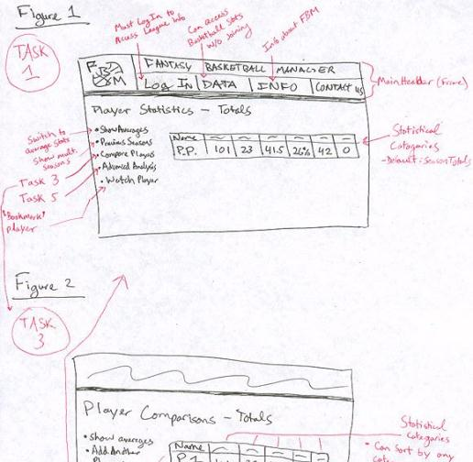
Rapid Prototyping
Fantasy Basketball
Build a mock-up of a design so
you can test it
Low fidelity techniques
  paper sketches
  cut, copy, paste
  low-fi testing allows us to quickly iterate
  get feedback from users & change right away
Interactive prototyping tools
  SketchFlow, Balsamiq, Axure, proto.io, Marvel, Invision, etc.
UI builders
  Expression Blend + Visual Studio, Xcode Interface Builder, etc.

Slide 26
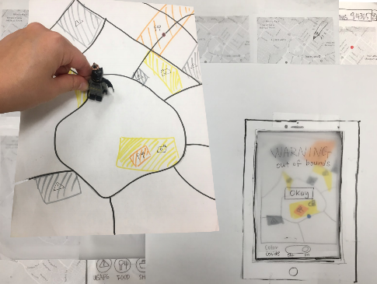
Evaluation
Wanderlust
Test with real customers (participants)
  w/ interactive prototype
  low-fi with paper “computer”
Low-cost techniques
  expert evaluation
  walkthroughs
  online testing
Notes:
All about trying to measure what works and what does not

Slide 27
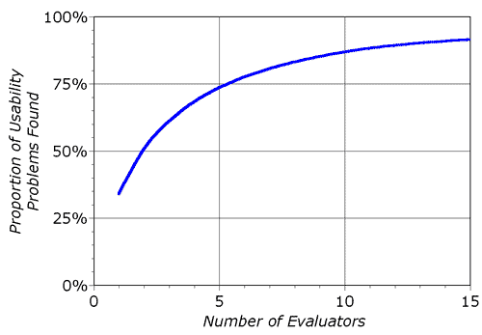
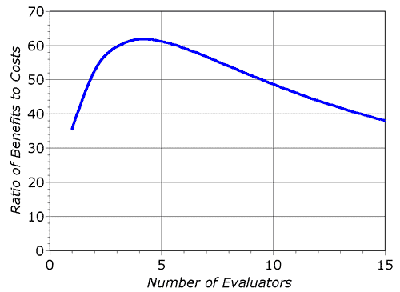
Heuristic Evaluation Decreasing Returns
problems found
benefits / cost
* Caveat: graphs for a specific example

Slide 28
Heuristic Evaluation Summary
Have evaluators go through the UI twice
Ask them to see if it complies with heuristics
  note where it doesn’t & say why
  exact heuristic less important than finding the problem
Combine the findings from 3 to 5 evaluators
Have evaluators independently rate severity
Alternate with user testing

Slide 29


User Testing Data
Process data
  observations of what users are doing & thinking
  qualitative
Bottom-line data
  summary of what happened
    time, errors, success
  i.e., the dependent variables
  quantitative
http://allazollers.com/discovery-research.php
http://www.fusionfarm.com/content/uploads/2012/10/analyzing-data.jpg

Slide 30
User Testing Summary
User testing is important, but takes time/effort
Use ????? tasks & ????? participants
  real tasks & representative participants
Be ethical & treat your participants well
Want to know what people are doing & why? collect
  process data
Bottom line data requires ???? to get statistically reliable results
  more participants
Difference between between & within groups?
  between groups: everyone participates in one condition
  within groups: everyone participates in multiple conditions

Slide 31
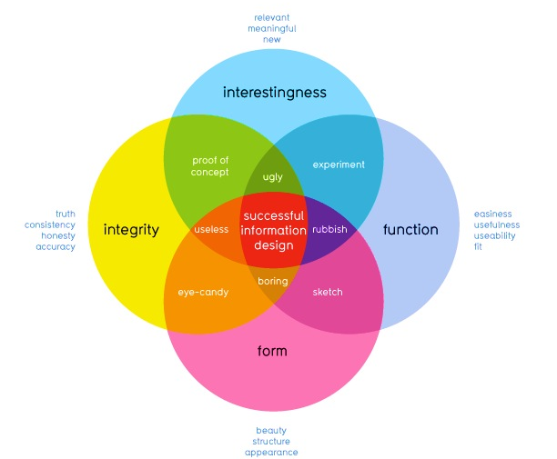
How well does it communicate?
How well does it work?
David McCandless
http://www.informationisbeautiful.net
Notes:
This graphic illustrates what should be balanced to achieve a design that can convey useful information to its observers by creating desire in the information itself.
This middle part (integrity and function) refers to the information itself, whether the data is accurate or useful. Arguably you are all rather talented at this part.
So today Im going to talk about the other two – some guidelines as to how to achieve designs that successfully allow the user to perform such functions without having to force themselves to do so

Slide 32
The Art of Balance
Promotion & demotion of important objects
First Question for any design
What are the most important things?
Information should be prioritized based on its importance to the user
Notes:
I’ve mentioned several times before that good design is about balance – visual design is no exception.
Information should be prioritized based on its importance or relationship to other information
: color, size, position and the other things we have discussed are methods to suggest this.
If we look at objects on a scale of importance, we can decide best how to use those techniques.
Scott Klemmer’s video gave you good examples of how Typography, Layout, and Color give you a good idea of visual hierarchy

Slide 33
Using Proximity to Indicate Relationships
“The whole is greater than the sum of the parts.”
– David Hothersall
Gestalt Psychology in information design
Information blocks should be grouped together if related, but unrelated elements should be located at some distance from each other.
Notes:
The principles of Gestalt psychology are based on the humans’ ability to perceive and generate visual forms.
One of the six Gestalt Principles, “The Proximity principle” is often used in information design.
We can use proximity to describe how elements are related to each other.

Slide 34
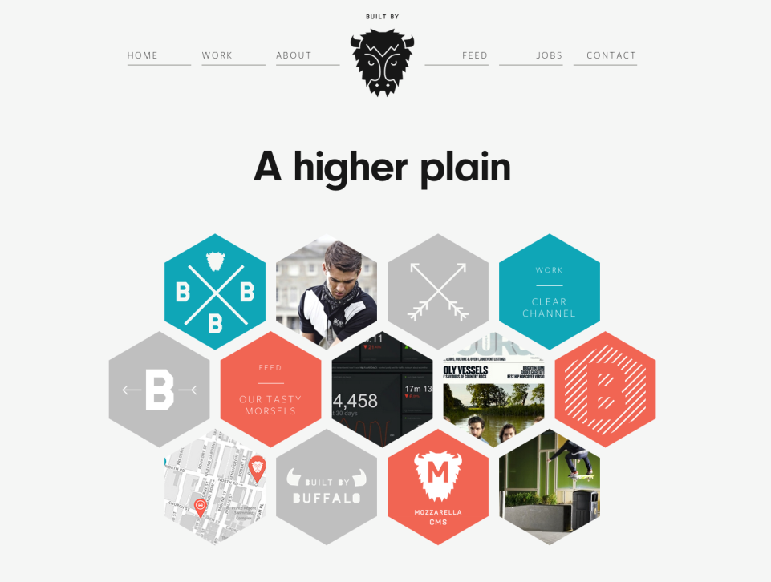
http://builtbybuffalo.com/
White Space = Value
Notes:
Web design provides good examples of the proximity rule where good layouts will organize related items into groups such as seen here with the menu and project elements grouped together.

Slide 35

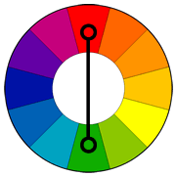
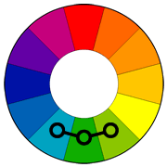
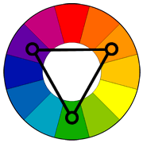
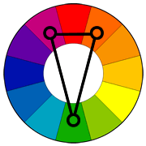
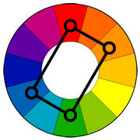
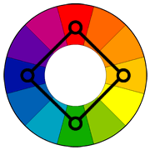
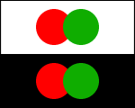
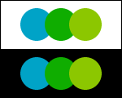
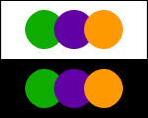
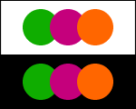
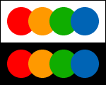
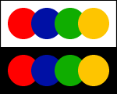
Using Appropriate Color “Harmonies”
Complementary
Analogous
Triad
Split
Complementary
Rectangle
(Tetradic)
Square
Notes:
So how to we pick the right colors?
While my suggestion for beginners is to stick to one color or “monochrome” pallets, there is the odd occasion where information must have multiple colors to be distinguishable, such as in graphs. In these cases, Color harmonies are particularly useful. They involve picking a primary color and using a color wheel to determine the best colors to go along with it.
For beginners, I suggest using these two (analogous and split-complimentary) as they are hard to get wrong and tend to work with lots of designs.
see: http://www.tigercolor.com/color-lab/color-theory/color-harmonies.htm

Slide 36
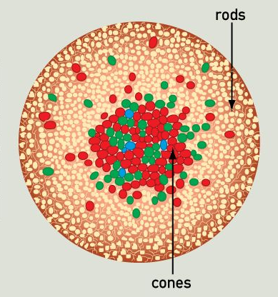
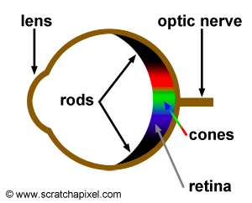
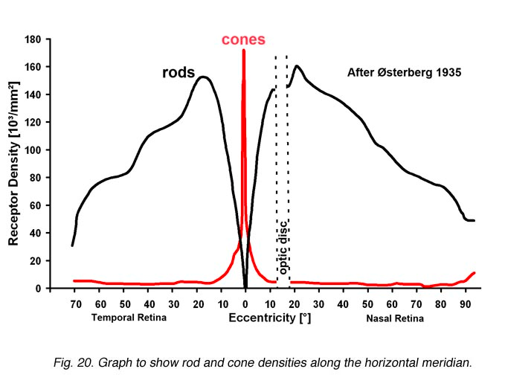
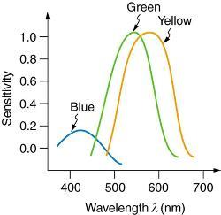
Human Abilities: Retina
Distribution & types of cones in the retina has major impact on our visual abilities
http://www.webexhibits.org/causesofcolor/1G.html
http://webvision.med.utah.edu/imageswv/Ostergr.jpeg

Slide 37
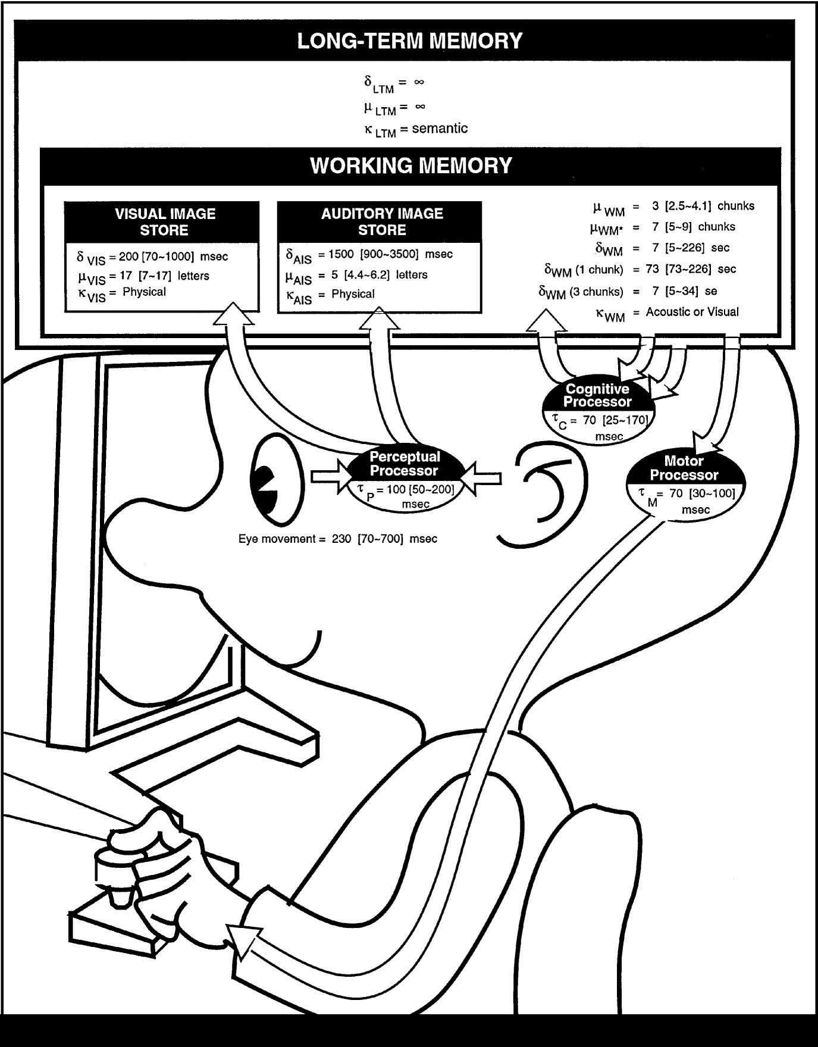
The Model Human Processor
Developed by Card, Moran & Newell (’83)
  based on empirical data
Basic model underlies other HCI techniques
Allows us to make predictions w/o users
  e.g., GOMS modeling
Know the processors, memories, cycle times, & decay times
  100ms Is a good enough approx. for times
Notes:
We model human performance to test understanding and
To predict the influence of new technology.
This is the classic image form the book “The Psychology of Human-Computer Interaction”

Slide 38
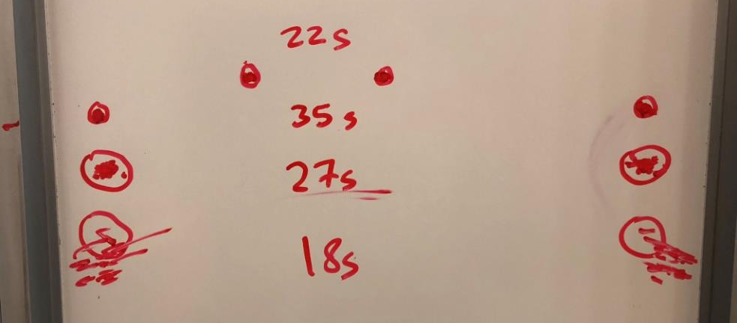
Experimental Results
Task
Quickly tap each target 50 times accurately
Notes:
Draw two circles on the board
both around 1/2 inches in diameter
1) distance of 6 inches
2) Repeat by extending the distance to 24 inches
Ask volunteer to put mark in circle 50 times each quickly, but accurately (outside of circle at most 4 times)
TURN to a partner and discuss what you think will happen and WHY????
ID=Log2(d/w+1) : try easy ID of 4 and hard of ID 8
log2 (13)=3.7
Log2 (49)=5.6
Now try it again with 24 inches but make the target 2 inches wide
3) log2 (13)=3.7
) Now try again asking the person to go as fast as they can independent of accuracy (should get more speed but see spread of circles outside)
Results:
30 sec
48 sec
31 sec (as predicted, almost the same as #1)
21 sec (lots of spread)

Slide 39
Principles of Operation (cont.)
Fitts’ Law
  moving hand is a series of microcorrections
    correction takes Tp + Tc + Tm = 240 msec
  time Tpos to move the hand to target size S,
  which is distance D away is given by:
    Tpos = a + b log2 (D/S + 1)
  summary
    time to move the hand depends only on the relative precision required
Notes:
Understand both D/S and relative position.

Slide 40
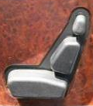
Conceptual Models
Conceptual model?
  mental representation of how the object works & how interface controls effect it
Design model should equal customer’s model?
  mismatches lead to errors
Design guides?
  use customer’s likely conceptual model to design
  make things visible
  map interface controls to customer’s model
  provide feedback
Design Model
Customer Model
System Image

Slide 41
QUESTIONS?

