Slide 1
Conceptual Models &
Interface Metaphors
November 7, 2018
Notes:
60 min+15 min team break + 35 min after (exactly on time)

Slide 2

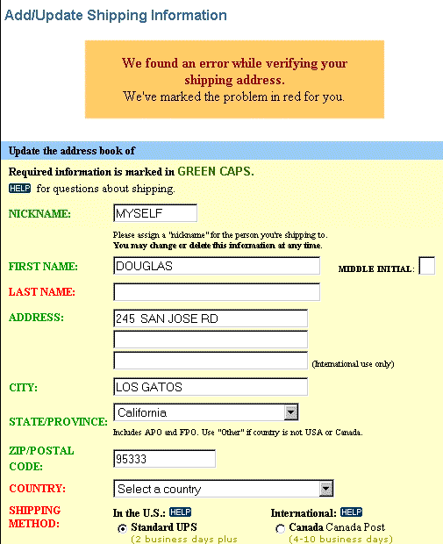
Hall of Fame or Shame?
Design based on a top retailer’s site

Slide 3

Hall of Shame!
Design based on a top retailer’s site
Color deficiency
  can’t distinguish between red & green
In study, user could not get by this screen!
How to fix?
  redundant cues

Slide 4
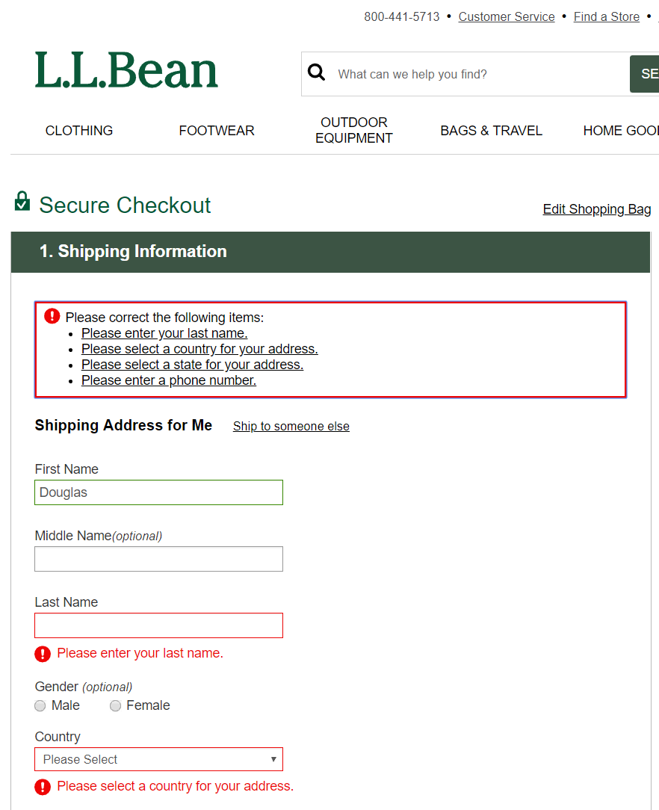
A Better Design
Instructions at the top for all errors
Redundant exclamation icons
Changed color on boxes around input fields with errors
Instructions on what to fix near each error

Slide 5
Hall of Fame or Shame?
M-Pesa mobile payments
Common in Africa
http://africanbusinessmagazine.com/wordpress/wp-content/uploads/2014/07/mobile-payment.png
http://blog.unibulmerchantservices.com/m-pesa-by-the-numbers/
Notes:
64% of Nigerians do not have a bank account
Over 80% have a mobile phone

Slide 6
Hall of Fame or Shame?
M-Pesa mobile payments
Common in Africa
http://africanbusinessmagazine.com/wordpress/wp-content/uploads/2014/07/mobile-payment.png
Notes:
64% of Nigerians do not have a bank account
Over 80% have a mobile phone

Slide 7

Hall of Fame or Shame?
M-Pesa mobile payments
Common in Africa
Simple UI, but brings banking services to the unbanked!
http://africanbusinessmagazine.com/wordpress/wp-content/uploads/2014/07/mobile-payment.png
http://blog.unibulmerchantservices.com/m-pesa-by-the-numbers/
Notes:
64% of Nigerians do not have a bank account
Over 80% have a mobile phone

Slide 8
Conceptual Models &
Interface Metaphors
November 7, 2018

Slide 9
Outline
Design of Everyday Things
Conceptual models
Team break
Design guides for conceptual models
Interface metaphors
UI consistency

Slide 10
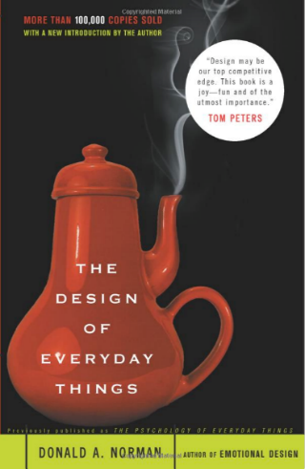
Design of Everyday Things
By Don Norman
  UCSD, Apple, HP, NN Group, NU, UCSD
Design of everyday objects illustrates problems faced by designers of systems
Explains conceptual models
  doors, washing machines, digital watches, & phones
Resulting design guides
→ Highly recommended
Notes:
This lecture tries to give some of the high level ideas in this book (and the 1st chapter you read gives a taste)

Slide 11
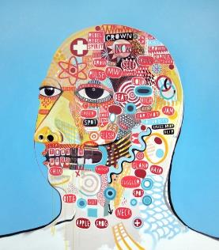
Conceptual Model?
Def. Mental representation of how an artifact works & how interface controls affect it
People may have preconceived models that
are hard to change
  (4 + 5) vs. (4 5 +)
  dragging to trash?
    deletes file but ejects disk
Interface must communicate model
  visually, possibly physically or using sound
David Shillinglaw
Notes:
Also sometimes called a “Mental Model”
Shouldn’t need online help or documentation to communicate the model

Slide 12
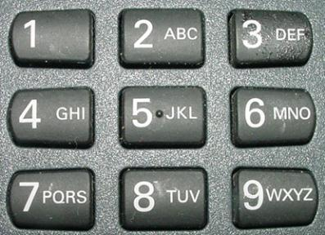

Affordances as Perceptual Clues
Well-designed objects have affordances
  clues to their operation
  often visual, but not always (e.g., speech)
iOS7
iOS7 w/ “button
shapes” accessibility
iOS6
What affordances do you see here?
Notes:
In DOET, affordances are visual. But affordances are more than that. Affordances can be physical or audio
Buttons in IOS… IOS7, iOS7 with “button shapes” accessibility turned on, and iOS6 (from http://blog.teamtreehouse.com/affordances-web-design)
People have now learned it, but still

Slide 13
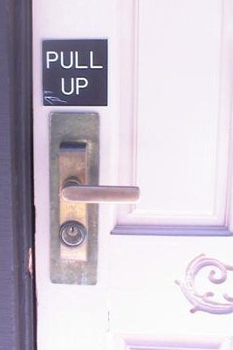
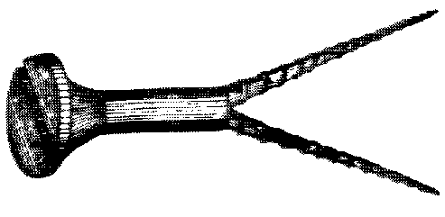
Affordances as Perceptual Clues
Poorly-designed objects
  no clues or misleading clues
French artist Jacques Carelman
Crazy design for a screw punch!
Notes:
misleading

Slide 14
Affordances as Perceptual Clues
Poorly-designed objects
  no clues or misleading clues
http://alistapart.com/article/flat-ui-and-forms
Notes:
What is wrong here?
[ADVANCE]
See how this second one makes it a bit more clear you should type in the box?
[ADVANCE]
See how this last one is even better. The white & the box make it clear what to do.

Slide 15
Refrigerator
freezer
fresh food
Problem: freezer too cold, but fresh food just right

Slide 16
Refrigerator Controls
Normal Settings C and 5
Colder Fresh Food C and 6-7
Coldest Fresh Food B and 8-9
Colder Freezer D and 7-8
Warmer Fresh Food C and 4-1
OFF (both) 0
A B C D E
9 8 7 6 5 4 3 2 1
What is your conceptual model?
Spend 30 sec. drawing a diagram showing your model
  where the cooling units are & how they are controlled
Share with your neighbor
Notes:
Take 30 seconds to draw it & then share with your neighbor

Slide 17
A Common Conceptual Model
A B C D E
cooling
unit
9 8 7 6 5 4 3 2 1
cooling
unit
independent cooling units

Slide 18
Actual Conceptual Model
A B C D E
cooling
unit
9 8 7 6 5 4 3 2 1
Can you fix the problem?
Possible solutions
  make controls map to customer’s model
  make controls map to actual system

Slide 19
Design Model & Customer Model
Design Model
Customer Model
System Image
Customers get model from experience & usage
  through system image
What if the two models don’t match?

Slide 20
Conceptual Model Mismatch
Mismatch between designer’s & customer’s conceptual models leads to…
  slow performance
  errors
  frustration
  ...

Slide 21
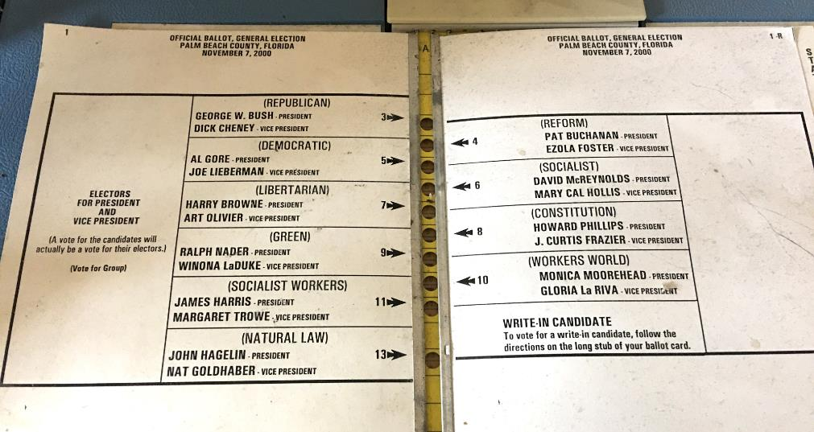
Notorious Example
Notes:
2000 Presidential Election. Palm Beach Florida

Slide 22
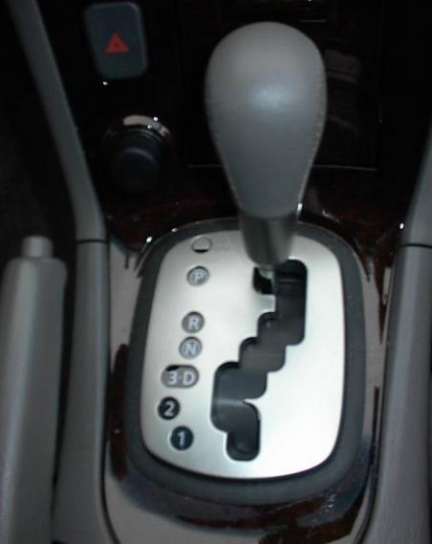
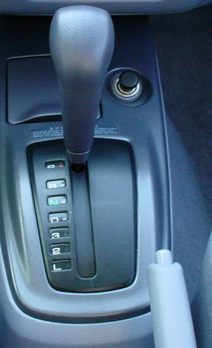
Car Automatic Shifter
Notes:
Image at left seems obvious, but many first time users of this design don’t notice the difference between “3 and D” and in fact put the car in third gear when they mean to put it in Drive.
The more standard gear shift distinguishes these more directly.
On the other hand, the newer design has a more PHYSICAL feedback

Slide 23
Administrivia
Assignment #4 – Concept Video
A4 Slides: ✓-: 0% ✓: 60% ✓+: 40%
A4 Video: ✓-: 14% ✓: 58% ✓+: 28%
Assignment #5 – Lo-fi Prototype & Test
A5 Writeup: ✓-: 2% ✓: 81% ✓+: 16%
A5 Group Presentation: ✓-: 2% ✓: 63% ✓+: 35%
A5 Individual Presentation: ✓-: 0% ✓: 35% ✓+: 65%
Assignment #6 – Medium-fi Prototype
A6 Prototype: ✓-: 2% ✓: 70% ✓+: 28%
A6 Group Slides: ✓-: 2% ✓: 61% ✓+: 37%
Quiz 1
  Average: 4.1/5 points, Median: 4/5 points, Range: 2-5 points, Stdev: .5
Quiz 2
  Average: 4.3/5 points, Median: 5/5 points, Range: 2-5 points, Stdev: .8
Quiz 3
  Average: 3.5/5 points, Median: 4/5 points, Range: 1-5 points, Stdev: .8
Notes:
Got here at 55 min in and took a team break of 15 min

Slide 24
Administrivia
Hi-Fi Prototype Assignment posted by Thursday
  mid-way milestone due on Thur/Fri Nov. 29/30 (at start of studio)
  final prototype due Thur/Fri Dec. 6-7 (at start of studio)
  final presentations at project fair, Fri Dec. 7, d.school, 6-9:30 PM (show starts at 6:30)
Notes:
Got here at 55 min in and took a team break of 15 min

Slide 25
TEAM BREAK
Talk about how to build your hi-fi prototype
Notes:
Broke at 60 min in for 15 min team break

Slide 26
Design Guides
Provide good conceptual model
  customer wants to understand how controls affect object
Make things visible
  if object has function, interface should show it
Map interface controls to customer’s model
  infix vs. postfix calculator – whose model is that?
Provide feedback
  what you see is what you get! (WYSIWYG)
Notes:
Let’s talk about each of these in more detail

Slide 27
Make Things Visible
Refrigerator?
  make the A..E dial something about percentage of cooling between the two compartments?
Controls available on watch w/ 3 buttons?
  too many & they are not visible!

Slide 28
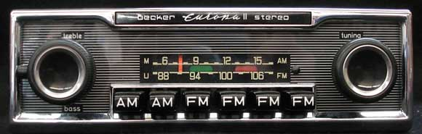
Make Things Visible
http://www.brucesallan.com/wp-content/uploads/2013/03/Becker-Car-Stereo.jpg
Compare to controls on old car radio
  #controls = #functions
  controls are labeled (?) and grouped together
Notes:
Where the term ”radio button” comes from
http://www.brucesallan.com/wp-content/uploads/2013/03/Becker-Car-Stereo.jpg

Slide 29
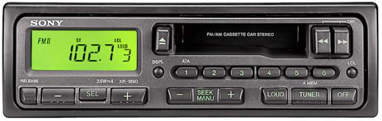
Make Things Visible
Compare to controls on old car radio
  #controls = #functions
  controls are labeled (?) and grouped together
Notes:
Where the term ”radio button” comes from
http://www.brucesallan.com/wp-content/uploads/2013/03/Becker-Car-Stereo.jpg

Slide 30
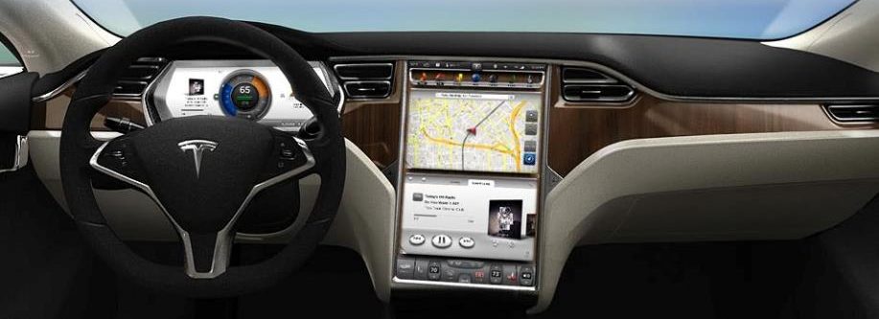
Make Things Visible
Compare to controls on old car radio
  #controls = #functions
  controls are labeled (?) and grouped together
  tradeoffs of the “glass UI” (e.g., Tesla)?
Notes:
Where the term ”radio button” comes from
http://www.brucesallan.com/wp-content/uploads/2013/03/Becker-Car-Stereo.jpg

Slide 31
Map Interface Controls to Customer’s Model
Which is better for car dashboard speaker front / back control?
Control should mirror real-world
Dashboard
1
2

Slide 32
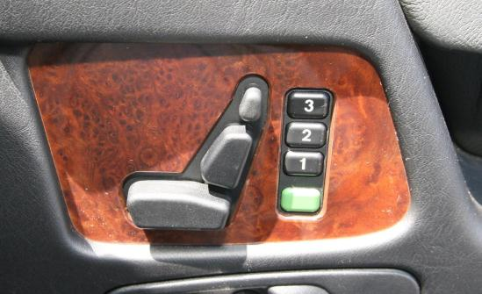
Map Interface Controls to Customer’s Model
Which is better for car dashboard speaker front / back control?
Control should mirror real-world
Mercedes Benz Seat Control

Slide 33
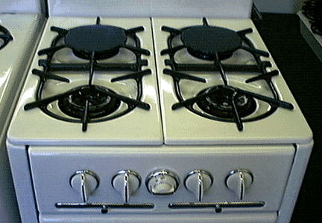
Map Interface Controls to Customer’s Model
Problem?
Which knob controls which burner?

Slide 34
Map Interface Controls to Customer’s Model
Possible fixes?

Slide 35
Metaphor
Definition ?
  “The transference of the relation between one set of objects to another set for the purpose of brief explanation.”
Lakoff & Johnson, Metaphors We Live By
  “...the way we think, what we experience, and what we do every day is very much a matter of metaphor.”
  in our language & thinking – “argument is war”
    … he attacked every weak point
    … criticisms right on target
    … if you use that strategy
We use metaphor in UI design to leverage existing conceptual models

Slide 36
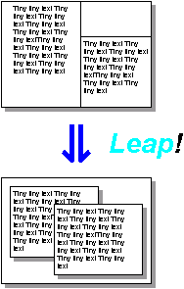
Desktop Metaphor
Suggests a conceptual model
  not really an attempt to simulate a real desktop
  a way to explain why some windows overlapped
  leverages knowledge about files, folders & trash
⇓ Leap!
Notes:
The first image is the windows as invented by Engelbart
When you push a metaphor TOO far is when it gets interesting

Slide 37
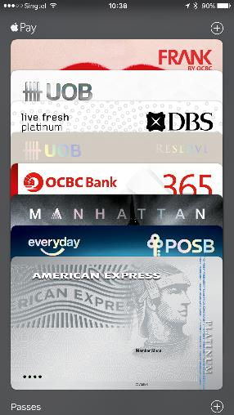
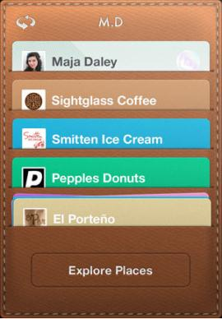
Example Metaphors
Global metaphors
  personal assistant, wallet, clothing, pens,
  cards, telephone, eyeglasses
Data & function
  rolodex, to-do list, calendar, documents,
  find, assist
Collections
  drawers, files, books, newspapers,
  photo albums
Square Card Case

Slide 38
How to Use Metaphor
Develop interface metaphor tied to conceptual model
Communicate that metaphor to the user
Provide high-level task-oriented operations, not low-level implementation commands
Notes:
38
Develop interface metaphor or conceptual model
Communicate that metaphor to the user
Provide high-level task-oriented operations not low-level implementation commands

Slide 39

Avoid Metaphor for Metaphor’s Sake
Skeuomorphism
  “making items resemble their real-world counterparts” or
  “a physical ornament or design on an object made to
  resemble another material or technique”
Argument against: takes up space
& leads to inconsistent look
Argument for: helps people learn
Apple iBooks2
Notes:
39
Pushback on use of metaphor. If it doesn’t help, why have it?
http://blog.tmcnet.com/blog/rich-tehrani/assets_c/2012/01/ibooks-thumb-500x717-10426.png
Why bad? Why good?
Skeuomorphism is the design concept of making items represented resemble their real-world counterparts. Skeuomorphism is commonly used in many design fields, including user interface (UI) and Web design, architecture, ceramics and interior design.
The shutter-click sound emitted by most camera phones when taking a picture is an auditory skeuomorph: it does not come from a mechanical shutter, which camera phones lack, but from a sound file in the phone's operating system.

Slide 40
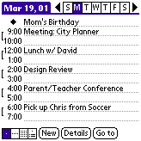
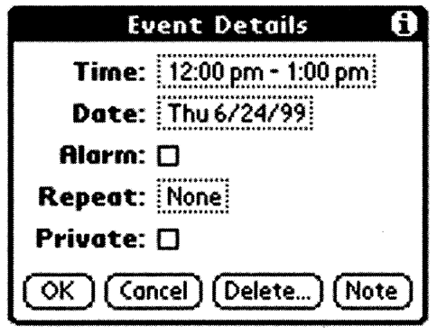
Is Consistent Always Better?
NO
Palm PDA example: should “new appointment” & “delete appointment” be in the same place?
New (add) is common, but delete is not
Notes:
Consistency of having add/delete together always, vs. making it faster for common task

Slide 41
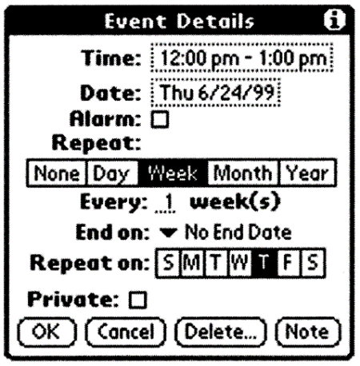

Is Consistent Always Better?
NO
Early Palm design
(like desktop version)
Streamlined design
Notes:
Consistency with desktop (early design) vs. making it better for mobile

Slide 42
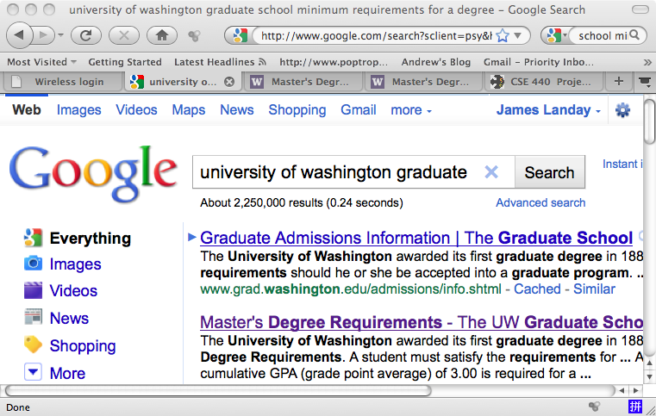
Is Consistent Always Better?
NO
Firefox 3 Back/Forward Buttons
Notes:
Why?

Slide 43
Ways of Being Consistent
Interfaces should be consistent in a meaningful way
  e.g., ubiquitous use of same keys for cut/copy/paste
Types of consistency
  consistent internally
    e.g., same terminology & layout throughout app
  consistent with other apps
    e.g., works like MS Word, uses same keyboard conventions
    design patterns (across many apps)
  consistent with physical world

Slide 44

Summary
Conceptual model?
  mental representation of how the object works & how interface controls effect it
Design model should equal customer’s model?
  mismatches lead to errors
  use customer’s likely conceptual model to design
Design guides?
  make things visible
  map interface controls to customer’s model
  provide feedback
Design Model
Customer Model
System Image

Slide 45
Further Reading
Design of Everyday Things, Donald Norman
Design as Practiced, Donald Norman
  Talks about failure to make changes to Macintosh
  http://www.jnd.org/dn.mss/Design_as_Practiced.html
Computing the Case Against User Interface Consistency, Jonathan Grudin
  Talks about why interfaces should not always be consistent
  http://citeseerx.ist.psu.edu/viewdoc/download?doi=10.1.1.90.6480&rep=rep1&type=pdf

Slide 46
Next Time
Lecture
  Monday: Usability Testing & Midterm Review
  Wednesday: Midterm
Studio
  This week: Group HE (for a grade)
  Next week: project work & feedback

