Slide 1
Early Stage (lo-fi & med-fi) Prototyping
October 17, 2018
Notes:
Ended exactly on time (with 20 min break) and 5 min quiz and start 6 min late due to technical difficulty, so PERFECT number of slides

Slide 2
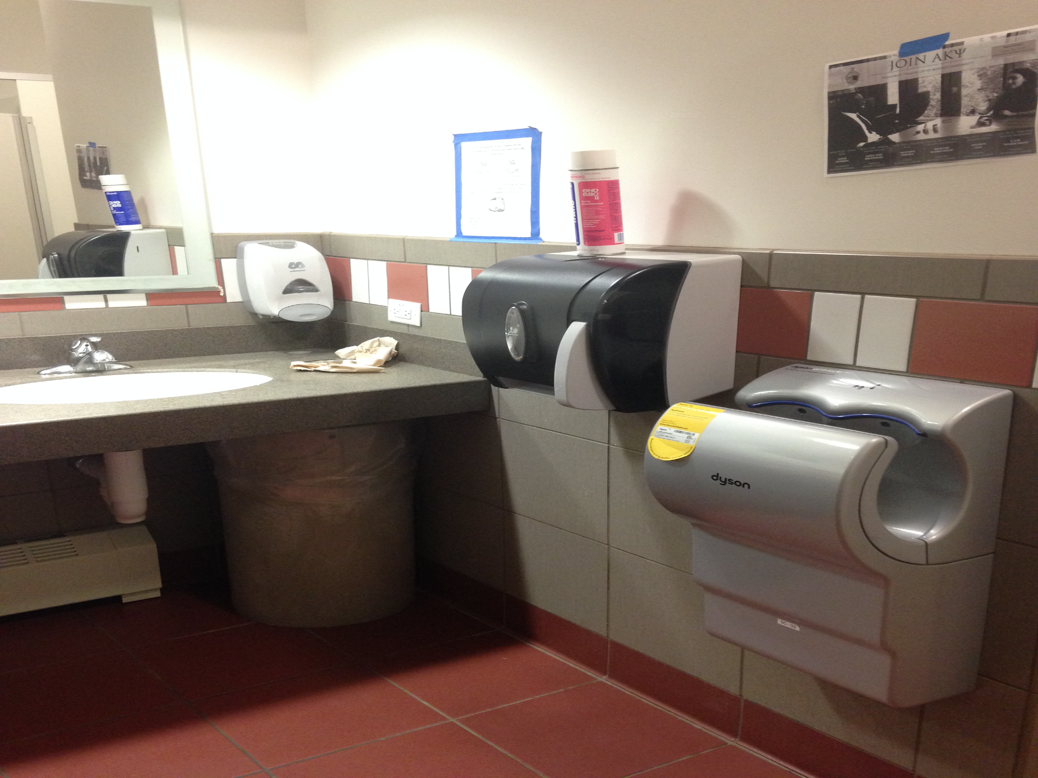
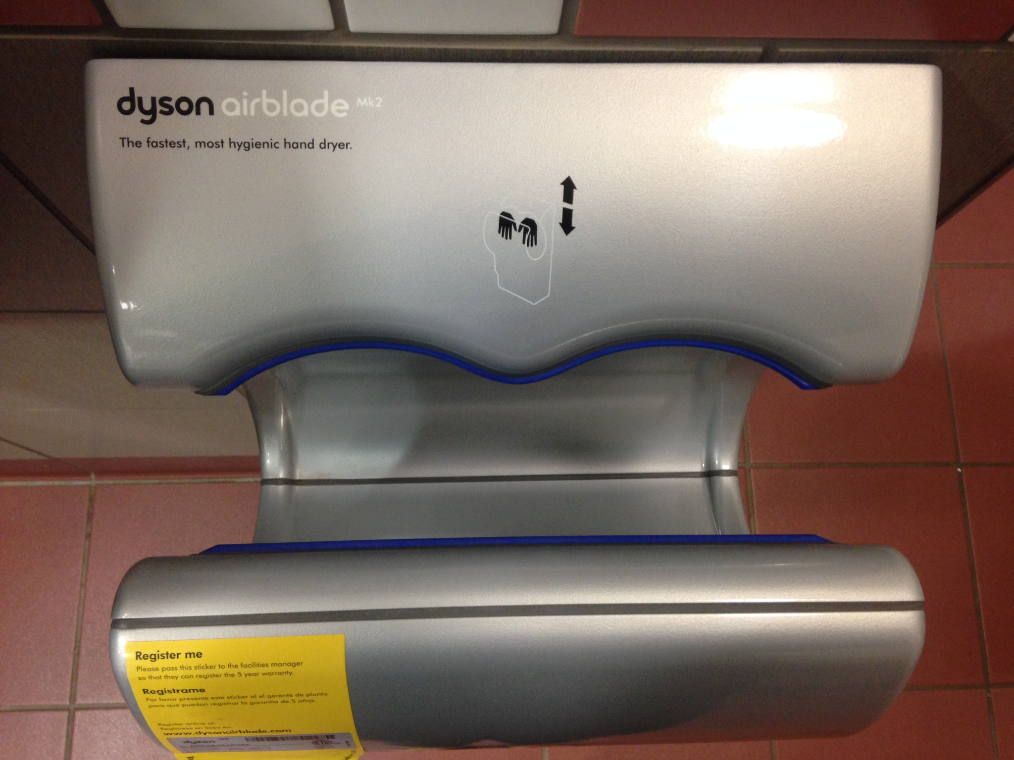
Interface Hall of Fame or Shame?
Dyson AirBlade hand dryer
example courtesy of Maya I.

Slide 3
Interface Hall of Fame or Shame?
Good
shape indicates function
so simple that instructions fit in 1 image
fun!
Bad
dripping water?
too much noise
still takes too long
Dyson AirBlade hand dryer
example courtesy of Maya I.

Slide 4
Interface Hall of Fame!
Good
shape indicates function
so simple that instructions fit in 1 image
fun!
Bad
dripping water?
too much noise
still takes too long
Dyson AirBlade hand dryer
example courtesy of Maya I.

Slide 5
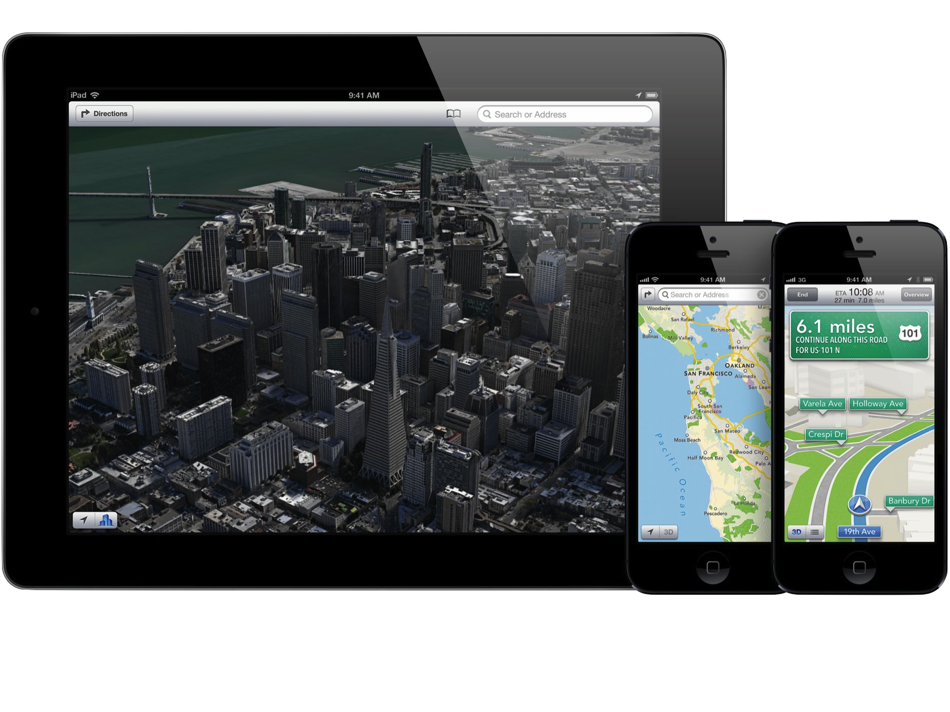
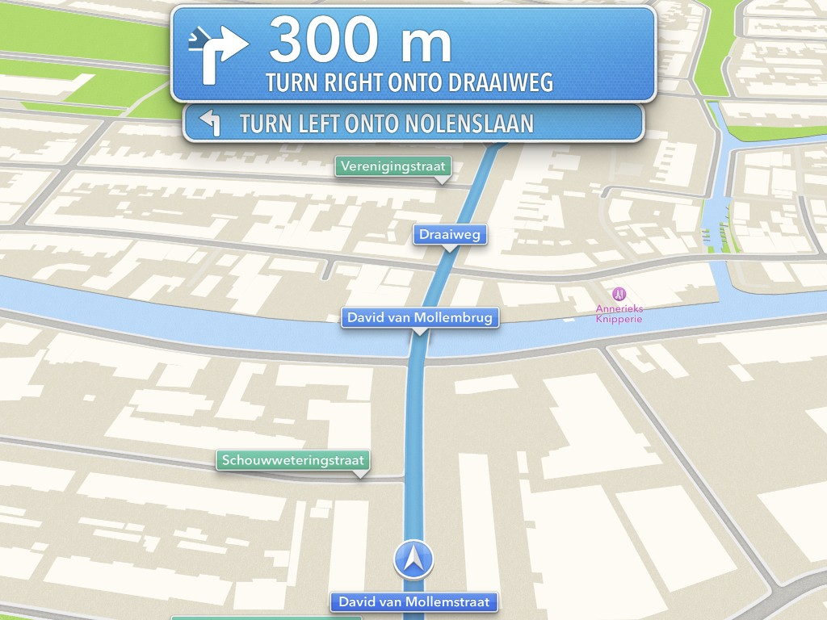
Hall of Fame or Shame?
iOS 6 Maps
By Apple Inc.
Notes:
Beautiful presentation of maps and driving directions
Launched in September of 2012 (5 years ago)
Anyone use it? Why not?

Slide 6
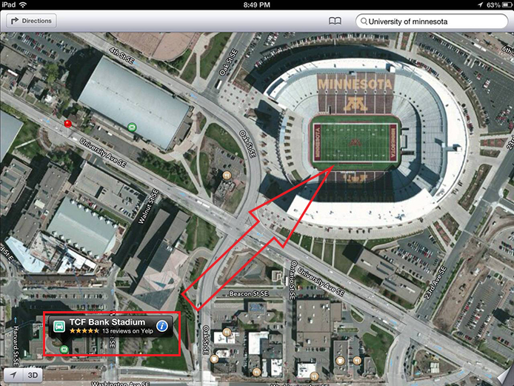
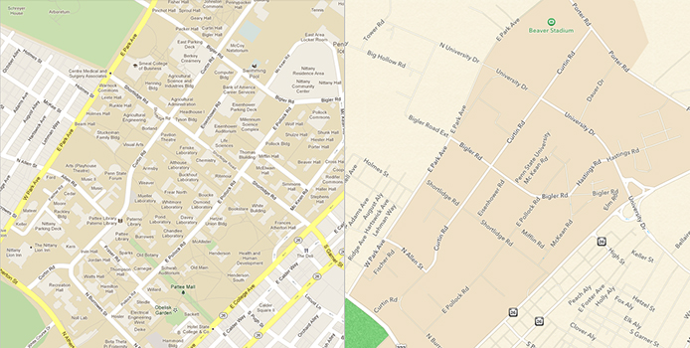
Hall of Shame!
Good
beautiful alternative to the competition & generally easier to read
turn by turn directions are efficient, clear & functions well – in general
Bad
despite any aesthetics, the data is wrong & sparse, meaning, it does not perform the one task it should do well – getting from A to B
iOS 6 Maps
By Apple Inc.

Slide 7
Hall of Shame!
Google Maps Data vs iOS6 Maps Data
Notes:
Penn State campus area…

Slide 8
Hall of Shame!
A clear example of where no matter how good a design may be, without its most important function in this case, correct data, the interface is useless
iOS 6 Maps
By Apple Inc.

Slide 9
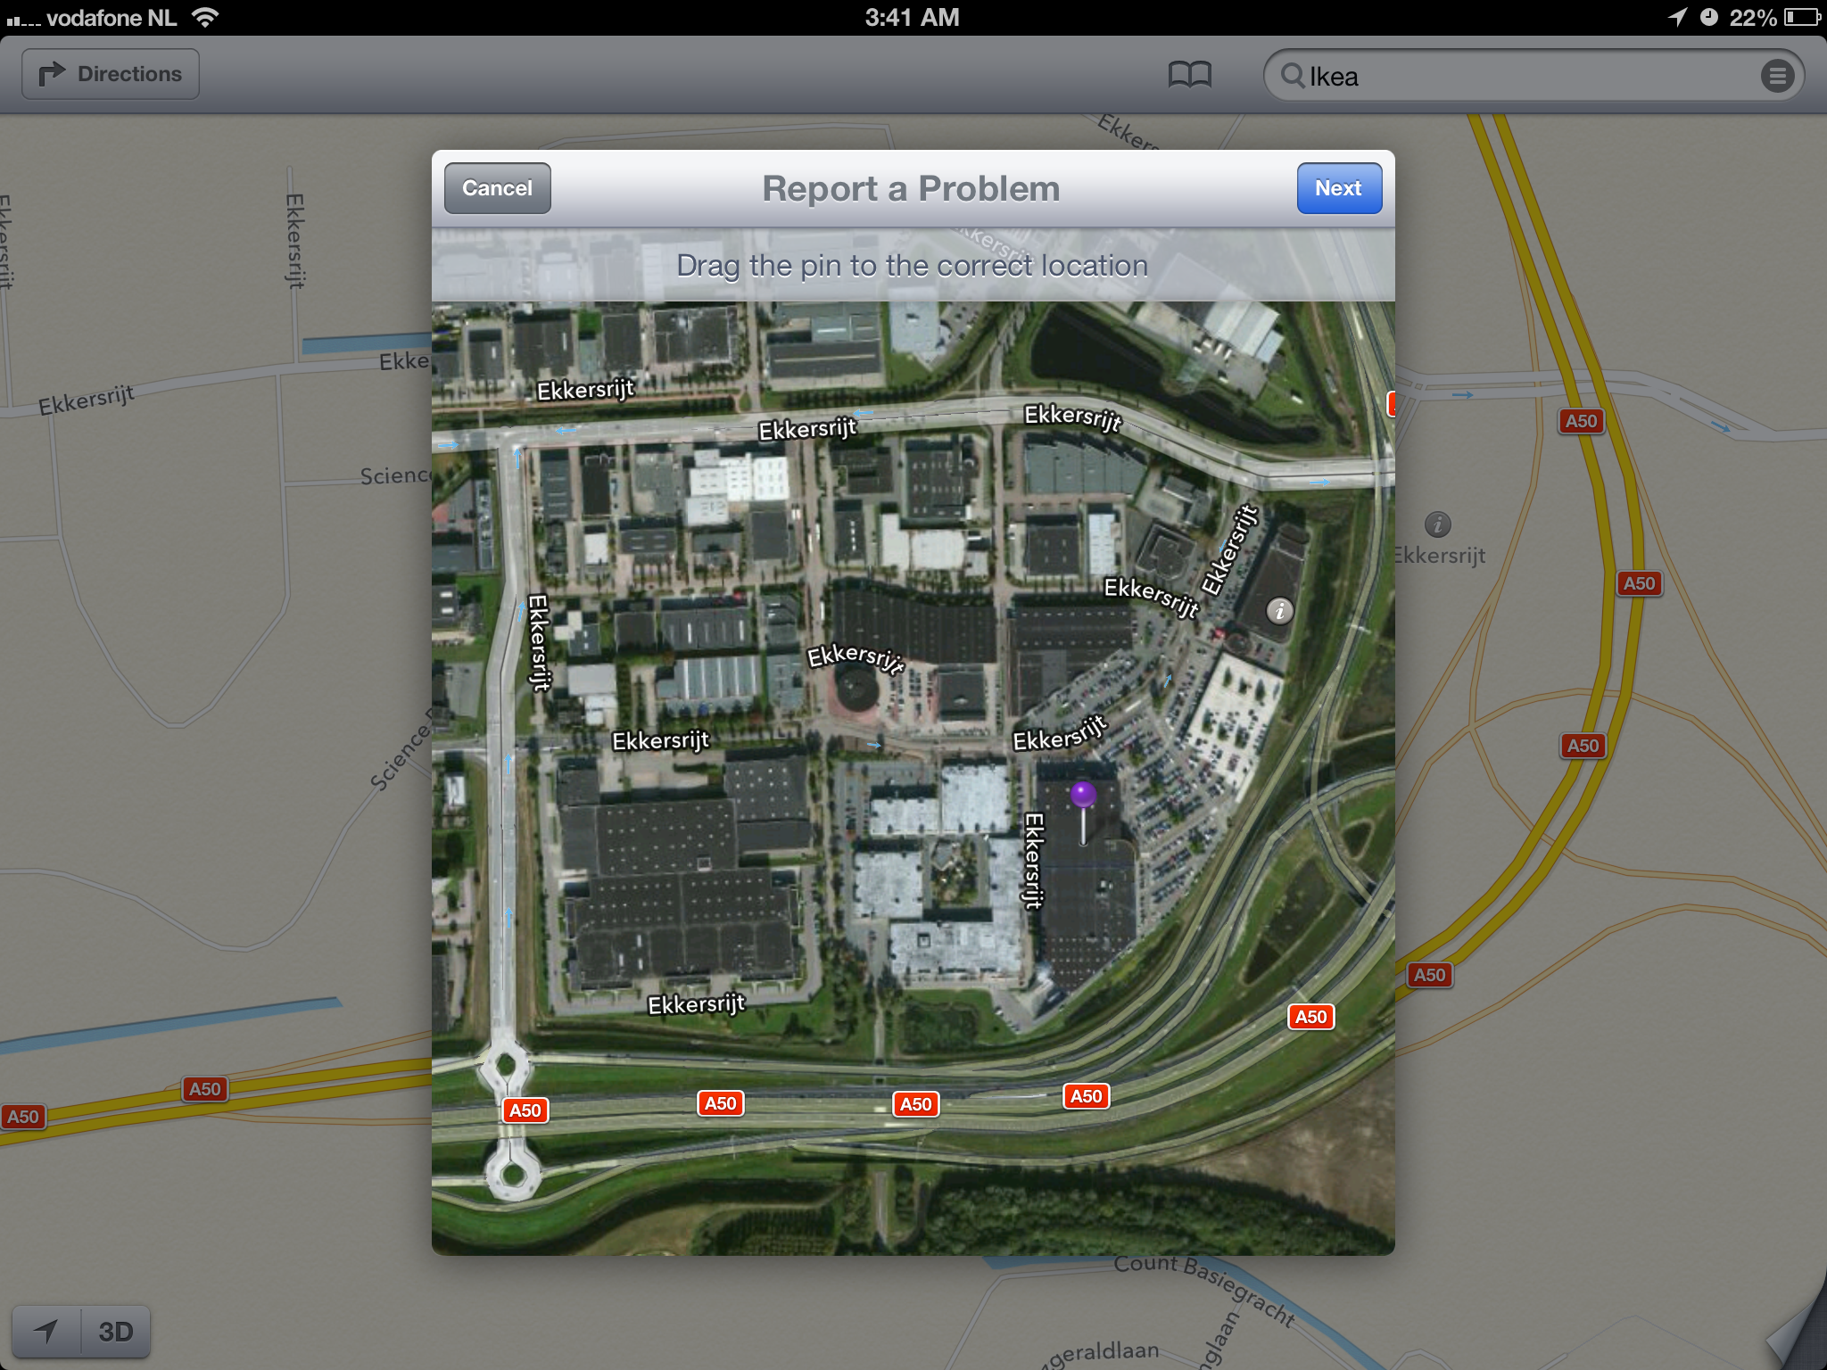
Potentially Hall of Fame
Apple crowd sourced data
The UI for problem reporting is well designed
With so many users have potential to fix data rapidly
→ it has gotten much better!
iOS 6 Maps
By Apple Inc.

Slide 10
Outline
Sketching vs. Storyboarding
Low-fi prototyping
Conducting a low-fi test
Medium-fi prototyping

Slide 11
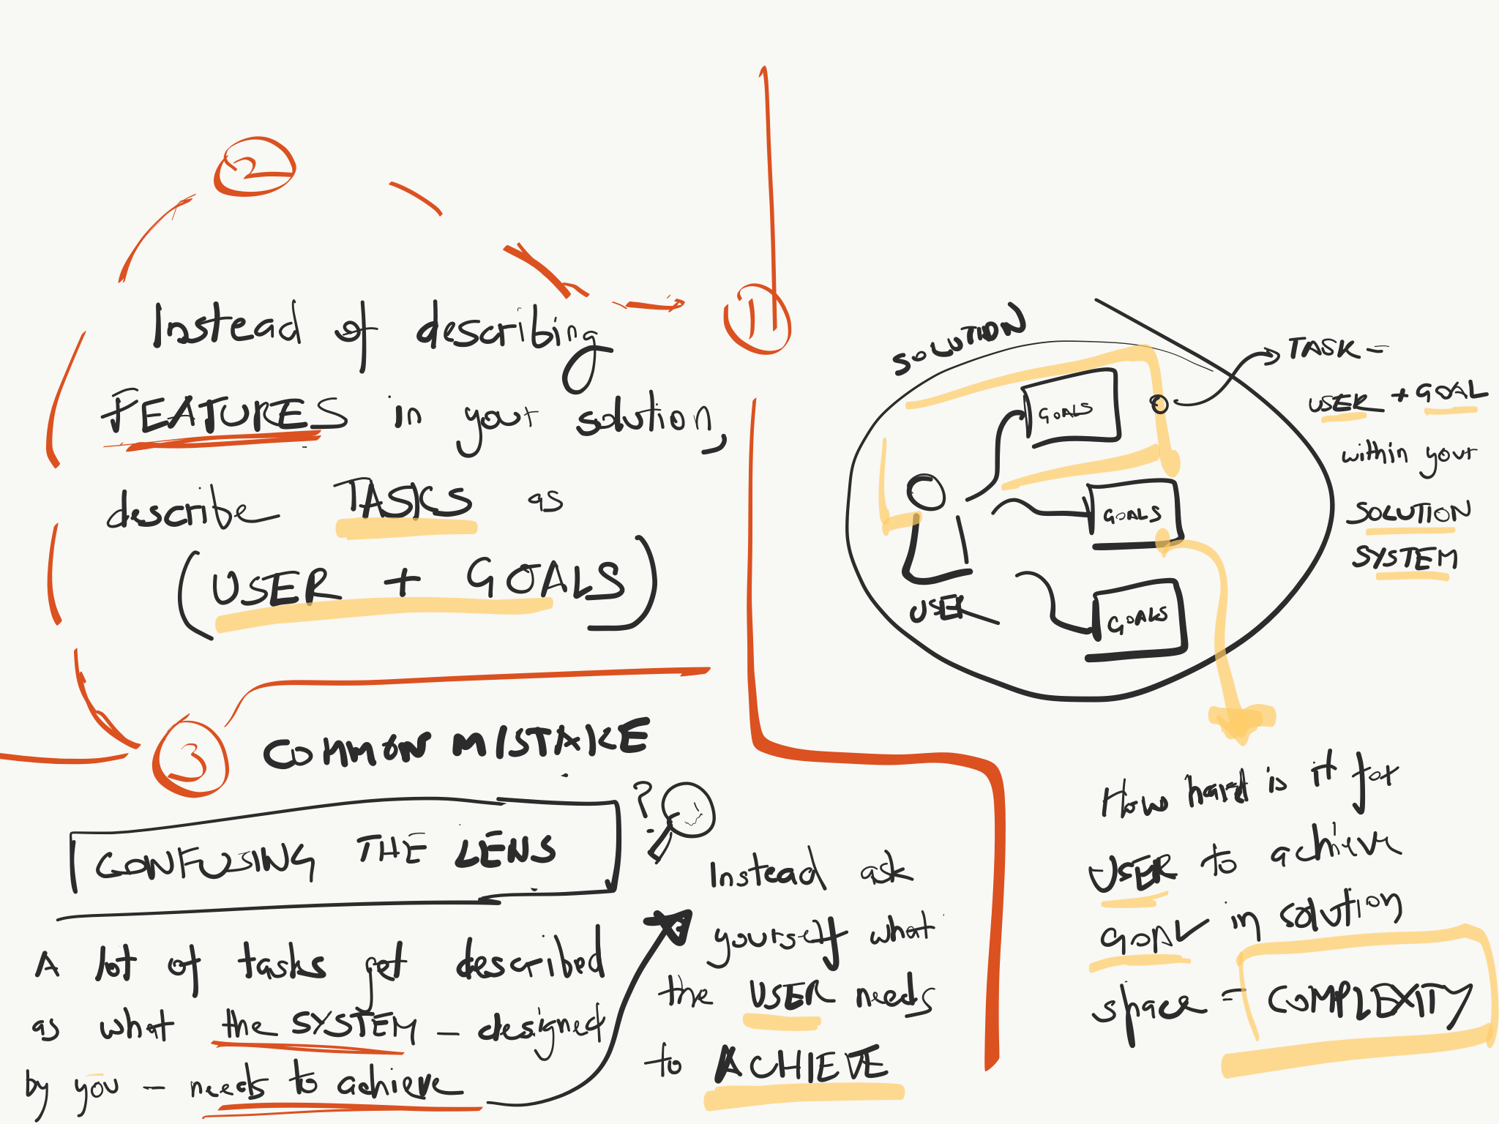
Tasks According To Trijeet

Slide 12
Sketches & Storyboards
Where do storyboards come from?
film & animation
Give you a “script” of important events
leave out the details
concentrate on the important interactions

Slide 13
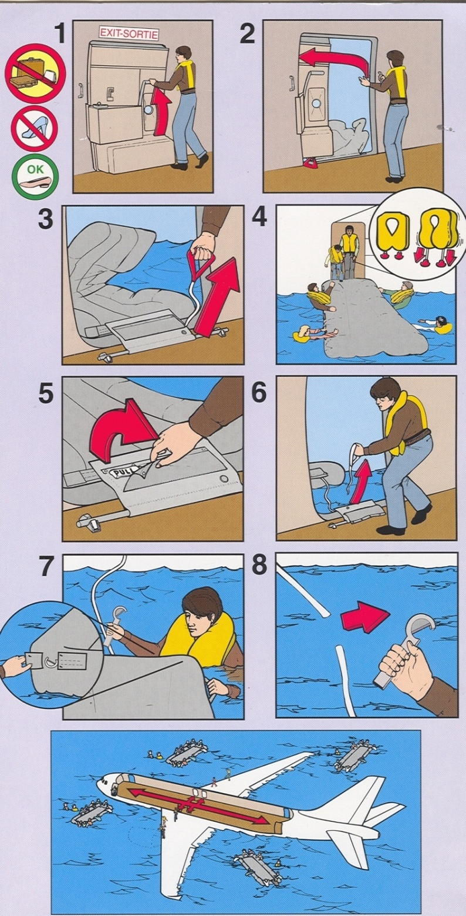
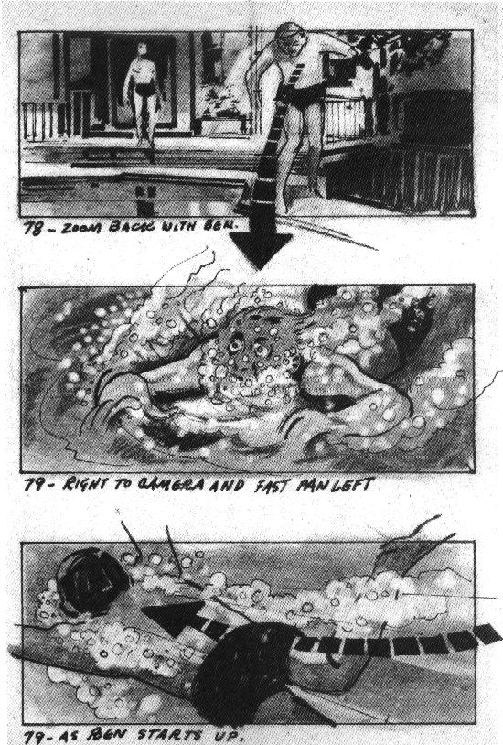

Slide 14
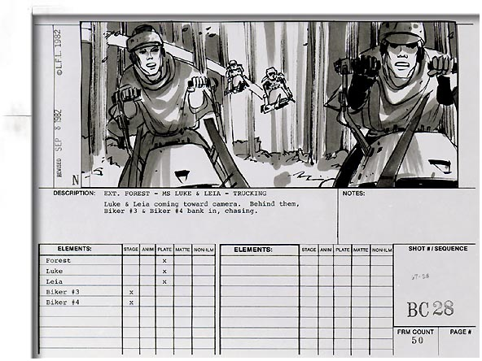

Slide 15
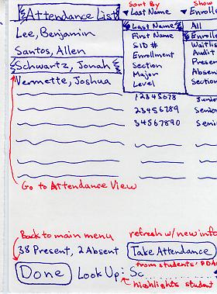
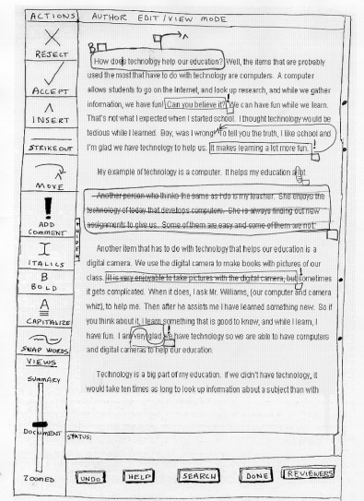
Sketches & Storyboards in UX Design
Notes:
This is the level of detail and fidelity you should be sketching in studio this week

Slide 16
Sketches & Storyboards in UX Design

Slide 17
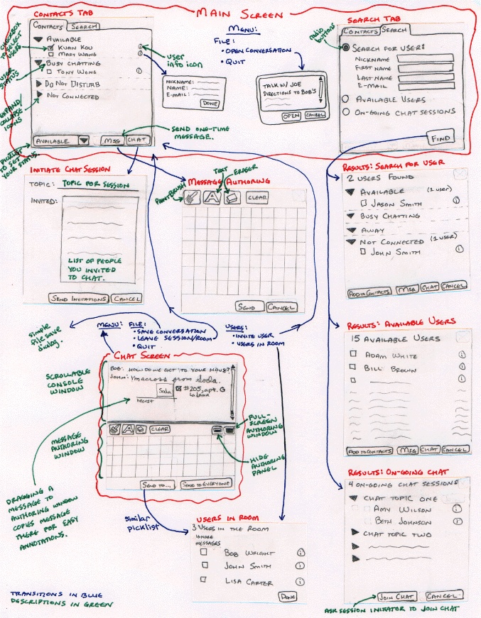
Ink Chat
Starts to tell a story, but still describes the design
Notes:
combination of the two

Slide 18
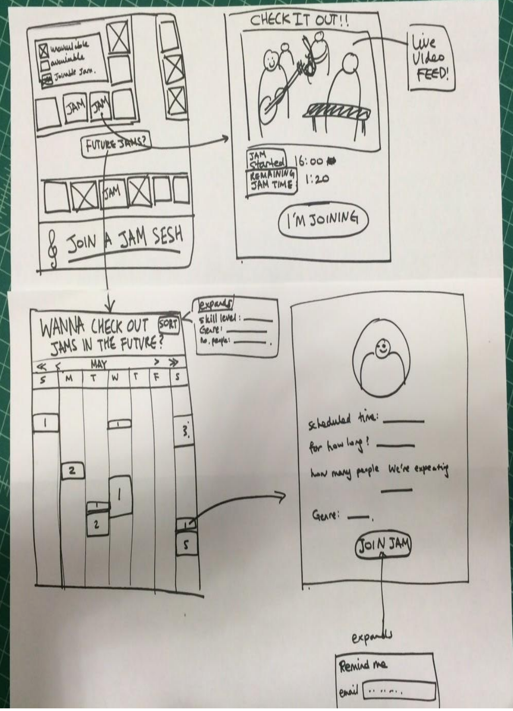
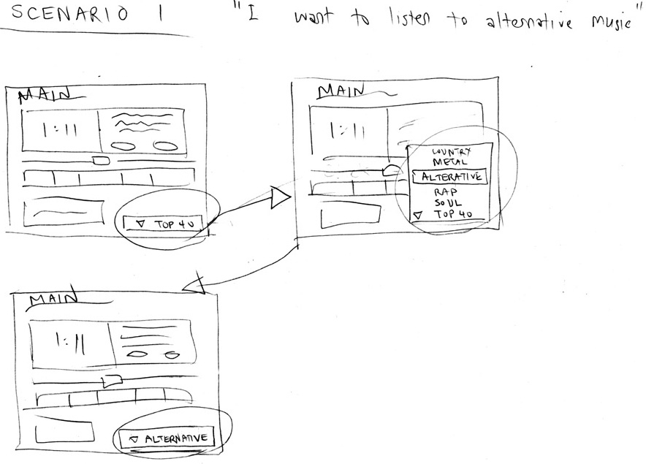
Sketches & Storyboards in UX Design
Task:
Task Flow #1
Notes:
Storyboards allow us to show interaction and time
Task vs. task flow
is this a form of prototype? Let’s define it more carefully

Slide 19
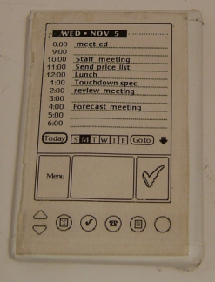
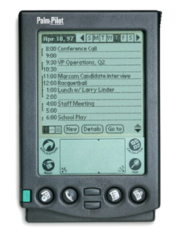
What is a Prototype?
“A prototype is an early sample or model built to test a concept or process or to act as a thing to be replicated or learned from.” – Wikipedia
a working representation of a final artifact
http://www.computerhistory.org/collections/accession/102716262
Notes:
Jeff Hawkins carried around a block of wood like this in his pocket & pulled it out when meeting people and used a pen to act like he was adding things to his device
This led to the prototype in the middle and
The final product: The PalmPilot (right)

Slide 20
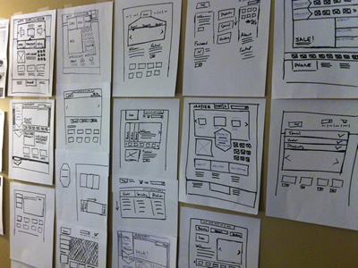
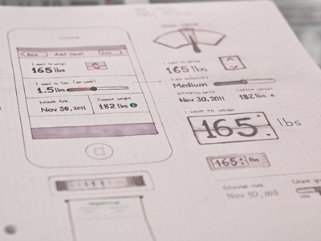
Types of Prototypes
Prototypes are concrete representations of a design
Prototype dimensions
representation: form of the prototype
off-line (paper) or on-line (software)
precision: level of detail (e.g., informal or polished)
interactivity: watch-only vs. fully interactive
fixed prototype (video clips)
fixed-path prototype (each step triggered by specified actions)
at extreme could be 1 path or possibly more open (e.g., Denim)
open prototype (real, but limited error handling or performance)
evolution: expected life cycle of prototype
e.g., throw away or iterative
PJ McCormick
Karem Suer
Notes:
PJ McCormick (left)
Kerem Suer (right)

Slide 21
Types of Prototypes
Prototypes are concrete representations of a design
Prototype dimensions
representation: form of the prototype
off-line (paper) or on-line (software)
precision: level of detail (e.g., informal or polished)
interactivity: watch-only vs. fully interactive
fixed prototype (video clips)
fixed-path prototype (each step triggered by specified actions)
at extreme could be 1 path or possibly more open (e.g., Denim)
open prototype (real, but limited error handling or performance)
evolution: expected life cycle of prototype
e.g., throw away or iterative
Notes:
PJ McCormick (left)
Kerem Suer (right)

Slide 22
Fidelity in Prototyping
Fidelity refers to the level of detail
High fidelity?
prototypes look like the final product
Low fidelity?
artists renditions with many details missing

Slide 23
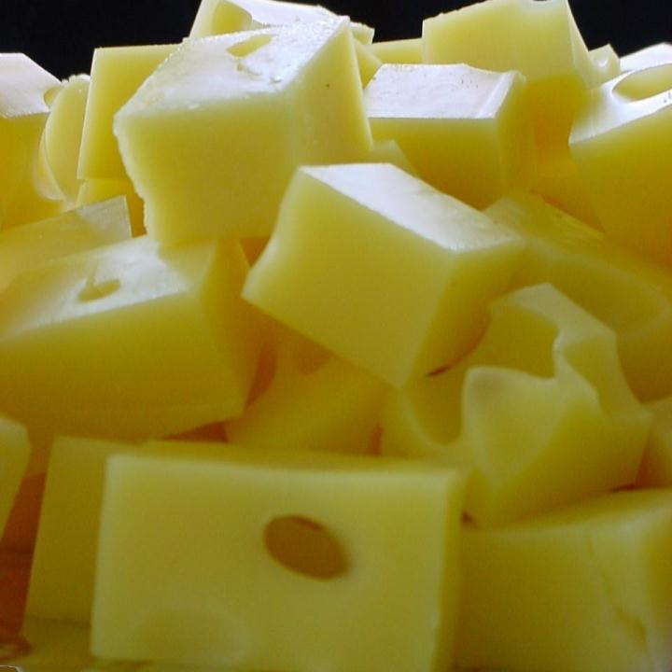
Hi-fi Prototypes Warp
Perceptions of the tester/reviewer
representation communicates “finished”
comments focus on color, fonts, & alignment
Time
encourage precision
specifying details takes more time
Creativity
lose track of the big picture

Slide 24
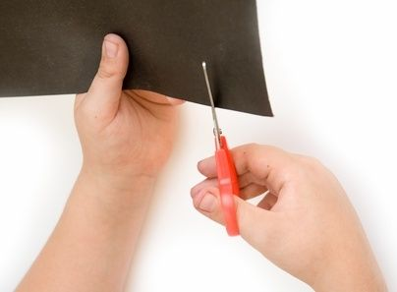
Why Use Low-fi Prototypes?
Traditional methods take too long
sketches → prototype → evaluate → iterate
Can instead simulate the prototype
sketches → evaluate → iterate
sketches act as prototypes
designer “plays computer”; others observe & record
Kindergarten building skills
allows non-programmers to participate

Slide 25
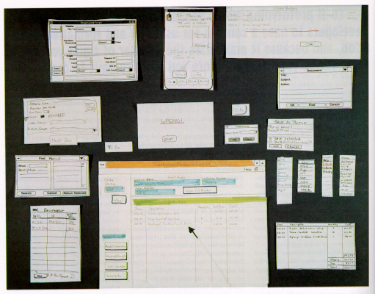
“Prototyping for Tiny Fingers” by Rettig

Slide 26
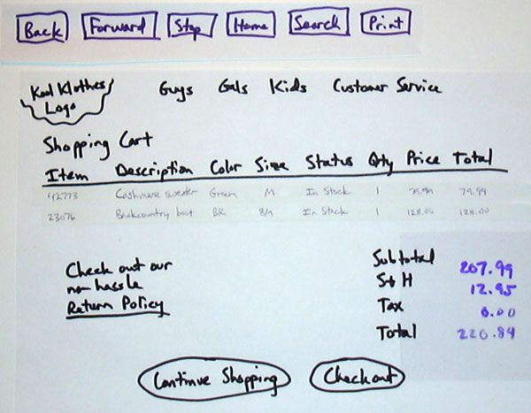

Slide 27
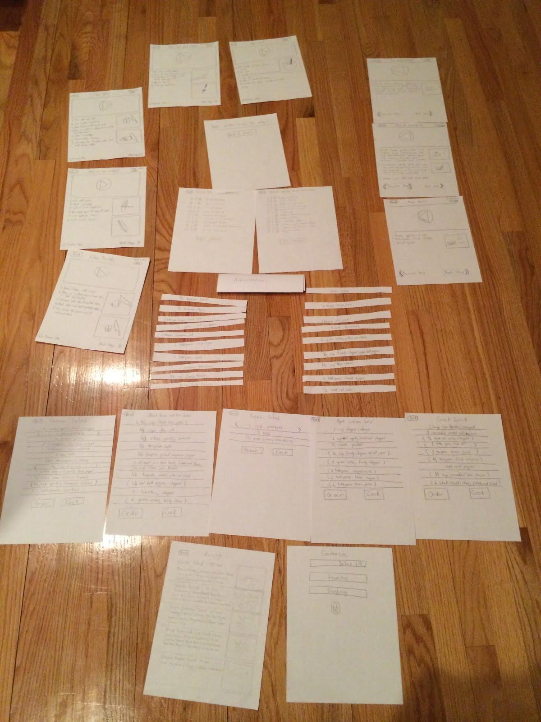
Cookable

Slide 28
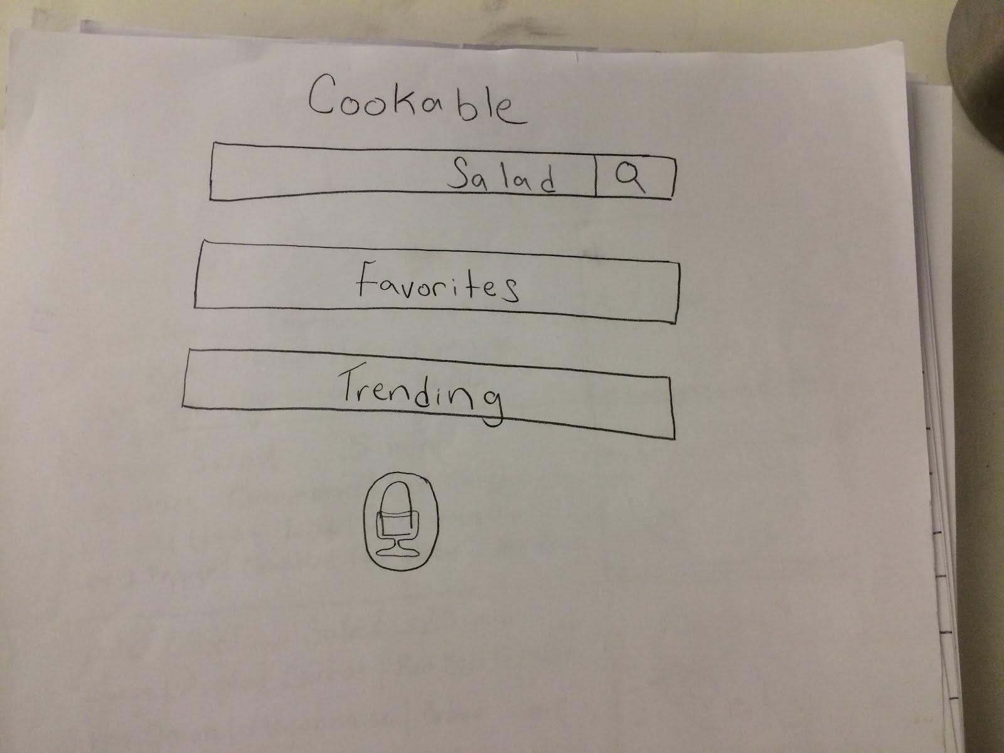
Cookable

Slide 29
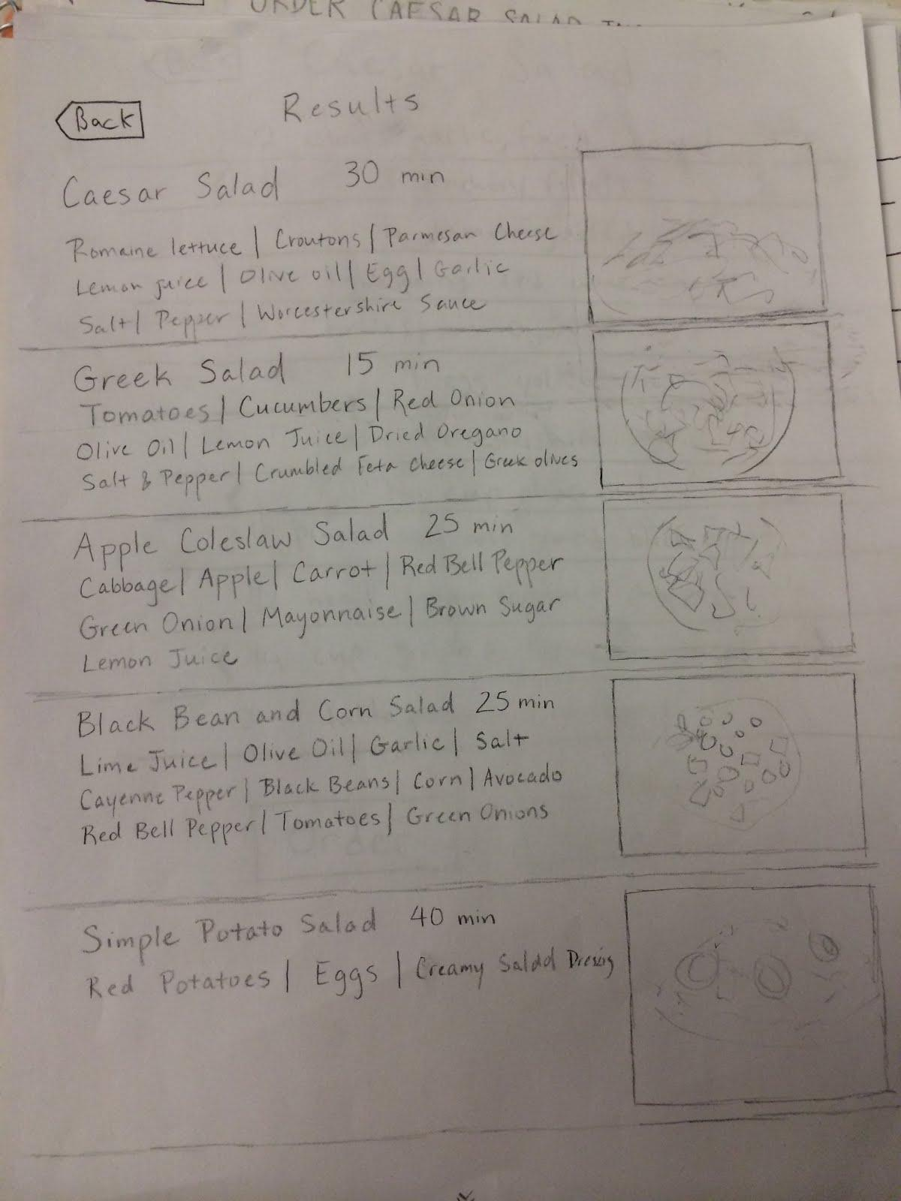
Cookable

Slide 30
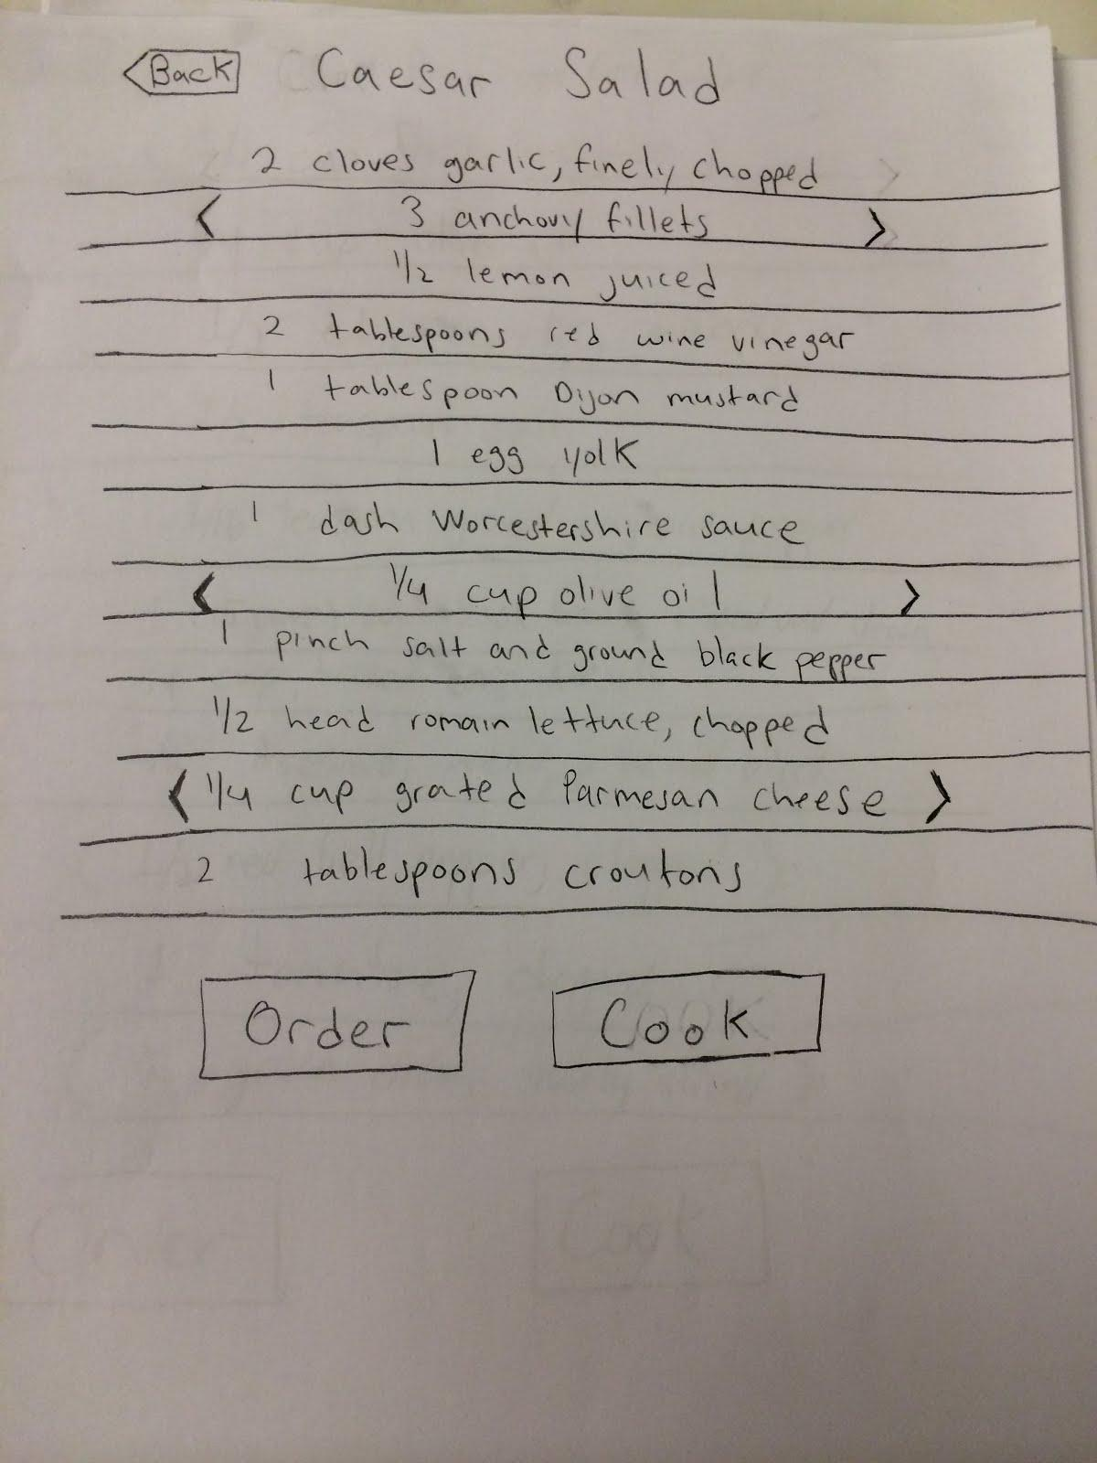
Cookable

Slide 31
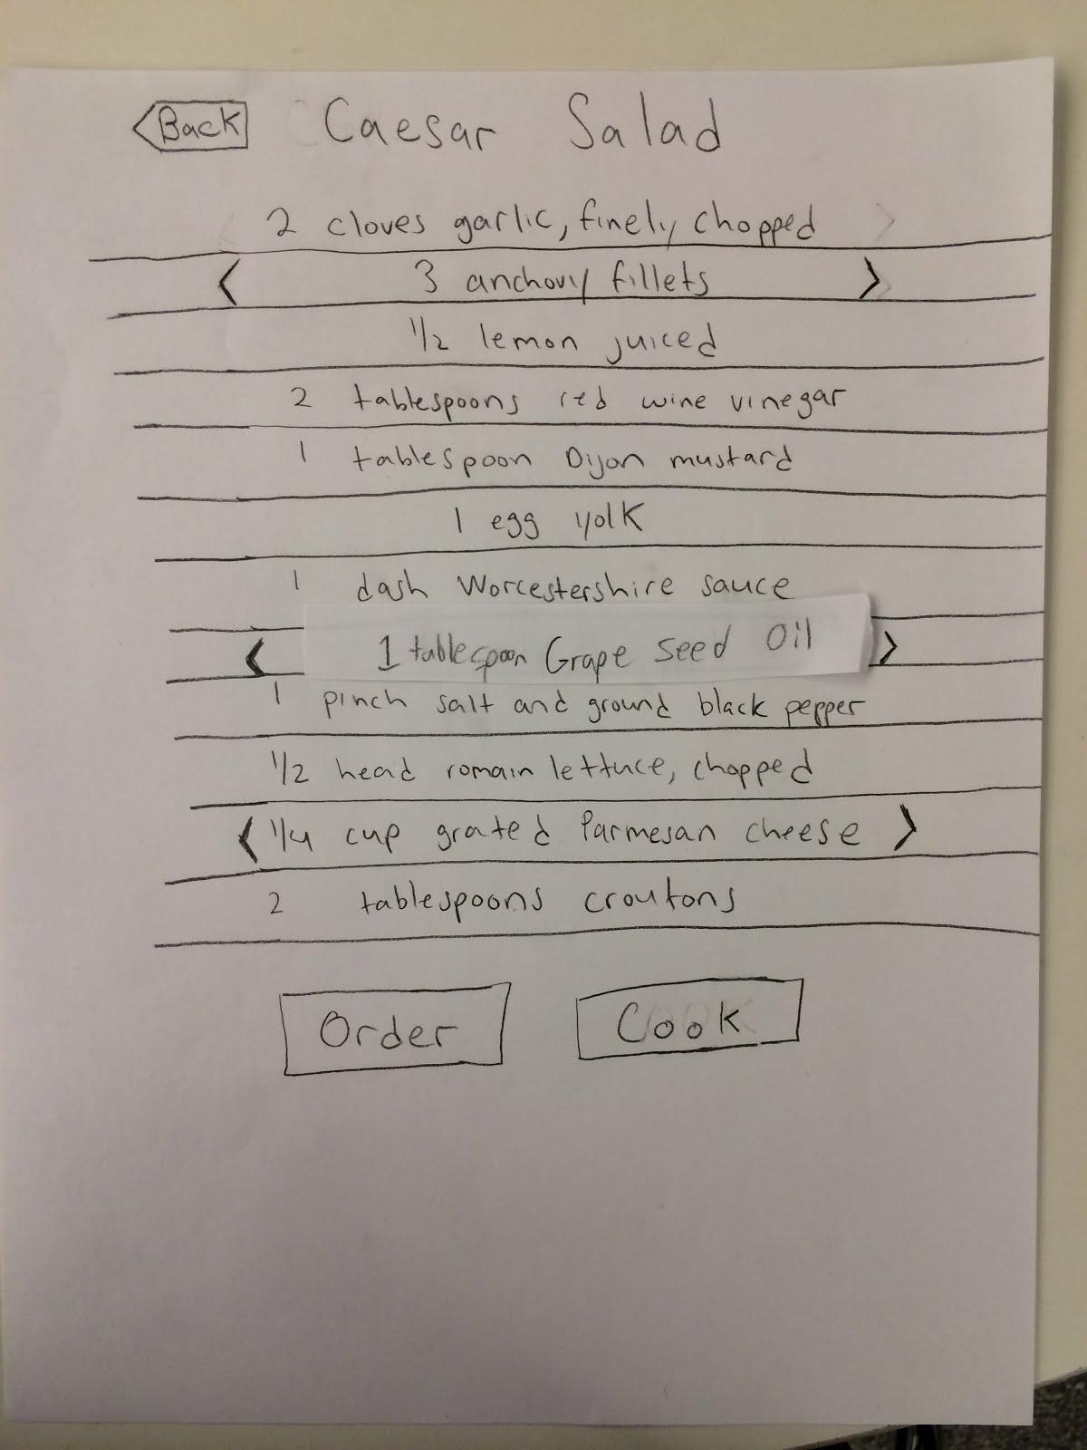
Cookable

Slide 32
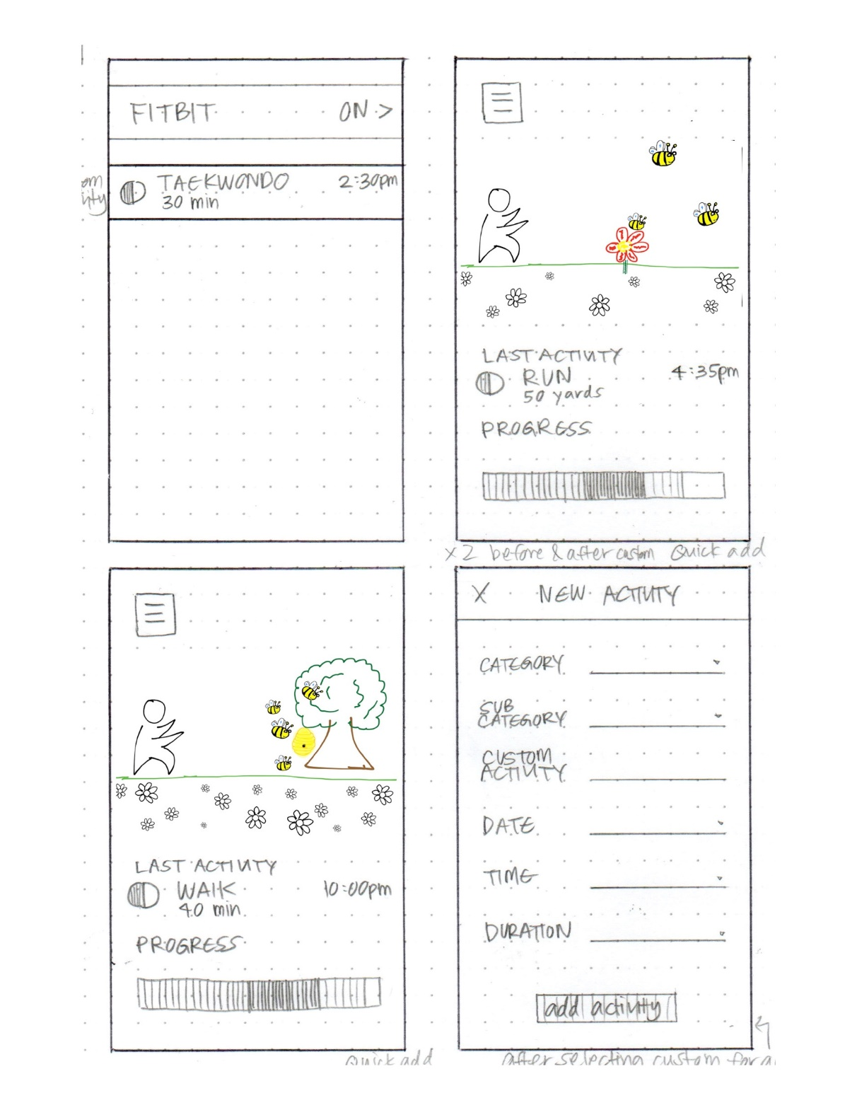
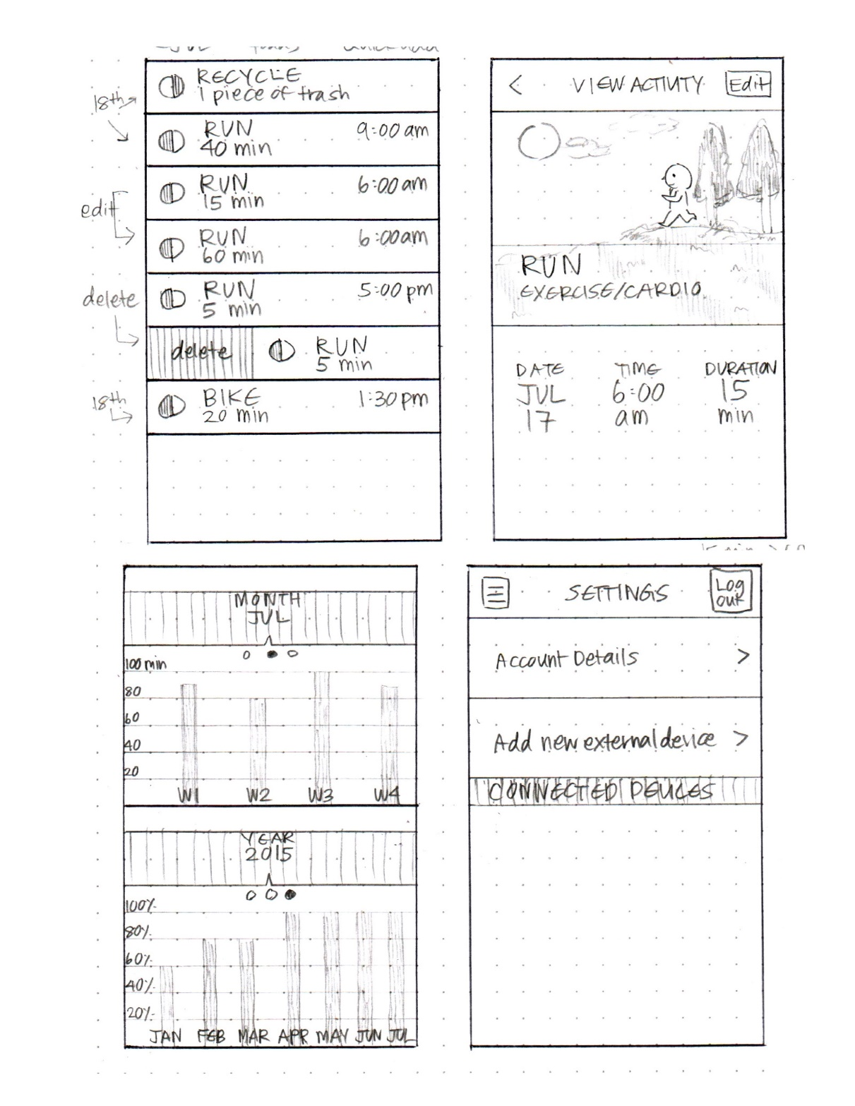
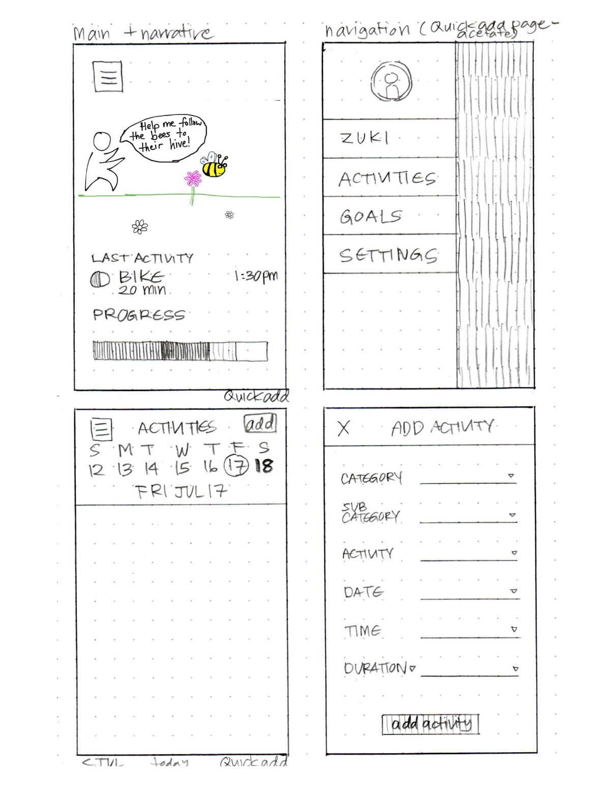
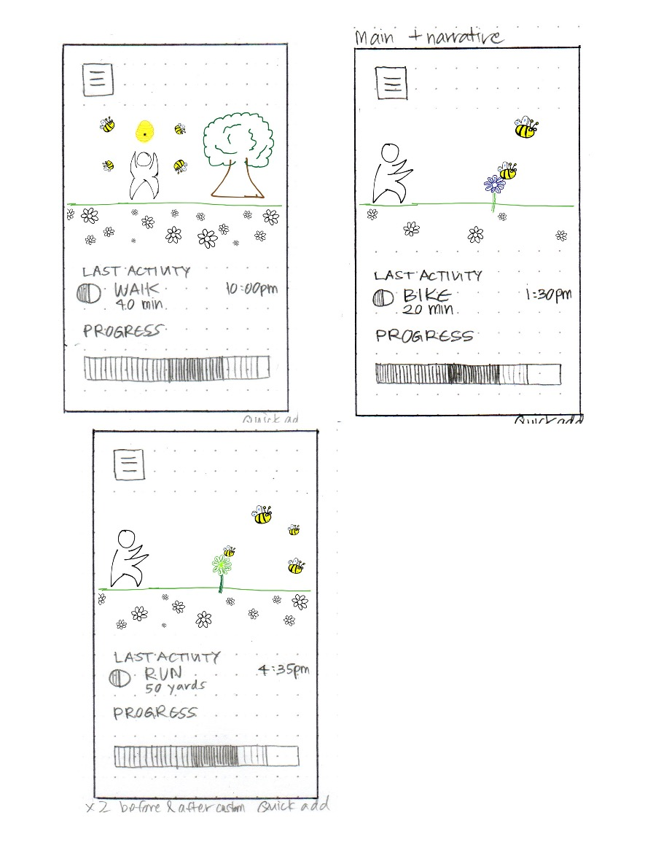
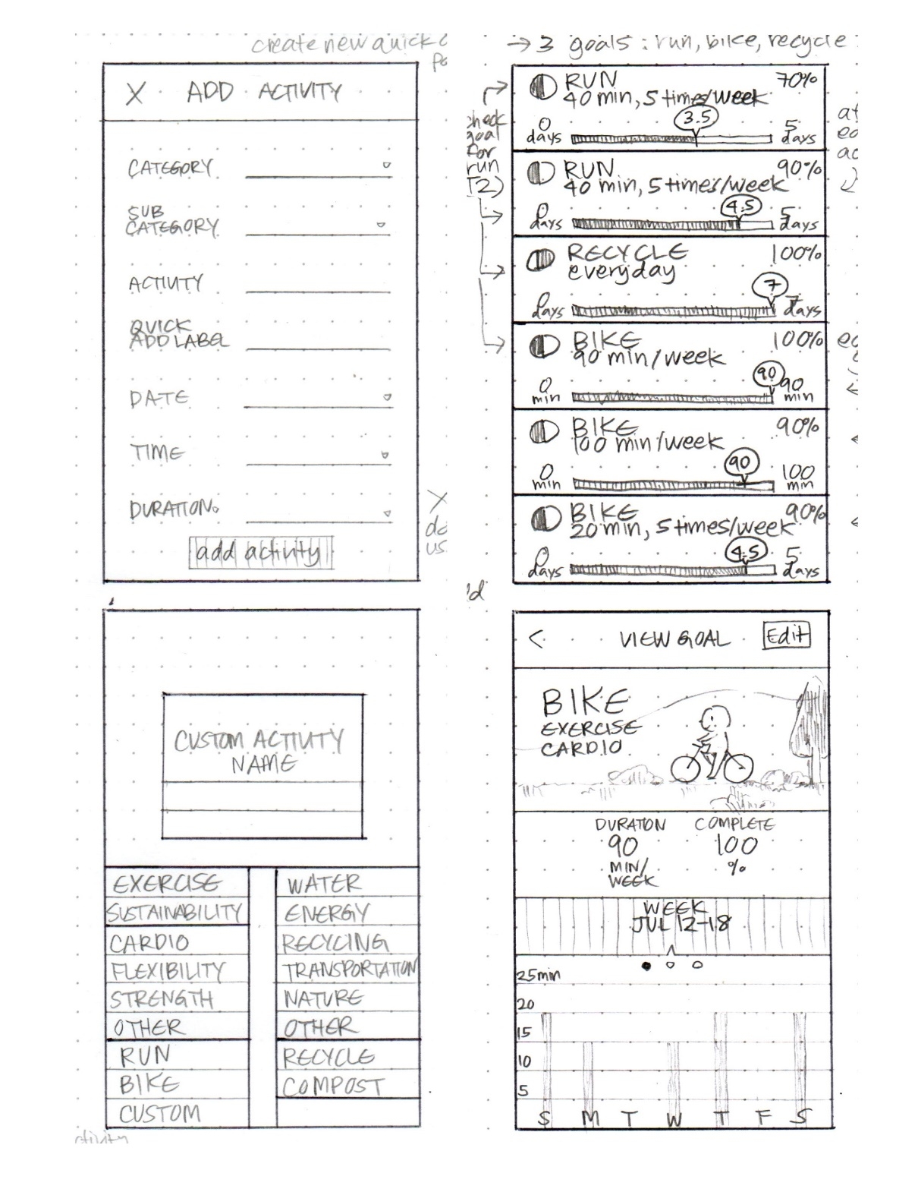
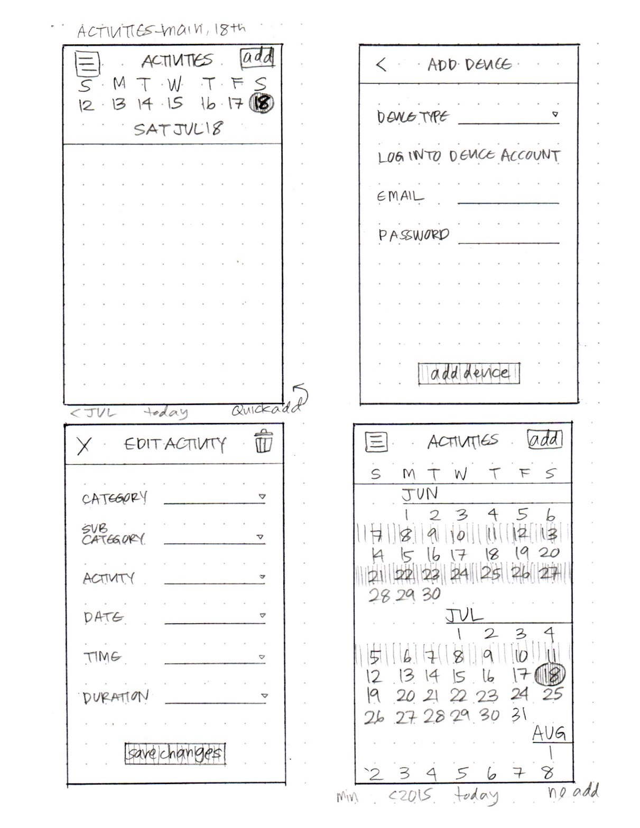
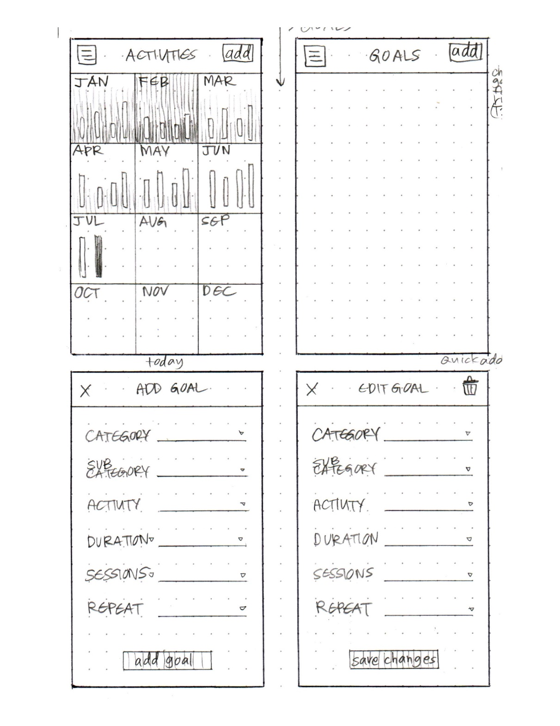
Who is Zuki?

Slide 33
Administrivia
Assignment #5 – Low-fi Prototype & Pilot Usability Test
15-20 rough sketches of different design realizations
everyone on team contributes
use different modalities (e.g., visual, speech, watch) or different visual UIs input techniques (gestures, taps, etc.)
will do some of this in studio this week
pick top 2 realizations & storyboard more
pick best realization & add details to storyboard
build low-fi prototype of the best & test it w/ at least 3 target participants (non Stanford)
Web sites directories will be created for each team by Thursday
10 teams have not yet filled in team name survey (we need it now!)
Start to get sites up there! Should have all your work – though not graded until end
TAs will send you your directory path/name on web.stanford.edu
Special Guest next Wed
Prof. Ge Wang (Music) on Artful Design (make sure to do the reading)

Slide 34
Grading on First Two Assignments
Needfinding Assignment #1
A1 Group Presentation: ✓-: 7% ✓: 72% ✓+: 21%
A1 Individual Presentation: ✓-: 0% ✓: 51% ✓+: 49%
POV, HMW, EP Assignment #2
A2 Group Report: ✓-: 2% ✓: 40% ✓+: 58% A2 Group Presentation: ✓-: 0% ✓: 35% ✓+: 65% A2 Individual Presentation: ✓-: 2% ✓: 30% ✓+: 68%
Notes:
These are all up from last week

Slide 35
T E A M
M E E T I N G S
Notes:
got here at 60 min in
20 minute break

Slide 36
Constructing the Model
Set a deadline
don’t think too long - build it!
Draw a window frame on large paper
Put different screen regions on cards
anything that moves, changes, appears/disappears
Ready response for any user action
e.g., have those pull-down menus already made
Use photocopier/printer to make many versions

Slide 37
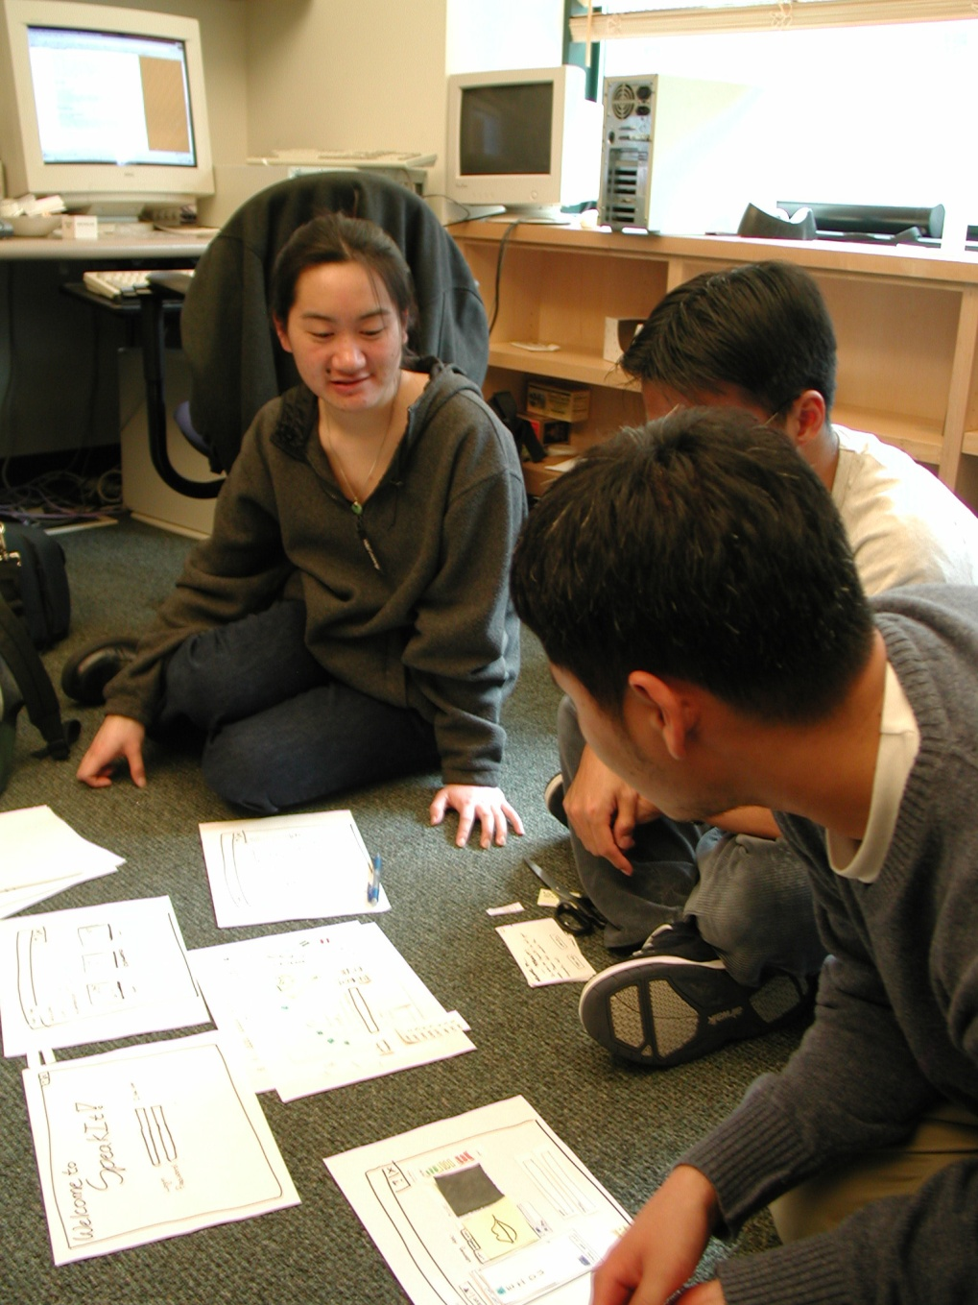
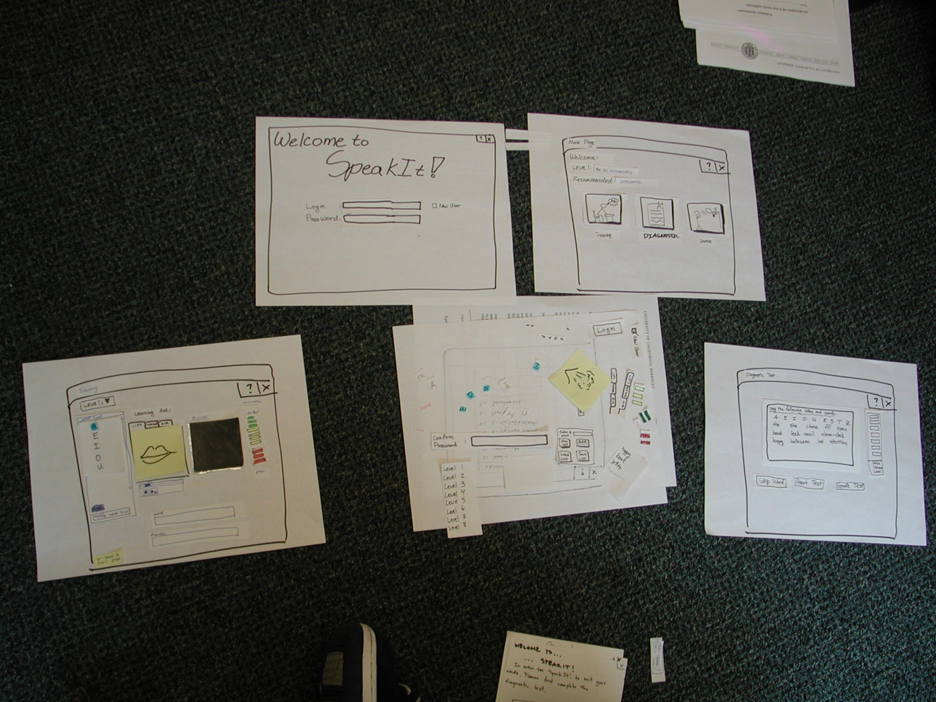
Constructing the Model

Slide 38
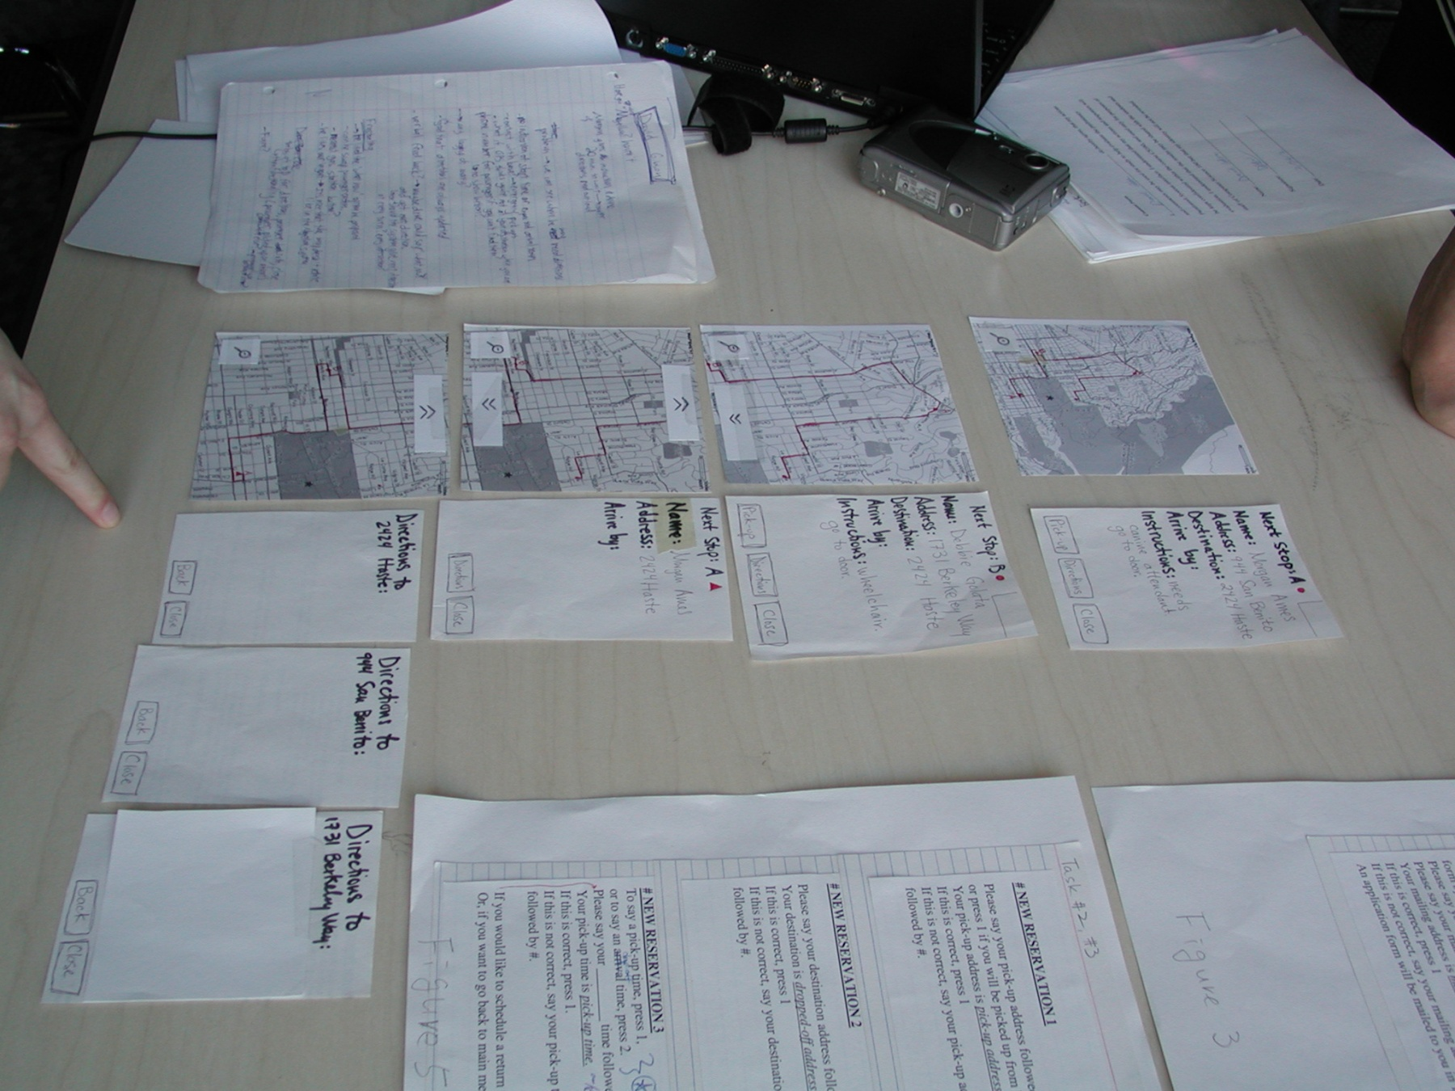
Constructing the Model

Slide 39
Preparing for a Test
Select your “customers”
understand background of intended users
use a questionnaire to get the people you need
don’t use friends or family
Prepare scenarios that are
typical of the product during actual use
make prototype support these (small, yet broad)
Practice to avoid “bugs”
Notes:
At most 1 stanford student

Slide 40
Conducting a Test
Four roles
greeter – puts users at ease & gets data
facilitator – only team member who speaks
gives instructions & encourages thoughts, opinions
computer – knows application logic & controls it
always simulates the response, w/o explanation
observers – take notes & recommendations

Slide 41
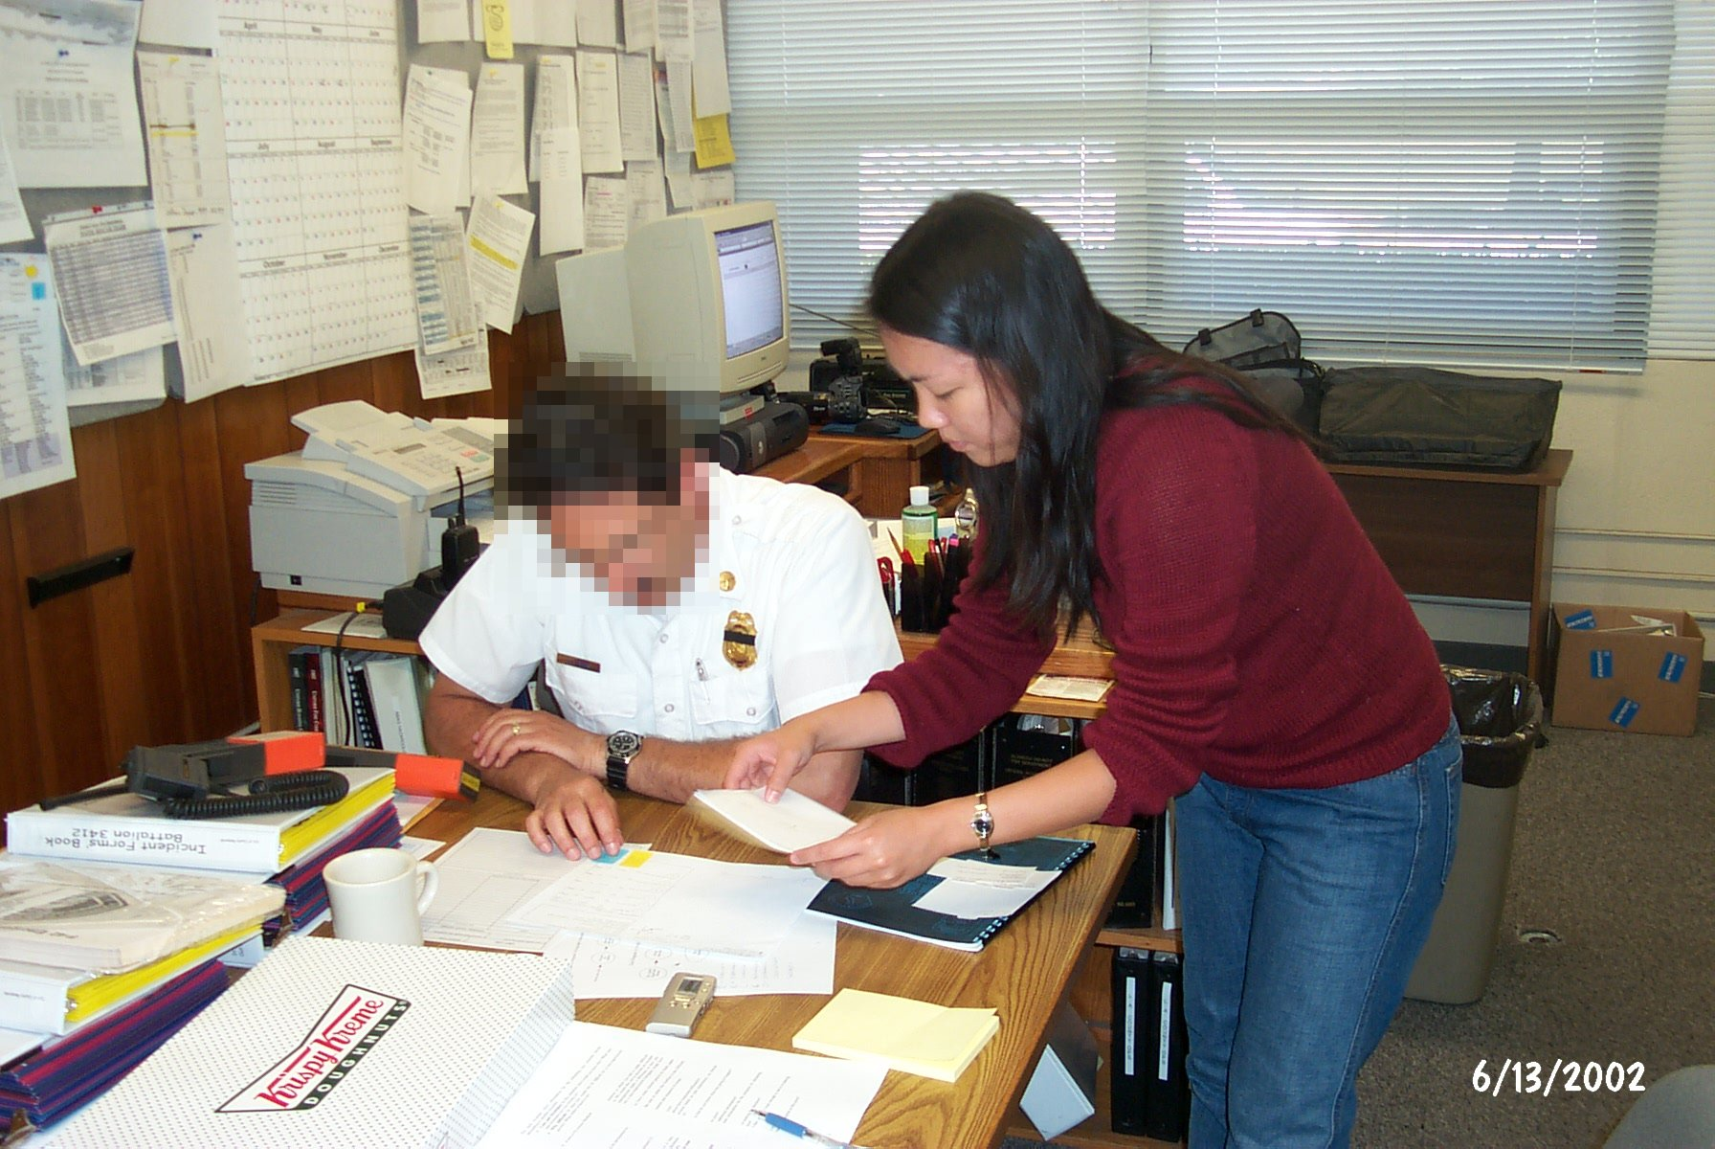
Conducting a Test
Notes:
Note USE REAL IMAGES in your reports (blur faces if you need to)

Slide 42
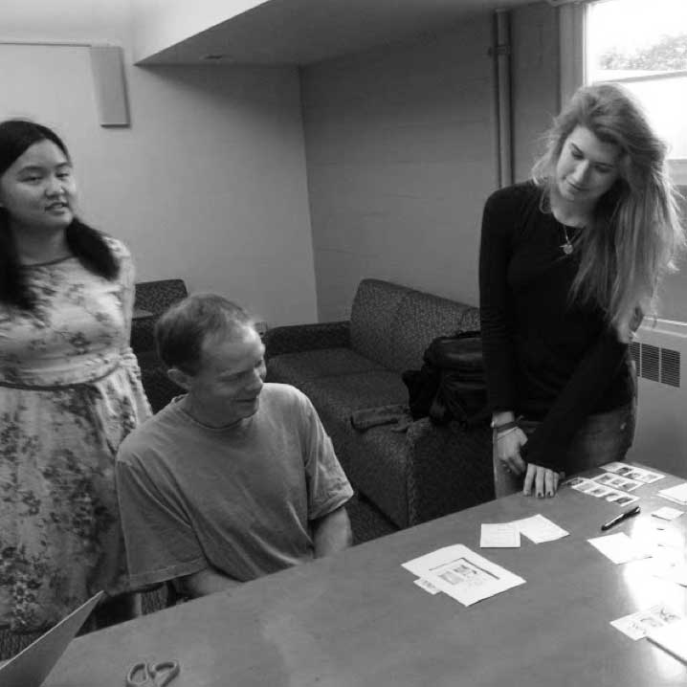
Wonderlust
Notes:
Wonderlust, CS147, 2014au

Slide 43
Who is Zuki?
Notes:
1:46 video

Slide 44
Evaluating Results
High level questions about your design
does it address the problem you want to solve?
is this the right realization of your solution?
Sort & prioritize observations
what was important?
lots of problems in the same area?
Make changes & iterate
even iterate between tests

Slide 45
Quiz
http://bit.ly/cs147-18au-quiz-2
Notes:
5 minutes

Slide 46
Fidelity in Prototyping: Instagator

Slide 47
Fidelity in Prototyping Task 1: Take a Destination Poll
Low-fi
Medium-fi
Notes:
Medium-fi start to give us more realism. Most often tested on the target device and fonts, colors, and interactive elements (widgets) look real to people.
Often harder to change as rapidly and can cause tunnel vision. So do NOT start with these.

Slide 48
Summary
Prototypes are a concrete representation of a design or final product
Low-fi testing allows us to quickly iterate
get feedback from users & change right away

Slide 49
Further Reading Prototyping
Books
Paper Prototyping: The Fast and Easy Way to Design and Refine User Interfaces, by Carolyn Snyder, Morgan Kaufmann, 2003
Articles
“Prototyping for Tiny Fingers” by Marc Rettig, in Communications of the ACM, 1994
“Using Paper Prototypes to Manage Risk” by Carolyn Snyder, http://world.std.com/~uieweb/paper.htm
“The Perils of Prototyping” by Alan Cooper, http://www.chi-sa.org.za/Documents/articles/perils.htm

Slide 50
Next Time
Lecture
Watch, Critique, & Vote on Concept Videos
Mid-term studio evaluation
No Reading
Project
15-20 sketches of 3-5 design realizations in studio…
Pick the top two & storyboard those
Pick the top 1 & build/test low-fi prototypes using 3 key tasks for next week’s studio presentation
Recruit representative participants now!

