Slide 1
Design Exploration
October 15, 2018
* slides marked Buxton are courtesy of Bill Buxton, from his talk “Why I Love the iPod, iPhone, Wii and Google”, remix uk, 18-19 Sept. 2008, Brighton
Notes:
Took 30 min break at 50 min in
Lecture ended 10 min early

Slide 2
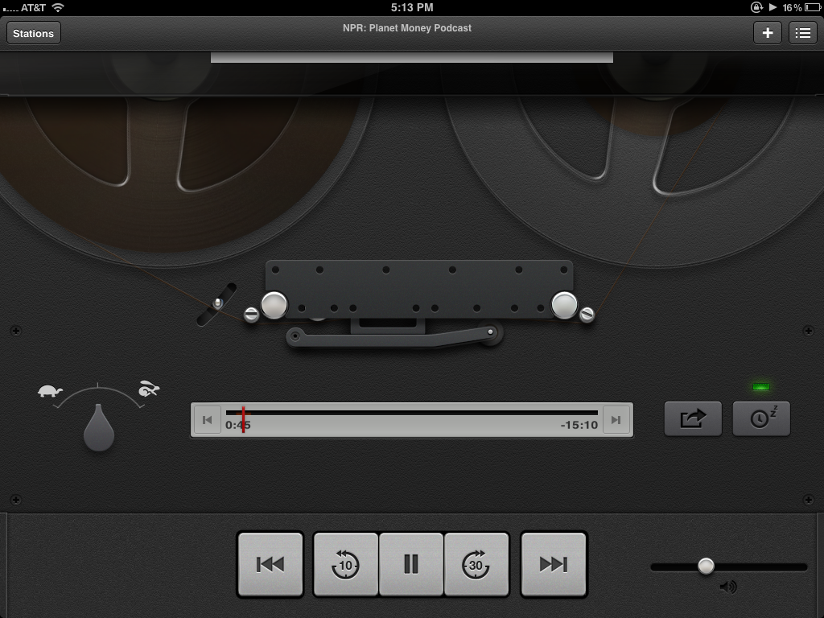
Hall of Fame or Shame?
Podcasts App
Apple Inc.
Notes:
prime example of Apple's foray in skeuomorphism
Skeuomorphism is the design concept of making items represented resemble their real-world counterparts.

Slide 3
Hall of Shame!
Good
At first glance, is fun and unique
Well polished, aesthetically pleasing
Bad
What does a tapedeck have to do with podcasts? – confused metaphor is difficult to understand
Focus on ‘retro’ means the user has to wait 5 seconds to watch animation of tape loading before anything plays
Podcasts App
Apple Inc.

Slide 4
Outline
Reviewing tasks
Sketching to explore user experiences

Slide 5
Design Process: Discovery
Assess Needs
understand client’s expectations
determine scope of project
characteristics of customers & tasks
evaluate existing practices & products
Discovery
Design Exploration
Design Refinement
Production

Slide 6
Task. The structured set of activities or high-level actions required to achieve a high level user goal.
what a user wants to do

Slide 7
Task-based Design & Evaluation
Real tasks customers have faced / will face
collect any necessary materials
Do your tasks support the problem you are solving?
Mixture of simple & complex tasks
simple task (common or introductory)
moderate task
complex task (infrequent or for power customers)

Slide 8
Token (Concept Video)

Slide 9
Token
Notes:
What do we think?
Could use a bit more detail
Location discovery doesn’t seem like a user problem?
How could we make these better?

Slide 10
Questions on Tasks or Concept Videos

Slide 11
Design Process: Exploration
Expand Design Space
brainstorming
sketching
storyboarding
prototyping
Discovery
Design Exploration
Design Refinement
Production
Notes:
Expand design space:
brainstorming, sketching, storyboarding, prototyping

Slide 12
Iteration
At every stage!
Design
Prototype
Evaluate
Sketch
Paper
Video
Tool
Program
Gut
Crit
Expert Eval Lo-fi Test
User Study

Slide 13
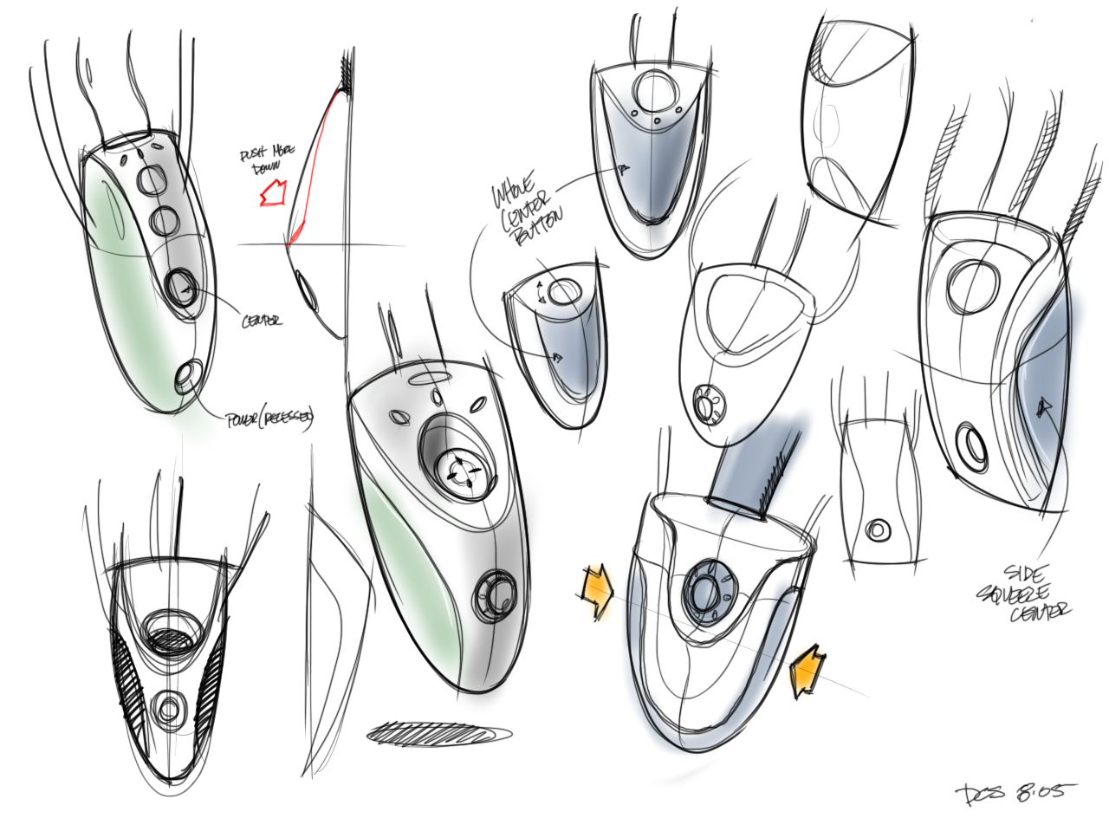
Sketching: A Quintessential Activity of Design
* Courtesy Bill Buxton
Notes:
Design and Innovation comes from sweat. From trying many ideas. Sketching them. Building prototypes.

Slide 14
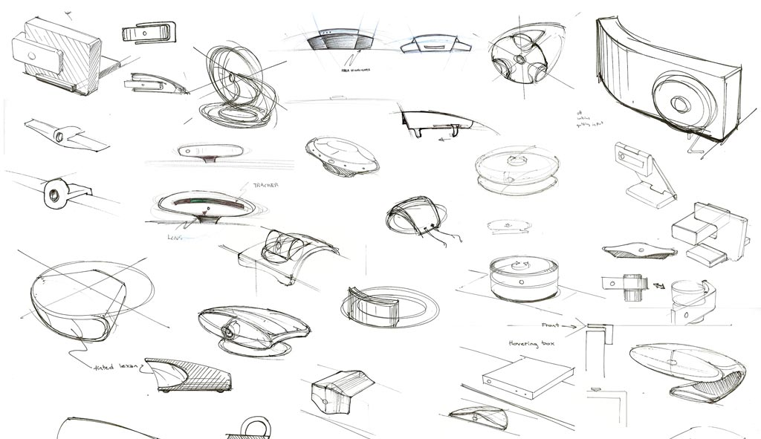
Kicker Studio, www.kickerstudio.com
Notes:
Trying literally dozens and dozens of ideas.

Slide 15
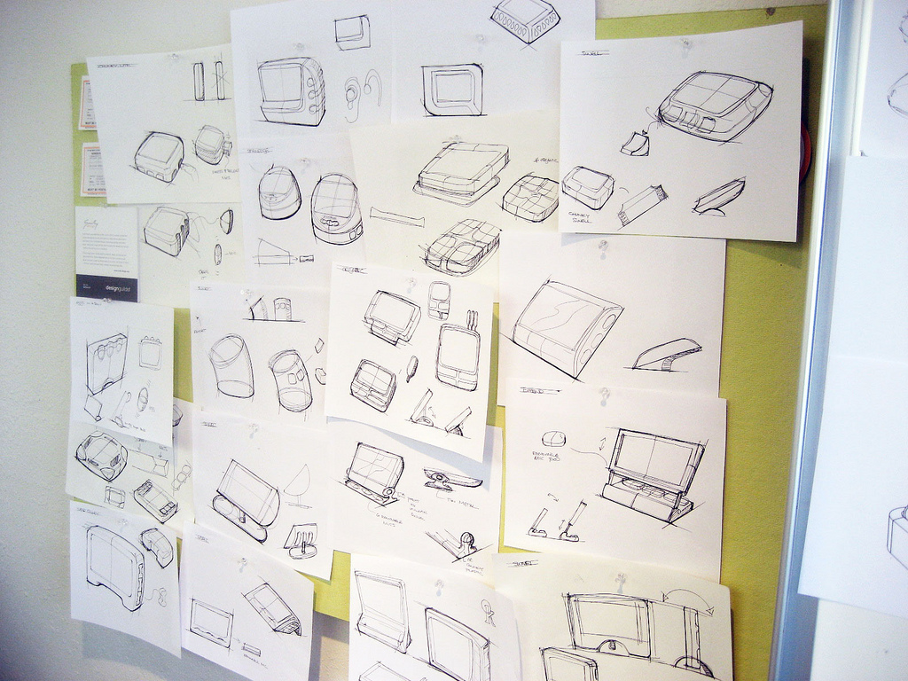
Kicker Studio, www.kickerstudio.com
Notes:
Trying them out with people and observing what occurs.

Slide 16
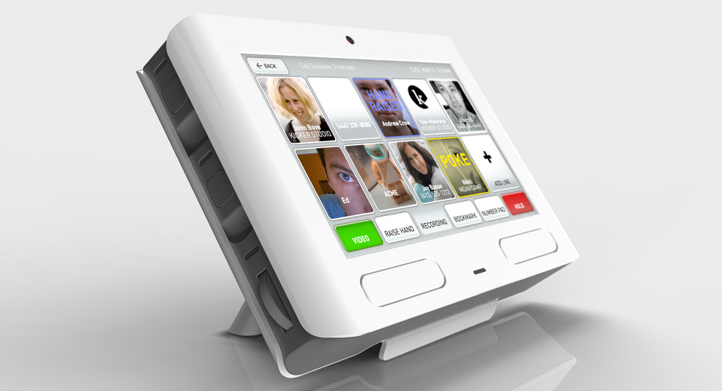
Kicker Studio, www.kickerstudio.com
Notes:
Until you find ideas/products/services that evoke an emotional response with your customers. Ideas that give new experiences that people value. The differences of opinion are on how you might get to this point.
Which group in the ceramics class described in the Buxton reading produced the highest quality pots? https://www.polleverywhere.com/multiple_choice_polls/D26SMQGMKxQQO5n

Slide 17
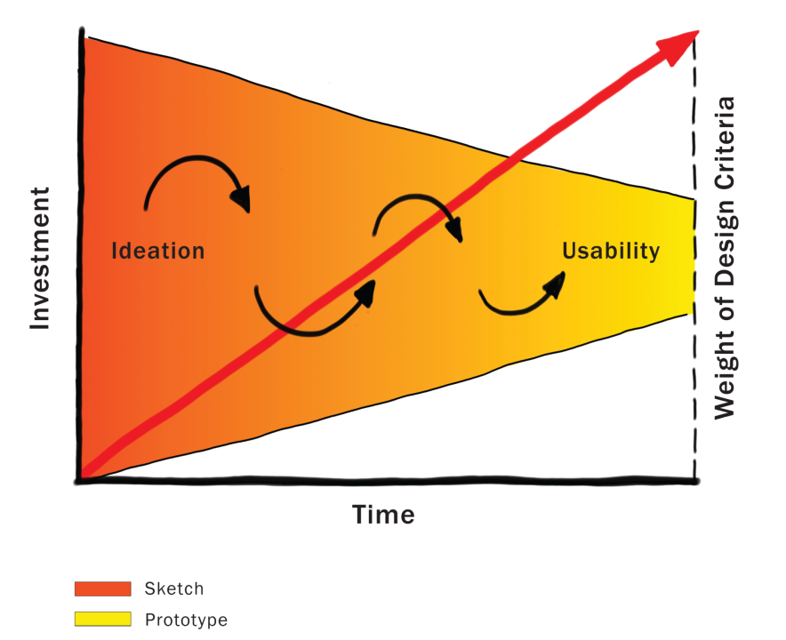
Courtesy Bill Buxton
Notes:
Because investment is low in the early stages, this is the one time in the product pipeline when one can afford to play, explore, learn, and really try and gain a deep understanding of the undertaking.
This is where YOUR TEAM WILL be for most of this quarter!!!!

Slide 18
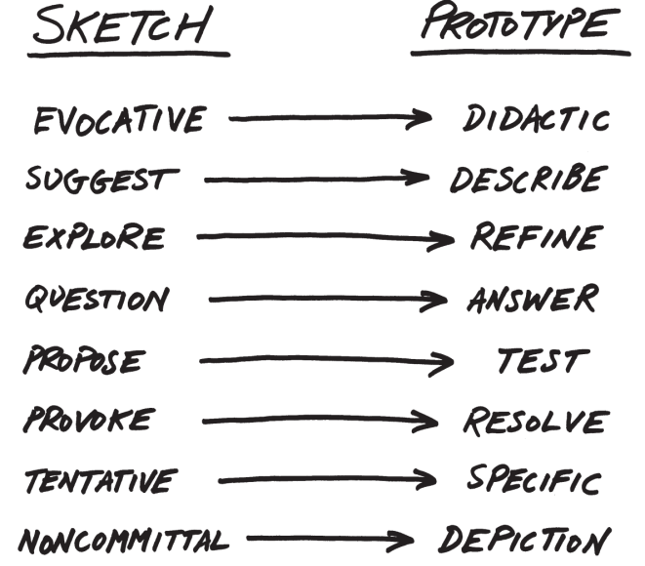
From Sketch to Prototype
Difference in intent rather than in form
Courtesy Bill Buxton
Notes:
This is a continuum, not an either/or proposition
[ADVANCE SLIDES]
The difference between the two is as much a contrast of purpose, or intent, as it is a contrast in form

Slide 19
The Anatomy of “Sketching”
Quick / Timely
Inexpensive / Disposable
Plentiful
Clear vocabulary. You know that it is a sketch (lines extend through endpoints, …)
No higher resolution than required to communicate the intended purpose/concept
Resolution doesn’t suggest a degree of refinement of concept that exceeds actual state
Ambiguous
Courtesy Bill Buxton

Slide 20
If you want to get the most out of a sketch, you need to leave big enough holes.
There has to be enough room for the imagination.
Courtesy Bill Buxton
Notes:
Ambiguity in sketches is VERY important

Slide 21
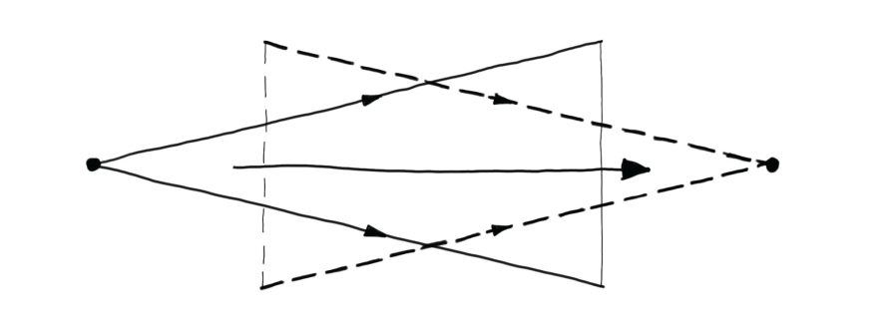
Design as Choice
Elaboration (“Flare”)
Reduction (“Focus”)
Courtesy Bill Buxton
Laseau (1980)
Notes:
Choice where there are two key places for creativity:
the creativity that you bring to enumerating meaningfully distinct options from which to choose
the creativity that you bring to defining the criteria, or heuristics, according to which you make your choices
Design is both GENERATIVE and REDUCTIVE

Slide 22
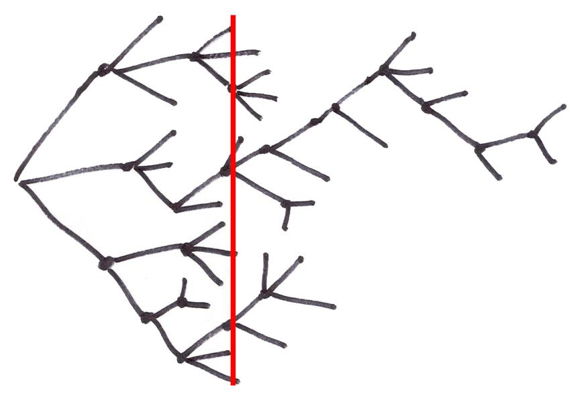
Exploration of Alternatives
… a designer that pitched three ideas would probably be fired. I’d say 5 is an entry point for an early formal review (distilled from 100’s). … if you are pushing one you will be found out, and also fired. … it is about open mindedness, humility, discovery, and learning. If you aren’t authentically dedicated to that approach you are just doing it wrong!
Alistair Hamilton
VP Design
Symbol Technologies
Courtesy Bill Buxton
Notes:
Design is NOT a straight path
We must generate and discard much more than we keep
All of these representations of the design process converge.
Some of the ideas thrown out may be your’s! – you need to learn to embrace this [ADVANCE]

Slide 23
Exploration of Alternatives
People on a design team must be as happy to be wrong as right. If their ideas hold up under strong (but fair) criticism, then great, they can proceed with confidence. If their ideas are rejected with good rationale, then they have learned something.
…
There are no dumb questions. There are no ideas too crazy to consider. Get it on the table, even if you are playing around. It may lead to something.
Bill Buxton
Sketching User Experiences
pg. 147-149
Courtesy Bill Buxton
Notes:
bringing “design rationale” or reasoning for decisions is key to making this work well
diverse teams help make this work better & that is why we created such teams in this class

Slide 24
Administrivia
Concept Videos due Thur/Fri
We will watch the top ones in class on Monday
Vote on awards
Project Selection Criteria
novelty
significant UI component
e.g., bad if all smart AI but no UI
impact (e.g., frequency, density & pain)
Workshops coming up (dates & times TBD)
Web Site
Figma/Sketch
Each team needs 1 person to fill out this form today
http://bit.ly/cs147-18au-team-name
Landay office hours (390 Gates)
Open door policy & by email
Fixed hours will be posted this week

Slide 25
Team Break
Reflect on last week’s assignment (5-10 min)
what did you like about your team work?
what do you wish could be improved?
share out
This weeks assignment (25 min)
work on your tasks
TA will come around and give feedback
Notes:
35 minute break at 50 minutes in

Slide 26
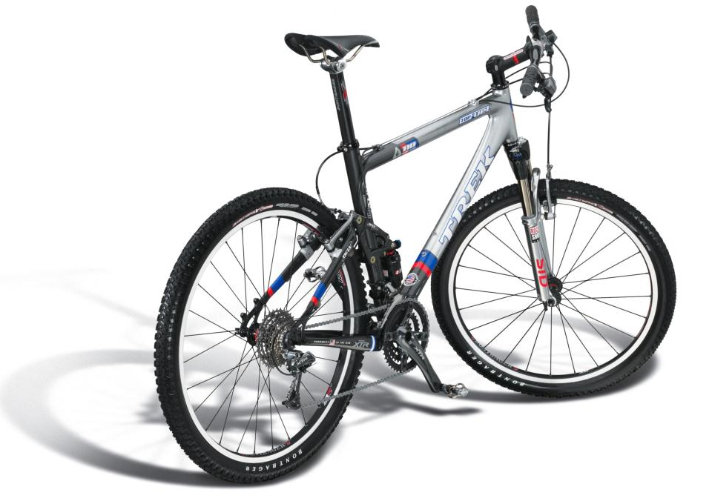
Design
What does the customer want to buy?
Courtesy Bill Buxton
Notes:
This clearly shows the DESIGN of the bike…
[ADVANCE]
But, What does the customer want to buy?
The bike owner wants to buy [ADVANCE]

Slide 27
Experience Design
“The experience of even simple artifacts does not exist in a vacuum but, rather, in dynamic relationship with other people, places, and objects” – Buchenau & Suri 2000
Courtesy Bill Buxton
Notes:
The EXPERIENCE of using the bike. The aspiration (and hopefully the reality) of the experience
Experience depends on the bike, your equipment, the weather, the terrain, your skill, your current state of mind, etc.

Slide 28
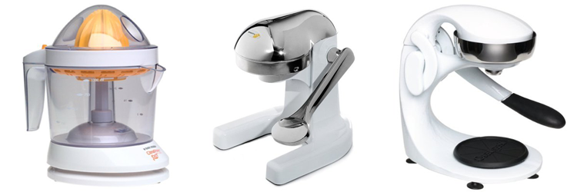
Experience vs. Interface Design
CitrusMate Plus Mighty OJ Manual Juicer OrangeX Manual Juicer
Notes:
He loved his first juicer every morning… complained he didn’t have it at the cabin
Then got the gift of the second for his cabin. Quiet!!! Loved the experience and now no longer liked the original!
Complained… then got a gift of the 3rd for home… Same interface as the second…
but DIFFERENT experience. Easy at end of pulling down lever.
USER EXPERIENCE was partly the UI but also the situation and environment
And the relative experience to what had come before!

Slide 29
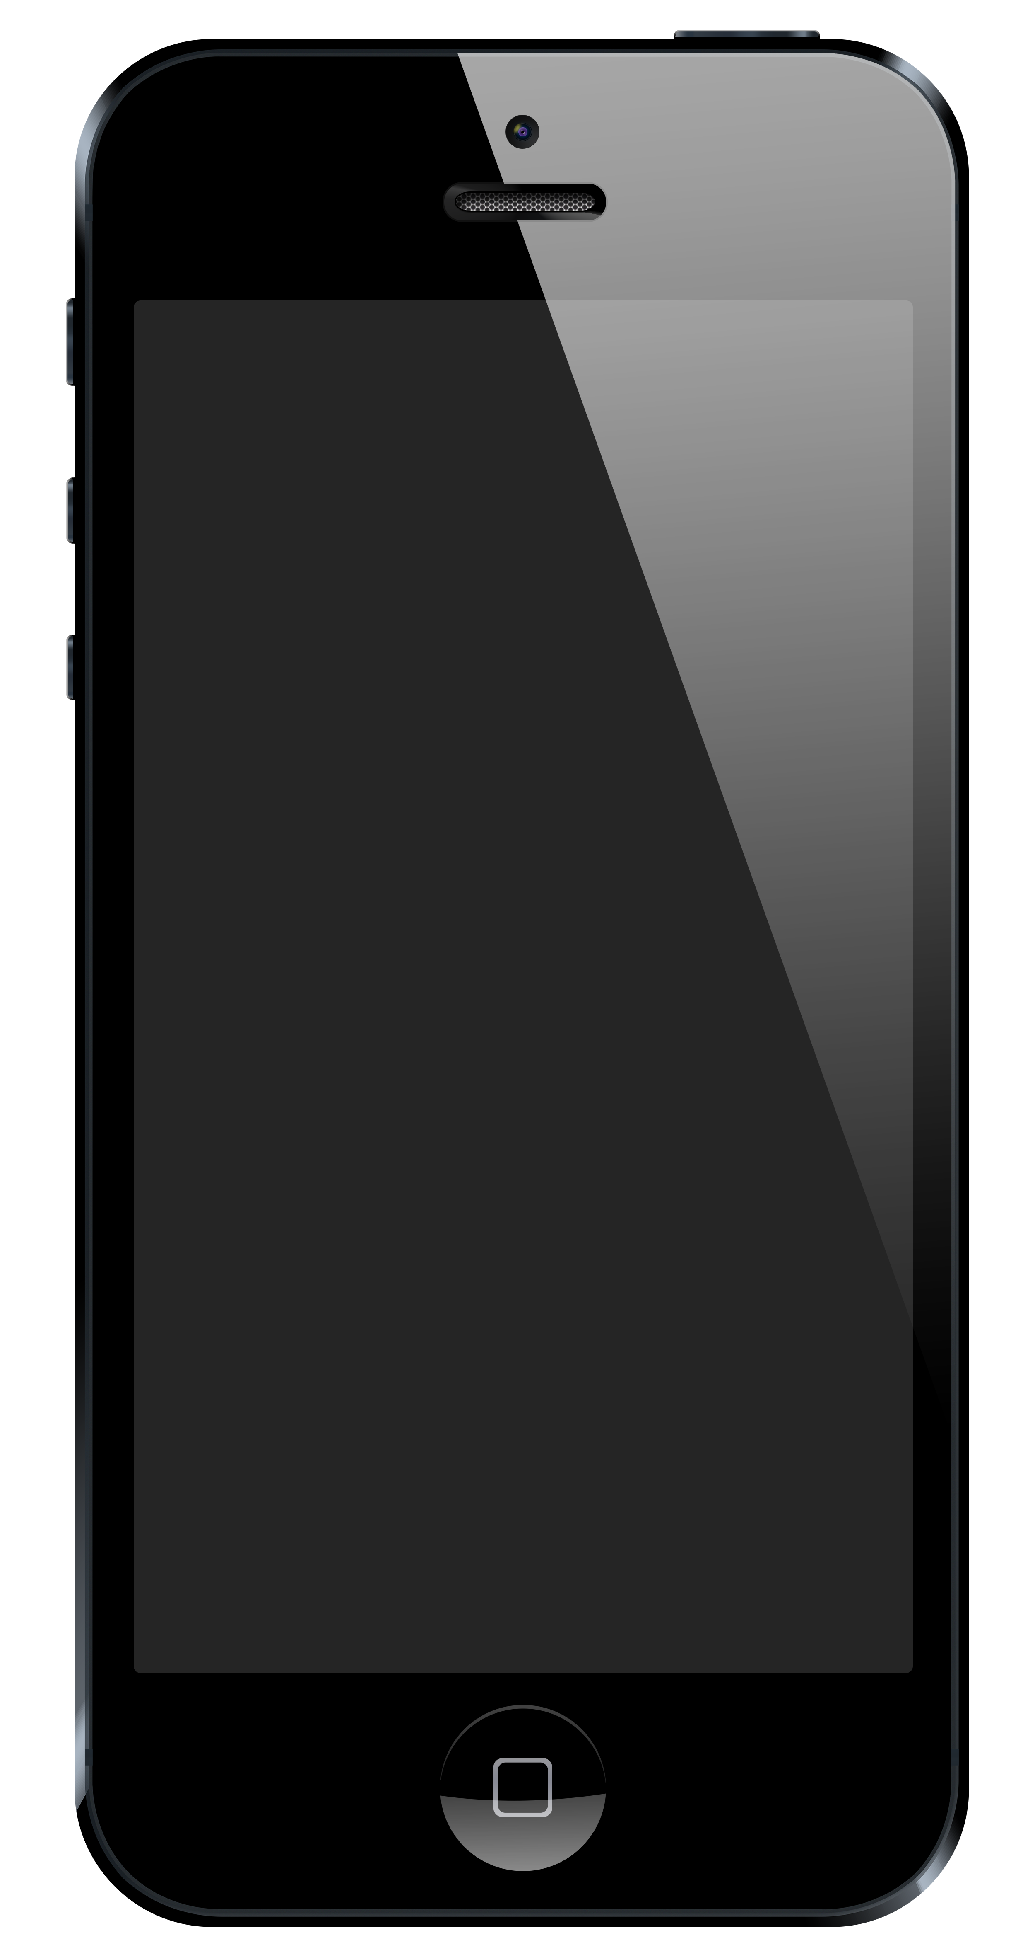
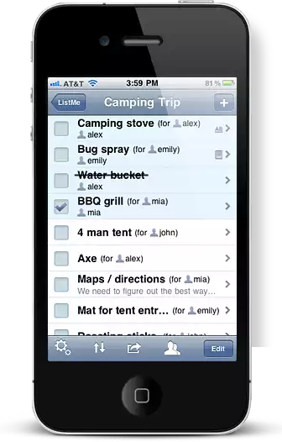
Experience Design for a Phone App?
Draw my phone
Draw my app’s interface
Draw the experience of using my app
Which is the true object of design?
http://www.listmeapp.com/
Courtesy Bill Buxton
Notes:
What is the experience design for our phone app?

Slide 30
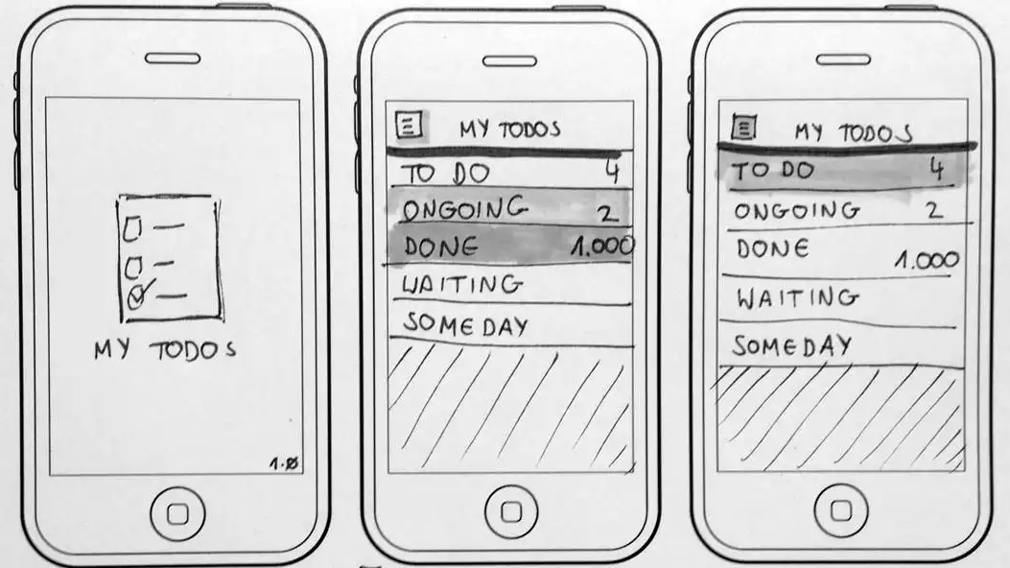
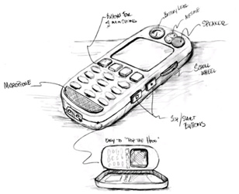
Minimal Detail
Include only what is required to render the intended purpose or concept
http://www.smashingmagazine.com/2013/06/sketching-for-better-mobile-experiences/
Notes:
Abstract it

Slide 31
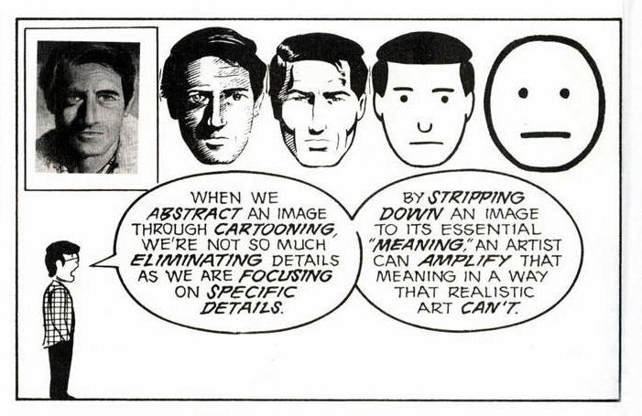
Scott McCloud’s Understanding Comics
People think focusing is about saying “yes.” But…
“Focusing is about saying no.” – Steve Jobs
Notes:
Scott McCloud’s Understanding Comics

Slide 32
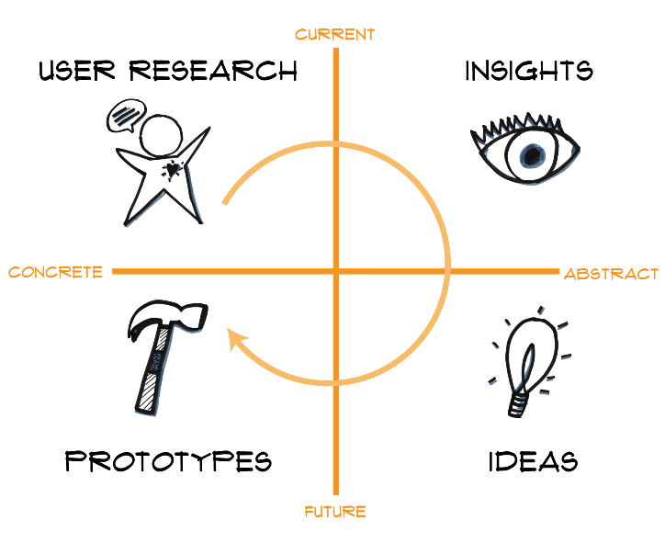
Design Thinking is Iterative

Slide 33
Summary
Sketching allows exploration of many concepts in the very early stages of design
As investment goes up, need to use more and more formal criteria for evaluation

Slide 34
Next Time
Lecture
Lo-fi Prototyping
Read
"Involving Customers with Iterative Design" (Ch 4) of The Design of Sites
"Making a Paper Prototype" (Ch 4) from Paper Prototyping by Carolyn Snyder
Project (due Thur/Fri in studio)
Concept Video
Short (90 seconds ideal)
Tell a story more than show an interface
Storyboard first!
Glad to look at rough cuts

