Slide 1
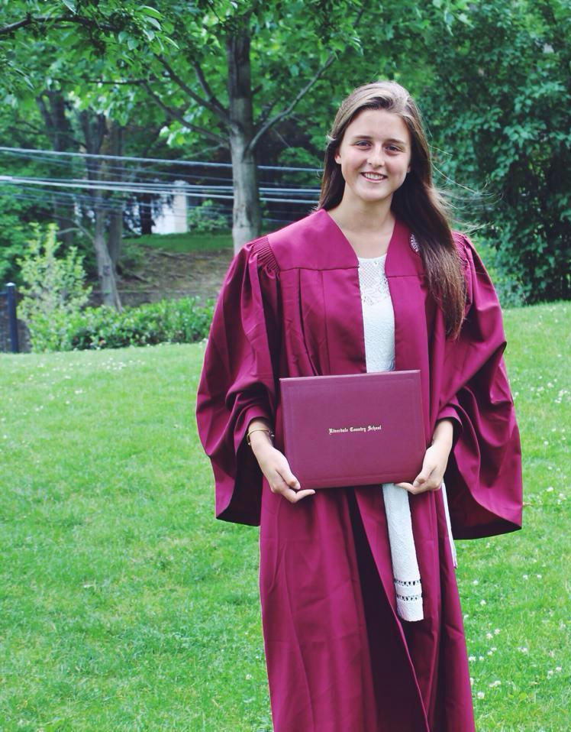
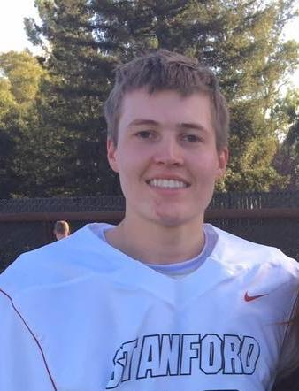
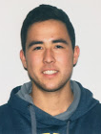
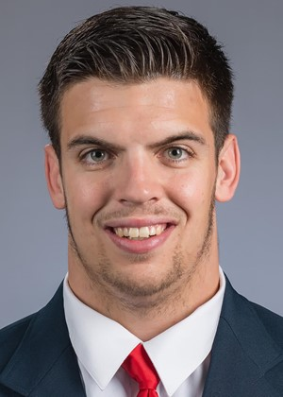
4 Cooking Dummies
Caillin Campbell
Max Kucera
Ian Jones
CJ Keller

Slide 2
Initial POV
Notes:
a. List and introduce your team members
b. What is your problem domain (in addition to the studio theme)

Slide 3
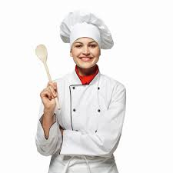
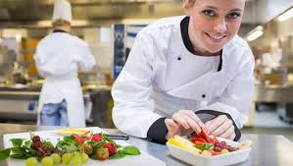
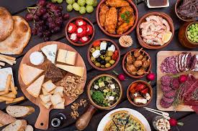
Row House Chef
We met Gilly, a Row House chef who graduated from culinary school.
We were amazed to realize that even though she went to school for cooking, she valued hands on education more than going to school.
It would be game changing to bring the personalized instruction in an accessible way to everyone willing to learn.
Notes:
We met Gilly, a Row House chef who graduated from culinary school.
We were amazed to realize that even though she went to school for cooking, she valued hands on education more than going to school.
It would be game changing to bring the personalized instruction in an accessible way to everyone willing to learn.

Slide 4
Additional Input from our Users
Notes:
Who you interviewed & what you found out

Slide 5
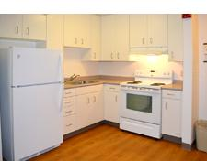
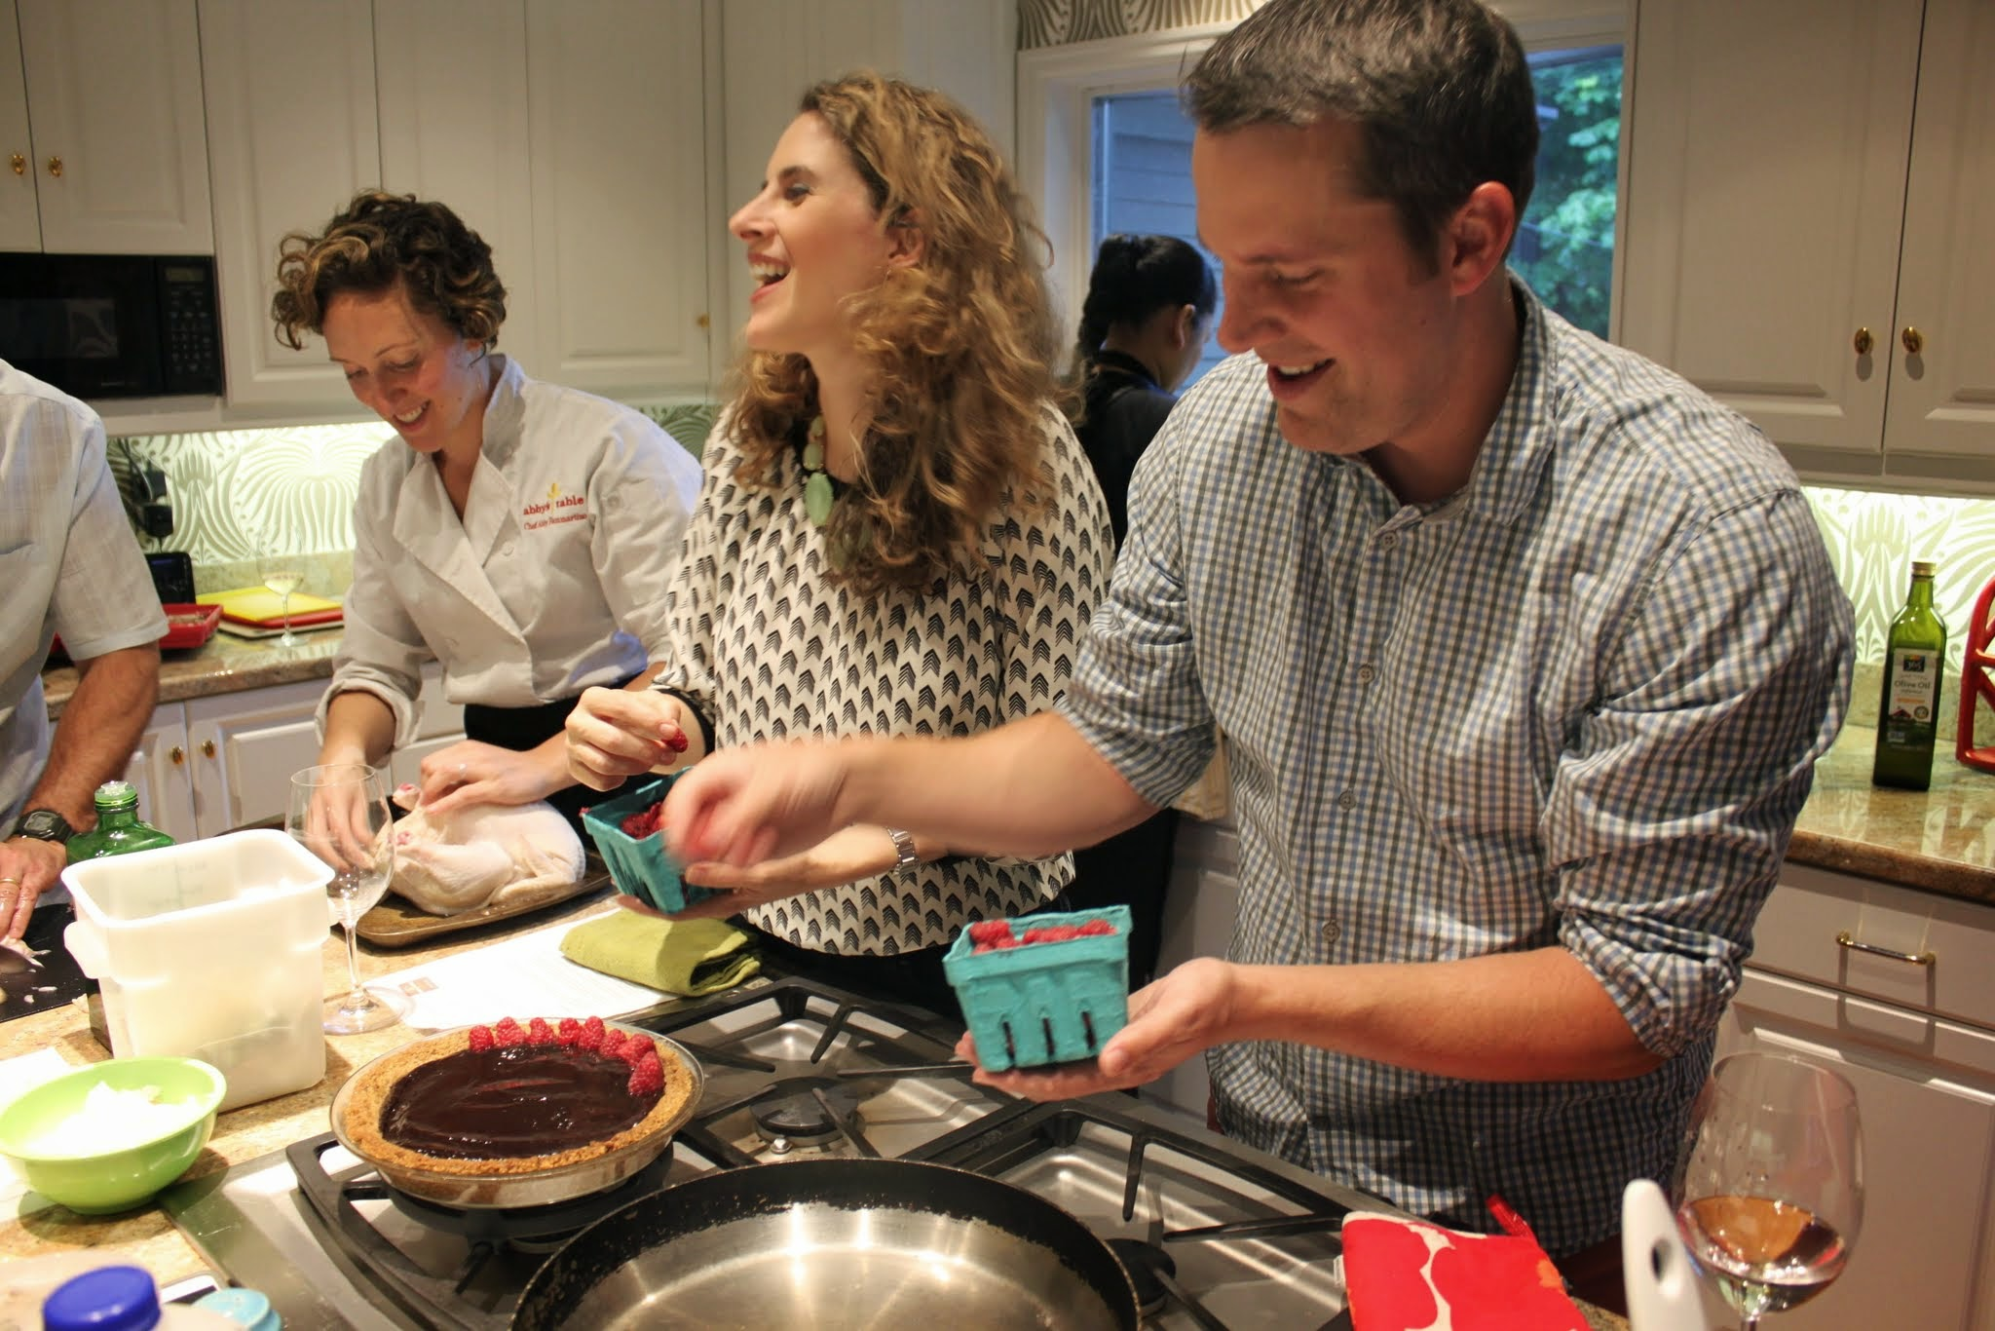
Stanford Student
Lived in SF this summer, had to cook for himself
Self-taught and had limited prior cooking experience
Had “cooking competitions” with his family
This summer: cooking on a budget
Wants way to keep track of what ingredients he owns and how much is left
Notes:
Self-taught
Wouldn’t look up recipes, would cook with what he had and experiment
Cooking contests with family
Went to the store and bought ingredients, then competed to make the best dish
Was a fun way to spend time and bond with his family
This summer
Issue: Budget and spontaneity
Wanted to know what dishes he could cook with a given budget
Bored because he had to repeat the same dishes over and over again
Social Cooking / Sharing online
“I don’t see why you would need an app”
“I like doing it in person”
Not a huge social media person
Doesn’t think that sharing a picture would be the same as sharing in real life
Cooking Instruction
Not interested
Would “take the fun out of it”

Slide 6
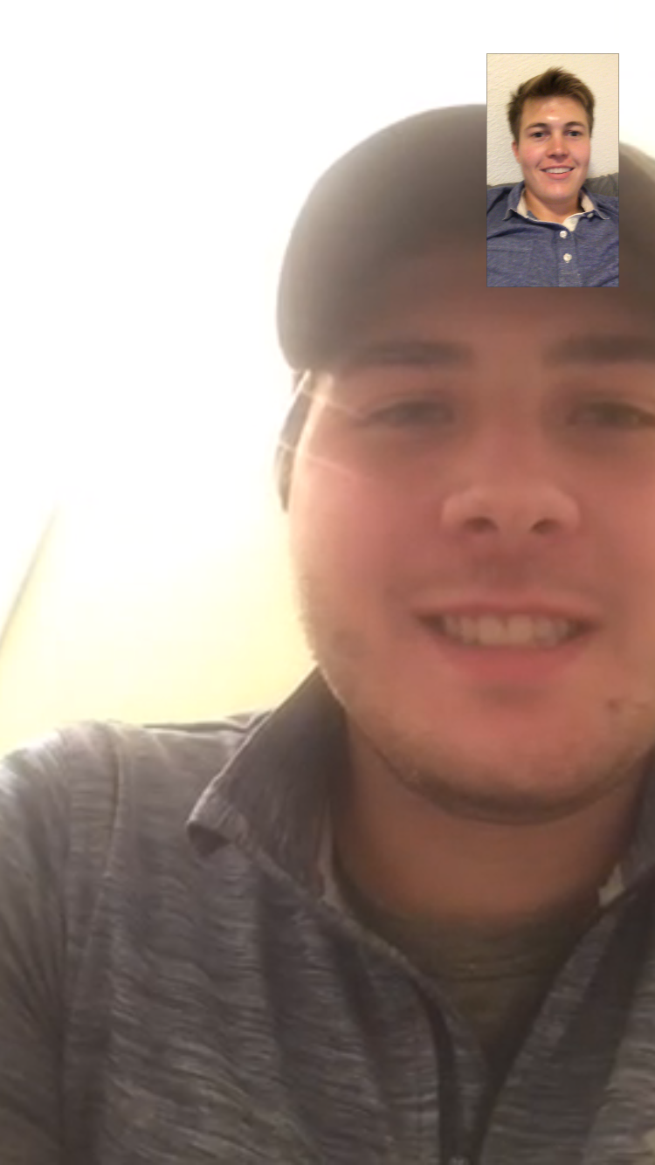
Miami University Student
Lives in apartment off campus
Has cooked all of his meals for last couple of months
Likes to imagine recipes in his head and then buys the necessary ingredients
Wants a way to input ingredients and output recipes that utilize them
Notes:
Lives in apartment off campus
Has cooked all of his meals for last couple of months
Likes to imagine recipes in his head and then buys the necessary ingredients
Wants a way to input ingredients and output recipes that utilize them
Likes when others are able to enjoy his food

Slide 7
Revised POV Slides
Notes:
“We met.. who needs… because … It would be game changing if…”)

Slide 8
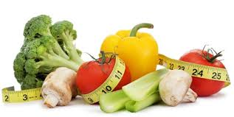
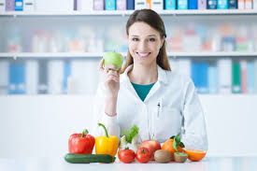
Sports Dietitian
We met Kristen, the Stanford Athletics Dietitian.
We were amazed to realize that although competition can originally make learning to cook intimidating, demonstrating successes to friends can serve as a reward and small victory.
It would be game changing to harness this competitive drive for novice users to become better cooks but leaving it at a level that does not drive away the users.
Notes:
We met Kristen, the Stanford Athletics Dietitian.
We were amazed to realize that although competition can originally make learning to cook intimidating, demonstrating successes to friends can serve as a reward and small victory.
It would be game changing to harness this competitive drive for novice users to become better cooks but leaving it at a level that does not drive away the users.

Slide 9
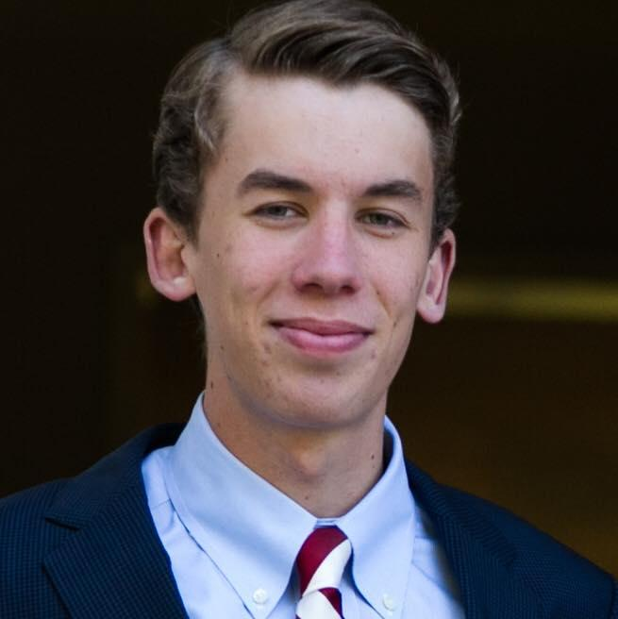
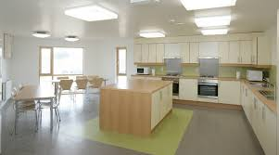
Stanford Student
We met Joe, a Stanford student living in Mirrielees and learning to cook on his own.
We were amazed to realize that although he has a kitchen, he often eats at dining halls or buys food as he views cooking as a chore.
It would be game changing to find a way to make cooking fun and enjoyable.

Slide 10
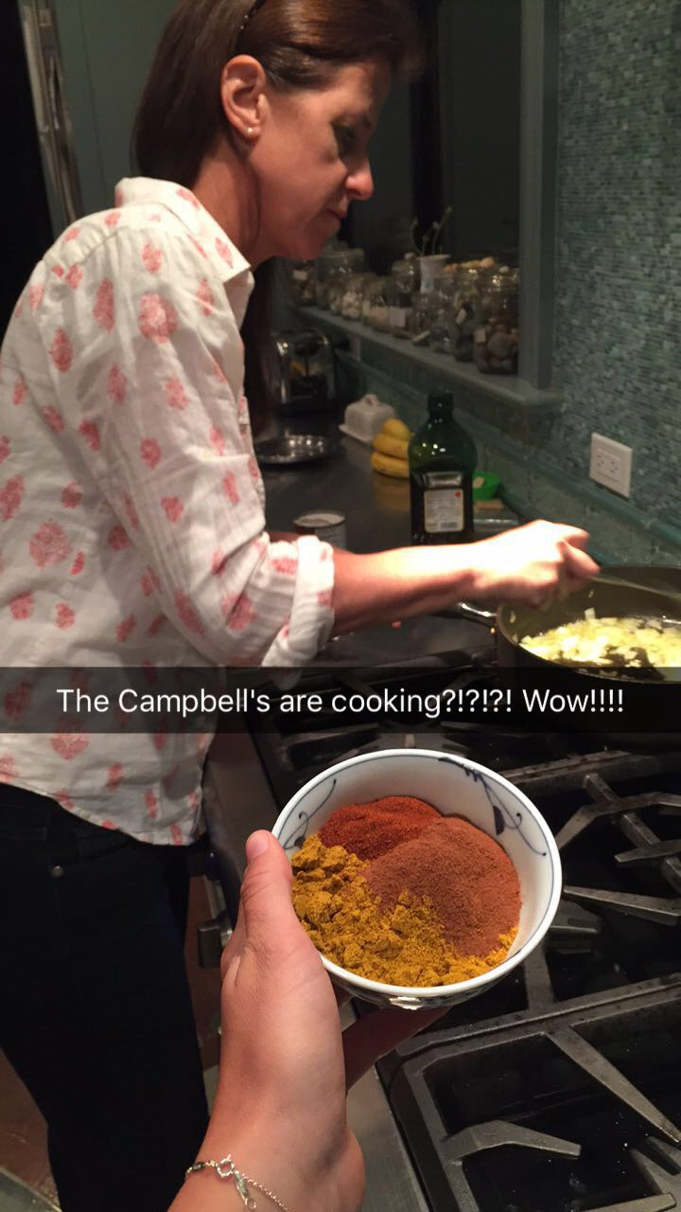
Mother of Young Children
We met Mrs. Campbell, a mother of five kids.
We were amazed to realize that despite having a strong willingness to learn, she had only taken 2 cooking classes 20 years ago and said learning with a friend would be the best way to motivate her.
It would be game changing to utilize social connections to encourage and motivate in the process of learning to cook.
Notes:
We met Mrs. Campbell, a mother of five kids.
We were amazed to realize that despite having a strong willingness to learn, she had only taken 2 cooking classes 20 years ago and said learning with a friend would be the best way to motivate her.
It would be game changing to utilize social connections to encourage and motivate in the process of learning to cook.

Slide 11
How Might We Make the World Better

Slide 12
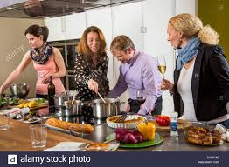
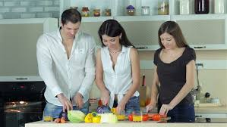
Sports Dietitian
How might we utilize competition to make the process of cooking more fun?
Notes:
How might we utilize competition to make the process of cooking more fun?

Slide 13
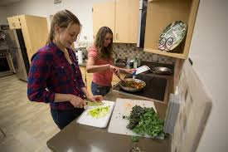
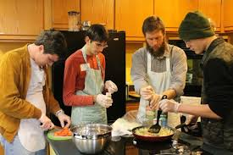
Stanford Student
How might we use friendships to make cooking an enjoyable experience, and motivate people to learn to cook

Slide 14
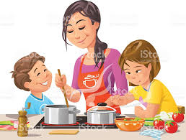
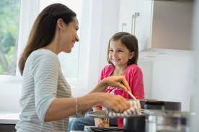
Mother of Young Children
How might we replace “cooking classes” with things that can be done in your own home at any hour of the day?

Slide 15
The Experience Prototypes
Notes:
a. Short description of the prototype and how it was tested (with pictures for both)
b. Results: 1-2 bullets on each of: Things that worked, things that didn’t work, surprises, and new learnings
c. Validity: Was the assumption valid? Why or Why Not? Any new assumptions that emerged?

Slide 16
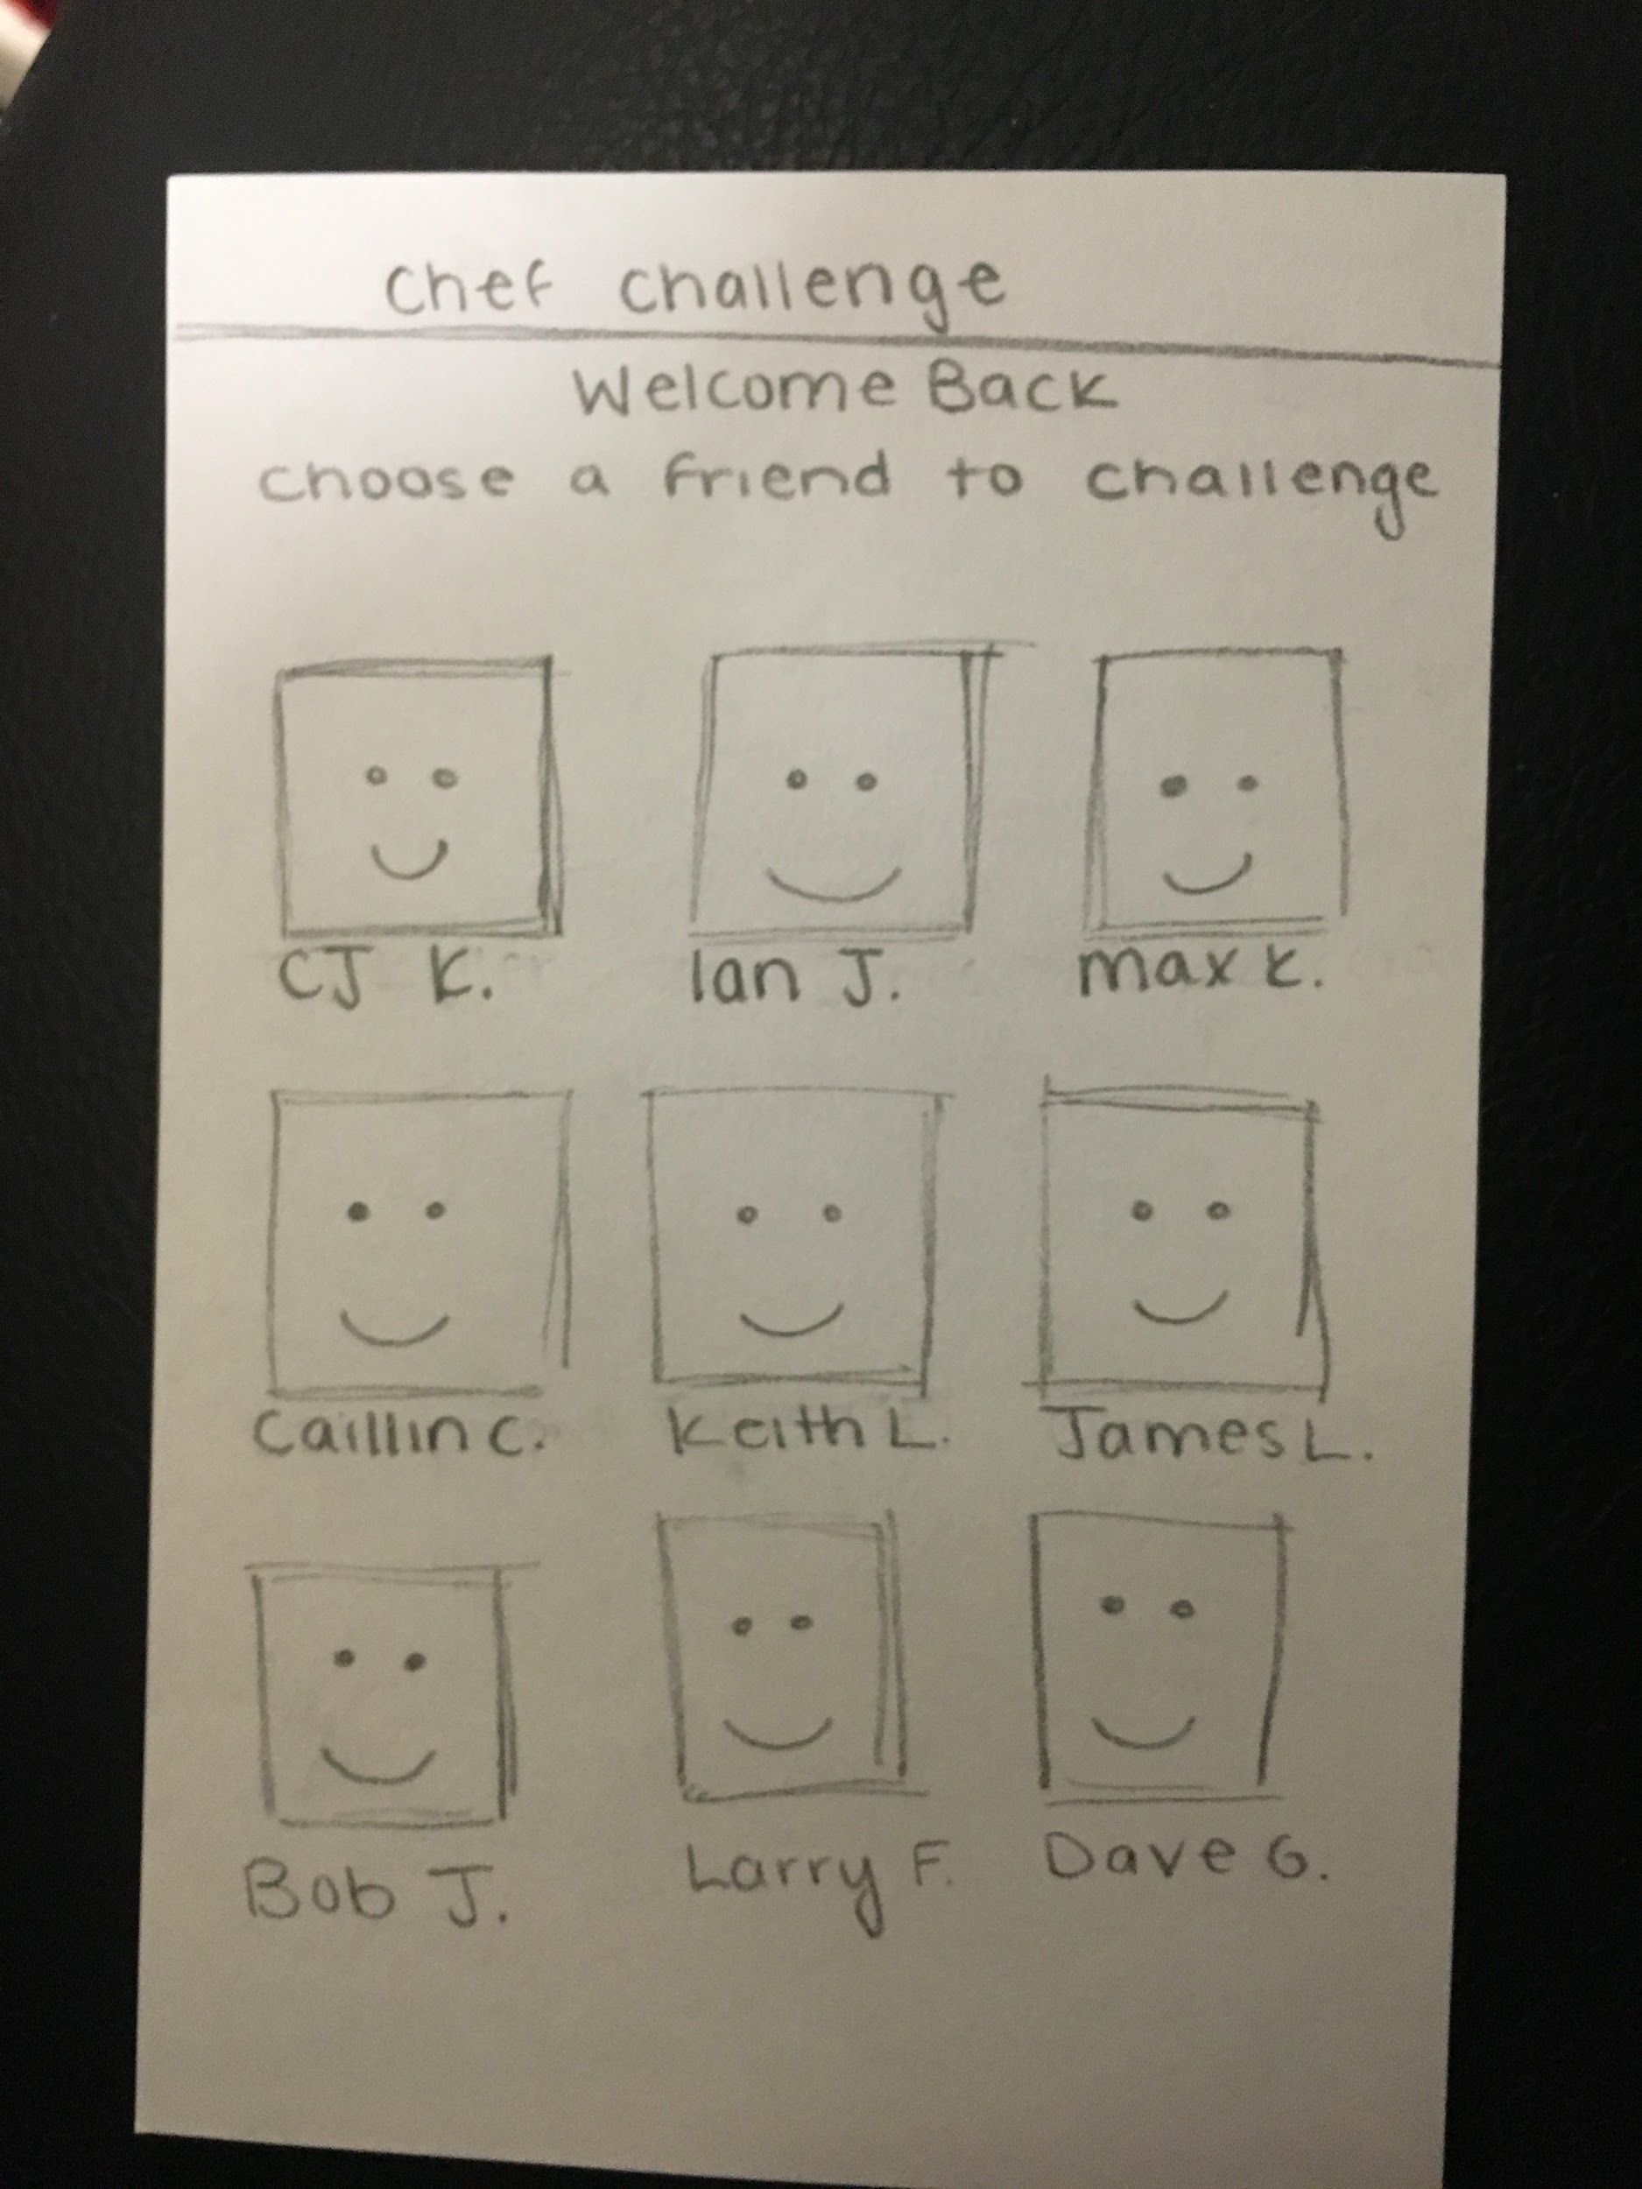
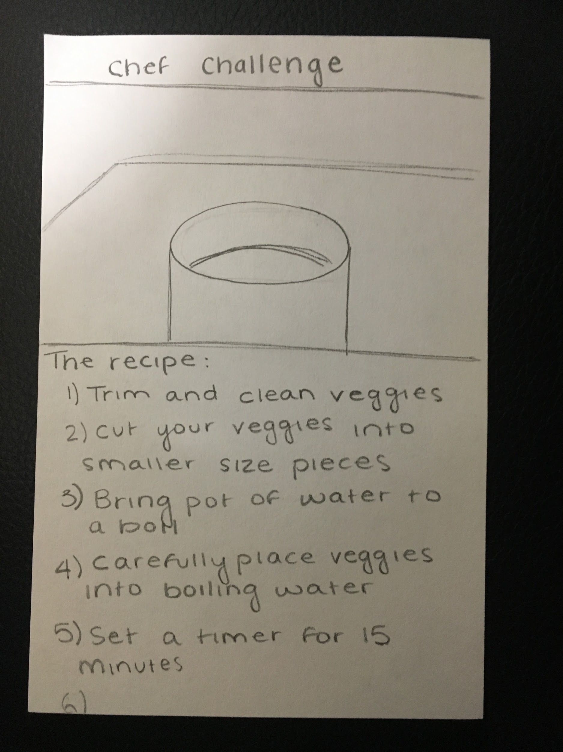
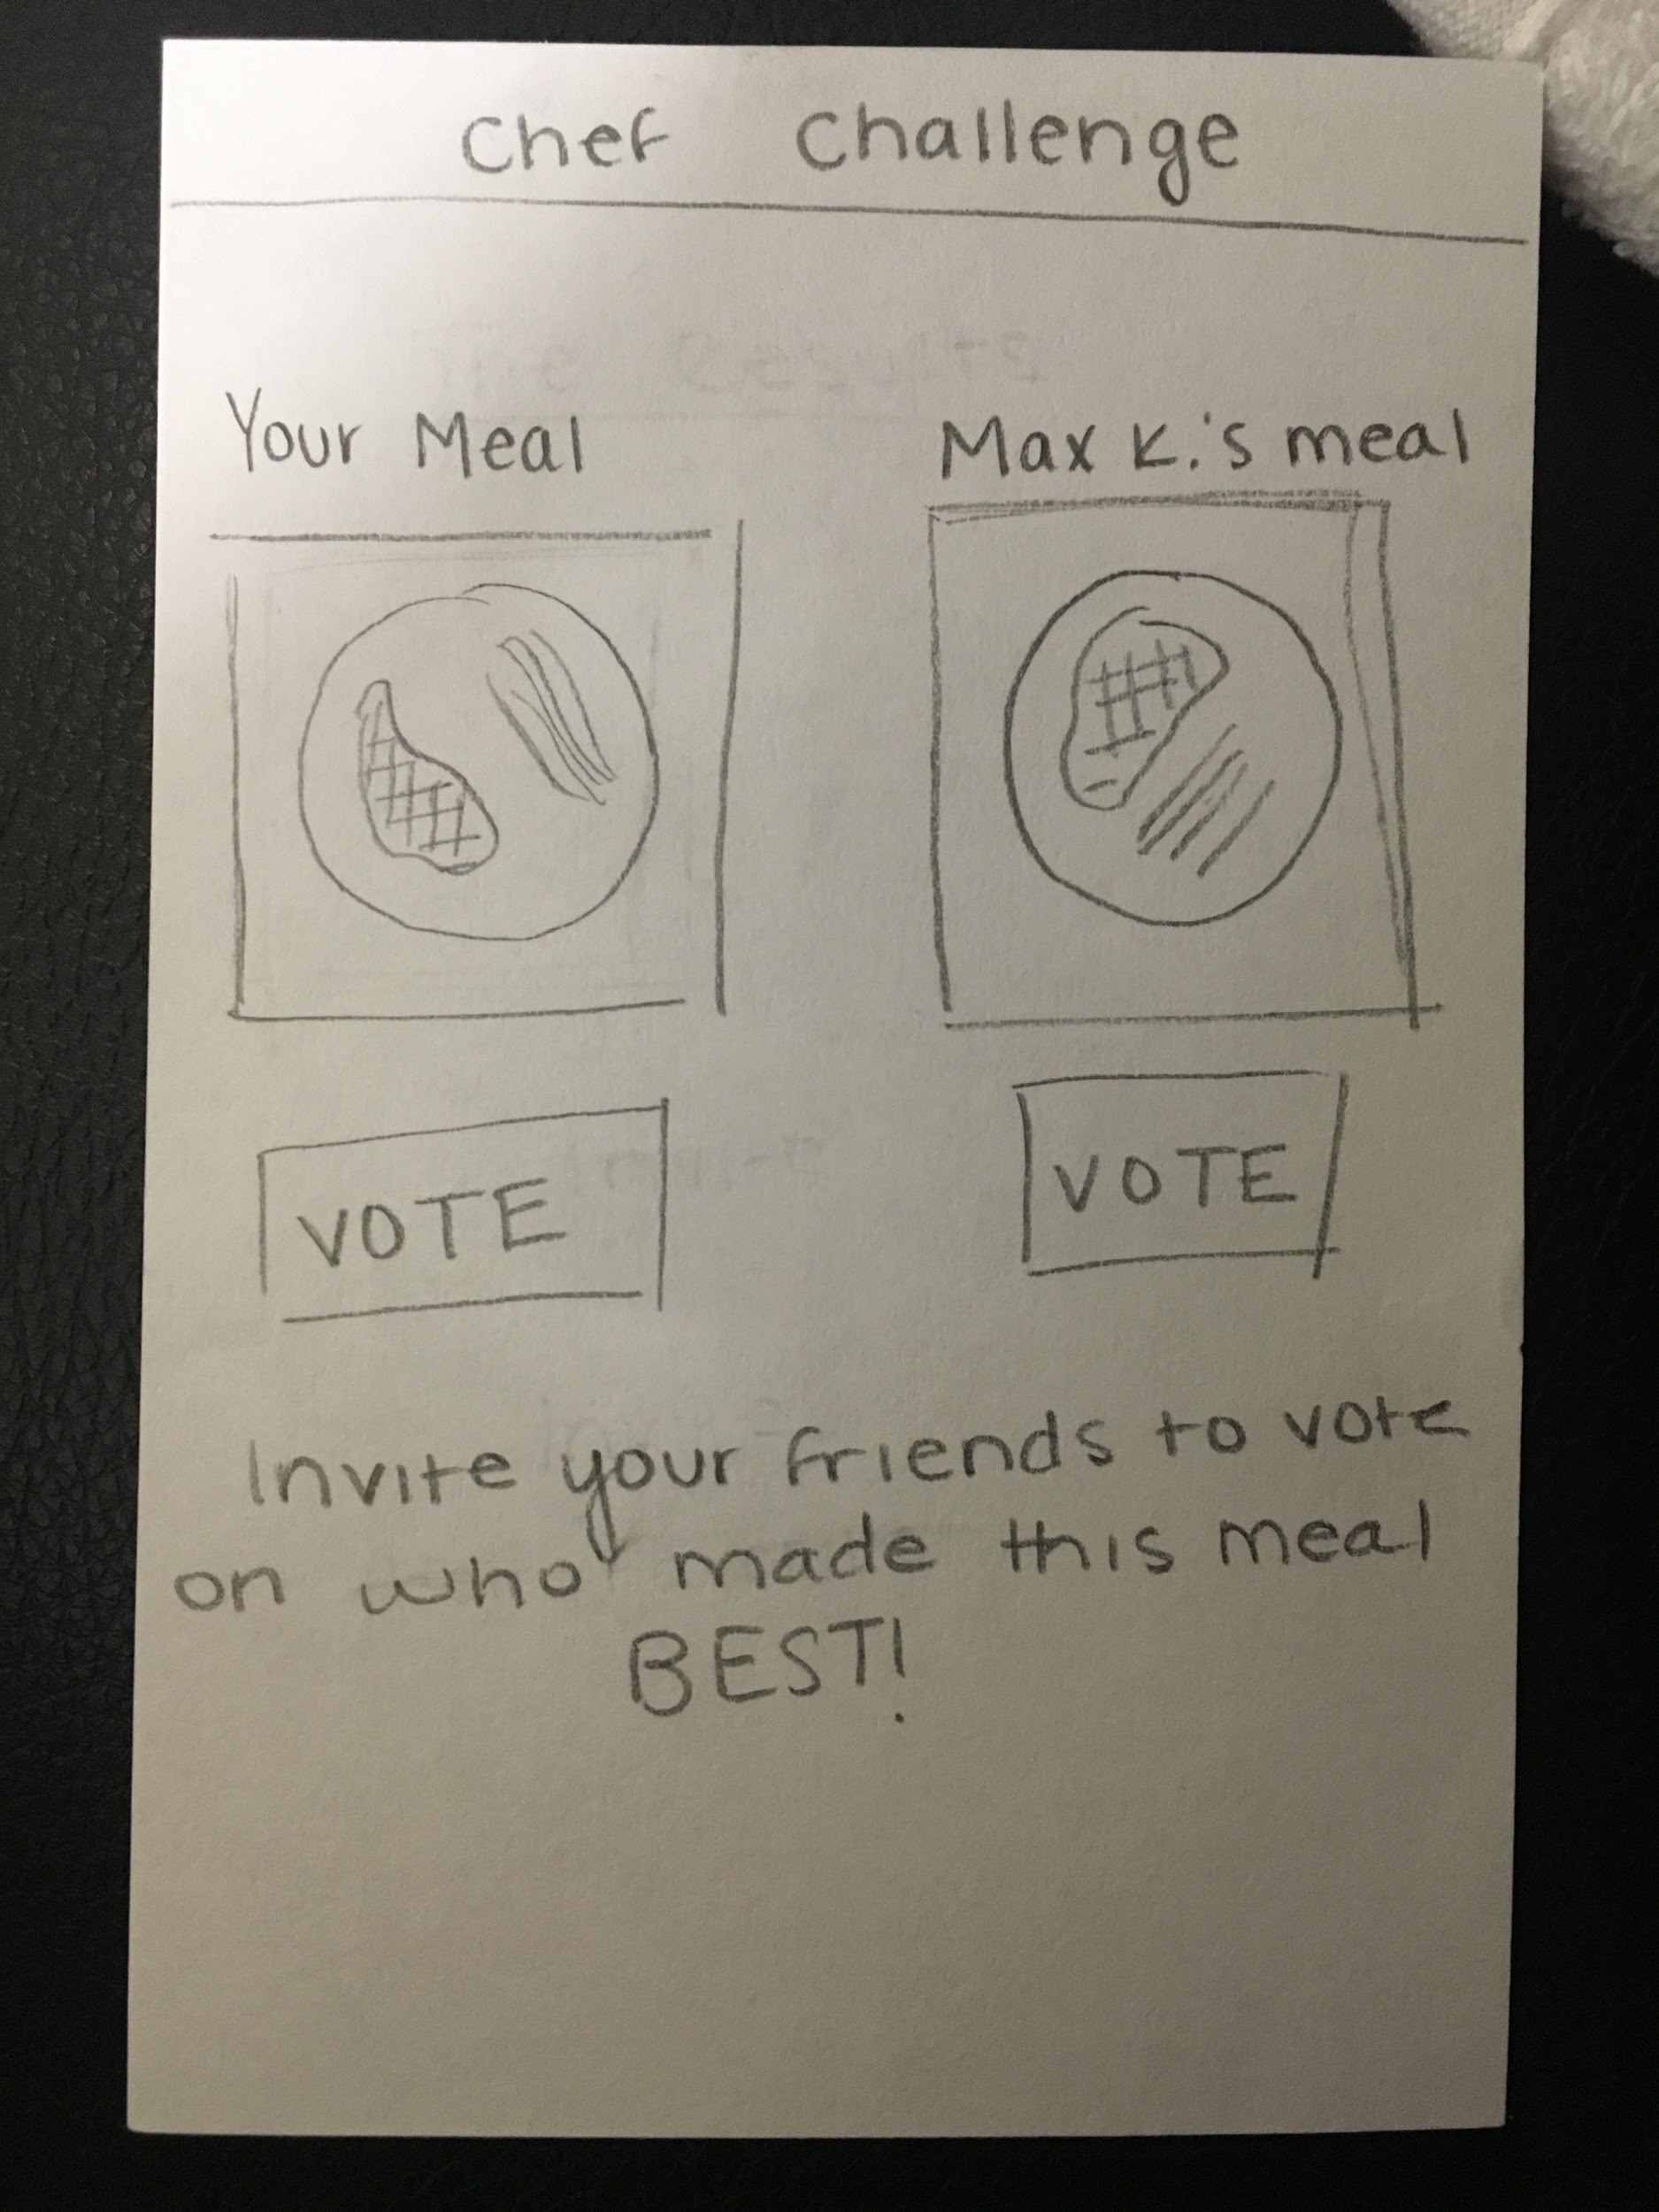
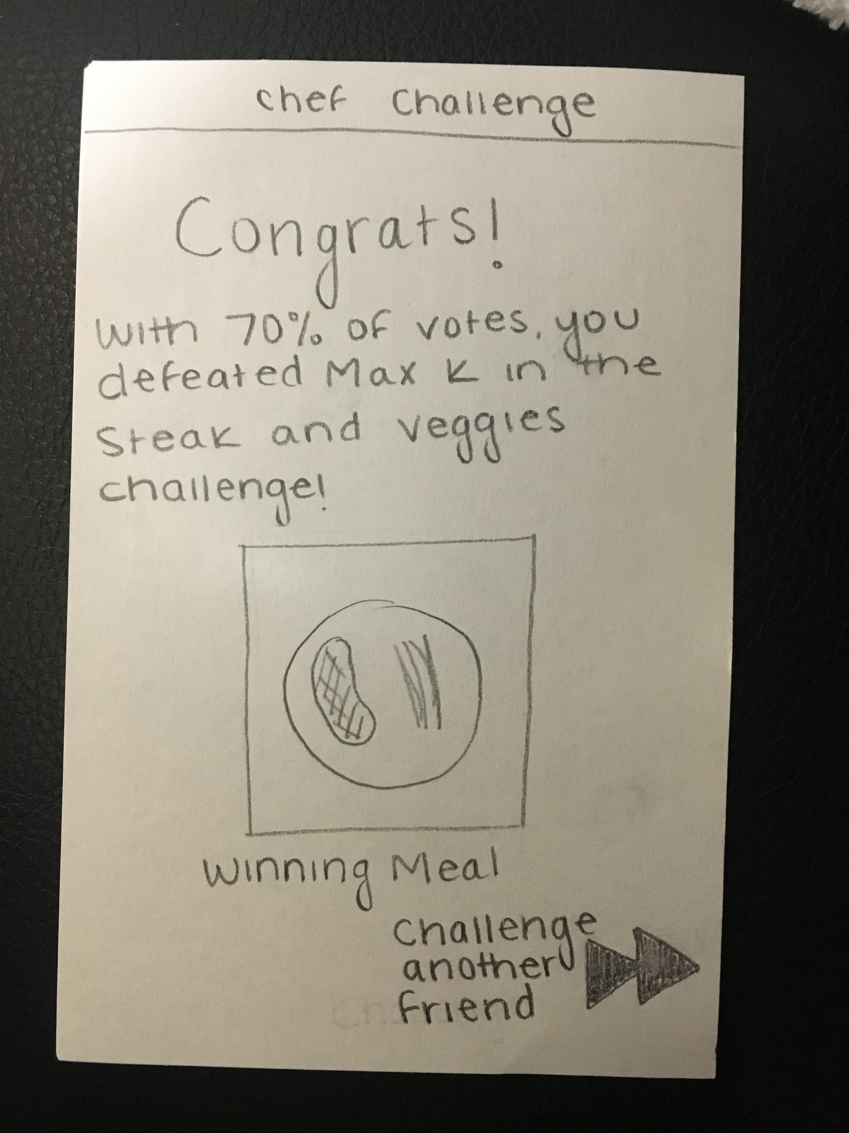
Cooking Competition

Slide 17
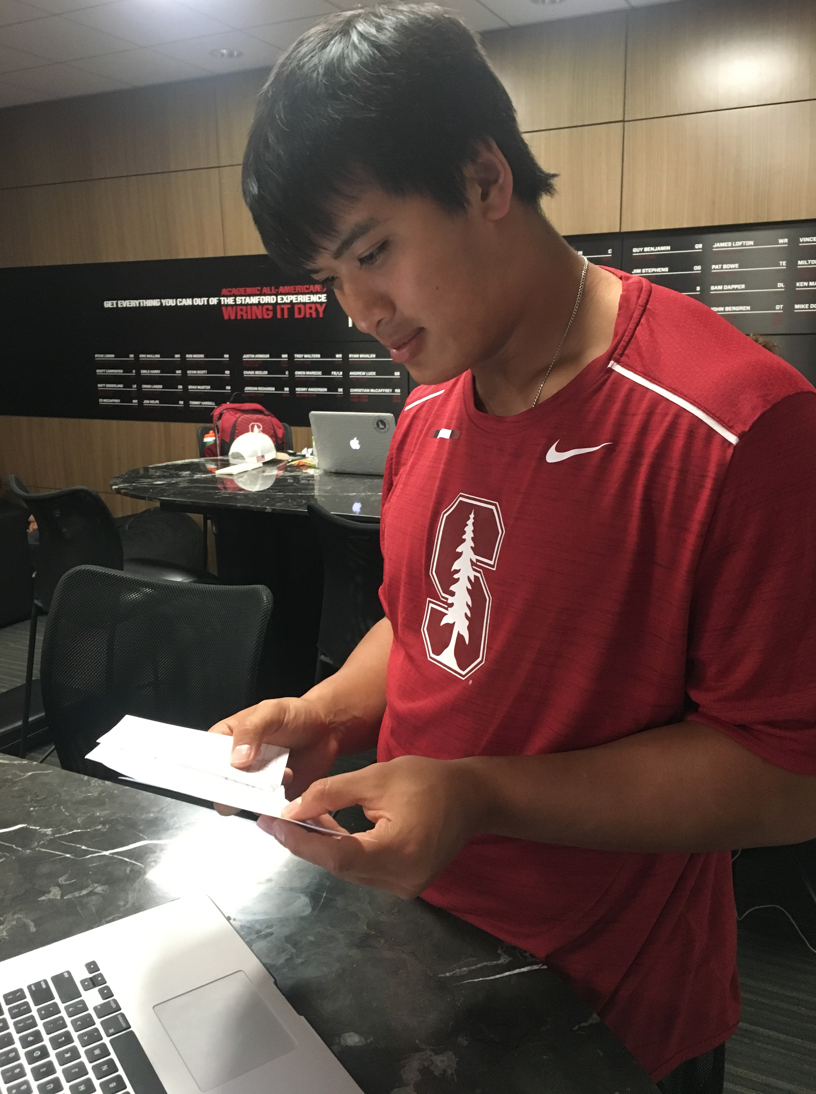
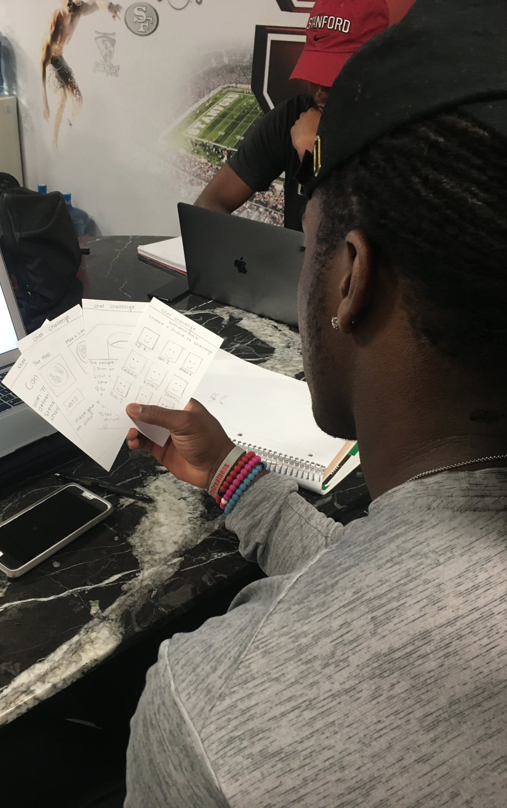
Cooking Competition App: Anthony Trinh & Trevor Speights
This cooking competition App would allow users to challenge a friend to make the same recipe, then invite their friends to vote on which final product looks better
Anthony likes idea of learning basic cooking techniques and likes that competition ranks him in relation to friends.
Trevor was unsure about learning from an app, but liked the idea of showing off his final product and challenging his friends
Our assumption was kind of there but we undervalued taste in the process
Notes:
This cooking competition App would allow users to challenge a friend to make the same recipe, then invite their friends to vote on which final product looks better Anthony likes idea of learning basic cooking techniques and likes that competition ranks him in relation to friends.
Trevor was unsure about learning from an app, but liked the idea of showing off his final product and challenging his friends

Slide 18
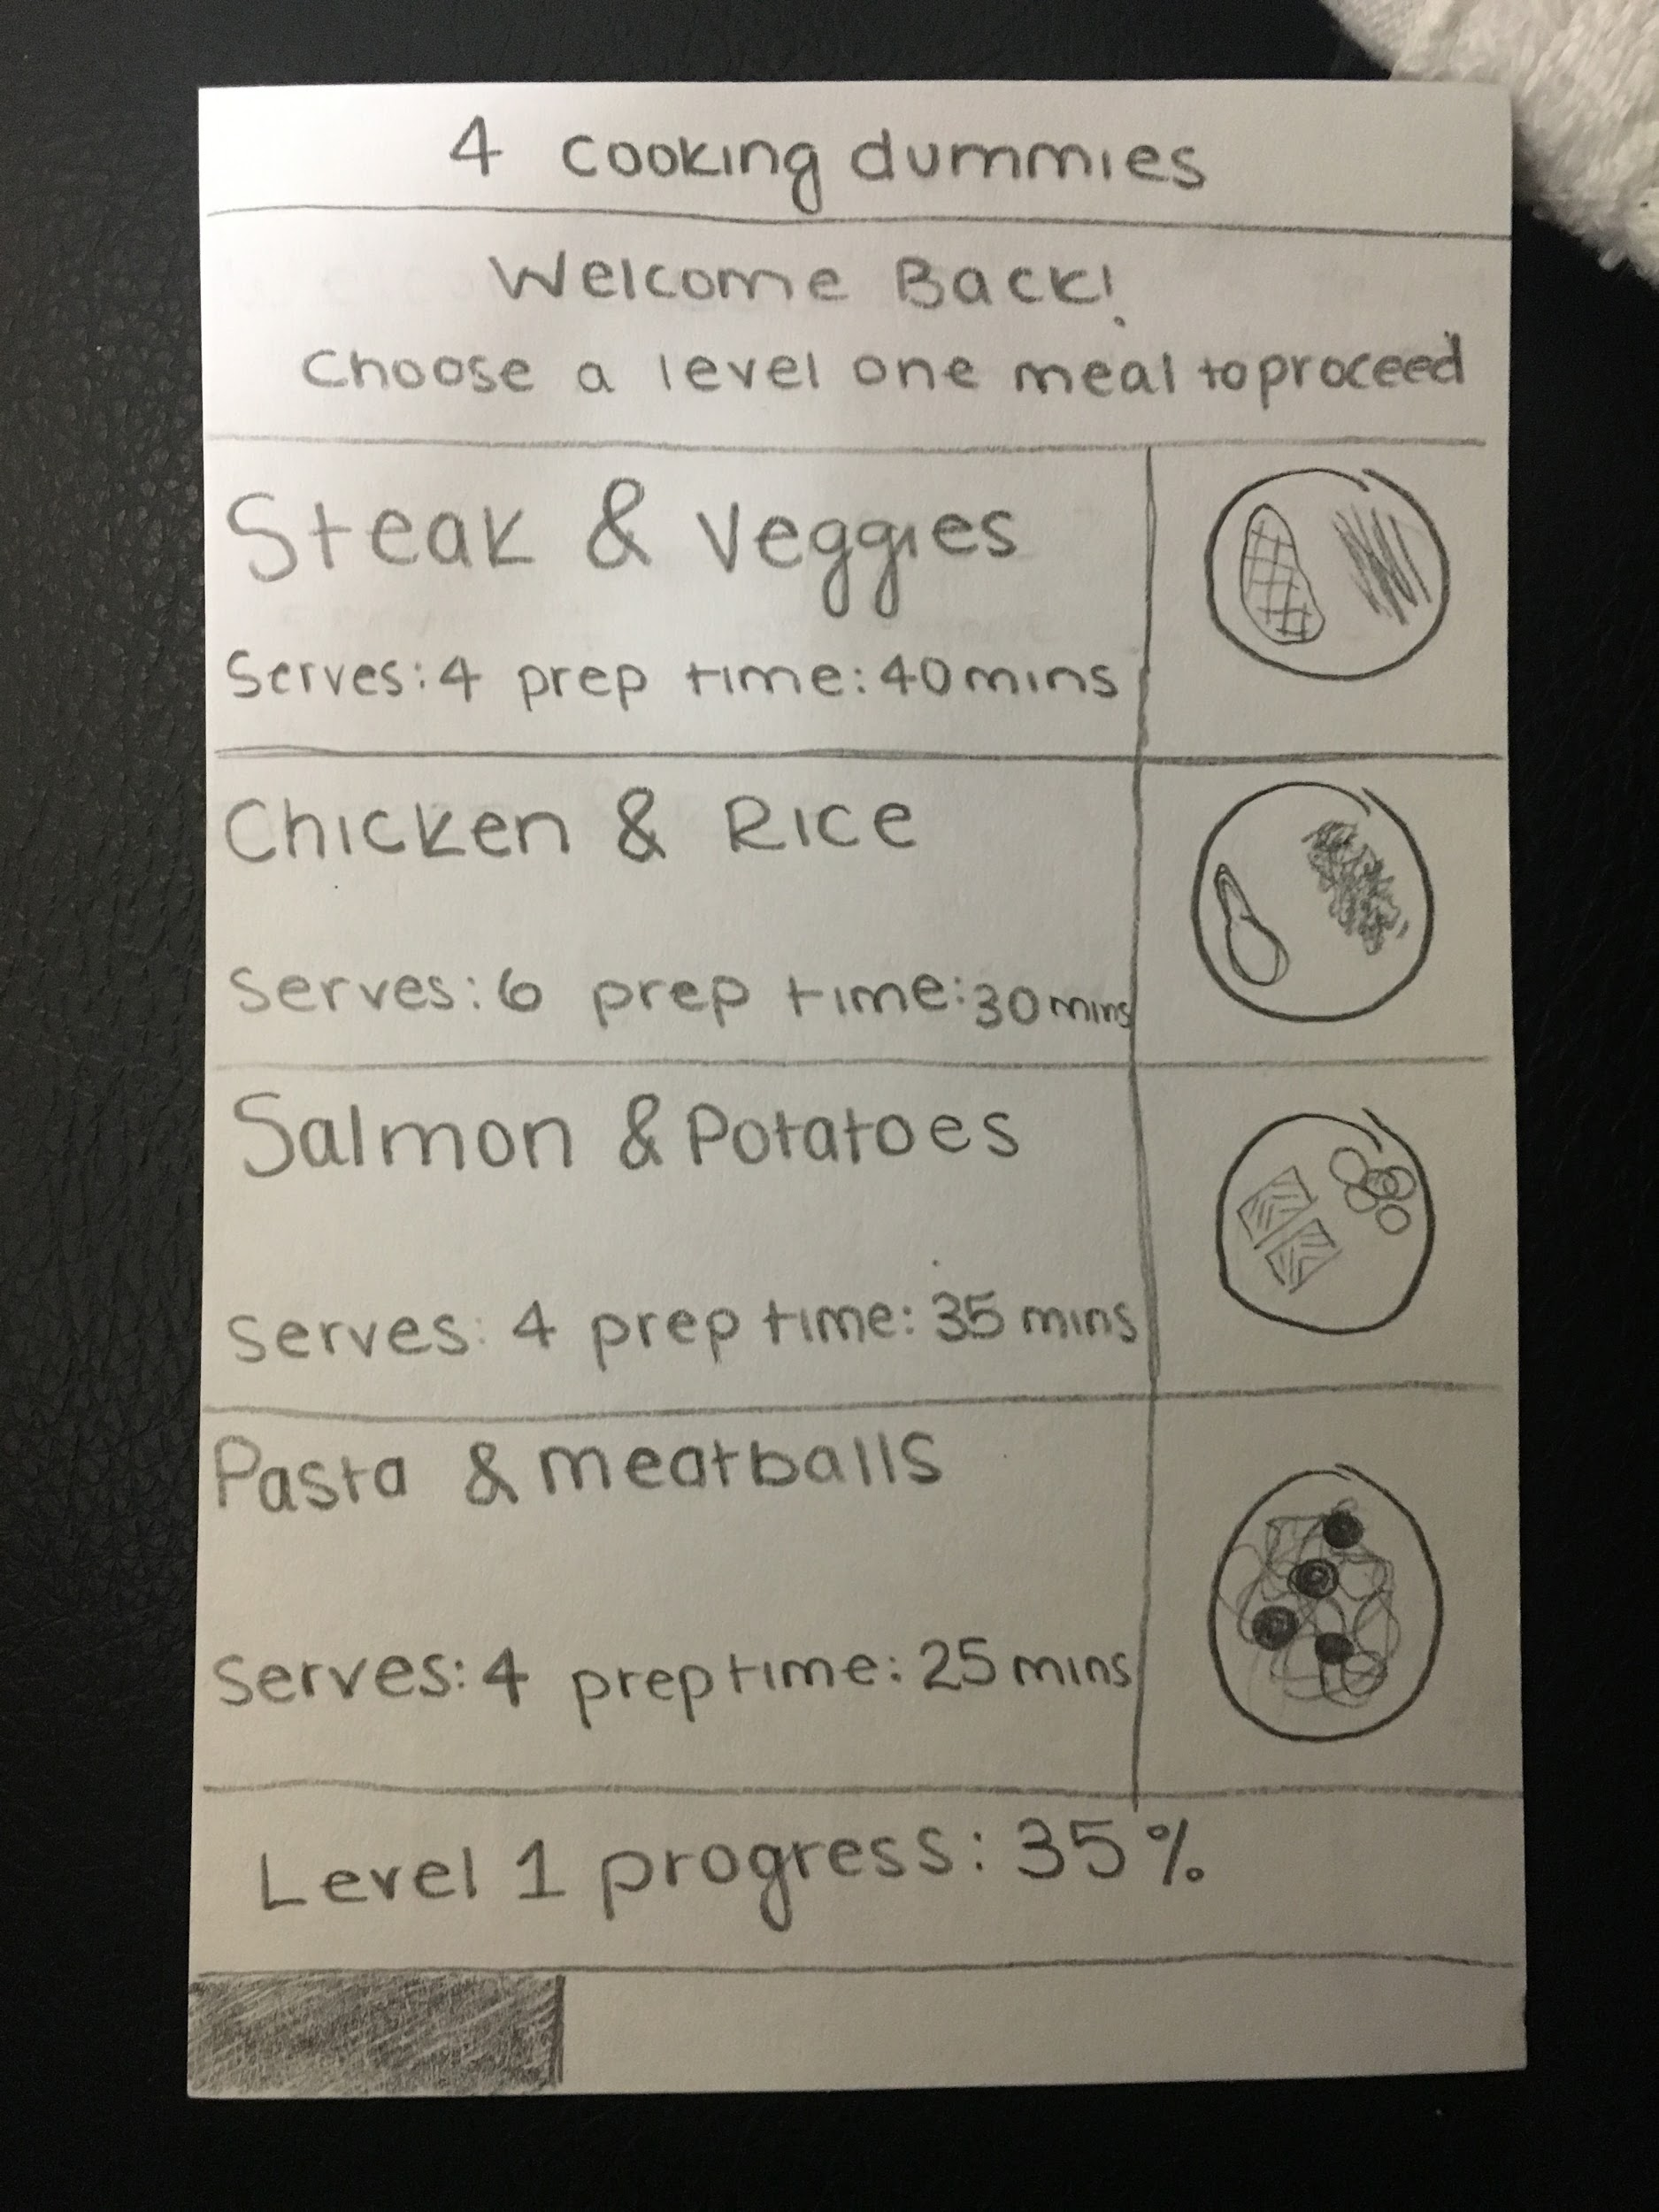
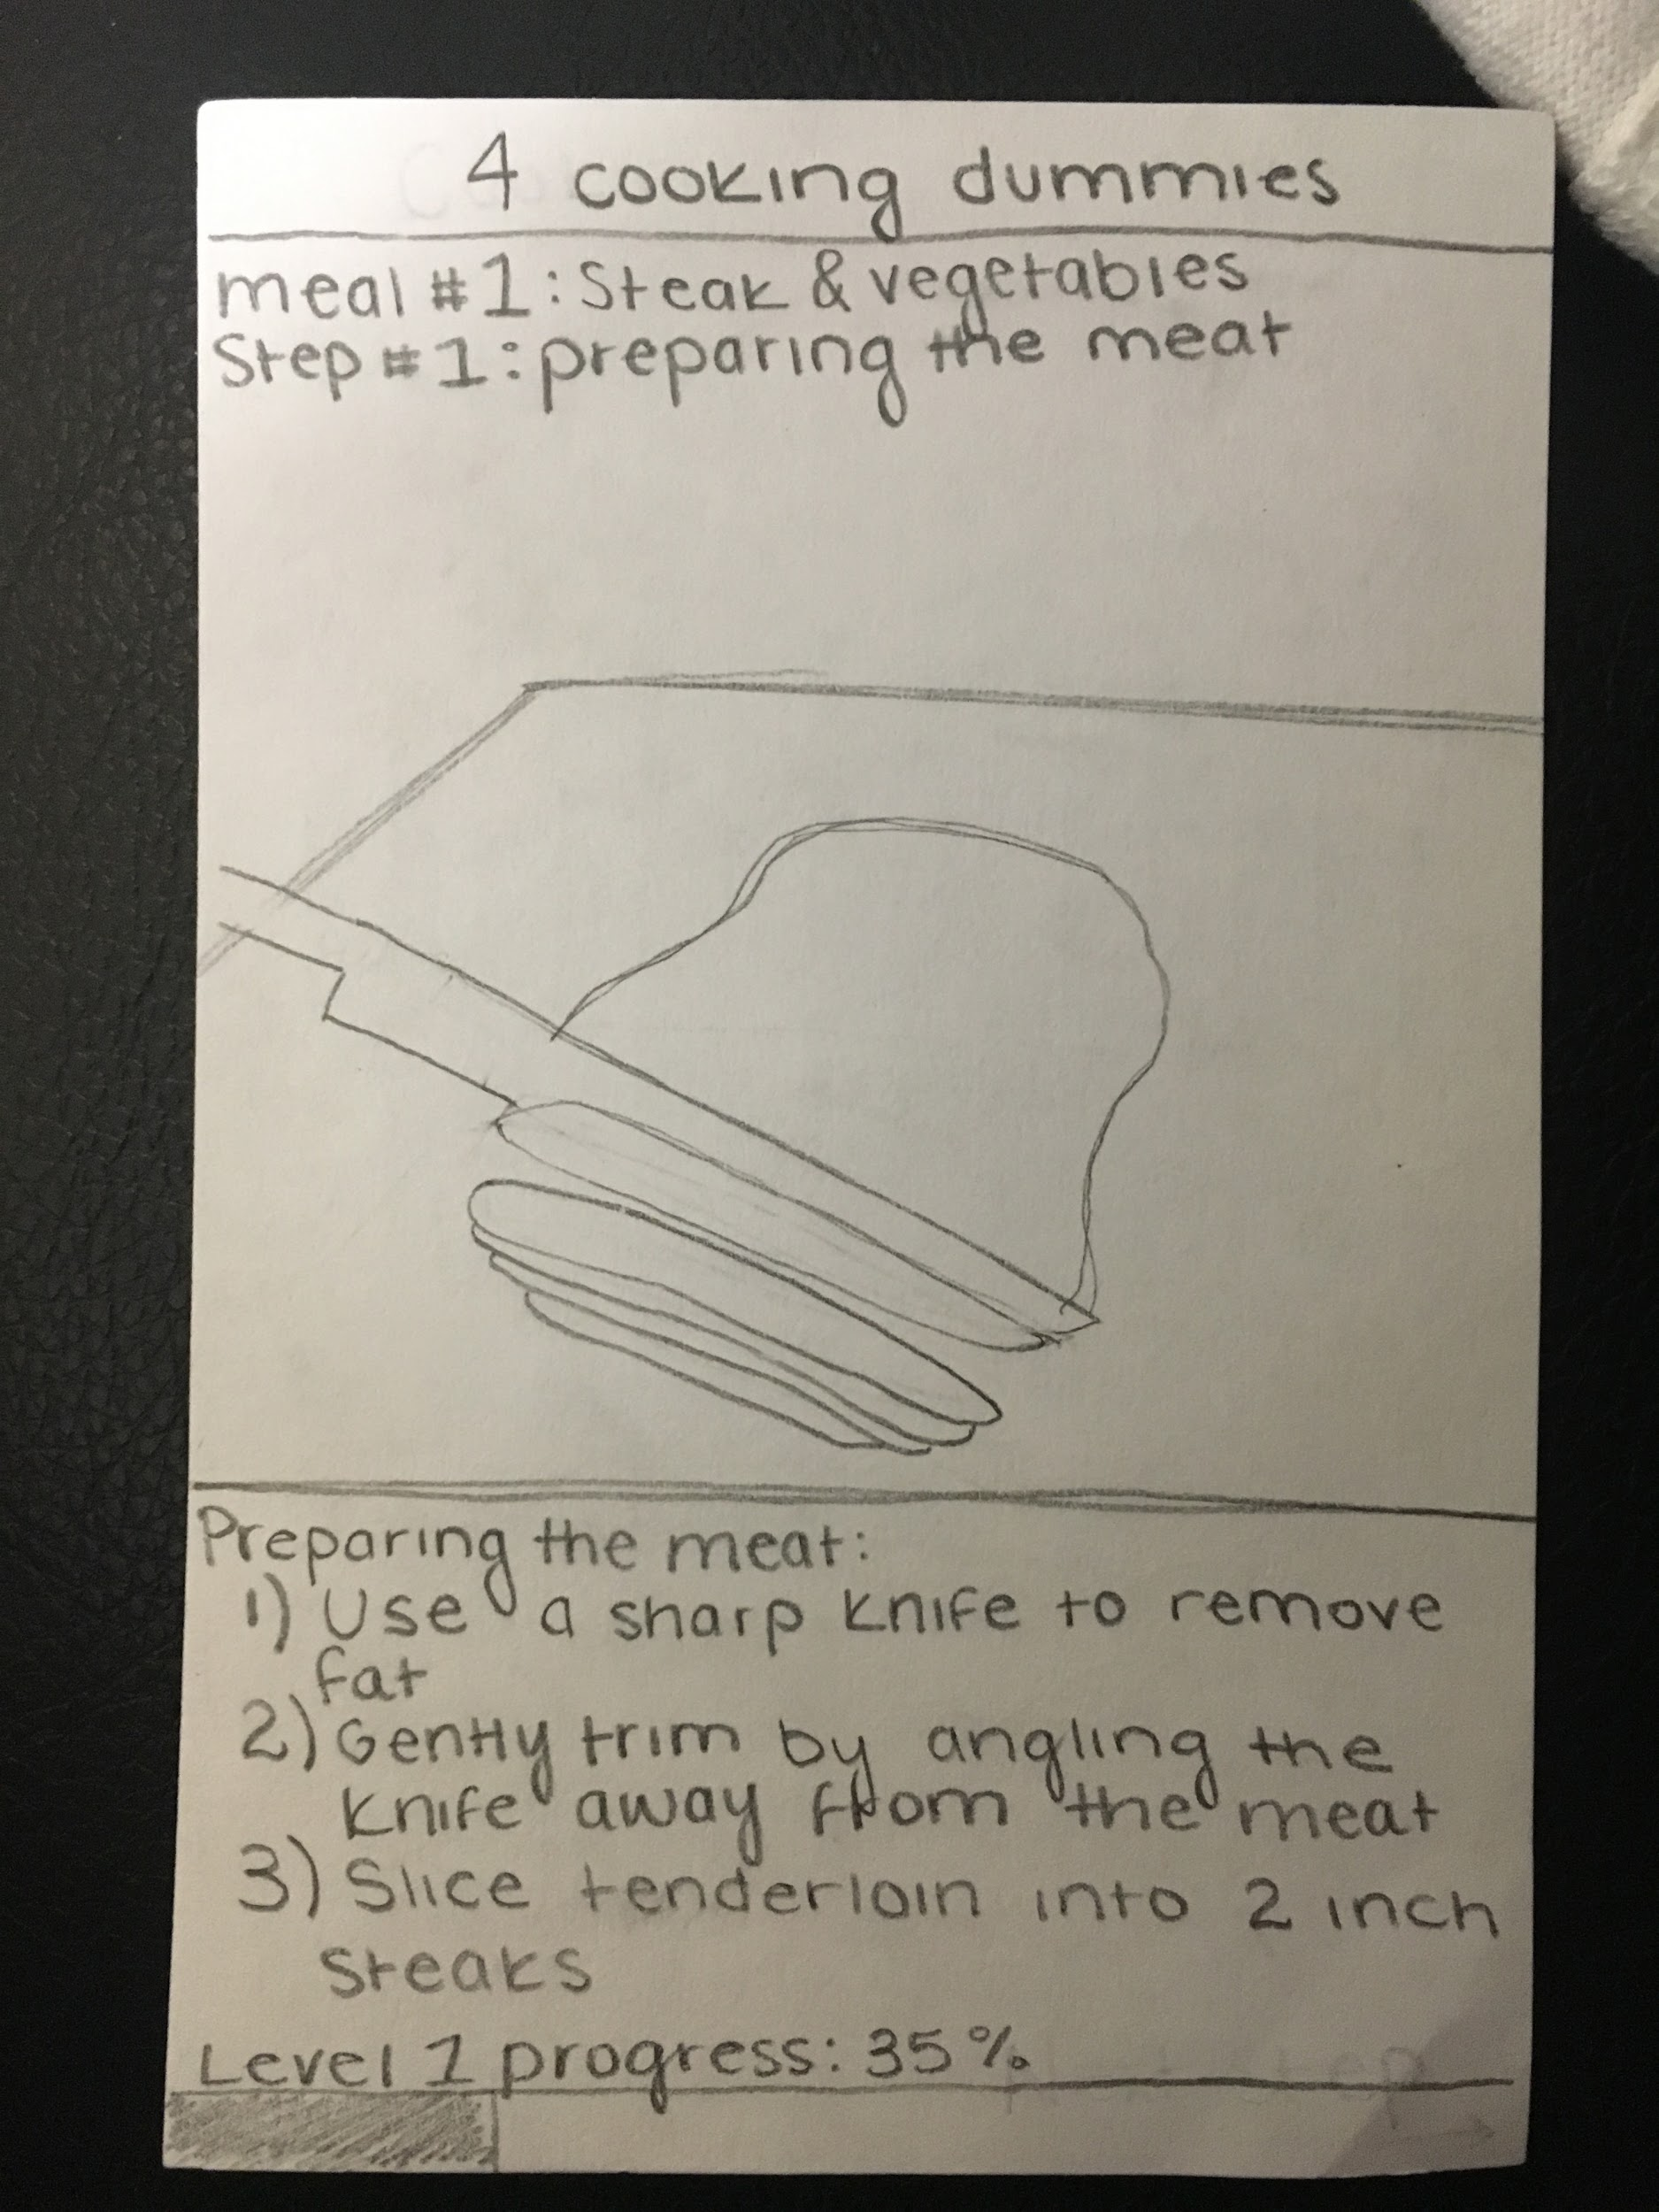
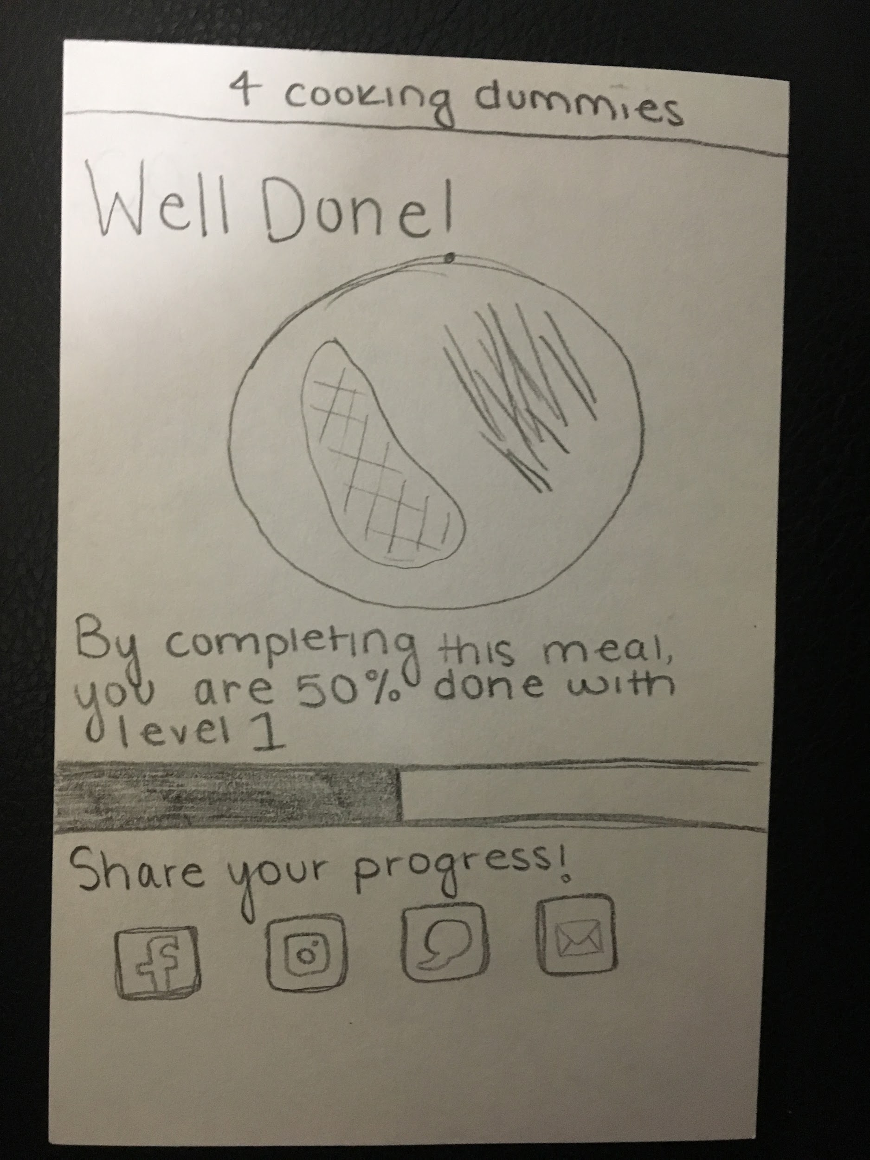
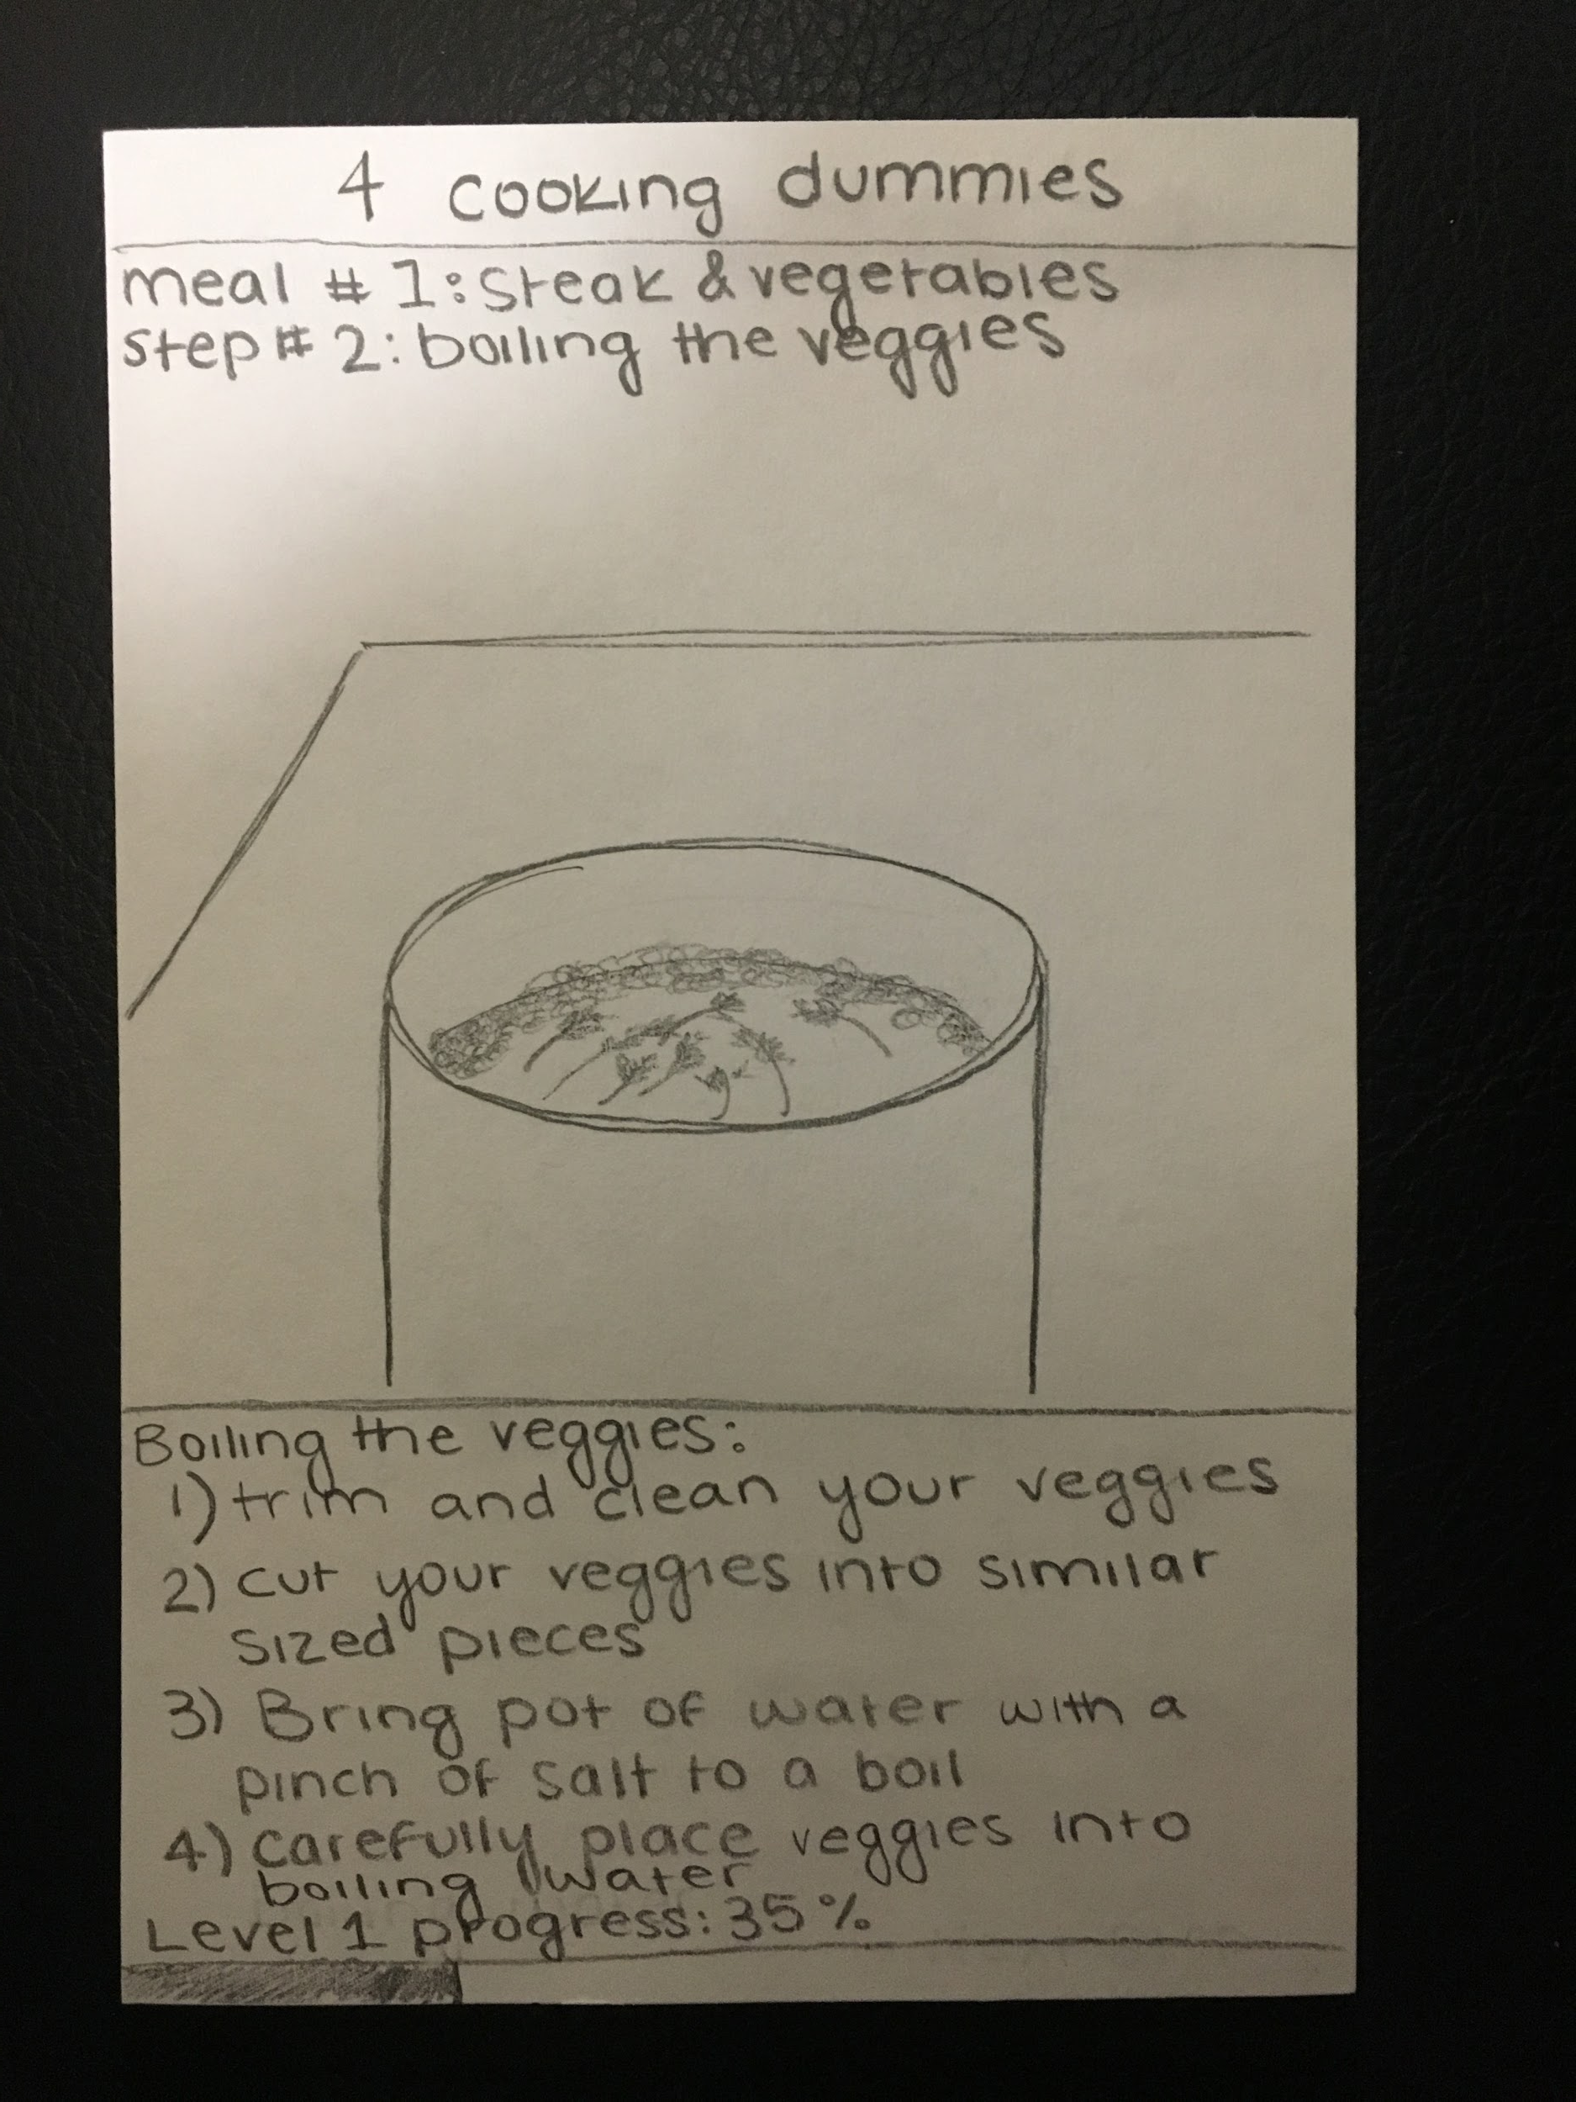
Sharing While Cooking

Slide 19
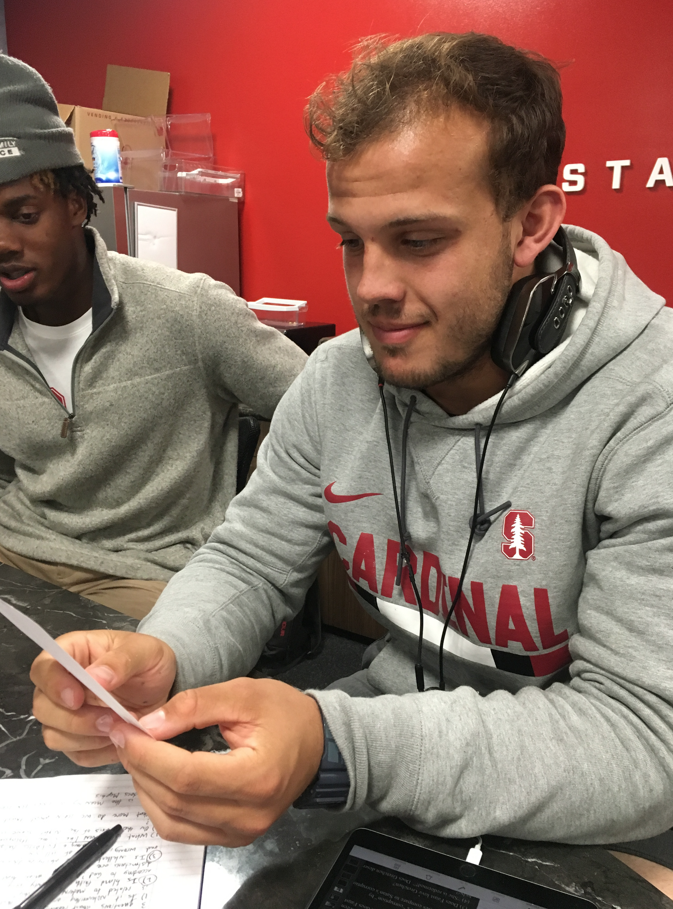
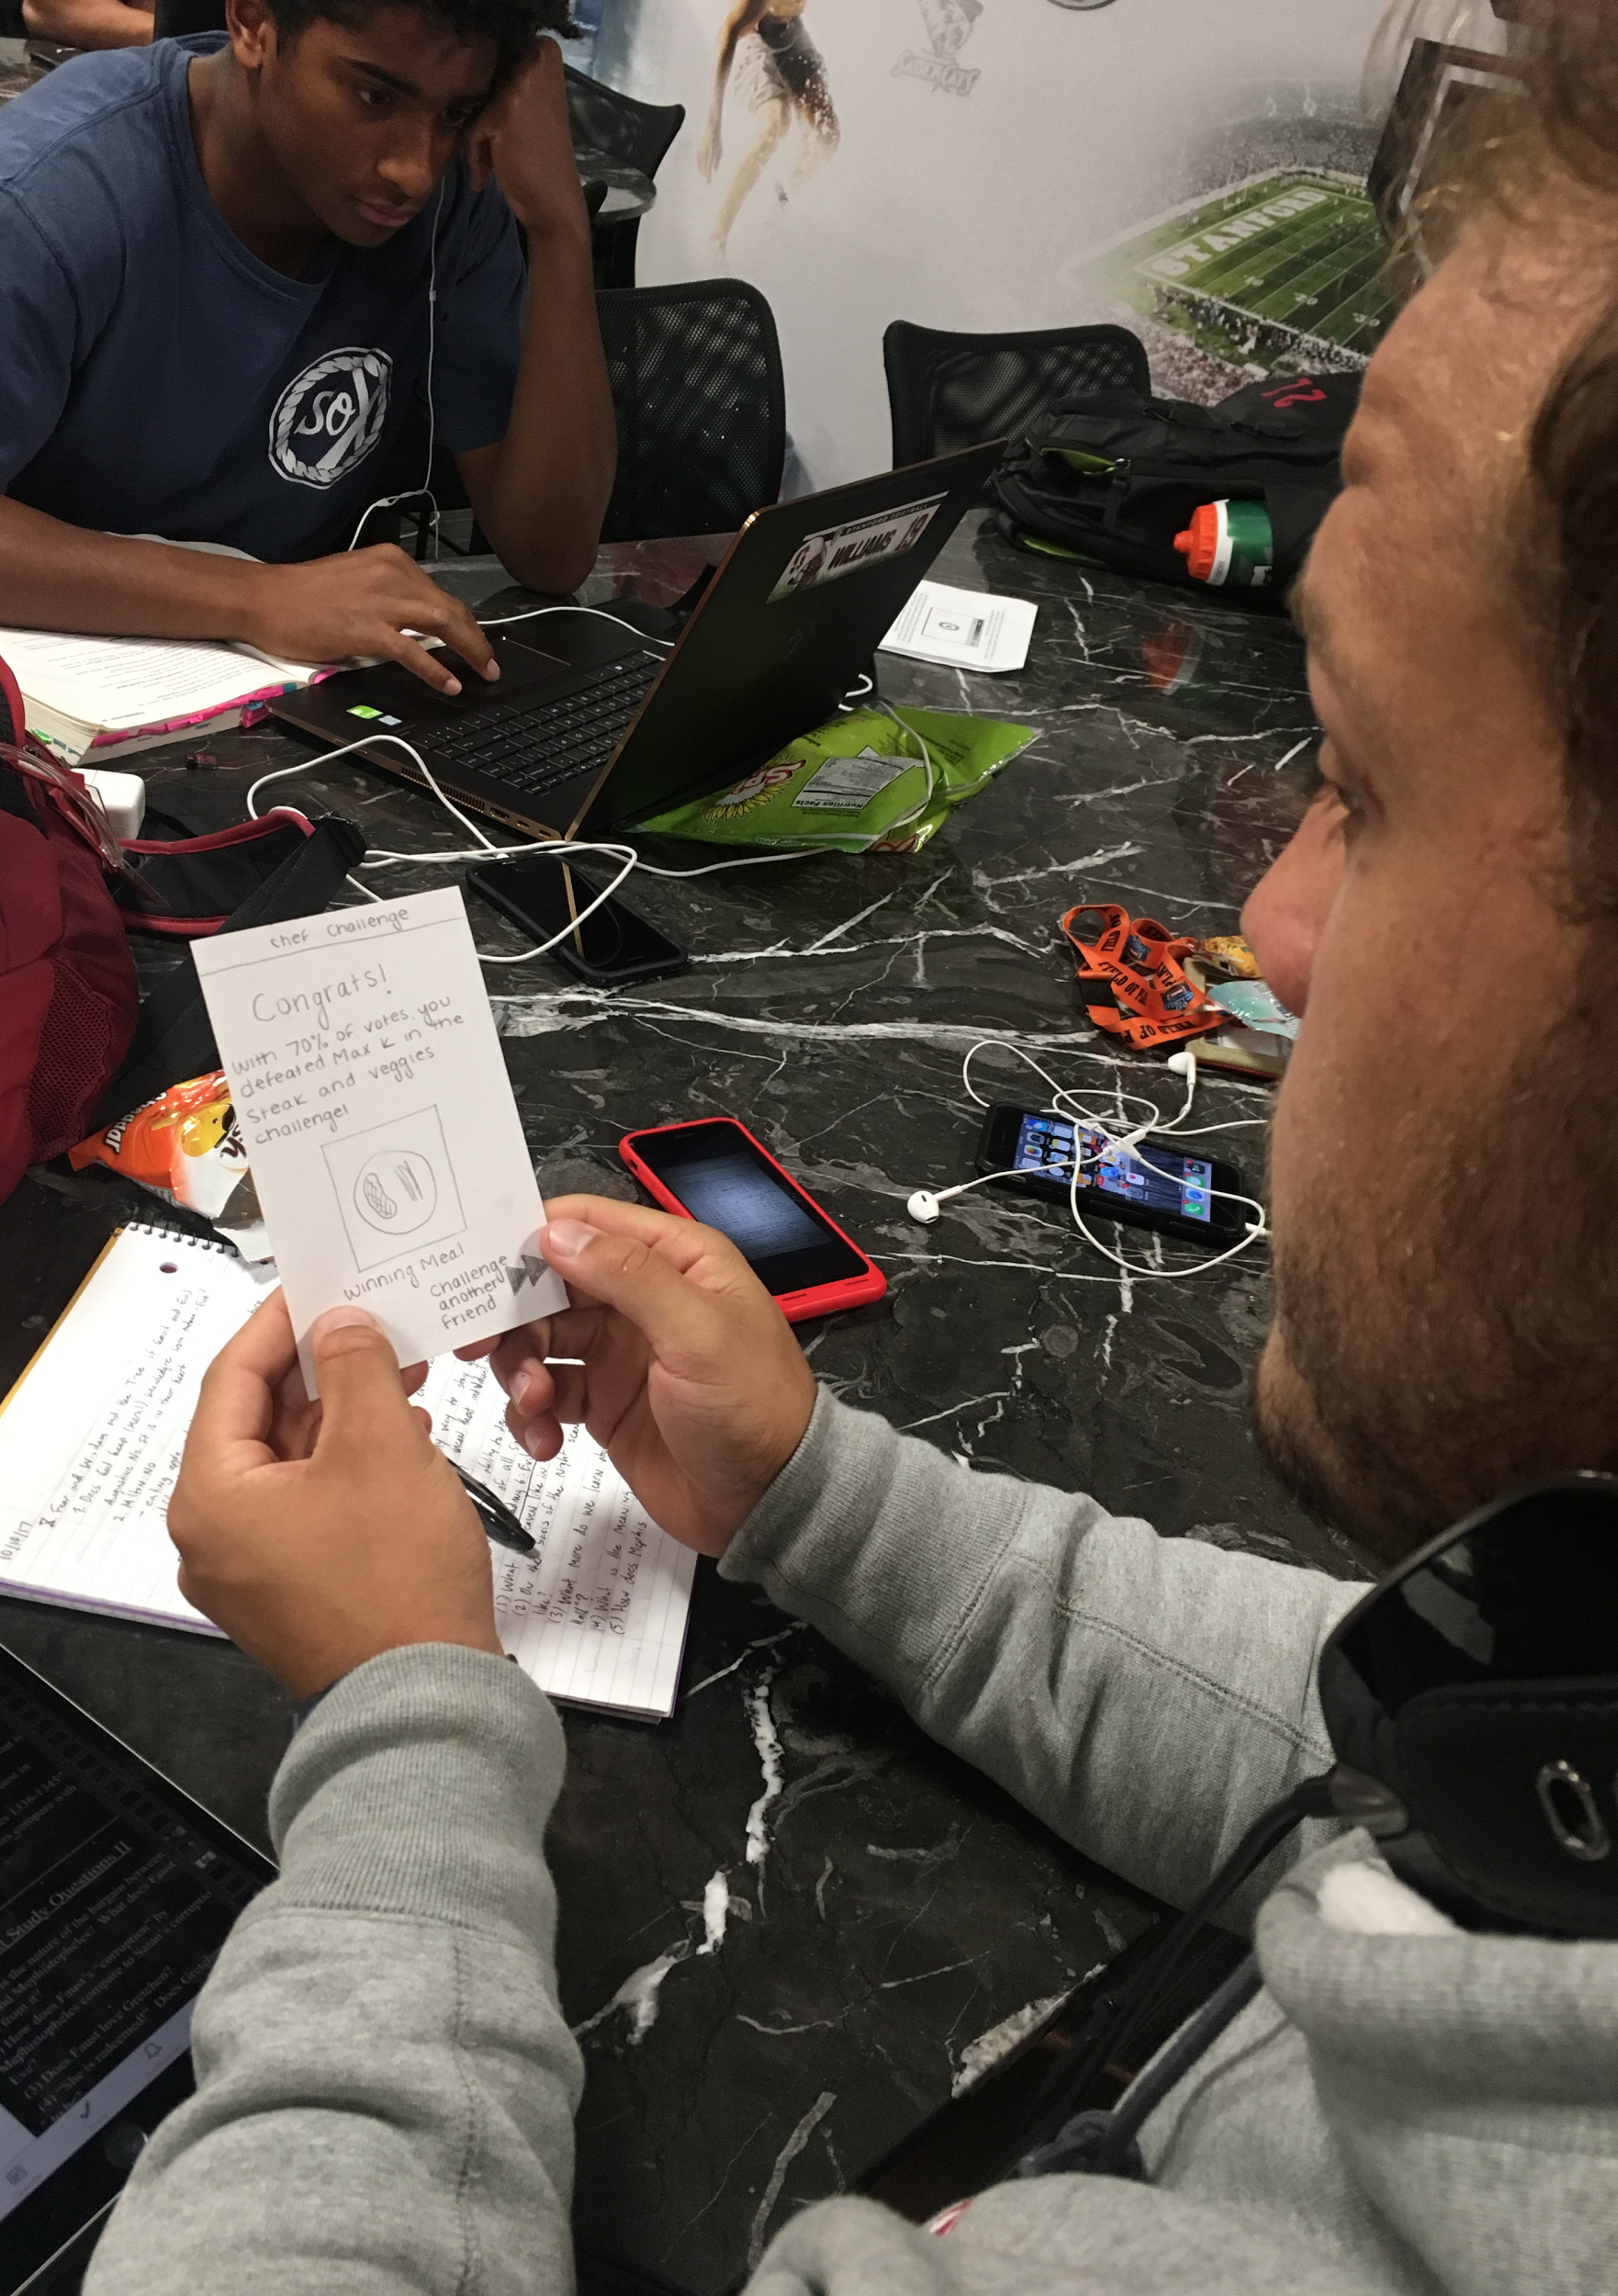
Sharing while Cooking: Hannes Bohning
This social app would provide provide recipes and tips, with the ability to share the final product with friends via messaging or social media
Hannes describes himself as a perfectionist, and loved concept of sharing his masterpieces on social media
Thinks competition doesn’t make sense without being able to taste food
Our assumption was in fact there because he loved showing off his creations
Notes:
Hannes really liked the idea of a learning to cook app as he is a perfectionist and struggles sometimes to know where to cut because he always wants things to be great. He took a look at the competition app, and didn’t like that you could have food competitions without being able to taste the food, but loved the idea that he could share his creations on social media!

Slide 20
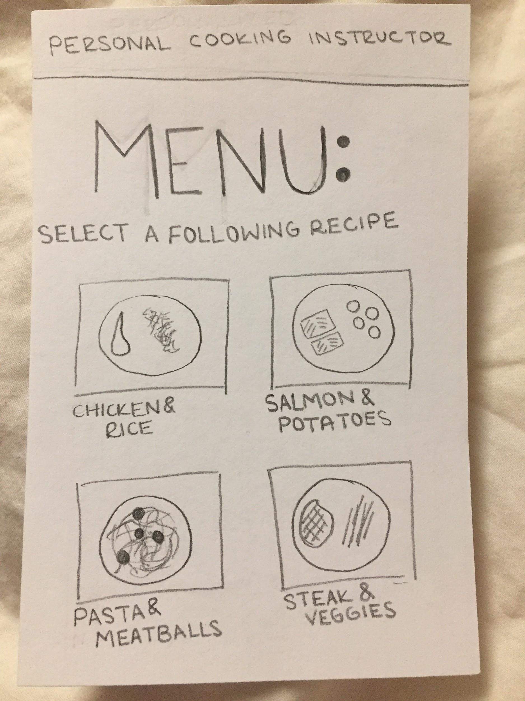
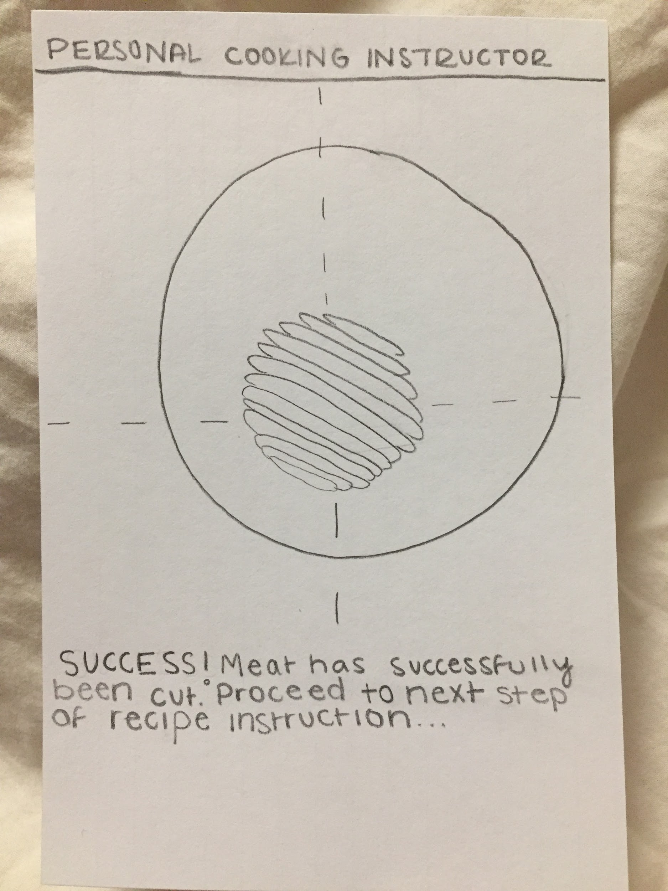
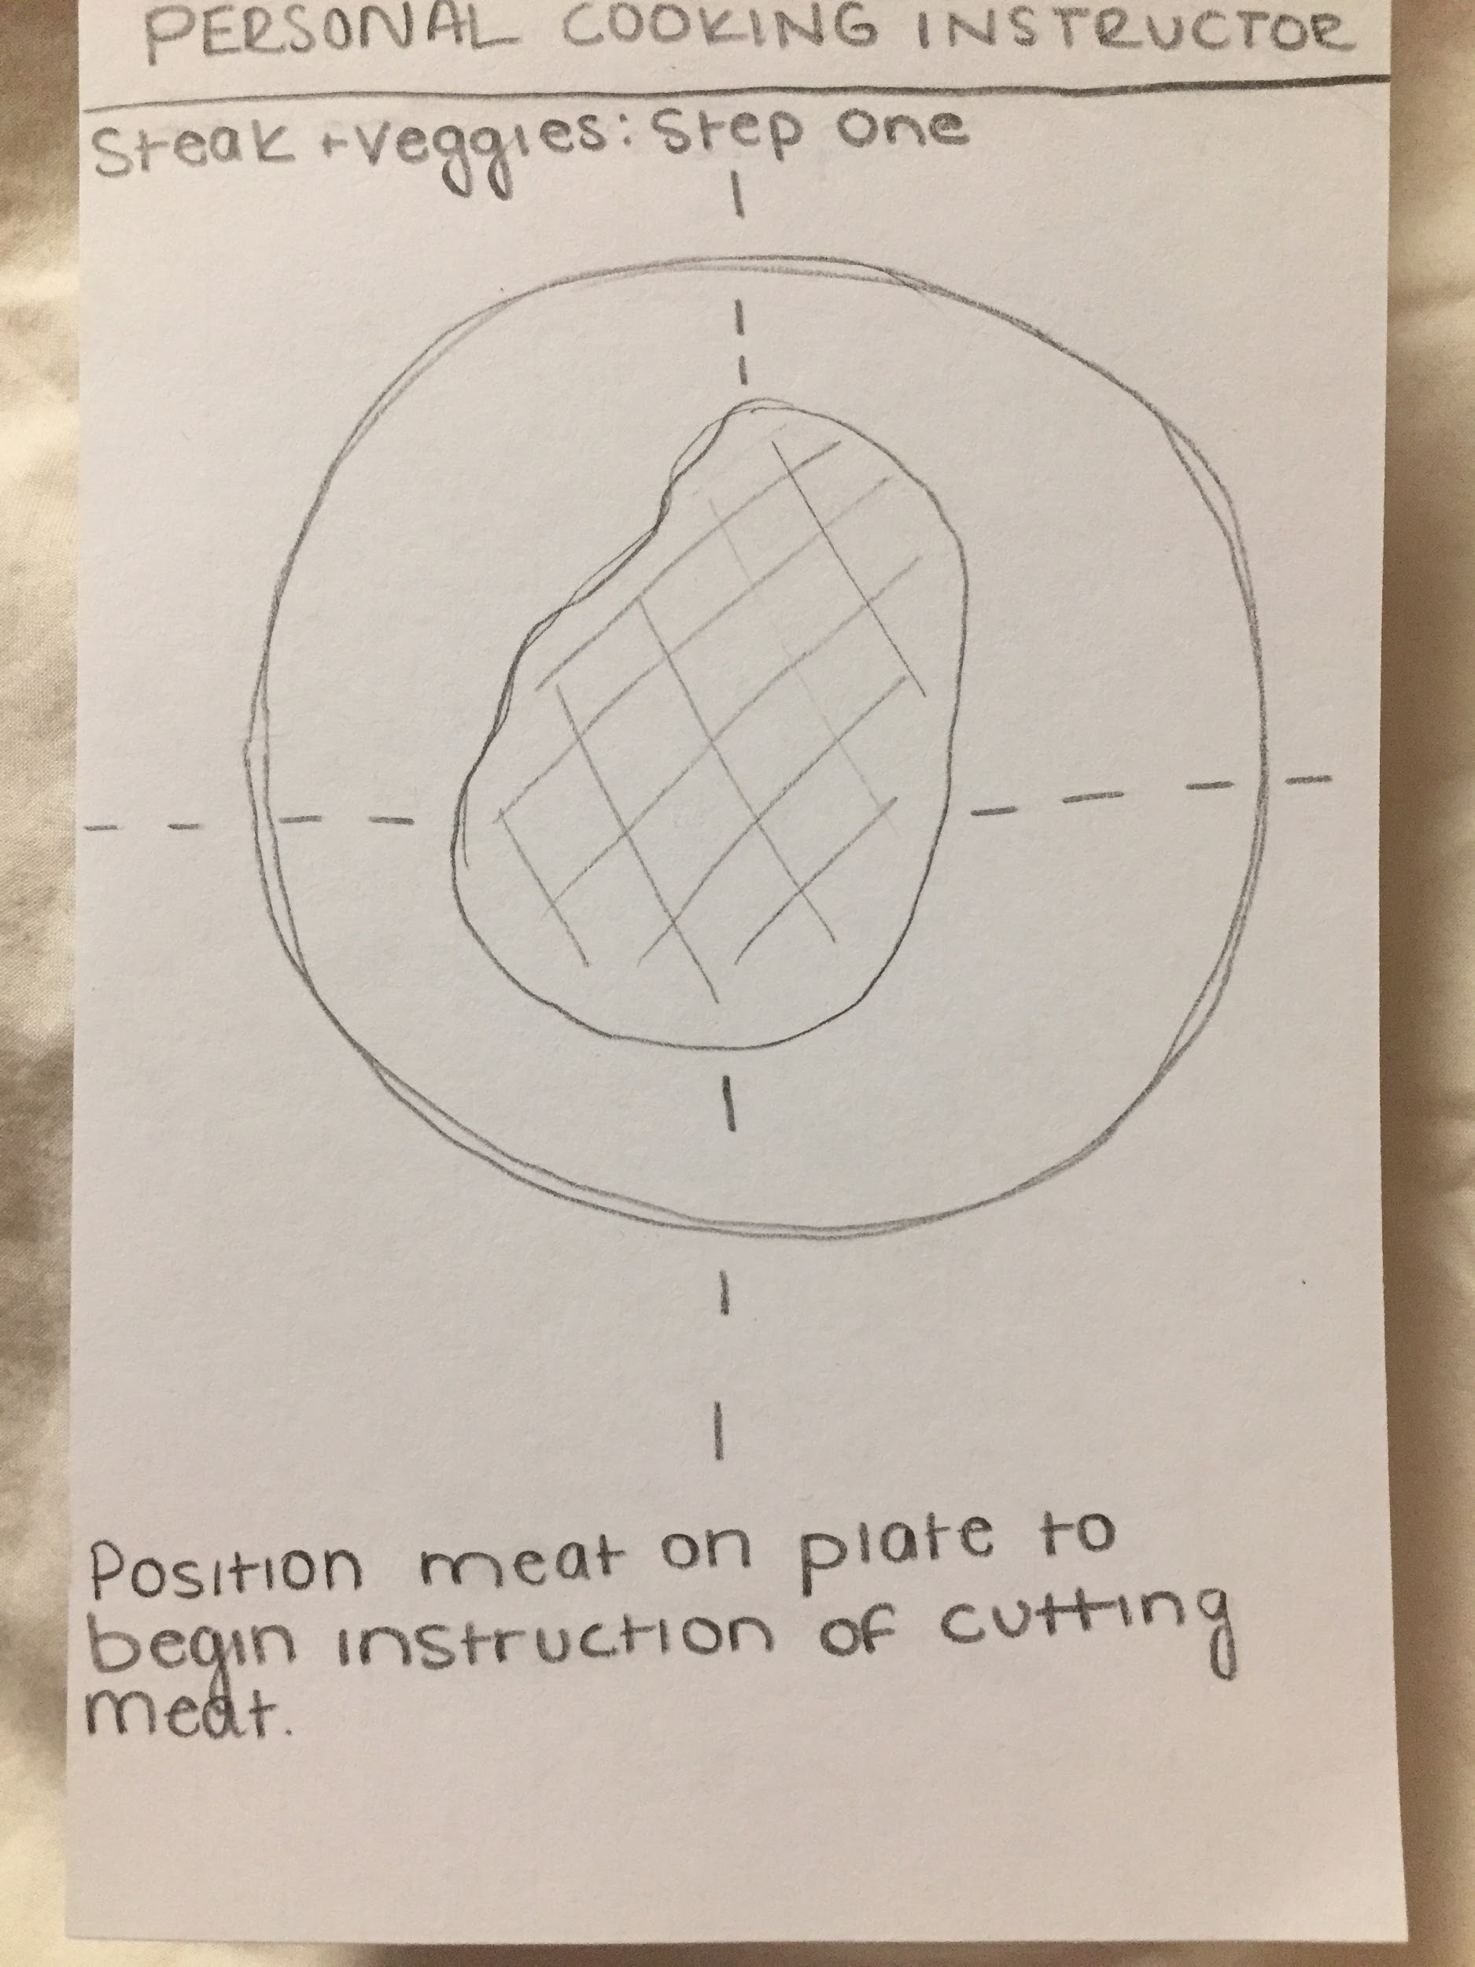
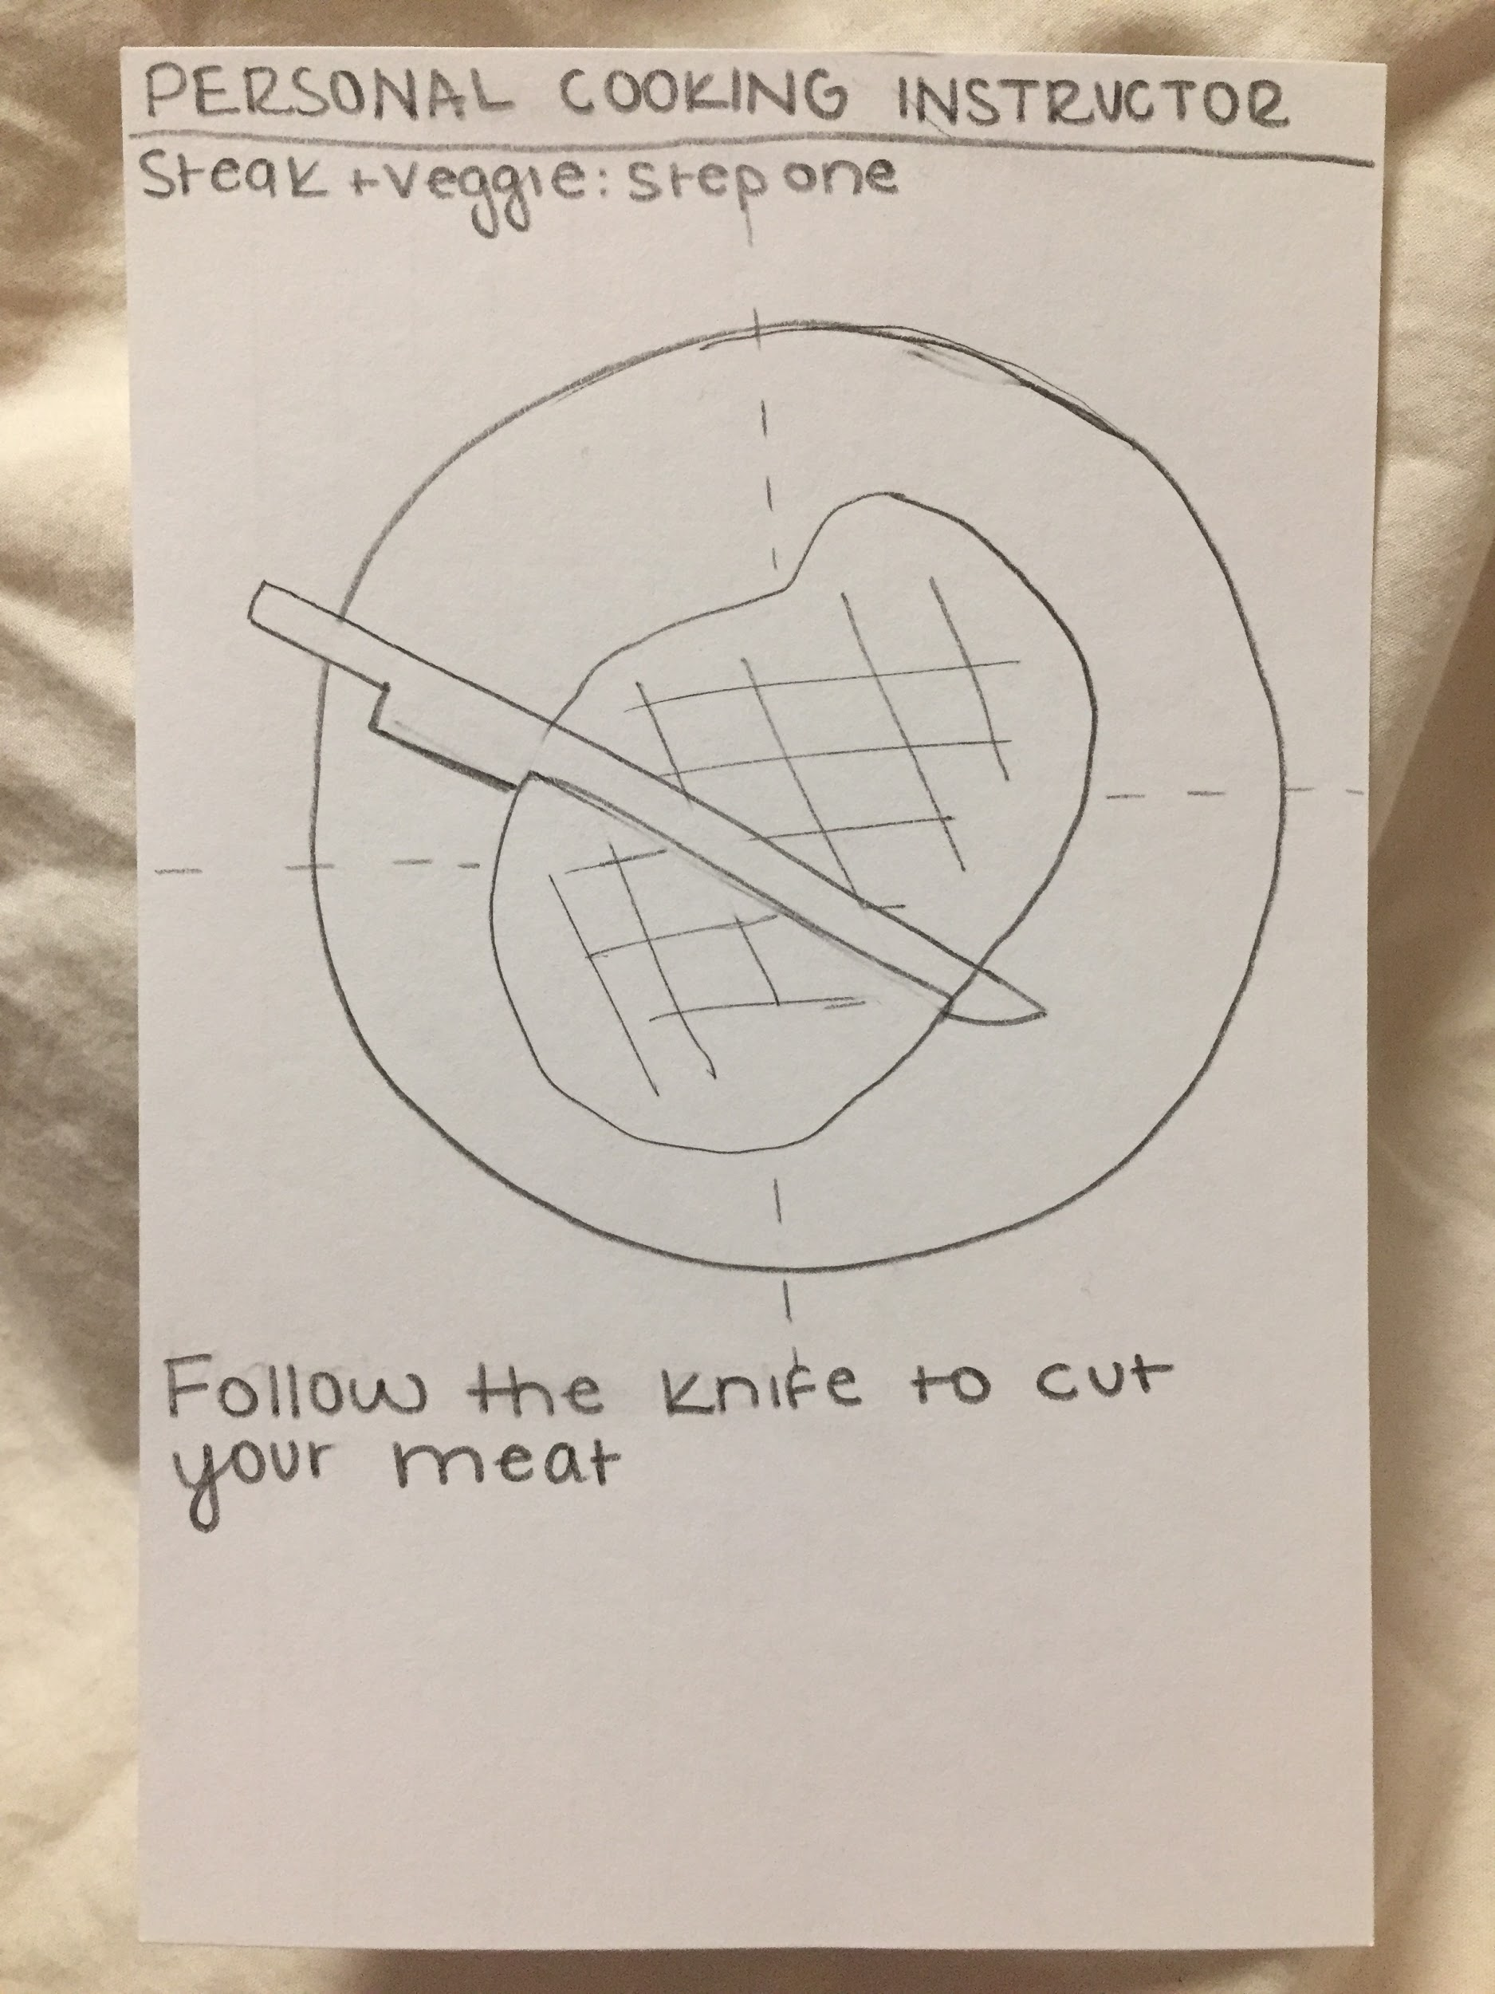
Personalized Instruction

Slide 21
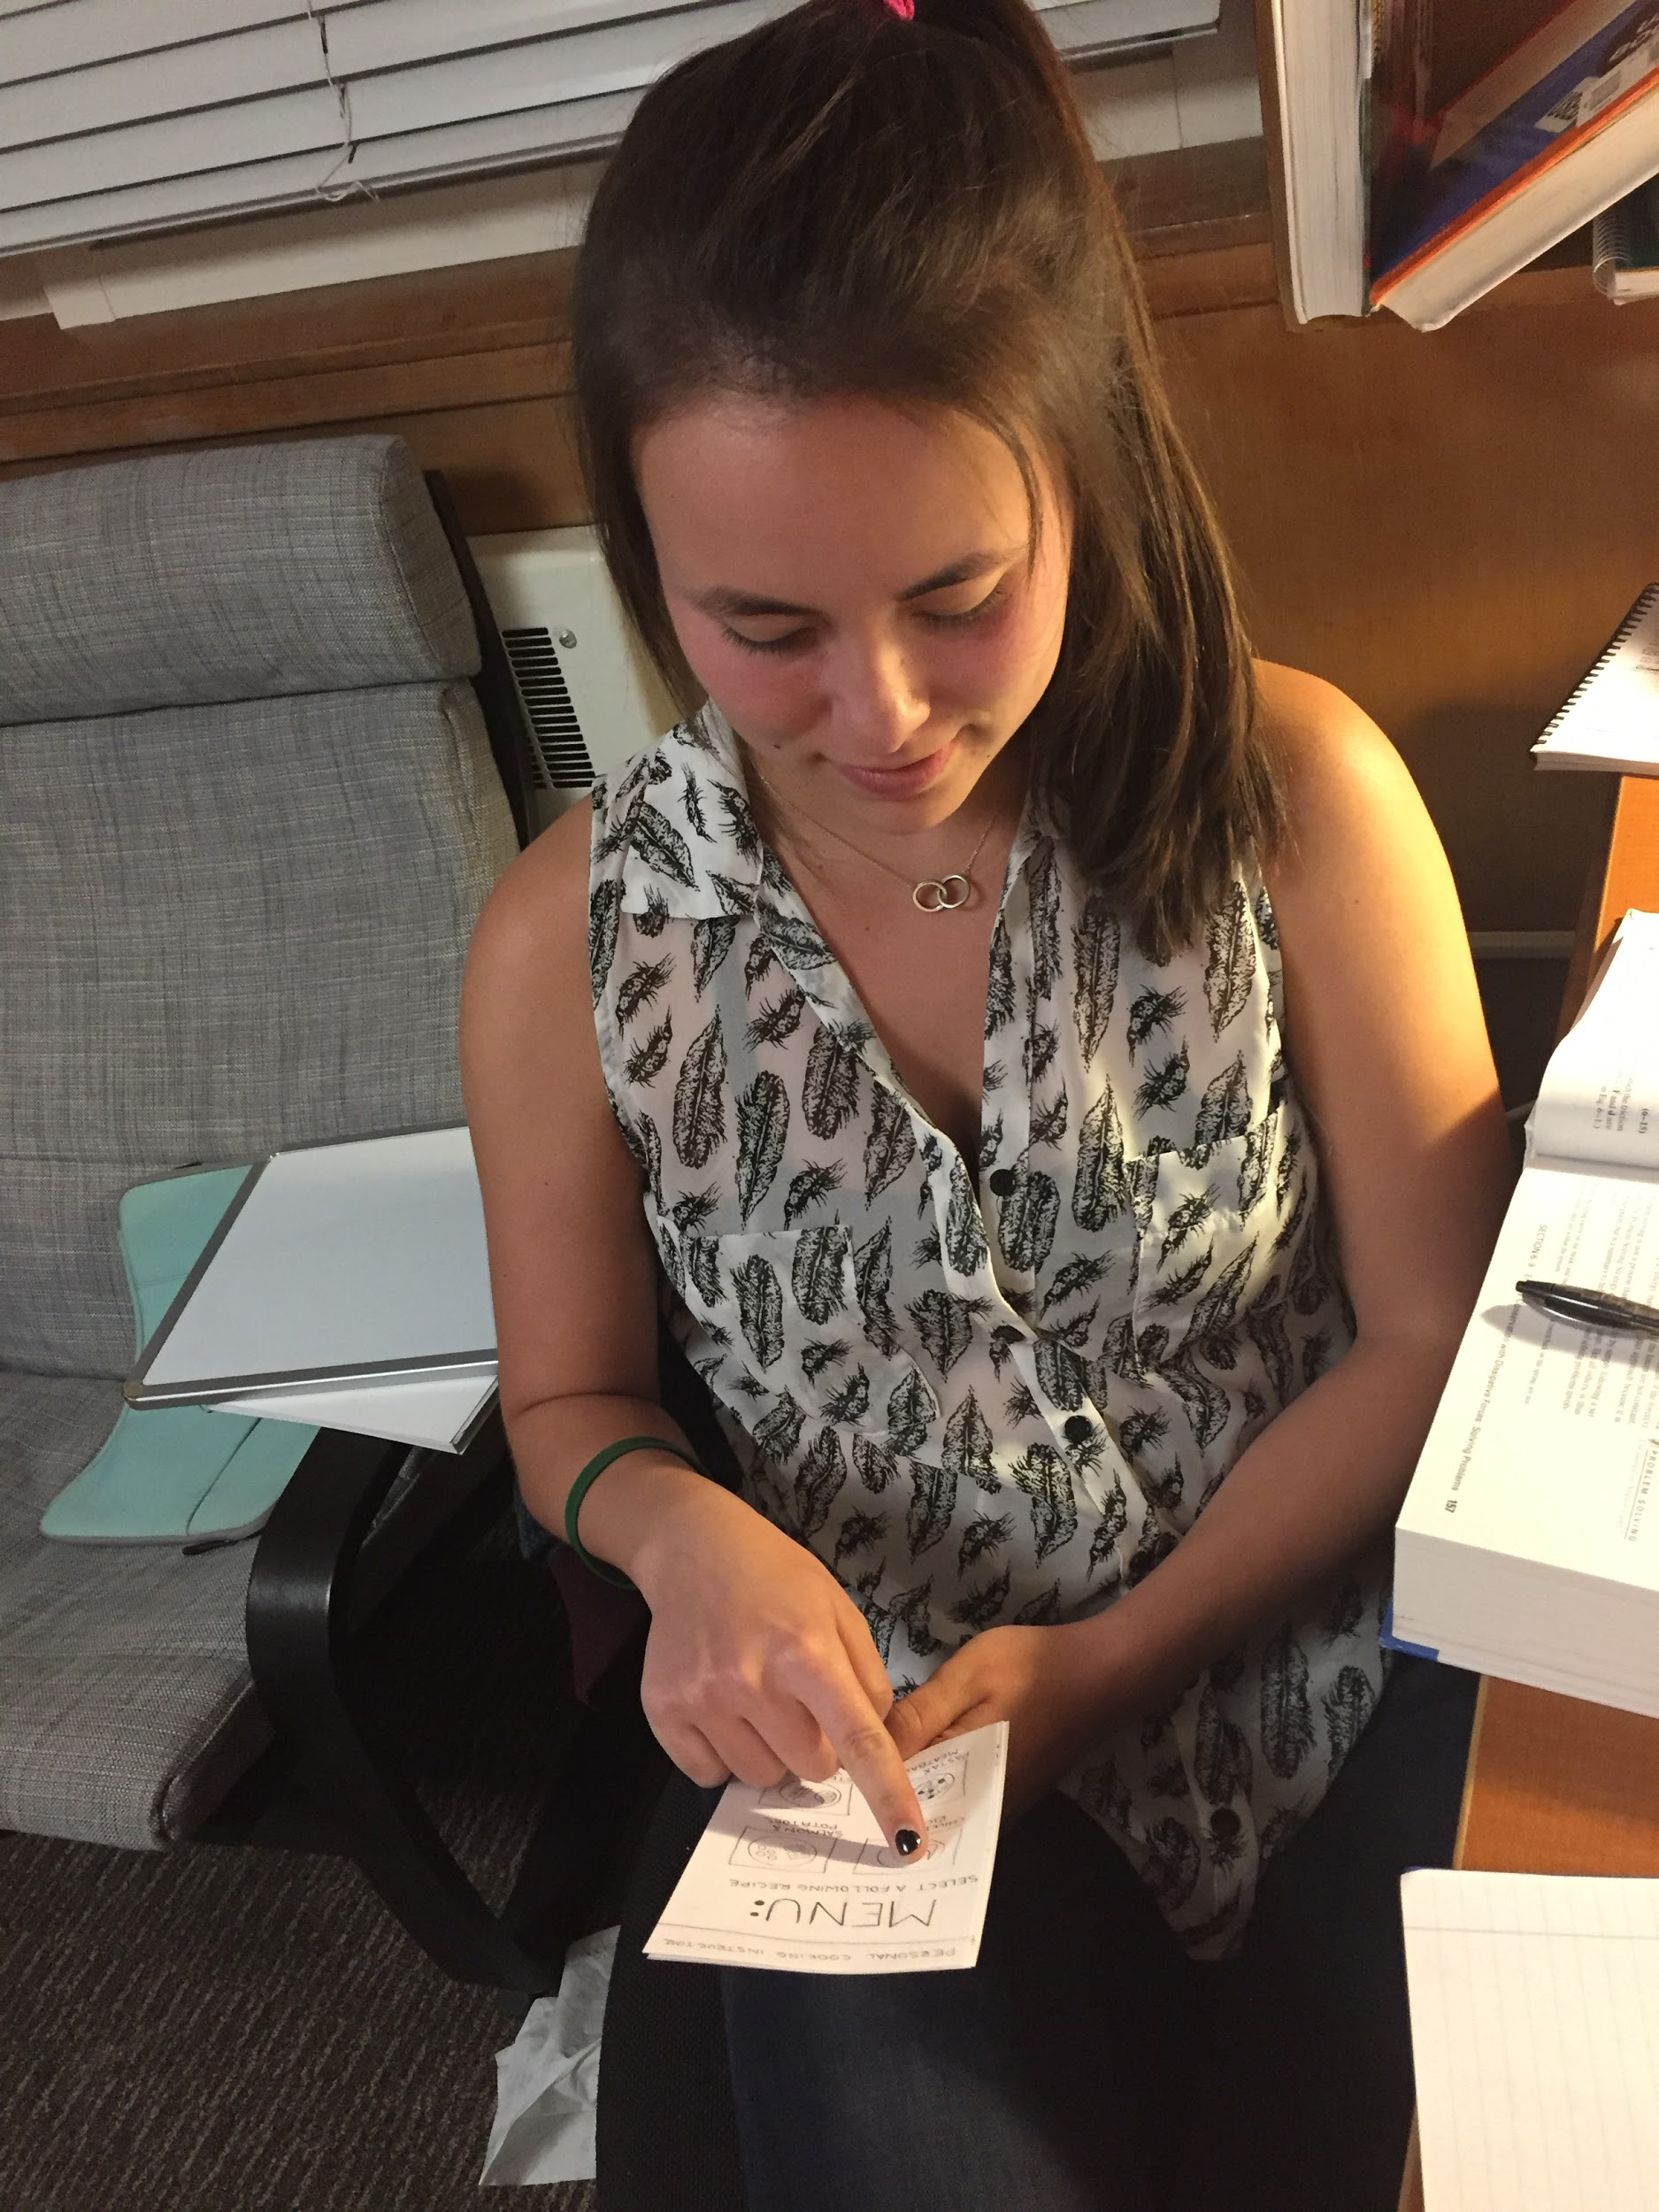
Personalized Instruction: Clare Young
The final prototype was an instructive app which would utilize a phone’s camera to give personalized instruction and feedback at every step of the cooking process.
Clare loved the concept of personalized step by step instruction, but pointed to the difficulty in reading these instructions off of a hand held devices, while also executing the steps, such as chopping.
Our assumption was valid because she loved the idea of personal instruction on her own schedule at her own pace

Slide 22
Thank You

