Slide 1
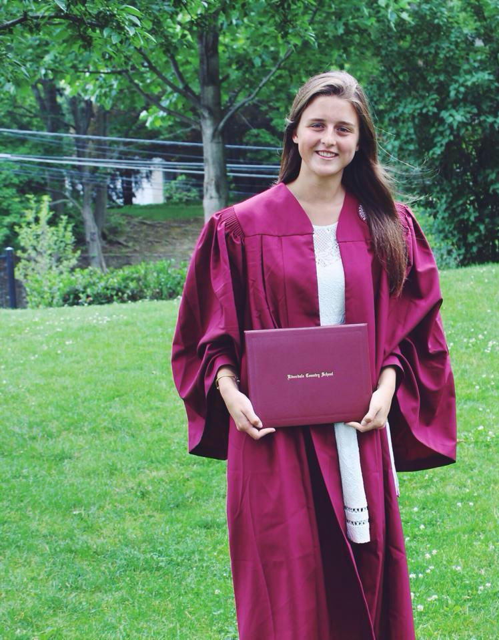
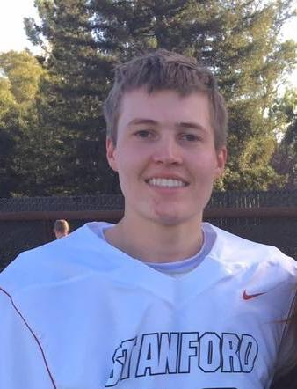
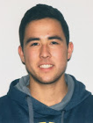
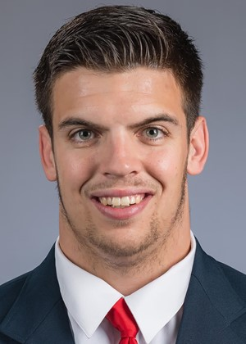
4 Cooking Dummies
Caillin Campbell
Max Kucera
Ian Jones
CJ Keller

Slide 2
Interviews

Slide 3
Questions
How would you describe your process when cooking?
Can you tell me about a time when you were frustrated while cooking?
Can you tell me about a time when you were successful in cooking?
What challenges do you face when cooking?
What helps motivate you to improve your cooking skills?
Can you tell me about a time when you taught someone how to make a dish?

Slide 4
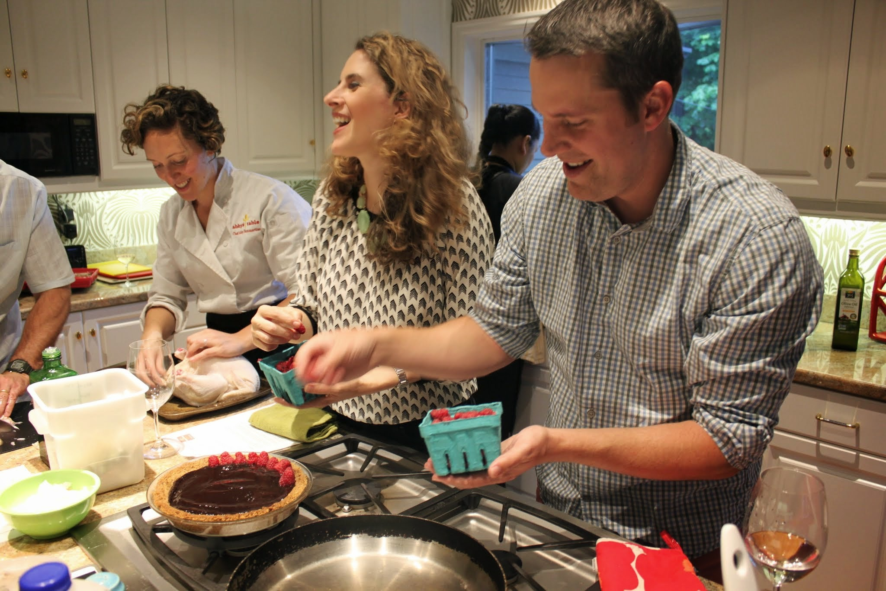
Stanford Student
Living in Mirrielees
Chosen to reflect user with no previous experience
Interviewed in his kitchen
Notes:
Views cooking as a chore
Waste of time / boring
Not satisfied with the result
Social Aspect
Scared and intimidated by cooking alone
Likes the process if he is with friends and performing easy roles
Situations when he would cook
Fast, easy, convenient, hand-holding process
Good results that are nutritious and filling
Wants it to be fun and worth his time

Slide 5
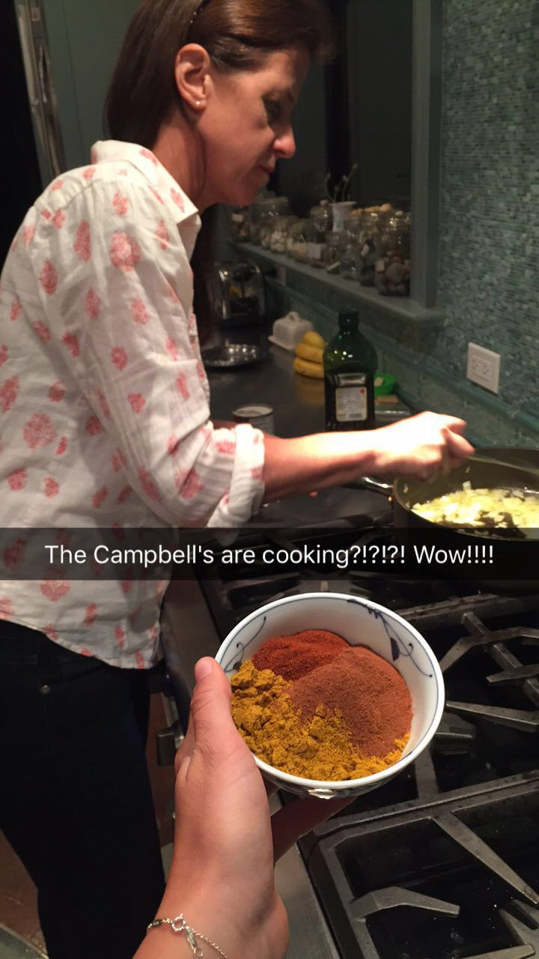
Mother
“Cooking Innocent”
Interviewed by Skype in her kitchen
Chosen because she possesses strong desire to learn to cook and improve her skills.
Notes:
Despite being a mother of five, she describes herself as “Cooking innocent” because she is lacking in training, ability, and skill. However, possesses a strong desire to learn to cook and to improve her skills

Slide 6
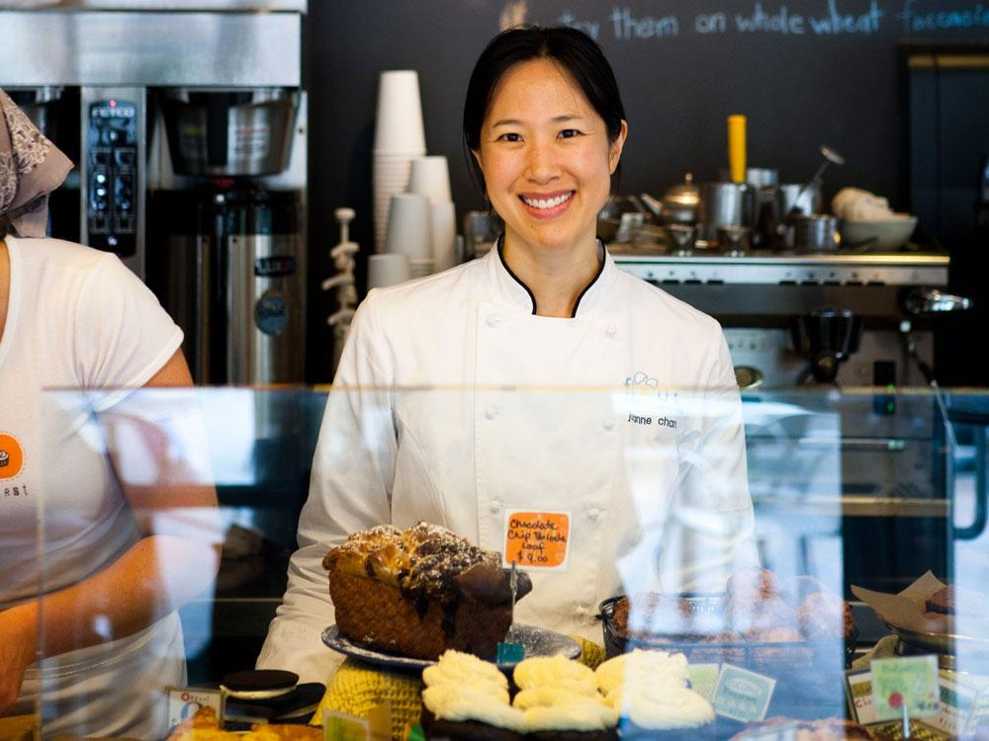
Row House Chef
Culinary school graduate
Already an expert → extreme user
Interviewed while she was making dinner
Notes:
Culinary school graduate
20+ years of experience cooking in restaurants/Row house
Chosen as an example of an extreme user: already an expert in the field of cooking and expressed desire to teach others
Interviewed in Durand’s kitchen while she was making dinner
Questions
First dish she ever made?
A time when she was taught how to make something? Was there a way she would have done it better?
A time when she taught someone how to make a dish?
How does she learn how to cook new things?

Slide 7
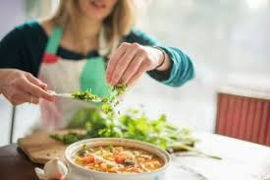
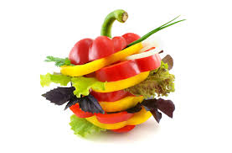
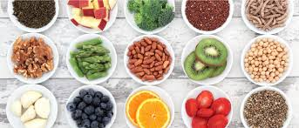
Nutritionist
A Sports Dietitian for 10+ years
Thought to be a user → wants students (usually with little experience) to cook and eat healthier
Notes:
Interviewed in her office
Constantly working in order to try to find ways to get her students to have healthier lifestyles
Chosen because of the fact that she is always trying to teach her students how to cook in order to allow themselves to have better control over their eating habits
Chosen as an extreme user because of the fact that she is always trying to get others to cook but does not really have a desired teaching method
Healthy Eating
Talking to athletes to make it less intimidating
Working in class to learn

Slide 8
Results

Slide 9
Quotes
“You don’t have to go to culinary school to learn to cook well”
“I think I’d be more motivated to learn if I had a friend to learn with”
“I want a personal chef to teach me for 1/10th of the price”
“I really liked the hard-ass aspect of a teacher when learning”
“Teaching made me proud of the students’ accomplishments”
“Cooking feels like a chore to me”

Slide 10
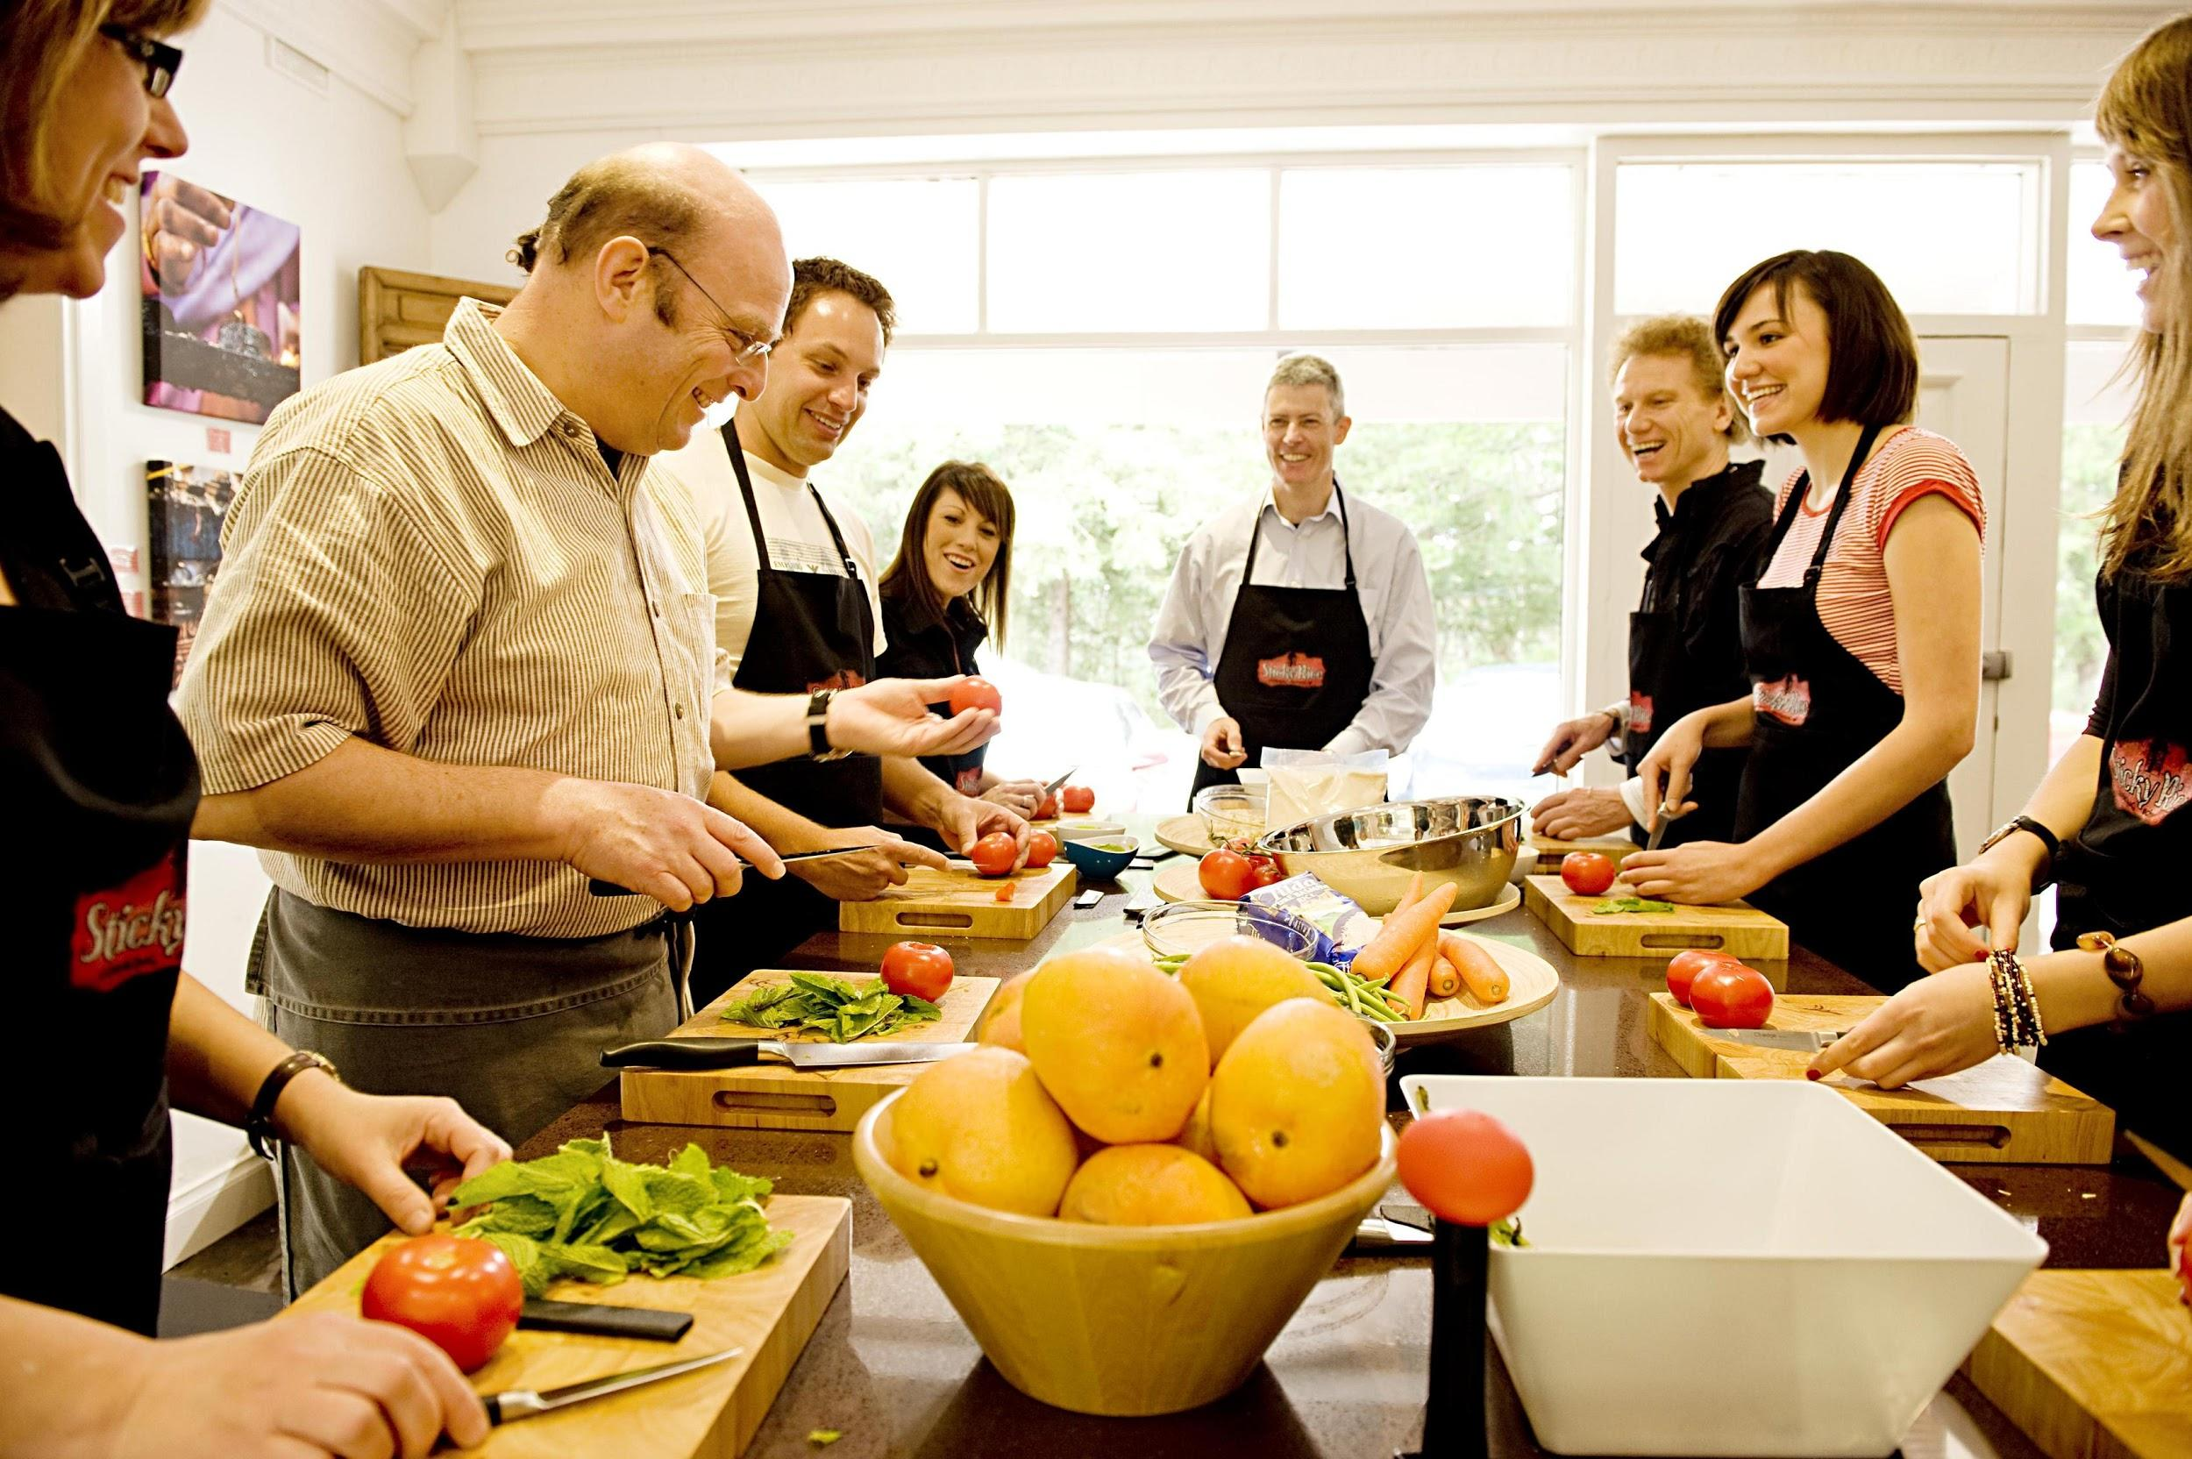
Notes:
Two of our interviewees reported that they would be more likely to cook, and would be more motivated to learn to do so, if they had a friend to cook with.
Cooking (and learning to cook) is a social activity

Slide 11
“Questions and feedback in real
“The best way to learn is hands-on”
time are important”
Notes:
Row chef emphasized the importance of real-time feedback when learning and teaching
Learn much better when you are critiqued and corrected immediately
Problem with learning from a cookbook/video is that there is no teacher to talk you through things
Mother said that, when cooking, she determines her success or failure based on what her family thinks of the food, not herself

Slide 12
Notes:
Time is a huge restraint and it can be difficult to plan in advance

Slide 13
Analysis

Slide 14
Say | THINK
DO | FEEL
“I make the same go-to meals if I’m too lazy to think of something to cook
Thinks her hands-on education helped her learn best
“I constantly have to get rid of cookbooks and magazines because they take up too much space”
Cooking could be fun, if properly prepared
Answering questions in real time is important
Don’t need culinary school education to learn how to cook
Smiled when talking about teaching students to cook
Constantly substitutes ingredients for ones she doesn’t have on hand
Feels self-conscious in front of crowds
Feel inspired when her friends are successful in cooking
Decides what to cook based on what is in the kitchen without planning in advance
Proud of students’ accomplishments learning to cook

Slide 15
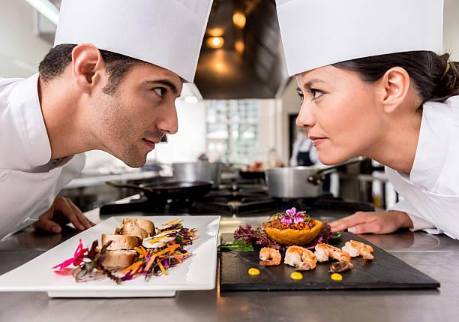
Insight: Competition Drives Success

Slide 16
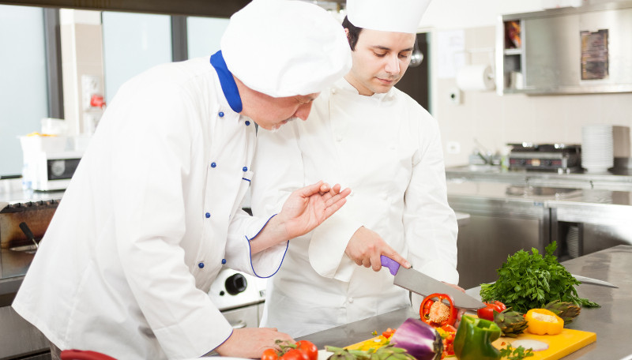
Need: Personalized Instruction
Notes:
Row chef said she likes teaching small groups or one on one best
Student said he wants personal teacher for 1/10th the price

Slide 17
Summary
Despite a strong desire to learn, many people feel they lack the access to personalized instruction, which serves as the best means of learning to cook.
On the other hand, the people who do have a fundamental foundation in cooking struggle to find time in order to cook healthy meals.

Slide 18
Thank You

