Slide 1
SKILLET
Caillin Campbell
Max Kucera
Ian Jones
CJ Keller

Slide 2
Food Fight
For young people or those lacking cooking experience, cooking a meal can seem like a chore rather than a fun activity. Skillet utilizes (optional) competition to make learning to cook a meal social and fun. Users choose a meal and a friend and are guided step by step through a recipe, striving to improve their cooking skills and end up with the best looking creation.

Slide 3
Tasks
Simple - Share the finished product: This app will allow users to take a picture of their finished product, and easily share it will friends in order to show off their finished masterpieces.
Medium - Determining a winner: In competitions between two people, it’s difficult to determine the winner without a third person being there. This app will allow two chefs who are competing to invite their friends to vote on which dish looks best prepared.
Complex - Choosing a meal and challenging a friend to cook it with you: One challenge that beginning cookers face is finding a companion to cook with, especially if they wish to work against someone to gain motivation through competition. This app will allow users to connect with their friends, and give them a way to challenge their friends to cook the same meals. Then, the app will guide both users through a recipe, teaching them beginners cooking skills as they go.

Slide 4
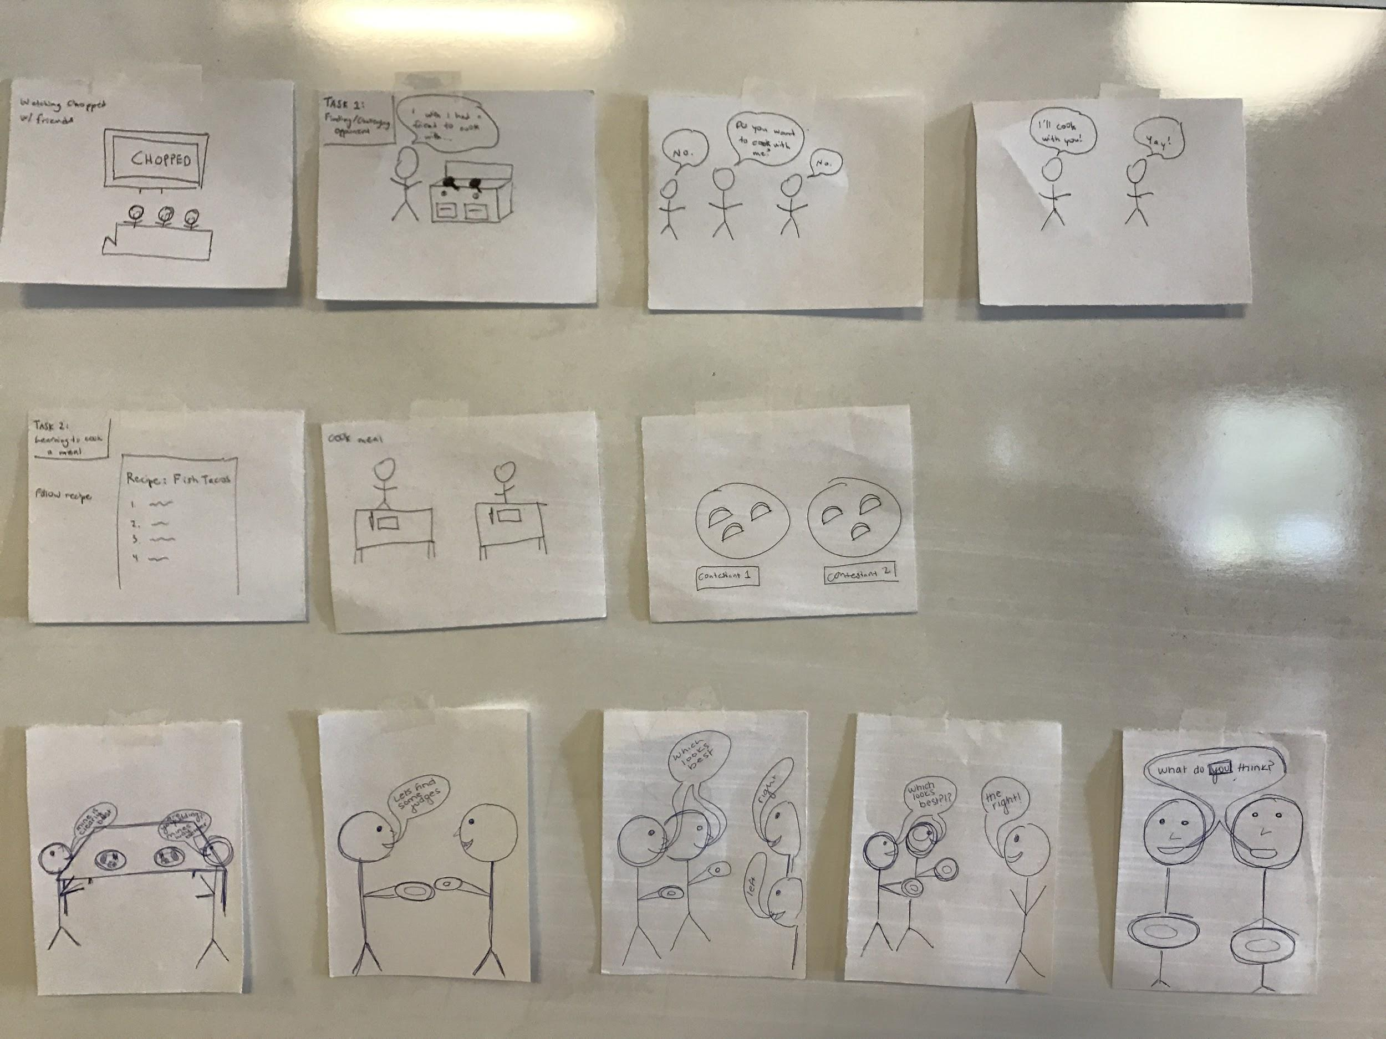
Storyboarding

Slide 6
Thank You

