Slide 1
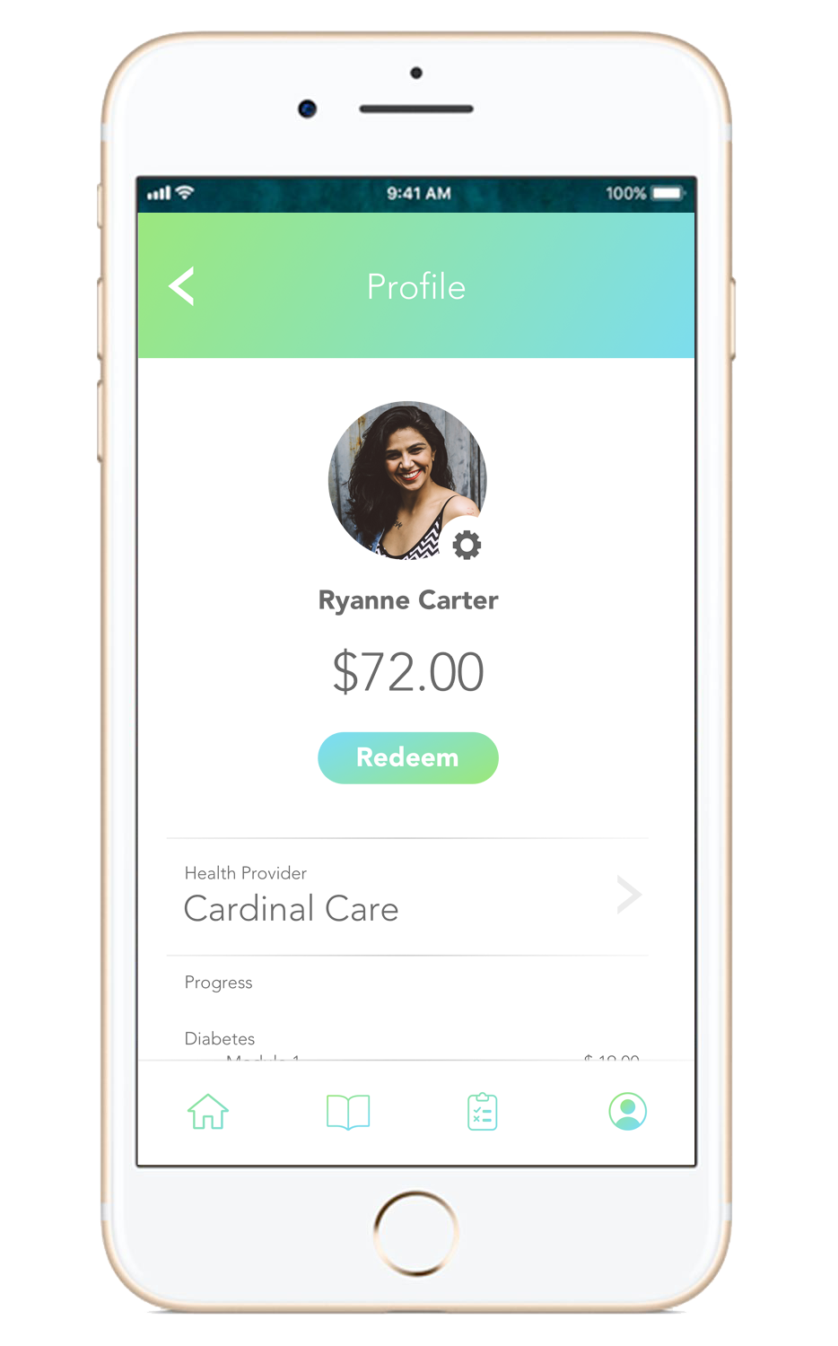
CheckUp
Earn health insurance benefits by educating yourself about your health!

