Slide 1

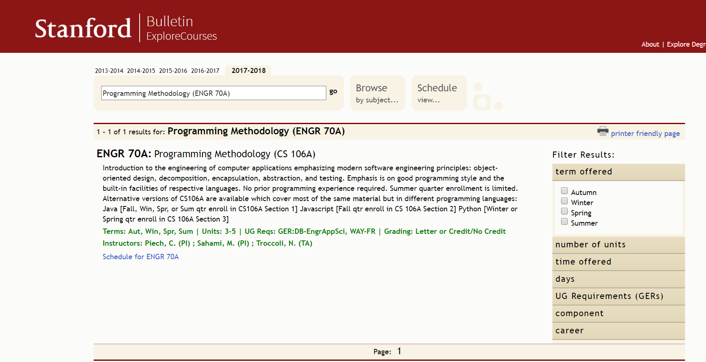
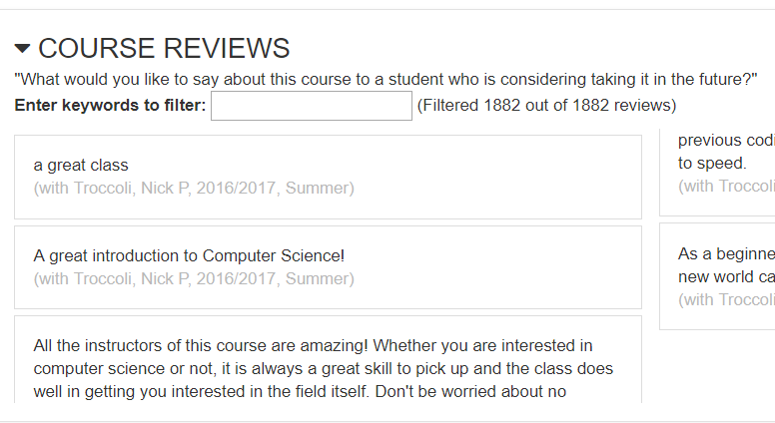
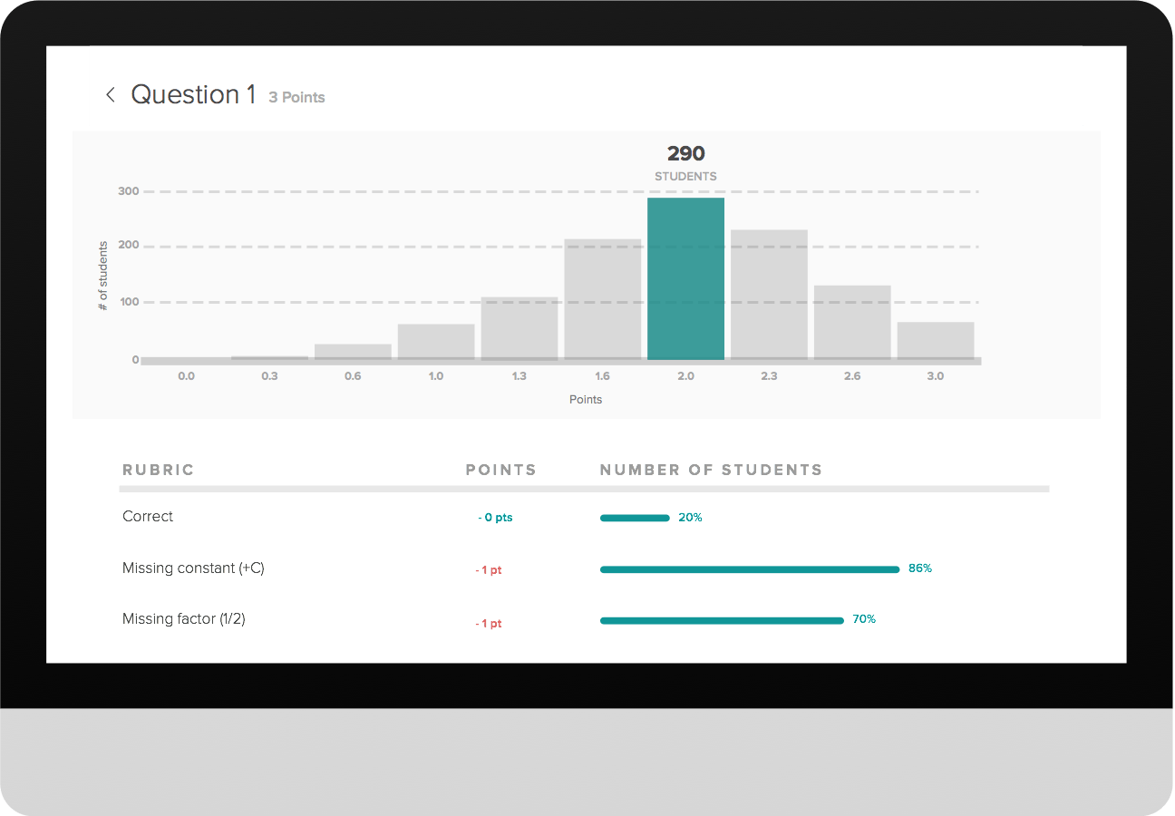
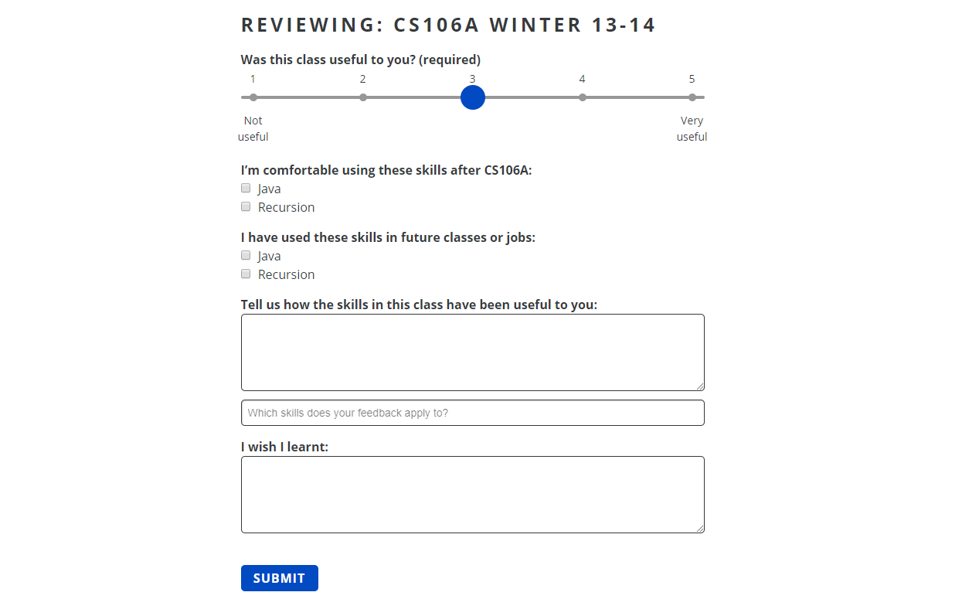
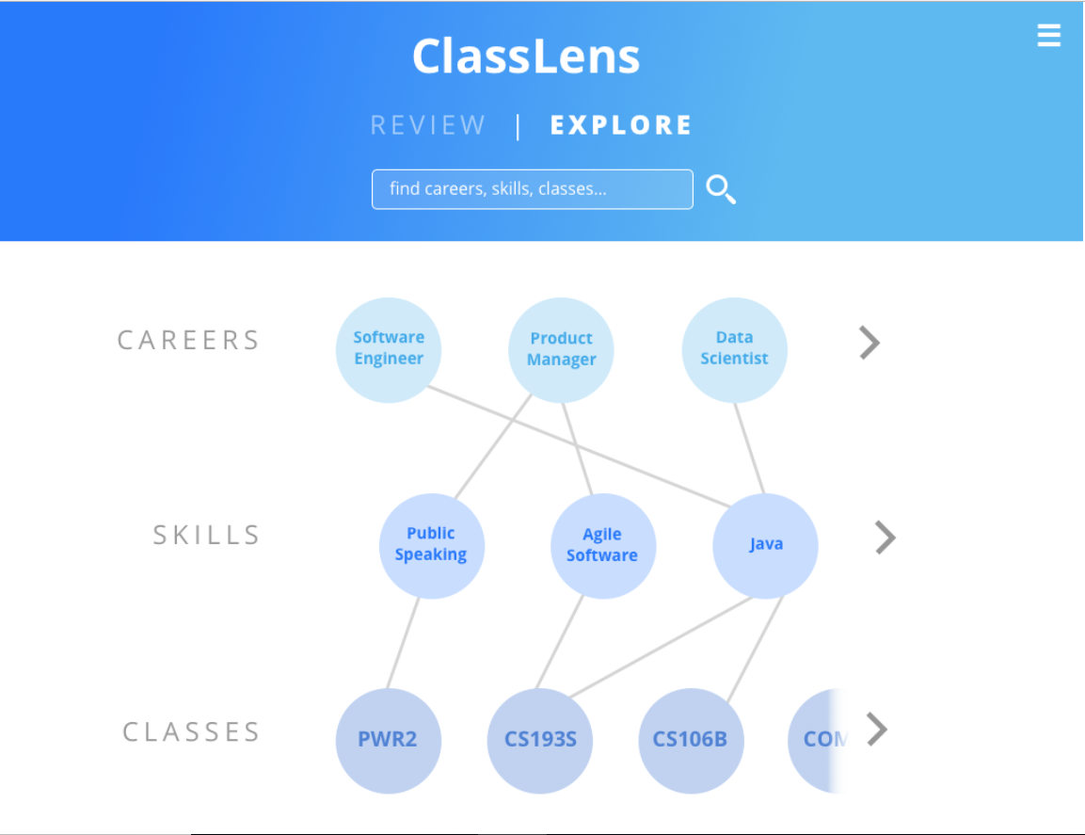
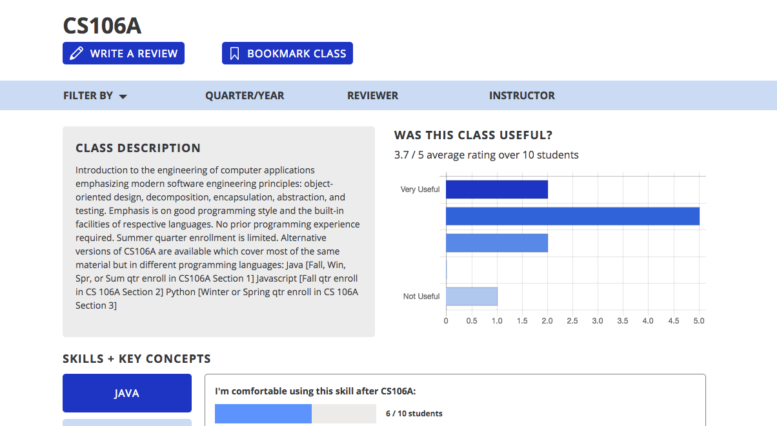
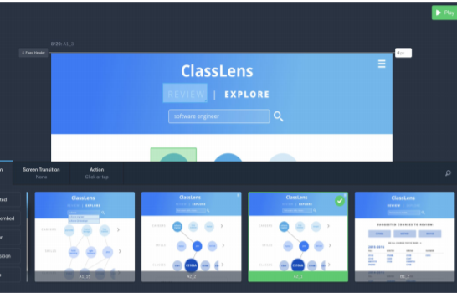
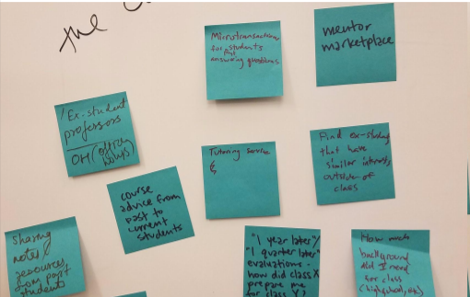
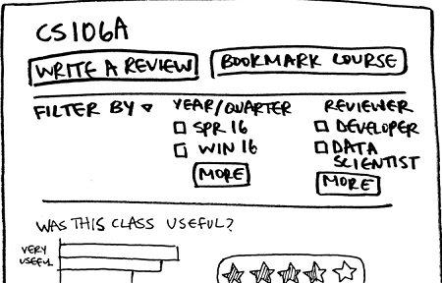
ClassLens
Class feedback that’s actually useful
Problem
Solution
Currently, there's no organized way to understand how skills gained in a class are useful in future classes or job
Former students ​give ​feedback ​on ​how skills ​gained ​in ​a ​class ​are useful in later jobs or classes
Current students ​can see ​whether ​a course ​is ​valuable ​for ​their ​short ​and ​long-term ​goals
Teachers ​can ​use ​this feedback ​to ​see ​how ​to ​revise their courses
Explore Courses
Carta
Key Features
Former students review past classes
Current students explore careers, skills and courses
Teachers view feedback
Design Process
Needfinding & Concept Sketches
Low-fi Prototype
Medium-fi Prototype
Amy Liu | Hope Casey-Allen | Yash Tambawala
http://web.stanford.edu/class/cs147/projects/education/classlens/
CS 147 Autumn 2017

